Slide 1
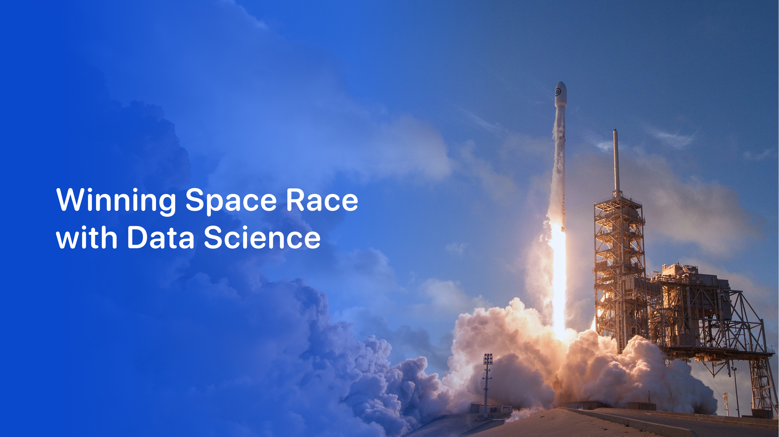

Rios Ruiz Jorge Diego
28-11-2024

Slide 2

Outline
Introduction
Executive summary
Data collection
Scrapping
Data Wrangling
EDA visualization
EDA SQL
Folium
Ploty Dash
Predictive model
Conclusion

Slide 3
Introduction
In this project, we will delve into the commercial space sector with a particular focus on SpaceX, exploring the company’s groundbreaking achievements and innovations. As the commercial space industry grows, other companies like Virgin Galactic, Rocket Lab, and Blue Origin are making strides in suborbital flights and reusable rocket technologies. However, SpaceX stands out as a pioneer in lowering the cost of launches, primarily through the reusability of its Falcon 9 rockets. With launches priced at $62 million, SpaceX has disrupted an industry where the average cost is approximately $165 million.
Our analysis will center on the Falcon 9 rocket, particularly its first stage, which plays a crucial role in the launch and represents a significant portion of the cost. SpaceX has revolutionized the sector by recovering and reusing this stage, allowing them to dramatically reduce launch costs. However, recovery is not always possible due to specific mission requirements, such as payload, orbit, or customer needs. This introduces complexity into the process, making it essential to understand the factors that influence recovery success.
As part of this project, we will assume the role of data scientists for a fictional competitor, "Space Y," aiming to challenge SpaceX’s dominance. We will focus on predicting the recovery of the Falcon 9's first stage using machine learning and data analysis techniques. Our work will involve estimating launch costs, analyzing variables that impact landing success, and building predictive models to forecast whether the first stage will be successfully recovered. By leveraging available data, including publicly accessible information, we will create dashboards and models to support Space Y’s competitive strategy, offering insights into reusability and optimizing space launch operations.

Slide 4
Methodology
Executive Summary
This project focuses on applying advanced data science techniques to assist decision-making for a private space launch company. As a data scientist, the first step will involve collecting relevant data from various sources, followed by cleaning and organizing the data to ensure its quality and consistency for analysis.
The project will follow several important steps:
Data Collection: Gathering relevant and detailed data from different sources to ensure all necessary information is available for analysis.
Data Cleaning: Processing and refining the raw data to remove inconsistencies and errors, making it accurate and ready for analysis.
Exploratory Data Analysis (EDA): Using visualization tools and SQL queries to explore the data, identify patterns, and understand the relationships between variables. This will involve analyzing the data based on different categories to gain deeper insights into the factors affecting space launches.
Interactive Analysis: Utilizing tools like Folium for creating interactive maps and Plotly Dash to build an engaging dashboard, providing dynamic visualizations of complex data relationships.
Predictive Modeling: Applying classification models to predict future trends, providing valuable insights that can guide decision-making and support strategic planning.

Slide 5
Data Collection
In this project, we collect data on SpaceX launches from two main sources: the SpaceX REST API and web scraping from Wikipedia. The SpaceX API offers valuable information on rocket launches, payloads, launch details, and landing outcomes, which will help in predicting landing attempts. By targeting specific API endpoints (like /launches/past), we retrieve historical data in JSON format, which is then processed into a structured table using the json_normalize method.
We also use the BeautifulSoup library to scrape launch data tables from Wikipedia, converting them into Pandas DataFrames for further analysis. Key data wrangling steps include filtering for Falcon 9 launches only, handling missing values (such as replacing null values in PayloadMass with the mean), and resolving any incomplete data by querying additional API endpoints for more information. The cleaned data is then stored in a well-organized dataset, ready for further analysis.

Slide 6
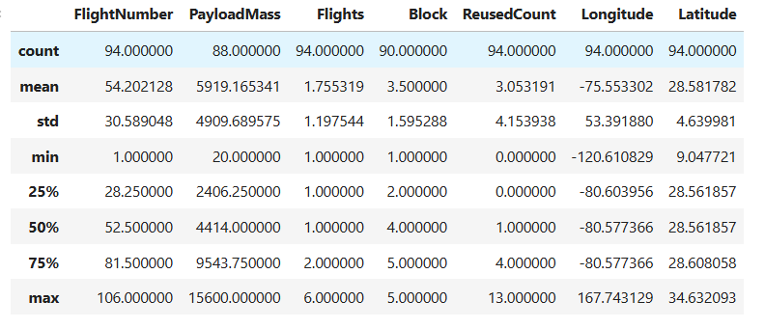
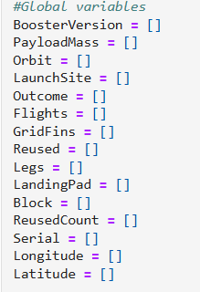
Data Collection - Scraping
We take the informacion from spaceX api information
Transform the data to have readable human information
'https://cf-courses-data.s3.us.cloud-object-storage.appdomain.cloud/IBM-DS0321EN-SkillsNetwork/datasets/API_call_spacex_api.json'

Slide 7
Data Wrangling
Data wrangling is a vital step in the data analysis workflow, involving the transformation of raw, unstructured data into a clean, usable format. In this project, we will focus on preparing SpaceX launch data for analysis by addressing inconsistencies, handling missing values, and reshaping the dataset for modeling purposes.
We begin by exploring key columns in the dataset, such as Flight Number, Date, Payload Mass, Orbit, Launch Site, and Launch Outcome. These attributes are fundamental in understanding the context of each launch. The Launch Site column indicates where each launch occurred, with locations like Kennedy Space Center and Vandenberg AFB. The Orbit attribute helps categorize the different trajectories, such as Low Earth Orbit (LEO) or Geosynchronous Transfer Orbit (GTO). The Launch Outcome column reveals the success or failure of the first-stage recovery, which is essential for understanding the feasibility of reusable rockets.

Slide 8
Data Wrangling
One of the primary tasks in data wrangling is simplifying the Launch Outcome data into a binary classification for easier analysis. For this, we convert successful landings (e.g., "True ASDS") into a label of 1, while unsuccessful landings (e.g., "False ASDS") are labeled as 0. This transformation creates a new column, Y, that will serve as our target variable for machine learning models aimed at predicting landing success.
Throughout this process, we also deal with missing or ambiguous data. Some columns, like Payload Mass, may contain null values that need to be filled with mean values or other imputation techniques. Additionally, we ensure that we handle all edge cases, such as distinguishing between different types of landing failures or partial successes, so that each outcome is clearly defined for modeling.

Slide 9
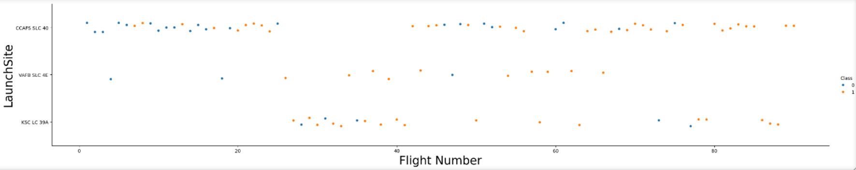
EDA with Data Visualization
Summarize what charts were plotted and why you used those charts
Add the GitHub URL of your completed EDA with data visualization notebook, as an external reference and peer-review purpose

Slide 10
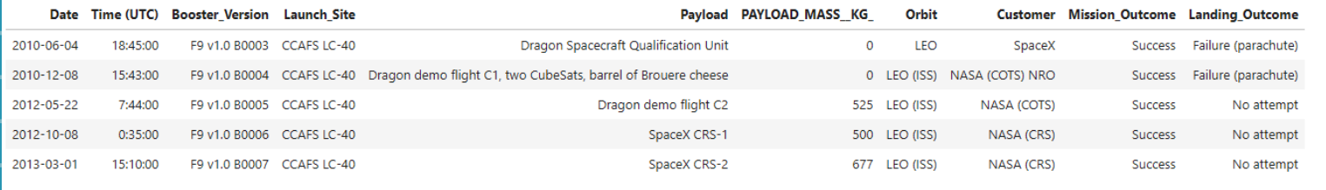
EDA with SQL
Cape Canaveral Air Force Station launches

Slide 11
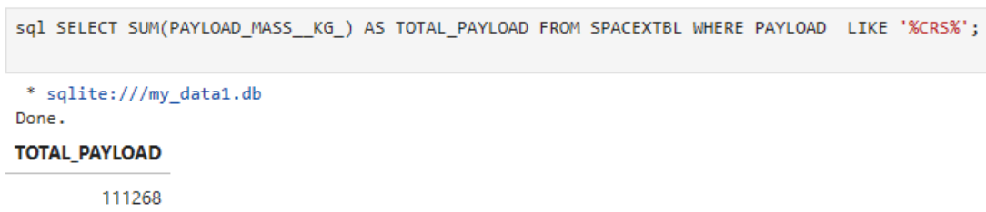
EDA with SQL
Commercial Resupply Services (NASA) total payload mass carried by Nasa

Slide 12
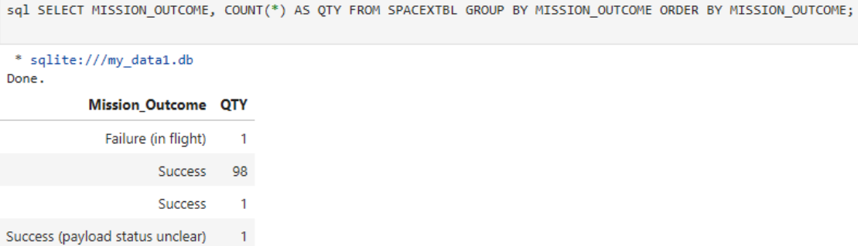
EDA with SQL
Successful and unsuccessfull mission outcomes

Slide 13
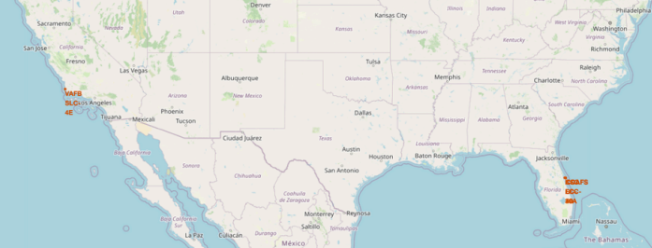
Build an Interactive Map with Folium
Most of the lauches are close to the sea or are done in the ocean to minimizing risk to injury people on populated areas

Slide 14
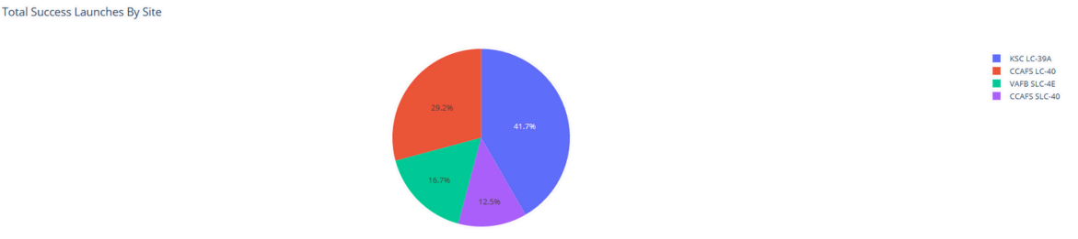
Build a Dashboard with Plotly Dash
We can see tha Kennedy Space Center has the most successful record followed by Cape Canaveral Air Force Station

Slide 15
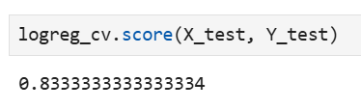
Predictive Analysis (Classification)
We develop a model that can predict if a launch of space x will successfully land or not:
Logistic Regression: This model predicts a binary outcome (success or failure) based on input features like flight number, payload mass, and launch site.
Fitting the Model: We trained the model using training data (X_train, y_train) to find the best parameters, then used these settings to predict the outcome of rocket landings.
Accuracy: After fitting, the model's accuracy was calculated on test data (X_test). This tells us how well the model predicts new data.
As we can see our model can predict successfully 83% sure if a lauch will land.

Slide 16
Conclusion
In this course, we learned how to analyze data from SpaceX launches and make predictions using various tools. We used Folium to create interactive maps that showed launch sites and other important locations, helping us visualize the geographical data. With NumPy, we worked with large datasets, making it easier to perform calculations and prepare the data for analysis. We also learned how to visualize data using charts and graphs, which helped us understand patterns in the SpaceX data more clearly.
Using Scikit-learn, we applied machine learning models like Logistic Regression to predict the success of rocket landings, which is important for SpaceX's goal of reusing rockets. We even fine-tuned these models using GridSearchCV to find the best settings for our predictions.
Overall, this course gave us the skills to work with complex data, visualize it effectively, and use machine learning to make predictions. These techniques can be applied to many areas, but in the context of SpaceX, they help make better decisions about rocket launches and landings, ultimately supporting their mission of reducing launch costs and increasing efficiency.

