Slide 1
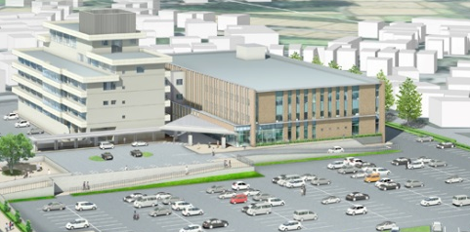
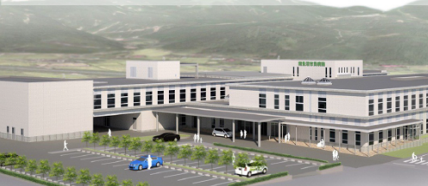
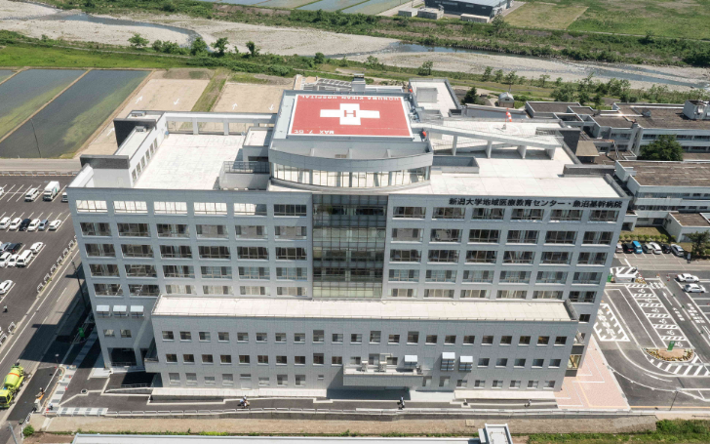
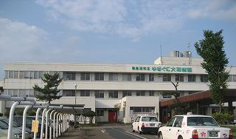
Now
Shortage of nurses in the region
Can’t let inpatients go home
308
Koide Hospital
134 beds
454 beds
Uonuma Kikan Hospital
?
Division of function,
Cooperation
?
Minamiuonuma City Hospital
?
140 beds
Patients for advanced medicine, critical emergency medical care
40 beds
Yukiguni Yamato Hospital
Looks like normal medicine, primary and secondary emergency have been shared in the region…

