Slide 1
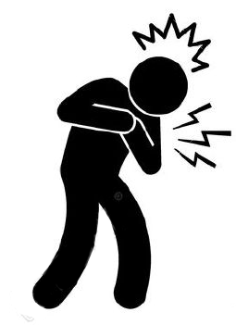

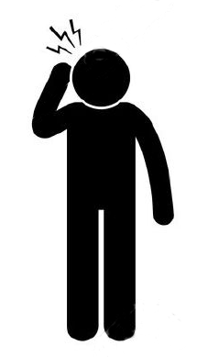

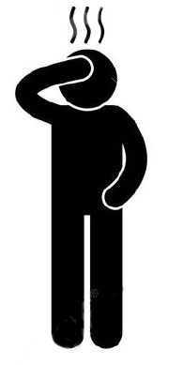
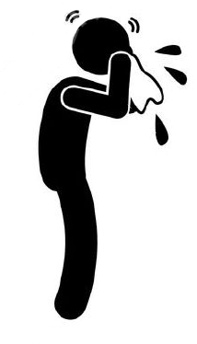
Looks like this
11
Reality
Dream
Kikan hospital
Kikan hospital
Yukiguni-Yamato
Yukiguni-Yamato
Moegi clinic
Moegi clinic

