Slide 1
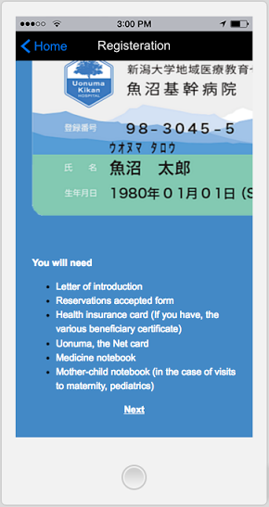
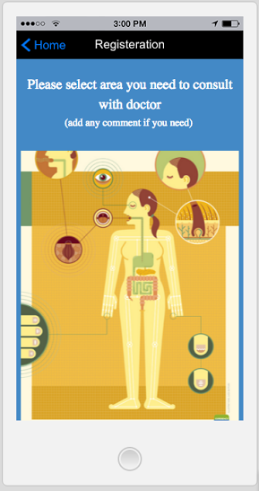
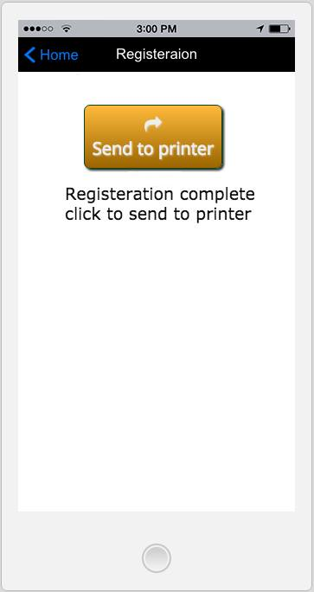
Registration
Document checklist

Slide 2
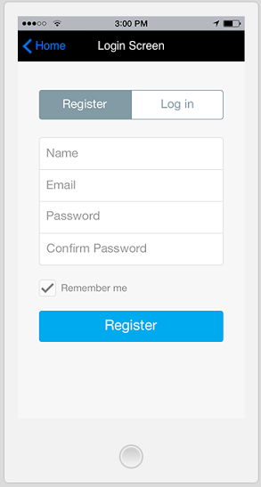
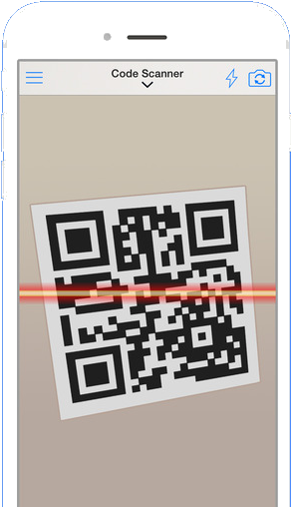

Log in
With user login patient can make appointment to the hospital
New patient can login with username and password from registration.
Existing patient can scan the card to shortcut the registration process
Existing patient please scan your card to register for username and password

Slide 3

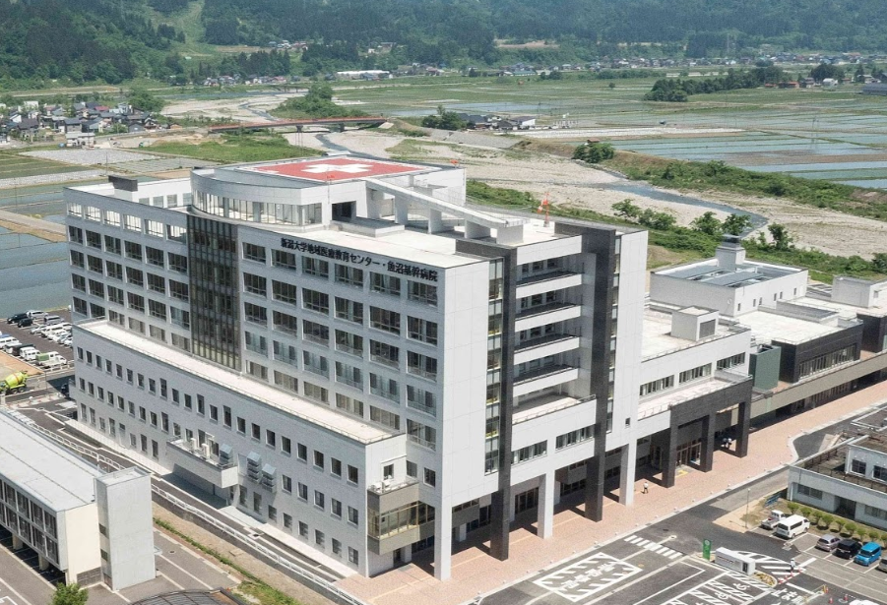



Service (Hospital Language Service)
For
Kikan Hospital
(First stage)
Develop
Quality Service
Create
Efficient Service
Hospital Language Service Center
For
All Hospitals
(Future stage)

