Slide 1
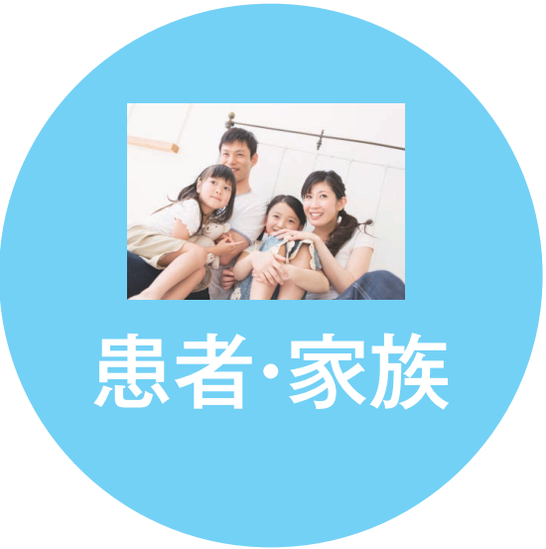
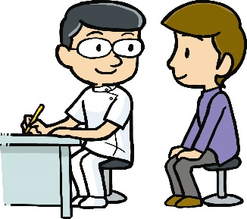
Peripheral medical institutes
After reorganization…
Koide hosp.
Horinouchi hosp.
Cooperation
Yukiguni yamato hosp.
Introduction
Minamiuonuma city hosp.
private hosp.
Reagional clinics,
患
者
Cooperation
Primary doctors
Indrodcution
A patient and his/her family
Cooperation
Every thing will
be done in one reagion
Introduction
Advanced and Emergency
Uonuma Kikan Hospital

