Slide 1
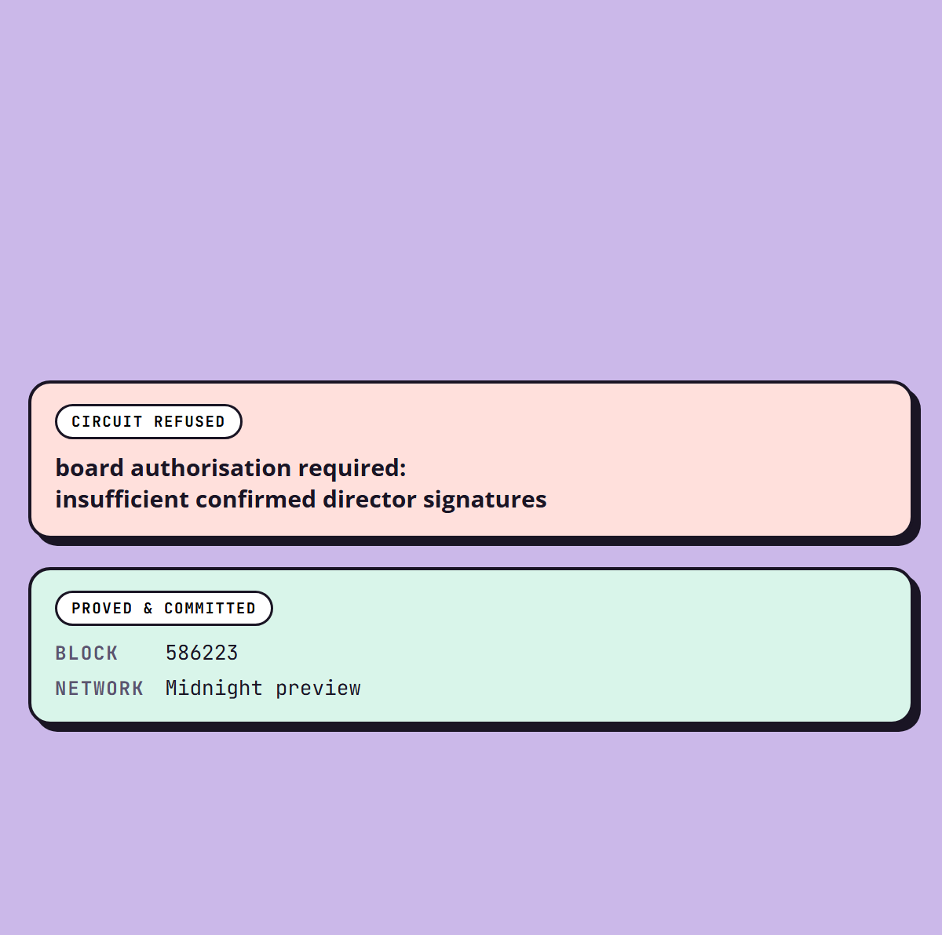

QUORUM
6
A BOARD VOTE
THAT PROVES
circuits deployed
ITSELF.
Supervisory infrastructure for bank loan classification, built on Midnight. A regulator's rules run inside a Compact contract, and the board approval behind a write-off is proved in zero knowledge.
Team Logarithm
Brainwave 2026 · Midnight Track

Slide 2
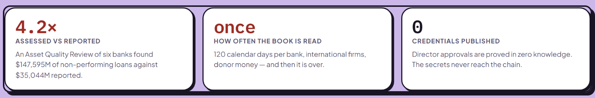
QUORUM
THE RULE EXISTS. THE RECORD DOES NOT.
PROBLEM 01
The book is held by the bank being examined, and can be revised afterwards.
Classification already needs two named signatures. Rescheduling is already capped. The later attempts already need the board. None of that is missing.
PROBLEM 02
It is read once a year, when an inspector is physically present.
PROBLEM 03
Proving board authority means publishing every director's signature.

Slide 3
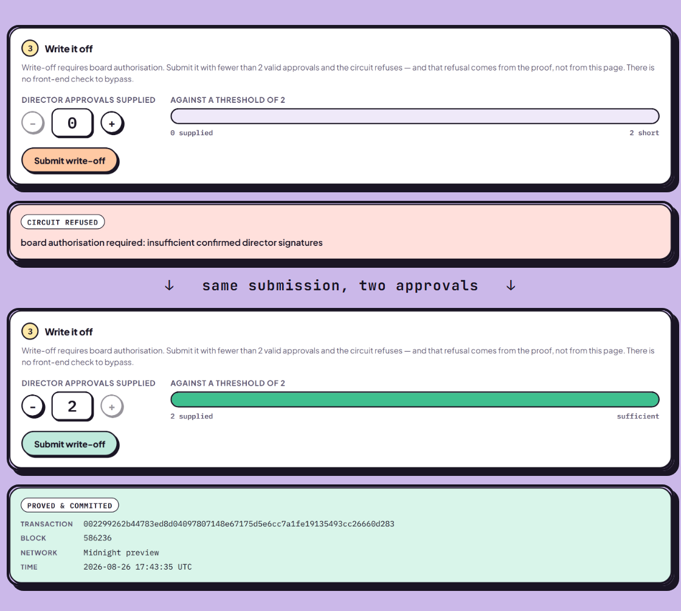
QUORUM
PROVE THE VOTE. PUBLISH ONLY THE COUNT.
The refusal comes from the proof, not from the page.
WHAT QUORUM DOES
A supervisor needs to know that enough of the right people approved. It does not need to know who they were. Midnight makes that difference expressible in a contract instead of a policy document.

Slide 4
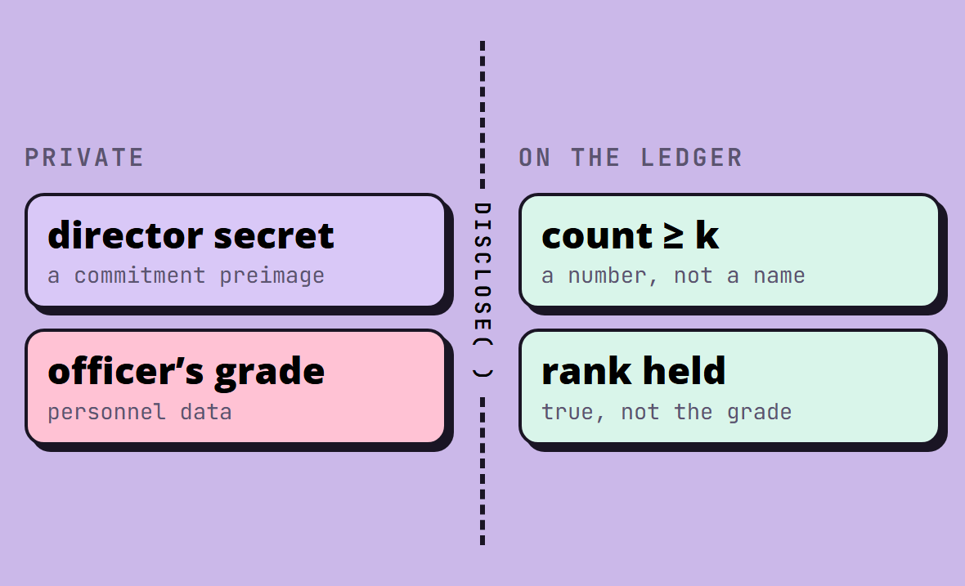
QUORUM
HOW IT WORKS
01 · COMMIT
02 · PROVE
A director registers persistentHash([secret]) — a commitment, never the secret.
To approve, they supply that secret privately. The circuit re-derives the hash.
03 · COUNT
04 · DISCLOSE
Confirmed, non-revoked, distinct slots are counted. Duplicates are rejected pairwise.
Only the count crosses the boundary. The secrets stay in the witness.
Compact's disclose() analysis enforces that boundary at compile time, not by convention.

Slide 5

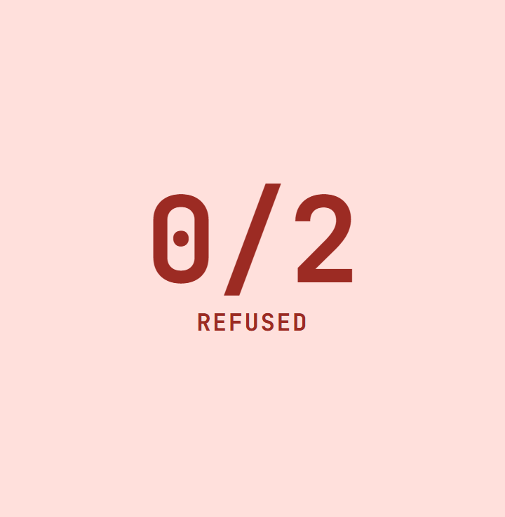
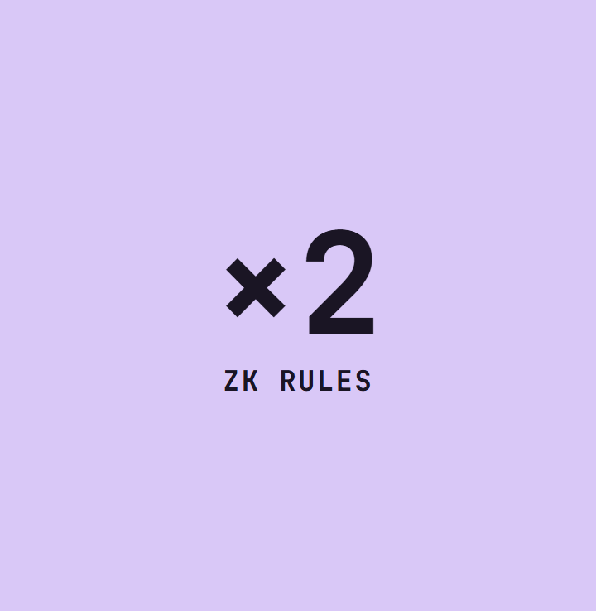
QUORUM
WHY IT WORKS
The transaction could not be constructed. No front-end check to bypass.
A second rule, a different privacy shape. Two is a pattern.
COMMITTED
same loan · 2 of 2 · block 586223
Same submission, two approvals. A receipt names contract and block.
REFUSED
AND AGAIN
write-off · 0 of 2
restructure · block 586236

Slide 6
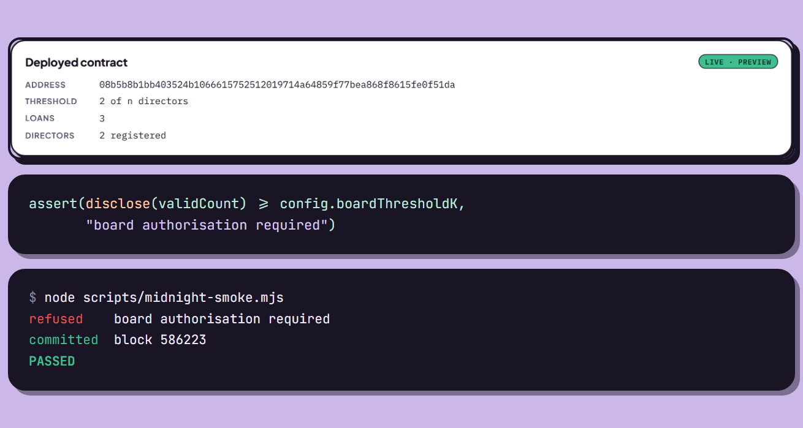
QUORUM
WHAT IT COST TO BUILD
14K/s
PREVIEW, NOT PREPROD
Wallet sync ran at ~80 events/s on the SDK's defaults. batchSize 5,000 fixed it.
PreProd is ~1,453,000 events. Preview's ~151,000 sync in minutes.
6 CIRCUITS
2 ZK RULES

Slide 7
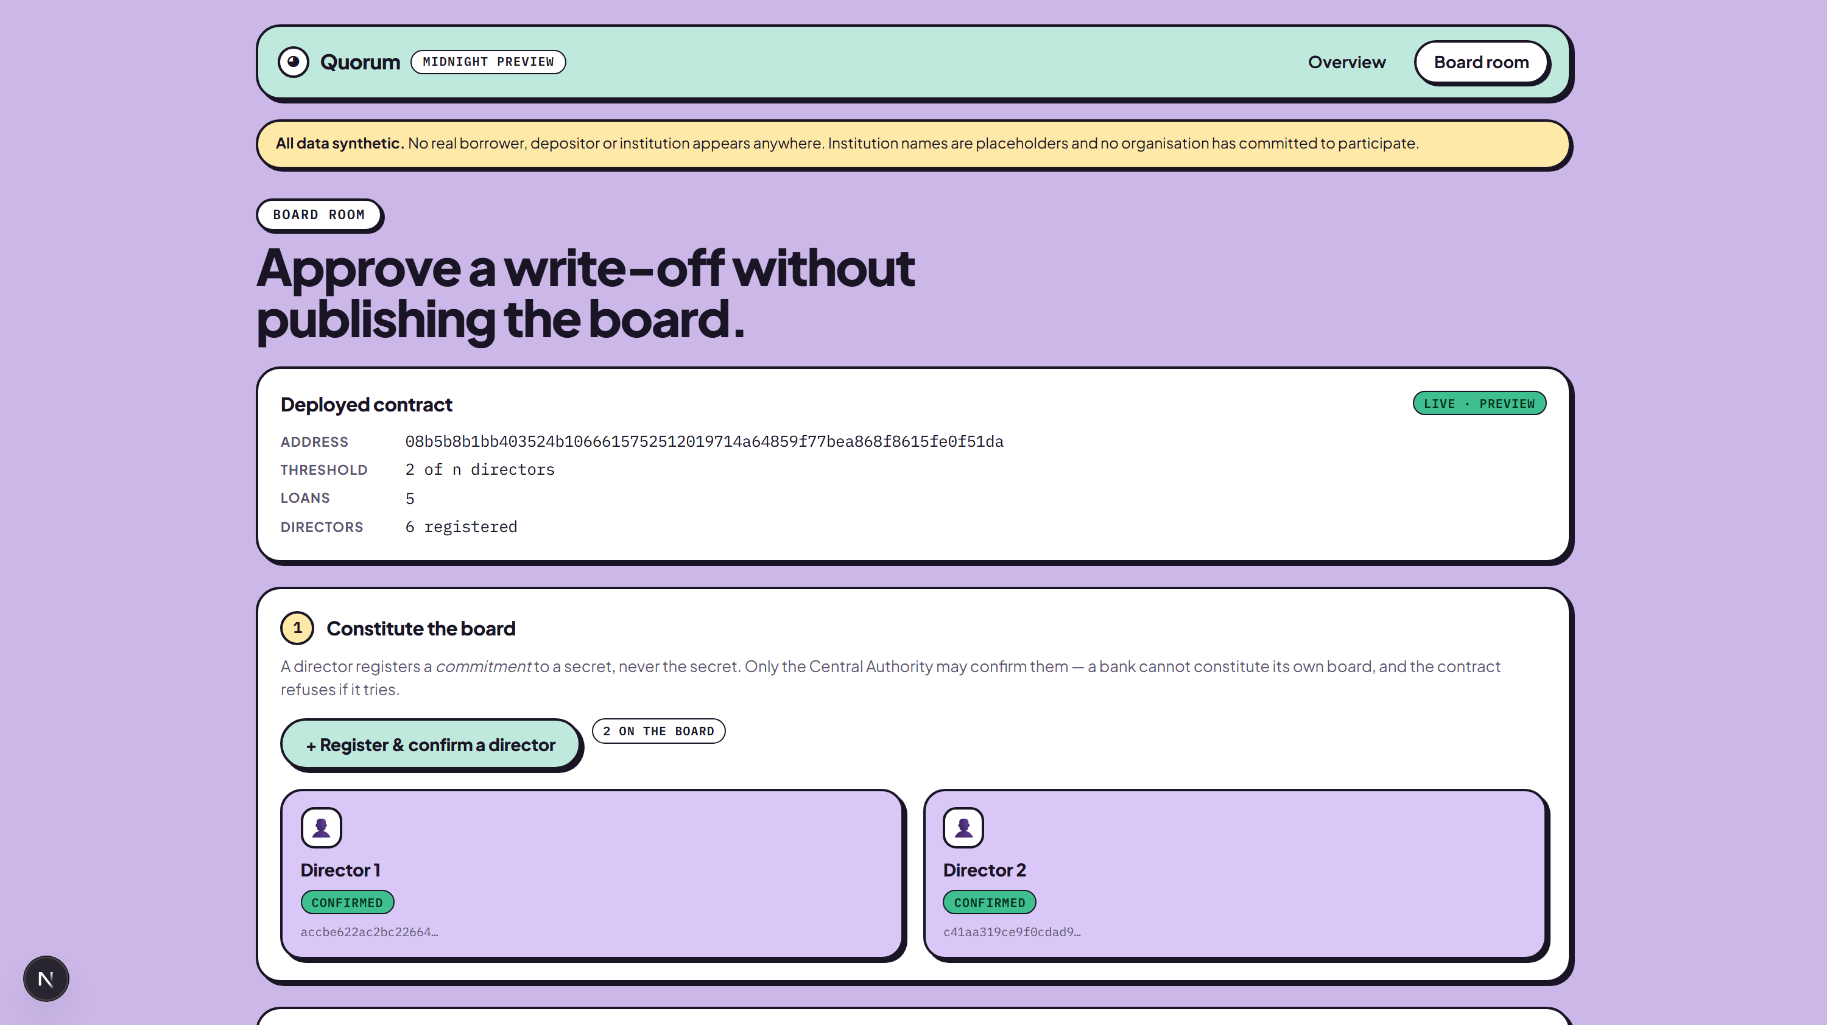
QUORUM
VERIFIED TWICE
LIVE ON MIDNIGHT PREVIEW
586223
block · write-off
Contract 08b5b8b1…fe0f51da, confirmed through the Preview indexer rather than our own bridge. Reproduce both refusals with node scripts/midnight-smoke.mjs.

Slide 8
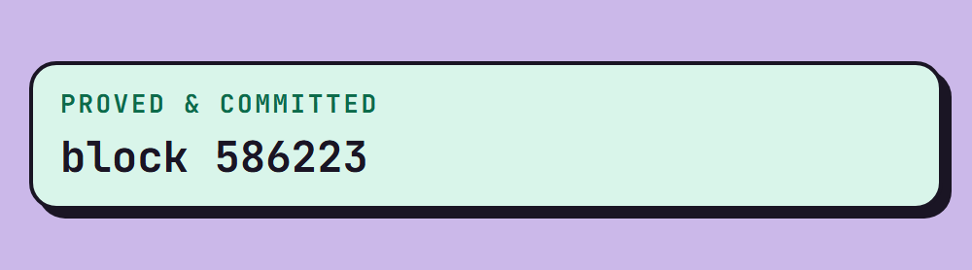
QUORUM
THANK YOU
Quorum · Team Logarithm. All data is synthetic, and the limits are written down in the README.
SO MUCH!
github.com/ripWr3ncH/BlockChain-Devpost

