Slide 1

Neighborhood Security
S. Ripamonti, L. Stornaiuolo
Design and Implementation of
Mobile Applications @ POLIMI
Simone Ripamonti (849786)
Luca Stornaiuolo (864278)
POLITECNICO DI MILANO

Slide 2





Introduction
S. Ripamonti, L. Stornaiuolo
The purpose of our application is to support «neighborhood watch» associations.
«Neighborhood watch» associations goals:
Reduce and prevent the incidence of residential crime inside a neighborhood
Encourage the citizens to work together in mutual assistance
Train citizens to recognize and report suspicious activities
Currently many of these associations use text based chat to communicate.
Our application goals:
Provide a platform where to report suspicious activities
Provide a way to notify these events to the users
Provide a simple and intuitive interface, suitable for everyone
Different
associations
logos
POLITECNICO DI MILANO

Slide 3






Introduction (2)
S. Ripamonti, L. Stornaiuolo
About the logo: the scream of the marmot is like the alarm by a sentinel.
Our app goal is the same: notify other users about recently happened dangerous events, in particular criminal ones
Full icon
Border icon
Colored icon
Wear notification
background
Launcher icon
POLITECNICO DI MILANO

Slide 4
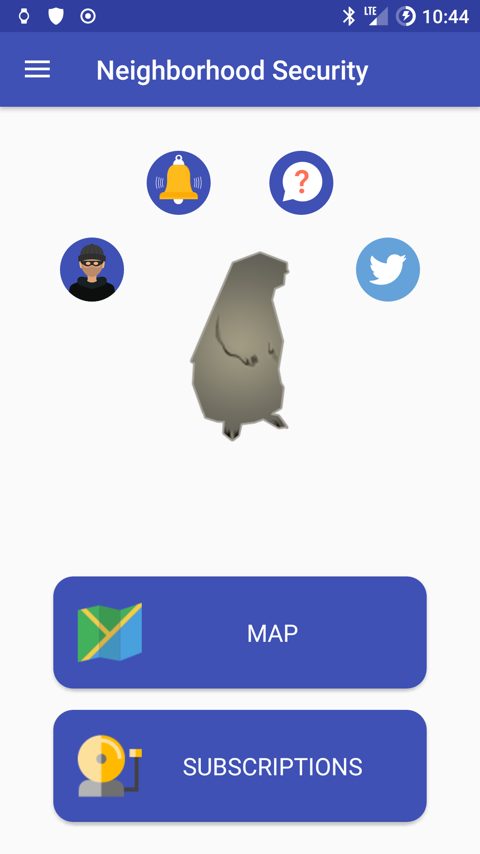
Functionalities
S. Ripamonti, L. Stornaiuolo
Users authentication (email, Facebook, Google)
Create / read / delete events
Create / read / delete subscriptions
Vote / unvote events
Enable / disable subscription notification
Receive events’ notification in real time
Caching system to work offline
Use device GPS position to speedup certain operations
Home page
POLITECNICO DI MILANO

Slide 5
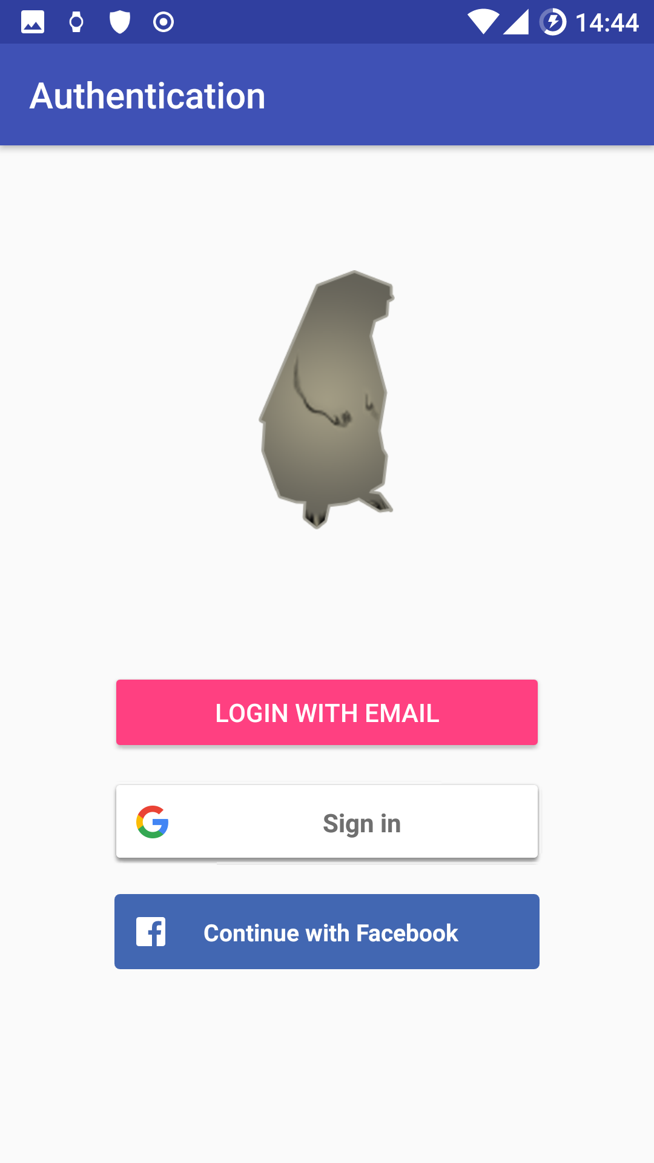
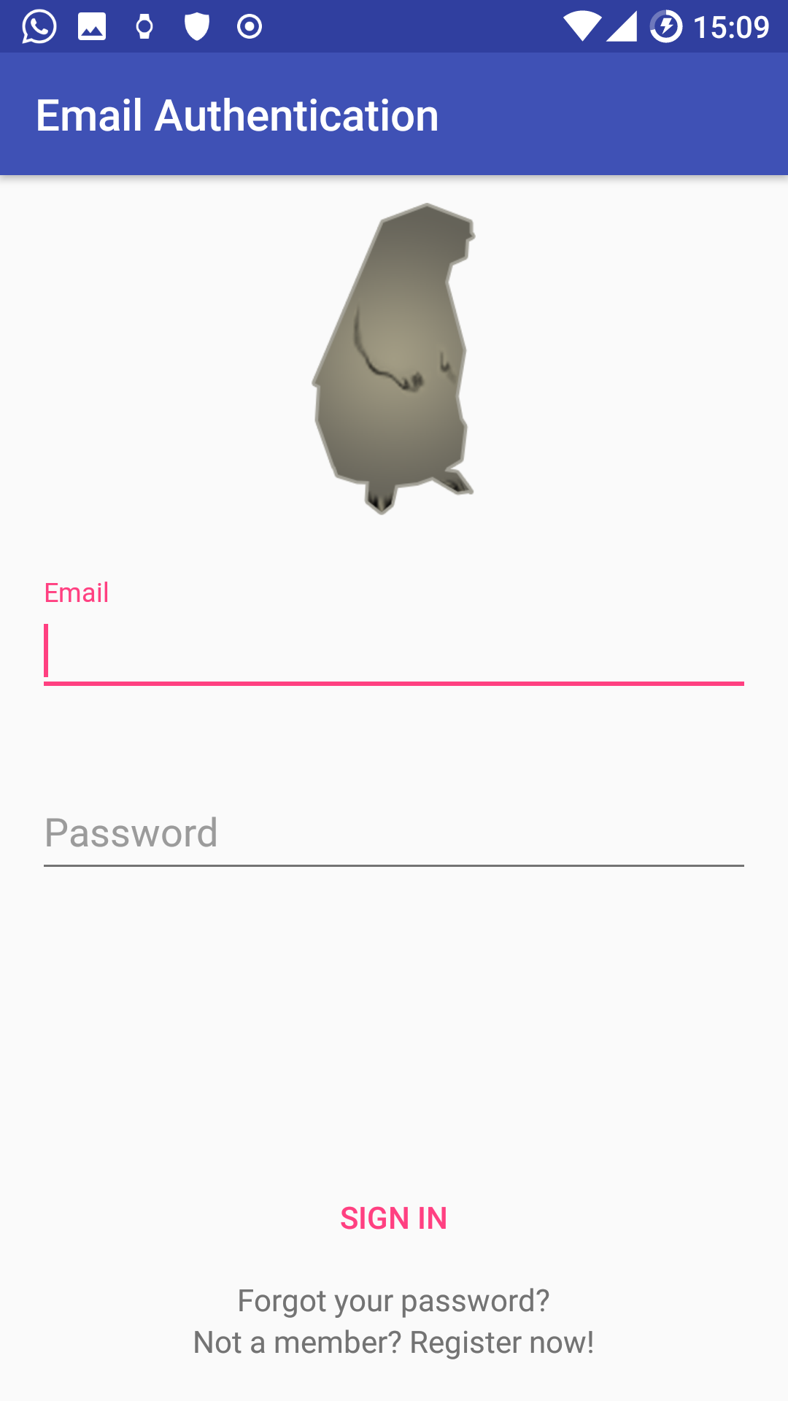




User Authentication
S. Ripamonti, L. Stornaiuolo
Email Auth
Authentication
Google Auth
Neighborhood Security
Web Service
Facebook Auth
POLITECNICO DI MILANO

Slide 6






Events
S. Ripamonti, L. Stornaiuolo
6 categories of events
Each event has a description, a location, a timestamp and a category
Events can be voted, a vote can be seen as the confirmation by another user that the event has truly occurred
Events are displayed on a map or in a list
User can search event by location or by subscription they belong in
Burglary
Theft
Carjacking
Shady people
Robbery
Scammer
POLITECNICO DI MILANO

Slide 7
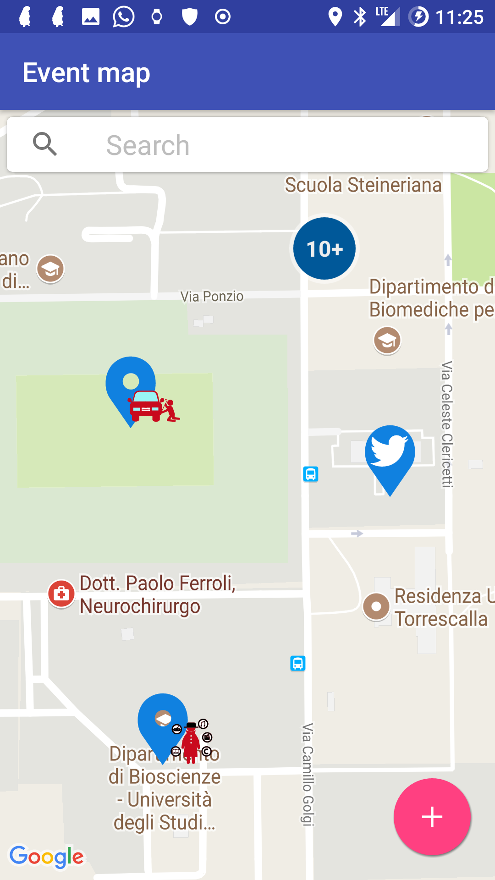
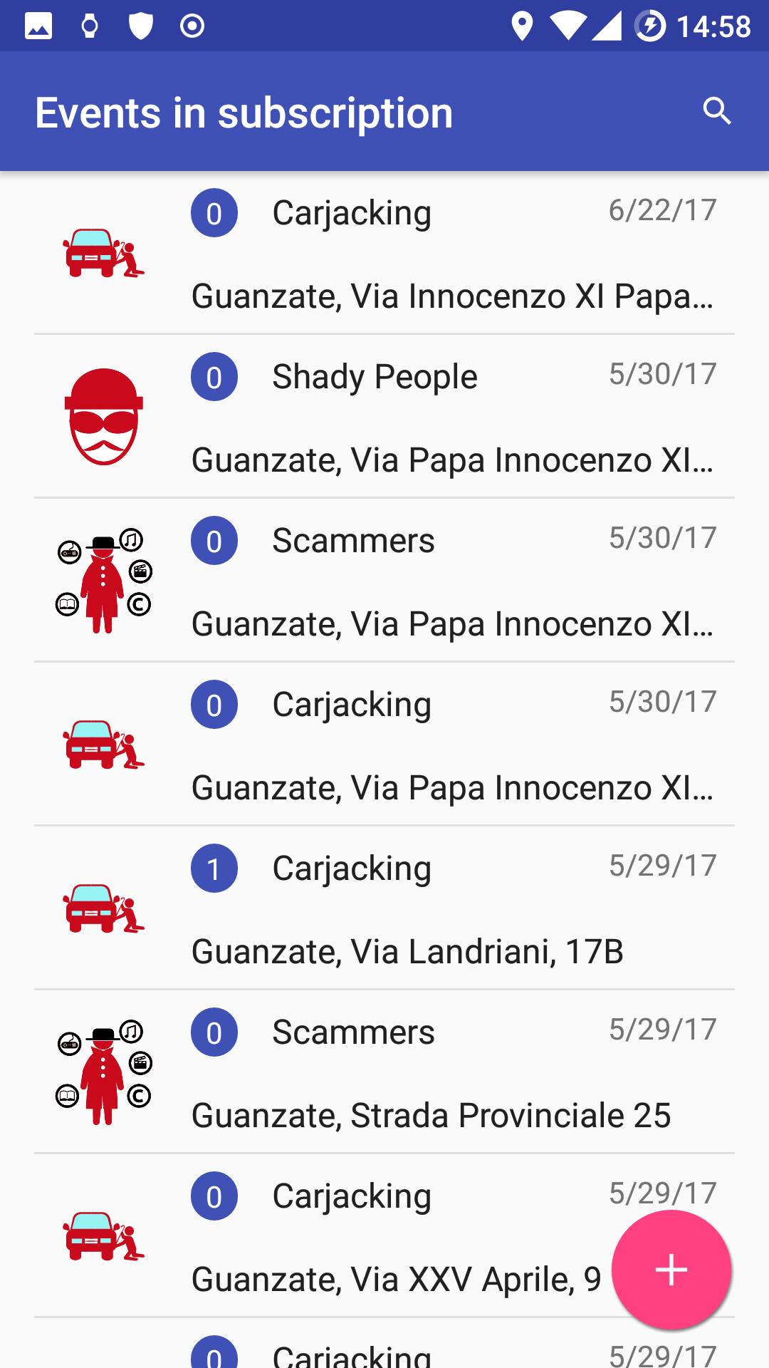
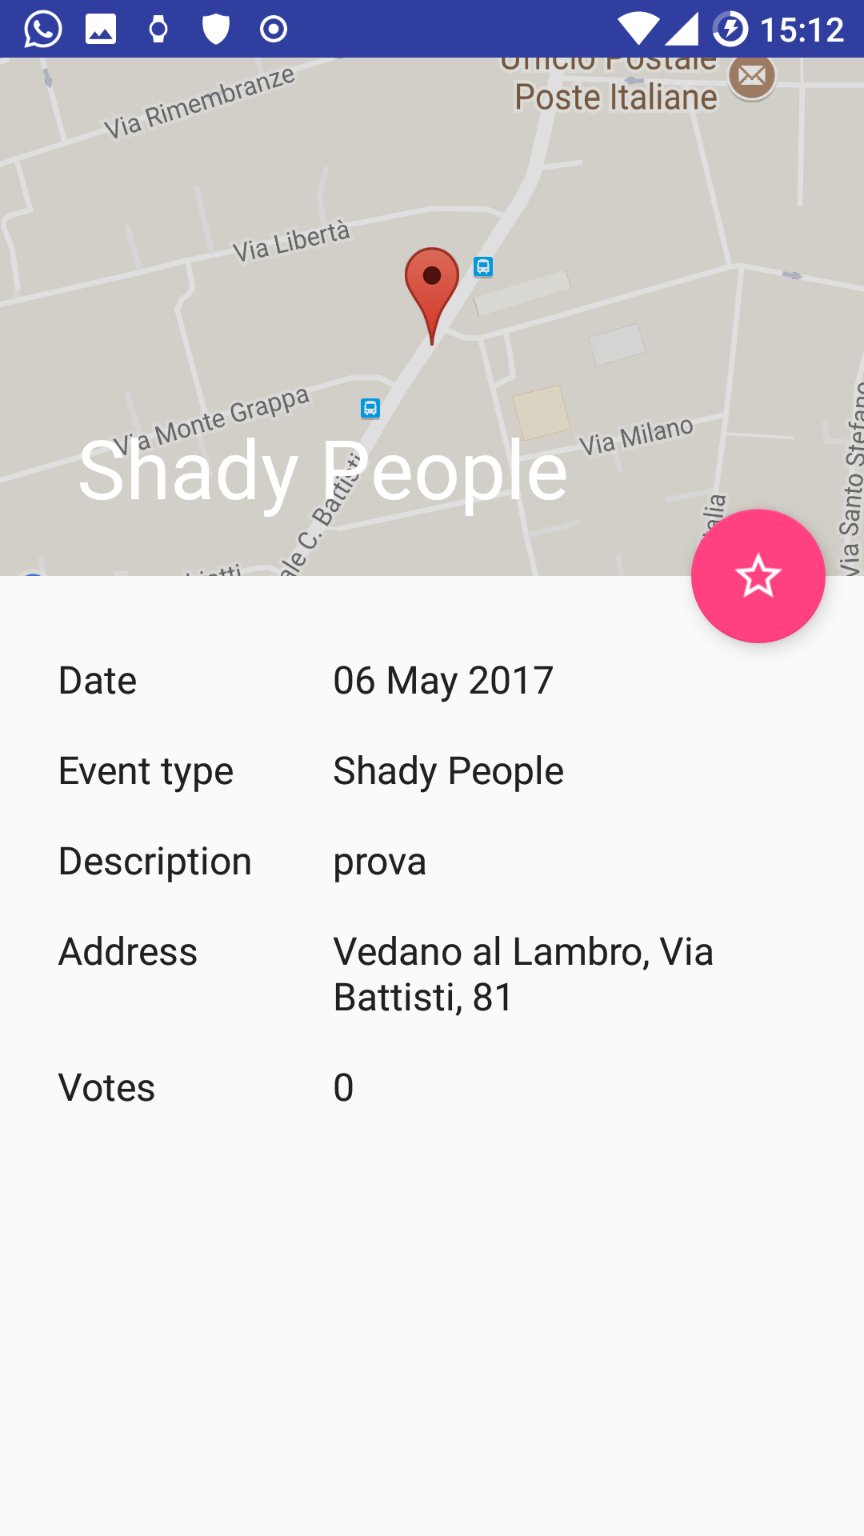
Displaying events
S. Ripamonti, L. Stornaiuolo
Event map
Event list
Event detail
POLITECNICO DI MILANO

Slide 8
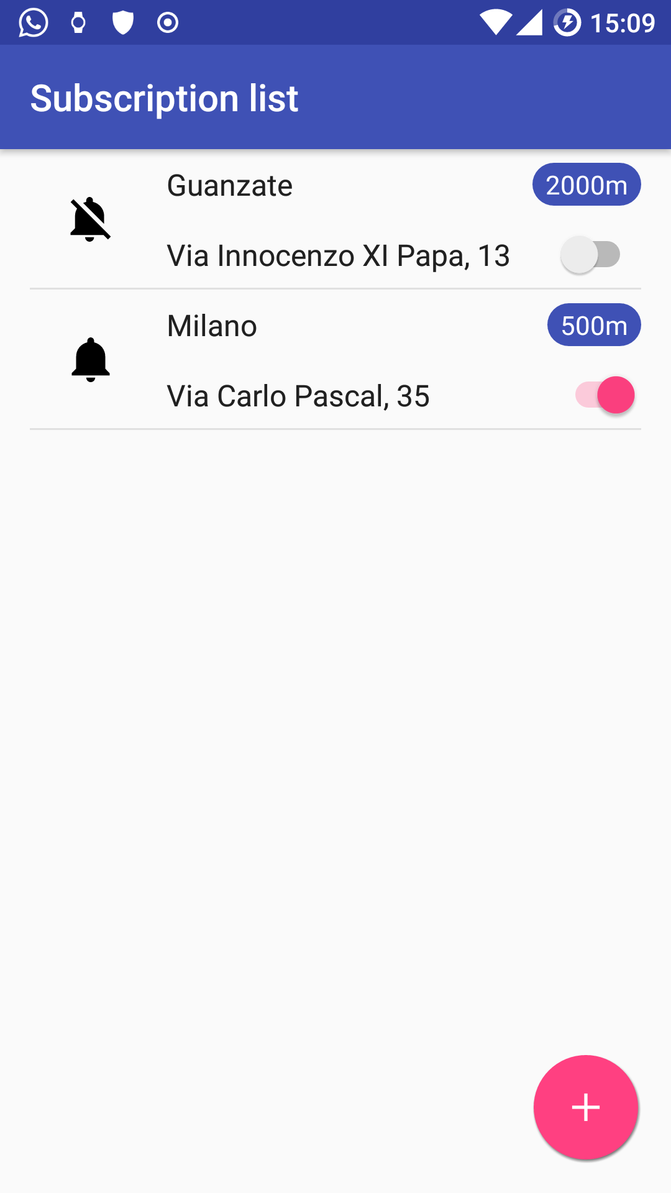
Subscriptions
S. Ripamonti, L. Stornaiuolo
Subscriptions are characterized by a center and a radius. The center can be chosen using pure coordinates or an address. The radius is up to 2000 meters.
Subscriptions are available only to registered users
Users will receive notifications about events that belong to one of their active subscription.
POLITECNICO DI MILANO

Slide 9
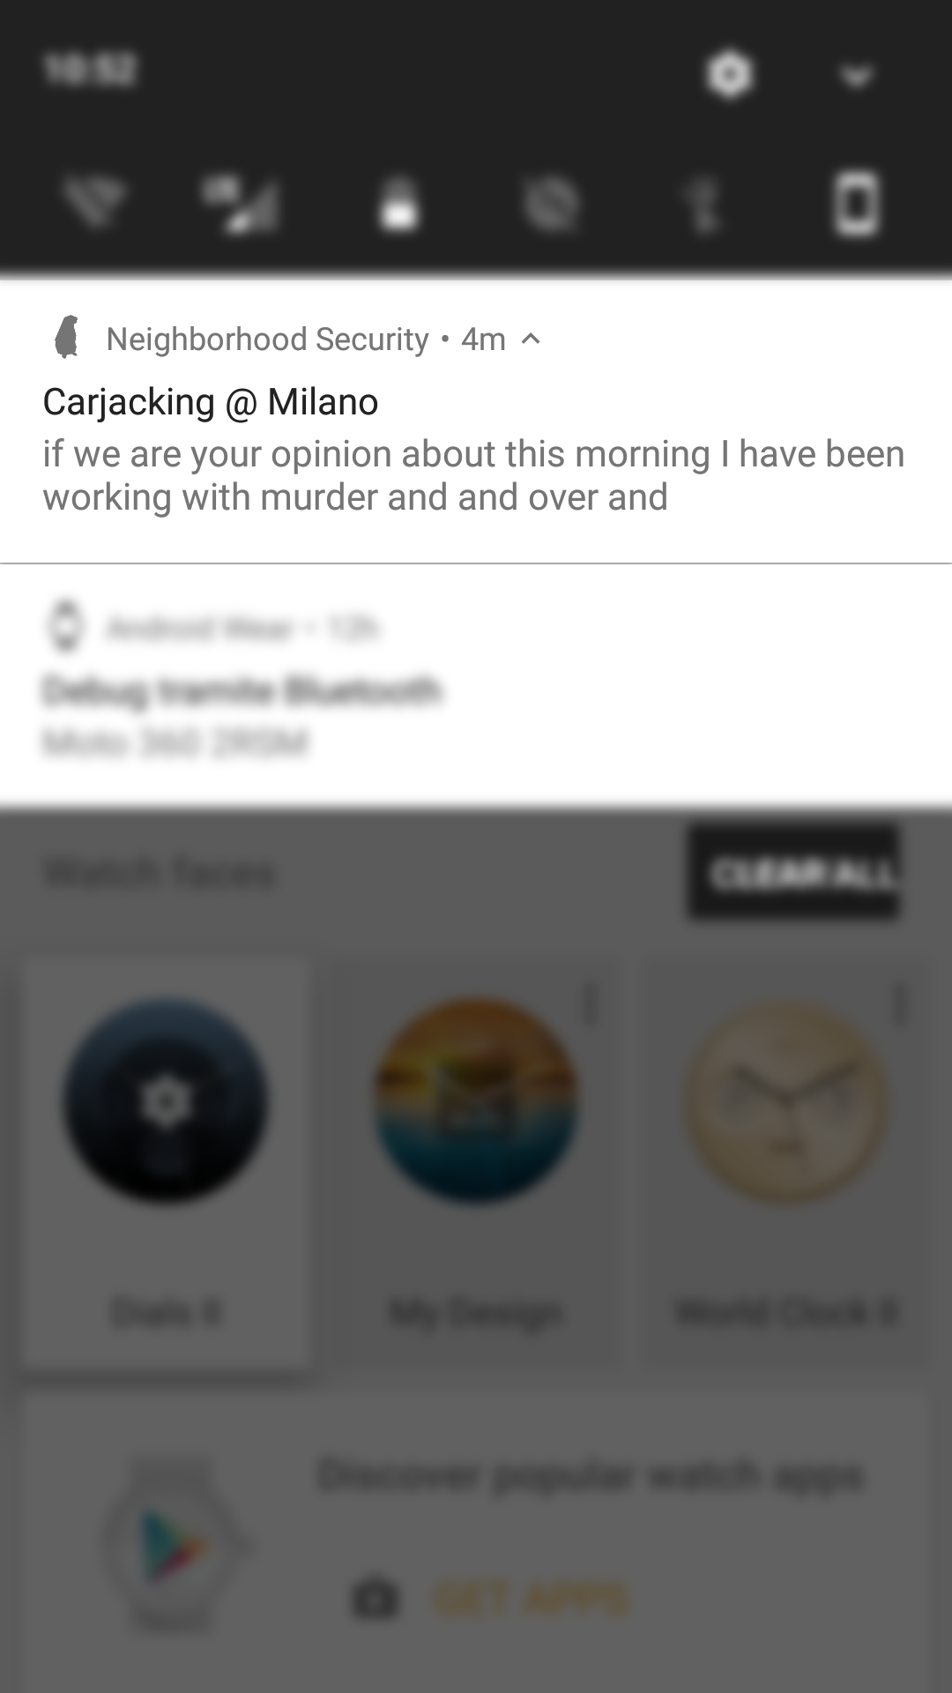
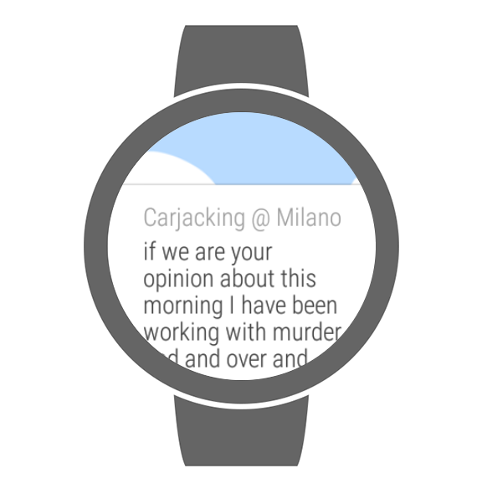
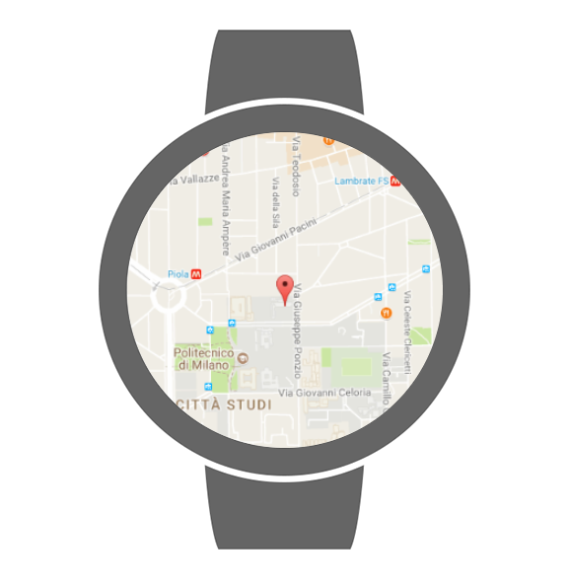
Notifications
S. Ripamonti, L. Stornaiuolo
Notification on phone
Notification on wearable, with addictional map
Achieved using Firebase Cloud Messaging API
POLITECNICO DI MILANO

Slide 10
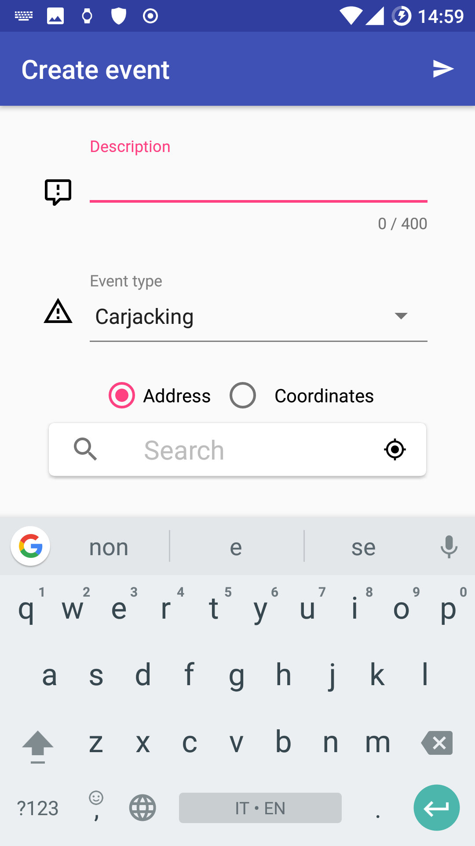
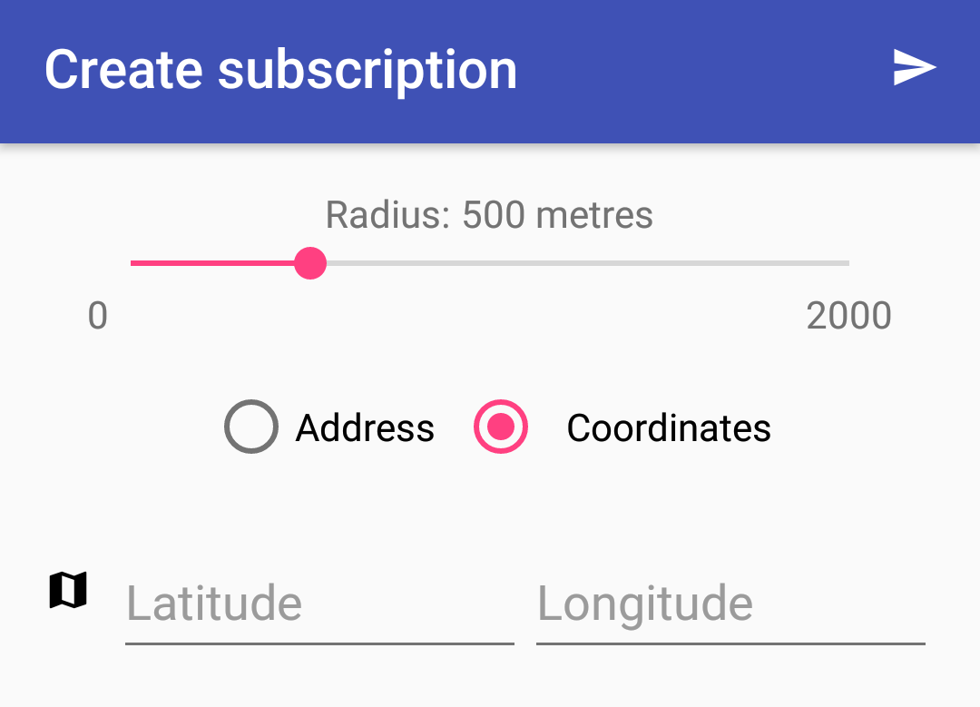
Event and Subscription creation
S. Ripamonti, L. Stornaiuolo
Creating both events and subscriptions is really easy and takes less than a few seconds to do.
Events:
Insert a description
Select the type
Input an address or a set of coordinates
Subscriptions:
Choose a radius
Input an address or a set of coordinates
Event creation
Subscription creation
POLITECNICO DI MILANO

Slide 11
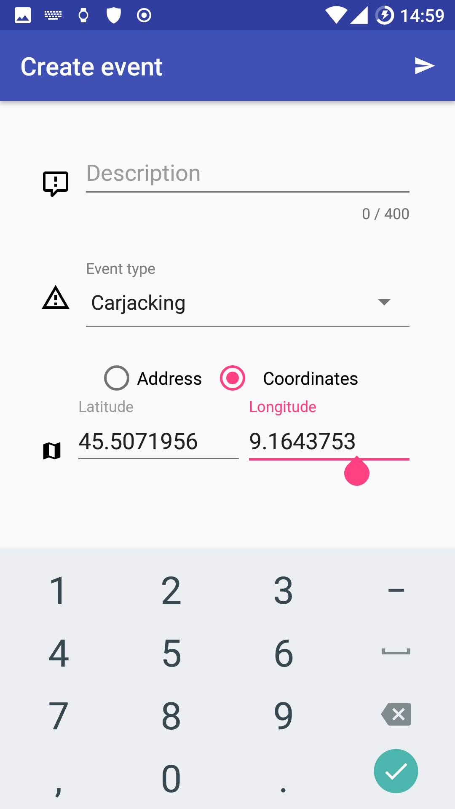
Google API: Places and Fused Location Provider
S. Ripamonti, L. Stornaiuolo
There are two ways to quickly insert the location of an event or a subscription:
Using Google’s Place Autocomplete, which suggests locations as the users types
Using Fused Location Provider to use device fine or coarse position, according to the permissions that have been granted
2)
1)
Event create
POLITECNICO DI MILANO

Slide 12
Google API: Maps and Map Utils
S. Ripamonti, L. Stornaiuolo
Google Maps API: display an interactive map, that can be scrolled or searched for a location (using Google Places API). Markers are shown on the map in order to display events or Tweets
Google Map Utils: collections of extensions for Google Maps on Android, allowing in our case to cluster event and Twitter markers
Event map
POLITECNICO DI MILANO

Slide 13
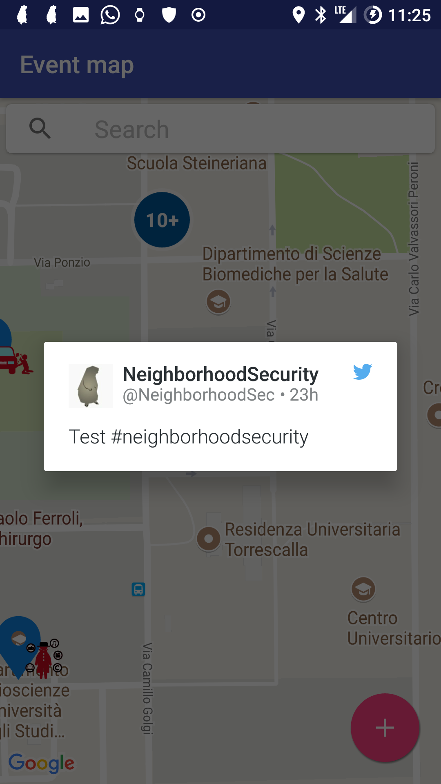


Twitter Integration
S. Ripamonti, L. Stornaiuolo
Idea: display Tweets containing a position (fine or coarse) and the hashtag #neighborhoodsecurity in the event map
Simple to implement using Twitter SDK
Twitter Core: interface to Twitter’s Rest API
Twitter UI: fancy view to display Tweets
Twitter Dialog Fragment
Marker on map
POLITECNICO DI MILANO

Slide 14
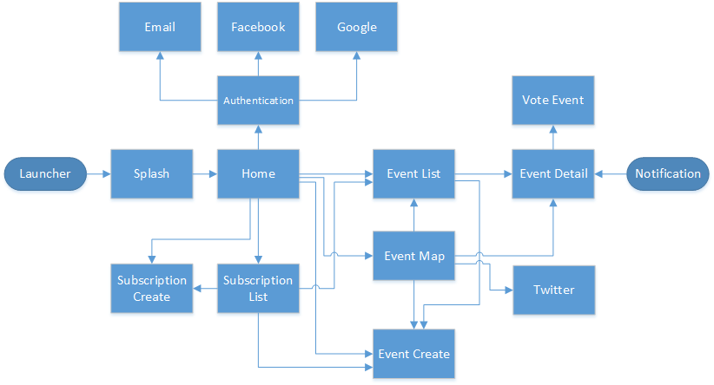
Application flow
S. Ripamonti, L. Stornaiuolo
POLITECNICO DI MILANO

Slide 15





Interaction with the Web Service
S. Ripamonti, L. Stornaiuolo
Using Retrofit library in order to easily interact with the Rest web service. Provides an easy way to recreate Java object starting from JSON objects
Endpoints:
/events
/subscriptions
/users
Web service characteristics:
Hosted on Heroku for free
Built with Java 8 and Jersey
Persistent database storage using JawsDB
Supports JSON (and XML)
User authentication via Firebase Authentication tokens
Notification sending via Firebase Cloud Messaging
POLITECNICO DI MILANO

Slide 16
What happens on the web service
S. Ripamonti, L. Stornaiuolo
Posting a new Event
Posting a new User
POST /events
Store Event on Database
Return «CREATED» status to the client
POST /users
Store User on Database
Store device FCM token
Return «CREATED» status to the client
Find subscriptions interested in the event
Find Firebase Cloud Messaging tokens of the subscription owners
Send notifications
Async
POLITECNICO DI MILANO

Slide 17
Data design
S. Ripamonti, L. Stornaiuolo
Server side
MySQL database provided by Heroku and JawsDB «as a service»
Tables: events, users, subscriptions, votes, authorizations
Client side
SQLite database to cache events and subscriptions retrieved from the web service
Tables: events, users (both with timestamp)
Shared Preferences to store additional informations (e.g. current active subscriptions)
POLITECNICO DI MILANO

Slide 18
Further Work
S. Ripamonti, L. Stornaiuolo
Browser and iOS version
Add highly dangerous events with continuous notification (e.g. flood, fire or others)
Add user comments to events
Add pictures to events
POLITECNICO DI MILANO

Slide 19
S. Ripamonti, L. Stornaiuolo
Code available on https://bitbucket.org/SimoneRipamonti/neighborhood-security
POLITECNICO DI MILANO

