Slide 1

REST Project
S. Ripamonti, L. Stornaiuolo, R. Pressiani
Board Game Manager: help people keep track of their board games nights
POLITECNICO DI MILANO

Slide 2

Architecture
S. Ripamonti, L. Stornaiuolo, R. Pressiani
LANGUAGE
APPLICATION SERVER
JAX-RS IMPLEMENTATION
Why?
Java: solid knowledge, thanks to the final project of Software Engineering and other courses
GlassFish: widely used, almost no configuration needed in order to work
Jersey: implements full JAX-RS and provides extensions (e.g. easy support for multipart data)
POLITECNICO DI MILANO

Slide 3
REST API General Overview
S. Ripamonti, L. Stornaiuolo, R. Pressiani
Everyone is allowed to browse the resources available on the Rest API
Users can register an account in order to be able to create new «Plays»
Only power users can create new «Games»
The web interface uses a cookie containing the authorization token in order to identify the users
The application interface, instead, uses a custom field in the HTTP header
All operations support media types application/xml, application/json and text/html
ENDPOINT | GET | POST
/users
/users/{id}
/users/{id}/plays
/games |  | (1)
/games/{id}
/plays |  | (2)
/plays/{id}
/login
/logout |  | (2)
Only by PowerUsers
Only by authenticated users
POLITECNICO DI MILANO

Slide 4
/games
S. Ripamonti, L. Stornaiuolo, R. Pressiani
@GET Retrieve the list of game, filtering using these optional query parameters
name: find games that contains name in their name
players: find games where minPlayers <= players <= maxPlayers
time: find games whose playTime is less than time
age: find games whose minAge is less than age
difficulty: find games whose difficulty is less than difficulty
designer: find games whose designer list contain the string designer
artist: find games whose artist list contain the string artist
publisher: find games whose publisher list contain the string publisher
orderby: value in [name, players, time, age, difficulty, designer, artist, publisher]
order: value in [asc, desc]
@POST Create a new game, using MULTIPART FORM DATA
name: of the game [REQUIRED]
minPlayers: minimum number of players required
maxPlayers: maximum number of players required
playTime: average play time, in minutes
minAge: minium age required
difficulty: value in the range [1.00, 5.00] where 1.00 is easy and 5.00 is hard
designer: list of designers [REQUIRED]
artist: list of artists
publisher: list of publishers
file: JPG image [REQUIRED]
POLITECNICO DI MILANO

Slide 5
/plays
S. Ripamonti, L. Stornaiuolo, R. Pressiani
@GET Retrieve the list of plays, filtering using these optional query parameters
date: of the play, in the format «yyyy-MM-dd»
game: id of the game played
orderby: value in [date, game]
order: value in [asc, desc]
@POST Create a new play, using APPLICATION FORM URLENCODED
gameId: id of the game played [REQUIRED]
date: of the play, in the format «yyyy-MM-dd» [REQUIRED]
timeToComplete: minutes needed to play the game
numPlayers: number of players that participated
winnerId: id of the winner user
The creator of the Play is not required since it is found by the authorization token used by the client (either in a Cookie or in the HTTP header)
POLITECNICO DI MILANO

Slide 6
/users
S. Ripamonti, L. Stornaiuolo, R. Pressiani
@GET Retrieve the list of users, filtering using these optional query parameters
id: find users whose username contain the string id
name: find users whose name contain the string name
country: find users whose country contain the string country
state: find users whose state contain the string state
town: find users whose town contain the string town
orderby: value in [id, name, country, state, town]
order: value in [asc, desc]
@POST Create a new user, using APPLICATION FORM URLENCODED
id: username used in the login procedure [REQUIRED]
password: password used in the login procedure [REQUIRED]
name: full name of the user [REQUIRED]
mail: contact email
country: country
state: state
town: town
POLITECNICO DI MILANO

Slide 7
Other
S. Ripamonti, L. Stornaiuolo, R. Pressiani
@POST /login
username: the id of the user to log in
password: the password of the user to log in
According to the Header field «Accepts», the authorization token is returned in a cookie or in a JSON/XML object
@POST /logout
@GET /img → returns the list of images stored, in plain text
@GET /img/{filename} → returns the image (if it exists) or a courtesy image
@GET /users/{id} → returns the user with the provided id, if any
@GET /users/count → returns the count of all users in plain text
@GET /users/{id}/plays → returns all the plays by the user with the provided id, if any
@GET /plays/{id} → returns the play with the provided id, if any
@GET /plays/count → returns the count of all plays in plain text
@GET /games/{id} → returns the game with the provided id, if any
@GET /games/count → returns the count of all the games in plain text
POLITECNICO DI MILANO

Slide 8
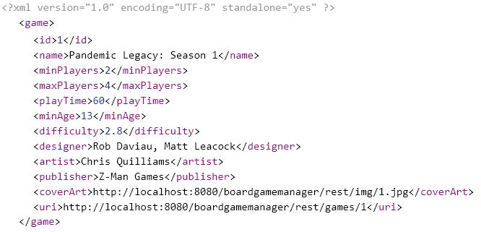
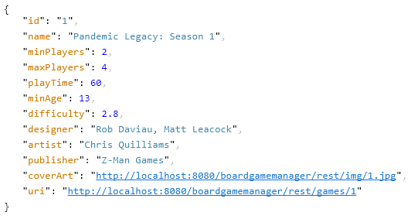
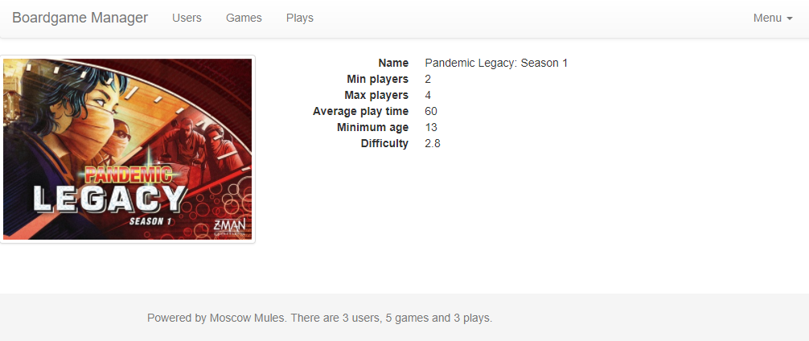
Examples
S. Ripamonti, L. Stornaiuolo, R. Pressiani
GET: http://localhost:8080/boardgamemanager/rest/games/1
application/xml
application/json
text/html
POLITECNICO DI MILANO

Slide 9
S. Ripamonti, L. Stornaiuolo, R. Pressiani
Code available on
https://github.com/ripa1993/mw_rest
POLITECNICO DI MILANO

