Slide 1
Approximation Algorithms
Colton Hines and Nolan Kramer

Slide 2
Approximation Algorithms
Used to find approximate solutions to optimization problems
Optimization - finding the best solution from a set of solutions
Motivation- Some optimization problems are too hard to solve, but approximate local solutions are still useful

Slide 3
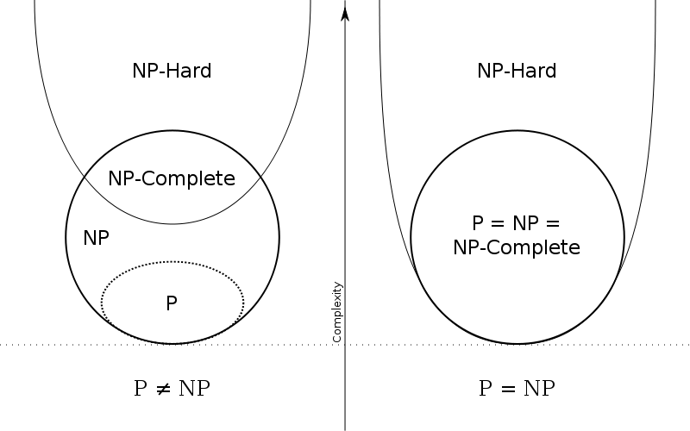
Overview of Complexity Theory
P problems have polytime
solutions
NP problems have solutions
that can be verified in polytime.
NP-hard problems are NP
problems that that any NP problem
can be reduced to in polytime.
Different implications if P = NP

Slide 4
Approximation Algorithm Application to Complexity Theory
If P != NP, NP-hard problems are unlikely to have polytime solutions.
Approximately optimal solutions can be significantly better than the average solution.
Can guarantee runtime- sacrifices small degree of accuracy for huge increase in speed.

Slide 5
How it Relates to Theoretical CS
How do you design approximation algorithms?
Greedy algorithms
Local search
Dynamic programming
Inapproximable problems
APX Complexity Class

Slide 6
Examples of Approximable Problems
Knapsack problem
Pathfinding

Slide 7
Maze time!!!
Have half the table do the maze as fast as possible
Have the other half do it with as few turns as possible
Time your maze solving skills and count the number of turns you make

Slide 8
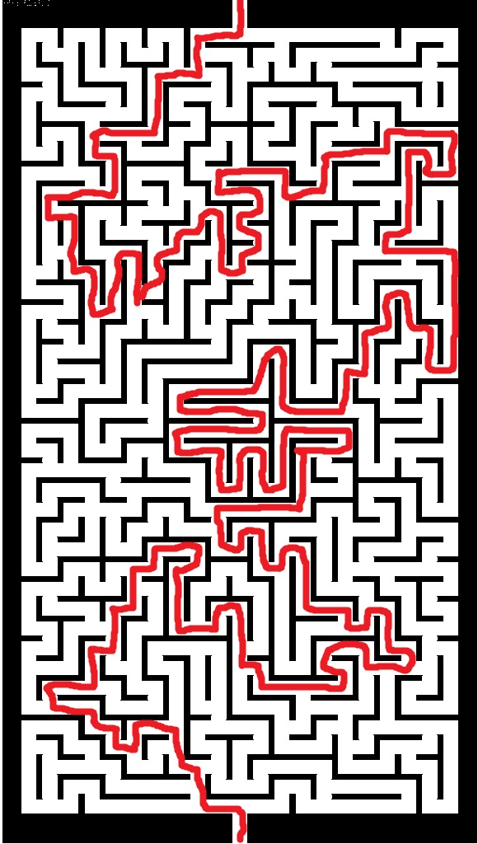
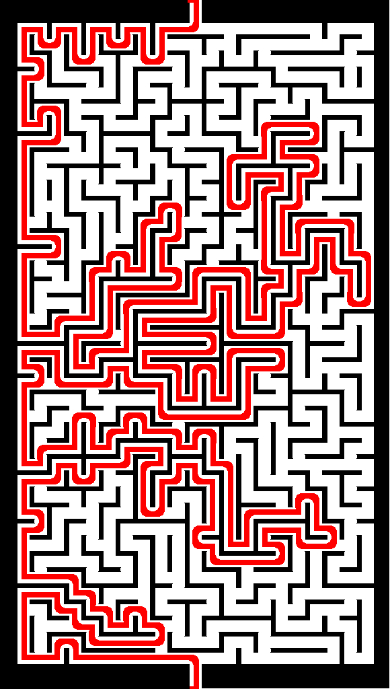
Our results
Our solution:
141 turns
Roughly 2 minutes
Computer solution:
263 turns
Roughly 3 seconds
Computer is almost 54x faster!
However, it is almost 2x as inaccurate.
R(x,y) = 1.934

Slide 9
Your results
To calculate performance guarantee:
R(x,y) = max(OPT/APPROX, APPROX/OPT)
We will use the classes worst and best number of corners to calculate the p-approximation guarantee.

Slide 10
Current results
Modern algorithm design techniques:
Greedy algorithms (first-fit)
Local searching (searching locally is faster than globally)
Enumeration & dynamic programming (breaking a larger problem into smaller pieces)
Convex minimization (local minimum as a global minimum)
Metric embedding (assigning values to path groups in order to pick fastest path)

Slide 11
Applications
Computational biology
Financial engineering
Transportation planning
Bin packing problem
Inventory management
Bin packing problem as well
Virtual machines
VM packing problem

Slide 12
Further Research
Open problems in the design of approximation algorithms:
Improved approximation for metric traveling salesman problem
Constant approximation for metric asymmetric traveling salesman problem
Polytime algorithm for bin packing problem with only constant extra bins
Primal-dual algorithm for survivable network design

Slide 13
Questions?

Slide 14
Sources
https://en.wikipedia.org/wiki/Approximation_algorithm
http://www.scottaaronson.com/blog/?p=122
http://www.designofapproxalgs.com/book.pdf
http://theory.stanford.edu/~amitp/GameProgramming/Heuristics.html
http://web.mit.edu/ehliu/Public/Spring2011/6.856/paper/main.pdf
http://math.mit.edu/~goemans/PAPERS/book-ch4.pdf

