Slide 1
Genetic Algorithms

Slide 2
Overview
“A genetic algorithm (or GA) is a variant of stochastic beam search in which successor states are generated by combining two parent states rather than by modifying a single state.” (Russel and Norvig, 126)
Inspired by Darwinian Theory of Evolution

Slide 3
Abstract
Let’s talk about Optimization and Constraints
What do we know?

Slide 4
Structure of GA’s
Population
Generated randomly
Fitness Function
Assess each individual
Selection
Of genes for crossover
Crossover
Allows for variety in gene pool
Mutation
Low probability for random gene mutation

Slide 5
More Examples
http://boxcar2d.com/
Randomly generated 2D platforming cars
N-Queens Problem
Pokémon team optimization
(my SMP)
Cycle graph

Slide 6
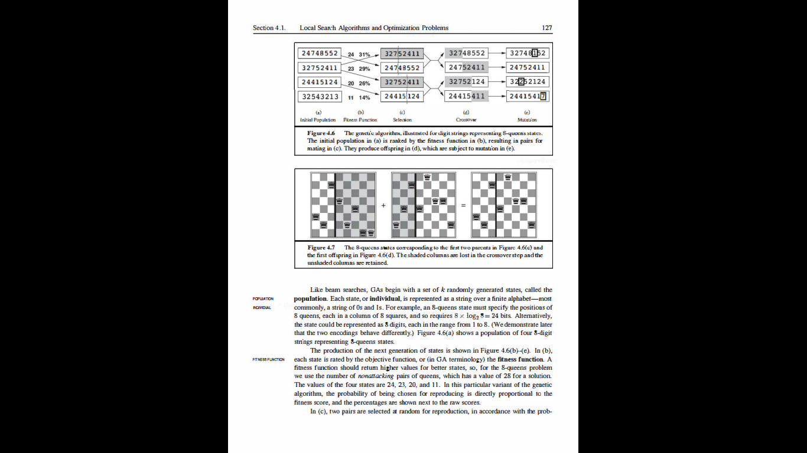

Slide 7
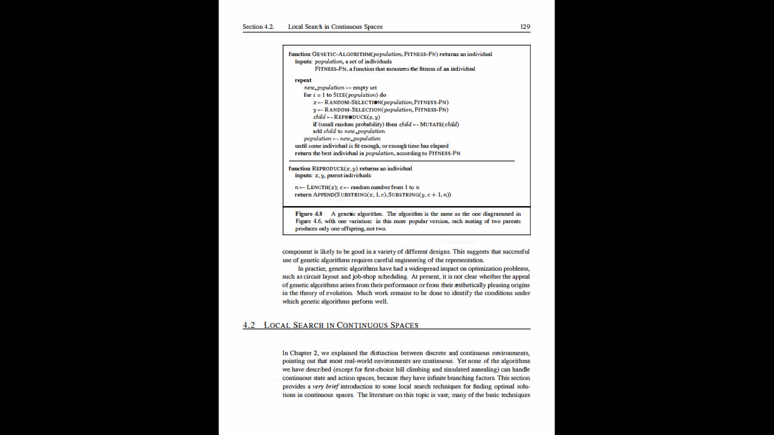

Slide 8
Practicality
Powerful because of simplicity
Held back by inefficiency
When would we use a GA?
Optimization towards some constraint
Relationship with AI

Slide 9
Pokémon
The individual is a team of six Pokémon
Each Pokémon on a team is a gene
The goal is to find the best team in terms of ability to win
Assume optimal AI
How do we structure this as a GA?

Slide 10
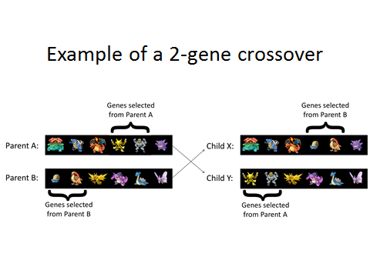

Slide 11
