Slide 1
Operations Research
Lecture 3

Slide 2
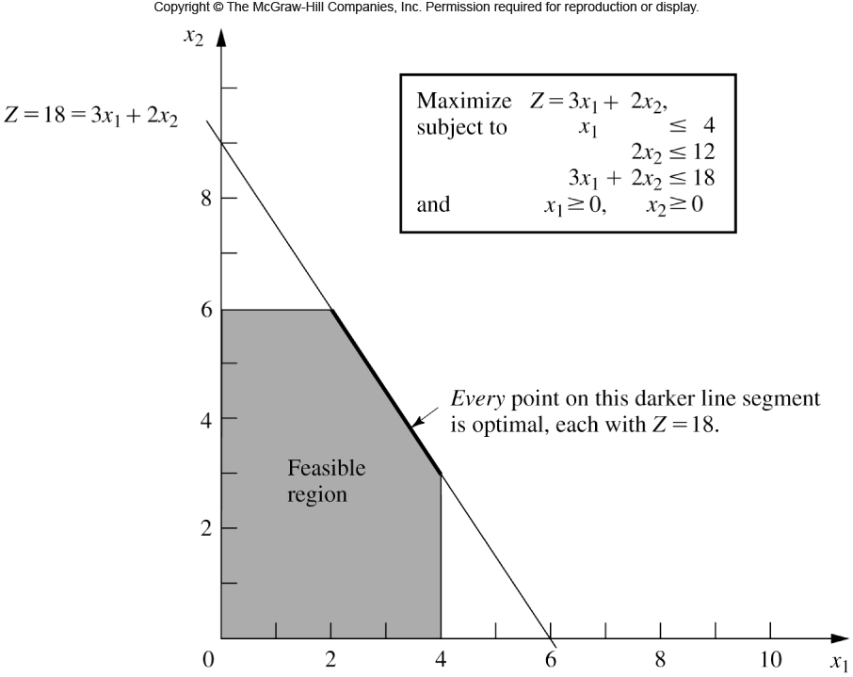
Fig. 3.5

Slide 3
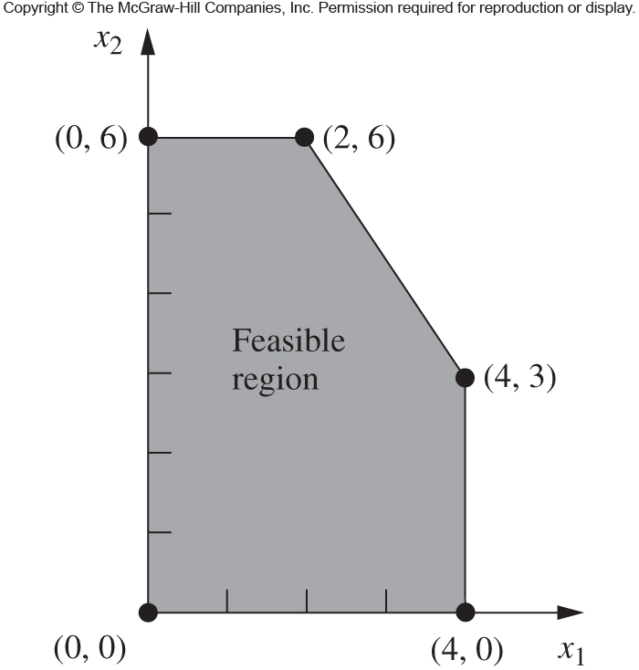
Fig. 3.7

Slide 4
Example Problem (Hiller & Lieberman)
The WYNDOR GLASS CO. produces high-quality glass products, including windows
and glass doors. It has three plants. Aluminum frames and hardware are made in
Plant 1, wood frames are made in Plant 2, and Plant 3 produces the glass and
assembles the products.
The company is launching two new products having large sales potential:
Product 1: 8’ glass door with aluminum framing ($3000 profit/batch)
Product 2: 4’ x 6’ double-hung wood-framed window ($5000 profit/batch)
Product 1 requires some of the production capacity in Plants 1 (1 hr/batch) and 3
(3 hr/batch). Product 2 requires Plants 2 (2 hr/batch) and 3 (2 hr/batch).
Marketing has determined that the company could sell as many of either product as
production allows. Determine what mix of products net the largest profit
considering that the amount of available time for Plant 1 is 4 hours, Plant 2 is 12
hours, and Plant 3 is 18 hours per week.

Slide 5
Now You!
Hi-V produces three types of canned juice drinks, A (apple), B (bear), and C (artificial snozzberries), using fresh strawberries, grapes, and apples. The daily supply is limited to 200 tons of strawberries, 100 tons of grapes, and 150 tons of apples. The cost per ton of strawberries, grapes, and apples is $200, $100, and $90, respectively. Each ton makes 1500 lb of strawberry juice, 1200 lb of grape juice, and 1000 lb of apple juice. Drink A is a 1:1 mix of strawberry and apple juice. Drink B is a 1:1:2 mix of strawberry, grape, and apple juice. Drink C is a 2:3 mix of grape and apple juice. All drinks are canned in 16-oz cans. The price per can is $1.15, $1.25, and $1.20 for drinks A, B, and C. Determine the optimal mix of the three drinks using Excel!
Source: Taha, 2.4E.1

