Slide 1
Operations Research
Lecture 5

Slide 2
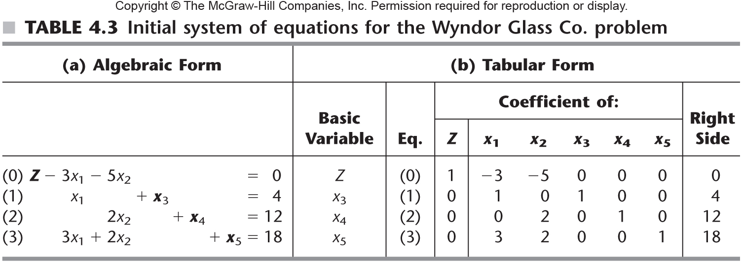

Slide 3
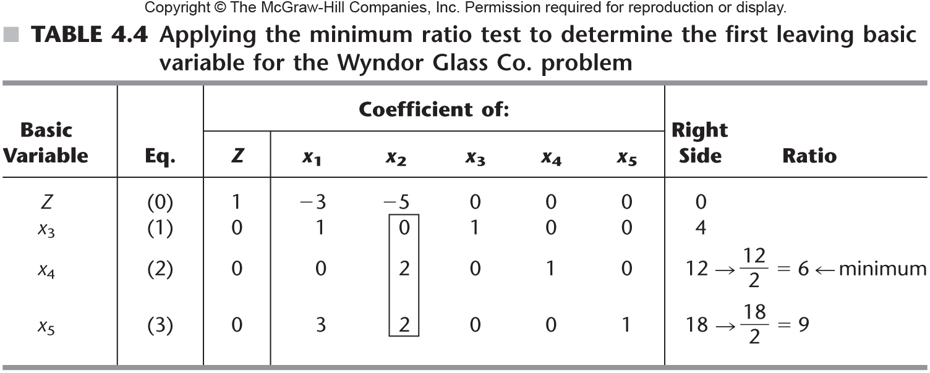
Table 4.4

Slide 4
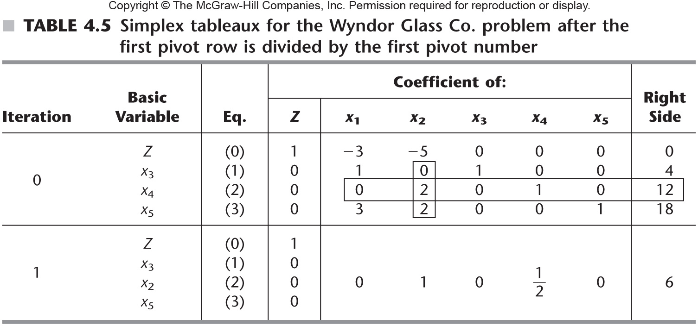
Table 4.5

Slide 5
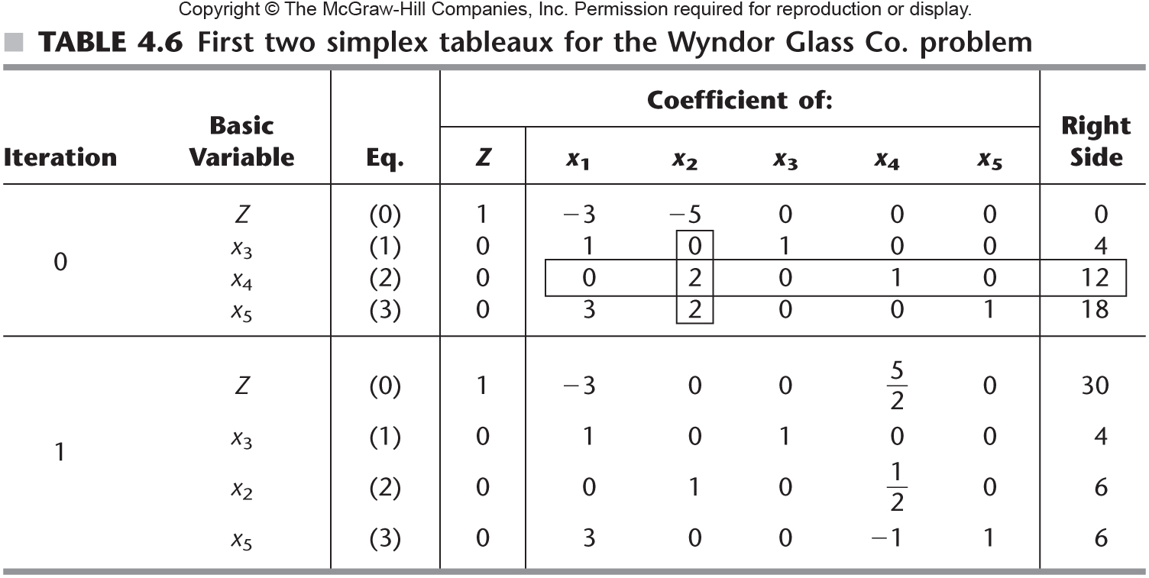
Table 4.6

Slide 6
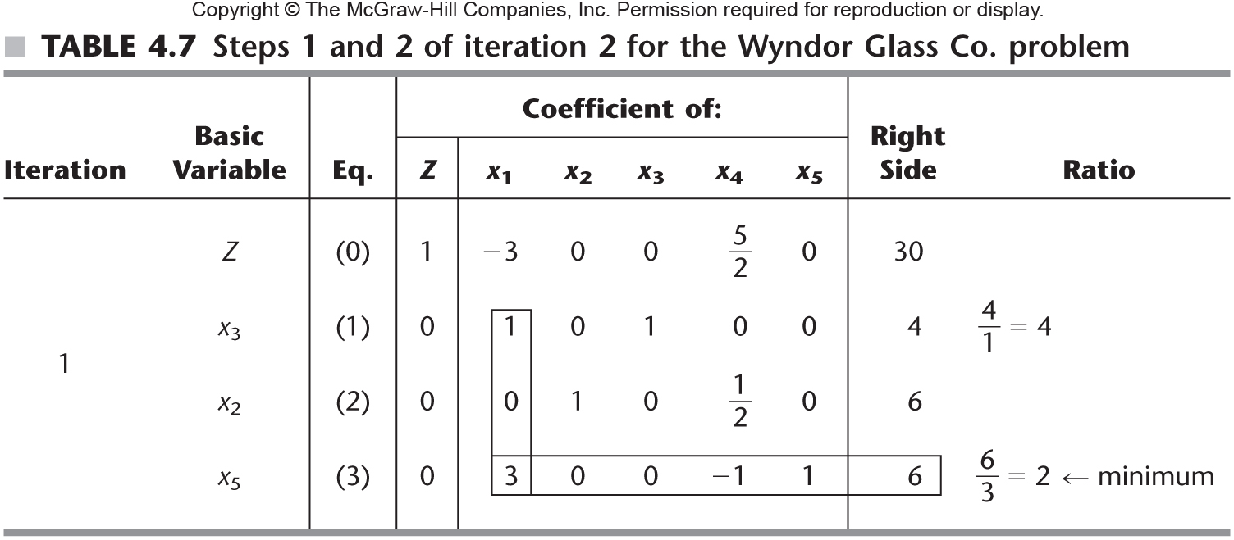
Table 4.7

Slide 7
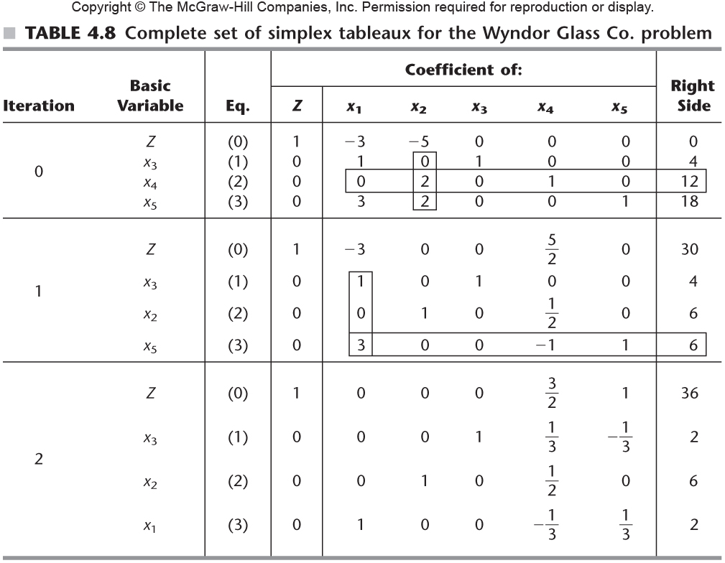
Table 4.8

Slide 8
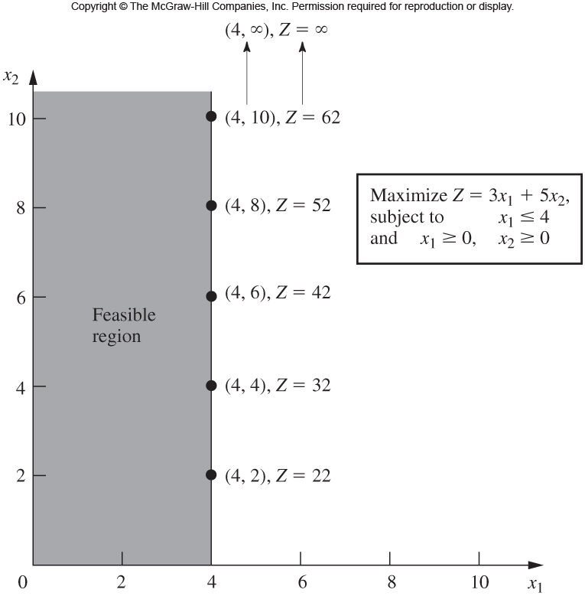
Fig. 3.6

