Slide 1
Quantum Computing - A new computation model?
Will Ferrin, Will Borwegan, Dillon Fitzgerald

Slide 2
Introduction/Background
Quantum computing is a new method for developing models of computation based on principles of quantum mechanics (superposition, entanglement)
1981 - Richard Feynman & Paul Benioff are both credited with giving separate talks proposing the idea of developing a quantum computer
1985 - David Deutsch created the first theoretical model of a universal quantum computer
1994 - Peter Shor develops famous algorithm for integer factorization
1998 - First working 2-qubit quantum computer developed at Oxford

Slide 3
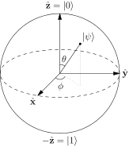
Qubit
A qubit is the quantum representation of the classical bit
A way to store quantum information
This quantum bit that can represent a 0,1, or a superposition of both
Represented using a Bloch Sphere
Can be implemented physically using: photons, states of compressed light, electrons and other particles
To convert a system of n-qubits, a classical computer requires 2^{n} complex coefficients

Slide 4
Superposition of states
The power behind the qubit lies in its superposition of states.
It allows the qubit to be in two states simultaneously, a 0 and a 1 at the same time, since it is constantly moving.
Although, once a qubit is observed, it reduces to a classical bit, either a 0 or a 1.
Based on the superposition of physical entities as a wave, particle, or both.
We can think of the current state as a probability of which classic state it may lie in, using complex coefficients of 0 and 1, called the probability amplitudes.

Slide 5
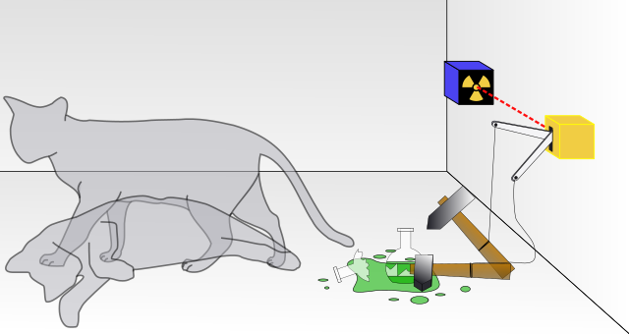

Schrödinger’s cat
Real world analogy for
superposition

Slide 6
Theoretical Model of Computation
A quantum computer can be modeled similar to a classical computer, but with a few additions
David Deutsch proposed the first model of a universal quantum Turing machine
Formally defined as a 7-tuple: M = ⟨ Q, Γ, b, Σ, δ, q, F⟩
States in Q are considered in Hilbert space - multidimensional states
Initial states can be either a pure or mixed state
The transition function consists of a set of unitary matrices mapping the space

Slide 7
Classical to Quantum
Turing machine -> Quantum Turing machine
Logical Circuits -> Quantum gates
Partial Recursive Functions -> Unitary Operators
Universal Programming Languages -> Quantum Programming Languages

Slide 8




Quantum Circuits
Hadmard gate - acts on a single qubit
Pauli-X gate - equivalent of the NOT gate
Pauli-Y gate & Pauli-Z gate - transformations on the Y and Z axis
C NOT gate - acts on 2 or more qubits, where the first is a control for the other

Slide 9
Shor’s Algorithm
Made for integer factorization, formulated in 1994
Runs in polynomial time and is in complexity class BQP
BQP - ability for a quantum algorithm to run in polynomial time with low error probability
Vastly faster than classical computers which solve in sub-polynomial time
Uses Quantum Fourier Transform
Requires O(n log n) gates to efficiently approximate
Is used to copy a set of qubits while preserving the initial states
Uses reversible gates to get around quantum modular exponentiation, which drastically slows the equation down.

Slide 10
D-Wave 1000 Qubit Computer
D-Wave Systems, Inc. built a record breaking 1000 qubit computer.
System can consider 2¹⁰⁰⁰ possibilities at the same time.
Using Josephson Tunnel Junctions on the most complex integrated circuit yielded with features as small as .25 micrometers
System is run at almost absolute zero.
Second largest Qubit system has 512 qubits

Slide 11
Applications/Benefits
Big data handling:
Drug discovery (amino acid search)
Social media
Machine learning (Still very theoretical, looks for patterns in big data)
Cyber security (possibility to crack RSA encryption using Shor’s algorithm)

Slide 12
Disadvantages/Constraints
Quite difficult to create large scale quantum computers
Decoherence: outside interference leaving the qubit offset, possibly affecting other entangled qubits
Quantum collapse: reduces to a single state (classical)
Temperatures within gates must be kept incredibly cold to ensure qubits are aligned properly/not affected by “noise”
Shor’s algorithm can (rare) lead to an invalid prime factor q, that doesn’t lead to the desired product N, in which case, just test another p.

Slide 13
References
Bennet, Charles H., E. Bernstein, G. Brassard, and U. Vazirani. “Strengths and Weaknesses of Quantum Computing.” SIAM Journal on Computing, vol. 26, no. 5, 1997, pp. 1510-1524.
Deutsch, D. “Quantum Theory, the Church-Turing Principle and the Universal Quantum Computer.” Proceedings of the Royal Society of London, Series A, Mathematical and Physical Sciences, vol. 400, no. 1818, 1985, pp. 97-117.
Farhi, Edward, J. Goldstone, S. Gutmann, J. Lapan, A. Lundgren, and D. Preda. “A Quantum Adiabatic Evolution Algorithm Applied to Random Instances of an NP-Complete Problem.” Science, vol. 292, no. 5516, 2001, pp. 472-475.
Igarashi, Yoshihide. Computing: A Historical and Technical Perspective. Taylor and Francis, 2014.
Wittek, Peter. Quantum Machine Learning: What Quantum Computing Means to Data Mining. Elsevier Science, 2014.

Slide 14
More References
Miller, Ian, and Aaron Dunbrack. "What Is the Difference between Quantum Decoherence and Wave Function Collapse?" Quora. N.p., 3 Mar. 2015. Web. 28 Nov. 2016.
Kishore, Nandha. "Quantum Computation Why Is Building a Large Quantum Computer Difficult?" Quora. N.p., 16 Jan. 2014. Web. 28 Nov. 2016.
"Quantum Decoherence." Wikipedia. Wikimedia Foundation, n.d. Web. 28 Nov. 2016.
Warner, Bernhard. "What Quantum Computing Can Do for You." Bloomberg.com. Bloomberg, 30 May 2013. Web. 29 Nov. 2016.
"Schrödinger's Cat." Wikipedia. Wikimedia Foundation, n.d. Web. 29 Nov. 2016.
Gokhale, Pranav. "How does Shor’s algorithm work in layman’s terms?" Quora. N.p., 16 Nov. 2015. Web. 29 Nov. 2016.
"Quantum Machine Learning." Wikipedia. Wikimedia Foundation, n.d. Web. 30 Nov. 2016.

Slide 15
More References
“D-Wave Systems Breaks the 1000 Qubit Quantum Computing Barrier.” dwavesys.com, 22 June 2015. Web. 29 Nov. 2016.
“File:Schrodinger’s Cat.svg.” Wikipedia. Wikimedia Foundation, n.d. Web. 30 Nov. 2016.
Omer, Bernhard. “Models for Quantum Computation.” tph.tuwien.ac.at/~oemer, n.d. Web 29 Nov 2016
“Schrodinger's Equation.” Wikipedia. Wikimedia Foundation, n.d. Web. 30 Nov. 2016.
“Shor’s Algorithm.” Wikipedia. Wikimedia Foundation, n.d. Web. 29 Nov. 2016.
“Quantum Gates.” Wikipedia. Wikimedia Foundation, n.d. Web. 30 Nov. 2016.
“Qubit.” Wikipedia. Wikimedia Foundation, n.d. Web. 30 Nov. 2016.
“Timeline of Quantum Computing.” Wikipedia. Wikimedia Foundation, n.d. Web. 29 Nov. 2016.

