Slide 1
Maps
Nick Mouriski

Slide 2
What are Maps?
A map is an unordered collection of key-value pairs
A map is also known as an associative array or a hash table
Maps are used to look up a value by its associated key
Keys can be strings
What does this mean?

Slide 3
Data Structures!
Maps are a fundamental type of data structure that allows associations to be set up between one set of objects and another.
Real life example: For a given IP address, what is the host name?

Slide 4
Maps
Maps allow for the possibility of keys in a key-value to appear only once in a collection.
In syntax, creating a map is similar to how we create lists and sets.
With maps though, the Key is the value that represents where we are mapping from and the Value is the value that represents where we are mapping to.

Slide 5
Lists, Sets, Maps Oh My…
The Java Collections Framework:
Lists are ordered collections of values where you can add and remove elements. (Ex. ArrayList)
Sets are unordered collections of values where a specific object will appear at most once. (Ex. HashSet)
Maps are structures that create associations between keys and values. (Ex. HashMap)

Slide 6
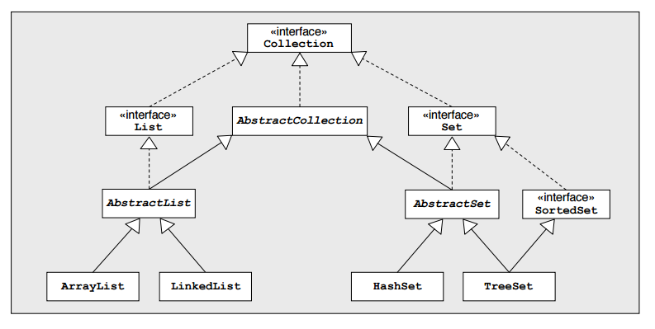
Java Collection Hierarchy

Slide 7
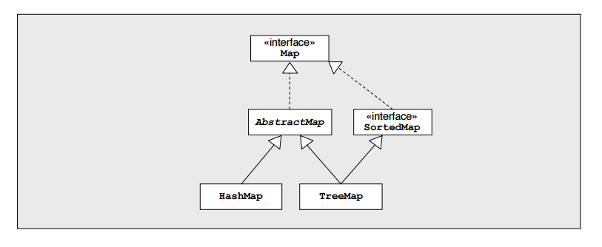
Map Hierarchy

Slide 8
Maps: Example
Map<String, String> countryNames = new HashMap<String, String>(3);
Here we are using a Map, pairing the key as a String to a String value named countryNames. Then we call it as a new HashMap with a defined quantity of 4
countryNames.put(“GB”, “Great Britain”);
countryNames.put(“FR”, “France”);
countryNames.put(“IT”, “Italy”);
countryNames.put(“US”, “Unite States of America”);
And then to retrieve one of the key-value pairs from the map:
String name = countryNames.get(“US”);

Slide 9
Exercise 1
What are some possible applications of maps?

Slide 10
Exercise 1
HashMaps and Hashtables are very convenient in the fact that they only take O(1) time to find a key.
Any instance where it will take intricate for looping to find an answer may have a cheap look up solution using maps.
Example: HashMaps vs. Binary search tree

Slide 11
Associative Arrays
There are many situations where we want to index elements differently than just by integers.
Examples: Dictionaries, phone books, menus, certain data bases
A map is an associative array.

Slide 12
Keys and Values
Keys are literally the keys to the values in a pair.
Even a simple string can be the key to a complex data value.
Think of a student ID as a key. The value in a pair to a student ID could be another associative array that contains grades, classes, etc.

Slide 13
Maps in Java
Java has a few different implementations of maps (java.util.Map)
HashMaps, Hashtables, TreeMaps are a some examples

Slide 14
java.util.Map
Some new methods from the Map interface:
containsKey(Object key) - Returns true if this map contains a mapping for the specified key
containsValue(Object value) - Returns true if this map maps one or more keys to the specified value
entrySet() - Returns a Set view of the mappings contained in this map.
keySet() - Returns a set view of the keys contained in this map.
get(Object key) - Returns the value to which the specified key is mapped
put(K key, V value) - Associates the specified value with the specified key in this map

Slide 15
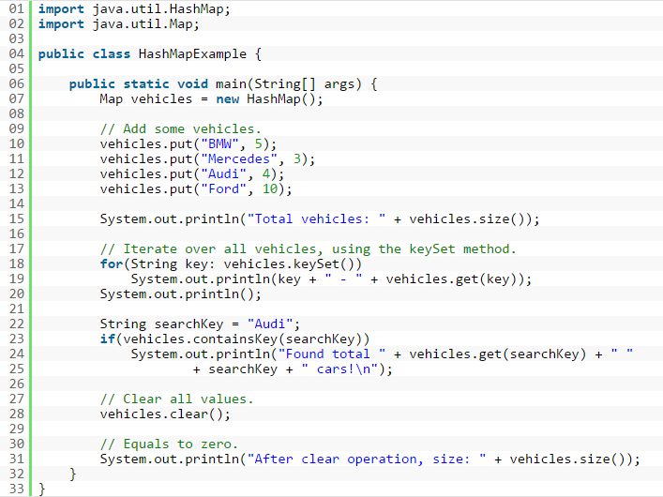

Slide 16
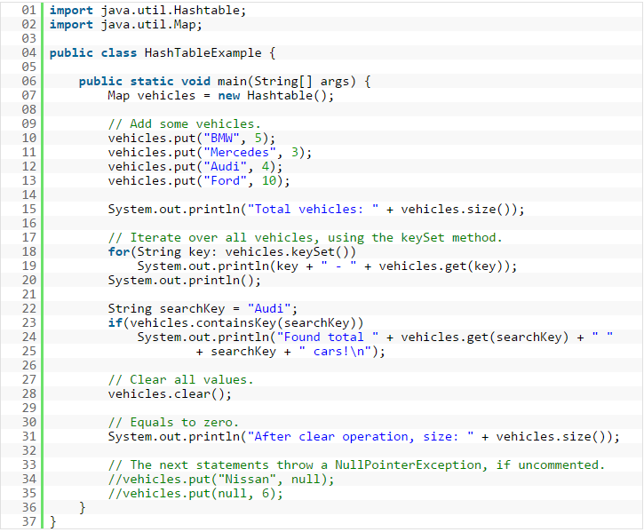

Slide 17
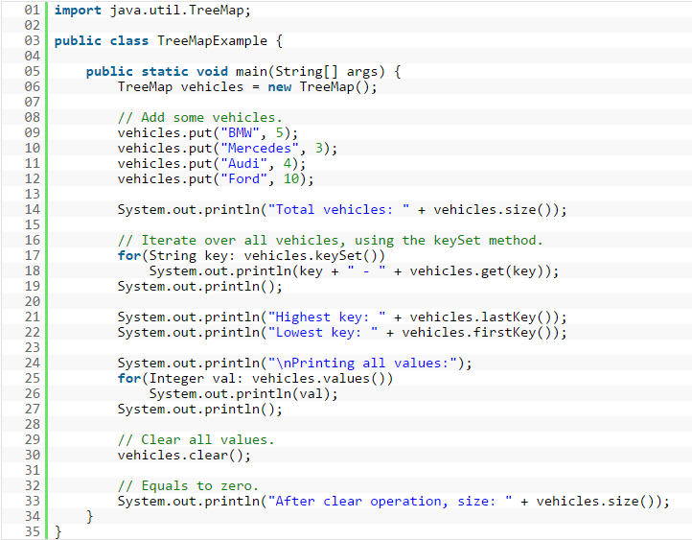

Slide 18
HashMap vs Hashtable
Hashtable does not allow keys or values to be null. HashMap allows one null key and however many null values.
Hashtable is synchronized where HashMap is not. This allows HashMap to work better on non-threaded applications.
Otherwise, these two maps are essentially the same

Slide 19
Treemaps?
Sorted by the key, based on red-black tree structures
Red-black trees are a whole separate topic

Slide 20
Exercise 2
Lets say we have a small class of students. The professor marks them true for present and false for absent. Implement a HashMap, then, using the Map API, print out the students who were present to class.
To get started:

Slide 21
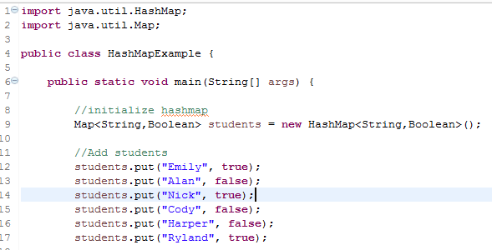

Slide 22
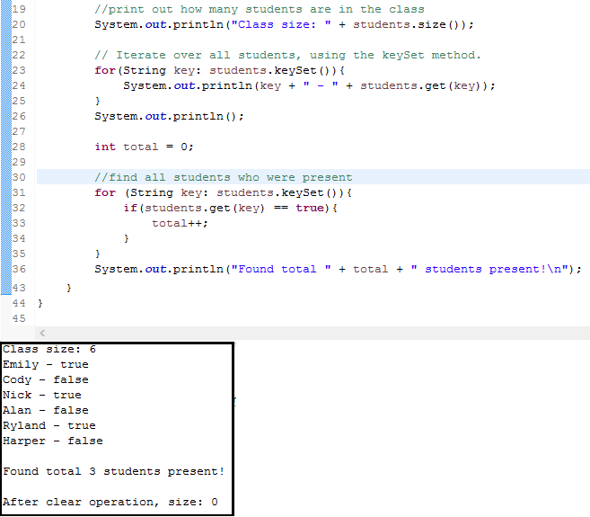

Slide 23
What is Hashing?
Hashing is the ability to maximize the efficiency of arrays
For maps, hashing is a technique that accomplishes direct access of data from a value in a key-value pair.
An address is obtained directly from the key in a pair which allows O(1) seek time

Slide 24
Hashing
Going back to our first example, the key is a hash of the value.
countryNames.put(“US”, “Unite States of America”);
Hashing can be intricate.
Keys being actual pointers in memory.

Slide 25
Sources
http://www.programcreek.com/2013/03/hashmap-vs-treemap-vs-hashtable-vs-linkedhashmap/
http://www.javamex.com/tutorials/collections/maps.shtml
http://examples.javacodegeeks.com/java-basics/java-map-example/
https://www.cs.cmu.edu/~fp/courses/15122-f15/lectures/12-hashtables.pdf
http://cs.stanford.edu/people/eroberts/courses/cs106a/handouts/54-collections.pdf

