Slide 1
Final presentation of group 32 on Principles of Digital Fabrication
Hanna Risteli
Laura Sarajärvi
Tatu Tallavaara
Siiri Tuomikoski

Slide 2
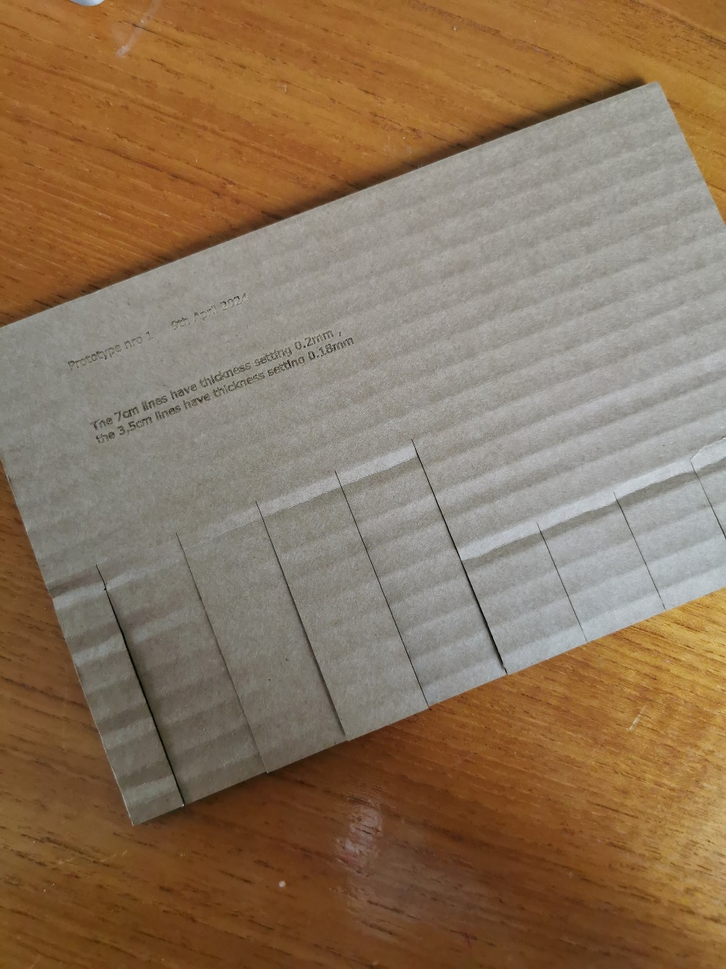
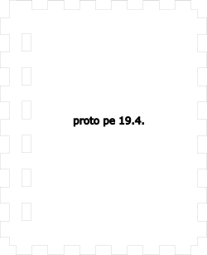
Group 32
A Keyboard instrument
-Laser cutting, simulation with Tinkercad, programming, 2D designing with Inkscape,
We are making a keyboard instrument with 8 keys
We are using Arduino instead of Raspberry Pi
What is our project about?
Processes
Sustainability
We have made test versions of the 2D files first in cardboard & a smaller size proto to test final details
Acrylic used only for keys
Electronic components are handled carefully and reused

Slide 3
Group 32
A Keyboard instrument
-Laser cutting, simulation with Tinkercad, programming, 2D designing with Inkscape,
We are making a keyboard instrument with 8 keys
We are using Arduino instead of Raspberry Pi
What is our project about?
Processes
Sustainability
We have made test versions of the 2D files first in cardboard & a smaller size proto to test final details
Acrylic used only for keys
Electronic components are handled carefully and reused

Slide 4
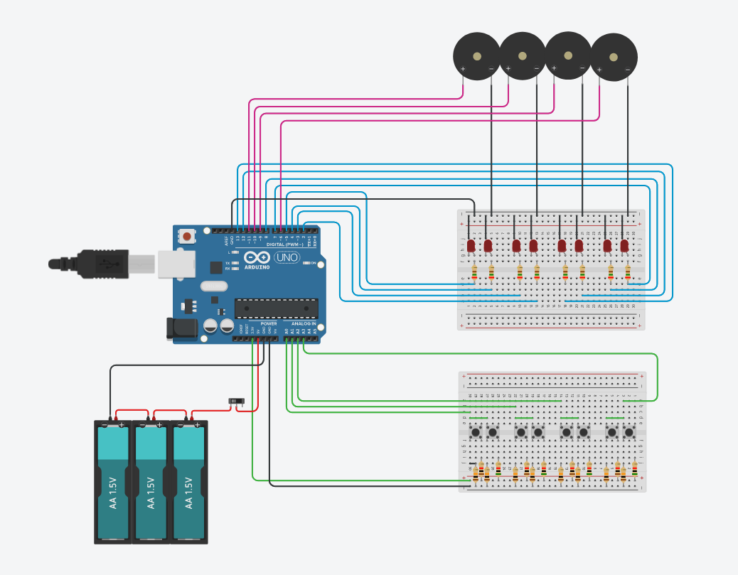
Group 32
Music player
Planning hasn't been very clear, we still have a lot to do before next week. Because of the problems with group formation, we're left behind on DesignEDU.
Inkscape usability
Raspberry Pi Pico W didn't work so we switched to using Arduino
Group coordination & starting late
How to use multiple buttons at the same time
Programming polyphony with just buzzers and the Tone library
Tone library is not included in Tinkercad
Challenges
Reflection
Prototype of the circuit in Tinkercad, no functional code yet.

