Slide 1
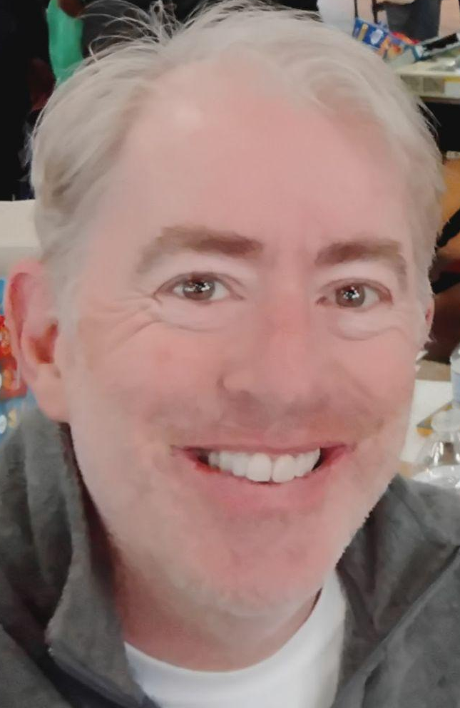
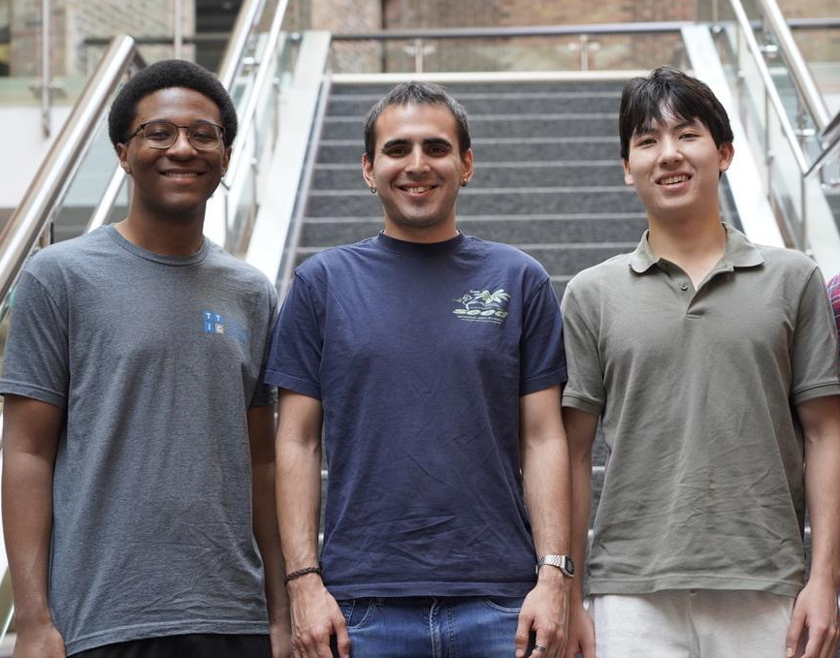

Meet your Mentor Interns
Mike
Adam
Tomás
Felix

Slide 2
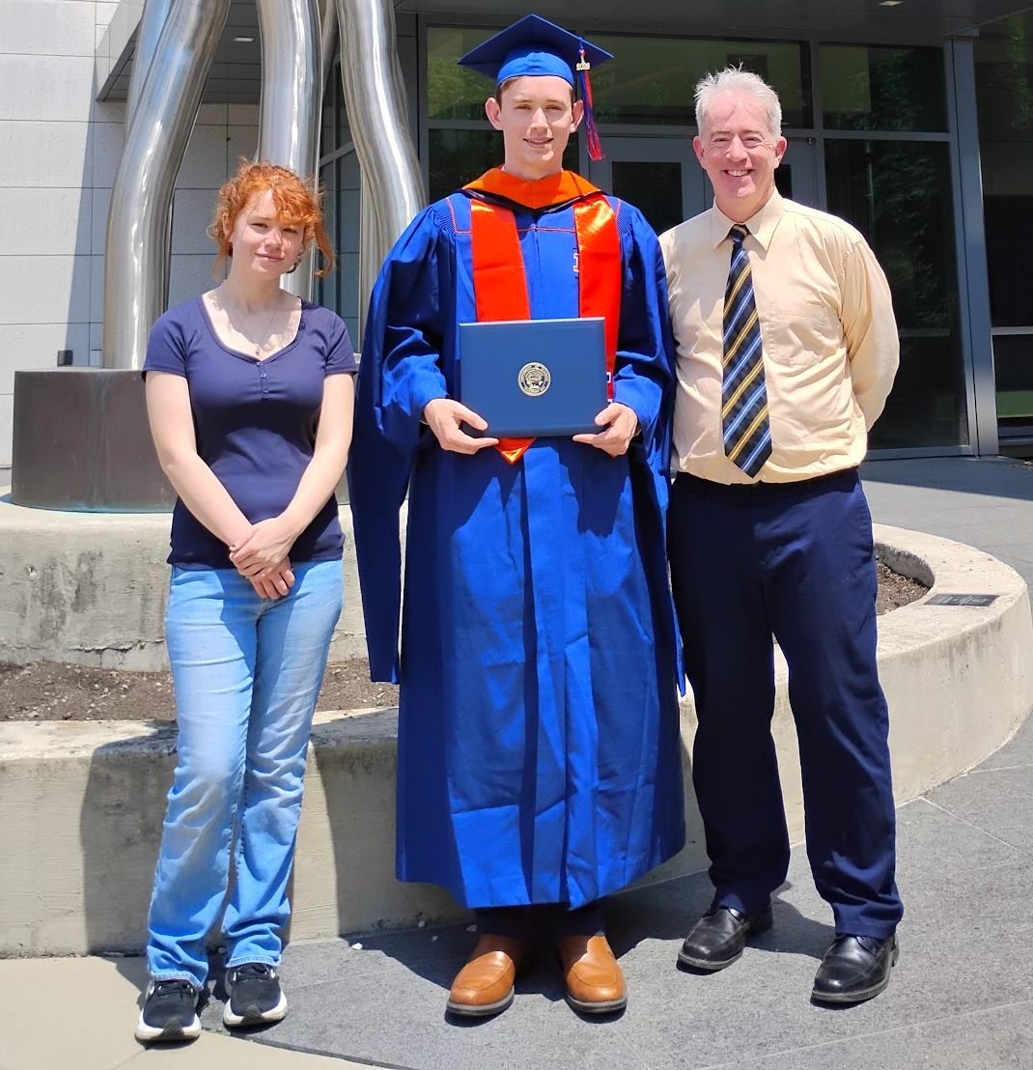
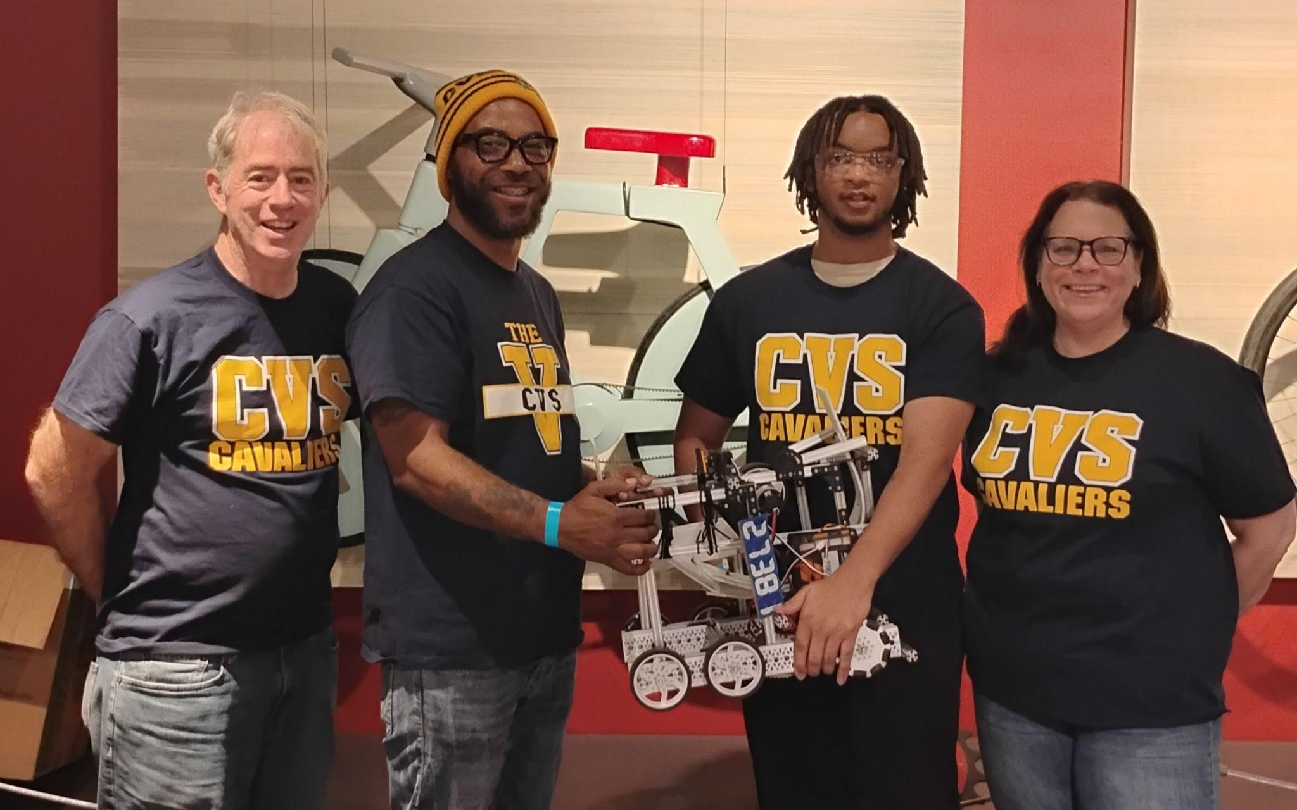
Mike (Dr. Rodgers)
PhD. Northwestern University (TAM).
M.S.E.M. University of Kentucky
B.S. Math (Physics Minor) Georgia State U.
CPS Teacher Chicago Vocational HS.
Math, Physics, Engineering, and CS.
HS Teacher 2008-. Robotics Coach 2014-.

Slide 3
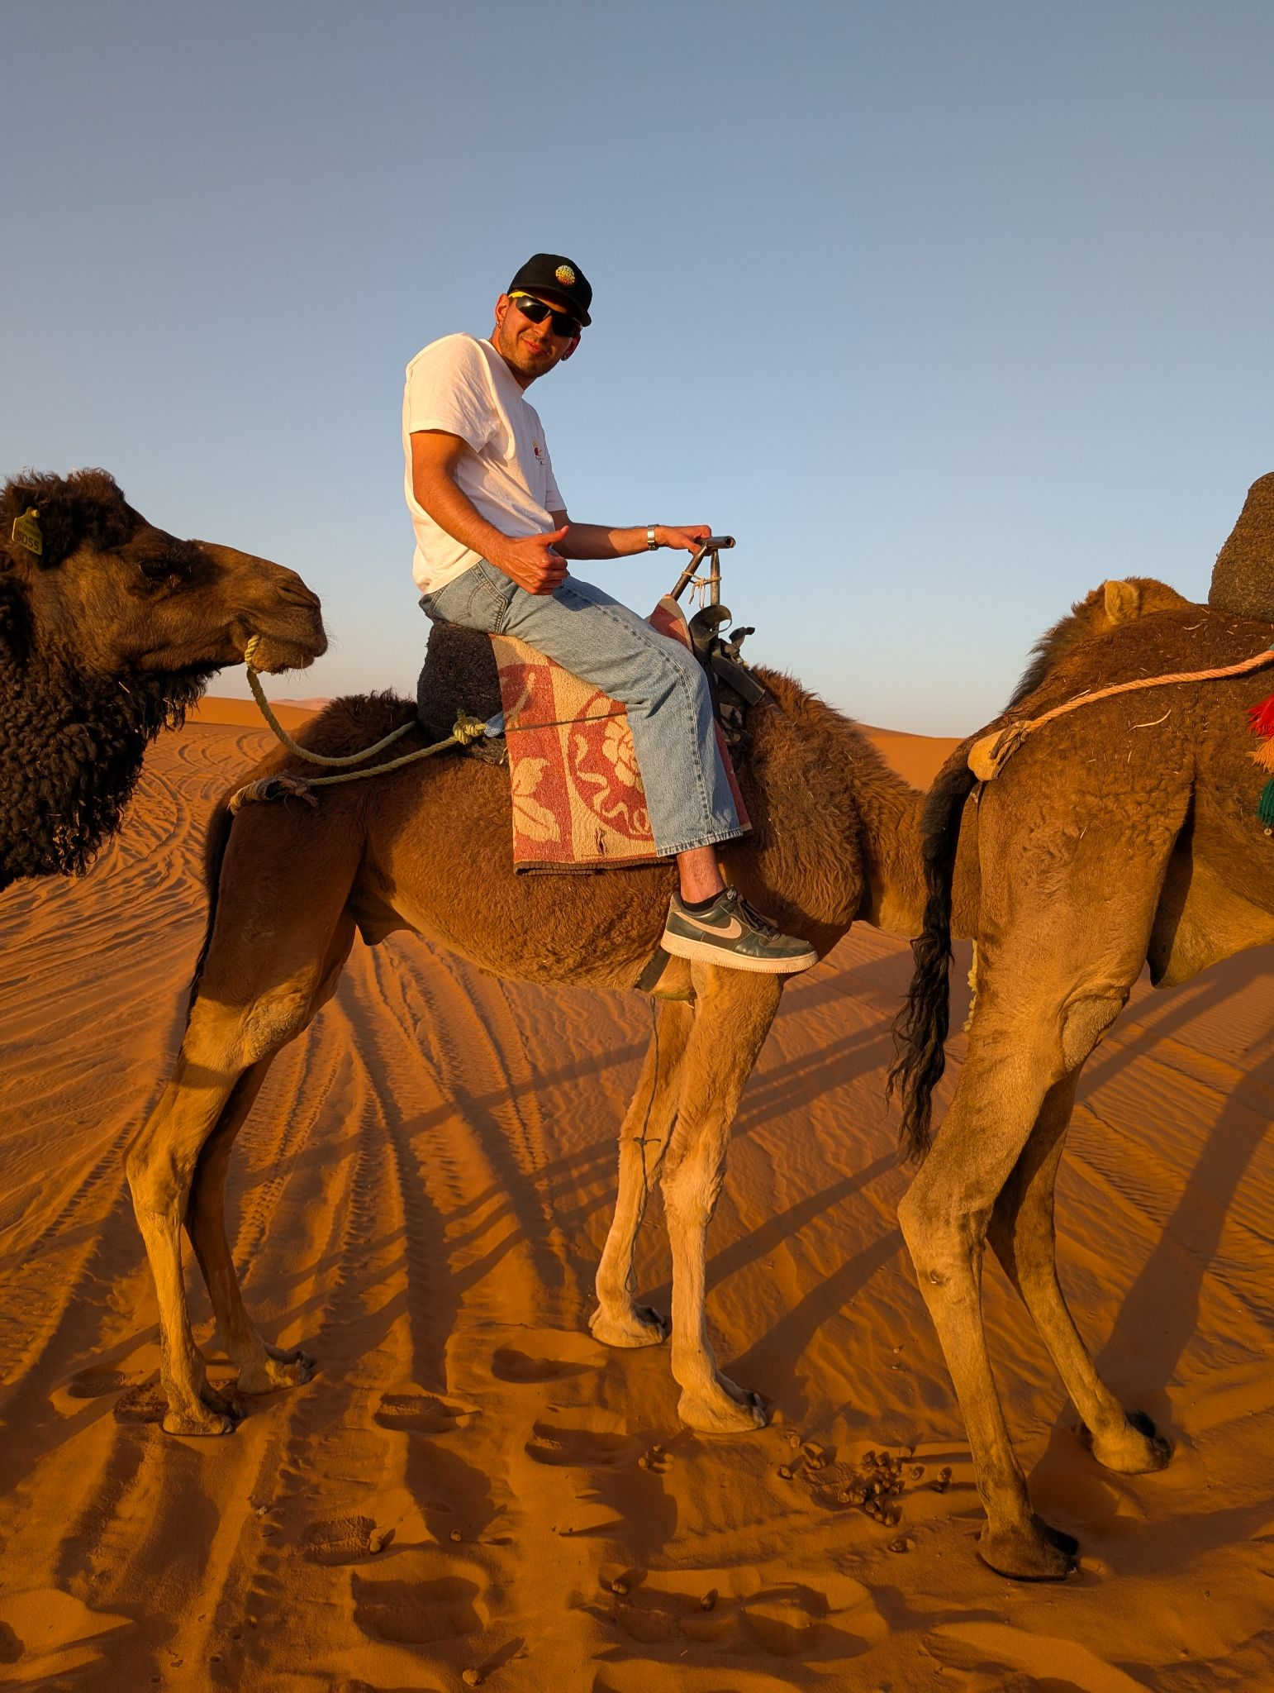
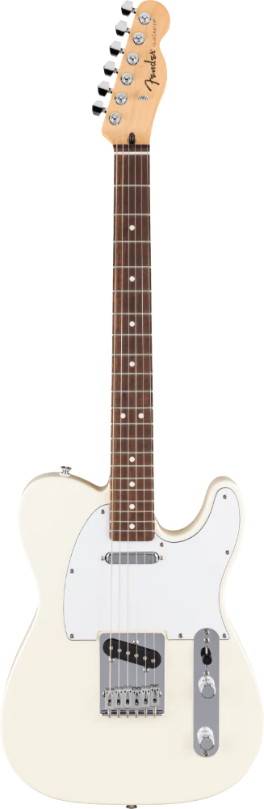


Tomás Quinteros
Rising senior at UChicago, Computer Science major
From Buenos Aires, Argentina
Very into soccer, music, and films

Slide 4
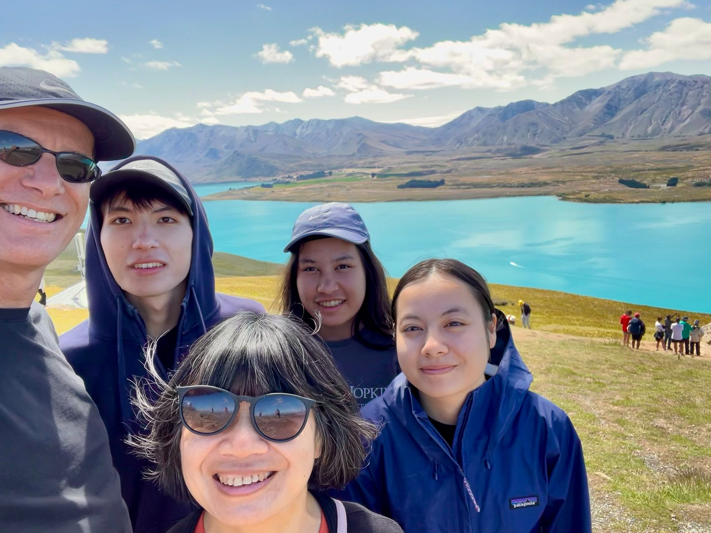
Felix Odenthal
Description
- Computational & Applied Math Major
- Rising senior at UChicago.
- From NYC
- I really enjoy tennis, piano, and traveling

Slide 5
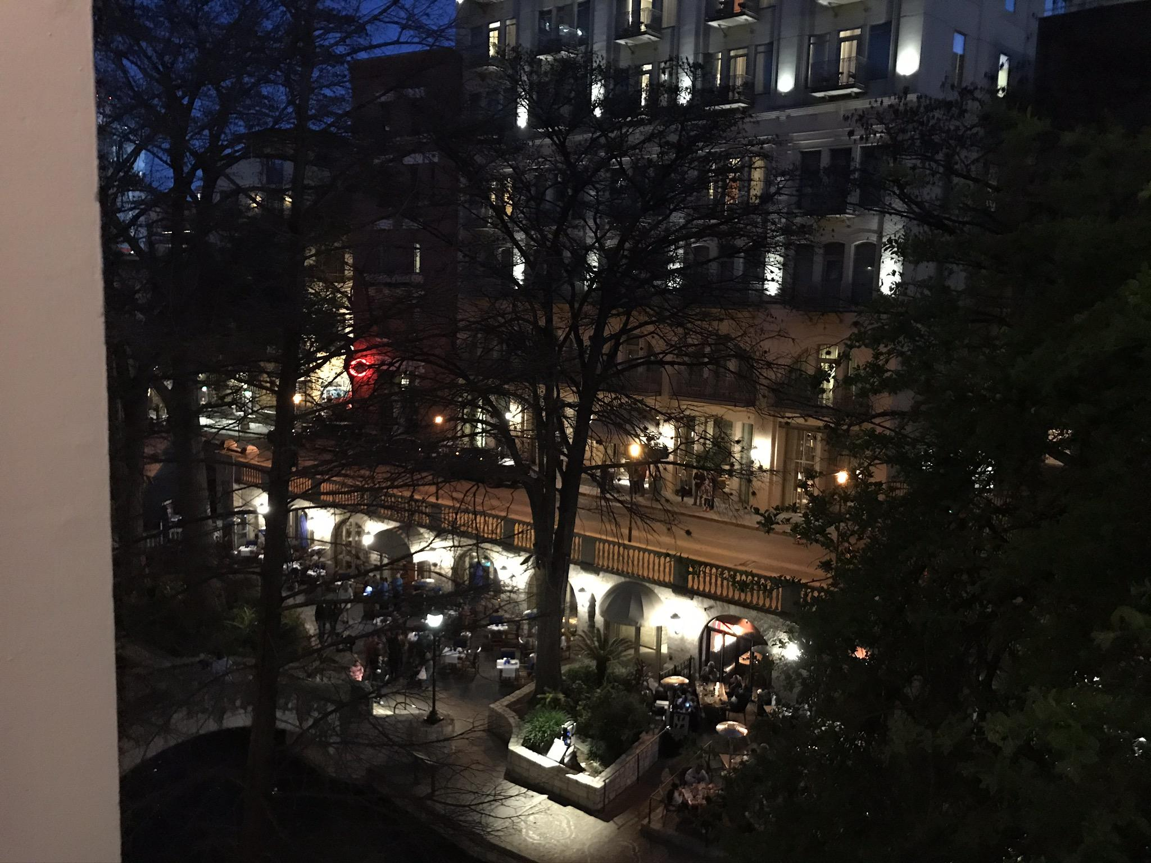
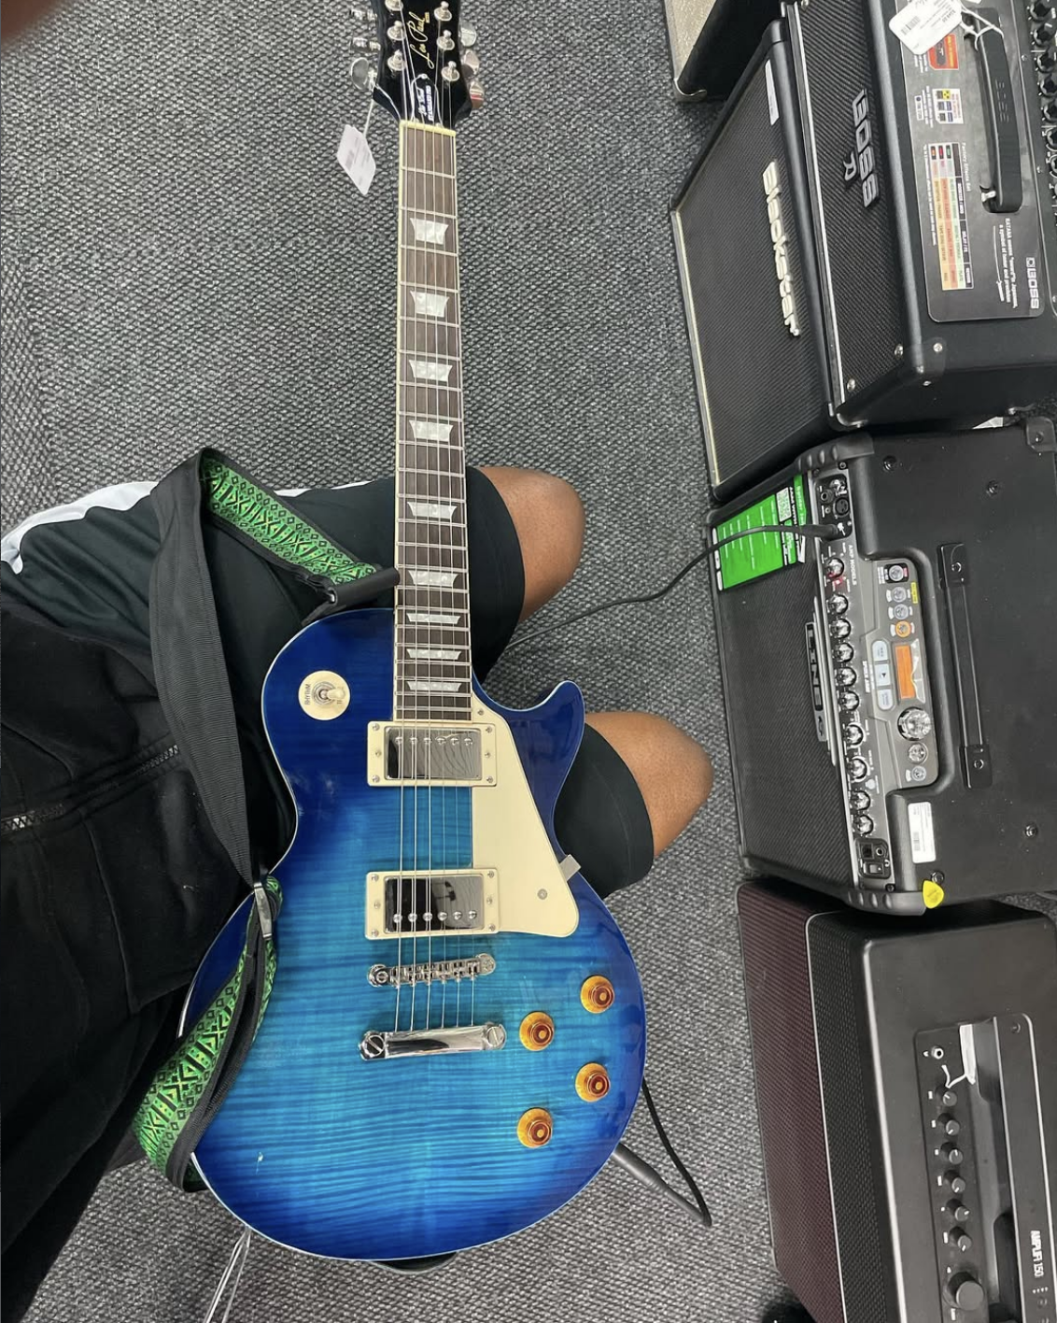
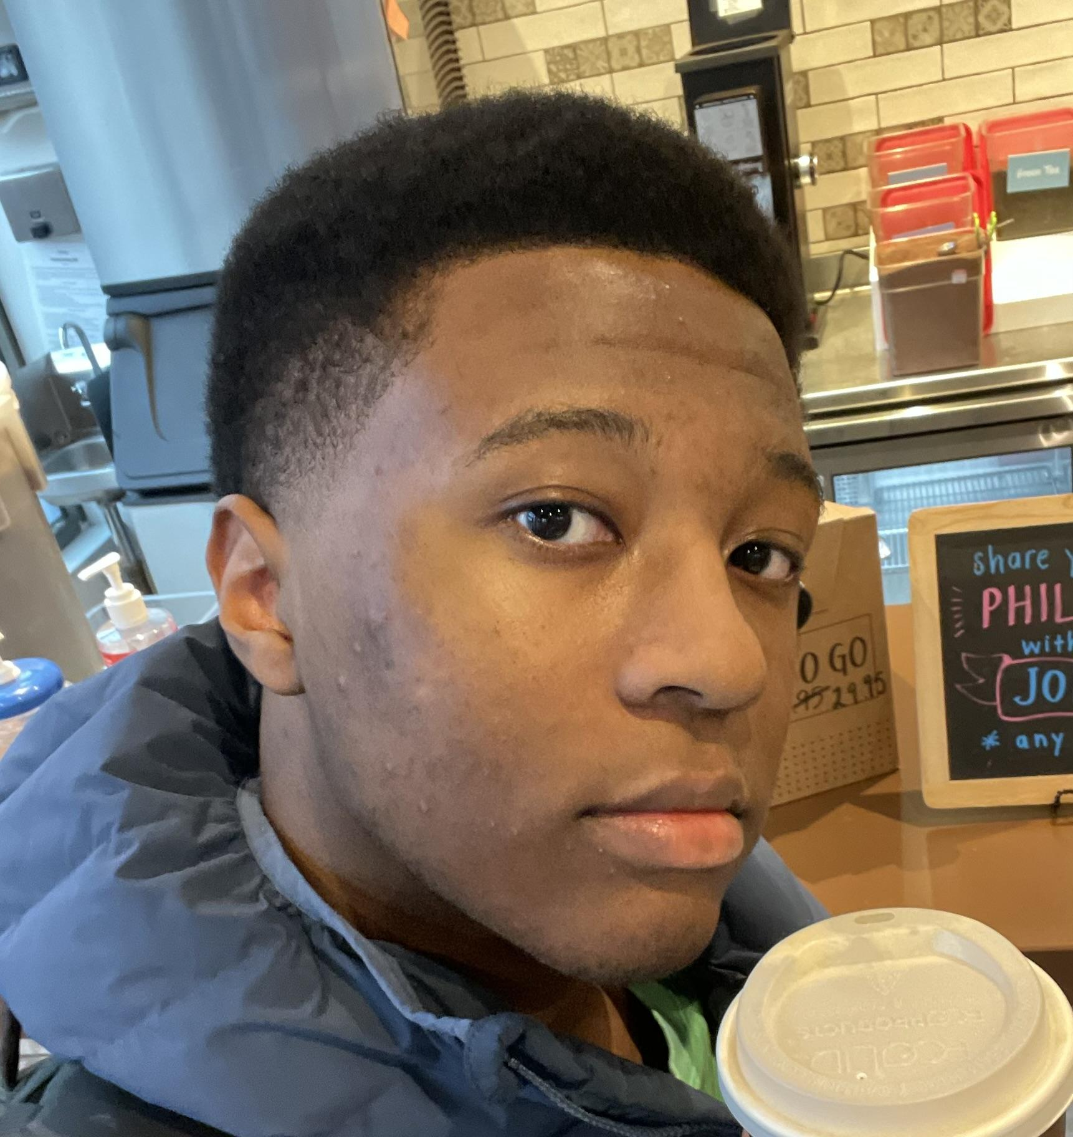

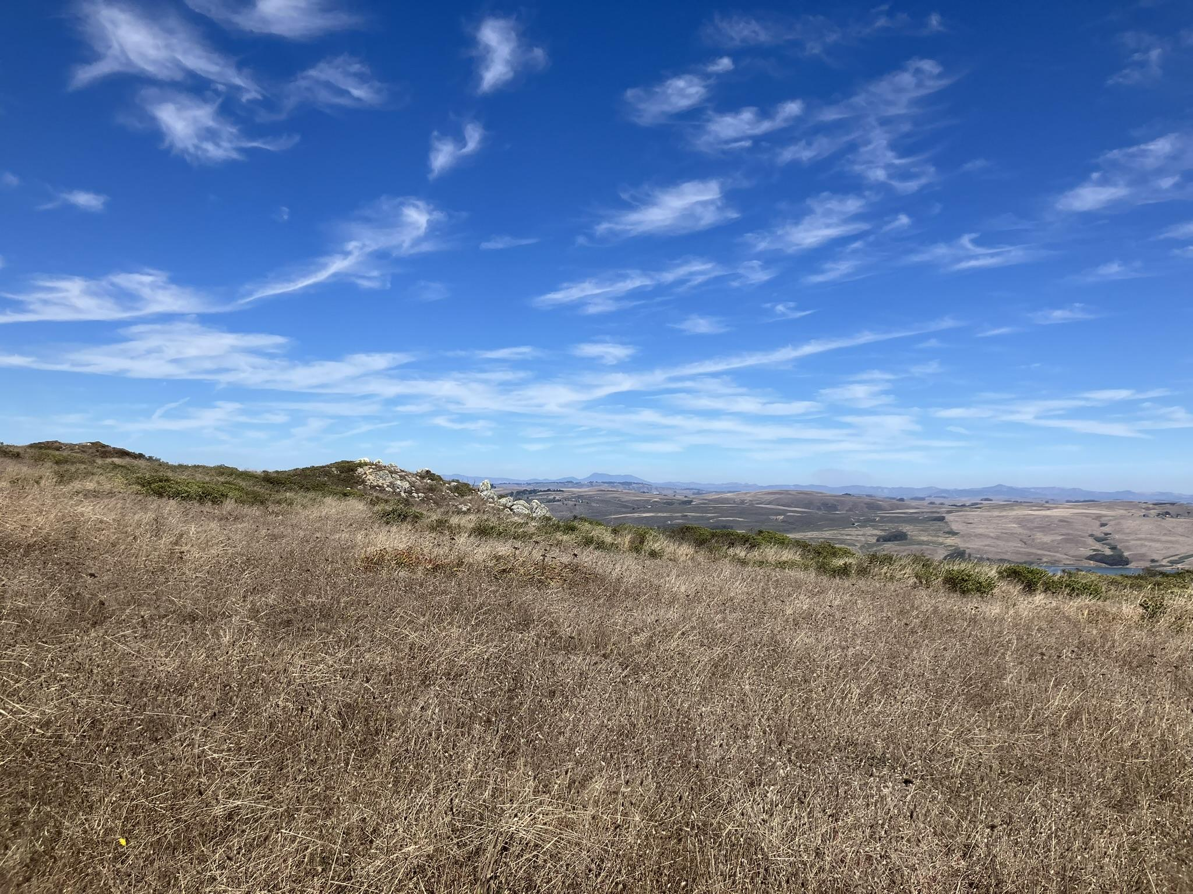

Adam Frison
Computer Science Major w/ Machine Learning Specialization
Hobbies: Guitar & music, video games, trading card games

Slide 6
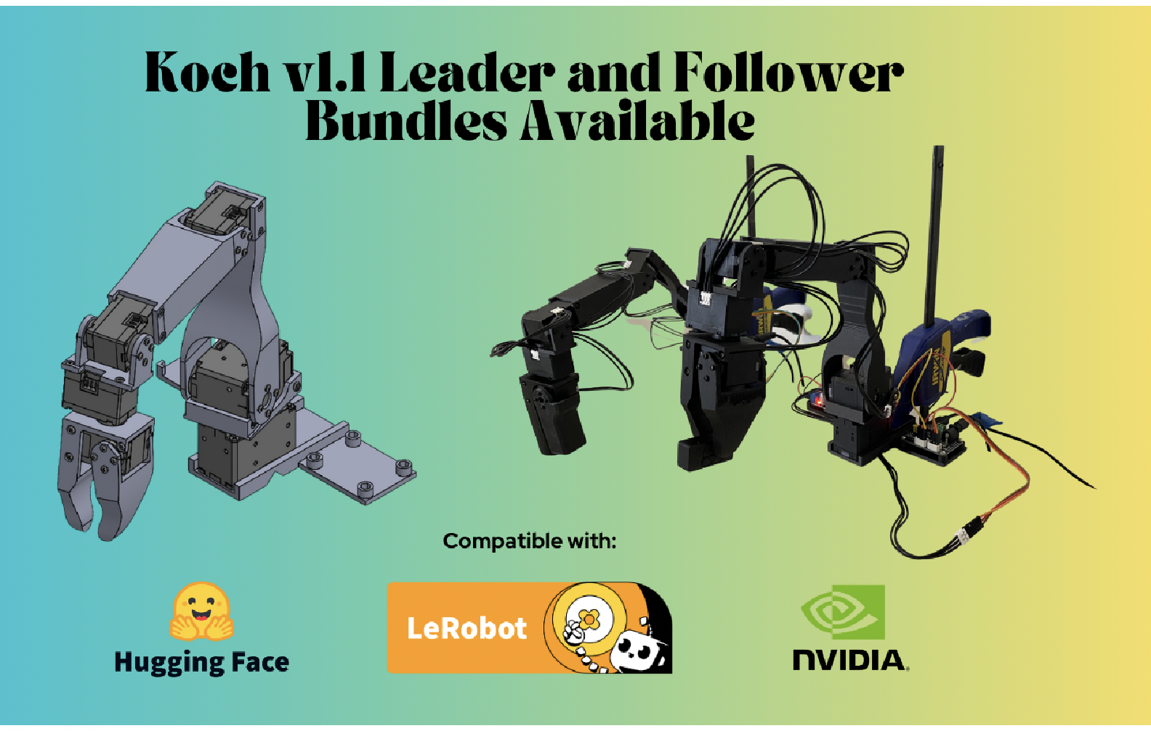
https://www.robotis.us/dynamixel-xl430-w250-t/

Slide 7
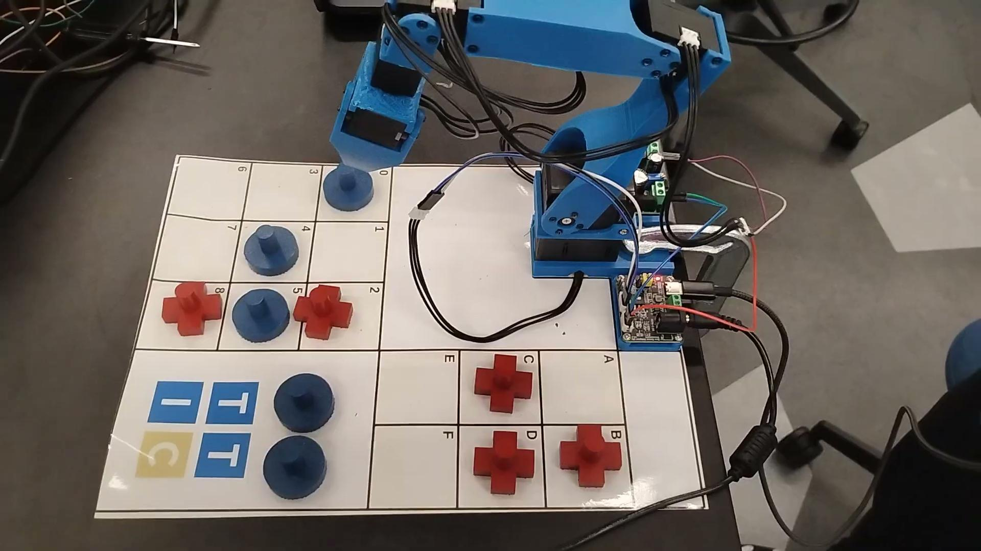
Quick Demo

