Slide 1
Computer Setup
Tomás and Adam

Slide 2

Visual Studio
Install Visual Studio Code:
Search “code” in the App Center and press install
To open a directory you can run the command “code .”
You should trust the authors of the folder the first time you open it

Slide 3
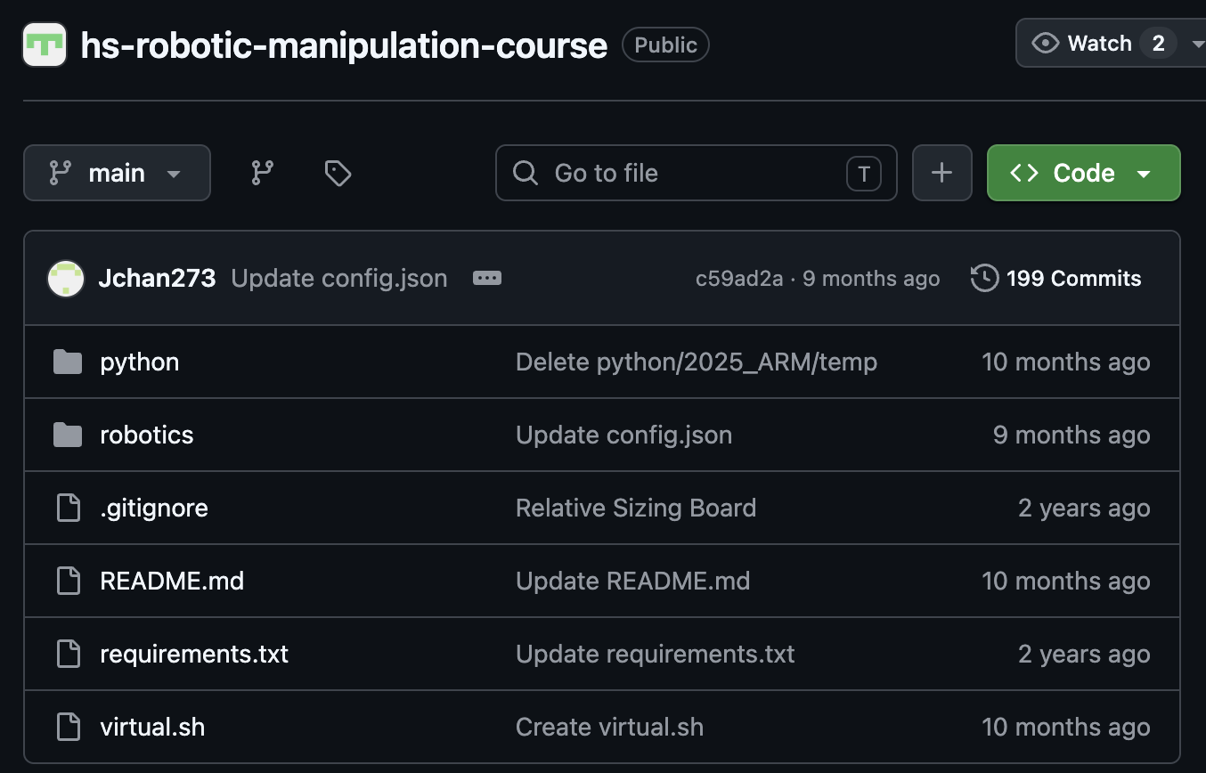
Github: Create a github account and clone the repo.
Press green button “Code”, copy HTTPS URL.
In a terminal window, navigate to where you want the repository to be cloned (useful commands: cd, ls, mkdir)
Install git: run the command “sudo apt install git”
Ctrl+Shift+V to paste the github link.

Slide 4
Set up virtual environment:
Navigate to where you cloned the repository (use cd command -> “cd hs-robotic-manipulation-course”)
python -m venv env
pwd
echo 'export PYTHONPATH="$PYTHONPATH:/absolute/path/to/hs-robotic-manipulation-course"' >> env/bin/activate
source env/bin/activate
pip install -r requirements.txt
To deactivate the virtual environment: run “deactivate” command

Slide 5
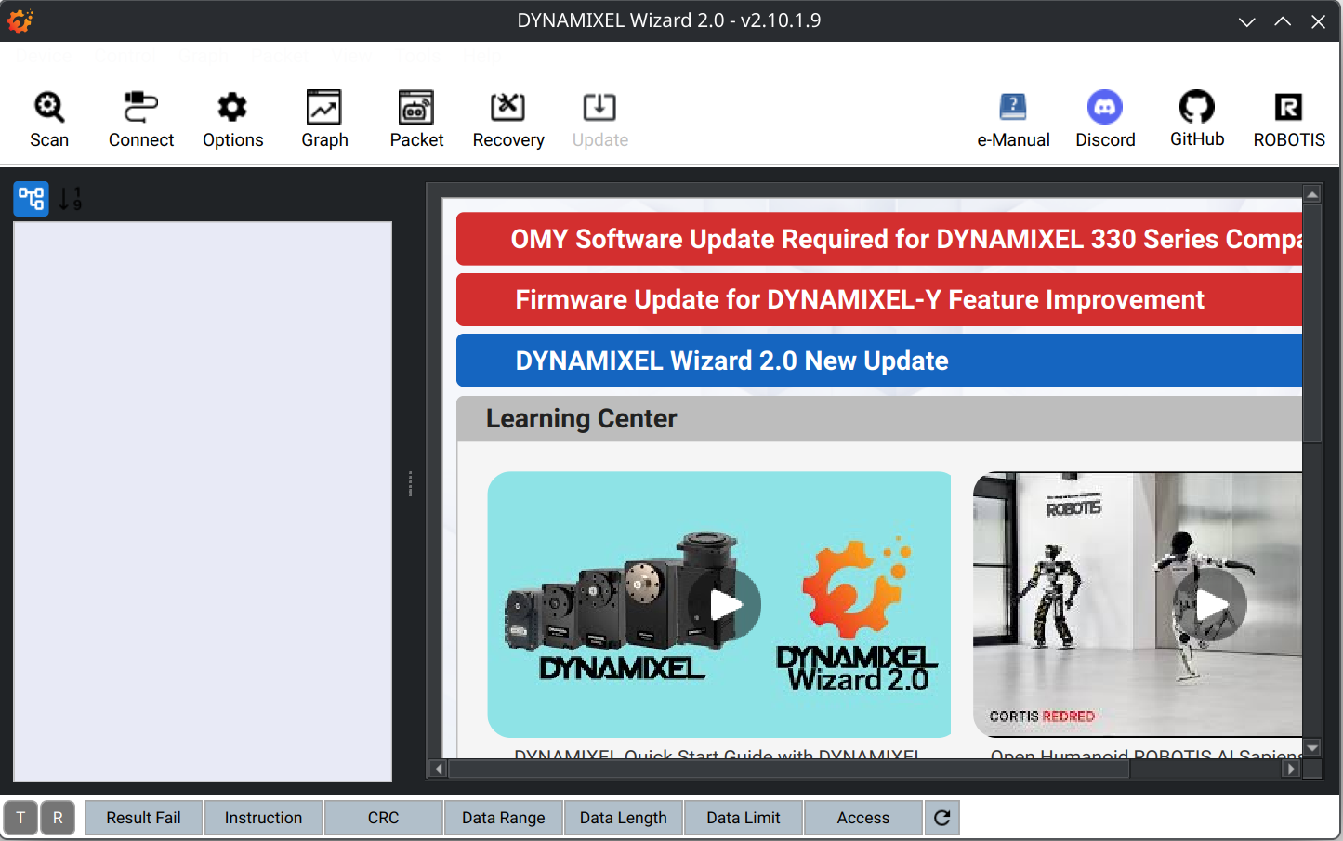
Install the Dynamixel Wizard 2.0:
sudo apt install libxcb-icccm4 libxcb-image0 libxcb-keysyms1 libxcb-render-util0 libxkbcommon0 libxkbcommon-x11-0
Download Linux x64 version from link
In the terminal, navigate using cd to the directory where the downloaded file is
Run chmod 755 DynamixelWizard2Setup-linux-x64.run
sudo usermod -a -G dialout $USER
Run ./DynamixelWizard2Setup-linux-x64.run
Follow the installer instructions, hit “Next” until it’s complete

Slide 6
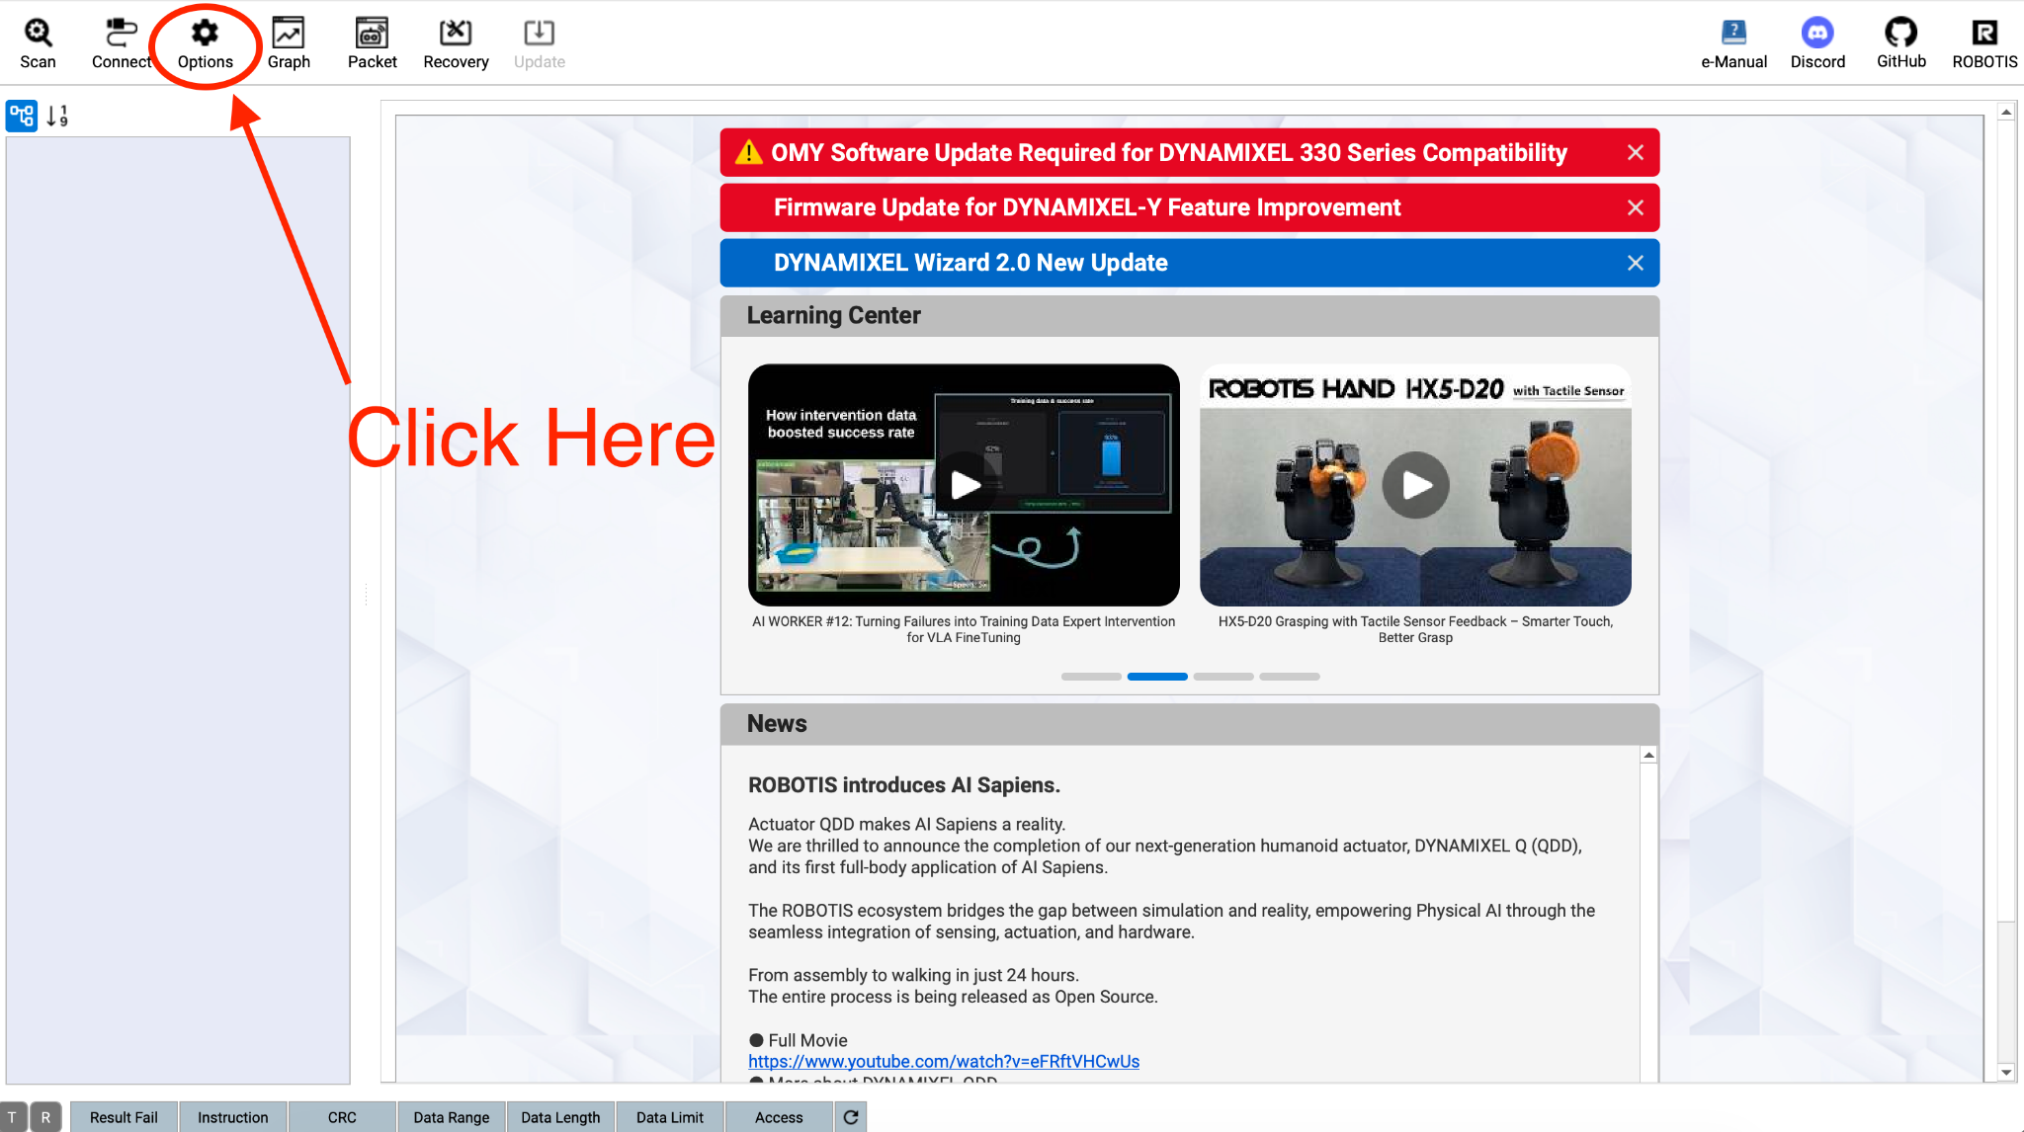
Scan Options
Open the “Options” menu in the top left
Scan within ID range 0 to 16
Enable only Protocol 2.0
Scan the ports named “usbmodem”
Disable all baud rates other than 57,600 and 1,000,000

Slide 7
Fix
sudo apt update
sudo apt install -y make build-essential libssl-dev zlib1g-dev \
libbz2-dev libreadline-dev libsqlite3-dev wget curl llvm \
libncurses5-dev libncursesw5-dev xz-utils tk-dev \
libffi-dev liblzma-dev python3-openssl git
pyenv global 3.10.12
eval "$(pyenv init --path)"
grep -q 'pyenv init' ~/.bashrc || echo -e '\nexport PYENV_ROOT="$HOME/.pyenv"\n[[ -d $PYENV_ROOT/bin ]] && export PATH="$PYENV_ROOT/bin:$PATH"\neval "$(pyenv init - bash)"' >> ~/.bashrc && source ~/.bashrc
python -m venv /home/ttic/hs-robotic-manipulation-course/env --without-pip

