Slide 1
Guess My Number
TTIC ARM Interns
Summer 2026

Slide 2
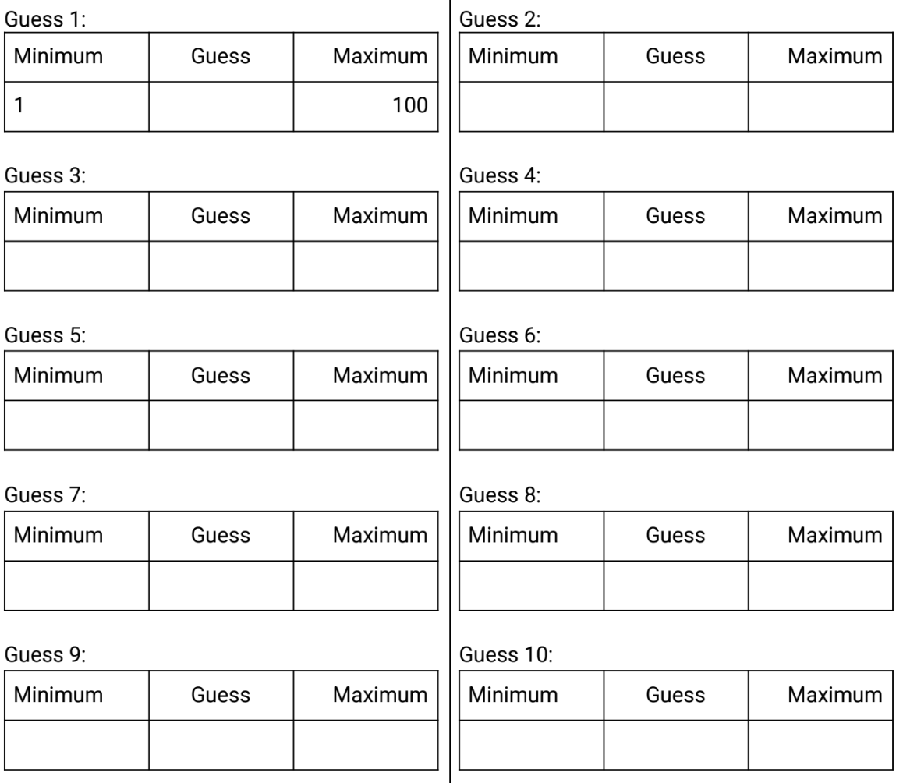
Unplugged
The first player chooses a random number between 1 and 100. Then the first player
asks the second player to guess that secret number.
The first player compares the second player’s guess with the secret number and responds “higher”, “lower”, or “you got it!”.
The process repeats until the second player’s guess is correct.

Slide 3
Player Guessing
import random
number = random.randint(1,100)
print("Let's play guess my number.")
print("I chose a random number between 1 and 100, inclusive.")
number_of_guesses = 0
game_over = False
while not game_over:
number_of_guesses += 1
guess = int(input(f"Guess #{number_of_guesses}: "))
if guess==number:
print("You got it!")
game_over = True
elif guess>number:
print("Lower")
else:
print("Higher")
print(f"It took you just {number_of_guesses} guesses.")
print("Thank you for playing.")

Slide 4
Computer Guessing
for i in range(100):
tries = []
number = random.randint(1,100)
number_of_guesses = 0
min = 1
max = 100
game_over = False
while not game_over:
number_of_guesses += 1
guess = computer_guess(min, max, 1)
tries.append(guess)
if guess==number:
game_over = True # Got it!
elif guess>number:
max = guess - 1 # Lower
else:
min = guess + 1 # Higher
# print(tries) # shows all the guesses
print(len(tries))
import random
def computer_guess(a, b, m):
if m == 0:
return random.randint(a,b)
else:
return (a+b)//2
Better names for a, b, m are
minimum, maximum, option.

Slide 5
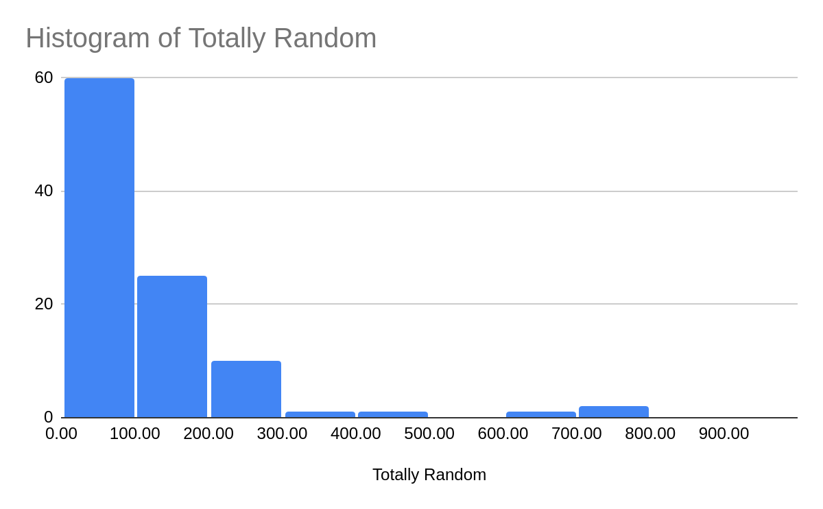
guess = computer_guess(1, 100, 0)
# random between 1 and 100, inclusive

Slide 6
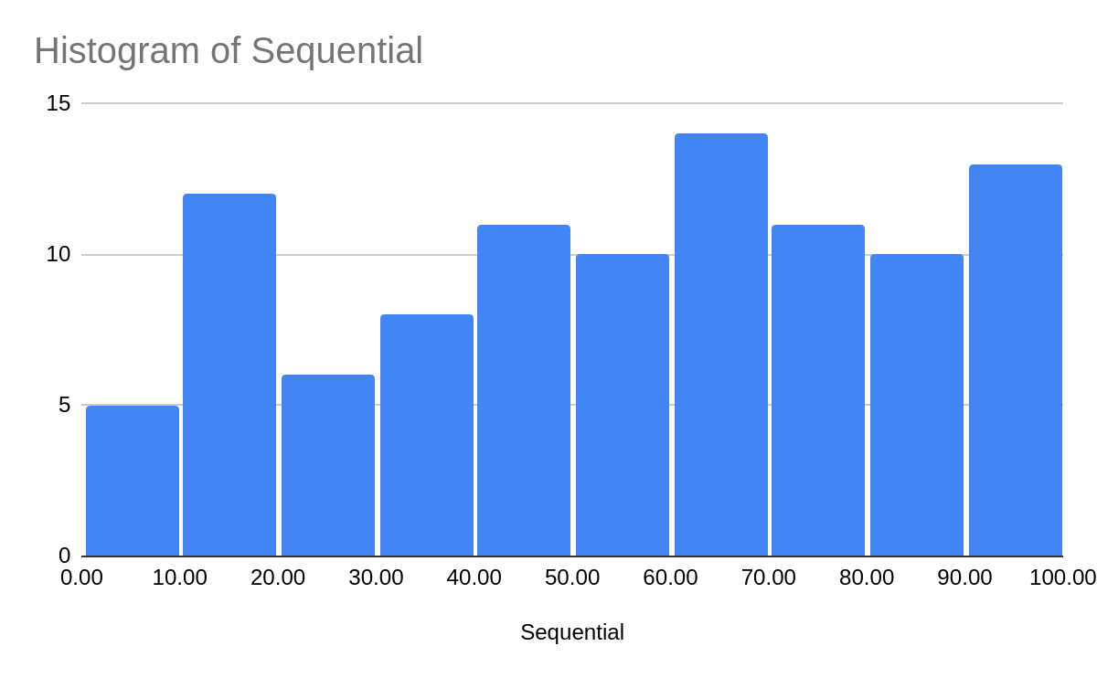
guess = number_of_guesses

Slide 7
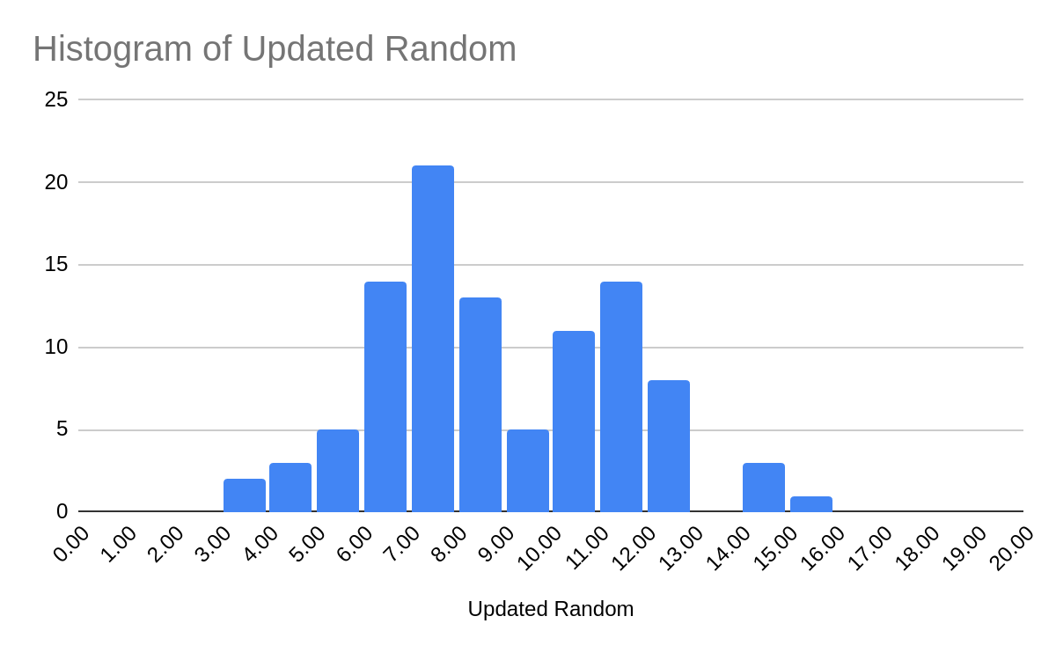
guess = computer_guess(min, max, 0)

Slide 8
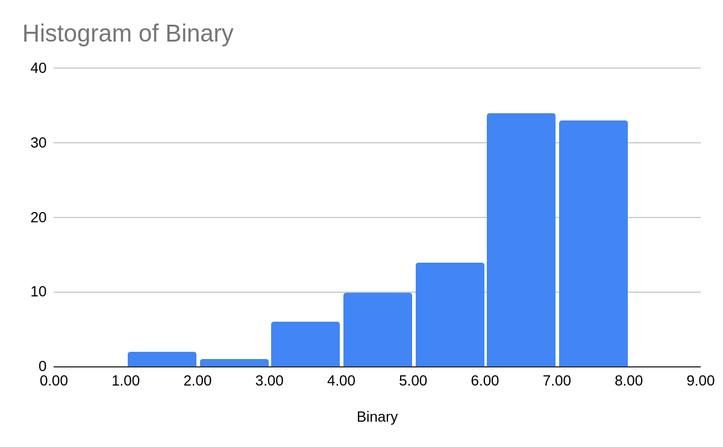
guess = computer_guess(min, max, 1)

Slide 9
Conclusion
Totally random was the worst. It guessed the same numbers over again because it was purely random with replacement.
Sequential was the next worst. It guessed one number after the next, in order, until it got the number.
Updated random did ok. It guessed random between the updated max and minimums, based on the higher and lower responses.
Binary search was the best, as it cut the solution space in half with each guess. Never more than 7 guesses needed. (Note: 2⁷ = 128)

