Slide 1
Introduction to RIPL Lab and ARM Course
Dr. Rodgers (Mike)

Slide 2

2026 Summer Robotics Internship @TTIC
Interns will be embedded for six weeks in the RIPL robotics lab at TTIC, working with computer science faculty, college students, and a CPS teacher.
Interns will take a hands-on approach to learning the fundamentals of robotics, computer science, and AI.
Interns will build robotic arms using 3D printed parts and electrical and mechanical components, and they will program their arms using cutting-edge AI algorithms.
Interns will explore how these capabilities extend to enable robots to perform a variety of practical tasks.

Slide 3
Python
Variables, Functions, Classes
Integers, Floats,
Booleans, Strings,
Lists, Tuples, Dictionaries
Loops:
for, for each, while
Conditionals:
if, if else, if elif else
Guess my number
Pig
Rock Paper Scissors
Tic Tac Toe
Hangman
Race for the Treasure
Attack of the Clones
Connect Four

Slide 4
Arm
Building
3D Printing
Wiring
Dynamixel
Screws
Wire management
Record Positions
Tic Tac Toe
Programming
Linux
Terminal commands
Python Virtual Environment
Minimax algorithm
Camera Detection

Slide 5
Hostings and Outings
Hostings
Blackstone Bicycle Works
Youth Internship Program Year 1
Wednesday Lunch w/Scientist
Possibly others….
Outings
Automate Show
Argonne Tour
McDonalds Tour
Carillon Tour
Starbucks Roastery
Jackson Park
Obama Presidential Center
Osaka Garden

Slide 6
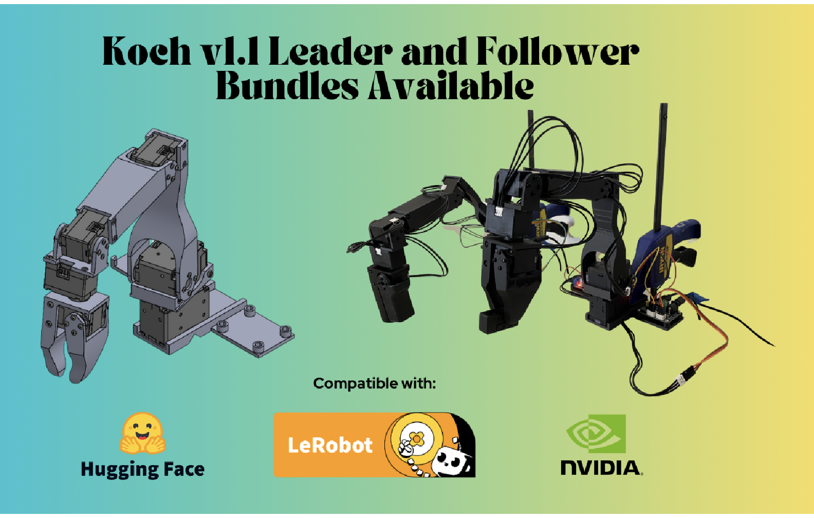
https://www.robotis.us/dynamixel-xl430-w250-t/

Slide 7
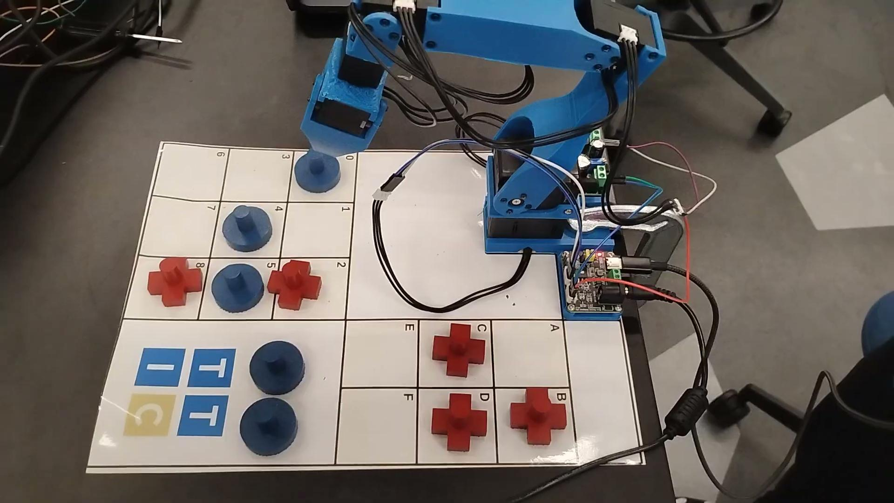
Quick Demo

