Slide 1
Introduction to Python
Adam Frison

Slide 2
variables

Slide 3
Variables
Computers utilize variables as a form of memory.
We can associate an expression with a name using the assignment operator '=', where '=' signifies the assignment.
x = 12
Once an expression or value is bound to a variable, we can use that variable in other expressions. This fundamental concept is essential in programming.

Slide 4
data types

Slide 5
Classifying Data
int
32//42
0
-2
In every programming language, data is classified into different types.
This classification helps determine how data can be manipulated and what operations can be performed on it.
Types also have an important role on memory allocation when variables are assigned.
For now we’ll focus on int and float
1890
2+2
int(2.0)
2024
1.0
float
ℼ
0.024232
2+3.0
5/3
-2.5
float(5)
sqrt(4)

Slide 6
Dynamic Typing
Python uses type inference, meaning that variable types are determined at the time of assignment based on the assigned value. For example:
x = 10
y = 10.0
This is also true for expressions. Depending on the operands of the expression or the result of a call expression, you always end up with a specific type. For example:
x = 10 / 2.0
y = 10 // 3
You can always verify the type of an expression using the built-in type() function.

Slide 7
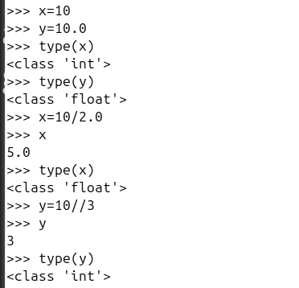
Dynamic Typing (Try it!)
Run the Python interpreter (python3) on your computer
Practice seeing the results of expressions
Use Control-L to clear the screen
Use Control-D or type exit() to exit Python.
The interpreter does not save any work!

Slide 8
Data in Memory
a = 10
b = 10
c = 20.0
Memory (Objects):
int
+----+ +----+
| 10 |<------| a |
| |<------| b |
+----+ +----+
float
+------+
| 20.0 |<------| c |
+------+
When we create variables and assign them values, the variables are references (or pointers) to objects stored in computer memory.
The actual values are stored in these objects, and multiple variables can reference the same object.
We can use the id() function to determine if two variables reference the same object!

Slide 9
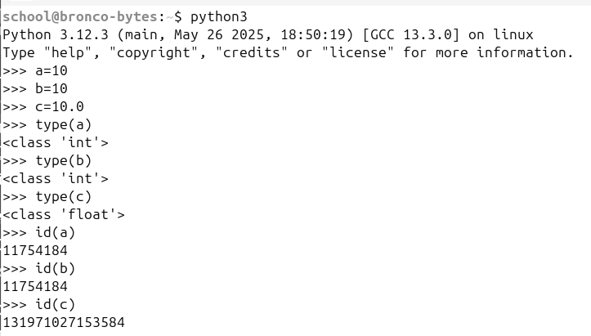
Data in Memory (Try it!)
same

Slide 10
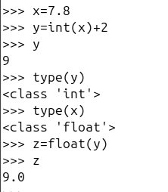
Type Conversion
We sometimes need to explicitly cast from one data type to another.
We cast from float to int by truncating (not rounding) the decimal.
We cast from int to float by adding the decimal point and a trailing 0 afterwards.

Slide 11
expressions

Slide 12
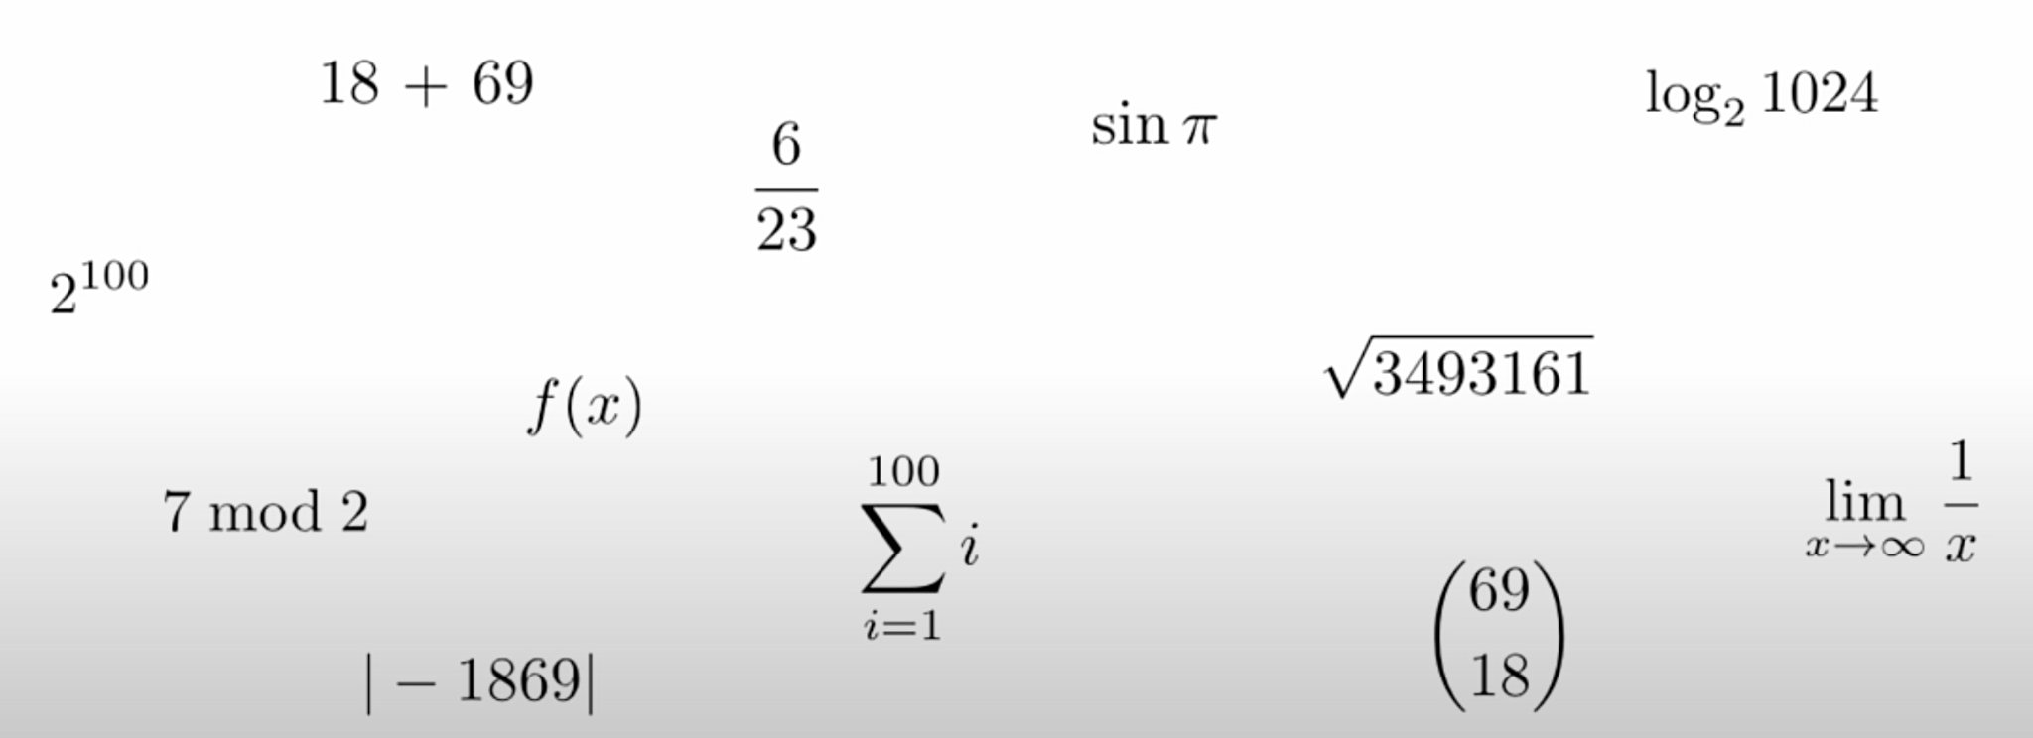
Expressions
an expression is a computation that
the computer evaluates to produce a result.

Slide 13
Evaluating Numeric Expressions
Arithmetic Operators
addition +
difference -
product *
exponation **
division /
modular div. %
floor div. //

Slide 14
Precedence
Follows the standard rules of algebra, Python applies operations in order of precedence.
Here is a summary of these rules from highest to lowest:
( ) - parentheses
** - the exponentiation operator, ordered right-to-left
- - the negation (unary minus) operators, as in -5**2
*, /, //, % - ordered left-to-right
+, - - ordered left-to-right
Notes:
2000 + 24
3032 - 1008
-11 * 4 - 20 * -100 + 68
2**11 - 2**5 + 2**3
16192 / 4 / 2
2021 % 2025 + 3 % 10
1 * 2 * ((3 * 4 * 5 // 6) ** 3) + 7 + 8 + 9

Slide 15
Try it!
Run the Python interpreter (python3) on your computer
Practice seeing the results of expressions
Use Control-L to clear the screen
Use Control-D or type exit() to exit Python.
The interpreter does not save any work!
>>> -11 * 4 - 20 * -100 + 68
2024
>>> 2**11 - 2**5 + 2**3
2024
>>> 16192 / 4 / 2
2024
>>> 2021 % 2025 + 3 % 10
2024
>>> 1 * 2 * ((3 * 4 * 5 // 6) ** 3) + 7 + 8 + 9
2024
Notes:
Run the Python interpreter (python3) on your computer
Practice seeing the results of expressions
Use Control-L to clear the screen
Use Control-D or type exit() to exit Python.
The interpreter does not save any work!

Slide 16
named functions

Slide 17
Nested Call Expressions
min(abs(-10)), max(-10, -22))
sub-expressions
expression

Slide 18
Call Expression Stack
min(abs(-10)), max(-10, -22))
|
+-- abs(-10)
| |
| +-- Result: 10
|
+-- max(-10, -22)
| |
| +-- Result: -10
|
+-- min(10, -10)
|
+-- Result: -10
min(abs(-10)), max(-10, -22))

Slide 19
Aside: arguments
In programming, we tend to call the operands of a call expression arguments.
min(4, 5, 6, 7, max(1, 0))
Arguments supply the input data the function needs to perform its task.
By specifying arguments, we can customize the function's behavior and output based on these inputs.

Slide 20
Aside: arguments
min( 4, 5, 6, 7, max(1, 0) )
first argument
third argument
fifth argument,
sub-expression
second argument
fourth argument

Slide 21
more about variables

Slide 22
Naming Conventions for Variables
The Google standard naming convention for variables is to use snake_case: all lowercase letters with words separated by underscores.
Generally, names should be simple, self explanatory.
amount_due
my_birthdate, birthday
num, nums, list_of_nums,
etc…

Slide 23
Aside: assignment operators
Assignment Operators
addition +=
difference -=
product *=
exponation **=
division /=
modular div. %=
floor div. //=

Slide 24
Why assignment matters...
>>> x = 6000
>>> x + 45
____
>>> x
____
>>> x = x + 45
____

Slide 25
Facts about a Circle
>>> p = 3.14
>>> r = 2.2
>>> a = p * (r ** 2)
>>> d = r * 2
>>> c = p * d

Slide 26
Variables help build meaning and purpose
pi = 3.14
radius = 2.2
area = pi * (radius ** 2)
diameter = radius * 2
circumference = pi * diameter

Slide 27
Buggy Code: NameError
A NameError in Python occurs when you try to use a variable or function name that hasn't been defined yet.
This typically means the name is either misspelled or the code attempting to use it is placed before its definition.

Slide 28
You Try!
In the interpreter: create length and width variables with values 18 and 4, respectively.
These variables will represent the dimensions of some rectangle.
compute the perimeter and area
2W + 2L
L x W

Slide 29
str

Slide 30
Strings
str
"a"
"(~_^)"
Another near universal data type in programming is the String type, referred to as str in Python.
Strings are always enclosed in either single or double quotes.
Strings are great for representing text! It’s also great for providing context to the expressions we build in Python.
We’ll be using Strings in our first program and will discuss them in detail during our next session!
"1890"
"🥸"
"Monday"
"hello, world"
" "
str(2.0)
""

Slide 31
print() Basics
>>> print(10 + 3 - 7)
6
>>> print() # No arguments, new line
>>> age = 22
>>> print("TTIC is", age, 'years old.') # Separate arguments by commas
TTIC is 22 years old.
>>> print(print("!!!"))
!!!
None

Slide 32
print(*objects, sep=' ', end='\n', file=None, flush=False)
>>> print('apples', 'oranges', sep=' and ', end='!\n')
apples and oranges!
>>> print(1, 2, 3, 4, sep=', ')
1, 2, 3, 4
>>> print('All aboard', end='!!!\n')
All aboard!!!
>>> print('cat', 'dog', 'mouse', sep=' | ')
cat | dog | mouse
>>> >>> print('apple', 'banana', 'cherry', sep=' + ', end=' = fruit\n')
apple + banana + cherry = fruit

Slide 33
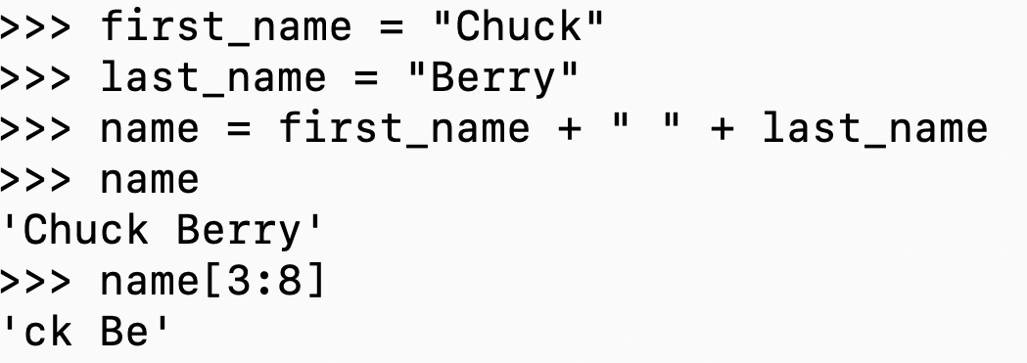
Strings are immutable
We often build new strings by concatenation.
We often slice strings by extracting 1 or more characters from a string.
0 | 1 | 2 | 3 | 4 | 5 | 6 | 7 | 8 | 9 | 10
C | h | u | c | k |  | B | e | r | r | y

Slide 34
tuple and list

Slide 35
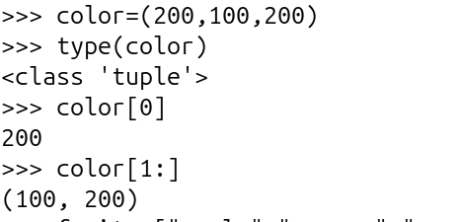
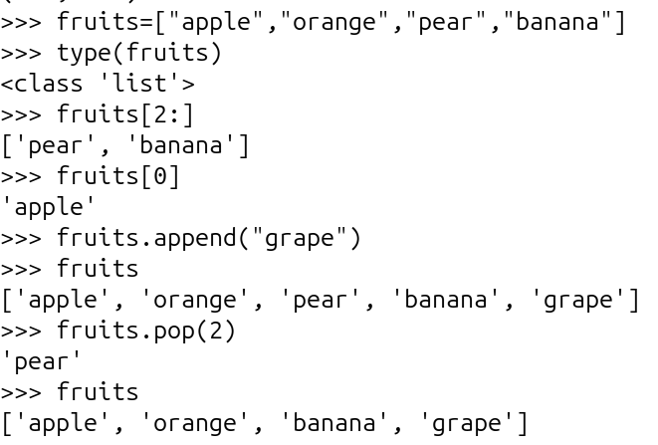
tuple list
A tuple is immutable. Neither the values nor the length can be changed.
A list can be changed. Its items can be changed. It can be made longer or smaller.
Note: We can access the parts of tuples and lists as we do for strings (slicing).

Slide 36
user-defined functions

Slide 37
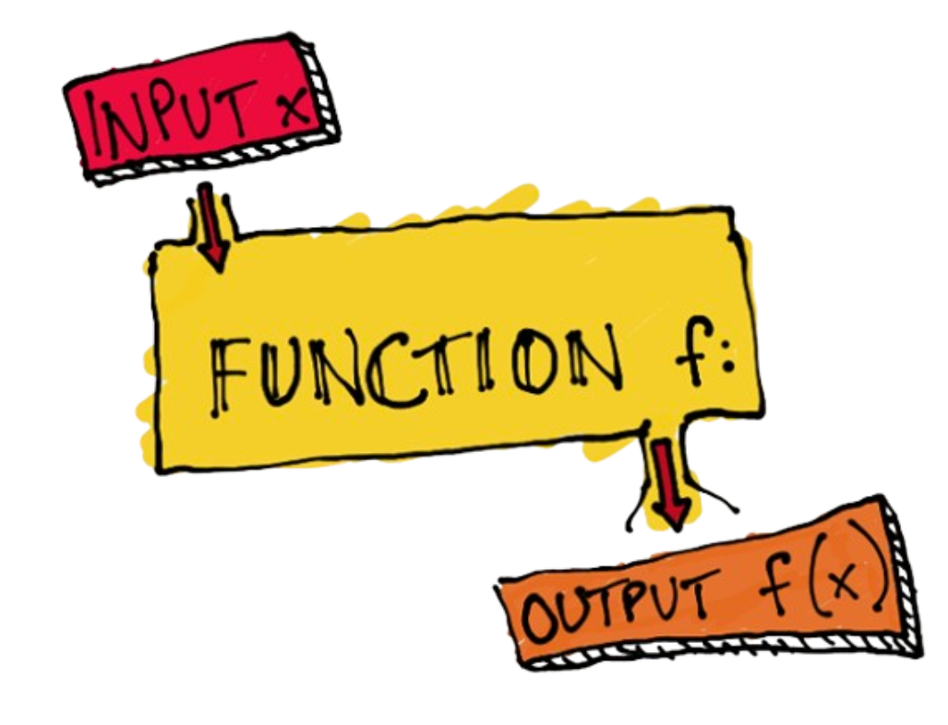
Functions
A function is an abstraction of a set of statements.
Generally, functions should be designed to do "one thing" extremely well.

Slide 38
Function Syntax
inputs
def <func_name>(<arguments>):
<body>
return <expression>
some process
outputs

Slide 39
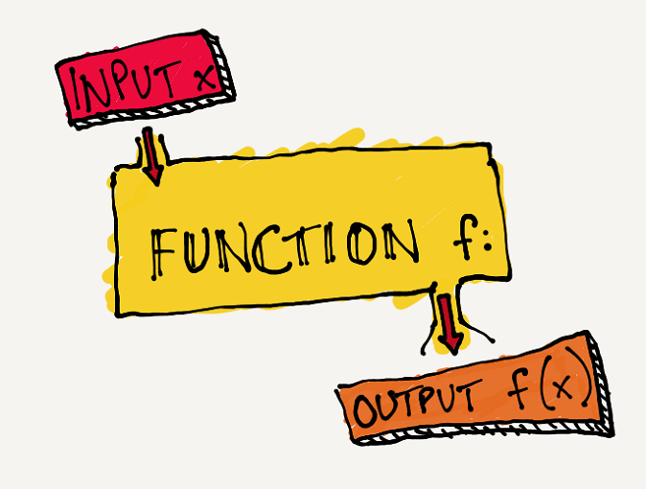
Call Expression, input → output
def add_3_mul_4( num ):
num = num + 3
num = num * 4
return num
x = 5
y = add_3_mul_4( 5 )
print(y)

