Slide 1
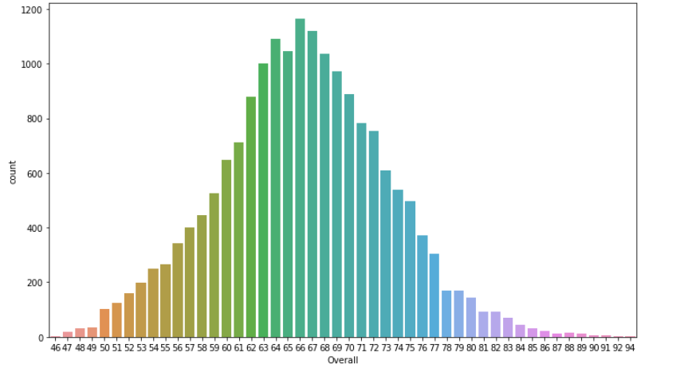
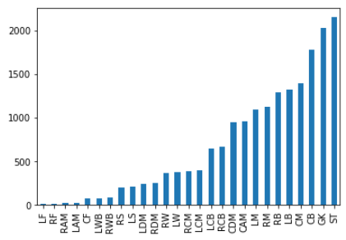
We can infer that most players are distributed between Overall Rating of 63 and 72.
Also, the Avg Rating of all 18207 is 66.238.
Elite Players with overall of 80 and above are rare and their value increases with overall.
average players are enough for a Club competing in the starting division.
We can see that some positions have an abundance of players to choose from while others positions are having a scarcity of players. We can provide competitive wages in positions with a less players, while remaining firm on positions with lots of players.
Also, a manager with a preffered system should be chosen such that it only requires positions that have plenty of players available.
For example, we shouldn’t use a system that requires RF&LF or LS,RS and CF as they are rare positions. Instead use standard 4-4-2 or 4-3-3 with traditionals

Slide 2
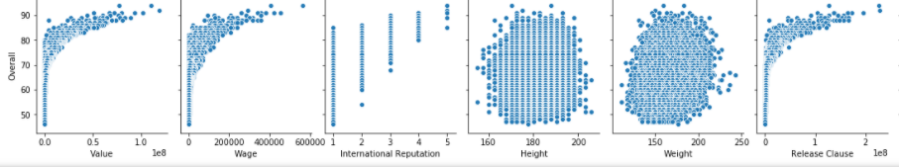
From the pair plots analysis of all players, it can be inferred that Overall has strong positive correlation to Value, Wages, and Release Clauses. The more talented the player, the costlier they are.
Only 17 people have their Contracts expiring in 2020, so we have to pay release clauses or negotiate fees with Clubs to sign other required players
These 17 players have average wages of around 205K and average around 29.95, so they are at their peaks career wise and age wise.
We can also see that all internationally highly reputed players have great Overalls as expected.
These 17 players’ overall and value have a +0.67 correlation meaning more the overall, usually more the value but not always.
Top 5 players from each position has been taken for further analysis .

Slide 3
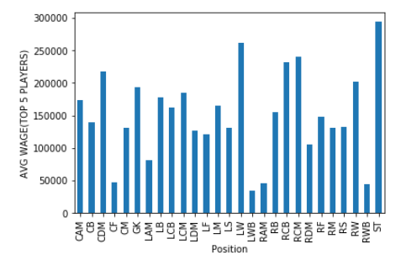
Top 5 strikers have the highest average wages, as expected as they are the main goal scorers and match winners.
They are followed by Left Wingers and interestingly CDMs . This shows how CDMs are highly valued as they can prevent counters and win the balls back and prevent opposition from attacking.
We can also see that avg value of Release Clauses of LW is the highest followed by ST,RCM and GK. This means every Clubs preferred wingers, strikers and GKs are highly sought after.
We can also see that No player can play at multiple positions at top 5 level as there are no duplicates in tables.
To conclude, If you are a financially stable club just starting out and ambitions to get promoted to the highest divison in the leauges, you should follow a strict system with carefully chosen players and their backups for all the positions in the system. The players can be chosen according to the results inferred in the above slides. A mix of elite experienced players and young upcoming (cheap) players will result in a strong squad with good morale.

