Slide 1
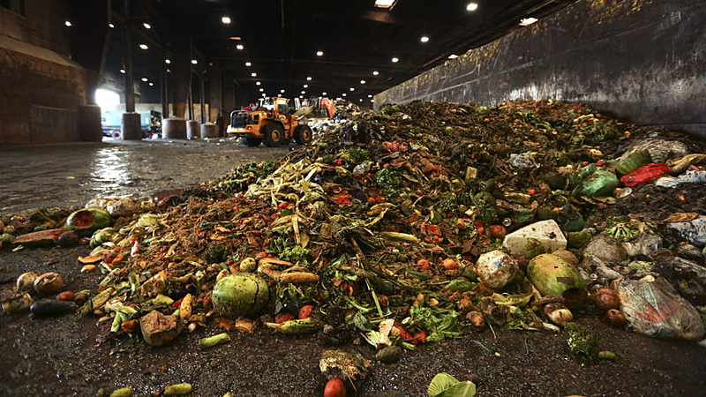
EcoHarvest
A food waste management project!! To eliminate climate change.
TEAM NAME – TEENCREATORS
PROBLEM STATEMENT:- OPEN INNOVATION (CLIMATE CHANGE)
This Photo by Unknown Author is licensed under CC BY-ND

Slide 2
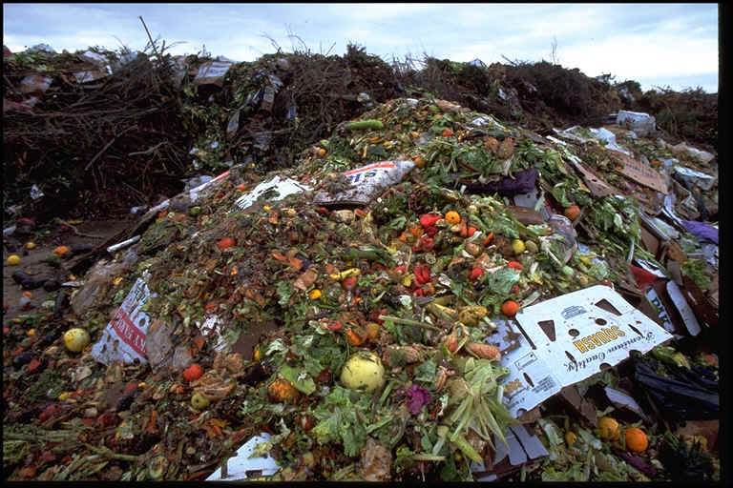
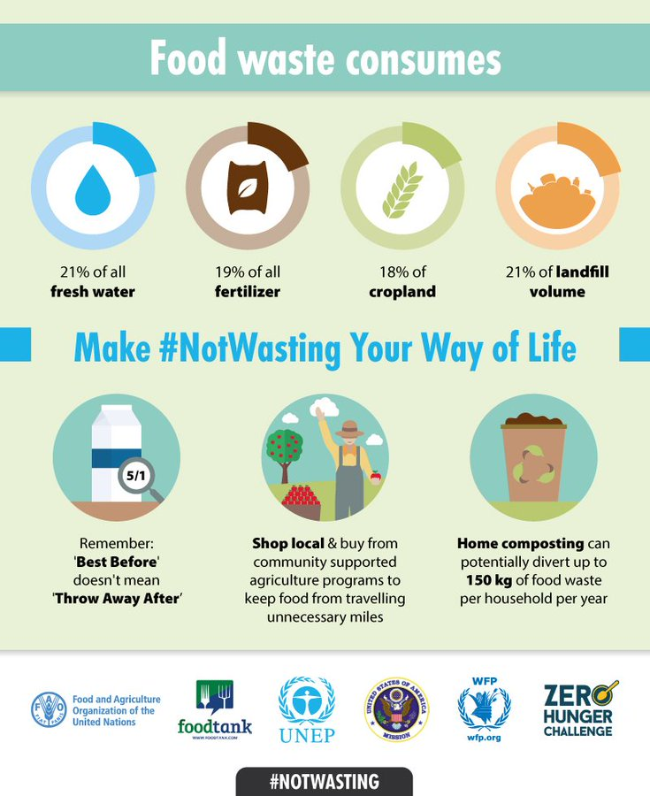
How food waste is affecting the climate:
Food waste is a significant contributor to greenhouse gas emissions, with approximately one-third of all food produced globally being wasted. Rotting food in landfills produces methane, a potent greenhouse gas that accelerates climate change.
Statistics:
One-third of global food production is wasted (FAO, 2019).
Food waste contributes to 8% of global greenhouse gas emissions (UNEP, 2020).
Resource Impact:
Food production consumes immense resources—water, land, and energy.
Wasted food means wasted resources.
Statistics:
Agriculture uses 70% of global freshwater (FAO, 2021).
Food production occupies 40% of the world's land area (IPBES, 2019).

Slide 3

EcoHarvest in Action
EcoHarvest is a web-based platform designed to bridge the gap between surplus food providers and individuals or organizations in need. Its core idea is to create an efficient and user-friendly system where surplus food, which might otherwise go to waste, can be redirected to those who can benefit from it to a particular location range.
It is built to serve 3 main purposes i.e. serving society, job generation and business development.
Food Redistribution Platform:
EcoHarvest serves as a web-based platform and mobile application where surplus food providers, such as restaurants, grocery stores, and individuals, can list their excess or unused food items.
Efficient Matching:
The platform utilizes geolocation technology to match available surplus food listings with potential recipients in the same geographic area. This efficient matching ensures that surplus food can be distributed quickly to those who can use it effectively.
User-Friendly Interface:
EcoHarvest features a user-friendly interface that makes it easy for both food providers and recipients to participate. Users can create profiles, list available food items, and search for nearby surplus food listings.
Promoting Sustainable Practices:
EcoHarvest promotes sustainable practices by encouraging individuals, businesses, and organizations to participate actively in reducing food waste. It fosters a culture of waste reduction and responsible consumption.

Slide 4
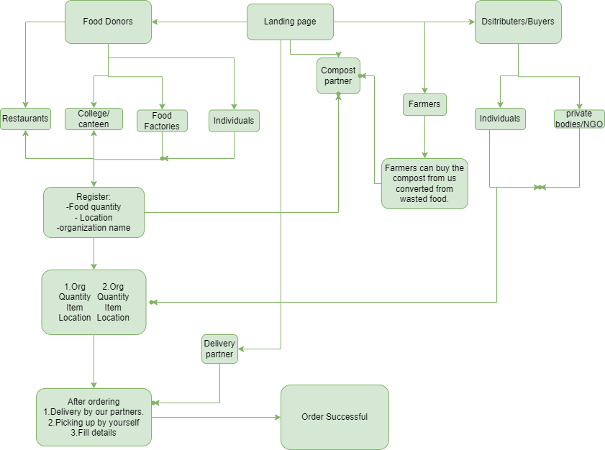
Flow chart (Mechanism)

Slide 5
What makes us different!
We are dedicated to operating a noble business that serves society on multiple fronts: feeding the hungry, generating employment opportunities, and upholding the principles of sustainability.
According to FASSAI, a staggering 68.76 million tones of food go to waste every day in India. This stark reality stands in stark contrast to the 224.3 million people who face hunger, constituting a staggering 16 percent of the total Indian population.
Our platform has the potential to address this critical issue head-on. By efficiently redistributing surplus food to those in need, we aspire to eliminate both food wastage and hunger simultaneously. This dual-purpose approach not only tackles a major societal problem but also aligns with our mission to create a more sustainable and equitable food system.
In addition to food redistribution, we plan to collaborate with composting partners to convert non-consumable food waste into valuable compost. This compost will be made available to farmers at an affordable price, enhancing soil fertility and promoting sustainable agriculture practices and also generate a revenue.
Furthermore, we recognize the opportunity to generate revenue and create a sustainable business model. By providing a delivery service for food donations, we bridge the accessibility gap between food donors and recipients. This not only makes the process more convenient but also allows us to operate as a viable business.
Ultimately, our holistic approach not only addresses food wastage and hunger but also contributes to employability generation and the establishment of a self-sustaining business model. We envision a future where EcoHarvest not only reduces food waste but also serves as a catalyst for positive change within India's food ecosystem.

Slide 6
Tech stack, UI and scalability
EcoHarvest is in the midst of a transformative upgrade, moving beyond its current use of local storage to store data, rather than relying solely on a local host. To enhance its capabilities, the platform now embraces a potent tech stack. The frontend is enriched with React, Vite, HTML, CSS, and JavaScript, combining to craft a dynamic and responsive user interface, promising a captivating user experience. Meanwhile, on the backend, Node.js, Express.js, and MongoDB collaborate seamlessly to efficiently manage server logic, routing, and data. MongoDB, a flexible NoSQL database, stores critical data such as user profiles, surplus food listings, and messaging records. This comprehensive tech stack empowers EcoHarvest to connect surplus food providers with those in need, fostering sustainability and reducing food waste, all within an aesthetically pleasing and user-friendly environment, poised for scalability and impact.
EcoHarvest prioritizes a seamless and user-friendly interface (UI) to enhance the overall user experience (UX). Our platform is designed to make it effortless for users to navigate, interact with surplus food listings, and engage in meaningful communication. The UI is structured intuitively, ensuring that users can access critical information and food listings with ease. Styling elements such as layouts, colors, fonts, and design aesthetics are thoughtfully crafted to create an appealing and visually engaging experience.
The platform's dynamic and interactive features, supported by real-time interactions, enable users to explore, discover, and connect efficiently. Messaging capabilities provide users with a convenient means of communication, fostering a sense of community and trust. Through these user-centric design principles, EcoHarvest aims to create a positive and engaging experience for both surplus food providers and those in need, all while promoting sustainability and reducing food waste.
As EcoHarvest's impact grows, it may expand to new geographic areas. Scalability is essential to support a wider reach and handle additional location-based data.

Slide 7
Thank you
Team Name:
Teen Creators
Institute:
Trident Academy of Technology
Team Members:
1.Jyoti Ranjan Dash (2nd year-CS AI&ML)
2. Subhranshu Sekhar Khilar (2nd year-CS AI&ML)

