Slide 1
PARTNERSHIP PROPOSAL
DavinTrade × Rise
Powering Global Affiliate Payouts, Together
money-service integration overview · Parts 12 · 17 · 18 · 19
12
17
18
19
Presented to Riseworks.io | July 23, 2026 | Davin, Founder — DavinTrade

Slide 2
AGENDA
What We'll Cover
1
DavinTrade at a Glance
The product, and the growth engine built around it
2
Inside the Product
A quick look at the live app affiliates are promoting
3
The Money Pipeline
Four business parts, one transaction boundary — money-service
4
How It All Connects
The end-to-end workflow, and where Rise fits in
5
Why Global Payouts Are Hard
The compliance problem we chose not to build ourselves
6
Why Rise
The platform our disbursement engine is already built around
7
What We've Already Built
Engineering depth — not a roadmap promise
8
The Ask & Next Steps
What we need from Rise today to go live
02

Slide 3
01 — COMPANY SNAPSHOT
DavinTrade at a Glance
DavinTrade is a SaaS trading-alerts platform built around XAUUSD (Gold) — real-time technical alerts, chart drawing tools, and tiered subscriptions for retail traders. Growth runs through a referral affiliate program: affiliates bring in subscribers, and are paid a commission on every conversion.
XAUUSD
2
8
Global
Single-symbol gold specialist product
Global payment rails — Stripe + dLocal
Local-currency markets served (dLocal)
Affiliate network, paid where they live
That referral engine is the reason this partnership matters: every new affiliate we sign is a new payee who needs to be paid, reliably, in their own currency.
03

Slide 4
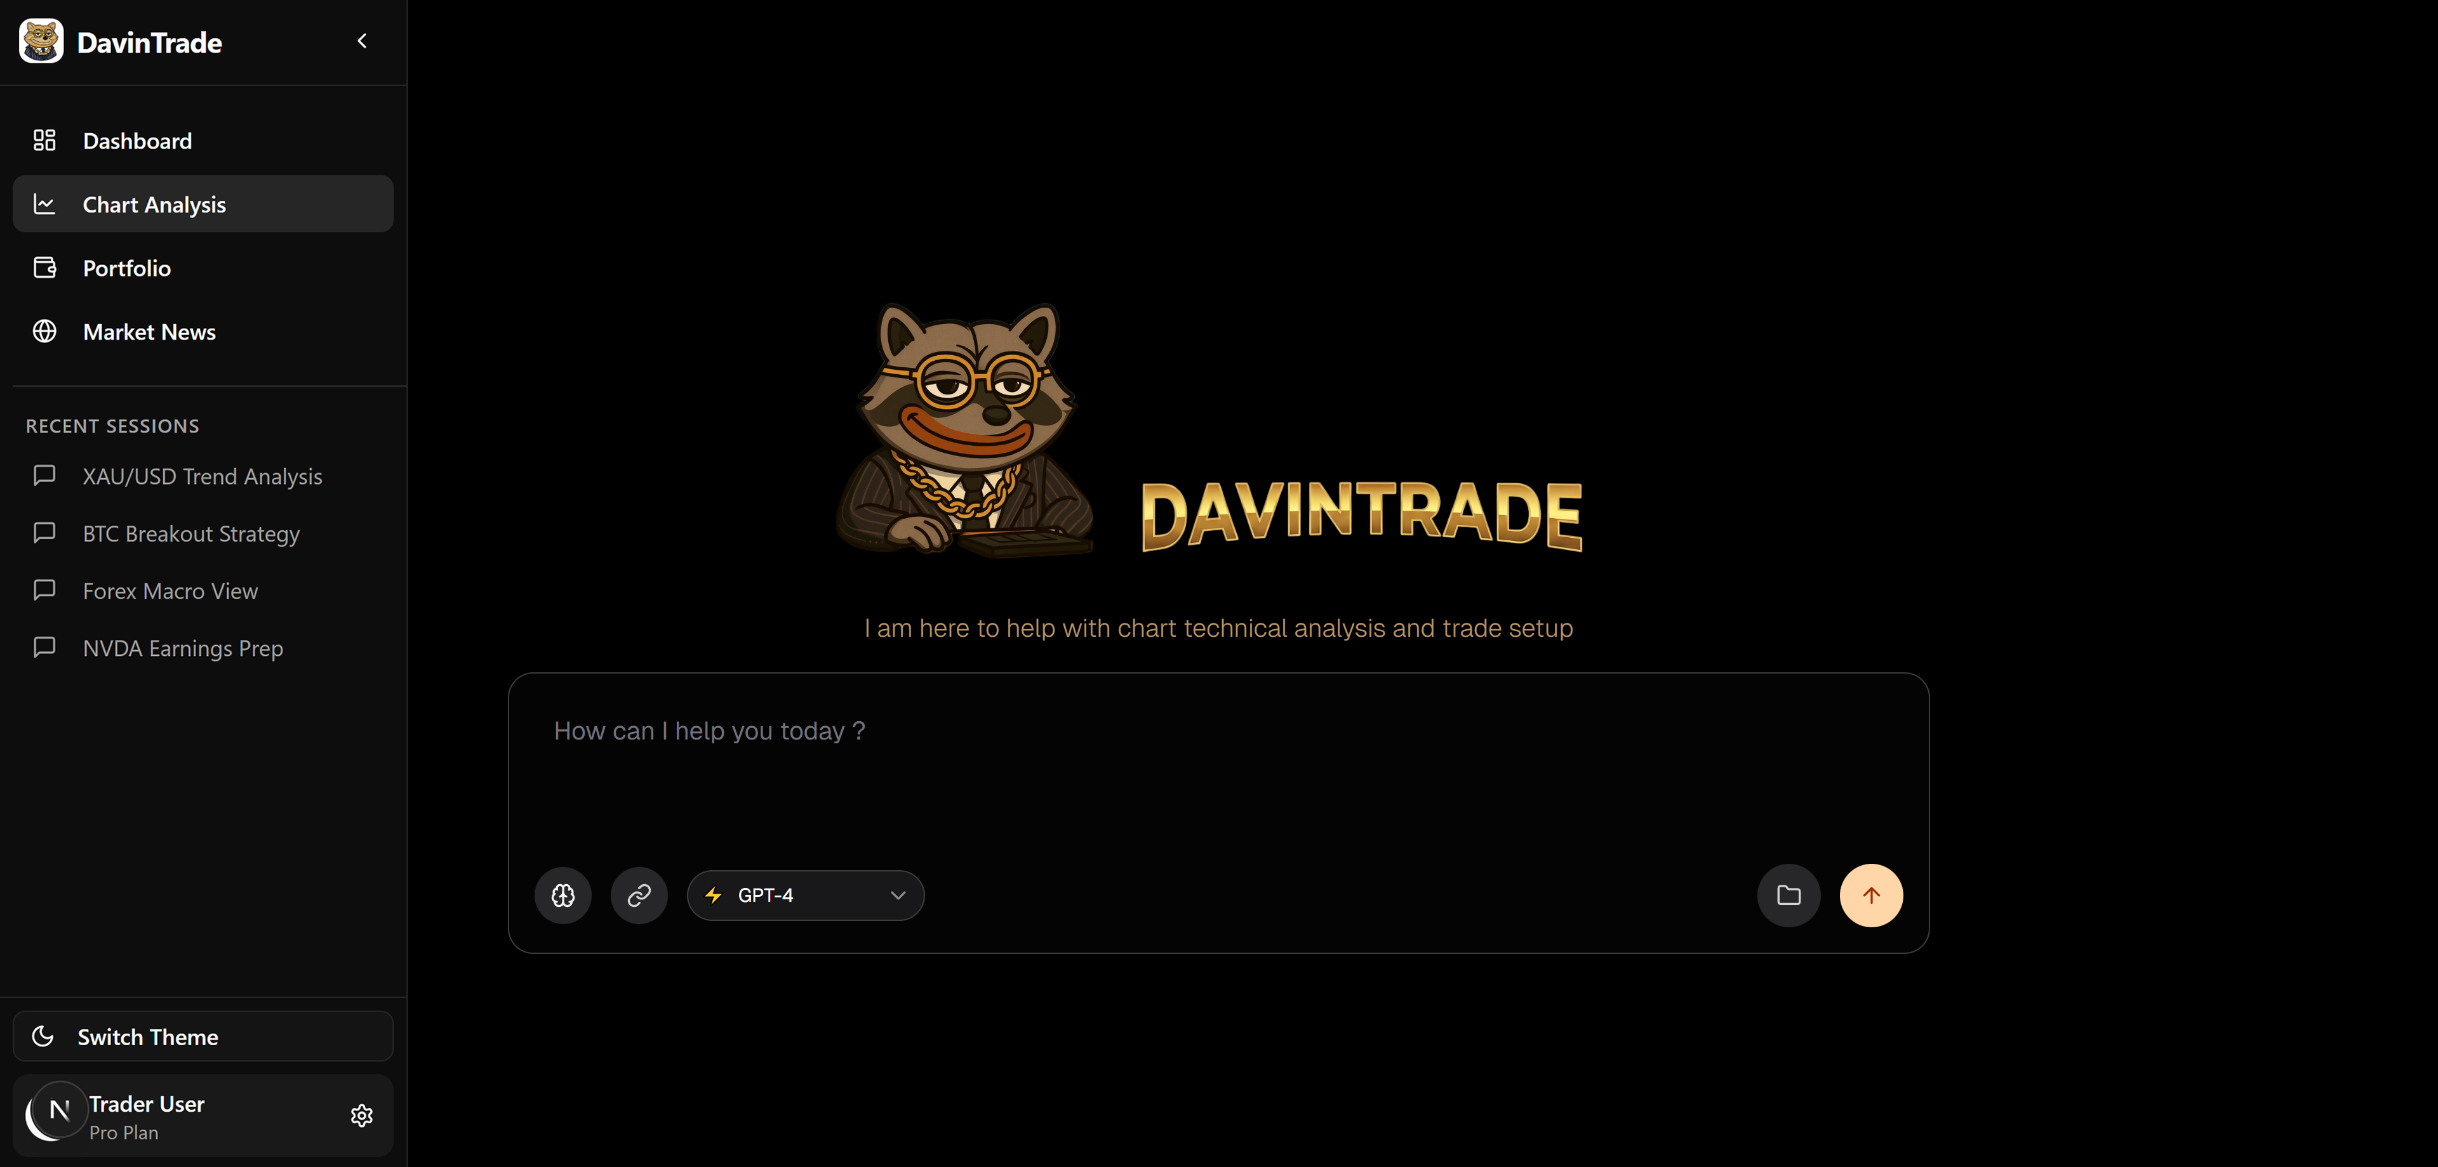
02 — PRODUCT TOUR
Inside the Product — Meet DavinTrade
Every affiliate-referred trader lands here first — a conversational, AI-first entry point, not a static dashboard.
✓
Chat-first onboarding
Traders open a conversation with DavinTrade's AI, not a menu of settings.
✓
Session history, saved
Past analyses are kept and revisited anytime
(Remark : XAUUSD is only symbol initially lunched in introductory phase while Cryptos, Forex, equities would be added in later phases).
✓
Subscription tier, visible in-product
The “Pro Plan” badge ties directly to the Stripe/dLocal billing covered earlier.
✓
Simple, focused navigation
Dashboard, Chart Analysis, Portfolio, and Market News — nothing extraneous.
DavinTrade's AI-first landing & chat page
04

Slide 5
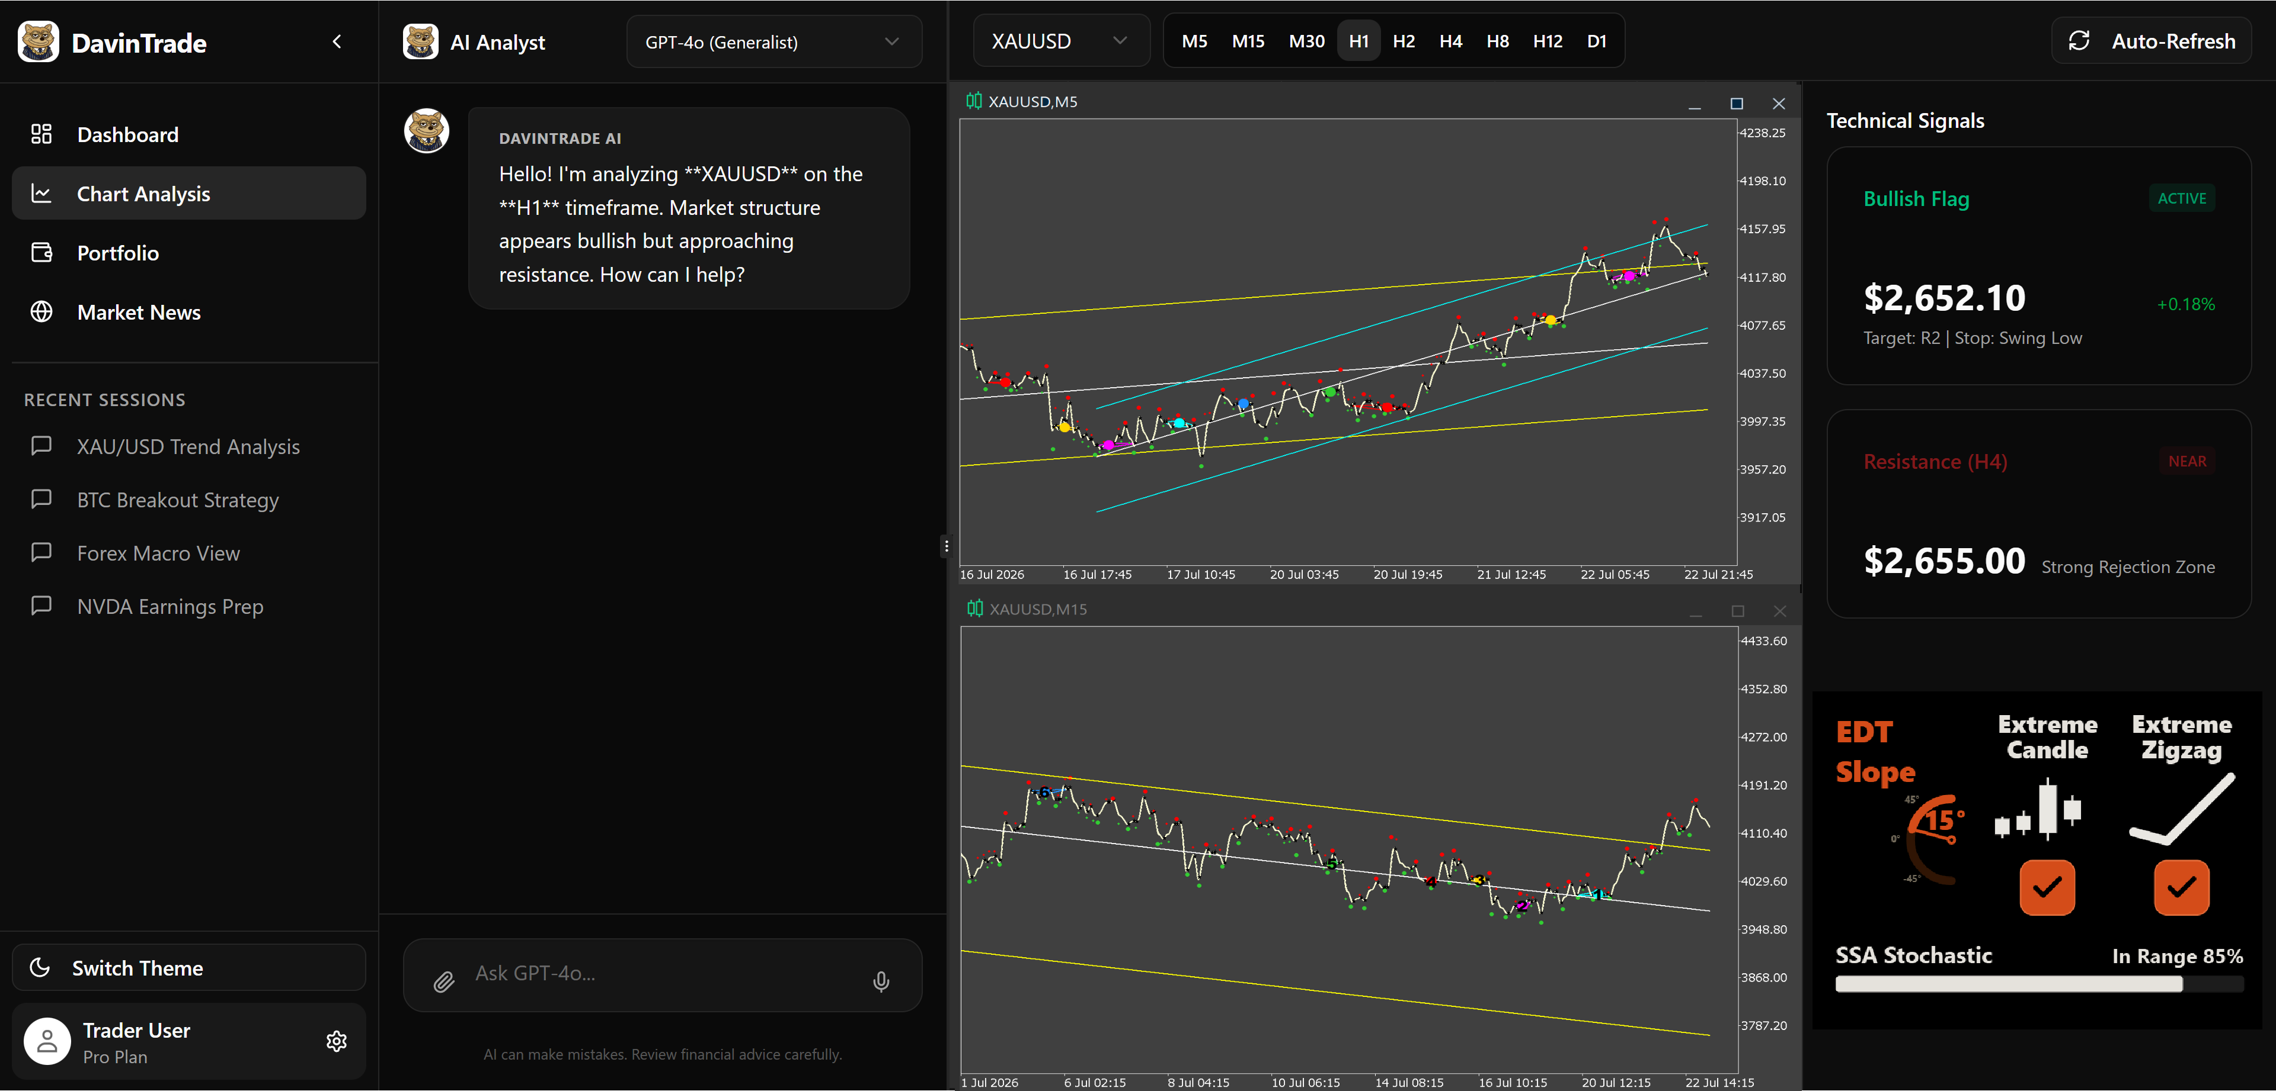
02 — PRODUCT TOUR
Inside the Product — Live Analysis in Action
The Chart Analysis workspace pairs a symbol-aware AI Analyst with live, multi-timeframe XAUUSD charts and a proprietary signal engine — trend channels, a Bullish Flag pattern alert with a live price target, a flagged resistance level, and custom indicators (EDT Slope, Extreme Candle, Extreme Zigzag, SSA Stochastic) surfaced in real time.
05

Slide 6
03 — ARCHITECTURE
The Money Pipeline — Four Parts, One System
Everything below lives in one purpose-built backend microservice: money-service (NestJS, on Railway).
12
Billing (Stripe)
17
Affiliate
Global card checkout, subscriptions, cancellations, invoices.
Referral codes, commission engine, payout eligibility, reporting.
18
dLocal Payments
19
RiseWorks Disbursement
Local payment methods across 8 emerging markets, fraud checks.
Batches affiliate commissions and pays them out globally via Rise.
06

Slide 7
04 — THE FULL WORKFLOW
How It All Connects
One transaction boundary, five moving parts — and Rise closes the loop.
S
Stripe
Global card payments & subscriptions
C
A
R
Customer
Affiliate Program
RiseWorks
Subscribes to DavinTrade with a referral code at checkout
Referral attributed; commission earned & tracked
Aggregates commissions and disburses globally — fiat, stablecoin, or crypto
D
dLocal
Local payment methods across 8 emerging markets
Every commission DavinTrade calculates has to end up in an affiliate's hands, somewhere in the world. Rise is the only node in this chain that makes that last step possible.
07

Slide 8
05 — THE PROBLEM
Paying a Global Affiliate Network Isn't a Feature —
It's a Compliance Problem
1
Every country, different rules
KYC/AML checks, tax documentation, and local banking rails all differ by jurisdiction.
2
Currency risk on both sides
Commissions are earned in USD but owed in 90+ local currencies — someone has to absorb the conversion.
3
Manual payout doesn't scale
Batch processing, retry logic, and reconciliation are required the moment there's more than a handful of affiliates.
4
Building this ourselves means becoming a money-service business
Wallet custody, compliance registration, and settlement rails are not our core product — they're Rise's.
08

Slide 9
06 — THE PARTNER
Why We Built Around Rise
$650M+
190+
90+ / 100+
Registered
Disbursed globally to date
Countries supported
Local currencies / cryptocurrencies supported
U.S. Money Service Business (FinCEN)
Rise's SIWE (Sign-In with Ethereum) wallet authentication, automated KYC/AML onboarding, and USDC/Arbitrum settlement rails are exactly the primitives our disbursement engine is already designed around — affiliates choose fiat, stablecoins, or crypto, and Rise handles the compliance underneath.
09

Slide 10
07 — HOW IT WORKS
From Commission to Payout — Fully Automated
1
Customer subscribes
Via Stripe or dLocal, with a referral code applied at checkout.
2
Commission created (PENDING)
Instantly, atomically, and idempotent against webhook retries.
3
Auto-approved after 14 days
A configurable maturation window — no manual sign-off needed for the happy path.
4
Aggregated across affiliates
Batched together once a payee's approved balance crosses a $50 threshold.
5
Batch submitted to Rise
Up to 100 payments per batch, with automatic retry on failure.
6
Rise confirms via webhook
Commission marked PAID, balances reconciled, dashboards updated in real time.
10

Slide 11
08 — ENGINEERING DEPTH
This Isn't a Concept — It's Already Built
✓
Dedicated disbursement module
Inside our production NestJS money-service, deployed on Railway.
✓
Batch orchestration engine
Automatic retries and idempotent processing on every payout batch.
✓
Provider abstraction layer
Rise is integrated behind a swappable interface, not hardcoded.
✓
Full audit logging
Every disbursement action is logged for financial traceability.
✓
SIWE authentication client
Wired end-to-end to Rise's Sign-In with Ethereum flow.
✓
9-page admin dashboard
Batches, transactions, accounts, audit logs, config, and health, live.
✓
Webhook signature verification
Implemented today; being finalized against Rise's current v2 spec.
✓
Scheduled automation
Cron jobs handle payout batching and account sync on a fixed schedule.
11

Slide 12
08 — ENGINEERING DEPTH
Built to Handle Money Correctly
✓
HMAC-SHA256 verification on Stripe & dLocal webhooks
Both signature-verified before processing; Rise verification is being finalized against their current v2 spec.
✓
Role-gated, JWT-authenticated admin APIs
Disbursement actions require an authenticated admin session.
✓
KYC-gated payouts
No disbursement executes without a verified Rise account (RiseID) on file.
✓
Full audit trail
Every mutating action is written to an immutable disbursement audit log.
✓
Rate limiting, fail-open by design
Infrastructure hiccups never block a customer checkout.
12

Slide 13
09 — STATUS
Where We Are Today
Built & Tested
Staging Validation
Awaiting Production Access
Production Cutover
Full pipeline against a mock-provider harness
Batches, retries, reconciliation confirmed
This is where Rise comes in
Live traffic, monitored rollout
The full disbursement pipeline — batching, retries, reconciliation, admin tooling — is built and tested end-to-end against a mock-provider harness. What's left: live production access, and confirming our webhook verification matches Rise's current v2 spec.
13

Slide 14
THE ASK
What We Need From Rise Today
1
Enable our company for B2B API — both environments
A support request with our company name + RiseID; staging and production are enabled separately.
2
Clarity on webhooks v1 vs. v2
Your docs reference both — confirm which we should target, the current event schema, and v1's retirement timeline.
3
A production webhook signing secret, once on v2
Plus the exact signature header format, so we verify events against the right spec.
4
Batch-payment & rate limits sized for our volume
Set appropriately for our affiliate network's payout cadence.
5
A named technical contact for go-live
One point of contact to unblock issues during rollout.
14

Slide 15
10 — NEXT STEPS
Proposed Path to Production
Phase 1
Phase 2
Phase 3
Phase 4
Environment Enablement
Webhook Spec Confirmation
Webhook Cutover
Full Go-Live
Company enabled for staging + production; our API wallet authorized
Confirm v2 event schema & secret; test against real signed payloads
Single, reversible slice — point Rise's dashboard at production
Batch payouts on, with active monitoring
15

Slide 16
11 — WHY IT WORKS
Why This Partnership Works Both Ways
For DavinTrade
For Rise
✓
Reliable global payouts without becoming a compliance operation ourselves
✓
A growing, recurring-revenue affiliate network as new disbursement volume
✓
One integrated provider for fiat, stablecoin, and crypto payout preference
✓
A partner already integrated at the code level — not evaluating alternatives
✓
A disbursement pipeline already built and tested against Rise's API
✓
A reference integration: SaaS billing plus affiliate payouts, done right
16

Slide 17
Let's Build This Together
Thank you for your time today.
Dhapanart (Davin) · Founder, DavinTrade Startup
dhapanart.kevalee@davintrade.app

