Slide 1




ARCHITECTURE COMPARISON — v3
Part 06: Before vs After
A dedicated worker VPS — fully isolated from the EA and the indicator pipeline
A Python process reads MT5 directly on its own Contabo VPS; Redis and Socket.IO on Railway handle the fan-out.
Dedicated Worker VPS
Redis Pub/Sub Fan-out
Socket.IO on Railway
Same API Contract
Trading Alerts SaaS | Backend Architecture Deck

Slide 2
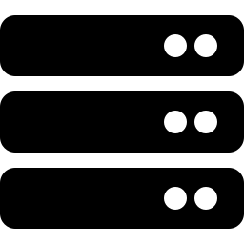




BEFORE — Monolithic Flask Process
15 MT5 connections and the public API all live inside one Python process
1
Part 07
Tier Routes API
MT5 Terminals
Single Flask Process
×15 (one per symbol)
Windows VPS
Connection Pool (15 MT5 sessions)
+ REST API + Socket.IO server
— all sharing one Python interpreter
Browser
Chart + Socket.IO client
Why this is risky
The MetaTrader5 Python package is built for one terminal per process — 15 sessions sharing one interpreter can interfere with each other. One crash or restart takes down all 15 symbols at once, and the API layer cannot scale separately from MT5 connectivity.
Stack: Flask 3.0 · flask-socketio 5.3 · eventlet · MetaTrader5 Python API · gunicorn + gevent

Slide 3

AFTER — Dedicated Worker VPS Pipeline
A Python worker on its own VPS reads MT5 directly — the EA and indicator pipeline are never touched
NEW
N
Part 07
Tier Routes API
MT5 Terminals
Python Worker
Redis
Realtime Gateway
Dedicated VPS #2
separate from EA terminals
no indicator EA installed
MetaTrader5 API +
redis-py, no EA
no WebRequest blocking
Pub/Sub channel per
symbol + timeframe
private network (Railway)
NestJS + Socket.IO
×N replicas (Railway)
same REST/WS contract
Browser
unchanged
Why this works
Running on its own VPS, the Python worker never competes with the EA's indicator math or its blocking WebRequest() calls — a slowdown on one machine can't freeze the other. The worker talks to MT5 the same way the current Part 06 service does today, just isolated onto dedicated hardware and paired with Redis + Socket.IO for fan-out.
Stack: Python + MetaTrader5 API (dedicated VPS) · redis-py · Redis Pub/Sub (Railway, private) · NestJS 11 + Socket.IO + redis-adapter (Railway, public)

Slide 4
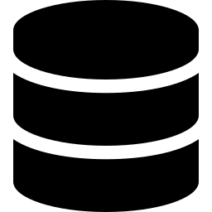

Why Two VPS, Not One
Physical isolation between the EA workload and the Part 06 live feed
VPS #1 — Indicator Pipeline (existing)
VPS #2 — Part 06 Live Feed (new)
ROLE
ROLE
Historical OHLC + 42 indicator columns per closed bar
Real-time OHLCV for the live chart
RUNS
RUNS
MT5 terminals + MQL5 EA (WebRequest, blocking)
MT5 terminals + Python worker (no EA involved)
CADENCE
CADENCE
Per bar close — 5-15 min+ timeframes
~0.25s — every tick / intra-bar change
DESTINATION
DESTINATION
NestJS API Gateway -> Bull Queue -> PostgreSQL
redis-py -> Redis Pub/Sub (Railway) -> Socket.IO
LOAD PROFILE
LOAD PROFILE
Heavier — indicator math + periodic HTTP pushes
Higher frequency, but isolated — can't stall the EA
Physical isolation, not just logical: a freeze or crash on VPS #2 never reaches the EA/indicator terminals on VPS #1, and vice versa. Two smaller Contabo instances cost a little more than one — but that's the single point of failure you were trying to remove.

Slide 5
Before vs After, at a Glance
What actually changes for Part 06
BEFORE
AFTER
Bridge to MT5
Python process calling MetaTrader5 API, bundled with REST/WS
Dedicated Python worker process, isolated on its own VPS
Terminal hosting
15 terminals, 1 shared Windows box
Terminals dedicated to Part 06 on a separate Contabo VPS
Live tick transport
Flask polls MT5 in-process every 0.25s
Worker publishes to Redis Pub/Sub; NestJS + Socket.IO fan out
Isolation from EA pipeline
N/A — Part 06 never touched indicators
Physically separate VPS; EA and worker never share a machine
Hosting
Everything pinned to one Windows box
2 VPS (EA + worker) + Railway (Gateway + Redis)
External API contract
REST + Socket.IO (Part 07 / Browser)
Unchanged — same REST + Socket.IO contract

