Slide 1




ARCHITECTURE COMPARISON — v2
Part 06: Before vs After
Railway + NestJS + the EA you've already built — no Python bridge required
The MQL5 EA pushes live OHLCV over HTTPS; Redis Pub/Sub and Socket.IO handle the fan-out on Railway.
EA Pushes via HTTPS
Redis Pub/Sub Fan-out
Socket.IO on Railway
Same API Contract
Trading Alerts SaaS | Backend Architecture Deck

Slide 2
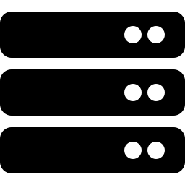




BEFORE — Monolithic Flask Process
15 MT5 connections and the public API all live inside one Python process
1
Part 07
Tier Routes API
MT5 Terminals
Single Flask Process
×15 (one per symbol)
Windows VPS
Connection Pool (15 MT5 sessions)
+ REST API + Socket.IO server
— all sharing one Python interpreter
Browser
Chart + Socket.IO client
Why this is risky
The MetaTrader5 Python package is built for one terminal per process — 15 sessions sharing one interpreter can interfere with each other. One crash or restart takes down all 15 symbols at once, and the API layer cannot scale separately from MT5 connectivity.
Stack: Flask 3.0 · flask-socketio 5.3 · eventlet · MetaTrader5 Python API · gunicorn + gevent

Slide 3

AFTER — EA-Driven Realtime Pipeline
The MQL5 EA pushes ticks over HTTPS; Railway fans them out — no Python, no per-terminal process limit
5
N
Part 07
Tier Routes API
MT5 Terminals
MQL5 EA
Redis
Realtime Gateway
×5 (Contabo VPS)
EA loops symbols via
OnTimer()
Runs inside terminal
WebRequest() HTTPS POST
OHLCV only, ~0.25s
Pub/Sub channel per
symbol + timeframe
private network (Railway)
NestJS + Socket.IO
×N replicas (Railway)
same REST/WS contract
Browser
unchanged
Why this works
The EA already multiplexes symbols per terminal, so the 15-terminal Python constraint disappears — 5 terminals can cover all 15 symbols. Redis stays fully private on Railway; only the Gateway's HTTPS endpoint is public. No queue in this path — it's fire-and-forget, latency-first, exactly what a live chart needs.
Stack: MQL5 WebRequest() (EA) · NestJS 11 + @nestjs/platform-socket.io · ioredis (pub/sub) · @socket.io/redis-adapter · Railway (Gateway public, Redis private)

Slide 4
Before vs After, at a Glance
What actually changes for Part 06
BEFORE
AFTER
Bridge to MT5
Python process calling MetaTrader5 API
MQL5 EA inside the terminal, WebRequest() over HTTPS
Terminal fleet
15 terminals (1 per symbol, Python API limit)
~5 terminals (EA multiplexes symbols, no process limit)
Live tick transport
Flask polls MT5 in-process every 0.25s
EA pushes; Redis Pub/Sub + Socket.IO fan out on Railway
Queue in the hot path
None (but no isolation either)
None — fire-and-forget, latency-first by design
Hosting
Everything pinned to one Windows box
Terminals on Contabo VPS; Gateway + Redis on Railway
External API contract
REST + Socket.IO (Part 07 / Browser)
Unchanged — same REST + Socket.IO contract

Slide 5
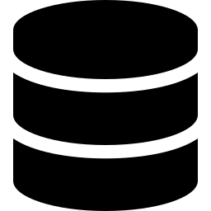

Two Pipelines, Not One
Part 06 (live chart) and the historical/indicator sync are separate systems sharing infrastructure
Part 06 — Live Chart Feed
Historical / Indicator Sync
PURPOSE
PURPOSE
Real-time price on the chart
Durable OHLC + indicator record per closed bar
CADENCE
CADENCE
~0.25s — every tick / intra-bar change
Per bar close — 5-15 min+ timeframes
TRANSPORT
TRANSPORT
EA -> NestJS Gateway -> Redis Pub/Sub -> Socket.IO
EA -> NestJS API Gateway -> Bull Queue
QUEUE
QUEUE
None — fire-and-forget, latency-first
Bull — retries, backoff, rate-limited
STORAGE
STORAGE
None — ephemeral, browser renders live
PostgreSQL — persisted, queryable
CONSUMER
CONSUMER
Browser via WebSocket, tier-gated
Backend workers, downstream analytics
Shared infrastructure, separate paths: both pipelines run from the same Contabo VPS terminals and the same Railway project — but different endpoints, different transport, and no shared queue.

