Slide 1
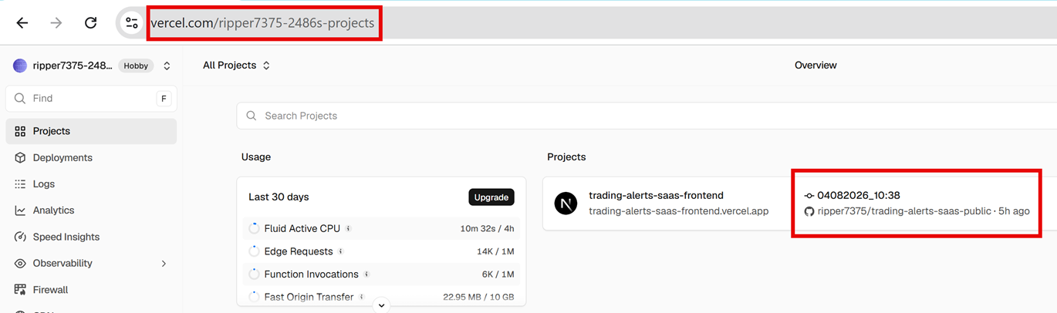
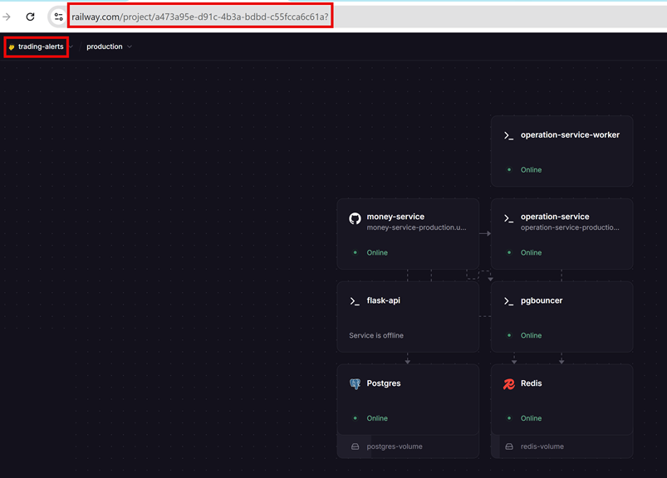
From Monolith to Microservices
Monolith Architecture
(BEFORE MIGRATION)
Microservices Architecture
(AFTER MIGRAION)
represent
Frontend UI
API Client
Vercel; Next.Js 16
Railway
ONE APP
Operation-Service
Money-Service
Pgbouncer
Operation-Service-Worker
represent
Contabo Windows VPS
+ VPS storage disk
Real time OHLCV Data
(Legacy Fallback)
Flask-api
Redis
Postgres
Socket.IO
MT5 Terminals
Indicator
Text Exports
NestJS
API
Gateway
Pgbouncer
SQLite
Python Push Worker
= Cross verification & Timestamp adjustment calculation

Slide 2
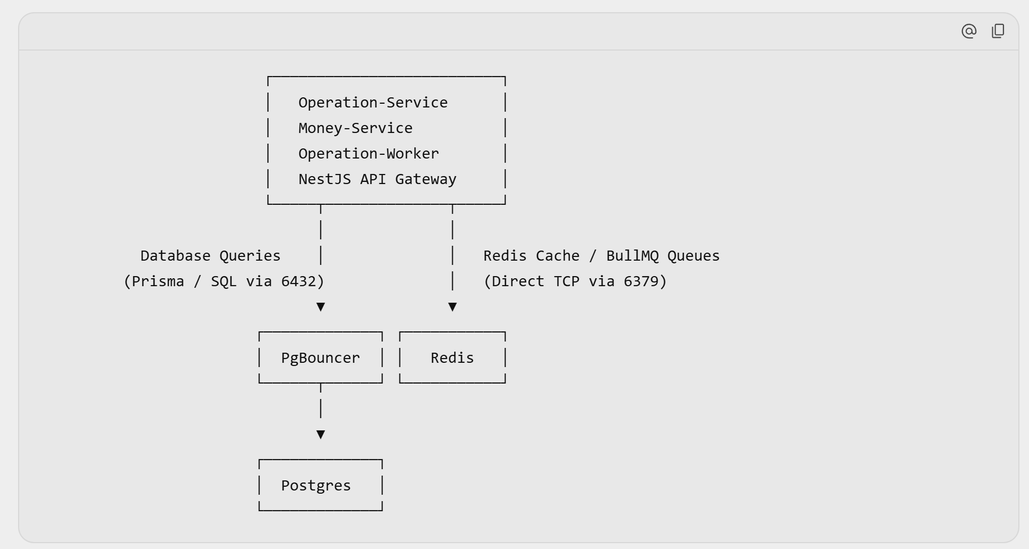
Asynchronous Data Pipeline Architecture
1. Postgres Traffic (Database Reads & Writes):
- MUST go through PgBouncer (e.g. port 6432 transaction pooling) to prevent database connection exhaustion.
2. Redis Traffic (Caching, BullMQ Queues, Socket.IO):
- Connects directly to Redis (e.g. port 6379), because PgBouncer is specifically a PostgreSQL-only connection pooler.

Slide 3
MT5 Flask Data Pipeline
Vercel; Next.Js 16
Frontend UI
Dual-Mode (Hybrid) = HTTPS / REST API + WebSocket
API Client
WebSocket
Communication
Railway
Operation-Service
MT5 Python API
(Inter-Process Communication)
Operation-Service-Worker
Contabo Windows VPS
+ VPS storage disk
Real time OHLCV Data
(Legacy Fallback)
Flask-api
Redis
Postgres
Socket.IO
MT5 Terminals
Python Push Worker

Slide 4
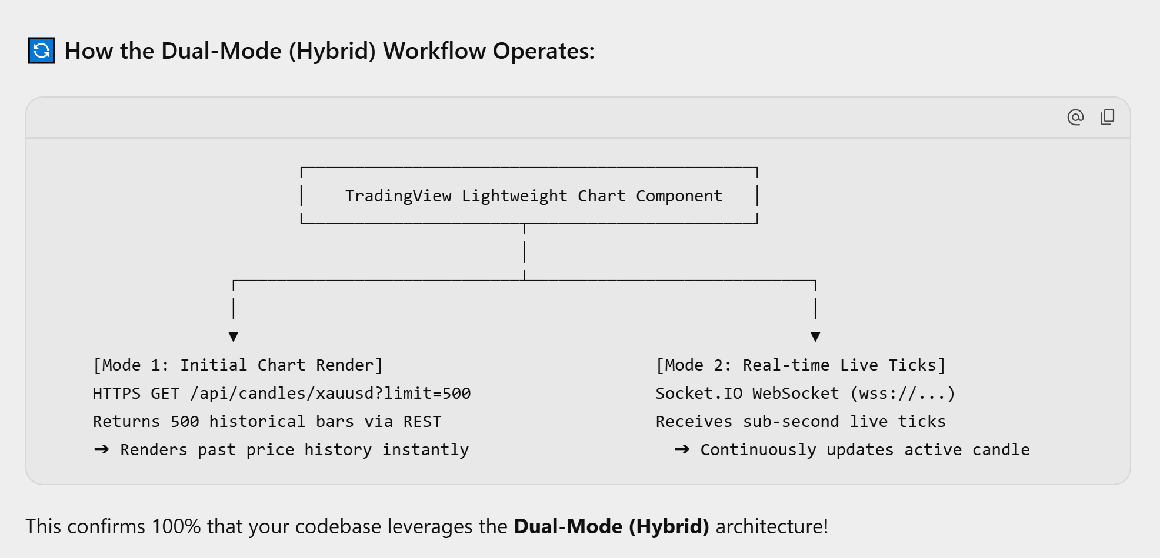
Dual-Mode (Hybrid) = HTTPS / REST API + WebSocket

Slide 5
OHLC WebSocket Data Pipeline
Apart from OHLC data display on TradingView Lightweight Charts, Do Indicator Data in the form of line plots, moving averages, symbols, etc. are displayed on TradingView Lightweight Charts ?
Frontend UI
API Client
Vercel; Next.Js 16
Railway
Operation-Service
Contabo Windows VPS
+ VPS storage disk
Postgres
Redis
MT5 Terminals
Indicator
Text Exports
NestJS
API
Gateway
SQLite
Python Push Worker
= Cross verification & Timestamp adjustment calculation

Slide 6
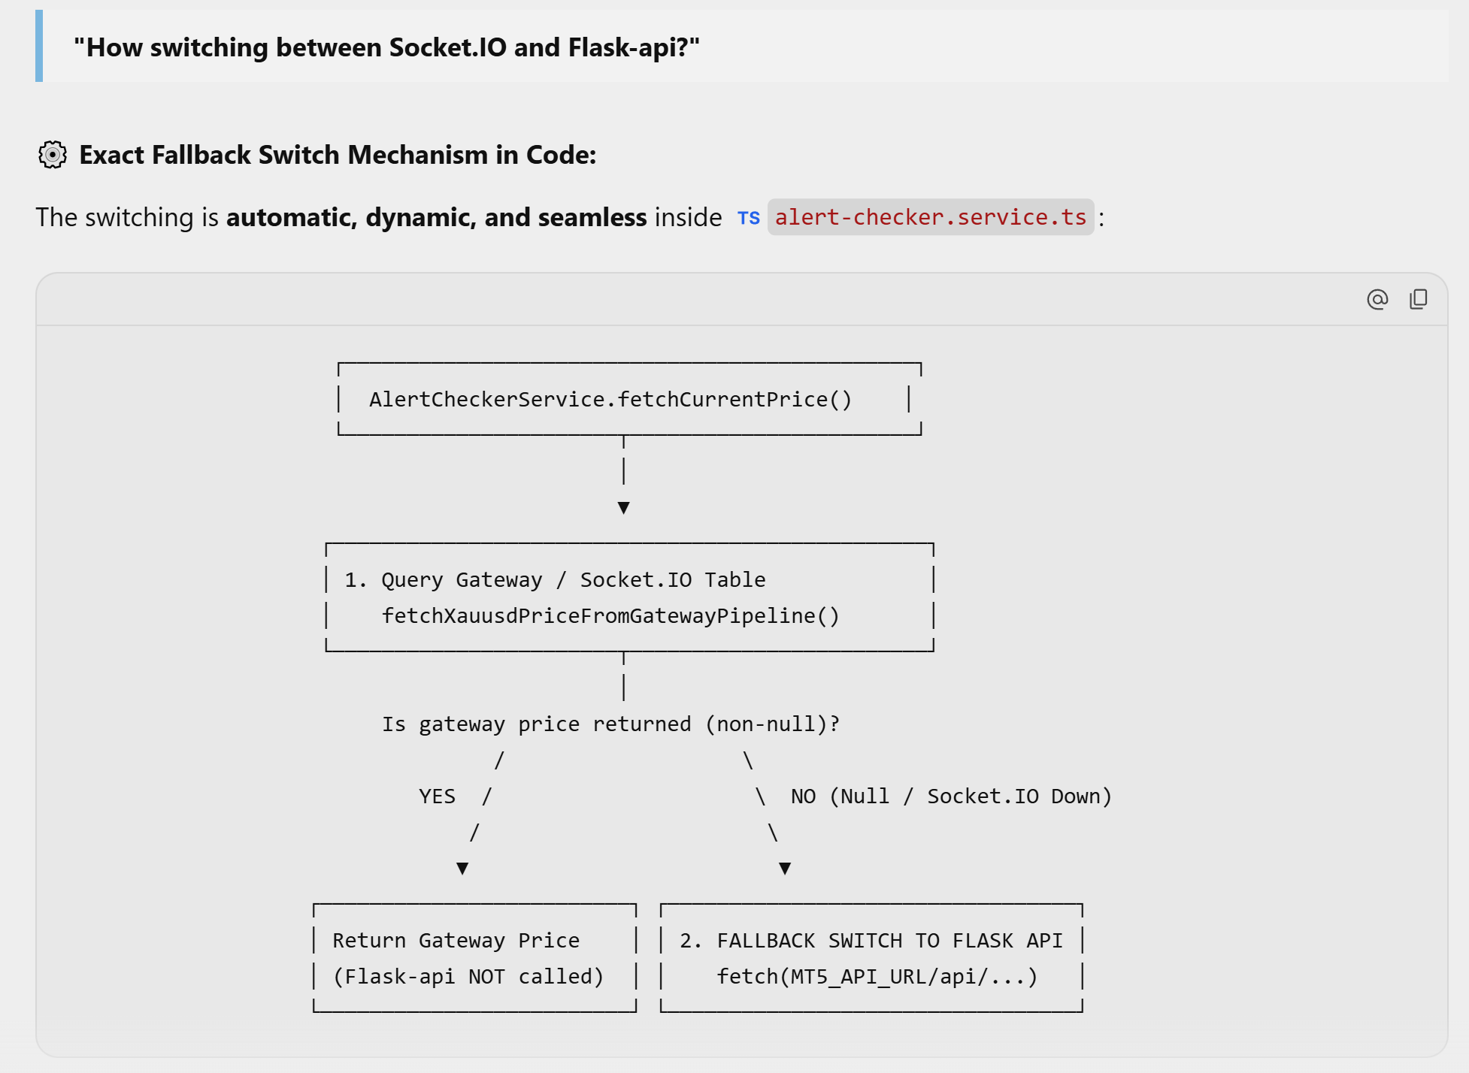
Switching between Socket.IO and Flask-api
Step 1 (Try Gateway / Socket.IO First): When checking price alert conditions for XAUUSD, fetchCurrentPrice() queries market_data_v6 (populated in real-time via NestJS Gateway & Redis Socket.IO stream).
Step 2 (Null Check): If gatewayPrice !== null, it immediately returns the real-time pipeline price. Flask-api is bypassed.
Step 3 (Automatic Fallback to Flask-api): If gatewayPrice === null (meaning the Socket.IO stream is disconnected, unpopulated, or delayed), execution automatically falls through to:
Typescript
const response = await fetch(`${MT5_API_URL}/api/indicators/${symbol}/${timeframe}?bars=100`);
The alert checker automatically switches to query http://localhost:5000 (Flask-api) to fetch OHLCV prices directly from the MT5 terminal connection, ensuring price alert monitoring never halts!

Slide 7
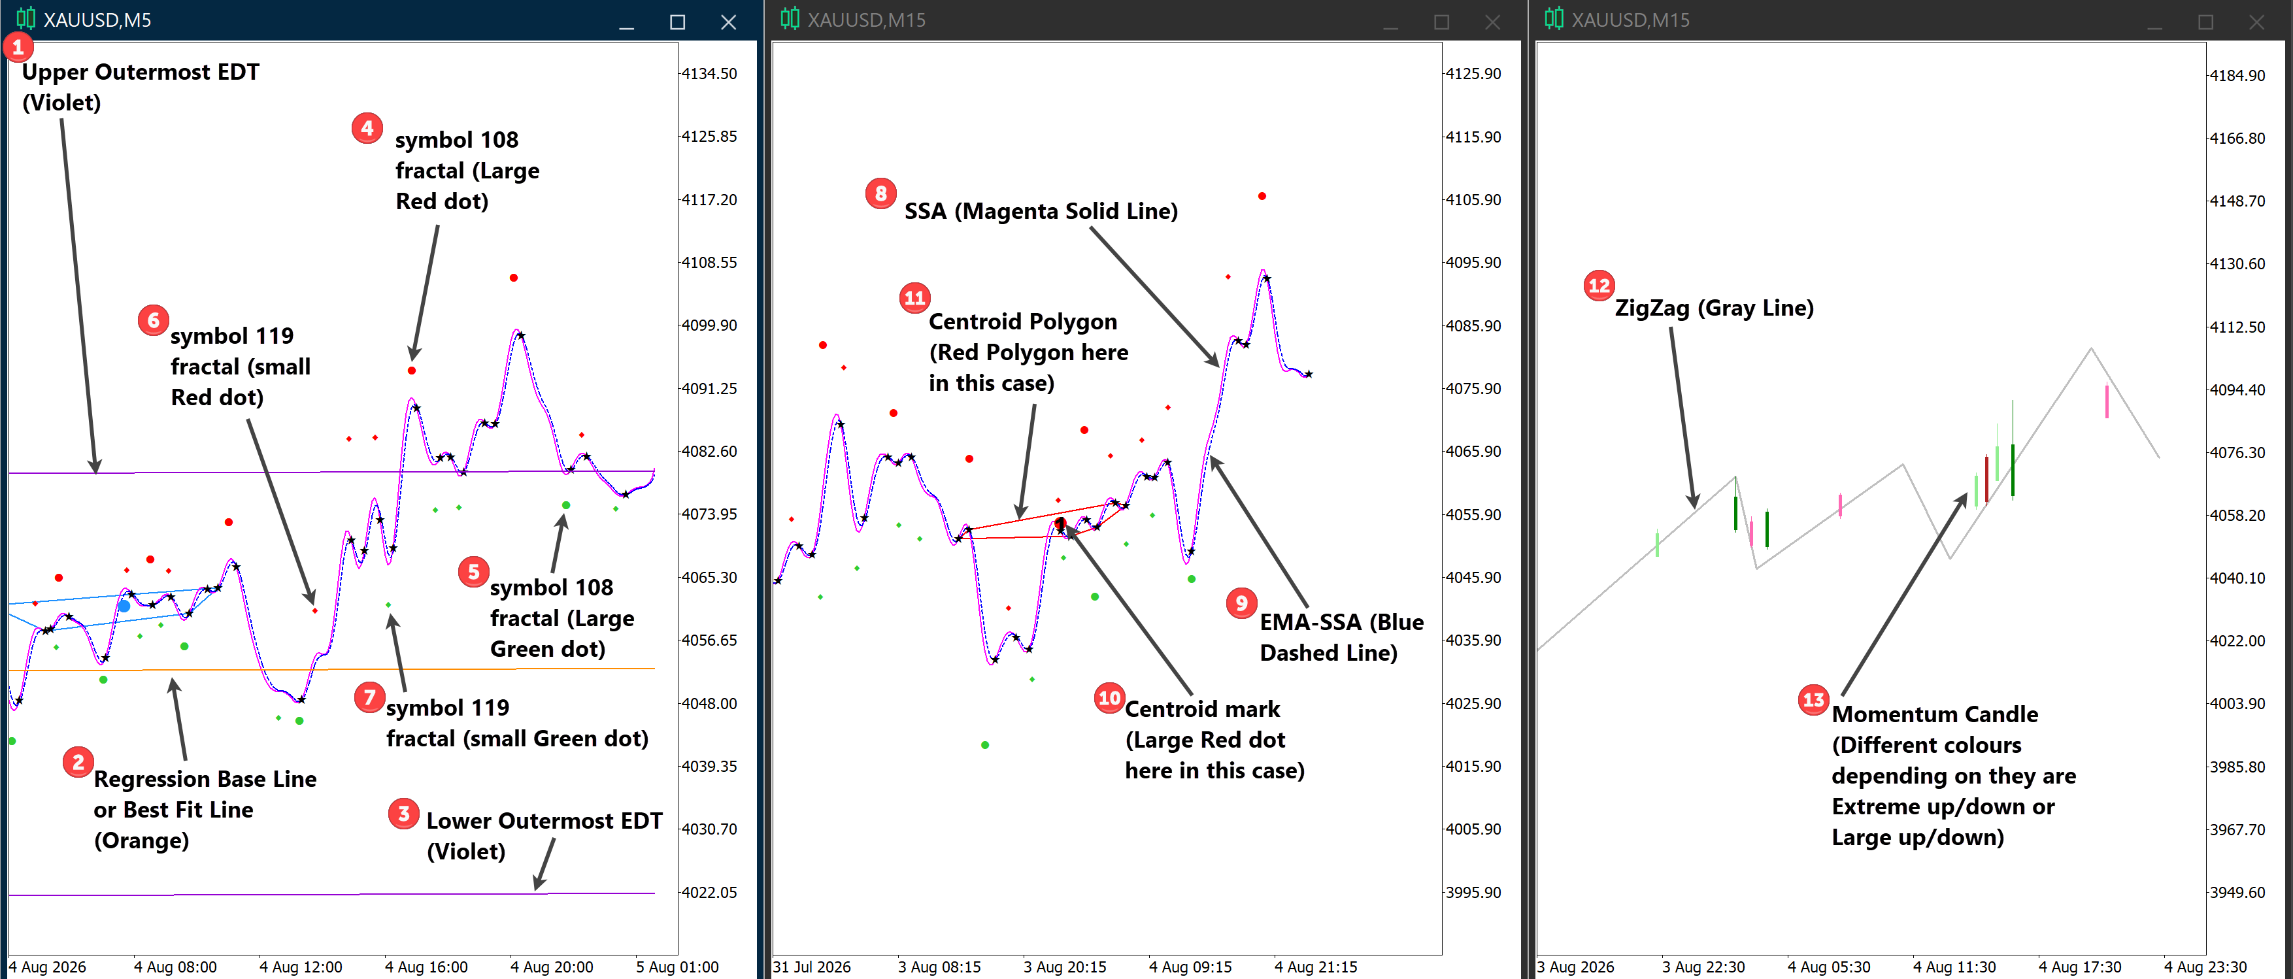
Types of Line & Symbol Plots Display on TradingView Lightweight Charts

Slide 8
Only most recent 3000 bars are constantly updated in PostgreSQL Database
In SQLite on the Contabo VPS, the database does NOT grow indefinitely. It is restricted to the most recent 3000 bars per timeframe (M5 and M15) matching the MT5 indicator export window.
Explanation: Every time a new collection cycle finishes, SQLite automatically deletes older rows beyond the 3000-bar window (once they have been synced to Railway).
Because indicators (such as SSA, Centroid Regression lines, and ZigZag pivots) recalculate across the lookback window on MT5, existing bars are updated/replaced in-place with their newly recalculated values.
When the Python Push Worker sends the rows across the internet to Railway, NestJS receives them and executes an UPSERT on PostgreSQL market_data_v6.
API Client
Railway
Every single data field required for these 13 plots is already calculated and stored in the 79-column market_data table (xauusd.db / PostgreSQL market_data_v6)
Contabo Windows VPS
+ VPS storage disk
Postgres
MT5 Terminals
Indicator
Text Exports
NestJS
API
Gateway
Pgbouncer
SQLite
Python Push Worker
= Cross verification & Timestamp adjustment calculation

Slide 9
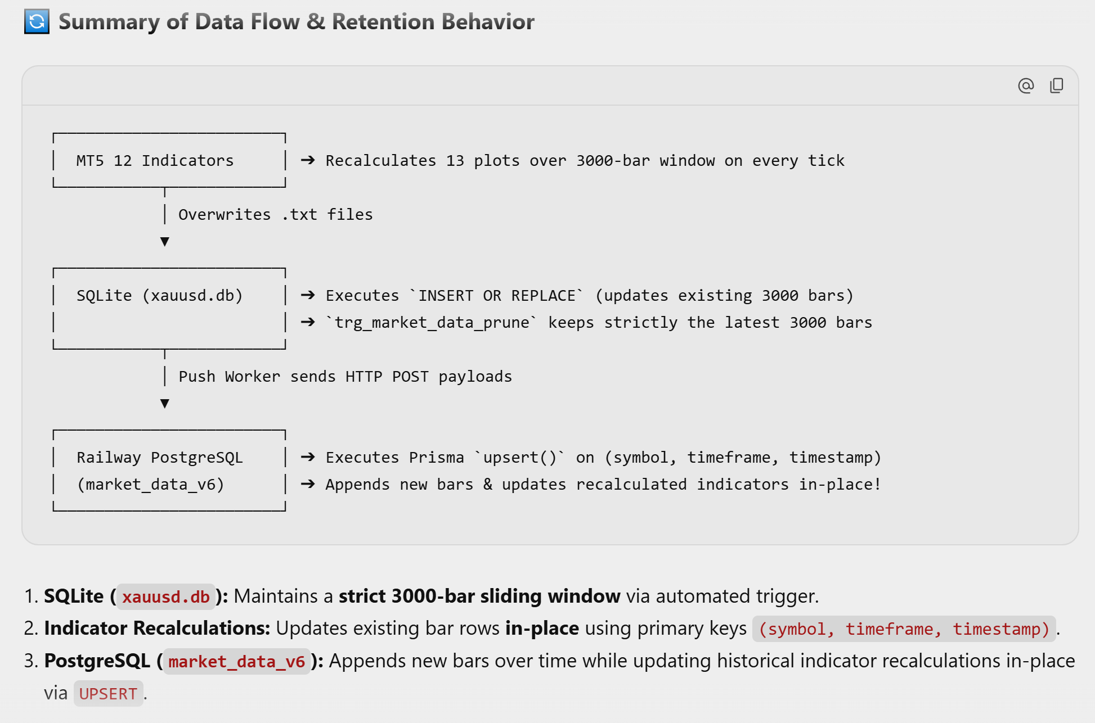
Only most recent 3000 bars are constantly updated in PostgreSQL Database

Slide 10
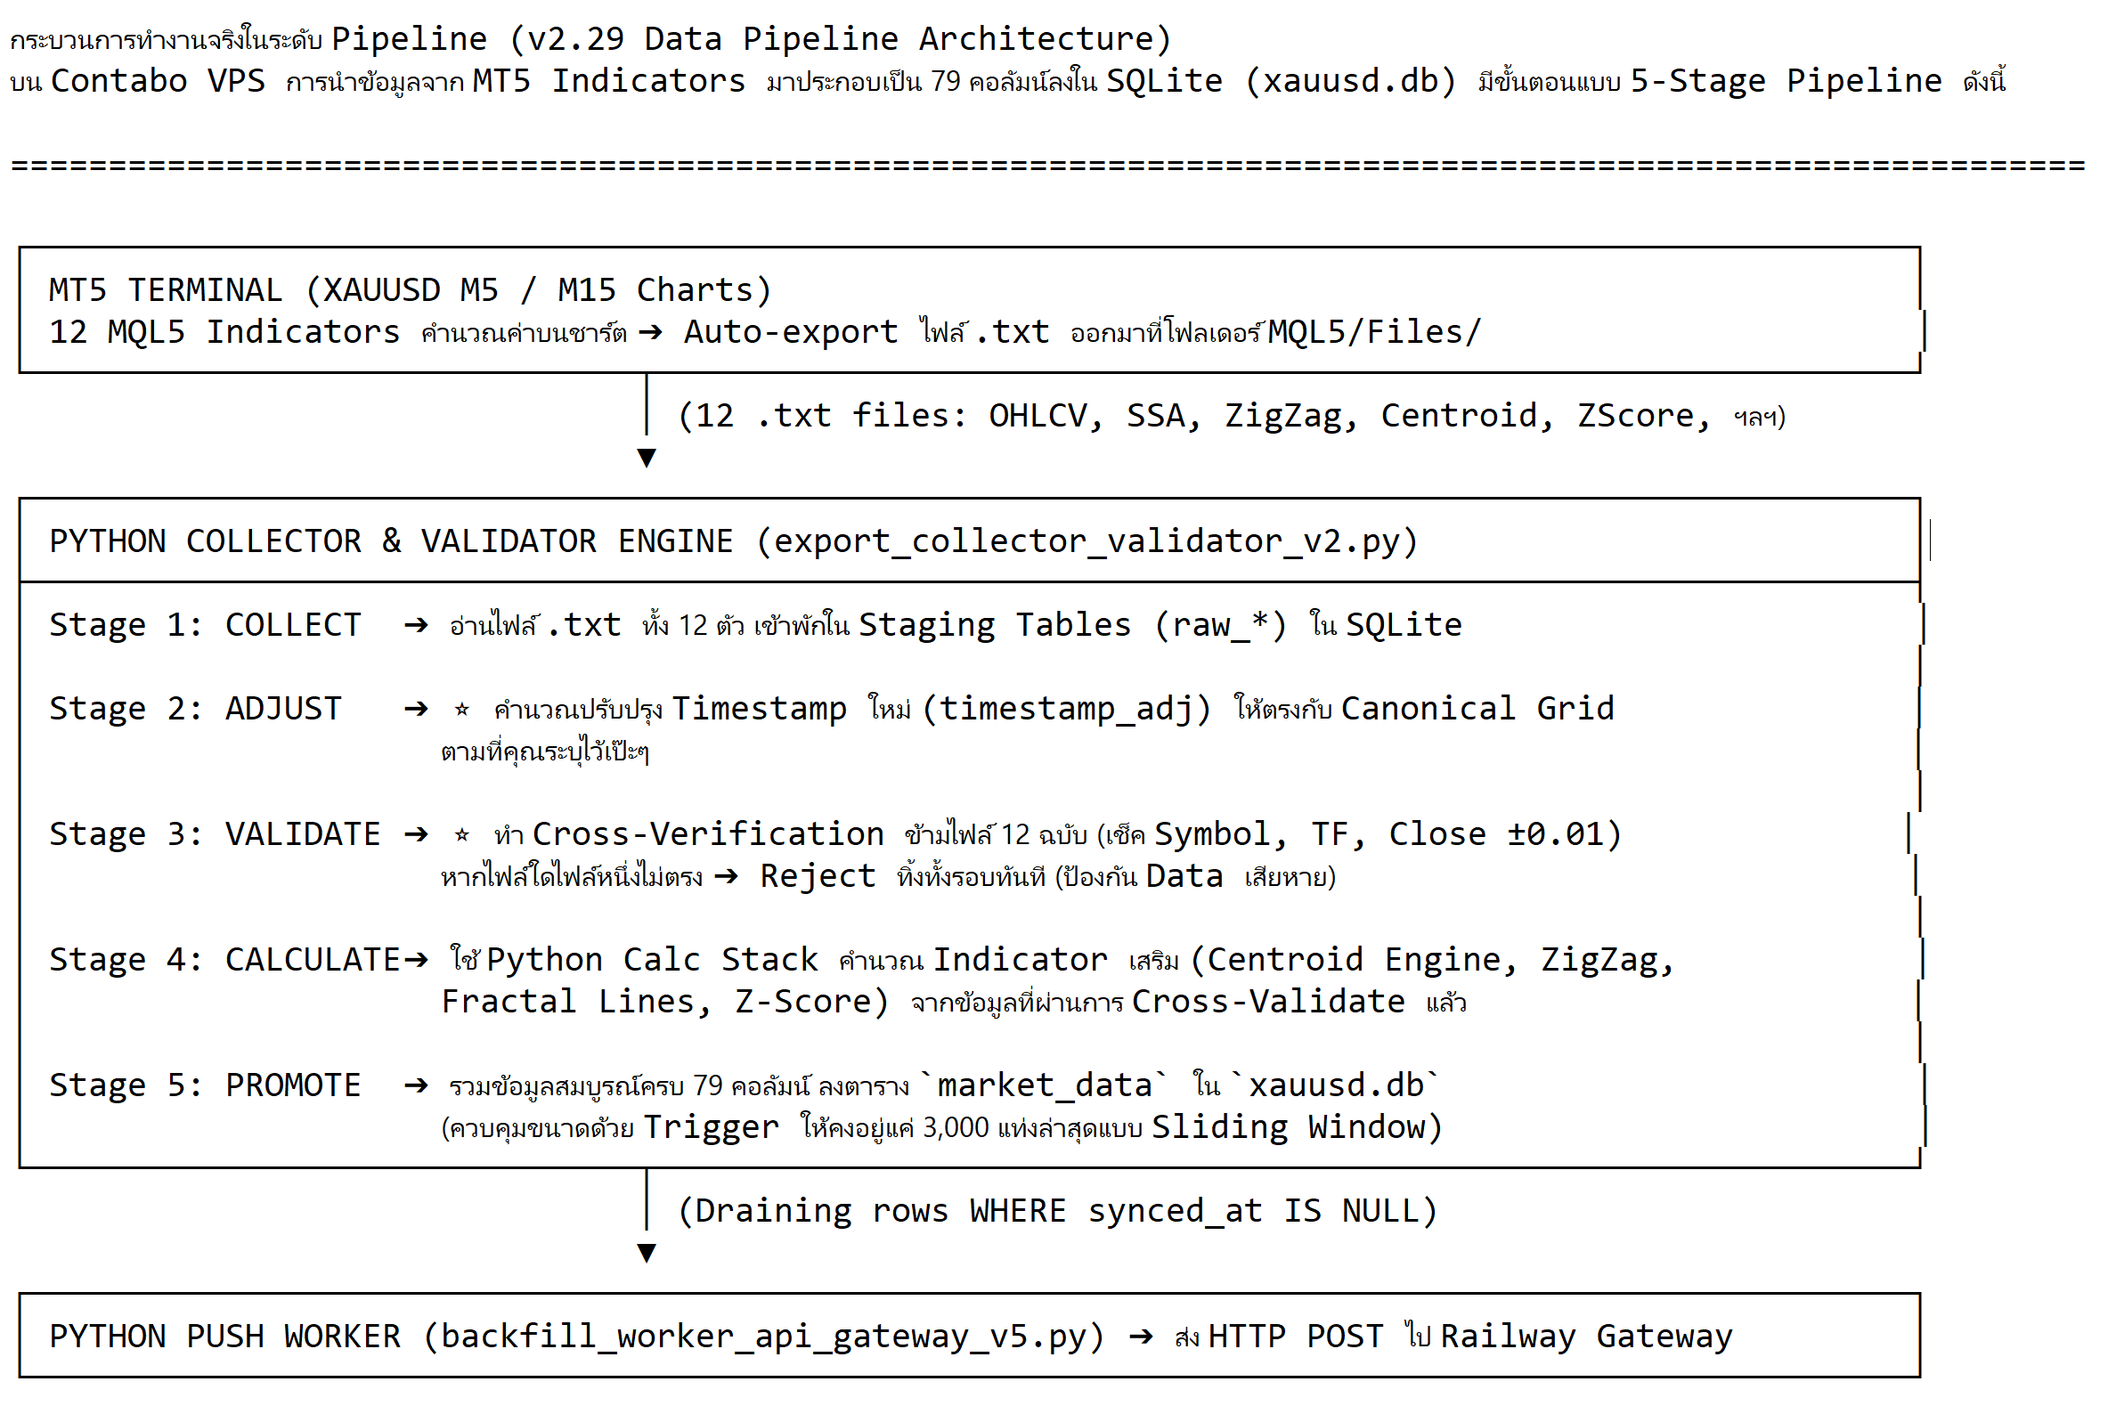
V2.29 Data Pipeline Architecture

Slide 11
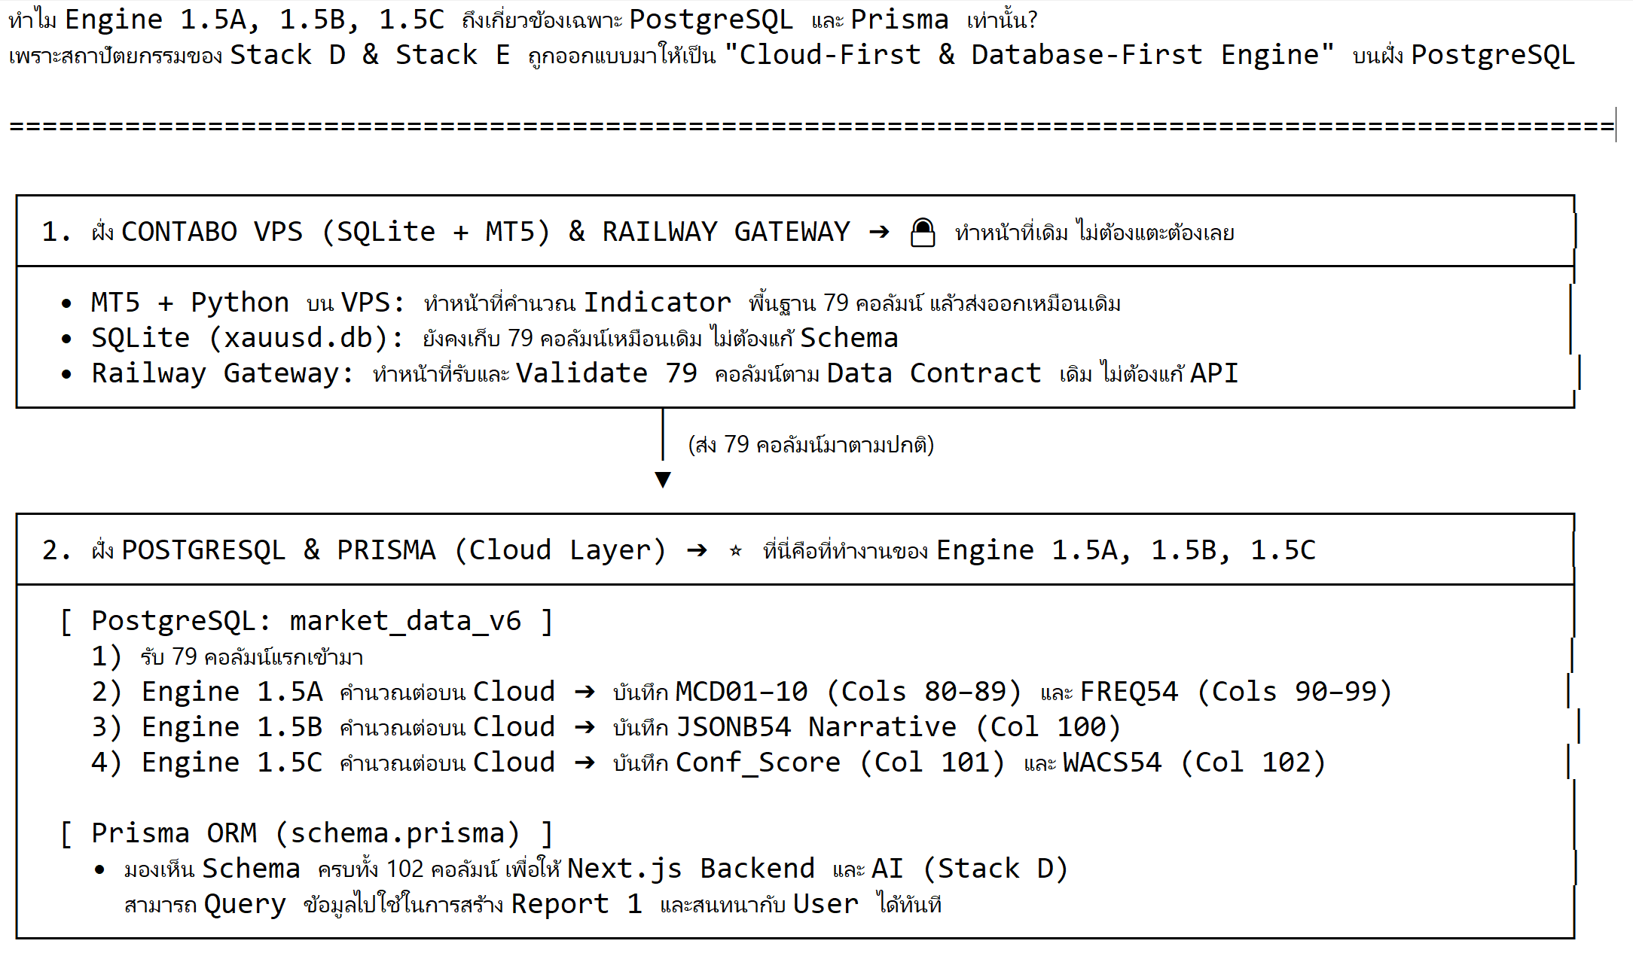
Contabo VPS → Railway Gateway → PostgreSQL → Prisma ORM → Nest.JS → Textai

