Slide 1
SmartCane
TPJ655 Final Project Presentation
Presenters:-
Siya Arora, Computer Engineering Technology Student, sarora106@myseneca.ca, +1 647-510-0957
Pranay Nair, Computer Engineering Technology Student, ppnair@myseneca.ca, +1 437-421-3663

Slide 2
AGENDA
Product Introduction
Product Specifications
Product Features & Functionalities
Technical Introduction
Major Components & Key Elements
Product Design & Structure
Conclusion
Future Developments

Slide 3
PRODUCT INTRODUCTION

Slide 4
Product Features
Obstacle Detection
Haptic feedback
Sound Alerts
Location Tracking
SMS alerts
User-friendly
Cost-effective
Lightweight and foldable

Slide 5
Product Specifications
Cane: 50 inches length
Metal Enclosure for circuit: 3"x 2.5" x 1.3" (L x B x H)
Product Weight: 500g
Battery: 9V / 595mAh
Battery Life: 13 – 14 months
System Operating Voltage: 5V
Obstacle detection range 0 – 25 cm

Slide 6
TECHNICAL OVERVIEW

Slide 7
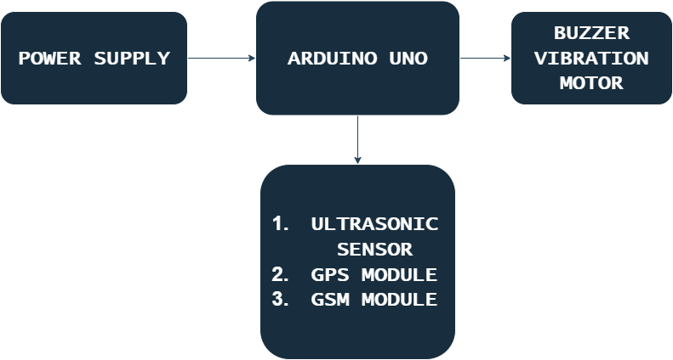
System Block Diagram

Slide 8
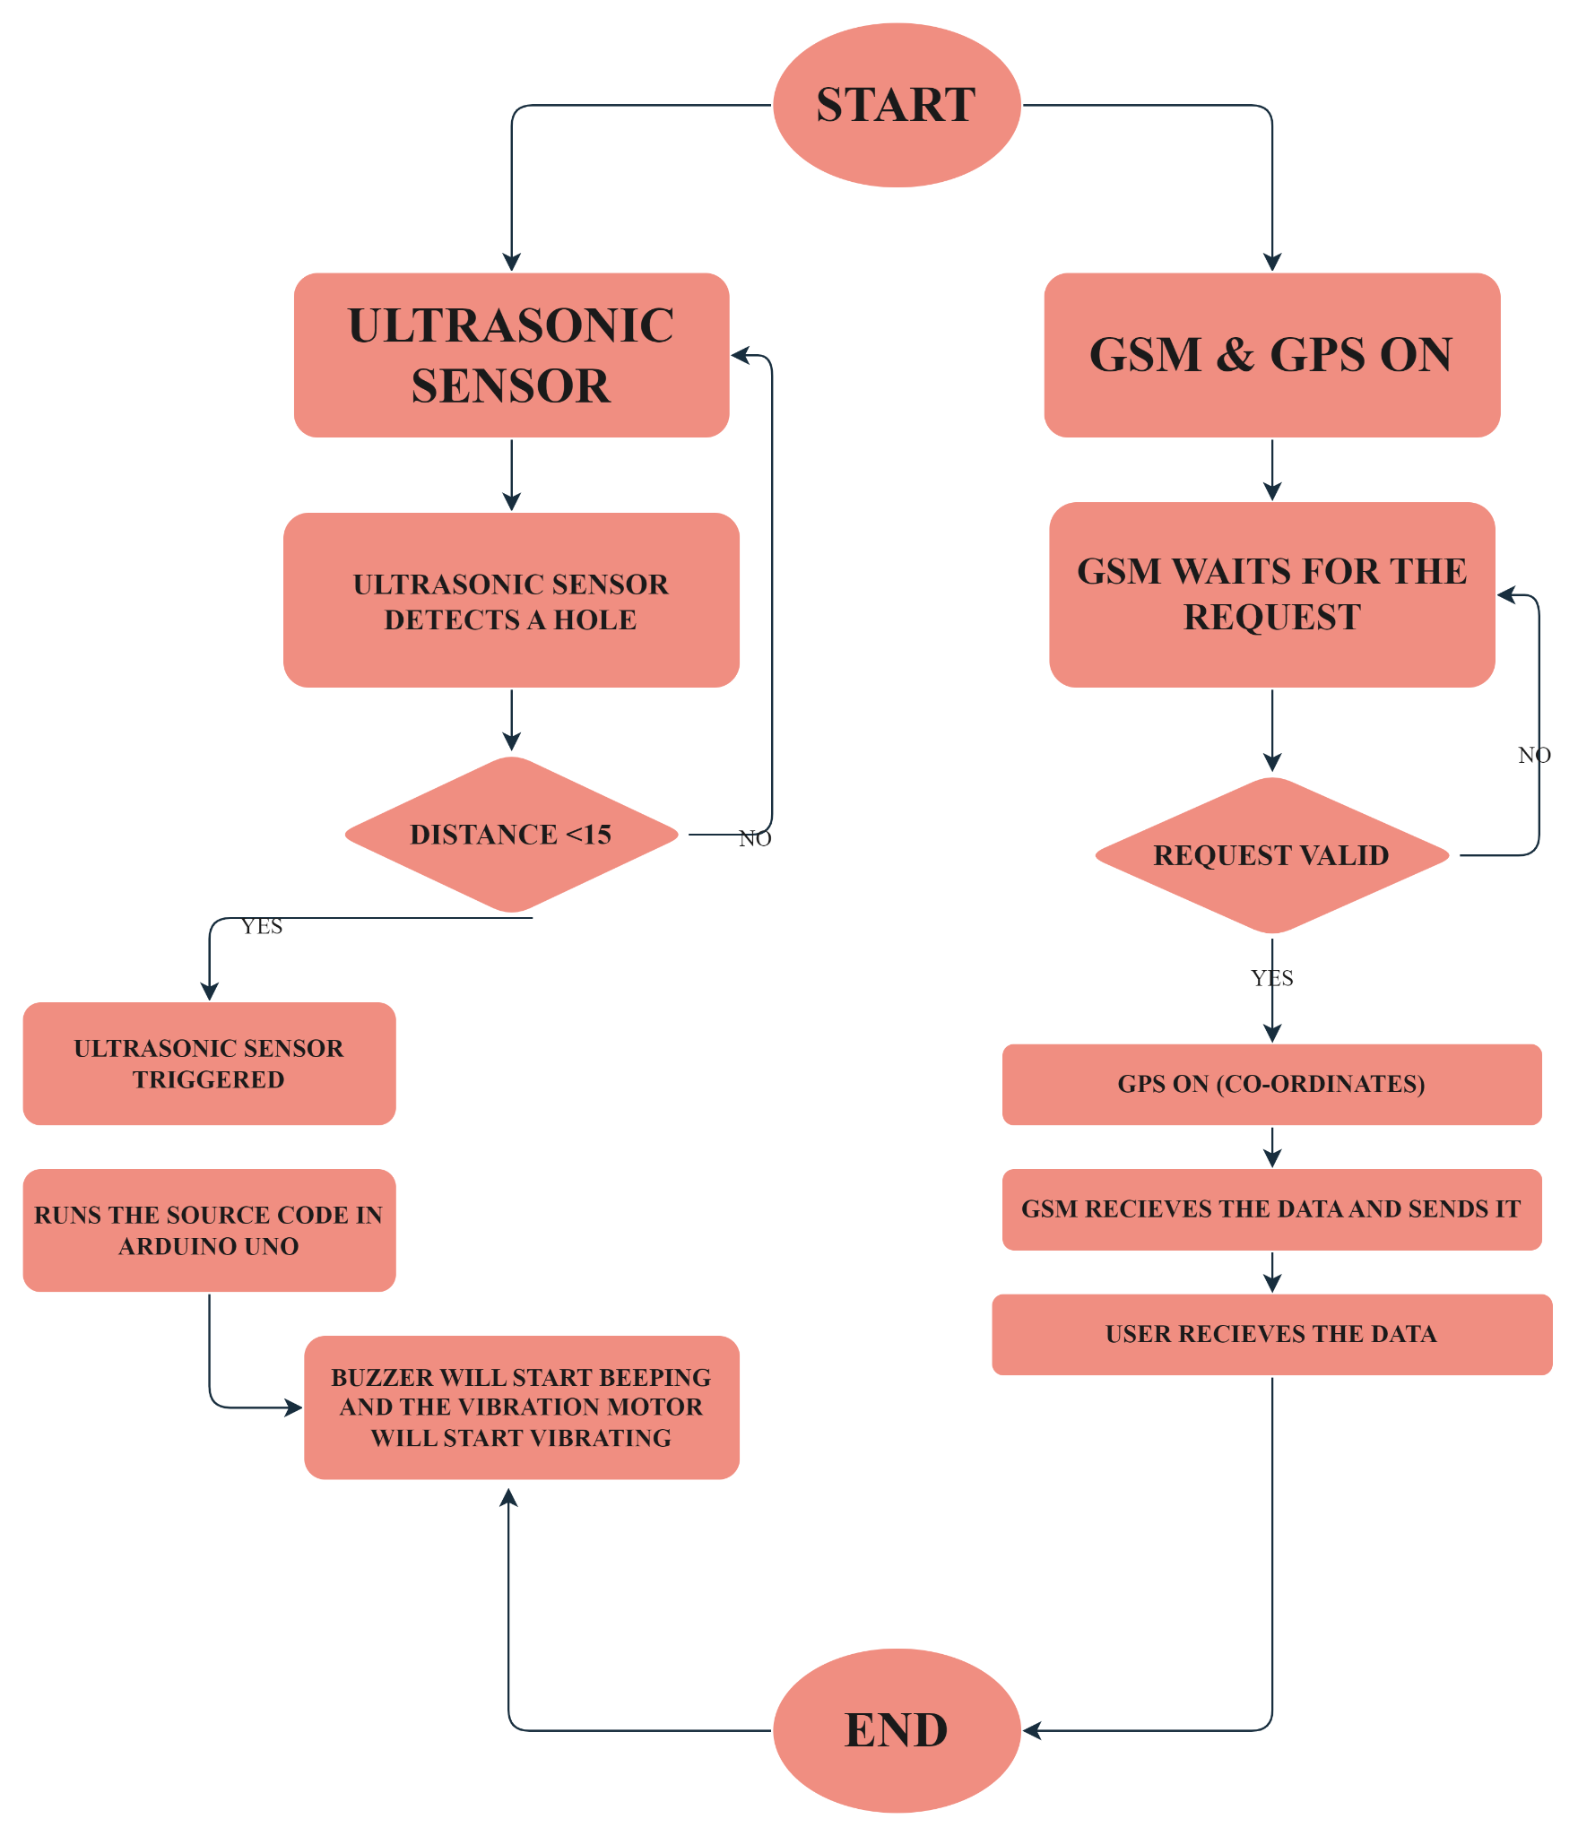
Software Diagram

Slide 9
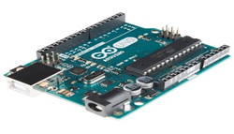
Major Components Used
Arduino Uno
Micro-Controller ATmega328P
Operating Voltage 5V
Input Voltage (recommended) 7-12V
Input Voltage (limits) 6-20V
Digital I/O Pins 14 (of which 6 provide PWM output)
Analog Input Pins 6

Slide 10
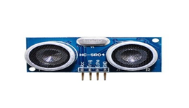
Major Components Used
Ultrasonic Range Finder
Voltage: +5 VDC
Measurable distances: 2cm – 700cm
Positive TTL pulse
Dimensions: 0.81 x 1.8 x 0.6 in (22 x 46 x 16 mm)
Operating temp range: +32 to +158°F (0 to+70°C)

Slide 11
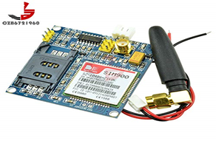
Major Components Used
GSM Module
Single supply voltage: 3.4V – 4.5V
Power saving mode: Typical power consumption in SLEEP mode is 1.5mA
Frequency bands: SIM900A Dual-band: EGSM900, DCS1800.
GSM class: Small MS
GPRS connectivity: GPRS multi-slot class 10 (default) , GPRS multi-slot class 8 (option)
Transmitting power: Class 4 (2W) at EGSM 900, Class 1 (1W) at DCS 1800

Slide 12
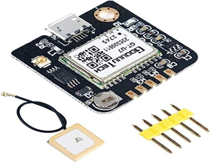
Major Components Used
NEO-6M GPS MODULE
Operating voltage: 3.6V-5V
Operating baud rate: 9600 (can be modified)
Onboard rechargeable button battery
Onboard E2PROM can save parameter data
NEMA output format is compatible with NEO-6M
Size: 27.6mm * 26.6mm can be inserted or selected patch (with positioning holes)

Slide 13
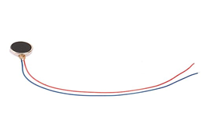
Major Components Used
VIBRATING MOTOR
Rated voltage: 3.0V DC
Operating voltage range: 2.3-4.0V DC
Direction of rotation: CM (clockwise) or CCW (counter clockwise)
Rated speed: 11000 ± 2500rpm
Rated current: 80mA Max

Slide 14
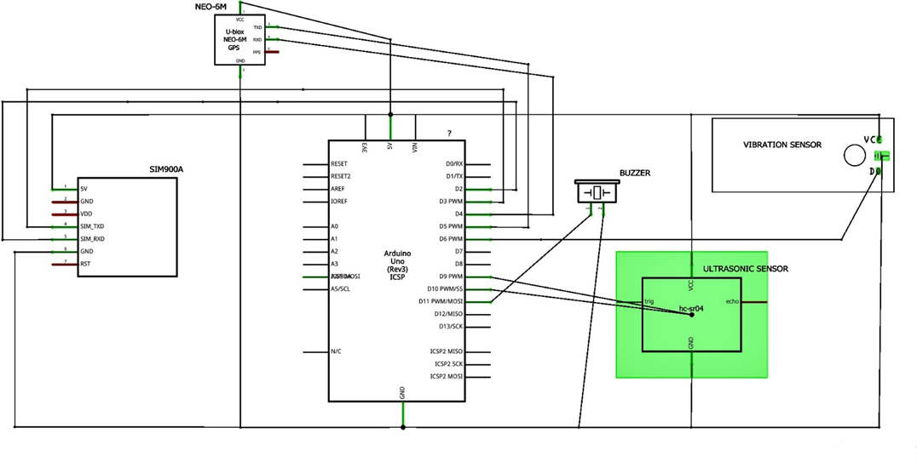
Electrical Schematics

Slide 15
SOFTWARE CODE

Slide 16
SOFTWARE CODE
#include <TinyGPS.h>
#include <SoftwareSerial.h>
const int trigPin = 9;
const int echoPin = 10;
const int vibration = 6;
int state = 0;
const int pin = 7;
float gpslat, gpslon;
TinyGPS gps;
SoftwareSerial sgps(4, 5);
SoftwareSerial sgsm(2, 3);
static const uint32_t GPSBaud = 9600;
1/6

Slide 17
long duration;
int distanceCm, distanceInch;
void setup()
{
Serial.begin(9600);
sgsm.begin(9600);
sgps.begin(9600);
pinMode(trigPin, OUTPUT);
pinMode(echoPin, INPUT);
pinMode(vibration, OUTPUT);
pinMode(6, OUTPUT); // Connect Vibration Pin D6
pinMode(11, OUTPUT); // Connect Buzzer Pin D11
}
void loop()
{
digitalWrite(trigPin, LOW);
2/6

Slide 18
delayMicroseconds(2);
digitalWrite(trigPin, HIGH);
delayMicroseconds(10);
digitalWrite(trigPin, LOW);
duration = pulseIn(echoPin, HIGH);
distanceCm= duration*0.034/2;
distanceInch = duration*0.0133/2;
Serial.println("Distance: ");
Serial.println(distanceCm);
delay (100);
if(distanceCm < 25)
{
digitalWrite(11, HIGH); // Buzzer ON
digitalWrite(6, HIGH); // Vibration ON
}
3/6

Slide 19
else
{
digitalWrite(11,LOW); // Buzzer OFF
digitalWrite(6,LOW); // Vibration OFF
}
sgps.listen();
while (sgps.available())
{
int c = sgps.read();
if (gps.encode(c))
{
gps.f_get_position(&gpslat, &gpslon);
}
}
4/6

Slide 20
sgsm.listen();
if (sgsm.available() > 0) {
String c = sgsm.readString();
c.trim();
if (c.indexOf("GET-GPS") >= 0) {
sgsm.print("\r");
delay(1000);
sgsm.print("AT+CMGF=1\r");
delay(1000);
/*Replace XXXXXXXXXX to 10 digit mobile number &
ZZ to 2 digit country code*/
sgsm.print("AT+CMGS=\"+014374213663\"\r");
delay(1000);
//The text of the message to be sent.
5/6

Slide 21
sgsm.print("Smart Cane Location - ");
sgsm.print("https://www.google.com/maps/?q=");
sgsm.print(gpslat, 6);
sgsm.print(",");
sgsm.print(gpslon, 6);
delay(1000);
sgsm.write(0x1A);
delay(1000);
}
delay(100);
}
}
6/6

Slide 22
CONCLUSION

Slide 23
Closing Remarks
This Smart Cane will help blind and visually-impaired people to explore their surroundings freely and with more confidence.
It will also reduce the risk of injuries due to trips and falls as it will help detect any obstacles and holes from a range of two meters and give a buzzing sound to alarm the user. It will make use of various sensors and modules attached to a microcontroller enclosed in a box.
This project has immense potential to make a significant impact in the lives of its users since they would be able to navigate their surroundings in a safer and more confident way.
Also, this project has allowed us to make use of the project management fundamentals and the knowledge of electronics learned throughout the course of the program.

Slide 24
Future Developments
Machine Learning -
Bluetooth Connectivity
Voice Assistants
Battery Life
GSM Module Range
Size and Weight

Slide 25
References
A. (2022a, June 15). SMART BLIND STICK USING ARDUINO ,GSM MODULE ,GSM MODULE,ULTRASONIC SENSOR AND RAIN SENSOR. Electronics Workshop. https://electronicsworkshops.com/2020/06/14/smart-blind-stick-using-gsm-module-gsm-moduleultrasonic-sensor-and-rain-sensor/
A. (2022b, November 18). Smart Blind Stick Using Arduino | Ultrasonic sensor based project. Techatronic. https://techatronic.com/smart-blind-stick-using-arduino-and-ultrasonic-sensor/
S. (2017, September 21). Smart Blind Stick using Arduino in Proteus. The Engineering Projects. https://www.theengineeringprojects.com/2017/09/smart-blind-stick-using-arduino-proteus.html
Interfacing GSM and GPS Module using Arduino: A step-by-step guide tutorial for tracking — Steemit. (n.d.). Steemit. https://steemit.com/utopian-io/@kimp0gi/interfacing-gsm-and-gps-module-using-arduino-a-step-by-step-guide-tutorial-for-tracking

Slide 26
Contact Information
Siya Arora
ECT Student
Phone - +1 647-510-0957
Email – sarora106@myseneca.ca
Pranay Nair
ECT Student
Phone - +1 437-421-3663
Email – ppnair@myseneca.ca

