Slide 1

Welcome to Hereford
For updates follow us on twitter: @smartdevsug
http://www.meetup.com/Smart-Devs-User-Group/

Slide 2
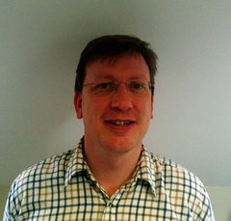
Ryan O’ Neill @ryanoneill1970 r@ryanoneill.com
@smartdevsug

Slide 3
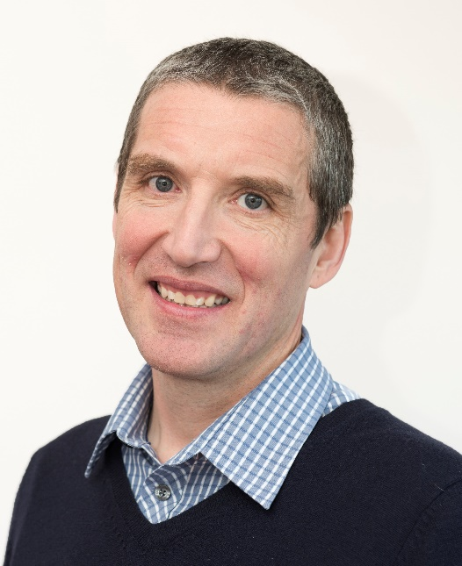
Richard Wilde @rippo richard@wildesoft.net
@smartdevsug

Slide 4
Upcoming Events..
Thanks to our sponsors;
- Manning x 2 FREE BOOKS + 36% off (ug367)!
- OzCode – email r@ryanoneill.com
- JetBrains
- Rippo/Ryan – Pizza + Venue
ALL donations gladly accepted!
@smartdevsug

Slide 5
Upcoming Events..
Coming up
Dec – Functional C# - Simon Painter
Jan – Matteo – Azure Devops
Feb – Mark Heath – you choose
@smartdevsug

Slide 6
Upcoming Events..
Coming up in Feb
Mark Heath
Azure Durable Functions
Running containers in Azure
VOTE!
@smartdevsug

Slide 7
Upcoming Events..
What do you want to see?
Do you want to present <INSERT TALK HERE>? Talk to us, email us, send us a tweet, we promise not to bite!
@smartdevsug

Slide 8
Upcoming Events..
Tonight Nov - Introduction to Log Analytics and Easy integration with Flow and Logic Apps – Steven Spencer
@smartdevsug

