Slide 1

Welcome to Hereford
For updates follow us on twitter: @smartdevsug
http://www.meetup.com/Smart-Devs-User-Group/

Slide 2
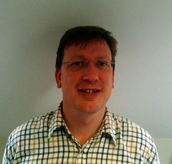
Ryan O’ Neill @ryanoneill1970 r@ryanoneill.com
@smartdevsug

Slide 3
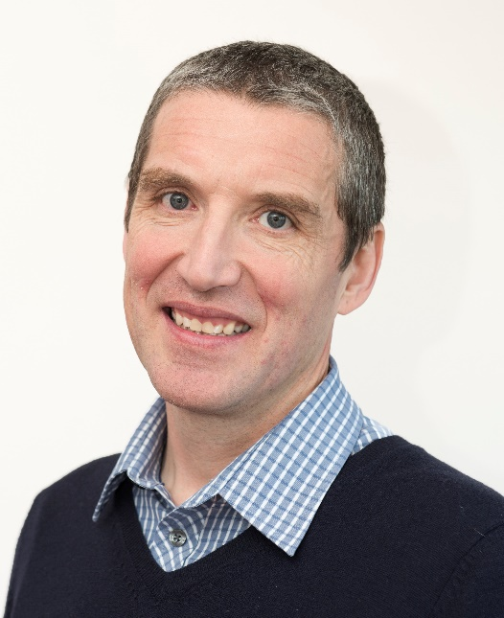
Richard Wilde @rippo richard@wildesoft.net
@smartdevsug

Slide 4
Upcoming Events..
Thanks to our sponsors;
- Manning x 2 FREE BOOKS + 36% off (ug367)!
- OzCode – email r@ryanoneill.com
- JetBrains
- Rippo/Ryan – Pizza + Venue
ALL donations gladly accepted!
@smartdevsug

Slide 5
Upcoming Events..
Coming up
Jun - Spot the difference: automating visual regression testing – Viv Richards
Jul – Kubernetes – Shahid Iqbal
Aug – Ideas?
Sep – Azure In Action - CosmosDB, Functions and ServiceBus in Perfect Harmony – Joel Hammond
Oct - Introduction to Alexa with .NET Core – Stephen Pears
Nov - Introduction to Log Analytics and Easy integration with Flow and Logic Apps – Steven Spencer
@smartdevsug

Slide 6
Upcoming Events..
What do you want to see?
Do you want to present <INSERT TALK HERE>? Talk to us, email us, send us a tweet, we promise not to bite!
@smartdevsug

Slide 7
Upcoming Events..
Tonight Spot the difference: automating visual regression testing Viv Richards
@smartdevsug

