Slide 1

Hereford
http://www.nxtgenug.net/hereford

Slide 2

Ryan O’Drop Database Master--Neill Coordinator
Hereford
@ryanoneill1970
r@ryanoneill.com

Slide 3
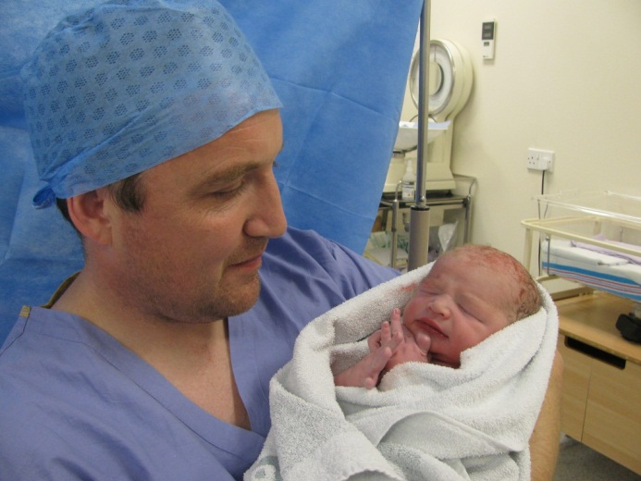
Richard Wilde Coordinator
Hereford
@rippo

Slide 4
Upcoming Events..
Hereford
Benefits of membership...
Access to 8 regions across the country.
At least 12 meetings per region each year.
Great sessions, food, swag & networking.
That’s 96 meetings a year for a membership fee of just £7.99 monthly or £89 annually!

Slide 5
Upcoming Events..
Hereford
Toilets are opposite the door you came in
Pizza & Drinks served around 7:50pm

Slide 6
Upcoming Events..
Hereford
Tonight...
Ross D Scott
The quick, the cheap and the ugly (expensive) ways to develop for Android.

Slide 7
Upcoming Events..
Hereford
Coming Soon...
At Hereford we aim for the 2nd Monday of every month please put it in your diary!
December 12th – Mark Rendle – Nancy and Simple.Data
January 9th 2012 – CQRS, bringing elegance to applications
February 13th 2012 – Paul Stack – Continuous Integration
March 12th 2012 – Marc Gravell - Web performance triage
April 9th 2012 – Seb Lambla – Web caching 101
Whatever you want (within reason)

Slide 8
Upcoming Events..
Hereford
We will be going for a pint (beer, coke, whatever) after tonight’s session, all welcome.

Slide 9
Upcoming Events..
Hereford
Presentation Time....

Slide 10
Upcoming Events..
Hereford
A big thank you to Ross
Please can you leave feed back as our speakers use this to further enhance their presentations...

