Slide 1
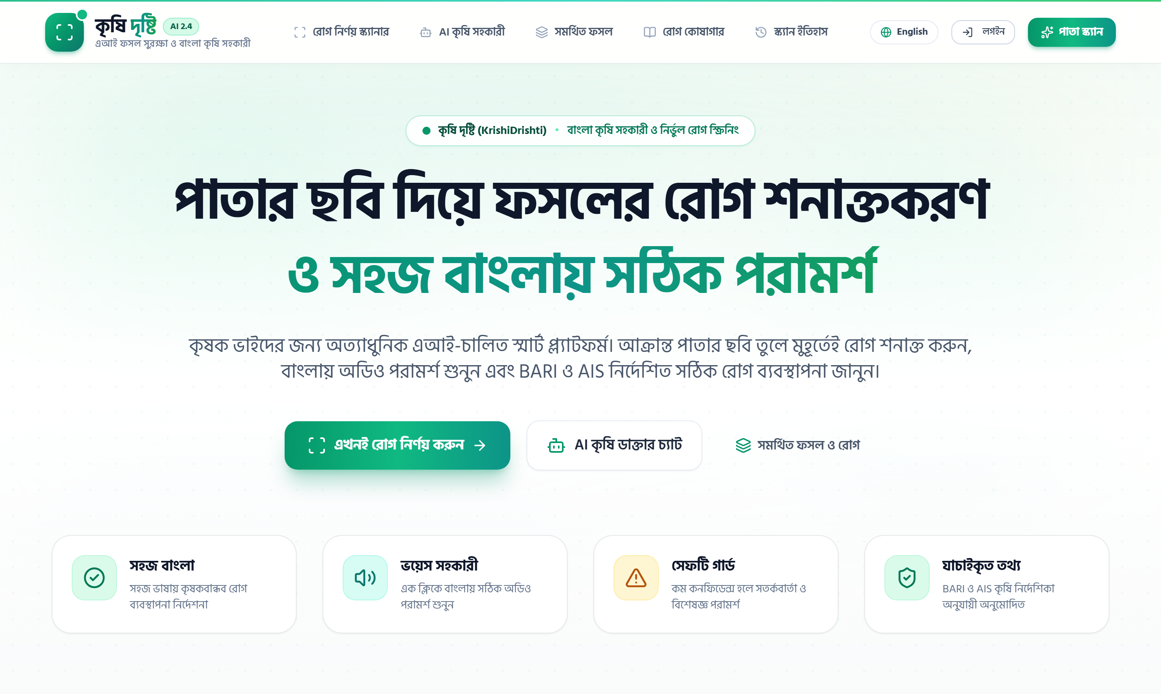
SMART AGRI-TECH & AI PLATFORM
KrishiDrishti Web Application (http://localhost:3000)
LIVE WEB PLATFORM
KrishiDrishti (কৃষি দৃষ্টি)
AI Foliar Pathology Screening & Bilingual Advisory Platform
Integrating ConvNeXt-Tiny Deep Learning Vision, Multi-Provider LLMs, and Two-Stage Clinical Gating for Sustainable Agriculture.
✔ Sub-150ms Neural Inference Latency
✔ 50 Disease Classes across 16 Crops
✔ Bilingual Native Bangla Voice & Chat
KrishiDrishti Engineering Architecture & Executive Presentation | 2026

Slide 2
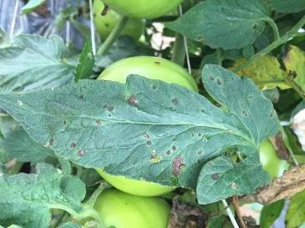
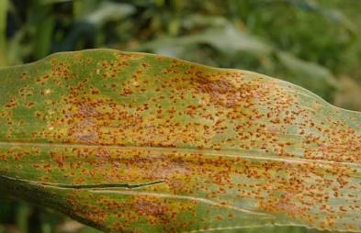
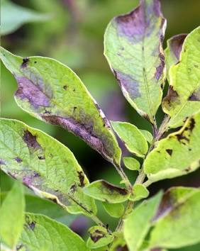
THE CRITICAL CHALLENGE
Severe Agronomic Vulnerabilities in Crop Pathology
Smallholder farmers face massive harvest destruction due to diagnostic lag and acute advisory shortages.
1. Severe Yield Loss (20-40%)
• Foliar pathogens and fungal blights silently destroy up to 40% of seasonal harvests.
• Delayed early detection allows localized blight to spread rapidly across fields.
• Heavy economic devastation for vulnerable smallholder farming households.
2. Agronomist Scarcity (1:15,000)
• Extension officer ratio exceeds 1:15,000 farming households in Bangladesh.
• Physical lab testing requires 3-7 days, far too slow for fast fungal progression.
• Remote rural farming clusters are geographically cut off from extension centers.
3. Chemical Misuse & Language Gap
• Panic-driven, uncalibrated pesticide spraying destroys soil microbiome & ecology.
• 85%+ of scientific plant pathology research is in academic English, inaccessible to farmers.
• Zero actionable split-dosage guidance leads to excessive chemical runoffs.
Foliar Blight Specimen (Tomato Early Blight)
Spore Outbreak Specimen (Corn Common Rust)
Lethal Rot Specimen (Potato Late Blight)

Slide 3
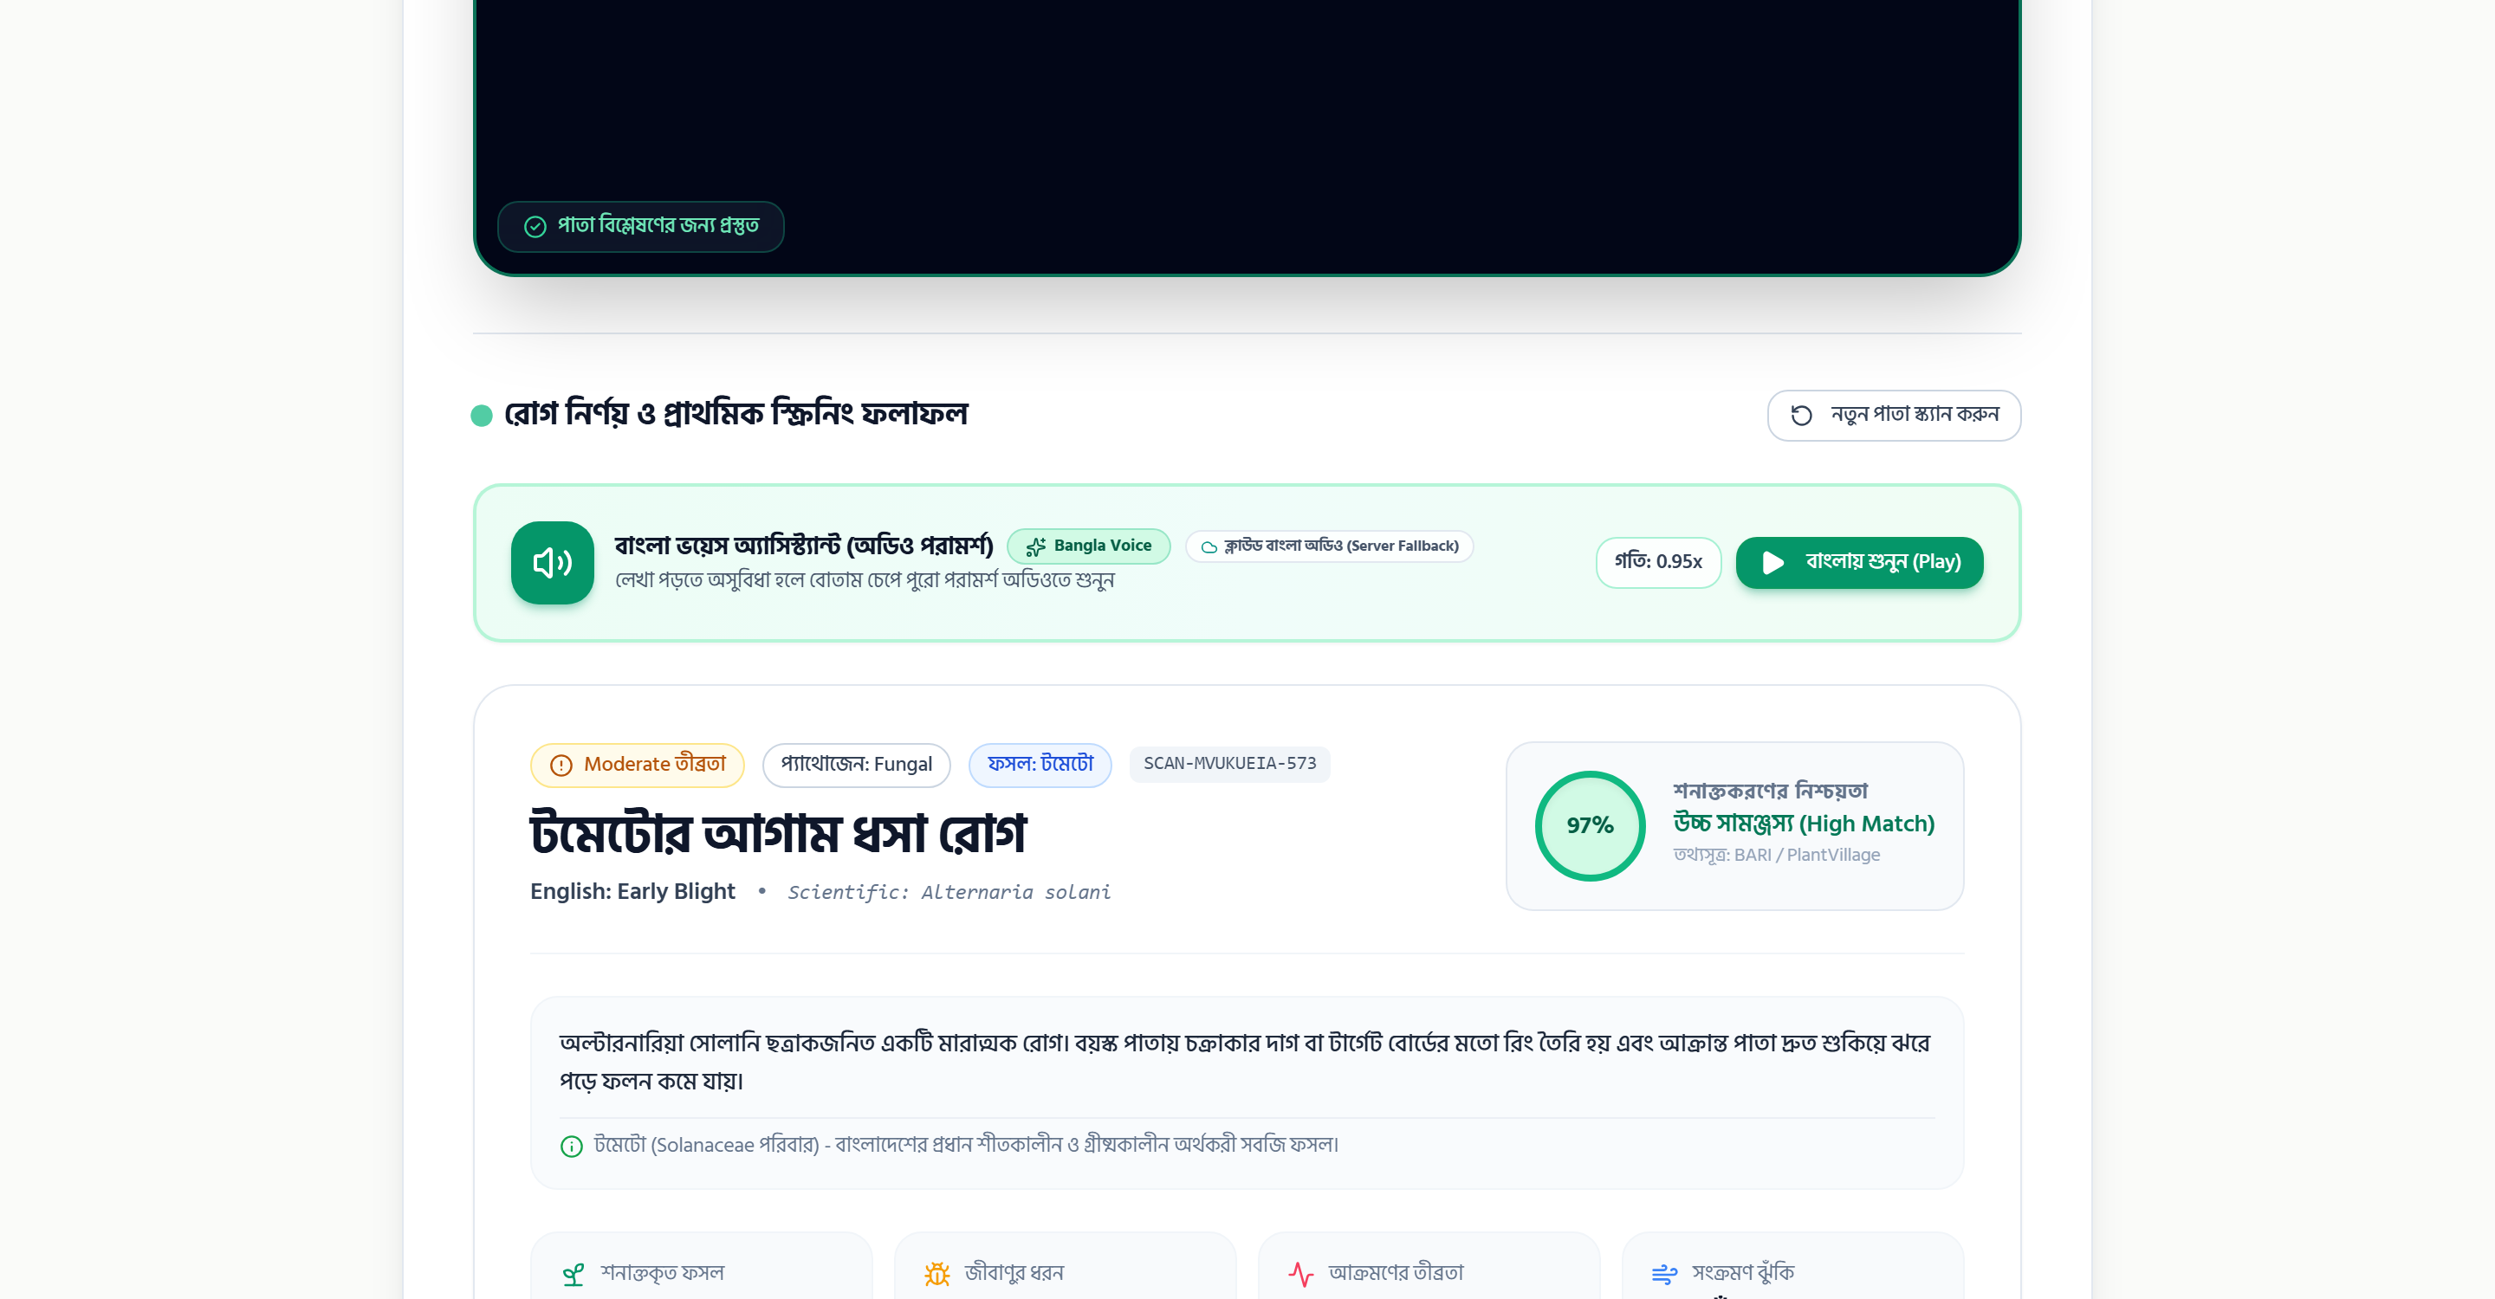
COMPREHENSIVE SOLUTION
KrishiDrishti: An Intelligent Farming Companion
A clinical, end-to-end digital agricultural ecosystem delivering instant diagnostics directly to the field.
Instant Vision Pathology Diagnosis
• High-resolution leaf scan with 50-class foliar pathology detection.
• Calculates 97% confidence matching, severity grade, and fungal/bacterial taxonomy.
• Provides verified BARI & AIS recommended treatments with Bangla audio playback.
• 1-Click PDF export downloads structured clinical pathology dossiers.
AI Leaf Disease Diagnostic Result (/scan)
REAL DIAGNOSIS MOCKUP
Conversational AI Crop Doctor & Tools
• Conversational agricultural Bangla advisory with Web Speech TTS audio.
• Precision balanced N-P-K fertilizer calculator adapted to Bigha / Acre land sizes.
• Human-in-the-loop escalation routing low-confidence scans to verified agronomists.
• Offline-tolerant database caching delivering instant 20ms repeated lookups.

Slide 4
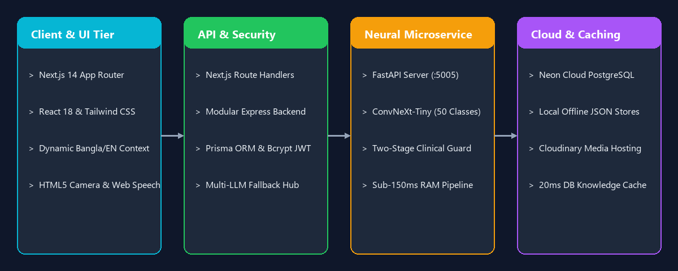
ENGINEERING ARCHITECTURE
Modern Multi-Tier Decoupled Platform Architecture
Engineered for sub-150ms edge performance, high availability, and zero-setup offline resilience.
Decoupled pipeline: Next.js 14 Client -> Express/Next API Layer -> Python FastAPI ConvNeXt-Tiny Microservice -> Neon Cloud DB

Slide 5
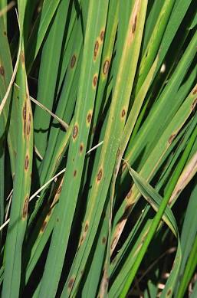
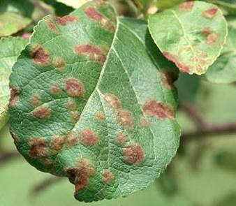

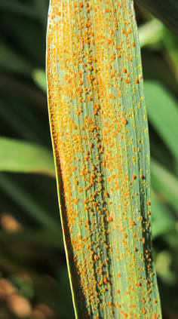
DEEP LEARNING CORE
50-Class Pathology Model Powered by ConvNeXt-Tiny
Cutting-edge pure convolutional vision architecture fine-tuned for high accuracy on foliar pathology.
ConvNeXt-Tiny Model Highlights
• Modern Vision Backbone: Adopts Vision Transformer design innovations (7x7 depthwise convolutions, inverted bottlenecks) with pure ConvNet efficiency.
• Sub-150ms CPU Execution: ~28M parameters, delivering instant classification on commodity CPU hardware without requiring costly GPUs.
• Broad Multi-Crop Scope: 50 classes across 16 major crops (Rice, Wheat, Potato, Tomato, Pepper, Corn, Apple, Grape, Strawberry, Soybean, etc.).
• Pathological Diversity: Accurately classifies Bacterial spots, Fungal blights, Powdery mildews, Leaf rusts, Viral mosaics, and Healthy controls.
• Publicly Published: Deployed and shared on Hugging Face Hub as ripro805/krishidrishti-plant-disease.
Rice Brown Spot (ধান)
Apple Scab (আপেল)
Grape Esca (আঙ্গুর)
Wheat Leaf Rust (গম)

Slide 6
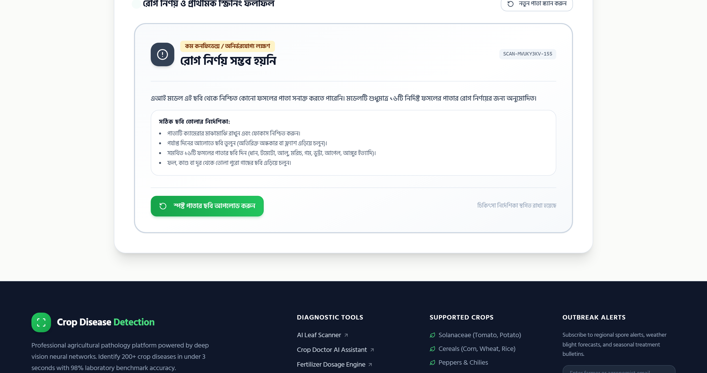
CLINICAL SAFETY MECHANISM
Two-Stage Gating: Eliminating Catastrophic Misdiagnosis
Why naive classification is hazardous in agriculture, and how KrishiDrishti guarantees clinical safety.
The Flaw in Naive Softmax Classifiers
• Conventional classification models force an output with highest softmax, even on random objects or mismatched leaves.
• Applying Potato Late Blight fungicides to a Tomato Mosaic Virus infection destroys crops and burns capital.
• Clinical agriculture requires intelligent specimen rejection whenever evidence is ambiguous.
Clinical Safety Gating Engine (/scan)
TREATMENT BLOCKED FOR SAFETY
Two-Stage Hierarchical Gating
• Stage 1 (Genus Probability Mass): Aggregates all 50 class probabilities by crop family to verify botanical genus.
• Stage 2 (Hint Verification): Flags mismatch if farmer selects 'Tomato' but specimen exhibits 'Potato' pathology.
• Ambiguity Rejection: Holds result as 'Inconclusive' and blocks chemical treatment if margin < 15%.

Slide 7
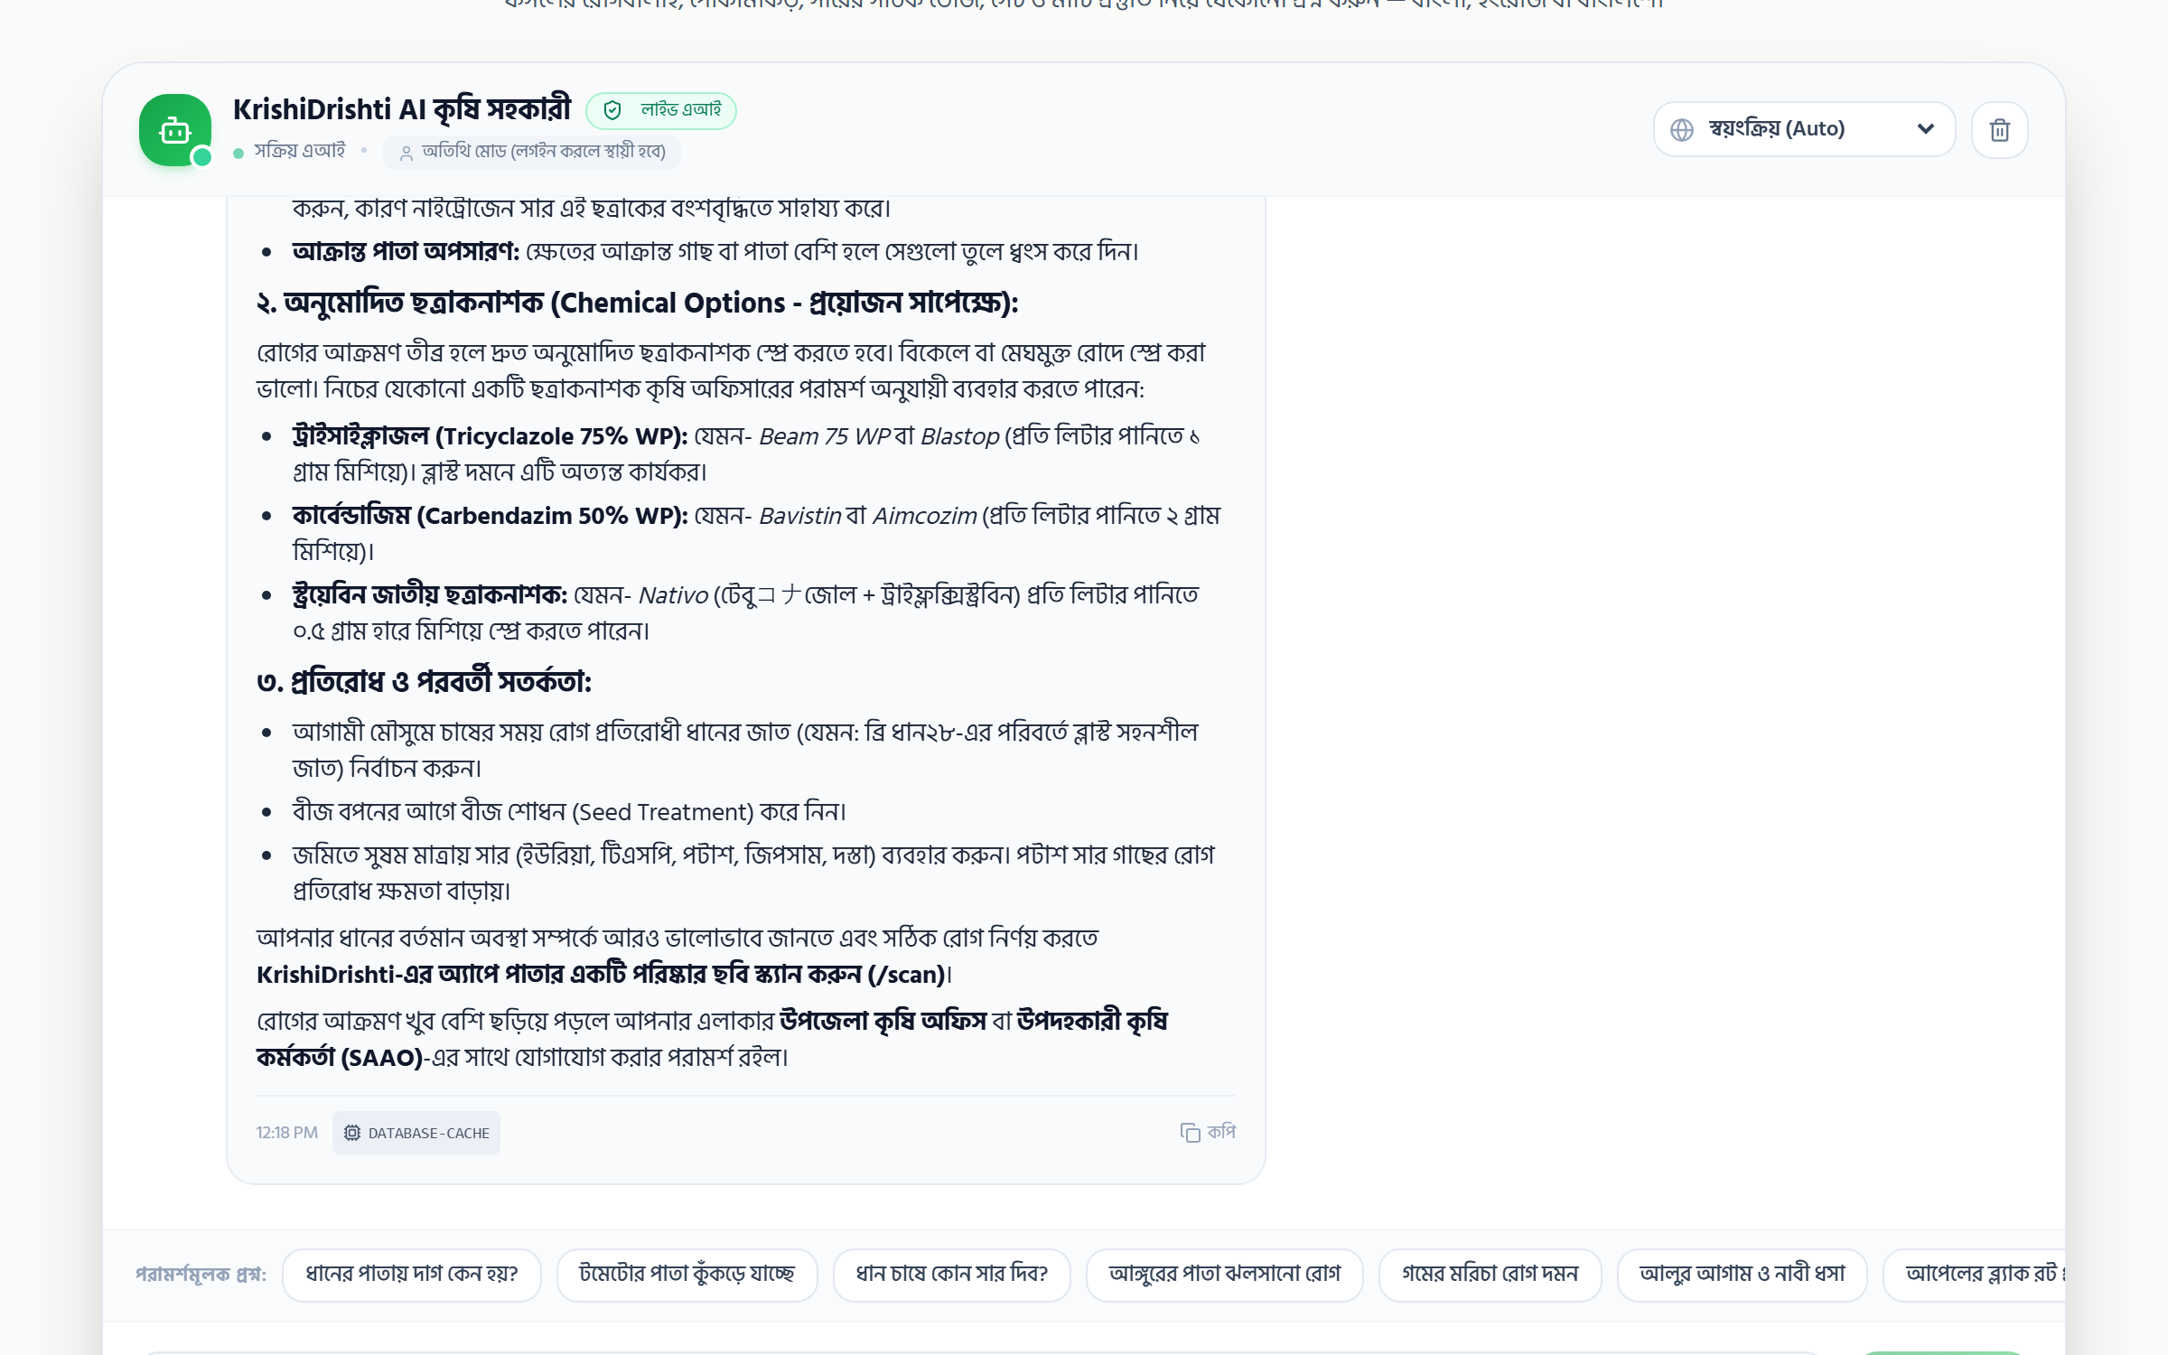
CONVERSATIONAL INTELLIGENCE
Bilingual Crop Doctor: Multi-Provider LLM & Voice
Democratizing agronomic intelligence through fluent Bangla conversational assistance and audio speech.
Multi-Provider Failover Architecture
• Tier 1 (Google Gemini 3.5 Flash): High-intelligence engine for complex pathology queries.
• Tier 2 (Groq Qwen 2.5): Ultra-low latency fallback generating responses in <500ms.
• Tier 3 (OpenAI GPT-4o-mini): Robust secondary backup ensuring 99.9% chatbot uptime.
• Autonomous Provider Hopping: Switches transparently on rate limits or network lag.
AI Agricultural Chatbot (/chat)
DATABASE CACHED (20ms)
20ms Knowledge Caching & Bangla Audio
• Database Knowledge Caching: Serves frequent agricultural queries in 20ms directly from database.
• Eliminates API Token Cost: Repeated pest and soil questions bypass external LLM calls entirely.
• Native Web Speech TTS: Speaks diagnostic instructions aloud in a natural Bengali accent.
• Removes Illiteracy Barrier: Enables illiterate smallholders to listen to prescriptions.

Slide 8
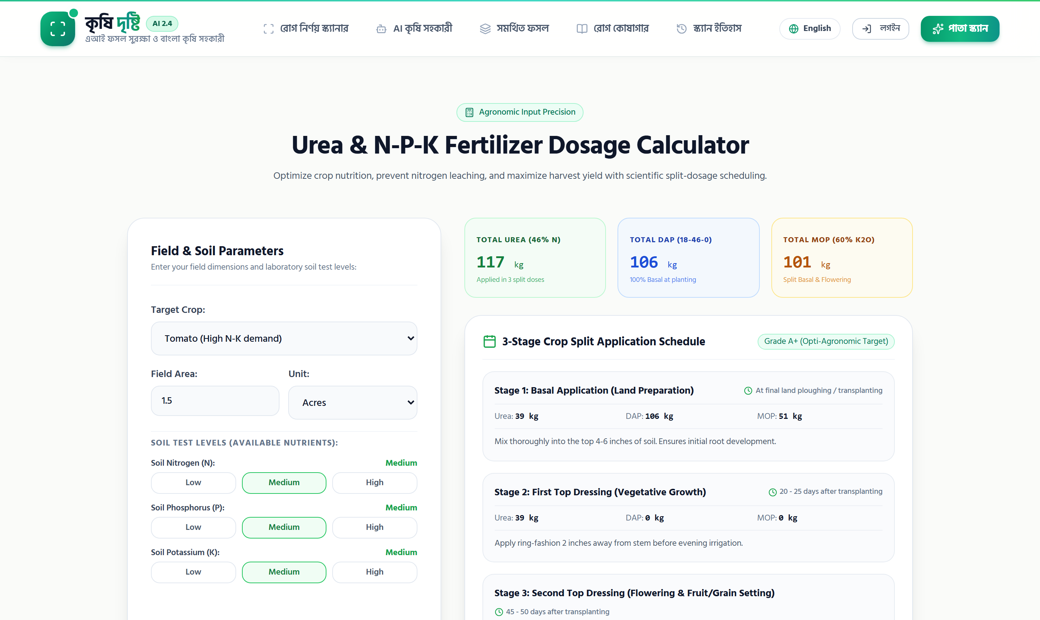
PRECISION NUTRITION
Balanced Fertilizer & Nutrient Dosage Calculator
Scientific N-P-K nutrient calculation adapted to localized agricultural land measurement units.
Localized Land & Crop Customization
• Bangladeshi Land Units: Supports native Bigha, Decimal, Katha, Acre, and Hectare conversions.
• Crop-Specific Formulations: Tailored nutrient requirements for Tomato, Potato, Rice, Wheat, etc.
• Balanced Primary Nutrients: Calculates exact Kilograms for Urea (N), TSP (P), MoP (K), and Gypsum.
Fertilizer Dosage Calculator (/calculator)
PRECISION N-P-K DOSES
Split-Application Growth Schedules
• Stage-Wise Guidance: Outlines basal dressing, vegetative split, and panicle initiation timing.
• Prevents Fertilizer Burn: Eliminates excessive single-dose chemical application.
• Ecological Preservation: Protects groundwater from nitrate pollution and prevents soil acidification.

Slide 9
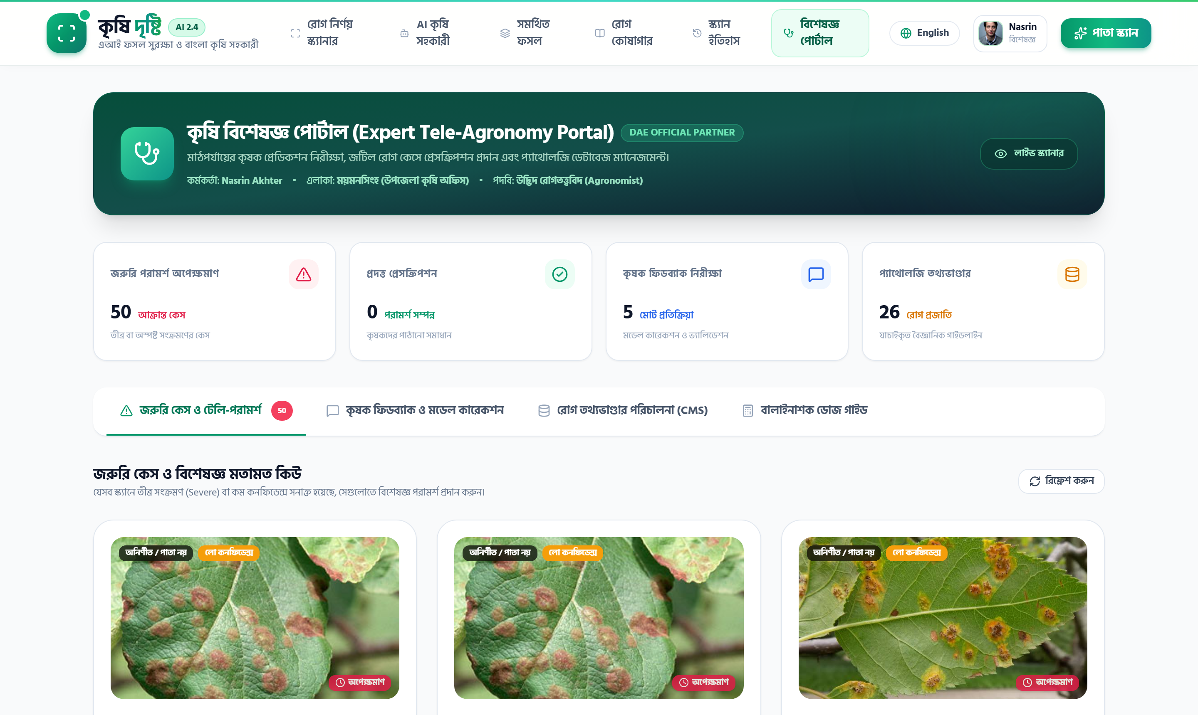
HUMAN-IN-THE-LOOP
Agronomist Tele-Consultation & Review Portal
Connecting grassroots smallholders with certified agricultural scientists for high-stakes decision making.
Escalation Queue & Clinical Triaging
• Automated Triaging: Low-confidence scans or cross-crop ambiguities automatically surface for review.
• Farmer Direct Escalation: Farmers attach location, crop age, and notes with one click.
• Urgency Prioritization: Escalations sorted by potential economic loss and pathogen virulence.
Agricultural Expert Portal (/expert)
CERTIFIED PRESCRIPTION DESK
Expert Prescription & Active Learning Loop
• Clinical Prescription Form: Verified agronomist writes formal diagnosis, active ingredients, and spray dosage.
• Official Verification Badge: Establishes credibility and farmer trust.
• Continuous Model Retraining: Agronomist validations produce gold-standard datasets to retrain vision models.

Slide 10
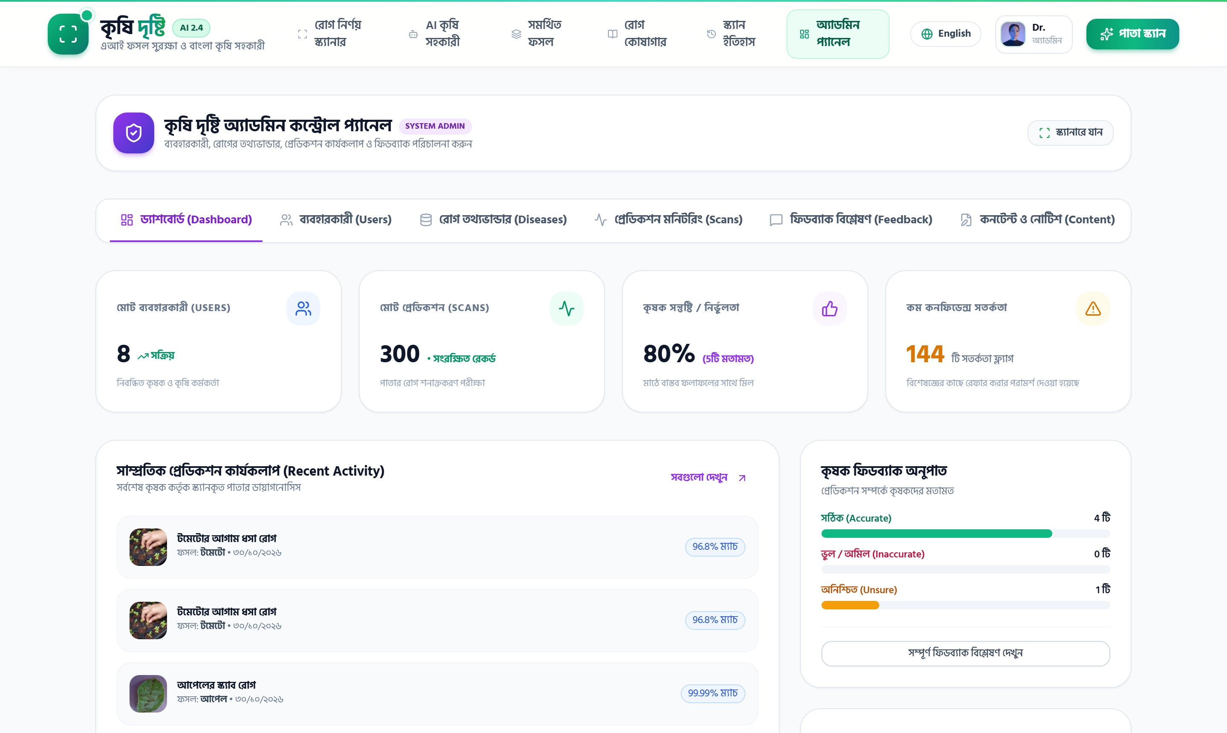
SECURITY & GOVERNANCE
Enterprise Authentication & Multi-Role Governance
Strict identity isolation, protected authorization barriers, and centralized administrative telemetry.
Three Distinct Persona Profiles
• Farmer: Private field scan records, personalized history, and local voice assistance.
• Agronomist Expert: Route-protected access to `/expert` tele-consultation and prescription issuing.
• System Administrator: Full platform telemetry, real-time metrics, and disease database CMS management.
Admin Telemetry & CMS Dashboard (/admin)
TELEMETRY & CMS DESK
Enterprise Security Architecture
• Cryptographic Tokens: Signed JSON Web Tokens (JWT) with secure HTTP-only cookies.
• Salt-Hashed Credentials: Bcrypt password hashing safeguarding against credential stuffing.
• Route Middleware Protection: Intercepts unauthenticated or unauthorized route navigation.

Slide 11

ENTERPRISE OPERATIONS
Dual Operations Control: Admin Command Desk & Expert Portal
Centralized epidemiological outbreak surveillance alongside human-in-the-loop clinical tele-consultations.
Admin Operations & Surveillance Desk (/admin)
ADMIN DASHBOARD
Agronomist Tele-Consultation Desk (/expert)
EXPERT PANEL
👑 Admin Surveillance & Governance
• Epidemiological Heatmaps: Real-time regional outbreak telemetry and scan distribution.
• Emergency Broadcast Alerts: Publish instant geofenced pest advisories to all farmers.
• CMS & Accuracy Audit: Manage pathogen treatment library & review farmer diagnostic ratings.
🩺 Clinical Consultation & Active Learning
• Clinical Case Triaging: Inspect ambiguous or high-severity scans escalated by smallholders.
• Certified Digital Prescriptions: Issue formal active-ingredient dosages and PHI intervals.
• Human-in-the-Loop: Expert verifications continuously retrain vision models with gold-standard data.

Slide 12
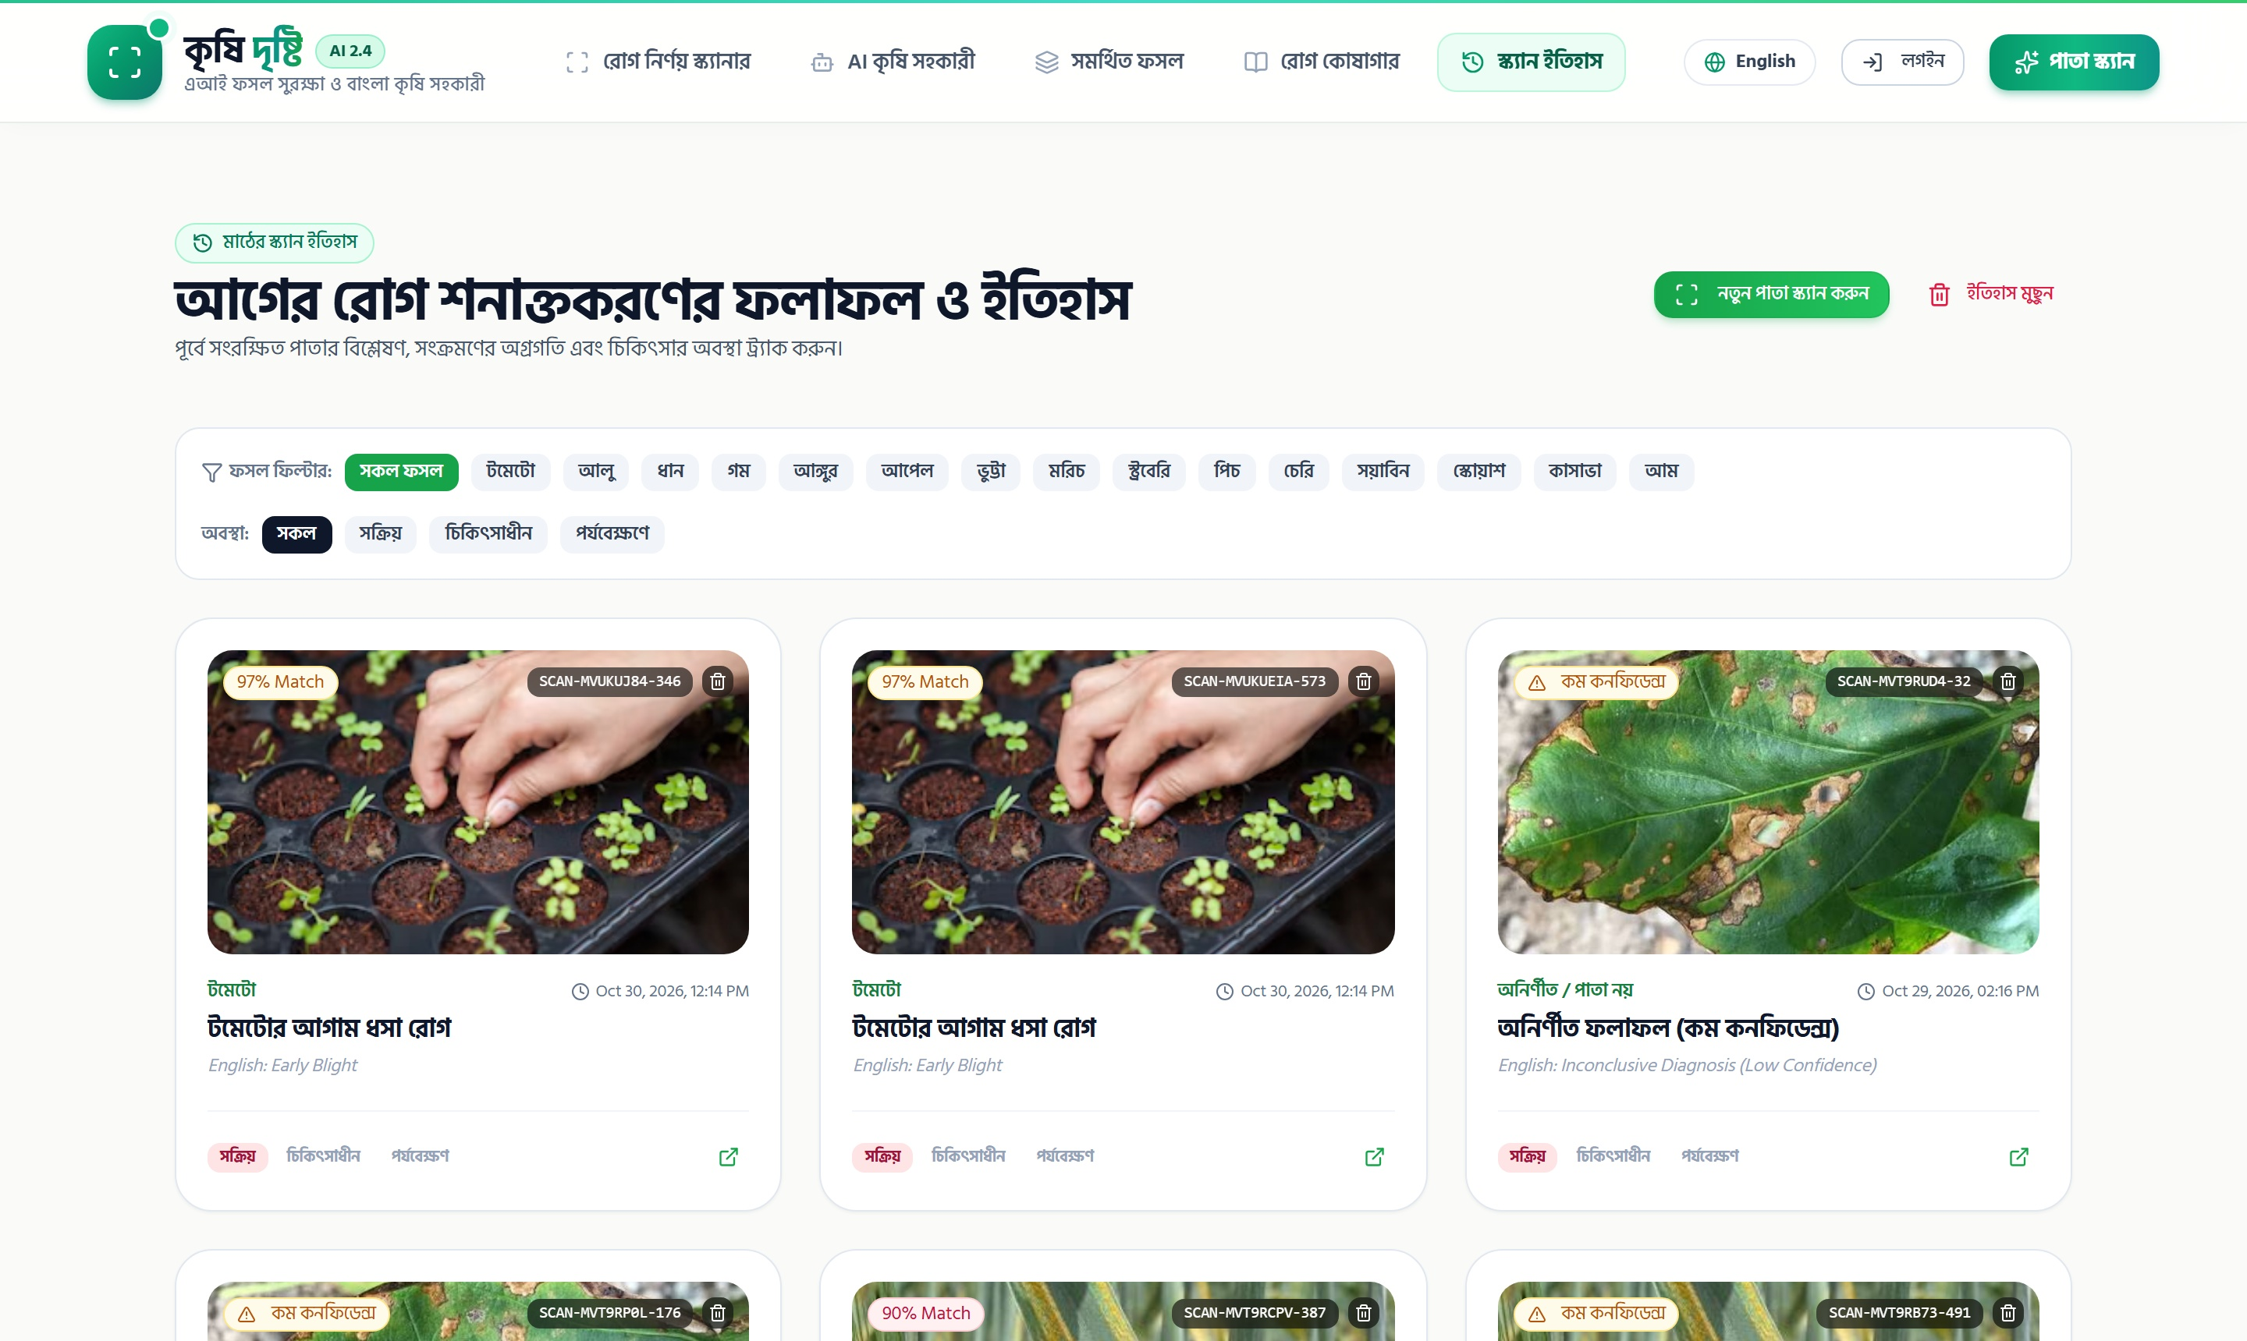
VERIFICATION & QUALITY ASSURANCE
Battle-Tested E2E Browser Automation Suite
100% verified test pass rate proving functional stability, clinical safety, and responsive design.
Exhaustive Test Suite Metrics
• 54 Total Automated Tests: 54 Passed | 0 Failed | 0 Skipped across desktop & mobile Chromium.
• 84 Seconds Execution: Serial execution protects transactional database stores from race conditions.
• Playwright v1.64 Engine: Standardized headless browser testing with automated HTML and JSON reporting.
Field Health History & Tracking (/history)
54/54 TESTS PASSED (100%)
11 Tested Functional Modules
• Smoke (9), Auth (7), RBAC Barriers (4), AI Scanner & Gating (6), Chatbot (4).
• Fertilizer Calculator (4), Disease Library (5), Scan History (4), Expert Portal (3), Admin (2), Responsive I18N (6).
• Dedicated Git Branch: Tracked and committed on test/playwright-e2e-automation.

Slide 13
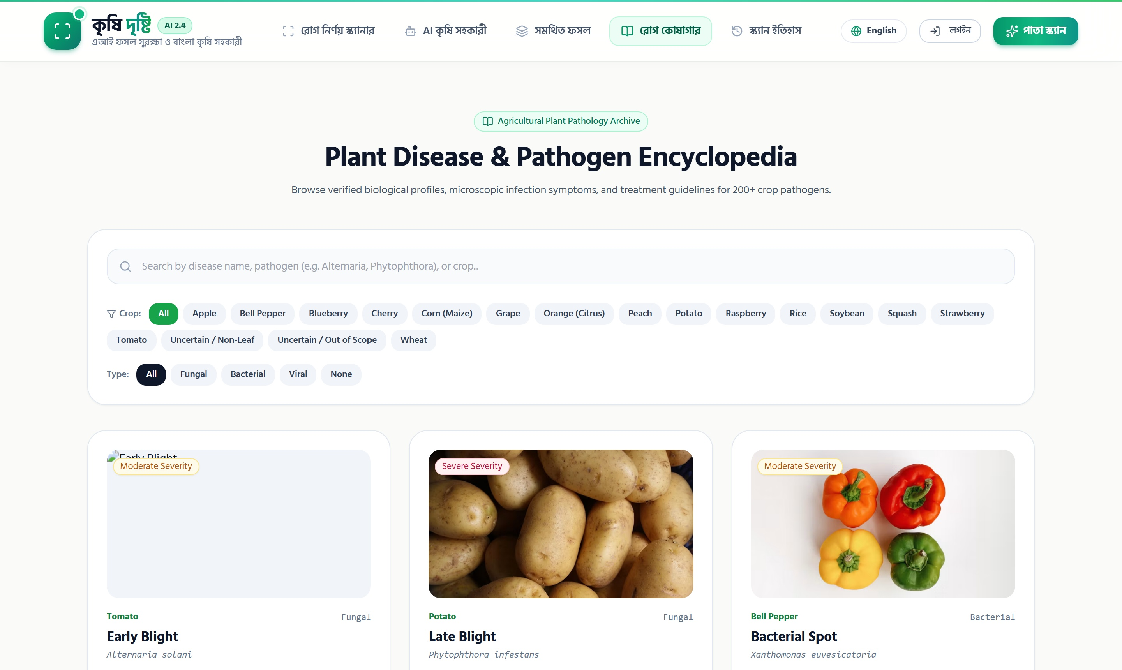
REAL-WORLD IMPACT
Measurable Socio-Economic & Ecological Benefits
Empowering grassroots agricultural communities through technology-driven stewardship.
Diagnostic Speed & Yield Preservation
• From Days to Seconds: Cuts diagnostic turnaround from 3-7 days to under 200 milliseconds.
• Salvages 15-25% Yield Losses: Rapid localized containment prevents broad acreage destruction.
• Immediate Household ROI: Protects vulnerable seasonal income for smallholder families.
Plant Disease Encyclopedia (/library)
50+ PATHOLOGIES CATALOGED
Ecological Protection & Language Inclusion
• Halts Blanket Spraying: Eliminates indiscriminate preventative chemical cocktails.
• Groundwater & Soil Health: Preserves beneficial soil microbiomes through scientific split-dosing.
• True Vernacular Access: High-quality Bengali interface and spoken audio instructions.

Slide 14
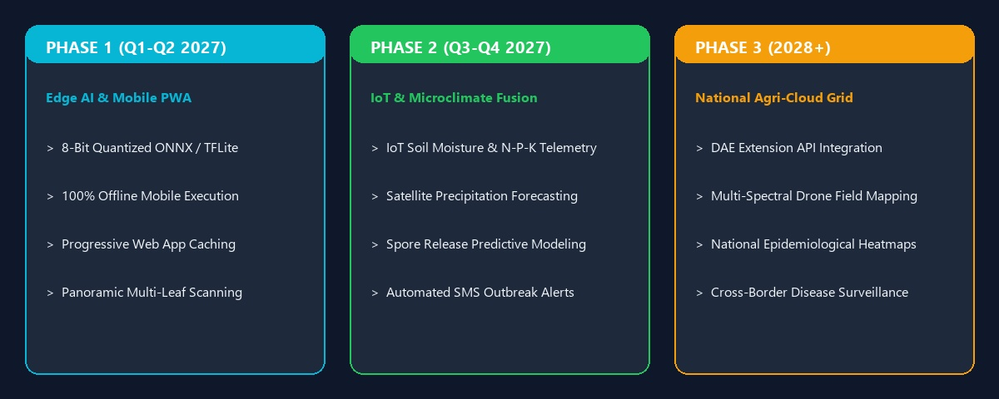
FUTURE HORIZONS
KrishiDrishti 2.0: Strategic Technology Roadmap
Evolving from reactive disease diagnosis into an all-encompassing predictive precision agriculture platform.
Strategic progression: Edge Quantization -> IoT Soil Telemetry & Satellite Fusion -> National DAE Agricultural Network

Slide 15
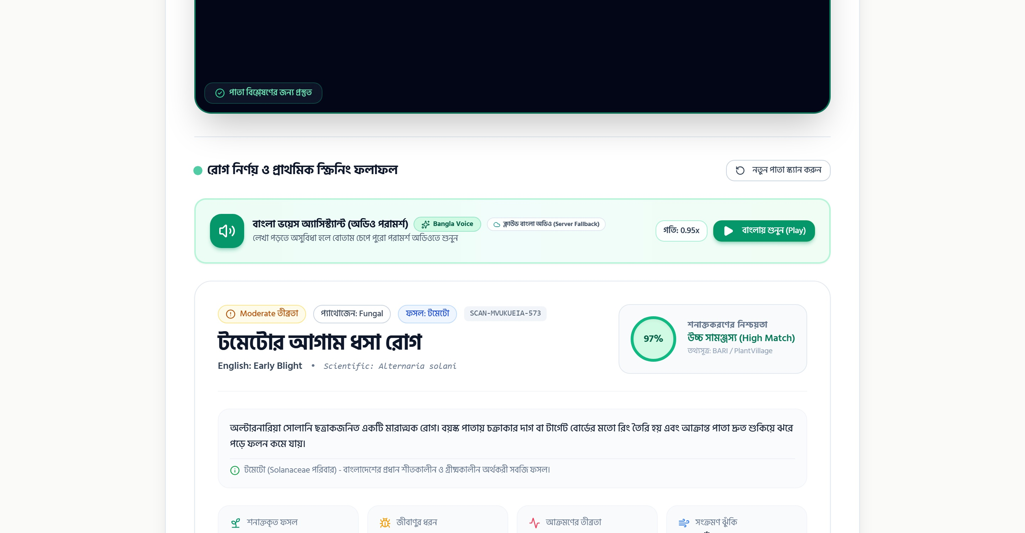
KrishiDrishti (কৃষি দৃষ্টি)
Smart Farming for a Sustainable, Food-Secure Bangladesh
Summary of Key Technical Achievements:
✔ Deployed 50-class ConvNeXt-Tiny vision model (sub-150ms inference on CPU).
✔ Engineered two-stage clinical gating to eliminate catastrophic botanical misdiagnosis.
✔ Integrated resilient multi-provider bilingual chatbot (Gemini + Groq + OpenAI) with native Bangla audio.
✔ Constructed full production stack: Next.js 14 App Router, Express, Prisma, and PostgreSQL.
✔ 100% verified quality assurance via 54-test Playwright E2E browser automation suite.
Thank You! | Open for Questions & Discussion
KrishiDrishti Diagnostic Core
READY FOR DEPLOYMENT

