Slide 1
HARDWARE MODELING USING VERILOG · NPTEL
Lecture 01 — Introduction
Prof. Indranil Sengupta · Department of Computer Science and Engineering · IIT Kharagpur · expanded for the Chip Design Associate programme
Theory 1 · Why this course exists — the six objectives, and what a hardware description language actually is
Theory 2 · The problem — complexity, Moore's Law, and why manual design was ruled out
Theory 3 · The answer — a standardized design flow, and the CAD tools that walk it
Theory 4 · The steps, one at a time — behavioural, data path, logic, physical, and the rest
Practical · Five labs · install the toolchain, then check every claim in the lecture on your own machine
Hardware Modeling using Verilog (NPTEL, IIT Kharagpur) · Lecture 01: Introduction · expanded for Chip Design Associate
L01 · 1

Slide 2
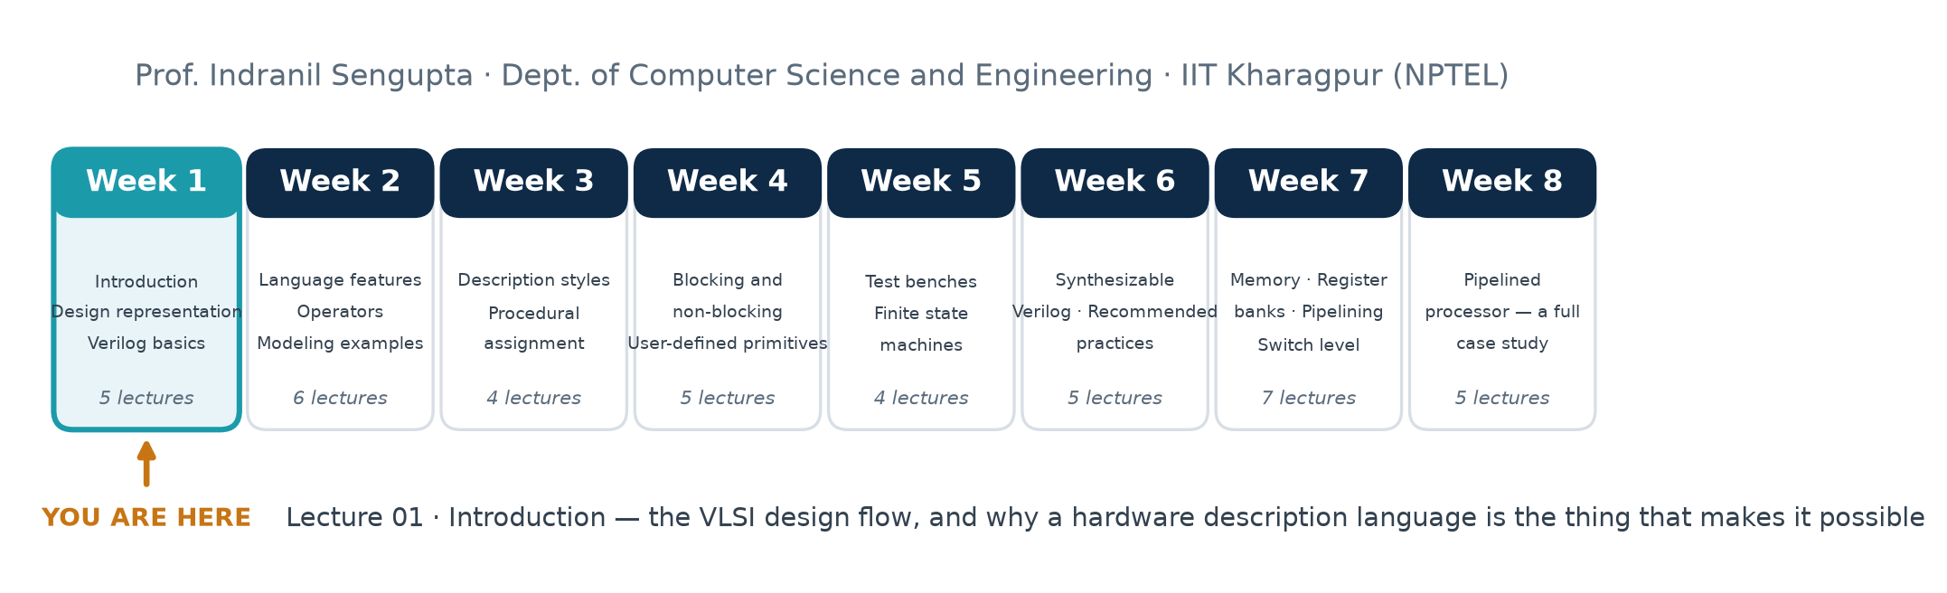
THE COURSE
Where This Lecture Sits
Eight weeks, forty-one lectures
Lecture 01 carries no Verilog syntax at all. Its job is to give you the map: what a VLSI design flow is, what each step of it produces, and why a language like Verilog has to exist at all. Everything in Weeks 2–8 is a detail of this picture.
Hardware Modeling using Verilog (NPTEL, IIT Kharagpur) · Lecture 01: Introduction · expanded for Chip Design Associate
L01 · 2

Slide 3
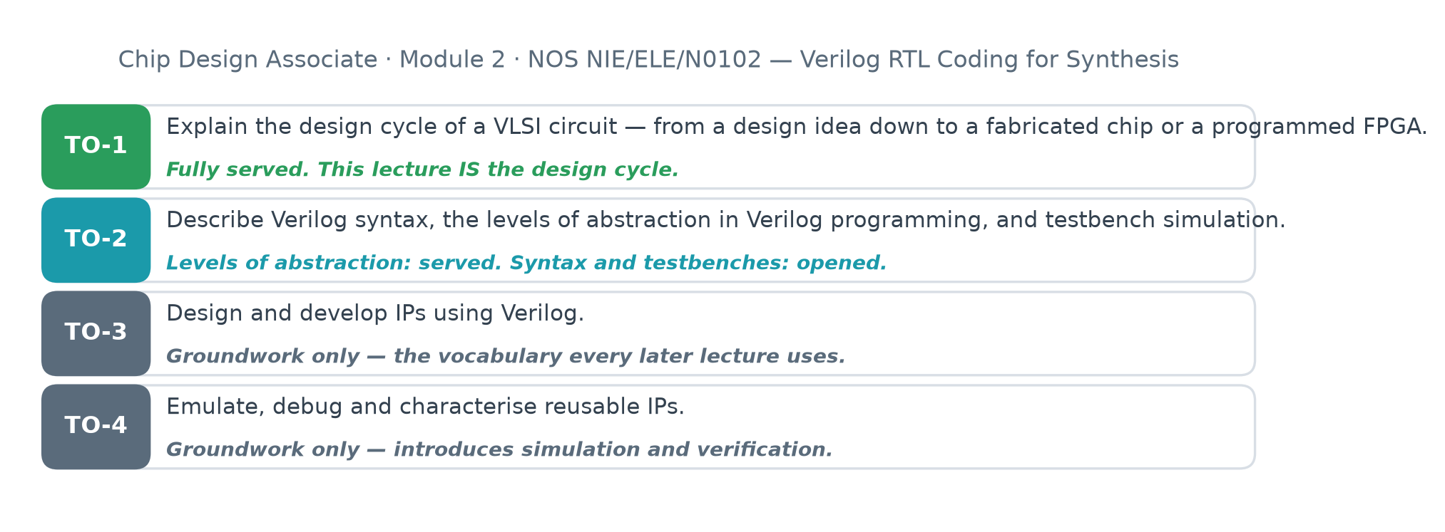
CHIP DESIGN ASSOCIATE · NOS NIE/ELE/N0102
Terminal Outcomes
Outcome 1 is this lecture, almost word for word
"Explain the design cycle of a VLSI circuit." That is the whole of Lecture 01. The remaining outcomes are opened here and closed over the rest of the module.
Hardware Modeling using Verilog (NPTEL, IIT Kharagpur) · Lecture 01: Introduction · expanded for Chip Design Associate
L01 · 3

Slide 4
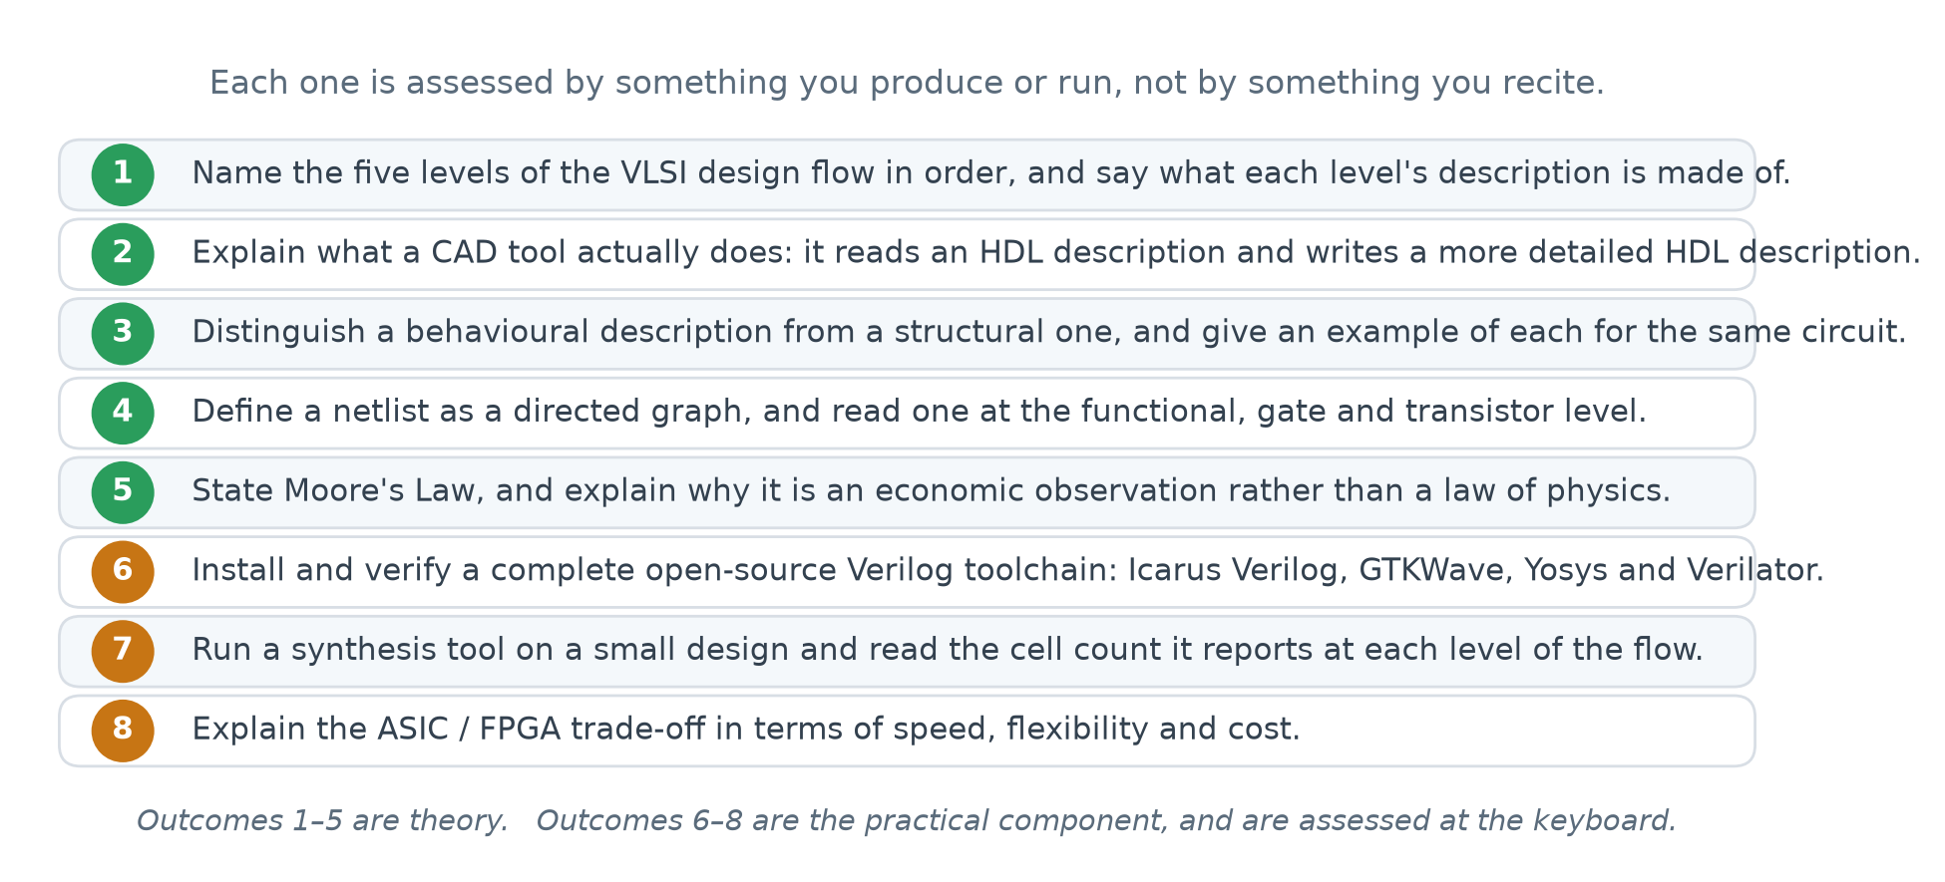
LECTURE 01
Learning Outcomes
Hardware Modeling using Verilog (NPTEL, IIT Kharagpur) · Lecture 01: Introduction · expanded for Chip Design Associate
L01 · 4

Slide 5
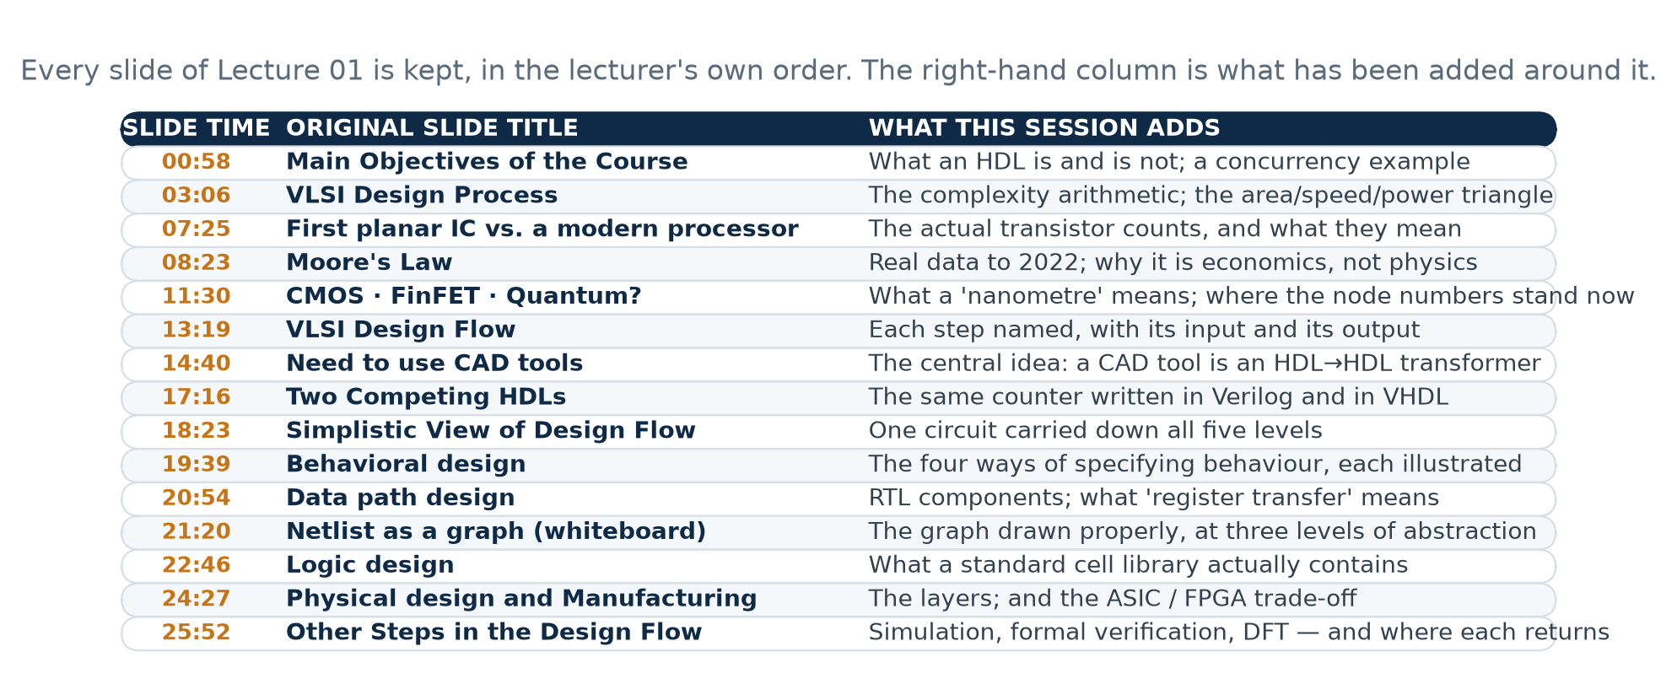
LECTURE 01 · COVERAGE
The Original Lecture, and How This Session Expands It
Hardware Modeling using Verilog (NPTEL, IIT Kharagpur) · Lecture 01: Introduction · expanded for Chip Design Associate
L01 · 5

Slide 6
HOW TO USE THIS DECK
Theory, Then Proof
THEORY
Four sections that follow the lecturer's own running order, slide by slide. Nothing has been reordered; material has only been added around what is already there.
PRACTICAL
Five labs. Every one of them is a command you run, and every number quoted in this deck came out of running them. If a slide states a figure, a lab produced it.
WORKBOOK
A companion document carries the full tutorial, the installation walkthrough, worked solutions and the exercises. The deck is for the room; the workbook is for afterwards.
The notional slot for Lecture 01 is about half an hour. This deck is deliberately longer: lecture from the section openers to fit the slot, and let the rest carry the labs and the self-study.
Hardware Modeling using Verilog (NPTEL, IIT Kharagpur) · Lecture 01: Introduction · expanded for Chip Design Associate
L01 · 6

Slide 7
THEORY 1
Why This Course Exists
The lecturer opens with six objectives. They are worth reading slowly, because between them they describe everything the next eight weeks will do.
The six objectives of the course, and what each one will mean
What a hardware description language is
And — more important — what it is not
Hardware Modeling using Verilog (NPTEL, IIT Kharagpur) · Lecture 01: Introduction · expanded for Chip Design Associate
L01 · 7

Slide 8
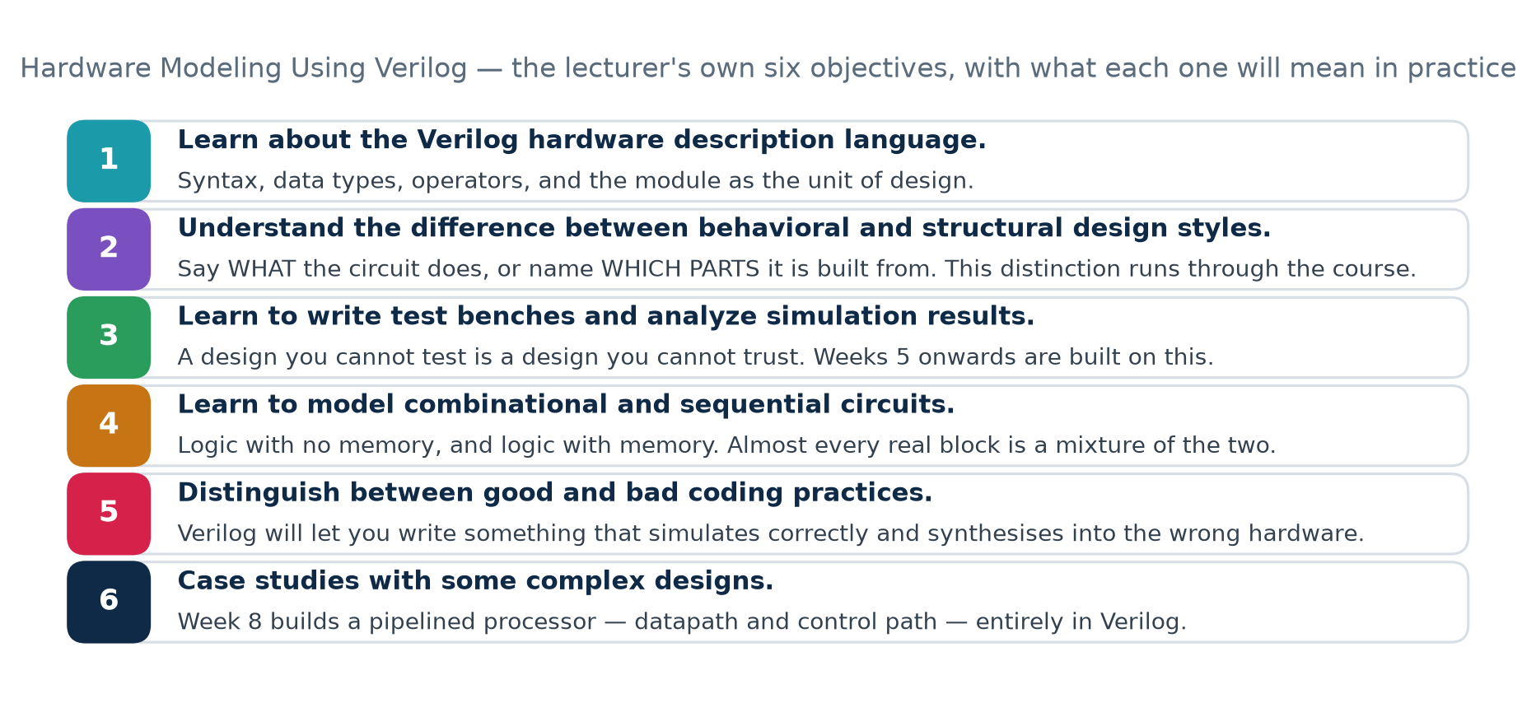
1.1 · THE OBJECTIVES
Main Objectives of the Course
Hardware Modeling using Verilog (NPTEL, IIT Kharagpur) · Lecture 01: Introduction · expanded for Chip Design Associate
L01 · 8

Slide 9
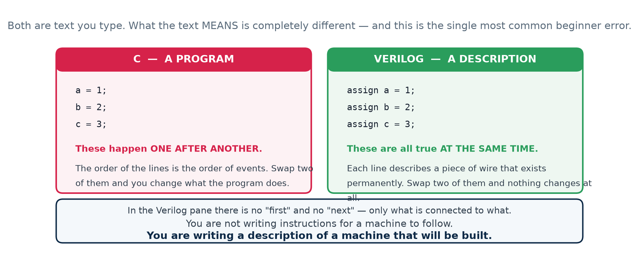
1.2 · WHAT AN HDL IS
A Hardware Description Language Is Not a Programming Language
The single most common beginner error
Reading Verilog as if it were C. It is not a list of steps to carry out; it is a description of something that exists all at once and stays there. Hold on to that and most of the confusion in Weeks 2 and 3 never happens.
Hardware Modeling using Verilog (NPTEL, IIT Kharagpur) · Lecture 01: Introduction · expanded for Chip Design Associate
L01 · 9

Slide 10
1.2 · WHAT AN HDL IS
The Same Three Lines, Side by Side
In C, this is a sequence
In Verilog, this is a circuit
Three assignments, carried out one after another. After the first line runs, a is 1. Time passes between the lines.
Three pieces of wire, each permanently driven. There is no "after". All three statements are true at every instant the circuit is powered.
the text looks similar; the meaning is not
// C // Verilog
a = 1; assign a = 1;
b = 2; assign b = 2;
c = 3; assign c = 3;
// swap two lines and // swap two lines and
// the program changes // NOTHING changes
Hardware is not executed. It is built, and then it sits there behaving.
Hardware Modeling using Verilog (NPTEL, IIT Kharagpur) · Lecture 01: Introduction · expanded for Chip Design Associate
L01 · 10

Slide 11
THEORY 2
The Problem
Before the flow and the tools and the language, the reason for all three: designs got far bigger, far faster, than anyone could follow by hand.
The complexity of VLSI circuits, and what drove it
Moore's Law — and why it is an observation, not a law
The requirements that conflict: area, speed, power
Why manual design was ruled out, in arithmetic
Hardware Modeling using Verilog (NPTEL, IIT Kharagpur) · Lecture 01: Introduction · expanded for Chip Design Associate
L01 · 11

Slide 12
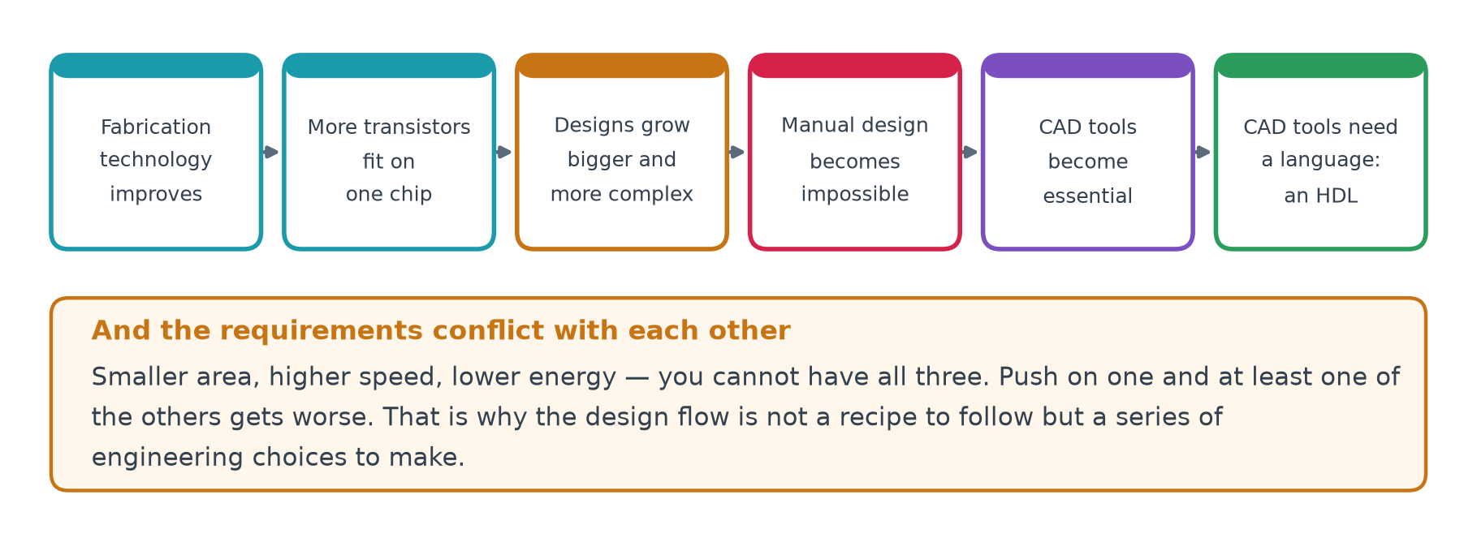
2.1 · THE PROCESS
VLSI Design Process
Read the chain left to right
Each box is caused by the one before it. The last box — "CAD tools need a language" — is where Verilog enters, and it is the only reason this course has a subject.
Hardware Modeling using Verilog (NPTEL, IIT Kharagpur) · Lecture 01: Introduction · expanded for Chip Design Associate
L01 · 12

Slide 13
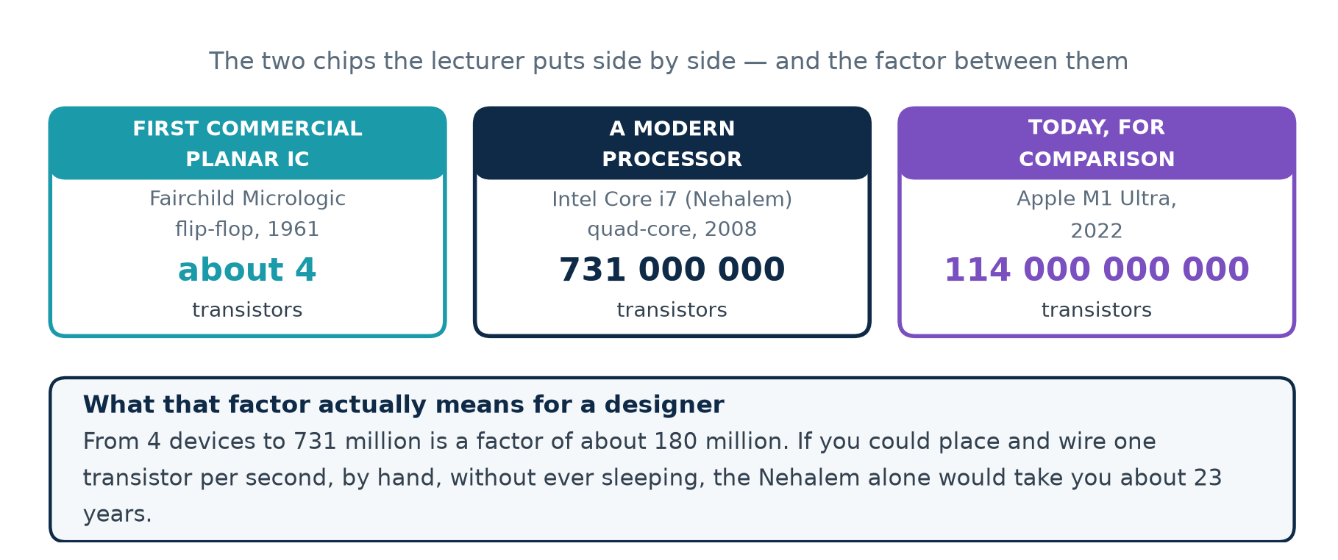
2.2 · THE SCALE
The Scale Problem, in Numbers
Hardware Modeling using Verilog (NPTEL, IIT Kharagpur) · Lecture 01: Introduction · expanded for Chip Design Associate
L01 · 13

Slide 14
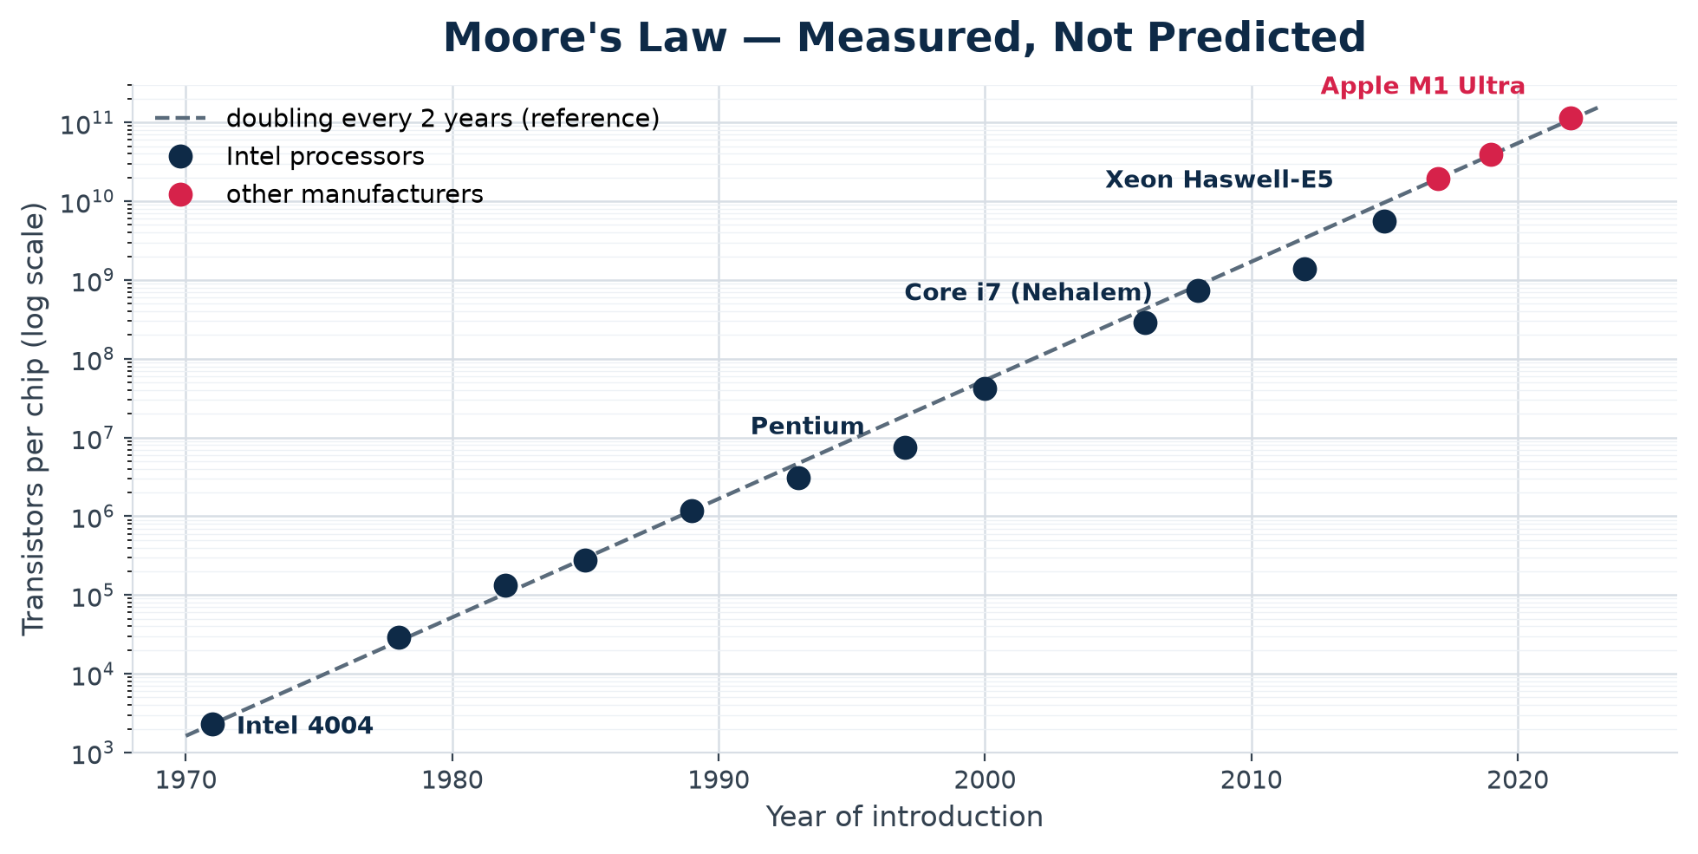
2.3 · MOORE'S LAW
Moore's Law — Measured, Not Predicted
What a straight line on a log scale means
Constant exponential growth. Every point is a real, published transistor count, and the dashed line is a plain doubling every two years anchored on the 4004 — drawn to show that the data really does track it over five decades.
Hardware Modeling using Verilog (NPTEL, IIT Kharagpur) · Lecture 01: Introduction · expanded for Chip Design Associate
L01 · 14

Slide 15
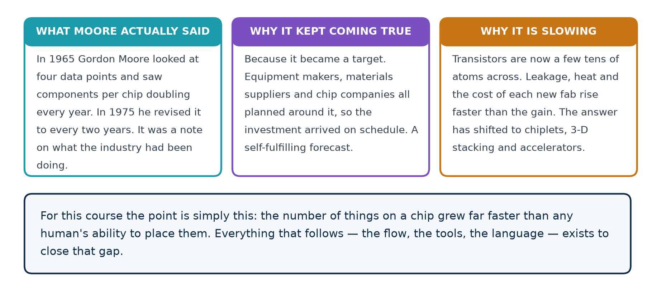
2.3 · MOORE'S LAW
Why It Is an Observation, Not a Law of Physics
Hardware Modeling using Verilog (NPTEL, IIT Kharagpur) · Lecture 01: Introduction · expanded for Chip Design Associate
L01 · 15

Slide 16
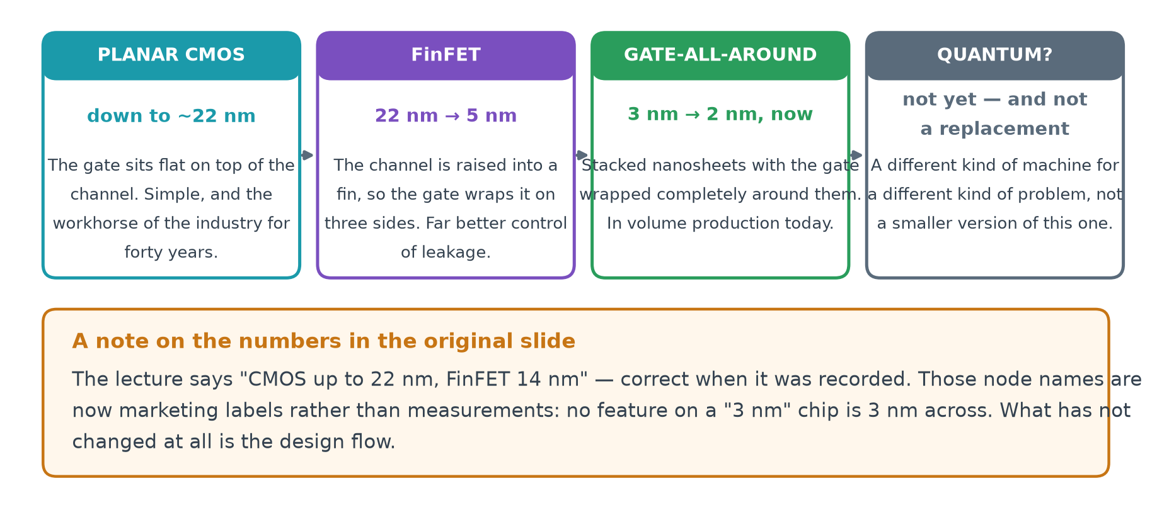
2.4 · THE TECHNOLOGY
What Made It Possible — and Where It Stands Now
Hardware Modeling using Verilog (NPTEL, IIT Kharagpur) · Lecture 01: Introduction · expanded for Chip Design Associate
L01 · 16

Slide 17
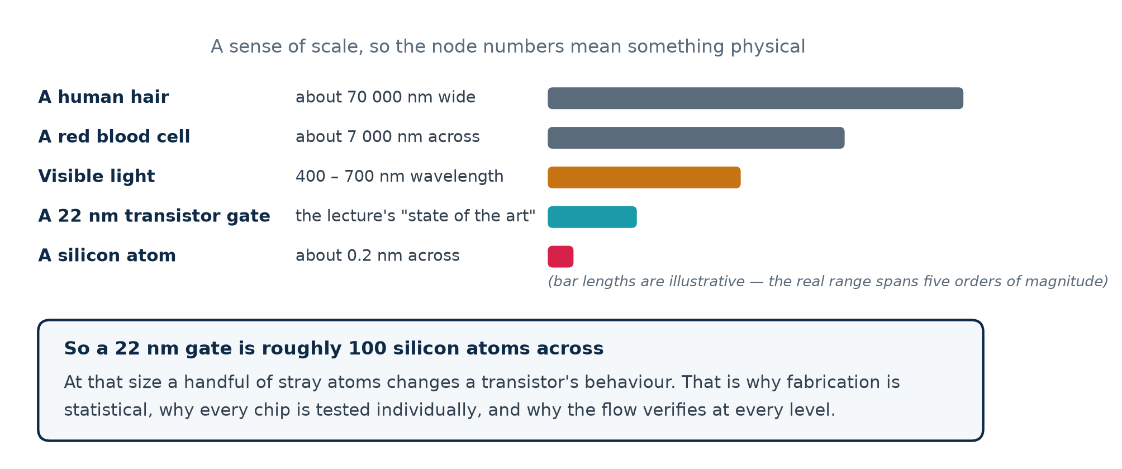
2.4 · THE TECHNOLOGY
What a "Nanometre" Actually Is
Hardware Modeling using Verilog (NPTEL, IIT Kharagpur) · Lecture 01: Introduction · expanded for Chip Design Associate
L01 · 17

Slide 18
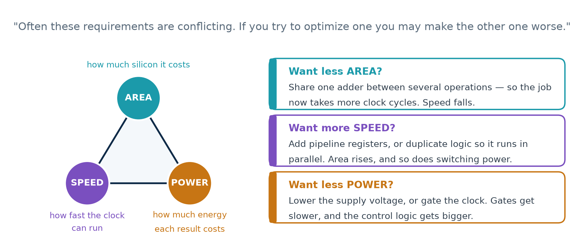
2.5 · THE TRADE-OFF
The Three Requirements That Fight Each Other
This is why the flow has choices in it
If one design were simply best, a tool could find it and the job would be done. Because these three pull against each other, somebody has to decide which matters most — and that somebody is the designer, not the tool.
Hardware Modeling using Verilog (NPTEL, IIT Kharagpur) · Lecture 01: Introduction · expanded for Chip Design Associate
L01 · 18

Slide 19
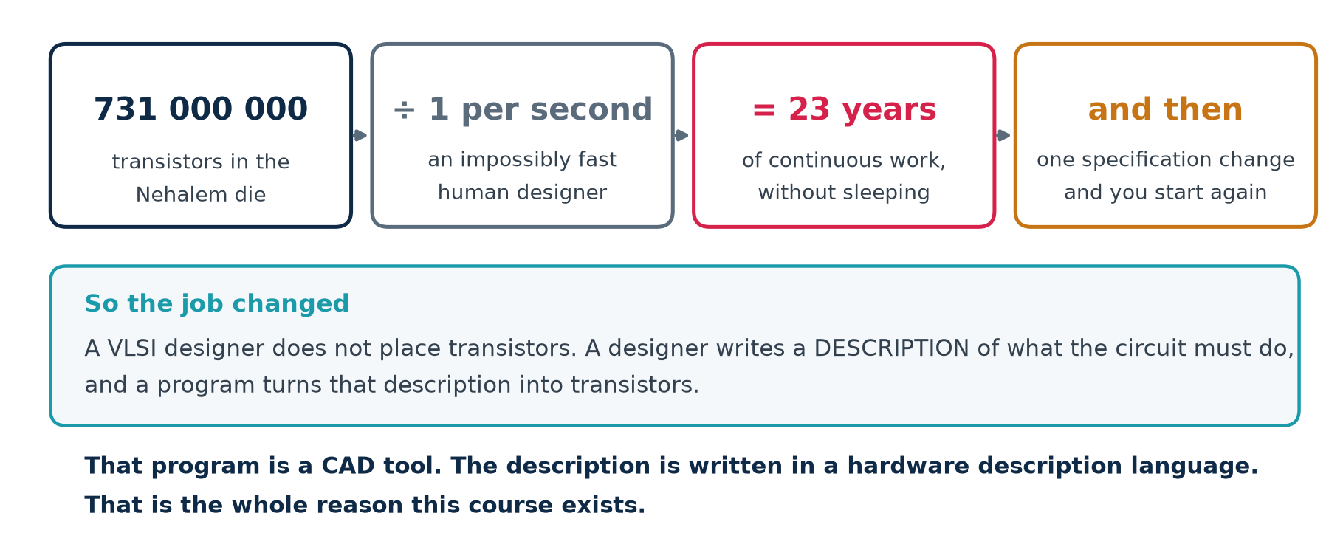
2.6 · THE CONSEQUENCE
"Manual Design Is Simply Ruled Out"
Hardware Modeling using Verilog (NPTEL, IIT Kharagpur) · Lecture 01: Introduction · expanded for Chip Design Associate
L01 · 19

Slide 20
THEORY 3
The Answer: a Standardized Design Flow
If no one person can place the transistors, the work has to be split into steps with defined inputs and outputs — and handed to programs.
The steps of the flow, and what each produces
What a CAD tool actually does: HDL in, more detailed HDL out
The two competing HDLs, and the others
One circuit carried down all five levels
Hardware Modeling using Verilog (NPTEL, IIT Kharagpur) · Lecture 01: Introduction · expanded for Chip Design Associate
L01 · 20

Slide 21
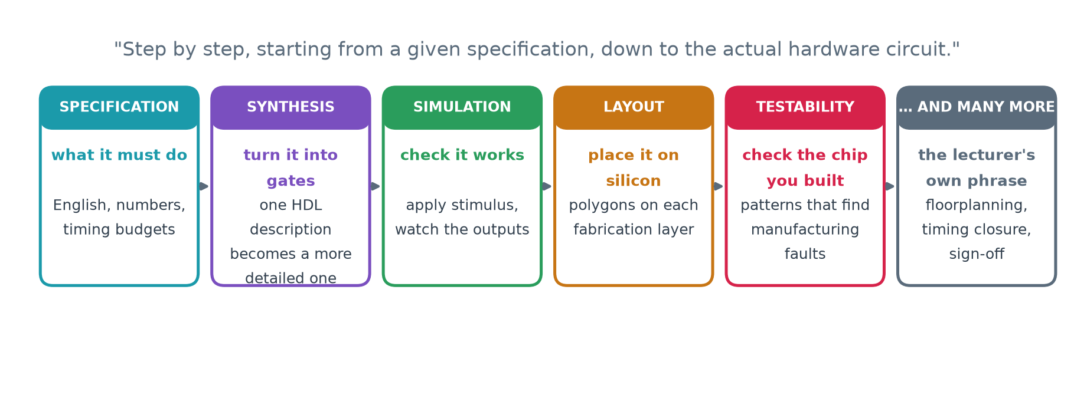
3.1 · THE FLOW
VLSI Design Flow
Why it had to be standardized
Dozens of engineers, several companies and a fabrication plant all work on one chip. A standard flow gives each step a defined input, a defined output and a defined check — so the work can be divided up, and a mistake is caught at the step that made it rather than three steps later.
Hardware Modeling using Verilog (NPTEL, IIT Kharagpur) · Lecture 01: Introduction · expanded for Chip Design Associate
L01 · 21

Slide 22
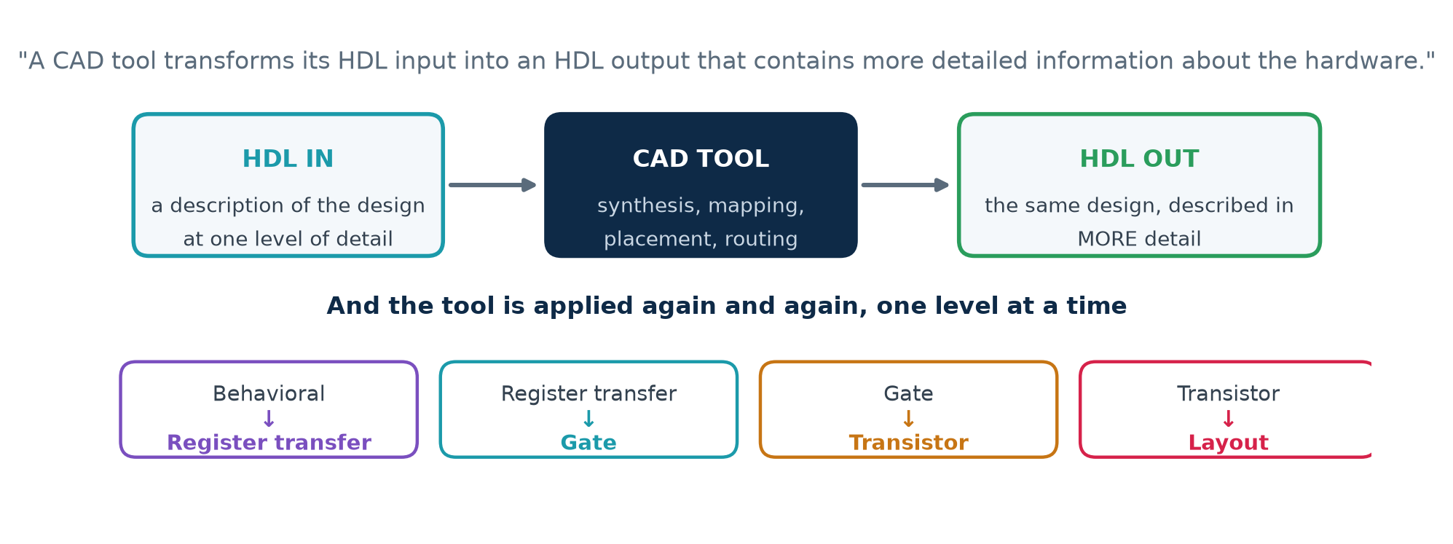
3.2 · THE CAD TOOL
What a CAD Tool Actually Does
The idea to hold on to
At every one of these steps, both the input and the output are hardware descriptions. Nothing is ever "compiled into a program" — the design simply gets described in progressively more concrete terms, until the last description is a set of shapes a factory can print.
Hardware Modeling using Verilog (NPTEL, IIT Kharagpur) · Lecture 01: Introduction · expanded for Chip Design Associate
L01 · 22

Slide 23
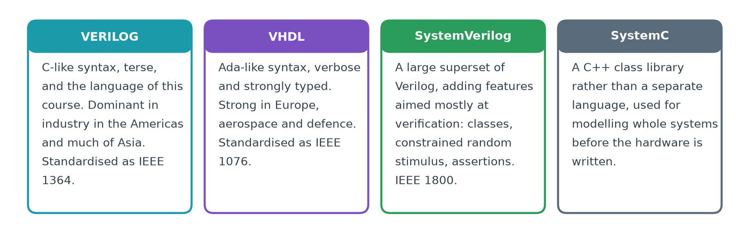
3.3 · THE LANGUAGES
Two Competing HDLs
"Designs are created typically using HDLs, which get transformed from one level of abstraction to the next as the design flow progresses."
Both Verilog and VHDL can describe the same hardware, and a synthesis tool will produce the same gates from either. The choice is a matter of house style, existing code and local convention — not of what the silicon can do. In Lab 5 you will write the same counter in both and compare the waveforms.
Hardware Modeling using Verilog (NPTEL, IIT Kharagpur) · Lecture 01: Introduction · expanded for Chip Design Associate
L01 · 23

Slide 24
3.3 · THE LANGUAGES
The Same Counter, in Both Languages
VERILOG · rtl/counter4.v
VHDL · vhdl/counter4.vhd
Terse. The register, the reset and the increment fit in four lines.
Verbose and strongly typed — the count has to be converted before it leaves the entity.
module counter4 (
input wire clk,
input wire rst,
output reg [3:0] q
);
always @(posedge clk) begin
if (rst) q <= 4'd0;
else q <= q + 4'd1;
end
endmodule
entity counter4 is
port (clk : in std_logic;
rst : in std_logic;
q : out std_logic_vector(3 downto 0));
end entity;
architecture rtl of counter4 is
signal cnt : unsigned(3 downto 0);
begin
process (clk) begin
if rising_edge(clk) then
if rst = '1' then cnt <= (others => '0');
else cnt <= cnt + 1;
end if;
end if;
end process;
q <= std_logic_vector(cnt);
end architecture;
Hardware Modeling using Verilog (NPTEL, IIT Kharagpur) · Lecture 01: Introduction · expanded for Chip Design Associate
L01 · 24

Slide 25
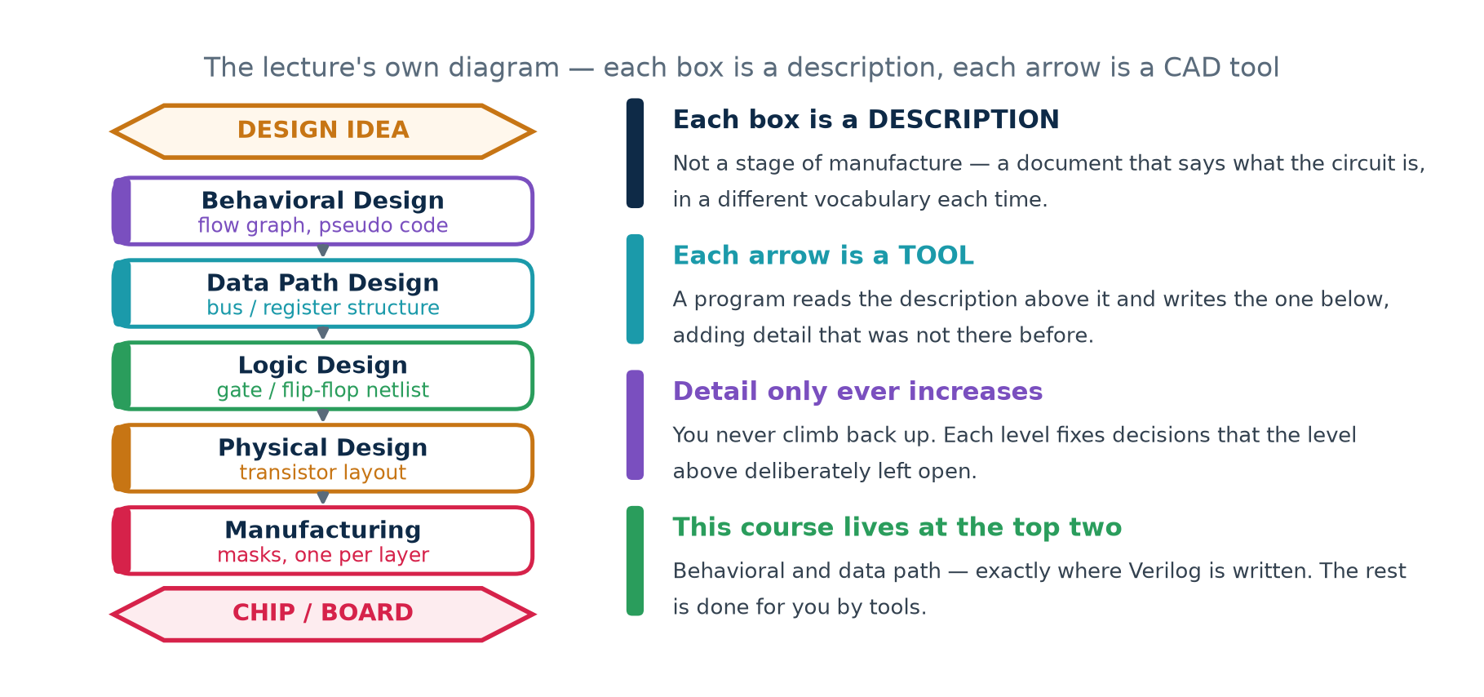
3.4 · THE LADDER
Simplistic View of the Design Flow
Hardware Modeling using Verilog (NPTEL, IIT Kharagpur) · Lecture 01: Introduction · expanded for Chip Design Associate
L01 · 25

Slide 26
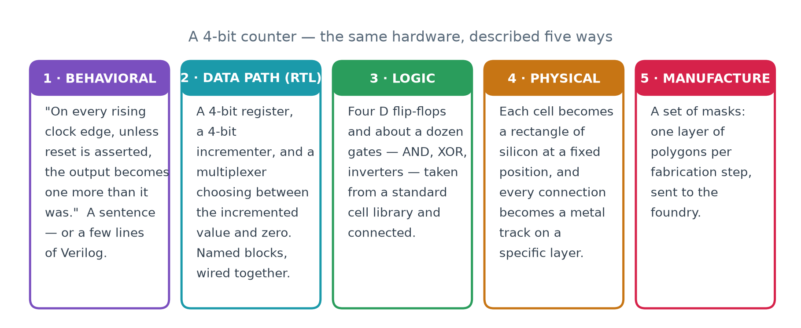
3.4 · THE LADDER
One Circuit, All Five Levels
The point of the exercise
All five describe exactly the same counter. A designer writes the first one; tools produce the other four. In Lab 3 you will run that descent yourself and count what comes out at each level.
Hardware Modeling using Verilog (NPTEL, IIT Kharagpur) · Lecture 01: Introduction · expanded for Chip Design Associate
L01 · 26

Slide 27
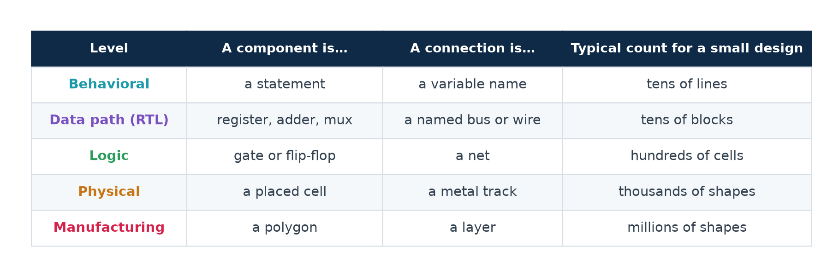
3.4 · THE LADDER
What Counts as a "Component" at Each Level
Read the last column
The number of things to keep track of grows by roughly a factor of ten at every level. That growth is exactly why a designer works at the top of the table and lets tools handle the bottom.
Hardware Modeling using Verilog (NPTEL, IIT Kharagpur) · Lecture 01: Introduction · expanded for Chip Design Associate
L01 · 27

Slide 28
THEORY 4
The Steps, One at a Time
The lecturer now walks down the ladder, naming each level and saying what its description is made of. This section follows him rung by rung.
Behavioral design — four ways of saying what a circuit does
Data path design, and what a netlist really is
Logic design, standard cells, and the optimisation trade-off
Physical design, manufacturing, and the FPGA alternative
The other steps: simulation, formal verification, test
Hardware Modeling using Verilog (NPTEL, IIT Kharagpur) · Lecture 01: Introduction · expanded for Chip Design Associate
L01 · 28

Slide 29
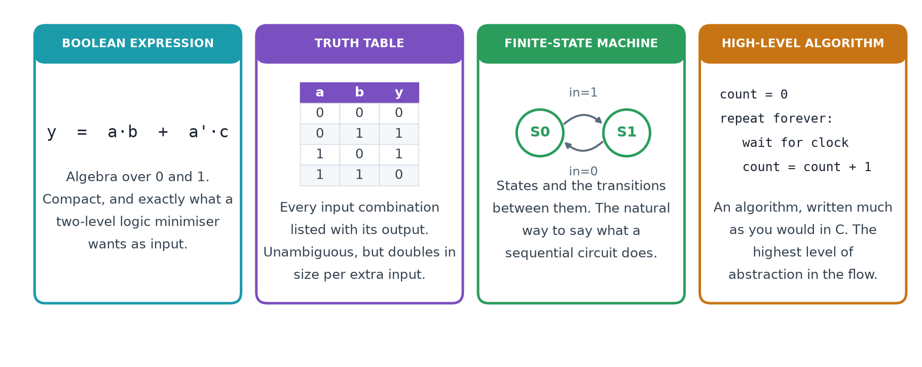
4.1 · BEHAVIORAL DESIGN
The Four Ways of Saying What a Circuit Does
What they have in common
Not one of these says how the circuit is BUILT. Each one says only what the circuit must DO. That is what makes them behavioural — and it is why a synthesis tool is free to build them in whichever way is cheapest.
Hardware Modeling using Verilog (NPTEL, IIT Kharagpur) · Lecture 01: Introduction · expanded for Chip Design Associate
L01 · 29

Slide 30
4.2 · DATA PATH DESIGN
Register Transfer Level
▪
The components are no longer statements. They are registers, adders, multipliers, multiplexers, decoders and buses — things you could point at on a block diagram.
▪
The name says what happens: on each clock edge, values are TRANSFERRED between REGISTERS, possibly through some logic on the way.
▪
This is the level a Verilog designer actually works at, and it is the level the rest of Module 2 is about.
out/counter4_rtl.v — produced by Yosys in Lab 2
// the behavioural description above, as the tool re-wrote it:
assign _0_ = q + 4'h1; // an incrementer
always @(posedge clk) // a 4-bit register
if (rst) q <= 4'h0; // with a synchronous reset
else q <= _0_;
Two components: one adder and one register. That is what "data path design" means, and you will see Yosys report exactly those two cells.
Hardware Modeling using Verilog (NPTEL, IIT Kharagpur) · Lecture 01: Introduction · expanded for Chip Design Associate
L01 · 30

Slide 31
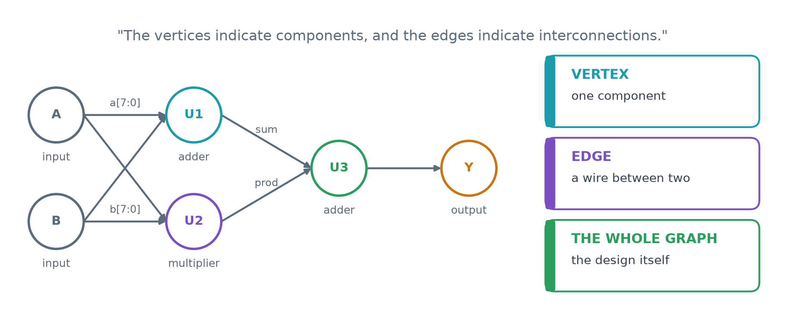
4.2 · DATA PATH DESIGN
A Netlist Is a Directed Graph
Why a graph, and not a drawing
Because a graph is something a program can hold in memory and transform. Every CAD step after this one — optimisation, mapping, placement, routing — is an operation on this graph.
Hardware Modeling using Verilog (NPTEL, IIT Kharagpur) · Lecture 01: Introduction · expanded for Chip Design Associate
L01 · 31

Slide 32
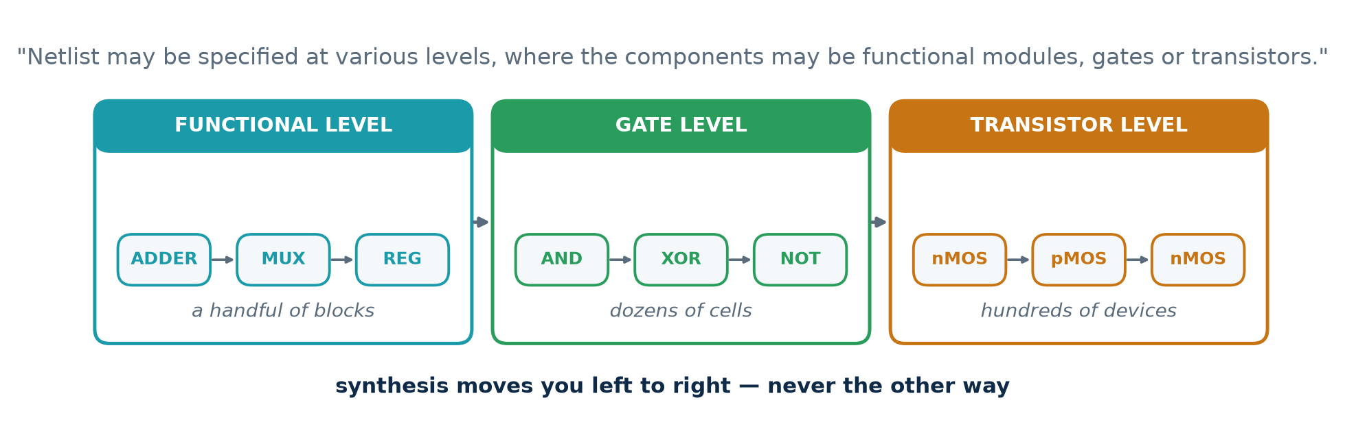
4.2 · DATA PATH DESIGN
The Same Netlist, at Three Levels
The same design, three times
Each level is a netlist. What changes is only what counts as a vertex. Synthesis is the process of rewriting a netlist in terms of smaller vertices.
Hardware Modeling using Verilog (NPTEL, IIT Kharagpur) · Lecture 01: Introduction · expanded for Chip Design Associate
L01 · 32

Slide 33
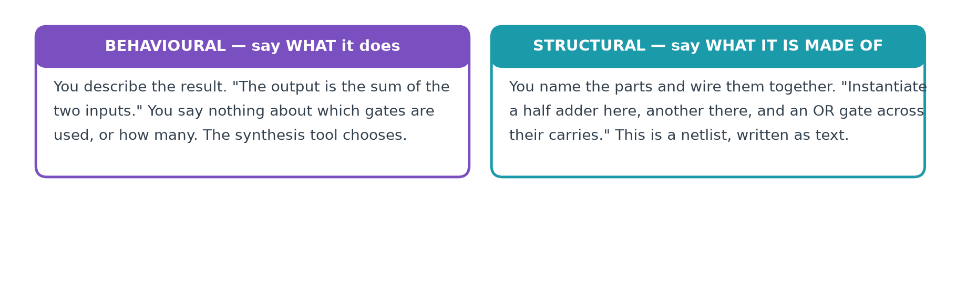
4.3 · THE DISTINCTION
Structural or Behavioural
Two consequences
A netlist IS a structural description — the lecturer says so explicitly. And synthesis is simply the act of turning one into the other: you write behavioural Verilog, and the tool emits structural Verilog.
Hardware Modeling using Verilog (NPTEL, IIT Kharagpur) · Lecture 01: Introduction · expanded for Chip Design Associate
L01 · 33

Slide 34
4.3 · THE DISTINCTION
The Same Adder, Written Both Ways
// BEHAVIOURAL - say what it does
module add2 (input a, b, cin,
output sum, cout);
assign {cout, sum} = a + b + cin;
endmodule
// one line. The tool picks the gates.
// STRUCTURAL - say what it is made of
module add2 (input a, b, cin,
output sum, cout);
wire s1, c1, c2;
xor u1 (s1, a, b);
and u2 (c1, a, b);
xor u3 (sum, s1, cin);
and u4 (c2, s1, cin);
or u5 (cout, c1, c2);
endmodule
Both are legal Verilog, and both describe the same adder
You will write far more behavioural code than structural. But the tool's OUTPUT is always structural — which is exactly why you have to be able to read it.
Hardware Modeling using Verilog (NPTEL, IIT Kharagpur) · Lecture 01: Introduction · expanded for Chip Design Associate
L01 · 34

Slide 35
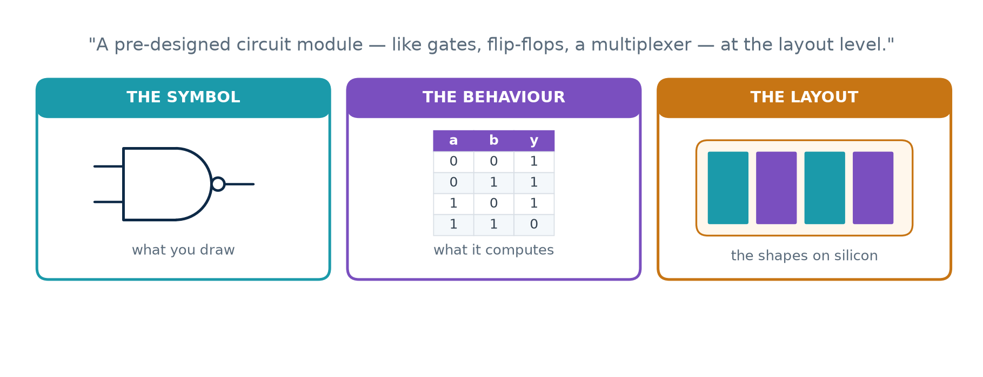
4.4 · LOGIC DESIGN
What a Standard Cell Is
A cell is all of these at once
A standard cell is stored in a library as a symbol to place, a truth table to simulate, a timing model, and a finished piece of layout. Synthesis picks cells from that library; the place-and-route tool stamps their layouts down.
Hardware Modeling using Verilog (NPTEL, IIT Kharagpur) · Lecture 01: Introduction · expanded for Chip Design Associate
L01 · 35

Slide 36
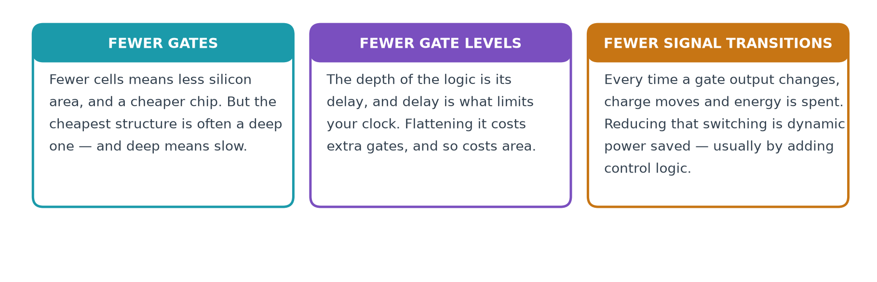
4.4 · LOGIC DESIGN
Why a Cell Library Exists
Why a library exists at all
Laying out a NAND gate correctly takes a skilled engineer a long time. Doing it once, perfectly, and then reusing it a million times is the only way the numbers work.
Hardware Modeling using Verilog (NPTEL, IIT Kharagpur) · Lecture 01: Introduction · expanded for Chip Design Associate
L01 · 36

Slide 37
4.4 · LOGIC DESIGN
Three Goals That Pull Apart
GATES
Fewer cells, less silicon, cheaper chip — but the cheapest structure is often a deep one, and deep means slow.
LEVELS
The depth of the logic IS its delay, and delay is what limits the clock. Flattening it costs extra gates.
TRANSITIONS
Every change at a gate output moves charge and spends energy. Reducing switching usually means adding control logic.
"These requirements are often conflicting"
A synthesis tool does not find THE answer — there isn't one. It finds an answer that satisfies the constraints you gave it. Give it different constraints and you get different hardware from the same Verilog.
Hardware Modeling using Verilog (NPTEL, IIT Kharagpur) · Lecture 01: Introduction · expanded for Chip Design Associate
L01 · 37

Slide 38
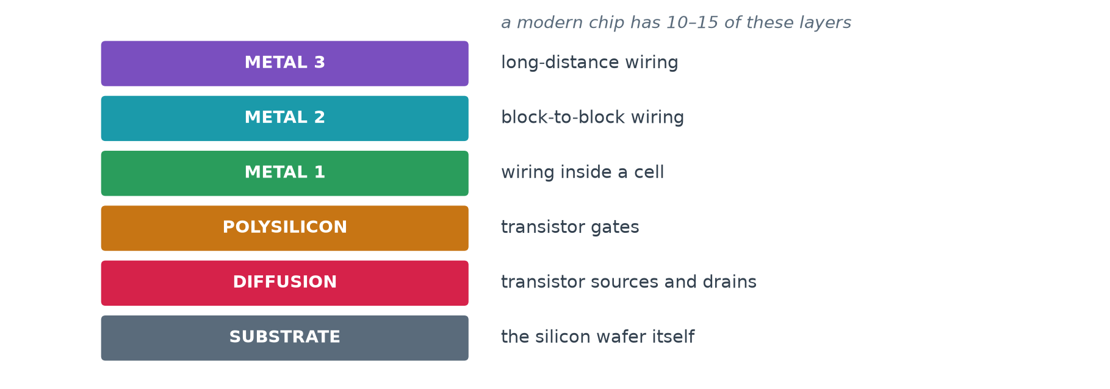
4.5 · PHYSICAL DESIGN
Polygons, One Layer at a Time
Why the shapes are all rectangles
Because they are printed photographically, layer by layer, onto a silicon wafer. Regular shapes expose cleanly and etch predictably; awkward ones do not.
Hardware Modeling using Verilog (NPTEL, IIT Kharagpur) · Lecture 01: Introduction · expanded for Chip Design Associate
L01 · 38

Slide 39
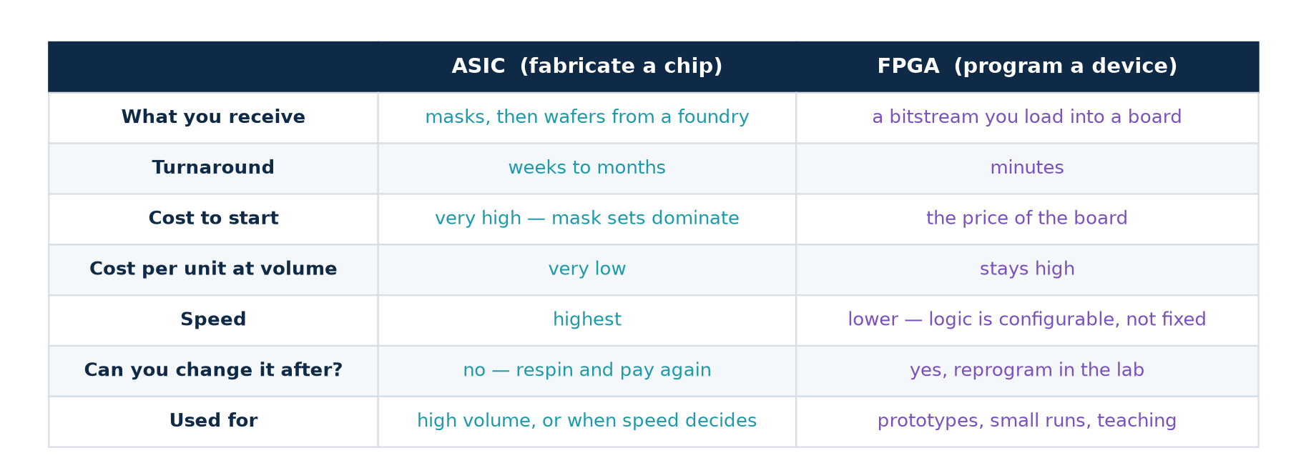
4.5 · PHYSICAL DESIGN
Two Ways to Finish: ASIC or FPGA
"Much greater flexibility, but less speed"
The trade-off the lecturer names. An FPGA is a chip already manufactured, full of configurable blocks you program in your own laboratory. An ASIC is a chip built for your design alone.
Hardware Modeling using Verilog (NPTEL, IIT Kharagpur) · Lecture 01: Introduction · expanded for Chip Design Associate
L01 · 39

Slide 40
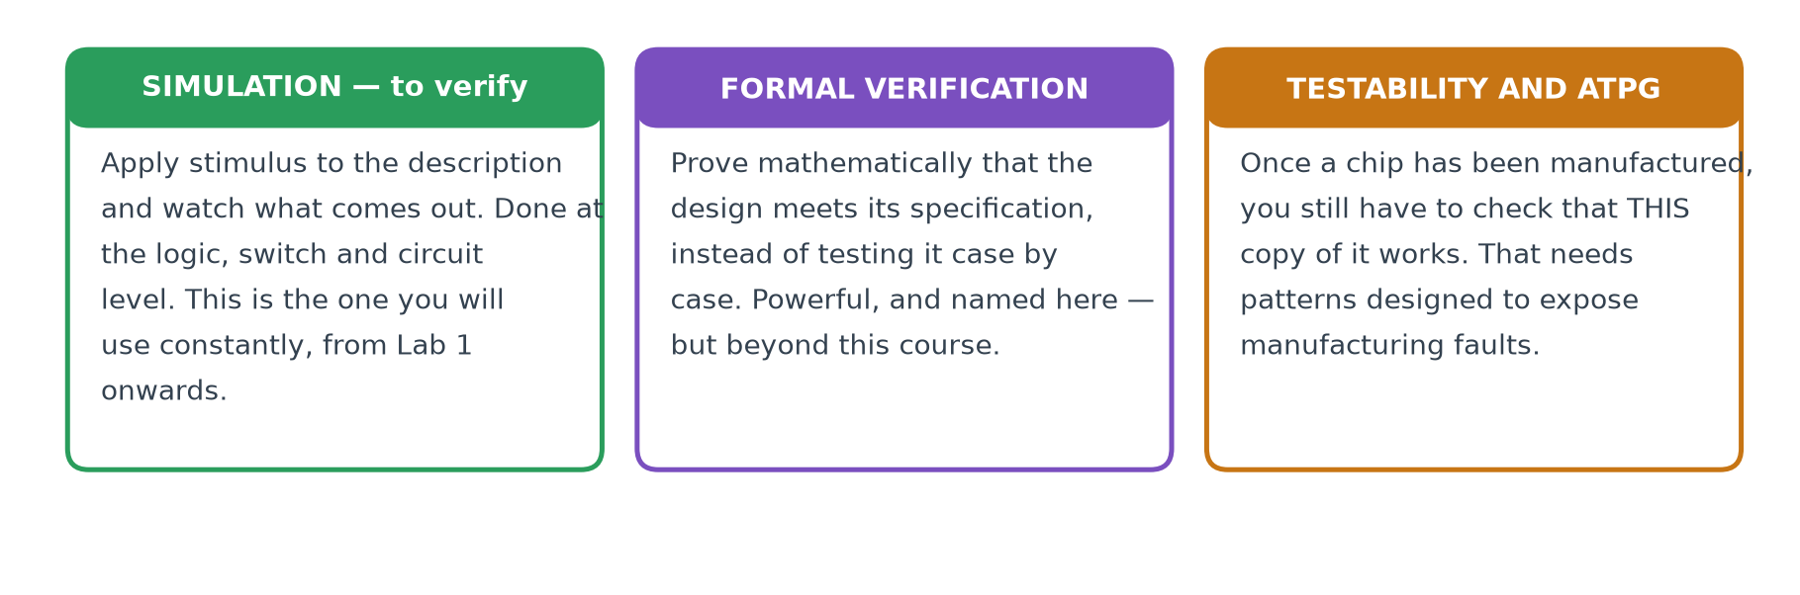
4.6 · THE REST
Other Steps in the Design Flow
Where each of these returns in the course
Simulation is used in almost every lecture from Week 1 onwards, and Week 5 is devoted to test benches. Formal verification and testability are named here, but are beyond this course's scope.
Hardware Modeling using Verilog (NPTEL, IIT Kharagpur) · Lecture 01: Introduction · expanded for Chip Design Associate
L01 · 40

Slide 41
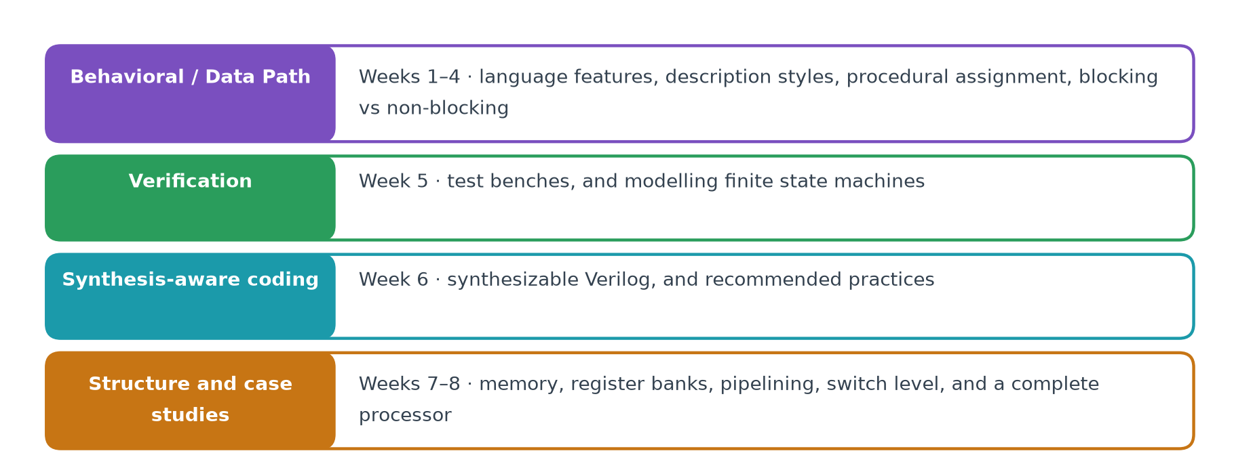
4.7 · THE MAP
Where the Rest of This Course Sits
Notice what is missing
Nothing after logic design. Physical design, manufacturing and test are real and essential, but in this course they are the tools' job. Your work ends at a netlist.
Hardware Modeling using Verilog (NPTEL, IIT Kharagpur) · Lecture 01: Introduction · expanded for Chip Design Associate
L01 · 41

Slide 42
PRACTICAL
Check It Yourself
Lecture 01 makes one big claim: a CAD tool rewrites a hardware description as a more detailed one without changing what it does. In this section you install four free tools and test that claim.
Install Icarus Verilog, GTKWave, Yosys and GHDL — any platform
Lab 1 · simulate a counter and look at its waveform
Lab 2 · watch a tool rewrite your Verilog, and prove it still works
Lab 3 · count the cells at each level of the flow
Lab 4 · ASIC mapping against FPGA mapping
Lab 5 · the same design in Verilog and in VHDL
Hardware Modeling using Verilog (NPTEL, IIT Kharagpur) · Lecture 01: Introduction · expanded for Chip Design Associate
L01 · 42

Slide 43
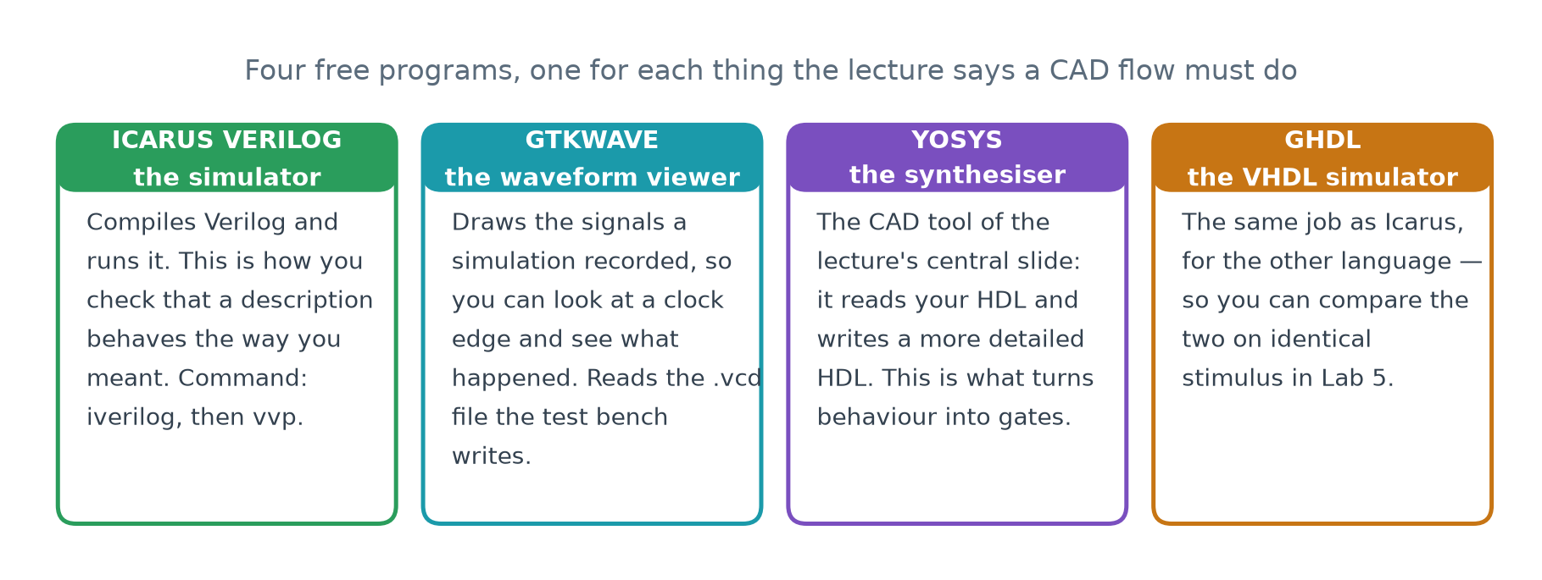
P.1 · THE TOOLS
The Toolchain for This Lecture
Why these four, and why they are free
Every tool here is open source and runs on Windows, macOS and Linux. Nothing in Lecture 01 needs a licence, a university server or a vendor account — which means you can do all of it on your own machine, tonight.
Hardware Modeling using Verilog (NPTEL, IIT Kharagpur) · Lecture 01: Introduction · expanded for Chip Design Associate
L01 · 43

Slide 44
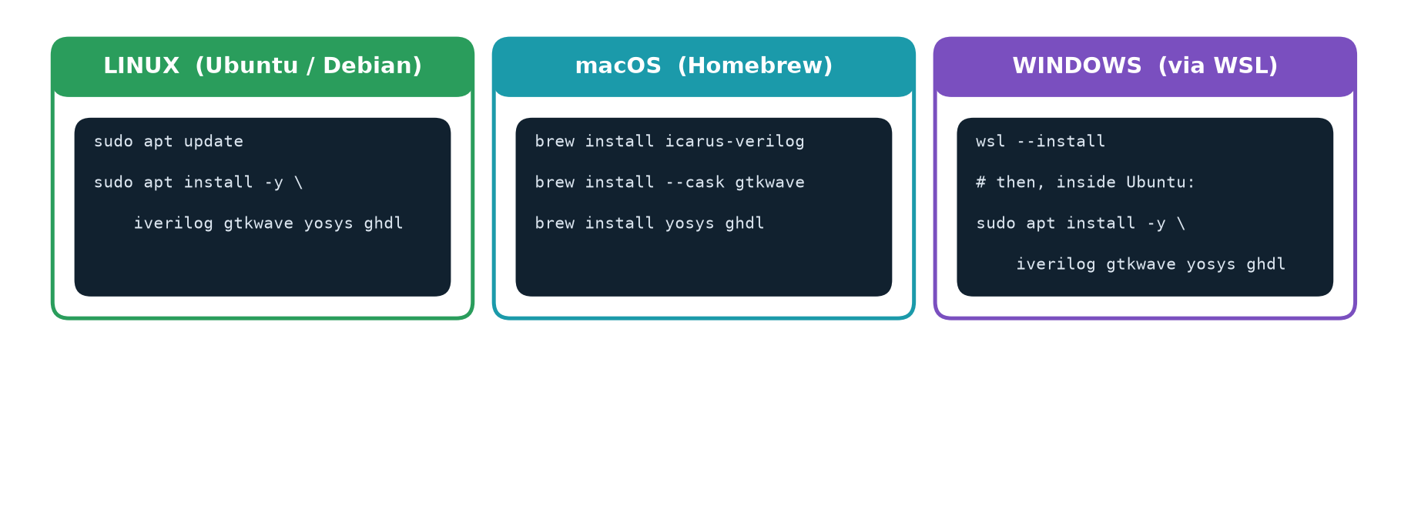
P.1 · THE TOOLS
Installing It — One Line per Platform
If you are on Windows, use WSL
Windows Subsystem for Linux gives you a real Ubuntu inside Windows, and every command in this lab then works unchanged. Install it once with wsl --install in an Administrator PowerShell, restart, and follow the Linux column.
Hardware Modeling using Verilog (NPTEL, IIT Kharagpur) · Lecture 01: Introduction · expanded for Chip Design Associate
L01 · 44

Slide 45
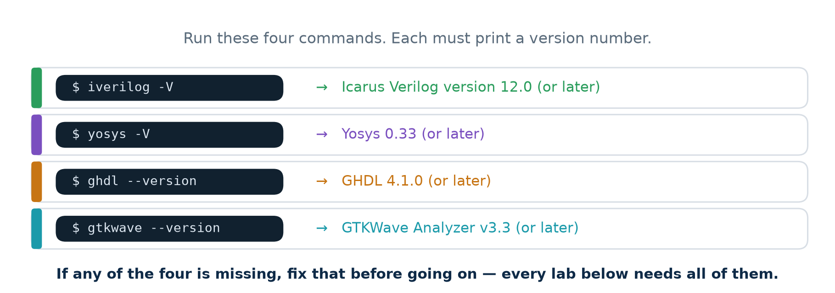
P.1 · THE TOOLS
Checking That It Worked
Versions newer than these are fine
The figures quoted throughout this deck were produced with Icarus 12.0, Yosys 0.33 and GHDL 4.1.0. A newer synthesiser may optimise slightly differently and report a different cell count — which is itself worth noticing, because it shows that optimisation has no single right answer.
Hardware Modeling using Verilog (NPTEL, IIT Kharagpur) · Lecture 01: Introduction · expanded for Chip Design Associate
L01 · 45

Slide 46
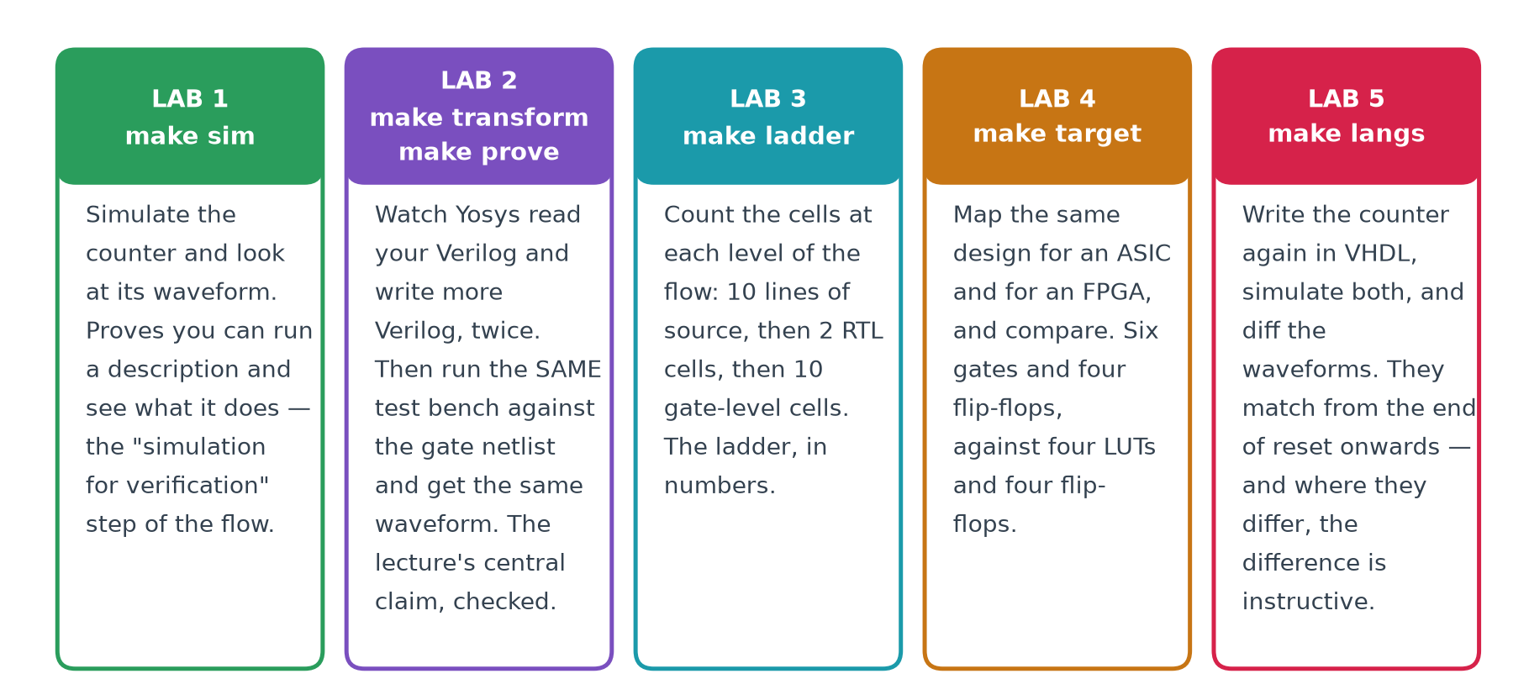
P.2 · THE LABS
The Five Labs, and What Each One Proves
Every claim in this lecture is checked by one of these
The theory section asserts that a CAD tool rewrites one hardware description as a more detailed one without changing what it does. Lab 2 proves exactly that, on your own machine, in about thirty seconds.
Hardware Modeling using Verilog (NPTEL, IIT Kharagpur) · Lecture 01: Introduction · expanded for Chip Design Associate
L01 · 46

Slide 47
LAB 1 · make sim
The Design: a 4-Bit Counter
rtl/counter4.v
// counter4 - a 4-bit up counter, written BEHAVIOURALLY.
//
// Nothing here says which gates to use, or how many. It says only
// what the output must be after each rising clock edge. Choosing
// the gates is the synthesis tool's job.
module counter4 (
input wire clk,
input wire rst, // synchronous, active high
output reg [3:0] q
);
always @(posedge clk) begin
if (rst) q <= 4'd0;
else q <= q + 4'd1;
end
endmodule
Ten lines of behaviour
This file never mentions a gate, a flip-flop or a wire between them. That is the whole point: it is a behavioural description, and everything below it in the flow will be produced from it by a program.
Hardware Modeling using Verilog (NPTEL, IIT Kharagpur) · Lecture 01: Introduction · expanded for Chip Design Associate
L01 · 47

Slide 48
LAB 1 · make sim
The Test Bench
rtl/tb_counter4.v (abridged)
`timescale 1ns/1ps
module tb_counter4;
reg clk = 1'b0, rst = 1'b1;
wire [3:0] q;
counter4 dut (.clk(clk), .rst(rst), .q(q));
always #5 clk = ~clk; // 100 MHz: a 10 ns period
initial begin
$dumpfile("out/counter4.vcd"); // record for GTKWave
$dumpvars(0, tb_counter4);
@(negedge clk); rst = 1'b0; // release reset
... // check 20 cycles
$display("PASS counter4 counted 0..15 and wrapped");
end
endmodule
A test bench is not hardware
It has no ports, it is never synthesised, and it may use delays, loops and $display freely. It is a program whose job is to drive the hardware and watch what comes out.
Hardware Modeling using Verilog (NPTEL, IIT Kharagpur) · Lecture 01: Introduction · expanded for Chip Design Associate
L01 · 48

Slide 49
LAB 2 · make transform
HDL In, HDL Out — Twice
// 1. what you wrote
always @(posedge clk)
begin
if (rst) q <= 4'd0;
else q <= q + 4'd1;
end
// 2. after synthesis (RTL)
assign _0_ = q + 4'h1;
always @(posedge clk)
if (rst) q <= 4'h0;
else q <= _0_;
// 3. after mapping (gates)
assign _02_[0] = ~q[0];
assign _00_ = q[0] & q[1];
assign _01_ = ~(q[2] & _00_);
assign _03_[3] = ~(q[3] ^ _01_);
assign _03_[1] = q[0] ^ q[1];
assign _03_[2] = q[2] ^ _00_;
All three are Verilog
That is the lecture's central slide, made concrete. The tool did not compile your design into something else — it re-described it, twice, each time in more detail. The third column is a netlist: gates and the wires between them.
Hardware Modeling using Verilog (NPTEL, IIT Kharagpur) · Lecture 01: Introduction · expanded for Chip Design Associate
L01 · 49

Slide 50
LAB 2 · make prove
And It Still Behaves the Same
the whole claim of Lecture 01, in one command
$ make prove
--- 1. the behavioural description (what the designer wrote) ---
PASS counter4 counted 0..15 and wrapped correctly
--- 2. synthesise it down to gates ---
wrote out/counter4_gates.v (33 lines)
--- 3. the SAME test bench, run against the gate netlist ---
PASS counter4 counted 0..15 and wrapped correctly
--- 4. compare the two waveforms, cycle by cycle ---
IDENTICAL - 22 transitions, same value at the same time.
The synthesiser changed the DESCRIPTION, not the BEHAVIOUR.
Why this is worth running yourself
One test bench, two very different descriptions, identical output at every instant. Nothing in the lecture has to be taken on trust after this.
Hardware Modeling using Verilog (NPTEL, IIT Kharagpur) · Lecture 01: Introduction · expanded for Chip Design Associate
L01 · 50

Slide 51
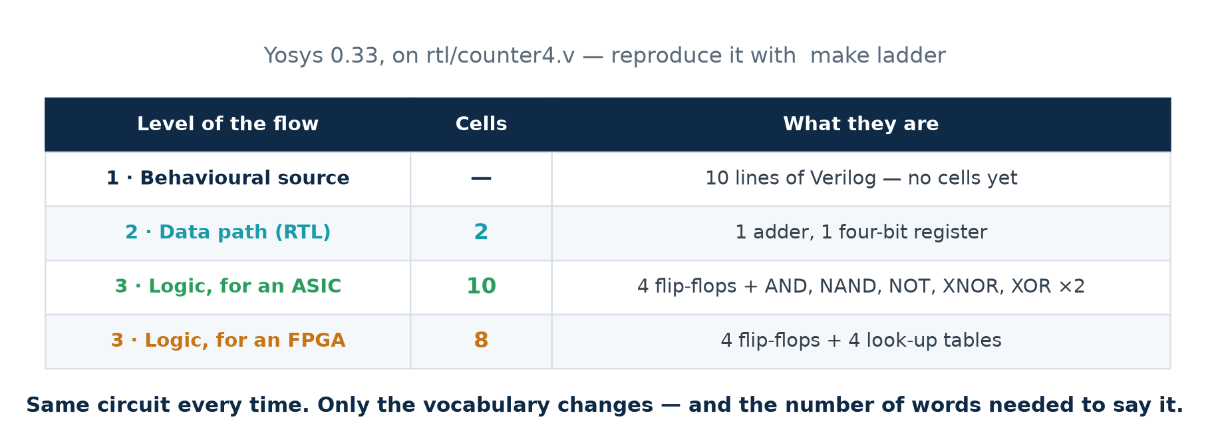
LAB 3 · make ladder
What the Tools Actually Reported
These are measured numbers, not illustrations
Every figure on this slide came out of Yosys 0.33 running on the counter in rtl/counter4.v. Run make ladder and you will get the same table. If your version of Yosys gives slightly different numbers, that is itself worth discussing — optimisation is not unique.
Hardware Modeling using Verilog (NPTEL, IIT Kharagpur) · Lecture 01: Introduction · expanded for Chip Design Associate
L01 · 51

Slide 52
LAB 4 · make target
ASIC Mapping against FPGA Mapping
=== mapped to logic GATES (the ASIC route) ===
Number of cells: 10
$_AND_ 1
$_NAND_ 1
$_NOT_ 1
$_SDFF_PP0_ 4
$_XNOR_ 1
$_XOR_ 2
=== mapped to 4-input LUTs (the FPGA route) ===
Number of cells: 8
$_SDFF_PP0_ 4
$lut 4
// four look-up tables replace
// the six gates on the left
Same source file, two different targets
The four flip-flops are the same either way — one per bit of the counter. What changes is the combinational logic: six dedicated gates for silicon you will manufacture, or four look-up tables inside a chip you can buy today. That is the flexibility-for-speed trade the lecturer names.
Hardware Modeling using Verilog (NPTEL, IIT Kharagpur) · Lecture 01: Introduction · expanded for Chip Design Associate
L01 · 52

Slide 53
LAB 5 · make langs
The Same Design in Two Languages
two languages, one circuit
$ make langs
--- Verilog (Icarus) --- PASS counted 0..15 and wrapped
--- VHDL (GHDL) --- PASS counted 0..15 and wrapped
--- the whole run, including time zero ---
they differ, and ONLY here:
< 0.000 ns xxxx (Verilog)
< 5.000 ns 0000
> 0.000 ns 0000 (VHDL)
--- from the end of reset onwards (15 ns) ---
IDENTICAL - 20 transitions, same value at the same time
The one difference is the most useful part of the lab
A Verilog reg holds x — unknown — until something drives it, so q reads xxxx until the reset edge clears it. The VHDL signal was declared with an initial value, so it reads 0000 from time zero. The hardware is identical: a real flip-flop also powers up unpredictably, which is why designs have resets.
Hardware Modeling using Verilog (NPTEL, IIT Kharagpur) · Lecture 01: Introduction · expanded for Chip Design Associate
L01 · 53

Slide 54
P.3 · EXERCISES
Take It Further
▪
1. Change the counter to 8 bits. Re-run make ladder and record the new cell counts. Did the number of gates double?
▪
2. Make the reset asynchronous — always @(posedge clk or posedge rst) — and compare the gate-level netlists before and after.
▪
3. Write a down-counter and prove it with make prove. How many cells does it take compared with counting up?
▪
4. Open both out/counter4_behav.vcd and out/counter4_gates.vcd in GTKWave at the same time and align them.
▪
5. Try abc -lut 6 instead of abc -lut 4. Why do larger look-up tables need fewer of them?
▪
6. Write the counter in VHDL from memory, then diff your version against vhdl/counter4.vhd.
The workbook carries all of these with full worked solutions, plus thirty more.
Hardware Modeling using Verilog (NPTEL, IIT Kharagpur) · Lecture 01: Introduction · expanded for Chip Design Associate
L01 · 54

Slide 55
CHECKPOINT
Ten Questions on Lecture 01
1. Name the five levels of the design flow, in order.
2. What are the INPUT and the OUTPUT of a CAD tool?
3. Define a netlist.
4. What does "register transfer" refer to?
5. Give two ways of specifying behaviour.
6. What is a standard cell, and why does a library of them exist?
7. State Moore's Law. Is it a law of physics?
8. Name three optimisation goals that conflict.
9. Give one advantage of an FPGA over an ASIC, and one the other way.
10. Why is a netlist also called a structural description?
Answers
Every one of these is answered somewhere in this deck, and all ten appear with model answers in the workbook. Questions 2, 3 and 10 are the ones that matter most for the rest of the module.
Hardware Modeling using Verilog (NPTEL, IIT Kharagpur) · Lecture 01: Introduction · expanded for Chip Design Associate
L01 · 55

Slide 56
SUMMARY
What Lecture 01 Established
THE PROBLEM
Chips grew from a handful of transistors to billions. No human can place them, and the requirements — area, speed, power — conflict.
THE ANSWER
A standardized design flow: specification, behavioural design, data path, logic, physical, manufacturing. Each step has a defined input and output, and each is carried out by a program.
THE MECHANISM
A CAD tool reads a hardware description and writes a more detailed hardware description. It never changes what the circuit does — you proved this yourself in Lab 2.
THE LANGUAGE
Those descriptions are written in an HDL. Verilog and VHDL are the two in common use; this course uses Verilog. An HDL is not a programming language.
YOUR PLACE IN IT
A Verilog designer works at the behavioural and data path levels. Everything below is the tools' job — which is why those two levels are what the next seven weeks teach.
Hardware Modeling using Verilog (NPTEL, IIT Kharagpur) · Lecture 01: Introduction · expanded for Chip Design Associate
L01 · 56

Slide 57
NEXT
Lecture 02 — Design Representation
The next lecture takes the one idea this one left implicit — that the same design can be looked at from different angles — and makes it the subject.
BEHAVIOURAL
STRUCTURAL
PHYSICAL
Algorithms, specifications, Boolean expressions, truth tables, state diagrams.
Netlists: modules, gates and transistors, and the wires between them.
Floorplans, cell placement, routing, and the final layout geometry.
The Y-diagram
Lecture 02 arranges those three as the arms of a Y, with the highest level of abstraction at the outside and the finished layout at the centre. Every design step is then a move along an arm, or a jump between arms — and Module 2 lives on the behavioural and structural arms.
Hardware Modeling using Verilog (NPTEL, IIT Kharagpur) · Lecture 01: Introduction · expanded for Chip Design Associate
L01 · 57

