Slide 1
TOPIC 3
Digital Logic Design Principles
Subtopic 3a: Boolean algebra and logic gates · 3b: Combinational logic design · 3c: Sequential logic — flip-flops, registers and state machines
3a · Binary, Boolean algebra, the seven gates, De Morgan, SOP/POS, K-map minimisation
3b · Design procedure, adders, MUX, decoders, ALU, hazards, delay and fan-out
3c · Latches, flip-flops, timing, metastability, registers, counters, FSMs
Tools · Logisim-Evolution, Icarus Verilog, GTKWave, Yosys · Tutorials T1–T4
Module 2 · Verilog RTL Coding for Synthesis
NIE/ELE/N0102 · Topic 3 · 1

Slide 2
TOPIC 3 · ROADMAP
What This Topic Covers and How the 4 Hours Are Spent
Where this sits. Topic 2 gave you the RTL methodology — the idea that we describe hardware, not program it. Topic 3 gives you the hardware vocabulary itself. Every Verilog construct you write in Topic 4 maps onto one of the structures in this topic. Without this, RTL coding is guesswork.
Syllabus bullet (NIE/ELE/N0102, Topic 3 — 4 hours)
Covered by
Time
Boolean algebra and logic gates
3a — slides 4–18
1 h 15 m
Combinational logic design concepts
3b — slides 19–32
1 h 15 m
Sequential logic design concepts
3c — slides 33–45
45 m
Flip-flops, registers and state machines
3c — slides 33–59
45 m
Hands-on tools and tutorials T1–T4
slides 60–66 + workbook
lab time
Learning outcomes — by the end of this topic you can
· Simplify any Boolean function algebraically and with a Karnaugh map, and justify why the minimal form matters in silicon.
· Design, analyse and hand-verify adders, multiplexers, decoders, comparators and an ALU.
· Explain latches vs flip-flops, compute fₘₐₓ from a timing path, and recognise setup/hold and metastability failures.
· Design a finite state machine end to end — state diagram → table → encoding → logic → Verilog → simulation → synthesis.
How to run the session
Deliver 3a and 3b before the break, with a 10-minute Logisim demo after each; run 3c after the break and finish in the lab with tutorials T1–T4.
The six worked numerical examples are your checkpoints — if the room cannot follow one, slow down rather than skipping ahead.
Module 2 · Verilog RTL Coding for Synthesis
NIE/ELE/N0102 · Topic 3 · 2

Slide 3
TOPIC 3 · MOTIVATION
Why a Verilog Engineer Still Needs Gate-Level Thinking
A synthesiser turns your Verilog into gates — so why learn gates at all? Because the tool optimises what you WROTE, not what you MEANT. Every one of the following is a real, common bug that is invisible at the Verilog level and obvious at the logic level.
You write
Tool infers
Consequence
You needed to know
an
incomplete if/else
in a combinational block
a
transparent LATCH
instead of pure gates
timing cannot be
closed; chip fails
intermittently
what a latch IS
and why level-
sensitivity is deadly
Three more examples of the same pattern
Async reset written as sync → the design never leaves an unknown state after power-up. You needed flip-flop reset behaviour.
A signal crossed from another clock → random one-in-a-million failures. You needed metastability.
A 32-bit ripple adder in a 1 GHz design → timing fails by 4 ns. You needed carry propagation delay.
The rule for this whole module: you must be able to picture the hardware your code will become — BEFORE you run synthesis.
Module 2 · Verilog RTL Coding for Synthesis
NIE/ELE/N0102 · Topic 3 · 3

Slide 4
SUBTOPIC 3A
Boolean Algebra and Logic Gates
The mathematics of 0 and 1 — and the physical devices that implement it.
Binary, the digital abstraction, number systems and codes
The seven gates, universal gates, and De Morgan's theorems
Boolean axioms, laws and theorems — with proofs you can do on paper
Canonical forms (SOP / POS) and Karnaugh-map minimisation
Module 2 · Verilog RTL Coding for Synthesis
NIE/ELE/N0102 · Topic 3 · 4

Slide 5
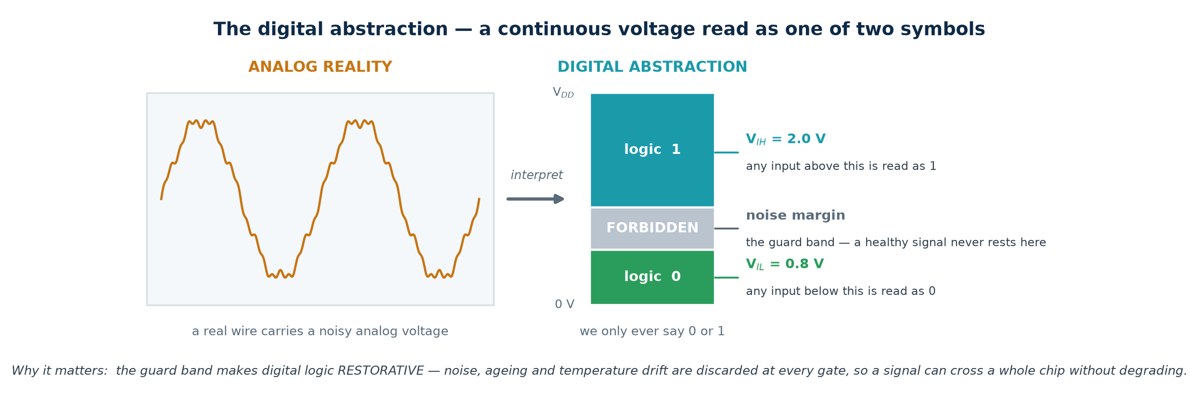
TOPIC 3A · FOUNDATION
Why Digital? The Two-Valued Abstraction
A digital circuit is an analog circuit that we have agreed to misread. The wire really does carry a continuous voltage. We simply declare two bands — anything below Vᴵʟ counts as 0, anything above Vᴵʜ counts as 1 — and design so a signal never rests in between. That single decision buys us noise immunity, testability, and the ability to reason with algebra instead of calculus.
Terms you must be able to define
Bit — one binary digit. Logic level — the 0/1 interpretation of a voltage. Noise margin — how much interference a signal can absorb and still be read correctly (NMᴸ = Vᴵʟ − Vᴼʟ, NMᴴ = Vᴼʜ − Vᴵʜ). Restoring logic — every gate outputs a clean full-swing level, so noise never accumulates.
Module 2 · Verilog RTL Coding for Synthesis
NIE/ELE/N0102 · Topic 3 · 5

Slide 6
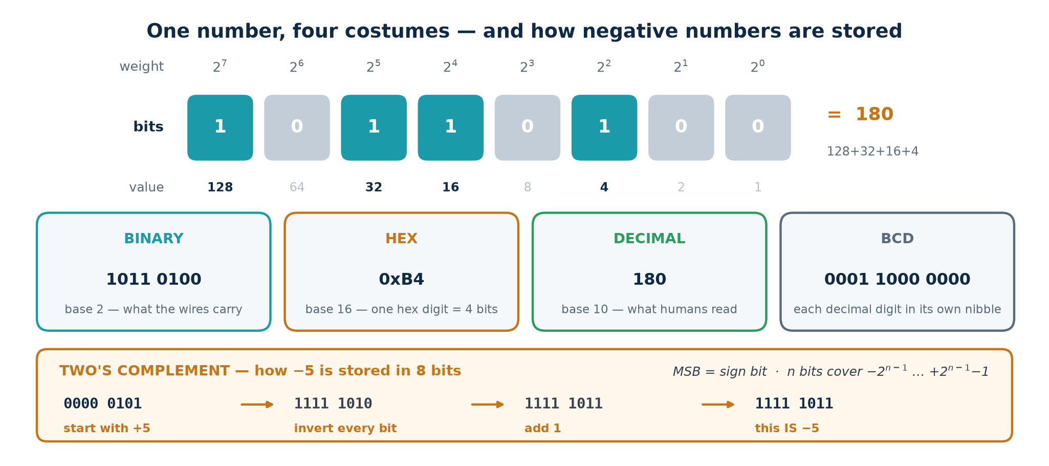
TOPIC 3A · REPRESENTATION
Number Systems and Codes You Will Meet in RTL
Hardware only stores bits. What those bits MEAN is a convention you choose and must apply consistently — the same 8 bits are 180 unsigned, −76 signed, 0xB4 in hex, or a BCD digit pair. Verilog will happily let you mix them up; the bug appears in silicon.
Gray code
BCD
Two's complement
Successive values differ in exactly ONE bit.
Used for K-maps, FIFO pointers crossing clock domains, and shaft encoders — because a multi-bit change can be sampled mid-flight.
Each decimal digit in its own 4-bit nibble.
Wastes 6 of 16 codes but makes decimal display and financial arithmetic exact. The mod-10 counter you build later is a BCD counter.
The universal signed format.
One adder handles + and −; there is only one zero. In Verilog, declare `signed` or the tool assumes unsigned and your comparisons invert.
Module 2 · Verilog RTL Coding for Synthesis
NIE/ELE/N0102 · Topic 3 · 6

Slide 7
TOPIC 3A · THE ALGEBRA
Boolean Variables, Operators and Truth Tables
Boolean algebra (George Boole, 1854; applied to switching circuits by Claude Shannon, 1937) is an algebra over exactly two values. A variable is 0 or 1. There are three primitive operators, and every digital circuit that has ever been built is a composition of these three.
Operator
Symbols used
Reads as
Result is 1 when…
AND
A · B A ∧ B AB A & B
conjunction
BOTH inputs are 1
OR
A + B A ∨ B A | B
disjunction
AT LEAST ONE input is 1
NOT
A' Ā ¬A ~A
complement / negation
the input is 0
The truth table — the ground truth of every combinational function
A truth table lists the output for every possible input combination. For n inputs there are 2ⁿ rows — 2 inputs → 4 rows, 4 inputs → 16 rows, 16 inputs → 65 536 rows. This exponential growth is exactly why we need algebra and K-maps rather than exhaustive tables.
Two circuits are functionally equivalent if and only if their truth tables match on every row — no matter how differently they are drawn. Equivalence checking (a signoff step in Topic 6) automates exactly this.
Precedence: NOT binds tightest, then AND, then OR — so A + B·C means A + (B·C). When in doubt, bracket it. Verilog follows the same order.
Module 2 · Verilog RTL Coding for Synthesis
NIE/ELE/N0102 · Topic 3 · 7

Slide 8
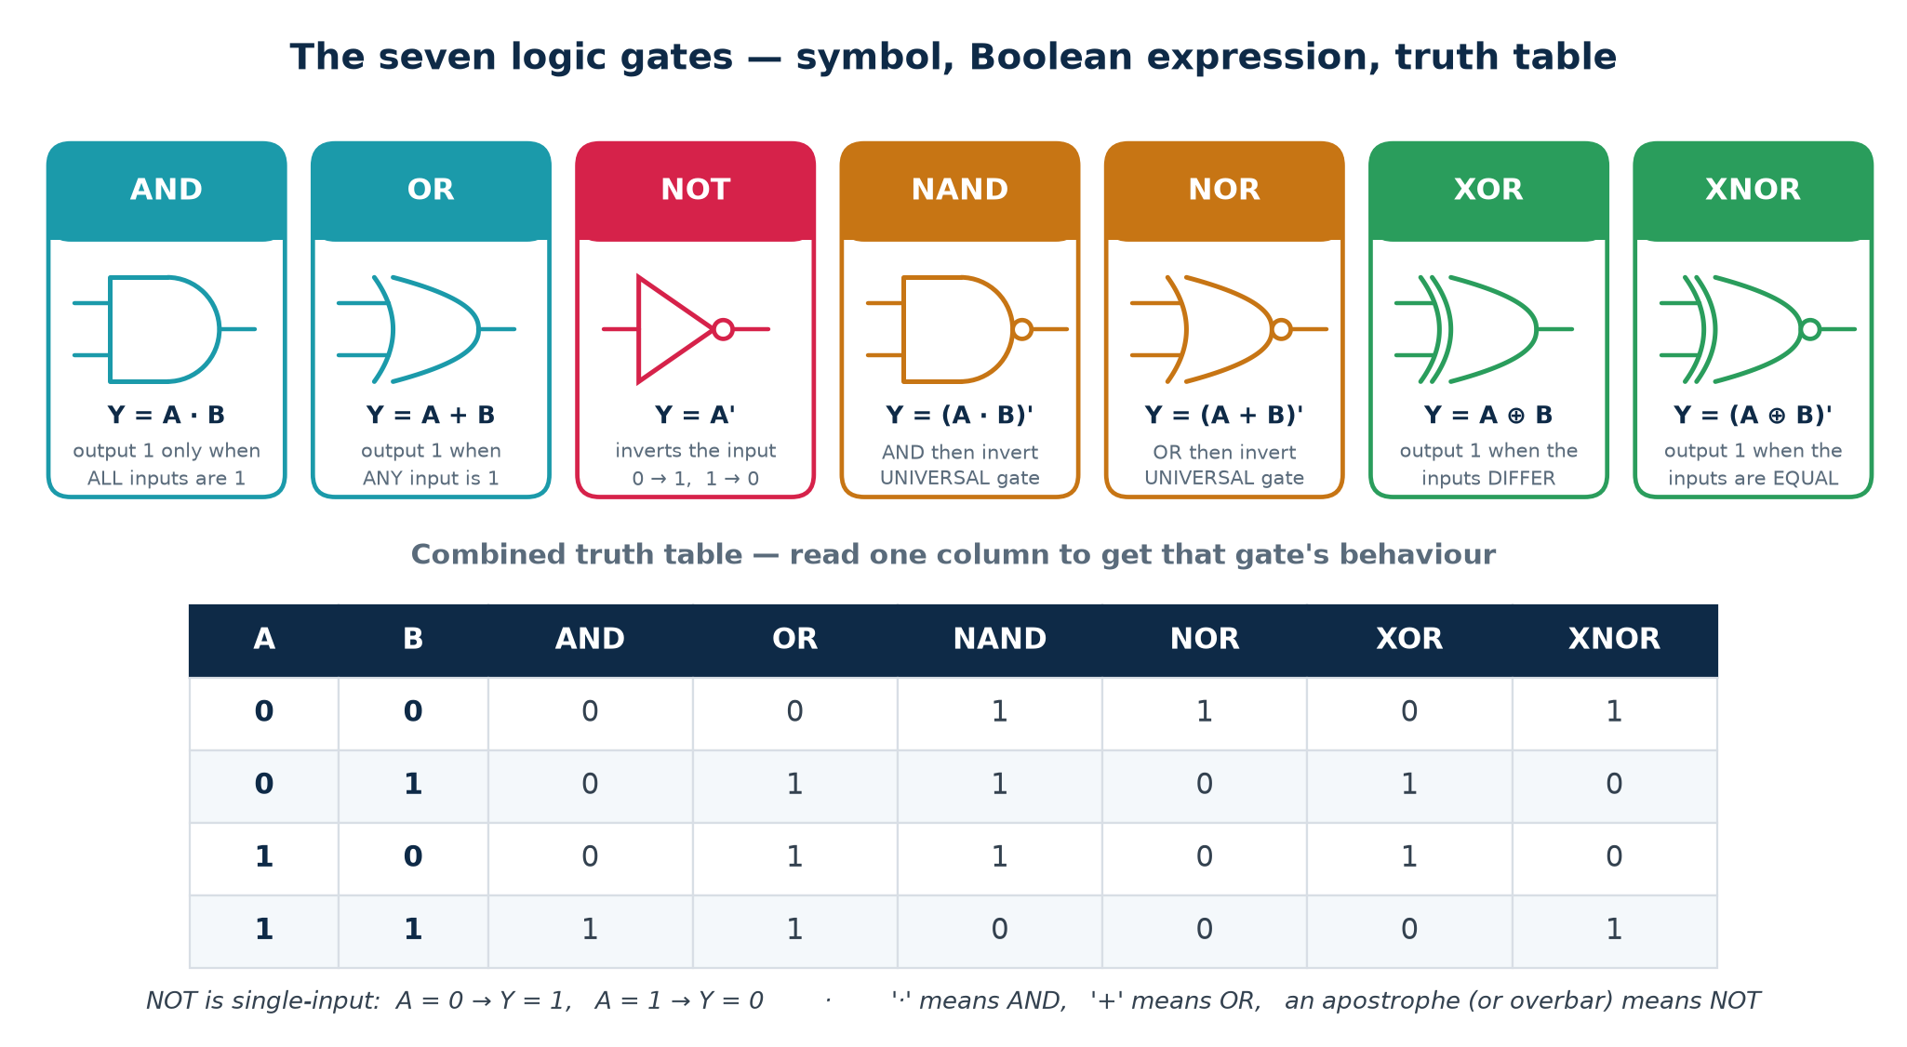
TOPIC 3A · THE GATES
The Seven Logic Gates — Symbol, Expression, Truth Table
A logic gate is a physical circuit (in CMOS, a handful of transistors) that computes one Boolean operator. Learn to read these symbols instantly — schematics, synthesis reports and datasheets all assume you can.
Transistor cost — why NAND and NOR are the cheapest gates in CMOS
In static CMOS, an inverter costs 2 transistors, a 2-input NAND or NOR costs 4, but a 2-input AND or OR costs 6 (they are built as NAND/NOR followed by an inverter). XOR costs 8–12. This is why standard-cell libraries are dominated by NAND/NOR/inverter cells and why synthesis output rarely contains a literal AND gate.
Module 2 · Verilog RTL Coding for Synthesis
NIE/ELE/N0102 · Topic 3 · 8

Slide 9
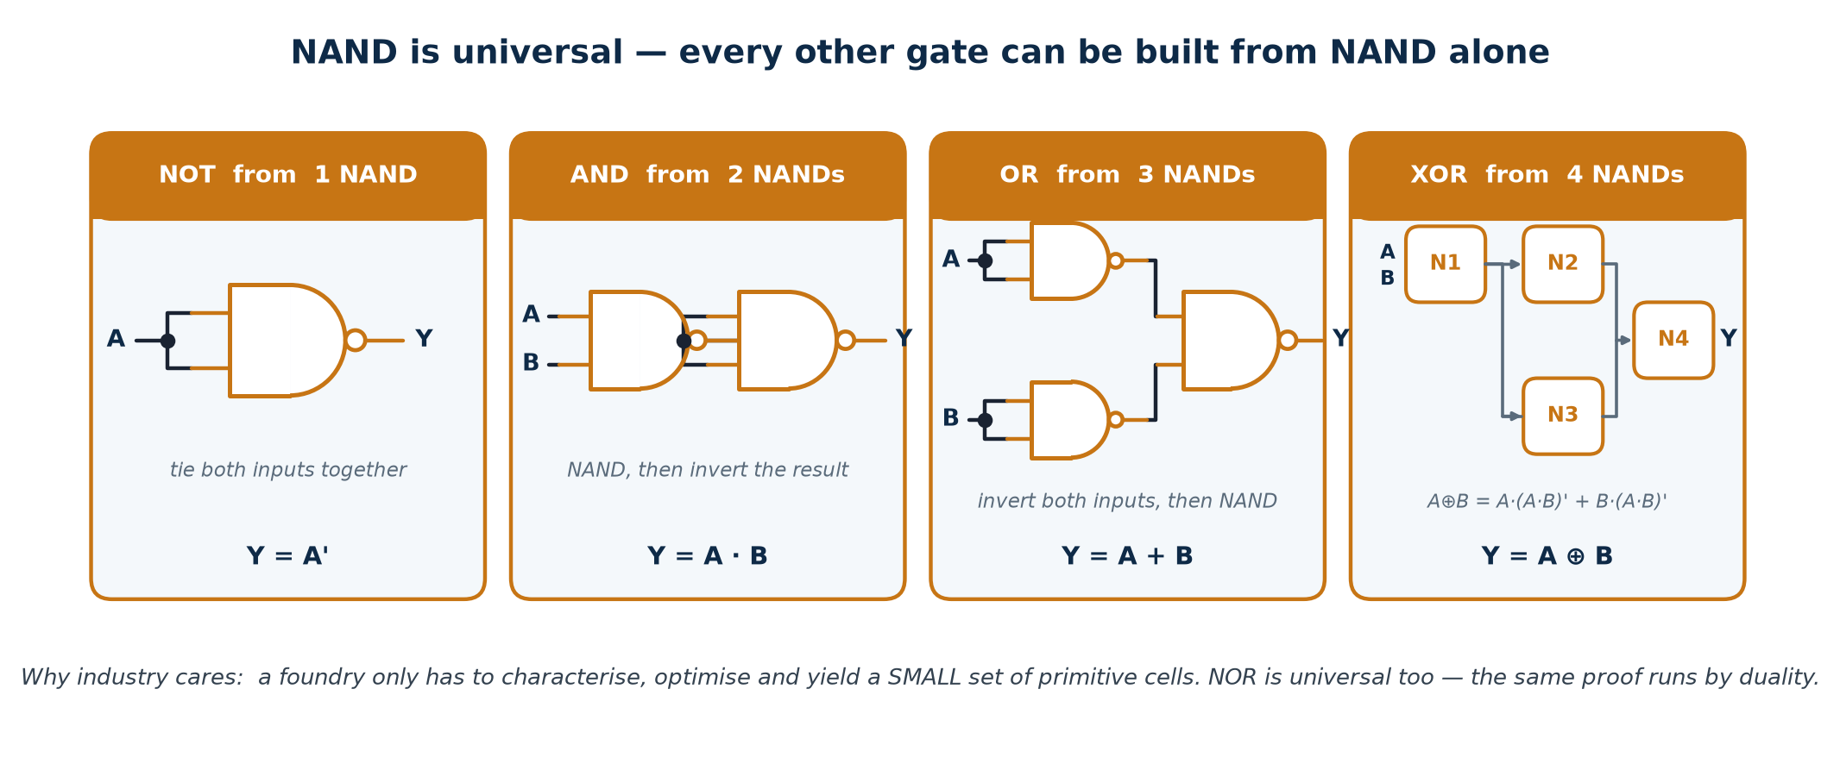
TOPIC 3A · UNIVERSALITY
Universal Gates — NAND and NOR Can Build Anything
A gate is UNIVERSAL if any Boolean function can be built from copies of it alone. NAND and NOR are the only two-input gates with this property (AND, OR and XOR are not — none of them can produce a NOT). The proof is constructive: build NOT, AND and OR from it, and since every function has an SOP form, you are done.
Why it matters in manufacturing
Why it matters in design
One well-characterised cell can be tiled everywhere, so the foundry optimises, models and yields a small library instead of a large one.
Synthesis 'technology maps' your logic onto whatever cells the library actually has — so your AND gate may well appear as two NANDs in the netlist.
Module 2 · Verilog RTL Coding for Synthesis
NIE/ELE/N0102 · Topic 3 · 9

Slide 10
TOPIC 3A · LAWS
Boolean Axioms, Laws and Theorems
Every one of these can be proved with a truth table, and every one is a legal, behaviour-preserving circuit transformation. Synthesis tools apply them thousands of times per second; you apply them by hand to check the tool and to simplify before you write the code.
Law
OR form
AND form
Identity
A + 0 = A
A · 1 = A
Null / Dominance
A + 1 = 1
A · 0 = 0
Idempotent
A + A = A
A · A = A
Complement
A + A' = 1
A · A' = 0
Involution
(A')' = A
—
Commutative
A + B = B + A
A · B = B · A
Associative
A + (B + C) = (A + B) + C
A · (B · C) = (A · B) · C
Distributive
A · (B + C) = A·B + A·C
A + (B · C) = (A+B) · (A+C)
Absorption
A + A·B = A
A · (A + B) = A
Simplification
A + A'·B = A + B
A · (A' + B) = A · B
Consensus
AB + A'C + BC = AB + A'C
(A+B)(A'+C)(B+C) = (A+B)(A'+C)
Two ideas that make the table half as long
Duality. Swap every AND ↔ OR and every 0 ↔ 1 and a true statement stays true — which is why the two columns above are mirror images. You only have to memorise one column.
Why the second distributive law surprises people. A + B·C = (A+B)(A+C) has no counterpart in ordinary arithmetic. Verify it on all 8 rows once and you will trust it forever.
Module 2 · Verilog RTL Coding for Synthesis
NIE/ELE/N0102 · Topic 3 · 10

Slide 11
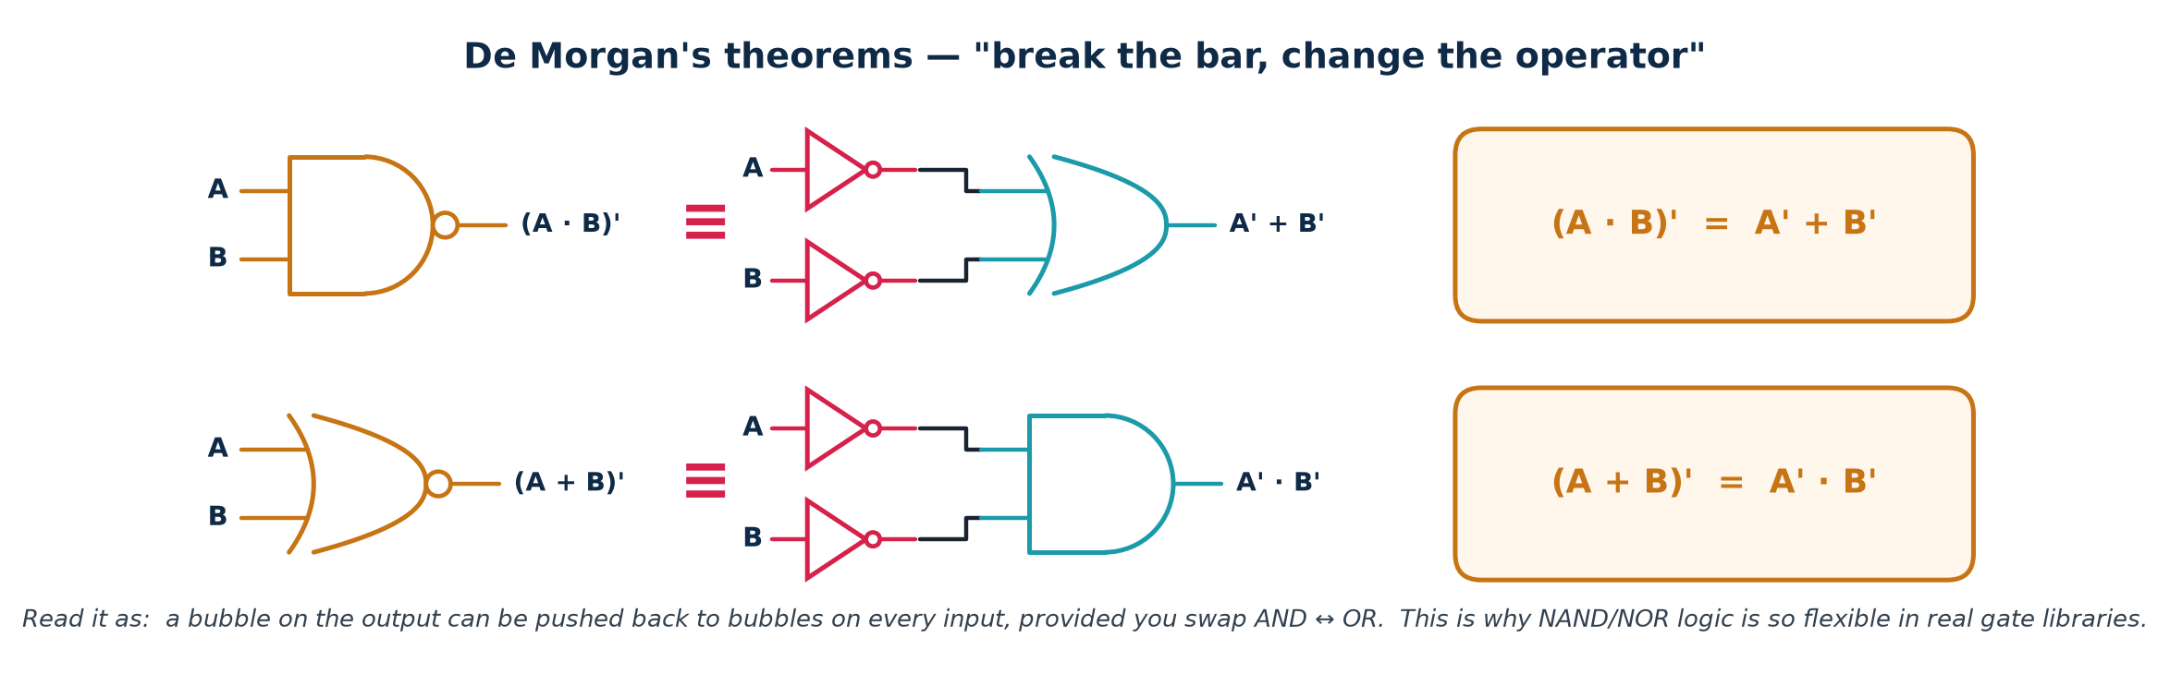
TOPIC 3A · DE MORGAN
De Morgan's Theorems — The Most-Used Identity in RTL
Break the bar, change the operator. These two identities let you push inversions through a network, convert any AND-OR structure into an all-NAND structure, and read active-low signals correctly. In practice this is the theorem you will use most often at a whiteboard.
Proof by perfect induction (exhaustive truth table)
A=0 B=0 → (A·B)' = 1, A'+B' = 1+1 = 1 ✓ A=0 B=1 → (A·B)' = 1, A'+B' = 1+0 = 1 ✓
A=1 B=0 → (A·B)' = 1, A'+B' = 0+1 = 1 ✓ A=1 B=1 → (A·B)' = 0, A'+B' = 0+0 = 0 ✓
All four rows agree, so the two expressions are the same function. The theorem generalises to n variables: (ABC…)' = A'+B'+C'+…
Active-low reading: a signal named rst_n asserted low means 'reset when rst_n = 0'. De Morgan is how you convert a spec written in active-low language into positive logic without errors.
Module 2 · Verilog RTL Coding for Synthesis
NIE/ELE/N0102 · Topic 3 · 11

Slide 12
TOPIC 3A · TIERED DEPTH
Understanding Boolean Algebra at Four Levels
The same idea, deepened. Use the level that matches your audience — and make sure you can climb all four.
BASIC
Circuits work with just two values, 0 and 1. Three operations — AND, OR and NOT — combine them, and a truth table lists what comes out for every possible input.
INTERMEDIATE
Boolean algebra is a formal algebra with its own laws. Those laws let you rewrite an expression into an equivalent one that needs fewer gates — which is exactly what minimisation means.
ADVANCED
Any function has canonical SOP and POS forms derived directly from its truth table. Minimisation (K-map, Quine–McCluskey, Espresso) finds a cover of prime implicants that is cheapest under a chosen cost model — literals, gates, or area.
INDUSTRY
Nobody minimises by hand at scale. Synthesis uses BDDs, AIGs and SAT-based rewriting (ABC) against a real standard-cell library, optimising area, timing and power together. Your job is to write clean RTL, set correct constraints, and read the report critically.
Module 2 · Verilog RTL Coding for Synthesis
NIE/ELE/N0102 · Topic 3 · 12

Slide 13
TOPIC 3A · PRACTICAL EXAMPLE 1
Worked: Algebraic Simplification, Step by Step
Problem. Simplify F = A·B·C + A·B·C' + A·B'·C + A'·B·C and state how many gates you saved.
Each line names the law that justifies it — never skip that column
F = ABC + ABC' + AB'C + A'BC
= AB(C + C') + AB'C + A'BC group terms 1 and 2 (distributive)
= AB(1) + AB'C + A'BC complement: C + C' = 1
= AB + AB'C + A'BC identity: X · 1 = X
= A(B + B'C) + A'BC factor A out of terms 1 and 2
= A(B + C) + A'BC simplification: B + B'C = B + C
= AB + AC + A'BC expand
= AB + A'BC + AC reorder
= B(A + A'C) + AC factor B
= B(A + C) + AC simplification again
= AB + BC + AC
F = AB + BC + AC ← the 'majority' function: 1 when ≥ 2 inputs are 1
Cost before
Cost after
Sanity check
4 AND gates (3-input)
1 OR gate (4-input)
3 inverters · 12 literals
3 AND gates (2-input)
1 OR gate (3-input)
0 inverters · 6 literals
Build the truth table for both forms and compare all 8 rows. Never trust an algebraic simplification you have not checked.
Module 2 · Verilog RTL Coding for Synthesis
NIE/ELE/N0102 · Topic 3 · 13

Slide 14
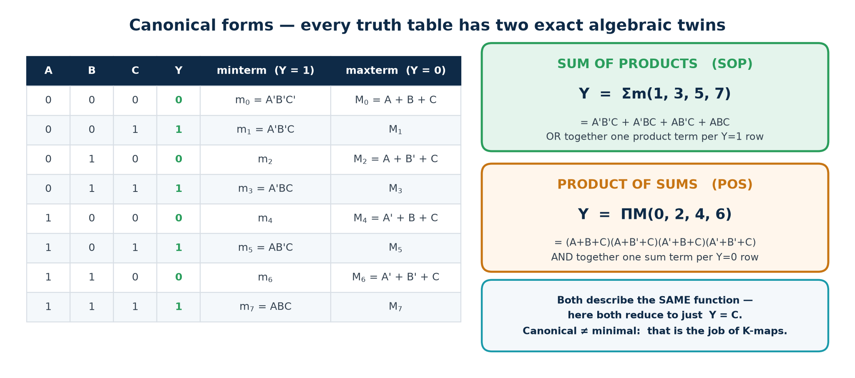
TOPIC 3A · CANONICAL FORMS
SOP and POS — Reading Algebra Straight Off a Truth Table
Given any truth table you can write down two exact expressions immediately, with no thinking required. They are called canonical because they are unique. They are also usually far from minimal — which is what the next two slides fix.
Minterm mᵢ
Maxterm Mᵢ
Relationship
The AND term that is 1 for exactly ONE input combination. Write the variable plain if its bit is 1, complemented if 0.
The OR term that is 0 for exactly ONE input combination — the complement rule is reversed.
Mᵢ = (mᵢ)'. A function's SOP minterm list and POS maxterm list are complementary sets of the same 2ⁿ indices.
Module 2 · Verilog RTL Coding for Synthesis
NIE/ELE/N0102 · Topic 3 · 14

Slide 15
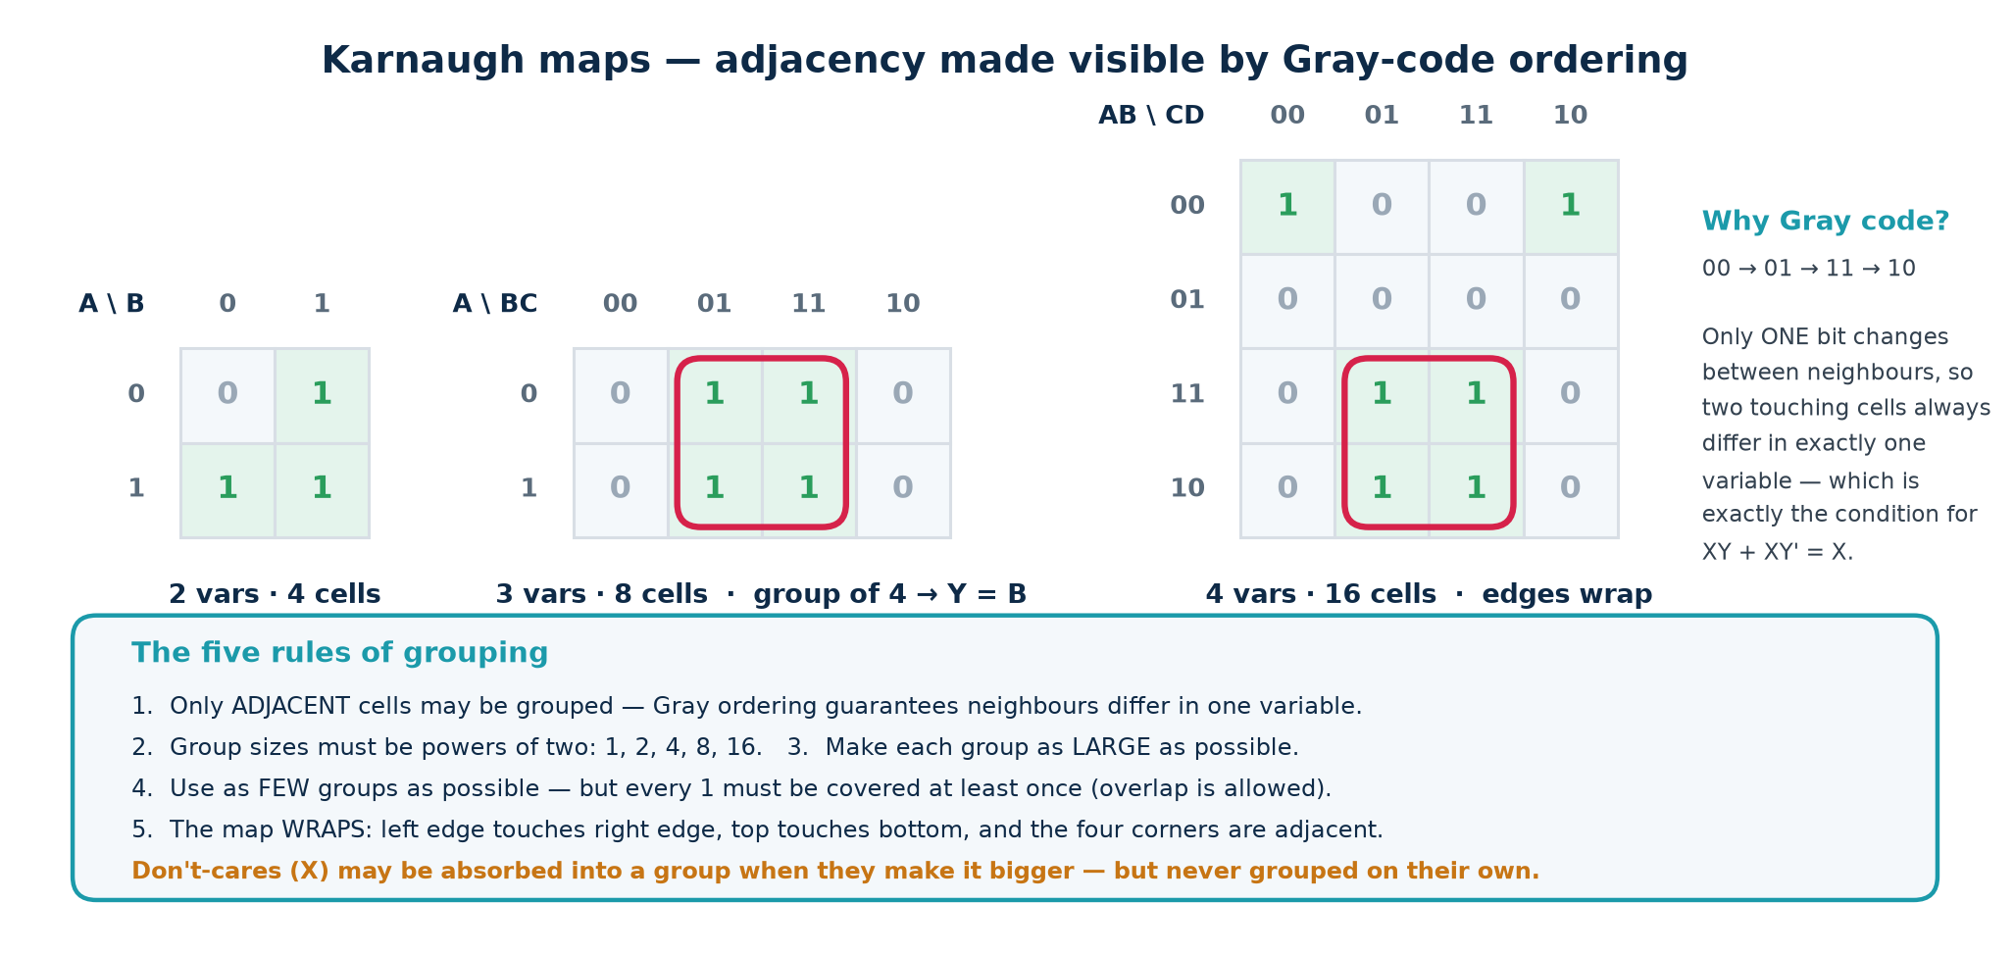
TOPIC 3A · MINIMISATION
Karnaugh Maps — Minimisation You Can Do by Eye
A K-map is a truth table redrawn so that physically adjacent cells differ in exactly one variable. That turns the algebraic law X·Y + X·Y' = X into a visual one: any group of adjacent 1s collapses into a single, shorter product term. Practical up to 4 variables (5–6 with effort).
Vocabulary: an implicant is any legal group; a prime implicant is one that cannot be made larger; an essential prime implicant is the only group covering some particular 1 — it must appear in every minimal solution.
Module 2 · Verilog RTL Coding for Synthesis
NIE/ELE/N0102 · Topic 3 · 15

Slide 16
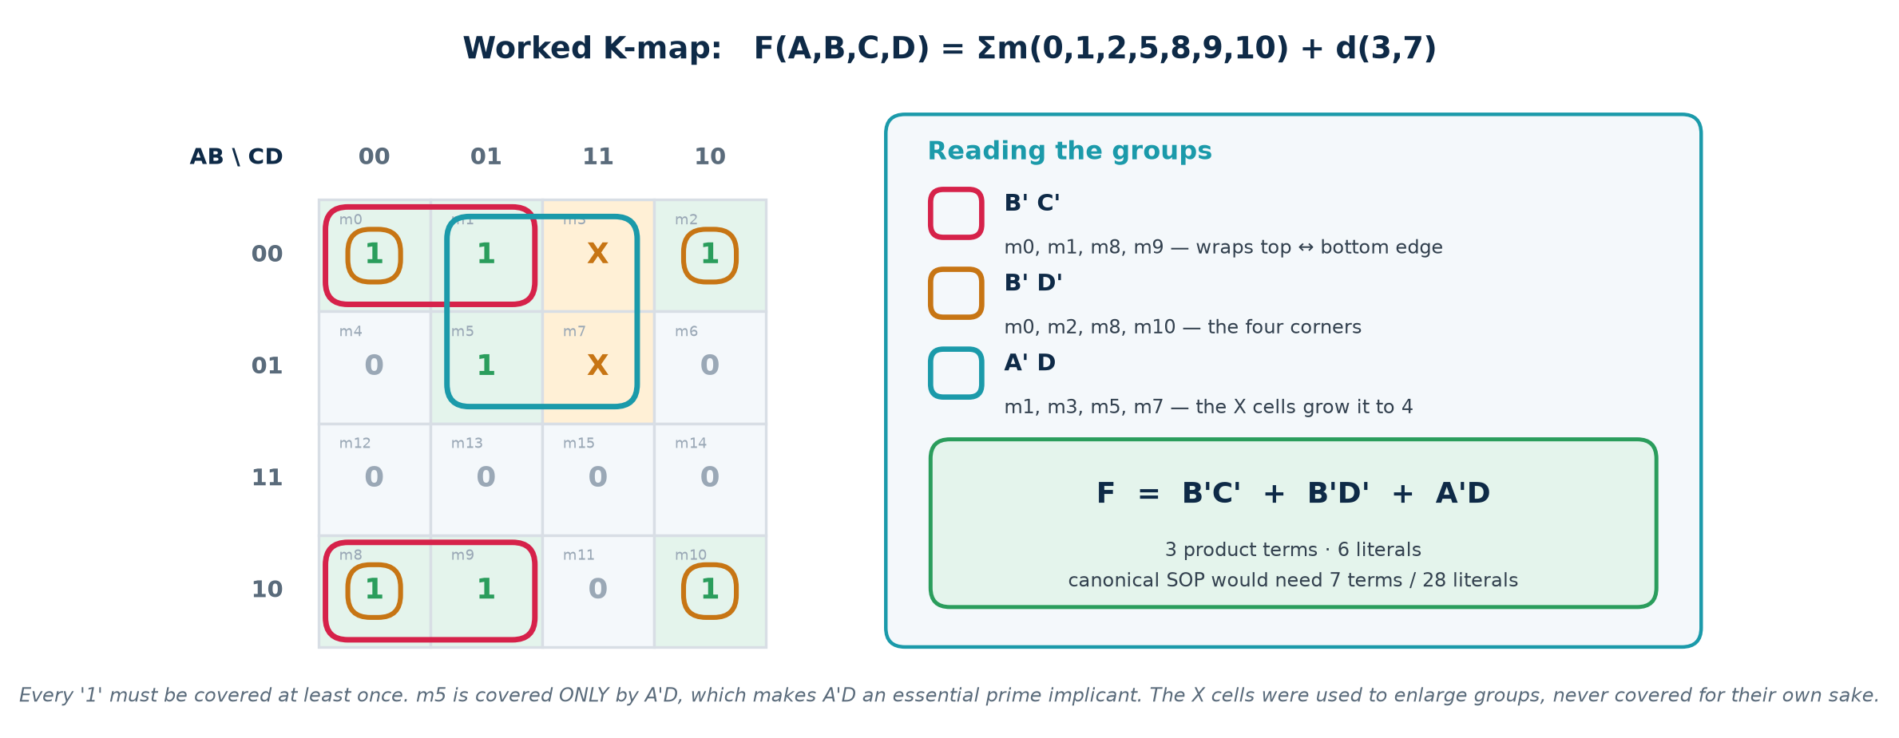
TOPIC 3A · WORKED EXAMPLE
A 4-Variable K-Map with Don't-Cares
Don't-cares (X) are input combinations that can never occur, or whose output nobody reads. You may assign each one 0 or 1 — whichever makes your groups bigger. They are free optimisation, and forgetting to declare them is a common source of oversized logic.
The procedure, in the order you should always follow it
1. Fill the map from the truth table. 2. Circle every ESSENTIAL prime implicant first. 3. Cover the remaining 1s with the fewest, largest groups. 4. Read each group as a product term: keep the variables that stay constant, drop those that change. 5. OR the terms together. 6. Verify against the original truth table.
Module 2 · Verilog RTL Coding for Synthesis
NIE/ELE/N0102 · Topic 3 · 16

Slide 17
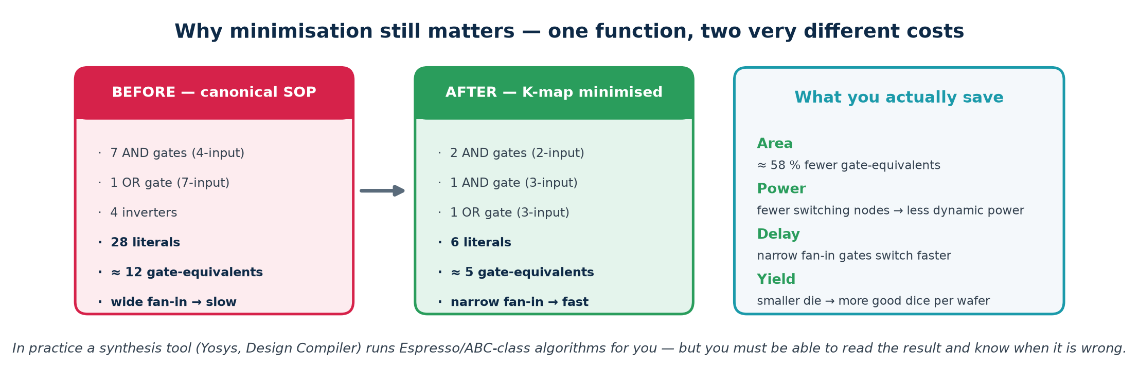
TOPIC 3A · PRACTICAL EXAMPLE 2
Numerical: What Minimisation Buys You in Silicon
Work it through with real numbers
Assume a 28 nm library where 1 gate-equivalent (GE) ≈ 0.5 µm² and a 2-input gate switching at 500 MHz burns ≈ 0.6 µW.
Before: 12 GE → 6.0 µm², ≈ 7.2 µW. After: 5 GE → 2.5 µm², ≈ 3.0 µW. Saving: 58 % area and power.
Now multiply by 200 000 instances of this block on a real SoC: 0.7 mm² of die and 0.84 W of dynamic power. That is the difference between a product that ships and one that does not.
Numbers are illustrative, chosen to show the method — always use your own library's datasheet.
Module 2 · Verilog RTL Coding for Synthesis
NIE/ELE/N0102 · Topic 3 · 17

Slide 18
TOPIC 3A · SCALING UP
Beyond K-Maps — What Real Tools Do
K-maps stop working past about 5 variables, and real blocks have hundreds of inputs. The algorithms below do the same job systematically. You will not implement them, but you must know their names and limits because they appear in every synthesis log.
Method
How it works
Scales to
Where you meet it
Karnaugh map
visual grouping on a Gray-coded grid
≤ 5–6 vars
exams, whiteboards, intuition
Quine–McCluskey
tabular; finds ALL prime implicants, then solves a covering problem
≤ ~15 vars
the exact algorithm K-maps approximate
Espresso
heuristic expand / reduce / irredundant loop — near-optimal, very fast
hundreds
classic two-level logic minimiser
ABC / AIG rewriting
multi-level: And-Inverter Graphs, cut rewriting, SAT sweeping
millions
inside Yosys and every commercial tool
BDD
canonical decision-diagram form of the function
varies wildly
equivalence checking, formal verification
So why learn K-maps at all?
Because you must be able to read what the tool produced and decide whether it is right. A synthesis report showing 4 000 gates for a function you know needs 40 means your RTL is wrong — an unintended latch, a runaway loop, or a missing don't-care. Minimisation intuition is your only defence against silently accepting bad hardware.
Module 2 · Verilog RTL Coding for Synthesis
NIE/ELE/N0102 · Topic 3 · 18

Slide 19
SUBTOPIC 3B
Combinational Logic Design
Circuits with no memory — the output is a pure function of the inputs, right now.
The defining property, and the seven-step design procedure
The standard building blocks: adders, MUX, decoders, comparators, ALUs
What limits them: propagation delay, fan-in, fan-out and hazards
How they are written in Verilog — and the inferred-latch trap
Module 2 · Verilog RTL Coding for Synthesis
NIE/ELE/N0102 · Topic 3 · 19

Slide 20
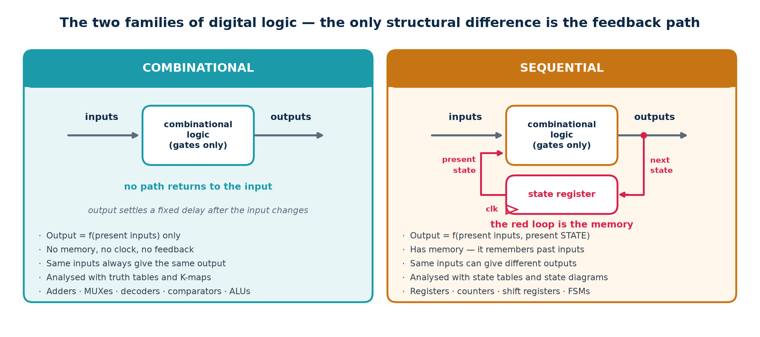
TOPIC 3B · DEFINITION
Combinational vs Sequential — The Only Real Difference
One structural feature separates the two families: a feedback path through a storage element. Everything else — that sequential circuits have memory, need a clock, and are analysed with state diagrams — follows from that one fact.
The formal definitions, worth memorising verbatim
Combinational: the output at any instant depends ONLY on the inputs at that instant (after a bounded settling delay).
Sequential: the output depends on the present inputs AND on the sequence of past inputs, summarised in a finite amount of stored STATE.
Module 2 · Verilog RTL Coding for Synthesis
NIE/ELE/N0102 · Topic 3 · 20

Slide 21
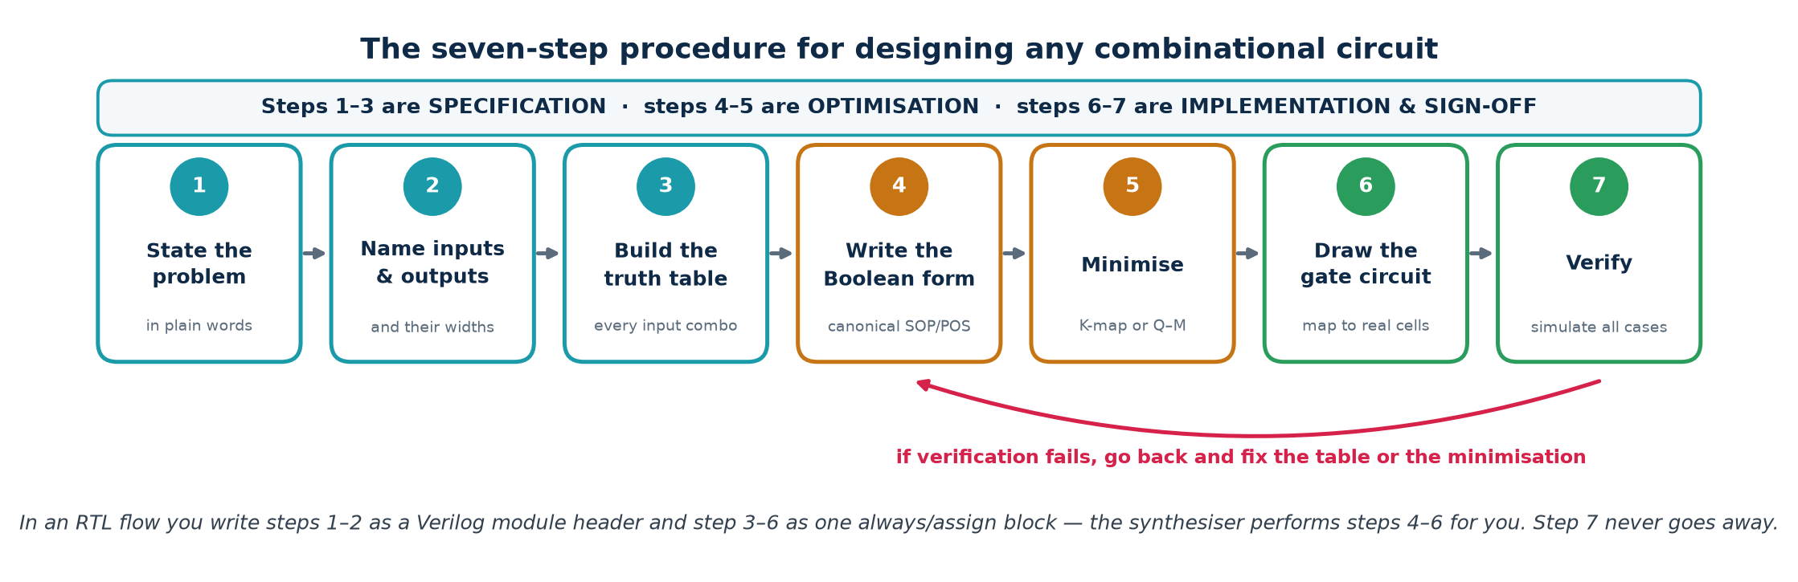
TOPIC 3B · PROCEDURE
The Seven-Step Combinational Design Procedure
Follow this every time, even when the answer looks obvious. Most combinational bugs come from an incomplete truth table at step 3 — a missing row, or a case nobody thought about.
Worked micro-example — steps 1 to 3
Steps 4 to 7
1. 'Light a warning LED when at least two of three sensors read high.'
2. Inputs A, B, C (1 bit each); output W (1 bit).
3. Truth table: W = 1 for ABC = 011, 101, 110, 111 — four of the eight rows.
4. W = A'BC + AB'C + ABC' + ABC (canonical SOP)
5. K-map → W = AB + BC + AC — the majority function again.
6. Three 2-input ANDs into one 3-input OR. 7. Simulate all 8 input cases.
Module 2 · Verilog RTL Coding for Synthesis
NIE/ELE/N0102 · Topic 3 · 21

Slide 22
TOPIC 3B · TIERED DEPTH
Understanding Combinational Logic at Four Levels
The same idea at four depths — pick the one that fits the room.
BASIC
A circuit with no memory. Change the inputs and, after a short delay, the outputs follow. Ask it the same question twice and you always get the same answer.
INTERMEDIATE
Built entirely from gates in an acyclic network. Fully described by a truth table. Standard blocks — adders, multiplexers, decoders, comparators — are reusable, well-understood patterns.
ADVANCED
Its speed is set by the critical path: the slowest input-to-output route, measured as a sum of gate delays plus wire RC. Multiple unequal paths to one output create hazards (glitches) even when the logic is correct.
INDUSTRY
Written as `assign` or `always @(*)` in RTL and left to synthesis, which restructures, resizes, buffers and technology-maps it against a timing constraint. Arithmetic is usually mapped to hand-tuned carry-lookahead or Wallace-tree macros, not to your literal gates.
Module 2 · Verilog RTL Coding for Synthesis
NIE/ELE/N0102 · Topic 3 · 22

Slide 23
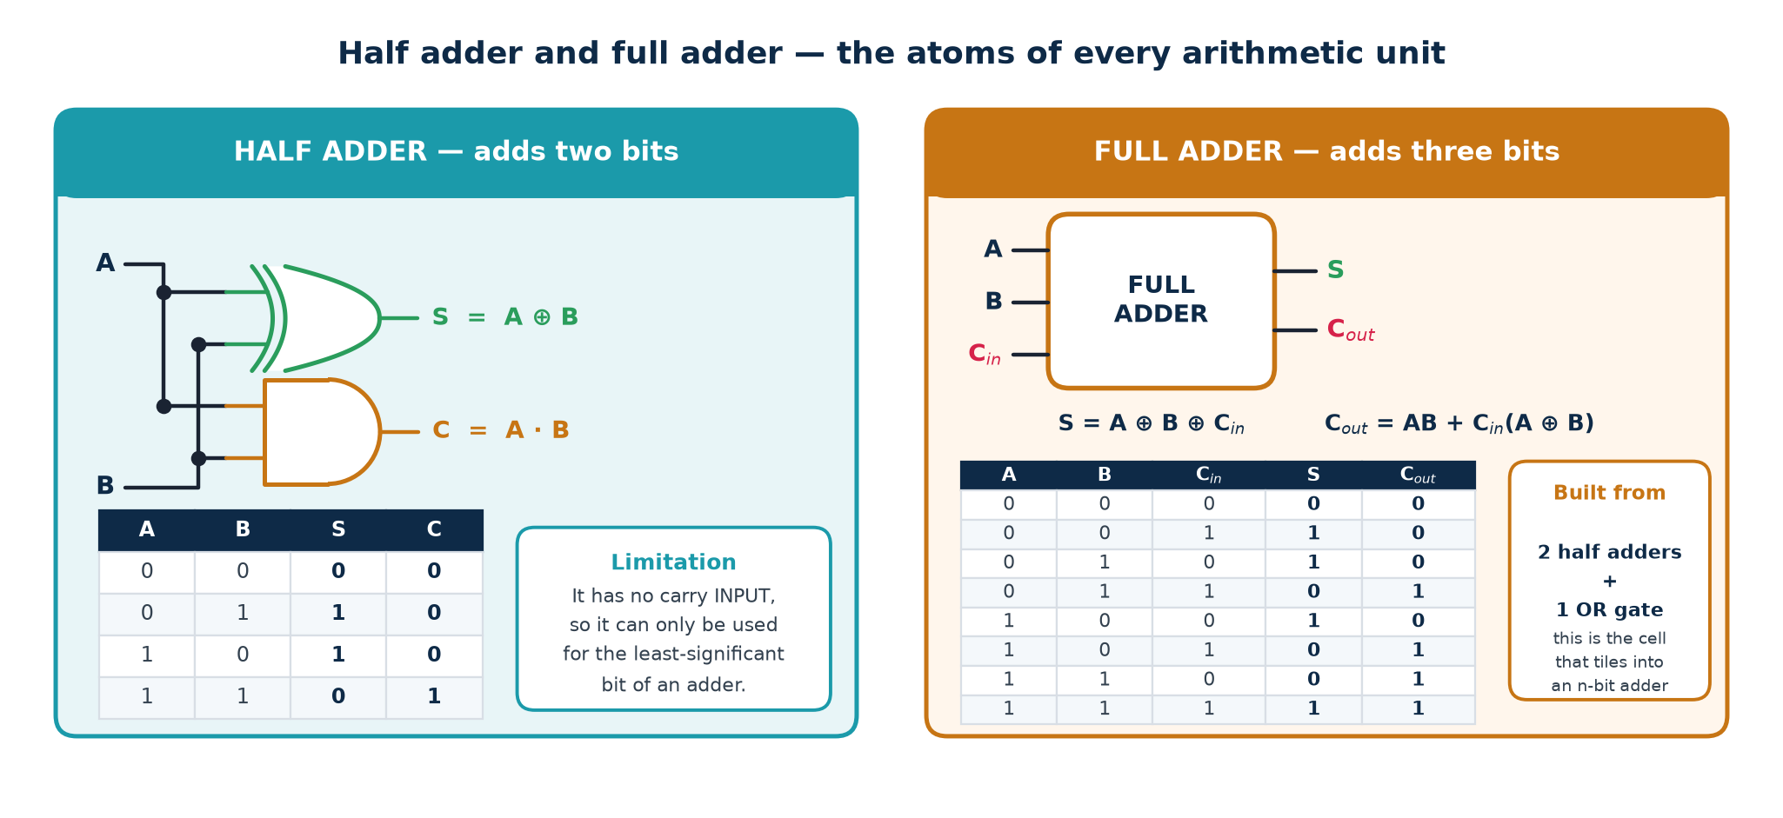
TOPIC 3B · ARITHMETIC
Half Adder and Full Adder
Binary addition is the most-used combinational function on any chip. It is built from one tiny cell — the full adder — repeated once per bit. Derive it once and you understand every adder, subtractor, multiplier and ALU that follows.
Subtraction comes free
A − B = A + (−B) = A + B' + 1. Feed B through XOR gates controlled by a sub signal (XOR with 1 inverts, XOR with 0 passes through) and tie that same sub to Cᵢₙ. One adder now does both operations — this is exactly the ADDER / SUBTRACTOR block in the ALU slide.
Module 2 · Verilog RTL Coding for Synthesis
NIE/ELE/N0102 · Topic 3 · 23

Slide 24
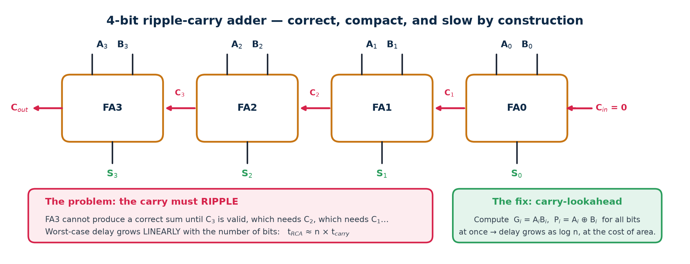
TOPIC 3B · THE CARRY PROBLEM
4-Bit Ripple-Carry Adder — Correct but Slow
Chain n full adders and you have an n-bit adder. It is minimal in area and trivially correct — and its delay grows linearly with n, which makes it the classic critical path in any first-attempt design.
Generate and Propagate
Carry-lookahead
Others you will meet
Gᵢ = AᵢBᵢ — this bit generates a carry regardless of Cᵢₙ.
Pᵢ = Aᵢ ⊕ Bᵢ — this bit propagates an incoming carry.
Cᵢ₊₁ = Gᵢ + PᵢCᵢ
Expand the recursion so every carry is a function of G/P only:
C₂ = G₁ + P₁G₀ + P₁P₀C₀ …
Delay ∝ log n instead of n — at the cost of much more area.
Carry-select, carry-skip, Brent–Kung, Kogge–Stone prefix adders.
Synthesis picks one for you from a `+` in Verilog, guided by your timing constraint.
Module 2 · Verilog RTL Coding for Synthesis
NIE/ELE/N0102 · Topic 3 · 24

Slide 25
TOPIC 3B · PRACTICAL EXAMPLE 3
Numerical: Critical Path and fₘₐₓ of a Ripple Adder
Given
A 4-bit ripple-carry adder built from full adders in a library where: carry-in to carry-out delay t_c = 90 ps, carry-in to sum delay t_s = 120 ps, and the input operands are driven by registers with t_cq = 60 ps into registers needing t_setup = 50 ps.
Answer the question in five steps — always state the path first
Step 1 Identify the critical path.
It runs A0/B0 -> C1 -> C2 -> C3 -> S3 (the last SUM, not the last carry).
Step 2 Count the stages on that path.
3 carry hops (FA0, FA1, FA2) + 1 final sum (FA3)
t_adder = 3 x t_c + t_s = 3 x 90 + 120 = 270 + 120 = 390 ps
Step 3 Add the register overhead to get the clock period.
T_clk >= t_cq + t_adder + t_setup
= 60 + 390 + 50 = 500 ps
Step 4 f_max = 1 / T_clk = 1 / 500 ps = 2.0 GHz
Step 5 Generalise to n bits: t_adder = (n-1) x t_c + t_s
n = 32 -> 31 x 90 + 120 = 2910 ps -> T_clk = 3020 ps -> f_max = 331 MHz
The lesson
The 4-bit adder runs at 2 GHz; the same design at 32 bits collapses to 331 MHz. Delay is linear in n, so frequency is roughly inverse-linear. This is precisely the calculation that forces a designer to move from ripple-carry to carry-lookahead, or to pipeline the adder across two clock cycles.
Module 2 · Verilog RTL Coding for Synthesis
NIE/ELE/N0102 · Topic 3 · 25

Slide 26
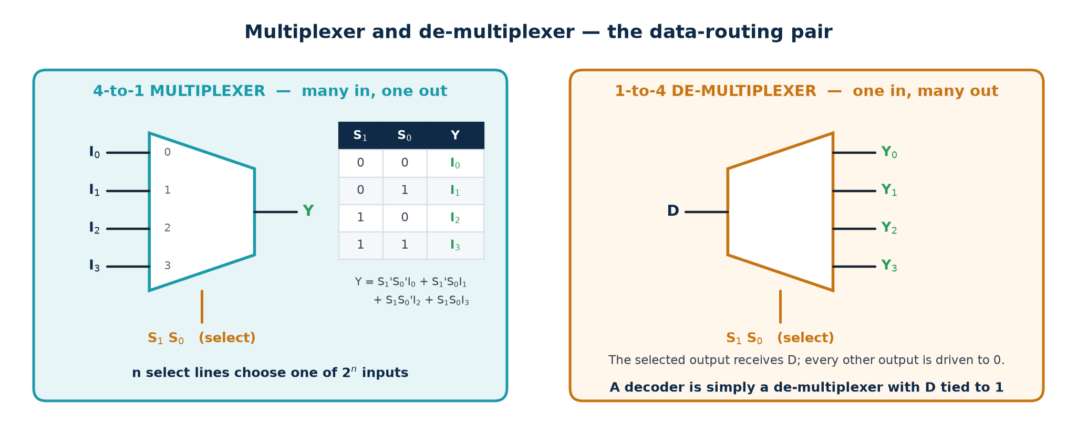
TOPIC 3B · DATA ROUTING
Multiplexers and De-multiplexers
A multiplexer is a controllable switch: n select lines choose one of 2ⁿ data inputs to appear at the output. It is the single most common structure in real hardware — every if, every case, every shared bus and every ALU function select becomes a MUX after synthesis.
In Verilog, all of these are MUXes
Why the size matters
assign y = sel ? a : b;
if (sel) y = a; else y = b;
case (sel) 2'b00: y = i0; ...
A 2ⁿ:1 MUX on an m-bit bus costs roughly 2ⁿ × m AND-OR pairs. A careless 16-way case on a 32-bit bus is 512 gates — and its delay grows with the number of select levels.
Module 2 · Verilog RTL Coding for Synthesis
NIE/ELE/N0102 · Topic 3 · 26

Slide 27
TOPIC 3B · A USEFUL TRICK
The Multiplexer as a Universal Logic Element
A 2ⁿ:1 MUX can implement ANY function of n variables — just wire the truth-table output column to the data inputs and the variables to the select lines. This is not a curiosity: it is exactly how an FPGA look-up table (LUT) works.
The construction
Halving the MUX
Why FPGAs are built this way
Target: F(A,B,C) = Σm(1,3,5,6).
Use an 8:1 MUX with S₂S₁S₀ = A,B,C.
Tie I₁ = I₃ = I₅ = I₆ = 1 and every other data input to 0.
Done — no minimisation needed at all.
A 4:1 MUX also suffices: use A,B as select and feed each data input with one of 0, 1, C or C'.
Read pairs of truth-table rows: 00 → C, 01 → C, 10 → C, 11 → C'.
In general an n-variable function needs only a 2ⁿ⁻¹:1 MUX.
An FPGA logic cell is a small SRAM (typically a 6-input LUT = a 64:1 MUX with programmable data bits) plus a flip-flop.
Programming an FPGA literally means writing truth tables into those SRAM cells.
Consequence for your RTL
On an FPGA, a 6-input function and a 2-input function cost the SAME single LUT. Deliberately splitting logic into tiny pieces therefore buys you nothing and can cost you levels of delay. On an ASIC the opposite is true. Know your target before you optimise.
Module 2 · Verilog RTL Coding for Synthesis
NIE/ELE/N0102 · Topic 3 · 27

Slide 28
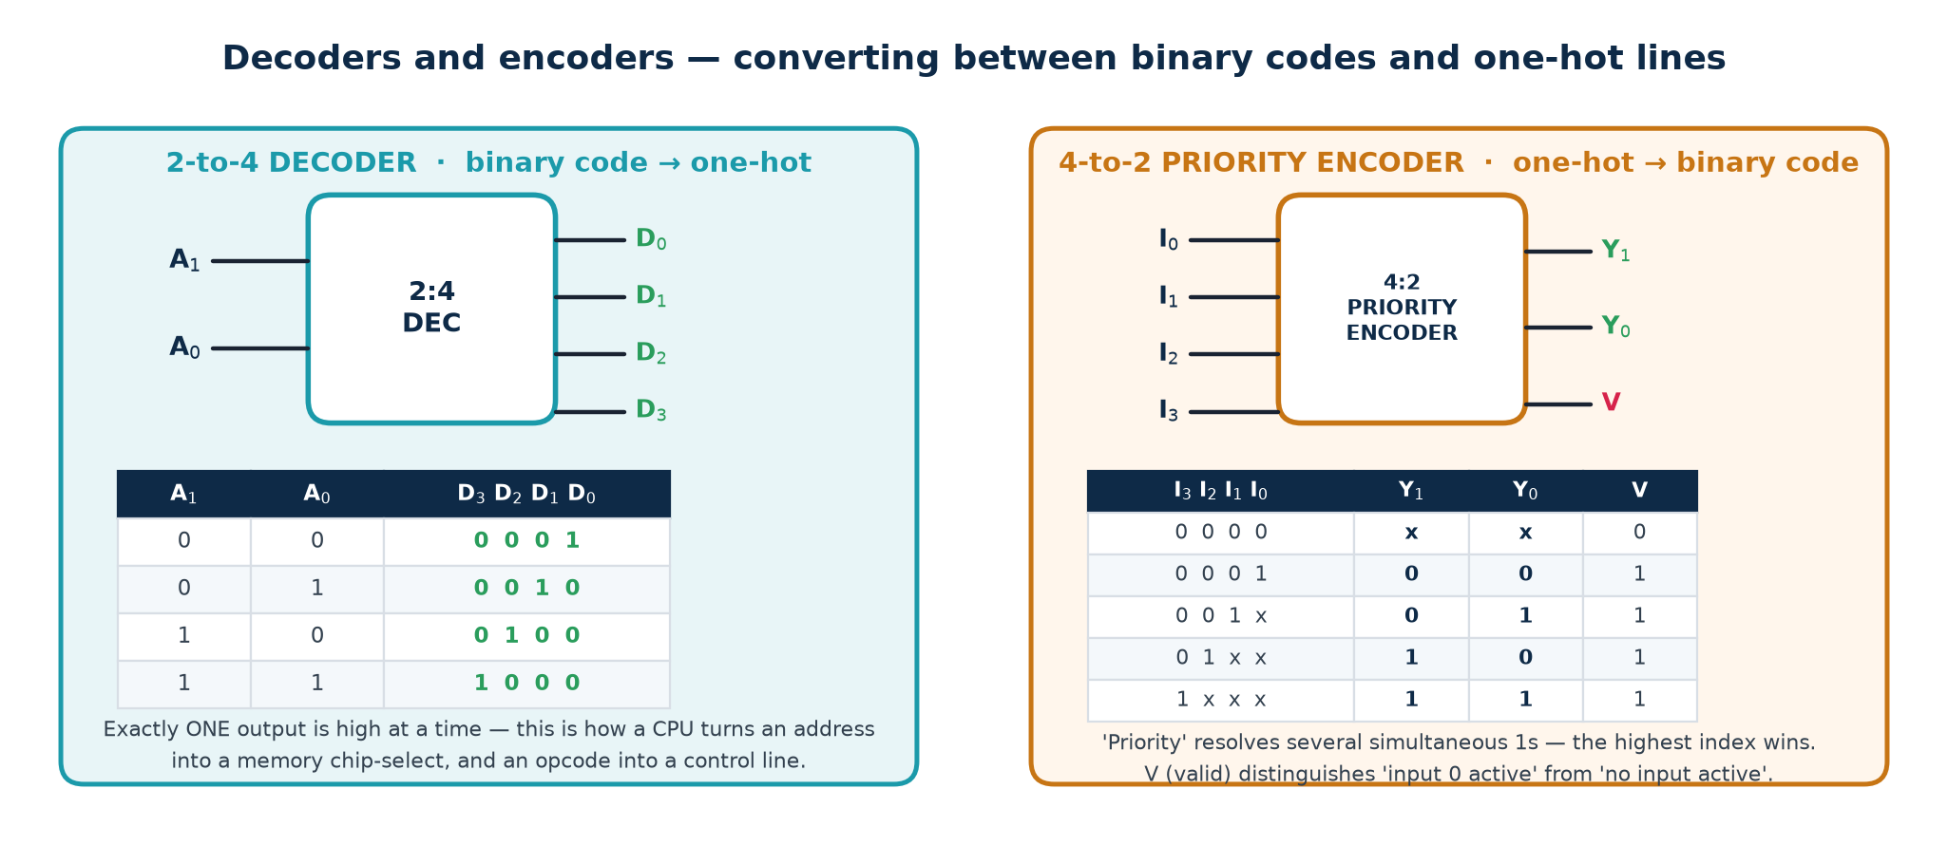
TOPIC 3B · CODE CONVERSION
Decoders, Encoders and Priority Encoders
A decoder turns a compact binary code into one-hot select lines; an encoder does the reverse. Address decode, instruction decode, chip-select generation and interrupt arbitration are all this one pattern.
Enable inputs
Why plain encoders are broken
Real decoders have an EN pin: when EN = 0 every output is inactive. This is how several decoders are cascaded to build a larger one (two 2:4 + one 1:2 = a 3:8 decoder).
A plain 4:2 encoder assumes exactly one input is high. If two are, it outputs the OR of their codes — a value that is simply wrong. A PRIORITY encoder resolves this, and the V (valid) output distinguishes 'input 0 active' from 'nothing active'.
Module 2 · Verilog RTL Coding for Synthesis
NIE/ELE/N0102 · Topic 3 · 28

Slide 29
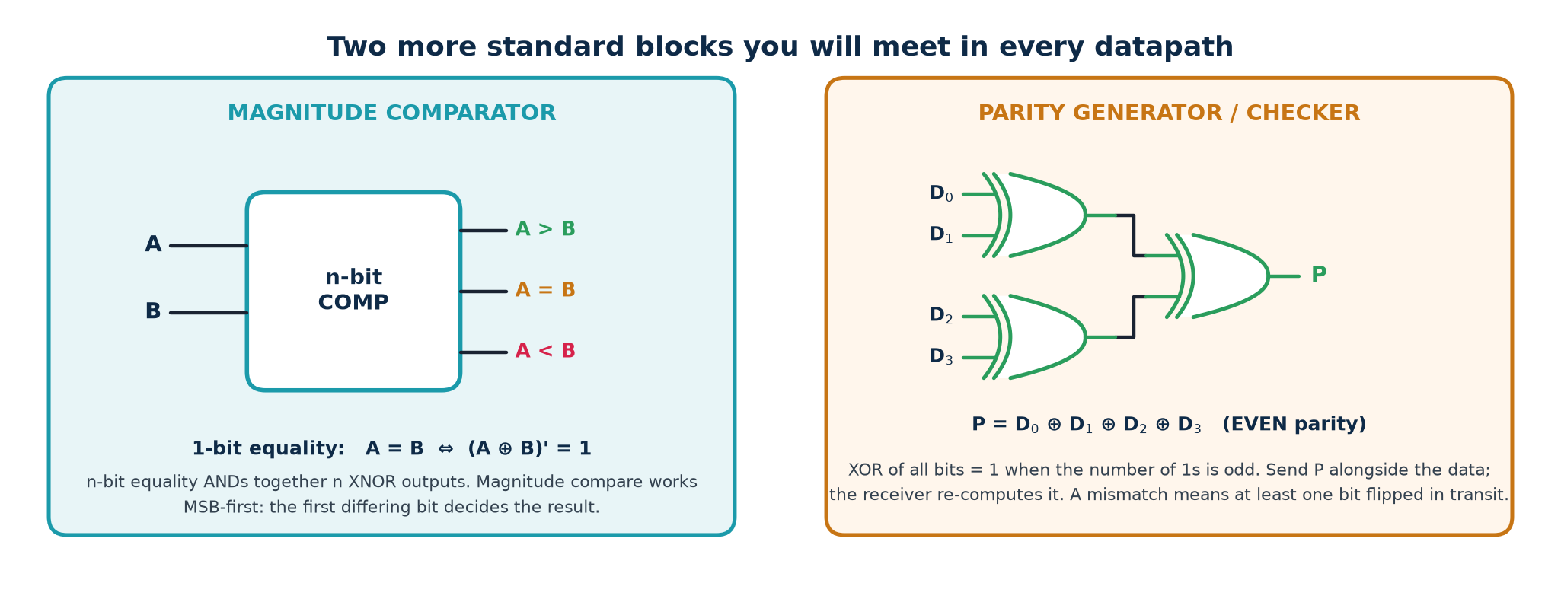
TOPIC 3B · MORE BLOCKS
Comparators, Parity and Other Standard Cells
Comparator — building it up
Parity — one XOR tree
Also in every library
1-bit equal: e = (A ⊕ B)'
n-bit equal: AND all n of those
Greater-than works MSB-first: A > B if the highest bit where they differ has A = 1. In Verilog this is just `A > B` and synthesis builds the ripple for you.
Even parity bit P = XOR of all data bits.
Detects ANY odd number of bit flips, but cannot correct and misses even ones. For real protection use Hamming or ECC — the same XOR-tree idea, more bits.
· Barrel shifter (a MUX per output bit)
· Priority arbiter
· Binary ↔ Gray converter
· Leading-zero counter
Trainer note: ask the class to derive the 1-bit equality gate before you show it — XNOR-as-equality is the single most useful gate identity in this whole topic.
Module 2 · Verilog RTL Coding for Synthesis
NIE/ELE/N0102 · Topic 3 · 29

Slide 30
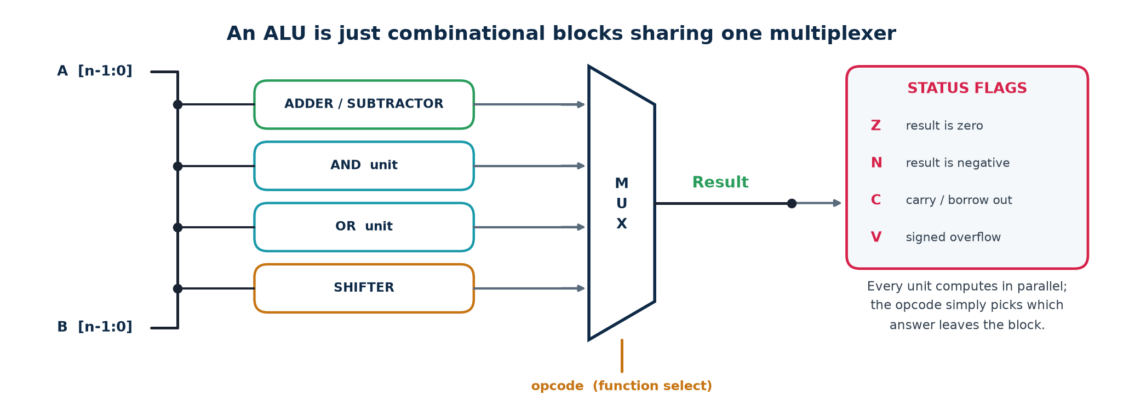
TOPIC 3B · PUTTING BLOCKS TOGETHER
An Arithmetic Logic Unit Is Just a MUX of Blocks
An ALU looks intimidating and is structurally trivial: run every operation in parallel on the same operands and use the opcode to select which answer leaves the block. It wastes power computing results you throw away — and it is fast, regular and easy to verify, which usually wins.
The status flags — and the mistake everyone makes with V
Z = result is all zeros (a NOR of every result bit). N = MSB of the result (the sign bit in two's complement). C = carry out of the MSB — meaningful for UNSIGNED overflow.
V = SIGNED overflow, and it is NOT the same as C. V = Cₙ ⊕ Cₙ₋₁ : the carry INTO the sign bit differs from the carry OUT of it. Adding two positives and getting a negative is the classic case.
Module 2 · Verilog RTL Coding for Synthesis
NIE/ELE/N0102 · Topic 3 · 30

Slide 31
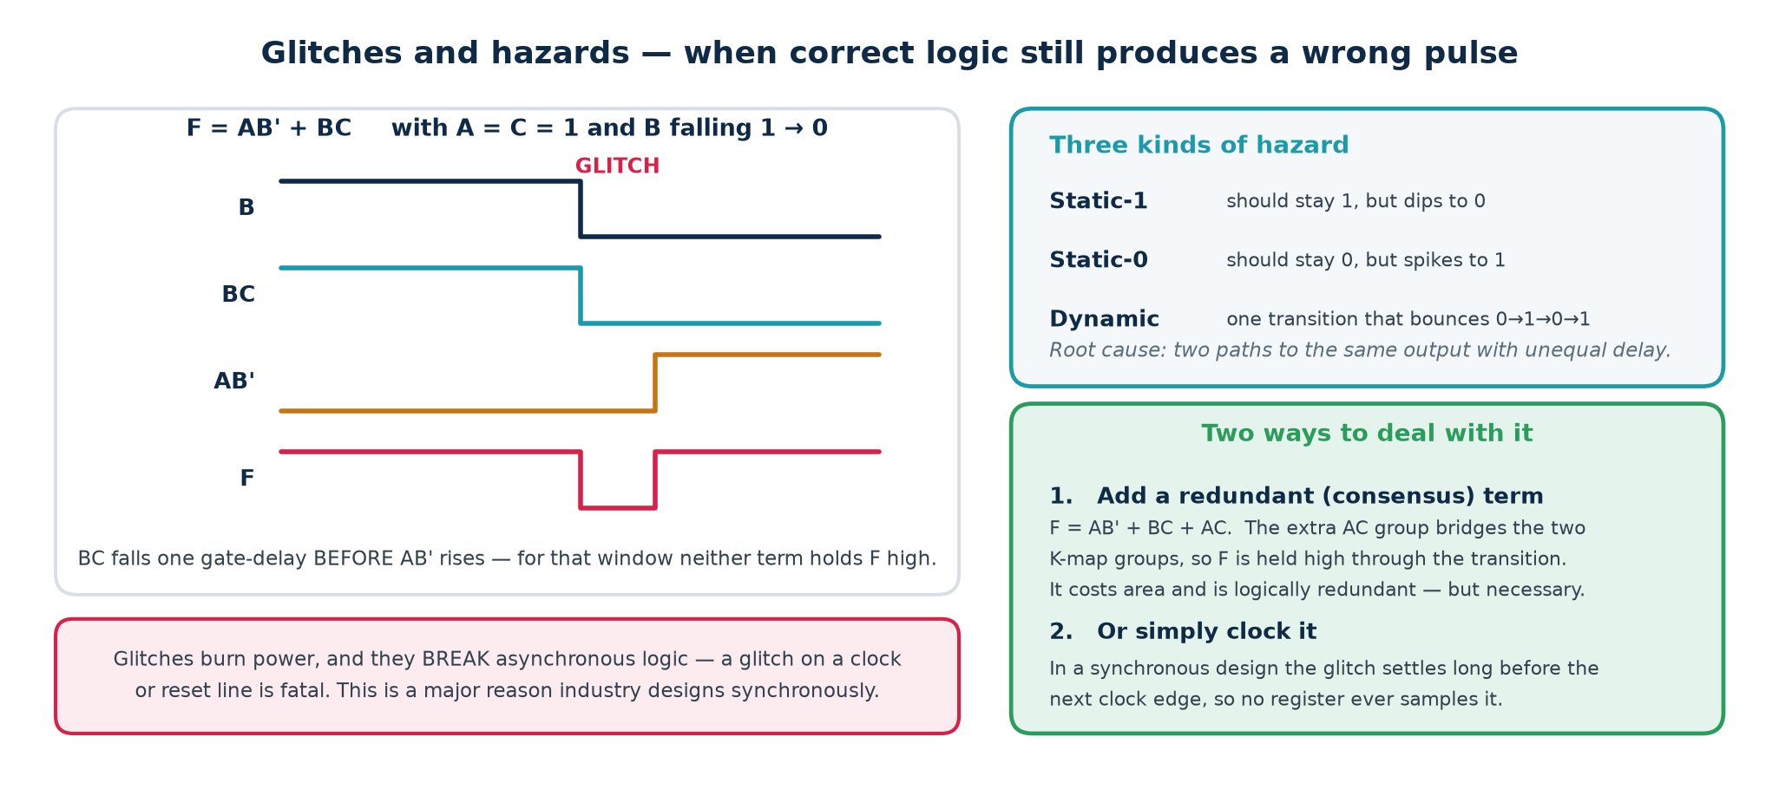
TOPIC 3B · HAZARDS
Glitches — When Correct Logic Produces a Wrong Pulse
A hazard is a momentary wrong output caused purely by unequal path delays. The steady-state logic is perfectly correct; the transient is not. Understanding this is what makes the case for synchronous design.
Where a glitch is harmless — and where it kills the chip
Harmless: feeding the D input of a flip-flop, provided it settles before the next clock edge. This is the normal case and why we design synchronously.
Fatal: on a clock line, a reset line, an asynchronous set/clear, a write-enable to memory, or any signal leaving the chip. Never generate a clock from combinational logic.
Module 2 · Verilog RTL Coding for Synthesis
NIE/ELE/N0102 · Topic 3 · 31

Slide 32
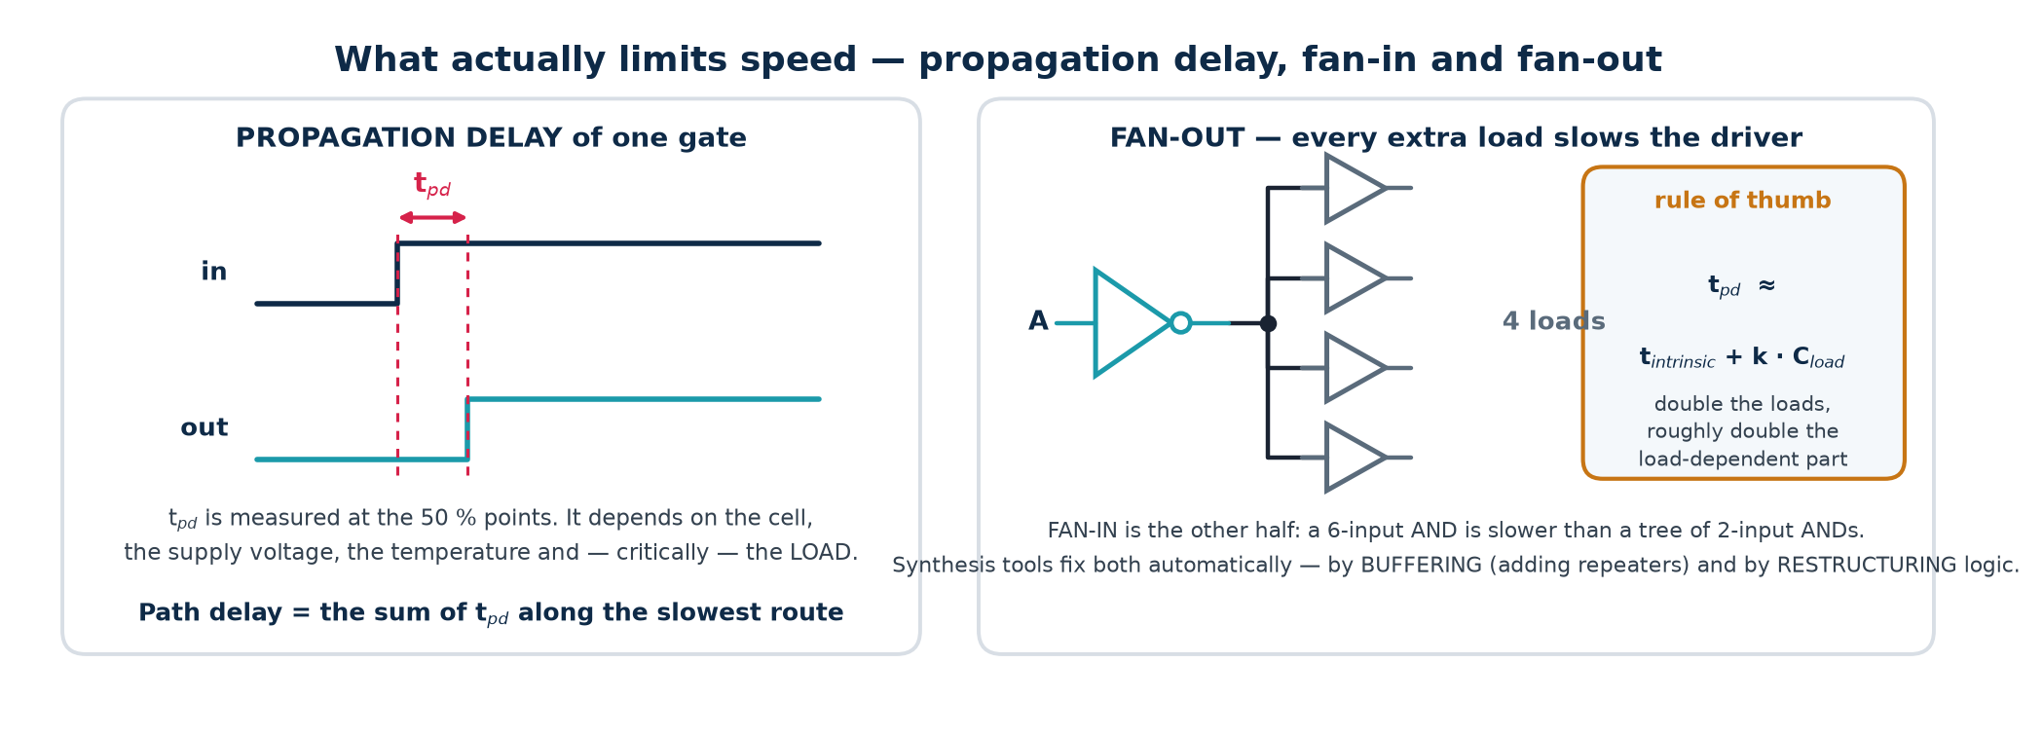
TOPIC 3B · WHAT LIMITS SPEED
Propagation Delay, Fan-In and Fan-Out
Terms
Why fan-out costs time
Why fan-in costs time
t_pd propagation delay of one gate
Fan-in inputs on one gate
Fan-out loads driven by one output
Critical path slowest route through the block
Each load adds gate capacitance. Charging more capacitance through the same driver resistance takes longer — delay rises roughly linearly with load.
Fix: insert buffers, or size the driver up.
A CMOS gate stacks transistors in series per input, so a 6-input NAND is far slower than a tree of 2-input NANDs.
Fix: let synthesis restructure — or write balanced expressions yourself.
Static timing analysis (STA), covered in Topic 6, is nothing more than this arithmetic done automatically over every path in the design.
Module 2 · Verilog RTL Coding for Synthesis
NIE/ELE/N0102 · Topic 3 · 32

Slide 33
TOPIC 3B · IN VERILOG
Writing Combinational Logic — and the Inferred-Latch Trap
Three ways to write pure combinational logic, and one way to get it catastrophically wrong.
Combinational always blocks: blocking assignments, complete assignment
// 1. Continuous assignment - always safe, always combinational
assign y = (a & b) | (~a & c);
// 2. always @(*) with BLOCKING assignments (=) and a DEFAULT
always @(*) begin
y = 1'b0; // <-- default first: kills every latch
case (sel)
2'b00: y = i0;
2'b01: y = i1;
default: y = 1'b0;
endcase
end
// 3. WRONG - incomplete assignment infers a transparent LATCH
always @(*) begin
if (enable) y = d; // no else -> 'hold y' -> latch
end
The three rules
How to catch it
1. Use = (blocking) in combinational blocks, never <=.
2. Assign every output on every path — a default at the top is the easiest way.
3. Use always @(*) never a hand-written sensitivity list.
Yosys prints: $_DLATCH_ cells in the statistics.
Commercial tools warn 'inferred latch for signal y'.
Treat every such warning as an ERROR. There is no case in this course where you want an unintended latch.
Module 2 · Verilog RTL Coding for Synthesis
NIE/ELE/N0102 · Topic 3 · 33

Slide 34
SUBTOPIC 3C
Sequential Logic, Flip-Flops, Registers and State Machines
Circuits that remember — where time, the clock and state enter the design.
The clock, latches, flip-flops and how edge-triggering is actually built
Setup, hold, clock-to-Q, metastability, skew and the fₘₐₓ calculation
Registers, shift registers and counters
Finite state machines: Moore, Mealy, encoding, and the Verilog template
Module 2 · Verilog RTL Coding for Synthesis
NIE/ELE/N0102 · Topic 3 · 34

Slide 35
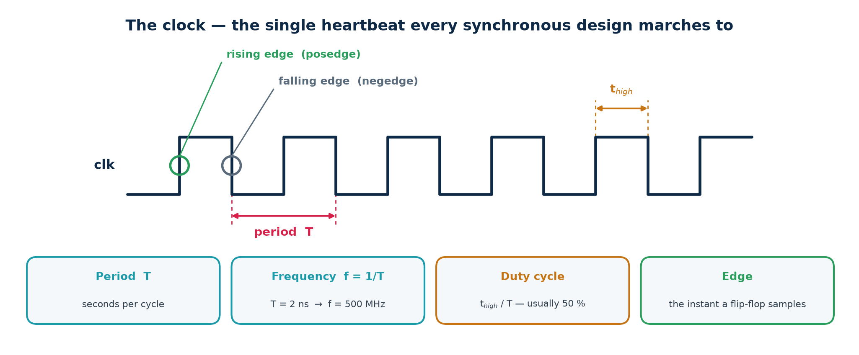
TOPIC 3C · THE CLOCK
The Clock — One Heartbeat for the Whole Design
Synchronous design means every storage element in a block changes at the same instant, on the same edge of one clock. That single convention is what makes a billion-transistor chip analysable at all: it reduces 'does this circuit work?' to a set of arithmetic checks on one clock period.
Worked conversions
Two rules that are never broken in RTL
T = 10 ns → f = 100 MHz. T = 2 ns → f = 500 MHz. T = 400 ps → f = 2.5 GHz.
f = 3.2 GHz → T = 312.5 ps.
1. Never generate a clock in combinational logic — use a clock enable instead.
2. Never mix posedge and negedge of the same clock in one design without a very good, documented reason.
Module 2 · Verilog RTL Coding for Synthesis
NIE/ELE/N0102 · Topic 3 · 35

Slide 36
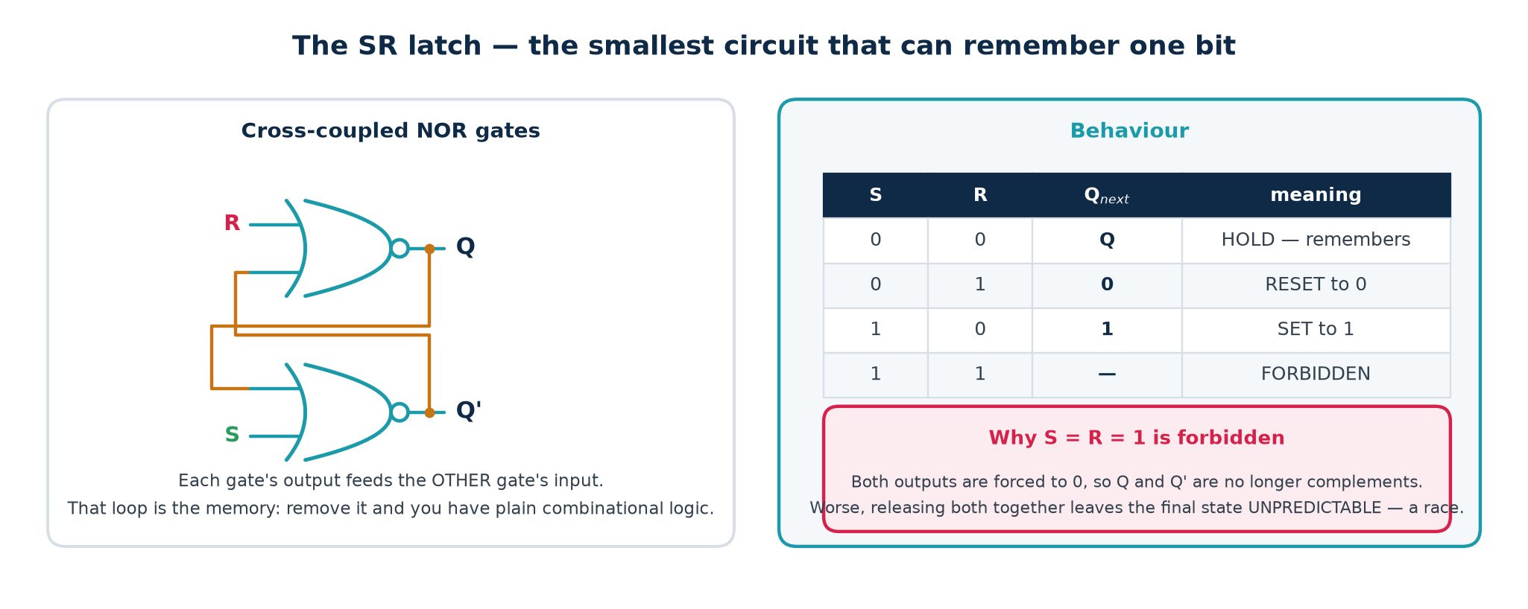
TOPIC 3C · THE FIRST MEMORY
The SR Latch — Cross-Coupling Creates Memory
Take two NOR gates and feed each one's output back into the other. The circuit now has two stable configurations and will sit in whichever one you last pushed it into. That is memory — and it is the ancestor of every flip-flop, register and SRAM cell on the chip.
Where you actually meet an SR latch
Rarely by choice in RTL — but it is the internal structure of every D latch, and a NAND version (active-low S̄R̄) is the standard hardware de-bouncer for a mechanical switch. It is also what an accidental combinational feedback loop in your Verilog turns into, which is why simulators warn about them.
Module 2 · Verilog RTL Coding for Synthesis
NIE/ELE/N0102 · Topic 3 · 36

Slide 37
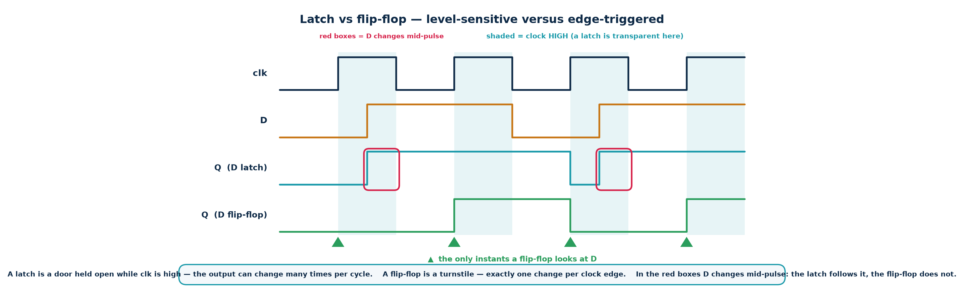
TOPIC 3C · THE KEY DISTINCTION
Latch vs Flip-Flop — The Difference That Matters Most
A latch is LEVEL-sensitive: it is transparent for as long as its enable is high. A flip-flop is EDGE-triggered: it samples once, at one instant. Everything about timing analysis assumes flip-flops. Get this wrong and nothing downstream works.
Latch
Flip-flop
Transparent while EN = 1
Output may change many times per cycle
Smaller and lower power
Hard to time; usually unintended
Samples only on the clock edge
Exactly one change per cycle
About twice the area of a latch
The only element you should infer
Module 2 · Verilog RTL Coding for Synthesis
NIE/ELE/N0102 · Topic 3 · 37

Slide 38
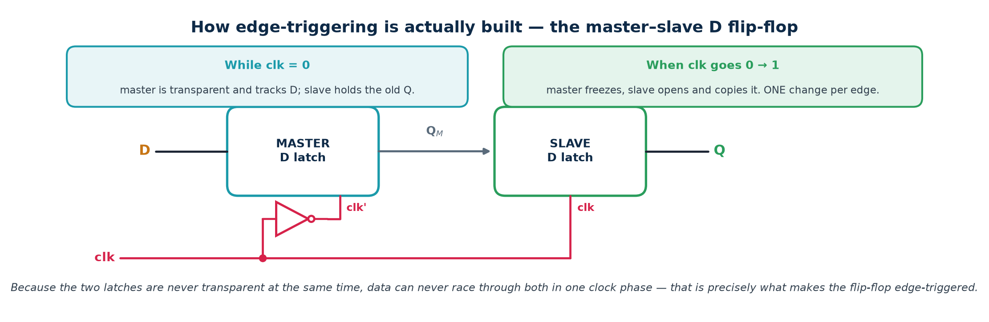
TOPIC 3C · CONSTRUCTION
How Edge-Triggering Is Built — The Master–Slave Pair
A flip-flop is two latches in series driven by opposite clock phases. Because they are never transparent at the same time, data cannot race through both in one clock phase — and that, precisely, is edge-triggering.
Why this matters to you as an RTL designer
It explains where t_setup, t_hold and t_cq physically come from: setup is the time the master latch needs to capture, hold is the time before the master closes, and t_cq is the delay through the slave. It also explains why a flip-flop is roughly twice the area of a latch — you are paying for two storage nodes.
Module 2 · Verilog RTL Coding for Synthesis
NIE/ELE/N0102 · Topic 3 · 38

Slide 39
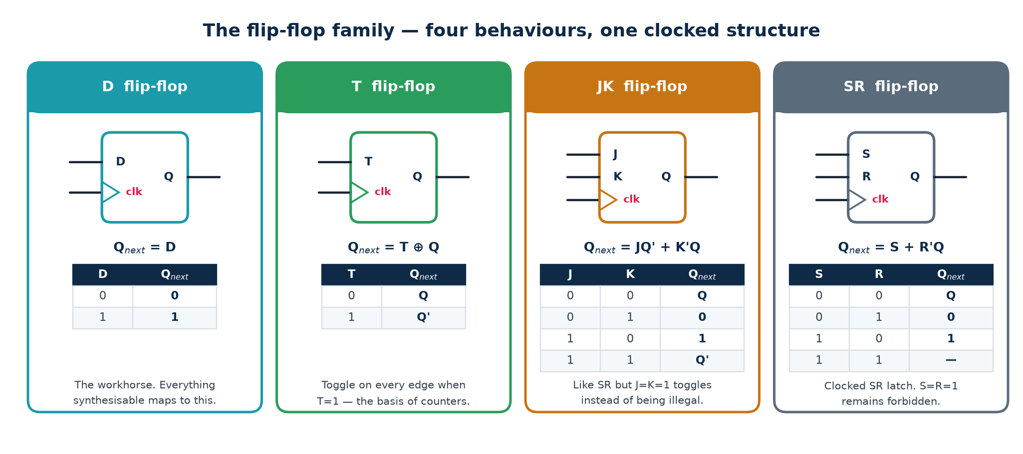
TOPIC 3C · THE FAMILY
D, T, JK and SR Flip-Flops
Four behaviours, one clocked structure. In modern design only the D flip-flop is ever instantiated — but you must be able to read and convert between all four, because textbooks, exams and legacy schematics use them all.
Why the D flip-flop won
It has no forbidden state, no toggle surprise, and its next state is simply its input — which means synthesis can map any state equation directly onto it. Standard-cell libraries therefore contain dozens of D flip-flop variants (with/without reset, set, enable, scan) and no JK at all. If you need a T or JK, build it from a D plus a little logic.
Module 2 · Verilog RTL Coding for Synthesis
NIE/ELE/N0102 · Topic 3 · 39

Slide 40
TOPIC 3C · TABLES YOU NEED
Characteristic and Excitation Tables, and FF Conversion
A characteristic table answers 'given the inputs, what is the next state?'. An excitation table answers the reverse — 'to make this transition happen, what inputs do I need?'. You use the characteristic table to ANALYSE a circuit and the excitation table to DESIGN one.
Q → Q_next
D
T
J K
S R
0 → 0
0
0
0 ×
0 ×
0 → 1
1
1
1 ×
1 0
1 → 0
0
1
× 1
0 1
1 → 1
1
0
× 0
× 0
Characteristic equations
Converting one to another
D-FF: Q⁺ = D
T-FF: Q⁺ = T ⊕ Q
JK-FF: Q⁺ = J·Q' + K'·Q
SR-FF: Q⁺ = S + R'·Q (SR ≠ 11)
Put the target's excitation table beside the source's, K-map the required source inputs as functions of (present state, target inputs), and add that logic in front.
D from T: D = T ⊕ Q T from D: T = D ⊕ Q
The × entries are don't-cares — and they are exactly what makes JK-based designs minimise so well on paper.
Module 2 · Verilog RTL Coding for Synthesis
NIE/ELE/N0102 · Topic 3 · 40

Slide 41
TOPIC 3C · INITIALISATION
Reset — Synchronous vs Asynchronous
At power-up every flip-flop holds an unknown value. Reset is what forces the design into a known starting state. Choosing the wrong style, or releasing reset carelessly, produces bugs that only appear on real silicon.
The two templates — memorise both exactly
// ASYNCHRONOUS reset - reset appears in the sensitivity list
always @(posedge clk or posedge rst)
if (rst) q <= 1'b0;
else q <= d;
// SYNCHRONOUS reset - reset is just another input to the D logic
always @(posedge clk)
if (rst) q <= 1'b0;
else q <= d;
Asynchronous
Synchronous
What industry actually does
Takes effect immediately, clock or no clock.
Essential at power-up, when the PLL has not locked and there is no clock yet.
Danger: its RELEASE is asynchronous and can violate recovery/removal time — so it must be de-asserted synchronously.
Takes effect only on a clock edge.
Fully covered by normal static timing analysis; no special constraints; filters glitches on the reset line.
Danger: useless if the clock is not running.
Asynchronous assert, synchronous de-assert — the 'reset synchroniser'.
Two flip-flops clocked by the destination clock, with their async reset tied to the raw reset. Best of both.
Also note: on most FPGAs a global reset costs routing resources and is often unnecessary because the bitstream initialises every flip-flop. On an ASIC it is mandatory.
Module 2 · Verilog RTL Coding for Synthesis
NIE/ELE/N0102 · Topic 3 · 41

Slide 42
TOPIC 3C · TIERED DEPTH
Understanding Sequential Logic at Four Levels
The same idea at four depths.
BASIC
A circuit that remembers. Its output depends not only on what you feed it now but on what happened before. A clock tells it when to update.
INTERMEDIATE
Combinational logic plus flip-flops in a feedback loop. The flip-flops hold the STATE; the logic computes the next state and the outputs. Counters, shift registers and controllers are all this shape.
ADVANCED
Correctness is a timing property, not just a logic one: every path must satisfy T ≥ t_cq + t_logic + t_setup and t_cq + t_logic,min ≥ t_hold. Any input not synchronous to the clock must be synchronised or it will cause metastability.
INDUSTRY
Written as `always @(posedge clk)` with non-blocking assignments. Timing is closed by STA against SDC constraints; clock trees are balanced by CTS; every clock-domain crossing is reviewed as a first-class design artefact — CDC bugs are the leading cause of silicon respins.
Module 2 · Verilog RTL Coding for Synthesis
NIE/ELE/N0102 · Topic 3 · 42

Slide 43
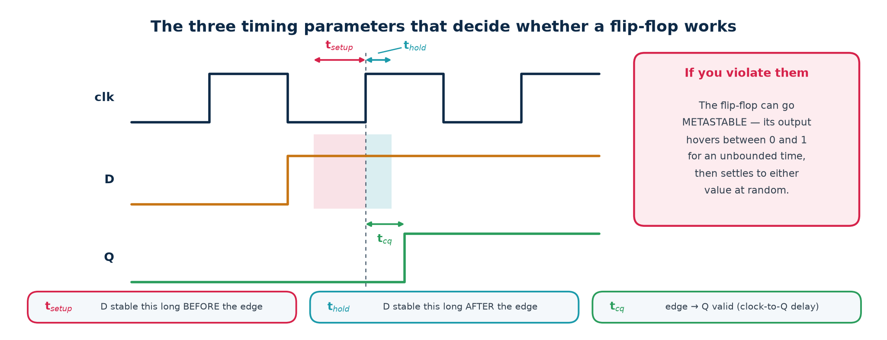
TOPIC 3C · TIMING PARAMETERS
Setup, Hold and Clock-to-Q
A flip-flop is not instantaneous. It requires the data to be steady for a window around the clock edge, and it takes time to produce its output afterwards. These three numbers come from the library datasheet and are the entire basis of timing analysis.
Setup violation
Hold violation
Clock-to-Q
Data arrives TOO LATE. Fix by shortening the logic path, or by slowing the clock. A setup problem is a speed problem.
Data arrives TOO EARLY and overwrites the value being captured. Fix by ADDING delay (buffers) on the short path. Slowing the clock does not help at all.
Not a constraint but a cost — it eats into every clock period before your logic even starts. Faster (larger) flip-flops have smaller t_cq and larger area and power.
Module 2 · Verilog RTL Coding for Synthesis
NIE/ELE/N0102 · Topic 3 · 43

Slide 44
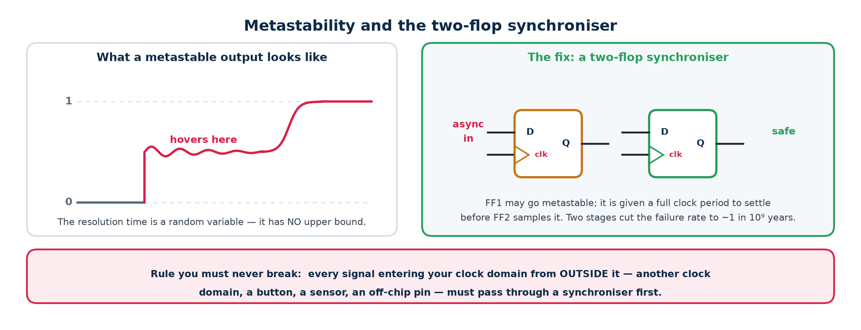
TOPIC 3C · METASTABILITY
When the Rules Are Broken — Metastability
If data changes inside the setup/hold window, the flip-flop may enter a metastable state: its output hovers at an invalid intermediate voltage for an unbounded time, then resolves randomly to 0 or 1. It cannot be prevented — only made astronomically unlikely.
MTBF — the number you quote in a design review
MTBF = e^(t_r / τ) / (T₀ · f_clk · f_data) where t_r is the resolution time you allow, τ and T₀ are library constants, and f_clk, f_data are the clock and data-change rates.
Because t_r sits in an exponential, adding ONE more synchroniser flip-flop typically moves MTBF from seconds to millions of years. That is why two stages is the universal minimum and three is used for very high-speed or safety-critical crossings.
Module 2 · Verilog RTL Coding for Synthesis
NIE/ELE/N0102 · Topic 3 · 44

Slide 45
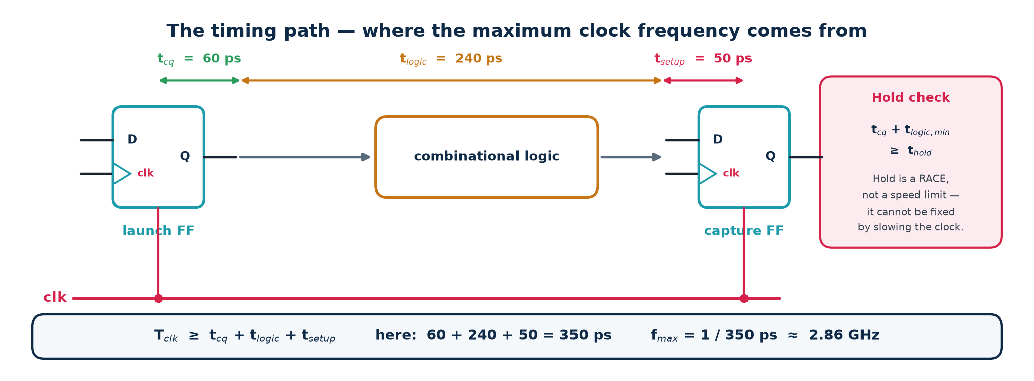
TOPIC 3C · THE TIMING PATH
Where the Maximum Clock Frequency Comes From
Every synchronous design reduces to this one picture: a launching flip-flop, some combinational logic, and a capturing flip-flop. The clock period must be long enough for a signal to get all the way across before the next edge arrives.
The two checks, and what each one means
Setup (max delay): T_clk ≥ t_cq + t_logic,max + t_setup + t_skew + t_jitter. The LONGEST path sets your maximum frequency.
Hold (min delay): t_cq + t_logic,min ≥ t_hold + t_skew. The SHORTEST path must still be long enough. This check is frequency-independent — a hold violation is broken at DC.
Module 2 · Verilog RTL Coding for Synthesis
NIE/ELE/N0102 · Topic 3 · 45

Slide 46
TOPIC 3C · PRACTICAL EXAMPLE 4
Numerical: fₘₐₓ, Slack and the Hold Check
Given
t_cq = 60 ps, t_setup = 50 ps, t_hold = 40 ps, clock skew = 25 ps (capture clock arrives LATE), jitter = 15 ps. The combinational path between two flip-flops has t_logic,max = 240 ps and t_logic,min = 30 ps. Target frequency 2.0 GHz.
Do setup and hold as two separate calculations — never together
SETUP CHECK
Required period T_req = t_cq + t_logic,max + t_setup + t_jitter - t_skew
= 60 + 240 + 50 + 15 - 25 (late capture clock HELPS setup)
= 340 ps
f_max = 1 / 340 ps = 2.94 GHz
Target 2.0 GHz -> T_target = 500 ps
SETUP SLACK = 500 - 340 = +160 ps PASS (positive slack = met)
HOLD CHECK
Required: t_cq + t_logic,min >= t_hold + t_skew
60 + 30 >= 40 + 25
90 >= 65
HOLD SLACK = 90 - 65 = +25 ps PASS
WHAT IF the short path were only 5 ps of logic?
60 + 5 = 65 >= 65 -> slack = 0 ps, marginal; the tool would insert delay buffers.
Sign convention
Note on skew
Positive slack = requirement met, with margin to spare.
Negative slack = VIOLATION. The number tells you by how much.
A late capture clock helps setup and hurts hold — which is why skew appears with opposite signs in the two checks. Getting that sign wrong is the single most common exam mistake.
Module 2 · Verilog RTL Coding for Synthesis
NIE/ELE/N0102 · Topic 3 · 46

Slide 47
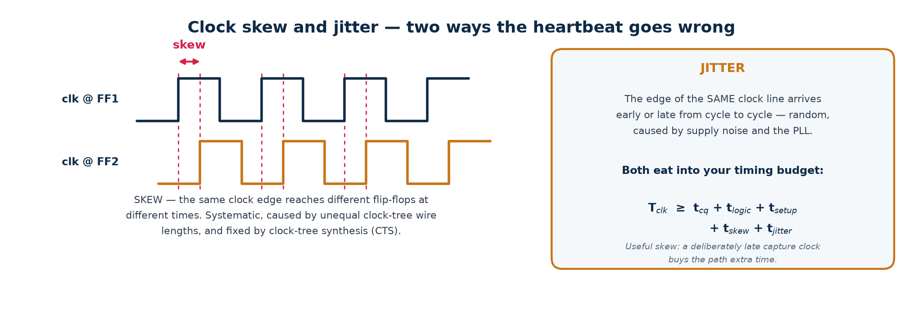
TOPIC 3C · CLOCK QUALITY
Clock Skew and Jitter
The idealisation that 'the clock edge arrives everywhere at once' is false. Skew is a fixed difference between flip-flops; jitter is a random difference between cycles. Both are subtracted from the time available for your logic.
Skew — systematic
Jitter — random
Useful skew
Cause: unequal clock-tree path lengths and loads.
Fixed by clock-tree synthesis (CTS), which inserts buffers to balance every branch to within a few tens of picoseconds.
Cause: PLL noise, supply droop, crosstalk, temperature.
Cannot be designed out; budgeted as an uncertainty in the SDC constraints and paid for out of every clock period.
Deliberately delaying a capture clock borrows time for a slow path from the next stage. Powerful, and dangerous — it tightens the hold check on the same path.
Module 2 · Verilog RTL Coding for Synthesis
NIE/ELE/N0102 · Topic 3 · 47

Slide 48
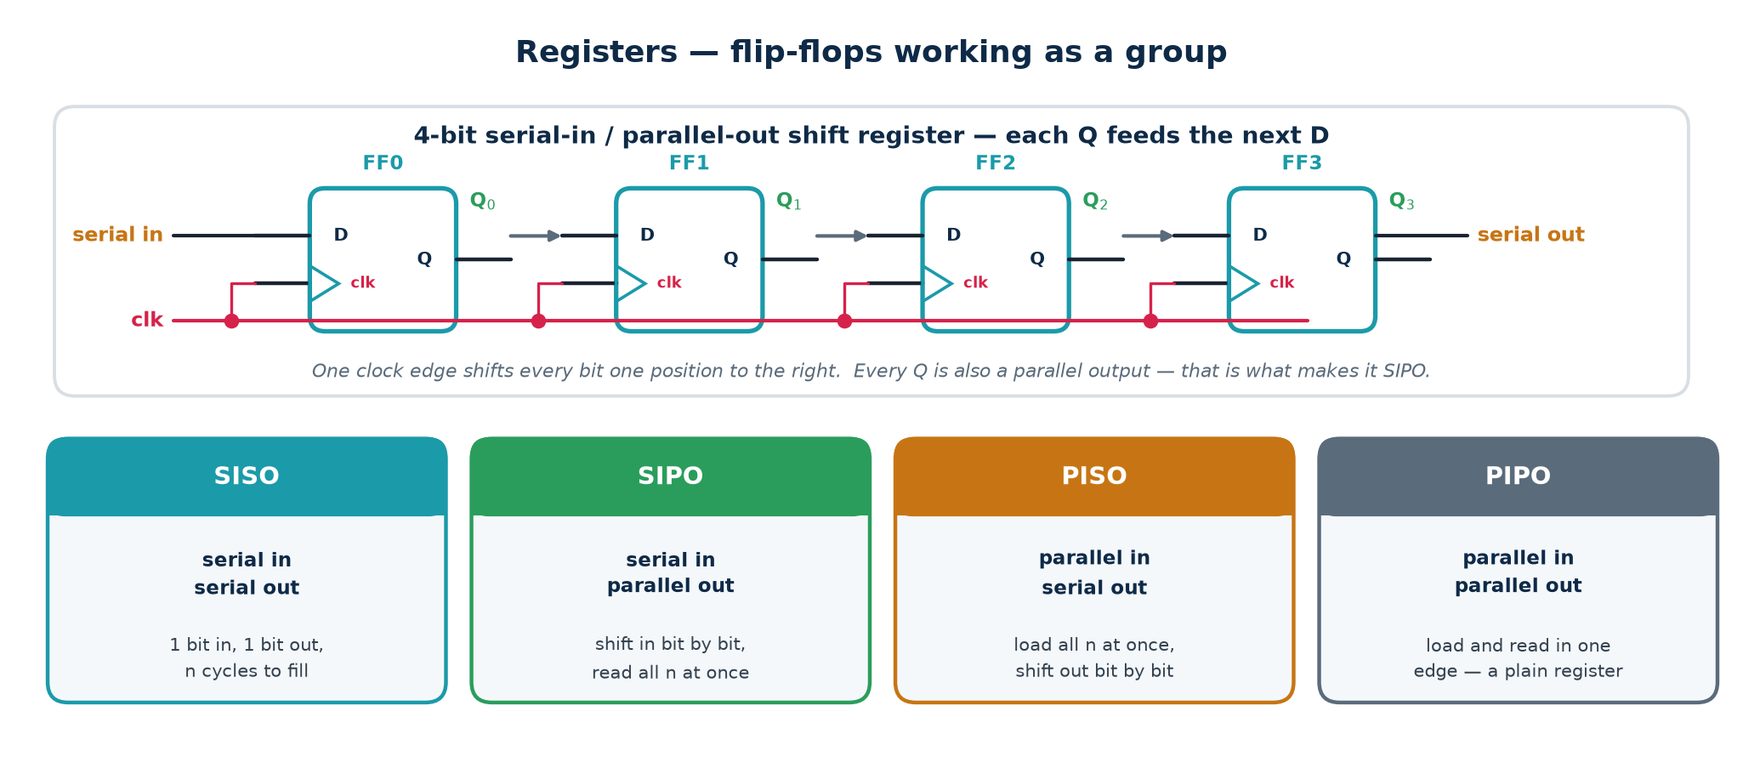
TOPIC 3C · REGISTERS
Registers and Shift Registers
A register is simply n flip-flops sharing one clock. Wire each Q to the next D and you have a shift register — the basis of serial links, delay lines, scan chains for test, and multiply/divide by two.
Applications you will actually build
Serialisation (SPI, UART, JTAG) · Delay lines and pipeline balancing · Synchronisers (a 2-bit shift register is exactly the 2-FF synchroniser) ·
Scan chains — during manufacturing test every flip-flop in the chip is rewired into one giant shift register so patterns can be loaded and results read out. LFSRs — add an XOR feedback tap and you have a pseudo-random generator or a CRC engine.
Module 2 · Verilog RTL Coding for Synthesis
NIE/ELE/N0102 · Topic 3 · 48

Slide 49
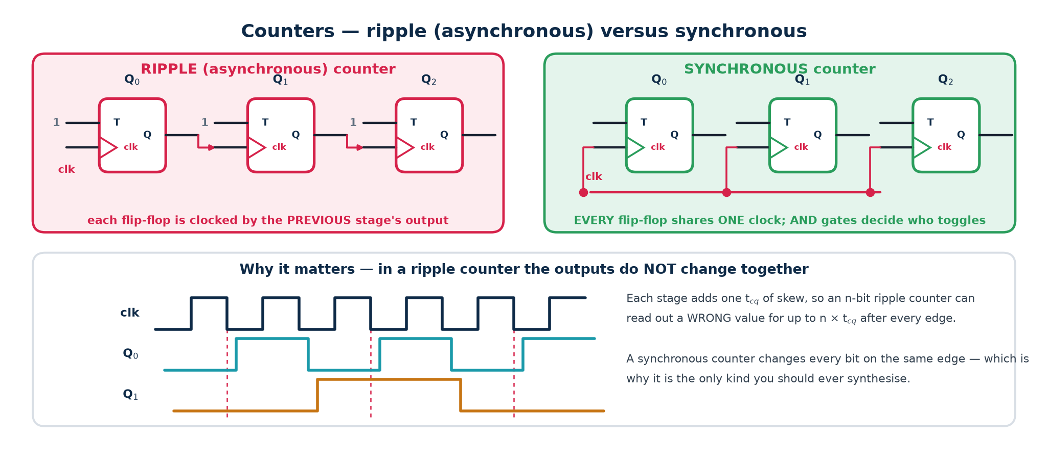
TOPIC 3C · COUNTERS
Counters — Ripple vs Synchronous
A counter is a state machine whose state happens to be a number. There are two ways to build one, and only one of them belongs in a synthesised design.
Varieties you should know
Rule
Up / down / up-down · loadable · with enable · mod-N (divide by N) · ring counter (one-hot, N states from N flip-flops) · Johnson / twisted-ring (2N states from N flip-flops) · LFSR (2ⁿ−1 states, maximal length, but not in numeric order).
Never write a ripple counter in RTL.
It creates a second clock domain out of a data signal, breaks static timing analysis, and produces transient wrong values. Always use one clock and an enable.
Module 2 · Verilog RTL Coding for Synthesis
NIE/ELE/N0102 · Topic 3 · 49

Slide 50
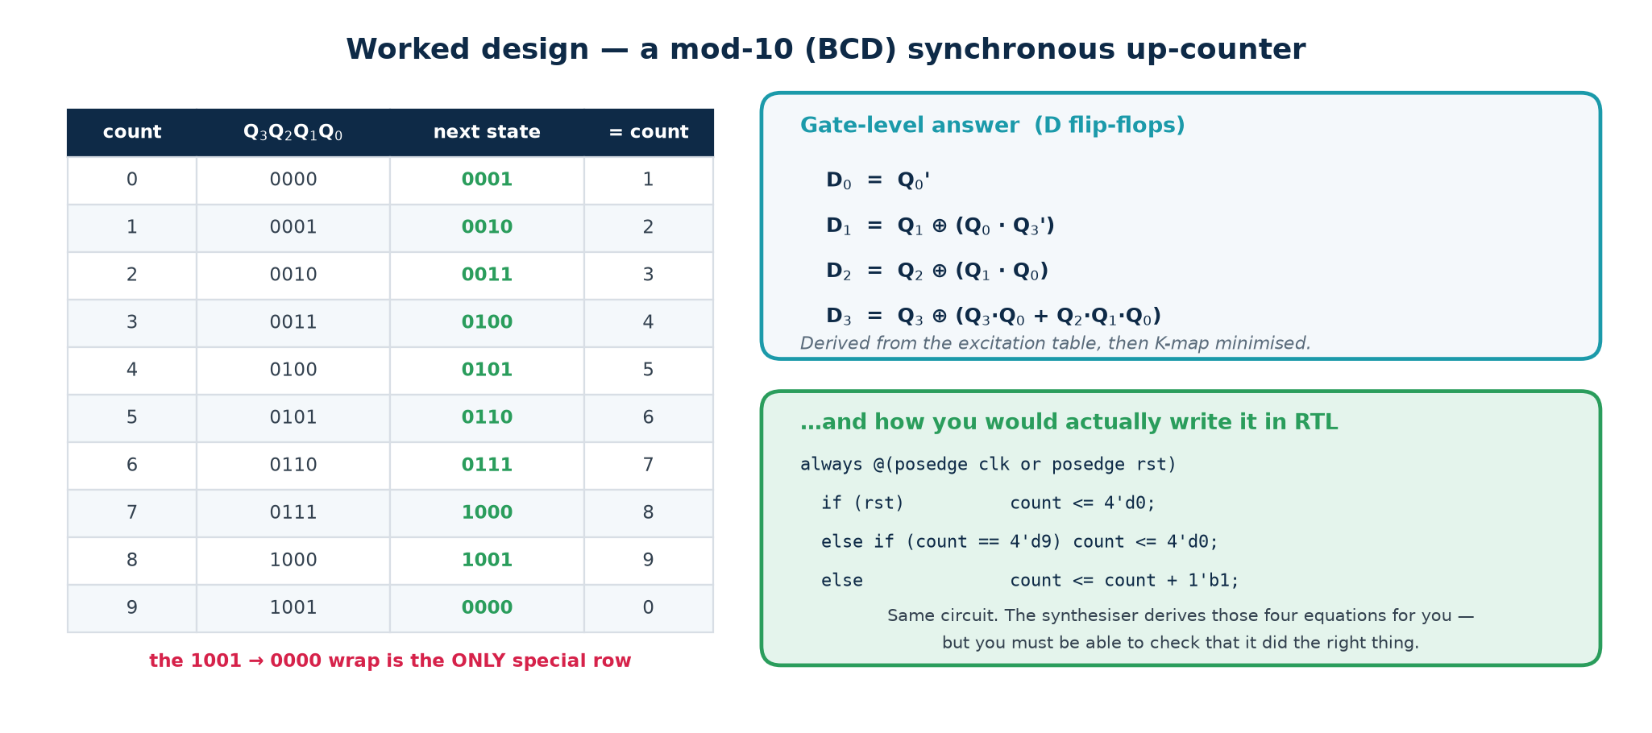
TOPIC 3C · PRACTICAL EXAMPLE 5
Worked: A Mod-10 (BCD) Synchronous Counter
How the gate-level equations were obtained
1. Write the state table (0000 … 1001 and the wrap to 0000). 2. For each bit, tabulate Qᵢ → Qᵢ⁺. 3. Since D = Q⁺, the D column IS the next-state column. 4. K-map each Dᵢ over Q₃Q₂Q₁Q₀, treating states 1010–1111 as don't-cares. 5. Read off the minimal SOP.
Check one row by hand: at count 9 (Q = 1001), D₀ = Q₀' = 0, D₁ = Q₁ ⊕ (Q₀·Q₃') = 0 ⊕ (1·0) = 0, D₂ = Q₂ ⊕ (Q₁·Q₀) = 0 ⊕ 0 = 0, D₃ = Q₃ ⊕ (Q₃Q₀ + Q₂Q₁Q₀) = 1 ⊕ 1 = 0. Next state = 0000. Correct.
Trap: states 1010–1111 are unreachable but not impossible — a glitch or SEU can land you there. Because we treated them as don't-cares the counter may lock up. A SAFE counter forces any illegal state back to 0000 explicitly.
Module 2 · Verilog RTL Coding for Synthesis
NIE/ELE/N0102 · Topic 3 · 50

Slide 51
TOPIC 3C · STATE MACHINES
Finite State Machines — The Universal Controller
An FSM is the formal name for 'a circuit that remembers where it is in a sequence'. Formally it is a 6-tuple (S, S₀, X, Y, δ, λ): a finite set of states, a start state, an input alphabet, an output alphabet, a next-state function δ, and an output function λ. Every protocol engine, bus controller, arbiter and CPU control unit is one.
The three pieces of hardware
What counts as a 'state'
Why finite matters
1. State register — n flip-flops holding the present state.
2. Next-state logic — combinational, computes δ(state, input).
3. Output logic — combinational, computes λ.
Nothing else. Every FSM is this.
A state is an equivalence class of histories: two input histories are the same state if the machine will behave identically from now on.
This is why the 1011 detector needs five states — 'nothing', '1', '10', '101', '1011' — and not thirty-two.
Finite states = finite flip-flops = a circuit you can actually build and exhaustively verify.
An FSM cannot count arbitrarily high or match arbitrarily deep nesting — for that you need a datapath (counter, stack) alongside it. That is the FSMD idea at the end of this section.
The Huffman model
Drawing the three blocks with the state register in a feedback loop is called the Huffman model of a sequential circuit. It is the same picture as the 'sequential' half of the very first diagram in subtopic 3b — every sequential circuit, however complicated, reduces to it.
Module 2 · Verilog RTL Coding for Synthesis
NIE/ELE/N0102 · Topic 3 · 51

Slide 52
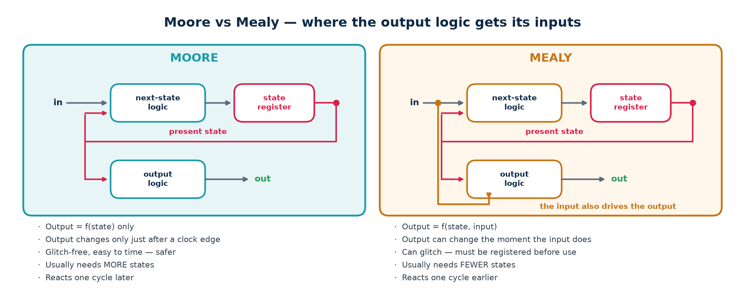
TOPIC 3C · TWO STYLES
Moore vs Mealy Machines
The only difference is whether the output logic can see the INPUT as well as the state. That one wire changes the timing behaviour, the state count and the glitch risk.
Which one should you use?
Default to Moore. Its outputs come straight off flip-flops, so they are glitch-free and easy to time. Use Mealy when you genuinely need the one-cycle-earlier response, and then register the Mealy output before it leaves the block — which, of course, turns it back into a Moore output one cycle later.
Module 2 · Verilog RTL Coding for Synthesis
NIE/ELE/N0102 · Topic 3 · 52

Slide 53
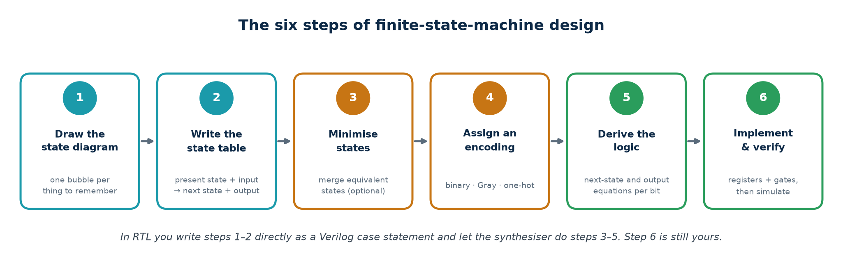
TOPIC 3C · PROCEDURE
The Six Steps of FSM Design
Do these in order, every time. The state diagram is the design; everything after it is mechanical. If the diagram is wrong, no amount of Verilog will save you.
Two checks to run on the state diagram before you write any code
Completeness: from every state, is there exactly one outgoing arc for EVERY possible input value? A missing arc means an undefined transition — in hardware, a latch or a lock-up.
Determinism: is there at most one arc for each input value? Two arcs labelled '1' out of one state is not a circuit, it is a contradiction.
For a machine with s states and one binary input, count the arcs: there must be exactly 2s of them.
State minimisation (step 3) is optional in practice — synthesis tools do it, and modern FPGAs have flip-flops to spare. Understand it; do not agonise over it.
Module 2 · Verilog RTL Coding for Synthesis
NIE/ELE/N0102 · Topic 3 · 53

Slide 54
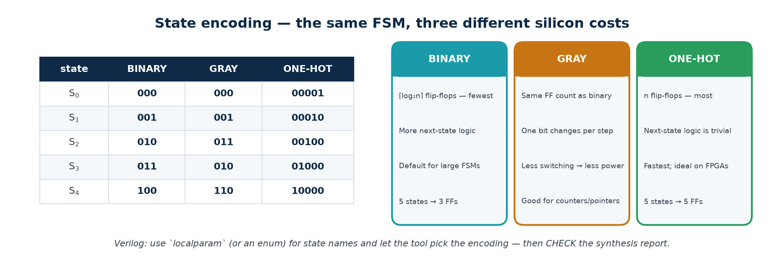
TOPIC 3C · ENCODING
State Encoding — Binary, Gray and One-Hot
The states in your diagram are names; the flip-flops hold bits. How you map one to the other changes the flip-flop count, the amount of next-state logic, the speed and the power — without changing the behaviour at all.
How to choose
FPGA: one-hot, almost always. Flip-flops are free and abundant; LUT depth is what costs you speed, and one-hot next-state logic is one level deep.
ASIC with many states: binary, to keep the register count and hence area down. Low-power or clock-crossing: Gray, because only one bit toggles per transition — less switching energy and safe to sample across a clock domain.
Module 2 · Verilog RTL Coding for Synthesis
NIE/ELE/N0102 · Topic 3 · 54

Slide 55
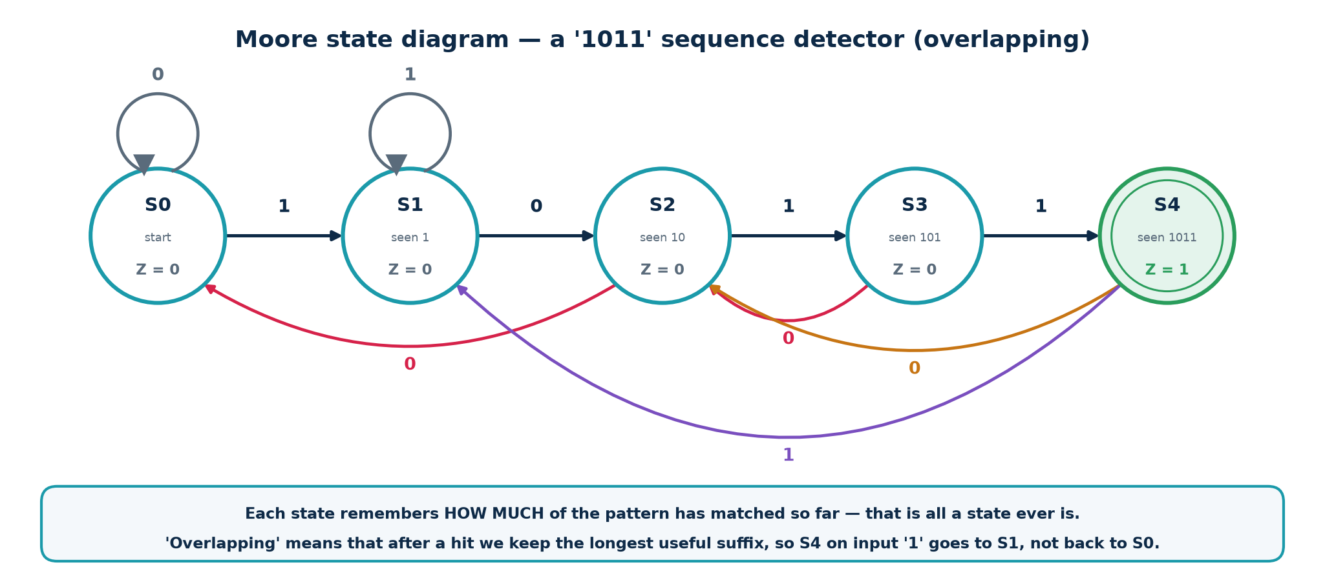
TOPIC 3C · WORKED EXAMPLE
Designing a '1011' Sequence Detector — Step 1
Specification. A serial input X arrives one bit per clock. Assert output Z whenever the last four bits received were 1, 0, 1, 1. Overlapping sequences count — so the stream 1011011 contains TWO occurrences.
How each state was chosen
Ask: 'what is the longest PREFIX of 1011 that is currently a suffix of what I have received?' That question has exactly five answers — none, 1, 10, 101, 1011 — so there are five states, and the answer to the question IS the state. This suffix-matching insight generalises to any pattern detector.
Module 2 · Verilog RTL Coding for Synthesis
NIE/ELE/N0102 · Topic 3 · 55

Slide 56
TOPIC 3C · WORKED EXAMPLE
'1011' Detector — Steps 2 to 5: Table, Encoding, Logic
Present state
Encoding Q₂Q₁Q₀
Next state (X=0)
Next state (X=1)
Z
S0 (start)
000
S0 000
S1 001
0
S1 (1)
001
S2 010
S1 001
0
S2 (10)
010
S0 000
S3 011
0
S3 (101)
011
S2 010
S4 100
0
S4 (1011)
100
S2 010
S1 001
1
Derive, then ALWAYS re-check against the table row by row
Next-state equations (K-map each D bit over Q2 Q1 Q0 X; codes 101-111 are don't-cares)
D2 = Q1 . Q0 . X only S3 (011) with X=1 reaches S4
D1 = X' . (Q2 + Q0) + Q1 . Q0' . X
^^^^^^^^^^^^^^ ^^^^^^^^^^^^
S1,S3,S4 on X=0 S2 on X=1 (010 -> 011)
D0 = X . (Q1 . Q0)' every X=1 arc lands on S1 or S3, both odd,
except S3 (011) which goes to S4 (100)
Output equation (Moore - a function of the state alone)
Z = Q2 S4 is the only state whose code has Q2 = 1
Check one row by hand: S3 = 011 with X = 1 gives D₂ = 1·1·1 = 1, D₁ = 0·(…) + 1·0·1 = 0, D₀ = 1·(1·1)' = 0 → next state 100 = S4. ✓ Notice too that Z = Q₂ fell out for free because we chose the encoding well. All of this is what synthesis does for you when you write the case statement on the next slide.
Module 2 · Verilog RTL Coding for Synthesis
NIE/ELE/N0102 · Topic 3 · 56

Slide 57
TOPIC 3C · THE RTL TEMPLATE
'1011' Detector — The Three-Block Verilog FSM
The three-always-block template — use this shape for EVERY FSM you write
module seq_detect_1011 (input clk, input rst_n, input x, output reg z);
localparam S0=3'd0, S1=3'd1, S2=3'd2, S3=3'd3, S4=3'd4;
reg [2:0] state, next;
// ---- BLOCK 1 : state register (sequential, non-blocking) ----
always @(posedge clk or negedge rst_n)
if (!rst_n) state <= S0;
else state <= next;
// ---- BLOCK 2 : next-state logic (combinational, blocking) ----
always @(*) begin
next = state; // default: no latch
case (state)
S0: next = x ? S1 : S0;
S1: next = x ? S1 : S2;
S2: next = x ? S3 : S0;
S3: next = x ? S4 : S2;
S4: next = x ? S1 : S2;
default: next = S0; // safe FSM: recover from illegal states
endcase
end
// ---- BLOCK 3 : output logic (Moore - state only) ----
always @(*) z = (state == S4);
endmodule
Why three blocks and not one
It separates the clocked element from the combinational logic, so the synthesised hardware matches the Huffman model exactly. It makes the reset behaviour explicit, keeps each block short enough to read, and makes latch inference impossible if you keep the default assignment. One-block FSMs are legal and much harder to debug.
Module 2 · Verilog RTL Coding for Synthesis
NIE/ELE/N0102 · Topic 3 · 57

Slide 58
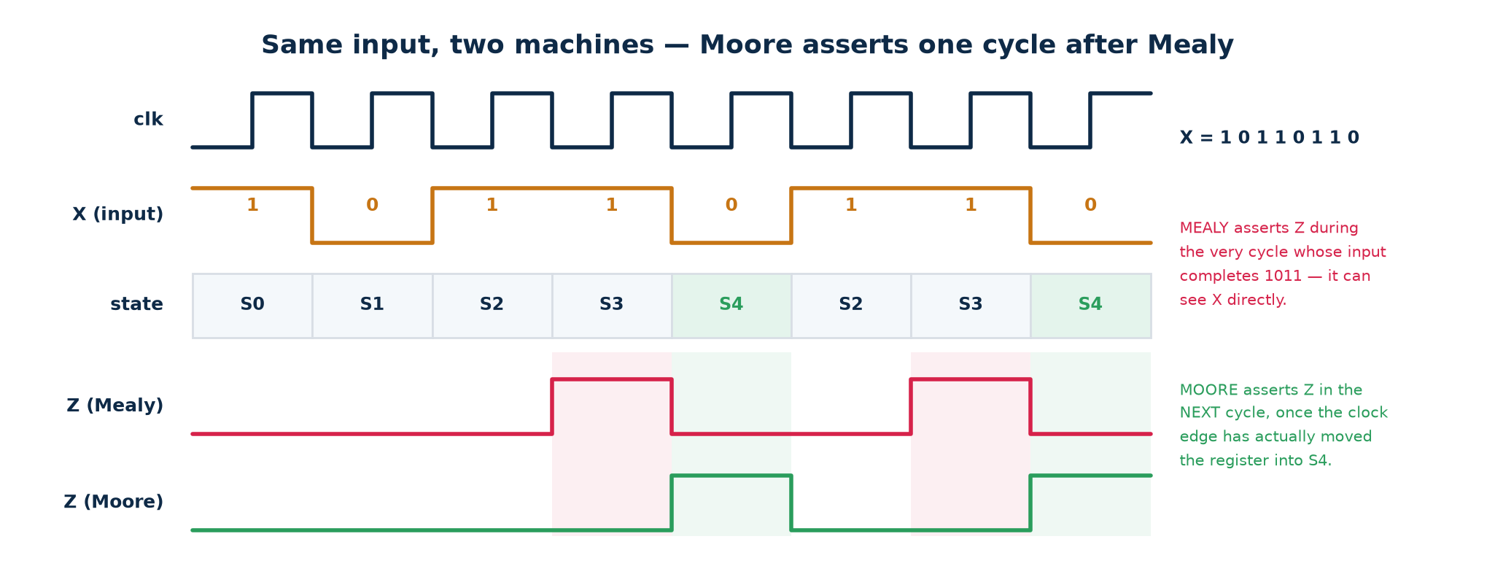
TOPIC 3C · PRACTICAL EXAMPLE 6
Trace: Moore and Mealy on the Same Input Stream
Read the trace with the class, cycle by cycle
Input X = 1 0 1 1 0 1 1 0. Both machines see the fourth bit complete the pattern.
Mealy asserts Z during cycle 4 — combinationally, the moment X goes high while the state is S3. Moore asserts Z during cycle 5 — the clock edge at the end of cycle 4 moved the register into S4, and only then does Z = Q₂ become 1.
Second detection: overlapping means the '11' at the end is reused, so the pattern completes again on bit 7 and both machines fire a second time.
Exam question you should be able to answer instantly: 'same behaviour, so why choose one?' — Mealy is one cycle faster and needs fewer states; Moore is glitch-free and trivially timeable.
Module 2 · Verilog RTL Coding for Synthesis
NIE/ELE/N0102 · Topic 3 · 58

Slide 59
TOPIC 3C · PITFALLS
Five Ways an FSM Goes Wrong in Silicon
Failure
What happens
How you prevent it
Unreachable / illegal states
With 5 states in 3 bits, codes 101–111 exist in hardware but not in your diagram. A glitch or radiation event lands you there.
Write a `default` branch that returns to a safe state — a SAFE FSM.
Deadlock / lock-up
A group of states with no path back to normal operation. The block hangs and only a reset recovers it.
Prove reachability: from every state, a path to the start state must exist.
Incomplete transitions
A state with no arc for some input value. In RTL this becomes an inferred latch.
Assign `next` a default value at the top of the always block.
Unregistered Mealy output
The glitchy combinational output drives a clock enable or a memory write. Random corruption.
Register the output, or use Moore.
Asynchronous input straight into the FSM
A button or a signal from another clock domain violates setup/hold and the FSM enters an illegal state.
Two-flop synchroniser on EVERY asynchronous input.
The one-line summary
A state machine is only as reliable as its handling of the cases you did NOT draw. Always write the default branch, always synchronise the inputs, always simulate an illegal-state injection.
Module 2 · Verilog RTL Coding for Synthesis
NIE/ELE/N0102 · Topic 3 · 59

Slide 60
TOPIC 3C · IN VERILOG
Sequential Logic — Blocking vs Non-Blocking
This is the single most common Verilog error in the industry. Both versions below simulate; only one synthesises to what you meant, and simulation and hardware then disagree — the worst class of bug there is.
Same intent, different hardware
// CORRECT - non-blocking (<=) in a clocked block gives a true 2-stage shift register
always @(posedge clk) begin
q1 <= d;
q2 <= q1; // q2 gets the OLD q1 -> two flip-flops in series
end
// WRONG - blocking (=) makes q1 update immediately, so q2 gets the NEW q1
always @(posedge clk) begin
q1 = d;
q2 = q1; // q2 gets d -> ONE flip-flop, and a race in simulation
end
The rule — no exceptions
Why the rule exists
Non-blocking <= in every always @(posedge clk) block.
Blocking = in every always @(*) block.
Never mix the two in one block. Never assign the same signal from two blocks.
Non-blocking assignments all sample their right-hand sides first, then update together at the end of the time step — which is exactly what a bank of flip-flops does on a clock edge.
Blocking assignments execute in order, like software, which models a wire, not a register.
Module 2 · Verilog RTL Coding for Synthesis
NIE/ELE/N0102 · Topic 3 · 60

Slide 61
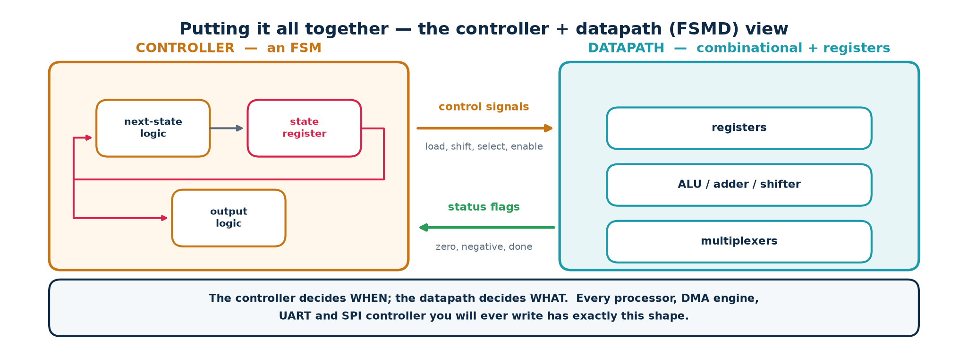
TOPIC 3C · SYNTHESIS OF IDEAS
Controller Plus Datapath — How Real Blocks Are Built
Everything in this topic now assembles into one architecture. The combinational blocks from 3b form the datapath; the FSM from 3c forms the controller; control signals go one way and status flags come back. This partition is how every non-trivial digital block is organised.
A concrete example you can build in one afternoon
A serial multiplier. Datapath: a shift register for the multiplier, an adder, an accumulator register, a counter. Controller: an FSM with states IDLE → LOAD → ADD/SHIFT (looping) → DONE, using the counter's 'terminal count' status flag to decide when to leave the loop and driving the datapath's load, add and shift enables.
Module 2 · Verilog RTL Coding for Synthesis
NIE/ELE/N0102 · Topic 3 · 61

Slide 62
HANDS-ON
Tools, Installation and Tutorials
Everything from here is done at a keyboard. The tools are free and take about fifteen minutes to install.
Install: Logisim-Evolution, Icarus Verilog, GTKWave, Yosys
T1 — Build and simulate gates, an adder and an FSM visually in Logisim
T2 — Compile and simulate a full adder and a 4-bit adder; read the waveform
T3 — Flip-flops, a shift register and a mod-10 counter
T4 — The 1011 FSM: simulate it, then synthesise it and read the netlist
Module 2 · Verilog RTL Coding for Synthesis
NIE/ELE/N0102 · Topic 3 · 62

Slide 63
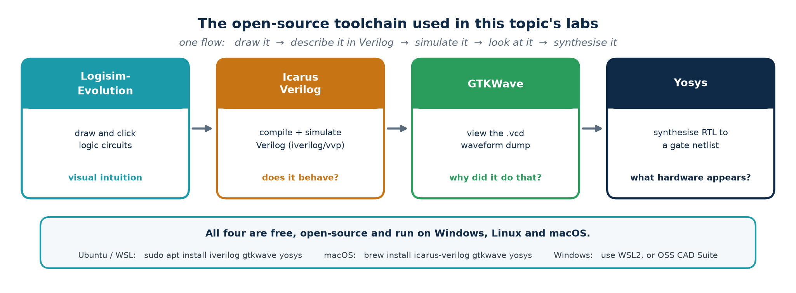
HANDS-ON · TOOLCHAIN
The Four Tools and What Each One Is For
Why this particular set
They are free, open-source, small, cross-platform and script-driven — so every student can run the identical flow at home, and the whole lab can be checked automatically. The commercial equivalents (ModelSim/Questa, VCS, Design Compiler, Vivado) do the same jobs with the same concepts and a larger price tag.
Java note: Logisim-Evolution needs a Java Runtime (JRE 17 or later). Everything else is native.
Module 2 · Verilog RTL Coding for Synthesis
NIE/ELE/N0102 · Topic 3 · 63

Slide 64
HANDS-ON · INSTALLATION
Installing the Toolchain — Step by Step
Windows (recommended: WSL2)
Ubuntu / Debian / WSL
macOS (Homebrew)
1. Open PowerShell as Administrator:
wsl --install -d Ubuntu
2. Reboot, then open the Ubuntu terminal.
3. Run the Ubuntu commands opposite.
4. For GTKWave graphics, install VcXsrv or use WSLg (Win 11).
Alternative without WSL: download the OSS CAD Suite ZIP, unzip, and run environment.bat.
sudo apt update
sudo apt install -y iverilog \
gtkwave yosys default-jre
Logisim-Evolution: download the .jar from its GitHub releases page and run:
java -jar logisim-evolution.jar
/bin/bash -c "$(curl -fsSL \
https://raw.githubusercontent.com/\
Homebrew/install/HEAD/install.sh)"
brew install icarus-verilog \
gtkwave yosys temurin
Verification — run this before the lab, not during it
# ---- VERIFY the installation - every one of these must print a version ----
iverilog -V | head -1 # expect: Icarus Verilog version 11.x or 12.x
vvp -V | head -1 # the Icarus runtime engine
gtkwave --version | head -1 # expect: GTKWave Analyzer v3.3.x
yosys -V # expect: Yosys 0.3x
java -version # expect: openjdk 17 or later
Troubleshooting: 'command not found' after apt succeeded → close and reopen the terminal. GTKWave opens but shows nothing → you forgot $dumpfile/$dumpvars in the testbench. Yosys 'read_verilog: syntax error' → Icarus accepts some non-standard code that Yosys rejects; fix the RTL, do not work around it.
Module 2 · Verilog RTL Coding for Synthesis
NIE/ELE/N0102 · Topic 3 · 64

Slide 65
HANDS-ON · TUTORIAL T1
Logisim-Evolution — See the Logic Before You Code It
Goal: build three circuits by clicking, poke the inputs, and watch the wires change colour. Thirty minutes here saves hours of confusion later. Deliverable: three .circ files plus a screenshot of each truth table.
T1.1 — A half adder from scratch (10 min)
1. Launch: java -jar logisim-evolution.jar
2. From the toolbar place two Input pins, label them A and B (right-click → Edit label).
3. From the Gates library drag in one XOR and one AND gate.
4. Place two Output pins, label them S and C.
5. Wire A and B to both gates; XOR → S, AND → C.
6. Press the poke (hand) tool and click A and B to toggle them. Verify all four rows against the truth table on slide 23.
T1.2 — 4-bit ripple adder (15 min)
T1.3 — The 1011 detector (20 min)
· Project → Add Circuit… name it full_adder; build it from two half adders + an OR.
· Back in main, place four copies of your full_adder from the project tree.
· Chain Cout → Cin. Drive A and B from 4-bit input pins.
· Add 5, add 3, check you get 8. Then add 15 + 1 and confirm Cout goes high.
· Place a 3-bit Register and a Clock from the Memory / Wiring libraries.
· Implement the next-state equations from slide 54 with gates.
· Simulate → Tick Enabled, then hand-enter 1,0,1,1 on X and watch Z pulse.
· Keep going with 0,1,1 and confirm the OVERLAPPING second hit.
Checkpoint question for the class: in T1.3, what happens if you tick the clock while X is changing? Relate the answer to the metastability slide.
Module 2 · Verilog RTL Coding for Synthesis
NIE/ELE/N0102 · Topic 3 · 65

Slide 66
HANDS-ON · TUTORIAL T2
Icarus Verilog + GTKWave — Simulate a Full Adder
Goal: take the same circuit you clicked together in T1 and describe it in Verilog, then prove it correct with a self-checking testbench and look at the waveform.
Two files — the design and a self-checking testbench
// ---------- full_adder.v ----------
module full_adder (input a, input b, input cin, output sum, output cout);
assign sum = a ^ b ^ cin;
assign cout = (a & b) | (cin & (a ^ b));
endmodule
// ---------- tb_full_adder.v ----------
`timescale 1ns/1ps
module tb_full_adder;
reg a, b, cin; wire sum, cout; integer i; integer errors = 0;
full_adder dut (.a(a), .b(b), .cin(cin), .sum(sum), .cout(cout));
initial begin
$dumpfile("fa.vcd"); $dumpvars(0, tb_full_adder); // <-- waveform dump
for (i = 0; i < 8; i = i + 1) begin
{a, b, cin} = i[2:0]; #10;
if ({cout, sum} !== (a + b + cin)) begin
$display("FAIL a=%b b=%b cin=%b -> %b%b", a, b, cin, cout, sum);
errors = errors + 1;
end
end
if (errors == 0) $display("PASS - all 8 cases correct");
$finish;
end
endmodule
Run it — three commands
iverilog -g2012 -o fa.out full_adder.v tb_full_adder.v # compile
vvp fa.out # run -> 'PASS - all 8 cases correct'
gtkwave fa.vcd & # view the waveform
# In GTKWave: pick tb_full_adder in the SST pane, select all, Insert, then 'zoom fit'.
Module 2 · Verilog RTL Coding for Synthesis
NIE/ELE/N0102 · Topic 3 · 66

Slide 67
HANDS-ON · TUTORIAL T3
Sequential Logic — Flip-Flop, Shift Register, Counter
Goal: see with your own eyes that a flip-flop samples only on the edge, that non-blocking assignment builds a real shift register, and that a mod-10 counter wraps at nine.
Three designs — build them in one file or three
// ---------- dff.v : the reference D flip-flop, async active-low reset ----------
module dff (input clk, input rst_n, input d, output reg q);
always @(posedge clk or negedge rst_n)
if (!rst_n) q <= 1'b0;
else q <= d;
endmodule
// ---------- shift4.v : four-stage shift register ----------
module shift4 (input clk, input rst_n, input sin, output reg [3:0] q);
always @(posedge clk or negedge rst_n)
if (!rst_n) q <= 4'b0000;
else q <= {q[2:0], sin}; // shift left, sin enters at bit 0
endmodule
// ---------- bcd_counter.v : mod-10 synchronous up-counter ----------
module bcd_counter (input clk, input rst_n, input en, output reg [3:0] cnt);
always @(posedge clk or negedge rst_n)
if (!rst_n) cnt <= 4'd0;
else if (en) begin
if (cnt == 4'd9) cnt <= 4'd0;
else cnt <= cnt + 4'd1;
end
endmodule
What to look for in the waveform
Experiments that teach the lesson
· q changes ONLY at rising clk edges, never when d moves mid-cycle.
· The shift register's bit 3 lags sin by exactly four cycles.
· cnt goes …8, 9, 0, 1… and never reaches 10.
Deliverable: one annotated GTKWave screenshot per design, with the key transition circled and one sentence explaining it.
1. Change <= to = in shift4 and re-run. How many flip-flops does Yosys report now?
2. Delete the if (cnt == 4'd9) line. Watch the counter run to 15 — a mod-16 counter.
3. Toggle en low for three cycles and confirm the count freezes.
Module 2 · Verilog RTL Coding for Synthesis
NIE/ELE/N0102 · Topic 3 · 67

Slide 68
HANDS-ON · TUTORIAL T4
The 1011 FSM — Simulate, Then Synthesise It
Goal: close the loop. Take the FSM you designed on paper, run it, then ask Yosys what hardware it actually becomes — and check that the answer matches your state diagram.
Four steps, four commands
# ---- Step 1 : simulate (seq_detect_1011.v is the module from slide 55) ----
iverilog -g2012 -o fsm.out seq_detect_1011.v tb_seq_detect.v
vvp fsm.out # testbench drives 1011011 and checks Z pulses twice
gtkwave fsm.vcd &
# ---- Step 2 : synthesise and read the statistics ----
yosys -p 'read_verilog seq_detect_1011.v; \
synth -top seq_detect_1011; \
stat'
# ---- Step 3 : look at the schematic Yosys produced ----
yosys -p 'read_verilog seq_detect_1011.v; proc; opt; show -format dot -prefix fsm'
dot -Tpng fsm.dot -o fsm.png # needs graphviz: sudo apt install graphviz
# ---- Step 4 : map to a real cell library and count gates ----
yosys -p 'read_verilog seq_detect_1011.v; synth -top seq_detect_1011; \
abc -g AND,OR,XOR,NAND,NOR; stat; write_verilog fsm_netlist.v'
# ---- or run the whole lab in one go ----
cd Topic3_Lab && ./scripts/run_all.sh && ./scripts/synth_all.sh
What the stat report should tell you
Experiments — each gives a real, different answer
· 18 cells in total
· 3 DFF cells — your 3-bit state register
· 15 combinational cells
· ZERO $_DLATCH_ cells
A latch means a default assignment is missing.
1. Synthesise broken_latch.v → find $_DLATCH_ in the cell list.
2. Synthesise seq_detect_1011_onehot.v → 14 cells and 5 flip-flops, not 18 and 3. The only change is one attribute.
3. Run fsm_detect → Yosys refuses to re-encode this FSM because the safe default makes it look self-resetting.
This is the whole point of the topic: you predicted the hardware from the state diagram, and the tool agreed with you.
Module 2 · Verilog RTL Coding for Synthesis
NIE/ELE/N0102 · Topic 3 · 68

Slide 69
HANDS-ON · ASSESSMENT
Lab Deliverables and Marking Rubric
Deliverable
Evidence required
Marks
T1 — Logisim circuits
half_adder.circ, adder4.circ, fsm1011.circ + one screenshot each
15
T2 — Full adder simulation
full_adder.v, tb_full_adder.v, console showing PASS, GTKWave screenshot
15
T3 — Sequential designs
dff.v, shift4.v, bcd_counter.v, three annotated waveform screenshots
20
T4 — FSM end to end
seq_detect_1011.v, testbench, waveform showing TWO Z pulses, Yosys stat output
25
Written answers
Workbook Part 5 exercises E1–E14 with working shown
15
Viva / explanation
Explain one design of the examiner's choosing at the whiteboard
10
Pass criteria
50 % overall, with a compulsory pass in T4 — a student who cannot take an FSM from state diagram to a verified, synthesised netlist has not met the terminal outcome for this topic. Resubmission of T4 is permitted once.
Module 2 · Verilog RTL Coding for Synthesis
NIE/ELE/N0102 · Topic 3 · 69

Slide 70
TOPIC 3 · GLOSSARY (1 of 2)
Key Terms — Boolean Algebra and Combinational Logic
Literal — A variable or its complement — A and A' are two literals.
Universal gate — NAND or NOR — enough on its own to build any function.
Minterm / Maxterm — The AND term true for exactly one row / the OR term false for exactly one row.
Duality — Swap AND↔OR and 0↔1; a true Boolean identity stays true.
Canonical form — SOP or POS written directly from the truth table; unique but rarely minimal.
Fan-in / Fan-out — Number of inputs to a gate / number of loads driven by one output.
Implicant — Any product term that covers only 1s of the function.
Propagation delay t_pd — Time from an input change to the corresponding output change.
Prime implicant — An implicant that cannot be combined further into a larger group.
Critical path — The slowest input-to-output route; it sets the block's maximum speed.
Essential prime implicant — The only prime implicant covering some particular minterm — always in the answer.
Hazard / glitch — A transient wrong output caused by unequal path delays; logic is still correct.
Don't-care (X) — An input combination that cannot occur, or whose output is never read.
Gate equivalent (GE) — Area unit: the area of one 2-input NAND cell in that technology.
Every term above appears in the workbook glossary with a worked micro-example.
Module 2 · Verilog RTL Coding for Synthesis
NIE/ELE/N0102 · Topic 3 · 70

Slide 71
TOPIC 3 · GLOSSARY (2 of 2)
Key Terms — Sequential Logic and State Machines
Latch — Level-sensitive storage: transparent for as long as its enable is asserted.
Clock skew — Fixed difference in edge arrival time between flip-flops; caused by the clock tree.
Flip-flop — Edge-triggered storage: samples its input at one instant per clock cycle.
Jitter — Random cycle-to-cycle variation in edge arrival; caused by noise and the PLL.
Setup time t_su — How long data must be stable BEFORE the clock edge.
Slack — Available time minus required time. Positive = met, negative = violation.
Hold time t_h — How long data must stay stable AFTER the clock edge.
State — An equivalence class of input histories — everything the circuit needs to remember.
Clock-to-Q t_cq — Delay from the clock edge until the output is valid.
Moore machine — Output depends on the state only; glitch-free, reacts one cycle later.
Metastability — An invalid intermediate output state after a setup/hold violation; resolves at random.
Mealy machine — Output depends on state AND input; fewer states, reacts immediately, can glitch.
Synchroniser — Two (or three) cascaded flip-flops that make metastable failure vanishingly unlikely.
Safe FSM — One whose default branch returns any illegal state code to a known good state.
Acronyms: SOP sum of products · POS product of sums · FSM finite state machine · CDC clock-domain crossing · STA static timing analysis · CTS clock-tree synthesis · MTBF mean time between failures.
Module 2 · Verilog RTL Coding for Synthesis
NIE/ELE/N0102 · Topic 3 · 71

Slide 72
TOPIC 3 · RECAP
Consolidation and Self-Check
3a — Boolean algebra and gates
3b — Combinational logic
3c — Sequential logic and FSMs
· Digital = two voltage bands with a guard band between them.
· Three operators; seven gates; NAND and NOR are universal.
· De Morgan lets you push bubbles through any network.
· Truth table → canonical SOP/POS → K-map → minimal form.
· Minimisation buys area, power and speed — all three at once.
· No feedback, no memory; output = f(inputs now).
· Seven-step procedure; the truth table is where bugs hide.
· Adders, MUX, decoders, comparators, ALU — know all five.
· Ripple carry is O(n); lookahead is O(log n).
· Hazards are real; synchronous design tolerates them.
· Feedback through a clocked element = memory = state.
· Latch is level-sensitive; flip-flop is edge-triggered. Use flip-flops.
· T ≥ t_cq + t_logic + t_setup sets fₘₐₓ; hold is a separate race.
· Synchronise every asynchronous input. Always.
· FSM = state register + next-state logic + output logic. Three always blocks.
Self-check — you should be able to answer all ten without notes
1. Prove (A+B)' = A'B' with a truth table. 2. Minimise Σm(0,2,5,7,8,10,13,15) on a 4-variable K-map. 3. Why is NAND universal but AND is not?
4. Draw a full adder from two half adders. 5. A 16-bit ripple adder has t_carry = 80 ps. What is its worst-case delay? 6. Name three hazards and one cure for each.
7. Why does slowing the clock never fix a hold violation? 8. Sketch the 2-flop synchroniser and say what it protects against. 9. Convert the 1011 Moore machine to Mealy — how many states now?
10. Given t_cq = 50, t_logic = 300, t_setup = 40, skew = 20 ps, what is fₘₐₓ?
Module 2 · Verilog RTL Coding for Synthesis
NIE/ELE/N0102 · Topic 3 · 72

Slide 73
TOPIC 3 · WHAT'S NEXT
From Logic Diagrams to Verilog — Topic 4
You now have the vocabulary. Topic 4 (RTL Design Using HDL, 6 hours) is where you stop drawing gates and start writing them. Every construct you meet there maps onto something from this topic — which is why this topic came first.
What you learned in Topic 3
How it appears in Topic 4
Truth table, SOP, K-map
assign and always @(*) with case/if
Multiplexer
the ternary operator and every case statement
Full adder, ripple carry
the + operator — and the timing report that follows it
D flip-flop, register
always @(posedge clk) with non-blocking assignment
Reset behaviour
the two reset templates, and why the async one is in the sensitivity list
State diagram, state table
the three-block FSM template with localparam states
Hazard, latch inference
the synthesis warnings you must never ignore
Before the next session
Finish tutorials T1–T4 and the workbook exercises. Bring your working seq_detect_1011.v — Topic 4 begins by rewriting it three different ways and comparing the synthesis results.
Module 2 · Verilog RTL Coding for Synthesis
NIE/ELE/N0102 · Topic 3 · 73

