Slide 1
TOPIC 4
RTL Design Using HDL
Subtopic 4a: Verilog syntax and constructs · 4b: Designing combinational and sequential logic using HDL · 4c: Writing RTL code for basic digital circuits
4a · The language — modules, types, literals, operators, and the synthesisable subset
4b · Modelling logic — assign, always @(*), always @(posedge clk), and what each infers
4c · Real circuits — MUXes, ALUs, counters, FSMs, memories, FIFOs and a working UART
Tools · Vivado · ModelSim · Icarus + GTKWave + Verilator + Yosys · Labs L1–L5
Chip Design Associate · Module 2 · Verilog RTL Coding for Synthesis · Topic 4: RTL Design Using HDL
M2-T4 · 1

Slide 2
TOPIC 4 · ROADMAP
What This Topic Covers, and How Much Time It Really Needs
Topic 3 gave you the hardware vocabulary. Topic 4 is where you stop drawing gates and start writing them — and where the majority of this module's practical hours are spent. The syllabus lists 6 theory hours for this subtopic and 40 hours of RTL Design and Implementation Labs in the practical component. This deck is sized for that reality.
Syllabus bullet — Topic 4
Covered by
Slides
Introduction to Verilog syntax and constructs
4a
4–27
Designing combinational and sequential logic using HDL
4b
28–49
Writing RTL code for basic digital circuits
4c
50–65
Practical: simulating and verifying the functionality of RTL designs
Verification + Labs
55–65, 75–79
Practical: designing and implementing digital circuits using HDL
Tools + Labs L1–L5
66–79
Learning outcomes — by the end of this topic you can
· Read and write the synthesisable Verilog subset fluently, and say exactly what hardware each construct becomes.
· Model combinational and sequential logic correctly — no accidental latches, no blocking/non-blocking races.
· Write a self-checking testbench with a reference model, a scoreboard and randomised stimulus.
· Take a real block — a UART, a FIFO, an FSM — from specification to verified, synthesised netlist.
How to run the session
Deliver 4a in one sitting — it is reference material and the room will not retain it all; the workbook carries the detail. Spend the real time on 4b and 4c, at the keyboard. Every design in this deck exists as verified, runnable code in Topic4_Lab/.
Chip Design Associate · Module 2 · Verilog RTL Coding for Synthesis · Topic 4: RTL Design Using HDL
M2-T4 · 2

Slide 3
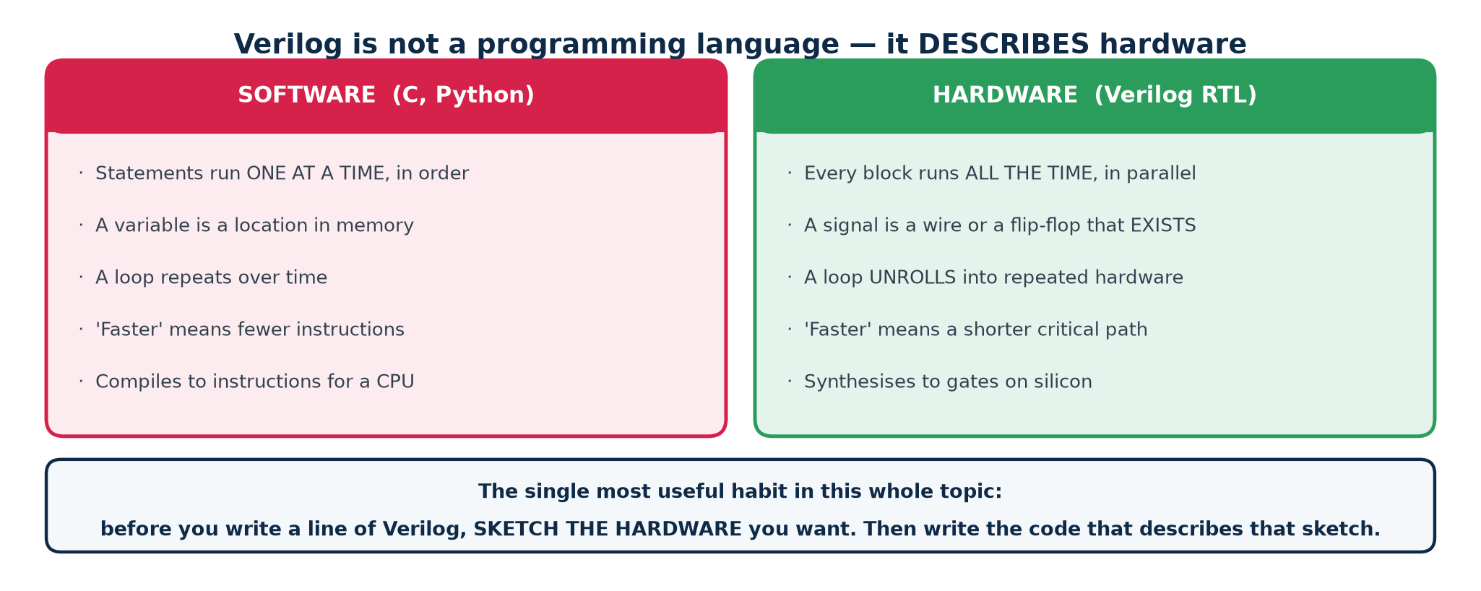
TOPIC 4 · MOTIVATION
Verilog Is Not a Programming Language
This is the single most important idea in the topic, and the one that costs beginners the most time. Verilog looks like C. It is not C. It DESCRIBES hardware that already exists and runs continuously and in parallel — it does not instruct a processor to do things in order.
The habit that fixes almost everything
Before you write a line of Verilog, sketch the hardware you want — the registers, the gates between them, what feeds what. Then write the code that describes that sketch. Designers who do this produce clean RTL from the start; designers who type first and hope produce latches, races and timing failures.
Chip Design Associate · Module 2 · Verilog RTL Coding for Synthesis · Topic 4: RTL Design Using HDL
M2-T4 · 3

Slide 4
SUBTOPIC 4A
Verilog Syntax and Constructs
The language itself — and the narrow subset of it that becomes hardware.
Modules, ports, and the four levels of abstraction
Values, nets and variables, literals, vectors
Operators, and the width rules that cause silent bugs
Procedural blocks, control flow, tasks, functions and generate
The synthesisable subset — and what is simulation-only
Chip Design Associate · Module 2 · Verilog RTL Coding for Synthesis · Topic 4: RTL Design Using HDL
M2-T4 · 4

Slide 5
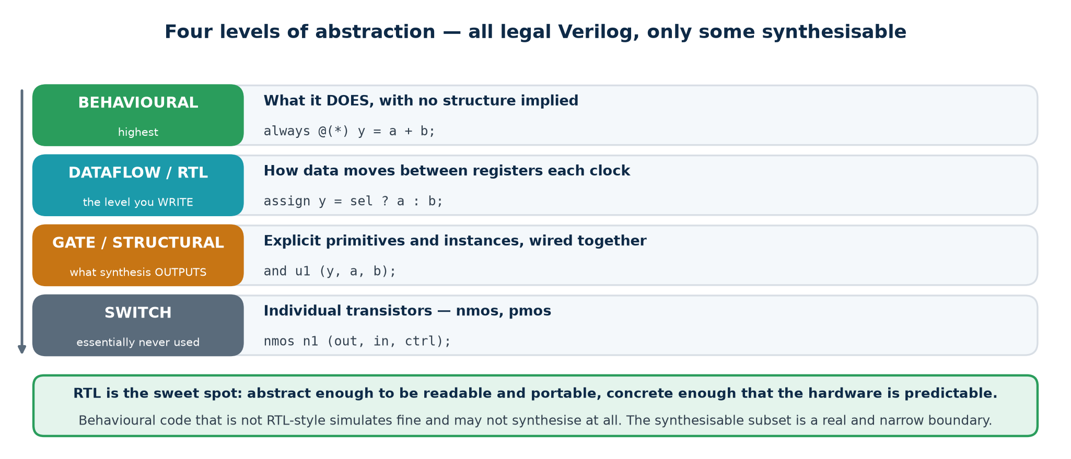
TOPIC 4A · ABSTRACTION
Four Levels of Description — Only Some Synthesise
Verilog can describe hardware at four levels of detail. All four are legal Verilog and all four simulate. Only the middle two are what you will write, and the synthesisable subset is a real, narrow boundary you must learn.
Why RTL is the level we work at
Register-transfer level describes WHAT happens to the data between clock edges, without saying which gates do it. That is abstract enough to be readable and portable between technologies, and concrete enough that the resulting hardware is predictable. Gate-level is what synthesis OUTPUTS; you should be able to read it, not write it.
Chip Design Associate · Module 2 · Verilog RTL Coding for Synthesis · Topic 4: RTL Design Using HDL
M2-T4 · 5

Slide 6
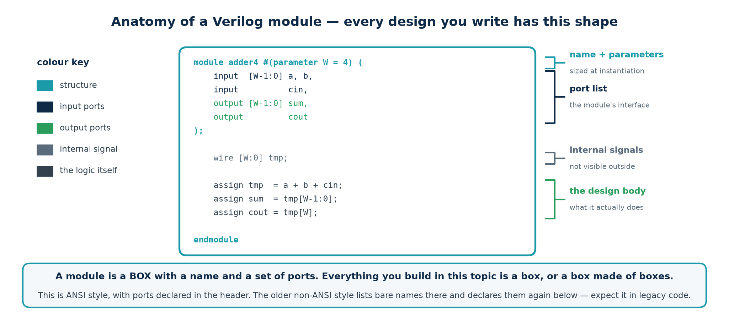
TOPIC 4A · THE MODULE
Anatomy of a Verilog Module
The module is the only unit of design in Verilog. It is a box with a name, a set of ports, and a body. Everything you build in this topic is a box, or a box made of boxes.
Port directions
Two port styles
input — read only inside the module.
output — driven by exactly ONE source.
inout — bidirectional; only on real chip pins.
ANSI (shown): direction, type and width all in the header. Use this.
Non-ANSI: bare names in the header, declared again in the body. You will meet it in older code; do not write new code that way.
Chip Design Associate · Module 2 · Verilog RTL Coding for Synthesis · Topic 4: RTL Design Using HDL
M2-T4 · 6

Slide 7
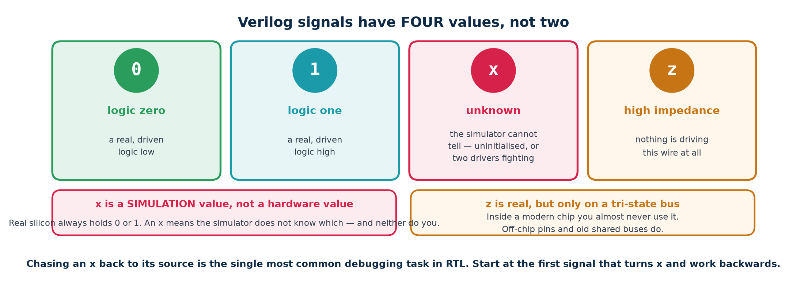
TOPIC 4A · VALUES
Signals Have Four Values, Not Two
Verilog's logic type has four states. Two of them are hardware; two of them are things the SIMULATOR needs to say. Confusing the two categories is the root of a great deal of wasted debugging time.
Where an x comes from — the five usual suspects
1. A register that was never reset. 2. A wire nothing drives. 3. A wire TWO things drive (a multi-driver).
4. Reading past the end of a vector or an array. 5. Arithmetic on a value that is already x — x is contagious, which is why you must chase it back to the FIRST signal that turned x, not the one you noticed.
Chip Design Associate · Module 2 · Verilog RTL Coding for Synthesis · Topic 4: RTL Design Using HDL
M2-T4 · 7

Slide 8
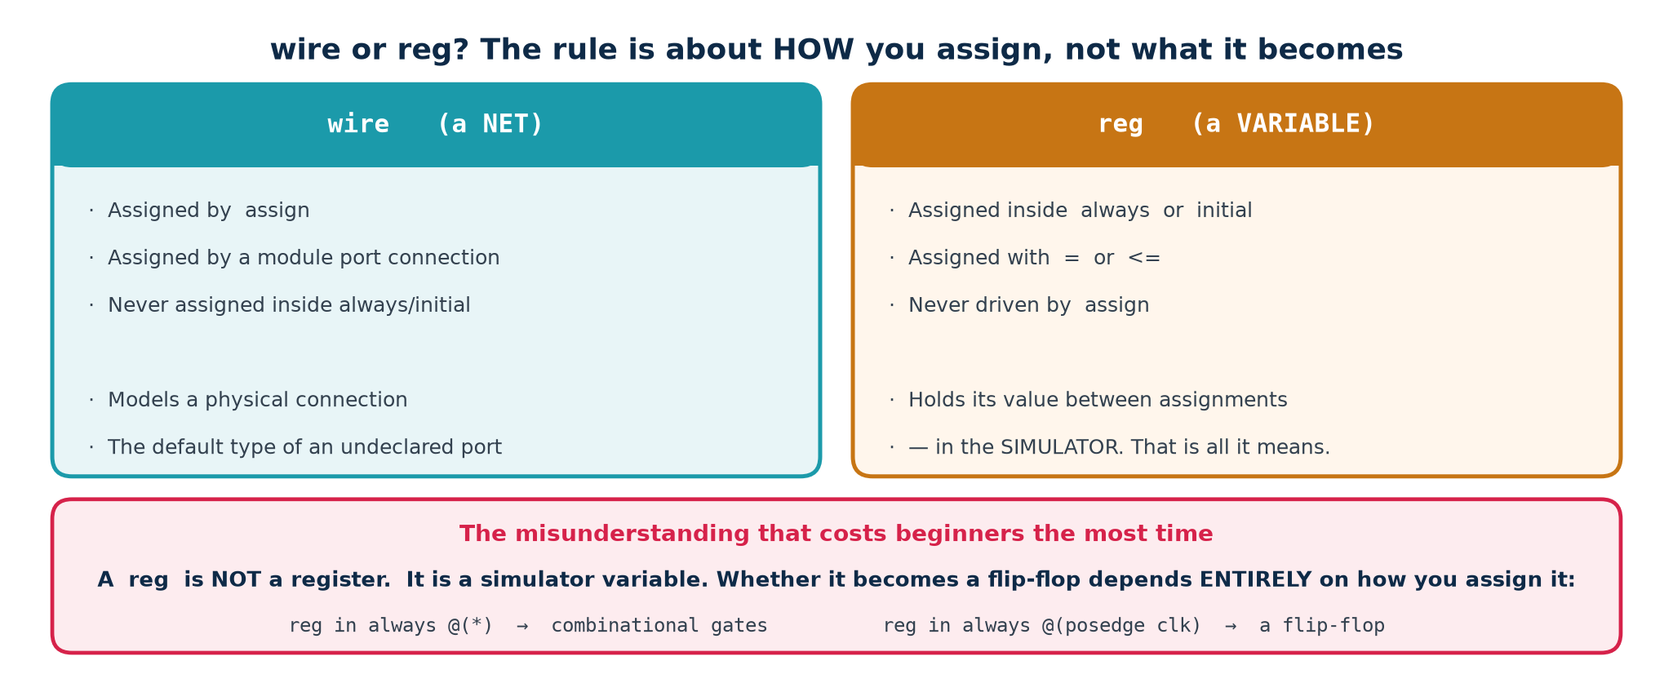
TOPIC 4A · TYPES
wire or reg? The Rule Is About How You Assign
This is a naming accident that has confused students since 1985. A reg is NOT a register. It is a variable in the simulator. Whether it becomes a flip-flop depends entirely on HOW you assign it, and not at all on what you called it.
You want
Declare it
Assign it with
A wire between two things
wire
assign, or a port connection
Combinational logic in a block
reg
= inside always @(*)
A flip-flop
reg
<= inside always @(posedge clk)
A module output driven by assign
wire (the default)
assign
A module output driven by a block
reg
inside the always block
Chip Design Associate · Module 2 · Verilog RTL Coding for Synthesis · Topic 4: RTL Design Using HDL
M2-T4 · 8
SystemVerilog fixes this with logic, which can be assigned either way. If your tools allow SystemVerilog, use it — but you must still be able to read Verilog-2001, because most existing IP is written in it.

Slide 9
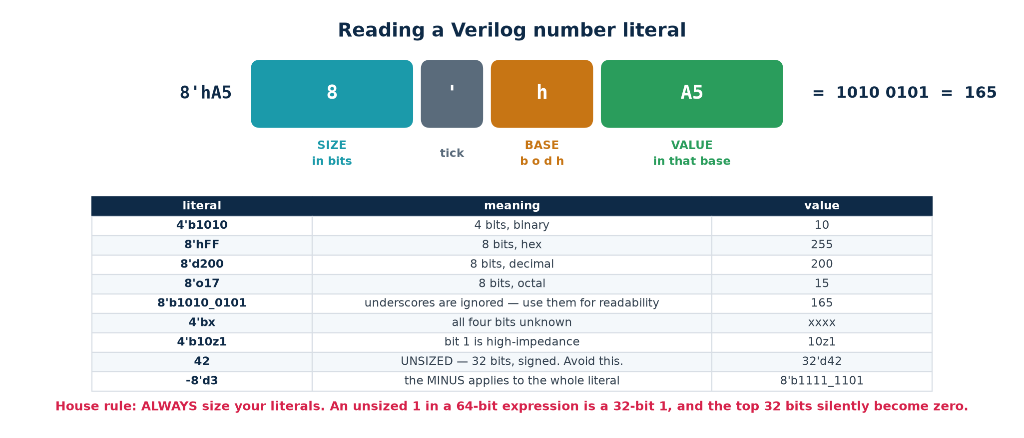
TOPIC 4A · LITERALS
Reading and Writing Number Literals
Every constant in Verilog has a WIDTH as well as a value. Leaving the width off does not mean 'whatever fits' — it means 32 bits, signed. That default is responsible for a whole family of silent bugs.
The house rule
Size every literal. Write 8'd0 not 0; 4'b0000 or {W{1'b0}} not a bare zero. It costs three keystrokes and removes an entire class of bug.
Chip Design Associate · Module 2 · Verilog RTL Coding for Synthesis · Topic 4: RTL Design Using HDL
M2-T4 · 9

Slide 10
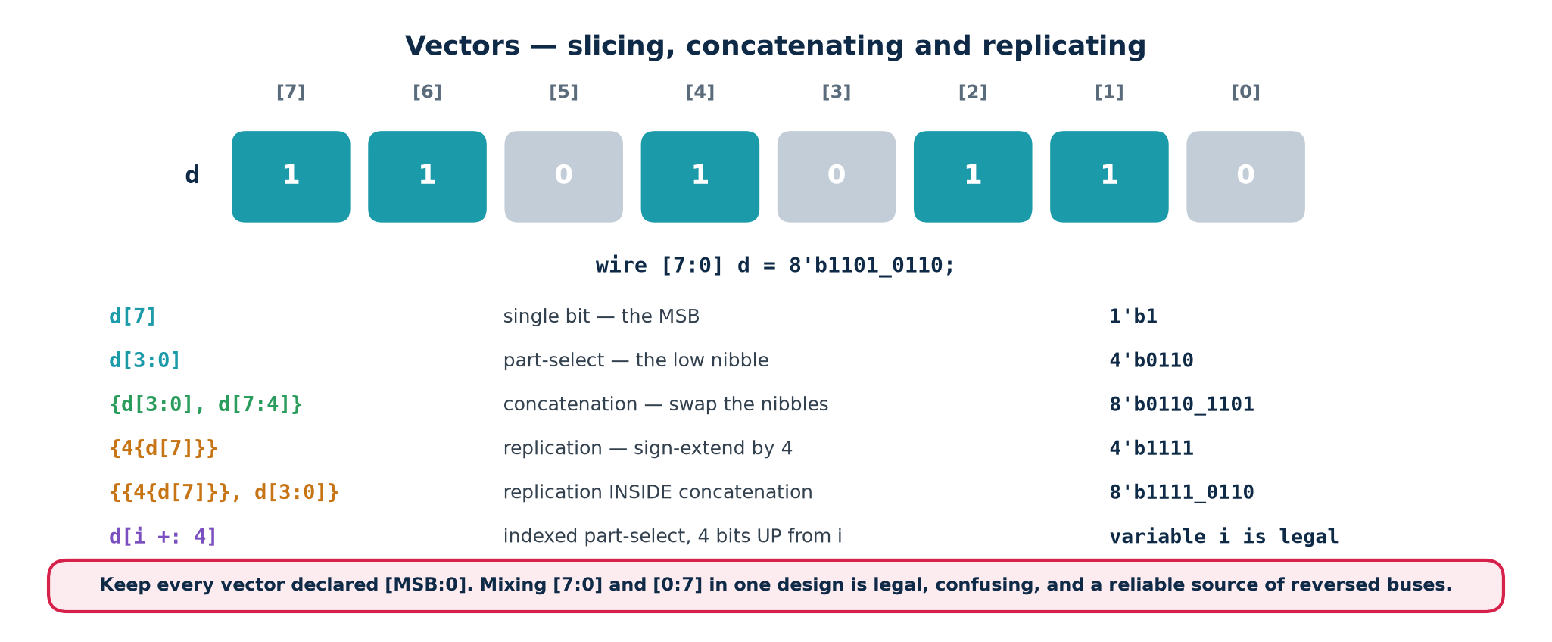
TOPIC 4A · VECTORS
Slicing, Concatenating and Replicating
Almost every signal in real RTL is a vector — a bus. These four operations are how you take buses apart and put them back together, and you will use them constantly.
Arrays are NOT vectors
Indexed part-select
reg [7:0] v; one 8-bit vector
reg v [0:7]; eight 1-bit elements
reg [7:0] m [0:255]; 256 bytes — a memory
You can slice a vector; you index an array.
A plain slice needs constant bounds: d[i:j] is illegal for variable i.
Use d[i +: 4] (4 bits UP from i) or d[i -: 4] (4 bits DOWN). The WIDTH is constant; only the position varies — which is exactly what a multiplexer can do.
Chip Design Associate · Module 2 · Verilog RTL Coding for Synthesis · Topic 4: RTL Design Using HDL
M2-T4 · 10

Slide 11
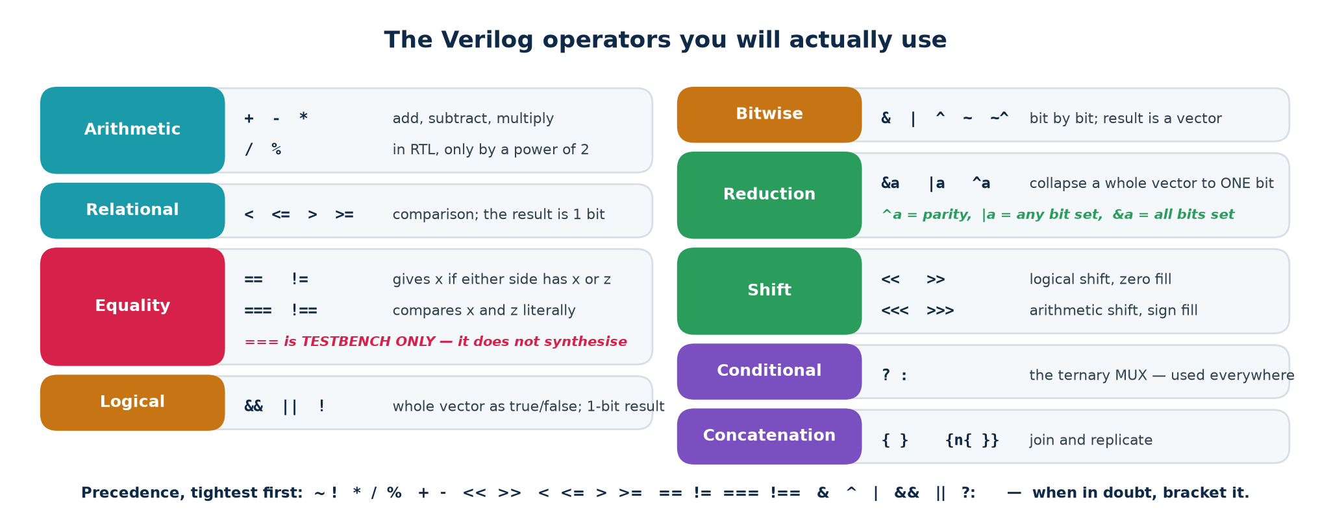
TOPIC 4A · OPERATORS
The Operators You Will Actually Use
Logical vs bitwise — a classic slip
Reduction operators are underused
a && b treats each side as true/false and gives ONE bit.
a & b operates bit by bit and gives a VECTOR.
For 4'b0011 and 4'b1100: && gives 1, & gives 0000.
|req — is ANY bit set? (a valid flag)
&full — are ALL bits set?
^data — parity, in one character.
~|result — is the result zero? That is the ALU's Z flag.
Chip Design Associate · Module 2 · Verilog RTL Coding for Synthesis · Topic 4: RTL Design Using HDL
M2-T4 · 11

Slide 12
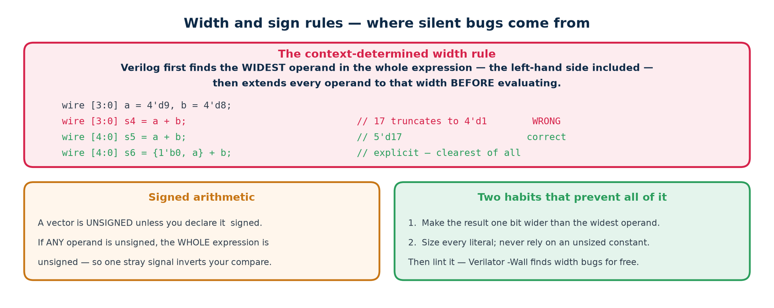
TOPIC 4A · WIDTH RULES
Where Silent Bugs Come From
Verilog will not warn you when a value does not fit. It truncates, silently, and the simulation and the hardware agree with each other — and both are wrong. This is the most common cause of 'it worked yesterday'.
This is not hypothetical — it happened while writing this lab
The UART in Topic4_Lab originally wrote its bit-timing limit as CLKS_PER_BIT[CW-1:0]. With CLKS_PER_BIT = 16, CW is 4 — and 16 does not fit in 4 bits, so it truncated to ZERO.
The receiver stopped waiting half a bit before sampling, began sampling on bit boundaries instead of bit centres, and corrupted some byte patterns but not others. 0x00 passed; 0xFF came back as 0xF7. See the UART lab for the full story.
Chip Design Associate · Module 2 · Verilog RTL Coding for Synthesis · Topic 4: RTL Design Using HDL
M2-T4 · 12

Slide 13
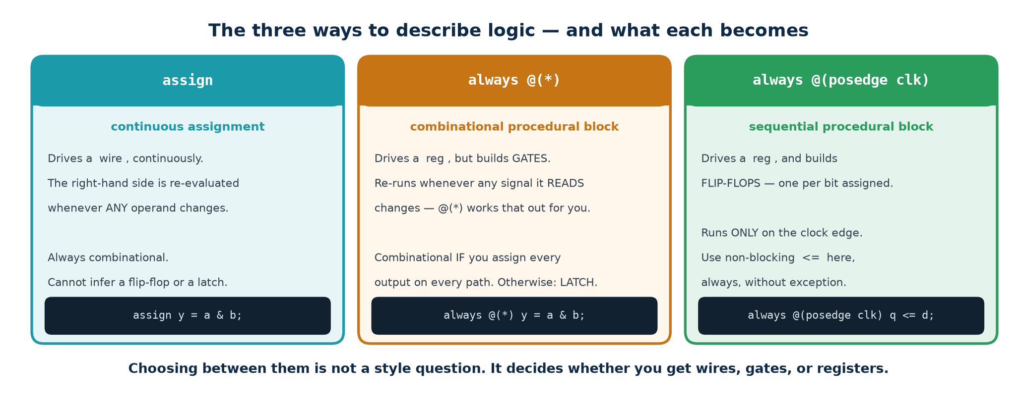
TOPIC 4A · CONSTRUCTS
The Three Ways to Describe Logic
Everything synthesisable in Verilog is written with one of three constructs. Learn what each one BECOMES and you can already read most RTL. The rest of subtopic 4b is simply the detail of using them correctly.
Construct
Written as
Becomes
Use it for
Continuous assignment
assign y = ...;
A cloud of gates
Short combinational expressions
Combinational block
always @(*) ... = ...
A cloud of gates
Longer logic: case, if/else chains
Clocked block
always @(posedge clk) ... <= ...
Flip-flops + gates
Anything that must remember
Chip Design Associate · Module 2 · Verilog RTL Coding for Synthesis · Topic 4: RTL Design Using HDL
M2-T4 · 13

Slide 14
TOPIC 4A · CONTINUOUS ASSIGN
assign — Wiring, Not Instruction
An assign statement is a permanent connection. It is not executed once — it is ALWAYS true. Whenever anything on the right-hand side changes, the left-hand side follows, in zero simulation time. Think of it as solder, not as a line of a program.
Continuous assignments — order-independent, always live
// The right-hand side is re-evaluated whenever ANY of a, b, sel, cin changes.
assign y = a & b; // one AND gate
assign z = sel ? p : q; // a 2:1 multiplexer
assign {co, sum} = a + b + cin; // a 9-bit result split into carry and sum
assign parity = ^data; // an XOR tree
assign any_req = |req; // an OR tree
// Order does not matter. These three lines describe the same circuit
// no matter which order you type them in — because they are wires.
assign c = a ^ b;
assign e = c & d;
assign d = ~a;
Rules
When to reach for it
· The left side must be a wire (net), never a reg.
· A wire may be driven by only ONE assign. Two drivers give x.
· No if/case/for — expressions only. Use ?: for choices.
Use assign for anything that fits comfortably on one line and has no choice structure. The moment you find yourself nesting three conditional operators, stop and rewrite it as an always @(*) block with a case statement — it will be far easier to read and reviews better.
Chip Design Associate · Module 2 · Verilog RTL Coding for Synthesis · Topic 4: RTL Design Using HDL
M2-T4 · 14

Slide 15
TOPIC 4A · PROCEDURAL BLOCKS
initial and always — and What a Sensitivity List Means
A procedural block contains statements that run in order, inside the block. The block itself is triggered by its sensitivity list. Blocks run CONCURRENTLY with each other; statements run SEQUENTIALLY within one block.
The forms you will meet
always @(*) begin ... end // re-runs whenever any input changes -> combinational
always @(posedge clk) begin ... end // runs once per rising clock edge -> flip-flops
always @(posedge clk or negedge rst_n) // adds an ASYNCHRONOUS reset
initial begin ... end // runs ONCE at time 0 -- SIMULATION ONLY
always begin ... end // runs forever -- used for clock generation in a TB
@(*)
Automatic sensitivity: the tool works out every signal READ inside the block and triggers on all of them. Always use this form for combinational logic — a hand-written list such as @(a or b) is a bug waiting to happen the day someone adds a signal to the expression and forgets the list.
@(posedge clk)
Edge sensitivity: the block runs at the instant the clock rises, and at no other time. Everything assigned with <= inside becomes a flip-flop clocked by clk.
initial
Runs once at time zero. There is no hardware equivalent of 'do this once at time zero' in ASIC logic, so initial is for testbenches. (FPGA tools DO honour initial for register power-up values; ASIC tools do not — never rely on it.)
Chip Design Associate · Module 2 · Verilog RTL Coding for Synthesis · Topic 4: RTL Design Using HDL
M2-T4 · 15

Slide 16
TOPIC 4A · CONTROL FLOW
if / else — a Priority Structure in Hardware
An if/else chain does not 'test conditions one after another'. It synthesises to a chain of multiplexers in which the FIRST condition has the highest priority. That chain has depth — and depth is delay.
Priority — deep, slow, sometimes required
Parallel — shallow, fast
if (a) y = 0;
else if (b) y = 1;
else if (c) y = 2;
else y = 3;
Three multiplexers in series. Use it when the conditions really do overlap and one must win — an interrupt controller, a bus arbiter.
case (sel)
2'd0: y = 0; 2'd1: y = 1;
2'd2: y = 2; 2'd3: y = 3;
endcase
One multiplexer. Use it when the conditions are mutually exclusive — which they usually are.
The rule that prevents accidental latches
Inside always @(*), every branch must assign every output. If a path through the code leaves a variable unassigned, the synthesiser must build something that REMEMBERS the old value — a latch. Two ways to guarantee you never do this: (1) write a default assignment at the top of the block, or (2) always write a final else / default:. We come back to this in detail in 4b.
Chip Design Associate · Module 2 · Verilog RTL Coding for Synthesis · Topic 4: RTL Design Using HDL
M2-T4 · 16

Slide 17
TOPIC 4A · CASE
case, casez, casex — and Why casex Is Banned
case compares the selector against each label using 4-state equality. Its two wildcard variants let labels contain don't-cares — one of them safely, one of them not.
case and casez
// case -- exact match, including x and z. The workhorse.
case (opcode)
4'b0000: y = a + b;
4'b0001: y = a - b;
default: y = 8'd0; // ALWAYS write a default
endcase
// casez -- ? and z in the LABEL are don't-care. Correct for priority encoders.
casez (req)
4'b1???: grant = 2'd3; // bit 3 set -- lower bits irrelevant
4'b01??: grant = 2'd2;
4'b001?: grant = 2'd1;
default: grant = 2'd0;
endcase
casex — do not use it
full_case / parallel_case
casex also treats an x in the SELECTOR as a wildcard. During simulation an uninitialised signal will then match the FIRST label and appear to work, while the synthesised hardware behaves differently. It hides exactly the bug you most need to see. Most coding standards ban it outright.
These synthesis pragmas promise the tool that all cases are covered / mutually exclusive. If the promise is false, simulation and synthesis silently disagree — the hardest class of bug there is. Write a real default instead; it costs nothing and cannot lie.
Chip Design Associate · Module 2 · Verilog RTL Coding for Synthesis · Topic 4: RTL Design Using HDL
M2-T4 · 17

Slide 18
TOPIC 4A · LOOPS
for, while, repeat — Loops Are Unrolled, Not Executed
A for loop in synthesisable Verilog is a copy-paste instruction to the tool. It does not create a counter or take time. The tool duplicates the loop body once per iteration — so the bounds must be constants, and eight iterations means eight copies of the hardware.
Synthesisable loop — constant bounds
integer i;
always @(*) begin
cnt = 4'd0;
for (i = 0; i < 8; i = i + 1)
cnt = cnt + data[i]; // becomes 8 adders in a tree -- NOT a loop in hardware
end
// Reversing a bus -- 8 wires crossed over, zero gates, zero delay.
always @(*)
for (i = 0; i < 8; i = i + 1) rev[i] = fwd[7-i];
Synthesisable
Simulation only
for with constant start, limit and step.
repeat (N) with constant N — also unrolled.
Loop variable is integer or genvar — it does not exist in the hardware.
while, forever, and any loop whose bound depends on a signal. The tool cannot know how many copies to make, so it refuses.
If you need 'repeat until a signal changes', that is a state machine or a counter — build it explicitly.
Chip Design Associate · Module 2 · Verilog RTL Coding for Synthesis · Topic 4: RTL Design Using HDL
M2-T4 · 18

Slide 19
TOPIC 4A · REUSE
Functions and Tasks
A function is a named expression; a task is a named block of statements. A function that obeys the rules synthesises — into a duplicate copy of its logic at every call site. Tasks are, in practice, a testbench tool.
Function vs task
// FUNCTION -- synthesisable. No time control, at least one input, returns one value.
function [3:0] bcd_digit;
input [7:0] v;
begin
bcd_digit = v % 10; // the function name IS the return variable
end
endfunction
assign d0 = bcd_digit(count); // one copy of the logic here ...
assign d1 = bcd_digit(other); // ... and a SECOND, independent copy here
// TASK -- may consume time, may have multiple outputs. Testbench use.
task send_byte(input [7:0] b);
begin
tx_data = b; tx_start = 1'b1; @(posedge clk); tx_start = 1'b0;
wait (tx_busy == 1'b0);
end
endtask
The cost you must remember
A function call is not a subroutine call — there is no 'calling' at run time. Each call site gets its own physical copy of the logic. Four calls to a 16-bit multiplier function means four multipliers on the die. If you want ONE shared unit used at different times, that is a datapath with a multiplexer in front of it and a controller — a design decision, not a syntax choice.
Chip Design Associate · Module 2 · Verilog RTL Coding for Synthesis · Topic 4: RTL Design Using HDL
M2-T4 · 19

Slide 20
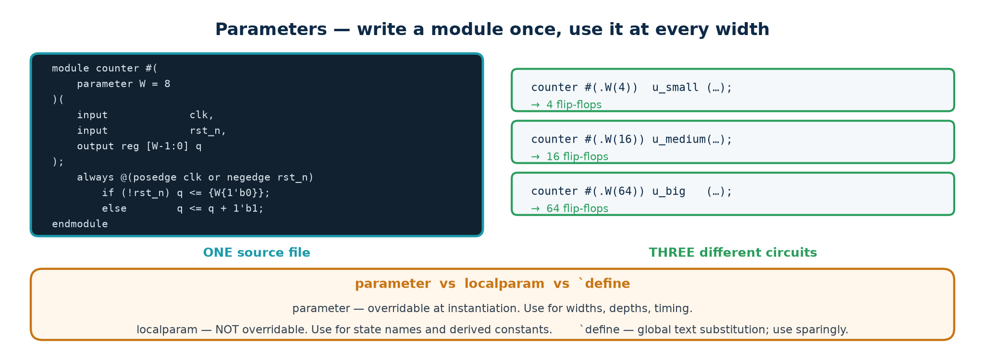
TOPIC 4A · PARAMETERS
Writing One Module That Fits Every Size
A parameter is a constant that the instantiating module can override. Parameterising is the difference between an 8-bit counter and a counter — between code you write once and code you copy and edit five times, introducing a bug in the fourth copy.
Parameterised module and an override
module counter #(parameter integer W = 8, parameter [W-1:0] MAX = {W{1'b1}})
(input clk, rst_n, en, output reg [W-1:0] q, output wire tc);
localparam [W-1:0] ZERO = {W{1'b0}}; // localparam CANNOT be overridden
assign tc = en & (q == MAX);
...
endmodule
counter #(.W(4), .MAX(4'd9)) u_dig0 (.clk(clk), .rst_n(rst_n), ...); // a decade counter
Use localparam for anything derived or internal — state encodings, computed widths — so that a careless override cannot break the module's internal consistency. Use $clog2(N) to compute the number of bits needed to count to N.
Chip Design Associate · Module 2 · Verilog RTL Coding for Synthesis · Topic 4: RTL Design Using HDL
M2-T4 · 20

Slide 21
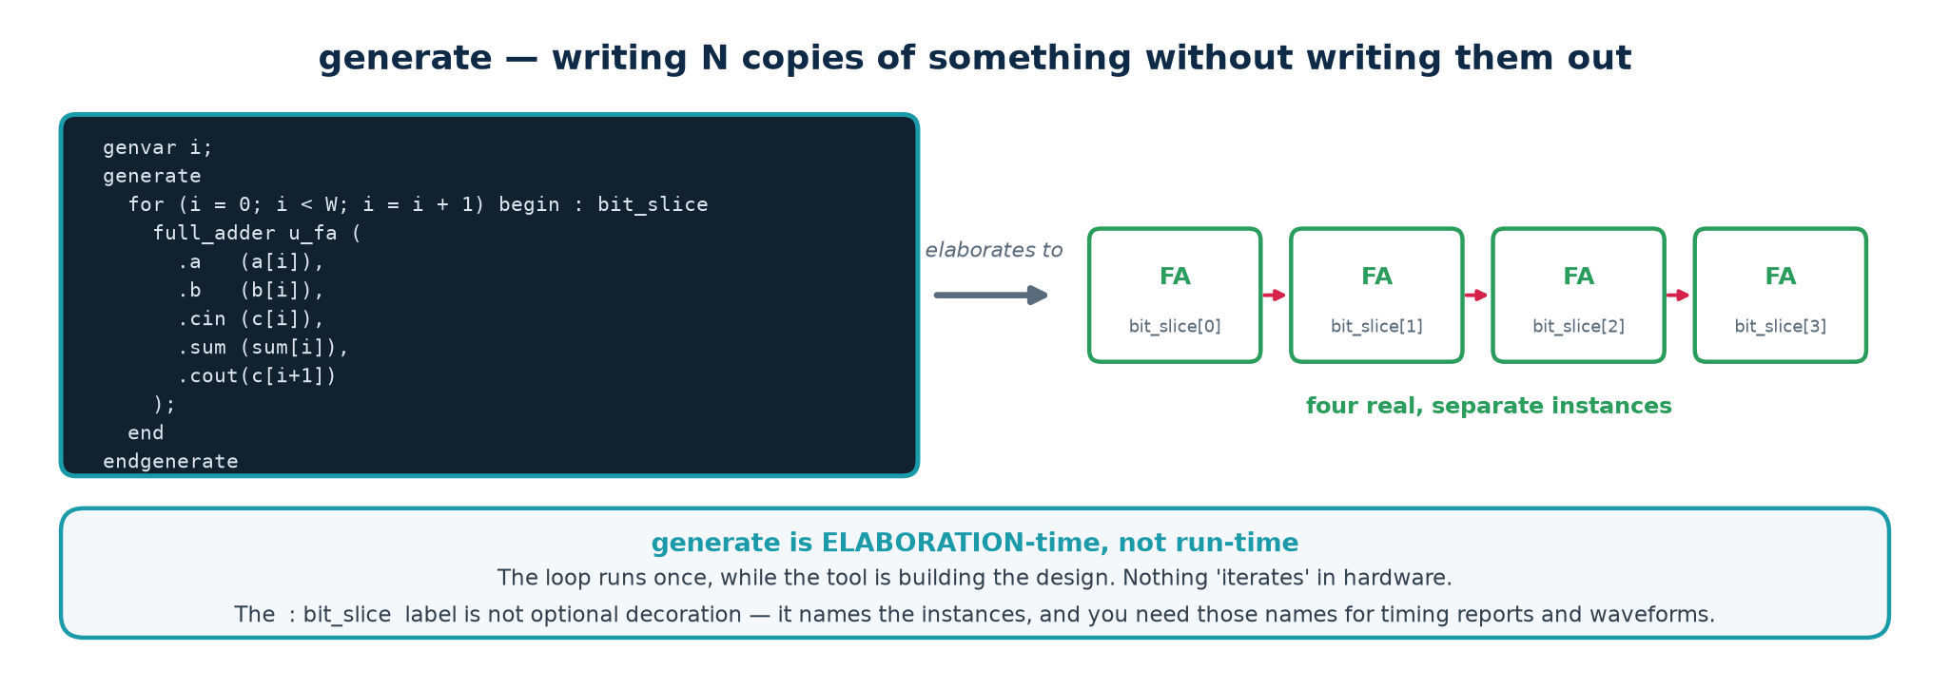
TOPIC 4A · GENERATE
generate — Building Structure Out of a Loop
generate lets a loop or an if create INSTANCES and blocks, not just logic. It runs at elaboration time — before simulation starts — and its result is a fixed structure. This is how you build an N-bit ripple adder from one full-adder module.
generate for — Topic4_Lab/rtl/adder_gen.v
genvar i;
generate
for (i = 0; i < W; i = i + 1) begin : bit_slice // the label is REQUIRED
full_adder u_fa (.a(a[i]), .b(b[i]), .cin(c[i]), .sum(sum[i]), .cout(c[i+1]));
end
endgenerate
// Instances are named bit_slice[0].u_fa, bit_slice[1].u_fa, ... -- use these in $dumpvars
generate if selects between whole implementations at elaboration — for example a fast carry-lookahead adder when W is large and a small ripple adder when it is not. The unselected branch is not elaborated at all, so it need not even be legal for the chosen parameters.
Chip Design Associate · Module 2 · Verilog RTL Coding for Synthesis · Topic 4: RTL Design Using HDL
M2-T4 · 21

Slide 22
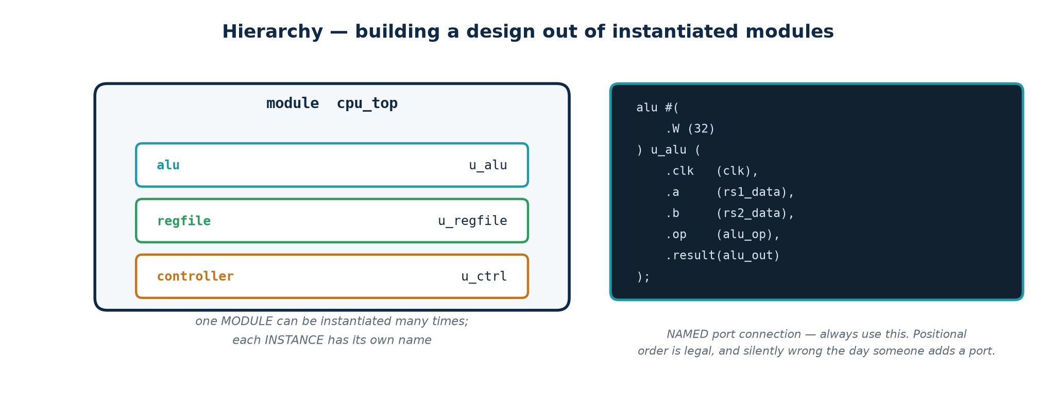
TOPIC 4A · HIERARCHY
Instantiating Modules — Always By Name
Real designs are trees of modules. A module is a TYPE; an instance is a physical copy. Two instances of the same module are two separate pieces of hardware that share nothing.
By name — do this
By position — do not
uart_tx u_tx (
.clk (clk),
.rst_n (rst_n),
.data (tx_data),
.tx (serial_out));
Order-independent, self-documenting, and a typo is a compile error.
uart_tx u_tx (clk, rst_n,
tx_data, serial_out);
Add a port to the module and every instance silently connects the wrong wires. Legal, common in old code, and a permanent source of accidents.
Naming convention used throughout this course: instances are prefixed u_; an unconnected output is written .name() explicitly so a reader can see it was deliberate.
Chip Design Associate · Module 2 · Verilog RTL Coding for Synthesis · Topic 4: RTL Design Using HDL
M2-T4 · 22

Slide 23
TOPIC 4A · DIRECTIVES
Compiler Directives — the Backtick Family
Directives are processed before compilation, like C's preprocessor. They begin with a backtick, not a hash, and they are NOT terminated with a semicolon.
Directive
What it does
Note
`timescale 1ns/1ps
Sets the unit and precision of delays
First line of every file; unit / precision
`define NAME value
Text macro, referenced as `NAME
GLOBAL — prefix to avoid clashes
`include "file.vh"
Textual inclusion
Use for shared parameter headers
`ifdef / `ifndef / `endif
Conditional compilation
Simulation-only code, ASIC vs FPGA
`default_nettype none
Turns off implicit wire creation
Put it in EVERY file. See below.
`resetall
Restores defaults
Pair with the line above at end of file
`default_nettype none — the single most valuable line in the file
By default, a name you never declared becomes a 1-bit wire, silently. Misspell data_valid as data_vaild in a port connection and Verilog creates a new, undriven 1-bit wire and says nothing; your design gets an x and you spend an afternoon on it.
Put `default_nettype none at the top of every file and that typo becomes a compile error on the exact line. Every file in Topic4_Lab does this.
Chip Design Associate · Module 2 · Verilog RTL Coding for Synthesis · Topic 4: RTL Design Using HDL
M2-T4 · 23

Slide 24
TOPIC 4A · SYSTEM TASKS
The Dollar Family — Your Simulation Instruments
System tasks are built-in routines the SIMULATOR provides. None of them synthesise — they are how you observe and control a simulation. Two of them ($clog2 and $bits) are exceptions that are legal in synthesisable code because they are evaluated at elaboration.
Task
Purpose
Typical use
$display / $write
Print once, when reached
$display("%0t got %h", $time, q);
$monitor
Print whenever any argument changes
One per simulation, in initial
$time / $realtime
Current simulation time
Timestamping messages
$dumpfile / $dumpvars
Write a VCD waveform file
$dumpvars(0, tb); — 0 = all levels
$finish / $stop
End / pause the simulation
$finish at the end of your stimulus
$random / $urandom
Pseudo-random stimulus
Seed it so failures reproduce
$fatal / $error
Report and optionally abort
Self-checking testbenches
$clog2(N)
Ceiling log2 — SYNTHESISABLE
localparam CW = $clog2(DEPTH);
Format specifiers: %b %o %d %h for radix, %s string, %t time. Prefix with 0 — %0d — to drop the padding that otherwise makes output unreadable.
Chip Design Associate · Module 2 · Verilog RTL Coding for Synthesis · Topic 4: RTL Design Using HDL
M2-T4 · 24

Slide 25
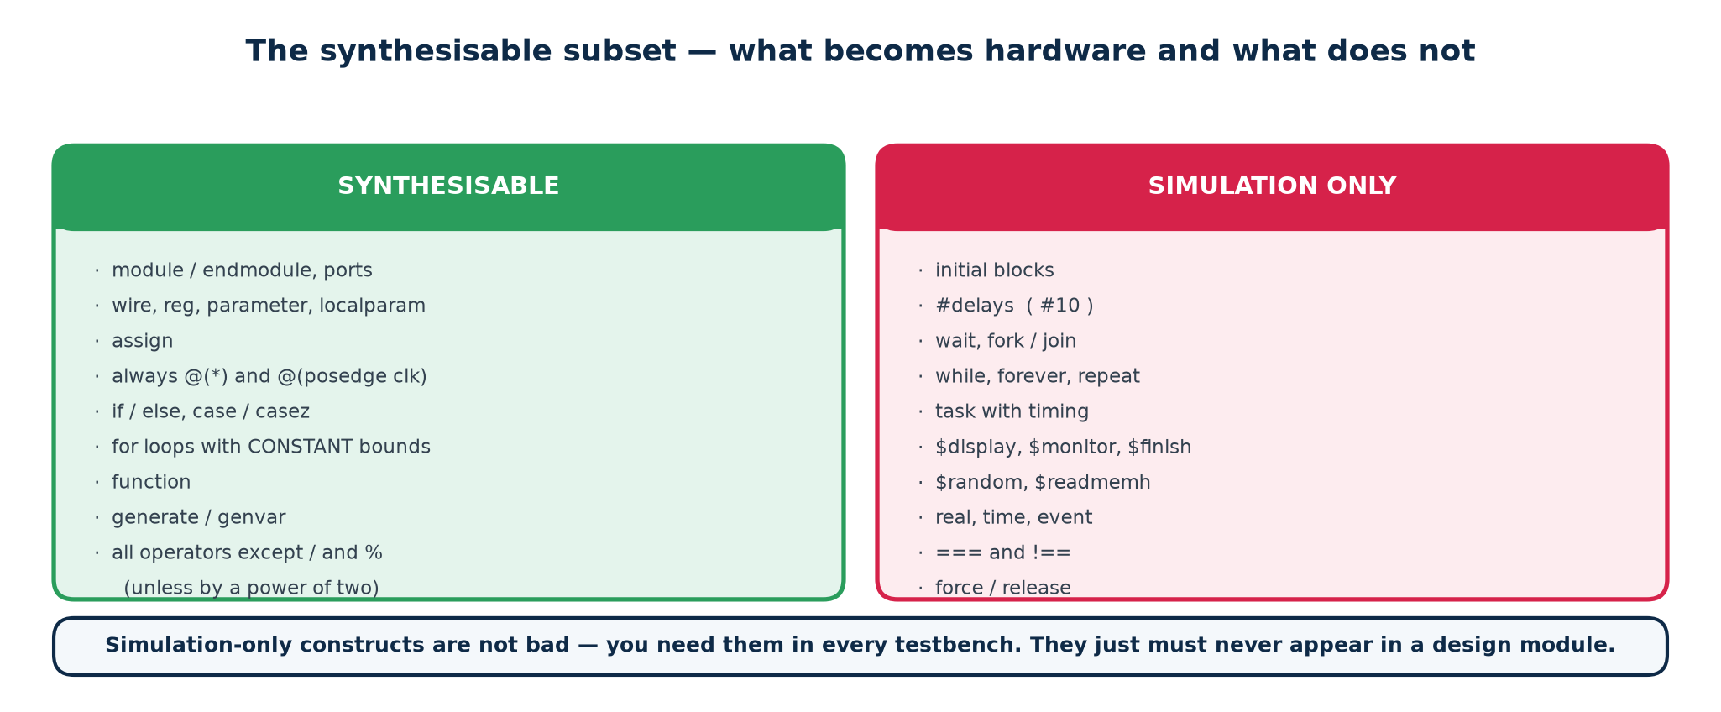
TOPIC 4A · THE SUBSET
What Synthesises, and What Does Not
This is the boundary that separates a design from a testbench. Verilog is a simulation language that HAPPENS to have a synthesisable subset. If you write something outside it, the simulation may run perfectly and the synthesiser will either reject it or — worse — quietly ignore it.
The four that catch people out
...continued
· Delays. #5 is ignored by synthesis. Timing comes from the clock and the technology, never from your source.
· initial blocks. Reset your registers with a reset signal.
· Multiple always blocks driving one signal. Illegal. One signal, one driver, one block.
· Mixing = and <= for the same variable. Legal Verilog, undefined behaviour in practice, rejected by every lint tool.
Chip Design Associate · Module 2 · Verilog RTL Coding for Synthesis · Topic 4: RTL Design Using HDL
M2-T4 · 25

Slide 26
TOPIC 4A · STYLE
House Rules — The Checklist Used in This Course
Every rule below exists because breaking it has cost somebody a day. They are the standing lint rules for all labs in Topic 4.
▪
One file, one module, and the file is named after the module.
▪
`default_nettype none at the top; `resetall at the bottom.
▪
ANSI port headers. Instantiate by name. Prefix instances with u_.
▪
Active-low signals end in _n (rst_n). Clocks are clk.
▪
Size every literal. Never write a bare 0 or 1 into a vector.
▪
Combinational: always @(*) with = and a default assignment. Sequential: always @(posedge clk) with <= only.
▪
Every case has a default. Never casex. Never full_case/parallel_case.
▪
One driver per signal. Reset every state-holding register.
▪
Lint with Verilator before you simulate; simulate before you synthesise; check the synthesis log for inferred latches every single time.
Why the log matters more than the waveform
A latch warning in the synthesis log is telling you the hardware does not match your intent. The simulation will often pass anyway, because in simulation the latch happens to hold the value you expected. The mismatch appears on silicon. Read the log.
Chip Design Associate · Module 2 · Verilog RTL Coding for Synthesis · Topic 4: RTL Design Using HDL
M2-T4 · 26

Slide 27
TOPIC 4A · CHECKPOINT
Before We Move On — Ten Questions
Ask the room. Do not move to 4b until most of these come back quickly. Answers are in the workbook, section T4-A.
Questions 1–5
Questions 6–10
1. Is reg a register? When is it, and when is it not?
2. What width and sign does the literal 12 have?
3. What does {3{2'b10}} evaluate to, and how wide is it?
4. Give one bit of output: ^8'b1101_0110 = ?
5. Why is a && b not the same as a & b?
6. How many adders does an unrolled 8-iteration for loop create?
7. Name two things that make code un-synthesisable.
8. What is the difference between parameter and localparam?
9. Why does every file start with `default_nettype none?
10. Why is casex banned?
If question 1 or 5 gave the room trouble
Go back to slides 11 and 16 now rather than pressing on. Everything in 4b is built on knowing what a reg becomes and how wide an expression is; a class that is shaky on those two will not follow the latch discussion at all.
Chip Design Associate · Module 2 · Verilog RTL Coding for Synthesis · Topic 4: RTL Design Using HDL
M2-T4 · 27

Slide 28
SUBTOPIC 4B
Designing Combinational and Sequential Logic Using HDL
From here on, every construct is judged by one question: what hardware does it produce?
The inference map — code pattern in, hardware out
Combinational modelling, and the latch you must never infer
Sequential modelling, blocking vs non-blocking, and the event queue
Reset strategy, counters, shift registers, edge detection, CDC
State machines: styles, encodings, safe defaults
Memories, and pipelining for speed
Chip Design Associate · Module 2 · Verilog RTL Coding for Synthesis · Topic 4: RTL Design Using HDL
M2-T4 · 28

Slide 29
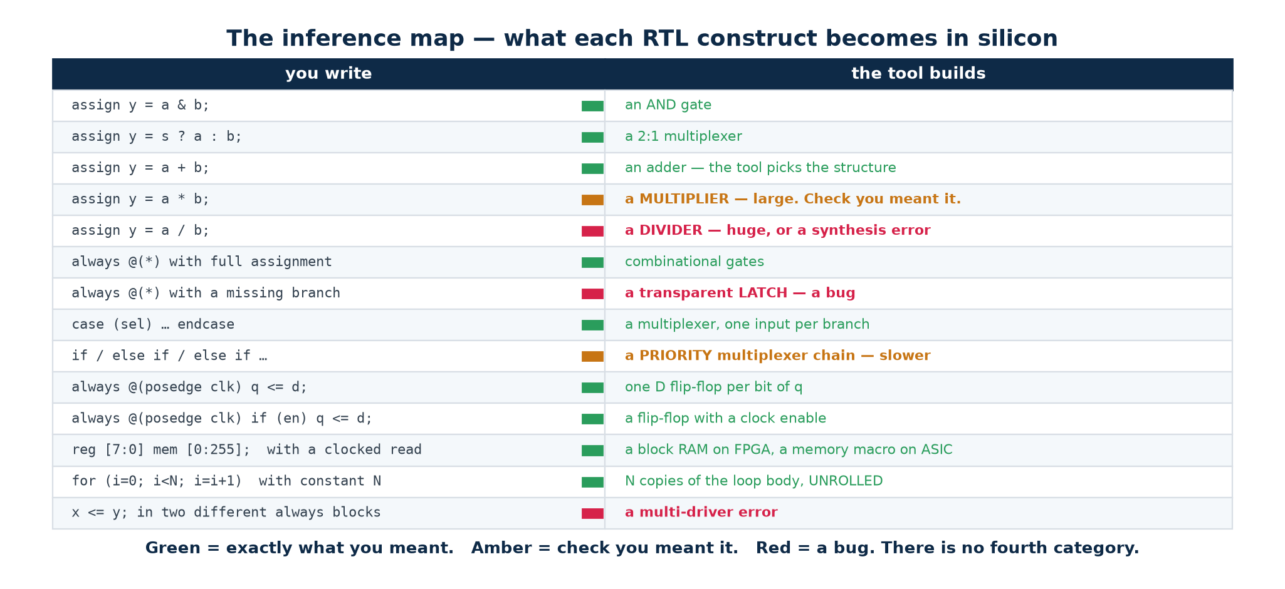
TOPIC 4B · INFERENCE
The Inference Map — Learn This Table Cold
Synthesis is pattern matching. The tool reads your code, recognises a pattern, and drops in the corresponding hardware. There is no intelligence in it — which is good news, because it means the mapping is completely predictable once you know the patterns.
The single question to ask of every line you write
"What does this become?" If you cannot answer that for a line of your own RTL, you have written something you do not understand, and the tool will make its own choice. Nine times out of ten that choice is a latch, a huge multiplexer, or a critical path you did not expect.
Chip Design Associate · Module 2 · Verilog RTL Coding for Synthesis · Topic 4: RTL Design Using HDL
M2-T4 · 29

Slide 30
TOPIC 4B · COMBINATIONAL
Three Ways to Write the Same Multiplexer
All three of these synthesise to identical hardware. Choose by readability, not by any belief about efficiency — the synthesiser flattens all of them to the same boolean function before it optimises.
Topic4_Lab/rtl/mux2.v uses style 1
// Style 1 -- continuous assignment. Best for short expressions.
assign y = sel ? b : a;
// Style 2 -- combinational always block with if/else.
always @(*) begin
if (sel) y = b;
else y = a; // the else is what stops a latch
end
// Style 3 -- combinational always block with case. Scales best.
always @(*) begin
case (sel)
1'b0: y = a;
default: y = b; // default covers 1'b1, 1'bx and 1'bz
endcase
end
Style 1 for one-liners. Style 3 the moment there are three or more choices — a 4:1 multiplexer written as nested ternaries is unreadable, and unreadable RTL is where bugs live.
Chip Design Associate · Module 2 · Verilog RTL Coding for Synthesis · Topic 4: RTL Design Using HDL
M2-T4 · 30

Slide 31
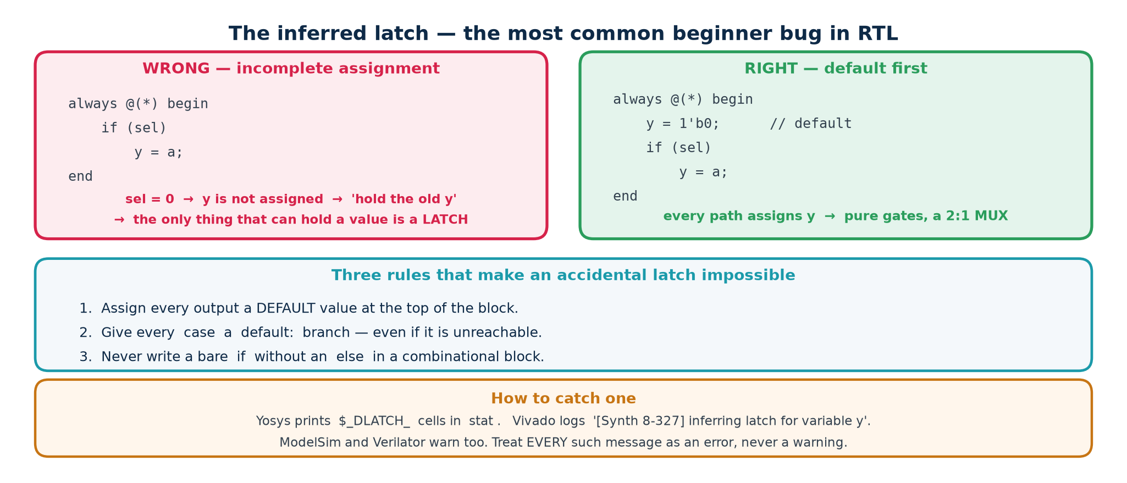
TOPIC 4B · LATCHES
The Accidental Latch — The Number One Beginner Bug
If a combinational block does not assign a variable on EVERY possible path, the variable must keep its old value when that path is taken. Keeping an old value is memory, and the only memory the tool can build from a level-sensitive block is a transparent latch.
Why a latch is bad news
The two cures — use both
· It is transparent while enabled — data flows straight through, so it does not isolate one cycle from the next.
· Static timing analysis of latch-based paths is far harder; many flows simply cannot close timing on them.
· It was almost certainly not what you meant.
1. Default first. Assign every output at the top of the block, then override in the branches.
2. Complete every branch. Every if has an else; every case has a default. Then grep the synthesis log for the word 'latch' before you go home.
Chip Design Associate · Module 2 · Verilog RTL Coding for Synthesis · Topic 4: RTL Design Using HDL
M2-T4 · 31

Slide 32
TOPIC 4B · LAB EVIDENCE
Seeing the Latch in a Real Tool Report
Do not take this on trust — make the tool show you. Topic4_Lab/rtl/broken_examples.v contains deliberately wrong modules so you can watch each failure appear in a synthesis report and then watch it disappear when you fix it.
rtl/broken_examples.v
// bad_latch -- BOTH always blocks are incomplete
always @(*) begin
if (enable) y = d[0]; // no else -> LATCH on y
end
always @(*) begin
case (sel)
2'b00: w = d[0];
2'b01: w = d[1];
2'b10: w = d[2]; // 2'b11 missing, no default -> LATCH on w
endcase
end
Verified output — run this yourself in Lab L1
$ yosys -p "read_verilog rtl/broken_examples.v; synth -top bad_latch; stat"
$_DLATCH_N_ 1
$_DLATCH_P_ 1 <-- two latches, exactly as predicted
Now add the else and the default, re-run, and the two DLATCH lines vanish. That before-and-after is the exercise; the slide is only the summary.
Chip Design Associate · Module 2 · Verilog RTL Coding for Synthesis · Topic 4: RTL Design Using HDL
M2-T4 · 32

Slide 33
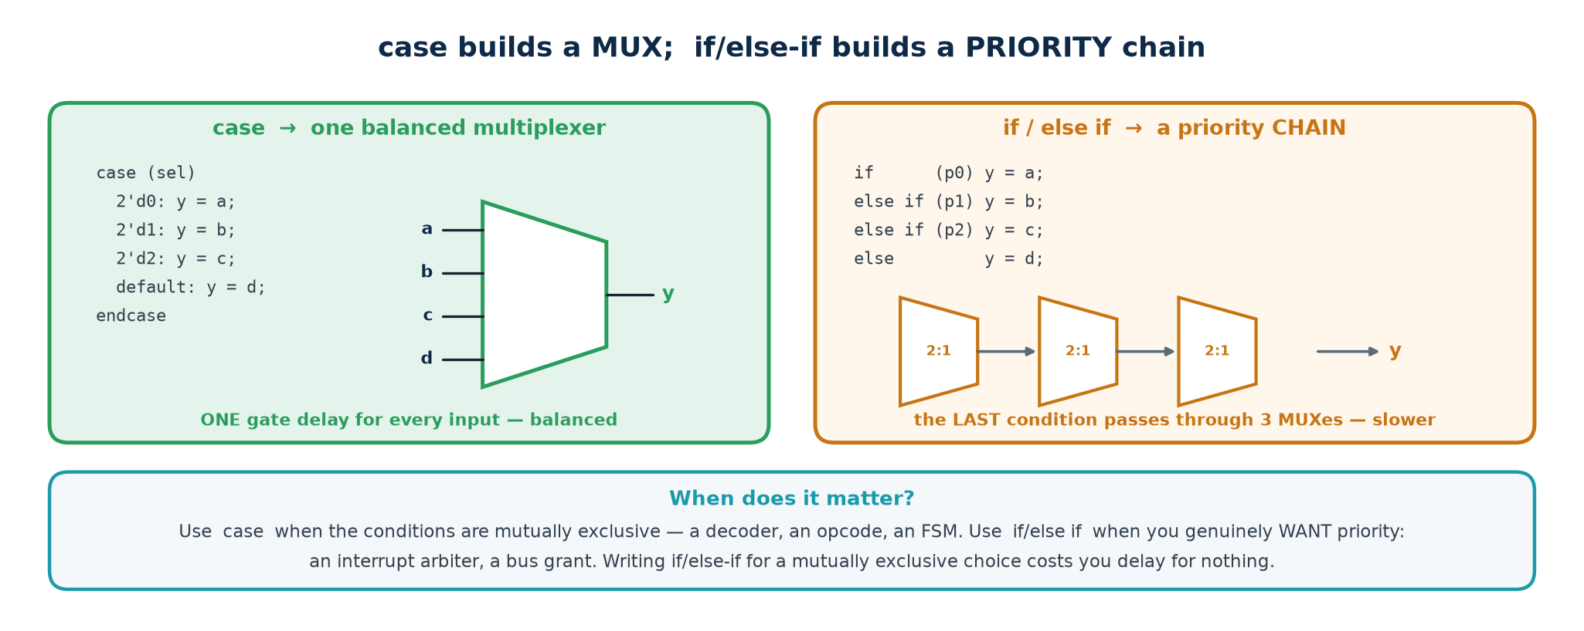
TOPIC 4B · DECODE
case Becomes a Multiplexer — or a Decoder, or an Encoder
One construct, three familiar building blocks. Which one you get depends only on what is being selected: data (multiplexer), a one-hot output (decoder), or a priority (encoder).
Decoder — Topic4_Lab/rtl/decoder3to8.v
Priority encoder — rtl/priority_encoder8.v
always @(*) begin
y = 8'b0;
if (en) y[sel] = 1'b1;
end
A variable INDEX on the left of an assignment is a decoder. Perfectly legal, perfectly synthesisable.
casez (req)
8'b1???????: {v,y} = {1'b1,3'd7};
8'b01??????: {v,y} = {1'b1,3'd6};
... default: {v,y} = {1'b0,3'd0};
casez, never casex. The valid bit tells you 'no request' apart from 'request 0'.
Chip Design Associate · Module 2 · Verilog RTL Coding for Synthesis · Topic 4: RTL Design Using HDL
M2-T4 · 33

Slide 34
TOPIC 4B · WORKED EXAMPLE
An 8-Operation ALU With Real Flags
This is the first design in the lab that is big enough to be interesting. Note the defaults at the top of the block, the width-(W+1) sum that captures the carry, and the fact that signed overflow is NOT the same thing as carry.
Topic4_Lab/rtl/alu.v (extract)
wire [W:0] sum_ext = {1'b0, a} + {1'b0, b}; // ONE bit wider -> carry is free
always @(*) begin
result = {W{1'b0}}; carry = 1'b0; overflow = 1'b0; // defaults -> no latch
case (op)
OP_ADD: begin
result = sum_ext[W-1:0];
carry = sum_ext[W];
overflow = (a[W-1] == b[W-1]) && (result[W-1] != a[W-1]);
end
OP_SLT: result = ($signed(a) < $signed(b)) ? {{(W-1){1'b0}},1'b1} : {W{1'b0}};
...
default: begin result = {W{1'b0}}; carry = 1'b0; overflow = 1'b0; end
endcase
end
assign zero = ~|result; // reduction NOR -- one operator, a whole NOR tree
assign negative = result[W-1];
The flag that always catches people
Carry is UNSIGNED overflow; V is SIGNED overflow. Adding 8'h7F + 8'h01 gives 8'h80: no carry out at all, but a signed overflow (127 + 1 became −128). Adding 8'hFF + 8'h01 gives 8'h00: carry out set, but no signed overflow (−1 + 1 = 0 is correct). The lab testbench checks both.
Chip Design Associate · Module 2 · Verilog RTL Coding for Synthesis · Topic 4: RTL Design Using HDL
M2-T4 · 34

Slide 35
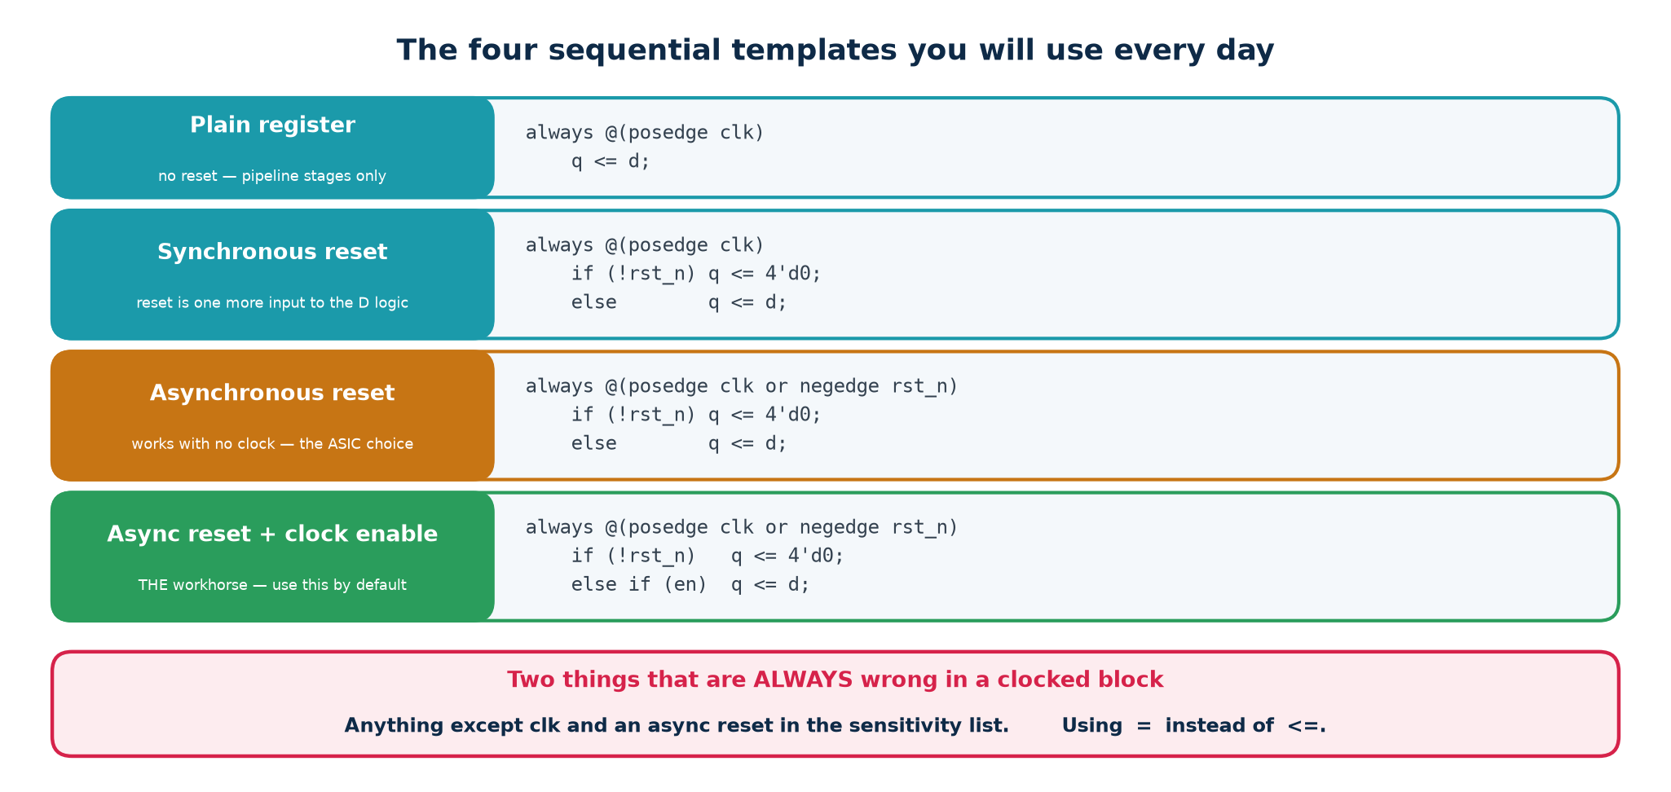
TOPIC 4B · SEQUENTIAL
The Clocked Block — One Template, Used Everywhere
Almost every sequential block you will ever write has this shape. Learn it as a pattern and type it from muscle memory; then all your attention goes on the logic instead of the boilerplate.
The template — priority runs top to bottom
always @(posedge clk or negedge rst_n) begin
if (!rst_n) q <= RESET_VALUE; // asynchronous, active-low reset
else if (clr) q <= {W{1'b0}}; // synchronous clear
else if (load) q <= din; // priority order matters:
else if (en) q <= next_value; // reset > clear > load > enable
end
Everything assigned in this block becomes a flip-flop. Nothing else in the design may assign q — one signal, one driving block, no exceptions.
Chip Design Associate · Module 2 · Verilog RTL Coding for Synthesis · Topic 4: RTL Design Using HDL
M2-T4 · 35

Slide 36
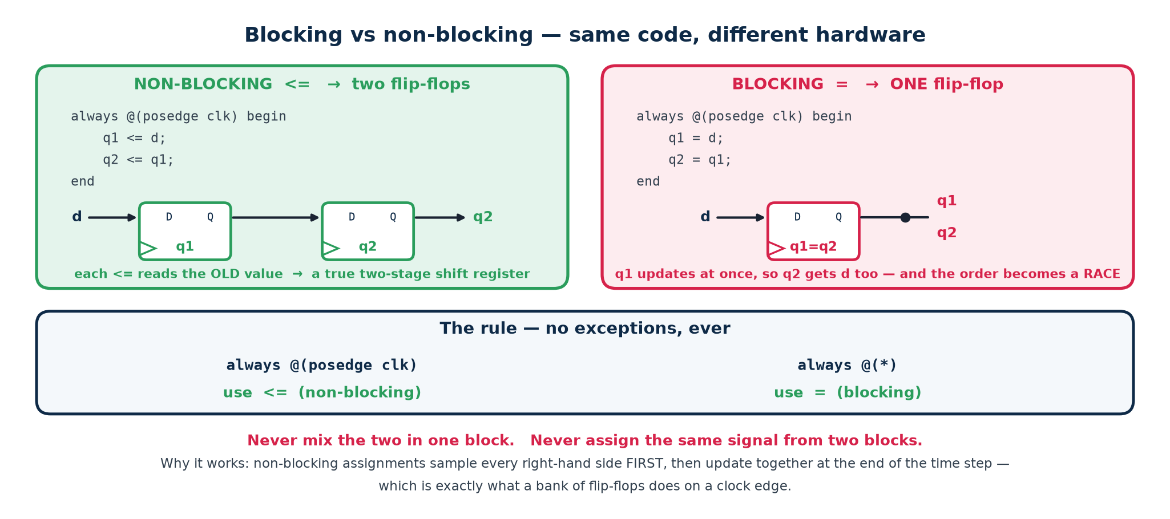
TOPIC 4B · = vs <=
Blocking and Non-Blocking — The Rule and the Reason
The rule is two lines long and you must never break it. Inside always @(*) use =. Inside always @(posedge clk) use <=. Never mix the two for the same variable, and never use = in a clocked block.
= blocking — happens NOW
<= non-blocking — happens at the END
The right-hand side is evaluated and the left-hand side updated immediately, before the next statement runs. In a clocked block that makes the result depend on the ORDER you typed the statements — which no real flip-flop cares about.
Every right-hand side in the block is sampled first, using the OLD values; only then are all the left-hand sides updated together. That is exactly what a bank of flip-flops does at a clock edge, which is why it is the correct operator.
Chip Design Associate · Module 2 · Verilog RTL Coding for Synthesis · Topic 4: RTL Design Using HDL
M2-T4 · 36

Slide 37
TOPIC 4B · LAB EVIDENCE
Two Flip-Flops or One? The Tool Decides
A three-line difference that changes the hardware. This is bad_blocking from the lab. Read the two versions, predict the flip-flop count, then run the synthesiser and see.
WRONG — blocking in a clocked block
RIGHT — non-blocking
always @(posedge clk) begin
q1 = d;
q2 = q1; // q1 is ALREADY d
end
q2 follows d in the same cycle. Synthesis merges them: 1 flip-flop.
always @(posedge clk) begin
q1 <= d;
q2 <= q1; // the OLD q1
end
A real two-stage shift register: 2 flip-flops, d delayed by two cycles.
$ yosys -p "read_verilog rtl/broken_examples.v; synth -top bad_blocking; stat"
$_DFF_P_ 1 <-- ONE flip-flop, not two. Verified.
Change the two = to <= and the same command reports 2. Nothing else in the file changes. That is how directly the operator maps to silicon.
Why the tool is entitled to do that
And if you swap the two lines?
Blocking assignment says 'update now, before the next statement'. So at the clock edge q1 takes d, and the very next statement gives q2 the NEW q1 — which is d. The tool sees two registers holding the same value and keeps one. It is not being clever; it is obeying the semantics you wrote.
Write q2 = q1; q1 = d; and you get two flip-flops and correct behaviour — from the same operator. That is the real objection to blocking assignment in a clocked block: the hardware depends on the ORDER you typed the lines, which is not a property real flip-flops have.
Chip Design Associate · Module 2 · Verilog RTL Coding for Synthesis · Topic 4: RTL Design Using HDL
M2-T4 · 37

Slide 38
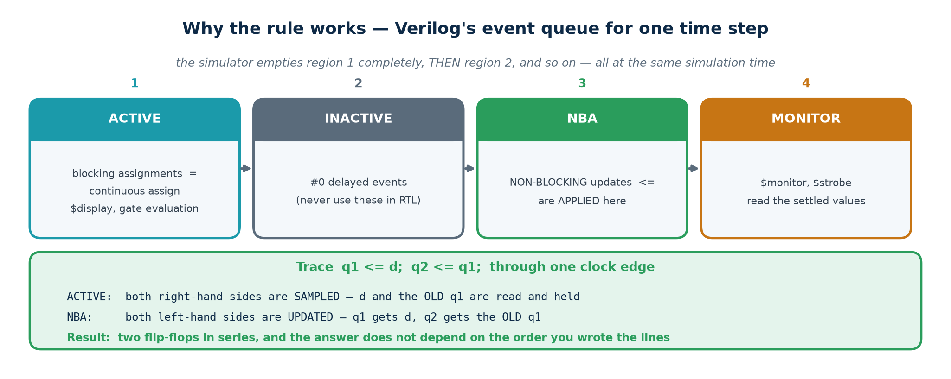
TOPIC 4B · UNDER THE HOOD
The Stratified Event Queue — Why <= Actually Works
This is the mechanism, for the students who want to know WHY. At a single simulation time step the simulator processes events in defined regions, in order. Non-blocking updates land in a later region than the right-hand-side evaluations — and that separation is the whole trick.
What this buys you
Every clocked block in the design samples its inputs in the Active region using the values that existed BEFORE the edge, and every register updates in the NBA region afterwards. So no clocked block can ever see another block's new value within the same edge — which is precisely the behaviour of real flip-flops, and why the order in which the simulator happens to visit your always blocks cannot change the answer. Use = in a clocked block and you throw that guarantee away.
Chip Design Associate · Module 2 · Verilog RTL Coding for Synthesis · Topic 4: RTL Design Using HDL
M2-T4 · 38

Slide 39
TOPIC 4B · RESET
Synchronous or Asynchronous Reset — Pick One and Be Consistent
Reset is a design decision, not a detail. Mixing styles inside one design is how you get a block that comes out of reset two cycles after its neighbour and starts in an impossible state.
Asynchronous reset (used in this lab)
Synchronous reset
always @(posedge clk or negedge rst_n)
if (!rst_n) q <= 1'b0;
else q <= d;
+ Works with no clock running — safe at power-up.
− Release must be synchronised, or flip-flops can come out of reset on different cycles (and can go metastable).
always @(posedge clk)
if (!rst_n) q <= 1'b0;
else q <= d;
+ One clock domain, easy timing, no release problem.
− Needs a running clock; costs logic in front of the D input; a glitch shorter than a cycle is missed.
Reset-release synchroniser — assert asynchronously, release synchronously
The standard solution: drive the reset tree from two flip-flops clocked by clk whose asynchronous reset is the raw input. The reset asserts the instant the signal falls, and releases cleanly on a clock edge two cycles later. Every serious design does this; it costs two flip-flops.
Chip Design Associate · Module 2 · Verilog RTL Coding for Synthesis · Topic 4: RTL Design Using HDL
M2-T4 · 39

Slide 40
TOPIC 4B · COUNTERS
A Counter Is a Register Plus an Incrementer
Counters are the workhorse of sequential design — timers, address generators, dividers, bit counters in a UART. The lab counter is parameterised, up/down, loadable and has a terminal count.
Topic4_Lab/rtl/counter.v — W=4, MAX=15
assign tc = en & (up ? (q == MAX[W-1:0]) : (q == {W{1'b0}}));
always @(posedge clk or negedge rst_n) begin
if (!rst_n) q <= {W{1'b0}};
else if (load) q <= din;
else if (en) begin
if (up) q <= (q == MAX[W-1:0]) ? {W{1'b0}} : q + 1'b1;
else q <= (q == {W{1'b0}}) ? MAX[W-1:0] : q - 1'b1;
end
end
$ yosys -p "read_verilog rtl/counter.v; synth -top counter; stat"
Number of cells: 38 $_DFF_NP0_ 4 <-- 4 bits of state, as expected
Set MAX = 9 and you have a BCD decade counter with no other change — that is what parameterisation buys. Chain two of them with tc as the enable of the next and you have a 0–99 counter.
Chip Design Associate · Module 2 · Verilog RTL Coding for Synthesis · Topic 4: RTL Design Using HDL
M2-T4 · 40

Slide 41
TOPIC 4B · SMALL, ESSENTIAL BLOCKS
Shift Register and Edge Detector
Two tiny modules that appear in almost every design you will ever build. The edge detector in particular is the standard way to turn a level into a single-cycle pulse.
Shift register — the concatenation idiom
Edge detector — one register and a gate
always @(posedge clk or negedge rst_n)
if (!rst_n) q <= {W{1'b0}};
else if (en) q <= {q[W-2:0], sin};
One line shifts the whole register left and inserts the new bit. Reverse the concatenation for a right shift. This idiom builds serialisers, deserialisers, CRC engines and LFSRs.
always @(posedge clk or negedge rst_n)
if (!rst_n) sig_d <= 1'b0; else sig_d <= sig;
assign rise = sig & ~sig_d;
assign fall = ~sig & sig_d;
Remember what the signal was last cycle; compare. rise is high for exactly one clock cycle.
A testbench lesson from building this lab
The first edge-detector test failed. The cause was not the design — the testbench changed the input in the middle of a clock cycle, so the pulse was half a cycle wide and the check sampled it at the wrong moment. Drive your stimulus just AFTER the active clock edge, and sample just BEFORE the next one. Half of all 'the design is broken' reports are really this.
Chip Design Associate · Module 2 · Verilog RTL Coding for Synthesis · Topic 4: RTL Design Using HDL
M2-T4 · 41

Slide 42
TOPIC 4B · CROSSING CLOCKS
Metastability and the Two-Flop Synchroniser
A flip-flop needs its D input stable for a setup time before the edge and a hold time after it. A signal from another clock domain cannot honour that, so the flip-flop can enter a metastable state — an output that is neither 0 nor 1 and settles at an unpredictable moment. You cannot prevent this. You can only give it time to decay.
Topic4_Lab/rtl/synchroniser.v
reg [1:0] sync;
always @(posedge clk or negedge rst_n) begin
if (!rst_n) sync <= 2'b00;
else sync <= {sync[0], async_in}; // stage 0 may go metastable ...
end
assign sync_out = sync[1]; // ... stage 1 has a whole cycle to settle
Rules for crossing a clock domain
What to do instead for buses
· Two flip-flops minimum for a single-bit LEVEL. Three at very high clock rates.
· Never synchronise a multi-bit bus bit by bit — the bits will arrive on different cycles and you will read a value that never existed.
· Gray-coded pointers (that is how an asynchronous FIFO works — only one bit changes per step, so a mis-sample gives the previous value, which is safe).
· Or a request/acknowledge handshake with the data held stable throughout.
Chip Design Associate · Module 2 · Verilog RTL Coding for Synthesis · Topic 4: RTL Design Using HDL
M2-T4 · 42

Slide 43
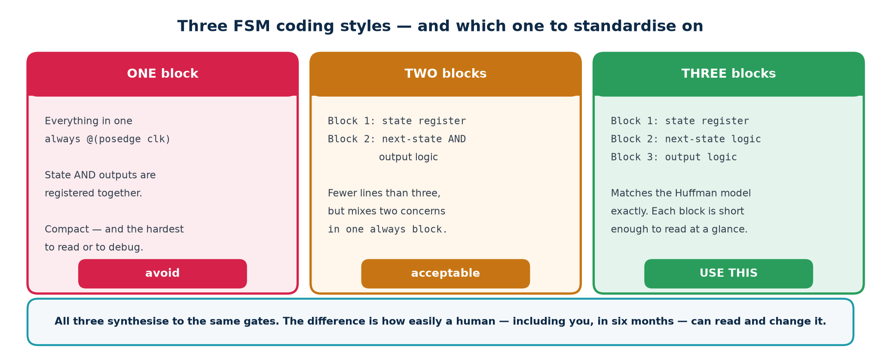
TOPIC 4B · STATE MACHINES
Three Coding Styles — Use the Three-Block Style
A finite state machine is a state register, next-state logic and output logic. How many always blocks you split those across is a style choice — and it matters more than students expect.
Style
Blocks
Pros
Cons
One-block
1 clocked
Compact; outputs are registered automatically
Next-state and output logic tangled; hard to read
Two-block
1 clocked + 1 comb
Clear separation of state and logic
Outputs still mixed into the combinational block
Three-block
1 clocked + 2 comb
State, next-state and outputs each separate
Slightly more typing — that is the whole cost
Chip Design Associate · Module 2 · Verilog RTL Coding for Synthesis · Topic 4: RTL Design Using HDL
M2-T4 · 43

Slide 44
TOPIC 4B · FSM WORKED EXAMPLE
A Traffic-Light Controller, Three Blocks
Topic4_Lab/rtl/traffic_fsm.v — verified: 52 cells, 12 flip-flops
// ---- BLOCK 1 : state register (and the dwell timer) ----
always @(posedge clk or negedge rst_n) begin
if (!rst_n) begin state <= MAIN_GREEN; timer <= 8'd0; end
else if (tick) begin
if (done) begin state <= next; timer <= 8'd0; end
else timer <= timer + 1'b1;
end
end
// ---- BLOCK 2 : next-state logic (pure combinational) ----
always @(*) begin
next = state; // default -> no latch, and a safe self-loop
case (state)
MAIN_GREEN : next = MAIN_YELLOW;
MAIN_YELLOW: next = SIDE_GREEN;
SIDE_GREEN : next = SIDE_YELLOW;
SIDE_YELLOW: next = MAIN_GREEN;
default : next = MAIN_GREEN; // SAFE FSM -- recover from an illegal state
endcase
end
// ---- BLOCK 3 : output logic (Moore -- depends on state ONLY) ----
always @(*) begin
main_light = RED; side_light = RED; // defaults
case (state)
MAIN_GREEN : begin main_light = GREEN; side_light = RED; end
...
endcase
end
Twelve flip-flops: eight for the timer and FOUR for the state — Yosys re-encoded the 2-bit state to one-hot by itself. Predict, then check the log.
Chip Design Associate · Module 2 · Verilog RTL Coding for Synthesis · Topic 4: RTL Design Using HDL
M2-T4 · 44

Slide 45
TOPIC 4B · FSM ENCODING
Binary or One-Hot — and How to Ask for It
The state names in your code are symbols; the tool chooses the bit pattern. Binary uses the fewest flip-flops; one-hot uses one flip-flop per state but makes the next-state and output logic trivially shallow — which on an FPGA, where flip-flops are free and logic depth is not, is usually the faster choice.
Requesting an encoding with an attribute
(* fsm_encoding = "one-hot" *) reg [1:0] state, next; // or "binary"
// Verified with Yosys 0.33 on a 4-state FSM, after abc -g AND,OR,XOR,NAND,NOR:
// binary : 9 cells, 2 flip-flops
// one-hot : 9 cells, 4 flip-flops <-- more FFs, shallower next-state logic
// And Yosys chose one-hot BY ITSELF for traffic_fsm -- read the log:
// FSM_RECODE: mapping auto encoding to `one-hot` for this FSM
Always write a safe default
A note from building this lab
With one-hot, N states use 2^N possible patterns — the vast majority illegal. A single upset bit puts the machine somewhere it can never leave. default: next = IDLE; costs nothing and guarantees recovery.
On this 4-state machine the two encodings tie on cell count — the advantage of one-hot only appears when the state count grows and the next-state decode would otherwise get deep. Do not assume; measure. And read the log: the tool may already have re-encoded your FSM without being asked, which is exactly what happened to traffic_fsm above.
Chip Design Associate · Module 2 · Verilog RTL Coding for Synthesis · Topic 4: RTL Design Using HDL
M2-T4 · 45

Slide 46
TOPIC 4B · MOORE vs MEALY
Where the Output Comes From Changes the Timing
Moore outputs depend on the state alone; Mealy outputs depend on the state AND the current inputs. A Mealy machine reacts one cycle sooner and often needs fewer states — but its output is combinational from an input, so it can glitch and it lands on the wrong side of a timing path.
Moore
Mealy
Output is a function of
state only
state and inputs
Reacts to an input
one clock later
in the same cycle
Output glitches?
no — it is registered
yes — it follows the input
Typical state count
more
fewer
Safe to drive off-chip?
yes
not without registering it
Use it when
you want clean, predictable outputs
you need the earliest possible response
Lab L3 — build the same 1011 sequence detector both ways
Topic4_Lab/rtl/seq_detect_1011.v implements both in one module so you can watch the two found outputs on the same waveform. The Mealy output pulses on the clock edge where the final 1 arrives; the Moore output pulses one cycle later. Overlapping detection is handled by returning to the correct partial-match state rather than to IDLE — 1011011 contains two matches, not one.
Chip Design Associate · Module 2 · Verilog RTL Coding for Synthesis · Topic 4: RTL Design Using HDL
M2-T4 · 46

Slide 47
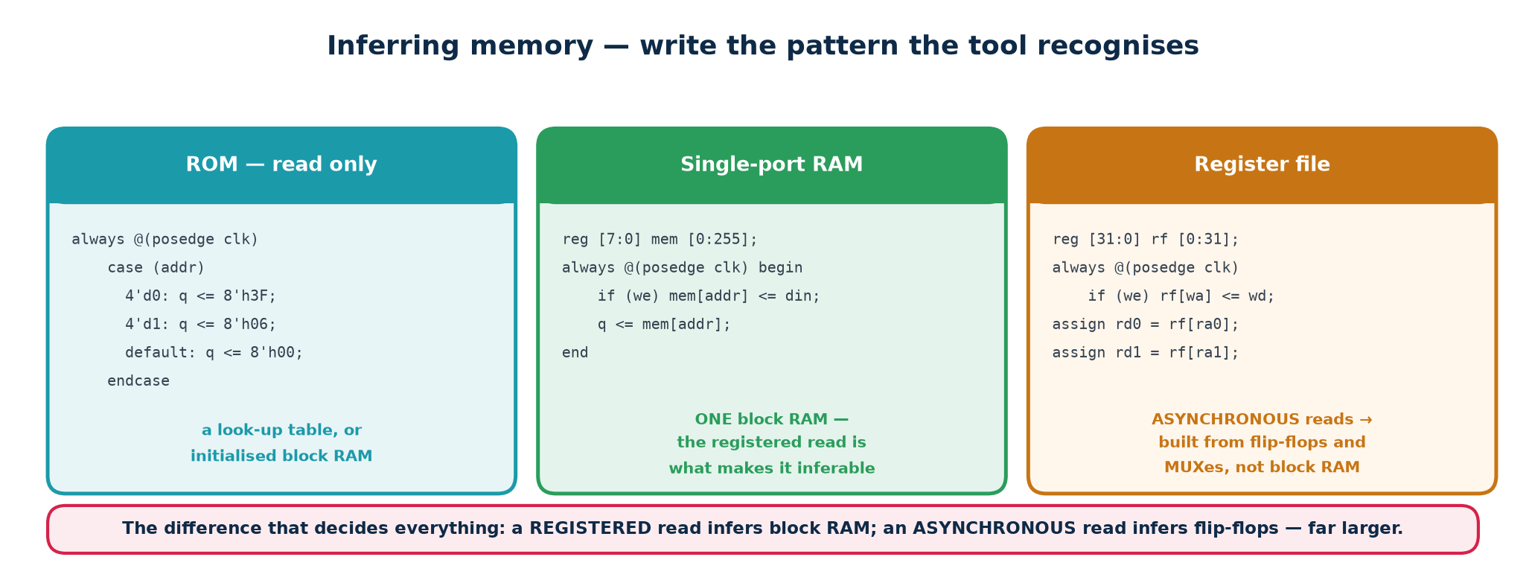
TOPIC 4B · MEMORY
Inferring RAM — Write It the Way the Tool Expects
You do not instantiate a RAM; you write a pattern the tool recognises. Get the pattern right and you get a dedicated block RAM. Get it slightly wrong and you get thousands of flip-flops, or a design that will not fit at all.
Topic4_Lab/rtl/sync_ram.v — synchronous read
reg [W-1:0] mem [0:DEPTH-1];
always @(posedge clk) begin
if (we) mem[waddr] <= wdata;
rdata <= mem[raddr]; // REGISTERED read -- this is what infers block RAM
end
Write assign rdata = mem[raddr]; instead — an asynchronous read — and no FPGA block RAM can implement it, so the tool builds the whole array out of registers and multiplexers. Same intent, wildly different silicon.
Chip Design Associate · Module 2 · Verilog RTL Coding for Synthesis · Topic 4: RTL Design Using HDL
M2-T4 · 47

Slide 48
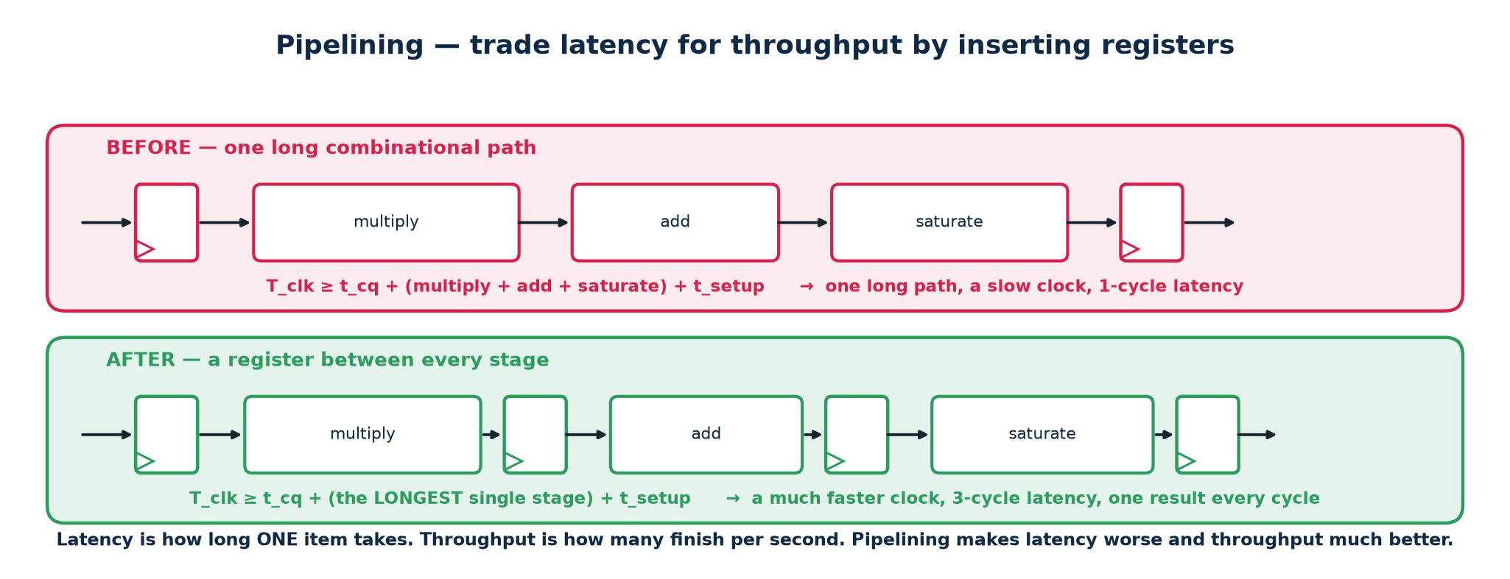
TOPIC 4B · SPEED
Pipelining — Trading Latency for Throughput
The clock period must be longer than the slowest combinational path between two flip-flops. If that path is too slow, cut it in half with a register in the middle. You now need two cycles to get an answer — but you can start a new one every cycle.
What you gain and what you pay
The trap
+ Throughput: one result per clock, at a much higher clock.
− Latency: the first result arrives N cycles later.
− Area: the pipeline registers, and any control signal that must now be delayed to stay aligned with its data.
Every signal travelling alongside the data must be delayed by the SAME number of stages. Pipeline the datapath and forget the valid bit, and your results arrive correctly but are marked valid two cycles early. Carry valid, and any tag or address, through the identical register chain.
Chip Design Associate · Module 2 · Verilog RTL Coding for Synthesis · Topic 4: RTL Design Using HDL
M2-T4 · 48

Slide 49
TOPIC 4B · CHECKPOINT
Predict the Hardware — Eight Snippets
Show each snippet, ask 'what does the tool build?', then run it. Full answers and the synthesis reports are in workbook section T4-B.
#
Snippet
What does synthesis produce?
1
assign y = sel ? b : a;
One W-bit 2:1 multiplexer, no state
2
always @(*) if (en) y = d;
A transparent latch on y
3
always @(posedge clk) q1 = d; q2 = q1;
ONE flip-flop (verified above)
4
always @(posedge clk) q <= {q[6:0], sin};
An 8-bit shift register
5
for (i=0;i<8;i=i+1) s = s + d[i];
An adder tree — eight adders, unrolled
6
assign z = ~|result;
A NOR reduction tree — the zero flag
7
rdata <= mem[raddr]; inside a clocked block
A block RAM with registered read
8
casex (sel) with an x in sel
Simulation/synthesis mismatch — banned
The habit this checkpoint is building
Predict, then verify. A designer who can look at a page of RTL and describe the netlist before running the tool will catch problems in review, in minutes. A designer who cannot will find them in the lab, in days — or on the silicon, in months.
Chip Design Associate · Module 2 · Verilog RTL Coding for Synthesis · Topic 4: RTL Design Using HDL
M2-T4 · 49

Slide 50
SUBTOPIC 4C
Writing RTL Code for Basic Digital Circuits
Twenty-two designs, five self-checking testbenches, one capstone. Everything from here on exists as runnable code.
The RTL development flow — specify, code, lint, simulate, synthesise
A catalogue of the standard blocks and how each is written
Verification: testbench anatomy, self-checking, scoreboards, randomisation
Two full designs: a synchronous FIFO and an 8N1 UART
Two real bugs, found while building this lab, and how they were caught
Chip Design Associate · Module 2 · Verilog RTL Coding for Synthesis · Topic 4: RTL Design Using HDL
M2-T4 · 50

Slide 51
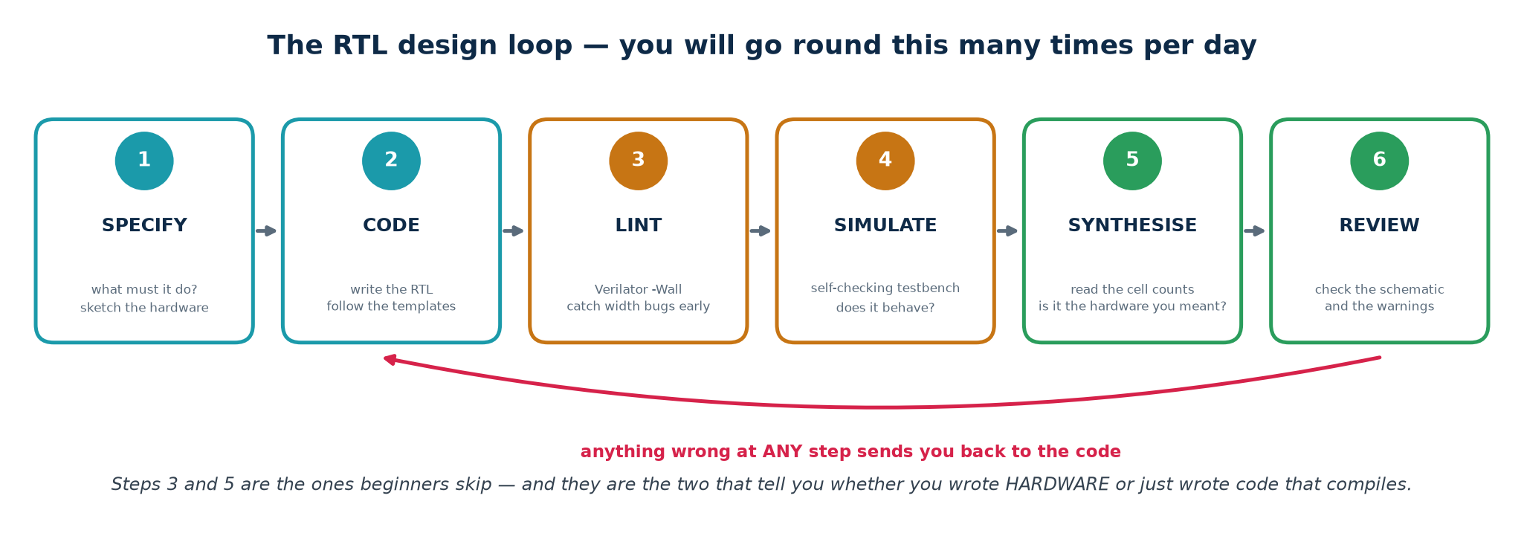
TOPIC 4C · FLOW
The Loop You Will Live In
Every RTL block goes round this loop, and the order is not negotiable. Lint takes one second and catches width bugs; simulation takes a minute and catches logic bugs; synthesis takes longer and catches structural bugs. Run them cheapest first.
The order matters more than the tools
Students who skip lint and go straight to the waveform viewer spend hours chasing symptoms of a truncation Verilator would have named in one second. Students who skip synthesis until the end discover their beautiful, fully-verified design contains forty latches. Lint, simulate, synthesise — every time, in that order.
Chip Design Associate · Module 2 · Verilog RTL Coding for Synthesis · Topic 4: RTL Design Using HDL
M2-T4 · 51

Slide 52
TOPIC 4C · CATALOGUE
The Standard Blocks — and the Idiom That Builds Each One
Almost all digital design is assembling these. Every row is a real, verified file in Topic4_Lab/rtl/.
Block
File
Core idiom
Lab
2:1 / 4:1 multiplexer
mux2.v mux4.v
assign y = sel ? b : a; / case
L1
3-to-8 decoder
decoder3to8.v
y = 0; if (en) y[sel] = 1'b1;
L1
8-input priority encoder
priority_encoder8.v
casez with ? wildcards
L1
8-operation ALU + flags
alu.v
defaults + case; {1'b0,a}+{1'b0,b}
L1
7-segment decoder
seven_seg.v
case on the nibble, active-low output
L1
N-bit ripple adder
adder_gen.v
generate for + full_adder instances
L1
Register with enable
reg_en.v
if (!rst_n) ... else if (en) q <= d;
L2
Shift register
shift_reg.v
q <= {q[W-2:0], sin};
L2
Up/down counter
counter.v
q <= q + 1'b1; with wrap and load
L2
Edge detector
edge_detect.v
sig & ~sig_d
L2
CDC synchroniser
synchroniser.v
sync <= {sync[0], async_in};
L2
Switch debouncer
debouncer.v
counter + stable-for-N-cycles
L2
Clock divider / tick gen
clk_divider.v
counter + terminal-count pulse
L2
Chip Design Associate · Module 2 · Verilog RTL Coding for Synthesis · Topic 4: RTL Design Using HDL
M2-T4 · 52

Slide 53
TOPIC 4C · CATALOGUE
…and the Bigger Blocks
These are the designs where architecture starts to matter. Each is a small system: a controller, a datapath, and a decision about how they communicate.
Block
File
Core idiom
Lab
Traffic-light controller
traffic_fsm.v
three-block Moore FSM + dwell timer
L3
Vending machine
vending_fsm.v
FSM with a credit datapath and change
L3
1011 sequence detector
seq_detect_1011.v
Moore AND Mealy in one module, overlapping
L3
Synchronous FIFO
sync_fifo.v
dual pointers with an extra MSB; inferred RAM
L4
Synchronous RAM
sync_ram.v
mem[waddr] <= wdata; rdata <= mem[raddr];
L4
UART transmitter
uart_tx.v
FSMD: shift register + bit timer + FSM
L5
UART receiver
uart_rx.v
half-bit alignment, mid-bit sampling, CDC
L5
Verified synthesis results — you should be able to predict these
counter (4-bit): 38 cells, 4 FF · traffic_fsm: 52 cells, 12 FF · uart_tx: 120 cells, 27 FF · uart_rx: 120 cells, 36 FF · sync_fifo (8×8): 255 cells, 72 FF
Before you run the tool on your own design, write down your prediction for the flip-flop count. Count the bits of state you declared. If the tool disagrees with you by more than a few, one of you is wrong — and it is worth finding out which.
Chip Design Associate · Module 2 · Verilog RTL Coding for Synthesis · Topic 4: RTL Design Using HDL
M2-T4 · 53

Slide 54
TOPIC 4C · TWO SHORT DESIGNS
A Display Decoder and a Generated Adder
seven_seg.v — a lookup table in case form
adder_gen.v — structure from a loop
always @(*) begin
seg = 7'b111_1111; // all off
case (nibble)
4'h0: seg = 7'b100_0000;
4'h1: seg = 7'b111_1001;
...
default: seg = 7'b011_1111; // '-'
endcase
end
Active-LOW because the display's common anode is tied high — read the board schematic, not the datasheet's picture.
genvar i;
assign c[0] = cin;
generate
for (i=0;i<W;i=i+1) begin: bit_slice
full_adder u_fa (.a(a[i]), .b(b[i]),
.cin(c[i]), .sum(sum[i]),
.cout(c[i+1]));
end
endgenerate
W full-adder instances chained by the carry. Slow for large W — the carry ripples — which is exactly the point of the experiment.
Experiment for Lab L1
Synthesise adder_gen at W = 4, 16 and 64 and watch the longest path grow linearly with W. Then look up carry-lookahead and carry-select adders and ask why a synthesiser given assign sum = a + b; will usually produce something faster than your hand-written ripple chain. Lesson: describe intent, let the tool choose the structure — unless you have a specific reason not to.
Chip Design Associate · Module 2 · Verilog RTL Coding for Synthesis · Topic 4: RTL Design Using HDL
M2-T4 · 54

Slide 55
TOPIC 4C · VERIFICATION
Simulating and Verifying the Functionality of RTL Designs
The syllabus names this as a practical outcome in its own right. Untested RTL is not a design; it is a guess.
Testbench anatomy — the six parts every testbench has
Self-checking: never read a waveform to decide if a test passed
Reference models, scoreboards and randomised stimulus
Waveform debugging, and the debug ladder to climb when stuck
Chip Design Associate · Module 2 · Verilog RTL Coding for Synthesis · Topic 4: RTL Design Using HDL
M2-T4 · 55

Slide 56
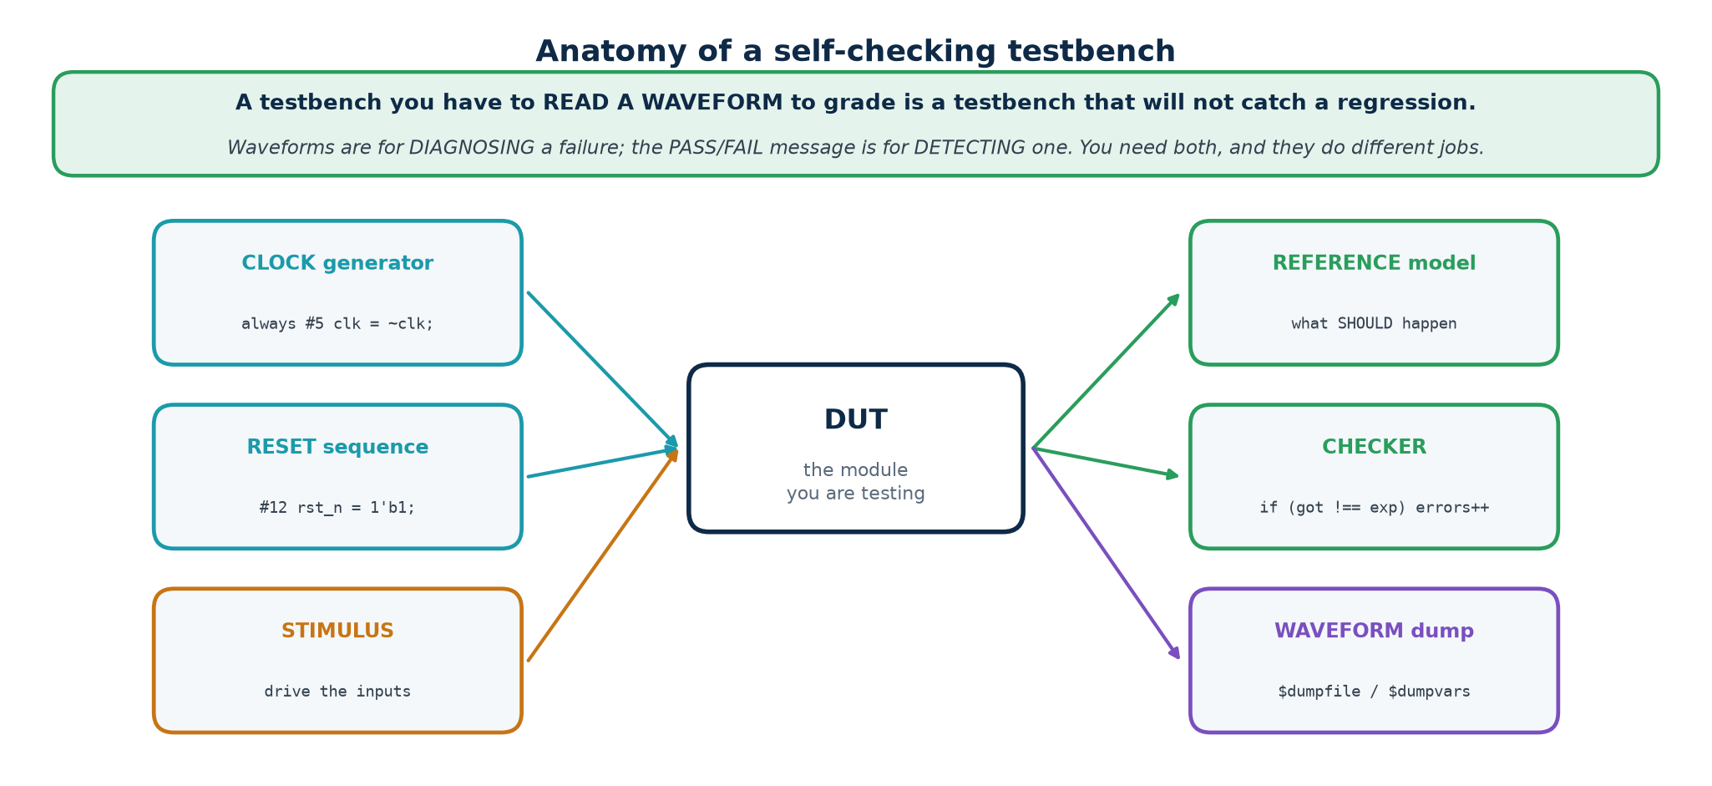
TOPIC 4C · TESTBENCH
Anatomy of a Testbench
A testbench is a module with no ports. It creates a clock, drives the design, and decides — automatically — whether the answers were right. It is NOT synthesised, so the whole language is available to you.
The rule that separates a testbench from a demo
A testbench must print PASS or FAIL and must be readable by a machine. If deciding whether the run was correct requires a human to look at a waveform, you cannot run it in a regression, you cannot run it overnight, and you will stop running it entirely within a week.
Chip Design Associate · Module 2 · Verilog RTL Coding for Synthesis · Topic 4: RTL Design Using HDL
M2-T4 · 56

Slide 57
TOPIC 4C · TESTBENCH
A Complete, Minimal, Self-Checking Testbench
Everything a testbench needs, in 24 lines
`timescale 1ns / 1ps
module tb_mux2;
reg [7:0] a, b; reg sel; wire [7:0] y;
integer errors = 0;
mux2 #(.W(8)) u_dut (.a(a), .b(b), .sel(sel), .y(y)); // 1. instantiate
// 2. one place that decides pass or fail
task check(input [7:0] got, input [7:0] exp, input [255:0] msg);
if (got !== exp) begin
$display("FAIL %0t: %0s got %h expected %h", $time, msg, got, exp);
errors = errors + 1;
end
endtask
initial begin
$dumpfile("mux2.vcd"); $dumpvars(0, tb_mux2); // 3. waveform dump
a = 8'hA5; b = 8'h5A;
sel = 1'b0; #1 check(y, 8'hA5, "sel=0 should pass a"); // 4. stimulus + check
sel = 1'b1; #1 check(y, 8'h5A, "sel=1 should pass b");
if (errors == 0) $display("PASS - mux2"); // 5. verdict
else $display("FAIL - %0d errors", errors);
$finish; // 6. stop
end
endmodule
Note !== not != — the four-state comparison. With !=, comparing against an x gives x, which is not true, so the check silently passes. Always use === and !== in a testbench.
Chip Design Associate · Module 2 · Verilog RTL Coding for Synthesis · Topic 4: RTL Design Using HDL
M2-T4 · 57

Slide 58
TOPIC 4C · TESTBENCH
Clock, Reset, and When to Drive and Sample
The clock and reset boilerplate
// A 100 MHz clock: 10 ns period, so toggle every 5 ns.
localparam integer CLK = 10;
initial clk = 1'b0;
always #(CLK/2) clk = ~clk;
// Reset: assert before the first edge, release BETWEEN edges.
initial begin
rst_n = 1'b0;
repeat (3) @(posedge clk);
#(CLK/5) rst_n = 1'b1; // released just after an edge, not ON one
end
A bug that cost real time while building this lab
The FSM testbench originally released reset exactly ON a clock edge. That is a race: the reset and the clock change at the same instant, so the state register saw an ambiguous condition and the state stayed x for two cycles. The sequence detector then found one match instead of two, and the design looked broken. It was not.
Rule: drive stimulus a small delay AFTER the active edge, and sample a small delay BEFORE the next one. Never change an input at the same instant as the clock.
Timescale matters
`timescale 1ns / 1ps means the unit of #1 is a nanosecond and the simulator rounds to a picosecond. Change the first number and every delay in the file changes meaning. Put the same timescale in every file, or put it in one included header.
Chip Design Associate · Module 2 · Verilog RTL Coding for Synthesis · Topic 4: RTL Design Using HDL
M2-T4 · 58

Slide 59
TOPIC 4C · VERIFICATION
Reference Models, Scoreboards and Randomisation
Hand-written expected values do not scale past about twenty cases. Beyond that you need a model that computes the right answer independently, and random stimulus to reach the corners you would never think of.
Topic4_Lab/tb/tb_mem.v (extract)
// A scoreboard: an independent model of what should be inside the FIFO.
reg [W-1:0] model [0:DEPTH-1];
integer mhead, mtail;
function integer mcount; mcount = mtail - mhead; endfunction
task fifo_push(input [W-1:0] dat);
begin
wr_en = 1'b1; wr_data = dat; @(posedge clk); #1 wr_en = 1'b0;
model[mtail % DEPTH] = dat; mtail = mtail + 1; // model, not DUT
end
endtask
// Randomised, but SEEDED -- so a failure reproduces exactly.
for (k = 0; k < 200; k = k + 1) begin
if (($random(seed) % 2) == 0) begin if (!full) fifo_push($random(seed)); end
else begin if (!empty) fifo_pop(); end
check1(count === mcount(), "fifo count disagrees with the scoreboard");
end
The model must be written from the SPECIFICATION, never by reading the RTL. A model derived from the design under test will happily agree with the design's bugs.
Chip Design Associate · Module 2 · Verilog RTL Coding for Synthesis · Topic 4: RTL Design Using HDL
M2-T4 · 59

Slide 60
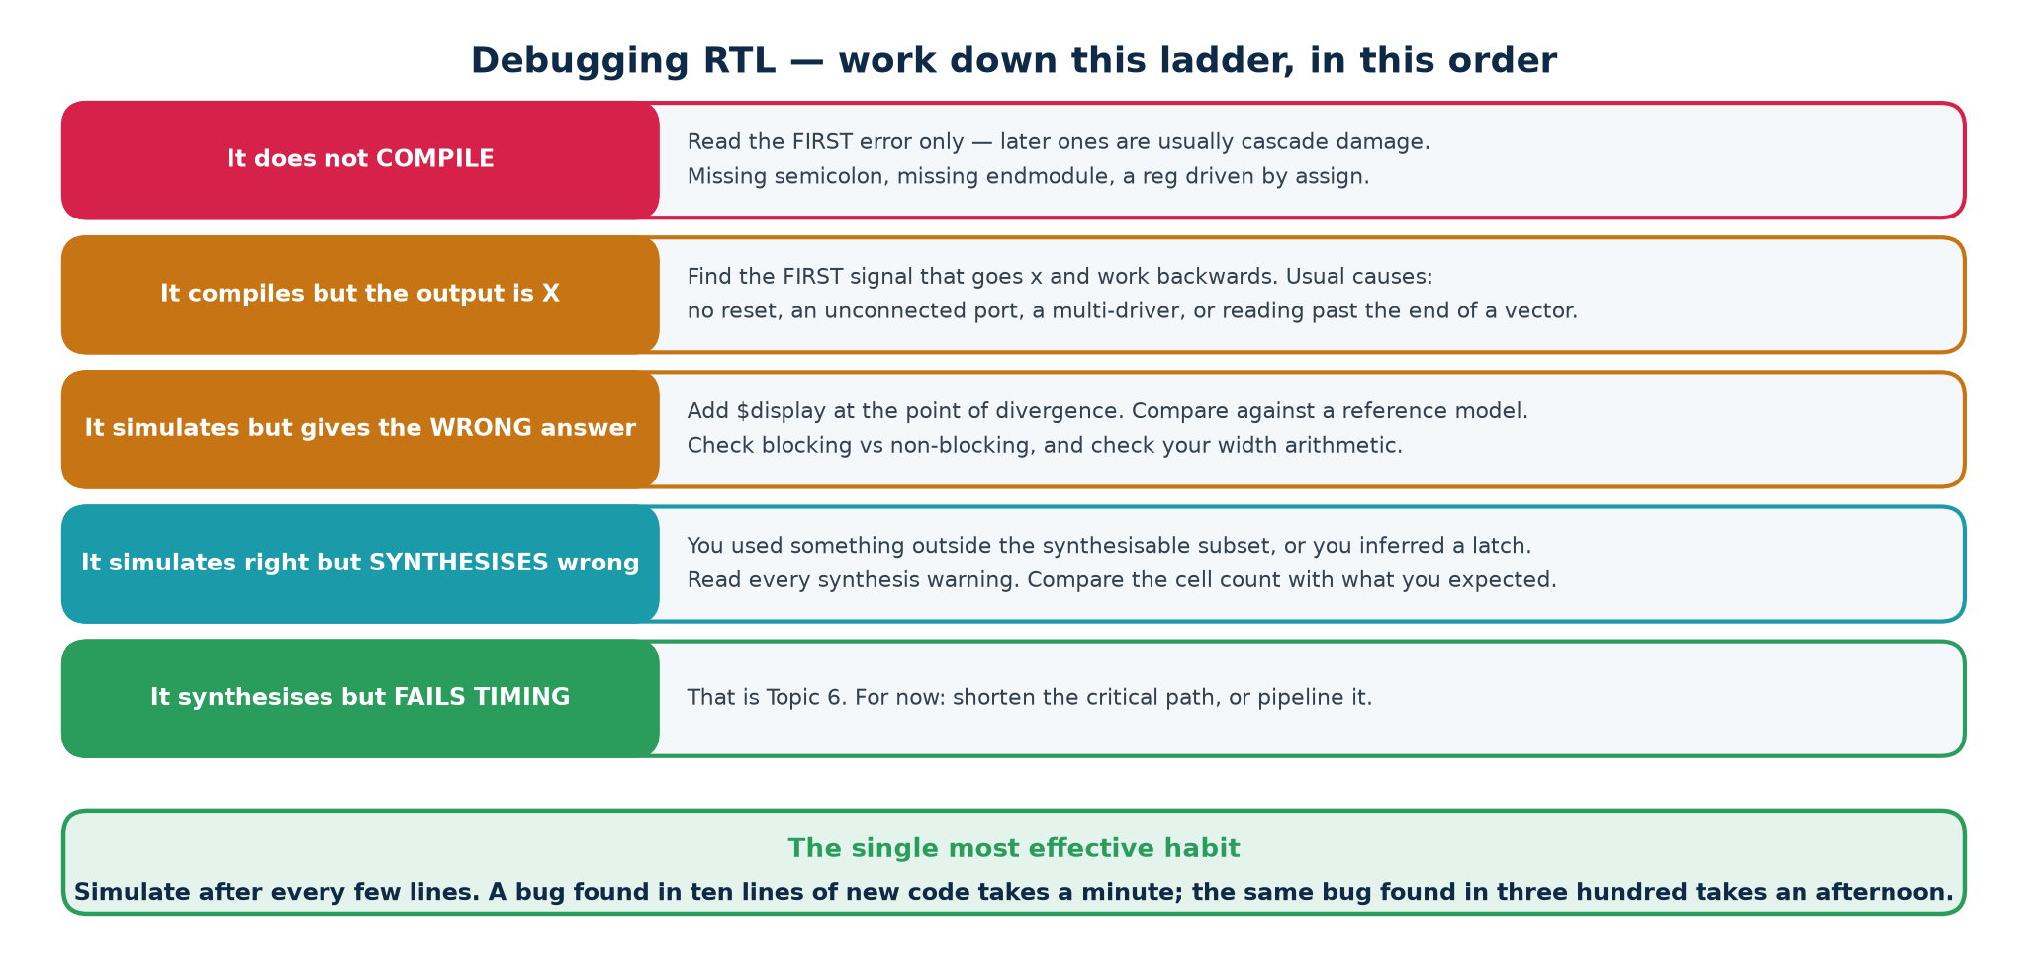
TOPIC 4C · DEBUG
When It Does Not Work — Climb the Ladder
Debugging RTL is not guessing; it is a procedure. Work from the cheapest check to the most expensive, and always find the FIRST moment the design went wrong, never the moment you noticed.
Chasing an x
Reading a VCD
x is contagious — by the time you see it on your output it may have travelled through ten signals. In GTKWave, add the suspect signal, find the FIRST edge where it goes x, then add whatever drives it and repeat. You are looking for the source, not the symptom.
$dumpvars(0, tb); dumps every signal at every level — start there. $dumpvars(1, tb.u_dut); dumps one level of one instance, for when the file gets too big to open.
Chip Design Associate · Module 2 · Verilog RTL Coding for Synthesis · Topic 4: RTL Design Using HDL
M2-T4 · 60

Slide 61
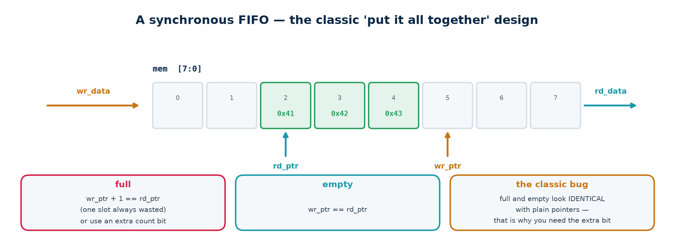
TOPIC 4C · DESIGN 1
A Synchronous FIFO — Pointers, and the Extra Bit
A FIFO is a memory plus two pointers. The only hard part is telling FULL from EMPTY: in both cases the two pointers are equal. The classic solution is to give each pointer one extra bit.
Topic4_Lab/rtl/sync_fifo.v — verified 255 cells, 72 FF at 8×8
reg [AW:0] wr_ptr, rd_ptr; // AW+1 bits for a 2**AW-deep FIFO
assign empty = (wr_ptr == rd_ptr); // identical, MSB included
assign full = (wr_ptr[AW] != rd_ptr[AW]) && // wrapped a different number
(wr_ptr[AW-1:0] == rd_ptr[AW-1:0]); // of times, same position
assign count = wr_ptr - rd_ptr; // subtraction wraps correctly, for free
Guard the pointers, not the caller: wr_en & ~full and rd_en & ~empty. A FIFO that silently corrupts itself when someone writes to it while full is a system-level bug waiting to happen.
Chip Design Associate · Module 2 · Verilog RTL Coding for Synthesis · Topic 4: RTL Design Using HDL
M2-T4 · 61

Slide 62
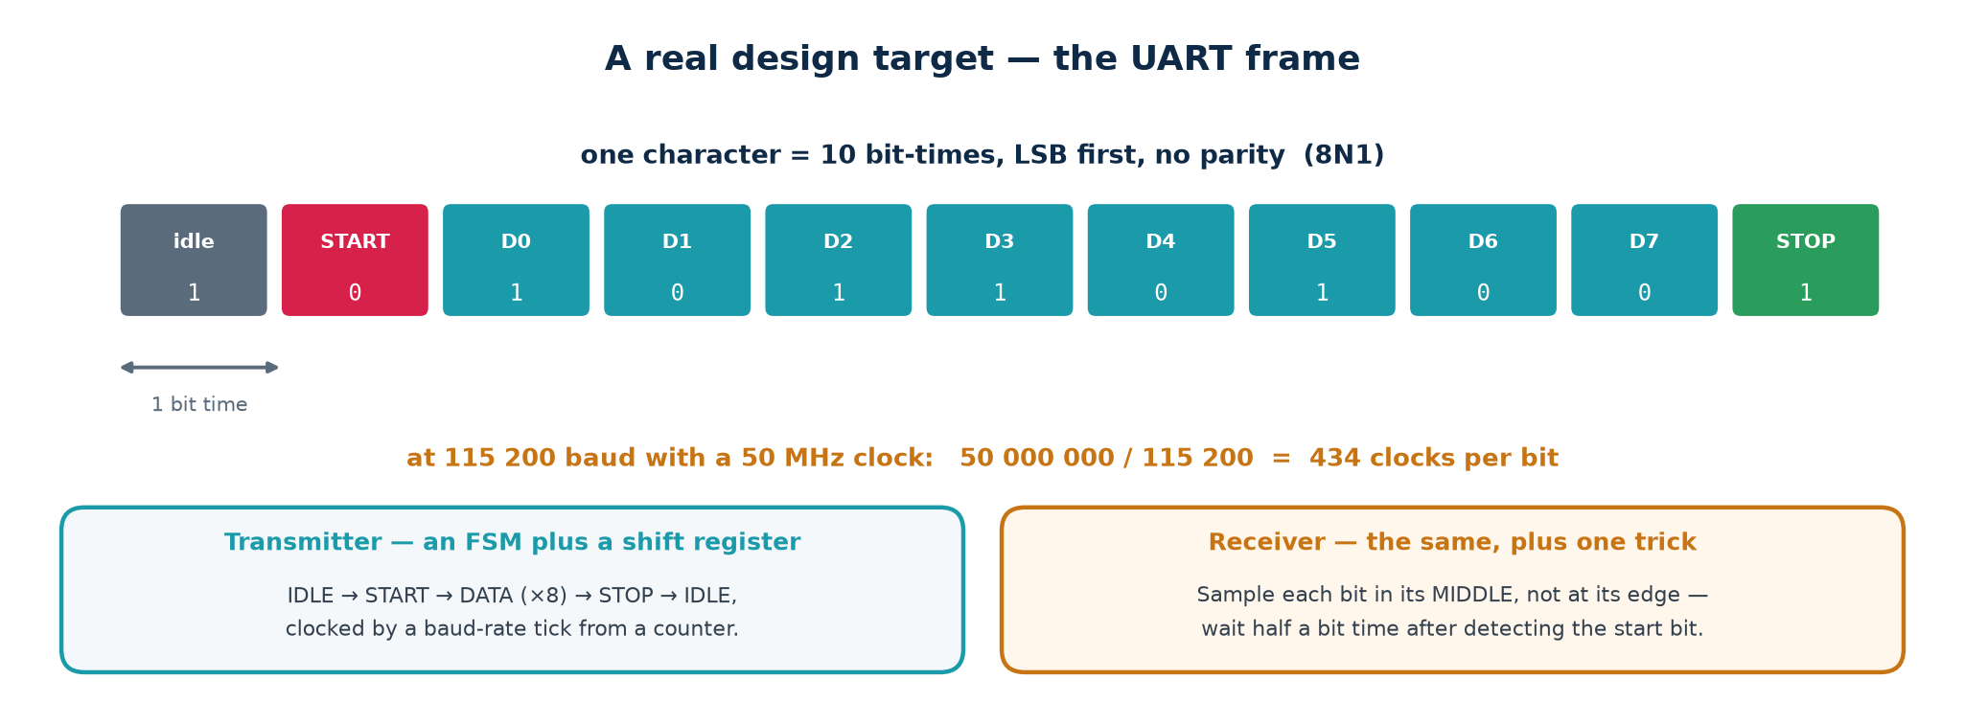
TOPIC 4C · DESIGN 2
A UART — the 8N1 Frame
The UART is the capstone because it forces every idea in this topic together. There is no clock on the wire: both ends agree a bit rate in advance and the receiver recovers timing from the start bit. That is the whole design problem.
8N1, and how you count clocks
The receiver's one trick
Idle high · one START bit low · eight DATA bits, LSB first · no parity · one STOP bit high. Ten bit times per byte.
CLKS_PER_BIT = f_clk / baud
50 MHz / 115200 = 434.03 → 434. The 0.03 error accumulates to 0.3 of a bit over ten bits: comfortably inside tolerance.
Sample each bit in its MIDDLE, not at its edge. On seeing the start bit fall, wait HALF a bit time and re-check the line is still low — that rejects a glitch. From then on, sample every FULL bit time and you land in the centre of every bit, with maximum margin against clock mismatch.
Chip Design Associate · Module 2 · Verilog RTL Coding for Synthesis · Topic 4: RTL Design Using HDL
M2-T4 · 62

Slide 63
TOPIC 4C · DESIGN 2
The Receiver — an FSMD in Four States
Topic4_Lab/rtl/uart_rx.v — verified 120 cells, 36 FF
synchroniser #(.STAGES(2)) u_sync (.clk(clk), .rst_n(rst_n),
.async_in(rx), .sync_out(rx_sync)); // CDC first!
case (state)
IDLE : begin
clk_cnt <= {CW{1'b0}}; bit_idx <= 3'd0;
if (!rx_sync) state <= START; // falling edge seen
end
START: if (clk_cnt == HALF_BIT[CW-1:0]) begin
if (!rx_sync) begin clk_cnt <= {CW{1'b0}}; state <= DATA; end // genuine
else state <= IDLE; // glitch
end else clk_cnt <= clk_cnt + 1'b1;
DATA : if (clk_cnt == FULL_BIT[CW-1:0]) begin
clk_cnt <= {CW{1'b0}};
shifter <= {rx_sync, shifter[7:1]}; // LSB arrives first
if (bit_idx == 3'd7) state <= STOP; else bit_idx <= bit_idx + 1'b1;
end else clk_cnt <= clk_cnt + 1'b1;
STOP : if (clk_cnt == FULL_BIT[CW-1:0]) begin
rx_data <= shifter; rx_valid <= 1'b1;
frame_error <= ~rx_sync; // stop bit must be high
state <= IDLE;
end else clk_cnt <= clk_cnt + 1'b1;
endcase
Three separate registers hold the state: the FSM state (2 bits), the clock counter (CW bits) and the bit index (3 bits). Counting those, plus the shifter and outputs, is how you predict 36 flip-flops before you run the tool.
Chip Design Associate · Module 2 · Verilog RTL Coding for Synthesis · Topic 4: RTL Design Using HDL
M2-T4 · 63

Slide 64
TOPIC 4C · CASE STUDY
The Bug That Made Some Bytes Work and Others Not
This is a genuine bug found while writing this lab, kept because it is better teaching material than anything invented. Read the symptom first and try to name the cause before turning to the next line.
SYMPTOM
The loopback test passed for 0x00 and 0x55 but failed for 0xFF — which came back as 0xF7. One bit, in one pattern. Everything else about the design looked correct, and the transmitter was provably fine.
CAUSE
The bit-timing limits were written CLKS_PER_BIT[CW-1:0]. The testbench used CLKS_PER_BIT = 16 to keep runs short, so CW = $clog2(16) = 4 — and 16 does not fit in 4 bits. It truncated to ZERO. HALF_BIT became 0, so the receiver never waited half a bit and sampled on bit BOUNDARIES instead of bit centres.
WHY SOME BYTES
Sampling on a boundary gives whichever value wins the race — which only matters when adjacent bits DIFFER. 0x00 and 0xFF-with-a-low-start-bit differ in different places, so some patterns survived and others did not. Intermittent, data-dependent failure: the worst kind.
FIX
Compute the limits as integers — localparam integer FULL_BIT = CLKS_PER_BIT - 1; — and slice them where they are USED. Verified at CLKS_PER_BIT = 16, 27 and 434. Verilator -Wall is clean on this form and flagged the alternatives.
How it was actually caught, and what would have caught it sooner
It was caught by the loopback testbench, which compares the received byte with the byte that was sent — in one second, with no waveform. It would have been caught EARLIER by verilator --lint-only -Wall, which reports WIDTHTRUNC on exactly that expression. Lint costs a second; this bug cost an hour.
Chip Design Associate · Module 2 · Verilog RTL Coding for Synthesis · Topic 4: RTL Design Using HDL
M2-T4 · 64

Slide 65
TOPIC 4C · CASE STUDY
What Those Two Bugs Actually Teach
Bug 1 — width truncation in the UART
Bug 2 — state timing in the vending machine
· A parameter used as an INDEX RANGE is not the same as a parameter used as a VALUE. Slicing a value that does not fit destroys it silently.
· Test at more than one parameter value. At 434 the bug is invisible, because 434 needs 9 bits and CW is 9. Only the short test value exposed it.
· Verilator would have said WIDTHTRUNC. Lint first, always.
· The credit register was cleared as the FSM ENTERED the DISPENSE state, so the output logic — which needs the credit to compute change — saw zero.
· The fix is to clear it as the machine LEAVES that state.
· Lesson: in a Moore machine the outputs are computed FROM the state you are in. Anything that state's outputs depend on must still be valid while you are in it.
The meta-lesson worth stating out loud to the class
Both bugs were found by a self-checking testbench, in seconds, and both would have been nearly impossible to find by looking at waveforms alone. Neither was a syntax error; both compiled and simulated cleanly. This is what verification is FOR.
Chip Design Associate · Module 2 · Verilog RTL Coding for Synthesis · Topic 4: RTL Design Using HDL
M2-T4 · 65

Slide 66
TOPIC 4 · TOOLS
Software Tools — Installation and Flow
The syllabus specifies Vivado Design Suite and ModelSim. The open-source chain does the same jobs and runs on any laptop.
What each tool does, and which one to reach for first
Installing the open-source chain — Linux, WSL2, macOS
Installing and driving Vivado Design Suite
Installing and driving ModelSim / Questa
A one-page command reference to keep beside the keyboard
Chip Design Associate · Module 2 · Verilog RTL Coding for Synthesis · Topic 4: RTL Design Using HDL
M2-T4 · 66

Slide 67
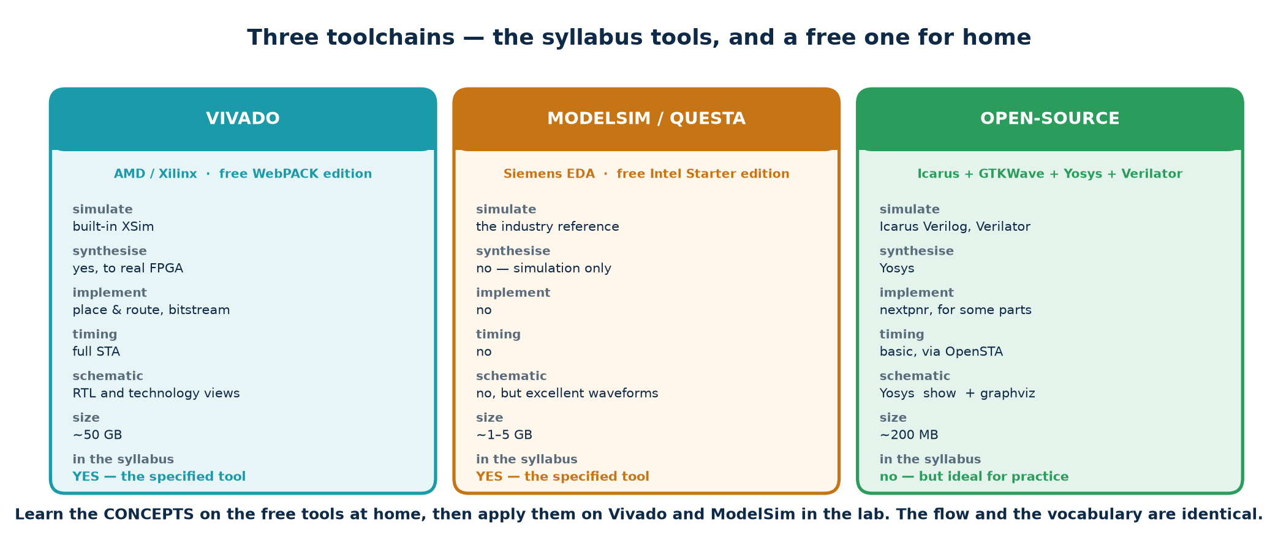
TOPIC 4 · TOOLS
Four Jobs, Several Tools for Each
Every flow does the same four jobs. Only the command names change. Learn the jobs and moving between vendors becomes a morning's work rather than a new skill.
Job
Open-source
Vendor (syllabus)
What it tells you
Lint / static check
Verilator --lint-only
Vivado report_methodology
Width bugs, latches, unused signals — in one second
Simulate
Icarus Verilog (iverilog/vvp)
ModelSim, Questa, Vivado xsim
Does it behave correctly?
View waveforms
GTKWave
ModelSim wave window, Vivado sim
Where and when it went wrong
Synthesise
Yosys
Vivado synth_design
What hardware it becomes; area; latch warnings
Chip Design Associate · Module 2 · Verilog RTL Coding for Synthesis · Topic 4: RTL Design Using HDL
M2-T4 · 67

Slide 68
TOPIC 4 · INSTALL
The Open-Source Toolchain — Every Command
Copy-paste installation
# ---- Ubuntu / Debian / WSL2 -------------------------------------------
sudo apt update
sudo apt install -y iverilog gtkwave verilator yosys graphviz
# ---- macOS (Homebrew) --------------------------------------------------
brew install icarus-verilog gtkwave verilator yosys graphviz
# ---- Windows -----------------------------------------------------------
# Best: install WSL2 (wsl --install in an admin PowerShell), then use
# the Ubuntu commands above inside it.
# Or: download the OSS CAD Suite release for Windows, unzip it, and
# run its start.bat -- it contains all four tools, already built.
# ---- verify the installation -------------------------------------------
iverilog -V | head -1 # Icarus Verilog version 12.0
verilator --version # Verilator 5.020
yosys -V # Yosys 0.33
gtkwave --version
GTKWave on WSL2
GTKWave is a GUI. On Windows 11, WSLg runs Linux GUI applications with no extra setup — just type gtkwave dump.vcd. On Windows 10 you need an X server (VcXsrv) and export DISPLAY=:0, or simply install the native Windows GTKWave and open the .vcd file the WSL side wrote.
Chip Design Associate · Module 2 · Verilog RTL Coding for Synthesis · Topic 4: RTL Design Using HDL
M2-T4 · 68

Slide 69
TOPIC 4 · TOOLS
Driving the Open-Source Chain — Four Commands
Topic4_Lab — these exact commands were used to verify this material
# 1. LINT -- one second, run it before anything else
verilator --lint-only -Wall -Wno-DECLFILENAME rtl/*.v
# 2. COMPILE + SIMULATE
iverilog -g2005 -Wall -o build/sim.vvp rtl/uart_tx.v rtl/uart_rx.v \
rtl/synchroniser.v tb/tb_uart.v
vvp build/sim.vvp # prints PASS or FAIL
# 3. VIEW WAVEFORMS (the testbench must call $dumpfile/$dumpvars)
gtkwave uart.vcd &
# 4. SYNTHESISE and look for latches
yosys -p "read_verilog rtl/counter.v; synth -top counter; stat"
yosys -p "read_verilog rtl/counter.v; synth -top counter" 2>&1 | grep -i latch
# ... or just use the scripts, which do all of the above for every lab
./scripts/lint.sh && ./scripts/run_all.sh && ./scripts/synth_all.sh
Expected output: LINT CLEAN · ALL LABS PASSED · ALL DESIGNS SYNTHESISED, NO LATCHES INFERRED
Chip Design Associate · Module 2 · Verilog RTL Coding for Synthesis · Topic 4: RTL Design Using HDL
M2-T4 · 69

Slide 70
TOPIC 4 · INSTALL
Vivado Design Suite — Installation
Vivado is the tool named in the syllabus. The free ML Standard edition covers every device you will use on a training board. Budget an afternoon: the download is large and the installer is slow.
▪
1. Create a free AMD/Xilinx account, then download the Unified Installer for Windows or Linux from the AMD downloads page.
▪
2. Run it and choose Vivado → Vivado ML Standard (free, no licence file needed).
▪
3. On the device page select ONLY the family your board uses — Artix-7 for Basys 3 / Arty A7, Zynq-7000 for Zybo / PYNQ. Selecting everything costs well over 100 GB.
▪
4. Keep Vivado Simulator (xsim) and, on Windows, the Cable Drivers — without the drivers the board will not be detected.
▪
5. Disk: allow 60–100 GB for one device family. RAM: 8 GB minimum, 16 GB comfortable.
▪
6. Linux only: run sudo <install>/data/xicom/cable_drivers/lin64/install_script/install_drivers/install_drivers after installation.
▪
7. Verify: vivado -version (source settings64.sh first on Linux).
Boards commonly used for this course
Installation problems you will meet
Plan the lab session around this
Basys 3 — Artix-7 xc7a35tcpg236-1. Switches, LEDs, four 7-segment digits. Ideal for L1–L3.
Arty A7 / Nexys A7 — Artix-7, with a USB-UART bridge, so L5 talks to a terminal on the PC.
Zybo / PYNQ-Z2 — Zynq-7000. More than this topic needs, but the same flow.
· Installer hangs at 'Generating installed device list' — it is not hung, it takes several minutes.
· Board not detected — the cable drivers were skipped, or on Linux the udev rules were not installed.
· 'No such part' from a TCL script — the part string does not match your board. Edit it in vivado_synth.tcl.
Do not spend a scheduled lab hour installing Vivado. Either pre-install it on the machines, or set the download running at the start of the session and teach the open-source flow — which installs in under a minute — while it runs. The concepts are identical, and the students are learning RTL, not an installer.
Chip Design Associate · Module 2 · Verilog RTL Coding for Synthesis · Topic 4: RTL Design Using HDL
M2-T4 · 70

Slide 71
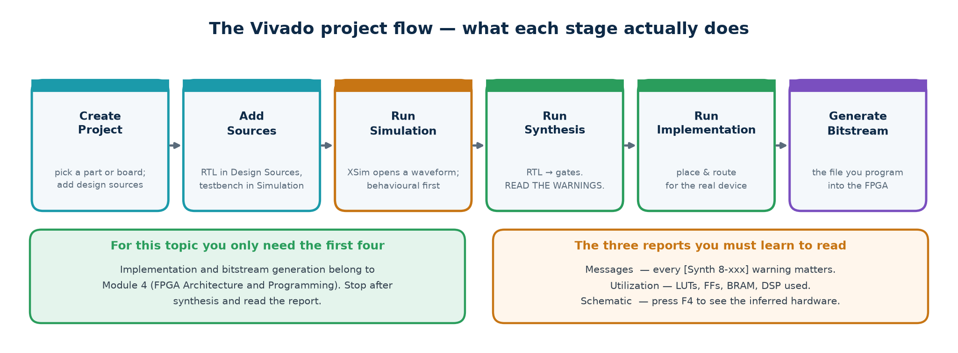
TOPIC 4 · VIVADO
The Vivado Flow — GUI and Batch
Topic4_Lab/scripts/vivado_sim.tcl and vivado_synth.tcl
# Batch simulation -- three tools, always in this order
xvlog rtl/uart_tx.v rtl/uart_rx.v rtl/synchroniser.v tb/tb_uart.v # analyse
xelab -debug typical tb_uart -s tb_uart_sim # elaborate
xsim tb_uart_sim -runall # run
# Batch synthesis with the provided script
vivado -mode batch -source scripts/vivado_synth.tcl -tclargs uart_tx
In the GUI the same steps are Create Project → Add Sources → Run Simulation → Run Synthesis → Open Synthesized Design. Learn the batch commands anyway: they are what you put in a makefile, and they are what a regression runs.
Chip Design Associate · Module 2 · Verilog RTL Coding for Synthesis · Topic 4: RTL Design Using HDL
M2-T4 · 71

Slide 72
TOPIC 4 · VIVADO
What to Read After Synthesis — Not the Schematic
scripts/vivado_synth.tcl — change the part to match your board
create_clock -period 20.000 -name clk [get_ports clk] # 50 MHz, or timing means nothing
synth_design -top uart_tx -part xc7a35tcpg236-1
report_utilization -file build/vivado/uart_tx_utilization.rpt
report_timing_summary -file build/vivado/uart_tx_timing.rpt
Utilisation report
Timing summary
Messages tab
LUTs, flip-flops, block RAMs, DSPs. Compare the flip-flop count with your own prediction from the source — a large disagreement means the tool built something you did not intend.
Worst negative slack (WNS). Positive means the design meets the clock you constrained; negative means it does not, and the number tells you by how much. Without a create_clock the report is meaningless.
Every [Synth 8-xxx] warning. Read all of them once. Latch inference, width mismatch and unconnected port warnings all live here.
Honesty note for the trainer
The Vivado and ModelSim scripts in Topic4_Lab are working templates written from standard, version-stable commands, but they were NOT executed while this material was prepared — neither tool was installed in the authoring environment. Everything quoted from Icarus, Verilator and Yosys was really run. Check the vendor scripts against your installed version before the session; part numbers and menu names change between releases.
Chip Design Associate · Module 2 · Verilog RTL Coding for Synthesis · Topic 4: RTL Design Using HDL
M2-T4 · 72

Slide 73
TOPIC 4 · MODELSIM
ModelSim / Questa — Installation and Flow
Installing
The three commands that matter
· ModelSim Intel FPGA Starter Edition is free and needs no licence; it ships with Intel Quartus Prime Lite. Questa Intel FPGA Starter is its successor — either is fine for this course.
· Windows: run the installer, accept the default path. Linux: it is 32-bit, so install the multilib packages lib32z1 lib32ncurses6 libxft2:i386 first or vsim will not start.
· Verify with vsim -version.
vlib work create the working library
vlog rtl/*.v tb/tb_uart.v compile into it
vsim -voptargs=+acc work.tb_uart elaborate and load
run -all simulate to $finish
+acc keeps signal visibility — without it the optimiser removes the very signals you want to look at.
Topic4_Lab/scripts/modelsim_run.do — covers all five labs
vsim -c -gLAB=L3_fsm -do scripts/modelsim_run.do # batch, prints PASS/FAIL
vsim -do scripts/modelsim_run.do # GUI, with waveforms added
Chip Design Associate · Module 2 · Verilog RTL Coding for Synthesis · Topic 4: RTL Design Using HDL
M2-T4 · 73

Slide 74
TOPIC 4 · REFERENCE
One-Page Command Card
Print this and keep it beside the keyboard for the whole module.
Task
Open-source
Vivado
ModelSim
Lint
verilator --lint-only -Wall rtl/*.v
report_methodology
vlog (warnings)
Compile
iverilog -g2005 -o sim.vvp <files>
xvlog <files>
vlog <files>
Elaborate
(part of iverilog)
xelab -debug typical <top>
(part of vsim)
Run
vvp sim.vvp
xsim <snapshot> -runall
vsim -c work.<top>; run -all
Waves
gtkwave dump.vcd
Vivado sim wave window
add wave -r /*
Synthesise
yosys -p "...; synth -top X; stat"
synth_design -top X -part P
(not a synthesis tool)
Area report
stat
report_utilization
—
Timing report
(none — no timing model)
report_timing_summary
—
Find latches
grep -i latch on the log
Messages: [Synth 8-327]
—
Chip Design Associate · Module 2 · Verilog RTL Coding for Synthesis · Topic 4: RTL Design Using HDL
M2-T4 · 74

Slide 75
TOPIC 4 · PRACTICAL
The Lab Programme
Mapped to the syllabus practical component: 40 hours of RTL Design and Implementation Labs, plus synthesis and timing.
L1 combinational · L2 sequential · L3 state machines · L4 memory · L5 UART capstone
Twenty-two designs, five self-checking testbenches, three toolchains
Deliberately broken examples, so failures can be seen in real tool reports
Assessment rubric and the common-error table
Chip Design Associate · Module 2 · Verilog RTL Coding for Synthesis · Topic 4: RTL Design Using HDL
M2-T4 · 75

Slide 76
TOPIC 4 · LABS
The Five Labs and Their Hours
These hours map onto the syllabus practical component. Every design listed exists, compiles, simulates to PASS and synthesises with no inferred latches.
Lab
Hours
Designs
Testbench
What it teaches
L1 Combinational
8
mux2 mux4 decoder3to8 priority_encoder8 alu seven_seg adder_gen
tb_comb.v
assign vs always @(*), defaults, case, generate
L2 Sequential
8
reg_en shift_reg counter edge_detect synchroniser debouncer clk_divider
tb_seq.v
the clocked templates, <=, clock enables, CDC
L3 State machines
8
traffic_fsm vending_fsm seq_detect_1011
tb_fsm.v
three-block FSM, safe defaults, Moore vs Mealy
L4 Memory & FIFO
8
sync_fifo sync_ram
tb_mem.v
memory inference, pointers, scoreboards, $random
L5 UART capstone
8
uart_tx uart_rx (+ synchroniser)
tb_uart.v
a complete FSMD, loopback, independent decoder
Forty hours in total, matching the syllabus allocation for RTL Design and Implementation Labs. The synthesis and timing exercises inside each lab feed the further 15 h Design Synthesis and 10 h Timing Analysis allocations.
What every lab produces
Running short of time?
· A clean lint run. · A simulation transcript ending in PASS.
· A synthesis report with a cell and flip-flop count, and no inferred latches.
· Two sentences from the student saying what the design became in hardware.
Do not cut L5. The UART is where combinational logic, sequential logic, an FSM, a datapath, a clock-domain crossing and a self-checking testbench all appear in one design — it is the only exercise that shows students how the pieces fit. Cut depth in L1 instead; those designs are the easiest to catch up on alone.
Chip Design Associate · Module 2 · Verilog RTL Coding for Synthesis · Topic 4: RTL Design Using HDL
M2-T4 · 76

Slide 77
TOPIC 4 · LABS
How to Run a Lab Session
BEFORE
Students clone Topic4_Lab and run ./scripts/lint.sh and ./scripts/run_all.sh unmodified. Everything must print PASS before anyone edits anything — that proves the environment works and removes 'it does not build' from the session.
READ
Open one design and one testbench side by side. Ask the room to predict the flip-flop count from the source, write the predictions on the board, then run the synthesiser and compare. Ten minutes; it changes how they read code.
BREAK
Introduce a fault deliberately: remove a default, change a <= to =, drop a case branch. Re-run lint, simulation and synthesis and see which one catches it. This is the single most effective exercise in the whole topic.
BUILD
The exercise proper — extend or write a design from the workbook. Every exercise has a specification, a required interface and an expected testbench result, so the student always knows when they are finished.
REPORT
Submit: source, the simulation transcript showing PASS, the synthesis utilisation figures, and two sentences on what the design became in hardware. The last item is the one being assessed.
Chip Design Associate · Module 2 · Verilog RTL Coding for Synthesis · Topic 4: RTL Design Using HDL
M2-T4 · 77

Slide 78
TOPIC 4 · TROUBLESHOOTING
The Errors Your Students Will Actually Hit
Nine out of ten support questions in this topic are one of these. Put this table on the wall of the lab.
Symptom
Almost always means
Fix
Output is x from time zero
A register was never reset, or a wire has no driver
Reset every register; check the port connections
Output is x after working
Two drivers, or reading past the end of a vector
One signal, one driving block
'Inferred latch for signal y'
A branch of always @(*) leaves y unassigned
Default assignment at the top of the block
Shift register is one flip-flop
Blocking = used in a clocked block
Use <= in every always @(posedge clk)
Result wraps at the wrong value
Width truncation on an expression
Make the target one bit wider; run Verilator
Signal not found in GTKWave
$dumpvars scope too narrow, or the file is stale
$dumpvars(0, tb); and re-run before re-opening
Testbench passes but hardware fails
casex, full_case, or an initial block
Remove all three; reset properly
FSM is stuck in an unknown state
No default branch; reset released on an edge
default: next = IDLE; release reset between edges
Works at one parameter, not another
A constant sliced to a width that cannot hold it
Compute as integer; slice at the point of use
Chip Design Associate · Module 2 · Verilog RTL Coding for Synthesis · Topic 4: RTL Design Using HDL
M2-T4 · 78

Slide 79
TOPIC 4 · ASSESSMENT
What 'Done' Looks Like
Assess the hardware understanding, not the typing. A student who can explain what their code became has learned the topic; one whose simulation happens to pass may not have.
Level
Evidence
Pass
Design compiles, lint is clean, the supplied testbench prints PASS, and synthesis reports no inferred latches.
Good
All of the above, plus: the student predicted the flip-flop count correctly and can point to which lines produced them.
Strong
All of the above, plus: a self-checking testbench of the student's own with a reference model, and a sensible explanation of the timing report.
Excellent
All of the above, plus: the student found and diagnosed a real bug — theirs or a planted one — and can explain which stage of the flow should have caught it and why it did not.
One question to ask every student, every session
"Point at a line and tell me what it became." If the answer is fluent, they have understood RTL design. If it is 'it assigns y', go back to the inference map.
Chip Design Associate · Module 2 · Verilog RTL Coding for Synthesis · Topic 4: RTL Design Using HDL
M2-T4 · 79

Slide 80
TOPIC 4 · GLOSSARY
Terms Used in This Topic — 1 of 2
Term
Meaning
RTL
Register-transfer level — describing what happens to data between clock edges, without specifying gates.
Synthesis
Translating RTL into a gate-level netlist for a target technology.
Netlist
A list of gates and flip-flops and the wires between them — what synthesis outputs.
Inference
The synthesiser recognising a code pattern and producing the corresponding hardware.
Latch
Level-sensitive storage. Transparent while enabled. In RTL, almost always an accident.
Flip-flop
Edge-triggered storage. Captures its input at one clock edge and holds it until the next.
Blocking (=)
Assignment that takes effect immediately, before the next statement. Combinational blocks only.
Non-blocking (<=)
Assignment scheduled to take effect at the end of the time step. Clocked blocks only.
Sensitivity list
The events that make a procedural block run. @(*) for combinational, @(posedge clk) for clocked.
Net / variable
wire is a net, driven continuously; reg is a variable, assigned inside a procedural block.
Four-state logic
0, 1, x (unknown) and z (high impedance).
Elaboration
Building the design hierarchy and resolving parameters and generate blocks, before simulation.
Chip Design Associate · Module 2 · Verilog RTL Coding for Synthesis · Topic 4: RTL Design Using HDL
M2-T4 · 80

Slide 81
TOPIC 4 · GLOSSARY
Terms Used in This Topic — 2 of 2
Term
Meaning
FSM
Finite state machine — a state register plus next-state and output logic.
Moore / Mealy
Outputs from state alone / from state and inputs.
One-hot
A state encoding using one flip-flop per state, exactly one of which is 1.
FSMD
Finite state machine with a datapath — a controller plus registers and arithmetic it steers.
Metastability
A flip-flop's output settling unpredictably after a setup or hold violation.
CDC
Clock domain crossing — moving a signal between two unrelated clocks.
Synchroniser
Two or more chained flip-flops that give metastability time to decay.
Pipelining
Inserting registers to shorten the longest combinational path, raising throughput at the cost of latency.
Slack / WNS
Time left over on a timing path; worst negative slack is the worst such path in the design.
Testbench
A port-less module that instantiates the design, drives it, and checks the results automatically.
Scoreboard
An independent model of expected behaviour, written from the specification, that the testbench compares against.
VCD
Value Change Dump — the waveform file format $dumpvars writes and GTKWave reads.
Chip Design Associate · Module 2 · Verilog RTL Coding for Synthesis · Topic 4: RTL Design Using HDL
M2-T4 · 81

Slide 82
TOPIC 4 · RECAP
The Ten Things That Matter
▪
Verilog describes hardware. Sketch the circuit first, then write the code that describes it.
▪
reg is not a register. What you assign it with, and in what block, decides the hardware.
▪
Three constructs: assign, always @(*), always @(posedge clk). Know what each becomes.
▪
= in combinational blocks, <= in clocked blocks. Never mix them for one variable.
▪
Assign every output on every path, or you get a latch. Default first, then override.
▪
Size every literal. Width truncation is silent, and it is the bug that comes back.
▪
Three-block FSMs, with a safe default that recovers from any illegal state.
▪
Anything crossing a clock domain goes through two flip-flops — and buses need Gray coding or a handshake.
▪
A testbench prints PASS or FAIL. If a human has to read a waveform to decide, it is not a testbench.
▪
Lint, then simulate, then synthesise — and read the synthesis log every single time.
Where this leads
Topic 5 takes this RTL into synthesis proper — constraints, optimisation, and reading a timing report until it means something. Everything you build from here on is written in the language you have just learned; the difference is that the clock, the area and the power start to have opinions about it.
Chip Design Associate · Module 2 · Verilog RTL Coding for Synthesis · Topic 4: RTL Design Using HDL
M2-T4 · 82

Slide 83
TOPIC 4 · COMPLETE
RTL Design Using HDL
Deck · workbook · 22 verified designs · 5 self-checking testbenches · 3 toolchains.
Slides: this deck, for delivery
Workbook: Module2_Topic4_Tutorial_Practice_Workbook.docx — tutorials, exercises and full solutions
Lab: Topic4_Lab/ — rtl/, tb/, scripts/, all verified end to end
Next: Module 2 Topic 5 — synthesis, constraints and timing closure
Chip Design Associate · Module 2 · Verilog RTL Coding for Synthesis · Topic 4: RTL Design Using HDL
M2-T4 · 83

