Slide 1
TOPIC 5
RTL Simulation and Verification
Functional verification techniques for RTL designs · Introduction to test benches and testbench development · Simulation and debugging of RTL designs
5a · Verification techniques — why, how much, and how you know when you are finished
5b · Testbenches — structure, reference models, randomisation, coverage, assertions
5c · Simulation and debugging — the event engine, waveforms, and a debugging procedure
Tools · Vivado · ModelSim · Icarus + Verilator + GTKWave · Labs V1–V6
Chip Design Associate · Module 2 · Verilog RTL Coding for Synthesis · Topic 5: RTL Simulation and Verification
M2-T5 · 1

Slide 2
TOPIC 5 · ROADMAP
What This Topic Covers, and Why It Is Bigger Than It Looks
Topic 4 taught you to write RTL. Topic 5 asks the harder question: how do you KNOW it works? The syllabus gives this subtopic 6 theory hours; in industry it is where the majority of the engineering effort goes, and the practical component reflects that.
Syllabus bullet — Topic 5
Covered by
Slides
Functional verification techniques for RTL designs
5a
5–14
Introduction to test benches and testbench development
5b
15–46
Simulation and debugging of RTL designs
5c
47–56
Practical: validate RTL designs through simulation using test benches and debugging techniques
Labs V1–V6
62–69
Practical: develop and execute test benches for comprehensive simulation and debugging
Tools + Labs
57–69
Learning outcomes — by the end of this topic you can
· Write a self-checking testbench with a reference model, and say why each check is there.
· Use constrained-random stimulus with seeds, and reproduce any failure exactly.
· Define a functional coverage model and close it across a regression.
· Write assertions that catch a broken rule at the cycle it breaks.
· Debug an RTL failure by procedure rather than by guesswork.
One sentence to open the session with
A testbench is not finished when it passes. It is finished when it would FAIL if the design were wrong — and this deck proves that with measured results.
Chip Design Associate · Module 2 · Verilog RTL Coding for Synthesis · Topic 5: RTL Simulation and Verification
M2-T5 · 2

Slide 3
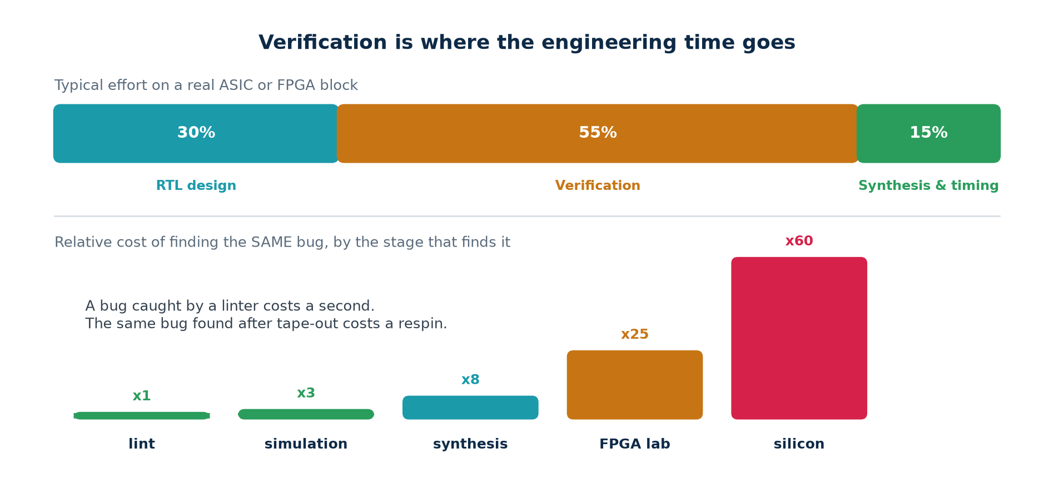
TOPIC 5 · MOTIVATION
Why This Is Half the Job
Verification is not a phase that follows design. It is a separate discipline with its own tools, its own metrics and, on most teams, its own engineers — and it consumes more effort than the design itself.
Why the cost curve is so steep
A bug is the same bug at every stage. What changes is what it costs to find and fix it. Lint reports it in one second with a file and a line number. The FPGA lab makes you re-synthesise, re-place and re-programme. Silicon makes you re-spin the mask set — months, and a great deal of money — and by then your customers have the part.
Chip Design Associate · Module 2 · Verilog RTL Coding for Synthesis · Topic 5: RTL Simulation and Verification
M2-T5 · 3

Slide 4
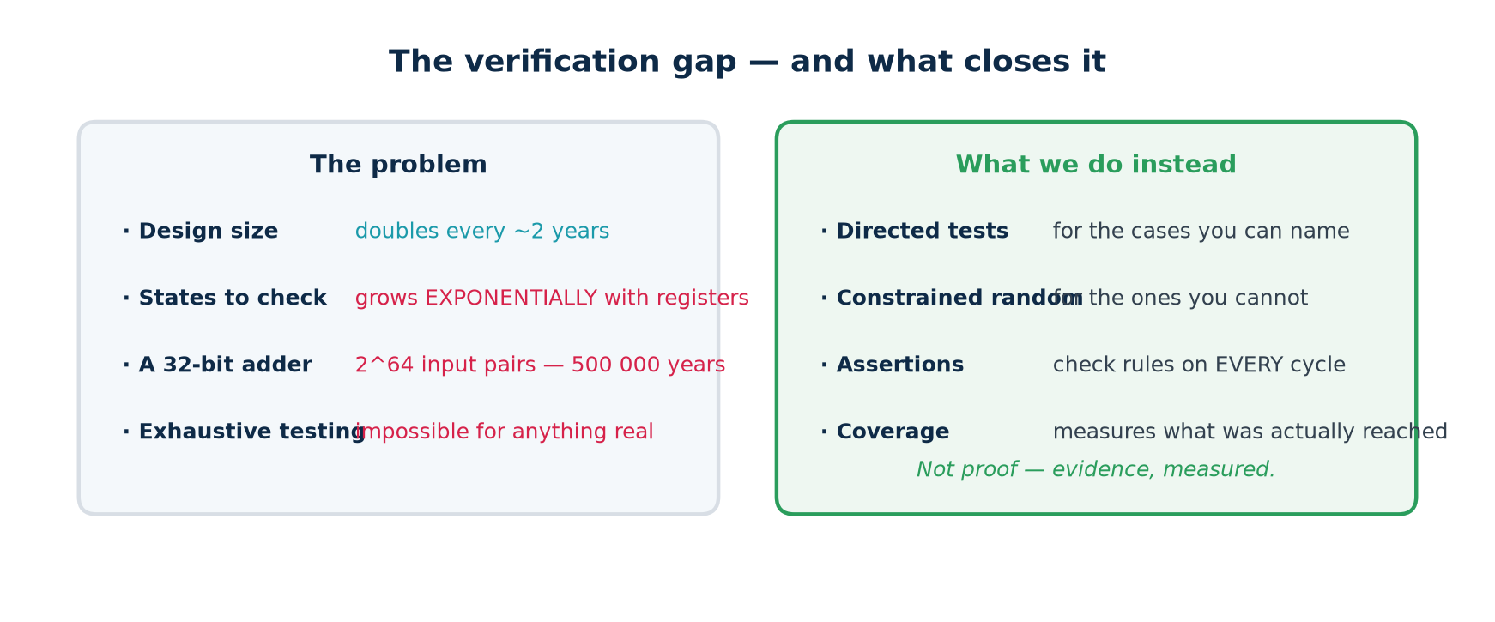
TOPIC 5 · THE PROBLEM
You Cannot Test Everything — So What Do You Do?
Exhaustive testing is impossible for anything real. A single 32-bit adder has 2^64 input pairs; at a billion per second that is over 500 000 years. The state space of a design with 100 flip-flops is larger than the number of atoms in the observable universe.
So verification is not proof — it is measured evidence
You choose the cases most likely to break it (directed), let a machine choose the ones you would not have thought of (random), state the rules so they are checked continuously (assertions), and then measure what you actually reached (coverage). The last of those is what turns 'we tested it' into a number somebody can review.
Chip Design Associate · Module 2 · Verilog RTL Coding for Synthesis · Topic 5: RTL Simulation and Verification
M2-T5 · 4

Slide 5
SUBTOPIC 5A
Functional Verification Techniques for RTL Designs
The methods, the metrics, and the argument for each one.
The verification loop, and why it ends at coverage rather than at PASS
Directed, constrained-random, and where each one earns its place
Four ways to decide whether an answer was right
Code coverage and functional coverage — only one of them knows the spec
The verification plan, regression, and closure
Measured proof: three testbenches against five broken designs
Chip Design Associate · Module 2 · Verilog RTL Coding for Synthesis · Topic 5: RTL Simulation and Verification
M2-T5 · 5

Slide 6
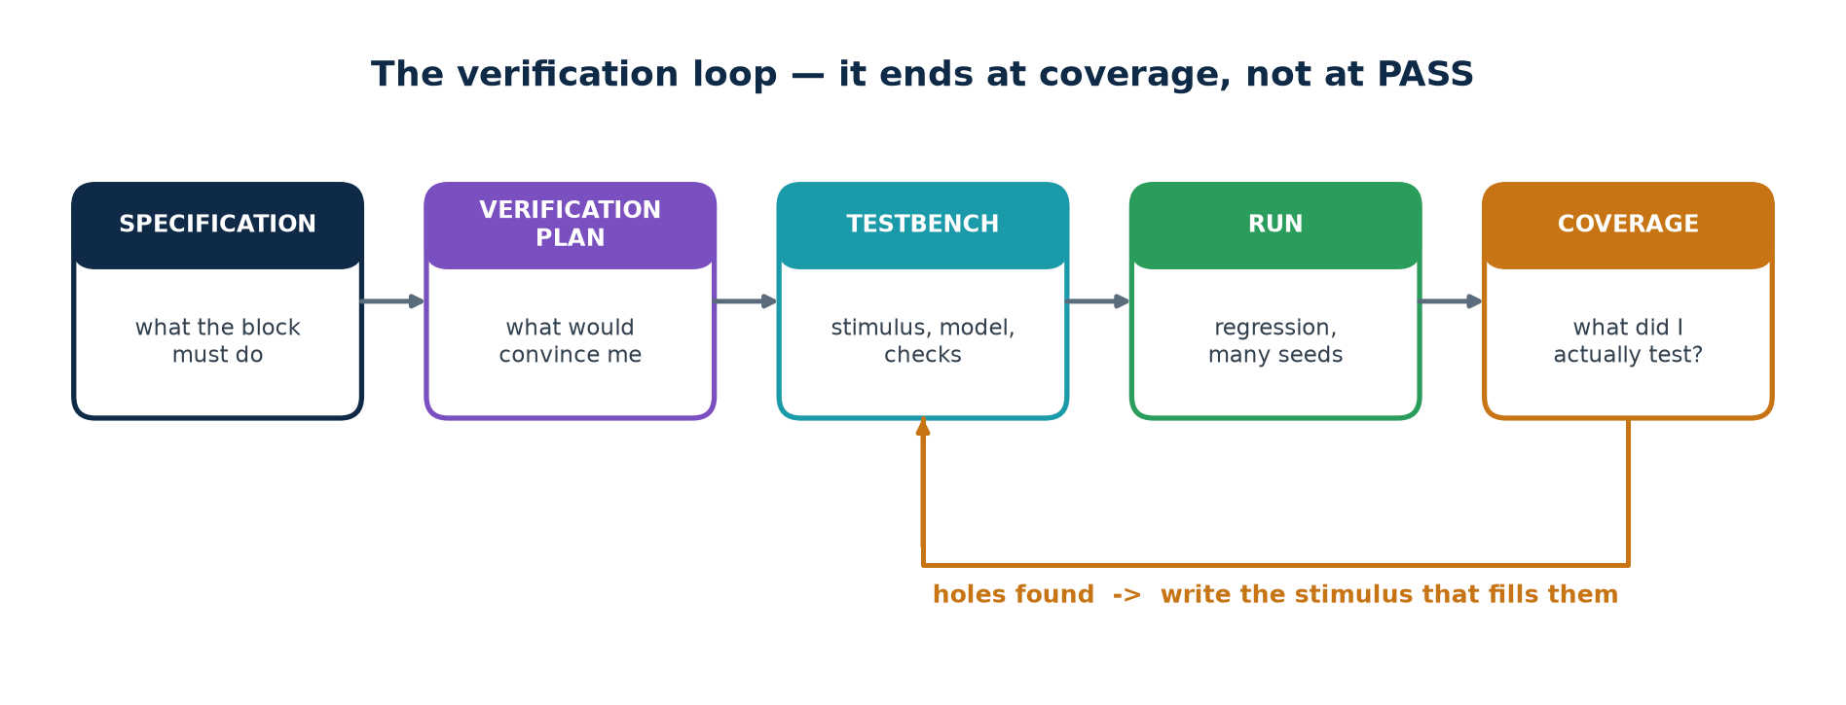
TOPIC 5A · THE LOOP
The Verification Loop
Notice where this loop ENDS. Not at 'the simulation passed' — at 'coverage is closed'. A pass with unmeasured coverage tells you only that nothing broke in the cases you happened to run.
The plan comes FIRST
The loop closes on the holes
Write the verification plan before the testbench, from the specification, and have it reviewed exactly as the design is reviewed. If you write the testbench first you will test what you happened to build, not what was asked for.
Coverage does not just report — it TELLS YOU WHAT TO DO NEXT. Every MISS is a specific piece of stimulus somebody has to write. That is why it is a loop and not a final report.
Chip Design Associate · Module 2 · Verilog RTL Coding for Synthesis · Topic 5: RTL Simulation and Verification
M2-T5 · 6

Slide 7
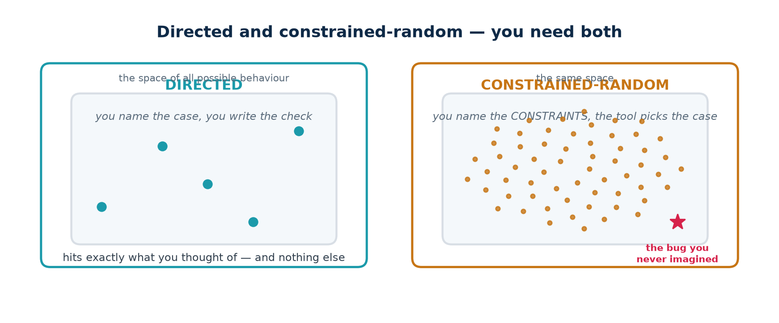
TOPIC 5A · TECHNIQUES
Directed and Constrained-Random
These are not alternatives; they are different instruments. Directed tests are precise and cheap and prove exactly what you meant. Random tests are broad and reach places you did not think of. A real project uses both, in that order.
Directed
Constrained-random
You write
the case AND the expected answer
the constraints; a model gives the answer
Cost per test
high — one test, one case
low — one test, thousands of cases
Reproducible
always
yes, from the seed
Finds
what you thought of
what you did not
Use it for
boundaries, reset, protocol corners
volume, and the long tail
Chip Design Associate · Module 2 · Verilog RTL Coding for Synthesis · Topic 5: RTL Simulation and Verification
M2-T5 · 7

Slide 8
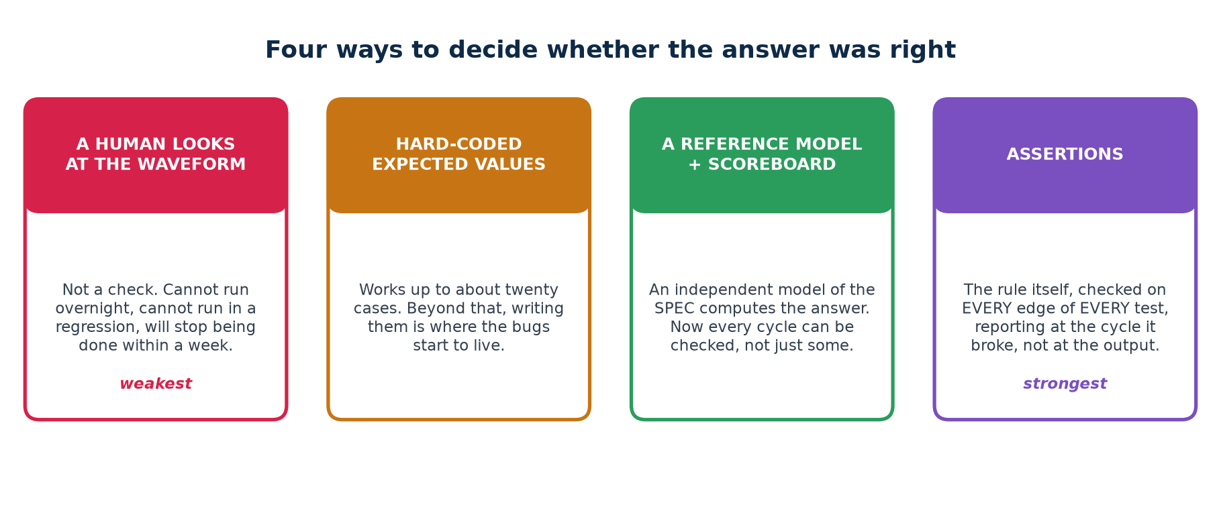
TOPIC 5A · CHECKING
Four Ways to Decide Whether the Answer Was Right
This is the single biggest determinant of how good a testbench is. Not how many test cases it runs — how it decides whether each one was correct.
The line that separates a testbench from a demonstration
If deciding whether the run was correct requires a human to look at a waveform, you cannot put it in a regression, you cannot run it overnight, and you will stop running it within a week. The verdict must be a line of text a machine can grep for.
Chip Design Associate · Module 2 · Verilog RTL Coding for Synthesis · Topic 5: RTL Simulation and Verification
M2-T5 · 8

Slide 9
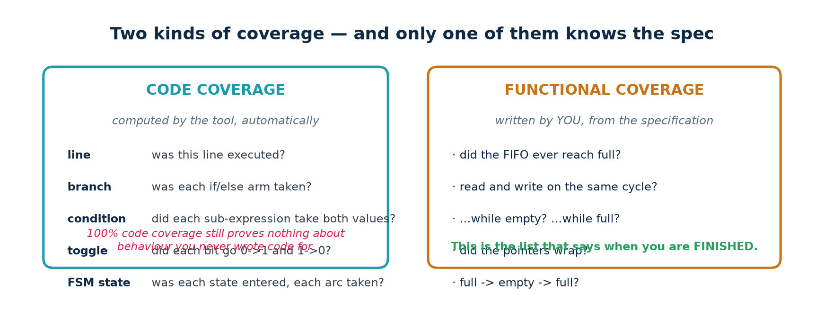
TOPIC 5A · COVERAGE
Code Coverage and Functional Coverage
Coverage answers the question a passing test cannot: WHAT DID I ACTUALLY TEST? There are two kinds, they measure different things, and you need both.
The trap that catches every team once
100% code coverage does not mean the design is verified. It means every line you wrote was executed. It says nothing about the behaviour you FORGOT to write code for, nothing about whether the outputs were checked, and nothing about whether the FIFO ever went full. Functional coverage is the one written from the specification — and it is the one that says when you are finished.
Chip Design Associate · Module 2 · Verilog RTL Coding for Synthesis · Topic 5: RTL Simulation and Verification
M2-T5 · 9

Slide 10
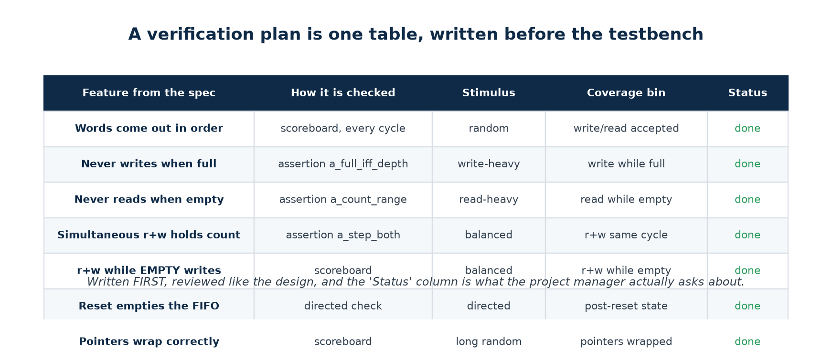
TOPIC 5A · THE PLAN
The Verification Plan Is One Table
A verification plan does not need to be a document. It needs to be a table, written before the testbench, reviewed like the design, with one row per feature in the specification and a column that says how each is checked.
Why writing it first matters
Why the Status column matters
A plan written afterwards documents what you happened to build. A plan written first tells you what to build — and the gaps are visible while they are still cheap to close.
It is the only honest answer to "are we done?". Not "the tests pass" — "these features are checked, by these mechanisms, and here are the ones that are not".
Chip Design Associate · Module 2 · Verilog RTL Coding for Synthesis · Topic 5: RTL Simulation and Verification
M2-T5 · 10

Slide 11
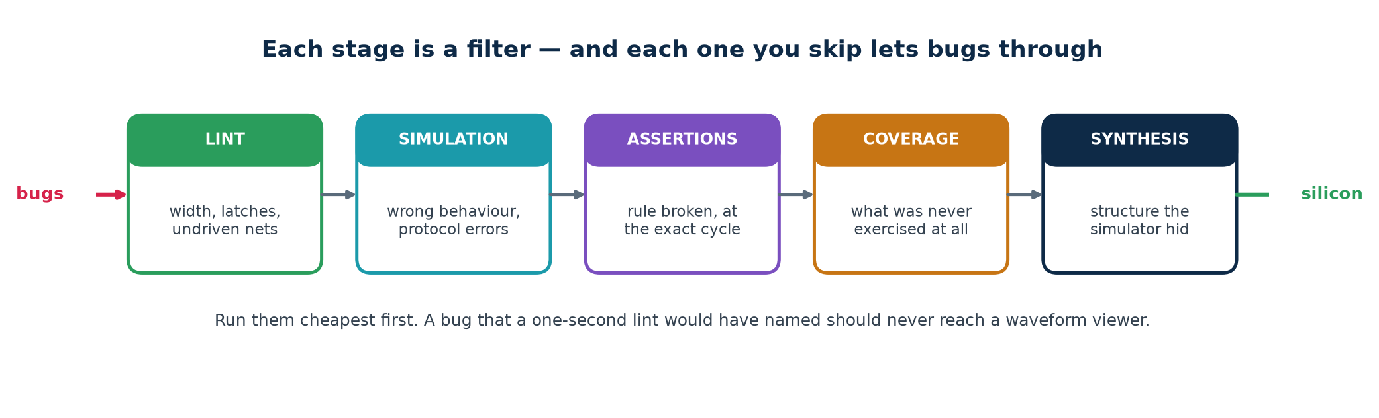
TOPIC 5A · THE FILTERS
Each Stage Catches What the Previous One Cannot
No single technique catches everything. Each is a filter with a different mesh, and skipping one lets a whole class of bug through to the next — where it costs more.
Run them in cost order, every time
Lint is one second and catches width truncation and inferred latches. Simulation is a minute and catches wrong behaviour. Assertions cost nothing extra once written and catch a broken rule at the cycle it breaks. Coverage catches what was never exercised at all. Synthesis catches the structural surprises the simulator hid from you.
Chip Design Associate · Module 2 · Verilog RTL Coding for Synthesis · Topic 5: RTL Simulation and Verification
M2-T5 · 11

Slide 12
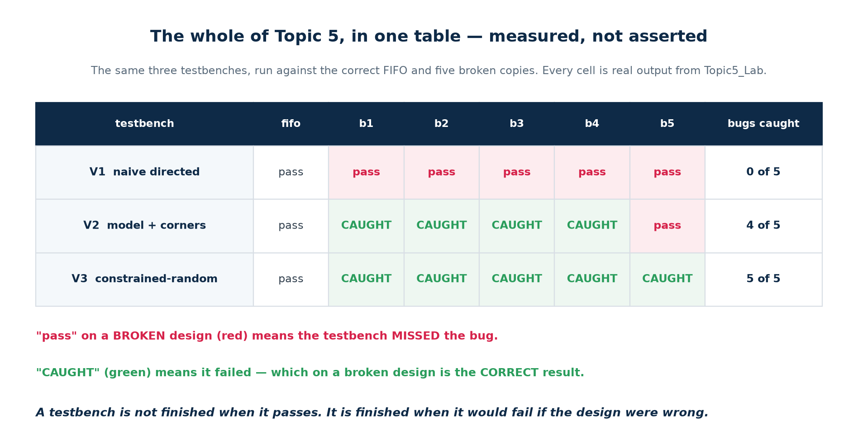
TOPIC 5A · THE PROOF
Three Testbenches, Five Broken Designs, One Table
Everything in this topic reduces to this experiment. One correct FIFO and five copies with a single realistic bug each. All five lint clean, all five synthesise, and all five pass a testbench that most students would call finished.
Run it yourself in ten seconds
cd Topic5_Lab && ./scripts/clinic.sh — every cell in that table is produced by that command, on the code in the lab folder. Show it to the room before you explain anything else; the rest of the topic is the explanation of why the numbers come out that way.
Chip Design Associate · Module 2 · Verilog RTL Coding for Synthesis · Topic 5: RTL Simulation and Verification
M2-T5 · 12

Slide 13
TOPIC 5A · READING THE TABLE
What Actually Changed Between V1, V2 and V3
The three testbenches do not differ in size or effort. They differ in three specific decisions, and each decision is worth a row of that table.
V1 → V2
Stopped typing expected values by hand and built a REFERENCE MODEL — an independent implementation of the specification. Once you have one, you can check every cycle instead of the few you remembered. Then added the boundary cases: fill to full, drain to empty, write while full, read while empty. Result: 0 of 5 becomes 4 of 5.
V2 → V3
Replaced hand-written stimulus with WEIGHTED RANDOM stimulus, seeded so any failure reproduces exactly. The fifth bug only appears when a read and a write are asserted together on an EMPTY FIFO — a combination no directed test in V2 ever produces, and one nobody thinks to write. Result: 4 of 5 becomes 5 of 5.
V3 → V4
Added a COVERAGE MODEL, so a run that passes also reports what it reached. Without it you cannot tell a thorough run from a lucky one — and the write-heavy profile, which passes cleanly, never reaches empty at all.
V3 → V6
Added ASSERTIONS bound to the DUT, so a broken rule is reported at the cycle it breaks with the name of the rule — rather than three hundred cycles later, at an output, as a wrong number.
Chip Design Associate · Module 2 · Verilog RTL Coding for Synthesis · Topic 5: RTL Simulation and Verification
M2-T5 · 13

Slide 14
TOPIC 5A · CHECKPOINT
Eight Questions Before We Build Anything
Ask the room. These are all conceptual — no code yet. Answers are in workbook section T5-A.
Questions 1–4
Questions 5–8
1. Why is 100% code coverage not the same as "verified"?
2. A testbench passes on a design you know is broken. What does that tell you about the testbench?
3. Why must a reference model be written from the specification and not from the RTL?
4. What does the SEED give you that makes random stimulus usable in a regression?
5. Name one bug an assertion catches earlier than a scoreboard, and one it cannot catch at all.
6. What is the difference between a coverage HOLE and a test FAILURE?
7. Why does a regression usually dump no waveforms?
8. Your random test has passed 10 000 seeds. Are you finished? What would you need to see?
If question 2 or 8 gave the room trouble
Those two are the whole topic. Go back to the clinic table and run ./scripts/clinic.sh live before continuing — the measured result convinces people in a way that an argument does not.
Chip Design Associate · Module 2 · Verilog RTL Coding for Synthesis · Topic 5: RTL Simulation and Verification
M2-T5 · 14

Slide 15
SUBTOPIC 5B
Introduction to Test Benches and Testbench Development
Built up in six stages, each one measured against five broken designs.
The six parts every testbench has, and the DUT under test
Clock, reset, and when to drive and when to sample
Reference models and scoreboards
Constrained-random stimulus, seeds and regressions
Functional coverage, and closing it
Assertions, and a layered testbench environment
Chip Design Associate · Module 2 · Verilog RTL Coding for Synthesis · Topic 5: RTL Simulation and Verification
M2-T5 · 15

Slide 16
TOPIC 5B · THE DUT
One Design, Six Testbenches — Meet the FIFO
Everything in 5b is built against a single device under test. A small synchronous FIFO — big enough to have interesting corners, small enough to hold in your head. Its header comment IS the specification your testbench checks.
Topic5_Lab/rtl/fifo.v — the interface contract
// * A write is accepted when wr_en=1 and full=0. A write while FULL is IGNORED
// and must not corrupt anything.
// * A read is accepted when rd_en=1 and empty=0. A read while EMPTY is IGNORED.
// * rd_data shows the OLDEST unread word at all times (first-word fall-through).
// * count is the number of words stored, 0..DEPTH.
// * empty <=> count==0. full <=> count==DEPTH.
// * Words come out in the ORDER they went in. None is lost or duplicated.
// * Asynchronous active-low reset empties the FIFO.
Every line of that comment becomes a check
And five broken copies
There are eight bullets. A finished testbench has a check for each one, and a coverage bin proving the situation actually arose. That mapping — spec bullet to check to bin — is the whole verification plan.
Topic5_Lab/rtl/fifo_bugs.v holds five variants with one realistic bug each. They all lint clean, all synthesise, and all pass a naive testbench. Do not read the bug list before attempting the clinic.
Chip Design Associate · Module 2 · Verilog RTL Coding for Synthesis · Topic 5: RTL Simulation and Verification
M2-T5 · 16

Slide 17
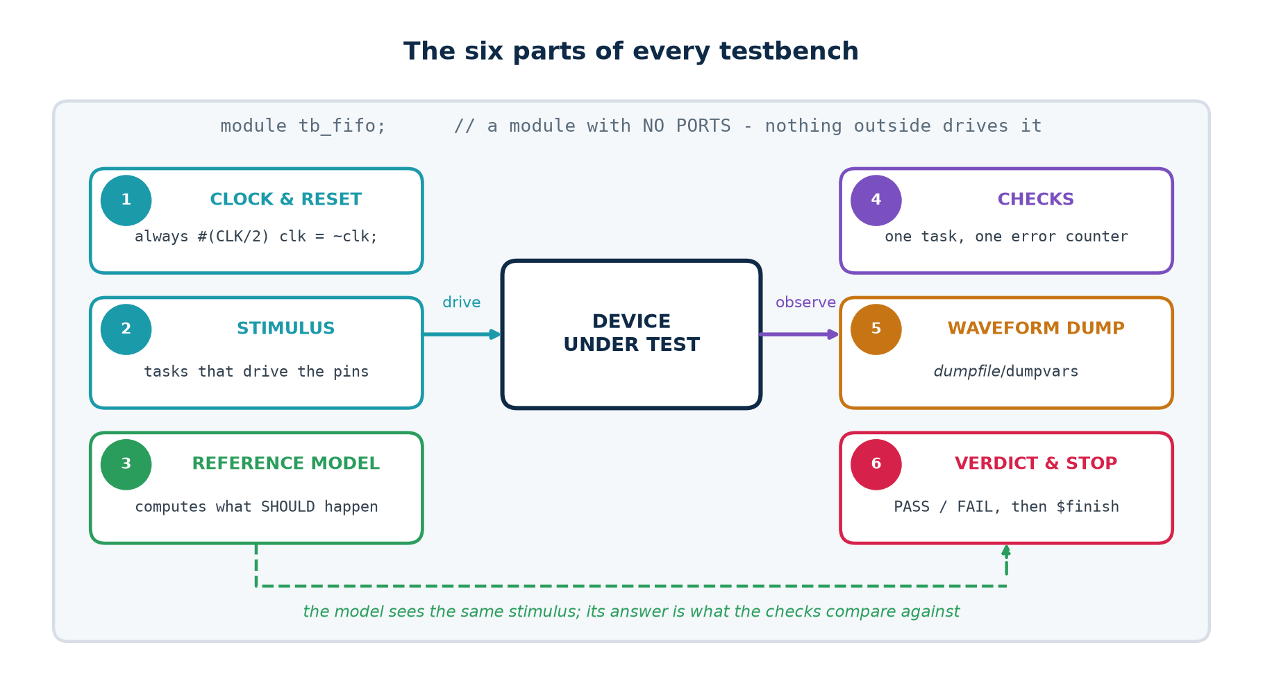
TOPIC 5B · ANATOMY
The Six Parts of Every Testbench
A testbench is a module with no ports. It is never synthesised, so the entire language is available — and every testbench you will ever write has these six parts, whatever the design.
Missing part 6 is the commonest omission
A testbench that never calls $finish runs until somebody kills it, which in a regression means the whole run hangs. Add a watchdog too: a second initial block that prints FAIL and finishes after a generous timeout, so a hung DUT FAILS rather than stalling the regression.
Chip Design Associate · Module 2 · Verilog RTL Coding for Synthesis · Topic 5: RTL Simulation and Verification
M2-T5 · 17

Slide 18
TOPIC 5B · LAB V1
The Testbench Everybody Writes First
Topic5_Lab/tb/tb_v1_naive.v — all six parts, and it does check its results
module tb_v1_naive;
fifo #(.W(8), .DEPTH(8)) u_dut (.clk(clk), .rst_n(rst_n), ...); // 1. instantiate
// 2. ONE place that decides pass or fail
task check(input [7:0] got, input [7:0] exp, input [255:0] msg);
if (got !== exp) begin
$display("FAIL %0t : %0s got %h expected %h", $time, msg, got, exp);
errors = errors + 1;
end
endtask
initial begin
$dumpfile("v1.vcd"); $dumpvars(0, tb_v1_naive); // 3. waveform dump
rst_n = 1'b0; repeat (3) @(posedge clk); #1 rst_n = 1'b1; // reset, released
// BETWEEN edges
push(8'hA1); push(8'hB2); push(8'hC3); // 4. stimulus
pop(got); check(got, 8'hA1, "first word out"); // and checks
pop(got); check(got, 8'hB2, "second word out");
pop(got); check(got, 8'hC3, "third word out");
if (errors == 0) $display("PASS - 3 words in, 3 words out"); // 5. verdict
$finish; // 6. stop
end
endmodule
This is not a bad testbench. It has every structural part, and it decides pass or fail without a human. It is still worth nothing — and the next slide says why.
Chip Design Associate · Module 2 · Verilog RTL Coding for Synthesis · Topic 5: RTL Simulation and Verification
M2-T5 · 18

Slide 19
TOPIC 5B · LAB V1
…and It Passes on Every Broken Design
Run that testbench against the golden FIFO and against all five broken ones. This is real output.
Verified output
$ ./scripts/clinic.sh
V1 naive directed pass pass pass pass pass pass
fifo fifo_b1 fifo_b2 fifo_b3 fifo_b4 fifo_b5
V1 : 0 of 5 bugs caught, golden design passes (no false alarm)
Why it misses everything
It never fills the FIFO. It never empties it past zero. It never asserts read and write on the same cycle. It never wraps the pointers. It never attempts a write while full or a read while empty.
Three words in and three words out exercises the one path where a broken FIFO and a correct FIFO behave identically. The bugs are all at the boundaries — which is where bugs generally are.
The lesson to state explicitly
Coverage of the SPECIFICATION, not volume of stimulus, is what makes a testbench worth having.
Chip Design Associate · Module 2 · Verilog RTL Coding for Synthesis · Topic 5: RTL Simulation and Verification
M2-T5 · 19

Slide 20
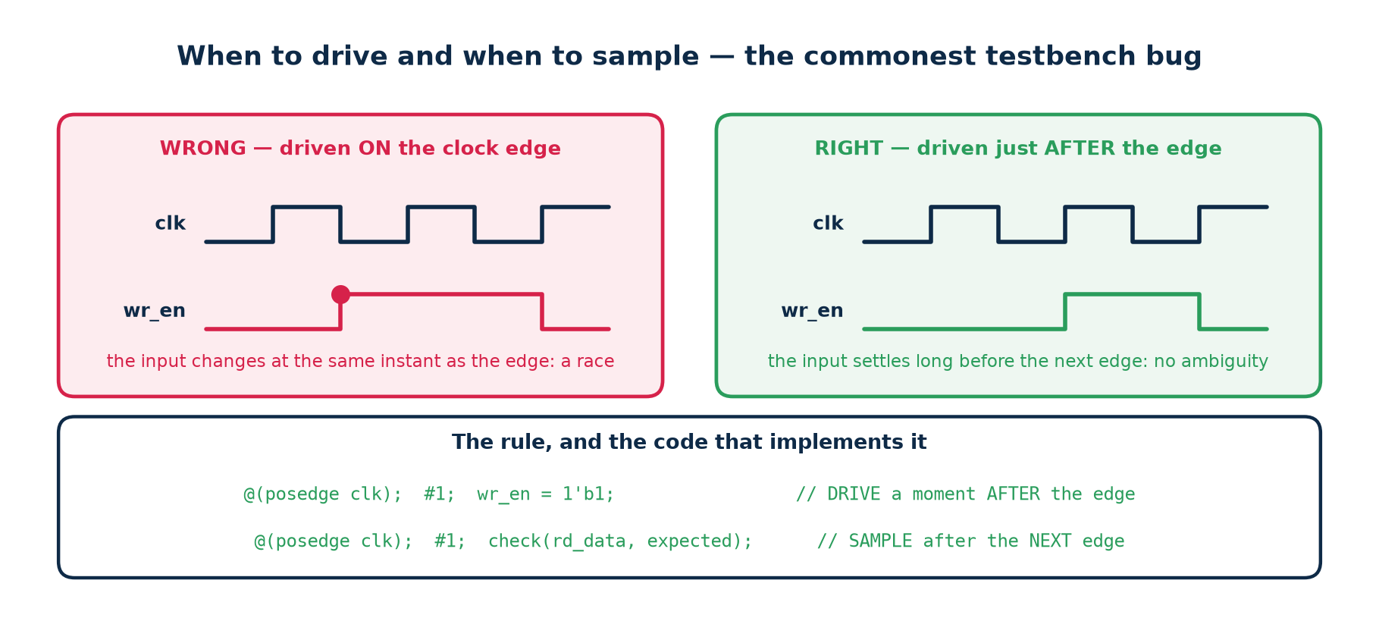
TOPIC 5B · TIMING
When to Drive and When to Sample
More 'the design is broken' reports come from this than from any other cause. If you change an input at the same instant as the clock edge, you have created a race — and which value the DUT sees is not defined.
Two real examples from these labs
Topic 4: an edge-detector test failed because the stimulus changed mid-cycle, so the pulse was half a cycle wide and the check sampled at the wrong moment.
Topic 4: an FSM testbench released reset exactly ON a clock edge; the state register saw an ambiguous condition and stayed x for two cycles, and the sequence detector found one match instead of two. Neither design was broken.
Chip Design Associate · Module 2 · Verilog RTL Coding for Synthesis · Topic 5: RTL Simulation and Verification
M2-T5 · 20

Slide 21
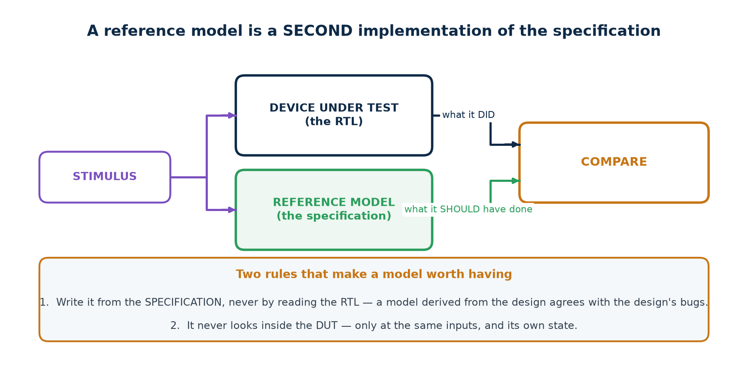
TOPIC 5B · REFERENCE MODEL
The Step That Changes Everything
Hand-written expected values do not scale past about twenty cases. A reference model is a second, independent implementation of the specification — usually far simpler than the RTL, because it need not be efficient or synthesisable.
Topic5_Lab/tb/tb_v2_selfcheck.v
// The FIFO's model: an array and two indices. That is all it needs to be.
reg [W-1:0] model [0:DEPTH-1];
integer mhead, mtail; // mtail - mhead is the occupancy
function [$clog2(DEPTH):0] mcount; input dummy; mcount = mtail - mhead; endfunction
Once the model exists you can compare EVERY cycle — count, empty, full and the output word — instead of only at the points where you happened to write a check.
Chip Design Associate · Module 2 · Verilog RTL Coding for Synthesis · Topic 5: RTL Simulation and Verification
M2-T5 · 21

Slide 22
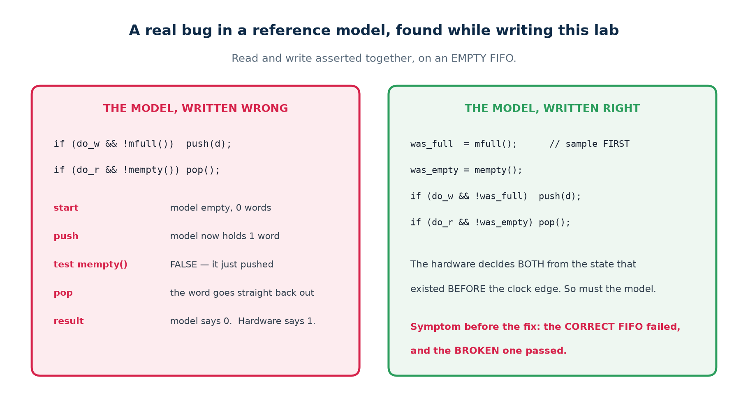
TOPIC 5B · CASE STUDY
A Real Bug — in the Reference Model
The model is code, and code has bugs. This one was found while writing this lab, and it is the most instructive failure in the whole topic: the CORRECT FIFO failed, and a BROKEN one passed.
The general rule this teaches
A model must make its decisions from the same state the hardware does. Hardware evaluates every enable from the state that existed BEFORE the clock edge, all at once. A model that applies one operation and then tests its own updated state is modelling something the hardware never does. Sample first; then apply.
Chip Design Associate · Module 2 · Verilog RTL Coding for Synthesis · Topic 5: RTL Simulation and Verification
M2-T5 · 22

Slide 23
TOPIC 5B · LAB V2
Model Plus Corners — 4 of 5
V2 adds two things to V1: the reference model, and the boundary cases. It is not a longer test — it is a better-chosen one.
The eight directed tests in tb_v2_selfcheck.v
T1 state immediately after reset
T2 fill to exactly full -> full must assert, empty must not
T3 a write WHILE FULL -> must be ignored, occupancy unchanged
T4 drain to exactly empty -> empty must assert, full must not
T5 a read WHILE EMPTY -> must be ignored, occupancy unchanged
T6 read and write on the SAME cycle, held half full
T7 keep going long enough to WRAP the pointers
T8 final drain, and the FIFO must end empty
$ ./scripts/clinic.sh
V2 model + corners pass CAUGHT CAUGHT CAUGHT CAUGHT pass
V2 : 4 of 5 bugs caught, golden design passes (no false alarm)
Four bugs, from eight well-chosen directed tests and a model. Nothing exotic — just the boundaries, checked against something that knows the right answer.
Chip Design Associate · Module 2 · Verilog RTL Coding for Synthesis · Topic 5: RTL Simulation and Verification
M2-T5 · 23

Slide 24
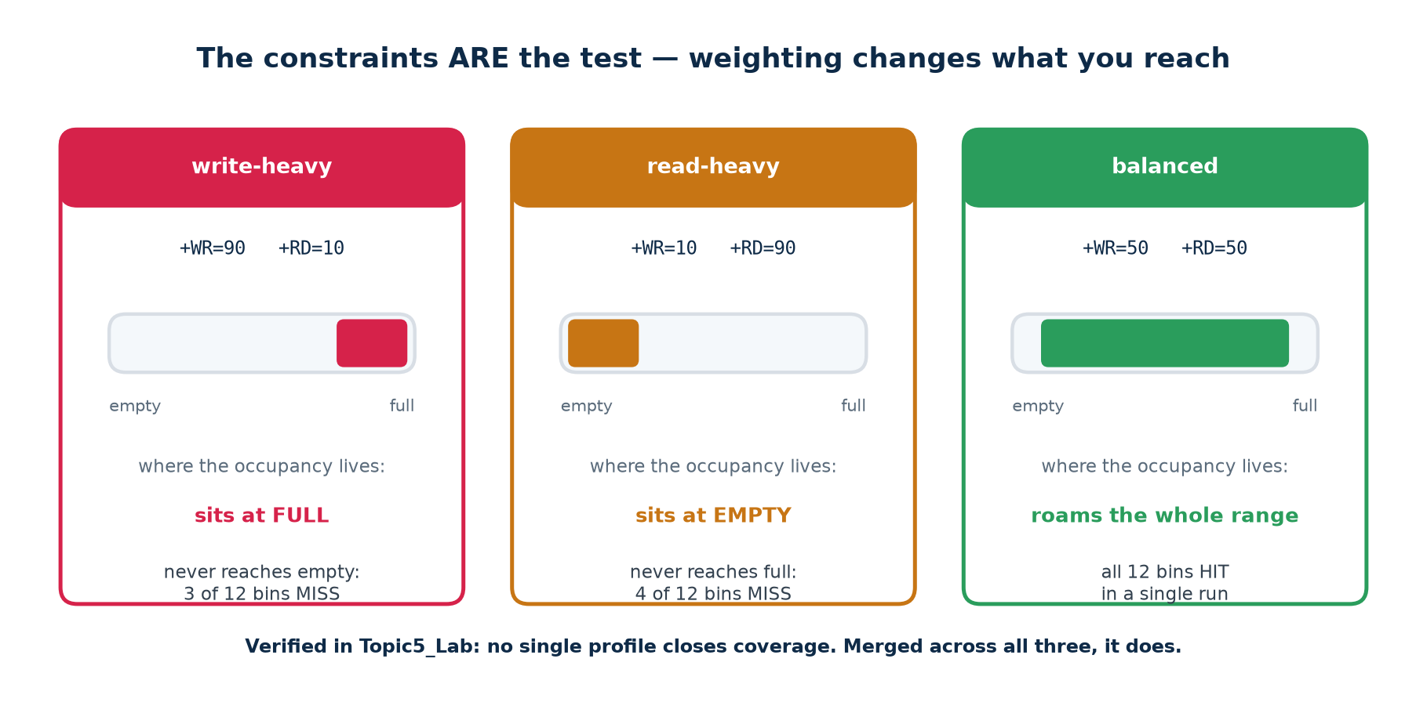
TOPIC 5B · RANDOM
The Constraints ARE the Test
Constrained-random does not mean 'random'. You still decide what the test does — you just express it as weights and let the generator produce the sequences. Change the weights and you are testing a different part of the design.
Topic5_Lab/tb/tb_v3_random.v — three lines of generator
do_w = (({$random(seed)} % 100) < p_wr); // p_wr and p_rd are the CONSTRAINTS
do_r = (({$random(seed)} % 100) < p_rd);
d = $random(seed);
Chip Design Associate · Module 2 · Verilog RTL Coding for Synthesis · Topic 5: RTL Simulation and Verification
M2-T5 · 24

Slide 25
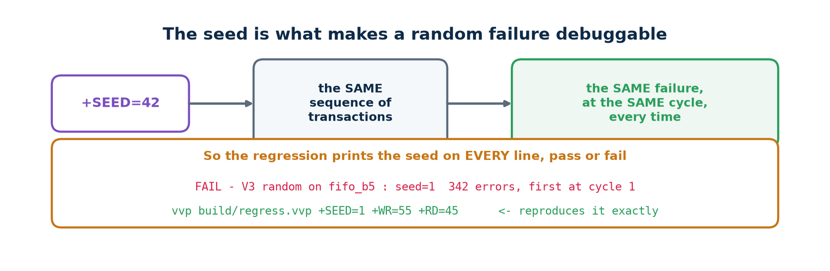
TOPIC 5B · SEEDS
Reproducibility Is What Makes Random Usable
A random failure you cannot reproduce is not a bug report — it is a rumour. The seed makes every run deterministic, so any failure can be replayed exactly, with waveforms this time.
Verified output
$ ./scripts/regress.sh 4 # 4 seeds x 3 profiles
profile seed cycles result
balanced 1 3000 pass
balanced 2 3000 pass
write-heavy 1 3000 pass
read-heavy 1 3000 pass
...
12 passed, 0 failed
REGRESSION CLEAN
Two traps: $random(seed) UPDATES seed in place, so save the original before the loop if you want to print it; and in SystemVerilog $urandom(seed) RE-SEEDS on every call — seed once, then call $urandom() with no argument.
Chip Design Associate · Module 2 · Verilog RTL Coding for Synthesis · Topic 5: RTL Simulation and Verification
M2-T5 · 25

Slide 26
TOPIC 5B · LAB V3
Constrained-Random — 5 of 5
The full clinic result — verified
$ ./scripts/clinic.sh
testbench fifo fifo_b1 fifo_b2 fifo_b3 fifo_b4 fifo_b5
---------------------------------------------------------------------------------
V1 naive directed pass pass pass pass pass pass
V2 model + corners pass CAUGHT CAUGHT CAUGHT CAUGHT pass
V3 constrained-random pass CAUGHT CAUGHT CAUGHT CAUGHT CAUGHT
V1 : 0 of 5 bugs caught, golden design passes (no false alarm)
V2 : 4 of 5 bugs caught, golden design passes (no false alarm)
V3 : 5 of 5 bugs caught, golden design passes (no false alarm)
What the fifth bug was, and why only random found it
fifo_b5 drops a write when wr_en and rd_en are asserted together while the FIFO is EMPTY. That is a legal, sensible combination — and no directed test in V2 ever produces it, because nobody thinks to write "read and write at once, from an empty FIFO" as a test case.
The random generator produced it ten times in three thousand cycles without being asked. That is the entire argument for constrained-random stimulus.
And note the first column
Every testbench passes on the golden design. A checker that fires on correct hardware is worse than no checker — the team learns to ignore it.
Chip Design Associate · Module 2 · Verilog RTL Coding for Synthesis · Topic 5: RTL Simulation and Verification
M2-T5 · 26

Slide 27
TOPIC 5B · COVERAGE
Writing a Coverage Model by Hand
SystemVerilog has covergroups. Plain Verilog does not — so you write one counter per interesting situation. Doing it by hand once is the best way to understand what the tool does for you later.
Topic5_Lab/tb/tb_v4_coverage.v
// THE COVERAGE MODEL. Write this list BEFORE the stimulus.
// 0 write accepted 6 occupancy reached DEPTH (full)
// 1 read accepted 7 occupancy reached 0 (empty)
// 2 read+write same cycle 8 pointers wrapped at least once
// 3 idle cycle 9 write attempted while full
// 4 read+write while EMPTY 10 read attempted while empty
// 5 read+write while FULL 11 a full -> empty -> full round trip
if (do_w && !was_full) cov[0] = cov[0] + 1; // sample, every cycle
if (do_w && do_r && was_empty) cov[4] = cov[4] + 1;
Bin 11 is the one worth pointing at
"full → empty → full" is not a state; it is a SEQUENCE over time, and it needs a little state machine in the testbench to detect. Real coverage models are full of these — 'a request followed by a retry', 'back-to-back bursts', 'reset in the middle of a transfer'. They are also where the interesting bugs live.
Chip Design Associate · Module 2 · Verilog RTL Coding for Synthesis · Topic 5: RTL Simulation and Verification
M2-T5 · 27

Slide 28
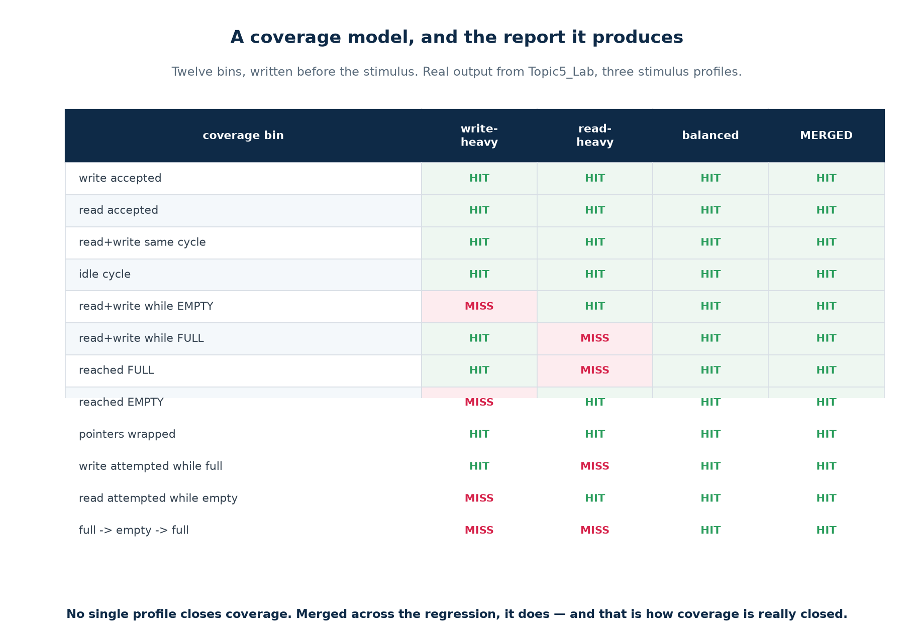
TOPIC 5B · LAB V4
Coverage Holes, and Closing Them
Here is the result that surprises students: a run can PASS and still prove almost nothing. The write-heavy profile passes cleanly — and never reaches empty at all.
This is what closure looks like in practice
No single profile closes coverage, and none has to. Each run contributes what it reached, the results are MERGED across the regression, and what is still missing is the specification for the next test you write. ./scripts/coverage.sh does exactly this and prints COVERAGE CLOSED.
Chip Design Associate · Module 2 · Verilog RTL Coding for Synthesis · Topic 5: RTL Simulation and Verification
M2-T5 · 28

Slide 29
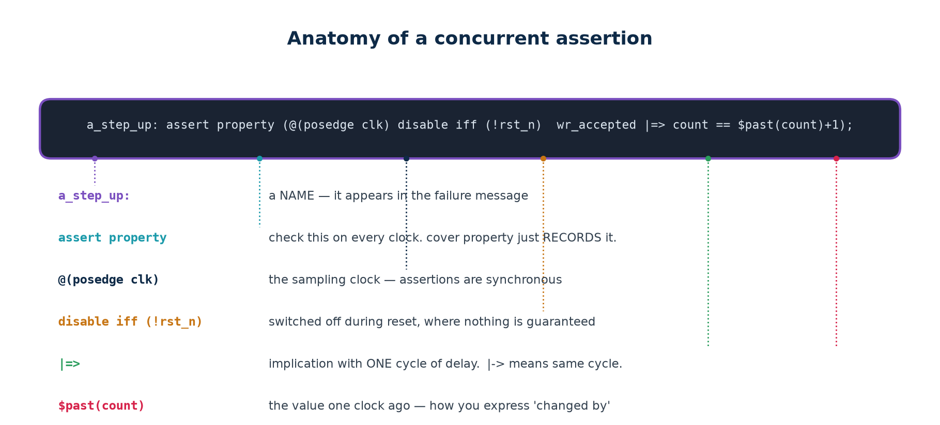
TOPIC 5B · ASSERTIONS
Stating the Rule Instead of Checking the Output
A scoreboard checks the outputs at the points you compare them. An assertion states a RULE, and the simulator checks it on every clock edge of every test, for ever — and reports at the exact cycle and the exact line where it broke.
assert versus cover
Where to put them
assert property — this must ALWAYS be true; fail loudly if not.
cover property — this is not a rule, just RECORD whether it ever happened. That is functional coverage, expressed in the same language.
In a separate module bound to the DUT's signals — as in sva/fifo_sva.sv. The design source stays clean, the assertions can be maintained by the verification engineer, and they can be switched off for synthesis without touching the RTL.
Chip Design Associate · Module 2 · Verilog RTL Coding for Synthesis · Topic 5: RTL Simulation and Verification
M2-T5 · 29

Slide 30
TOPIC 5B · ASSERTIONS
The FIFO's Specification, Written as Properties
Topic5_Lab/sva/fifo_sva.sv — lint-clean under Verilator 5.020
// 1. count and the flags must always agree
a_empty_iff_zero: assert property (@(posedge clk) disable iff (!rst_n)
empty == (count == 0)) else $error("empty=%0b but count=%0d", empty, count);
a_full_iff_depth: assert property (@(posedge clk) disable iff (!rst_n)
full == (count == DEPTH_C)) else $error("full=%0b but count=%0d", full, count);
// 2. occupancy may only move by one per cycle, in the right direction
a_step_up: assert property (@(posedge clk) disable iff (!rst_n)
(wr_en && !full && !(rd_en && !empty)) |=> (count == $past(count) + 1));
a_step_both: assert property (@(posedge clk) disable iff (!rst_n)
(wr_en && !full && rd_en && !empty) |=> (count == $past(count)));
// 3. COVER: not checks. They record that the interesting situations HAPPENED.
c_both_empty: cover property (@(posedge clk) disable iff (!rst_n)
wr_en && rd_en && empty);
Read the property names aloud and they are the specification: "empty if and only if count is zero", "a write steps the count up by one". That readability is the point — an assertion nobody can read is an assertion nobody will maintain.
Chip Design Associate · Module 2 · Verilog RTL Coding for Synthesis · Topic 5: RTL Simulation and Verification
M2-T5 · 30

Slide 31
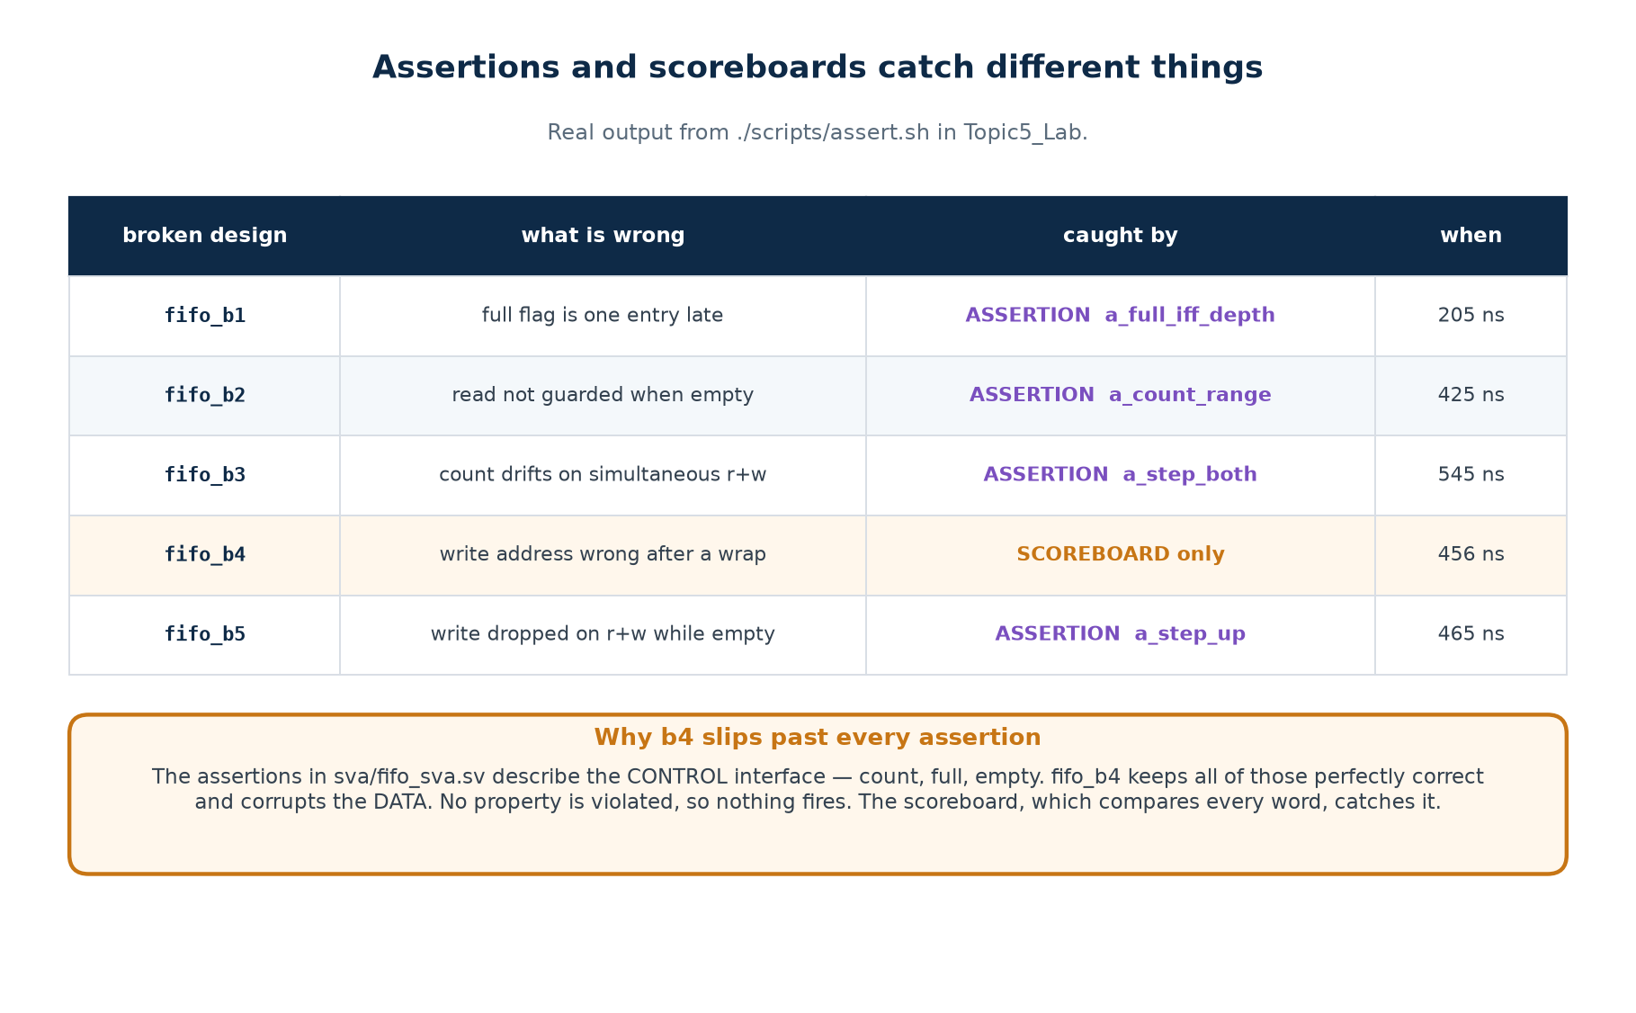
TOPIC 5B · LAB V6
Which Caught Which — and the One That Slipped Through
Assertions and scoreboards are not alternatives. Here is the measured proof, from the same five broken FIFOs.
Read the fourth row to the class twice
Four bugs are caught by a NAMED assertion, at the exact cycle, with a message that says which rule broke. One is not caught by any assertion — because these assertions describe the CONTROL interface and that bug corrupts DATA. Assertions catch what you described; scoreboards catch what you compared. You need both, and neither is a substitute for the other.
Chip Design Associate · Module 2 · Verilog RTL Coding for Synthesis · Topic 5: RTL Simulation and Verification
M2-T5 · 31

Slide 32
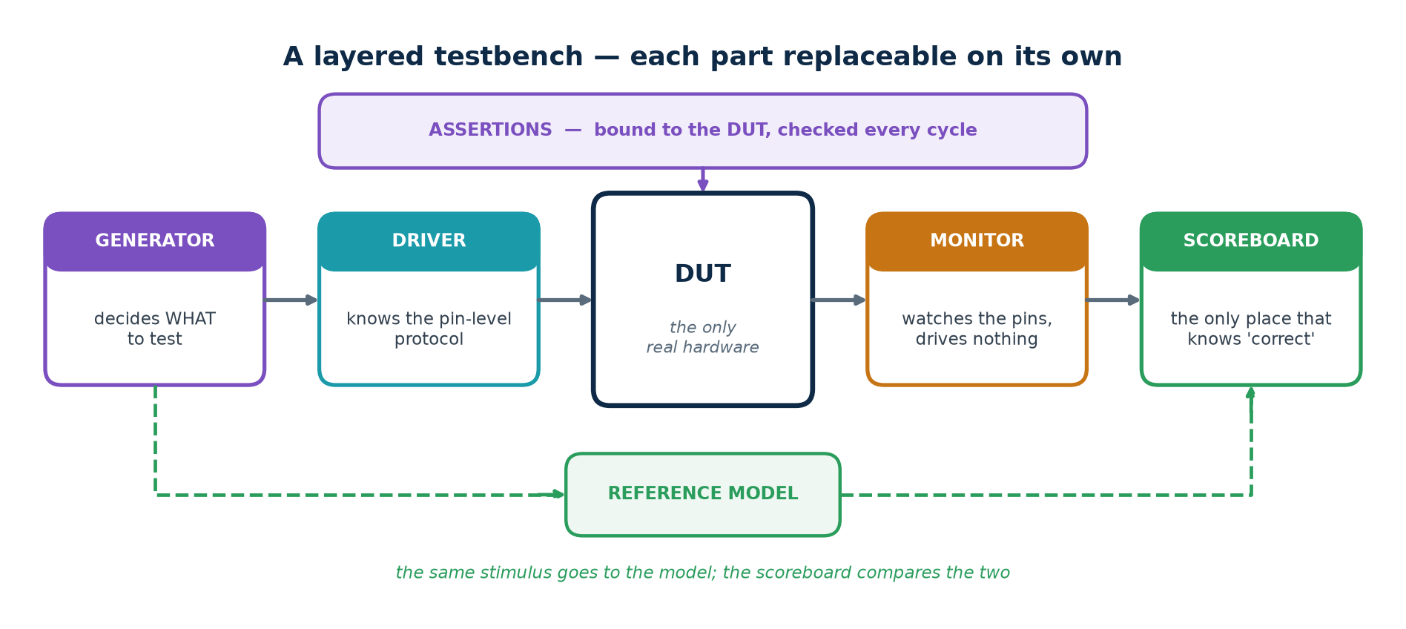
TOPIC 5B · ARCHITECTURE
A Layered Testbench
A flat testbench works for one design. A layered one survives contact with the second, because the part that decides WHAT to test is separate from the part that knows HOW to wiggle the pins.
Layer
Knows about
Does NOT know about
Generator
the test intent — what scenarios matter
pins, timing, the DUT
Driver
the pin-level protocol and its timing
why this transaction was chosen
Monitor
how to observe the pins
how to drive anything
Scoreboard
what 'correct' means
pins, timing, protocol
Chip Design Associate · Module 2 · Verilog RTL Coding for Synthesis · Topic 5: RTL Simulation and Verification
M2-T5 · 32

Slide 33
TOPIC 5B · LAB V6
The Capstone Testbench
Topic5_Lab/tb/tb_v6_assert.sv — verified: 2027 checks, 895 words in, 895 out
// LAYER 3: monitor -- watches the pins and tells the scoreboard what happened.
task automatic mon_apply(bit did_wr, bit did_rd, logic [W-1:0] dat);
bit was_full = m_full(); // sample BOTH before applying either
bit was_empty = m_empty();
if (did_wr && !was_full) begin model[mtail % DEPTH] = dat; mtail++; end
if (did_rd && !was_empty) begin mhead++; end
endtask
// LAYER 2: driver -- knows the pin protocol and nothing else.
task automatic drv_cycle(bit do_w, bit do_r, logic [W-1:0] dat, string where);
@(posedge clk); #1; wr_en = do_w; rd_en = do_r; wr_data = dat;
@(posedge clk); #1; wr_en = 1'b0; rd_en = 1'b0;
mon_apply(do_w, do_r, dat);
sb_check(where);
endtask
// LAYER 1: generator -- corners first (cheap, deterministic), then random.
for (int i = 0; i < DEPTH + 2; i++) drv_cycle(1'b1, 1'b0, 8'h10+i[7:0], "fill");
drv_cycle(1'b1, 1'b1, 8'hAA, "read+write while empty");
for (int i = 0; i < cycles; i++) begin
bit b_w = (($urandom() % 100) < p_wr); // seeded ONCE, before the loop
bit b_r = (($urandom() % 100) < p_rd);
drv_cycle(b_w, b_r, W'($urandom()), "random");
end
Directed corners first, then the random body. The corners fail fast and cheaply; the random body finds what the corners did not.
Chip Design Associate · Module 2 · Verilog RTL Coding for Synthesis · Topic 5: RTL Simulation and Verification
M2-T5 · 33

Slide 34
TOPIC 5B · CHECKPOINT
Build It Yourself — Eight Tasks
These are the tasks that make the difference between reading about verification and being able to do it. Full solutions in workbook section T5-B.
Tasks 1–4
Tasks 5–8
1. Add a ninth directed test to V2 that V2 currently lacks. What does it check?
2. Change V3's weights so the FIFO spends most of its time empty. Which coverage bins go MISS?
3. Break the golden FIFO with a one-character change. Which stage catches it — V1, V2 or V3?
4. Write a bug that V3 misses. What kind of bug is it, and what would catch it?
5. Add a coverage bin for "three consecutive idle cycles". Does anything hit it?
6. Add an assertion that would have caught fifo_b4. Why is it harder than the others?
7. Comment out a_step_both and re-run assert.sh. What changes about fifo_b3's diagnosis?
8. Run the same seed twice and diff the transcripts. Then change the seed. Explain both results.
Task 4 is the one that teaches the most
Writing a bug that survives a good testbench forces you to think about what the testbench does NOT check — which is exactly the skill a verification plan is supposed to produce.
Chip Design Associate · Module 2 · Verilog RTL Coding for Synthesis · Topic 5: RTL Simulation and Verification
M2-T5 · 34

Slide 35
TOPIC 5B · MECHANICS
Tasks, Functions and Concurrency in a Testbench
A testbench is not synthesised, so the whole language is available — including everything Topic 4 told you never to use in design code. Delays, while loops, file I/O, hierarchical references: all legal, all useful here.
The testbench-only constructs you will actually use
// A TASK may consume time. This is how you package a bus transaction.
task automatic push(input [W-1:0] dat);
begin
@(posedge clk); #1; wr_en = 1'b1; wr_data = dat;
@(posedge clk); #1; wr_en = 1'b0;
end
endtask
// FORK/JOIN runs several stimulus threads at once - a writer and a reader,
// independent of each other, exactly as two masters on a bus would be.
fork
begin : writer repeat (100) push($random(seed)); end
begin : reader repeat (100) pop(); end
join
// join_any + disable fork is the standard TIMEOUT idiom in SystemVerilog.
automatic matters
A watchdog is not optional
task automatic gives each call its own copy of the arguments and locals. Without it, two concurrent calls from a fork share one set — and corrupt each other in a way that looks like a DUT bug.
Every testbench needs a second initial block that prints FAIL and calls $finish after a generous timeout. Without one, a hung DUT stalls the whole regression instead of failing it — and a regression that hangs is a regression nobody runs.
Chip Design Associate · Module 2 · Verilog RTL Coding for Synthesis · Topic 5: RTL Simulation and Verification
M2-T5 · 35

Slide 36
TOPIC 5B · FILE I/O
Golden Vectors — When the Answer Comes From Elsewhere
Sometimes the reference is not a model you write but a file somebody else produced — a C reference implementation, a MATLAB run, the output of the previous chip. The testbench then reads stimulus and expected results from files.
$readmemh, $fopen, $fdisplay, $fclose
reg [7:0] stim [0:1023];
reg [7:0] golden [0:1023];
integer i, fd, errors;
initial begin
$readmemh("vectors/stim.hex", stim); // one hex value per line
$readmemh("vectors/golden.hex", golden);
fd = $fopen("build/mismatch.log", "w"); // and write our own report
for (i = 0; i < 1024; i = i + 1) begin
apply(stim[i]);
if (dut_out !== golden[i]) begin
$fdisplay(fd, "%0d sent %h got %h expected %h", i, stim[i], dut_out, golden[i]);
errors = errors + 1;
end
end
$fclose(fd);
end
When golden vectors are the right answer
And when they are not
· A published standard with official test vectors (AES, CRC, a codec).
· A bit-exact C or MATLAB reference that already exists and is trusted.
· Regression against the PREVIOUS revision of the same block.
· They fix the stimulus, so they cannot find the corner nobody generated.
· They rot: the file and the specification drift apart and nobody notices.
· A mismatch tells you WHICH vector failed, not which rule was broken.
Chip Design Associate · Module 2 · Verilog RTL Coding for Synthesis · Topic 5: RTL Simulation and Verification
M2-T5 · 36

Slide 37
TOPIC 5B · REUSE
A Testbench That Survives the Next Project
The testbenches in this lab are parameterised the same way the design is. Change W or DEPTH in one place and everything — stimulus, model, coverage bins — follows. That is not tidiness; it is what makes the testbench reusable at all.
How the clinic runs one testbench against six designs
// The DUT is selected by a `define, so ONE testbench runs against SIX designs.
`ifndef DUT
`define DUT fifo
`endif
`DUT #(.W(W), .DEPTH(DEPTH)) u_dut ( .clk(clk), .rst_n(rst_n), ... );
// and on the command line:
iverilog -DDUT=fifo_b3 -DDUTNAME=\"fifo_b3\" rtl/*.v tb/tb_v3_random.v
xvlog -d DUT=fifo_b3 ... # Vivado
vlog +define+DUT=fifo_b3 ... # ModelSim
Three habits that make a testbench outlive its design
1. Parameterise everything the DUT parameterises, and derive nothing by hand.
2. Keep the layers separate — a new DUT usually needs a new DRIVER only, and the generator, monitor and scoreboard survive unchanged.
3. Never reach inside the DUT from the scoreboard. A white-box check is fine for debugging and fatal for reuse: the moment the design is refactored, the testbench breaks and nobody can tell whether the design did too.
Chip Design Associate · Module 2 · Verilog RTL Coding for Synthesis · Topic 5: RTL Simulation and Verification
M2-T5 · 37

Slide 38
TOPIC 5B · BY DESIGN TYPE
What to Check, for Each Kind of Block
The six parts of a testbench are always the same. What changes is what you check, and where the bugs hide.
Kind of DUT
The checks that matter
Where the bugs actually are
Combinational
exhaustive if the input space is small; otherwise random + a reference function
boundaries, sign, and width truncation
Registered / pipelined
output correct AND arriving at the right cycle; valid delayed with the data
latency, and control not pipelined with the data
Counter / timer
wrap, load, enable priority, terminal count
off-by-one at the wrap, and at the reload
FSM
every state entered, every arc taken, illegal states recovered from
the arcs nobody drew, and the missing default
Memory / FIFO
order, occupancy, full, empty, simultaneous access
the boundaries: full, empty, and both at once
Protocol / bus
handshake rules as assertions; a checker independent of the DUT
the rule the other end violates, not the one you do
CDC
not by simulation alone — structural CDC checks and a Gray/handshake review
multi-bit buses crossing without a handshake
Chip Design Associate · Module 2 · Verilog RTL Coding for Synthesis · Topic 5: RTL Simulation and Verification
M2-T5 · 38

Slide 39
TOPIC 5B · SYSTEMVERILOG
What SystemVerilog Adds for Verification
Verilog-2005 is enough to build everything in this lab, and doing it by hand once is worth the effort. SystemVerilog then gives you the same things as language features — and you will meet them in every professional environment.
SystemVerilog feature
What it replaces in this lab
Support
logic
the wire / reg decision
everywhere
always_comb / always_ff
always @(*) and the latch you inferred by mistake
everywhere
assert / cover property
hand-written checks scattered through the code
vendor: full; open-source: a subset
covergroup / coverpoint / bins
the twelve integer counters in Lab V4
vendor tools
rand / randc + constraint blocks
the weighted $random in Lab V3
vendor tools
classes, mailboxes, semaphores
the layers written as tasks in Lab V6
vendor tools
interface / modport
the long port lists in every instantiation
vendor tools
queues, dynamic arrays, associative arrays
the fixed model array and its indices
vendor tools
Why this lab is written in Verilog-2005
Because you learn what a covergroup IS by writing twelve counters once, and what a constraint IS by writing the weights yourself. And because it then runs on every tool on every machine, including the ones your students have at home. Move to SystemVerilog as soon as your tool flow allows — but move to it understanding what it is doing for you.
Chip Design Associate · Module 2 · Verilog RTL Coding for Synthesis · Topic 5: RTL Simulation and Verification
M2-T5 · 39

Slide 40
TOPIC 5B · SYSTEMVERILOG
Constraints, Written as Constraints
In Verilog you weight a coin and hope. In SystemVerilog you state the rules and a constraint solver generates values that satisfy them — which is a considerably more powerful thing.
The same generator as Lab V3, expressed declaratively
class fifo_txn;
rand bit do_wr;
rand bit do_rd;
rand bit [7:0] data;
// weights, expressed directly
constraint c_mix { do_wr dist { 1 := 55, 0 := 45 };
do_rd dist { 1 := 45, 0 := 55 }; }
// and rules the generator must respect
constraint c_burst { (do_wr && do_rd) -> data inside {[8'h80:8'hFF]}; }
endclass
fifo_txn t = new();
repeat (2000) begin
if (!t.randomize()) $fatal(1, "constraints are unsatisfiable");
drv_cycle(t.do_wr, t.do_rd, t.data);
end
What the solver buys you
And the trap
· Constraints compose: add one and the others still hold.
· randomize() with { ... } adds a temporary constraint at one call site — a directed test written as a narrowing of the random one.
An over-constrained set has no solution and randomize() returns 0. If you ignore the return value the test silently drives the same unrandomised value for ever — and passes. Always check it, and always $fatal on failure.
Chip Design Associate · Module 2 · Verilog RTL Coding for Synthesis · Topic 5: RTL Simulation and Verification
M2-T5 · 40

Slide 41
TOPIC 5B · SYSTEMVERILOG
Covergroups — the Same Twelve Bins, Declared
Lab V4's coverage model, as a SystemVerilog covergroup
covergroup cg_fifo @(posedge clk);
cp_op : coverpoint {wr_en, rd_en} {
bins idle = {2'b00};
bins wr = {2'b10};
bins rd = {2'b01};
bins both = {2'b11};
}
cp_occ: coverpoint count {
bins empty = {0};
bins mid = {[1:DEPTH-1]};
bins full = {DEPTH};
}
// the CROSS is where the real value is: read+write WHILE empty, and
// read+write WHILE full, are cells of this cross - and both were bugs.
x_op_occ: cross cp_op, cp_occ;
endgroup
cg_fifo cg = new(); // sampled automatically on every posedge clk
The cross is the point
cp_op has 4 bins and cp_occ has 3, so the cross has 12 cells — and two of them, "both while empty" and "both while full", are exactly where two of the five planted bugs live. A cross says "this situation, in that state" in one line — the combination hand-written counters make tedious, and that people skip.
Coverage is reported and merged by the tool
vsim -coverage ; coverage report -details and merged across a regression with vcover merge. That is the vendor equivalent of the awk merge in scripts/coverage.sh.
Chip Design Associate · Module 2 · Verilog RTL Coding for Synthesis · Topic 5: RTL Simulation and Verification
M2-T5 · 41

Slide 42
TOPIC 5B · UVM
What UVM Is, and When It Is Worth It
The Universal Verification Methodology is a SystemVerilog class library that standardises exactly the layers in Lab V6. It is what most professional verification environments are built from — and it is considerable overhead for a small block.
Lab V6 calls it
UVM calls it
What UVM adds
generator
uvm_sequence / uvm_sequencer
reusable, layered, randomisable sequences
driver
uvm_driver
a standard handshake with the sequencer
monitor
uvm_monitor
publishes transactions to any number of subscribers
scoreboard
uvm_scoreboard
standard comparison and reporting
(the whole thing)
uvm_env / uvm_agent
a package you can instantiate twice, or reuse on the next project
$display
uvm_info / uvm_error with verbosity
filterable, gradable reporting
(nothing)
the factory and config_db
swap a component or a setting without editing the environment
Worth it when
Not worth it when
· The block has a real protocol interface that other blocks also use.
· Several people work on the environment at once.
· The environment will be reused across projects, or at chip level.
· The block is a FIFO, and Lab V6 already verifies it in 160 lines.
· Nobody on the team has used UVM before and the schedule is four weeks.
· Your simulator licence does not include the class library.
Chip Design Associate · Module 2 · Verilog RTL Coding for Synthesis · Topic 5: RTL Simulation and Verification
M2-T5 · 42

Slide 43
TOPIC 5B · FORMAL
Formal Verification — Proof Instead of Sampling
Simulation samples the state space. Formal tools SEARCH it. Given the same assertions you already wrote, a formal engine tries to prove no input sequence can ever violate them — or produces a counter-example waveform that does.
WHAT YOU GET
For a property that is PROVEN, no amount of simulation adds anything: it holds for every input sequence, for ever. For one that fails, you get the shortest counter-example — usually far easier to understand than a random failure at cycle 40 000.
WHAT IT COSTS
The state space can explode. Formal works beautifully on control logic — FIFOs, arbiters, protocol adapters, CDC handshakes — and poorly on wide datapaths such as multipliers, where the engine runs out of memory rather than returning an answer.
THE OVERLAP
The assertions in sva/fifo_sva.sv are already formal properties. That is the practical point: writing assertions for simulation costs you nothing extra and gives you a formal testbench for free if you later get access to a tool.
WHERE IT IS USED
Almost universally for connectivity checks, register maps, clock-domain crossings, arbiters and cache coherence — and almost never as a replacement for simulation at the system level.
Chip Design Associate · Module 2 · Verilog RTL Coding for Synthesis · Topic 5: RTL Simulation and Verification
M2-T5 · 43

Slide 44
TOPIC 5B · CDC
Why Simulation Alone Cannot Verify a Clock Crossing
This is the most important limitation to state out loud. A simulator has no model of metastability. It resolves every flip-flop to a clean 0 or 1, so a design with a genuinely broken clock crossing simulates perfectly and fails intermittently in the lab.
What simulation WILL catch
What it will NOT catch
· Functional errors in the handshake protocol itself.
· Data being sampled before it was stable, if you model the delay.
· A Gray-code pointer that is not actually Gray.
· With randomised clock phases, some — not all — sampling races.
· Metastability. There is no such value in the simulator.
· A missing synchroniser: two flip-flops or none simulate identically.
· A multi-bit bus crossing without a handshake — in simulation all the bits arrive together, which is exactly what does not happen on silicon.
So CDC is verified structurally, not dynamically
Every professional flow runs a dedicated CDC checker that reads the netlist, identifies every path between unrelated clocks, and demands a recognised synchroniser structure on each one. Review the crossings by eye as well: two flip-flops for a single-bit level, Gray coding or a handshake for a bus, and never bit-by-bit synchronisation of a vector.
Chip Design Associate · Module 2 · Verilog RTL Coding for Synthesis · Topic 5: RTL Simulation and Verification
M2-T5 · 44

Slide 45
TOPIC 5B · METRICS
How a Project Decides Verification Is Finished
"We ran all the tests and they passed" is not a sign-off criterion. These are — and every one of them is a number somebody outside the team can read.
Metric
What it means
Typical sign-off bar
Functional coverage
spec-level situations reached
100% of the plan, or every hole waived in writing
Code coverage
lines, branches, conditions, toggles exercised
95–100%, with the rest explained
Assertion coverage
each assertion actually evaluated, not vacuously true
every assertion hit at least once
Regression pass rate
seeds passing over the last N runs
100%, sustained, not 'usually'
Bug discovery rate
new bugs found per week
flattened, and staying flat
Bug severity trend
are the new ones getting less serious?
no high-severity bugs for N weeks
The bug-rate curve is the one experienced teams watch
If you are still finding serious bugs at the same rate as last month, you are not near the end however good the coverage number looks. If the rate has flattened AND coverage is closed AND the regression is green, you have as much evidence as this method can give you.
Chip Design Associate · Module 2 · Verilog RTL Coding for Synthesis · Topic 5: RTL Simulation and Verification
M2-T5 · 45

Slide 46
TOPIC 5B · CHECKPOINT
Six Questions on the Advanced Material
Discussion questions — there is no code to type. Answers in workbook section T5-B.
Questions 1–3
Questions 4–6
1. Your testbench uses golden vectors from a trusted C model and every vector passes. Name two classes of bug this cannot find.
2. Why does a scoreboard that reads the DUT's internal pointers make the testbench worse, even though it makes debugging easier?
3. A cross of a 4-bin and a 3-bin coverpoint has 12 cells, and two of them are impossible by construction. What do you do about them?
4. randomize() returns 0 and the test still passes. Explain how, and what you should have written.
5. A design with no synchroniser at all simulates perfectly. Why, and what actually catches it?
6. Coverage is 100% and the regression is green, but the team is still finding two serious bugs a week. Are you finished? What does that tell you?
Question 6 is the one to spend time on
It is the difference between measuring what you tested and knowing whether the measurement was the right one. A closed coverage model that misses a whole category of behaviour reports 100% and means nothing — which is why the verification plan is reviewed by somebody other than its author.
Chip Design Associate · Module 2 · Verilog RTL Coding for Synthesis · Topic 5: RTL Simulation and Verification
M2-T5 · 46

Slide 47
SUBTOPIC 5C
Simulation and Debugging of RTL Designs
How the simulator actually works, and what to do when the answer is wrong.
The event-driven engine, and what happens inside one time step
Analyse, elaborate, run — the same three steps in every tool
Waveforms: dumping, reading, and saving a view
A debugging procedure: bisect in time, bisect in space, chase the x
Symptom-to-cause, and how to make simulation fast enough to live with
Chip Design Associate · Module 2 · Verilog RTL Coding for Synthesis · Topic 5: RTL Simulation and Verification
M2-T5 · 47

Slide 48
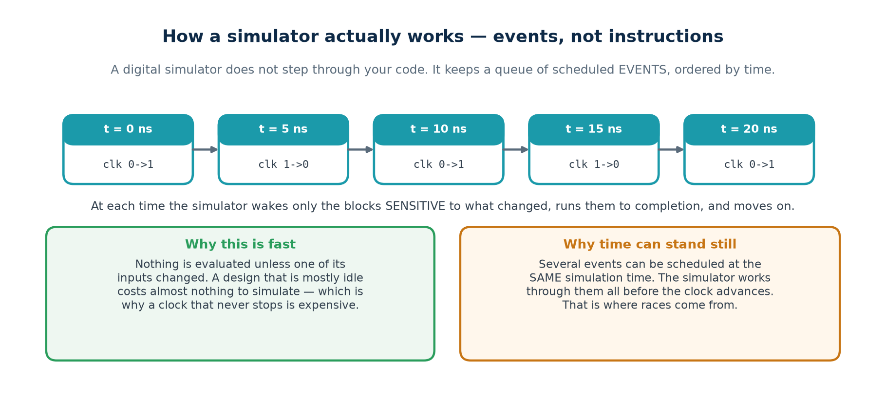
TOPIC 5C · THE ENGINE
A Simulator Runs Events, Not Instructions
A digital simulator does not step through your code. It keeps a queue of scheduled EVENTS ordered by time, and at each time it wakes only the blocks sensitive to what changed. Understanding that explains almost every surprising thing a simulation does.
Why simulation time is not wall-clock time
Why a loop with no delay hangs
A million simulated clock cycles may take a second or an hour, depending entirely on how much of the design is switching. Time in the simulator advances only when there is nothing left to do at the current time.
while (!done) ; in a testbench never lets simulation time advance, so done can never change. The simulator is not stuck — it is doing exactly what you wrote. Every wait loop needs an @ or a #.
Chip Design Associate · Module 2 · Verilog RTL Coding for Synthesis · Topic 5: RTL Simulation and Verification
M2-T5 · 48

Slide 49
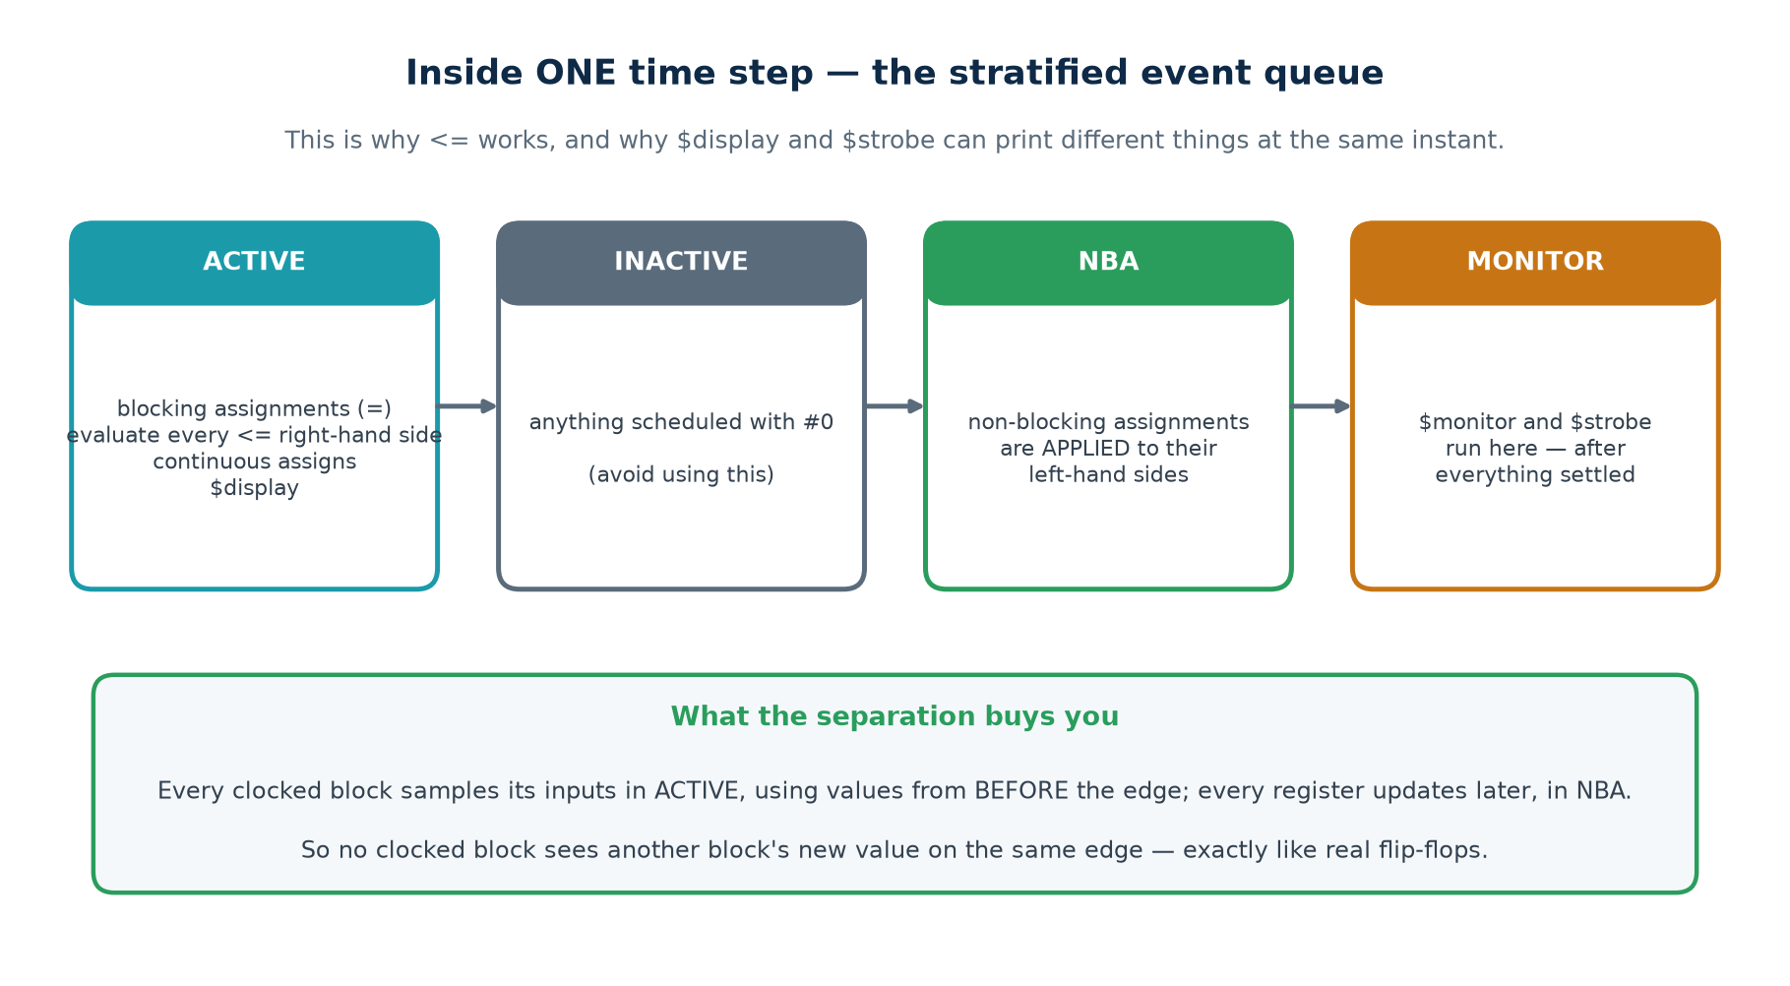
TOPIC 5C · ONE TIME STEP
The Stratified Event Queue
Several events can be scheduled at the SAME simulation time. The standard defines regions that are processed in order, and that ordering is what makes non-blocking assignment model a flip-flop correctly.
The practical consequence you will meet first
$display runs in the ACTIVE region, so at a clock edge it prints the value from BEFORE the edge. $strobe runs in the MONITOR region, after every non-blocking update has landed, so it prints the settled value. If a printout disagrees with the waveform by exactly one cycle, this is why.
Chip Design Associate · Module 2 · Verilog RTL Coding for Synthesis · Topic 5: RTL Simulation and Verification
M2-T5 · 49

Slide 50
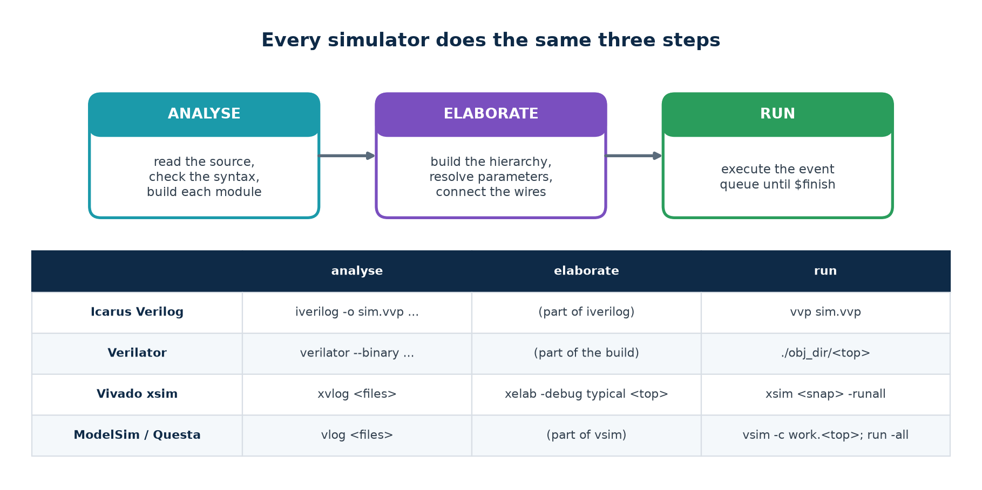
TOPIC 5C · THE FLOW
Analyse, Elaborate, Run
Every simulator you will ever use does the same three things. Only the command names change — which is why moving between Icarus, xsim and ModelSim is a morning's work rather than a new skill.
Where each kind of error appears
ANALYSE reports syntax errors and undeclared names — file and line. ELABORATE reports missing modules, port mismatches and parameter problems. RUN is where your logic is finally wrong. Knowing which step failed tells you which kind of mistake you made.
Chip Design Associate · Module 2 · Verilog RTL Coding for Synthesis · Topic 5: RTL Simulation and Verification
M2-T5 · 50

Slide 51
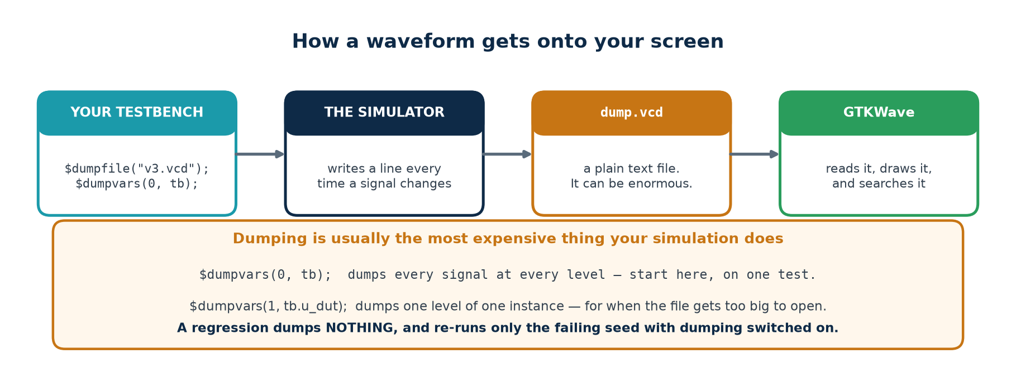
TOPIC 5C · WAVEFORMS
How a Waveform Gets Onto Your Screen
The simulator does not draw waveforms. Your testbench asks it to write a change-log file, and a separate program draws that. Knowing this explains why dumping is optional, why it is slow, and why the file can be enormous.
Format
Written by
Note
VCD
any simulator; $dumpvars
plain text, universal, large
FST
Icarus (-fst), GTKWave
compressed VCD; much smaller and faster
WLF
ModelSim / Questa
native, fast, read by their own viewer
FSDB
commercial (Verdi)
the industry standard on large projects
Chip Design Associate · Module 2 · Verilog RTL Coding for Synthesis · Topic 5: RTL Simulation and Verification
M2-T5 · 51

Slide 52
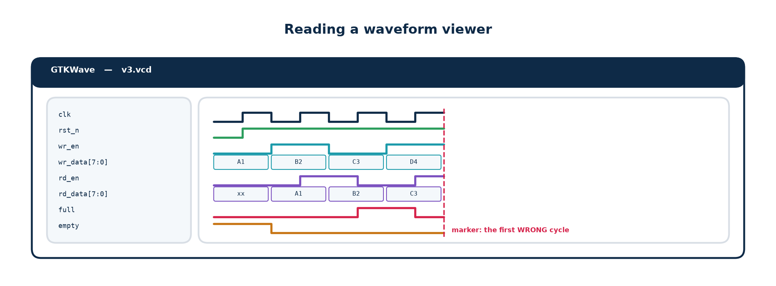
TOPIC 5C · WAVEFORMS
Reading a Waveform Viewer Properly
Most students open a viewer, drag in every signal, and stare. Four habits turn it from a wall of lines into an instrument.
Group and order
Set the radix
Use the marker
Save the view
Stimulus at the top, DUT outputs next, internals last. A jumbled list hides the answer in plain sight.
A counter in binary is unreadable; in hex the pattern is obvious. Right-click the signal to change it.
Put it on the FIRST wrong cycle named in the transcript, then walk backwards, signal by signal.
File → Write Save File writes a .gtkw. Commit it, open with gtkwave v3.vcd wave/v3_fifo.gtkw and everyone sees the SAME picture.
Chip Design Associate · Module 2 · Verilog RTL Coding for Synthesis · Topic 5: RTL Simulation and Verification
M2-T5 · 52

Slide 53
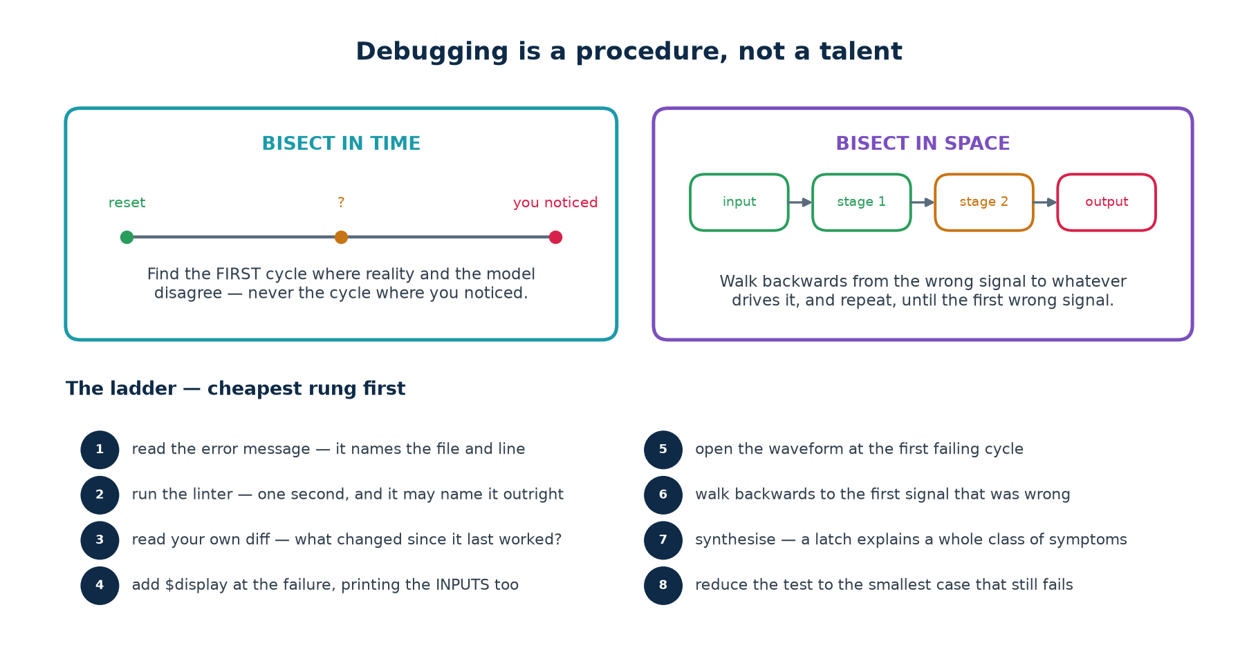
TOPIC 5C · DEBUGGING
A Procedure, Not a Talent
Fast debuggers are not more clever — they are more systematic. Two searches, and a ladder of checks run in cost order.
The single most important habit
Find the FIRST moment things went wrong, never the moment you noticed. A wrong output is usually many cycles downstream of the cause, and every cycle you spend looking at the output is a cycle not spent looking at the cause.
Chip Design Associate · Module 2 · Verilog RTL Coding for Synthesis · Topic 5: RTL Simulation and Verification
M2-T5 · 53

Slide 54
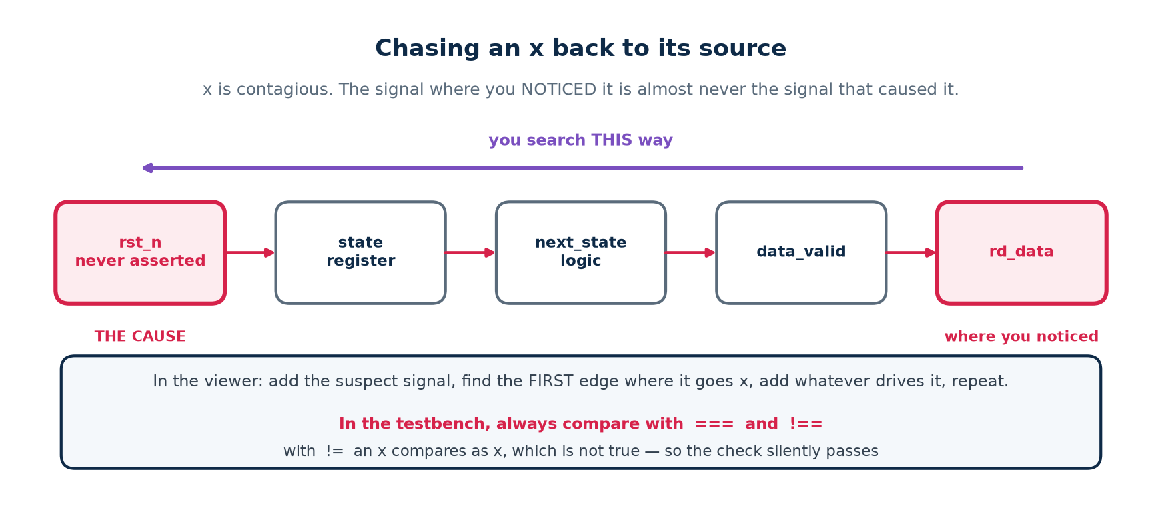
TOPIC 5C · DEBUGGING
Chasing an x
An x is the simulator saying "I cannot determine this". It spreads through every expression it touches, so by the time you see it on an output it may have travelled through ten signals.
The five usual causes
And one prevention
1. A register that was never reset. 2. A wire nothing drives — often a typo in a port connection. 3. A wire TWO things drive.
4. Reading past the end of a vector or an array. 5. Arithmetic on a value that was already x.
`default_nettype none at the top of every file turns a misspelt port connection from a silent undriven wire into a compile error naming the line. It costs one line and removes an entire category of x.
Chip Design Associate · Module 2 · Verilog RTL Coding for Synthesis · Topic 5: RTL Simulation and Verification
M2-T5 · 54

Slide 55
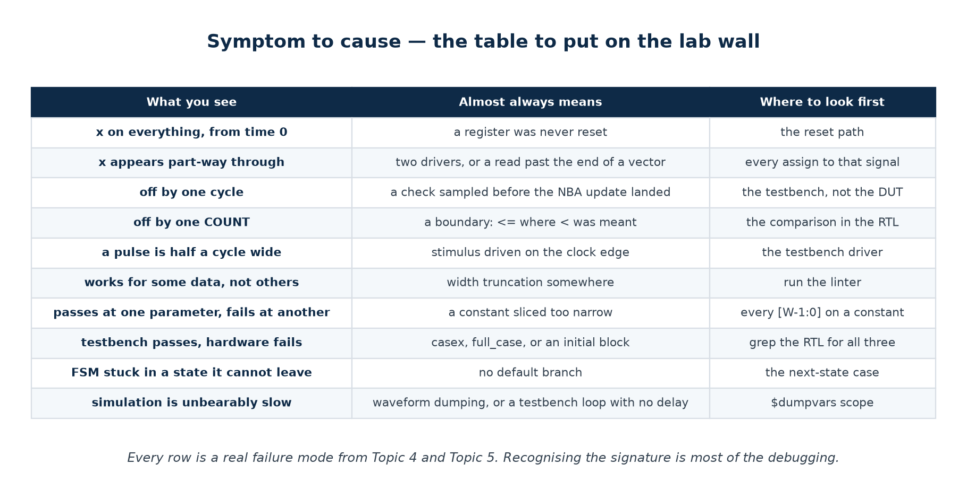
TOPIC 5C · TROUBLESHOOTING
Symptom to Cause
Most failures have a signature. Recognising it is most of the debugging — and this table is worth printing and putting on the wall of the lab.
Chip Design Associate · Module 2 · Verilog RTL Coding for Synthesis · Topic 5: RTL Simulation and Verification
M2-T5 · 55

Slide 56
TOPIC 5C · SPEED
Making Simulation Fast Enough to Live With
A regression that takes all night gets run once a week; a regression that takes five minutes gets run on every commit. Simulation speed is therefore a verification-quality issue, not a convenience.
What costs time
Why
What to do about it
Waveform dumping
every signal change becomes a line of text
dump nothing in a regression; re-run the failing seed with dumping on
Dumping the whole hierarchy
$dumpvars(0, tb) includes every instance
$dumpvars(1, tb.u_dut) once you know where to look
A clock that never stops
every edge wakes every clocked block
stop the clock when the test is idle, if the design allows it
Very fine timescale
1ps precision means more scheduling work
1ns/1ps is plenty for RTL; you are not doing SPICE
$display in a hot loop
formatting and I/O are slow
print on events, not on cycles
Long random runs at one seed
one long run is not better than many short ones
many shorter runs, different seeds — and they parallelise
Verilator compiles the design to C++ and is often 10–100× faster than an interpreted simulator — which is why it is used for long random regressions even on projects whose sign-off simulator is a vendor tool.
Chip Design Associate · Module 2 · Verilog RTL Coding for Synthesis · Topic 5: RTL Simulation and Verification
M2-T5 · 56

Slide 57
TOPIC 5 · TOOLS
Software Tools — Installation and Flow
The syllabus specifies Vivado Design Suite and ModelSim. The open-source chain does the same jobs and installs in a minute.
What each tool does, and which one to reach for
Installing the open-source verification flow
Driving Vivado xsim and ModelSim / Questa
Regression scripting, and what a CI loop looks like
Chip Design Associate · Module 2 · Verilog RTL Coding for Synthesis · Topic 5: RTL Simulation and Verification
M2-T5 · 57

Slide 58
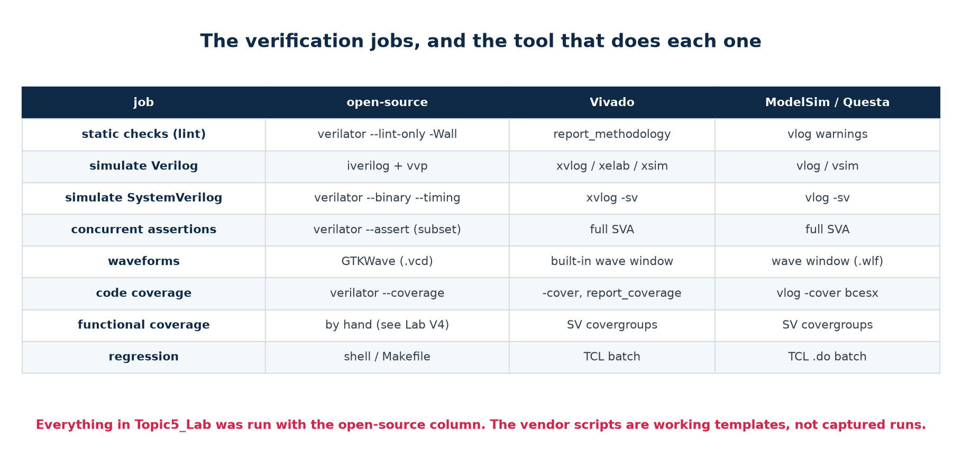
TOPIC 5 · TOOLS
The Verification Jobs, and the Tool for Each
Four jobs — lint, simulate, view, measure. Every flow does all four; only the command names change.
Honesty note for the trainer
Every result quoted in this deck was produced by the open-source column — Icarus Verilog 12.0 and Verilator 5.020 — on the code in Topic5_Lab. The Vivado and ModelSim scripts in the lab are working templates written from standard, version-stable commands, but they were NOT executed, because neither tool is installed in the authoring environment. Check them against your release before the session.
Chip Design Associate · Module 2 · Verilog RTL Coding for Synthesis · Topic 5: RTL Simulation and Verification
M2-T5 · 58

Slide 59
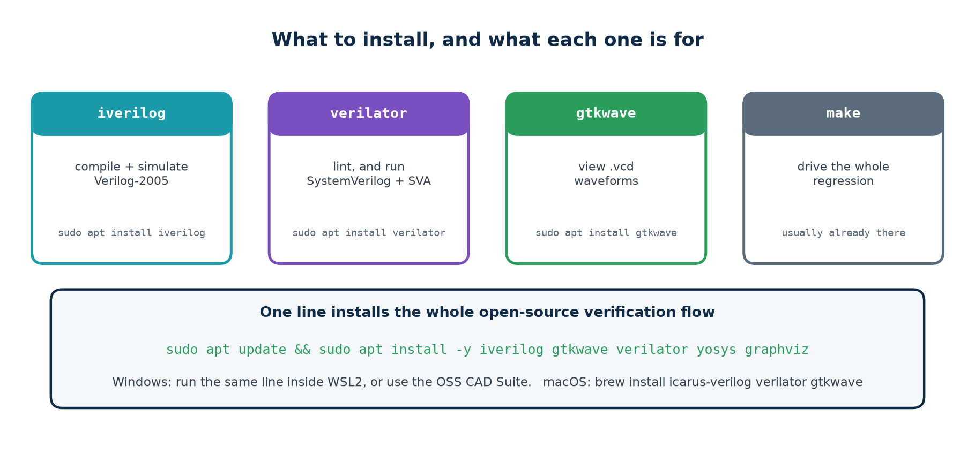
TOPIC 5 · INSTALL
The Open-Source Verification Flow
Copy-paste installation
# ---- Ubuntu / Debian / WSL2 -------------------------------------------
sudo apt update && sudo apt install -y iverilog gtkwave verilator yosys graphviz
# ---- verify ------------------------------------------------------------
iverilog -V | head -1 # Icarus Verilog version 12.0
verilator --version # Verilator 5.020
gtkwave --version
macOS: brew install icarus-verilog verilator gtkwave Windows: run the Ubuntu line inside WSL2 (wsl --install in an admin PowerShell), or unzip the OSS CAD Suite.
Chip Design Associate · Module 2 · Verilog RTL Coding for Synthesis · Topic 5: RTL Simulation and Verification
M2-T5 · 59

Slide 60
TOPIC 5 · VENDOR TOOLS
Vivado xsim and ModelSim / Questa
Vivado simulator (xsim)
ModelSim / Questa
xvlog -d DUT=fifo_b1 rtl/*.v tb/tb_v3_random.v
xelab -debug typical tb_v3_random -s sim
xsim sim -runall -testplusarg SEED=1
· -d NAME=value passes a `define, exactly like -D to iverilog.
· -testplusarg passes a plusarg, so the SAME seed gives the same run as under Icarus.
· Supports the FULL SystemVerilog assertion language, including the ranged delay forms the open-source flow cannot handle.
vlib work
vlog -sv +define+DUT=fifo_b1 rtl/*.v sva/*.sv tb/*.sv
vsim -voptargs=+acc -assertdebug +SEED=7 work.tb_v6_assert
assertion fail -action break -r /*
run -all
· +acc keeps signal visibility — without it the optimiser removes the very signals you want to see.
· -assertdebug reports every assertion pass and failure, and can break on the first failure.
Both flows are scripted in the lab
scripts/vivado_sim.tcl takes a lab and a DUT as arguments; scripts/modelsim_run.do takes them as -g parameters. Both cover all six labs and all six designs, so the clinic can be reproduced on the vendor tools exactly as it is on the open-source ones.
Chip Design Associate · Module 2 · Verilog RTL Coding for Synthesis · Topic 5: RTL Simulation and Verification
M2-T5 · 60

Slide 61
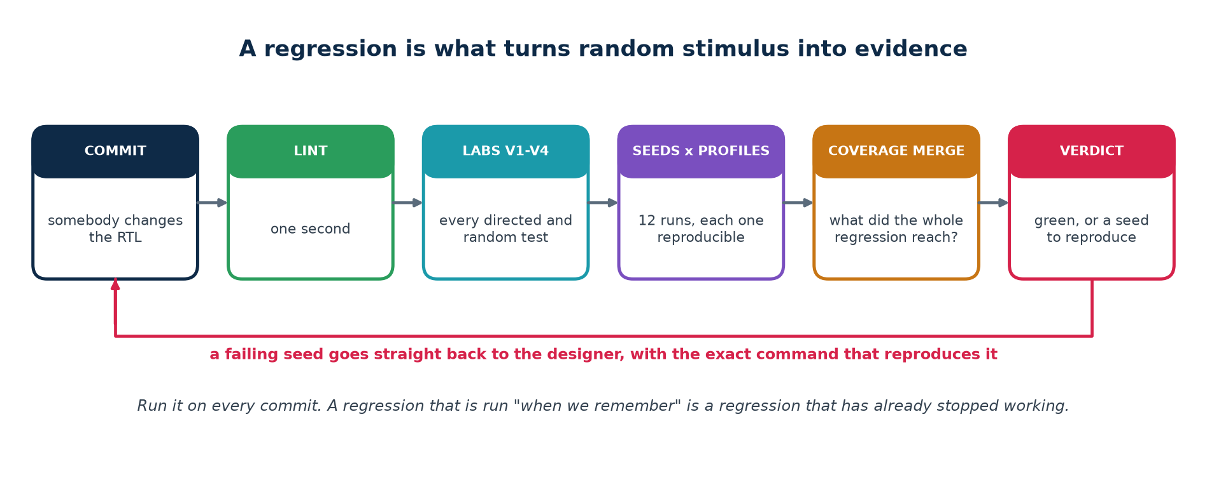
TOPIC 5 · REGRESSION
What Turns Random Stimulus Into Evidence
A single random run is one sample. A regression — many seeds, several profiles, run automatically after every change — is what makes it evidence.
$ ./scripts/regress.sh 4
regression on fifo : 4 seeds x 3 profiles
...
12 passed, 0 failed
REGRESSION CLEAN
When a run fails, the script prints the exact command that reproduces it. That one line is the difference between a bug report somebody can act on and one they cannot.
Chip Design Associate · Module 2 · Verilog RTL Coding for Synthesis · Topic 5: RTL Simulation and Verification
M2-T5 · 61

Slide 62
TOPIC 5 · PRACTICAL
The Lab Programme
Six labs, thirty-four hours, inside the syllabus practical component: simulating and verifying the functionality of RTL designs.
V1 naive · V2 model + corners · V3 random · V4 coverage · V5 clinic · V6 layered + assertions
One DUT, five planted bugs, and a measured catch rate for every stage
Scripts for the open-source chain, Vivado and ModelSim
Assessment rubric and the troubleshooting table
Chip Design Associate · Module 2 · Verilog RTL Coding for Synthesis · Topic 5: RTL Simulation and Verification
M2-T5 · 62

Slide 63
TOPIC 5 · LABS
The Six Labs
Every lab builds on the one before, against the same device under test. Nothing is thrown away; the testbench grows.
Lab
h
What you build
What it teaches
V1 naive
3
a directed testbench with all six parts
structure, a verdict, and why passing is not proving
V2 model
6
a reference model and the boundary cases
expected values come from the spec, not from you
V3 random
6
weighted constrained-random, seeded
reproducibility, and the corner nobody writes
V4 coverage
6
a coverage model, sampled and merged
what did I actually test, and when do I stop
V5 clinic
5
diagnosis of five unknown bugs
bisection, x-chasing, reading a waveform properly
V6 capstone
8
a layered environment with assertions
separation of concerns; assertions vs scoreboards
Thirty-four hours, from the syllabus practical bullet "simulating and verifying the functionality of RTL designs".
What every lab produces
Running short of time?
· A lint run that is clean.
· A simulation transcript ending in a machine-readable PASS or FAIL.
· From V4 on, a coverage report with a closure verdict.
· One sentence from the student on what their testbench would NOT catch.
Do not cut V5, the clinic. It is the only exercise where students meet a bug they did not plant, with no hint about what it is — which is the actual job. Shorten V1 instead: the naive testbench can be read rather than typed, provided the room still watches it pass on all five broken designs.
Worth ten minutes of the session
Have every student plant ONE bug in a copy of the golden FIFO and hand it to a neighbour, whose testbench must catch it and name it.
Chip Design Associate · Module 2 · Verilog RTL Coding for Synthesis · Topic 5: RTL Simulation and Verification
M2-T5 · 63

Slide 64
TOPIC 5 · LABS
How to Run the Session
OPEN WITH THE CLINIC
Do not begin with theory. Run ./scripts/clinic.sh live, in front of the room, before explaining anything. The table — 0 of 5, 4 of 5, 5 of 5 — does the persuading, and everything afterwards is the explanation of why.
READ THE SPEC FIRST
Have the class read the header comment of rtl/fifo.v and list, on the board, every rule it states. That list IS the verification plan. Only then look at a testbench.
BUILD, DO NOT COPY
V1 and V2 are typed from scratch, not copied. The supplied versions are for comparing against afterwards. The point is the decisions, and you only meet them by making them.
BREAK IT ON PURPOSE
Every student plants one bug in a copy of the golden FIFO and hands it to a neighbour, whose testbench must catch it. This single exercise teaches more about verification than any lecture, and the room enjoys it.
CLOSE WITH COVERAGE
Finish on ./scripts/coverage.sh. Passing tests feel like the end; the coverage report showing three MISSes is what teaches that they are not.
Chip Design Associate · Module 2 · Verilog RTL Coding for Synthesis · Topic 5: RTL Simulation and Verification
M2-T5 · 64

Slide 65
TOPIC 5 · TROUBLESHOOTING
What Your Students Will Hit
Testbench problems, not design problems. Nine out of ten support questions in this topic are one of these.
Symptom
Almost always means
Fix
Everything is x from time 0
reset never asserted, or the DUT port is misspelt
check reset polarity; `default_nettype none
The check passes when the value is x
== used instead of ===
use === and !== in every testbench check
The design looks one cycle late
sampled before the NBA update landed
sample after the NEXT edge, or use $strobe
A pulse is half a cycle wide
stimulus driven ON the clock edge
drive at #1 after the edge, never on it
Random test passes but drove 9 transactions
$urandom(seed) called in the loop
seed once with void'($urandom(s)), then $urandom()
The correct design fails
the reference model is wrong
sample full/empty once, before applying either operation
Simulation never ends
no $finish, or a wait loop with no delay
add $finish and a watchdog timeout
The waveform has no signals
$dumpvars scope too narrow, or a stale VCD
$dumpvars(0, tb); and re-run before re-opening
Coverage is 100% but bugs escape
the coverage model is too coarse
add bins for SEQUENCES, not just states
Chip Design Associate · Module 2 · Verilog RTL Coding for Synthesis · Topic 5: RTL Simulation and Verification
M2-T5 · 65

Slide 66
TOPIC 5 · ASSESSMENT
What 'Done' Looks Like
Assess the testbench, not the design. Give every student the same correct FIFO and the same five broken ones, and grade them on what their own testbench catches.
Level
Evidence
Pass
The testbench is self-checking, prints PASS or FAIL, terminates, and catches at least three of the five planted bugs.
Good
All of the above, plus: it catches all five, and the student can say which check caught each one and why.
Strong
All of the above, plus: a coverage model with a closure verdict, and a regression over several seeds and profiles.
Excellent
All of the above, plus: assertions bound to the DUT, and the student can explain a bug that assertions cannot catch and why the scoreboard is needed too.
One question to ask every student
"Show me a change to the design that your testbench would NOT catch." If they can answer immediately, they understand verification. If they cannot, they have been testing rather than verifying.
Chip Design Associate · Module 2 · Verilog RTL Coding for Synthesis · Topic 5: RTL Simulation and Verification
M2-T5 · 66

Slide 67
TOPIC 5 · GLOSSARY
Terms Used in This Topic
Term
Meaning
Verification
establishing that a design does what its specification says.
Validation
establishing that the specification was the right one. A different question, usually answered by somebody else.
DUT
device under test — the design the testbench instantiates.
Testbench
a port-less module that instantiates the DUT, drives it, and decides automatically whether the results were correct.
Self-checking
the testbench forms its own verdict; no human reads a waveform to decide.
Reference model
an independent implementation of the specification, written from the spec, used to compute expected results.
Scoreboard
the component that compares DUT behaviour against the model.
Directed test
a test whose case and expected result you wrote by hand.
Constrained-random
stimulus generated by weighted random choice within constraints you specify.
Seed
the number that makes a random run reproducible.
Regression
the full set of tests, run automatically after every change.
Code coverage
which lines, branches, conditions and toggles the tests reached.
Functional coverage
which SPECIFICATION-level situations the tests reached. Written by you.
Coverage hole
a bin nothing ever hit — a gap in testing, not a failure.
Assertion
a rule stated in the design's own language and checked on every clock edge.
Cover property
the same syntax used to RECORD that a situation occurred, rather than to require it.
VCD / FST / WLF
waveform file formats — plain, compressed, and vendor-native.
Chip Design Associate · Module 2 · Verilog RTL Coding for Synthesis · Topic 5: RTL Simulation and Verification
M2-T5 · 67

Slide 68
TOPIC 5 · RECAP
The Ten Things That Matter
▪
A testbench is finished when it would FAIL if the design were wrong — not when it passes.
▪
Every testbench has six parts, and the one people omit is the verdict and the watchdog.
▪
Drive stimulus just AFTER the clock edge; sample just before the next one. Never on the edge.
▪
Expected values come from an independent model of the SPECIFICATION, never from the RTL.
▪
A model must sample the state ONCE, before applying any operation — exactly as the hardware does.
▪
Constrained-random finds the corner nobody writes a directed test for. Seed it, and print the seed.
▪
Coverage is what turns "it passed" into "here is what was tested". Merge it across the regression.
▪
Assertions catch a broken rule at the cycle it breaks; scoreboards catch what no assertion describes.
▪
Debug by procedure: first wrong cycle, then walk backwards. Never start at the output.
▪
Lint, then simulate, then measure. Run the regression on every commit, or it will stop working.
Where this leads
Topic 6 takes these verified designs into timing — constraints, setup and hold analysis, and closure. The verification skills here do not stop being needed: every timing fix is a design change, and every design change has to be re-verified. That is what the regression is for.
Chip Design Associate · Module 2 · Verilog RTL Coding for Synthesis · Topic 5: RTL Simulation and Verification
M2-T5 · 68

Slide 69
TOPIC 5 · COMPLETE
RTL Simulation and Verification
Deck · workbook · one DUT · five planted bugs · six testbenches · three toolchains.
Slides: this deck, for delivery
Workbook: Module2_Topic5_Tutorial_Practice_Workbook.docx — tutorials, exercises and full solutions
Lab: Topic5_Lab/ — rtl/, tb/, sva/, scripts/, all verified end to end
Next: Module 2 Topic 6 — timing constraints and analysis
Chip Design Associate · Module 2 · Verilog RTL Coding for Synthesis · Topic 5: RTL Simulation and Verification
M2-T5 · 69

