Slide 1

CHIP DESIGN ASSOCIATE · O-LEVEL CHIP DESIGN
Module 1
VLSI Design Fundamentals
A complete 60-hour foundation — from silicon and the MOS transistor to CMOS logic, layout, interconnect and timing.
Comprehensive Training Deck · 127 slides · worked examples throughout
NIELIT · Centre of Excellence in Chip Design
Module 1 · VLSI Design Fundamentals
1

Slide 2

MODULE OVERVIEW
About this Module & Learning Outcomes
Module 1 builds the conceptual bedrock for the entire chip-design course. Everything in later modules — RTL, timing closure, FPGA — rests on the transistor-level understanding you gain here.
By the end you will be able to:
At a glance
Explain the VLSI design cycle and abstraction levels
Describe how NMOS / PMOS transistors switch and conduct
Analyse the CMOS inverter, its VTC, noise margins, delay & power
Design any static gate (NAND, NOR, AOI) from a Boolean function
Read schematics, stick diagrams and basic layout with design rules
Model on-chip wires as RC and estimate interconnect delay
Compute propagation delay and reason about setup/hold timing
Duration
60 hours (theory + lab)
Prerequisite
Basic digital electronics
Tools introduced
NGSpice, Magic VLSI
Assessment
Concept + design problems
Leads into
M2 Verilog · M3 STA · M4 FPGA
Module 1 · VLSI Design Fundamentals
2

Slide 3

SYLLABUS MAP
Four Topics, One Foundation
The official Module 1 syllabus has four topic areas. This deck expands each into theory + multiple worked examples.
1
VLSI Design Cycle & CMOS Transistor Theory
~16 hrs
Topics 1–2: VLSI flow & significance, MOS physics, I–V, switch model
2
CMOS Inverter Characteristics & Logic Design
~14 hrs
Topics 3–4: VTC, noise margins, delay, power, NAND/NOR/AOI, adders
3
Layout, Interconnect & Packaging
~14 hrs
Topics 5–7: schematics, layout, design rules, wire modelling, bonding & packaging
4
Delay, Timing & Optimization
~16 hrs
Topics 8–10: gate delays & logical effort, critical-path optimization, sequential timing
Module 1 · VLSI Design Fundamentals
3

Slide 4


SECTION 1
VLSI Design Cycle & CMOS Transistor Theory
How chips are designed, and the physics of the MOS switch that makes it all possible.
Topic 1.1 · approx. 18 hours
VLSI technology, significance & applications
Front-end & back-end design flow in detail
Design styles: full-custom, standard-cell, FPGA
CMOS theory: MOSFET operation, modeling & characteristics
Square-law model, capacitances, second-order effects
Scaling trends: Moore/Dennard, nodes, FinFET & GAA
Module 1 · VLSI Design Fundamentals
4

Slide 5

TOPIC 1.1 · INTRODUCTION
What is VLSI?
VLSI (Very Large Scale Integration) is the process of creating an integrated circuit by combining millions–billions of transistors onto one silicon chip — enough to build a whole digital system (a System-on-Chip).
SSI
1960s
~1–10 gates
MSI
1970s
~10–100 gates
LSI
late 70s
~hundreds–thousands
VLSI
1980s+
tens of thousands+
Example — Moore's Law in numbers
Intel 4004 (1971): ~2,300 transistors.
Apple M-series / modern SoC: tens of billions.
That is roughly a doubling every ~2 years for 50 years.
ULSI / SoC
today
millions–billions
Module 1 · VLSI Design Fundamentals
5

Slide 6
TOPIC 1.1 · INTRODUCTION
Evolution of IC Integration
Integrated circuits have grown through five named eras, each defined by how many devices fit on one chip. VLSI is the era that made the modern computer possible.
SSI
Small-Scale Integration
~1–10 gates
Single logic gates, flip-flops
early 1960s
MSI
Medium-Scale Integration
~10–100 gates
Adders, counters, multiplexers
late 1960s
LSI
Large-Scale Integration
~1k–10k devices
First microprocessors, memories
1970s
VLSI
Very-Large-Scale Integration
tens of thousands+
Full CPUs on one chip
1980s onward
ULSI / SoC
Ultra-Large-Scale / System-on-Chip
millions–billions
Entire systems on one die
today
The pace — a doubling of transistor count roughly every two years — is Moore's Law, and it has held for ~50 years.
Module 1 · VLSI Design Fundamentals
6

Slide 7



TOPIC 1.1 · SIGNIFICANCE
Where VLSI Powers the World
Almost every electronic product you touch is enabled by VLSI chips. Integration is what makes them small, fast, cheap and power-efficient enough to be everywhere.
Computing
Mobile & Wireless
AI & Accelerators
CPUs, GPUs, memory — laptops to data-centre servers
Smartphone SoCs, 5G modems, Wi-Fi & Bluetooth radios
Neural-network chips, TPUs, edge-AI inference engines
Automotive
IoT & Wearables
Healthcare & Comms
Engine/EV control, ADAS, sensors, infotainment
Ultra-low-power microcontrollers & sensor hubs
Medical imaging, implants, networking & satellites
Module 1 · VLSI Design Fundamentals
7

Slide 8
TOPIC 1.1 · SIGNIFICANCE
Why VLSI Matters
Integration is not just convenient — it fundamentally improves every design metric, and it underpins a strategically vital global industry.
Technical advantages of integration
Economic & strategic importance
Smaller size: Billions of devices on a fingernail-sized die
Semiconductors are a trillion-dollar global industry underpinning all modern electronics.
Chip design (front-end) and fabrication (foundry) are increasingly separate businesses — the fabless model.
Nations treat chip capability as strategic infrastructure; India's Semiconductor Mission aims to build design & fab talent.
This course trains the design side — exactly the skills in highest demand.
Higher speed: Short on-chip wires → faster signalling
Lower power: Tiny capacitances switch with little energy
Lower cost: Batch fabrication → very low cost per chip at volume
Better reliability: Fewer external connections → fewer failure points
Module 1 · VLSI Design Fundamentals
8

Slide 9
TOPIC 1.1 · MOTIVATION
Why VLSI? Design Metrics (PPA)
Integrating more on one chip improves almost everything that matters. Chip designers constantly trade off three metrics — Power, Performance, Area (PPA) — plus cost and reliability.
Performance
Power
Area
Speed / clock frequency, throughput, latency
Dynamic + leakage power; battery life & heat
Silicon area → cost per chip; smaller = cheaper
Cost
Reliability
Trade-off example
Widening a transistor speeds up a gate (lower R)
but costs area & power (higher C). PPA is always a balance.
Design (NRE) + per-unit manufacturing cost
Noise immunity, yield, lifetime
Module 1 · VLSI Design Fundamentals
9

Slide 10
TOPIC 1.1 · DESIGN FLOW
The VLSI Design Flow — Big Picture
A chip is built through well-defined stages, each refining the design and adding detail from idea to fabricated silicon. The flow splits into a logic-focused FRONT-END and a geometry-focused BACK-END.
1
2
3
4
5
6
7
Specification
RTL Design
Verification
Synthesis
Physical Design
Sign-off
GDSII → Fab
Function, PPA targets
Verilog / VHDL
Simulate & check
RTL → gate netlist
Floorplan, P&R
Timing, DRC, LVS
Masks → foundry
FRONT-END (logic design)
BACK-END (physical)
The hand-off between them is the gate-level netlist produced by synthesis.
Each stage is verified before the next — a bug caught late costs far more to fix.
Where the course tools fit
Yosys → synthesis; OpenSTA → timing;
NGSpice → simulation; Magic → layout/DRC; GTKWave → waveforms.
Module 1 · VLSI Design Fundamentals
10

Slide 11
TOPIC 1.1 · DESIGN FLOW
Front-End Design Flow (Logic)
The front-end turns an idea into a verified, technology-mapped gate-level netlist. It is all about defining and proving correct behaviour — no physical geometry yet.
1
Specification
Capture function, interfaces and PPA targets in a spec / micro-architecture.
2
Architectural design
Partition into blocks (datapath, control, memory); define the high-level plan.
3
RTL coding
Describe behaviour in Verilog/VHDL at the register-transfer level.
4
Functional verification
Simulate against a testbench; check coverage. (GTKWave views waveforms.)
5
Logic synthesis
Map RTL to a gate-level netlist in a target cell library. (Yosys.)
6
DFT & formal checks
Insert scan/test logic; run equivalence checking and early timing.
Output of the front-end → a verified gate-level netlist, handed to the back-end.
Module 1 · VLSI Design Fundamentals
11

Slide 12

TOPIC 1.1 · DESIGN FLOW
Back-End Design Flow (Physical)
The back-end turns the netlist into manufacturable geometry (GDSII). It is all about placing cells, wiring them, and proving the layout meets timing and fabrication rules.
1
Floorplanning
Fix the die size, block locations, power grid and I/O placement.
2
Placement
Position every standard cell on the floorplan, minimising wire length.
3
Clock-tree synthesis
Build a balanced clock network so all flip-flops switch together.
4
Routing
Connect all cells with metal layers, honouring spacing rules.
5
Extraction & STA
Extract real R/C parasitics; sign off timing on every path. (OpenSTA.)
6
Physical verification
Run DRC and LVS; export GDSII for the foundry. (Magic.)
Output of the back-end → GDSII layout, the file a foundry uses to make photomasks.
Module 1 · VLSI Design Fundamentals
12

Slide 13
TOPIC 1.1 · DESIGN FLOW
Front-End vs Back-End
Both halves are essential and tightly linked through the netlist hand-off. Knowing which concerns live where helps you debug and optimise effectively.
Aspect | Front-End | Back-End
Concern | What the chip does (logic) | Where everything physically goes
Main inputs | Specification | Gate-level netlist + constraints
Key activities | RTL, verification, synthesis | Floorplan, place, CTS, route
Verified by | Functional sim, equivalence | STA, DRC, LVS
Primary output | Gate-level netlist | GDSII layout
Course tools | Yosys, GTKWave, NGSpice | OpenSTA, Magic
The hand-off
Synthesis ends the front-end by emitting a gate-level netlist; the back-end consumes it. A timing problem found in back-end STA may send the design all the way back to RTL — which is why front-end quality matters so much.
Module 1 · VLSI Design Fundamentals
13

Slide 14
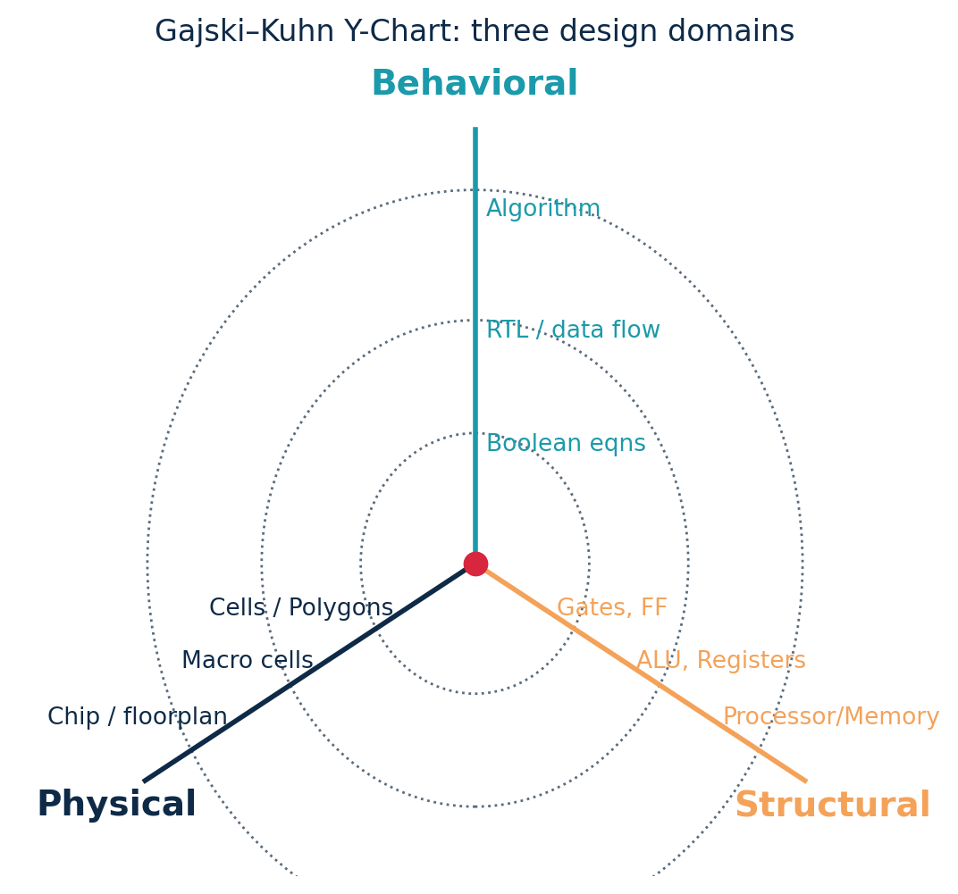
TOPIC 1.1 · ABSTRACTION
Levels of Abstraction & the Y-Chart
System / Architecture
Blocks: CPU, memory, bus
Register-Transfer (RTL)
Registers + logic in Verilog
Logic / Gate
AND, OR, NAND, flip-flops
more detail
Circuit / Transistor
NMOS & PMOS, the inverter
Physical / Layout
Masks & polygons → GDSII
Module 1 · VLSI Design Fundamentals
14

Slide 15
TOPIC 1.1 · IMPLEMENTATION
Design Styles & ASIC vs FPGA
The same logic can be realised in different ways, trading design effort, cost, performance and flexibility.
Full-custom
Standard-cell
Every transistor hand-drawn. Best PPA, slowest to design (e.g. CPU cores).
Pre-designed cell library auto placed & routed. The mainstream ASIC flow.
Gate array / SoG
FPGA
Pre-fabricated transistors, customise only wiring. Faster turnaround.
Re-programmable logic — no fabrication. Best for prototyping (Module 4).
ASIC vs FPGA at a glance
Rule of thumb
Aspect | ASIC | FPGA
Unit cost (high vol.) | Low | High
Upfront/NRE cost | Very high | Low
Time-to-market | Long | Short
Re-programmable | No | Yes
Prototyping or low volume → FPGA.
Millions of units, tight power → ASIC.
Module 1 · VLSI Design Fundamentals
15

Slide 16

MODULE 1 · TOPIC 2
CMOS Transistor Theory
A deep dive into the MOSFET — the switch behind every CMOS gate: how it works, how we model it, and how it has scaled for fifty years.
a
Fundamentals of MOSFET operation
Channel formation, threshold, NMOS & PMOS, on/off behaviour
b
MOSFET characteristics & modeling
I–V regions, the square-law model, capacitances, non-idealities
c
Scaling trends & technology advancements
Moore & Dennard scaling, nodes, FinFET and gate-all-around
Module 1 · VLSI Design Fundamentals
16

Slide 17

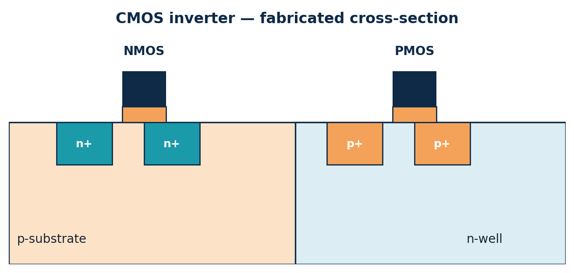
TOPIC 2A · FUNDAMENTALS
Semiconductor & MOS Basics
Silicon is a semiconductor — conductivity between metal and insulator.
Doping adds impurities: n-type (extra electrons) or p-type (extra holes).
A pn-junction is the basic building block; a MOSFET uses doped source/drain regions in a body.
MOS = Metal–Oxide–Semiconductor: a gate over a thin oxide controls a channel.
Threshold voltage Vth
The gate voltage at which a conducting channel just forms.
For NMOS: channel of electrons forms when V_{GS} > V_{th} (positive).
For PMOS: channel of holes forms when V_{GS} < V_{tp} (negative).
Typical |Vth| ≈ 0.3–0.7 V in modern processes.
A CMOS process places NMOS in the p-substrate and PMOS in an n-well, side by side.
Module 1 · VLSI Design Fundamentals
17

Slide 18
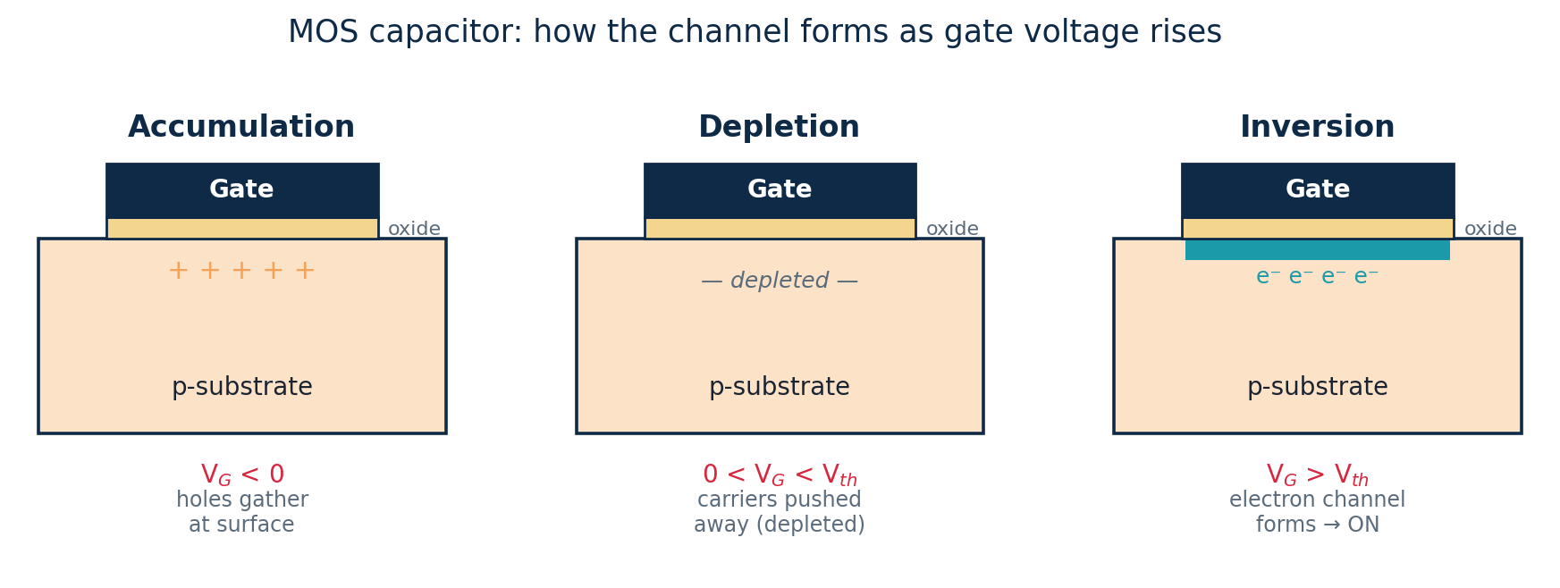
TOPIC 2A · FUNDAMENTALS
The MOS Capacitor & Channel Formation
Before current can flow, the gate must create a conducting channel. Watch what happens at the silicon surface as the gate voltage on an NMOS (p-substrate) rises.
Threshold voltage Vth
V_{th} is the gate voltage at which inversion begins.
Set by oxide thickness, doping, and the gate material.
Typical |V_{th}| ≈ 0.3–0.7 V.
Accumulation: V_{G} < 0: majority holes pile up at the surface — no channel.
Depletion: 0 < V_{G} < V_th: holes are pushed away, leaving a depleted region.
Inversion: V_{G} > V_th: electrons invert the surface → a conducting n-channel forms.
Module 1 · VLSI Design Fundamentals
18

Slide 19
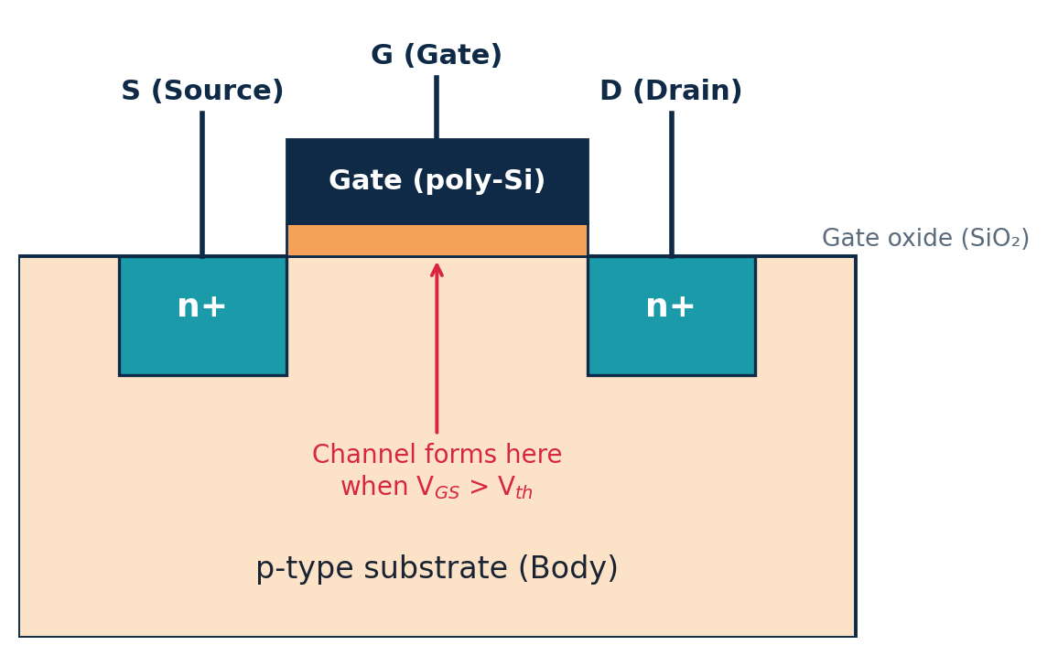
TOPIC 2A · FUNDAMENTALS
NMOS Structure & Operation
Four terminals: Gate, Source, Drain, Body.
Built in the p-substrate with n+ source/drain.
V_{GS} > V_{th} → electron channel forms → ON.
Passes a strong 0, a weak 1 → used to pull down.
Example — is the NMOS on?
Given V_{th} = 0.5 V.
(a) V_{G}=1.8 V, V_{S}=0 → V_{GS}=1.8 V > 0.5 → ON.
(b) V_{G}=0.3 V, V_{S}=0 → V_{GS}=0.3 V < 0.5 → OFF.
(c) As a pass device V_{S}=1.3 V, V_{G}=1.8 V → V_{GS}=0.5 V = V_{th} → barely on (weak 1).
NMOS — a switch closed by a HIGH gate
Module 1 · VLSI Design Fundamentals
19

Slide 20
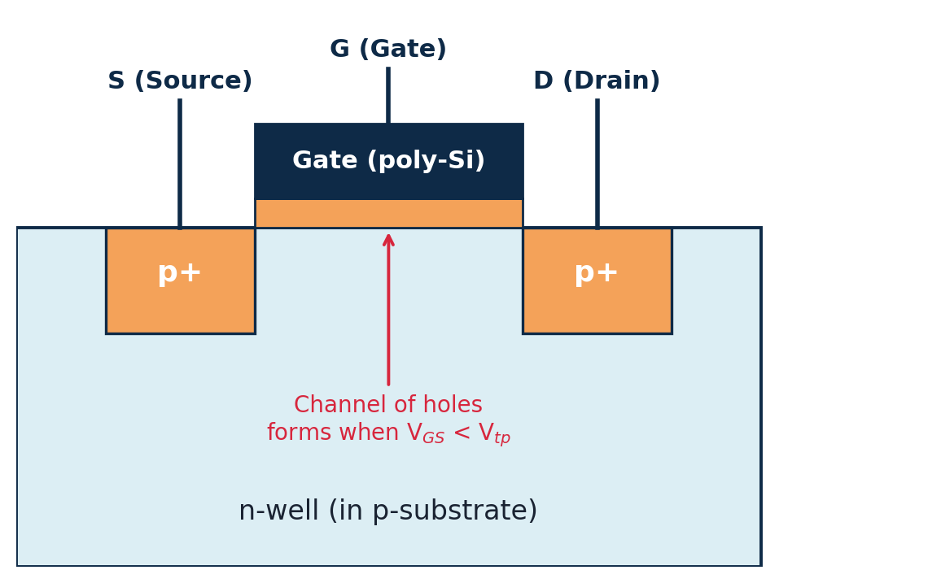
TOPIC 2A · FUNDAMENTALS
PMOS Structure & Operation
Built inside an n-well with p+ source/drain.
V_{GS} < V_{tp} (negative) → hole channel → ON.
Passes a strong 1, a weak 0 → used to pull up.
PMOS is the electrical complement of NMOS.
Example — is the PMOS on?
Given V_{tp} = −0.5 V, source tied to V_{DD} = 1.8 V.
(a) V_{G}=0 V → V_{GS}=0−1.8=−1.8 V < −0.5 → ON.
(b) V_{G}=1.8 V → V_{GS}=0 V > −0.5 → OFF.
So a LOW input turns the pull-up PMOS on — exactly what an inverter needs.
PMOS — a switch closed by a LOW gate
Module 1 · VLSI Design Fundamentals
20

Slide 21
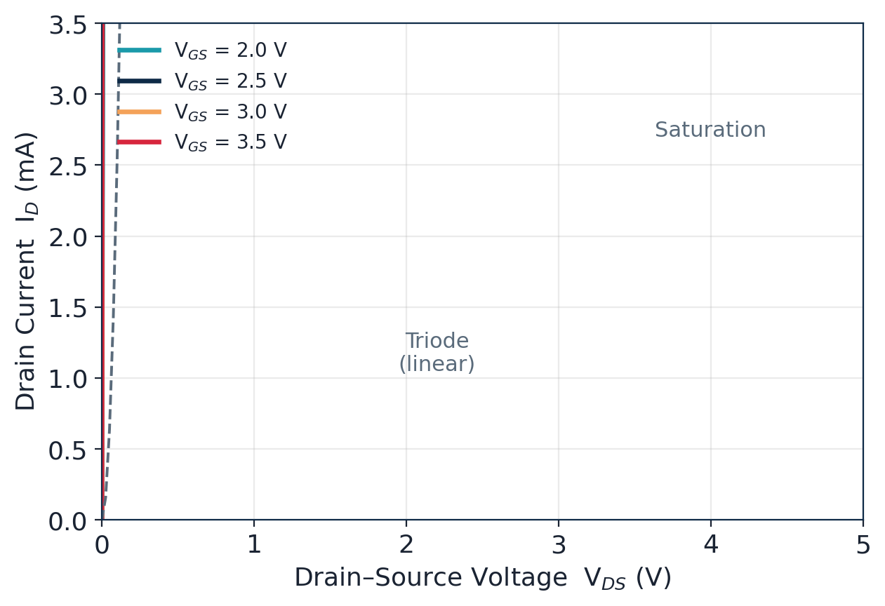
TOPIC 2B · CHARACTERISTICS & MODELING
MOSFET I–V & Operating Regions
Cutoff
V_GS < V_th
I_D ≈ 0. Switch OFF.
Triode / Linear
V_DS < V_GS − V_th
I_D = k[(V_GS−V_th)V_DS − V_DS²/2]. Resistor-like.
Saturation
V_DS ≥ V_GS − V_th
I_D = ½k(V_GS−V_th)². ~Constant current.
Quick check
V_{th}=0.4, V_{GS}=1.2, V_{DS}=0.3: overdrive=0.8; V_{DS}(0.3)<0.8 → triode.
Module 1 · VLSI Design Fundamentals
21

Slide 22
TOPIC 2B · CHARACTERISTICS & MODELING
The Square-Law (Shockley) Model
The first-order MOSFET model gives one equation per region. It is the workhorse for hand analysis and for understanding behaviour.
Cutoff (V_GS < V_th)
The parameters
I_D = 0
k = µ·C_{ox}·(W/L) — the transconductance parameter.
µ = carrier mobility (electrons > holes).
C_{ox} = oxide capacitance / area.
W/L = transistor aspect ratio — the designer's main knob.
λ = channel-length-modulation factor.
The switch is open — only tiny leakage flows.
Triode / Linear (V_DS < V_GS − V_th)
I_D = k·[(V_GS−V_th)·V_DS − V_DS²/2]
Channel acts like a voltage-controlled resistor.
Saturation (V_DS ≥ V_GS − V_th)
I_D = ½·k·(V_GS−V_th)²·(1+λV_DS)
Channel pinches off; current ≈ constant (λ adds slope).
Module 1 · VLSI Design Fundamentals
22

Slide 23
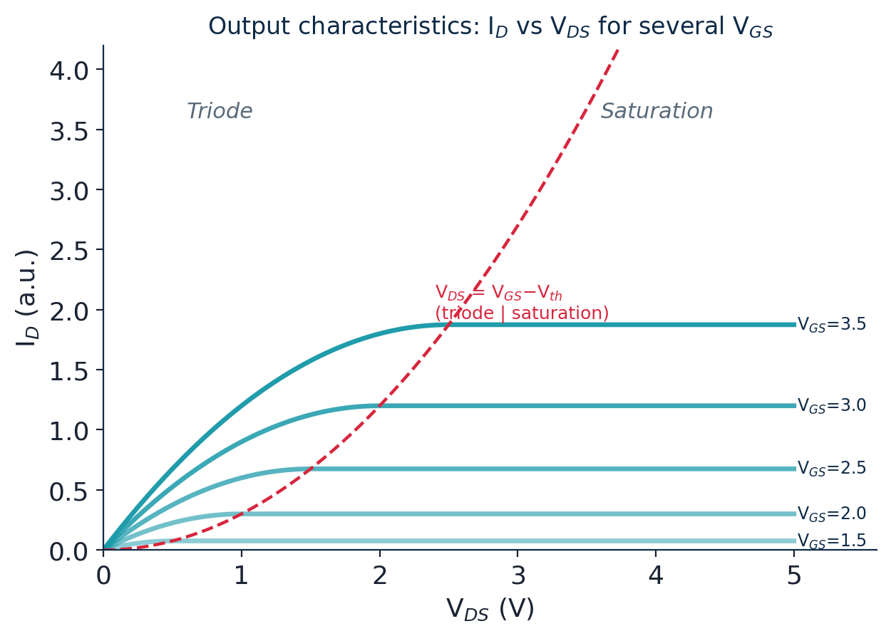
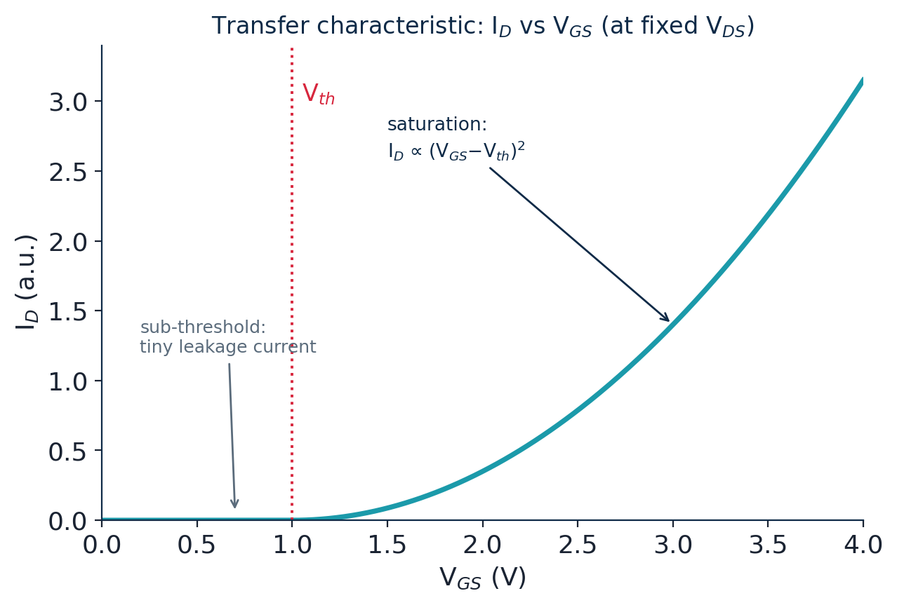
TOPIC 2B · CHARACTERISTICS & MODELING
Output & Transfer Characteristics
Two standard plots summarise a transistor's behaviour. Together they let you read off the operating region and the drive current at a glance.
Output: I_{D}–V_{DS} for stepped V_{GS} — shows triode→saturation.
Transfer: I_{D}–V_{GS} — shows V_{th} and the sub-threshold tail.
Module 1 · VLSI Design Fundamentals
23

Slide 24
TOPIC 2B · CHARACTERISTICS & MODELING
Worked Examples — Drain Current
For all three: k = 200 µA/V², Vth = 0.5 V. First find the region, then apply the right equation.
Example 1 — saturation
Example 2 — triode
V_{GS}=1.5, V_{DS}=2.0 V. Overdrive = 1.0 V; V_{DS} ≥ 1.0 → saturation.
I_{D} = ½·k·(V_{ov})² = ½·200µ·(1.0)² = 100 µA.
V_{GS}=1.5, V_{DS}=0.5 V. Overdrive = 1.0 V; V_{DS} < 1.0 → triode.
I_{D} = k·[(V_{ov})V_{DS}−V_{DS}²/2] = 200µ·[0.5−0.125] = 75 µA.
Example 3 — cutoff
Example 4 — sizing effect
V_{GS}=0.3 V < V_{th} (0.5). The device is off.
I_{D} ≈ 0 (only leakage).
Double W/L (so k → 400 µA/V²) in Example 1.
I_{D} = ½·400µ·(1.0)² = 200 µA — current scales with W/L.
Module 1 · VLSI Design Fundamentals
24

Slide 25
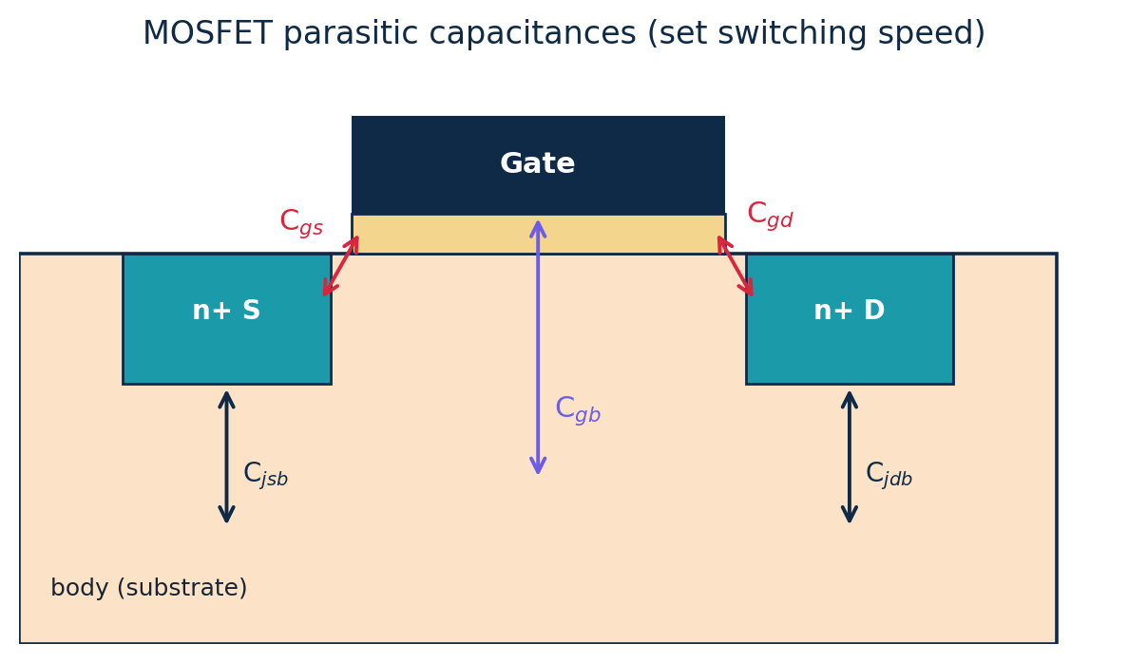
TOPIC 2B · CHARACTERISTICS & MODELING
MOSFET Capacitances & Speed
A transistor is not just a switch — it has parasitic capacitances that must be charged and discharged.
Gate caps: C_{gs}, C_{gd}, C_{gb} — between gate and the other terminals.
Junction caps: C_{jsb}, C_{jdb} — reverse-biased source/drain to body.
These set how fast a gate can switch and how much dynamic power it burns.
Why modeling capacitance matters
Delay ≈ 0.69·R·C and dynamic power ∝ C·V²·f.
Every fF of gate and wire capacitance directly slows the circuit and raises its energy — so accurate C models drive timing and power sign-off.
Module 1 · VLSI Design Fundamentals
25

Slide 26
TOPIC 2B · CHARACTERISTICS & MODELING
Second-Order (Non-ideal) Effects
The simple square-law model is a teaching tool. Real short-channel devices show extra effects you should recognise:
Channel-length modulation
Body effect
I_D rises slightly with V_DS in saturation (the λ term).
V_th increases when source-to-body voltage is non-zero.
Velocity saturation
Sub-threshold leakage
Carriers stop speeding up at high fields → current grows ~linearly, not squared.
A small current flows even below V_th — a key source of static power.
Sub-threshold leakage
A small current flows even below Vth — a major source of static power in modern chips, and why leakage now matters as much as switching.
You won't be asked to derive these in Module 1 — just to know they exist and why the ideal equations are approximations.
Module 1 · VLSI Design Fundamentals
26

Slide 27
TOPIC 2B · CHARACTERISTICS & MODELING
The Transistor as a Switch (RC Model)
For digital design we hide the I–V curves and treat each MOSFET as an ideal switch with a finite ON resistance.
NMOS: ON when gate = 1 (closes to GND).
PMOS: ON when gate = 0 (closes to V_{DD}).
ON device ≈ resistor R; the load it drives ≈ capacitor C → an RC switching model.
Example — ON resistance & delay
A gate's ON resistance R≈8 kΩ drives C≈30 fF.
Switching time constant τ = RC = 8k × 30f = 0.24 ns.
Delay ≈ 0.69·RC ≈ 166 ps.
Switch ↔ logic mapping
Why this model is powerful
Gate input | NMOS | PMOS
0 (Low) | OPEN | CLOSED
1 (High) | CLOSED | OPEN
It lets us reason about whole gates and paths with simple R and C values — no differential equations.
Series switches → resistances add; parallel switches → conductances add.
This is the foundation for the delay maths in the performance topics.
Exactly opposite — the basis of complementary CMOS.
Module 1 · VLSI Design Fundamentals
27

Slide 28
TOPIC 2C · SCALING & TECHNOLOGY
Moore's Law & Dennard Scaling
Moore's Law
Dennard Scaling
An economic / empirical observation: transistor count per chip doubles ~every 2 years.
Driven by shrinking feature sizes — it predicts density, not speed.
A physics rule: as dimensions shrink by 1/S, voltage scales too, so power density stays constant.
This is what made each node both smaller and faster at the same power.
The key distinction
Moore's Law says we can put more transistors on a chip; Dennard scaling explained why doing so used to come for free in power. Around 2005 Dennard scaling broke down — the start of the 'power wall'.
Consequence of the breakdown: clock frequencies stalled near a few GHz, and designers turned to multi-core and specialised accelerators instead of ever-faster single cores.
Module 1 · VLSI Design Fundamentals
28

Slide 29
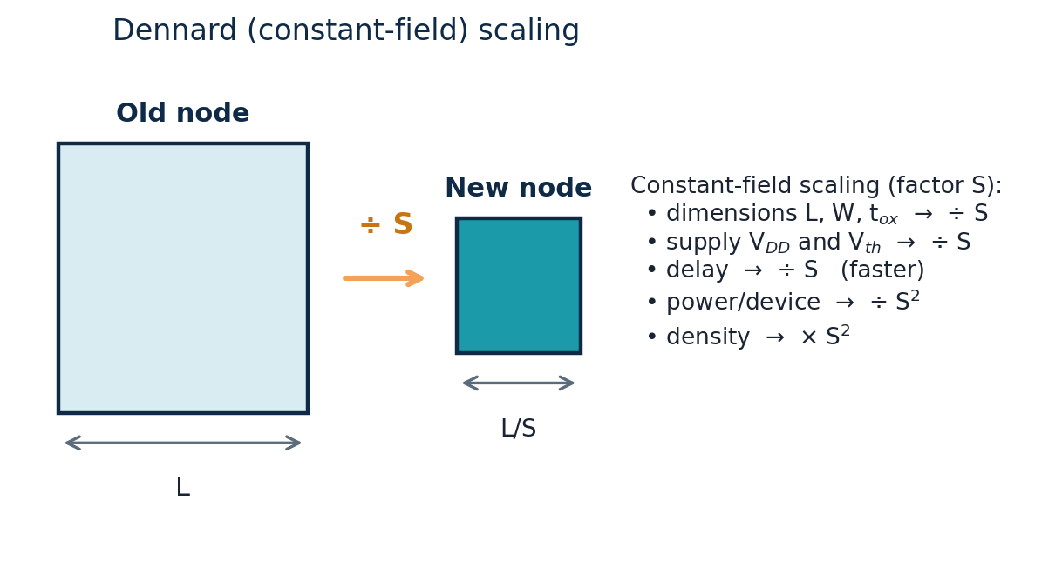
TOPIC 2C · SCALING & TECHNOLOGY
Constant-Field Scaling Theory
In ideal constant-field scaling, every dimension and the supply voltage shrink by the same factor S, keeping the internal electric field constant.
How key quantities scale (factor S)
Quantity | Scales by
Length, width, oxide | ÷ S
Supply voltage VDD | ÷ S
Gate delay | ÷ S (faster)
Power per device | ÷ S²
Power density | ≈ constant
Transistors / area | × S²
Worked example
Scaling a device by factor S
S = 2: dimensions halve, density ×4, delay halves, power/device ÷4 — power density unchanged.
Module 1 · VLSI Design Fundamentals
29

Slide 30
TOPIC 2C · SCALING & TECHNOLOGY
Technology Nodes & Short-Channel Effects
The 'node' (once the gate length, now a marketing label) has shrunk from microns to a few nanometres. Shrinking brings new problems collectively called short-channel effects.
1µm
350nm
130nm
45nm
14nm
5nm
2nm
1985
1995
2002
2008
2014
2020
~2025
Short-channel effects to know
Velocity saturation
DIBL
Current grows ~linearly, not as the square, at high fields.
Drain voltage lowers the barrier → V_th drops with V_DS.
Increased leakage
V_th variation
Thin oxides & low V_th raise sub-threshold and gate-tunnelling current.
Random dopant fluctuation makes identical devices differ.
Module 1 · VLSI Design Fundamentals
30

Slide 31
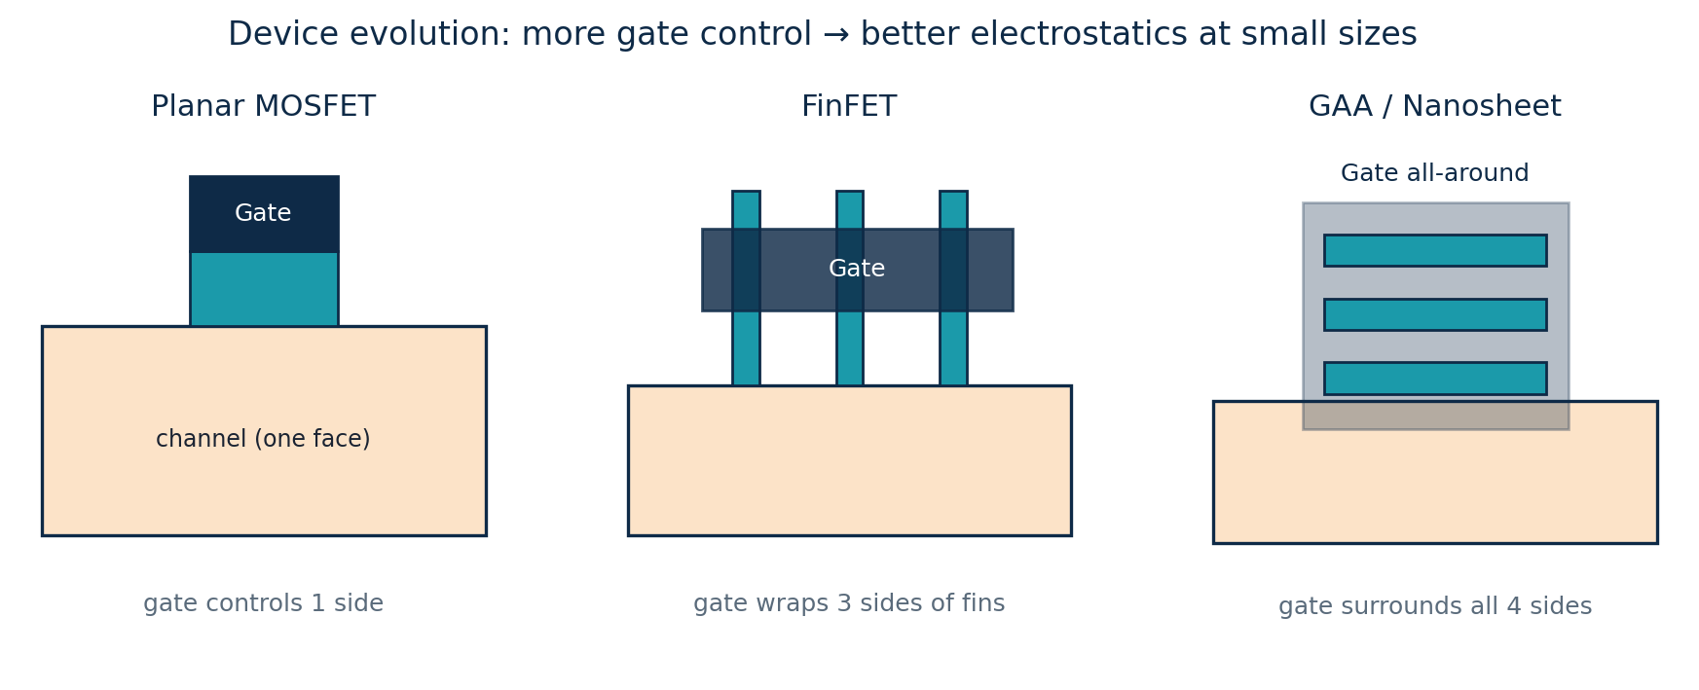
TOPIC 2C · SCALING & TECHNOLOGY
Device Evolution: Planar → FinFET → GAA
To keep scaling working once planar transistors leaked too much, the industry re-shaped the device so the gate controls the channel from more sides.
Better control →
Planar: 1 side.
FinFET: 3 sides (≈2011, 22nm).
GAA / nanosheet: all 4 sides (≈2nm).
Plus material & technique advances
Strained silicon (faster carriers), high-k / metal gate (less gate leakage), and EUV lithography (printing tiny features) all keep Moore's Law alive even as Dennard scaling has slowed.
Module 1 · VLSI Design Fundamentals
31

Slide 32
SECTION 2
CMOS Inverter Characteristics & Logic Design
The inverter is the 'hello world' of VLSI. Master its behaviour, robustness and sizing, and every other gate follows.
Topic 1.2 · approx. 18 hours
Inverter operation and the voltage transfer characteristic (VTC)
Switching threshold and voltage gain
Noise-margin analysis and power (dynamic, short-circuit, leakage)
Inverter sizing: the β ratio and equal rise/fall
Driving large loads: buffer chains, FO4 and optimal stages
Static CMOS logic and NAND / NOR / AOI design
Module 1 · VLSI Design Fundamentals
32

Slide 33
MODULE 1 · TOPIC 3
CMOS Inverter Characteristics
Everything that makes the inverter a good digital gate — its transfer curve, its robustness to noise, its power, and how we size it for speed.
a
Operation & voltage transfer characteristic
The five VTC regions, switching threshold V_M and gain
b
Noise margins & power consumption
NM_H / NM_L analysis; dynamic, short-circuit and leakage power
c
Sizing & optimization techniques
β ratio, equal rise/fall, buffer chains, FO4 and optimal stages
Module 1 · VLSI Design Fundamentals
33

Slide 34
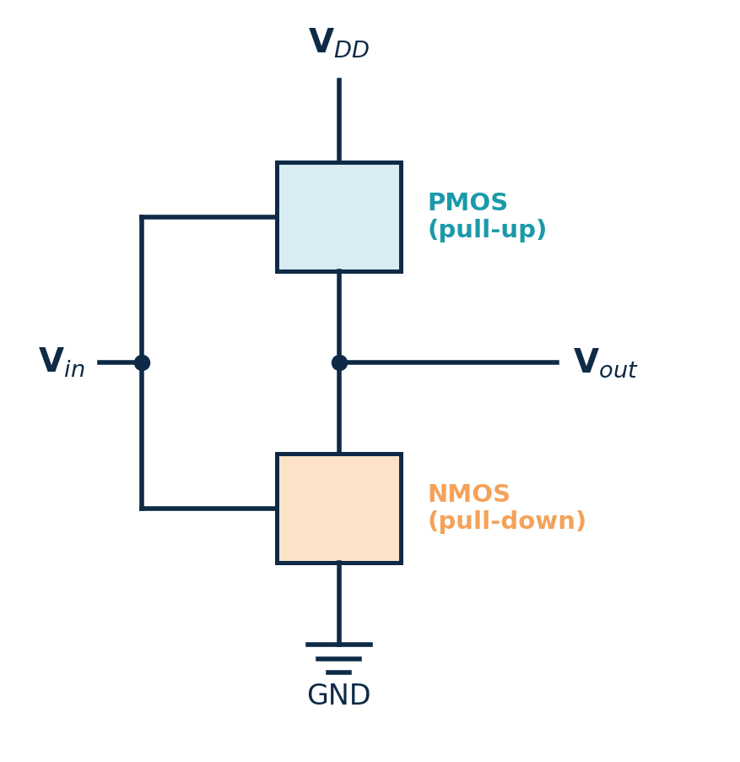
TOPIC 3A · OPERATION & VTC
The CMOS Inverter
One PMOS (pull-up) + one NMOS (pull-down) share the input at their gates and the output at their drains, between V_{DD} and GND.
Vin | PMOS | NMOS | Vout
0 (Low) | ON | OFF | 1 (High)
1 (High) | OFF | ON | 0 (Low)
Trace it — Vin = 0
PMOS gate sees 0 → ON; NMOS gate sees 0 → OFF. Output connects to V_{DD} → logic 1. Complement confirmed.
Key property: exactly one network conducts at a time, so there is no steady DC path from V_{DD} to GND → near-zero static power. This is why CMOS won.
Module 1 · VLSI Design Fundamentals
34

Slide 35
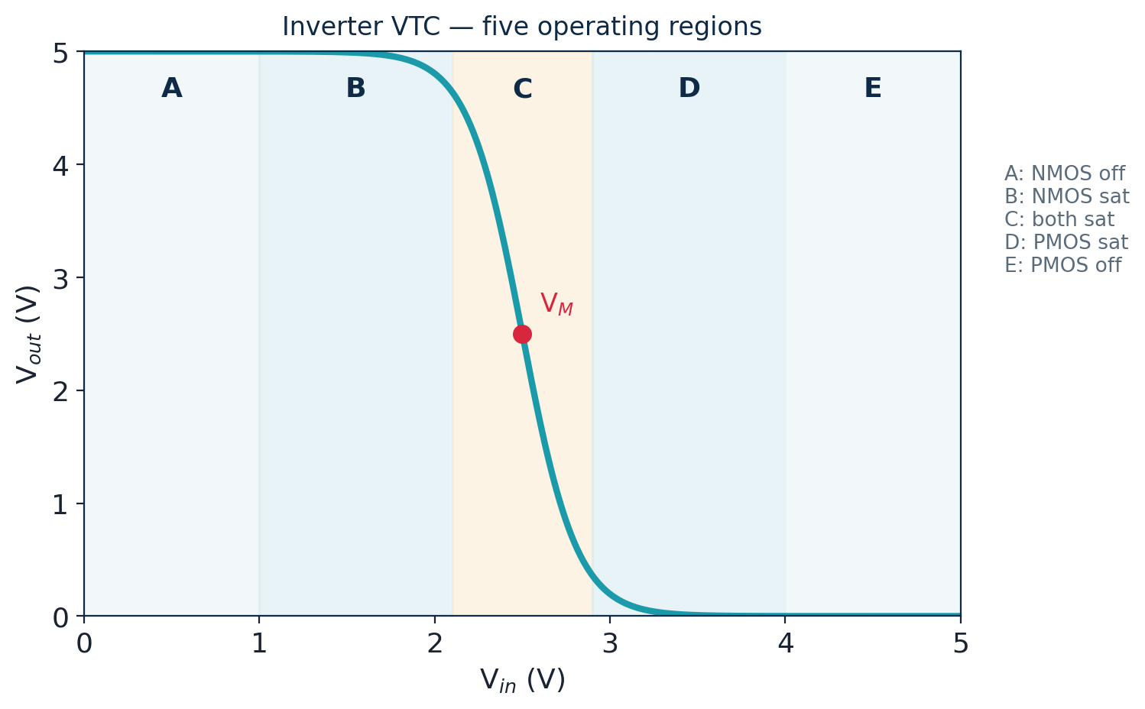
TOPIC 3A · OPERATION & VTC
Voltage Transfer Characteristic (VTC)
The VTC plots V_{out} vs V_{in} and passes through five regions (A–E).
Region A: NMOS off, output = V_{DD}.
Region C: both transistors saturated — the steep, high-gain transition.
Region E: PMOS off, output = 0.
A steeper transition (|gain| ≫ 1) = a more 'ideal' digital gate.
Switching threshold VM
V_{M} is where V_{in} = V_{out}. For a balanced inverter V_{M} ≈ V_{DD}/2.
Sizing PMOS wider raises V_{M}; sizing NMOS wider lowers it.
Module 1 · VLSI Design Fundamentals
35

Slide 36
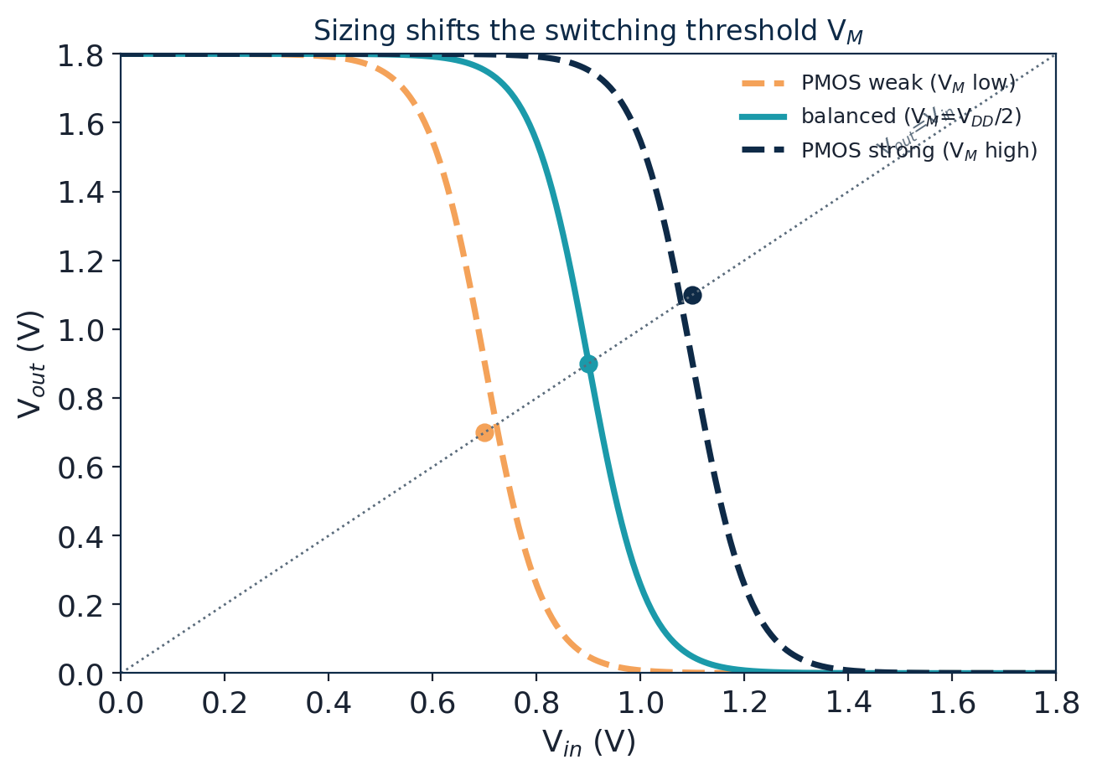
TOPIC 3A · OPERATION & VTC
Switching Threshold & Voltage Gain
The switching threshold V_{M} is the input at which V_{out} = V_{in} (both devices saturated).
It is set by the drive strengths: V_{M} rises if the PMOS is made relatively stronger (wider).
Voltage gain = the slope dV_{out}/dV_{in} near V_{M} — a good inverter has |gain| ≫ 1.
High gain regenerates weak logic levels back to full V_{DD}/0 — essential for cascading gates.
Why a centred VM is good
V_{M} ≈ V_{DD}/2 makes the high and low noise margins roughly equal → the most robust, balanced gate.
This is the target the β ratio (Topic 3c) is chosen to hit.
Module 1 · VLSI Design Fundamentals
36

Slide 37
TOPIC 3B · NOISE & POWER
Noise Margins
Noise margins measure how much unwanted voltage a signal can absorb and still be read correctly.
NM_{H} = V_{OH} − V_{IH} (high-side margin)
NM_{L} = V_{IL} − V_{OL} (low-side margin)
V_{IH}, V_{IL} are the VTC points where the slope = −1.
Worked example — compute margins
Given V_{OH}=1.8, V_{OL}=0.0, V_{IH}=1.1, V_{IL}=0.7 V.
NM_{H} = 1.8 − 1.1 = 0.7 V.
NM_{L} = 0.7 − 0.0 = 0.7 V.
Equal, healthy margins → robust, well-balanced gate.
The four key voltages
Why it matters
Symbol | Meaning
VOH | Output high level
VOL | Output low level
VIH | Min input read as 1
VIL | Max input read as 0
Crosstalk, supply droop and IR drop all inject noise.
Larger NM → fewer functional failures, better yield.
Margins shrink as V_{DD} scales down — a real design challenge.
Module 1 · VLSI Design Fundamentals
37

Slide 38
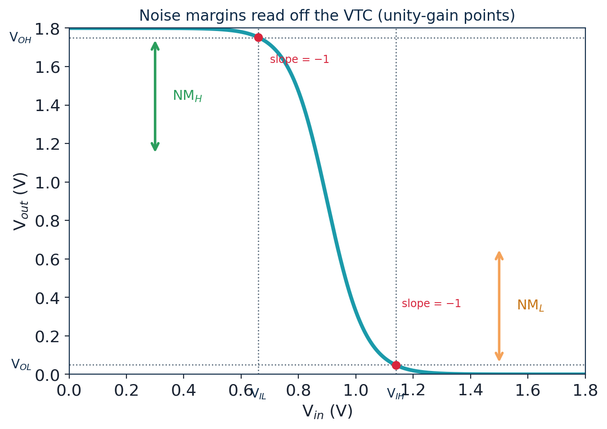
TOPIC 3B · NOISE & POWER
Noise-Margin Analysis on the VTC
V_{IL} and V_{IH} are the two points where the VTC slope = −1 (unity gain).
Below V_{IL} the input is safely a 0; above V_{IH} safely a 1.
The margins are the gaps to the output levels: NM_{H}=V_{OH}−V_{IH}, NM_{L}=V_{IL}−V_{OL}.
A steeper VTC pushes V_{IL} and V_{IH} toward V_{M} → larger margins.
Worked example (3.3 V logic)
V_{OH}=3.3, V_{OL}=0.1, V_{IH}=2.0, V_{IL}=1.1 V.
NM_{H} = 3.3−2.0 = 1.3 V; NM_{L} = 1.1−0.1 = 1.0 V.
Both positive and sizeable → a robust gate.
Module 1 · VLSI Design Fundamentals
38

Slide 39

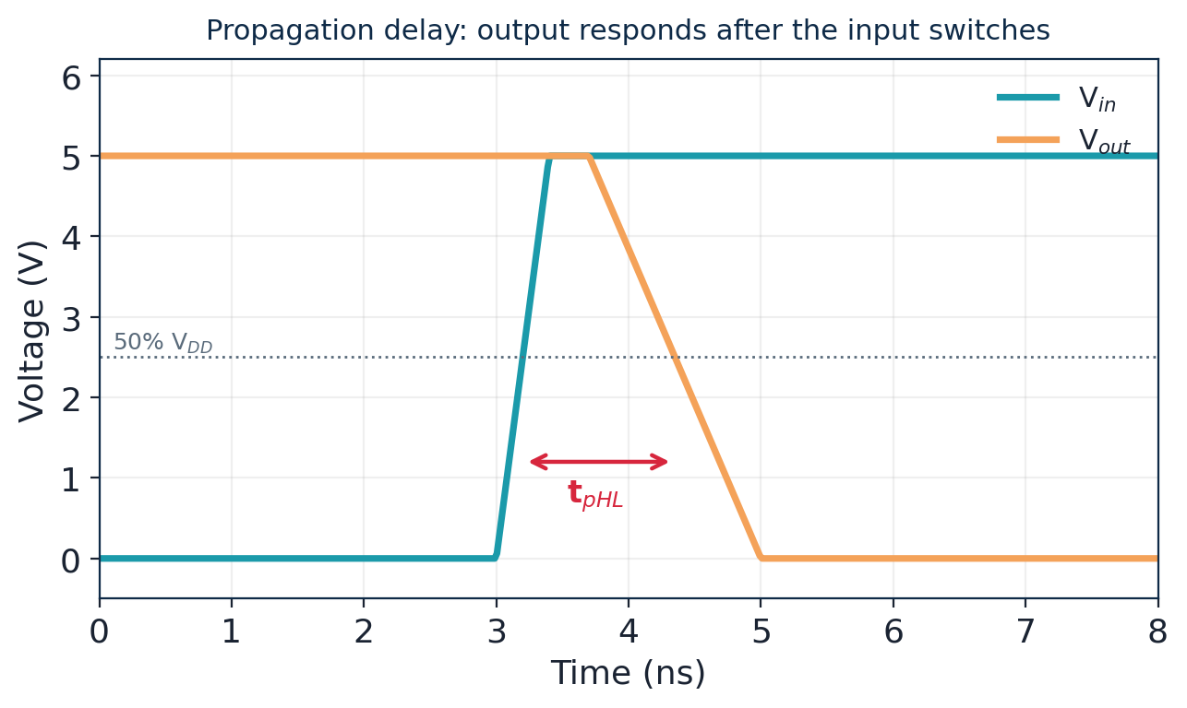
TOPIC 3B · SWITCHING CHARACTERISTICS
Switching Delay of the Inverter
Propagation delay t_{p}: input-50% to output-50%. Average of t_{pHL} and t_{pLH}.
Rise/fall times t_{r}, t_{f}: 10%–90% output transition.
RC model: t_{p} ≈ 0.69·R_{on}·C_{L}.
Lower R (wider transistors) or lower C (lighter load) → faster.
Worked example — inverter delay
R_{on} = 12 kΩ, C_{L} = 25 fF.
RC = 12×10³ × 25×10⁻¹⁵ = 3.0×10⁻¹⁰ s.
t_{p} = 0.69 × 3.0×10⁻¹⁰ = 207 ps.
Double the load → delay doubles (414 ps): delay is linear in C.
Fan-out, wire load and input slope all add to the effective C and slow the gate down.
Module 1 · VLSI Design Fundamentals
39

Slide 40
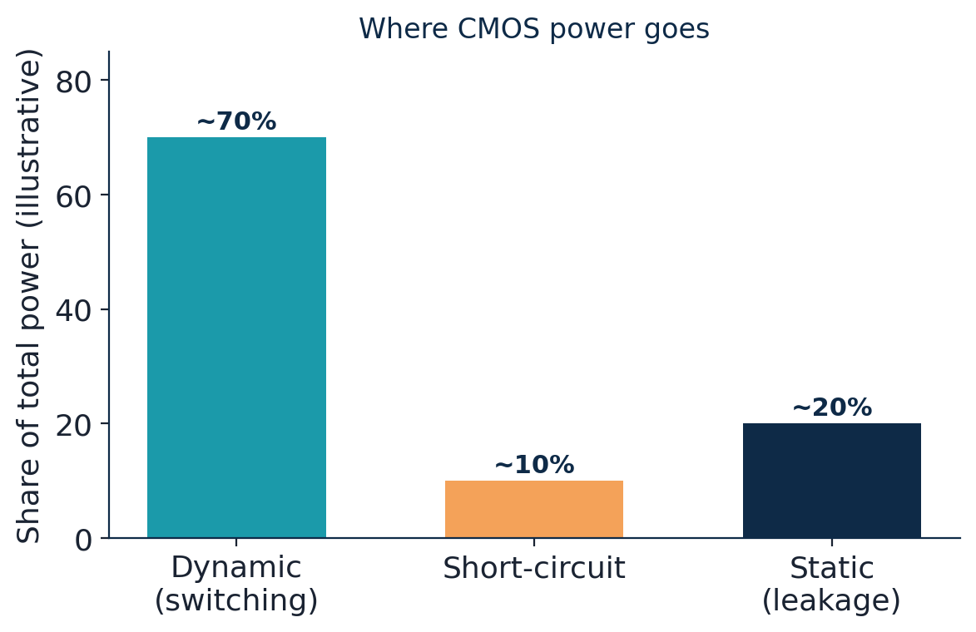
TOPIC 3B · POWER CONSUMPTION
Power Dissipation in CMOS
Dynamic (switching): P = α·C·V_{DD}²·f. Charging/discharging load caps — usually dominant.
Short-circuit: brief V_{DD}-to-GND current while both devices conduct during a transition.
Static (leakage): sub-threshold + gate leakage; flows even when idle. Grows as devices shrink.
Worked example — dynamic power
C = 5 pF total switching cap, V_{DD} = 1.2 V, f = 1 GHz, activity α = 0.2.
P = 0.2 × 5×10⁻¹² × (1.2)² × 1×10⁹
= 0.2 × 5×10⁻¹² × 1.44 × 10⁹ = 1.44 mW.
Halving V_{DD} cuts dynamic power ~4× — why voltage scaling is so valuable.
Energy per switch = ½·C·VDD² — independent of frequency.
Module 1 · VLSI Design Fundamentals
40

Slide 41
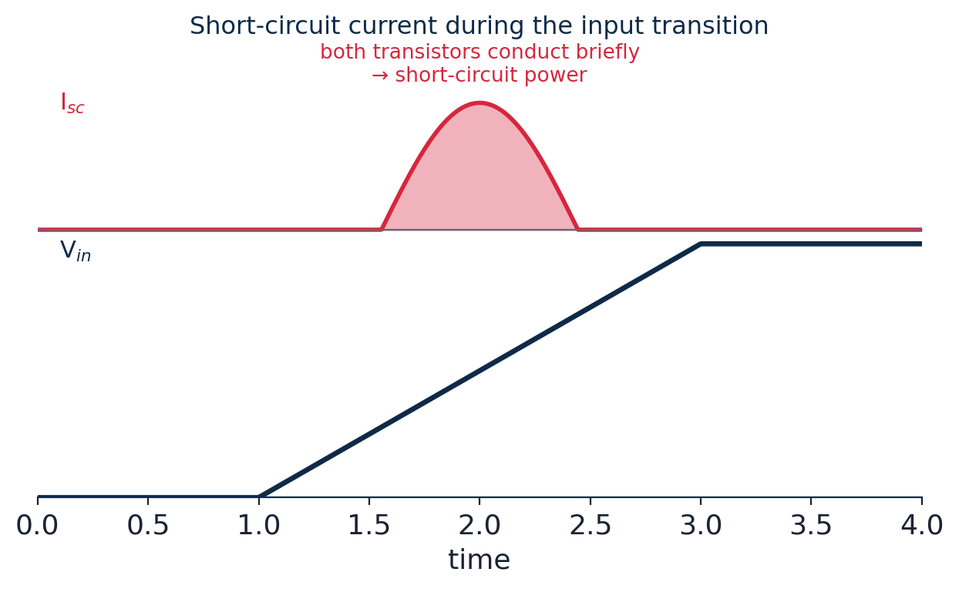
TOPIC 3B · POWER CONSUMPTION
Short-Circuit, Leakage & Low-Power
Short-circuit power: during the input transition there is a brief window where V_{tn} < V_{in} < V_{DD}−|V_{tp}| and both transistors conduct — a current spike straight from V_{DD} to GND.
Kept small by fast input edges (sharp transitions spend less time in the danger window).
Leakage (static) power: sub-threshold + gate-oxide tunnelling; now a major fraction at advanced nodes.
Low-power design techniques
Voltage scaling (biggest lever, V² term) · clock gating (cut α) · power gating (cut leakage when idle) · multi-V_{th} cells (fast where needed, low-leak elsewhere) · smaller sizing (less C).
Module 1 · VLSI Design Fundamentals
41

Slide 42
TOPIC 3C · SIZING & OPTIMIZATION
Inverter Sizing: the β Ratio
Electrons move ~2–3× faster than holes, so an equal-width PMOS is weaker than the NMOS. We size the PMOS wider to balance the inverter.
For a symmetric VTC (VM = VDD/2)
Size so the pull-up and pull-down strengths match: Wp / Wn ≈ µn/µp ≈ 2–3.
Effect of the ratio (β = βn/βp)
Wider PMOS → higher V_{M}, stronger pull-up, faster rise; costs area & input capacitance.
Trade-off
A ratio of ~2 balances rise and fall and centres the VTC; using 1:1 saves area but skews V_{M} low and makes the rise slower than the fall.
Module 1 · VLSI Design Fundamentals
42

Slide 43
TOPIC 3C · SIZING & OPTIMIZATION
Sizing for Delay & Equal Rise/Fall
Delay ≈ 0.69·R·C. Making a transistor wider lowers its R (faster) but raises the C it presents to the previous stage.
Equal rise/fall: choose Wp ≈ 2·Wn so t_{pLH} ≈ t_{pHL}.
Up-sizing a gate only helps if it drives a large external load; for self-load it just moves the problem upstream.
The right size depends on the fan-out (load ÷ input cap) the gate must drive.
Rule of thumb
Need balanced VTC
Wp/Wn ≈ 2–3
Need min area
Wp/Wn = 1 (skewed)
Driving big load
Up-size whole gate / add buffers
Worked example — equal rise/fall
Speed-critical path
NMOS R_{n}=10 kΩ; PMOS of equal width R_{p}=20 kΩ (holes slower).
Double the PMOS width → R_{p} halves to 10 kΩ → rise and fall delays now match.
Use FO4-sized stages
Module 1 · VLSI Design Fundamentals
43

Slide 44
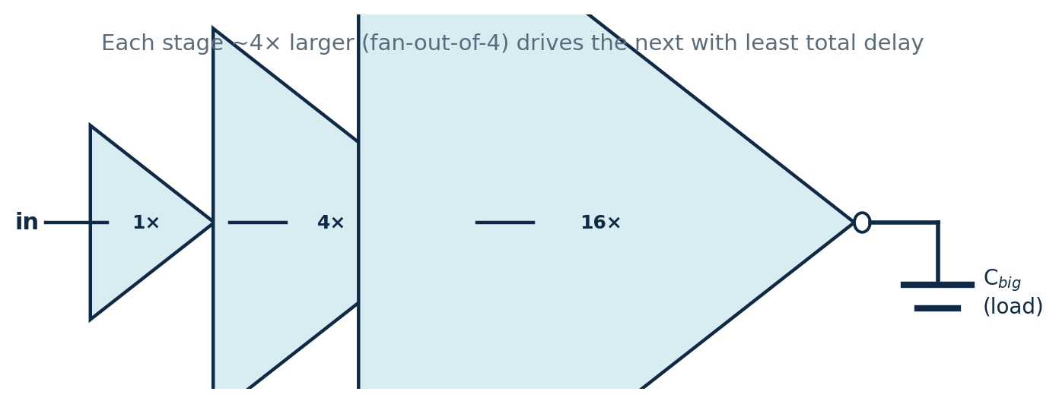
TOPIC 3C · SIZING & OPTIMIZATION
Driving Large Loads: Buffer Chains & FO4
A tiny gate cannot quickly drive a big load (a long wire or many inputs). The fix is a chain of inverters that grows geometrically in size.
Why taper?
One big gate would overload the source.
Too many tiny stages add overhead.
A geometric taper shares the effort evenly.
Fan-out-of-4 (FO4): each stage about 4× the previous one is close to the minimum-delay taper — a standard rule of thumb and a common delay unit.
Module 1 · VLSI Design Fundamentals
44

Slide 45
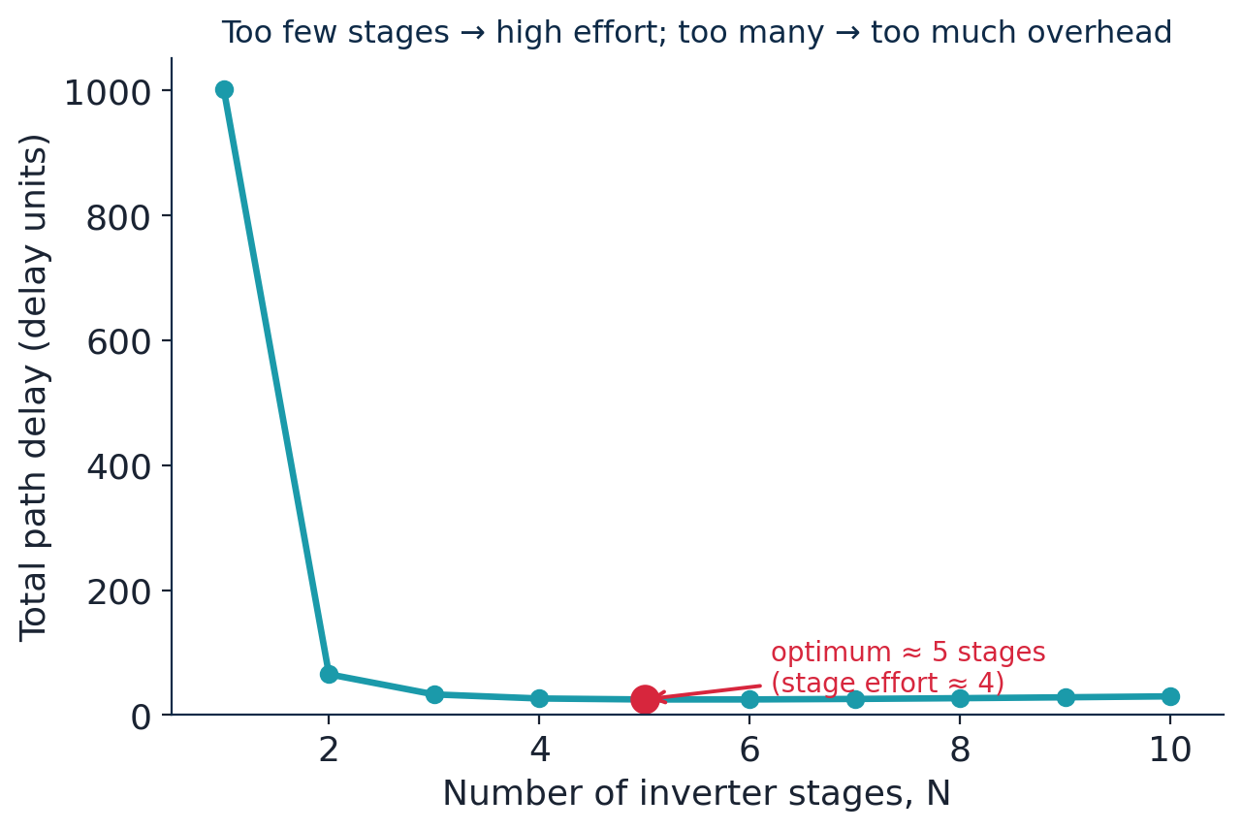
TOPIC 3C · SIZING & OPTIMIZATION
Choosing the Optimal Number of Stages
For a fixed total job (path effort F), there is a sweet spot in the number of stages N.
Too few stages → each must do too much work (huge fan-out) → slow.
Too many stages → the fixed per-stage overhead (parasitic delay) dominates → slow.
Minimum delay is near a per-stage effort of ≈ 4 (the mathematical optimum is e ≈ 2.7, but ~4 is used in practice).
Worked example
Drive a load 64× the input cap (F = 64).
Use stage effort ≈ 4 → N = log₄(64) = 3 stages sized 1× → 4× → 16× (driving 64×).
Module 1 · VLSI Design Fundamentals
45

Slide 46
MODULE 1 · TOPIC 4
CMOS Logic Design
From the four basic gates to any combinational function — built systematically from complementary MOS networks.
a
Basic logic gates: AND, OR, NAND, NOR
Symbols, truth tables, CMOS realisation and universality
b
Combinational logic design in CMOS
The PUN/PDN method and a systematic design procedure
c
Designing complex logic functions
AOI / OAI gates, factoring, and transmission-gate logic
Module 1 · VLSI Design Fundamentals
46

Slide 47
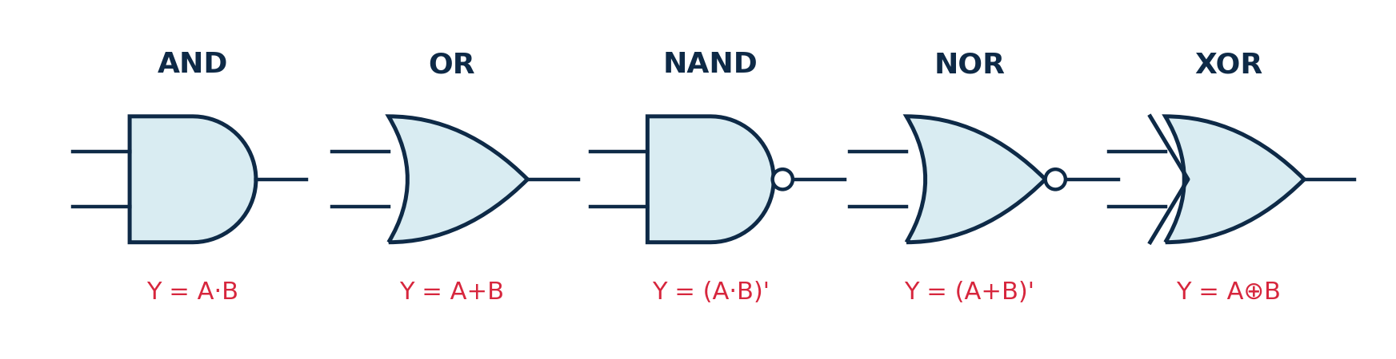
TOPIC 4A · BASIC GATES
Basic Logic Gates
Every digital function is built from a small set of gates. Here are the workhorses, their Boolean expressions and truth tables.
A | B | AND | OR | NAND | NOR | XOR
0 | 0 | 0 | 0 | 1 | 1 | 0
0 | 1 | 0 | 1 | 1 | 0 | 1
1 | 0 | 0 | 1 | 1 | 0 | 1
1 | 1 | 1 | 1 | 0 | 0 | 0
In CMOS
NAND & NOR are the natural CMOS gates; AND/OR add an inverter.
Module 1 · VLSI Design Fundamentals
47

Slide 48
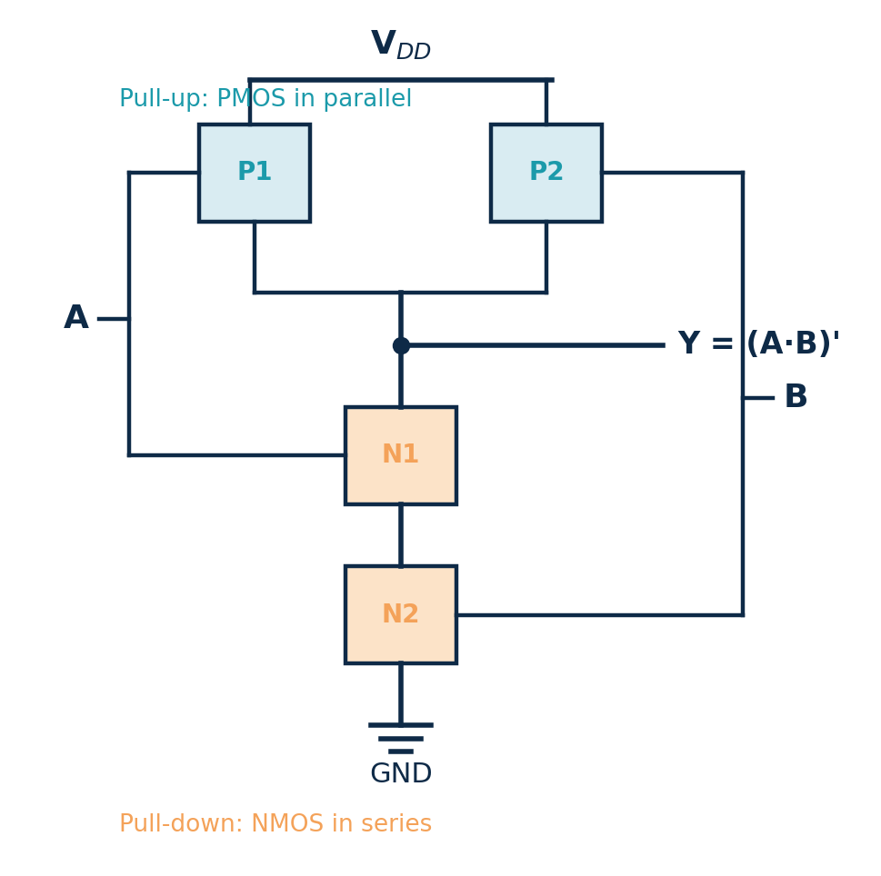
TOPIC 4A · BASIC GATES
Designing a 2-input NAND
Y = (A · B)′
1
Output is 0 only when A AND B = 1. (AND condition.)
2
PDN: two NMOS in SERIES to GND. (series = AND.)
3
PUN (dual): two PMOS in PARALLEL to VDD. (parallel.)
4
Total = 4 transistors. Verify all 4 rows.
A | B | Y
0 | 0 | 1
0 | 1 | 1
1 | 0 | 1
1 | 1 | 0
Generalise it
An n-input NAND needs 2n transistors (n NMOS in series + n PMOS in parallel).
3-input NAND → 6 transistors.
Module 1 · VLSI Design Fundamentals
48

Slide 49
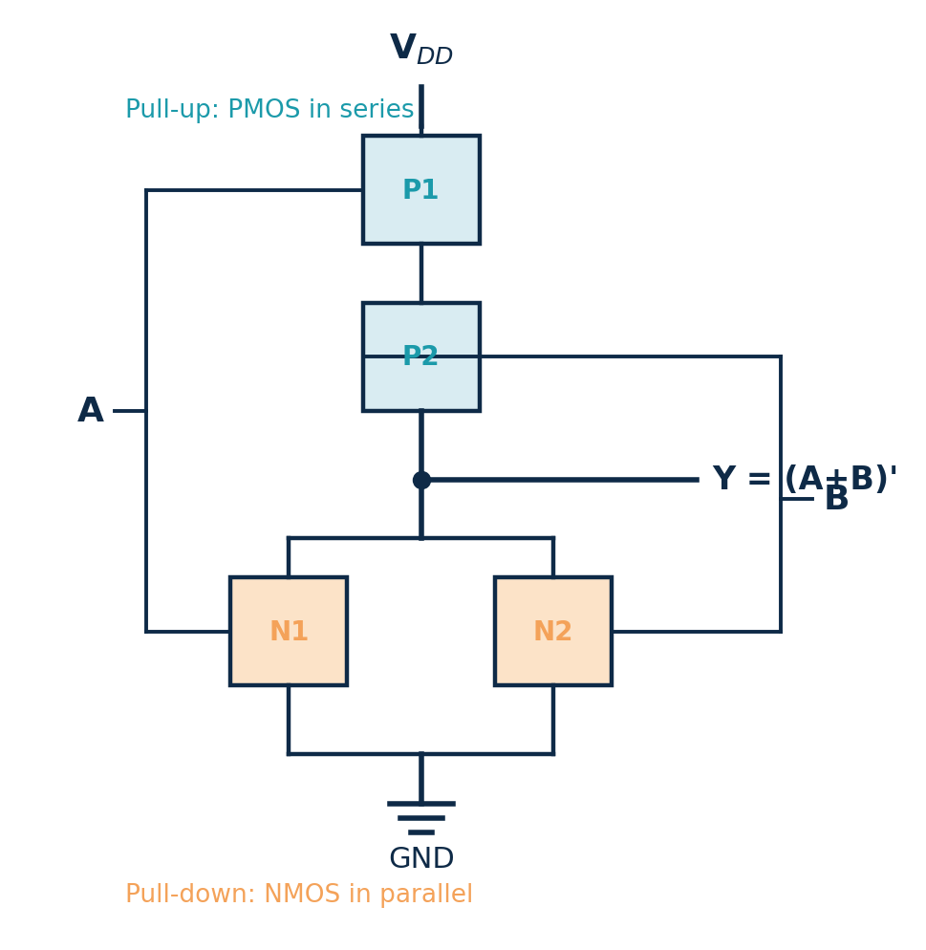
TOPIC 4A · BASIC GATES
Designing a 2-input NOR
Y = (A + B)′
1
Output is 0 when A OR B = 1. (OR condition.)
2
PDN: two NMOS in PARALLEL to GND. (parallel = OR.)
3
PUN (dual): two PMOS in SERIES to VDD. (series.)
4
Total = 4 transistors. Verify all 4 rows.
A | B | Y
0 | 0 | 1
0 | 1 | 0
1 | 0 | 0
1 | 1 | 0
NAND vs NOR pattern
NAND → NMOS series, PMOS parallel.
NOR → NMOS parallel, PMOS series.
In practice NAND is preferred (PMOS in series is slow).
Module 1 · VLSI Design Fundamentals
49

Slide 50
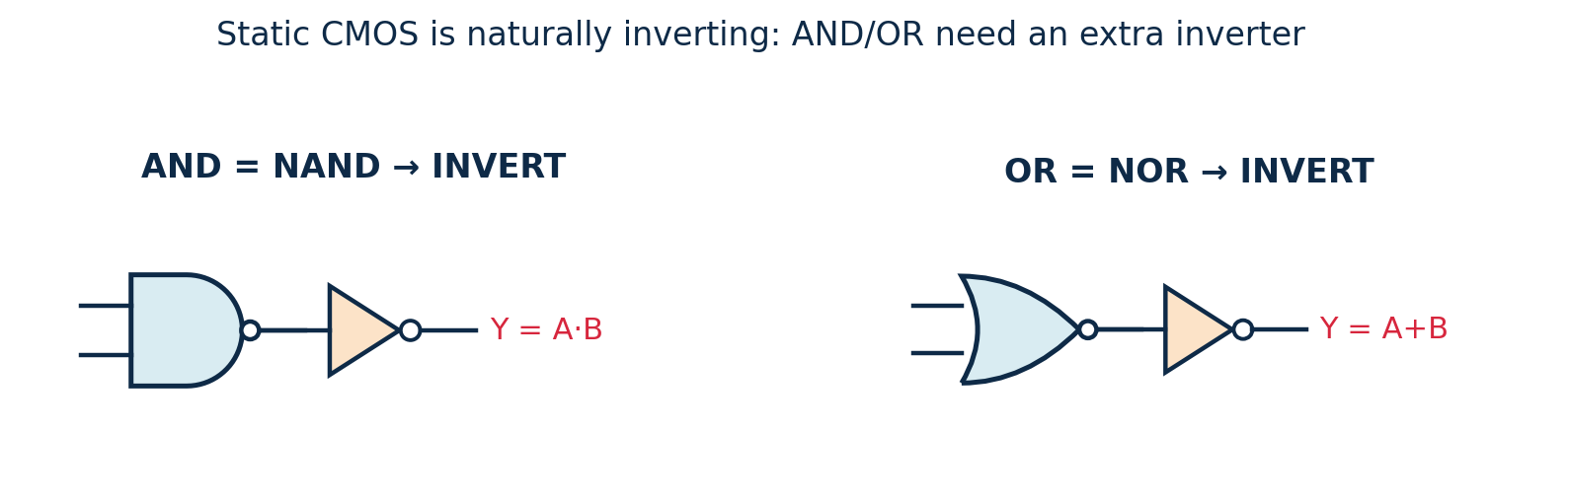
TOPIC 4A · BASIC GATES
Building AND and OR in CMOS
Static CMOS gates are naturally inverting (the output network always inverts). A plain AND or OR therefore needs an extra inverter on the output of a NAND or NOR.
Consequence: AND = 4 (NAND) + 2 (INV) = 6 transistors; a NAND alone is only 4. This is why synthesis tools favour NAND/NOR/AOI over AND/OR.
Module 1 · VLSI Design Fundamentals
50

Slide 51
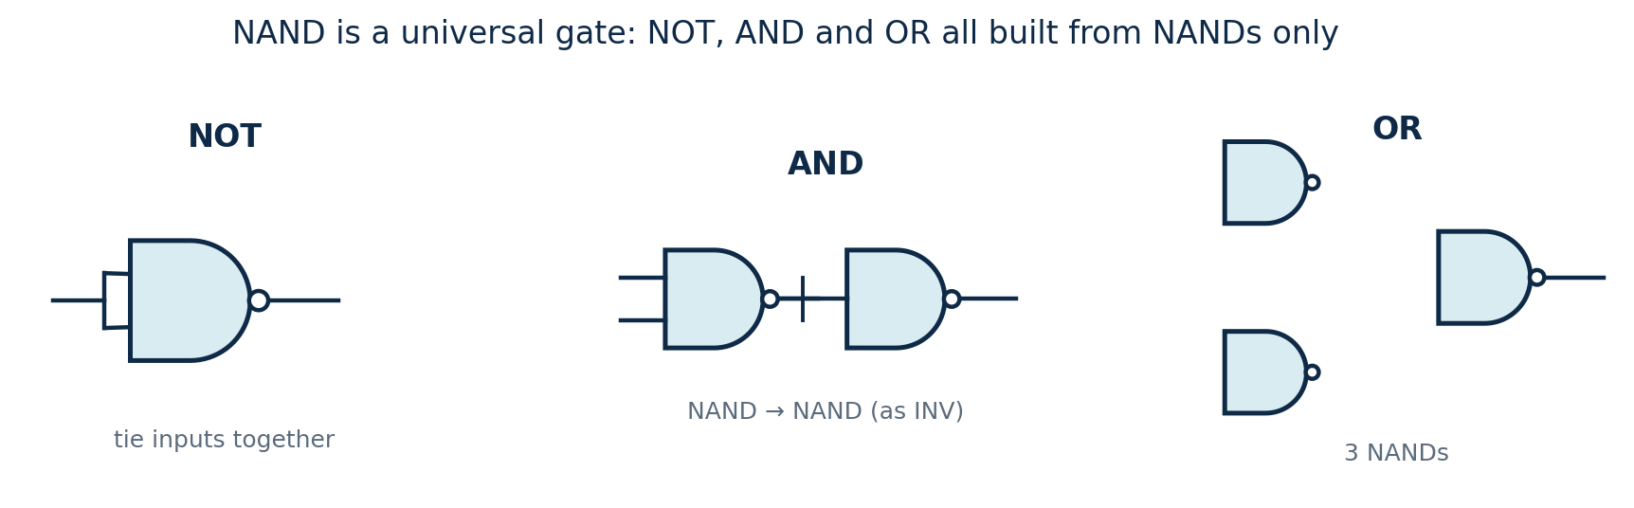
TOPIC 4A · BASIC GATES
NAND & NOR are Universal
A single gate type from which ANY logic function can be built is called universal. Both NAND and NOR are universal — a powerful and practical fact.
Why it matters
A whole chip can be built from one repeated cell — simpler libraries and fabrication.
De Morgan's laws let you convert any AND/OR network into NAND-only or NOR-only form.
NAND is usually preferred over NOR (faster pull-up).
NOT = a NAND with its inputs tied together.
AND = NAND followed by NAND-as-inverter.
OR = invert both inputs (NANDs) then NAND them (De Morgan).
Module 1 · VLSI Design Fundamentals
51

Slide 52
TOPIC 4B · COMBINATIONAL DESIGN
Static CMOS: the Universal Recipe
Every static CMOS gate is built from two complementary networks between the output and the rails.
Pull-Up Network (PUN)
4-step design recipe
PMOS only. Connects output to V_{DD} → drives a logic 1. Conducts when the inputs are LOW.
Write the output as Y = (expression)′.
1
2
Build the PDN: AND → NMOS in series; OR → NMOS in parallel.
Pull-Down Network (PDN)
NMOS only. Connects output to GND → drives a logic 0. Conducts when the inputs are HIGH.
3
Build the PUN as the dual (swap series ↔ parallel) with PMOS.
Duality: PUN and PDN are duals — devices in series in one network are in parallel in the other.
4
Count transistors (2 per input) and verify the truth table.
Module 1 · VLSI Design Fundamentals
52

Slide 53
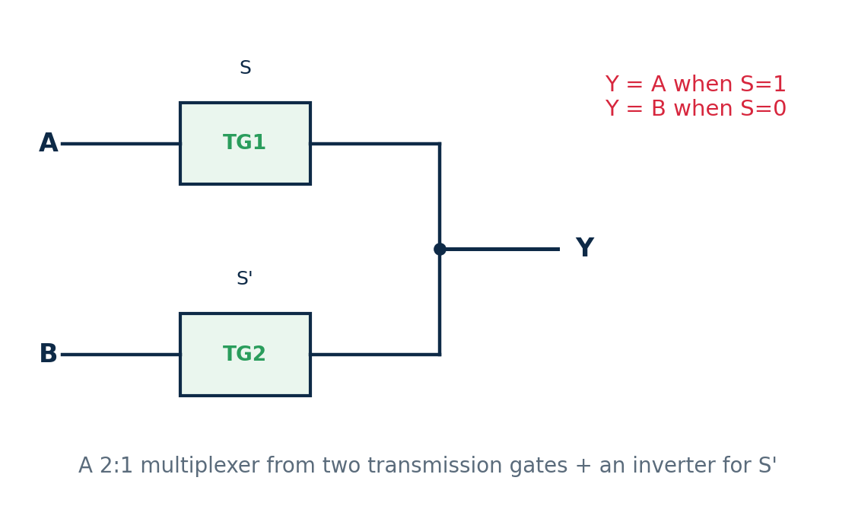
TOPIC 4B · COMBINATIONAL DESIGN
Worked Example — a 2:1 Multiplexer
A multiplexer selects one of two inputs. It is a classic small combinational block, and shows two valid CMOS styles.
Function: Y = S·A + S′·B
S | Y
0 | B
1 | A
Static-CMOS style: realise Y′ = (S·A + S′·B)′ as one AOI-style gate, then invert.
Transmission-gate style: two TGs select A or B — only ~6 transistors (shown).
Takeaway
Most combinational blocks (adders, comparators, decoders) are assembled from these gate-level pieces.
Module 1 · VLSI Design Fundamentals
53

Slide 54
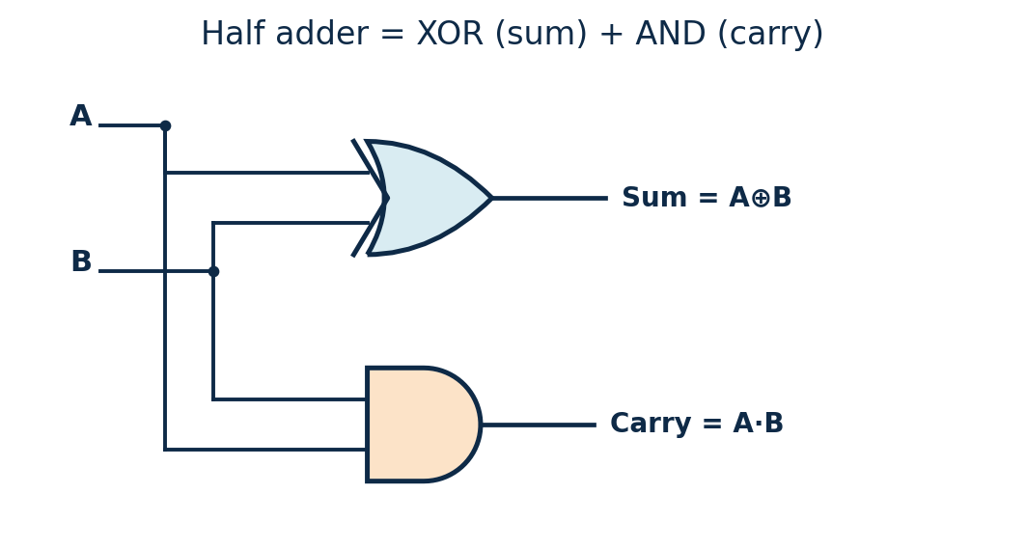
TOPIC 4B · COMBINATIONAL DESIGN
Worked Example — a Half Adder
A half adder adds two bits and produces a sum and a carry. It shows how a small combinational block is assembled from basic gates.
Logic: Sum = A ⊕ B, Carry = A·B
A | B | Sum | Carry
0 | 0 | 0 | 0
0 | 1 | 1 | 0
1 | 0 | 1 | 0
1 | 1 | 0 | 1
Sum is an XOR (true when inputs differ).
Carry is an AND (true only when both are 1).
CMOS realisation
XOR ≈ 8–12 transistors; AND = NAND+INV. Or build the whole thing in transmission-gate logic for fewer devices.
Module 1 · VLSI Design Fundamentals
54

Slide 55
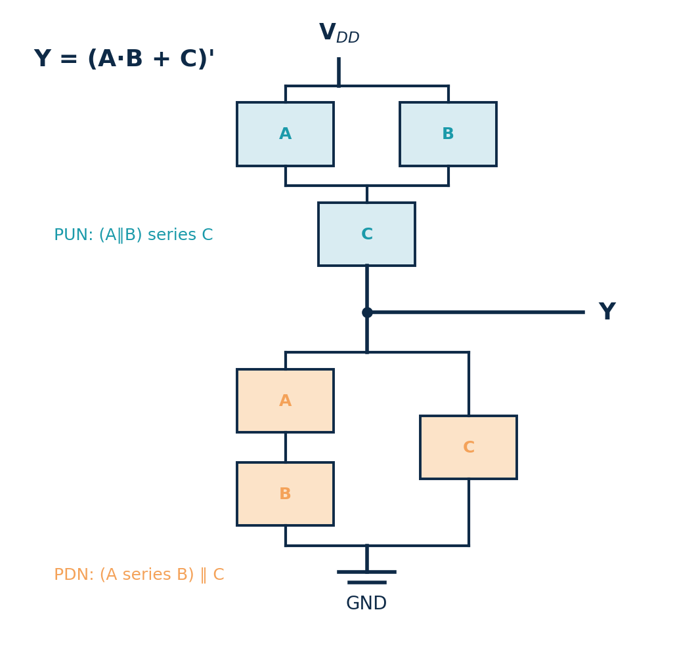
TOPIC 4C · COMPLEX FUNCTIONS
Complex Gates — AOI
Y = (A·B + C)′ — AND-OR-Invert
1
Inside the inversion: (A·B) + C. (read the expression.)
2
PDN: (A series B) in PARALLEL with C. (AND→series, OR→parallel.)
3
PUN dual: (A ∥ B) in SERIES with C. (swap everything.)
4
3 NMOS + 3 PMOS = 6 transistors.
Why complex gates are great
A single AOI gate implements A·B+C′-style logic with fewer transistors and less delay than wiring separate AND + OR + INV gates (which would need ~14 transistors).
Module 1 · VLSI Design Fundamentals
55

Slide 56
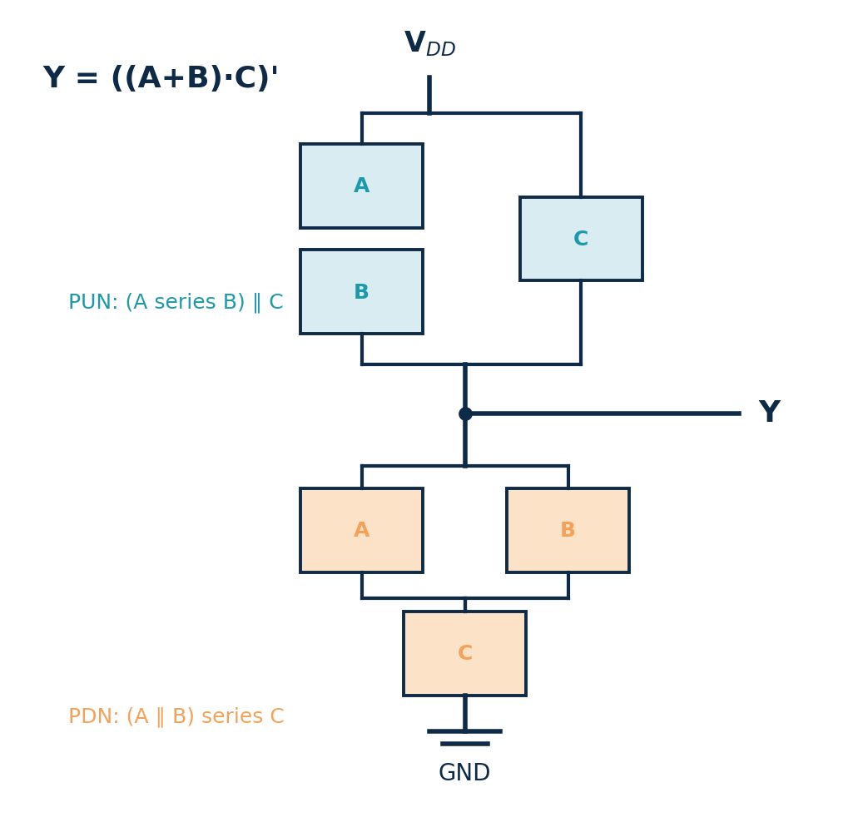
TOPIC 4C · COMPLEX FUNCTIONS
Complex Gates — OAI
Y = ((A + B)·C)′ — OR-AND-Invert
1
Inside the inversion: (A+B)·C. (read the expression.)
2
PDN: (A ∥ B) in SERIES with C. (OR→parallel, AND→series.)
3
PUN dual: (A series B) in PARALLEL with C. (swap everything.)
4
3 NMOS + 3 PMOS = 6 transistors.
AOI vs OAI
OAI is the dual of AOI: start from the OR terms in the PDN. Choose whichever matches your Boolean expression with the fewest transistors.
Module 1 · VLSI Design Fundamentals
56

Slide 57
TOPIC 4C · COMPLEX FUNCTIONS
Mapping Any Function to a CMOS Gate
Any inverting function can become one complex static gate. The trick is to factor the Boolean expression to minimise transistors.
1
Express the output in inverted form Y = (f)′.
Practical limits
2
In the PDN map AND→series, OR→parallel of NMOS.
Series stacks are slow — keep them to ≈ 4 transistors high (fan-in limit).
Tall PMOS stacks are worst (slow holes) — prefer AOI over OAI when you can.
Big functions are split into several gates (multi-level logic) for speed.
Output is always inverting; add an inverter for the true polarity if needed.
3
Build the PUN as the dual with PMOS.
4
Factor f to share transistors and shrink the stack.
Factoring example
Y = (A·B + A·C)′ has 6 literals.
Factor: A·B + A·C = A·(B + C) → Y = (A·(B+C))′ — now only 3 NMOS in the stack (A in series with B∥C) instead of 4.
Module 1 · VLSI Design Fundamentals
57

Slide 58
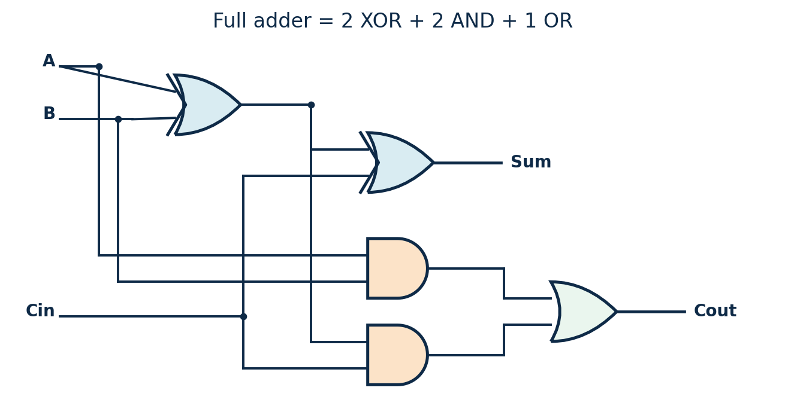
TOPIC 4C · COMPLEX FUNCTIONS
Worked Example — a Full Adder
A full adder adds three bits (A, B and a carry-in). It is the canonical example of multi-level logic — several gates composed to realise a richer function.
Logic: Sum = A ⊕ B ⊕ Cin
Cout = A·B + Cin·(A ⊕ B)
A | B | Cin | Sum | Cout
0 | 0 | 0 | 0 | 0
0 | 1 | 0 | 1 | 0
1 | 1 | 0 | 0 | 1
1 | 1 | 1 | 1 | 1
Built from 2 XOR + 2 AND + 1 OR (or two half adders + an OR).
Why it matters
Chaining n full adders gives an n-bit ripple-carry adder — the heart of every ALU.
Module 1 · VLSI Design Fundamentals
58

Slide 59
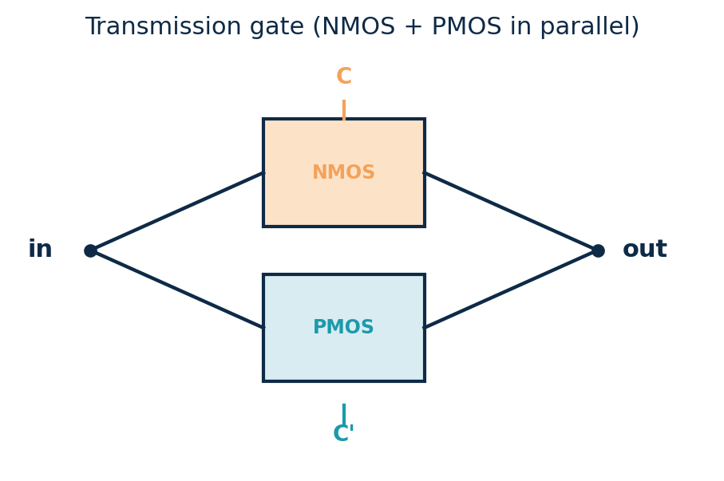
TOPIC 4C · COMPLEX FUNCTIONS
Transmission-Gate & Pass Logic
A single NMOS passes a strong 0 but weak 1; a single PMOS the opposite.
Put them in parallel (gated by C and C′) → a transmission gate that passes both 0 and 1 cleanly.
Used to build multiplexers, latches and XOR compactly.
This is pass-transistor logic — efficient, but needs care with signal levels and drive.
Example — a 2:1 multiplexer
Two transmission gates select between inputs A and B using S and S′:
Out = A when S=1, B when S=0 — just 4 transistors plus an inverter for S′.
Static CMOS is the default; pass-transistor logic is a specialised tool.
Module 1 · VLSI Design Fundamentals
59

Slide 60
SECTION 3
Transistor Schematic, Layout & Wire Modelling
Turning a circuit into geometry that a foundry can actually manufacture.
Topic 1.3 · approx. 12 hours
Transistor-level schematic design & Euler-path layout
Schematic vs layout, stick diagrams & standard cells
λ design rules, DRC & LVS verification
Drawing the inverter layout; metal layers & routing
Standard-cell strategy and full-custom layout
Then: a dedicated topic on on-chip wire modeling
Module 1 · VLSI Design Fundamentals
60

Slide 61
MODULE 1 · TOPIC 5
Transistor-Level Schematics & Layouts
From a transistor netlist to a manufacturable polygon layout — the physical-design half of the flow.
a
Transistor-level design techniques
Reading schematics, shared diffusion and Euler-path ordering
b
Schematic design & layout considerations
Schematic vs layout, stick diagrams, cell layout & standard cells
c
Design rules, metal layers & routing
λ-rules, DRC/LVS, the metal stack, vias and interconnect routing
Module 1 · VLSI Design Fundamentals
61

Slide 62
TOPIC 5A · DESIGN TECHNIQUES
Transistor-Level Schematic Design
Before any layout, the circuit is captured as a transistor schematic (and an equivalent text netlist). It fixes exactly which transistors connect to which nets.
Each transistor is drawn with its gate, source, drain (and body) and a W/L size.
Nets (wires) join terminals; V_{DD} and GND are the rails.
A SPICE netlist lists every device, e.g. M1 Y A VDD VDD pmos W=2u L=0.1u.
Simulated in NGSpice to check function, delay and power before layout.
Example netlist — inverter
* CMOS inverter
M1 Y A VDD VDD pmos W=2u L=0.1u
M2 Y A GND GND nmos W=1u L=0.1u
C1 Y GND 4f
.end
Schematic → layout → silicon
The schematic defines connectivity & sizes; the layout then realises it as polygons. LVS later proves the two match before tape-out.
Module 1 · VLSI Design Fundamentals
62

Slide 63
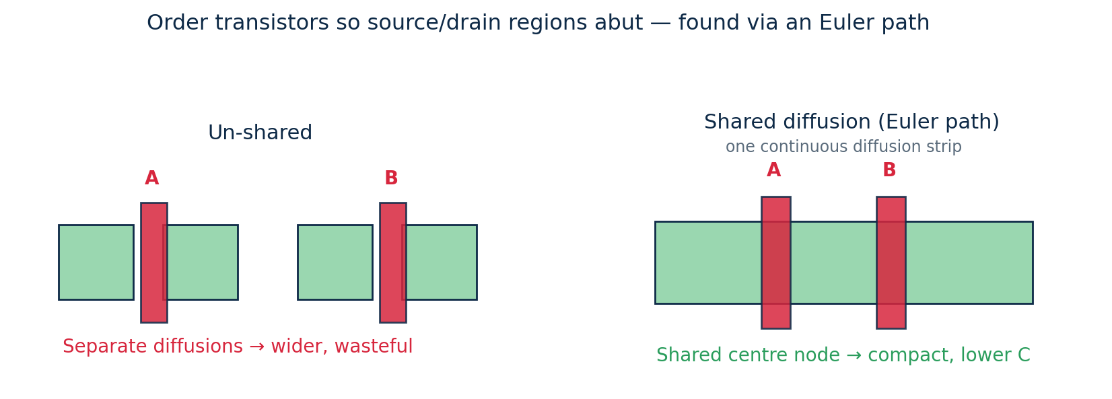
TOPIC 5A · DESIGN TECHNIQUES
Shared Diffusion & Euler Paths
A key transistor-level layout technique: order transistors so that adjacent ones share a source/drain diffusion. This shrinks area and capacitance.
Why it matters
Series transistors (as in a NAND PDN) naturally share their middle node.
A good ordering means one continuous diffusion per row → minimum width.
Standard-cell libraries are hand-tuned this way for density.
Abutting diffusions removes a contact and a gap → smaller, faster cell.
An Euler path through the gate network gives the transistor ordering that keeps the diffusion strip unbroken.
Module 1 · VLSI Design Fundamentals
63

Slide 64
TOPIC 5B · LAYOUT CONSIDERATIONS
Schematic vs Layout
Schematic
Layout
Shows WHAT connects to what (connectivity).
Transistors as symbols, nets as lines.
Captures the logical & electrical design.
Verified by simulation (NGSpice).
Says nothing about physical size or position.
Shows WHERE every shape sits on silicon.
Coloured polygons on stacked mask layers.
This is literally what gets fabricated.
Must obey design rules (checked by DRC).
Determines real area, parasitics and yield.
Module 1 · VLSI Design Fundamentals
64

Slide 65
TOPIC 5B · LAYOUT CONSIDERATIONS
CMOS Fabrication Layers
n-well
Houses the PMOS devices
Active / diffusion
n+ and p+ source/drain regions
Polysilicon
Transistor gates + short wires
Contacts / vias
Vertical connections between layers
Metal 1…N
Horizontal wiring; many stacked layers
Layers are built up by repeated deposit → pattern (mask) → etch steps.
Each layer = one photomask
A modern process can use 40–60+ masks. Mask cost is a big part of the high ASIC NRE we saw in Section 1.
Module 1 · VLSI Design Fundamentals
65

Slide 66
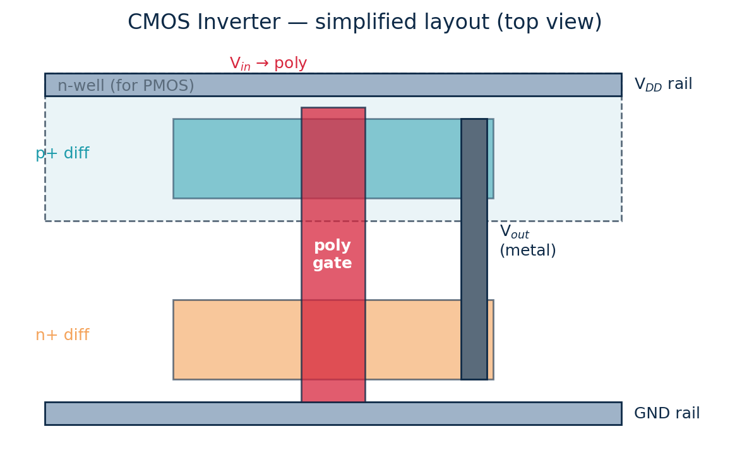
TOPIC 5B · LAYOUT CONSIDERATIONS
Stick Diagrams
A stick diagram is a colour-coded cartoon of the layout — lines for wires, no exact dimensions.
Colours by convention: green diffusion, red poly, blue metal.
Where poly crosses diffusion, a transistor is formed.
Used to plan topology & ordering before committing to full layout.
Example — inverter stick
One vertical poly line = the shared gate (input).
PMOS diffusion on top (in n-well, near V_{DD}), NMOS below (near GND).
A metal line joins the two drains = output. That's the whole inverter.
Module 1 · VLSI Design Fundamentals
66

Slide 67
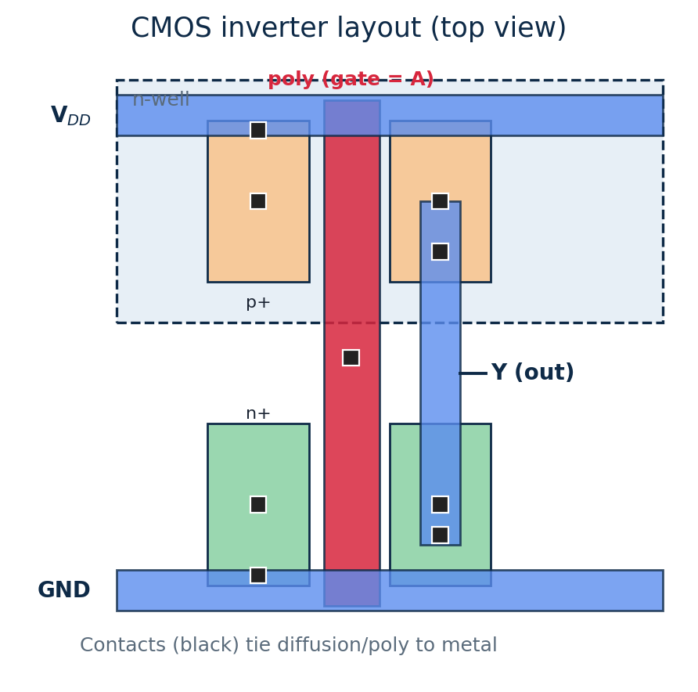
TOPIC 5B · LAYOUT CONSIDERATIONS
Drawing the Inverter Layout
PMOS on top (p+ in the n-well, by V_{DD}); NMOS below (n+, by GND).
One vertical poly strip forms both gates = the input A.
Metal-1 makes the V_{DD} and GND rails and the shared output Y.
Contacts (black) tie diffusion and poly up to the metal.
Both transistors share the input gate and the output node — exactly the schematic.
Layout = the schematic, in geometry
Every wire and device in the schematic maps to specific polygons on specific mask layers.
Module 1 · VLSI Design Fundamentals
67

Slide 68
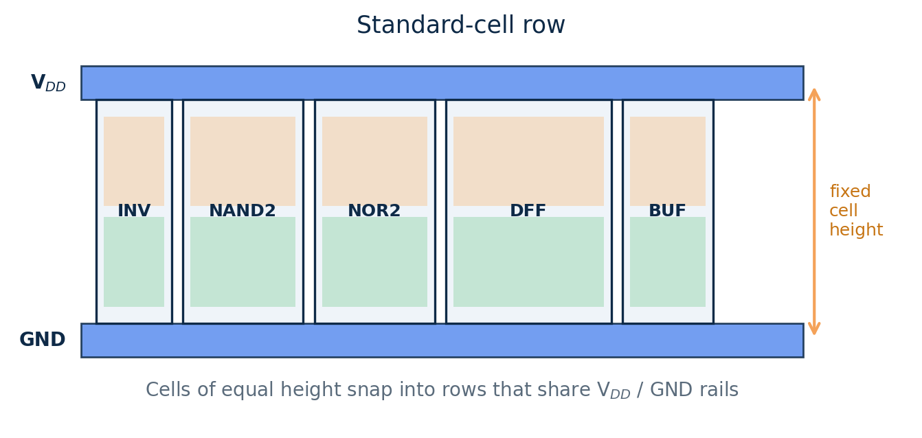
TOPIC 5B · LAYOUT CONSIDERATIONS
Standard-Cell Layout Strategy
Rather than hand-draw every gate, modern chips use a library of fixed-height standard cells that the tools place in rows — the basis of automated physical design.
Why standard cells?
Pre-characterised for timing & power.
Enable automatic place & route.
Reused across designs → fast turnaround.
Full-custom is reserved for critical blocks.
Fixed cell height lets cells abut into rows that share V_{DD}/GND rails; width varies with complexity.
Module 1 · VLSI Design Fundamentals
68

Slide 69

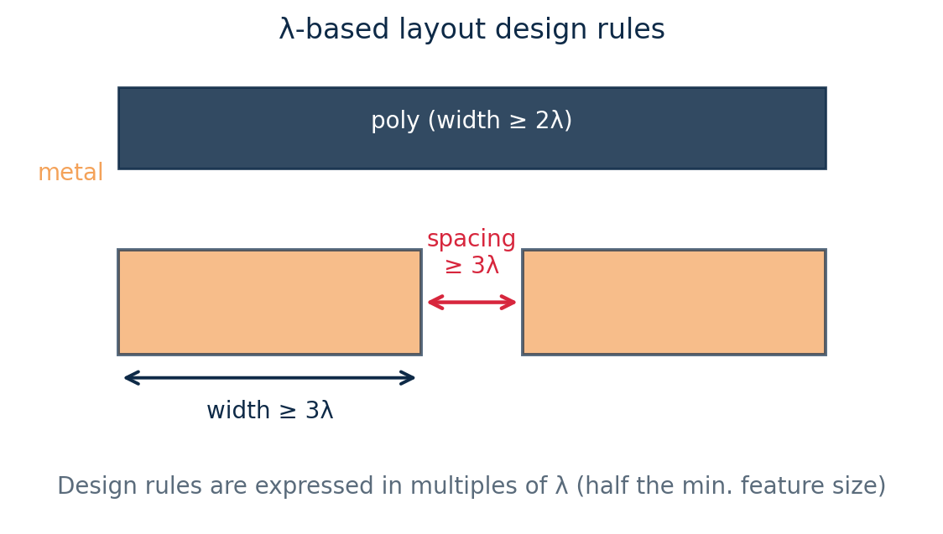
TOPIC 5C · RULES, METAL & ROUTING
Layout Design Rules (λ-rules)
Design rules are the minimum widths and spacings the foundry guarantees it can build reliably.
Expressed in λ (lambda) — a scalable unit ≈ half the minimum feature size.
Examples: min metal width 3λ, min spacing 3λ, gate poly 2λ.
DRC (Design-Rule Check) flags every violation before tape-out.
LVS separately checks Layout-vs-Schematic equivalence.
Example — λ scaling
If λ = 0.1 µm, a 3λ wire is 0.3 µm wide. Move to a newer node (λ = 0.05 µm) and the same drawing shrinks 2× automatically.
Module 1 · VLSI Design Fundamentals
69

Slide 70
TOPIC 5C · RULES, METAL & ROUTING
Physical Verification: DRC & LVS
Before a layout can be sent to the foundry it must pass two automated checks that guarantee it is both manufacturable and correct.
DRC — Design Rule Check
LVS — Layout vs Schematic
Checks the layout obeys every geometric rule (min width, spacing, enclosure).
Guarantees the shapes can actually be fabricated with acceptable yield.
Answers: “Can this be made?”
Extracts a netlist from the layout and compares it to the schematic.
Confirms the geometry implements the intended circuit — same devices and connections.
Answers: “Did we draw the right circuit?”
In this course, Magic performs DRC (and extraction) on your layouts. Both checks must be clean before tape-out.
Module 1 · VLSI Design Fundamentals
70

Slide 71
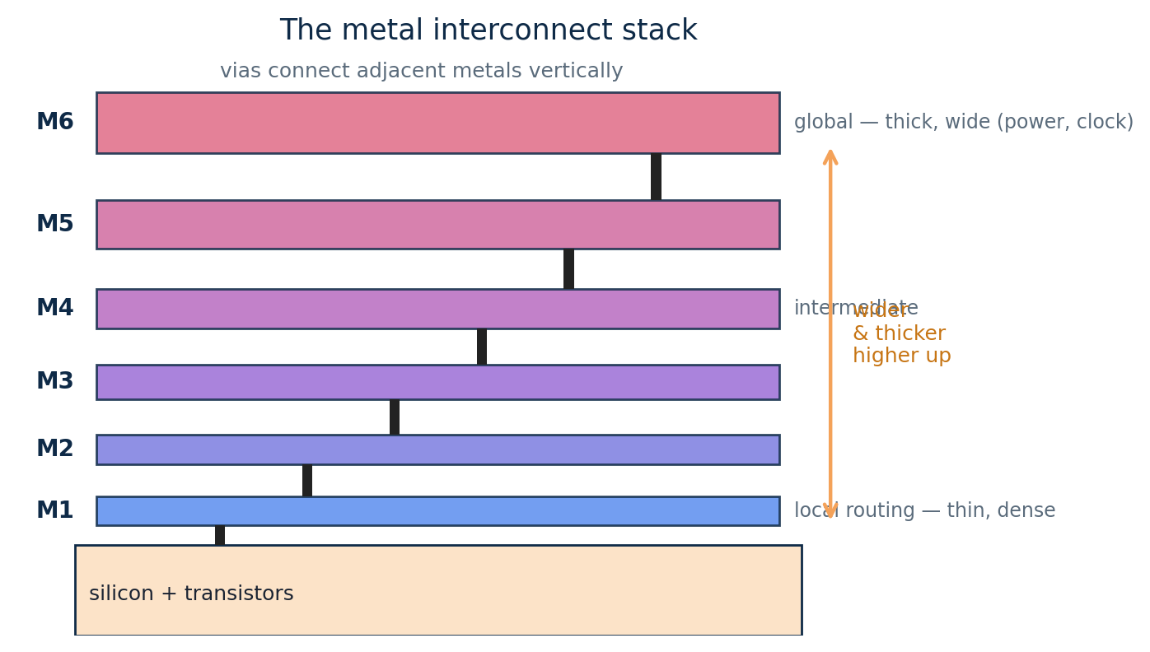
TOPIC 5C · RULES, METAL & ROUTING
Metal Layers & the Routing Stack
Wiring runs on several stacked metal layers (M1, M2, … up to 10+), separated by insulator.
Lower metals (M1–M3) are thin and dense → local, short connections.
Upper metals are thick and wide → low-resistance global routing, power grids and clocks.
Vias are the vertical connections between adjacent metal layers.
Why so many layers?
Millions of nets cannot share one plane. Many layers give the routing capacity to connect everything without short circuits.
Module 1 · VLSI Design Fundamentals
71

Slide 72
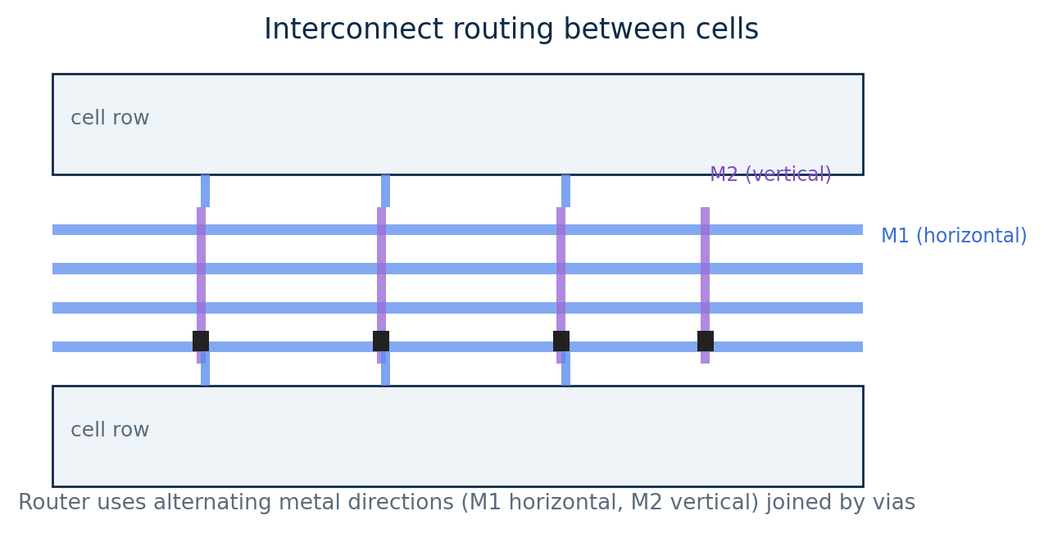
TOPIC 5C · RULES, METAL & ROUTING
Interconnect Routing
Routing is the step that connects all the placed cells with wires on the metal stack, obeying the design rules and the available tracks.
Preferred directions: one layer routes horizontally, the next vertically, to avoid clashes.
Vias jump between layers where a wire must change direction.
Tracks are the legal wire positions; congestion happens when too many nets want the same region.
Goals: 100% connection, meet timing, minimise wire length & vias.
Module 1 · VLSI Design Fundamentals
72

Slide 73

MODULE 1 · TOPIC 6
On-Chip Wire Modeling
Wires are no longer free. At modern nodes the interconnect — not the transistor — often sets a chip's speed and power.
a
Introduction to on-chip interconnects
The wire hierarchy and why interconnect now matters
b
Wire parasitics & their impact
R, C and coupling — delay, crosstalk, IR drop, electromigration
c
Modeling & simulation of on-chip wires
Lumped / π / distributed / Elmore models, repeaters and extraction
Module 1 · VLSI Design Fundamentals
73

Slide 74
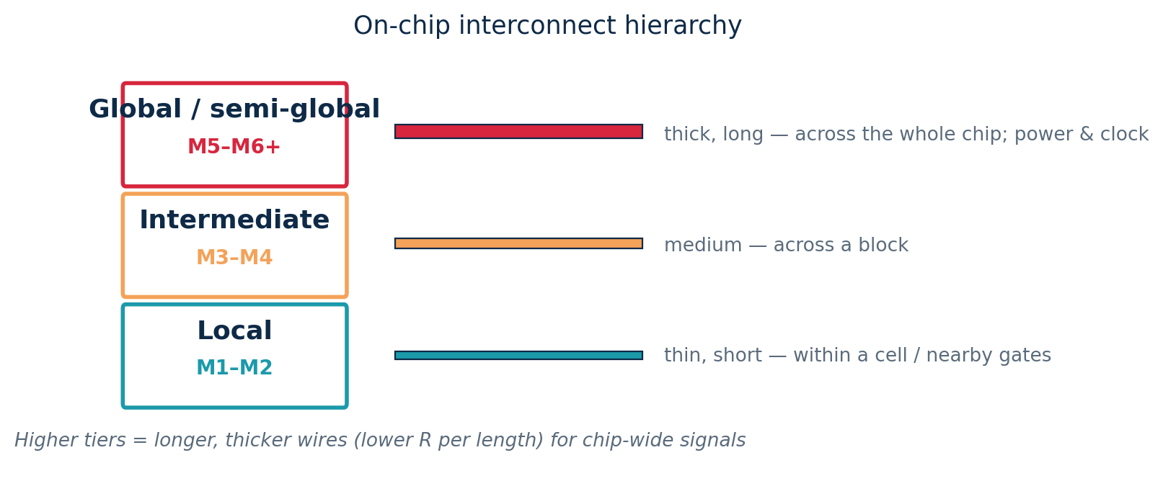
TOPIC 6A · INTERCONNECTS
Introduction to On-Chip Interconnects
An interconnect is simply the metal wire that carries a signal between gates. A modern chip holds kilometres of wiring across many metal tiers.
The interconnect problem
Transistors got faster every node.
Wires got relatively slower (thinner → more R).
So interconnect now dominates delay, power and area on many paths.
Local wires are short and thin; global wires are long and thick (lower resistance) for chip-wide signals, power and clocks.
Module 1 · VLSI Design Fundamentals
74

Slide 75
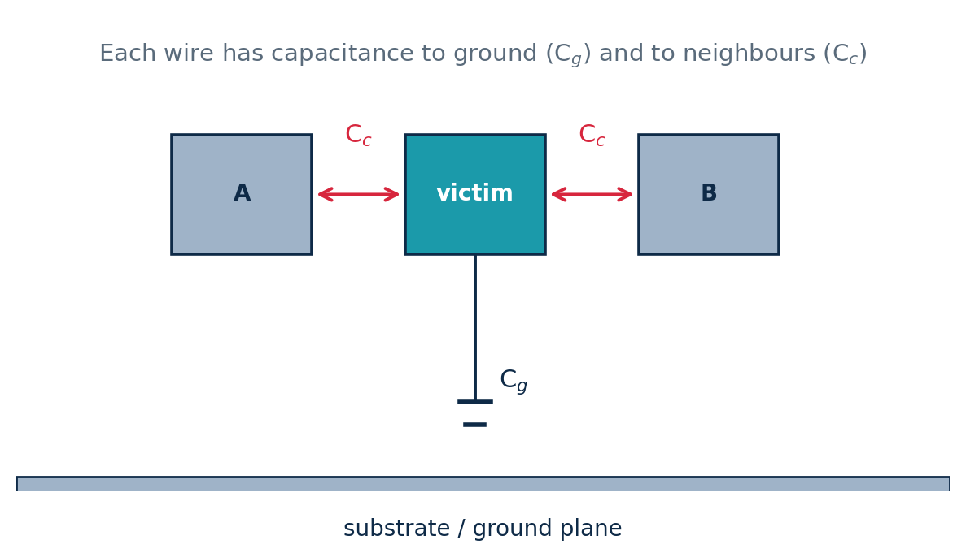
TOPIC 6B · WIRE PARASITICS
On-Chip Wires Are Not Ideal
Every wire has resistance R (grows with length, shrinks with width/thickness).
and capacitance C — to the substrate (C_{g}) and to neighbours (coupling C_{c}).
Coupling C_{c} causes crosstalk — a switching neighbour disturbs a quiet wire.
At advanced nodes wire delay can exceed gate delay.
Scaling reality
Transistors got faster every node, but wires got relatively slower — so interconnect now dominates many timing paths.
Module 1 · VLSI Design Fundamentals
75

Slide 76
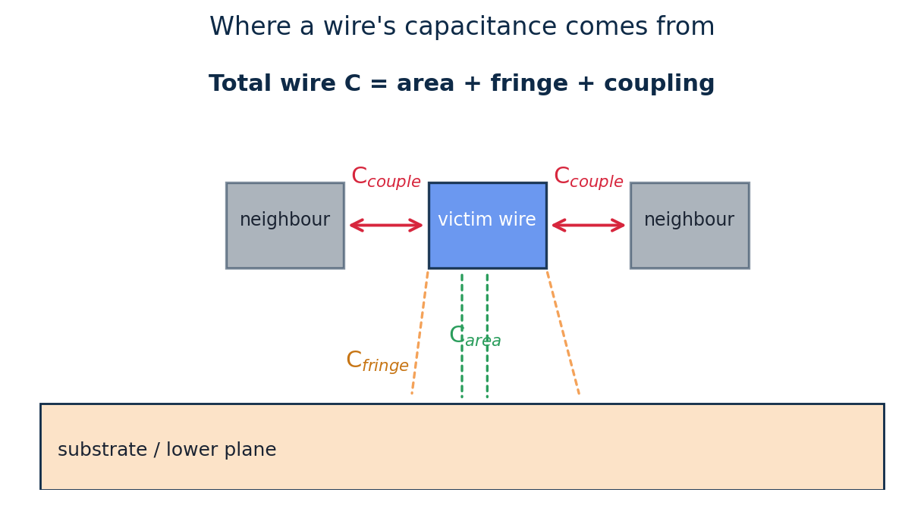
TOPIC 6B · WIRE PARASITICS
Wire Resistance & Capacitance
Resistance R = ρ·L /(W·t) = R_{sheet}·(L/W). Long, thin wires are resistive.
Capacitance has three parts: area (to the plane below), fringe (edge fields) and coupling (to side neighbours).
As wires get closer, coupling C dominates — and it is data-dependent.
Worked example — wire R
R_{sheet} = 0.1 Ω/□, length 200 µm, width 0.2 µm.
Squares = L/W = 200/0.2 = 1000.
R = 0.1 × 1000 = 100 Ω for that single wire.
Module 1 · VLSI Design Fundamentals
76

Slide 77
TOPIC 6B · WIRE PARASITICS
Impact on Circuit Performance
Wire parasitics degrade a design in four distinct ways. Physical design exists largely to keep these under control.
Propagation delay
Crosstalk noise
RC of the wire adds to path delay; long wires can dominate timing.
Coupling C lets a switching aggressor inject noise onto a victim net.
IR drop
Electromigration
Resistance in the power grid lowers the local V_DD, slowing gates.
High current density in thin wires moves metal atoms → long-term failure.
Module 1 · VLSI Design Fundamentals
77

Slide 78
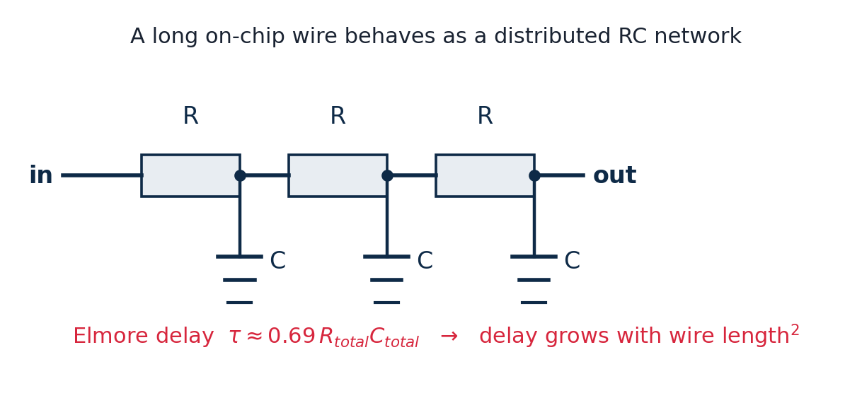
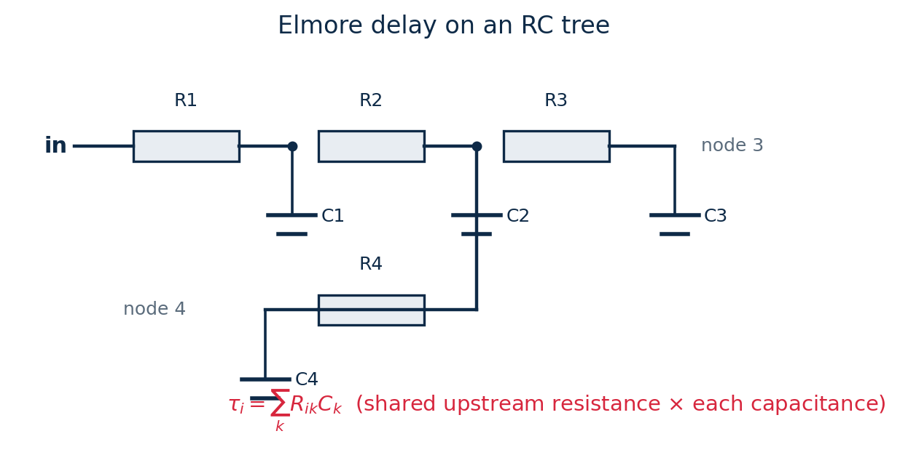
TOPIC 6C · MODELING & SIMULATION
RC Wire-Delay Models
Lumped RC: treat the whole wire as one R and one C. Simple, pessimistic.
Distributed RC: a ladder of small R–C segments. Delay ∝ length².
Worked example — Elmore delay
Wire as 2 segments: R₁=R₂=1 kΩ, C₁=C₂=10 fF.
τ = R₁(C₁+C₂) + (R₁+R₂)C₂ = 1k·20f + 2k·10f = 40 ps.
Fix long wires by inserting buffers to break length² growth.
Module 1 · VLSI Design Fundamentals
78

Slide 79
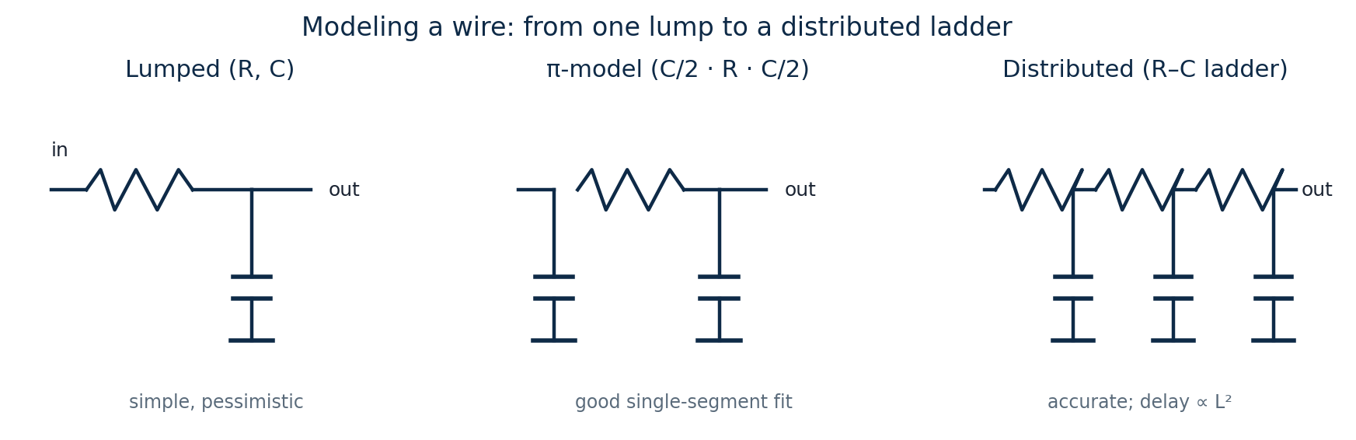
TOPIC 6C · MODELING & SIMULATION
Choosing a Wire Model
How a wire is modelled trades accuracy for effort. Pick the simplest model that is accurate enough for the job.
Model | Use it for | Accuracy
Lumped R, C | Quick hand estimates of short nets | Pessimistic
π-model (C/2·R·C/2) | One-segment sign-off of medium nets | Good
Distributed / Elmore | Long nets and RC trees | High
Module 1 · VLSI Design Fundamentals
79

Slide 80
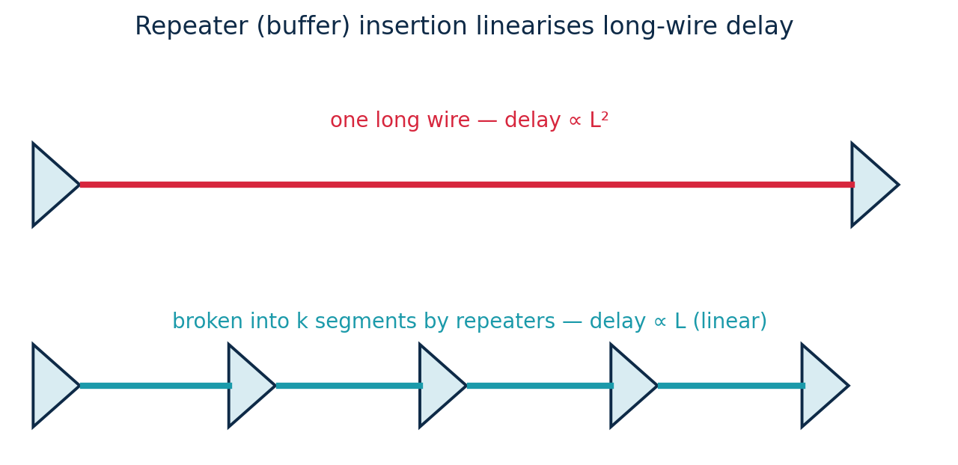
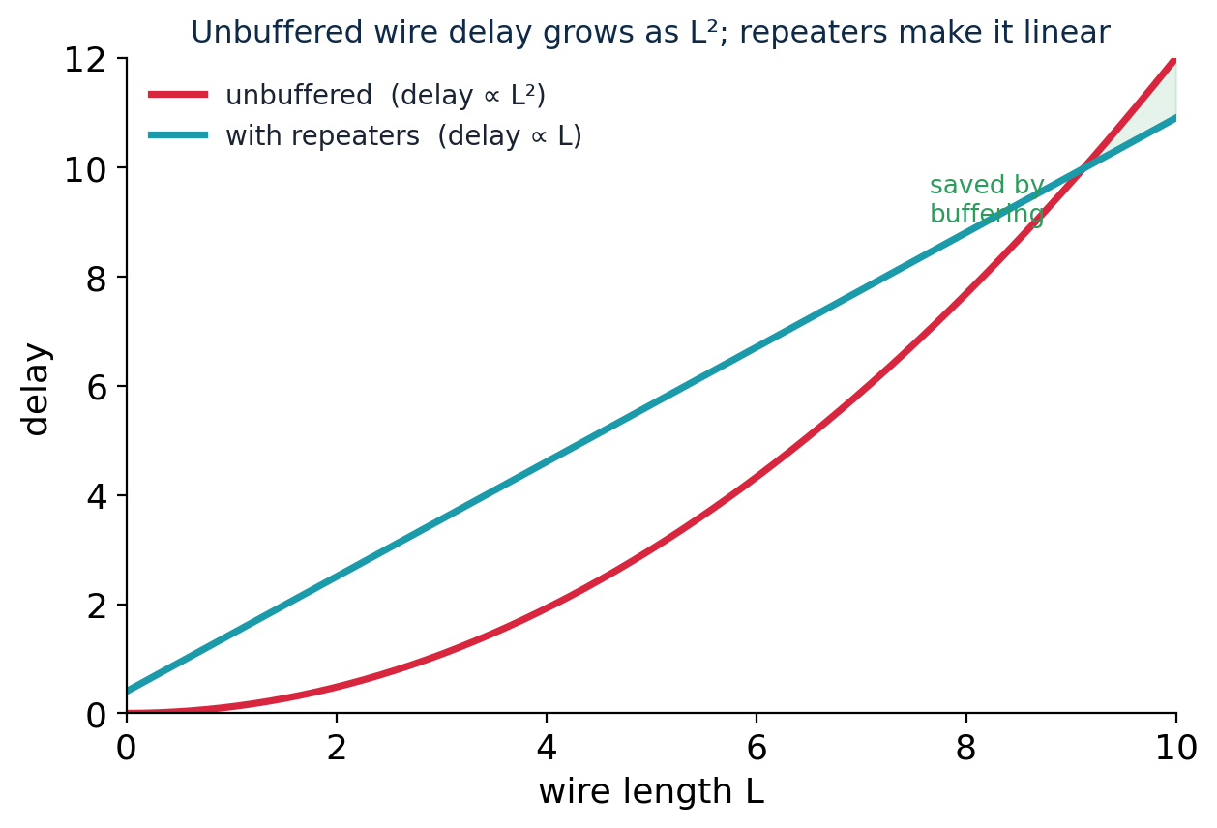
TOPIC 6C · MODELING & SIMULATION
Repeaters: Taming Long-Wire Delay
An unbuffered wire's delay grows as L² (distributed RC).
Splitting it into k segments with repeaters (buffers) makes delay grow linearly with L.
There is an optimal repeater size and spacing that minimises total delay — a standard back-end optimisation.
Module 1 · VLSI Design Fundamentals
80

Slide 81
TOPIC 6C · MODELING & SIMULATION
Extracting & Simulating Wires
Before sign-off, the real wires in a layout are turned into R and C values and simulated — this is how timing tools know the true delay.
1
2
3
4
Layout
Parasitic extraction
RC netlist (SPEF)
Simulate / STA
the drawn polygons (Magic)
compute R & C of every wire from geometry
an annotated, back-annotated netlist
NGSpice or static timing uses the real R, C
Extraction reads the layout geometry and the process data to compute resistance and capacitance for each net.
The result feeds circuit simulation (NGSpice) and static timing — closing the loop between layout and real-world performance.
In this course
Magic extracts parasitics from your layout; NGSpice then simulates the netlist with those R and C values to confirm the delay you estimated by hand.
Module 1 · VLSI Design Fundamentals
81

Slide 82
MODULE 1 · TOPIC 7
Bonding, Packaging & Assembly
A bare die cannot be used on its own. Packaging protects it, connects it to the board, and removes its heat — the bridge from silicon to system.
a
Packaging technologies & assembly
The assembly flow and the main package families
b
Bonding diagram design & considerations
Wire-bond vs flip-chip, and mapping die pads to package pins
c
Packaging trends & challenges
Advanced packaging, thermal, signal integrity, heterogeneous integration
Module 1 · VLSI Design Fundamentals
82

Slide 83
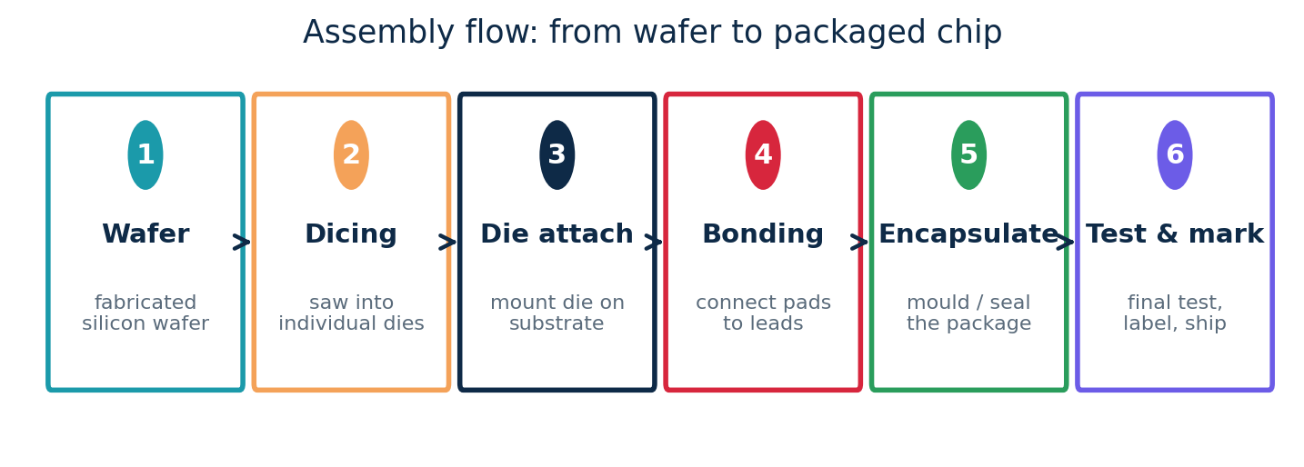
TOPIC 7A · PACKAGING & ASSEMBLY
From Die to Package: the Assembly Flow
After fabrication, the wafer is cut into dies and each good die is assembled into a package. Packaging gives the chip mechanical protection, electrical connections and a heat path.
A package must deliver four things: protection, power & signal connections, heat removal, and a footprint the board can use.
Module 1 · VLSI Design Fundamentals
83

Slide 84
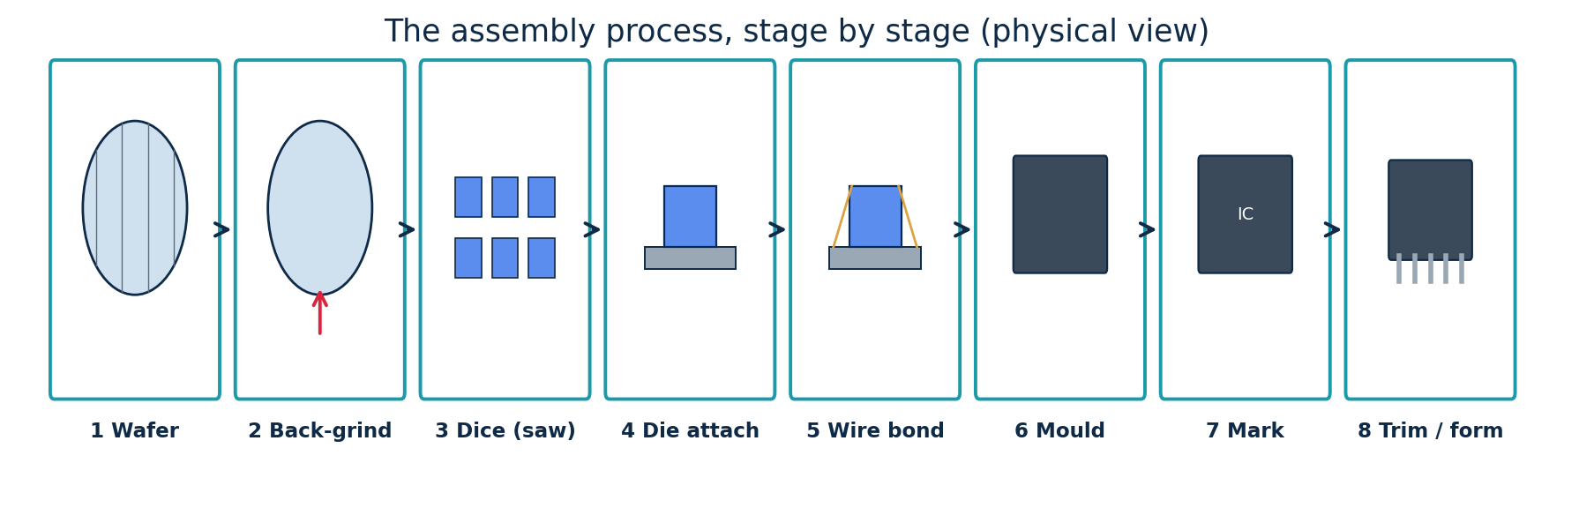
TOPIC 7A · PACKAGING & ASSEMBLY
The Assembly Process, Step by Step
1–2 Wafer & back-grind: the finished wafer is thinned from the back so the die is flatter and dissipates heat better
3 Dicing (sawing): a diamond saw (or laser) cuts the wafer into individual dies along the scribe lines
4 Die attach: each good die is picked and glued onto the leadframe paddle (or substrate) with epoxy
5 Wire bonding: fine gold/copper wires join the die's bond pads to the package leads
6 Encapsulation (mould): the assembly is sealed in epoxy mould compound (or a ceramic/metal lid) for protection
7–8 Mark, trim & form: laser-mark the part number, then trim the leadframe and bend the leads to shape; final test follows
Module 1 · VLSI Design Fundamentals
84

Slide 85
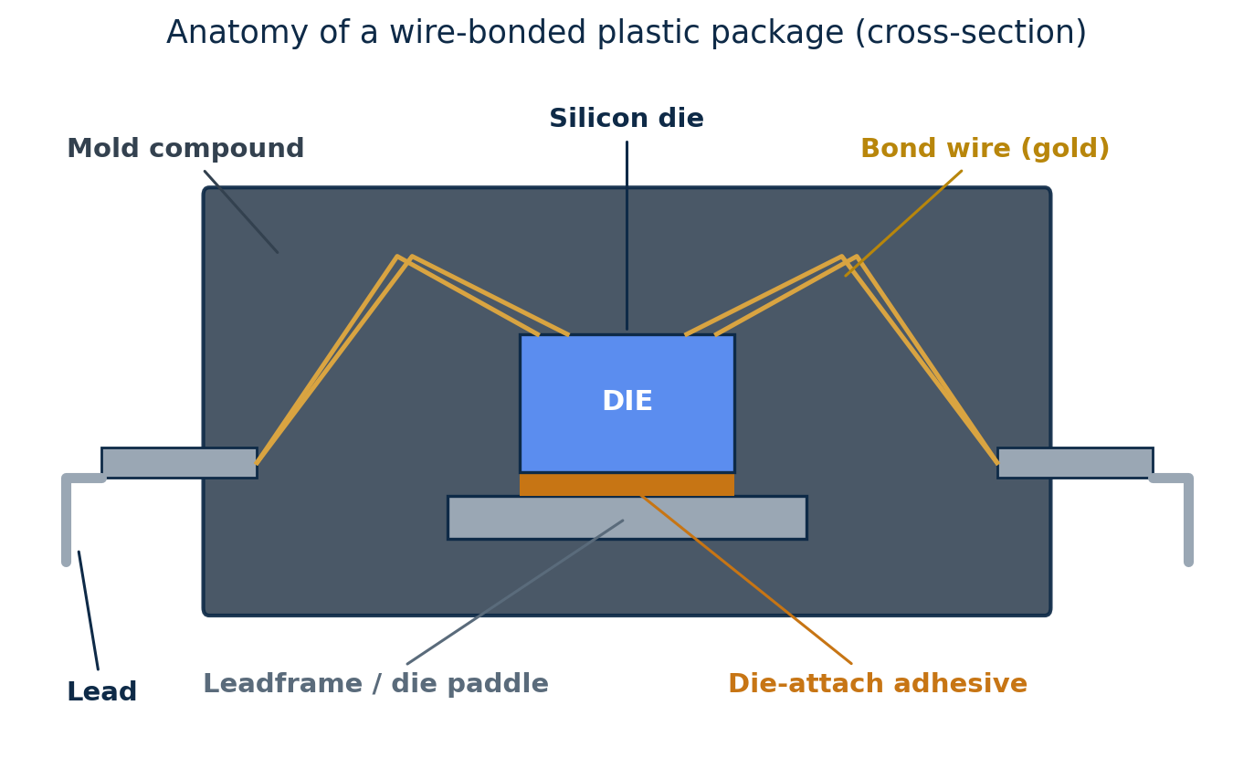
TOPIC 7A · PACKAGING & ASSEMBLY
Anatomy of a Package
What is actually inside a packaged chip:
Silicon die: the chip itself
Die-attach adhesive: glues the die to the paddle, conducts heat
Leadframe / paddle: metal frame that supports the die and forms the leads
Bond wires: carry signals from die pads to the leads
Mould compound: epoxy that seals and protects everything
Leads / balls: the external pins the board solders to
Module 1 · VLSI Design Fundamentals
85

Slide 86
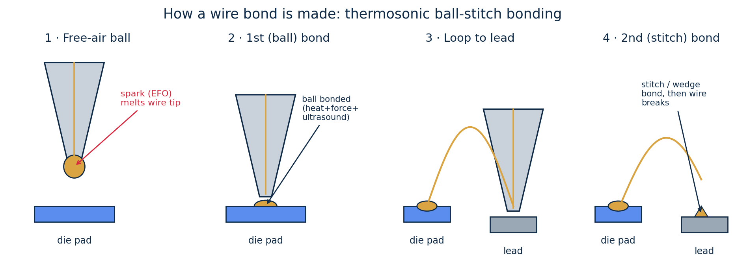
TOPIC 7A · PACKAGING & ASSEMBLY
How a Wire Bond Is Made
The bonding step (4 in the assembly flow) is itself a precise four-stage process. The most common method is thermosonic ball-stitch bonding, using heat, force and ultrasonic energy.
1 Free-air ball: an electric spark (EFO) melts the wire tip into a tiny ball at the capillary
2 First (ball) bond: the ball is pressed onto the die pad — heat + force + ultrasound weld it
3 Loop: the capillary rises and moves to the lead, paying out a controlled arc of wire
4 Second (stitch) bond: the wire is crushed onto the lead (wedge bond), then the wire is broken to finish
Wedge bonding (aluminium wire, no ball) is the other main method — slower, but used for power and aluminium pads.
Module 1 · VLSI Design Fundamentals
86

Slide 87

TOPIC 7A · PACKAGING & ASSEMBLY
Packaging Technologies (Families)
Packages have evolved from a handful of through-hole pins to dense ball arrays and stacked multi-die modules, tracking the rising pin counts and integration of the chips inside.
Module 1 · VLSI Design Fundamentals
87

Slide 88

TOPIC 7A · PACKAGING & ASSEMBLY
Classifying Packages
The same families can be sorted along three independent axes — a useful way to read any package's datasheet.
How to read it
Mounting: through-hole pins go through the board; surface-mount sit on top (denser, dominant today).
I/O location: peripheral leads sit on the edges; area-array balls cover the underside (far more I/O).
Material: plastic is cheap and common; ceramic is hermetic for harsh/high-reliability use.
Module 1 · VLSI Design Fundamentals
88

Slide 89

TOPIC 7A · PACKAGING & ASSEMBLY
Levels of Packaging
Packaging is a hierarchy. The single-chip package (Level 1) is just one rung between the bare die and the finished product.
Each level adds interconnect: bond wires/bumps (L1), solder joints to the PCB (L2), and connectors/cables (L3) — every hop adds delay, loss and cost.
Module 1 · VLSI Design Fundamentals
89

Slide 90

TOPIC 7A · PACKAGING & ASSEMBLY
Through-Hole vs Surface-Mount
How a package attaches to the board is a basic technology split. Surface-mount has largely replaced through-hole because it is far denser and machine-assembled.
Why SMT won
Both sides of the board can be populated.
No drilled holes → smaller pads, finer pitch.
Automated pick-and-place + reflow soldering.
Through-hole survives where mechanical strength matters (connectors, power).
Surface-mount enables the QFP, QFN and BGA families; through-hole is the DIP/PGA world.
Module 1 · VLSI Design Fundamentals
90

Slide 91
TOPIC 7A · PACKAGING & ASSEMBLY
Package Types at a Glance
A quick reference to the main package types, their typical pin counts and where each is used.
Package | Mounting | Pin count | Pitch | Typical use
DIP | Through-hole | 8–64 | 2.54 mm | legacy, prototyping
SOIC | Surface-mount | 8–32 | 1.27 mm | small jellybean ICs
QFP | Surface-mount | 32–256 | 0.4–0.8 mm | MCUs, ASICs
QFN | Surface-mount | 16–64 | 0.4–0.65 mm | compact, low-cost
PGA | Through-hole | 100–1000+ | 2.54 mm | older CPUs
BGA | Surface-mount | 100–2000+ | 0.4–1.0 mm | high pin count, SoCs
WLCSP | Surface-mount | 4–200 | 0.35–0.5 mm | mobile, chip-scale
Pin count and pitch are indicative — exact ranges vary by vendor and generation.
Reading the trend
As you move down, mounting goes surface-mount, pitch shrinks and pin count climbs — exactly the DIP → BGA/WLCSP progression seen in the family chart.
Module 1 · VLSI Design Fundamentals
91

Slide 92

TOPIC 7A · PACKAGING & ASSEMBLY
Wafer-Level & Advanced Assembly
Traditionally a wafer is diced first, then each die is packaged. Wafer-level packaging (WLP) builds the package on the whole wafer before dicing — giving the smallest possible packages.
Why it matters
Smallest footprint and lowest profile.
Shorter connections → better electrical performance.
A path toward 2.5D/3D integration.
Fan-in (WLCSP): the package is the size of the die; solder balls fit within the die footprint. Best for low pin counts and tiny mobile parts.
Fan-out (FOWLP): the die is embedded in mould and a redistribution layer (RDL) spreads the I/O beyond the die, allowing more balls and finer integration.
Module 1 · VLSI Design Fundamentals
92

Slide 93

TOPIC 7B · BONDING DIAGRAM
Connecting the Die: Wire-Bond vs Flip-Chip
Wire bond: die face-up; thin gold/copper wires arc from pads to the substrate. Cheap, mature, but pads only on the die edge.
Flip-chip: die face-down on solder bumps in an area array. More I/O, shorter connections, better electrical & thermal — used at high performance.
Module 1 · VLSI Design Fundamentals
93

Slide 94

TOPIC 7B · BONDING DIAGRAM
The Bonding Diagram & Its Considerations
A bonding diagram maps every die pad to its package pin and shows each bond wire — the contract between the chip designer and the assembly house.
Pad placement: distribute pads around the die edge for short, even wires.
Wire length & angle: keep bonds short and avoid crossing or shorting wires.
Power & ground: use multiple bonds for V_{DD}/GND to lower inductance and IR drop.
Signal integrity: bond-wire inductance causes ground bounce — a real limit on fast I/O.
Pin assignment: match the package pinout to the board for clean routing.
Module 1 · VLSI Design Fundamentals
94

Slide 95
TOPIC 7C · TRENDS & CHALLENGES
Packaging Trends & Challenges
As single-die scaling slows, packaging has become a primary lever for performance — but it brings its own hard problems.
Trends
Challenges
Heterogeneous integration: combine CPU, memory, analog & chiplets in one package
Thermal: removing heat from dense, stacked dies.
Signal & power integrity: inductance, ground bounce, IR drop at high speed.
Mechanical stress: thermal-expansion mismatch and warpage.
Yield & test: known-good-die testing before costly stacking.
Cost: advanced packaging can rival the die in cost.
2.5D (interposers): dies side-by-side on a silicon interposer with dense links
3D stacking: stack dies vertically (e.g. HBM memory) with through-silicon vias
System-in-Package (SiP): a whole subsystem in one module
Module 1 · VLSI Design Fundamentals
95

Slide 96
MODULE 1 · PERFORMANCE & TIMING
Delay, Power & Timing
How fast can the chip run? The next four sections build from first principles of delay to full sequential timing.
•
Foundations
Propagation delay, transition times and the RC / Elmore model
8
Gate delays & logical effort
Estimating and sizing gates for speed
9
Critical-path optimization
Finding and shortening the longest combinational path
10
Sequential-circuit timing
Flip-flops, setup/hold and pipelining
Module 1 · VLSI Design Fundamentals
96

Slide 97
PERFORMANCE · FOUNDATIONS
Delay & Transition Times
t_{pHL} / t_{pLH}: output high→low / low→high delay, measured at 50%.
t_{p} = ½(t_{pHL} + t_{pLH}) — the gate's average delay.
Rise/fall t_{r}, t_{f}: 10%–90% transition; set by drive strength and load.
A balanced gate has t_{pHL} ≈ t_{pLH} (size PMOS ~2× NMOS to match).
Example — balancing
Electrons move ~2× faster than holes, so a same-size PMOS is ~2× weaker. Widening PMOS ~2× equalises rise and fall delays.
Module 1 · VLSI Design Fundamentals
97

Slide 98
PERFORMANCE · FOUNDATIONS
The RC Delay Model
Model each driver as resistance R, each node as capacitance C.
Single stage: t_{p} ≈ 0.69·R·C.
RC trees: use Elmore delay — each node's delay = Σ (shared upstream R × downstream C).
Series resistances add; parallel branches share upstream R.
Worked example — two-stage path
Driver R=6 kΩ charges C₁=15 fF (wire) then gate input C₂=10 fF.
Lumped C = 25 fF → t_{p} ≈ 0.69 × 6k × 25f = 104 ps.
To speed up: lower R (bigger driver) or split the wire with a buffer.
Rule of thumb
Delay scales with fan-out: driving more gates adds load C and slows the stage.
Buffer insertion trades a little extra delay per stage for a big win on long nets.
Module 1 · VLSI Design Fundamentals
98

Slide 99
MODULE 1 · TOPIC 8
Gate Delays & Logical Effort
A simple, powerful way to estimate gate delay by hand, size gates for speed, and balance speed against power.
a
Gate delay modeling & estimation
The linear delay model d = g·h + p; effort, parasitic and electrical effort
b
Introduction to logical effort
Logical effort g of gates, path effort and sizing for minimum delay
c
Delay–power trade-off via P/N ratio
How β = W_p/W_n trades speed against area and power
Module 1 · VLSI Design Fundamentals
99

Slide 100

TOPIC 8A · DELAY MODELING
Modeling Gate Delay: d = g·h + p
Logical effort models a gate's delay as a straight line. Delay is split into a fixed part and a part that grows with the load the gate must drive.
d = g·h + p (in units of an inverter's basic delay τ).
g — logical effort: how much worse than an inverter the gate is at producing output current (gate-type property).
h — electrical effort (fanout): h = C_{out} / C_{in} — the load ÷ the gate's own input cap.
p — parasitic delay: the intrinsic self-load delay, independent of fanout.
g·h is the effort delay; the line's slope is g and its intercept is p.
Real delay
Absolute delay = d × τ, where τ (≈ a few ps) is the technology's basic inverter delay.
Module 1 · VLSI Design Fundamentals
100

Slide 101

TOPIC 8A · DELAY ESTIMATION
Estimating Delay: Fanout & Gate Type
Bigger load (higher h) → more delay, linearly.
A gate with larger g or p is slower than an inverter at the same fanout.
NAND beats NOR: series PMOS in the NOR make it weaker, so g_{NOR} > g_{NAND} — prefer NAND-based logic.
Worked estimate
A NAND2 (g=4/3, p=2) drives a load 3× its input cap (h=3).
d = g·h + p = (4/3)(3) + 2 = 4 + 2 = 6 τ.
An inverter (g=1, p=1) at the same h: d = 3 + 1 = 4 τ — clearly faster.
Module 1 · VLSI Design Fundamentals
101

Slide 102

TOPIC 8B · LOGICAL EFFORT
Logical Effort of Common Gates
Logical effort g captures how a gate's topology hurts its drive strength. An inverter is the reference (g = 1); every other gate is worse.
Where g comes from
Series transistors must be made wider to keep drive → larger input cap → larger g.
NAND stacks NMOS (strong); NOR stacks PMOS (weak), so NOR's g is higher.
n-input gates: g grows with n — wide gates are costly.
Rule: keep fan-in low and favour NAND.
Module 1 · VLSI Design Fundamentals
102

Slide 103

TOPIC 8B · LOGICAL EFFORT
Sizing a Path for Minimum Delay
Logical effort extends to a whole path of gates, telling us how to size each stage so the path is as fast as possible.
Worked: F = 64
Best stage effort ≈ 4 → N = log₄64 = 3 stages.
Each stage f = 64^(1/3) = 4; size 1× → 4× → 16×.
Path effort F = G·B·H (G = product of g's, B = branching, H = C_{L}/C_{in}).
Minimum delay when each of N stages carries equal effort f = F^(1/N); then size stages back-to-front from C_{in} = g·C_{out}/f.
Module 1 · VLSI Design Fundamentals
103

Slide 104

TOPIC 8C · DELAY–POWER TRADE-OFF
The P/N Ratio (β = W_p / W_n)
The P/N ratio sets how strong the PMOS pull-up is relative to the NMOS pull-down — the central knob for trading delay against area and power.
Holes are ~2× slower, so an equal-width PMOS is weaker; raising β strengthens the pull-up.
β ≈ 2: equal rise and fall times (symmetric VTC, balanced margins).
β ≈ √2 (~1.4): minimum average delay — the speed-optimal point.
β = 1: smallest PMOS → least area, input cap and dynamic power, but slower rise.
The trade-off
Larger β buys speed/symmetry; smaller β buys area & power. Area/power ∝ (1+β), so pushing β up costs more on every gate.
Module 1 · VLSI Design Fundamentals
104

Slide 105
TOPIC 8C · DELAY–POWER TRADE-OFF
Choosing the Best P/N Ratio
There is no single 'right' β — it depends on what the design is optimising. These are the standard operating points.
P/N ratio β | What it optimises | Cost / trade-off
1 | Minimum area, input cap & dynamic power | Asymmetric VTC; slower rise than fall
√2 ≈ 1.4 | Minimum average gate delay (speed) | Rise/fall slightly unequal
2 | Equal rise/fall, symmetric VTC, balanced noise margins | More area & power than β=1
>2 | Faster rise / drives heavy capacitive loads | Diminishing returns; large area & power
Practical guidance
Low-power / dense logic: use β ≈ 1–1.5 to save area and switching power.
Balanced standard cells: use β ≈ 2 so cells behave symmetrically in timing.
Speed-critical nets: size up (β toward 2 and beyond) only where the path demands it — the energy cost is paid on every switch.
Module 1 · VLSI Design Fundamentals
105

Slide 106
MODULE 1 · TOPIC 9
Critical-Path Optimization
A chip is only as fast as its slowest combinational path. Finding that path — and shortening it — is the heart of timing closure.
a
Identifying critical paths
Arrival times, the longest path, slack and static timing analysis
b
Gate sizing & logic restructuring
Upsizing critical gates and rebuilding logic into shallow trees
c
Timing optimization for performance
The optimisation loop and the full toolbox of speed-up techniques
Module 1 · VLSI Design Fundamentals
106

Slide 107

TOPIC 9A · IDENTIFYING CRITICAL PATHS
What Is the Critical Path?
The critical path is the longest delay path from any input (or register) to any output (or register). Its delay sets the fastest clock the circuit can run at.
How to find it
Arrival time at each gate = max of input arrivals + that gate's delay.
Propagate forward from inputs to outputs.
The output with the largest arrival is the critical path.
Here: A→g1→g4→g6→g7 = 10, the longest of all paths.
Module 1 · VLSI Design Fundamentals
107

Slide 108
TOPIC 9A · IDENTIFYING CRITICAL PATHS
Static Timing Analysis & Slack
Real designs have millions of paths, so tools find the critical ones automatically with Static Timing Analysis (STA) — no simulation vectors needed.
Arrival time: when a signal actually reaches a node (forward pass).
Required time: when it must arrive to meet the clock (backward pass).
Slack = required − arrival. Negative slack = a timing violation.
The critical path is the one with the worst (most negative) slack.
STA also flags false paths (can't actually toggle) and multicycle paths so they aren't fixed needlessly.
The timing equation
T_{clk} ≥ t_{cq} + t_{logic} + t_{setup}
t_logic is the combinational critical-path delay — the only term logic optimisation can shrink.
Lower t_logic → higher clock frequency.
Why only the critical path matters
Speeding up a non-critical path does nothing for the clock. Effort goes only where slack is negative — then the next-worst path becomes the new target.
Module 1 · VLSI Design Fundamentals
108

Slide 109

TOPIC 9B · SIZING & RESTRUCTURING
Technique 1: Gate Sizing
The quickest fix: make the transistors in the critical gates wider so they drive their load faster. Logical effort tells us how much.
Upsize only the gates on the critical path — leave the rest small.
Larger gate → lower output resistance → less delay.
Cost: more area, input capacitance and power.
Diminishing returns: a bigger gate also loads the stage before it.
Best done with logical-effort sizing (Topic 8).
Module 1 · VLSI Design Fundamentals
109

Slide 110

TOPIC 9B · SIZING & RESTRUCTURING
Technique 2: Logic Restructuring
Sizing only goes so far. Often the bigger win is changing the logic itself so the critical signal passes through fewer levels.
Other restructuring
Factoring to shorten the late-arriving input's path.
Buffer/repeater insertion on long, heavily-loaded nets.
Cloning/duplication to split a high-fanout driver.
Re-association / tree balancing: turn a deep chain of gates into a balanced tree — same function, fewer logic levels.
Late-arriving inputs
Restructure so the signal that arrives latest passes through the fewest remaining gates — a powerful, area-cheap speed-up.
Module 1 · VLSI Design Fundamentals
110

Slide 111

TOPIC 9C · TIMING OPTIMIZATION
Optimising for Performance
Timing optimisation is an iterative loop: find the worst path, fix it, re-analyse — until all slack is non-negative (timing closure).
The optimisation toolbox
Gate sizing — widen critical gates.
Restructuring — balance trees, factor, clone.
Buffer insertion — drive long/loaded nets.
Pipelining — split logic with a register to cut t_{logic}.
Retiming — move registers to balance stages.
V_{th}/V_{DD} tuning — faster cells on critical paths.
Closure
Fixing one path can expose another; iterate until every path meets its constraint, balancing speed against area and power.
Module 1 · VLSI Design Fundamentals
111

Slide 112
MODULE 1 · TOPIC 10
Timing in Sequential Circuits
Real chips have memory. Flip-flops store state on the clock edge — and the clock period must respect their setup and hold requirements.
a
Sequential circuits: flip-flops & registers
Latches vs edge-triggered flip-flops, and registers
b
Setup & hold time analysis
The sampling window and the max/min-delay timing equations
c
Timing considerations & optimization
Clock skew, jitter, metastability, pipelining and retiming
Module 1 · VLSI Design Fundamentals
112

Slide 113

TOPIC 10A · FLIP-FLOPS & REGISTERS
Sequential Circuits & the D Flip-Flop
Combinational logic depends only on its present inputs. Sequential logic also depends on stored state — held in flip-flops and clocked by a common clock.
A D flip-flop copies D to Q on the rising clock edge, then holds it.
Between edges the output is stable — a 1-bit memory.
A register is just N flip-flops sharing one clock, storing an N-bit word.
State + logic + clock = a synchronous system.
Module 1 · VLSI Design Fundamentals
113

Slide 114

TOPIC 10A · FLIP-FLOPS & REGISTERS
Latches vs Flip-Flops
Both store a bit, but they capture data differently — a distinction that matters for timing.
Build-up
2 latches (master + slave) on opposite clock phases = one edge-triggered flip-flop.
Latch (level-sensitive): transparent the whole time the clock is high — Q follows D — and holds when the clock is low.
Flip-flop (edge-triggered): samples D only at the clock edge, so the output changes at most once per cycle — easier to reason about, and the default for synchronous design.
Module 1 · VLSI Design Fundamentals
114

Slide 115

TOPIC 10A · FLIP-FLOPS & REGISTERS
Inside the Flip-Flop: Master–Slave
An edge-triggered flip-flop is built from two level-sensitive latches in series, clocked on opposite phases — this is what makes it capture on the edge.
While clk = 0: the master is transparent and tracks D; the slave holds the old value.
On the rising edge: the master freezes its value and the slave becomes transparent, passing it to Q.
Net effect: Q updates once, exactly at the edge — true edge-triggered behaviour.
The master's last value before the edge is why setup time exists.
Module 1 · VLSI Design Fundamentals
115

Slide 116
TOPIC 10A · FLIP-FLOPS & REGISTERS
Flip-Flop Types
The D flip-flop is the workhorse of synchronous design, but the same edge-triggered storage comes in four classic flavours.
Type | Inputs | Next state Q⁺ | Typical use
D | D | Q⁺ = D | data storage, registers (most common)
T | T | toggle if T=1, else hold | counters, frequency dividers
JK | J, K | set/reset; J=K=1 toggles | general-purpose, no invalid state
SR | S, R | S=1 set, R=1 reset; S=R=1 invalid | basic latch / control
Why D dominates
D flip-flops map directly onto how synthesis tools build registers, are easy to time, and avoid the invalid/forbidden states of SR. T and JK are mainly seen inside counters; SR is the underlying latch primitive.
Module 1 · VLSI Design Fundamentals
116

Slide 117

TOPIC 10A · FLIP-FLOPS & REGISTERS
Registers, Shift Registers & Counters
Group flip-flops together and they become the storage and data-movement building blocks of every datapath.
Also built from FFs
Counters (toggle FFs that count clock edges).
State machines (a state register + next-state logic).
Register: N flip-flops on one clock holding an N-bit word — the basic parallel store.
Shift register: flip-flops chained Q→D so data moves one position per clock — used for serial↔parallel conversion and delays.
Module 1 · VLSI Design Fundamentals
117

Slide 118

TOPIC 10B · SETUP & HOLD ANALYSIS
Setup & Hold Time
For a flip-flop to capture data reliably, the data input must be stable in a window around the clock edge — or the output can go metastable.
Setup time t_{setup}: data must be steady before the edge.
Hold time t_{hold}: data must stay steady after the edge.
Violate either → metastability: the output hovers between 0 and 1 unpredictably.
These set the timing constraints on every path.
Module 1 · VLSI Design Fundamentals
118

Slide 119

TOPIC 10B · SETUP & HOLD ANALYSIS
Reading a Timing Diagram
Putting clock, data and output on one timing diagram shows exactly where setup, hold and clock-to-Q live.
t_{cq} (clock-to-Q): delay from the edge until Q is valid.
t_{setup}: D must already be steady this long before the edge.
t_{hold}: D must stay steady this long after the edge.
The shaded band is the keep-out window where D must not change.
Module 1 · VLSI Design Fundamentals
119

Slide 120

TOPIC 10B · SETUP & HOLD ANALYSIS
Timing a Register-to-Register Path
Between two flip-flops sits combinational logic. Two inequalities must hold — one for the slowest path, one for the fastest.
Worked: max clock
t_{cq}=50ps, t_{logic}=300ps, t_{setup}=40ps.
T_{clk} ≥ 390ps → f_{max} ≈ 2.56 GHz.
Setup (max-delay): T_{clk} ≥ t_{cq} + t_{logic} + t_{setup} — limits the fastest clock.
Hold (min-delay): t_{cq} + t_{logic(min)} ≥ t_{hold} — independent of clock period; fix with min-delay buffers.
Module 1 · VLSI Design Fundamentals
120

Slide 121

TOPIC 10B · SETUP & HOLD ANALYSIS
Clock Skew & Timing Margins
The clock never reaches every flip-flop at the same instant. That difference — clock skew — shifts the timing budget, helping one check and hurting the other.
Skew δ = clock arriving later at the capture flip-flop than the launch one.
Setup relaxes: T_{clk} + δ ≥ t_{cq} + t_{logic} + t_{setup} — the data gets extra time.
Hold tightens: t_{cq} + t_{logic(min)} ≥ t_{hold} + δ — skew eats hold margin.
So skew is a double-edged sword; clock-tree design works to minimise it.
Module 1 · VLSI Design Fundamentals
121

Slide 122
TOPIC 10C · CONSIDERATIONS & OPTIMIZATION
Clock Skew, Jitter & Metastability
Beyond the basic equations, real clocks are imperfect — three effects every sequential design must manage.
Clock skew
the clock reaches different flip-flops at slightly different times; it eats into setup margin (or worsens hold) and must be budgeted.
Clock jitter
cycle-to-cycle variation in the clock edge; it shrinks the usable period, so designers keep a margin.
Metastability
a setup/hold violation can leave a flip-flop's output undefined for a while; synchronizers (two FFs in series) reduce the risk for asynchronous inputs.
Module 1 · VLSI Design Fundamentals
122

Slide 123

TOPIC 10C · CONSIDERATIONS & OPTIMIZATION
Metastability & Synchronizers
When an input is asynchronous (from another clock domain or the outside world), it can violate setup/hold and make a flip-flop metastable. A synchronizer manages the risk.
Rules of thumb
Synchronise every signal crossing a clock domain.
Never fan out an un-synchronised async signal to many places.
Metastability: a flip-flop caught mid-transition can sit between 0 and 1 for an unpredictable time before settling.
Two-FF synchronizer: a second flip-flop gives the first a full clock cycle to resolve, so the chance of a metastable value reaching the logic becomes astronomically small (huge MTBF).
Module 1 · VLSI Design Fundamentals
123

Slide 124

TOPIC 10C · CONSIDERATIONS & OPTIMIZATION
Pipelining & Retiming
To run a sequential design faster, shorten the logic between registers. Two classic transformations do exactly that.
Pipelining: insert registers to split a deep logic block into shorter stages → smaller t_{logic} → faster clock and higher throughput (at the cost of latency).
Retiming: move existing registers across logic to balance stage delays — same function, better worst-case stage.
Also: parallelism, and the gate-level tricks from Topic 9 (sizing, restructuring).
Module 1 · VLSI Design Fundamentals
124

Slide 125
REFERENCE
Module 1 Formula Sheet
Saturation current
Triode current
I_D = ½·k·(V_GS − V_th)²
I_D = k·[(V_GS−V_th)·V_DS − V_DS²/2]
Propagation delay
Elmore delay
t_p ≈ 0.69 · R · C
τ_i = Σ_k R_ik · C_k
Dynamic power
Energy per switch
P_dyn = α · C · V_DD² · f
E = ½ · C · V_DD²
Noise margins
Logical effort delay
NM_H = V_OH−V_IH ; NM_L = V_IL−V_OL
d = g · h + p
Setup constraint
Wire delay scaling
T ≥ t_cq + t_logic + t_setup
t_wire ∝ (length)² (un-buffered)
Module 1 · VLSI Design Fundamentals
125

Slide 126
WRAP-UP
Module 1 — Key Takeaways
VLSI integrates billions of transistors
The MOSFET is a voltage-controlled switch
designed through a layered flow (spec → GDSII), trading off Power-Performance-Area.
NMOS pulls down on a HIGH input; PMOS pulls up on a LOW input.
CMOS is complementary
Every gate = PUN + PDN duals
one network conducts at a time → full swing and near-zero static power.
series ↔ parallel; NAND, NOR and AOI all follow one 4-step recipe.
Layout makes it physical
Wires are not free
stick diagrams, λ design rules and DRC/LVS turn schematics into silicon.
RC interconnect adds delay; models and repeaters keep it in check.
Timing sets the speed
Packaging bridges chip & system
t_p ≈ 0.69·RC; setup/hold and the critical path fix the clock frequency.
bonding, assembly, thermal and advanced packaging finish the job.
Module 1 · VLSI Design Fundamentals
126

Slide 127
Practice makes it permanent
Your companion workbook expands every topic above into guided tutorials and a large graded problem set — all with full worked solutions.
14 Guided Tutorials
80 Practice Problems
Full Solutions
Step-by-step: design flow, transistor analysis, gate design, delay, layout & wires.
Conceptual, design and numerical — graded easy → hard, across nine sections.
Every answer worked out so you can self-assess and learn.
Up next → Module 2: Verilog RTL Coding for Synthesis
Module 1 · VLSI Design Fundamentals
127

