Slide 1
TOPIC 1
Introduction to VLSI Design
Subtopic 1a: VLSI technology and its applications · Subtopic 1b: the VLSI design flow. Tiered Basic→Industry, with worked examples and hands-on tutorials.
1a · What VLSI is, IC evolution, Moore's law, applications, ecosystem, ASIC/FPGA/SoC
1b · The design flow, front/back-end, RTL-to-GDSII
Practical examples · Worked example (4-bit counter) · Tutorials T1–T2 · Glossary
Module 2 · Verilog RTL Coding for Synthesis
NIE/ELE/N0102 · Topic 1 · 1

Slide 2
TOPIC 1A · OVERVIEW
What Is VLSI? From a Transistor to a Billion of Them
VLSI (Very-Large-Scale Integration) is the practice of fabricating an entire electronic system — millions to billions of transistors — onto a single piece of silicon called a die. The transistor is the atomic switch of digital electronics: apply a voltage to its gate and it conducts, remove it and it blocks. Wire millions of these switches in the right pattern and you get adders, processors, memories and radios.
The word “scale” refers to how many devices share one chip. Integration grew through clear eras — SSI, MSI, LSI and finally VLSI — as photolithography printed ever-smaller features. A 1971 microprocessor held ~2,300 transistors; modern processors hold tens of billions on a fingernail-sized die. No human places those by hand: we describe behaviour in Verilog and let synthesis build the gates. RTL is therefore the human entry point into VLSI — the purpose of this module.
What · Why · How · Limitation
What: a complete system on silicon. Why: integration cuts cost, power and size while raising performance. How: lithography prints transistors; designers describe behaviour in HDL. Limitation: physics (heat, leakage, cost) is slowing pure scaling — so efficient design and reuse now differentiate.
Key takeaways
Interview & industry
VLSI = an entire system of millions–billions of transistors on one die.
Integration scaled SSI → MSI → LSI → VLSI as feature sizes shrank.
RTL is how humans design at that scale; the tools build the transistors.
Q: What does the “scale” in VLSI refer to, and name the integration eras.
Tip: Know approximate transistor counts per era; it is a common warm-up question.
Running example used throughout this topic
We will follow one tiny design — a 4-bit binary counter — from idea, through the design flow, to simulation and synthesis in the tutorials. Reusing one example keeps every concept concrete and connected.
Module 2 · Verilog RTL Coding for Synthesis
NIE/ELE/N0102 · Topic 1 · 2
Notes:
LEARNING OBJECTIVE: Define VLSI and introduce the running 4-bit-counter example. SPEAKER SCRIPT / TIMING: ~6 min. Transistor-as-switch → billions → we describe behaviour, tools build gates. Announce the counter as the thread we will reuse. INTERVIEW QUESTIONS: Basic: Expand VLSI. · Advanced: Why is design productivity, not transistor count, the modern bottleneck? COMMON MISCONCEPTION: Students think engineers draw transistors; stress they write RTL. TAGS: TO1 · Bloom: Understand

Slide 3
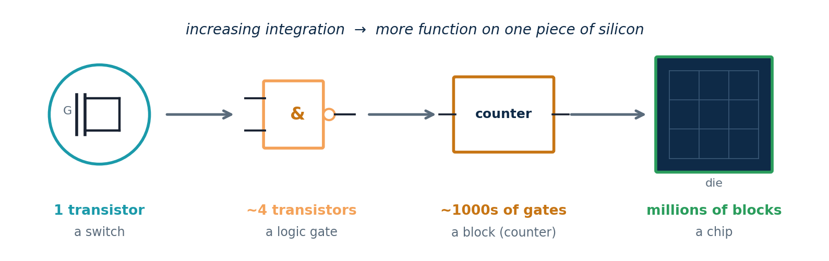
TOPIC 1A · BUILD-UP
From a Transistor to a System — Integration by Hierarchy
How do a few switches become a billion-transistor chip? By hierarchy. Each level is built from many copies of the level below: transistors form logic gates, gates form functional blocks, and blocks tile up into a complete chip. You, the RTL designer, work at the block level — describing behaviour — while synthesis and the foundry handle the gates and transistors beneath you.
Why this matters: abstraction is what makes VLSI humanly possible. Nobody reasons about a billion transistors at once; they reason about a handful of blocks, each verified and reused. RTL is the level where that human reasoning happens.
Module 2 · Verilog RTL Coding for Synthesis
NIE/ELE/N0102 · Topic 1 · 3
Notes:
LEARNING OBJECTIVE: Show how integration is achieved by hierarchical composition. SPEAKER SCRIPT / TIMING: ~4 min. Walk left-to-right: switch → gate → block → chip. Land the point that the RTL designer lives at the block level and trusts the levels below to the tools. INTERVIEW QUESTIONS: Basic: What is built from logic gates? · Advanced: Why is hierarchy essential to managing complexity? COMMON MISCONCEPTION: Students picture designers placing transistors; reinforce the block-level reality. TAGS: TO1 · Bloom: Understand

Slide 4
TOPIC 1A · TIERED DEPTH
Understanding VLSI at Four Levels
The same idea, deepened. Every concept in this module is taught at four levels so it is accessible to a beginner yet useful to a practitioner.
BASIC
VLSI means putting a whole circuit — lots of tiny switches (transistors) — onto one small chip instead of many separate parts.
INTERMEDIATE
Those switches form logic gates; gates form blocks (adders, registers); blocks form systems. Designers work at the block level using a hardware language, not at the transistor level.
ADVANCED
Designs are captured at register-transfer level (RTL) and synthesised to gates for a target process. Trade-offs in area, timing and power are managed quantitatively across the flow.
INDUSTRY
With scaling slowing, value comes from architecture, verified reusable IP, low-power design and fast timing closure — so clean, synthesis-aware, well-verified RTL is the skill employers pay for.
Module 2 · Verilog RTL Coding for Synthesis
NIE/ELE/N0102 · Topic 1 · 4
Notes:
LEARNING OBJECTIVE: Show the Basic→Industry progression for VLSI itself. SPEAKER SCRIPT / TIMING: ~4 min. Read each tier; ask the class which tier they are at now. Reassure beginners we start at Basic everywhere. TAGS: TO1 · Bloom: Understand

Slide 5
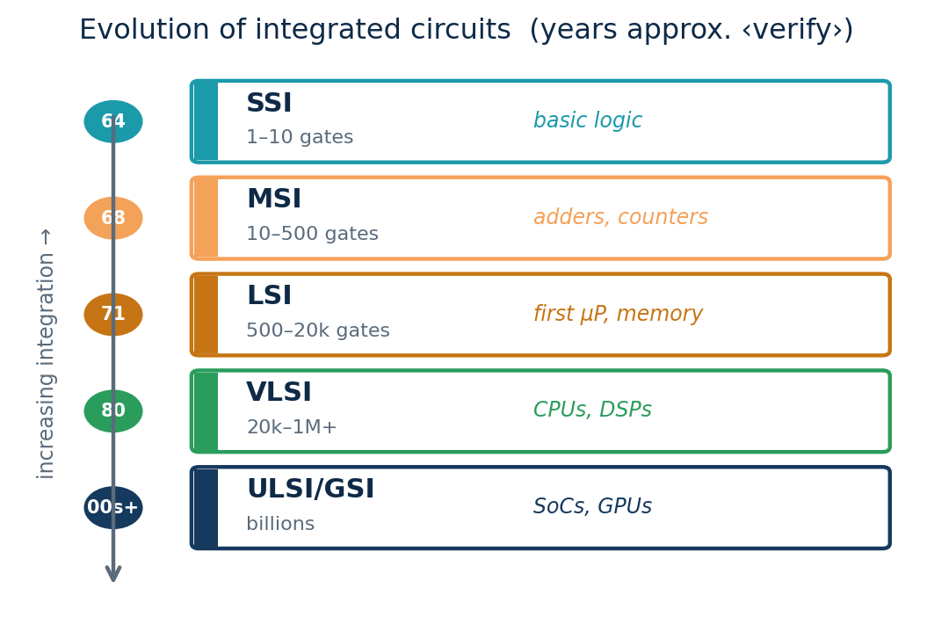
TOPIC 1A · EVOLUTION
The Evolution of Integrated Circuits
Before ICs, computers used discrete transistors and vacuum tubes — bulky, hot, unreliable. Jack Kilby (TI, 1958) and Robert Noyce (Fairchild, 1959) independently integrated components on one substrate, founding the IC. Integration density then climbed through well-defined generations, each multiplying gates per chip and unlocking new product classes.
Each era enabled a new product class
SSI (1–10 gates): basic logic on a chip → early digital boards.
MSI (tens of gates): adders, counters, multiplexers → calculators.
LSI (hundreds–thousands): the first microprocessors and memories.
VLSI (tens of thousands+): full CPUs, DSPs, graphics.
ULSI / GSI (millions–billions): today's SoCs, GPUs, AI chips.
Gate-count bands are approximate ‹verify exact ranges›.
Module 2 · Verilog RTL Coding for Synthesis
NIE/ELE/N0102 · Topic 1 · 5
Notes:
LEARNING OBJECTIVE: Trace IC history and tie each era to a product class. SPEAKER SCRIPT / TIMING: ~5 min. Stress each density step was newly-possible, not just more of the same. INTERVIEW QUESTIONS: Basic: Who is credited with the IC? · Advanced: Why is the SSI/MSI naming about gate count? TAGS: TO1 · Bloom: Remember · Understand

Slide 6
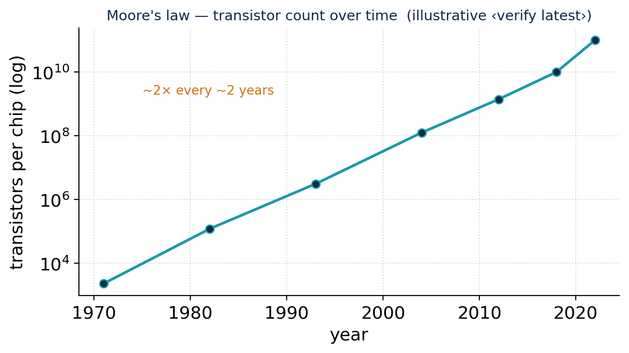
TOPIC 1A · TREND
Moore's Law and Why Scaling Is Slowing
Moore's law (Gordon Moore, 1965) observes that transistors per chip double roughly every two years at constant cost. It is an economic/historical trend, not a physical law — but it held for ~50 years and drove the digital revolution by making computing cheaper every cycle.
Dennard scaling was the companion: as transistors shrank, power density stayed constant, so smaller also meant faster and cooler. It broke down around 2005 — shrinking no longer cut power proportionally — so clock speeds plateaued and the industry pivoted to multi-core and accelerators.
Today geometric scaling is decelerating and per-transistor cost has stopped falling, so performance now comes from architecture (chiplets, 3D stacking, AI accelerators) and design efficiency — raising the value of disciplined RTL.
Key takeaways
Interview & industry
Moore's law: ~2× transistors every ~2 years — economic, not physical.
Dennard scaling (constant power density) broke ~2005 → multi-core & accelerators.
Scaling is slowing; architecture, reuse and good RTL are the new levers.
Q: Difference between Moore's law and Dennard scaling?
Tip: Quote latest node/transistor figures from a current source, marked ‹verify› — never from memory.
Module 2 · Verilog RTL Coding for Synthesis
NIE/ELE/N0102 · Topic 1 · 6
Notes:
LEARNING OBJECTIVE: Explain Moore's law vs Dennard scaling and the architectural pivot. SPEAKER SCRIPT / TIMING: ~7 min. Draw the log curve. Separate count (Moore) from power (Dennard). INTERVIEW QUESTIONS: Intermediate: Why did clocks stop rising ~2005? · Advanced: What replaced pure scaling for performance? COMMON MISCONCEPTION: Students equate Moore's law with 'chips get faster' — that was Dennard scaling. TAGS: TO1 · Bloom: Understand · Analyze

Slide 7
TOPIC 1A · PRACTICAL EXAMPLE 1
Numerical: Applying Moore's Law
Problem
Interpretation
The Intel 4004 (1971) had about 2,300 transistors. If transistor count doubles every 2 years, estimate the count 50 years later (2021), and compare with reality.
Step 1 — number of doublings:
n = 50 years ÷ 2 = 25 doublings
Step 2 — apply the doubling:
N = 2,300 × 2²⁵ = 2,300 × 33,554,432
N ≈ 7.7 × 10¹⁰ ≈ 77 billion transistors
Real high-end chips around 2021 held tens of billions of transistors ‹verify exact figures› — the same order of magnitude as our estimate.
The model slightly overshoots because the doubling period stretched toward ~2.5–3 years as scaling slowed.
Lesson: Moore's law is a remarkably good first-order estimator over decades, but it is a trend — always sanity-check against current data, and treat memorised figures as ‹verify›.
Try it yourself
If a design had 1 million gates in 2010, roughly how many would the trend predict for 2020? (Answer: 5 doublings → ×2⁵ = ×32 ≈ 32 million gates.) Discuss why the real number is usually lower.
Module 2 · Verilog RTL Coding for Synthesis
NIE/ELE/N0102 · Topic 1 · 7
Notes:
LEARNING OBJECTIVE: Apply Moore's law quantitatively and interpret the result critically. SPEAKER SCRIPT / TIMING: ~6 min. Work it on the board. Emphasise order-of-magnitude reasoning and the ‹verify› habit. INTERVIEW QUESTIONS: Numerical: Given a start count and a doubling period, compute a future estimate. TAGS: TO1 · Bloom: Apply

Slide 8
TOPIC 1A · APPLICATIONS
Where VLSI Chips Are Used — Six Domains
VLSI is invisible but everywhere. The same RTL skills serve every domain, each with a dominant constraint — performance, power, cost, safety or reliability — that shapes its sign-off criteria.
Compute & data centre
Mobile & consumer
Automotive
CPUs, GPUs, AI accelerators; performance & memory bandwidth dominate, power/cooling limit.
Phone/wearable SoCs, TVs; energy-per-operation (battery life) is king.
ECUs, ADAS, EV power; functional safety (ISO 26262) and temperature range dominate.
Medical
Industrial / IoT
Space & defence
Imaging, implants, monitors; ultra-low power, reliability, certification.
Sensors, controllers, edge AI; cost, integration, long lifetimes.
Radiation-hardened, high-reliability parts; correctness over raw speed.
Same skill, different sign-off: a counter written in Verilog is the same RTL in a toy or a satellite — the satellite just adds radiation hardening and far heavier verification.
Module 2 · Verilog RTL Coding for Synthesis
NIE/ELE/N0102 · Topic 1 · 8
Notes:
LEARNING OBJECTIVE: Survey domains and their dominant constraints. SPEAKER SCRIPT / TIMING: ~5 min. Ask which devices they used today; map to domains. INTERVIEW QUESTIONS: Advanced: How do constraints differ between automotive and data-centre chips? TAGS: TO1 · Bloom: Understand

Slide 9
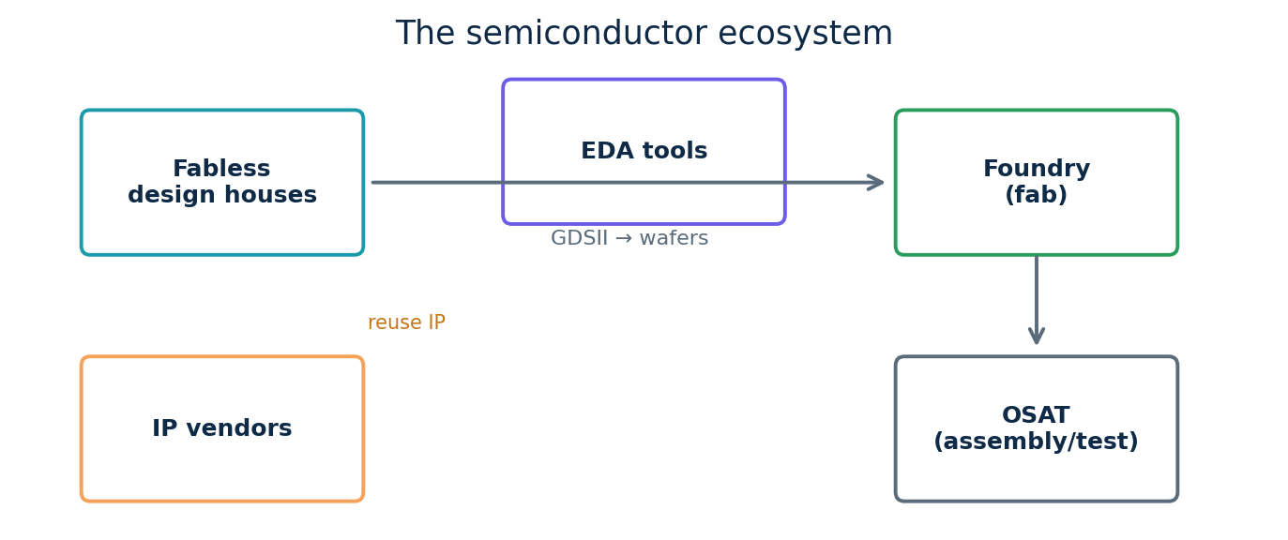
TOPIC 1A · INDUSTRY STRUCTURE
The Semiconductor Ecosystem
No single company designs, makes, packages and sells a chip alone. The industry specialised, and the chain tells you where an RTL engineer works.
Fabless design houses create the chip — RTL is written and verified here — but own no factory.
Foundries manufacture silicon from the GDSII the design house sends; a leading-edge fab costs tens of billions.
IP vendors license reusable blocks; EDA companies provide the tools; OSATs assemble, package and test.
Key takeaways
Interview & industry
Fabless designs (RTL here) → foundry manufactures → OSAT packages/tests.
IP vendors supply reusable blocks; EDA vendors supply the tools.
Specialisation gave each layer huge scale and capital efficiency.
Q: What is a fabless company, and why did the model win?
Tip: India's Semiconductor Mission funds across the chain; near-term graduate opportunity is design (RTL/verification).
Where you fit: this module trains the front-end design skill fabless houses and IP vendors hire for — your Verilog becomes the foundry's input and, ultimately, silicon.
Module 2 · Verilog RTL Coding for Synthesis
NIE/ELE/N0102 · Topic 1 · 9
Notes:
LEARNING OBJECTIVE: Map the value chain and locate the RTL engineer. SPEAKER SCRIPT / TIMING: ~6 min. Use real company names per role. INTERVIEW QUESTIONS: Advanced: Why is the fabless/foundry split economically rational? COMMON MISCONCEPTION: Students assume one company does everything (old IDM model). TAGS: TO1 · Bloom: Understand

Slide 10
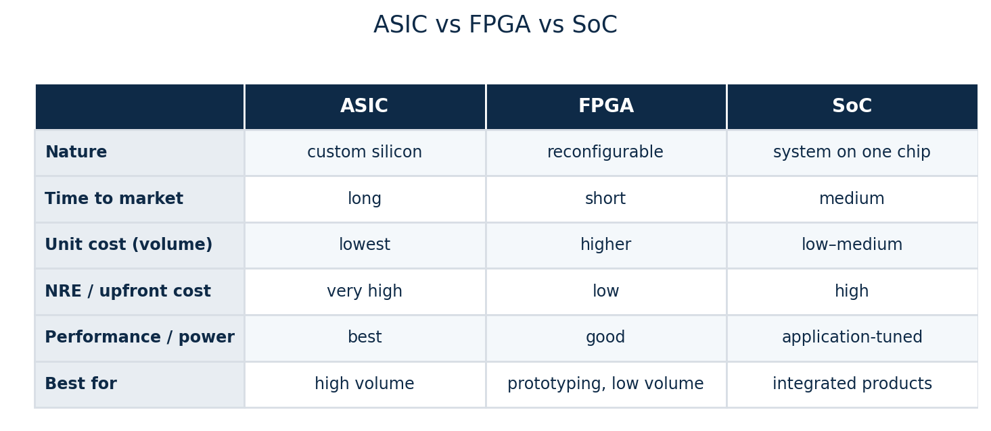
TOPIC 1A · TARGETS
ASIC vs FPGA vs SoC — Choosing the Silicon
RTL is the common starting point, but it can be realised on different silicon. The choice trades upfront cost against unit cost, performance and time-to-market — and the same Verilog can target all three.
The RTL connection
Same synthesizable Verilog targets all three.
FPGA — reprogrammable, low upfront cost: prototype and low volume.
ASIC — custom silicon, lowest unit cost and best power at high volume, but huge NRE.
SoC — a whole system (logic + CPU + IP) on one die; the dominant modern form.
Module 2 · Verilog RTL Coding for Synthesis
NIE/ELE/N0102 · Topic 1 · 10
Notes:
LEARNING OBJECTIVE: Compare the three targets; emphasise RTL portability. SPEAKER SCRIPT / TIMING: ~6 min. Walk the table rows. INTERVIEW QUESTIONS: Intermediate: What is NRE and why is it high for ASICs? TAGS: TO1 · Bloom: Understand · Analyze

Slide 11
TOPIC 1A · PRACTICAL EXAMPLE 2
Numerical: ASIC vs FPGA Break-Even
Problem & setup
Decision
You must ship a product. Two options (illustrative ‹verify›):
FPGA: NRE = $0, unit cost = $50.
ASIC: NRE = $2,000,000, unit cost = $5.
Find the volume N where total costs are equal.
Total cost = NRE + unit×N:
FPGA: 50N ASIC: 2,000,000 + 5N
Set equal: 50N = 2,000,000 + 5N
45N = 2,000,000 → N ≈ 44,444 units
Below ~44,000 units the FPGA is cheaper overall — no NRE to amortise.
Above ~44,000 units the ASIC wins — its low unit cost repays the NRE.
This is why teams prototype on FPGA and migrate to ASIC only once volume justifies the NRE.
Real decisions also weigh power, performance, time-to-market and risk — not cost alone — but the break-even is the first cut.
Try it yourself
If ASIC NRE were $500,000 instead, what is the new break-even? (45N = 500,000 → N ≈ 11,111 units — a lower NRE makes the ASIC attractive much sooner.)
Module 2 · Verilog RTL Coding for Synthesis
NIE/ELE/N0102 · Topic 1 · 11
Notes:
LEARNING OBJECTIVE: Compute an ASIC/FPGA cost break-even and interpret it. SPEAKER SCRIPT / TIMING: ~6 min. Derive the linear equations together; stress non-cost factors too. INTERVIEW QUESTIONS: Numerical/scenario: Given NREs and unit costs, find break-even volume and recommend a target. TAGS: TO1 · Bloom: Apply · Evaluate

Slide 12
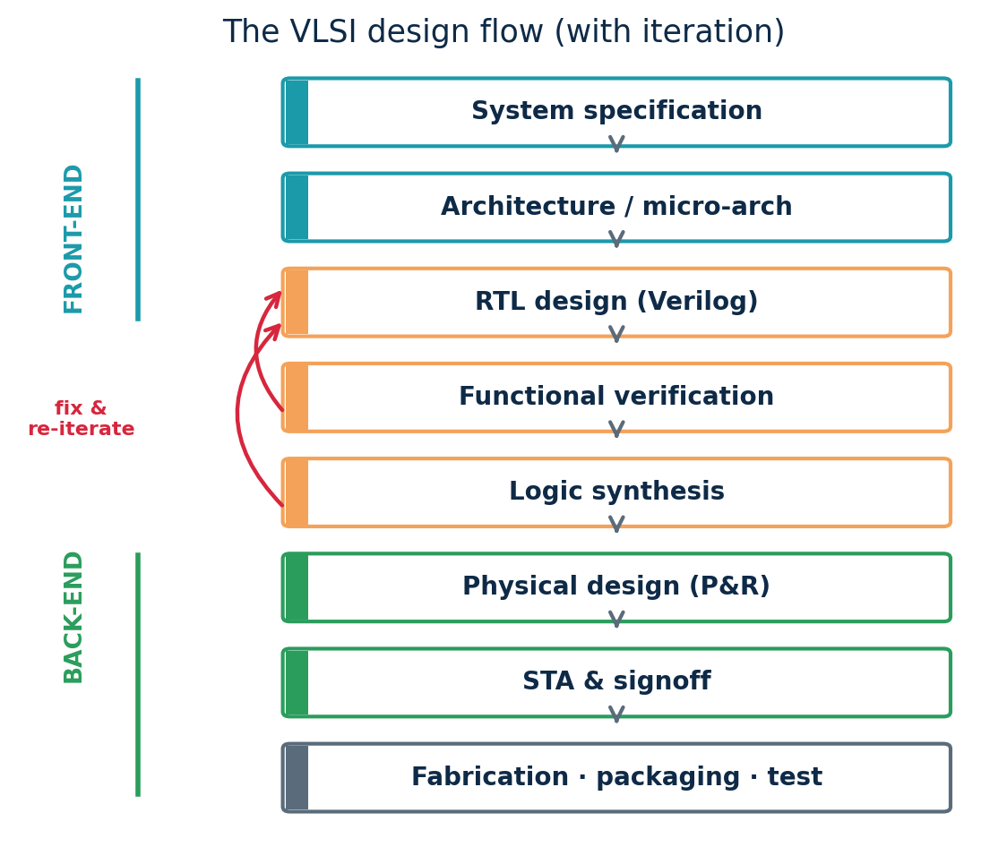
TOPIC 1B · DESIGN FLOW
The VLSI Design Flow — Specification to Silicon
A chip is built through a disciplined sequence, each stage refining the design and handing it on.
1. Specification & architecture — define function, performance, power, area; partition into blocks and a micro-architecture.
2. RTL design — capture behaviour in synthesizable Verilog. The creative heart of the front-end and the focus of this module.
3. Functional verification — prove the RTL matches the spec via testbenches, simulation, assertions and coverage, before any silicon.
4. Logic synthesis — map RTL to a gate-level netlist for a target library, optimising timing, area and power.
5. Physical design — floorplan, place, route and build the clock tree into a layout.
6. STA, signoff, fabrication — verify timing across corners, run signoff, send GDSII to the foundry for manufacture, packaging and test.
Animation: reveal stages top-down; highlight RTL + verification (this module); fade the back-end.
Module 2 · Verilog RTL Coding for Synthesis
NIE/ELE/N0102 · Topic 1 · 12
Notes:
LEARNING OBJECTIVE: Walk the flow stage by stage and locate RTL. SPEAKER SCRIPT / TIMING: ~8 min. For each stage state what comes in and out. Mark RTL+verification as 'this module'. INTERVIEW QUESTIONS: Intermediate: What does synthesis produce? · Advanced: Why is verification before synthesis? COMMON MISCONCEPTION: Students think it is one-pass; emphasise iteration. TAGS: TO1 · Bloom: Understand

Slide 13
TOPIC 1B · TIERED DEPTH
Understanding the Design Flow at Four Levels
The design flow, deepened from a beginner's mental model to how it is run in industry.
BASIC
You decide what the chip should do, describe it, check it works, then turn it into something a factory can build.
INTERMEDIATE
Spec → RTL (Verilog) → verify by simulation → synthesise to gates → place & route → send layout (GDSII) to the foundry.
ADVANCED
Each stage has tools and checks: lint and coverage in verification; timing/area/power optimisation in synthesis; STA across process corners before signoff. The flow iterates — failures loop back to RTL.
INDUSTRY
Front-end and back-end teams hand off a constrained netlist; 'shift-left' pushes verification early because a silicon respin costs months and millions. Clean, synthesis-aware RTL minimises late surprises.
Module 2 · Verilog RTL Coding for Synthesis
NIE/ELE/N0102 · Topic 1 · 13
Notes:
LEARNING OBJECTIVE: Tier the design flow Basic→Industry. SPEAKER SCRIPT / TIMING: ~4 min. Connect to the diagram on the previous slide. TAGS: TO1 · Bloom: Understand

Slide 14
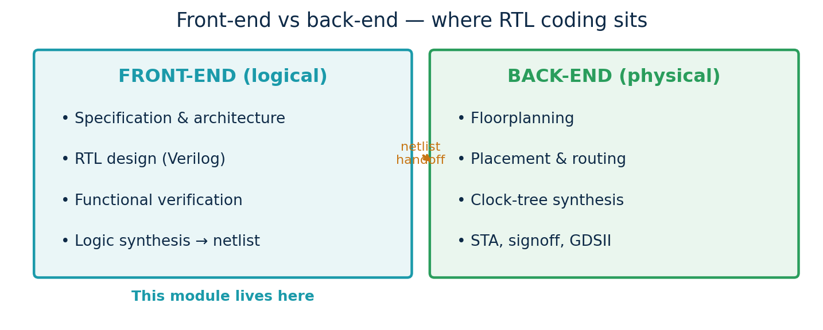
TOPIC 1B · FLOW SPLIT
Front-End vs Back-End — Where RTL Lives
The flow divides into a logical front-end (what the chip does) and a physical back-end (how it is laid out). They meet at the gate-level netlist handoff. RTL engineers own the front-end — but must write code aware of the back-end's timing and area realities.
Module 2 · Verilog RTL Coding for Synthesis
NIE/ELE/N0102 · Topic 1 · 14
Notes:
LEARNING OBJECTIVE: Distinguish front-end from back-end and the handoff. SPEAKER SCRIPT / TIMING: ~5 min. The front-end delivers a verified netlist + constraints. INTERVIEW QUESTIONS: Basic: Is synthesis front- or back-end? TAGS: TO1 · Bloom: Understand

Slide 15
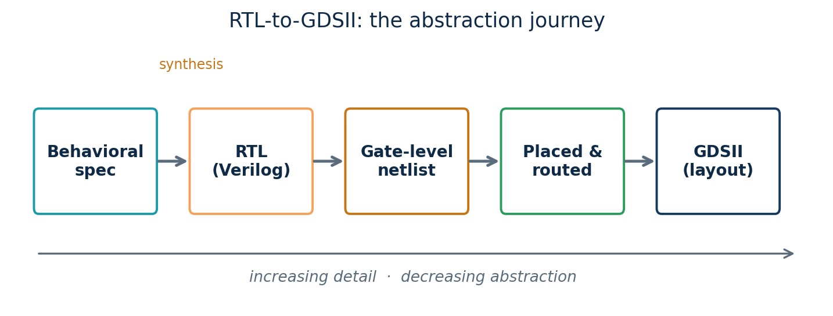
TOPIC 1B · ABSTRACTION DESCENT
RTL-to-GDSII — Your Code Becomes Polygons
From intent to manufacturable layout is a steady descent in abstraction: you write behaviour at RTL; synthesis makes a gate-level netlist; place-and-route makes a physical arrangement; GDSII is the polygon file the foundry uses. You will perform the RTL→netlist step yourself in Tutorial T2.
Why care as an RTL coder? Every downstream stage inherits your decisions. Huge combinational paths, accidental latches or a poor reset strategy create timing/area problems the back-end cannot fully fix. Clean RTL is the cheapest place to get the whole chip right.
Module 2 · Verilog RTL Coding for Synthesis
NIE/ELE/N0102 · Topic 1 · 15
Notes:
LEARNING OBJECTIVE: Show the abstraction descent; RTL quality propagates downstream. SPEAKER SCRIPT / TIMING: ~5 min. Preview that Topic 4 coding rules exist for this reason. INTERVIEW QUESTIONS: Advanced: Give an RTL mistake the back-end cannot recover from. TAGS: TO1 · Bloom: Understand

Slide 16
TOPIC 1B · WORKED EXAMPLE
Tracing a 4-Bit Counter Through the Flow
Our running example, stage by stage — so the abstract flow becomes concrete before we ever write full Verilog.
1 · Spec
“A 4-bit counter: on each rising clock edge, increment 0→15 then wrap; an active-low reset forces 0.”
2 · RTL
A short Verilog module with a clocked always block (shown in Tutorial T2). Human-readable behaviour.
3 · Verify
A testbench drives clk and rst_n and checks the count sequence; we view it as a waveform in GTKWave.
4 · Synthesis
Yosys maps the RTL to gates: four flip-flops + an incrementer. 'stat' reports the cell/area count.
5 · Phys/GDSII
Place-and-route would arrange those cells and wires into a layout (out of scope here; done by OpenLane).
Module 2 · Verilog RTL Coding for Synthesis
NIE/ELE/N0102 · Topic 1 · 16
Notes:
LEARNING OBJECTIVE: Make the flow concrete by tracing the counter through every stage. SPEAKER SCRIPT / TIMING: ~6 min. This is the bridge into the tutorials — they will actually do stages 2–4. INTERVIEW QUESTIONS: Intermediate: What hardware does a 4-bit counter synthesise to? TAGS: TO1 TO3 · Bloom: Understand · Apply

Slide 17
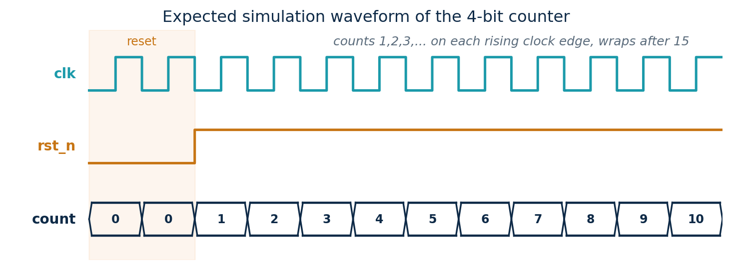
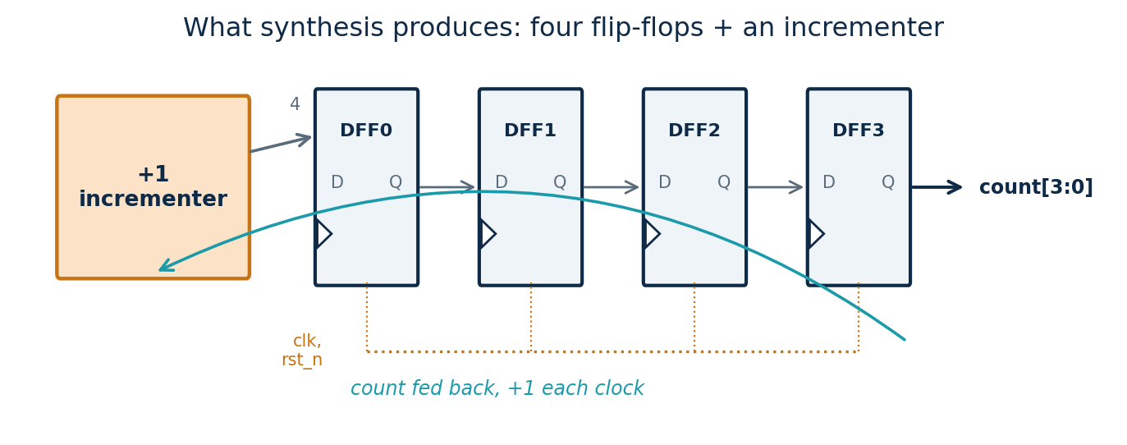
TOPIC 1B · WORKED EXAMPLE
What the Counter Becomes — Two Views of One Design
The same counter has two complementary views. Verification looks at behaviour over time (a waveform); synthesis looks at structure (gates). Both describe the identical design — you will produce both in Tutorial T2.
Behaviour (what verification sees)
Structure (what synthesis produces)
Reading the waveform
Reading the gates
While rst_n=0 the count is held at 0. Once reset releases, count increments by 1 on every rising clock edge — 0,1,2,…,15 — then wraps back to 0. This is the functional behaviour a testbench checks.
Synthesis turns the RTL into four D flip-flops (one per bit) plus an incrementer that adds 1 to the current value and feeds it back. Yosys' stat report will list exactly these cells — structure, not behaviour.
Module 2 · Verilog RTL Coding for Synthesis
NIE/ELE/N0102 · Topic 1 · 17
Notes:
LEARNING OBJECTIVE: Show the behaviour (waveform) and structure (gates) views of the counter. SPEAKER SCRIPT / TIMING: ~6 min. Put the two views side by side and stress: same design, two lenses. Verification cares about the waveform; synthesis about the gate count. This primes both Tutorial T2 outputs. INTERVIEW QUESTIONS: Intermediate: How many flip-flops does a 4-bit counter need, and why? · What does the count do after 15? COMMON MISCONCEPTION: Students think the waveform and the schematic are different designs; they are the same RTL seen two ways. TAGS: TO1 TO3 · Bloom: Understand · Apply

Slide 18
TOPIC 1B · TUTORIAL T1
Set Up the Open-Source RTL Toolchain
Objective: install and verify the free toolchain on Ubuntu so every later lab runs. Industry relevance: these tools mirror commercial EDA steps (simulate, synthesize, analyse).
# Ubuntu terminal (‹verify versions›)
Notes & troubleshooting
# 1. update package lists
sudo apt update
# 2. install simulator, waveform viewer,
# linter, synthesis tool, git
sudo apt install -y iverilog gtkwave \
verilator yosys git
# 3. verify each tool is on the PATH
iverilog -V
yosys -V
gtkwave --version
verilator --version
Recommended alternative: the OSS CAD Suite bundle ships current, matched versions of all these tools — prefer it if the apt versions are old ‹verify›.
'command not found' → the install failed or the PATH is stale; re-run install, reopen the terminal.
GTKWave won't open on a headless server → use an X-forwarding SSH session or a desktop VM.
Expected output: each '-V' prints a version banner. That confirms a working environment.
Checkpoint: all four version commands print a banner with no errors. Commit a short README to Git recording the versions you installed — reproducibility is an industry habit.
Module 2 · Verilog RTL Coding for Synthesis
NIE/ELE/N0102 · Topic 1 · 18
Notes:
LEARNING OBJECTIVE: Install and verify the open-source toolchain. SPEAKER SCRIPT / TIMING: ~15 min hands-on. Have students run each command and paste version output into a shared sheet. Resolve PATH issues live. INTERVIEW QUESTIONS: Viva: Which tool simulates, which synthesises, which views waveforms? TAGS: TO1 · Lab Block 1 · Bloom: Apply

Slide 19
TOPIC 1B · TUTORIAL T2
Run the Counter: Compile → Simulate → View → Synthesize
Objective: take the running 4-bit counter through the front-end flow on real tools. (Full Verilog is taught in Topic 4; here you run it to see the flow work.)
counter4.v (synthesizable design)
counter4_tb.v (testbench — sim only)
module counter4 (
input clk,
input rst_n, // active-low
output reg [3:0] count
);
always @(posedge clk or negedge rst_n)
if (!rst_n) count <= 4'b0000;
else count <= count + 1'b1;
endmodule
`timescale 1ns/1ps
module counter4_tb;
reg clk=0, rst_n=0; wire [3:0] count;
counter4 dut(.clk(clk),.rst_n(rst_n),
.count(count));
always #5 clk = ~clk; // 100 MHz
initial begin
$dumpfile("c.vcd"); $dumpvars(0,counter4_tb);
#12 rst_n=1; #200 $finish;
end
endmodule
# simulate + view waveform
# synthesize with Yosys
iverilog -o c.vvp counter4_tb.v counter4.v
vvp c.vvp
gtkwave c.vcd &
# expect: count 0,1,2,...,15,0,... after reset
yosys -p "read_verilog counter4.v; \
synth -top counter4; stat"
# expect: ~4 DFFs + an incrementer;
# 'stat' lists the cell/area summary
Guardrail: $dumpfile/$dumpvars and #delays live only in the testbench — never in the synthesizable design. This is the rule we enforce all module.
Module 2 · Verilog RTL Coding for Synthesis
NIE/ELE/N0102 · Topic 1 · 19
Notes:
LEARNING OBJECTIVE: Run the counter through compile/sim/view/synthesis on real tools. SPEAKER SCRIPT / TIMING: ~25 min hands-on. Walk the four command blocks. Show the waveform counting and the Yosys 'stat' output (4 flip-flops). Do not yet explain Verilog syntax in depth — that is Topic 4; here the goal is to experience the flow. INTERVIEW QUESTIONS: Viva: Which file is synthesizable and which is not, and why? · What does Yosys 'stat' report? COMMON MISCONCEPTION: Students try to synthesise the testbench; clarify only counter4.v goes to Yosys. TAGS: TO1 TO2 · Lab Block 1 · Bloom: Apply

Slide 20
TOPIC 1 · GLOSSARY
Key Terms & Acronyms (Topic 1)
VLSI
Very-Large-Scale Integration — millions+ transistors on one chip
IC / die
Integrated Circuit / the silicon piece a chip is cut from
RTL
Register-Transfer Level — the design-entry abstraction
HDL
Hardware Description Language (e.g., Verilog)
Synthesis
mapping RTL to a gate-level netlist
Netlist
a circuit described as gates and their connections
GDSII
the layout/polygon file sent to the foundry
ASIC
Application-Specific IC — custom silicon
FPGA
Field-Programmable Gate Array — reconfigurable chip
SoC
System-on-Chip — logic + CPU + IP on one die
Fabless / Foundry
design house without a fab / the manufacturer
NRE
Non-Recurring Engineering — one-time design/tooling cost
STA
Static Timing Analysis
Tapeout
sending the final layout to the foundry
Module 2 · Verilog RTL Coding for Synthesis
NIE/ELE/N0102 · Topic 1 · 20
Notes:
LEARNING OBJECTIVE: Provide a reusable glossary for Topic 1 terms. SPEAKER SCRIPT / TIMING: ~3 min. Tell students this glossary grows each topic and is in the handbook. TAGS: TO1 · Bloom: Remember

Slide 21
TOPIC 1 · RECAP
Topic 1 — Consolidation & Self-Check
What you should now be able to do
Self-check
Explain what VLSI is and why RTL is the human entry point (Basic→Industry).
Recount the IC eras and state Moore's law and why scaling is slowing.
Apply Moore's law and an ASIC/FPGA break-even numerically.
Identify application domains, the ecosystem, and ASIC/FPGA/SoC trade-offs.
Trace the design flow and a 4-bit counter through it.
Run the toolchain: install it (T1) and compile/simulate/synthesize (T2).
Why can't a billion-transistor chip be drawn gate by gate?
State Moore's law and one reason scaling is slowing.
Fabless vs foundry — what is the difference?
At what volume does the ASIC beat the FPGA in our example?
What does synthesis produce, and which tool did we use?
Which file in T2 is NOT synthesizable, and why?
Looking ahead
Topic 2 — RTL Design Methodology zooms into the front-end: what RTL really is, why it is the design-entry level, and the HDL landscape — setting up the hands-on Verilog coding in Topic 4, still using our counter.
Module 2 · Verilog RTL Coding for Synthesis
NIE/ELE/N0102 · Topic 1 · 21
Notes:
LEARNING OBJECTIVE: Consolidate Topic 1 and bridge to Topic 2. SPEAKER SCRIPT / TIMING: ~5 min. Run self-check as think-pair-share. TAGS: TO1 · Bloom: Evaluate

