Slide 1
TOPIC 2
RTL Design Methodology
Basics of RTL · the RTL design process & methodology · Hardware Description Languages (Verilog / VHDL)
2a · What RTL is — registers, combinational logic, clocking, datapath & control
2b · The RTL design process & methodology — spec → code → verify → synthesize
2c · HDLs — Verilog & VHDL, styles, sim vs synthesis, worked code
Practical examples · Worked FSM · Hands-on tutorials (Verilog & VHDL)
Module 2 · RTL Design Methodology
NIE/ELE/N0102 · Topic 2 · 1

Slide 2
TOPIC 2A · OVERVIEW
What Is RTL Design? Registers with Logic in Between
Register-Transfer Level (RTL) is the abstraction at which digital designers actually work. You describe a circuit as a set of registers (storage) and the combinational logic that computes the next value moved into them on every clock edge — not as individual transistors or gates.
What · Why · How · Scope
What: describe hardware as data transferred between registers each clock cycle, through combinational logic. Why: it is compact, readable and — crucially — synthesizable into real gates. How: written in an HDL (Verilog/VHDL). Scope: RTL is the front-end design-entry level; tools take it down to gates and layout.
Key takeaways
RTL = registers + combinational logic, evaluated once per clock edge.
It sits between behavioural (algorithm) and gate-level (netlist).
RTL is what humans write; synthesis builds the transistors.
Interview & industry
Q: In one line, what does 'RTL' capture?
A: How data moves between registers each clock cycle, and the logic that transforms it.
Running example used throughout this topic
We reuse one tiny design — a 4-bit binary counter — and grow it into an FSM, to keep every idea (RTL, methodology, HDL, simulation, synthesis) concrete and connected.
Module 2 · RTL Design Methodology
NIE/ELE/N0102 · Topic 2 · 2

Slide 3
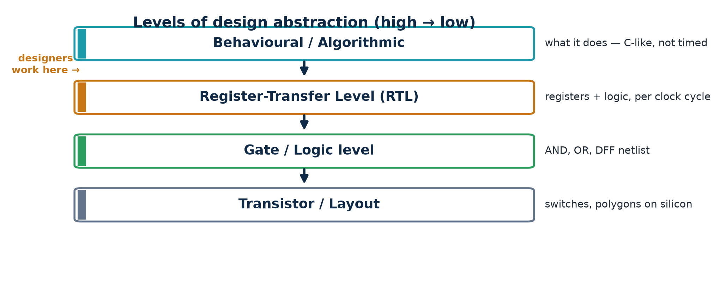
TOPIC 2A · BUILD-UP
Where RTL Sits — The Levels of Design Abstraction
Digital design is done at different levels of abstraction. Higher levels say what the circuit does; lower levels say exactly how it is built. RTL is the sweet spot: high enough to be human-writable, low enough to be automatically turned into hardware.
Why abstraction matters
Designers describe intent at RTL; synthesis tools translate it down to gates and, ultimately, transistors. You get productivity (write behaviour) and control (it maps to real hardware).
Module 2 · RTL Design Methodology
NIE/ELE/N0102 · Topic 2 · 3

Slide 4
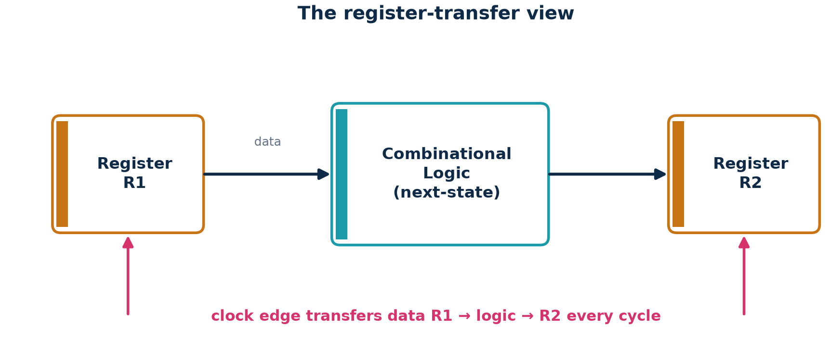
TOPIC 2A · CONCEPT
The Register-Transfer View — Data Moving Each Clock Cycle
The core mental model: values live in registers; on every clock edge, combinational logic reads the current registers, computes new values, and those new values are latched into registers. 'Register transfer' literally means the transfer of data from register to register through logic.
Read it as a sentence
'On each rising clock edge, R2 gets the function of R1.' Everything in synchronous RTL is a variation of this one pattern — which is exactly why it is so learnable and so synthesizable.
Module 2 · RTL Design Methodology
NIE/ELE/N0102 · Topic 2 · 4

Slide 5
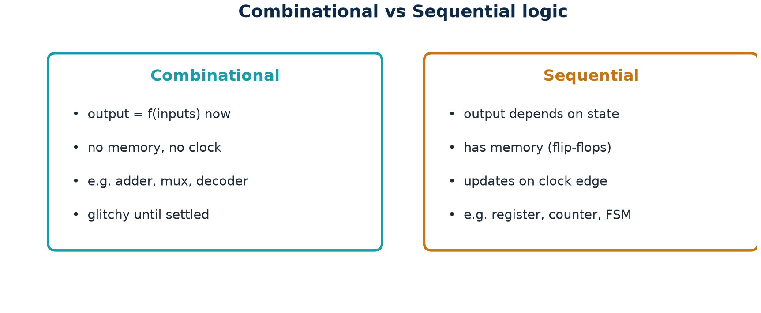
TOPIC 2A · CONCEPT
Two Kinds of Logic — Combinational vs Sequential
Every RTL design is built from just two kinds of logic. Knowing which is which — and coding each correctly — is the single most important RTL skill.
Rule of thumb
Combinational = pure function of present inputs (no clock). Sequential = has memory, updates on a clock edge. Registers are the only things that remember; everything else is combinational.
Module 2 · RTL Design Methodology
NIE/ELE/N0102 · Topic 2 · 5

Slide 6
TOPIC 2A · CONCEPT
Synchronous Design — One Clock, One Edge, One Reset
Modern RTL is synchronous: a single clock times the whole block, all registers update on the same edge, and a reset puts the design into a known state. This discipline is what makes large chips timeable and reliable.
Clock
A periodic signal that paces the design.
Registers sample on one edge — usually the rising edge (posedge).
Frequency (e.g. 100 MHz) sets how fast the design runs.
One clock domain = one shared time base.
Reset
Forces registers to a known initial value.
Asynchronous (acts immediately) or synchronous (on the clock edge).
Active-low 'rst_n' is common (0 = reset).
Without reset, start-up state is unknown.
Timing (intuition)
Logic between two registers must settle within one clock period.
Setup: data must arrive before the edge.
Hold: data must stay stable just after it.
Static Timing Analysis (STA) checks this later — RTL choices decide it.
Golden rule
Design one clock, one edge, and a clean reset. Avoid gated clocks and latches at RTL — they break timing analysis.
Module 2 · RTL Design Methodology
NIE/ELE/N0102 · Topic 2 · 6

Slide 7
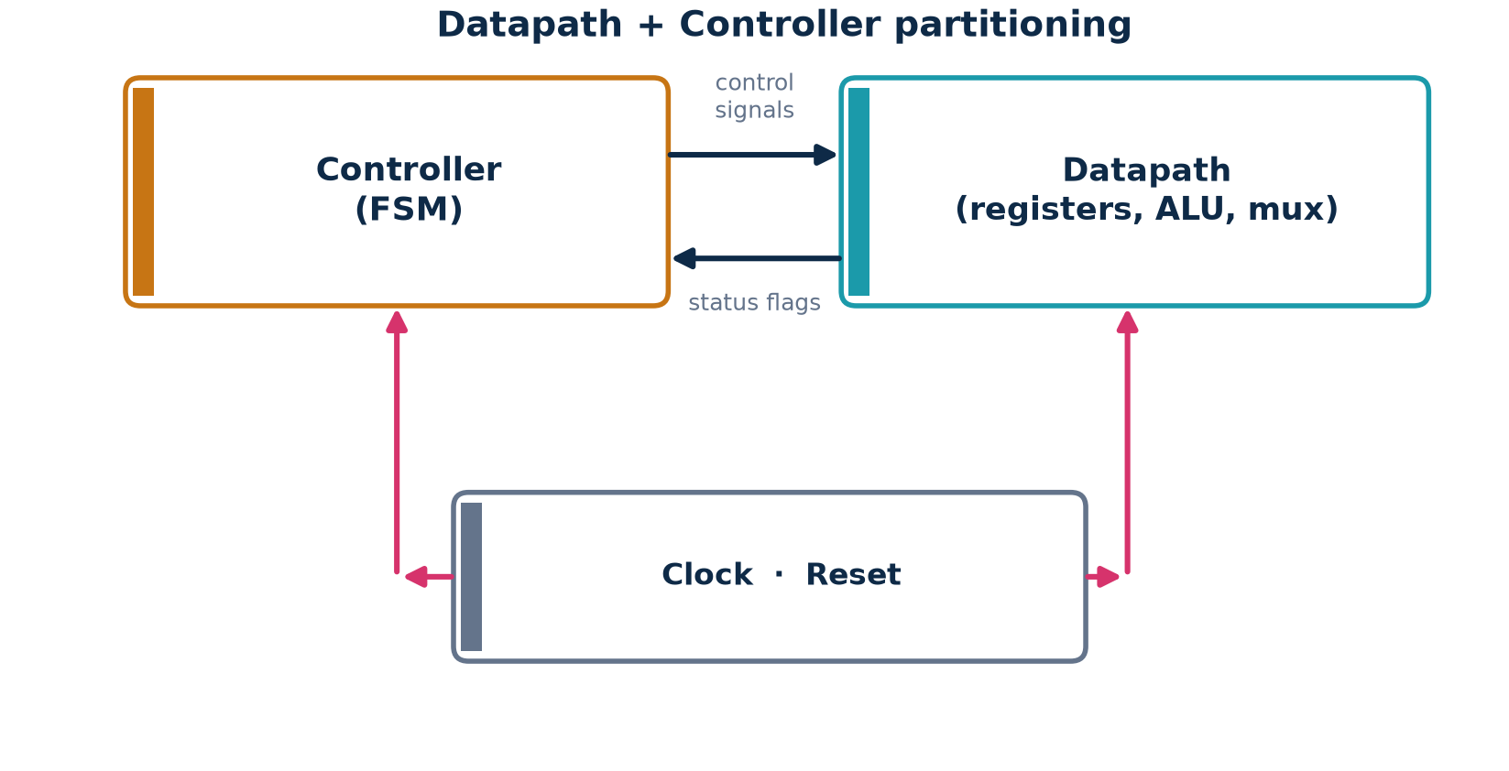
TOPIC 2A · CONCEPT
Structuring a Design — Datapath + Controller
Almost every real block is organised into a datapath (the registers, adders, muxes that move and transform data) and a controller (an FSM that decides what the datapath does each cycle). This partition is the backbone of RTL methodology.
Why split them
Separating 'what computes' (datapath) from 'what decides' (controller) makes designs easier to write, verify and reuse — the controller sequences operations; the datapath executes them.
Module 2 · RTL Design Methodology
NIE/ELE/N0102 · Topic 2 · 7

Slide 8
TOPIC 2A · EXAMPLE
A Minimal RTL Block — One Register, One Adder
The smallest useful RTL: a register whose next value is computed by combinational logic. Here an accumulator adds its input to itself each cycle.
accumulator.v (RTL)
Read the RTL
'sum' is a register (updated on posedge clk).
'sum + din' is the combinational next-state logic.
'<=' is a non-blocking assignment — the register-transfer operator.
On reset, sum = 0; otherwise sum accumulates din every cycle.
This one block already shows the whole RTL pattern.
module accumulator (
input clk,
input rst_n,
input [7:0] din,
output reg [7:0] sum // the register
);
always @(posedge clk or negedge rst_n)
if (!rst_n) sum <= 8'd0; // reset
else sum <= sum + din; // register <= comb logic
endmodule
Module 2 · RTL Design Methodology
NIE/ELE/N0102 · Topic 2 · 8

Slide 9
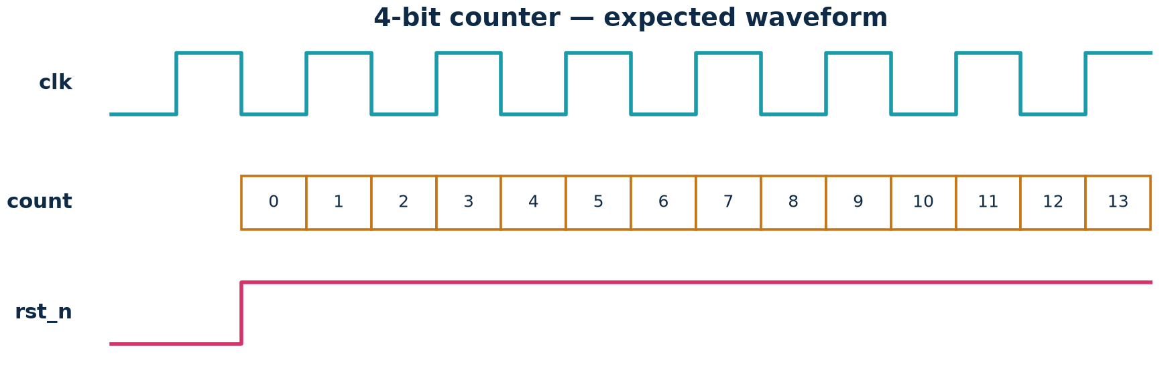
TOPIC 2A · RUNNING EXAMPLE
The 4-Bit Counter as RTL — Code and Waveform
Our running example. The counter is a register whose next-state logic is simply 'add one'. Watch how the RTL and the waveform correspond.
counter4.v
module counter4 (
input clk,
input rst_n,
output reg [3:0] count
);
always @(posedge clk or negedge rst_n)
if (!rst_n) count <= 4'b0000;
else count <= count + 1'b1;
endmodule
RTL ↔ behaviour
After reset releases, 'count' increments by one every rising clock edge and wraps 15 → 0. The register holds the value; the '+1' is the combinational next-state logic.
Module 2 · RTL Design Methodology
NIE/ELE/N0102 · Topic 2 · 9

Slide 10
TOPIC 2A · WHY RTL
Why Design at RTL and Not at Gate Level?
Before RTL, engineers drew gate schematics by hand. RTL changed the industry by raising the abstraction — the same reason we write C instead of assembly.
Productivity
One line of RTL can become hundreds of gates.
Describe behaviour, not wiring.
Faster to write, read and change.
Portability & reuse
Same RTL synthesizes to ASIC or FPGA.
Retarget to a new technology by re-synthesizing.
Parameterized RTL becomes reusable IP.
Verifiability
Simulate and check behaviour early.
Bugs are far cheaper to fix at RTL than in silicon.
Tools optimise timing/area/power for you.
Bottom line
RTL lets a small team design a billion-transistor chip — by describing intent and letting synthesis build the gates.
Module 2 · RTL Design Methodology
NIE/ELE/N0102 · Topic 2 · 10

Slide 11
TOPIC 2A · PRACTICAL EXAMPLE 1
Numerical — Reasoning About a Synchronous Counter
Problem
An 8-bit counter is clocked at 50 MHz and increments every cycle after reset.
(a) What is the clock period?
(b) How many values before it wraps around?
(c) How long (in µs) does one full wrap take?
(d) It is an up-counter with a synchronous reset — on which edge does 'count' actually change?
Solution
(a) Period = 1 / 50 MHz = 20 ns.
(b) 8 bits → 2^8 = 256 distinct values (0…255).
(c) One wrap = 256 × 20 ns = 5120 ns = 5.12 µs.
(d) Values change only on the rising clock edge (posedge); a synchronous reset also acts on that edge.
Takeaway: RTL timing = (number of cycles) × (clock period). Counting cycles is how you reason about hardware.
Try it yourself
A 12-bit counter at 100 MHz — how long is one full wrap? (Answer: 4096 × 10 ns = 40.96 µs.)
Module 2 · RTL Design Methodology
NIE/ELE/N0102 · Topic 2 · 11

Slide 12
TOPIC 2A · RECAP
Basics of RTL — What You Should Now Know
You can now explain
RTL = registers + combinational logic, per clock edge.
The register-transfer view (R2 ← f(R1) each cycle).
Combinational vs sequential logic.
Synchronous design: one clock, one edge, clean reset.
Datapath + controller structuring.
Why RTL (productivity, portability, verifiability).
Common interview questions
What is RTL, in one sentence?
Difference between combinational and sequential logic?
What does '<=' mean and where is it used?
What is a clock domain? Why avoid latches?
What is the datapath/controller split?
Why is a reset needed?
Module 2 · RTL Design Methodology
NIE/ELE/N0102 · Topic 2 · 12

Slide 13
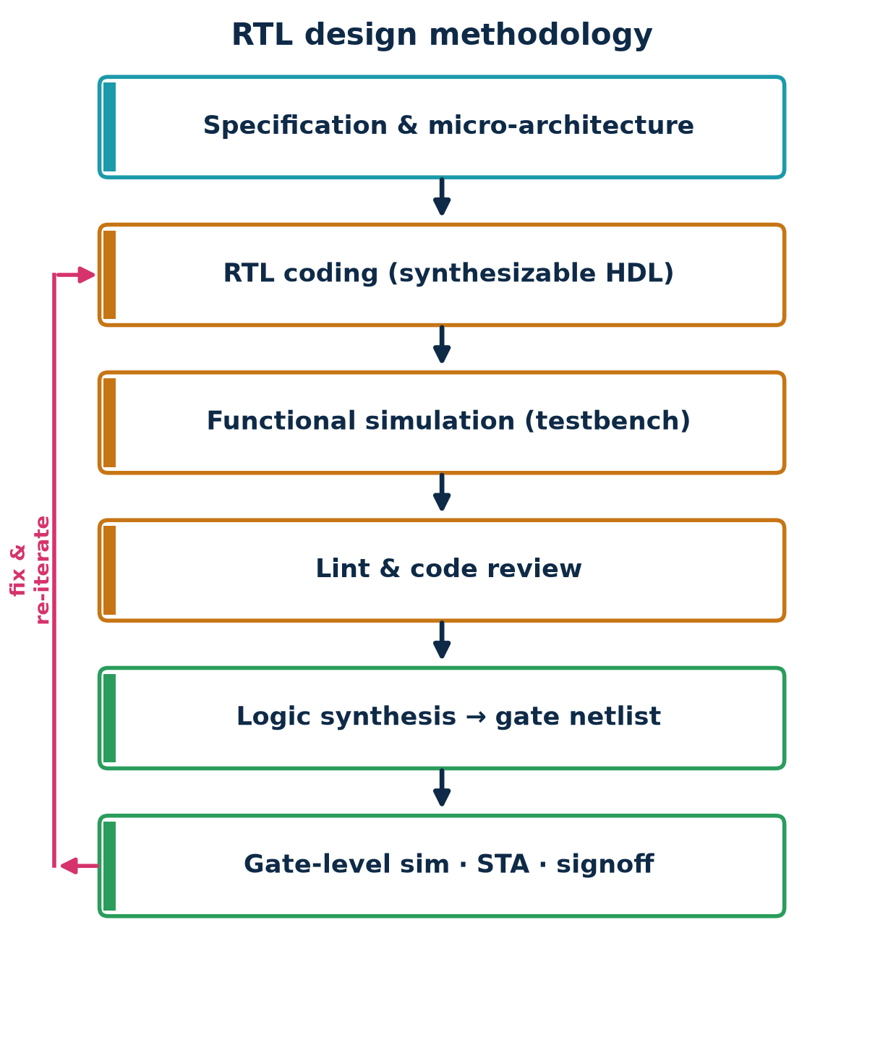
TOPIC 2B · OVERVIEW
The RTL Design Methodology — Spec to Signed-Off Netlist
'Methodology' means the disciplined sequence a designer follows to turn a specification into correct, synthesizable RTL and then into gates. Each step feeds the next; problems loop back for a fix-and-re-iterate.
The front-end you own
As an RTL/Chip-Design Associate you live in the orange steps — coding, simulating, linting — and hand a clean, synthesizable design to synthesis.
Module 2 · RTL Design Methodology
NIE/ELE/N0102 · Topic 2 · 13

Slide 14
TOPIC 2B · STEP 1
Step 1 — Specification & Micro-Architecture
Before any code, pin down what the block must do and sketch how it will be built — the registers, datapath and control needed to meet performance, area and power.
Capture the spec
Function, interfaces, protocols.
Performance (clock, throughput).
Area & power budgets.
Corner cases & error behaviour.
Micro-architecture
Block diagram of datapath + FSM.
Pipeline stages / cycle budget.
Register and memory plan.
Decide reused IP.
Deliverable
A short design doc + block diagram.
Interface (port) definition.
A cycle-by-cycle plan.
This is the 'contract' the RTL implements.
Module 2 · RTL Design Methodology
NIE/ELE/N0102 · Topic 2 · 14

Slide 15
TOPIC 2B · STEP 2
Step 2 — RTL Coding (the Synthesizable Subset)
Translate the micro-architecture into HDL, using only constructs that synthesis understands. Good RTL is a direct, readable description of hardware — not a software program.
Code the hardware
Sequential logic in clocked always/process.
Combinational logic in always@* / assign.
One register set per module intent.
Meaningful names, small modules.
Stay synthesizable
No #delays, no $display in the design.
No initial blocks for hardware state.
Avoid unintended latches.
Reset every state element.
Golden rules
Non-blocking (<=) for sequential.
Blocking (=) for combinational.
Never mix them in one block.
Complete your if/case (else/default).
Module 2 · RTL Design Methodology
NIE/ELE/N0102 · Topic 2 · 15

Slide 16
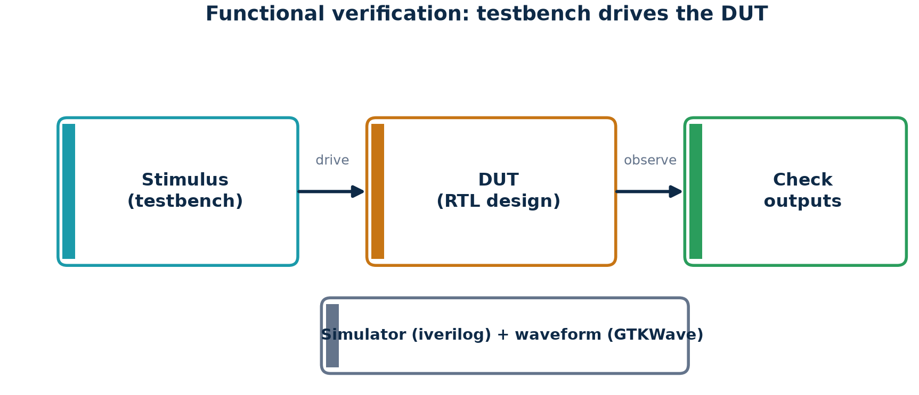
TOPIC 2B · STEP 3
Step 3 — Functional Verification (Simulate the RTL)
You must prove the RTL does what the spec says before spending effort on synthesis. A testbench applies stimulus to the design (the DUT) and checks the outputs — in simulation, not hardware.
What a testbench does
Generate a clock and reset, drive inputs, and compare outputs against expected values (self-checking). Waveforms (GTKWave) let you see exactly what happened, cycle by cycle.
Module 2 · RTL Design Methodology
NIE/ELE/N0102 · Topic 2 · 16

Slide 17
TOPIC 2B · STEP 4
Step 4 — Linting & Code Review
Automated linting and a human review catch a large class of bugs before simulation and synthesis — cheaply and early.
Lint checks
Unintended latches.
Incomplete sensitivity lists.
Width mismatches, unused signals.
Multiple drivers on a net.
Code review
Readability & naming.
Reset & clock correctness.
Spec conformance.
Reusability & comments.
Why it pays
A latch found by lint costs seconds; found in silicon it costs months.
'Clean lint' is an industry gate before sign-off.
Module 2 · RTL Design Methodology
NIE/ELE/N0102 · Topic 2 · 17

Slide 18
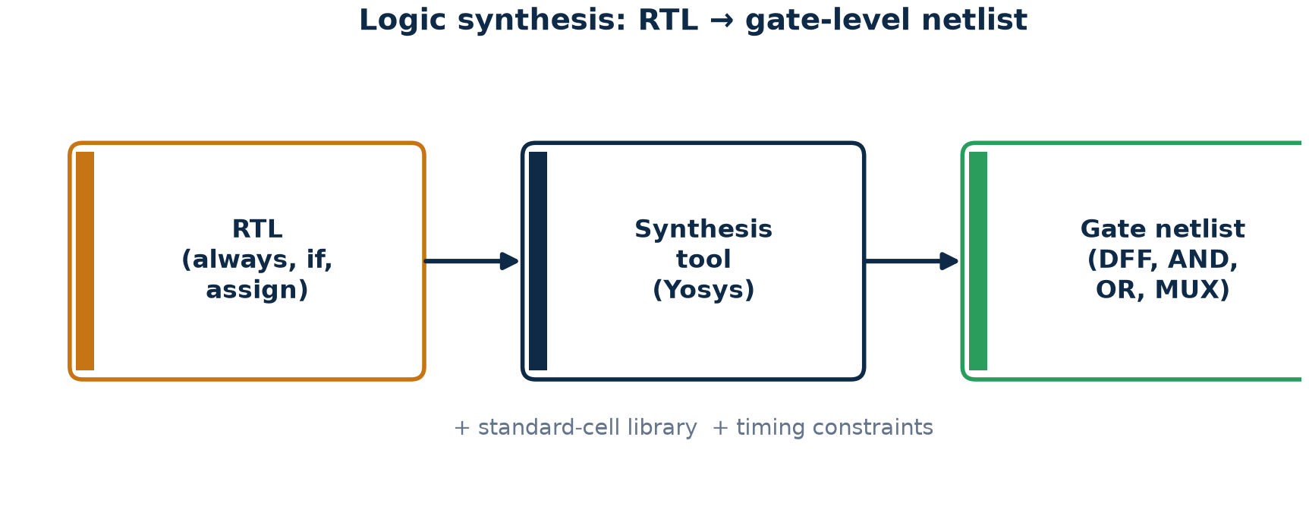
TOPIC 2B · STEP 5
Step 5 — Logic Synthesis (RTL → Gate Netlist)
Synthesis is the automatic translation of your RTL into a netlist of real gates from a standard-cell library, optimised to meet the timing, area and power constraints you provide.
What synthesis produces
A gate-level netlist — flip-flops and combinational cells wired together — functionally identical to your RTL. Open-source Yosys or commercial tools (Design Compiler, Genus) do this.
Module 2 · RTL Design Methodology
NIE/ELE/N0102 · Topic 2 · 18

Slide 19
TOPIC 2B · STEP 6
Step 6 — Gate-Level Sim · STA · Sign-Off
After synthesis, confirm the gates still behave correctly and that timing closes. These back-end-facing steps close the loop from RTL to a manufacturable design.
Gate-level simulation
Re-run tests on the netlist.
Catches synthesis mismatches.
Optional but valuable.
Static Timing Analysis
Checks every path meets setup/hold.
No test vectors needed.
Fails → fix RTL/constraints.
Sign-off
Timing, area, power all met.
Clean lint & coverage.
Hand off to physical design.
Module 2 · RTL Design Methodology
NIE/ELE/N0102 · Topic 2 · 19

Slide 20
TOPIC 2B · METHODOLOGY
Coding for Synthesis — The DOs
Methodology is mostly a set of habits that keep RTL synthesizable and predictable. Learn these as reflexes.
Always DO
Use non-blocking (<=) in clocked blocks.
Use blocking (=) in combinational blocks.
Give every combinational output a default value.
Complete every if with else, every case with default.
Reset all sequential state.
Keep one clock and one reset per block.
Good sequential + combinational
// sequential: non-blocking
always @(posedge clk or negedge rst_n)
if (!rst_n) q <= 1'b0;
else q <= d;
// combinational: blocking + default
always @* begin
y = 1'b0; // default
if (sel) y = a;
end
Module 2 · RTL Design Methodology
NIE/ELE/N0102 · Topic 2 · 20

Slide 21
TOPIC 2B · METHODOLOGY
Coding for Synthesis — The DON'Ts (and Why)
Most beginner RTL bugs come from a handful of anti-patterns. Each one either won't synthesize, or synthesizes into something you didn't intend.
Avoid
Incomplete if/case → unintended latch.
Mixing = and <= in one always block.
Reading and writing the same reg with = across cycles.
#delays / $display inside the design.
initial blocks to set hardware state (use reset).
Gated / derived clocks at RTL.
Latch bug vs fix
// BUG: no else -> y remembers (latch!)
always @* if (sel) y = a;
// FIX: default (or else) -> pure comb
always @* begin
y = 1'b0;
if (sel) y = a;
end
Module 2 · RTL Design Methodology
NIE/ELE/N0102 · Topic 2 · 21

Slide 22
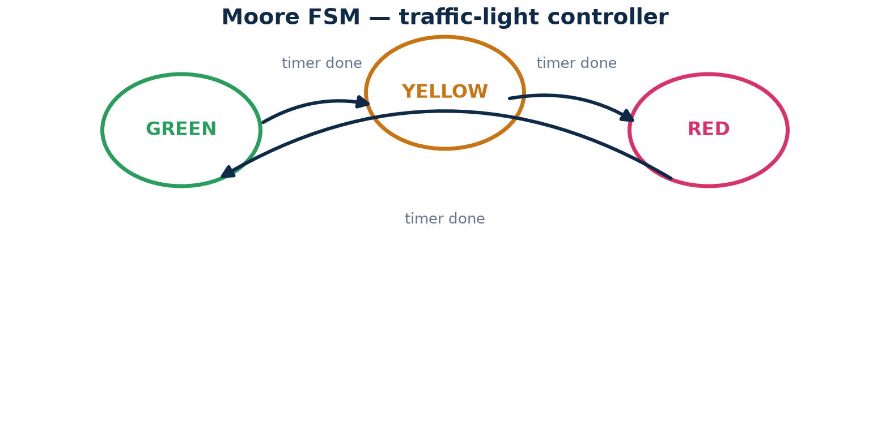
TOPIC 2B · FSM METHODOLOGY
Finite-State Machines — the Controller Pattern
The controller in most designs is a finite-state machine (FSM): a small set of named states with rules for moving between them. FSMs are the standard methodology for sequencing behaviour.
How to code an FSM
Three pieces: a state register (sequential), next-state logic (combinational), and output logic. Use symbolic state names and a case statement — never magic numbers.
Module 2 · RTL Design Methodology
NIE/ELE/N0102 · Topic 2 · 22

Slide 23
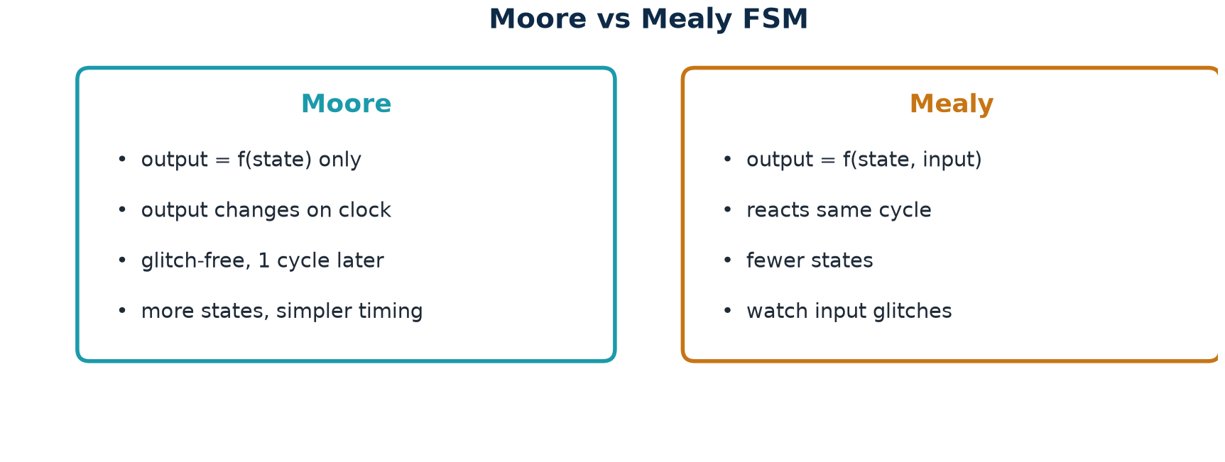
TOPIC 2B · FSM METHODOLOGY
Two FSM Styles — Moore vs Mealy
FSMs come in two flavours, differing only in how outputs are produced. Choosing correctly is a classic design decision — and a very common interview question.
Rule of thumb
Prefer Moore for clean, glitch-free, registered outputs; use Mealy when you must react in the same cycle and want fewer states. Both use the same three-block coding pattern.
Module 2 · RTL Design Methodology
NIE/ELE/N0102 · Topic 2 · 23

Slide 24
TOPIC 2B · WORKED EXAMPLE
Applying the Methodology — From Counter to 'Count-and-Flag'
Let us apply the whole methodology to a small extension of the running example: a counter that raises a 'tick' output for one cycle every time it wraps.
Methodology steps
1. Spec: count 0→15; pulse 'tick' high for one cycle at 15→0.
2. Micro-arch: 4-bit register + comparator (comb) + output register.
3. RTL: clocked counter; tick = (count == 4'd15).
4. Verify: testbench checks tick pulses once per 16 cycles.
5. Lint: complete reset, no latch.
6. Synthesize: ~4 DFFs + incrementer + comparator.
count_tick.v
module count_tick (
input clk, rst_n,
output reg [3:0] count,
output tick // comb output
);
assign tick = (count == 4'd15);
always @(posedge clk or negedge rst_n)
if (!rst_n) count <= 4'd0;
else count <= count + 1'b1;
endmodule
Module 2 · RTL Design Methodology
NIE/ELE/N0102 · Topic 2 · 24

Slide 25
TOPIC 2B · PRACTICAL EXAMPLE 2
Design Task — A '101' Sequence Detector (FSM)
Problem
Design an FSM that outputs '1' whenever the serial input bit-stream contains the pattern 1-0-1 (overlapping allowed).
(a) How many states are needed?
(b) Name them and give the transitions.
(c) Is a Moore or Mealy output more natural?
(d) Sketch the RTL structure (three blocks).
Solution outline
(a) 3–4 states: S0 (none), S1 (saw 1), S2 (saw 10), detect on 101.
(b) S0-1→S1; S1-0→S2; S2-1→S1 & output 1; reset to S0 on mismatch.
(c) Mealy detects in the same cycle with fewer states; Moore registers the output.
(d) state register + next-state case + output logic.
This is the datapath/controller method in miniature.
Try it yourself
Extend to detect '1011'. How many states now, and where does overlap change the transitions?
Module 2 · RTL Design Methodology
NIE/ELE/N0102 · Topic 2 · 25

Slide 26
TOPIC 2B · RECAP
RTL Methodology — What You Should Now Know
The process
Spec & micro-architecture → RTL coding → simulation → lint → synthesis → STA/sign-off.
Fix-and-re-iterate at every step.
Datapath + controller (FSM) structuring.
Moore vs Mealy FSM choice.
Design reuse via parameterization.
The habits
Non-blocking for sequential, blocking for combinational.
Defaults + complete if/case (no latches).
Reset every register.
One clock, one reset per block.
Clean lint before synthesis.
Module 2 · RTL Design Methodology
NIE/ELE/N0102 · Topic 2 · 26

Slide 27
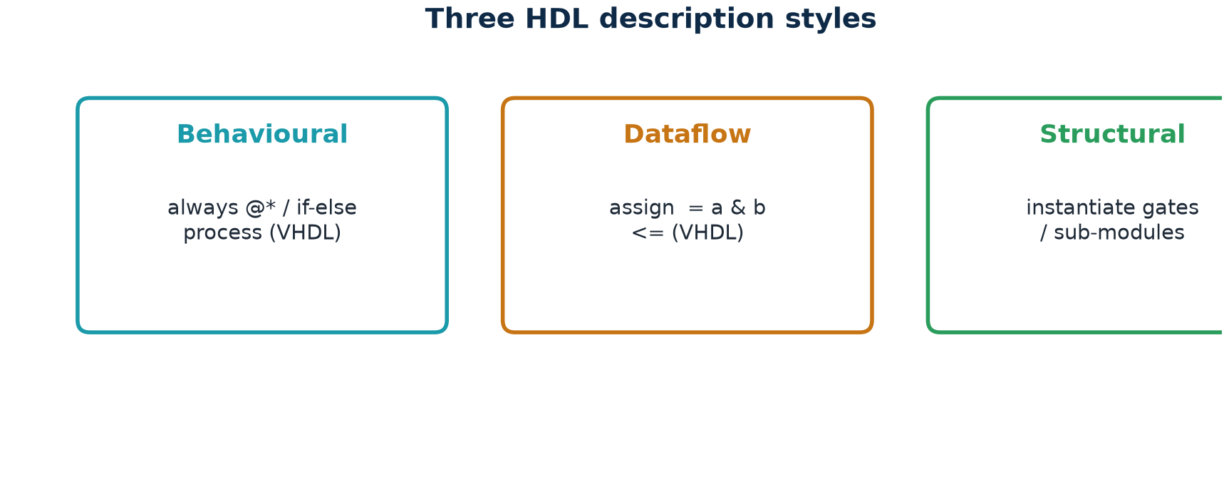
TOPIC 2C · OVERVIEW
Hardware Description Languages — Describing Circuits in Text
RTL is written in a Hardware Description Language (HDL). Unlike a programming language, an HDL describes hardware that all runs in parallel — and the same text can be both simulated and synthesized. The two dominant HDLs are Verilog and VHDL.
Three ways to describe the same hardware
HDLs let you write behaviourally (what it does), in dataflow (equations), or structurally (wire up sub-blocks). RTL mostly mixes behavioural + dataflow.
Module 2 · RTL Design Methodology
NIE/ELE/N0102 · Topic 2 · 27

Slide 28
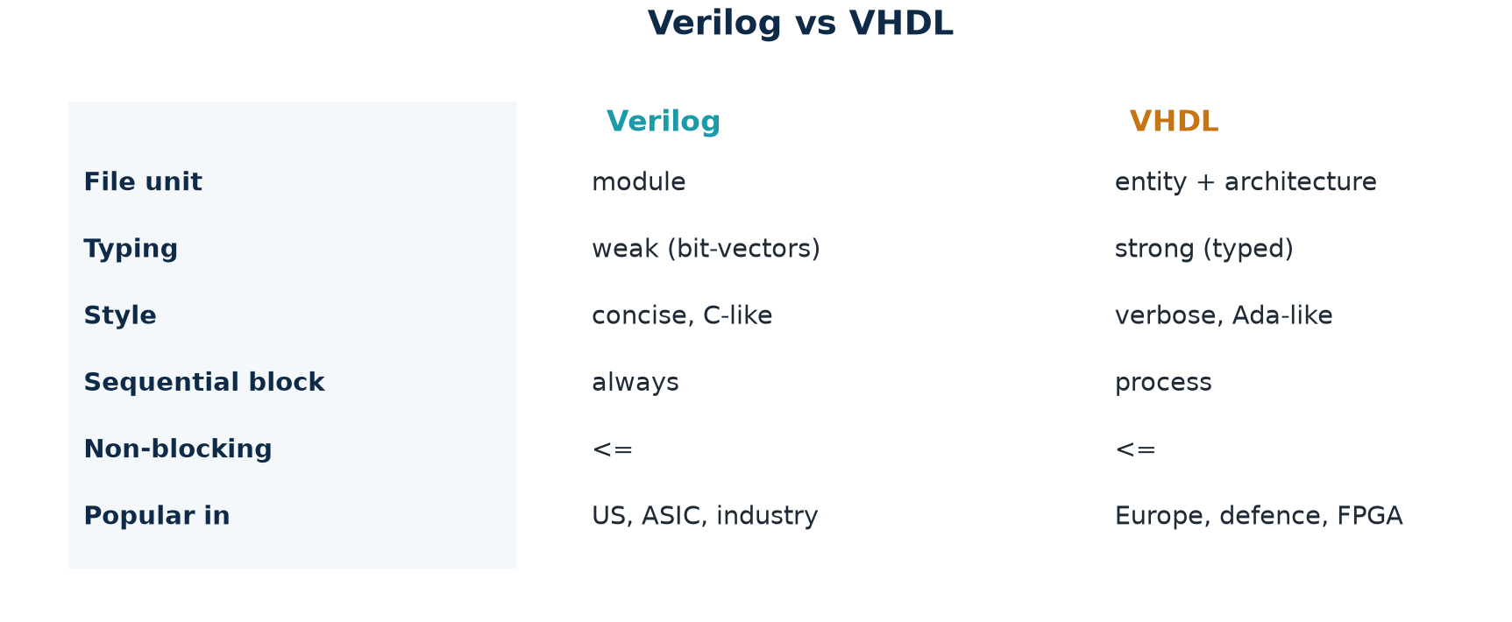
TOPIC 2C · COMPARE
Verilog vs VHDL — Same Job, Different Flavour
Verilog and VHDL are both IEEE-standard HDLs that can describe the same hardware. They differ in style and typing, not in capability. As a Chip-Design Associate you should be able to read both and write at least one fluently.
Which to learn first
Verilog (and its superset SystemVerilog) dominates ASIC design and the semiconductor industry; VHDL is strong in FPGA, aerospace and defence. This course leads with Verilog.
Module 2 · RTL Design Methodology
NIE/ELE/N0102 · Topic 2 · 28

Slide 29
TOPIC 2C · VERILOG
Verilog Basics — Module, Ports, Data Types
A Verilog design is a hierarchy of modules. A module has a name, a port list (its interface) and a body. Nets ('wire') carry combinational values; variables ('reg') hold values assigned in procedural blocks.
module skeleton + types
Key ideas
module = a reusable hardware block.
Ports: input / output / inout.
[7:0] declares an 8-bit bus.
wire — driven by assign / gates.
reg — assigned inside always.
Numbers: 8'd5, 4'b1010, 8'hFF.
Comments: // line, /* block */.
module block_name (
input clk,
input rst_n,
input [7:0] a, b, // 8-bit inputs
output reg [7:0] y, // registered output
output valid // wire output
);
wire [7:0] sum; // combinational net
assign sum = a + b; // continuous assign
// ... procedural blocks (always) go here ...
endmodule
Module 2 · RTL Design Methodology
NIE/ELE/N0102 · Topic 2 · 29

Slide 30
TOPIC 2C · VERILOG
Verilog — Combinational Logic
Combinational logic is written with continuous assignments (assign) or a combinational always block (always @*). It has no memory: outputs are a pure function of current inputs.
three combinational styles
Rules for combinational
Use blocking '=' assignments.
List all inputs — or use '@*' to do it automatically.
Give every output a default value.
Complete every case (default) and if (else).
No clock, no '<='.
Miss any of these → an accidental latch.
// 1) dataflow (assign)
assign y = a & b;
assign sum = a + b;
// 2) conditional (mux)
assign y = sel ? a : b;
// 3) always @* with default (safe)
always @* begin
y = 8'd0; // default -> no latch
case (sel)
2'b00: y = a;
2'b01: y = b;
default: y = 8'd0;
endcase
end
Module 2 · RTL Design Methodology
NIE/ELE/N0102 · Topic 2 · 30

Slide 31
TOPIC 2C · VERILOG
Verilog — Sequential Logic (Registers)
Sequential logic lives in a clocked always block. It uses non-blocking '<=' assignments so that all registers update together, exactly like real flip-flops sampling on the clock edge.
register patterns
Rules for sequential
Sensitivity list = clock edge (and async reset).
Use non-blocking '<=' only.
Reset every register to a known value.
Don't compute long combinational chains here — keep logic in @* blocks and register the result.
One clock edge per block.
// D flip-flop with async active-low reset
always @(posedge clk or negedge rst_n)
if (!rst_n) q <= 1'b0;
else q <= d;
// enabled register
always @(posedge clk)
if (en) q <= d;
// counter
always @(posedge clk or negedge rst_n)
if (!rst_n) cnt <= 0;
else cnt <= cnt + 1;
Module 2 · RTL Design Methodology
NIE/ELE/N0102 · Topic 2 · 31

Slide 32
TOPIC 2C · VHDL
VHDL Basics — Entity & Architecture
VHDL splits a design into an entity (the interface — like a module's port list) and one or more architectures (the implementation). It is strongly typed and more verbose than Verilog, which catches some errors at compile time.
counter in VHDL
Map to Verilog
entity ≈ module port list.
architecture ≈ module body.
signal ≈ wire/reg.
process ≈ always block.
rising_edge(clk) ≈ posedge clk.
<= is the signal-assign (like Verilog non-blocking).
Strong typing: unsigned, std_logic.
library IEEE;
use IEEE.STD_LOGIC_1164.ALL;
use IEEE.NUMERIC_STD.ALL;
entity counter4 is
port( clk, rst_n : in std_logic;
count : out unsigned(3 downto 0) );
end entity;
architecture rtl of counter4 is
signal cnt : unsigned(3 downto 0);
begin
process(clk, rst_n) begin
if rst_n = '0' then cnt <= (others => '0');
elsif rising_edge(clk) then cnt <= cnt + 1;
end if;
end process;
count <= cnt;
end architecture;
Module 2 · RTL Design Methodology
NIE/ELE/N0102 · Topic 2 · 32

Slide 33
TOPIC 2C · SIDE BY SIDE
Same Counter — Verilog vs VHDL
The identical hardware, described in both languages. Read them together: the structure is the same; only the syntax differs.
Verilog
VHDL
module counter4(
input clk, rst_n,
output reg [3:0] count);
always @(posedge clk or negedge rst_n)
if (!rst_n) count <= 4'b0;
else count <= count + 1'b1;
endmodule
process(clk, rst_n) begin
if rst_n = '0' then
cnt <= (others => '0');
elsif rising_edge(clk) then
cnt <= cnt + 1;
end if;
end process;
count <= cnt;
Module 2 · RTL Design Methodology
NIE/ELE/N0102 · Topic 2 · 33

Slide 34
TOPIC 2C · CONCEPT
Two Worlds in One File — Simulation vs Synthesis
A key HDL idea: the same language expresses both the hardware (synthesizable) and the test environment (simulation-only). You must know which constructs belong to which world.
Synthesizable (hardware)
always @(posedge clk) …
assign, case, if/else, arithmetic.
reg / wire, parameters.
Reset logic.
→ becomes real gates.
Simulation-only (testbench)
initial begin … end
#delays (e.g. #5 clk = ~clk;)
$display, $monitor, $finish.
$dumpfile / $dumpvars (waveform).
→ never in the design module.
The guardrail
If it has a #delay, an initial block, or a $task, it belongs in the testbench — not in the synthesizable design.
Module 2 · RTL Design Methodology
NIE/ELE/N0102 · Topic 2 · 34

Slide 35
TOPIC 2C · VERIFICATION
The Testbench — How We Simulate RTL
A testbench is itself HDL, but it is not hardware. It instantiates the design (the DUT), generates a clock and reset, applies stimulus, and checks results. Waveforms let you watch every signal.
counter4_tb.v (simulation only)
Anatomy
Declare clk/rst as reg (driven by TB).
Instantiate DUT by name (.port(sig)).
'always #5' toggles the clock.
'initial' runs once at t=0.
$dumpvars records a .vcd waveform.
$finish ends the simulation.
Open c.vcd in GTKWave to view.
`timescale 1ns/1ps
module counter4_tb;
reg clk=0, rst_n=0; wire [3:0] count;
counter4 dut(.clk(clk), .rst_n(rst_n), .count(count));
always #5 clk = ~clk; // 100 MHz clock
initial begin
$dumpfile("c.vcd"); $dumpvars(0, counter4_tb);
#12 rst_n = 1; // release reset
#200 $finish; // stop
end
endmodule
Module 2 · RTL Design Methodology
NIE/ELE/N0102 · Topic 2 · 35

Slide 36
TOPIC 2 · TUTORIAL T1
Hands-On T1 — A Combinational 2:1 Multiplexer
Objective: write, simulate and inspect a purely combinational block. Industry relevance: the mux is the most common combinational primitive in any datapath.
mux2.v
mux2_tb.v + run
module mux2 #(parameter W=8) (
input [W-1:0] a, b,
input sel,
output [W-1:0] y
);
assign y = sel ? b : a; // combinational
endmodule
module mux2_tb; reg [7:0] a,b; reg sel; wire [7:0] y;
mux2 dut(.a(a),.b(b),.sel(sel),.y(y));
initial begin
a=8'hAA; b=8'h55;
sel=0; #5 $display("sel0 y=%h",y);
sel=1; #5 $display("sel1 y=%h",y);
$finish;
end
endmodule
// iverilog -o m.vvp mux2_tb.v mux2.v && vvp m.vvp
// expect: sel0 y=aa sel1 y=55
Module 2 · RTL Design Methodology
NIE/ELE/N0102 · Topic 2 · 36

Slide 37
TOPIC 2 · TUTORIAL T2
Hands-On T2 — Sequential: Run the Counter End-to-End
Objective: take the running 4-bit counter through the full front-end flow — compile, simulate, view the waveform, and synthesize — on free tools.
simulate + view
synthesize (Yosys)
# 1) compile design + testbench
iverilog -o c.vvp counter4_tb.v counter4.v
# 2) run the simulation
vvp c.vvp
# 3) view the waveform
gtkwave c.vcd &
# expect: count 0,1,2,...,15,0,... after reset
yosys -p "read_verilog counter4.v; \
synth -top counter4; stat"
# expect in 'stat':
# ~4 D flip-flops
# a 4-bit incrementer (adder)
# -> RTL became a real gate netlist
Checkpoint & guardrail
The waveform must show a clean count after reset; 'stat' must list ~4 DFFs. Remember: $dumpfile/$dumpvars and #delays live only in the testbench — never in counter4.v.
Module 2 · RTL Design Methodology
NIE/ELE/N0102 · Topic 2 · 37

Slide 38
TOPIC 2 · TUTORIAL T3
Hands-On T3 — An FSM: Traffic-Light Controller
Objective: build a Moore FSM using the three-block methodology (state register, next-state logic, output logic). This ties together everything in Topic 2.
traffic.v (Moore FSM)
Learning outcomes
Three-block FSM pattern in real code.
Symbolic states (localparam).
Sequential state reg + combinational next-state.
Moore output = f(state).
Extend: add a counter so 'tick' fires every N cycles.
Write a testbench and view the state on a waveform.
module traffic (input clk, rst_n, input tick,
output reg [1:0] light); // 00 R,01 G,10 Y
localparam RED=2'd0, GREEN=2'd1, YEL=2'd2;
reg [1:0] state, nxt;
// 1) state register (sequential)
always @(posedge clk or negedge rst_n)
if (!rst_n) state <= RED; else state <= nxt;
// 2) next-state logic (combinational)
always @* begin nxt = state;
if (tick) case (state)
RED: nxt=GREEN; GREEN: nxt=YEL; YEL: nxt=RED; endcase
end
// 3) output logic (Moore)
always @* light = state;
endmodule
Module 2 · RTL Design Methodology
NIE/ELE/N0102 · Topic 2 · 38

Slide 39
TOPIC 2 · GLOSSARY
Key Terms & Acronyms (Topic 2)
RTL
Register-Transfer Level — registers + logic per clock
Moore / Mealy
FSM output = f(state) / f(state,input)
HDL
Hardware Description Language (Verilog, VHDL)
Blocking (=)
procedural assign for combinational logic
Combinational
logic with no memory — output = f(inputs)
Non-blocking (<=)
procedural assign for sequential logic
Sequential
logic with memory — updates on a clock edge
Latch
unwanted memory from an incomplete if/case
Register / FF
storage element that samples on the clock edge
Testbench / DUT
sim stimulus / Design-Under-Test
Synchronous
one clock times all registers
Synthesis
RTL → gate-level netlist
Datapath
registers, adders, muxes that move/transform data
STA
Static Timing Analysis — checks setup/hold
Controller / FSM
state machine that sequences the datapath
Entity / Architecture
VHDL interface / implementation
Module 2 · RTL Design Methodology
NIE/ELE/N0102 · Topic 2 · 39

Slide 40
TOPIC 2 · RECAP
Topic 2 in One Page — RTL Design Methodology
2a · Basics of RTL
Registers + combinational logic per clock.
Register-transfer view; comb vs seq.
Synchronous design; datapath+controller.
4-bit counter running example.
2b · Methodology
Spec → RTL → simulate → lint → synthesize → STA.
Fix-and-re-iterate.
FSM (Moore/Mealy) controller.
DO non-blocking/blocking; avoid latches.
2c · HDLs
Verilog & VHDL describe the same hardware.
Behavioural / dataflow / structural.
Sim-only vs synthesizable constructs.
Testbench drives the DUT.
Next
Topic 3 goes deeper into the HDL — full Verilog syntax, operators and hierarchy — building directly on this methodology.
Module 2 · RTL Design Methodology
NIE/ELE/N0102 · Topic 2 · 40

