Slide 1
TOPIC 6
Timing Constraints and Analysis
Introduction to timing constraints in RTL design · Timing analysis and optimization techniques · Setup and hold time violations and resolution
6a · Constraints — what the tool cannot know until you tell it
6b · Analysis — how static timing analysis actually computes slack
6c · Violations — setup and hold, why they are opposite, and how to fix each
Tools · Vivado · OpenSTA · a 400-line STA engine you build · Labs T1–T7
Chip Design Associate · Module 2 · Verilog RTL Coding for Synthesis · Topic 6: Timing Constraints and Analysis
M2-T6 · 1

Slide 2
TOPIC 6 · ROADMAP
What This Topic Covers, and Why Every Chip Depends On It
Topic 4 taught you to write RTL. Topic 5 taught you to prove it is functionally correct. Topic 6 asks the last question before silicon: is it fast enough, and will it work at all? A design that simulates perfectly can still fail on the bench - because simulation does not know how long a wire takes.
Syllabus bullet — Topic 6
Covered by
Slides
Introduction to timing constraints in RTL design
6a
5–26
Timing analysis and optimization techniques
6b
27–48
Setup and hold time violations and resolution
6c
49–68
Practical: Timing Analysis and Closure Labs (10 h)
Labs T1–T7
69–78
Practical: Design Synthesis and Optimisation Labs (15 h)
Labs T5–T7
74–78
Learning outcomes — by the end of this topic you can
· Write a complete SDC/XDC constraint file and defend every line in it.
· Compute arrival, required and slack by hand, then verify a tool's answer against your own.
· Read any timing report - Vivado, OpenSTA, PrimeTime - and find the problem in under a minute.
· Diagnose a setup violation and pick the cheapest fix that works.
· Recognise a hold violation, explain why slowing the clock cannot help, and fix it properly.
One sentence to open the session with
A functional bug makes the chip do the wrong thing. A timing bug makes it do the right thing at the wrong moment - and no amount of simulation will show you that.
Chip Design Associate · Module 2 · Verilog RTL Coding for Synthesis · Topic 6: Timing Constraints and Analysis
M2-T6 · 2

Slide 3
WHY THIS MATTERS
The Bug That Simulation Cannot Find
Your testbench applies a value, waits for a clock edge, and checks the answer. It assumes the logic finished in time. Real gates take real time. If the answer is 0.2 ns late, the flop captures the OLD value - and your simulation, which had no delays in it, never noticed.
What RTL simulation checks
What static timing analysis checks
What neither one checks
Does the design compute the right value, given unlimited time?
Every functional bug you found in Topic 5 lives here.
Zero-delay: every assignment lands instantly.
Does that value ARRIVE before the next clock edge?
And does it stay put long enough to be captured?
Real gate delays, real wire delays, real clock skew.
Whether your CONSTRAINTS describe the real system.
A wrong period or a missing input delay makes both tools lie in the same direction: everything looks fine.
The order of operations, and it is not negotiable
1. Simulate until the function is right. 2. Constrain until the report is honest. 3. Analyse until the slack is positive. 4. Only then build.
Skip step 2 and step 3 becomes theatre: the tool reports MET on paths it never examined.
Chip Design Associate · Module 2 · Verilog RTL Coding for Synthesis · Topic 6: Timing Constraints and Analysis
M2-T6 · 3

Slide 4
PART 6a
Timing Constraints in RTL Design
Synthesis has no idea how fast you want to go until you tell it. This part is about telling it - completely, and truthfully.
The clock: create_clock, period, waveform, uncertainty
The boundary: set_input_delay and set_output_delay
The exceptions: set_false_path and set_multicycle_path
The order to write a constraint file, and the holes to check for
Chip Design Associate · Module 2 · Verilog RTL Coding for Synthesis · Topic 6: Timing Constraints and Analysis
M2-T6 · 4

Slide 5
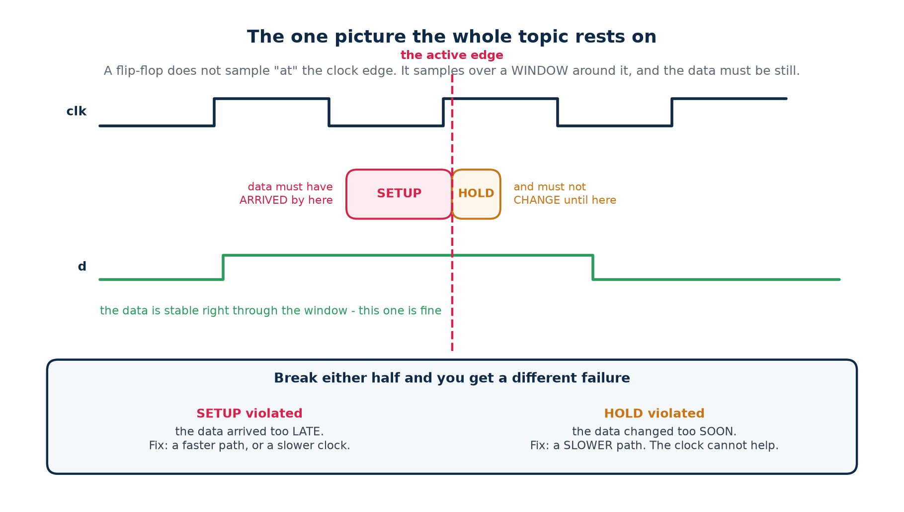
6a · THE ONE PICTURE
A Flip-Flop Samples Over a Window, Not At an Instant
Every timing concept in this topic comes from this one diagram
SETUP time: the data must be stable for this long BEFORE the edge. HOLD time: it must stay stable for this long AFTER it. Break the first and the flop captures a stale value; break the second and it captures the NEXT value, a whole cycle early.
Chip Design Associate · Module 2 · Verilog RTL Coding for Synthesis · Topic 6: Timing Constraints and Analysis
M2-T6 · 5

Slide 6
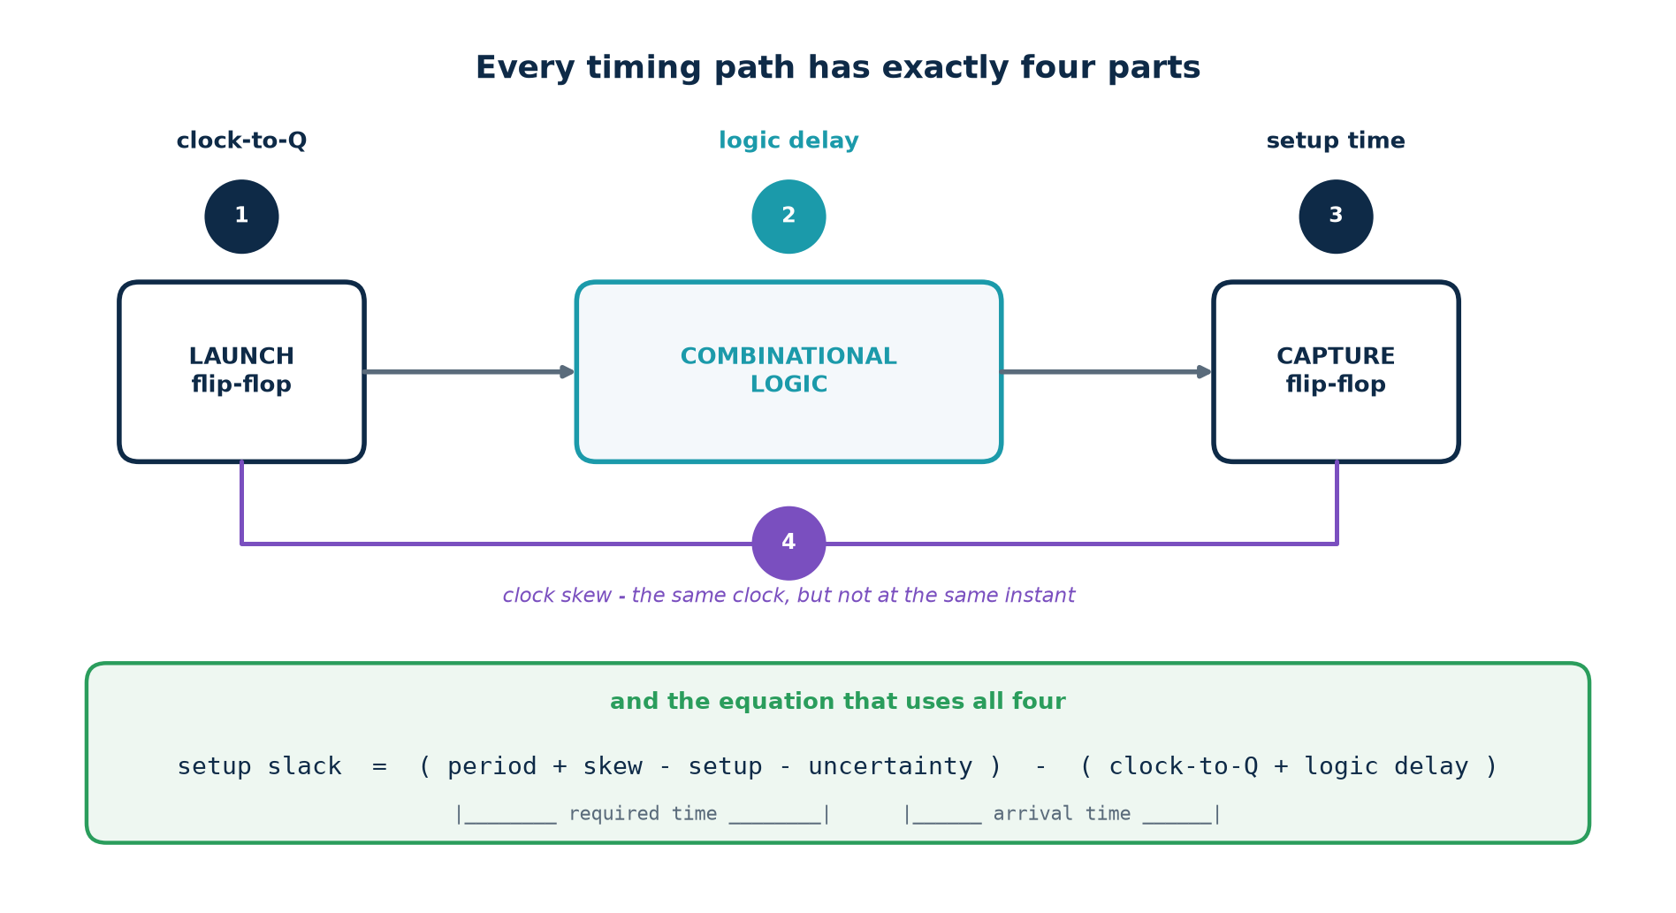
6a · THE TIMING PATH
Every Path Has Exactly Four Parts
Learn these four names and the rest of the topic is arithmetic
clock-to-Q (how long the launching flop takes to produce Q) · logic delay (the combinational path) · setup time (how early the capturing flop needs it) · clock skew (the two flops do not see the edge at the same instant)
Chip Design Associate · Module 2 · Verilog RTL Coding for Synthesis · Topic 6: Timing Constraints and Analysis
M2-T6 · 6

Slide 7
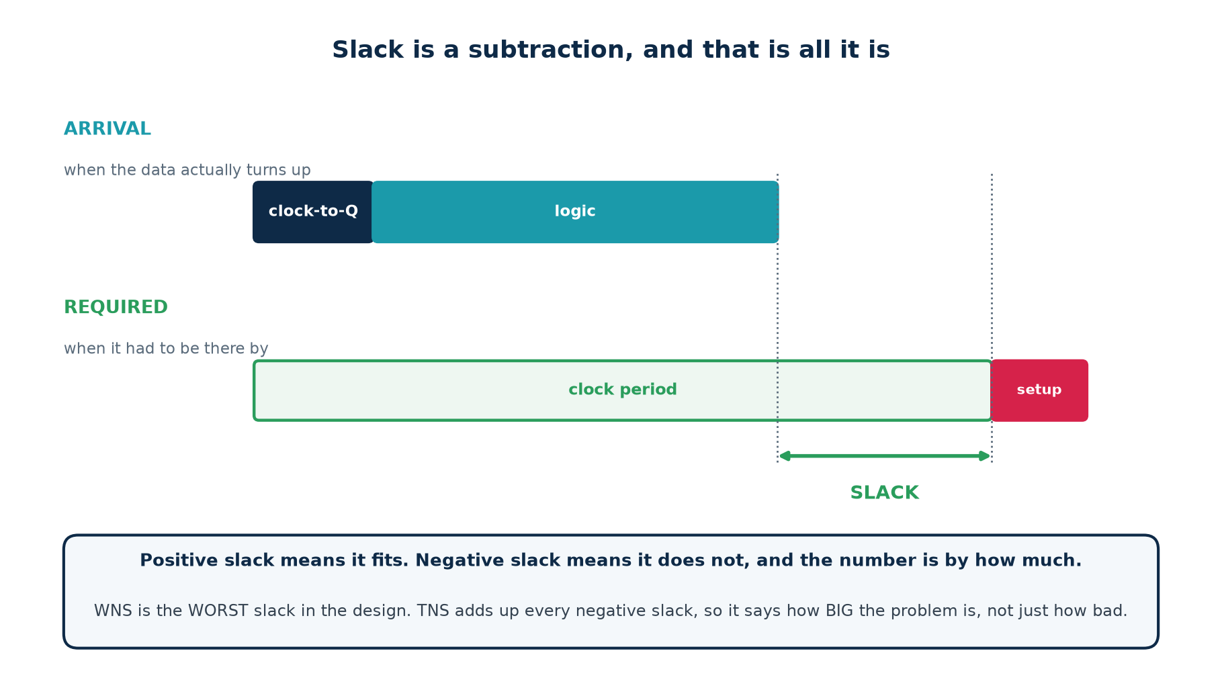
6a · SLACK
Slack Is a Subtraction, and That Is All It Is
the only equation you must memorise
slack = required time - arrival time
arrival = clock-to-Q + logic delay (when the data turns up)
required = period + skew - setup - uncertainty (when it had to be there)
Positive slack: it fits, with room to spare. Negative slack: it does not fit, and the number is by how much.
Chip Design Associate · Module 2 · Verilog RTL Coding for Synthesis · Topic 6: Timing Constraints and Analysis
M2-T6 · 7

Slide 8
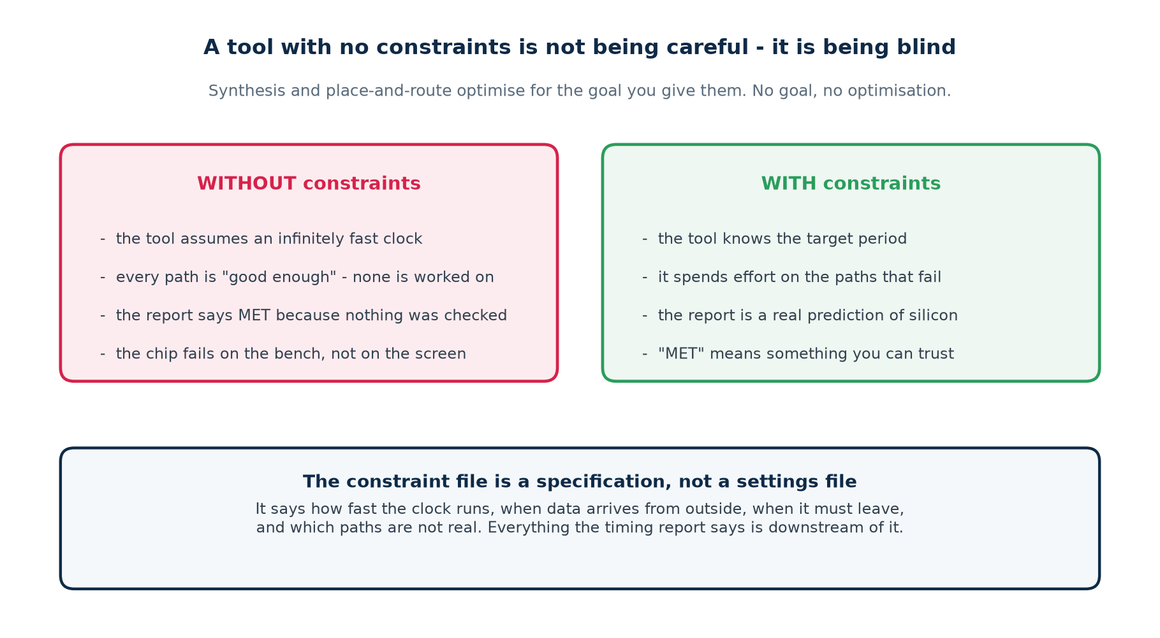
6a · WHY CONSTRAIN
A Tool With No Constraints Is Not Careful - It Is Blind
The single most dangerous report in engineering
A timing report with no violations on an unconstrained design. It is not telling you the design is fast. It is telling you it did not look.
Chip Design Associate · Module 2 · Verilog RTL Coding for Synthesis · Topic 6: Timing Constraints and Analysis
M2-T6 · 8

Slide 9
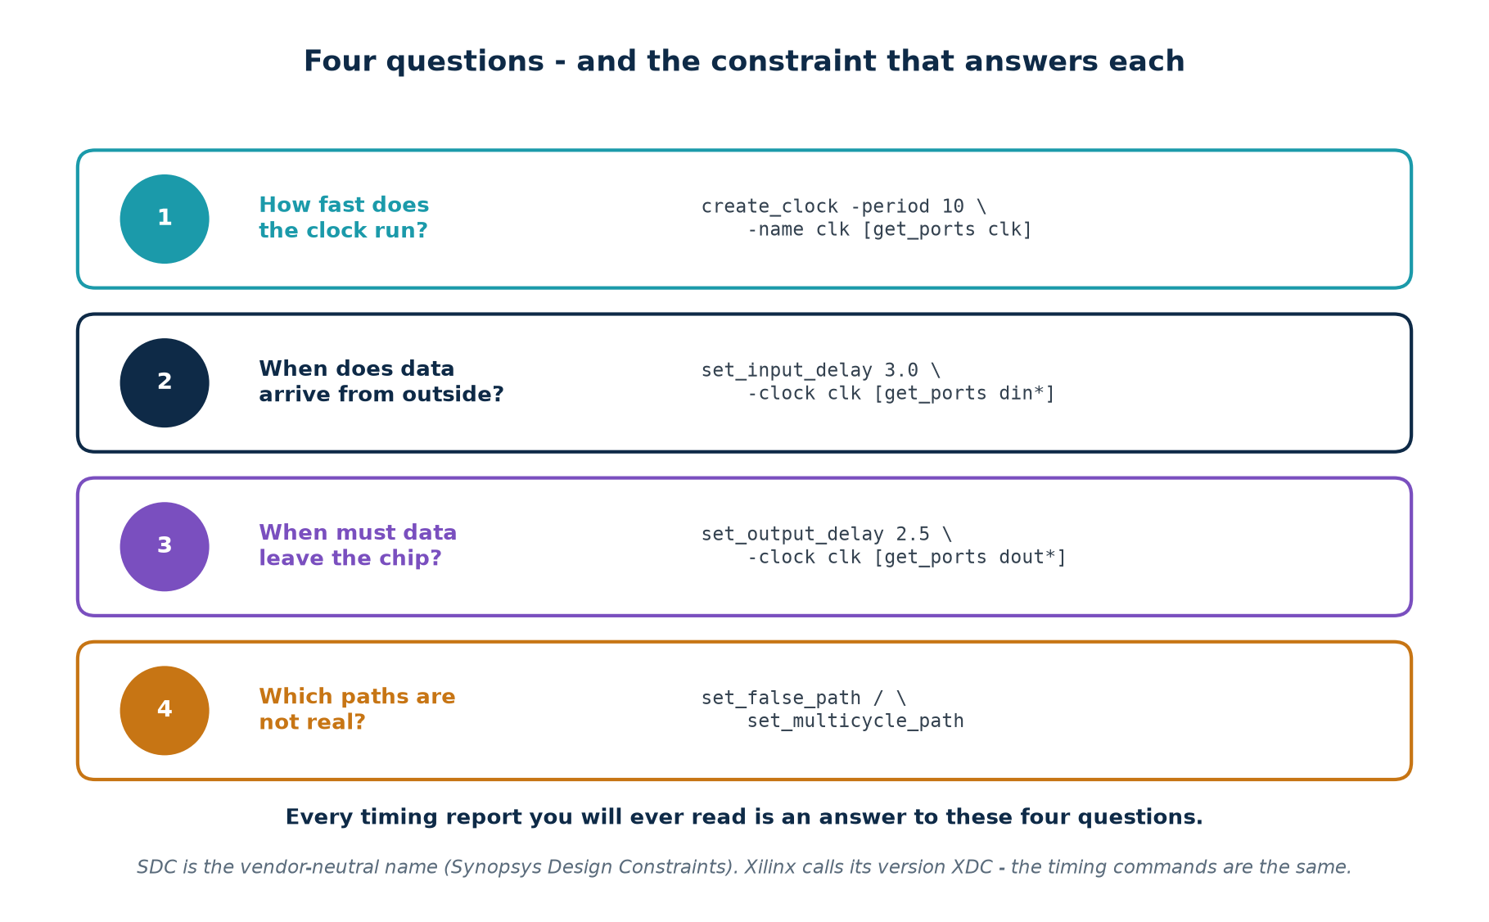
6a · THE FOUR QUESTIONS
Every Constraint File Answers the Same Four Things
SDC (Synopsys Design Constraints) is the vendor-neutral format. Xilinx XDC is SDC plus physical constraints. Intel Quartus reads SDC directly. Learn it once.
Chip Design Associate · Module 2 · Verilog RTL Coding for Synthesis · Topic 6: Timing Constraints and Analysis
M2-T6 · 9

Slide 10
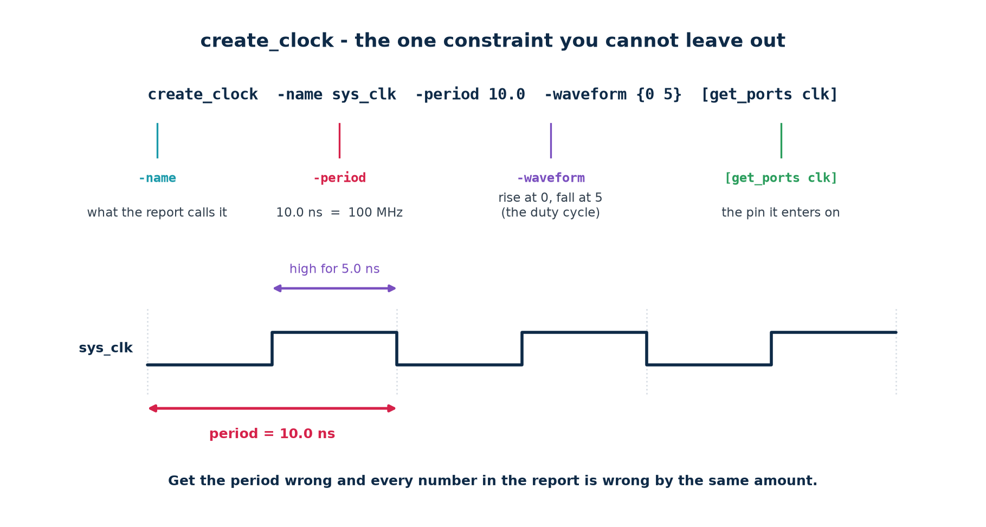
6a · create_clock
The One Constraint You Cannot Leave Out
clocks, primary and generated
# a 100 MHz primary clock arriving on the port called clk
create_clock -name sys_clk -period 10.000 -waveform {0.000 5.000} [get_ports clk]
# a clock made by a divide-by-2 inside the design - derive it, never re-declare it
create_generated_clock -name clk_div2 -source [get_ports clk] \
-divide_by 2 [get_pins div_reg/Q]
If a register is clocked by something you never declared, its paths are unconstrained and silently unchecked.
Chip Design Associate · Module 2 · Verilog RTL Coding for Synthesis · Topic 6: Timing Constraints and Analysis
M2-T6 · 10

Slide 11
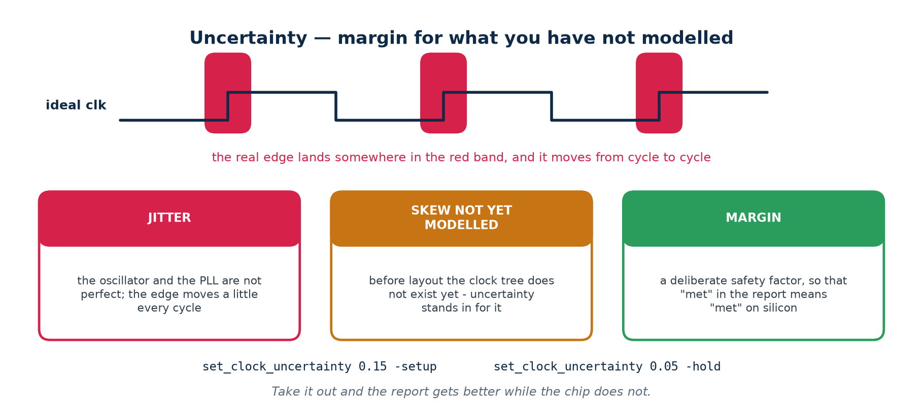
6a · UNCERTAINTY
Margin For What You Have Not Modelled Yet
before layout, uncertainty stands in for the clock tree
set_clock_uncertainty 0.150 -setup [get_clocks sys_clk] # jitter + unbuilt skew
set_clock_uncertainty 0.050 -hold [get_clocks sys_clk] # jitter only
A number you will be tempted to reduce, and should not
Uncertainty is the difference between "the report says MET" and "the silicon works". Shrinking it makes the report prettier and the chip no faster. Typical FPGA practice: 0.1-0.2 ns pre-layout, then let the tool use the real clock tree afterwards.
Chip Design Associate · Module 2 · Verilog RTL Coding for Synthesis · Topic 6: Timing Constraints and Analysis
M2-T6 · 11

Slide 12
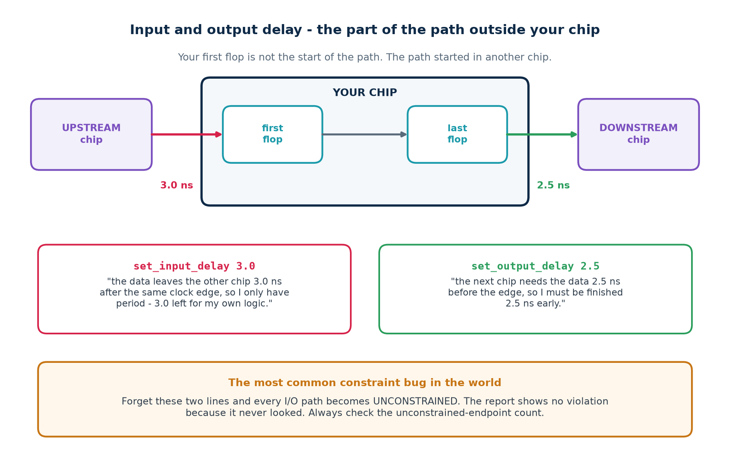
6a · I/O CONSTRAINTS
Your First Flop Is Not the Start of the Path
The most common constraint bug in the world
Forget these two lines and every path touching a pin becomes UNCONSTRAINED. The report shows no violation because it never looked at them. Always check the unconstrained-endpoint count before you believe a clean report.
Chip Design Associate · Module 2 · Verilog RTL Coding for Synthesis · Topic 6: Timing Constraints and Analysis
M2-T6 · 12

Slide 13
6a · I/O CONSTRAINTS
Writing Them - and Where the Numbers Come From
constraints/io.sdc
# INPUT: how late the data arrives, measured from the SAME clock edge
set_input_delay -clock sys_clk -max 3.0 [get_ports {din[*] valid}]
set_input_delay -clock sys_clk -min 0.5 [get_ports {din[*] valid}]
# OUTPUT: how much of the period the NEXT chip needs, before its own edge
set_output_delay -clock sys_clk -max 2.5 [get_ports {dout[*] ready}]
set_output_delay -clock sys_clk -min 0.2 [get_ports {dout[*] ready}]
# a quick sanity sweep: constrain everything that is still bare
set_input_delay -clock sys_clk 3.0 [remove_from_collection \
[all_inputs] [get_ports clk]]
-max is used for
-min is used for
Where the number comes from
the SETUP check
the HOLD check
the upstream chip's datasheet: clock-to-out
the slow corner
the fast corner
plus the board trace delay
the LATEST the data can arrive
the EARLIEST it can change
when unknown, budget 30% of the period and revisit
A rule of thumb that has saved many projects
Register every input and every output. It costs one cycle of latency and removes the entire I/O timing problem: the path from pin to flop becomes short and the path from flop to pin becomes short. Do it unless you have a measured reason not to.
Chip Design Associate · Module 2 · Verilog RTL Coding for Synthesis · Topic 6: Timing Constraints and Analysis
M2-T6 · 13

Slide 14
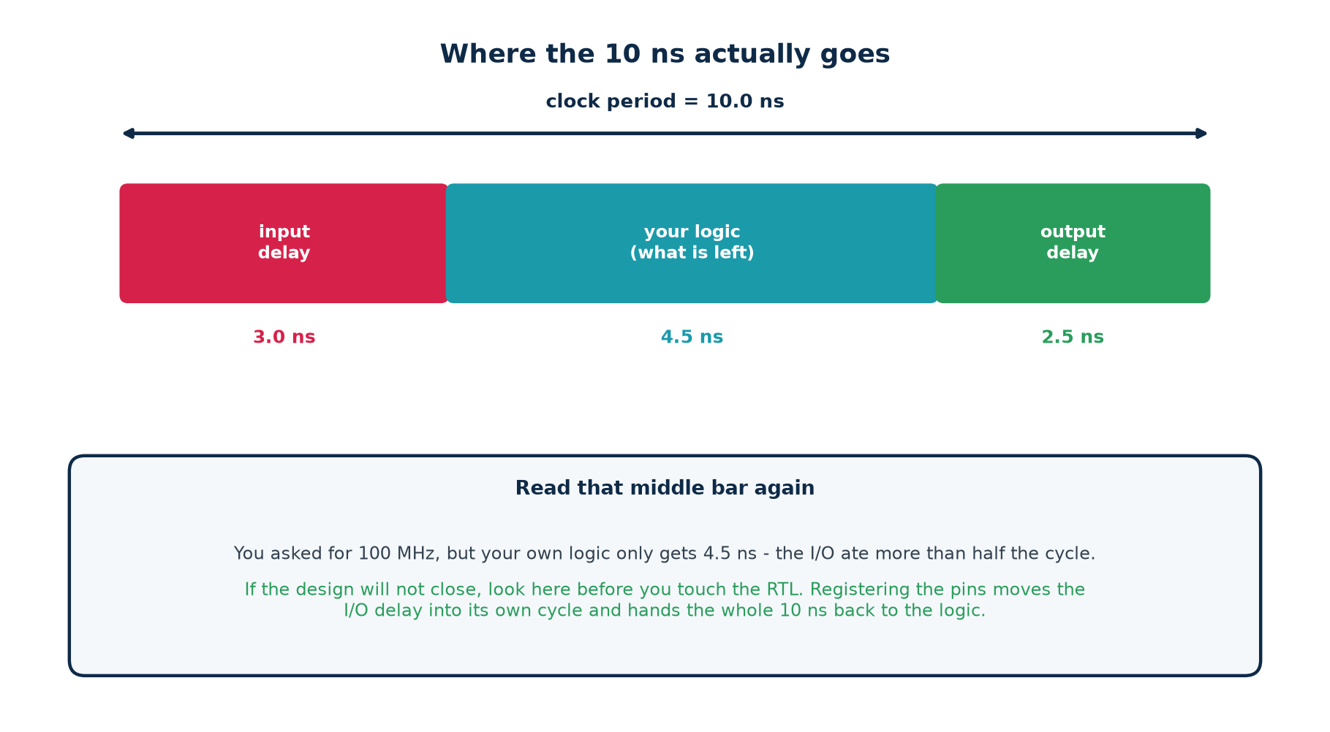
6a · THE BUDGET
Where the 10 Nanoseconds Actually Goes
Read the middle bar before you touch the RTL
You asked for 100 MHz and your own logic got 4.5 ns of it. If the design will not close, the I/O budget is the first place to look - and registering the pins hands the whole period back.
Chip Design Associate · Module 2 · Verilog RTL Coding for Synthesis · Topic 6: Timing Constraints and Analysis
M2-T6 · 14

Slide 15
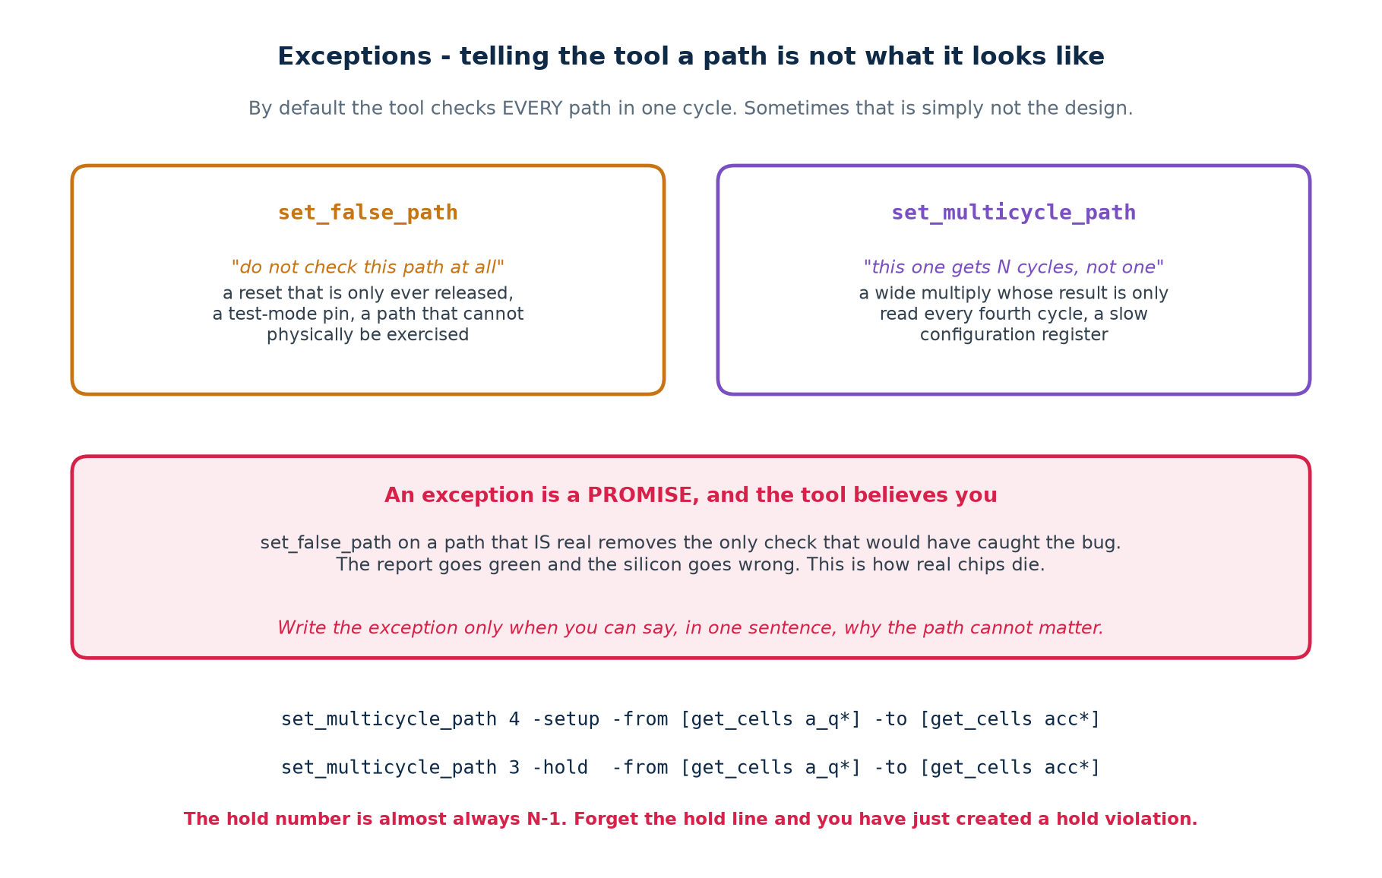
6a · EXCEPTIONS
Telling the Tool a Path Is Not What It Looks Like
An exception is a promise, and the tool believes you without checking. Every one needs a comment saying why it is true.
Chip Design Associate · Module 2 · Verilog RTL Coding for Synthesis · Topic 6: Timing Constraints and Analysis
M2-T6 · 15

Slide 16
6a · FALSE PATHS
When "Do Not Check This" Is the Honest Answer
the three legitimate uses
# a reset that is asserted asynchronously and released synchronously:
# the assertion edge is never timed, the release IS - so cut only one direction
set_false_path -from [get_ports rst_n]
# a mode pin written once at power-up and never again
set_false_path -from [get_cells cfg_mode_reg]
# two clocks that are genuinely unrelated (no data crosses without a synchroniser)
set_clock_groups -asynchronous -group [get_clocks sys_clk] \
-group [get_clocks usb_clk]
Legitimate
Not legitimate
The path physically cannot be exercised.
A synchroniser already handles the crossing.
The endpoint is not sampled by that clock at all.
"It always fails and I do not know why."
"The tool is being pessimistic."
"We ran out of time before tape-out."
How this kills a chip
set_false_path on a path that IS real removes the only check that would have caught the bug. The report goes green, the design ships, and the failure appears in the field at one temperature and one voltage. Write the justification in the file, next to the line.
Chip Design Associate · Module 2 · Verilog RTL Coding for Synthesis · Topic 6: Timing Constraints and Analysis
M2-T6 · 16

Slide 17
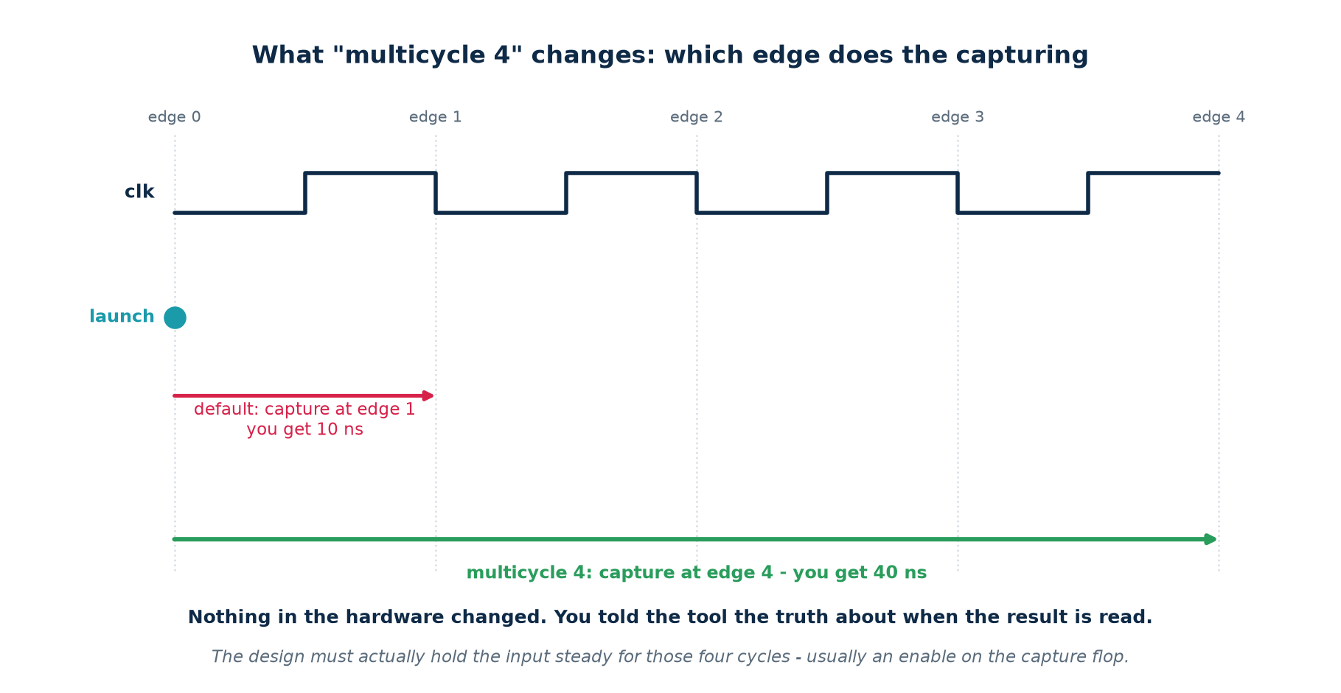
6a · MULTICYCLE PATHS
When One Cycle Was Never the Requirement
setup N, hold N-1 - and the hold line is not optional
set_multicycle_path 4 -setup -from [get_cells a_q*] -to [get_cells acc*]
set_multicycle_path 3 -hold -from [get_cells a_q*] -to [get_cells acc*]
Why the hold number is N-1
The setup line moves the CAPTURE edge four cycles later. Left alone, the hold check would then compare against that same distant edge and demand an absurd amount of delay. The -hold N-1 line moves the hold check back to where it belongs: one edge after the launch.
Chip Design Associate · Module 2 · Verilog RTL Coding for Synthesis · Topic 6: Timing Constraints and Analysis
M2-T6 · 17

Slide 18
6a · MULTICYCLE PATHS
The Part Everyone Forgets: the Hardware Must Agree
rtl/slow_path.v — the enable that justifies the exception
// the SDC exception is a claim about this design. Make the claim true:
reg [1:0] phase;
always @(posedge clk) phase <= phase + 1'b1;
wire tick = (phase == 2'b11); // one cycle in four
always @(posedge clk) begin
if (tick) acc <= a_q + b_q; // the ENABLE is what makes it legal
end
// a_q and b_q must also be held steady across all four cycles -
// if they change every cycle, the multicycle claim is simply false.
Without the exception
With it
Measured in the lab
worst slack -1.193 ns
worst slack +0.392 ns
one SDC line
the tool times a 32-bit ripple add in one cycle
it times it across four
no RTL changed at all
you pipeline something that never needed it
you ship what you already had
hours of work avoided
The discipline
Never write a multicycle path you cannot point at the enable for. If the capture register has no enable, the exception is a lie and the silicon will find it.
Chip Design Associate · Module 2 · Verilog RTL Coding for Synthesis · Topic 6: Timing Constraints and Analysis
M2-T6 · 18

Slide 19
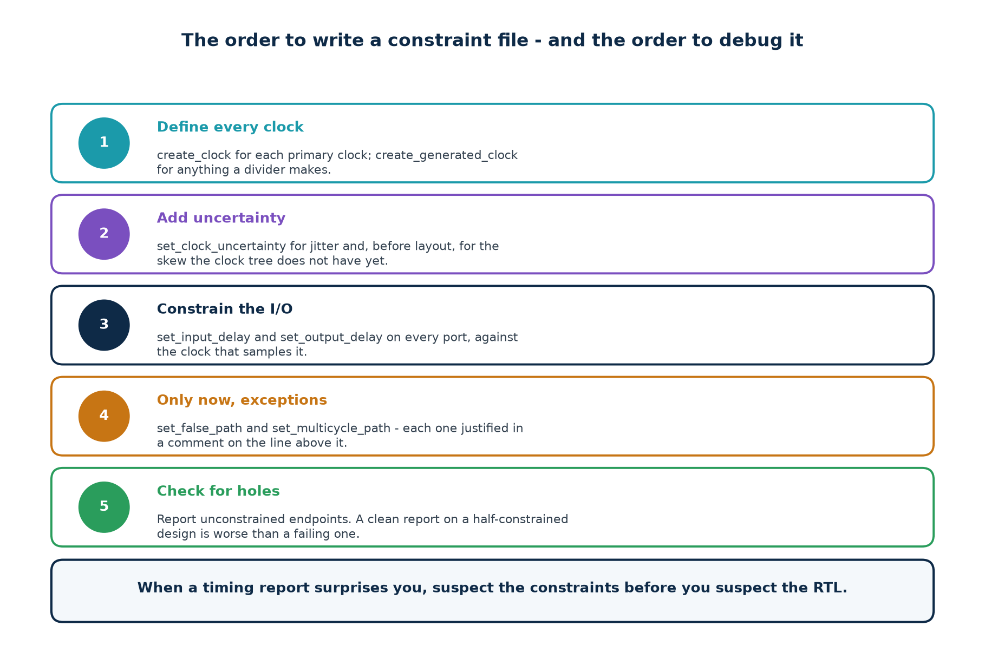
6a · WRITING THE FILE
The Order To Write It - and the Order To Debug It
The check that catches everything else
Report unconstrained endpoints on every run. A design with 400 of them and WNS +2.0 ns is in far worse shape than one with zero and WNS -0.1 ns - the first one has not been analysed at all.
Chip Design Associate · Module 2 · Verilog RTL Coding for Synthesis · Topic 6: Timing Constraints and Analysis
M2-T6 · 19

Slide 20
6a · A COMPLETE FILE
Everything Above, In One Real Constraint File
# ============================================================ constraints/add32.sdc
# clock ---------------------------------------------------------------------------
create_clock -name clk -period 5.000 [get_ports clk]
set_clock_uncertainty 0.100 -setup [get_clocks clk]
set_clock_uncertainty 0.030 -hold [get_clocks clk]
# boundary ------------------------------------------------------------------------
set_input_delay -clock clk -max 1.20 [get_ports {a[*] b[*]}]
set_input_delay -clock clk -min 0.30 [get_ports {a[*] b[*]}]
set_output_delay -clock clk -max 1.00 [get_ports {sum[*] cout}]
set_output_delay -clock clk -min 0.20 [get_ports {sum[*] cout}]
# exceptions ----------------------------------------------------------------------
# cfg_mode is written by software at boot and read only when the core is halted.
set_false_path -from [get_cells cfg_mode_reg]
# environment ---------------------------------------------------------------------
set_max_fanout 16 [current_design]
Chip Design Associate · Module 2 · Verilog RTL Coding for Synthesis · Topic 6: Timing Constraints and Analysis
M2-T6 · 20

Slide 21
6a · CHECKPOINT
Ten Questions Before We Move On
#
Question
The answer in one line
1
What does create_clock actually do?
gives the tool a target; without it there is none
2
What is the unit of slack?
time - nanoseconds, signed
3
Positive slack means?
the path fits, with that much to spare
4
What does set_input_delay describe?
the part of the path outside your chip
5
What happens if you omit it?
those paths become unconstrained - unchecked
6
Why is uncertainty there?
jitter, and skew that does not exist yet
7
When is a false path legitimate?
when the path cannot be exercised, and you can say why
8
Multicycle 4 setup needs what hold?
3 - almost always N-1
9
What must the RTL have for it?
an enable that really does hold the capture
10
What do you check last, every time?
the unconstrained-endpoint count
If any of these is still fuzzy, the analysis in part 6b will not land. Ask now.
Chip Design Associate · Module 2 · Verilog RTL Coding for Synthesis · Topic 6: Timing Constraints and Analysis
M2-T6 · 21

Slide 22
PART 6b
Timing Analysis and Optimization Techniques
How a tool turns a netlist into a slack number - and what to do when that number is negative.
Static timing analysis: the graph, the two sweeps, the subtraction
Reading a timing report line by line
Path groups, WNS, TNS, Fmax and PVT corners
Optimisation: constraints, mapping, restructuring, pipelining, retiming
Chip Design Associate · Module 2 · Verilog RTL Coding for Synthesis · Topic 6: Timing Constraints and Analysis
M2-T6 · 22

Slide 23
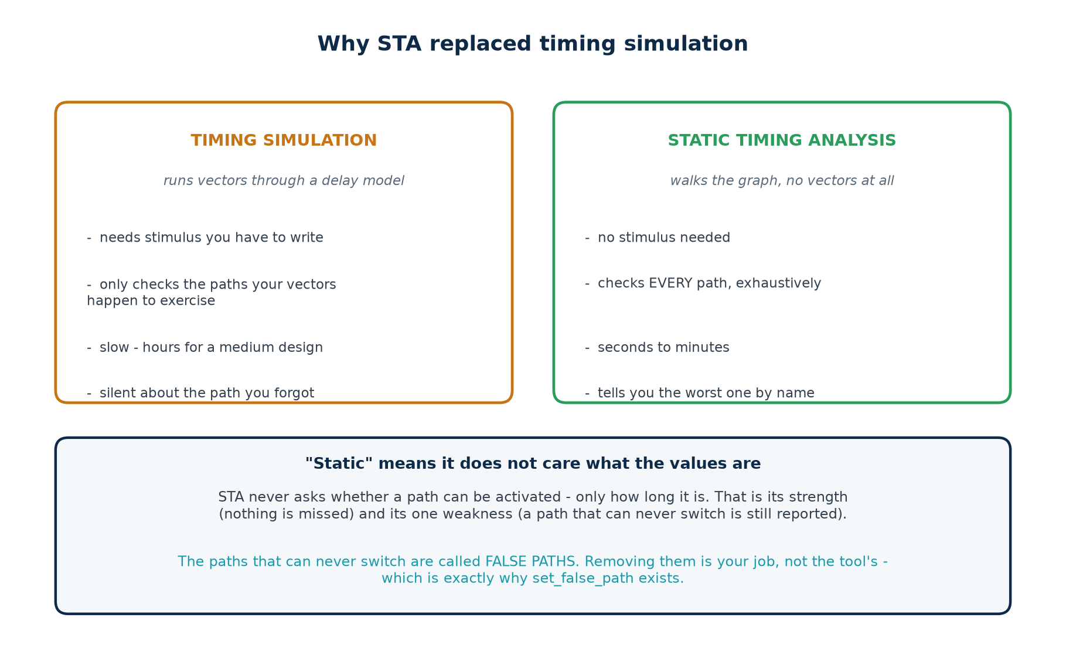
6b · WHY STA
Static Timing Analysis Replaced Timing Simulation
The word "static" is the whole idea
STA never asks what the data values are. It only asks how long the path is. That is why it needs no stimulus, why it cannot miss a path - and why it will happily report a path that can never actually switch.
Chip Design Associate · Module 2 · Verilog RTL Coding for Synthesis · Topic 6: Timing Constraints and Analysis
M2-T6 · 23

Slide 24
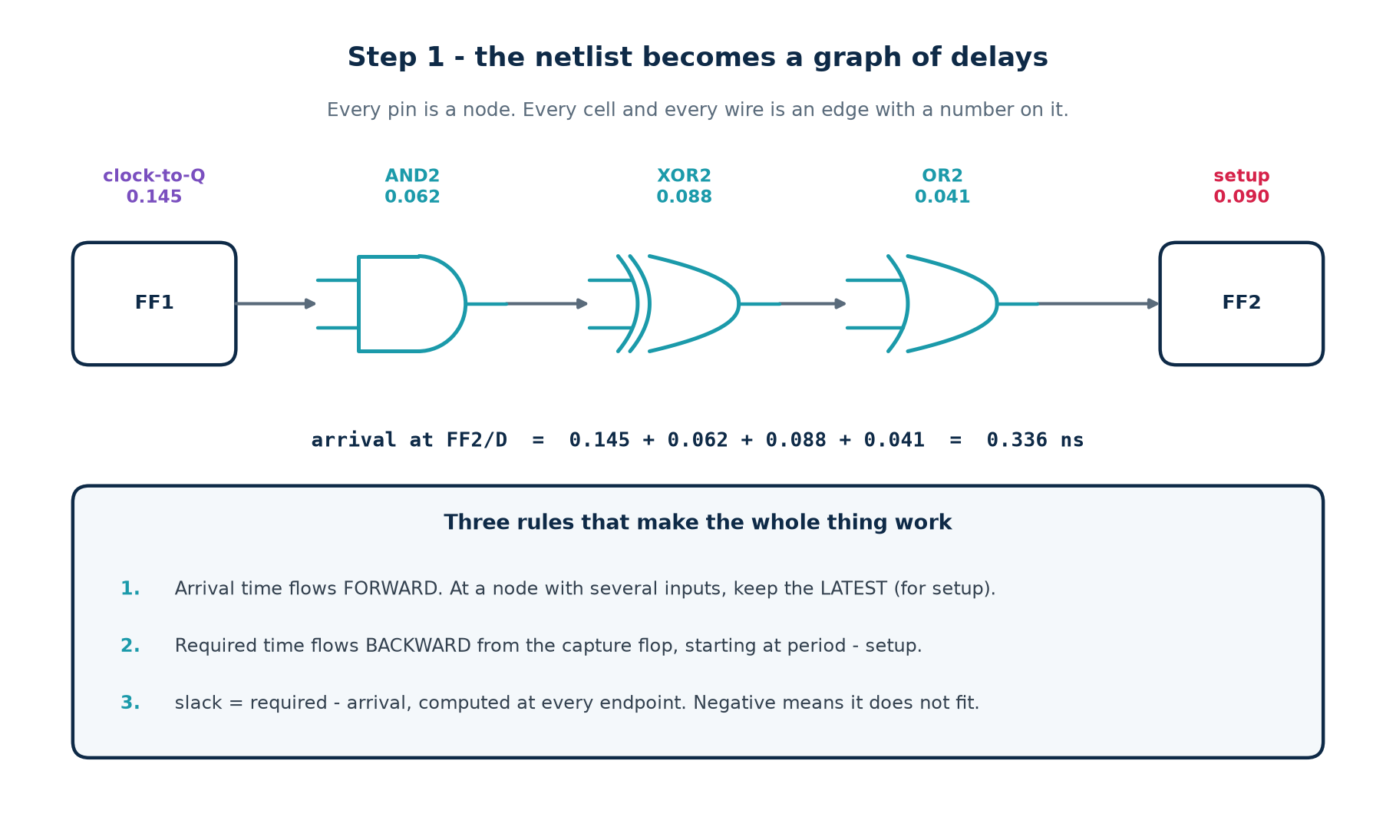
6b · STEP 1
The Netlist Becomes a Graph of Delays
the delay model used throughout this topic
cell delay = intrinsic + load_factor x (sum of input caps on the output net)
Real Liberty libraries use a 2-D table indexed by input slew and output load. The arithmetic below is the same; only the lookup is bigger.
Chip Design Associate · Module 2 · Verilog RTL Coding for Synthesis · Topic 6: Timing Constraints and Analysis
M2-T6 · 24

Slide 25
6b · THE DELAY MODEL
A Liberty Cell, In Full
lib/cda_edu.lib — you write this file in lab T1
cell (XOR2) {
area : 4.0 ;
cda_intrinsic : 0.088 ; /* ns, with no load at all */
cda_load_factor : 0.018 ; /* ns per unit of capacitance on Y */
cda_input_cap : 1.5 ; /* what this cell presents to its driver */
pin (A) { direction : input ; }
pin (B) { direction : input ; }
pin (Y) { direction : output ; function : "(A^B)" ; }
}
cell (DFF) {
cda_clk_to_q : 0.145 ; /* CK rising -> Q valid */
cda_setup : 0.090 ; /* D stable before CK */
cda_hold : 0.035 ; /* D stable after CK */
cda_input_cap : 1.6 ;
}
Why you write the library yourself
Every delay number in this topic is one you chose. When the report says 0.164 ns you can point at the two lines of the library it came from. There is no black box anywhere in the chain.
Chip Design Associate · Module 2 · Verilog RTL Coding for Synthesis · Topic 6: Timing Constraints and Analysis
M2-T6 · 25

Slide 26
6b · WORKED EXAMPLE
One Path, By Hand, To Three Decimal Places
path: p_reg/Q -> u12/A -> u12/Y -> q_reg/D
1. p_reg/Q clk-to-Q 0.145, driving a net loaded by u12/A (cap 1.5)
0.145 + 0.013 x 1.5 = 0.1645 <- DFF load_factor 0.013
2. u12 (XOR2) intrinsic 0.088, driving a net loaded by q_reg/D (cap 1.6)
0.088 + 0.018 x 1.6 = 0.1168
arrival at q_reg/D = 0.1645 + 0.1168 = 0.2813 ns
3. required = period 1.000 - setup 0.090 - uncertainty 0.000 = 0.910 ns
slack = 0.910 - 0.281 = +0.629 ns MET
This is not an illustration - it is the lab's actual output
Run make tiny and the engine prints +0.629. You will have computed it on paper first. If the two ever disagree, one of them has a bug, and finding out which is the most useful hour in the topic.
Chip Design Associate · Module 2 · Verilog RTL Coding for Synthesis · Topic 6: Timing Constraints and Analysis
M2-T6 · 26

Slide 27
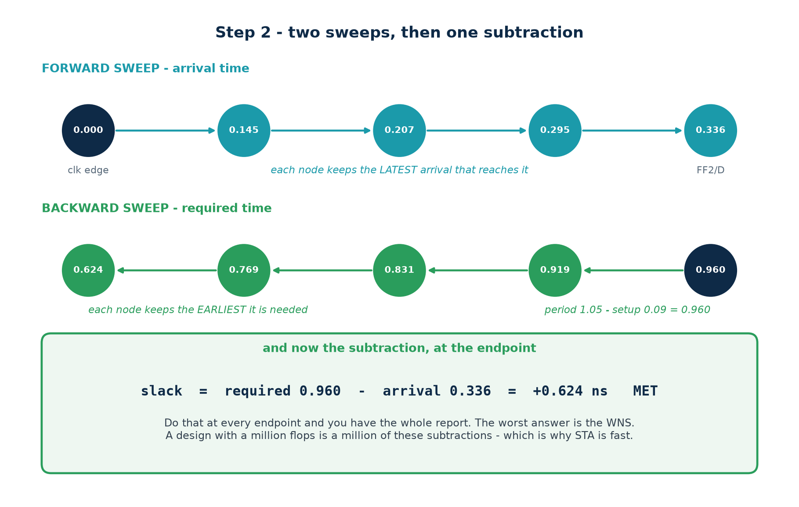
6b · STEP 2
Two Sweeps, Then One Subtraction
Forward for arrival, backward for required, subtract at every endpoint. A million-flop design is a million of these subtractions - which is why STA finishes in minutes.
Chip Design Associate · Module 2 · Verilog RTL Coding for Synthesis · Topic 6: Timing Constraints and Analysis
M2-T6 · 27

Slide 28
6b · THE ALGORITHM
Fifteen Lines That Do the Whole Job
sta/sta.py — the core of the engine you complete in lab T3
def propagate(self):
for n in self._order(): # topological order
for arc in n.fanin:
src, dly = arc.src, arc.delay
n.amax = max(n.amax, src.amax + dly) # LATEST -> setup
n.amin = min(n.amin, src.amin + dly) # EARLIEST-> hold
def setup_slack(self, ep):
required = self.period + self.skew(ep) - ep.cell.setup - self.uncert_setup
return required - ep.amax
def hold_slack(self, ep):
required = self.skew(ep) + ep.cell.hold + self.uncert_hold
return ep.amin - required
# WNS = min(setup_slack(ep) for ep in endpoints)
# TNS = sum(s for s in slacks if s < 0)
Chip Design Associate · Module 2 · Verilog RTL Coding for Synthesis · Topic 6: Timing Constraints and Analysis
M2-T6 · 28

Slide 29
6b · MAX AND MIN
Why the Engine Carries Two Numbers Per Node
Setup check (max delay)
Hold check (min delay)
propagates
the LATEST arrival
the EARLIEST arrival
asks
did it get there in time?
did it stay put long enough?
compares against
the NEXT clock edge
the SAME clock edge
uses the period
yes
no - not at all
signed off at
the SLOW corner
the FAST corner
a violation means
the chip must run slower
the chip does not work
A trap worth naming
What this looks like in a tool
If you propagate only the max delay, your hold check silently uses the wrong number and reports violations that are not there - or misses ones that are.
The engine in the lab keeps both, and the hold report traces the MIN path.
Vivado: report_timing -delay_type max vs -delay_type min.
PrimeTime / OpenSTA: -setup vs -hold, or report_timing -delay_type min_max for both at once.
Every real STA tool does exactly this. The two-number rule is not a simplification - it is the whole reason setup and hold can disagree.
Chip Design Associate · Module 2 · Verilog RTL Coding for Synthesis · Topic 6: Timing Constraints and Analysis
M2-T6 · 29

Slide 30
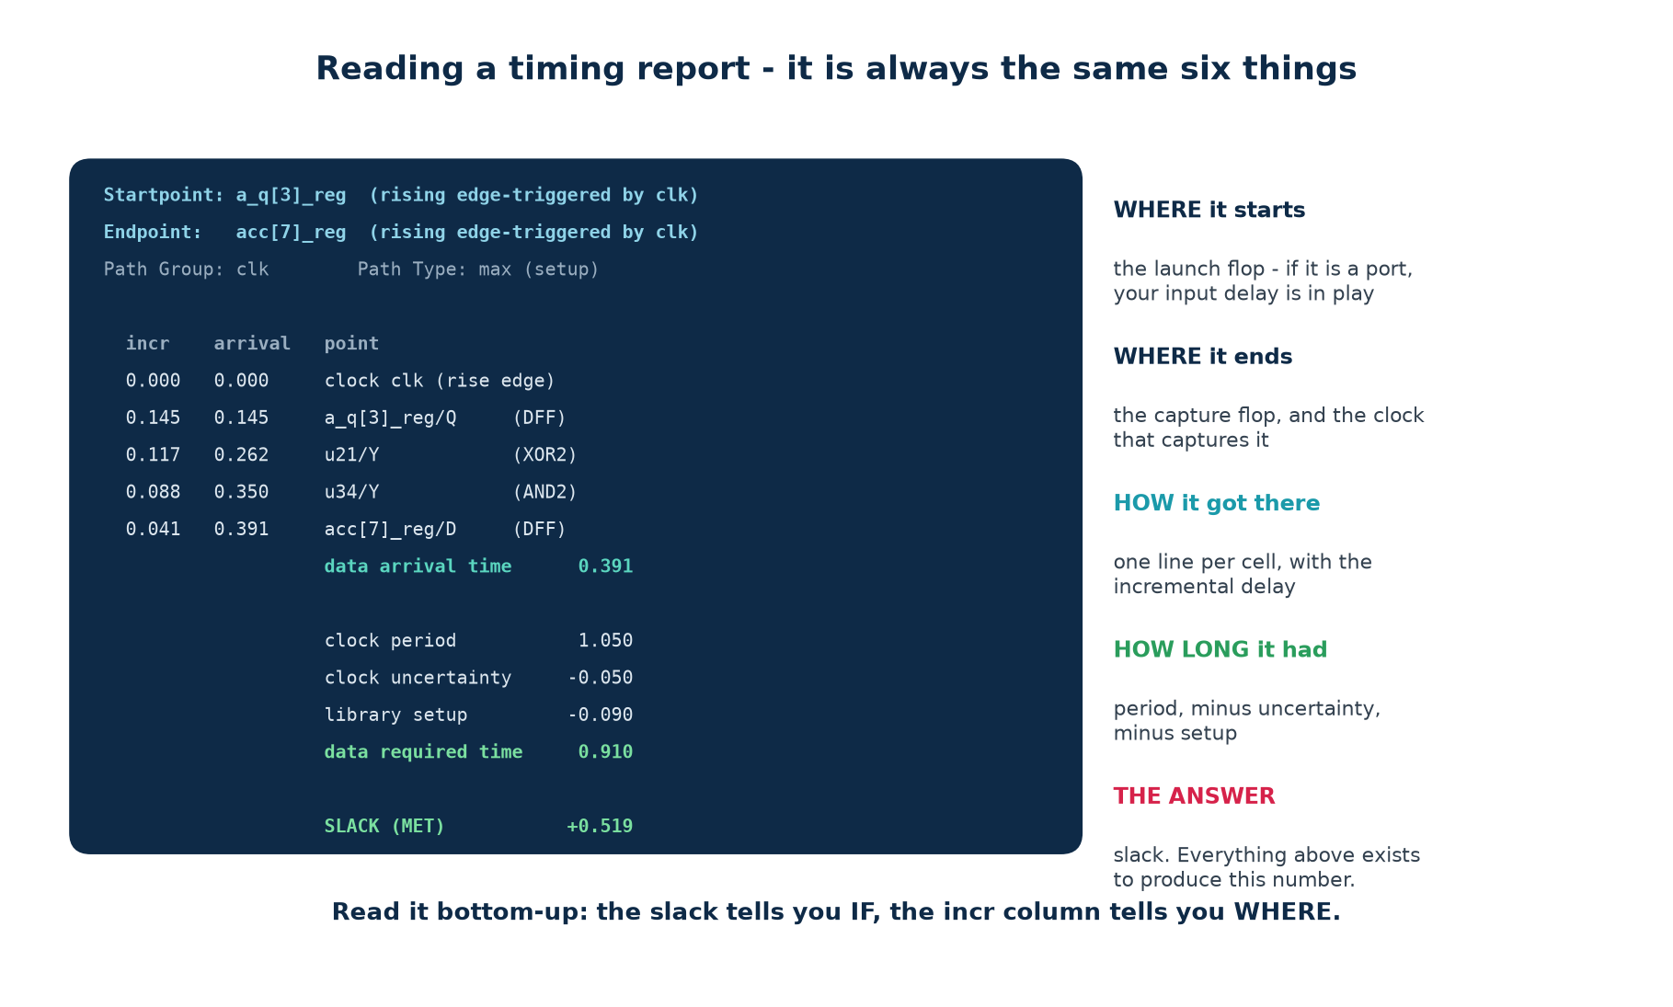
6b · READING A REPORT
It Is Always the Same Six Things
Read it bottom-up: the slack tells you IF there is a problem, the incr column tells you WHERE it is.
Chip Design Associate · Module 2 · Verilog RTL Coding for Synthesis · Topic 6: Timing Constraints and Analysis
M2-T6 · 30

Slide 31
6b · READING A REPORT
The Four Numbers To Look At First
Look at
If it says
Then
SLACK
a positive number
this path is fine - look at the next one
SLACK
a negative number
the size tells you how hard the fix is
Startpoint
a port, not a flop
your input delay is in play - check it first
the largest incr
one cell dominating
that cell or its load is the problem
the largest incr
fifty small cells
the path is too deep - restructure or pipeline
TNS
roughly equal to WNS
one bad path - a local fix
TNS
hundreds of times WNS
systemic - the target or the architecture is wrong
unconstrained
anything but zero
fix that before believing any other number
A habit that will make you fast
Do not read the whole report. Read the slack, then the startpoint, then the biggest incr line. Three numbers will tell you what kind of problem you have in about twenty seconds.
Chip Design Associate · Module 2 · Verilog RTL Coding for Synthesis · Topic 6: Timing Constraints and Analysis
M2-T6 · 31

Slide 32
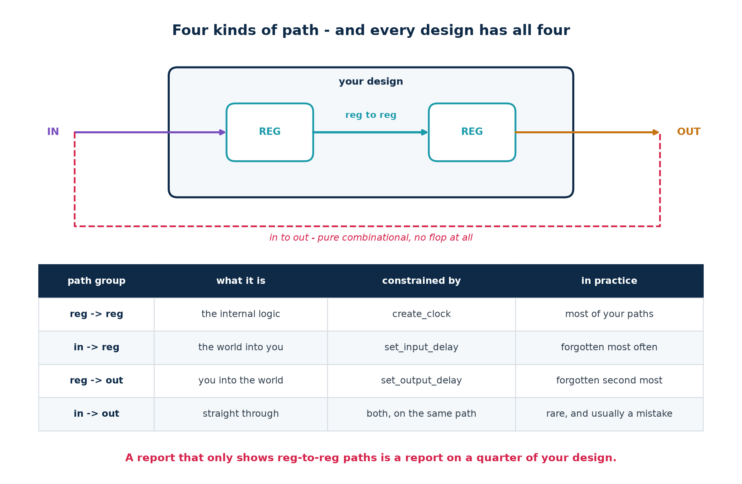
6b · PATH GROUPS
Four Kinds of Path, and Every Design Has All Four
A report that only shows reg-to-reg paths is a report on a quarter of your design.
Chip Design Associate · Module 2 · Verilog RTL Coding for Synthesis · Topic 6: Timing Constraints and Analysis
M2-T6 · 32

Slide 33
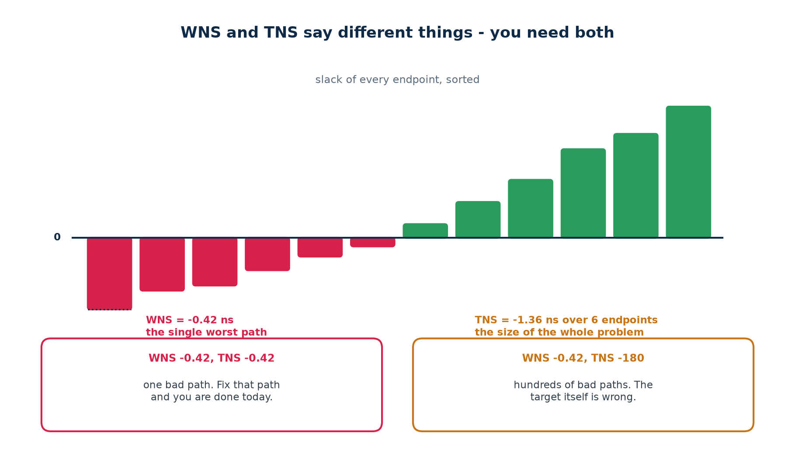
6b · WNS AND TNS
Two Numbers That Say Different Things
Use them together or you will misjudge the work
WNS tells you how bad the worst path is. TNS tells you how many paths are bad. WNS -0.42 with TNS -0.42 is an afternoon; WNS -0.42 with TNS -180 is an architecture review.
Chip Design Associate · Module 2 · Verilog RTL Coding for Synthesis · Topic 6: Timing Constraints and Analysis
M2-T6 · 33

Slide 34
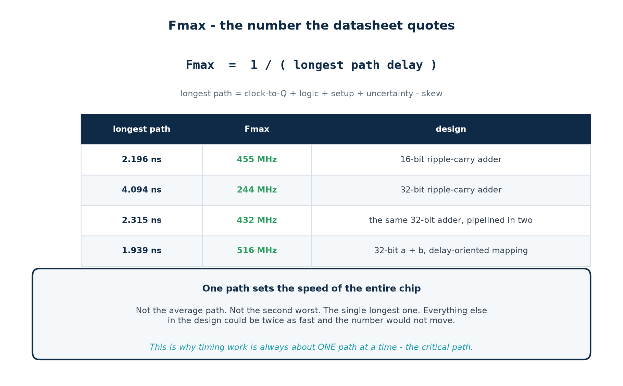
6b · FMAX
One Path Sets the Speed of the Entire Chip
Not the average path. Not the second worst. The single longest one - which is why all timing work is about one path at a time.
Chip Design Associate · Module 2 · Verilog RTL Coding for Synthesis · Topic 6: Timing Constraints and Analysis
M2-T6 · 34

Slide 35
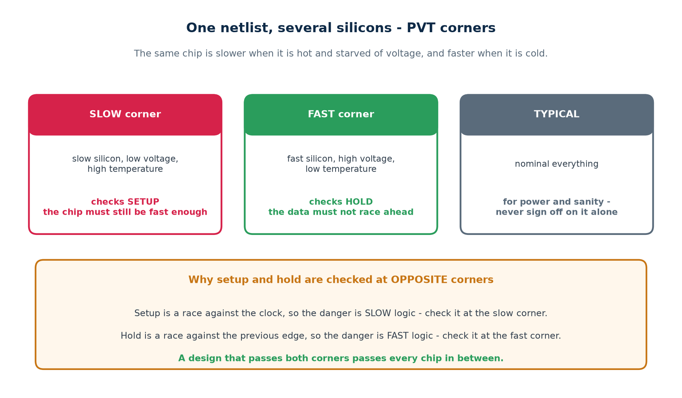
6b · PVT CORNERS
One Netlist, Several Silicons
Setup is a race against the clock, so check it where the logic is SLOW. Hold is a race against the previous edge, so check it where the logic is FAST.
Chip Design Associate · Module 2 · Verilog RTL Coding for Synthesis · Topic 6: Timing Constraints and Analysis
M2-T6 · 35

Slide 36
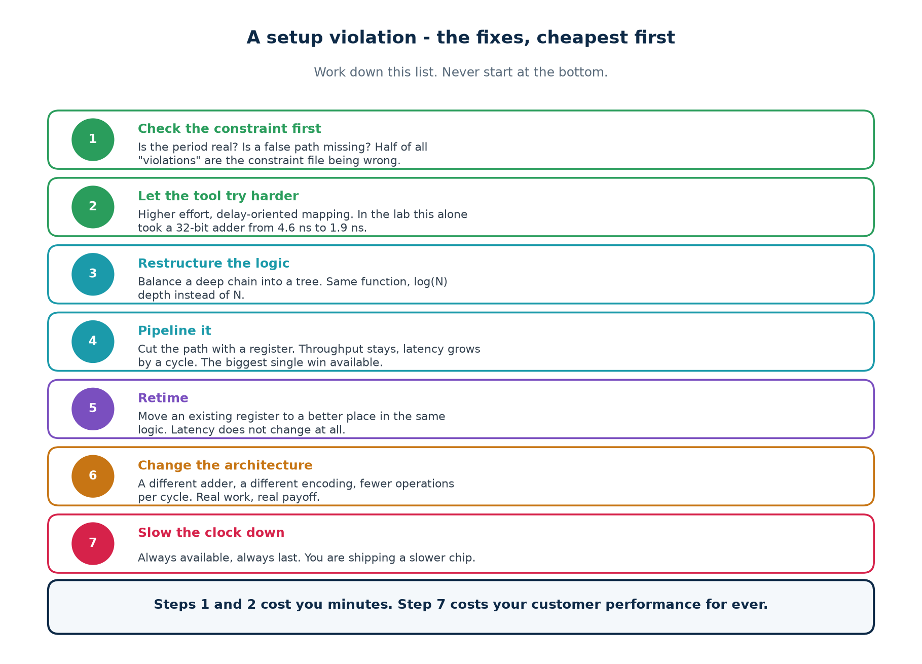
6b · OPTIMISATION
The Menu, Cheapest First
Steps 1 and 2 cost you minutes. Step 7 costs your customer performance for ever.
Chip Design Associate · Module 2 · Verilog RTL Coding for Synthesis · Topic 6: Timing Constraints and Analysis
M2-T6 · 36

Slide 37
6b · FIX 1
Check the Constraint Before You Touch the Design
The report says
Suspect first
How to confirm in one minute
a huge violation on a reset path
a missing false path
look at the startpoint - is it rst_n?
every I/O path fails by the same amount
input/output delay too large
compare it against the upstream datasheet
a path you know is slow fails
a missing multicycle path
does the capture register have an enable?
a path across two clocks fails
missing set_clock_groups
are the two clocks actually related?
WNS is exactly -(period)
an undeclared generated clock
report_clocks - is anything missing?
nothing fails but you do not believe it
unconstrained endpoints
report the count - it should be zero
Roughly half of all reported violations are not design problems
They are constraint problems. Fixing the design first is the single biggest waste of time in timing closure - you can spend a week pipelining a path that was never real.
Chip Design Associate · Module 2 · Verilog RTL Coding for Synthesis · Topic 6: Timing Constraints and Analysis
M2-T6 · 37

Slide 38
6b · FIX 2
Let the Tool Try Harder - the Measured Result
one flag, 2.4x the frequency
# the SAME RTL: assign {cout, sum} = a_q + b_q;
$ ABC=abc make fmax # default: area-oriented mapping
longest path 4.615 ns -> 217 MHz
$ ABC='abc -fast' make fmax # delay-oriented mapping
longest path 1.939 ns -> 516 MHz
# and the hand-written ripple-carry chain, for comparison:
longest path 4.094 ns -> 244 MHz (area mapping)
The result nobody expects
What it means
Under area-oriented mapping, the plain a + b is SLOWER than the hand-written ripple chain: 4.615 ns against 4.094 ns.
Both netlists were proved equivalent to the RTL over 400 random vectors before these numbers were quoted.
"Describe intent, not structure" is only half the rule.
The other half: check what your tool did with it. The same source can be a slow design or a fast one depending on one option you did not set.
You will reproduce both numbers yourself in lab T5.
Chip Design Associate · Module 2 · Verilog RTL Coding for Synthesis · Topic 6: Timing Constraints and Analysis
M2-T6 · 38

Slide 39
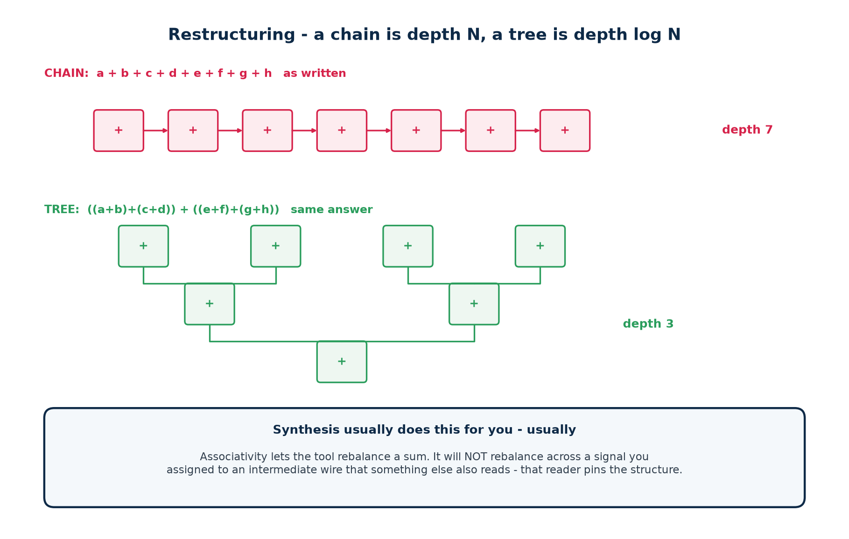
6b · FIX 3
Restructuring - a Chain Is Depth N, a Tree Is Depth log N
What stops the tool doing it for you
Assign an intermediate sum to a named wire that something else also reads, and that reader pins the structure: the tool can no longer rebalance across it. If a sum must be fast, do not publish its intermediate results.
Chip Design Associate · Module 2 · Verilog RTL Coding for Synthesis · Topic 6: Timing Constraints and Analysis
M2-T6 · 39

Slide 40
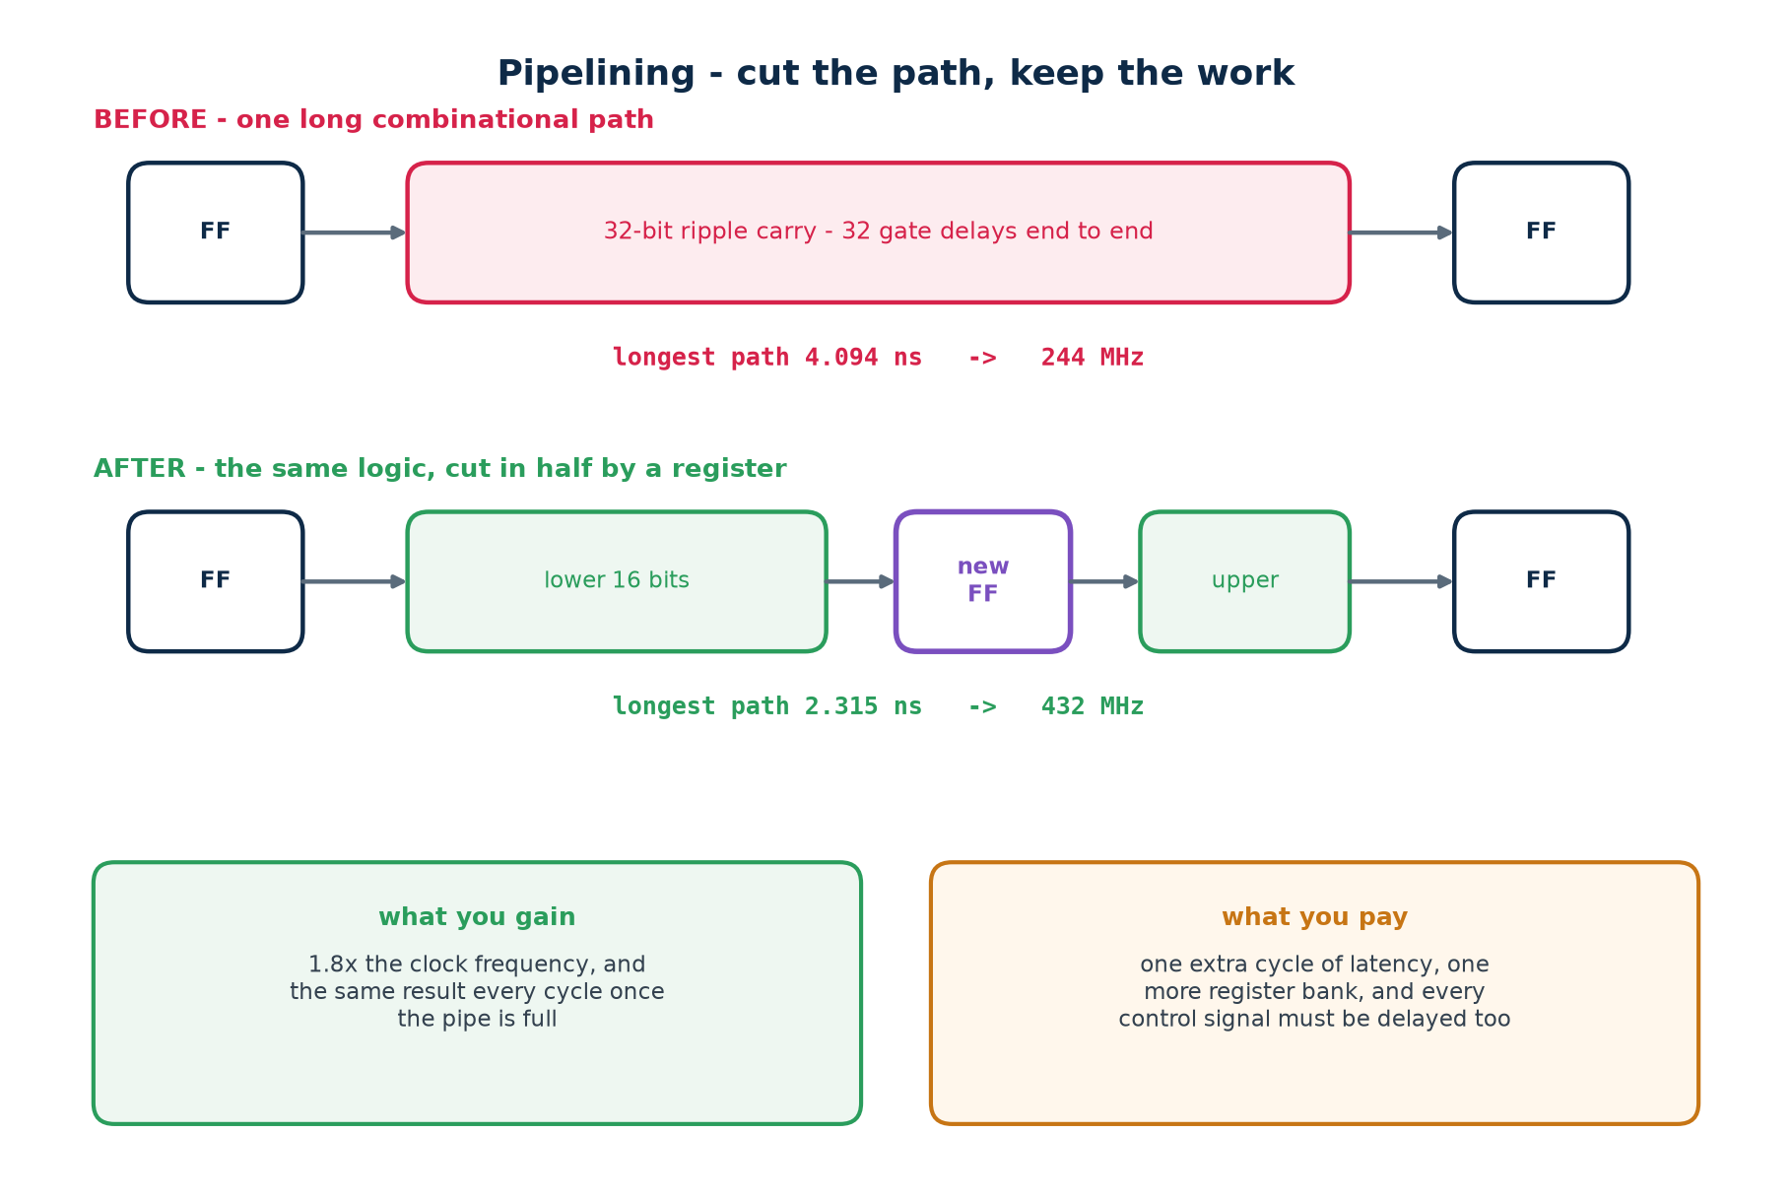
6b · FIX 4
Pipelining - Cut the Path, Keep the Work
The biggest single win available - and the one with a real cost: one more cycle of latency, and every control signal alongside the data must be delayed to match.
Chip Design Associate · Module 2 · Verilog RTL Coding for Synthesis · Topic 6: Timing Constraints and Analysis
M2-T6 · 40

Slide 41
6b · FIX 4
Pipelining In RTL - and the Mistake To Avoid
rtl/add_ripple_pipe.v
// BEFORE - one stage, the whole 32-bit carry chain in one cycle
always @(posedge clk) {cout, sum} <= a_q + b_q;
// AFTER - cut at bit 16. Note that a_q[31:16] and b_q[31:16] must be DELAYED
// to meet the carry when it arrives, or the upper half adds the wrong operands.
always @(posedge clk) begin
{cmid_q, sl_q} <= a_q[15:0] + b_q[15:0]; // stage 1
ah_q <= a_q[31:16]; // <- the easy line to forget
bh_q <= b_q[31:16];
{cout, sum} <= {ah_q + bh_q + cmid_q, sl_q}; // stage 2
end
The classic pipelining bug, in one sentence
You cut the datapath and forget to delay something that travels beside it - an operand, a valid flag, a write enable. The design still meets timing beautifully and computes the wrong answer. Lab T5 makes you find this one deliberately.
Chip Design Associate · Module 2 · Verilog RTL Coding for Synthesis · Topic 6: Timing Constraints and Analysis
M2-T6 · 41

Slide 42
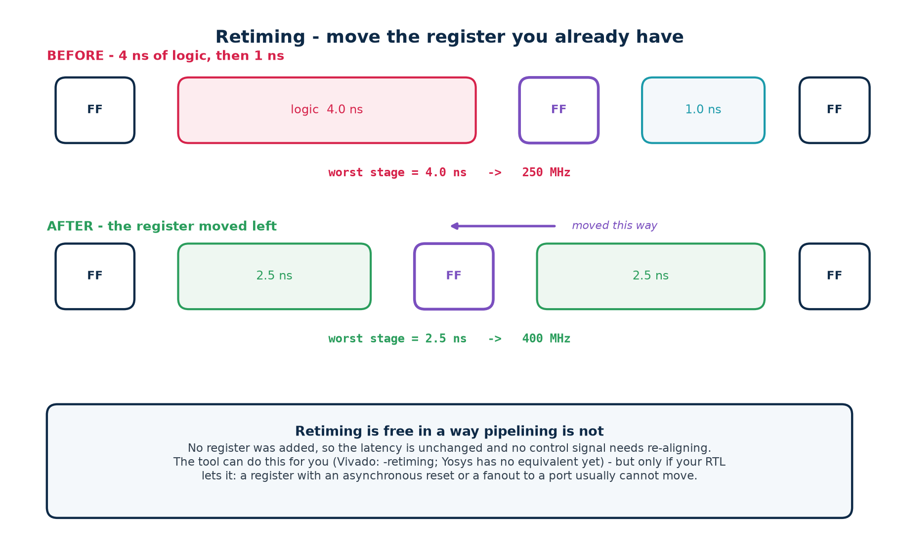
6b · FIX 5
Retiming - Move the Register You Already Have
Free in a way pipelining is not
No register is added, so latency does not change and no control signal needs re-aligning. Vivado does it with synth_design -retiming; most ASIC tools have an equivalent. A register with an asynchronous reset, or one whose output goes straight to a port, usually cannot move.
Chip Design Associate · Module 2 · Verilog RTL Coding for Synthesis · Topic 6: Timing Constraints and Analysis
M2-T6 · 42

Slide 43
6b · CHECKPOINT
Eight Questions Before We Move On
#
Question
The answer in one line
1
What does STA propagate forward?
arrival time - the latest, for setup
2
And backward?
required time, from period minus setup
3
Why does it need no stimulus?
it measures path length, not path activity
4
What is the one weakness of that?
it reports paths that can never switch - false paths
5
WNS -0.1, TNS -95. Diagnosis?
systemic; many paths just fail - review the target
6
Which corner signs off setup?
slow: slow silicon, low V, high T
7
Cheapest fix for a setup violation?
check the constraint, then the mapping effort
8
What does pipelining cost?
a cycle of latency, and every parallel signal must match
Part 6c is where the two failures separate: setup and hold need opposite fixes, and confusing them wastes days.
Chip Design Associate · Module 2 · Verilog RTL Coding for Synthesis · Topic 6: Timing Constraints and Analysis
M2-T6 · 43

Slide 44
PART 6c
Setup and Hold Violations, and Their Resolution
Two failures that look similar in a report and could not be more different in the silicon.
Setup: the data was too late. The chip runs slower.
Hold: the data changed too soon. The chip does not work at any speed.
Clock skew, jitter, and why hold problems appear only after layout
A decision procedure you can follow under deadline pressure
Chip Design Associate · Module 2 · Verilog RTL Coding for Synthesis · Topic 6: Timing Constraints and Analysis
M2-T6 · 44

Slide 45
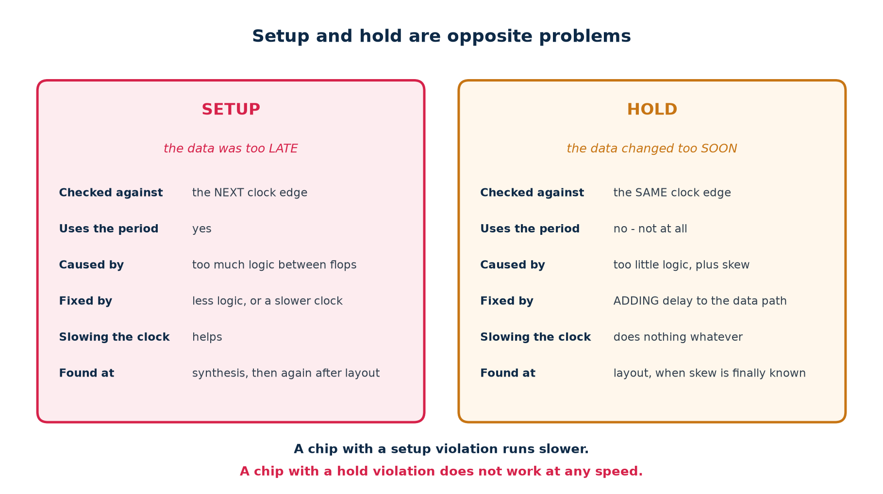
6c · THE TWO FAILURES
Setup and Hold Are Opposite Problems
A chip with a setup violation runs slower. A chip with a hold violation does not work at any speed. That difference decides everything you do next.
Chip Design Associate · Module 2 · Verilog RTL Coding for Synthesis · Topic 6: Timing Constraints and Analysis
M2-T6 · 45

Slide 46
6c · THE TWO EQUATIONS
Side By Side, With the Difference Circled
everything in part 6c follows from these two
SETUP required = period + skew - setup - uncertainty
arrival = clk_to_q + logic
slack = required - arrival
HOLD required = skew + hold + uncertainty
arrival = clk_to_q + logic <- the SHORTEST path, not the longest
slack = arrival - required
# the period appears in the setup equation and NOWHERE in the hold equation
# the subtraction is the other way round: setup wants arrival SMALL,
# hold wants it LARGE
Consequence 1
Consequence 2
Slowing the clock fixes setup and does nothing at all for hold.
Speeding it up breaks setup and, again, does nothing to hold.
Adding logic fixes hold and breaks setup.
Removing logic fixes setup and can break hold. Every fix trades one against the other.
Chip Design Associate · Module 2 · Verilog RTL Coding for Synthesis · Topic 6: Timing Constraints and Analysis
M2-T6 · 46

Slide 47
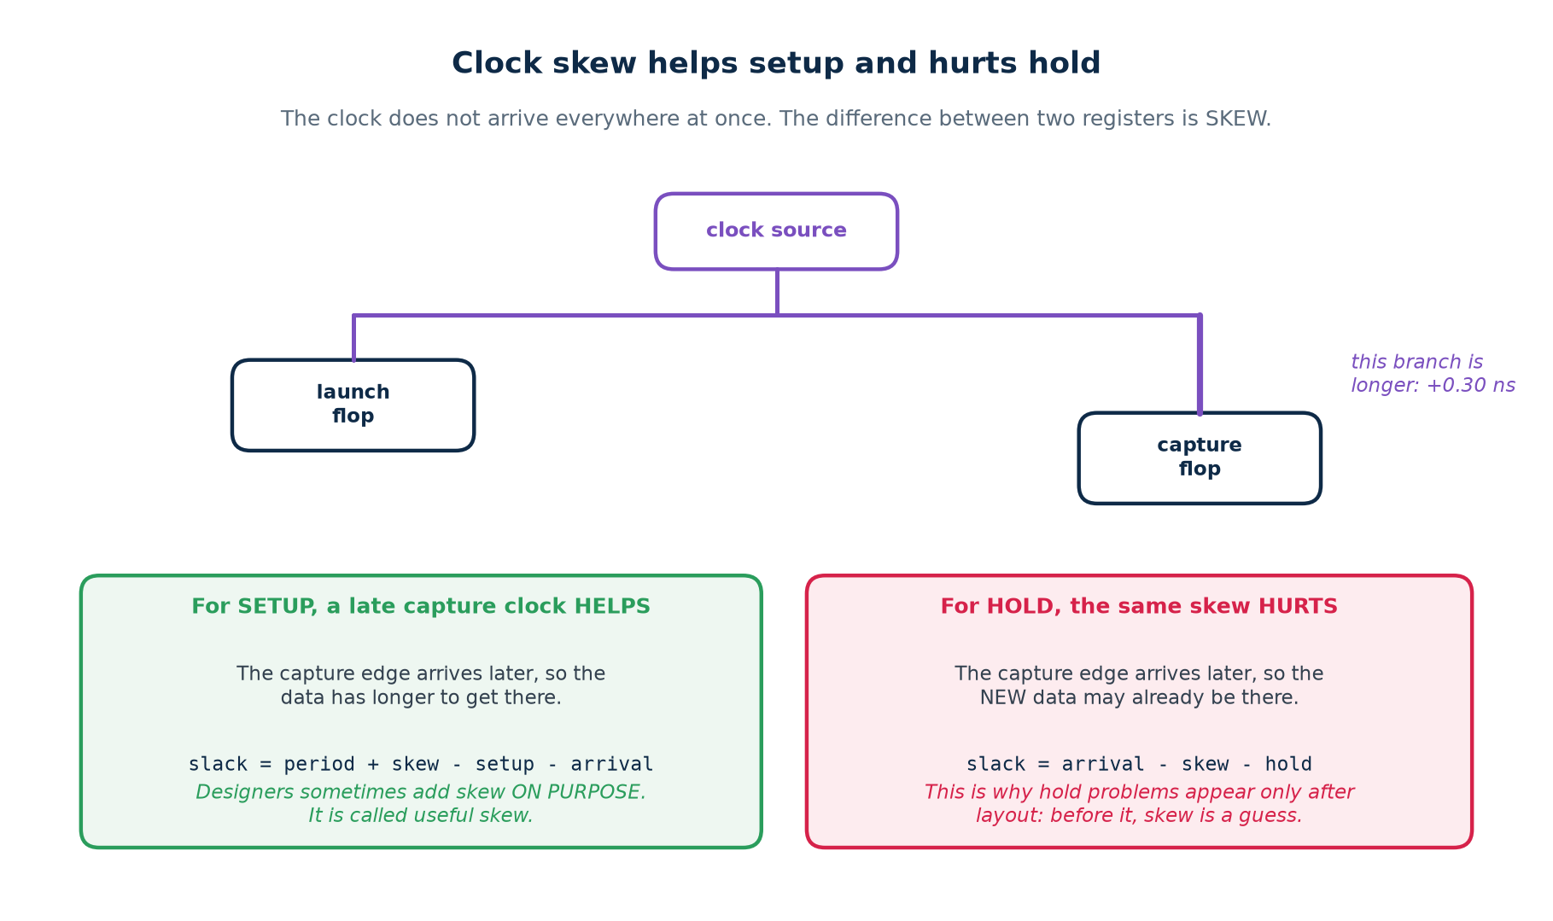
6c · CLOCK SKEW
The Clock Does Not Arrive Everywhere At Once
Skew that makes the capture edge LATE helps setup and hurts hold. Designers sometimes add it deliberately - it is called useful skew.
Chip Design Associate · Module 2 · Verilog RTL Coding for Synthesis · Topic 6: Timing Constraints and Analysis
M2-T6 · 47

Slide 48
6c · SKEW AND JITTER
Where the Numbers Come From, and When You Know Them
Effect
What causes it
Known when?
Modelled by
Clock skew
different clock-tree branch lengths
after clock-tree synthesis
the real tree, or uncertainty before it
Clock jitter
PLL and oscillator imperfection
from the datasheet
set_clock_uncertainty, both checks
Duty-cycle distortion
unbalanced buffers in the tree
after layout
matters for both clock edges
On-chip variation
process gradients across the die
statistically
derating factors, or extra uncertainty
Crosstalk
a neighbouring net switching
after routing
signal-integrity analysis, post-route
Why hold violations always seem to arrive late in a project
Before layout there is no clock tree, so there is no real skew - and the hold check has almost nothing to fail against. The moment the tree is built, the skew becomes real and hold violations appear all at once. This is normal, and it is why hold is a place-and-route problem far more often than an RTL one.
Chip Design Associate · Module 2 · Verilog RTL Coding for Synthesis · Topic 6: Timing Constraints and Analysis
M2-T6 · 48

Slide 49
6c · UNCERTAINTY
The Margin That Stands In For What You Cannot See Yet
Stage
Typical setup uncertainty
Why
post-synthesis (FPGA)
0.10 - 0.20 ns
no clock tree exists; jitter unknown
post-place-and-route
jitter only, 0.02 - 0.05 ns
the tool now uses the real skew
ASIC, pre-CTS
0.15 - 0.30 ns
plus a margin for OCV
ASIC, sign-off
jitter + OCV derating
the tree is measured
Take the uncertainty out and the report improves while the chip does not.
Chip Design Associate · Module 2 · Verilog RTL Coding for Synthesis · Topic 6: Timing Constraints and Analysis
M2-T6 · 49

Slide 50
6c · SETUP VIOLATIONS
What They Look Like, and What Causes Them
Symptom in the report
Most likely cause
First thing to try
one path fails, the rest are fine
a genuinely long path
look at its incr column
one cell has a huge incr
high fanout, or a weak driver
set_max_fanout, or let the tool buffer it
fifty small cells in the path
the logic is too deep
restructure, then pipeline
every path fails by a similar amount
the period is too aggressive
sanity-check the target against the technology
fails only after place-and-route
routing delay, not logic
floorplanning; keep the path local
fails only at the slow corner
correct behaviour
that is the corner you sign off at
The number that tells you how much work it is
A slack of -0.05 ns on a 5 ns period is a 1% problem - the tool will often find it with a higher effort setting. A slack of -2.5 ns on the same period is a 50% problem: no option will close that, and you are looking at pipelining or a different architecture.
Chip Design Associate · Module 2 · Verilog RTL Coding for Synthesis · Topic 6: Timing Constraints and Analysis
M2-T6 · 50

Slide 51
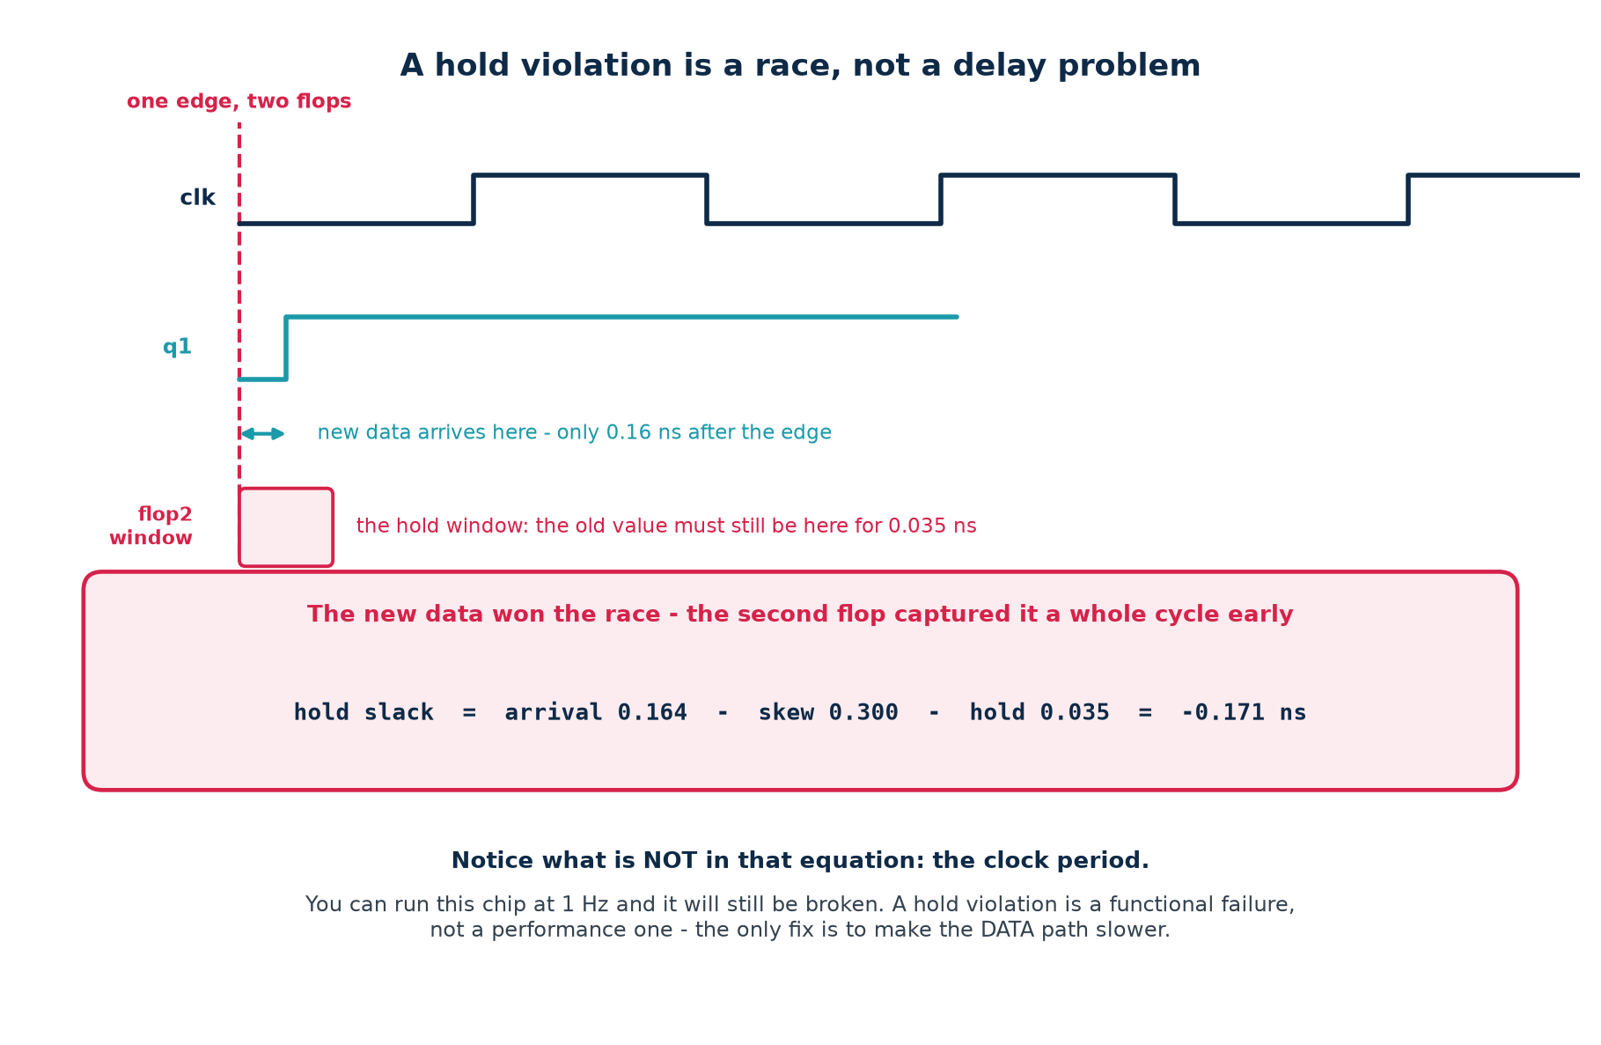
6c · HOLD VIOLATIONS
A Race, Not a Delay Problem
Notice what is not in the hold equation: the clock period. You can run this chip at 1 Hz and it is still broken.
Chip Design Associate · Module 2 · Verilog RTL Coding for Synthesis · Topic 6: Timing Constraints and Analysis
M2-T6 · 51

Slide 52
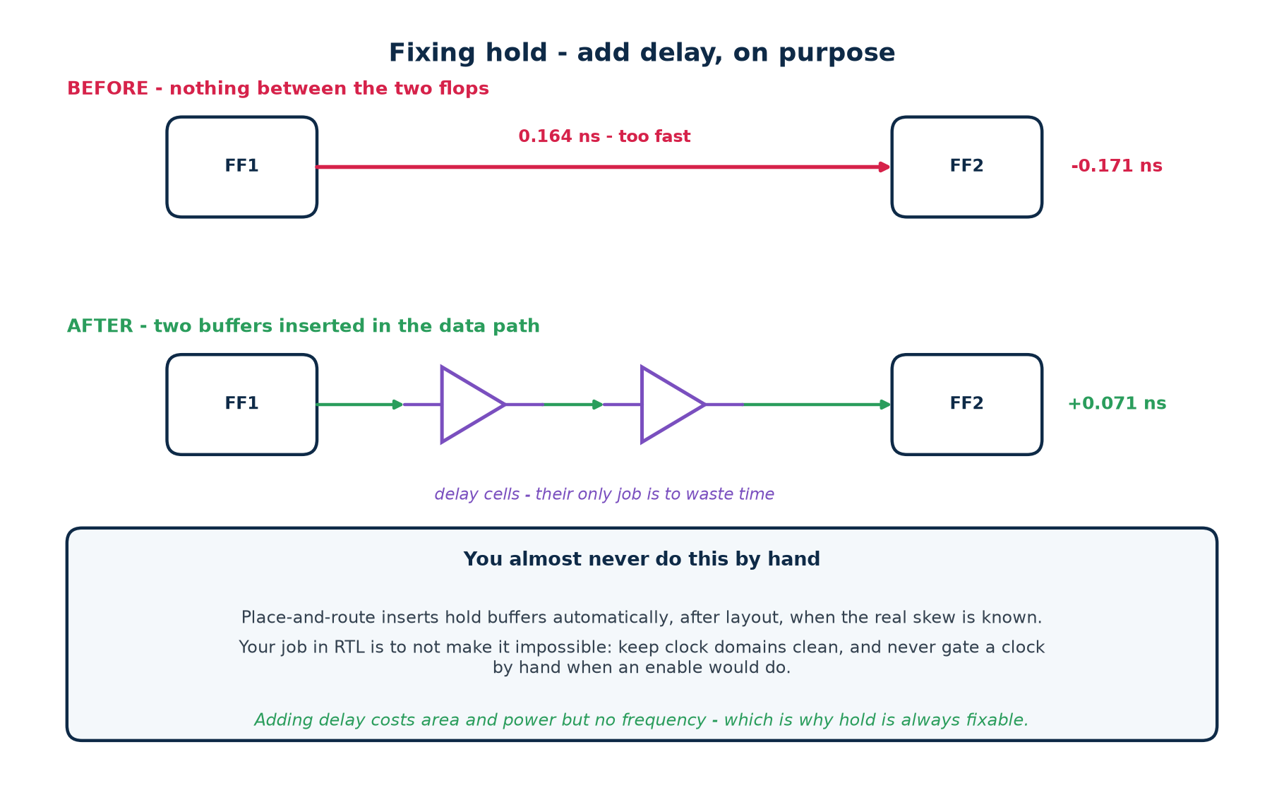
6c · FIXING HOLD
Add Delay, On Purpose
Measured in the lab
hold_demo with 0.30 ns of skew: -0.165 ns, VIOLATED. The same design with two delay cells in the data path: +0.071 ns, MET. Nothing else changed - not the clock, not the function.
Chip Design Associate · Module 2 · Verilog RTL Coding for Synthesis · Topic 6: Timing Constraints and Analysis
M2-T6 · 52

Slide 53
6c · FIXING HOLD
Who Actually Fixes It - and What Your RTL Must Not Do
Place-and-route does the fixing
What RTL can do to make it impossible
After layout, when the real skew is known, the tool inserts hold buffers automatically.
It has the one thing you do not: the actual clock-tree delays.
Hold fixing costs area and power, never frequency - which is why it is always possible.
Gate a clock by hand instead of using an enable - it adds skew you cannot control.
Cross clock domains without a synchroniser - no amount of buffering fixes that.
Use both clock edges in the same path - it halves the hold budget.
The one hold fix that belongs in RTL
A proper two-flop synchroniser on every asynchronous crossing. That is not a hold fix in the STA sense - it is what stops the crossing being a timing question at all.
Chip Design Associate · Module 2 · Verilog RTL Coding for Synthesis · Topic 6: Timing Constraints and Analysis
M2-T6 · 53

Slide 54
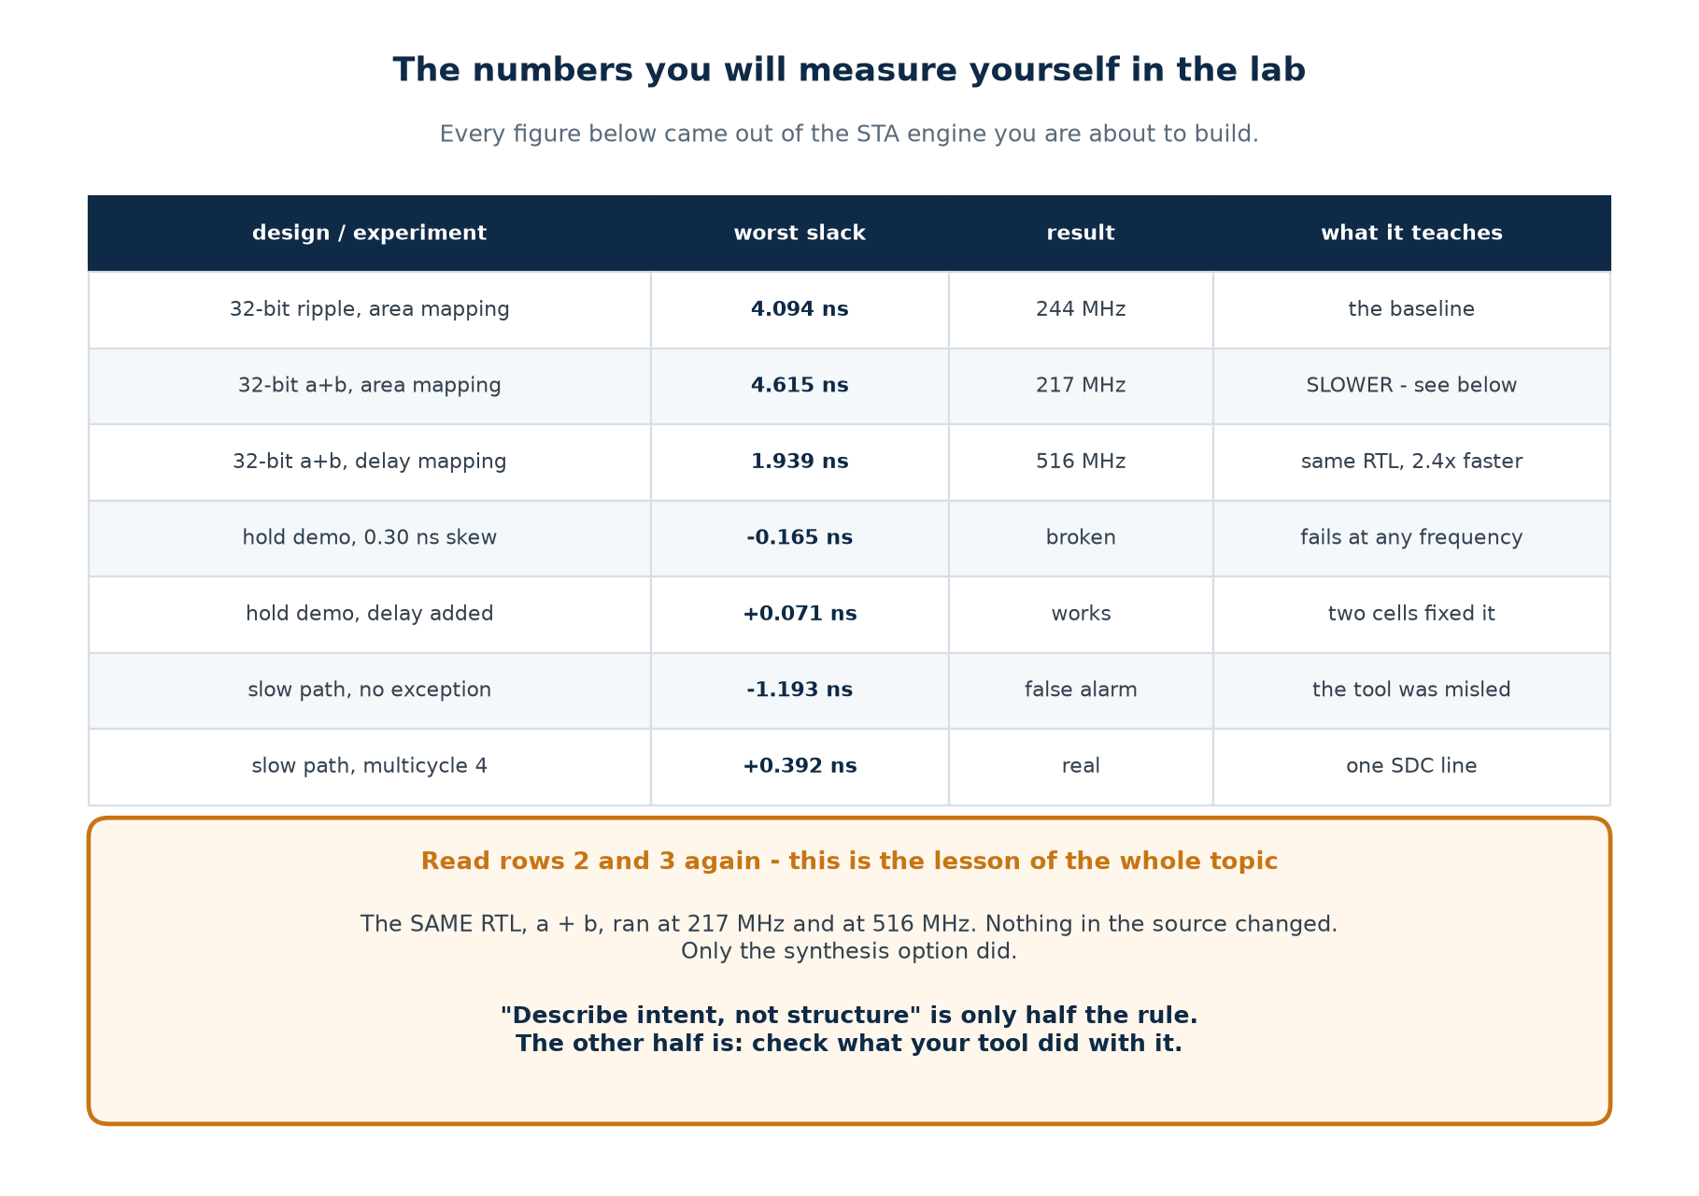
6c · MEASURED
The Numbers You Will Produce Yourself
Nothing quoted in this topic is a claim you cannot reproduce with make.
Chip Design Associate · Module 2 · Verilog RTL Coding for Synthesis · Topic 6: Timing Constraints and Analysis
M2-T6 · 54

Slide 55
6c · AN HONEST NOTE
How the Hold Demo Adds Its Delay, and Why
what the lab actually does, and what it is standing in for
// rtl/hold_fixed.v
// dly_sel is a real input port, tied to 0 by the testbench.
assign d0 = q1 ^ dly_sel[0]; // two XOR gates in the data path
assign d1 = d0 ^ dly_sel[1]; // functionally a no-op when dly_sel == 0
// Why not a chain of buffers with (* keep *) ?
// opt_clean deletes them. keep_hierarchy plus -flatten deletes them too.
// Only logic that a real port can influence survives optimisation.
What this demonstrates honestly
What it is NOT
That adding delay to the data path turns a hold violation into a met one, and by how much.
That the tool cannot be asked politely to keep useless logic.
A style to copy. In a real flow, place-and-route inserts hold buffers with knowledge of the actual clock tree.
Writing XOR gates into your datapath to fix hold is not engineering - it is a teaching device, and it is labelled as one.
Being told what a demonstration cannot show is part of the demonstration.
Chip Design Associate · Module 2 · Verilog RTL Coding for Synthesis · Topic 6: Timing Constraints and Analysis
M2-T6 · 55

Slide 56
6c · THE PROCEDURE
What To Do When the Report Is Red
Step
Do this
Because
1
Read the unconstrained-endpoint count first
a clean report on half a design is worthless
2
Is it setup or hold? Look at the path type
the two need opposite fixes
3
Read the startpoint and endpoint by name
it often names the problem for you
4
Ask whether the path is real
half of all violations are constraint bugs
5
Look at the largest incr in the path
one big cell or fifty small ones - different fixes
6
Compare WNS with TNS
one path, or the whole design?
7
Apply the cheapest fix that could work
and re-run before trying the next one
8
Change ONE thing per run
or you will not know what helped
Step 8 is the one people skip
Under deadline pressure it is tempting to change the period, the effort level and the RTL all at once. When the slack moves you will have no idea which change did it - and no idea what to undo when it moves the wrong way.
Chip Design Associate · Module 2 · Verilog RTL Coding for Synthesis · Topic 6: Timing Constraints and Analysis
M2-T6 · 56

Slide 57
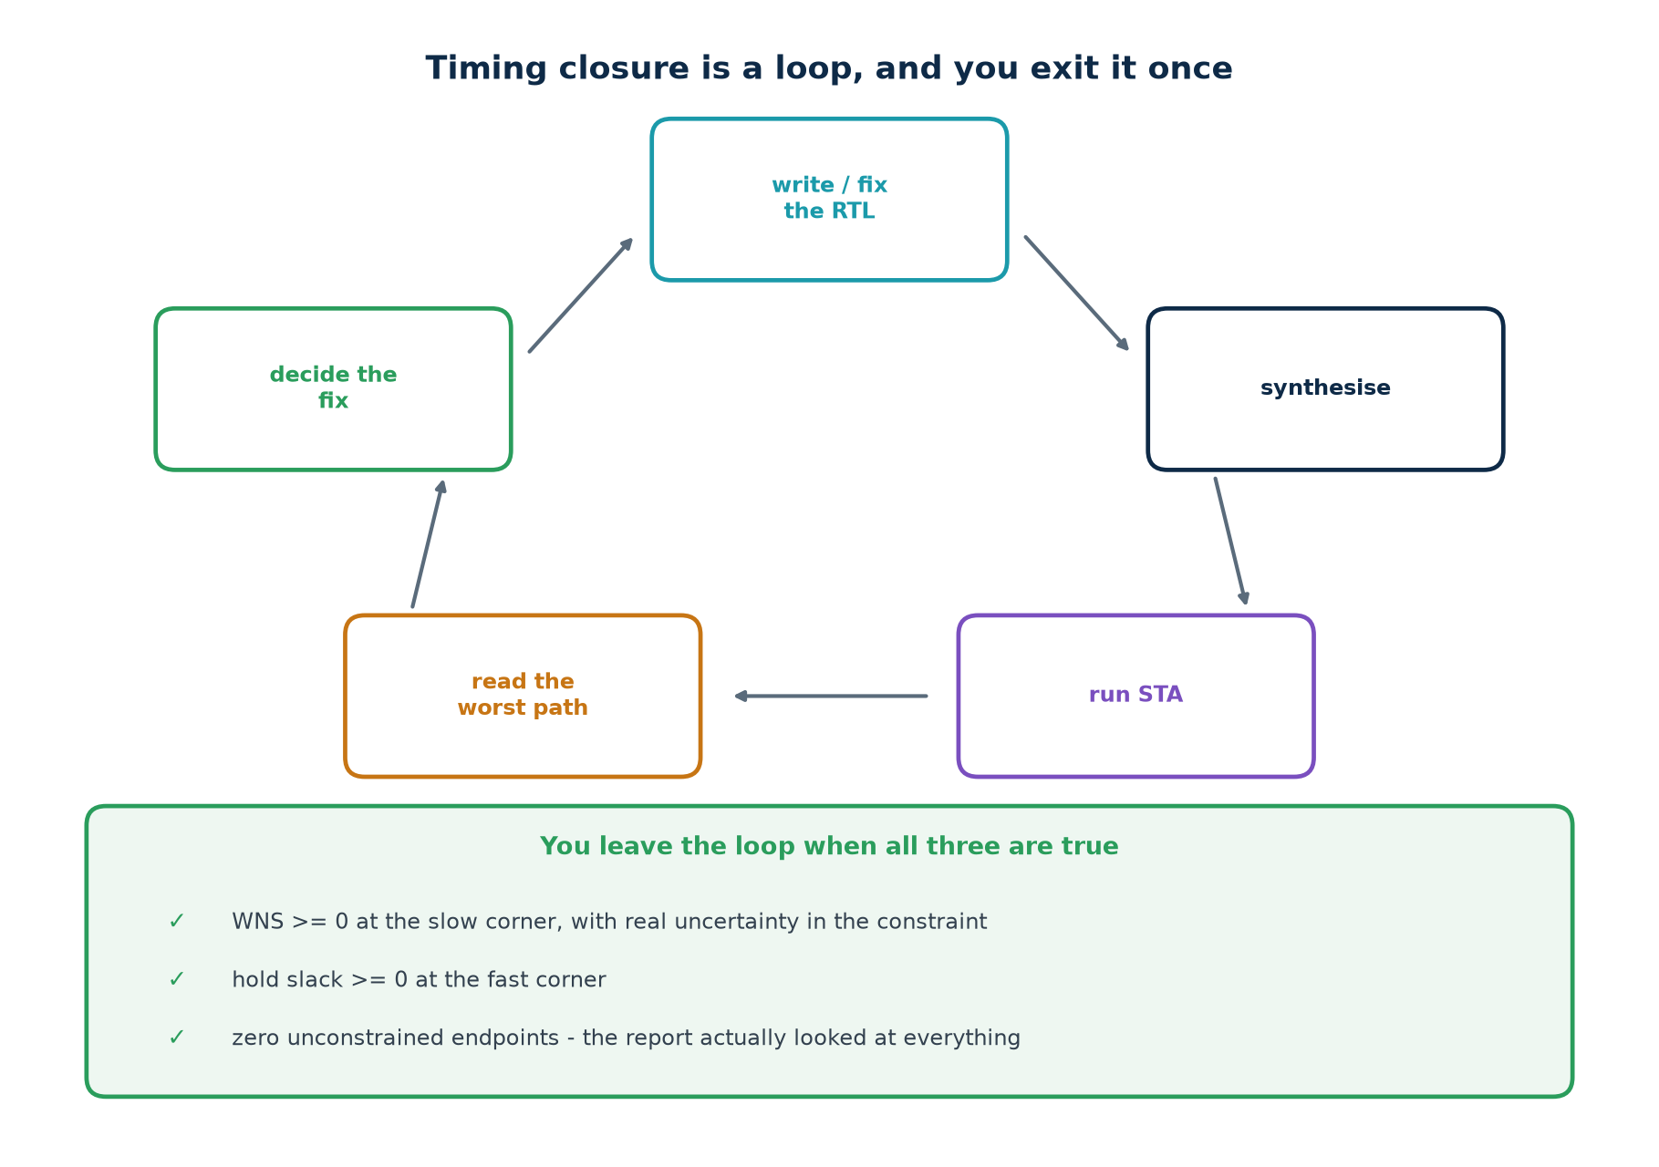
6c · CLOSURE
Timing Closure Is a Loop, and You Exit It Once
A design is closed when WNS >= 0 at the slow corner, hold >= 0 at the fast corner, and the unconstrained count is zero. Two out of three is not closed.
Chip Design Associate · Module 2 · Verilog RTL Coding for Synthesis · Topic 6: Timing Constraints and Analysis
M2-T6 · 57

Slide 58
6c · MISTAKES
Ten Ways To Get a Green Report and a Broken Chip
#
The mistake
What it costs you
1
No constraint file at all
every path unchecked, report meaningless
2
Clock declared, I/O not
every boundary path unchecked
3
A generated clock never declared
a whole domain unchecked
4
set_false_path used to silence a real path
a field failure
5
Multicycle setup without the hold line
a hold violation you created
6
Multicycle claimed without an enable in the RTL
wrong data captured
7
Uncertainty reduced to make the report pass
no margin on silicon
8
Signing off setup at the typical corner
fails on slow silicon
9
Ignoring hold because the clock is slow
fails at every speed
10
Never checking the unconstrained count
all of the above, silently
Nine of these ten produce a report that says everything is fine.
Chip Design Associate · Module 2 · Verilog RTL Coding for Synthesis · Topic 6: Timing Constraints and Analysis
M2-T6 · 58

Slide 59
6c · CHECKPOINT
Eight Questions Before the Labs
#
Question
The answer in one line
1
Setup violation - what does the chip do?
works, but only at a lower frequency
2
Hold violation - what does it do?
does not work at any frequency
3
Does the period appear in the hold equation?
no - that is the whole point
4
Late capture clock: helps which check?
setup; it hurts hold by the same amount
5
Why do hold problems appear after layout?
before it, there is no clock tree, so no real skew
6
How is hold fixed?
by ADDING delay to the data path
7
What does that cost?
area and power, never frequency
8
Setup at which corner, hold at which?
setup at slow, hold at fast
Answer these eight and the labs will feel like confirmation rather than discovery.
Chip Design Associate · Module 2 · Verilog RTL Coding for Synthesis · Topic 6: Timing Constraints and Analysis
M2-T6 · 59

Slide 60
TOOLS
Installing and Running the Timing Flow
Everything in this topic runs on free software. The vendor tools the syllabus names are covered too - as the last step, not the first.
The landscape: Vivado, Quartus, PrimeTime, Tempus, OpenSTA, and yours
Tier 1 install: one apt line, and every exercise runs
The lab flow: RTL in, slack out - with no black box in between
The same four steps in Vivado, and how SDC maps onto XDC
Chip Design Associate · Module 2 · Verilog RTL Coding for Synthesis · Topic 6: Timing Constraints and Analysis
M2-T6 · 60

Slide 61
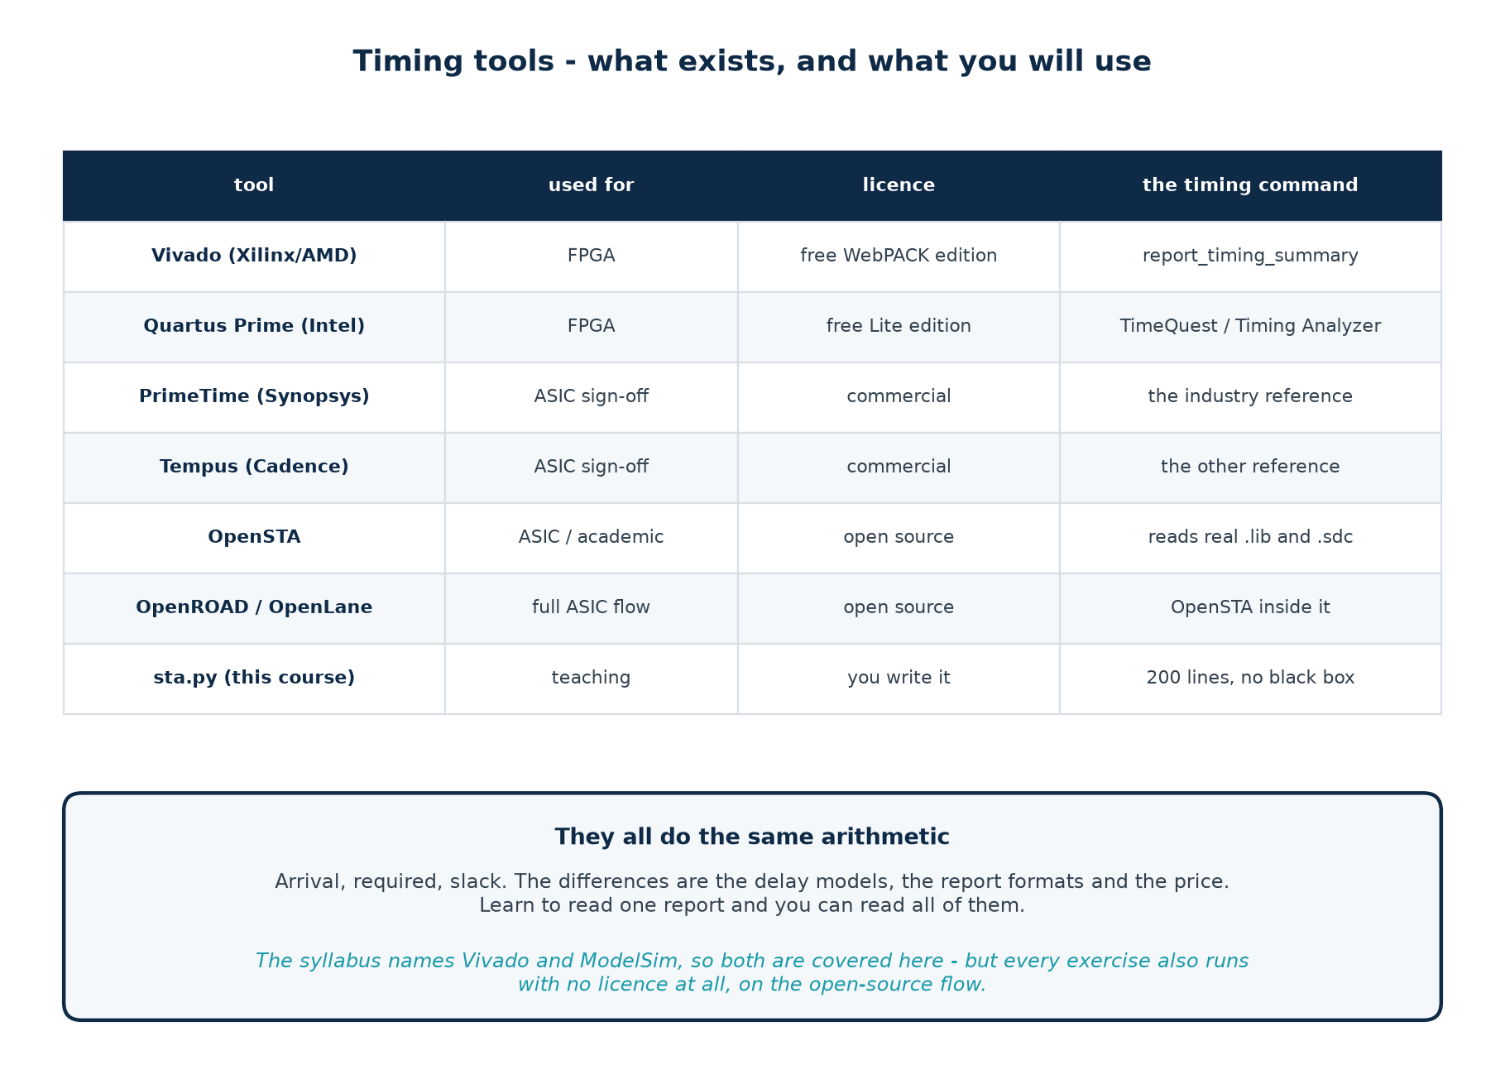
TOOLS · LANDSCAPE
What Exists, and What You Will Use
They all compute arrival, required and slack. The differences are the delay models, the report format and the price.
Chip Design Associate · Module 2 · Verilog RTL Coding for Synthesis · Topic 6: Timing Constraints and Analysis
M2-T6 · 61

Slide 62
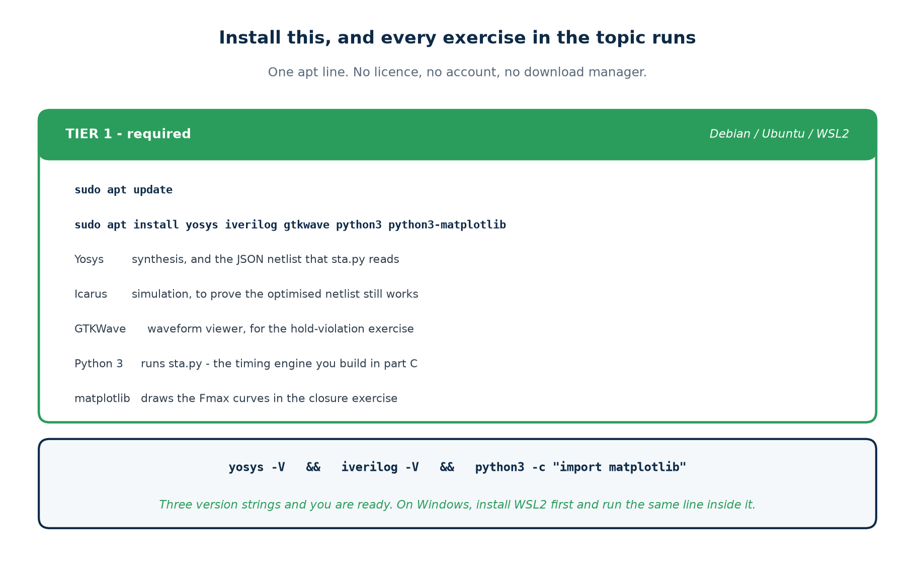
TOOLS · INSTALL
Tier 1 - One Line, and Every Exercise Runs
Debian / Ubuntu / WSL2 — copy this line
sudo apt update
sudo apt install yosys iverilog gtkwave python3 python3-matplotlib
yosys -V && iverilog -V && python3 -c "import matplotlib; print('ok')"
On Windows: install WSL2 first (wsl --install), then run the same three lines inside it.
Chip Design Associate · Module 2 · Verilog RTL Coding for Synthesis · Topic 6: Timing Constraints and Analysis
M2-T6 · 62

Slide 63
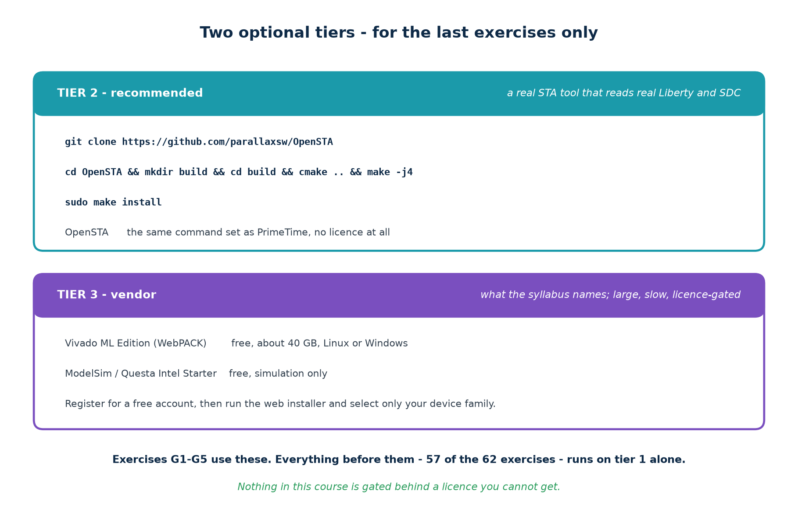
TOOLS · INSTALL
Tiers 2 and 3 - For the Last Four Exercises Only
Nothing in this course is gated behind a licence you cannot get
57 of the 62 exercises run on tier 1 alone. Tier 2 (OpenSTA) lets you check your engine against a real one. Tier 3 (Vivado, ModelSim) is there because the syllabus names them and because you will meet them at work.
Chip Design Associate · Module 2 · Verilog RTL Coding for Synthesis · Topic 6: Timing Constraints and Analysis
M2-T6 · 63

Slide 64
TOOLS · VIVADO
Installing Vivado, Step By Step
Step
What to do
Watch out for
1
Create a free AMD/Xilinx account
the download will not start without it
2
Download the Unified Installer (web installer, ~200 MB)
not the full 40 GB archive
3
Choose "Vivado ML Edition" then "Vivado ML Standard"
Standard is the free one - no licence file needed
4
Deselect every device family except Artix-7
this cuts 40 GB to about 8 GB
5
On Linux, install the cable drivers afterwards
only needed if you program a real board
6
Verify: vivado -version
then everything below runs headless
You do not need a board
Every timing exercise in this topic is a synthesis-and-report exercise. Vivado will happily target a device it has never seen and give you a real timing report for it.
Chip Design Associate · Module 2 · Verilog RTL Coding for Synthesis · Topic 6: Timing Constraints and Analysis
M2-T6 · 64

Slide 65
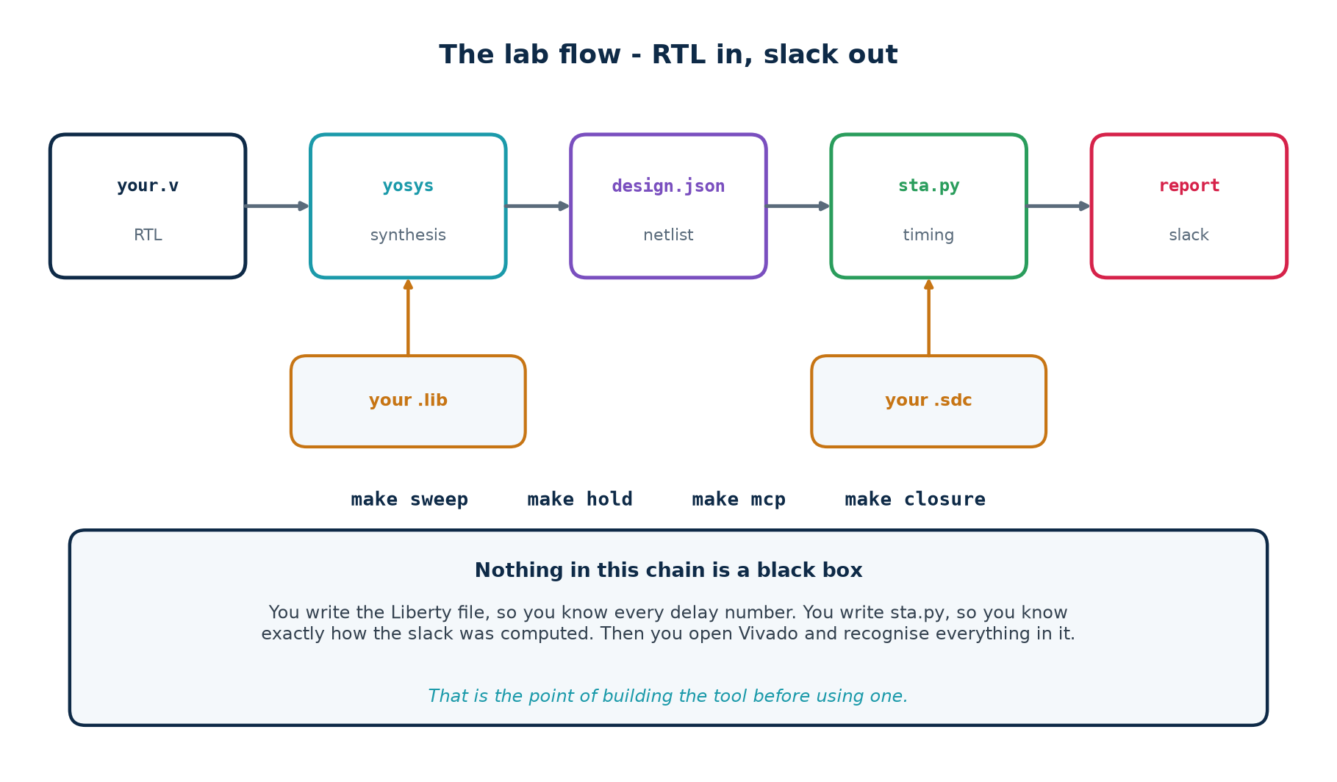
TOOLS · THE FLOW
RTL In, Slack Out - With No Black Box In Between
make lib # read the Liberty file and print the cell table
make tiny # three flops - a report you can check by hand
make sweep # Fmax against width, for three adder styles
make hold # a hold violation, then the same design fixed
make mcp # a false violation, then the multicycle path that removes it
make verify # prove every optimised netlist still computes the right answer
Chip Design Associate · Module 2 · Verilog RTL Coding for Synthesis · Topic 6: Timing Constraints and Analysis
M2-T6 · 65

Slide 66
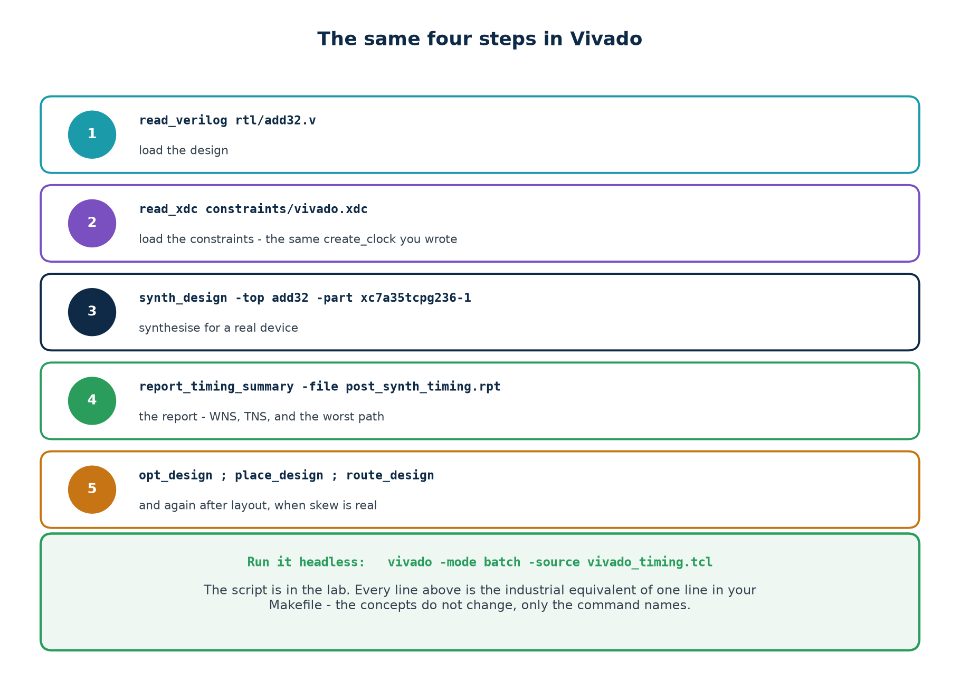
TOOLS · VIVADO
The Same Four Steps, In Vivado
Every line is the industrial equivalent of one line in your Makefile. The concepts do not change - only the command names.
Chip Design Associate · Module 2 · Verilog RTL Coding for Synthesis · Topic 6: Timing Constraints and Analysis
M2-T6 · 66

Slide 67
TOOLS · VIVADO
The Script, In Full
# scripts/vivado_timing.tcl - run with: vivado -mode batch -source this.tcl
set part xc7a35tcpg236-1
read_verilog [glob rtl/*.v]
read_xdc constraints/vivado.xdc
synth_design -top add32 -part $part -flatten_hierarchy rebuilt
report_timing_summary -file rpt/post_synth_summary.rpt
report_timing -delay_type max -max_paths 10 -file rpt/post_synth_setup.rpt
report_timing -delay_type min -max_paths 10 -file rpt/post_synth_hold.rpt
opt_design ; place_design ; route_design
report_timing_summary -file rpt/post_route_summary.rpt
# the number to compare against your own engine:
puts "WNS = [get_property SLACK [get_timing_paths -delay_type max]]"
The comparison that makes the whole topic land
Run your engine and Vivado on the same RTL. The absolute numbers will differ - different technology, different delay model. The STRUCTURE of the report, the critical path it names, and the effect of every constraint change will be the same.
Chip Design Associate · Module 2 · Verilog RTL Coding for Synthesis · Topic 6: Timing Constraints and Analysis
M2-T6 · 67

Slide 68
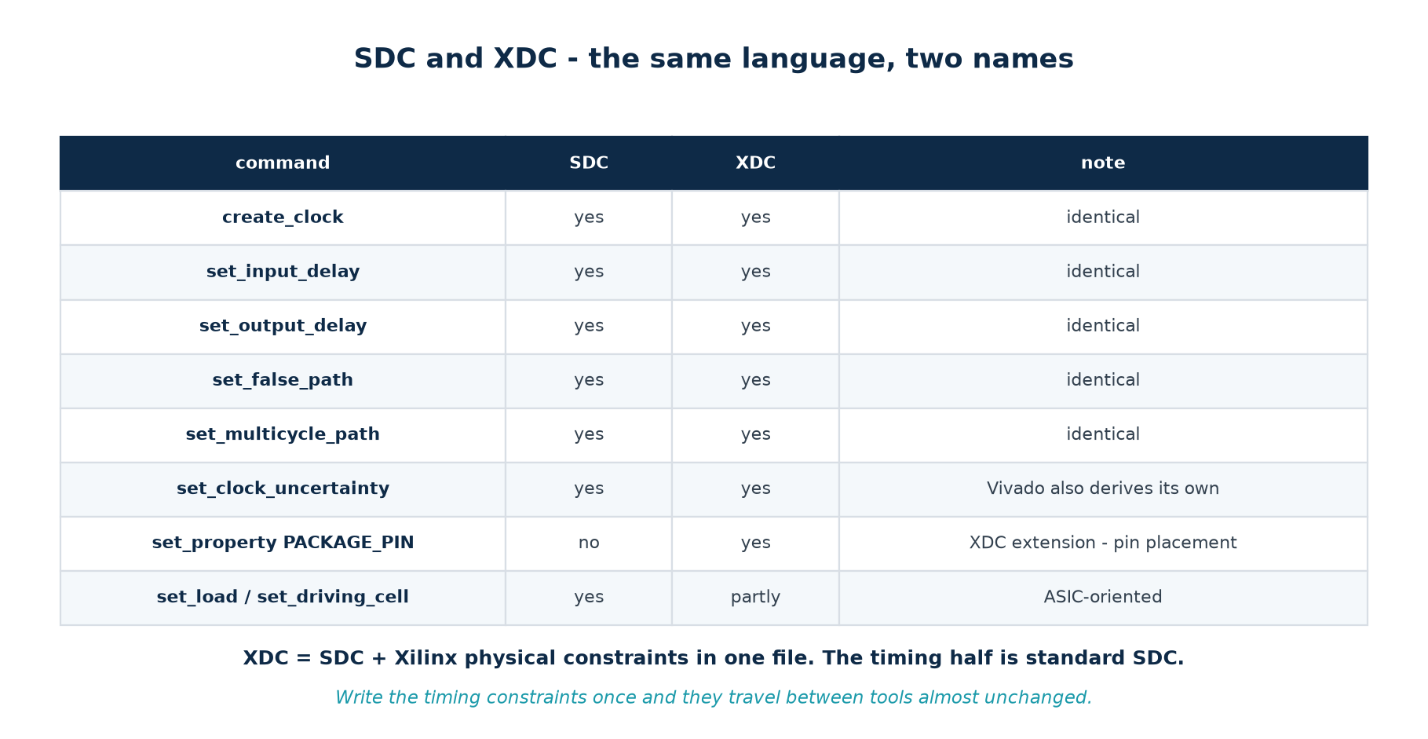
TOOLS · SDC AND XDC
The Same Language, Two Names
# constraints/vivado.xdc - the timing half is identical to the SDC file
create_clock -name clk -period 5.000 [get_ports clk]
set_input_delay -clock clk -max 1.20 [get_ports {a[*] b[*]}]
set_property PACKAGE_PIN W5 [get_ports clk] # <- the XDC-only half
set_property IOSTANDARD LVCMOS33 [get_ports clk]
Chip Design Associate · Module 2 · Verilog RTL Coding for Synthesis · Topic 6: Timing Constraints and Analysis
M2-T6 · 68

Slide 69
LABS T1–T7
The Practical Component
25 hours of hands-on work: build the analyser, then use it on real violations, then prove the ideas transfer to an industrial tool.
Syllabus: Timing Analysis and Closure Labs (10 h)
Syllabus: Design Synthesis and Optimisation Labs (15 h)
62 graded exercises, every one with a worked solution
Nothing quoted in this topic that you cannot reproduce with make
Chip Design Associate · Module 2 · Verilog RTL Coding for Synthesis · Topic 6: Timing Constraints and Analysis
M2-T6 · 69

Slide 70
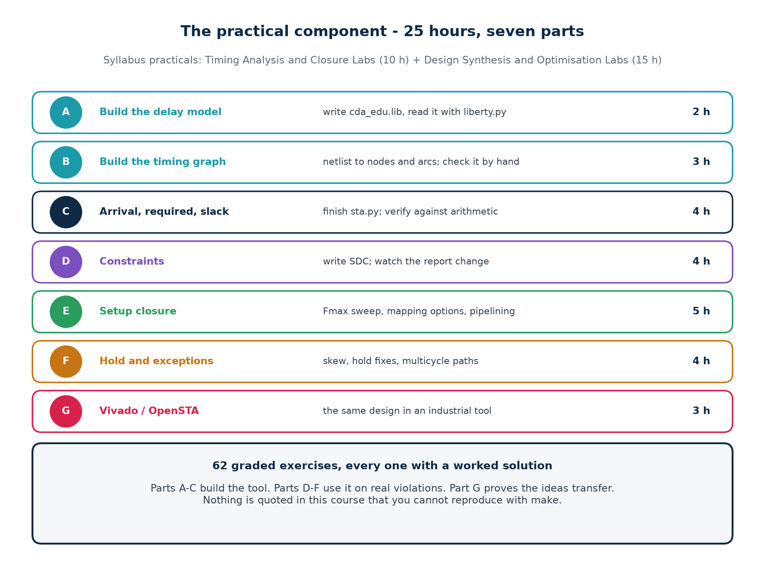
LABS · MAP
Seven Parts, 25 Hours
Parts A-C build the tool. Parts D-F use it on real violations. Part G proves the ideas transfer.
Chip Design Associate · Module 2 · Verilog RTL Coding for Synthesis · Topic 6: Timing Constraints and Analysis
M2-T6 · 70

Slide 71
LABS · T1 AND T2
Build the Delay Model, Then the Graph
T1 · The delay model (2 h)
T2 · The timing graph (3 h)
Write lib/cda_edu.lib: 14 cells, each with an intrinsic delay, a load factor and an input capacitance.
Write sta/liberty.py to read it and print the cell table.
Deliverable: a table of 14 cells with every number accounted for.
Check: make lib
Synthesise rtl/tiny.v with Yosys, write the netlist as JSON.
Turn the JSON into nodes and arcs: one node per pin, cell delay on the internal input-to-output arc.
Deliverable: the graph for a three-flop design, drawn on paper and printed by your code - and they agree.
Check: make tiny
The arc convention that makes reports readable
Charge the cell delay on the arc INSIDE the cell, using the load on its output net; charge clock-to-Q at the Q pin. Net arcs cost zero. Get this wrong and every report line is attributed to the wrong cell.
Chip Design Associate · Module 2 · Verilog RTL Coding for Synthesis · Topic 6: Timing Constraints and Analysis
M2-T6 · 71

Slide 72
LABS · T3
Arrival, Required, Slack - the Engine Itself
what your engine prints when T3 is finished
$ ./scripts/sta.sh tiny --paths 1 -p 1.0
Path 1 endpoint q_reg/D (DFF)
startpoint p_reg
incr arrival pin
0.000 0.000 clock edge at p_reg
0.164 0.164 p_reg/Q (DFF)
0.000 0.164 u97/B (XOR2)
0.117 0.281 u97/Y (XOR2)
0.000 0.281 q_reg/D (DFF)
0.910 required (period - setup)
0.629 SLACK MET
WNS (worst slack) : +0.629 ns MET
longest path : 0.371 ns Fmax : 2693.2 MHz
The exercise that matters most in the whole topic
Compute +0.629 on paper before you run it. When your arithmetic and your code agree to three decimals, you understand static timing analysis - and no report from any vendor will ever be mysterious again.
Chip Design Associate · Module 2 · Verilog RTL Coding for Synthesis · Topic 6: Timing Constraints and Analysis
M2-T6 · 72

Slide 73
LABS · T4
Constraints - Watch the Report Change
Exercise
What you change
What you must observe
T4.1
the period, from 5 ns down to 1 ns
the slack falls linearly; the path does not change
T4.2
add set_input_delay for the first time
new paths appear in the report that were not there before
T4.3
remove it again
the unconstrained count goes up; the WNS improves. Explain that.
T4.4
add 0.15 ns of uncertainty
every setup slack drops by exactly 0.15
T4.5
add 0.30 ns of skew to one register
its setup slack improves and its hold slack collapses
T4.6
set_false_path on the critical path
the WNS jumps. Write down why that is dangerous.
T4.3 and T4.6 are the two that teach the most
Both make the report look BETTER while making the analysis worse. Learning to distrust an improving number is the professional skill this topic is really about.
Chip Design Associate · Module 2 · Verilog RTL Coding for Synthesis · Topic 6: Timing Constraints and Analysis
M2-T6 · 73

Slide 74
LABS · T5
Setup Closure - the Fmax Sweep
the experiment that shows what synthesis actually did
$ make sweep
=== hand-written carry chain === === a + b, delay-driven mapping ===
W cells longest(ns) ns/bit W cells longest(ns) ns/bit
4 30 0.773 0.1933 4 33 0.831 0.2077
8 62 1.247 0.1559 8 74 1.183 0.1479
16 126 2.196 0.1373 16 159 1.547 0.0967
32 254 4.094 0.1279 32 332 1.939 0.0606
64 510 7.889 0.1233 64 681 2.318 0.0362
ripple: ns/bit converges on 0.123 -> delay is LINEAR in width
a+b fast: ns/bit keeps FALLING -> the tool built a carry tree
What you must explain
Then prove it still works
Why ns/bit is constant for the ripple chain and falling for the tool's adder.
Why the plain a+b is SLOWER than the ripple chain under area mapping.
make verify runs all three netlists against a reference over 500 random vectors.
An optimisation you have not verified is not an optimisation.
Chip Design Associate · Module 2 · Verilog RTL Coding for Synthesis · Topic 6: Timing Constraints and Analysis
M2-T6 · 74

Slide 75
LABS · T6
Hold Violations and Exceptions
two violations, two different kinds of fix
$ make hold
WNS (worst slack) : -0.165 ns VIOLATED (hold_demo, 0.30 ns skew)
WNS (worst slack) : +0.071 ns MET (hold_fixed, same skew)
$ make mcp
WNS (worst slack) : -1.193 ns VIOLATED (slow_path, no multicycle)
WNS (worst slack) : +0.392 ns MET (slow_path, multicycle 4)
Exercise
Task
T6.1
Reproduce both violations, then explain in one sentence each why the fix works
T6.2
Increase the skew until hold_fixed also fails - how much delay would it need?
T6.3
Add the multicycle -setup line but NOT the -hold line. Predict, then measure.
T6.4
Remove the enable from slow_path.v. The SDC is now a lie - show what breaks.
T6.5
Write a false path that hides a real violation, then argue against yourself.
Chip Design Associate · Module 2 · Verilog RTL Coding for Synthesis · Topic 6: Timing Constraints and Analysis
M2-T6 · 75

Slide 76
LABS · T7
The Same Design In an Industrial Tool
Exercise
Tool
What you produce
T7.1
Vivado
the same add32, synthesised for an Artix-7, with your own XDC
T7.2
Vivado
post-synthesis and post-route timing summaries, compared
T7.3
Vivado
the multicycle path applied in XDC - same effect, vendor syntax
T7.4
OpenSTA
your netlist and a real .lib, read by a real STA tool
T7.5
both
a one-page comparison: what matched, what did not, and why
T7.5 is the deliverable that proves you learned the topic
The numbers will differ. The reasoning will not. If you can explain why Vivado's WNS differs from yours, and point at the delay model rather than shrugging, you can close timing on a real design.
Chip Design Associate · Module 2 · Verilog RTL Coding for Synthesis · Topic 6: Timing Constraints and Analysis
M2-T6 · 76

Slide 77
LABS · ASSESSMENT
How the 62 Exercises Are Weighted
Part
Exercises
Weight
Assessed on
A · delay model
6
8%
every number traceable to the library
B · timing graph
8
12%
hand-drawn graph matches the code
C · the engine
10
20%
hand arithmetic matches the report
D · constraints
12
15%
a defensible line-by-line SDC file
E · setup closure
12
20%
measured Fmax, plus verification
F · hold and exceptions
9
15%
correct diagnosis before the fix
G · industrial tools
5
10%
the comparison write-up
The rule that runs through every part
A fix you cannot explain is not a fix. Marks are given for the reasoning, not for the green report - because in this field it is trivially easy to produce a green report on a broken design.
Chip Design Associate · Module 2 · Verilog RTL Coding for Synthesis · Topic 6: Timing Constraints and Analysis
M2-T6 · 77

Slide 78
REFERENCE
Glossary - Terms Used In This Topic (1 of 2)
Term
Meaning
arrival time
when the data actually reaches a pin, measured from the clock edge
required time
when it had to be there by, for the check to pass
slack
required minus arrival. Positive fits, negative does not
WNS
worst negative slack - the single worst path in the design
TNS
total negative slack - every negative slack added up
setup time
how long D must be stable BEFORE the clock edge
hold time
how long D must stay stable AFTER the clock edge
clock-to-Q
how long after the edge before Q is valid
clock skew
the difference in clock arrival between two registers
clock jitter
cycle-to-cycle variation in the clock edge position
uncertainty
the margin that stands in for jitter and unmodelled skew
critical path
the path with the worst slack - the one that sets Fmax
Chip Design Associate · Module 2 · Verilog RTL Coding for Synthesis · Topic 6: Timing Constraints and Analysis
M2-T6 · 78

Slide 79
REFERENCE
Glossary - Terms Used In This Topic (2 of 2)
Term
Meaning
Fmax
1 divided by the longest path delay - the highest safe clock
endpoint
where a path ends: a flop's D pin, or an output port
startpoint
where it begins: a flop's Q pin, or an input port
path group
reg-to-reg, in-to-reg, reg-to-out, in-to-out
false path
a path the tool must not check, because it cannot be exercised
multicycle path
a path allowed more than one cycle to complete
SDC / XDC
the constraint language; XDC adds Xilinx physical constraints
Liberty (.lib)
the file that gives each cell its delay, setup and hold
PVT corner
a process/voltage/temperature combination to analyse at
retiming
moving an existing register across logic to balance stages
pipelining
adding a register to cut a long path in two
timing closure
the loop that ends when every check passes at every corner
Chip Design Associate · Module 2 · Verilog RTL Coding for Synthesis · Topic 6: Timing Constraints and Analysis
M2-T6 · 79

Slide 80
SUMMARY
Topic 6 In Ten Lines
▪
A flip-flop samples over a WINDOW around the clock edge, not at an instant.
▪
Setup means the data was too late. Hold means it changed too soon.
▪
slack = required - arrival, computed at every endpoint. That is all STA does.
▪
The clock period is in the setup equation and nowhere in the hold equation.
▪
An unconstrained path is not a passing path - it is an unexamined one.
▪
An exception is a promise. The tool believes you without checking.
▪
Half of all reported violations are constraint bugs, not design bugs.
▪
Setup is fixed by less logic or a slower clock; hold only by MORE delay.
▪
The same RTL ran at 217 MHz and 516 MHz. Only a synthesis option changed.
▪
Describe intent, not structure - then check what your tool did with it.
Chip Design Associate · Module 2 · Verilog RTL Coding for Synthesis · Topic 6: Timing Constraints and Analysis
M2-T6 · 80

Slide 81
CLOSE
What To Do Next
Before the next session
Carry into every project after this
Install tier 1 and run make in the lab directory. It should end with "Topic 6 lab complete".
Compute the +0.629 ns slack on paper. Bring your working.
Read one timing report - any tool, any design - and find its critical path.
Write the constraint file before you write the RTL. It is the specification.
Check the unconstrained-endpoint count on every single run.
Never write an exception you cannot justify in one sentence.
Verify every optimisation. A faster design that computes the wrong answer is not faster.
The sentence to leave with
A timing report is not a verdict on your design. It is a verdict on your design AND your constraints - and only one of those two is usually the problem.
Chip Design Associate · Module 2 · Verilog RTL Coding for Synthesis · Topic 6: Timing Constraints and Analysis
M2-T6 · 81

