Slide 1
MODULE 2 · TOPIC 2
RTL Design Methodology
Basics of register transfer level (RTL) design · Overview of the RTL design process and methodology · Introduction to hardware description languages such as Verilog or VHDL
Theory 1 · What RTL is — from the transistor up: what a signal is, what a register does, and where RTL sits on the ladder of abstraction
Theory 2 · The language you say it in — an HDL is not a program
Theory 3 · The methodology — the flow, the synthesisable subset, the rules, and what the tool actually builds
Theory 4 · The patterns — datapath and controller, state machines, parameters and generate
Practical · Labs A–N · 26 hours · 103 exercises · every number measured
Chip Design Associate · Module 2 · Verilog RTL Coding for Synthesis · Topic 2: RTL Design Methodology
M2-T2 · 1

Slide 2
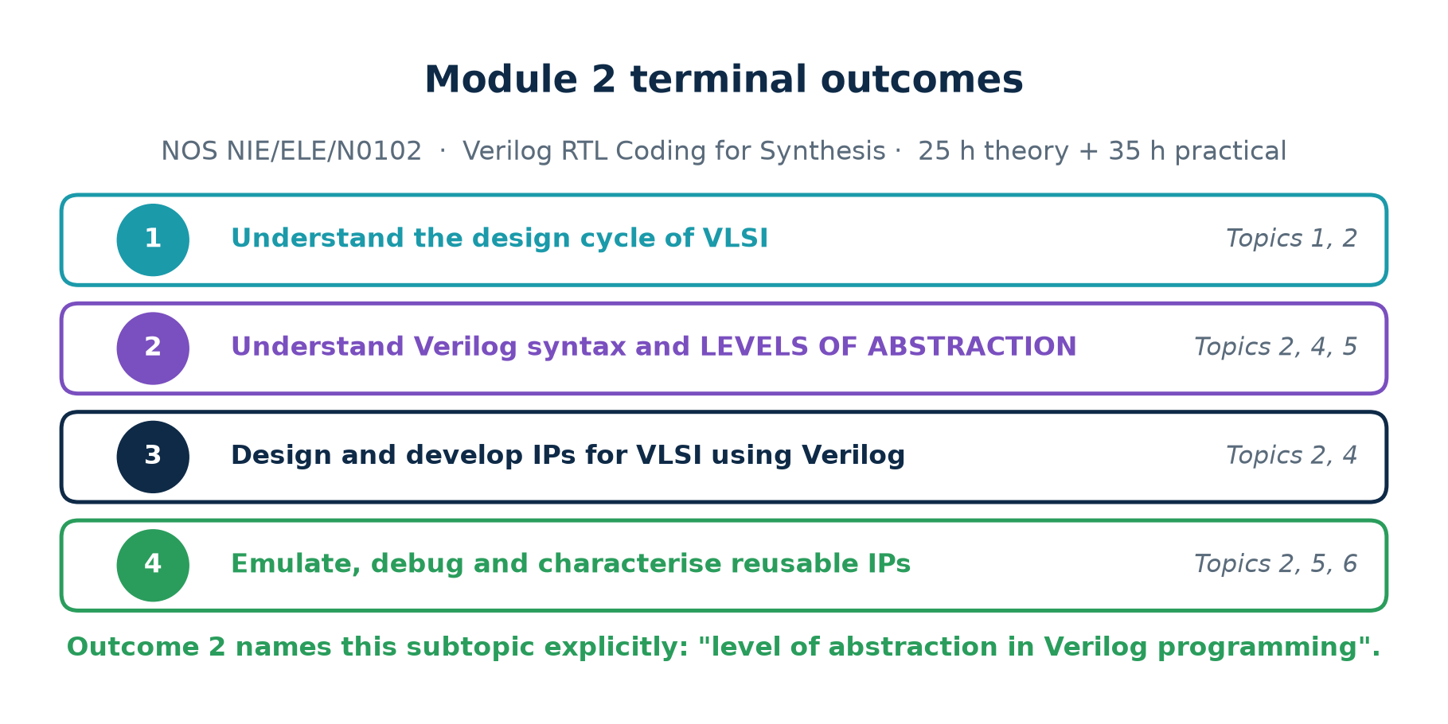
MODULE 2 · NOS NIE/ELE/N0102
Terminal Outcomes
Outcome 2 names this subtopic in the NOS itself
"Level of abstraction in Verilog programming" is the phrase. This session takes one circuit down all four levels, simulates them together, and proves they are the same — which is the deliverable the outcome asks for.
Chip Design Associate · Module 2 · Verilog RTL Coding for Synthesis · Topic 2: RTL Design Methodology
M2-T2 · 2

Slide 3
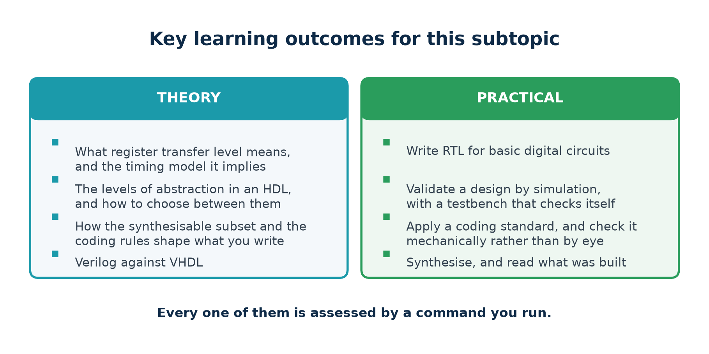
MODULE 2 · TOPIC 2
Key Learning Outcomes
Every outcome is assessed by a command you run, not by something you recite.
Chip Design Associate · Module 2 · Verilog RTL Coding for Synthesis · Topic 2: RTL Design Methodology
M2-T2 · 3

Slide 4
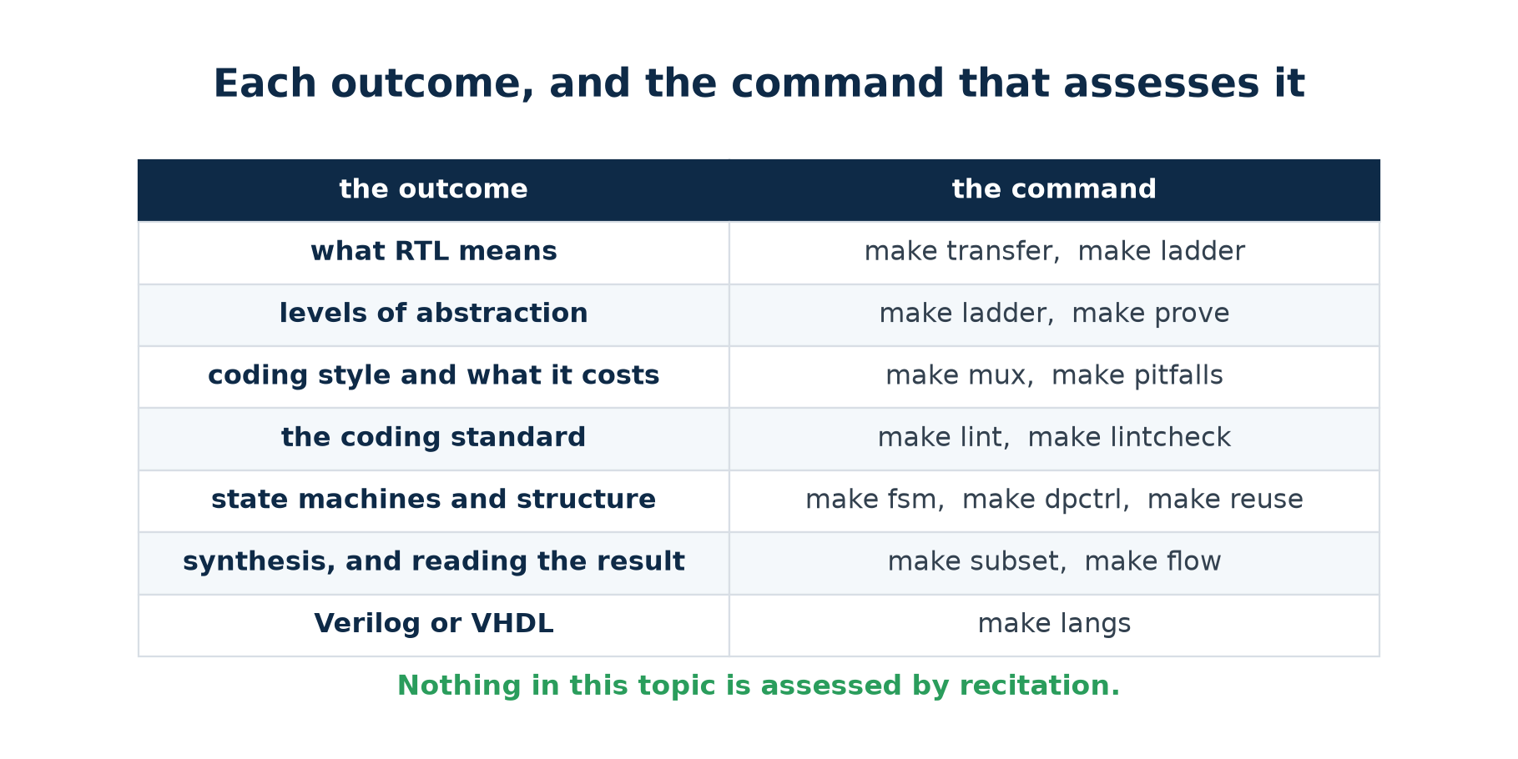
MODULE 2 · TOPIC 2
Which Command Assesses Which Outcome
Run the right-hand column and you have evidence for the left-hand one.
Chip Design Associate · Module 2 · Verilog RTL Coding for Synthesis · Topic 2: RTL Design Methodology
M2-T2 · 4

Slide 5
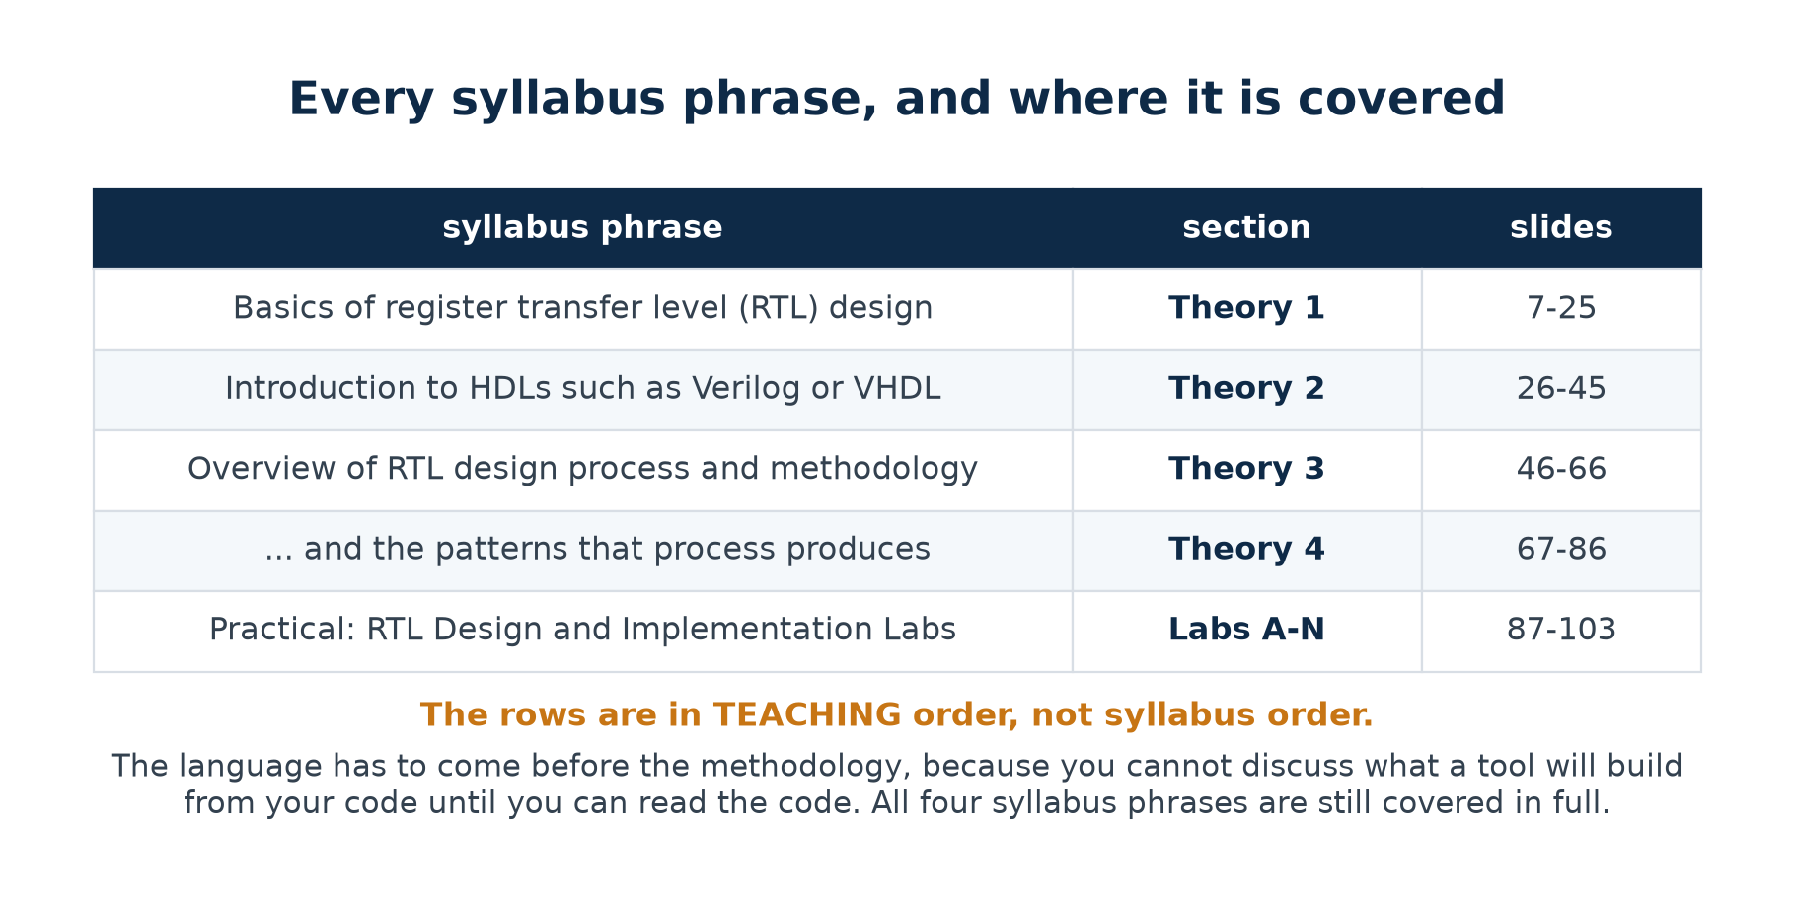
TOPIC 2 · COVERAGE
Every Syllabus Phrase, and Where It Is Covered
On the four notional hours
Four hours is enough to define the terms. It is not enough to make anyone believe them — and nothing in this subtopic is believed until it has been seen to happen. Lecture from the summary slides to fit four hours; run the lab alongside to teach it.
Chip Design Associate · Module 2 · Verilog RTL Coding for Synthesis · Topic 2: RTL Design Methodology
M2-T2 · 5

Slide 6
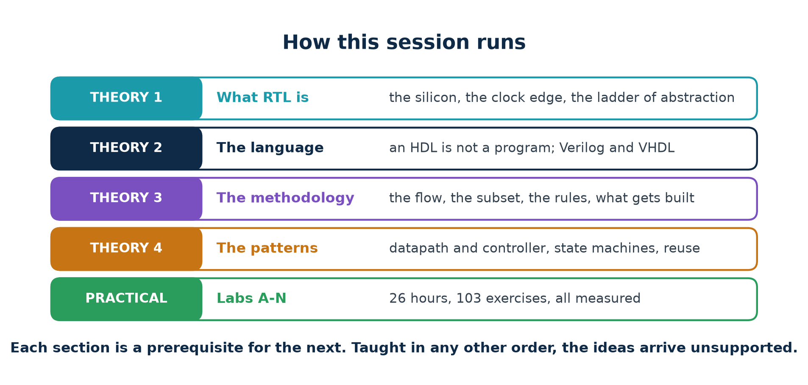
TOPIC 2 · STRUCTURE
How This Session Runs
RTL is not a language and it is not a tool. It is a way of thinking about hardware.
Chip Design Associate · Module 2 · Verilog RTL Coding for Synthesis · Topic 2: RTL Design Methodology
M2-T2 · 6

Slide 7
THEORY 1
What RTL Is
RTL is an abstraction, and an abstraction only means something once you have seen the thing it abstracts. So this section starts with the silicon and works upwards.
What is physically on the chip, and what a signal physically is
What a register does, and what happens between two clock edges
The ladder of abstraction, and which rung RTL is
Only then: the definition, and what follows from it
The two kinds of logic, and the synchronous discipline
Chip Design Associate · Module 2 · Verilog RTL Coding for Synthesis · Topic 2: RTL Design Methodology
M2-T2 · 7

Slide 8
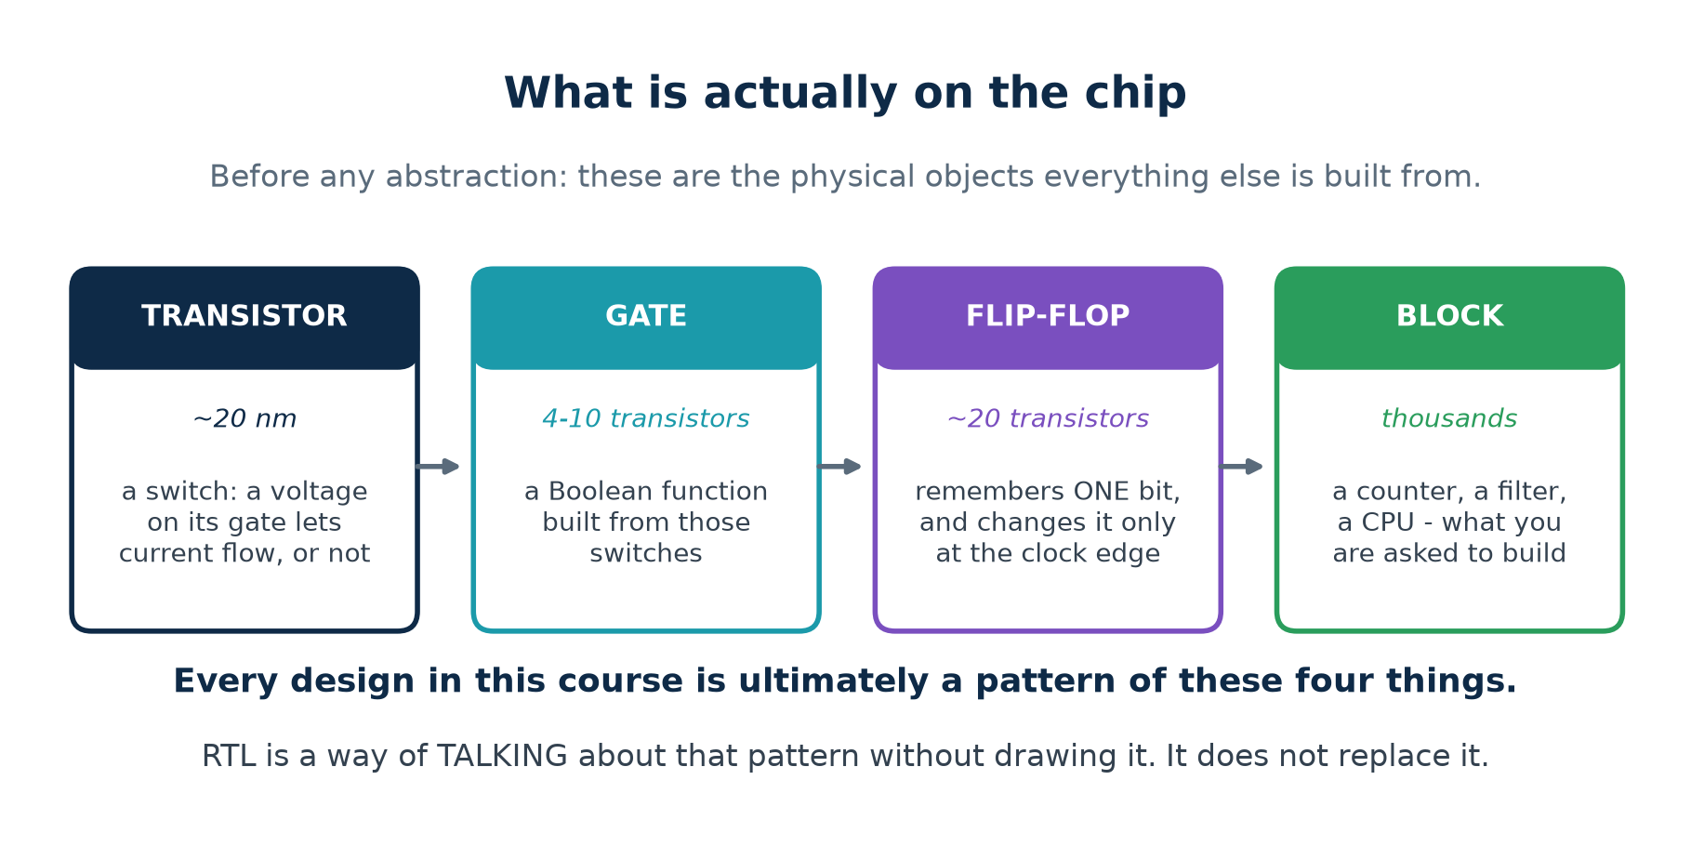
1.1 · THE PHYSICAL PICTURE
What Is Actually On the Chip
Start here, not with a definition. Everything later in this topic is a way of talking about these four things.
Chip Design Associate · Module 2 · Verilog RTL Coding for Synthesis · Topic 2: RTL Design Methodology
M2-T2 · 8

Slide 9
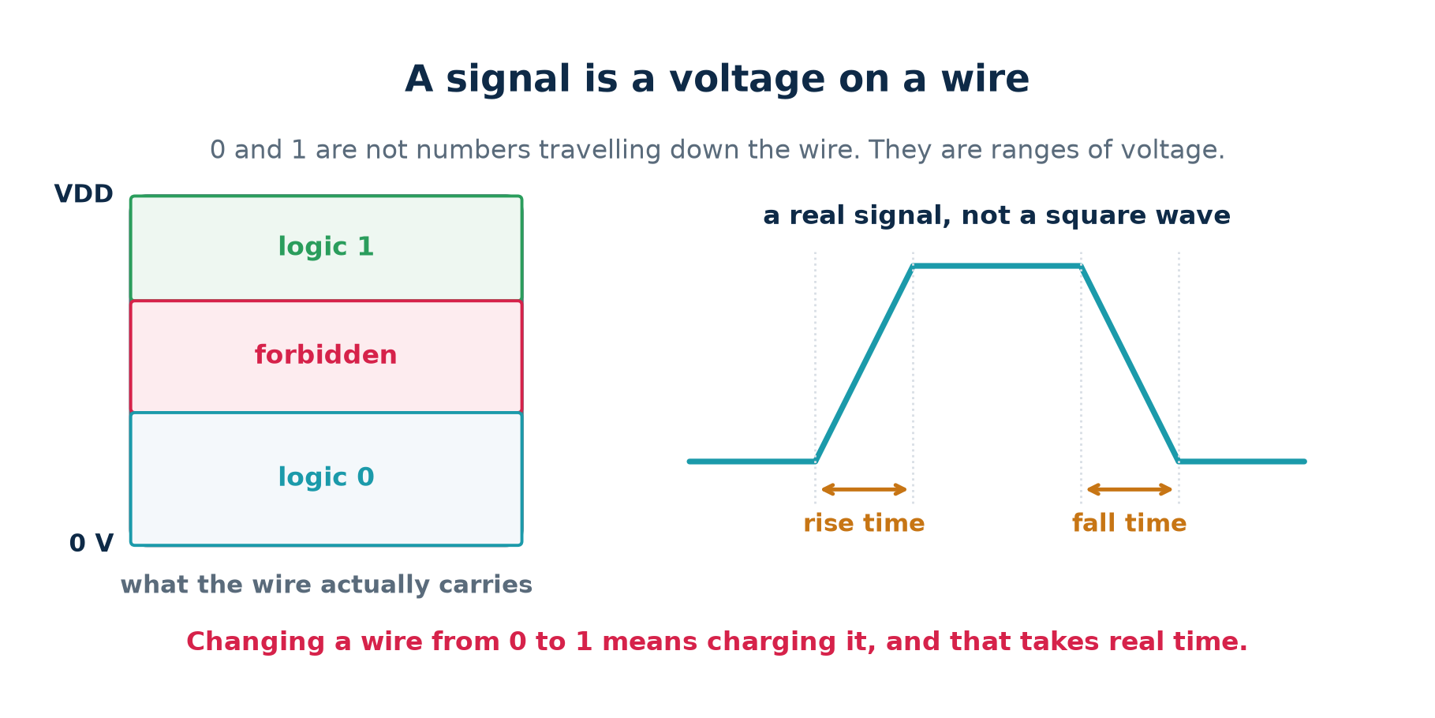
1.1 · THE PHYSICAL PICTURE
A Signal Is a Voltage on a Wire
Why this matters for everything that follows
A wire is a small capacitor, and driving it from 0 to 1 means charging it. Propagation delay, setup time, hold time and maximum clock frequency are all consequences of that one physical fact.
Chip Design Associate · Module 2 · Verilog RTL Coding for Synthesis · Topic 2: RTL Design Methodology
M2-T2 · 9

Slide 10
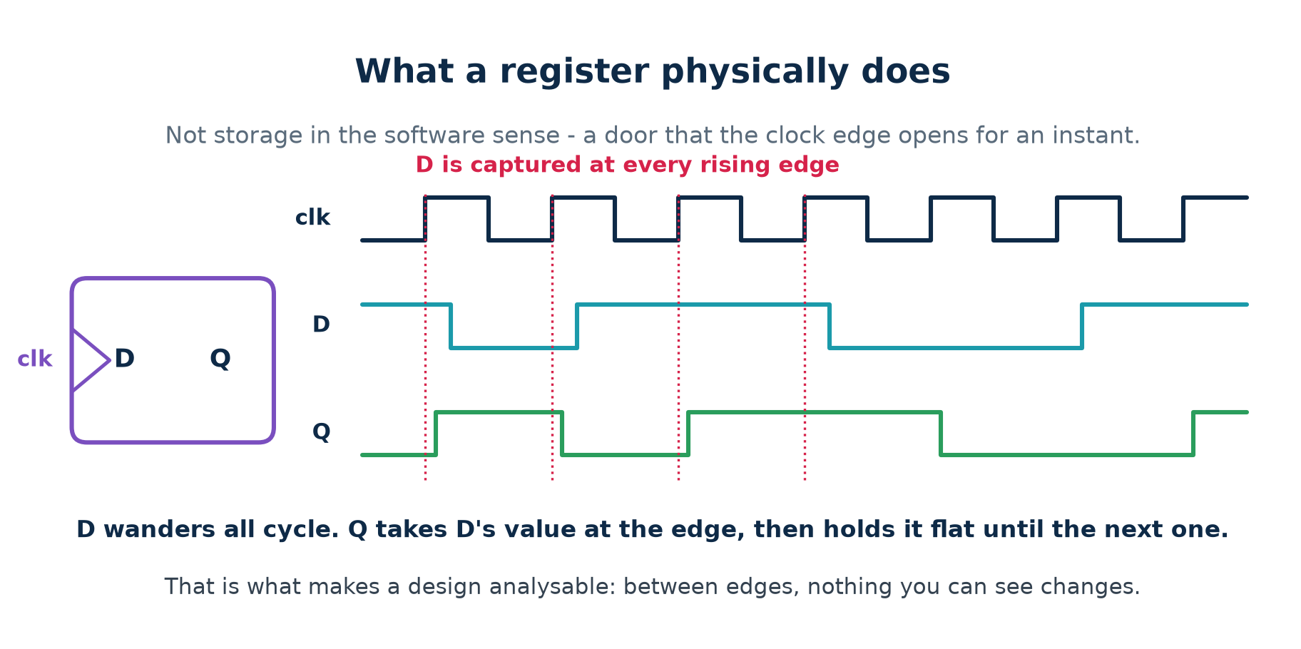
1.2 · THE REGISTER
What a Register Physically Does
A flip-flop is not a variable. It is a door the clock edge opens for an instant.
Chip Design Associate · Module 2 · Verilog RTL Coding for Synthesis · Topic 2: RTL Design Methodology
M2-T2 · 10

Slide 11
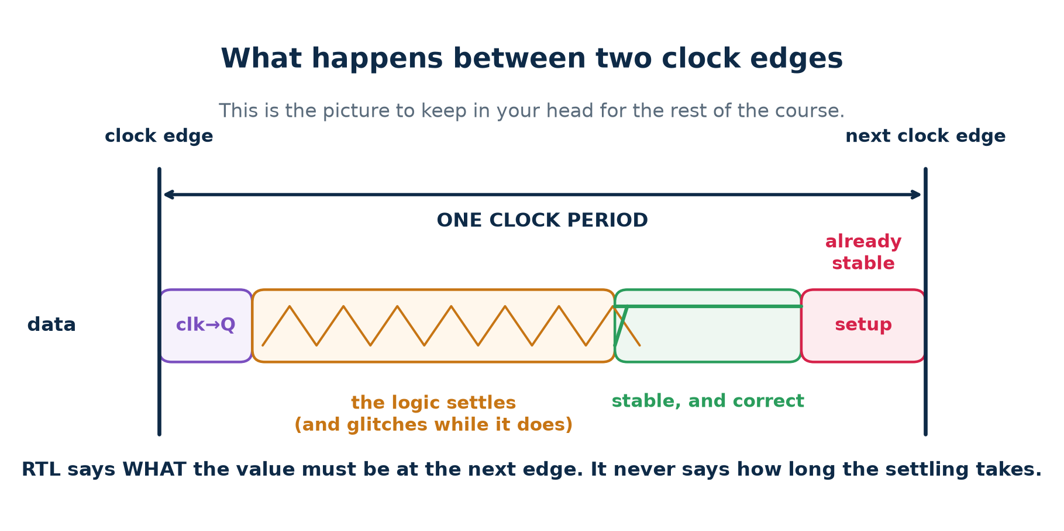
1.2 · THE REGISTER
What Happens Between Two Clock Edges
Memorise this picture. Almost every rule in Topics 2, 5 and 6 is a statement about some part of it.
Chip Design Associate · Module 2 · Verilog RTL Coding for Synthesis · Topic 2: RTL Design Methodology
M2-T2 · 11

Slide 12
1.2 · THE REGISTER
Reading That Picture
clk → Q
The edge arrives and the register drives its new value out. This takes a real, non-zero time, and it is the first thing that eats into your clock period.
SETTLING
The combinational logic between registers now recomputes. While it does, its output is briefly WRONG — signals arrive down different paths at different times and the output glitches. This is normal and harmless, because nothing is looking.
STABLE
The logic has finished. The value on the wire is now the correct answer, and it stays there.
SETUP
Just before the next edge, the value must ALREADY have been stable for a short window, or the register may capture the wrong thing. Miss it and you have a setup violation.
Everything you write in RTL has to fit in that gap. You never say how long it takes — you say what the answer must be by the end of it.
Chip Design Associate · Module 2 · Verilog RTL Coding for Synthesis · Topic 2: RTL Design Methodology
M2-T2 · 12

Slide 13
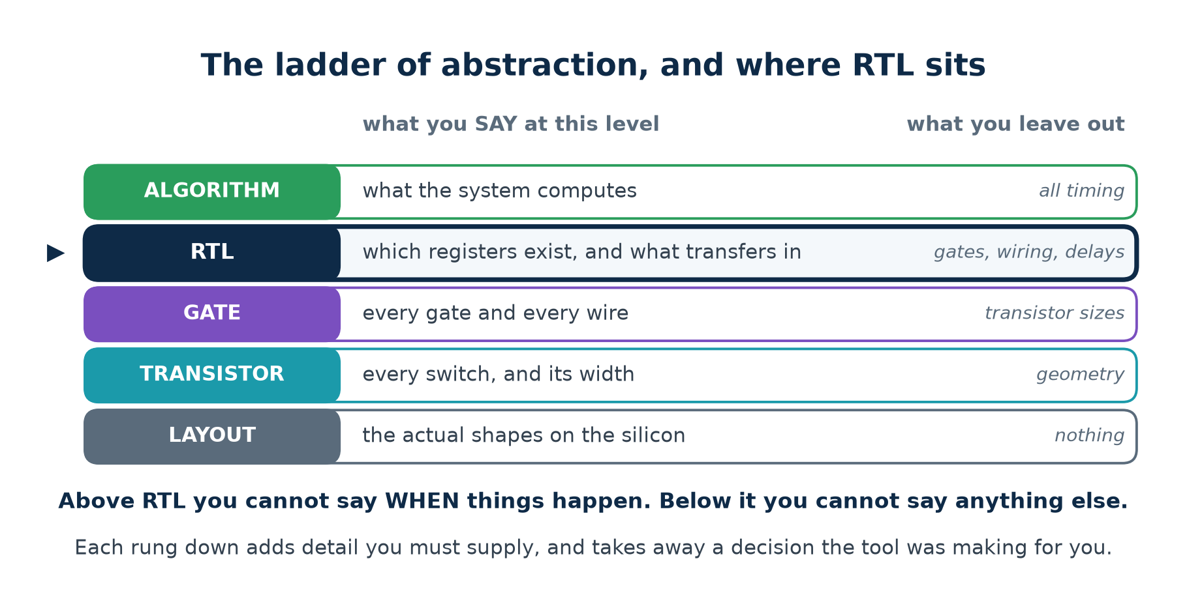
1.3 · ABSTRACTION
The Ladder, and Which Rung RTL Is
RTL is not a language and not a tool. It is a LEVEL of description — one rung on this ladder.
Chip Design Associate · Module 2 · Verilog RTL Coding for Synthesis · Topic 2: RTL Design Methodology
M2-T2 · 13

Slide 14
1.3 · ABSTRACTION
Why Anyone Designs At This Level
Behavioural / algorithmic
RTL
Gate netlist
you write
the algorithm
registers and transfers
every gate
timing
none at all
one clock period per stage
exact, per gate
synthesisable
rarely
yes — this is the target
yes, but why would you
a 10k-gate design
unbuildable
a few hundred lines
tens of thousands of lines
who writes it
architects, in C or SystemC
you
the synthesiser
RTL is the level where the trade lands correctly
High enough that a human can write and read a real design; low enough that a tool can build it without guessing at your intent.
Every industrial digital design in the last thirty years was written here. That is not fashion — it is where the abstraction pays for itself.
Chip Design Associate · Module 2 · Verilog RTL Coding for Synthesis · Topic 2: RTL Design Methodology
M2-T2 · 14

Slide 15
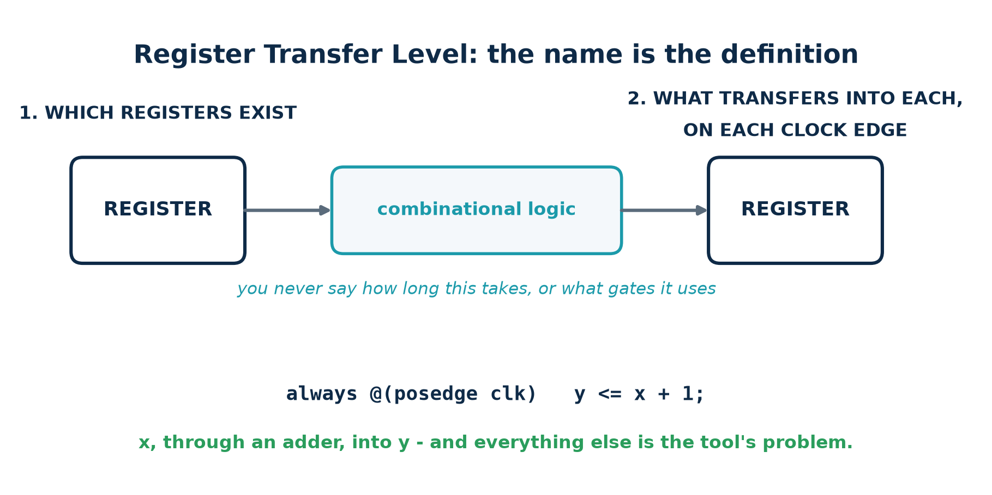
1.4 · RTL, DEFINED
Now the Definition Means Something
Read it against the physical picture
"Which registers exist" means: which of those edge-triggered doors are in the design. "What transfers into them" means: what the logic between them must have settled to before the next edge arrives. Nothing else — not the gates, not the wiring, not the delay — is yours to state.
Chip Design Associate · Module 2 · Verilog RTL Coding for Synthesis · Topic 2: RTL Design Methodology
M2-T2 · 15

Slide 16
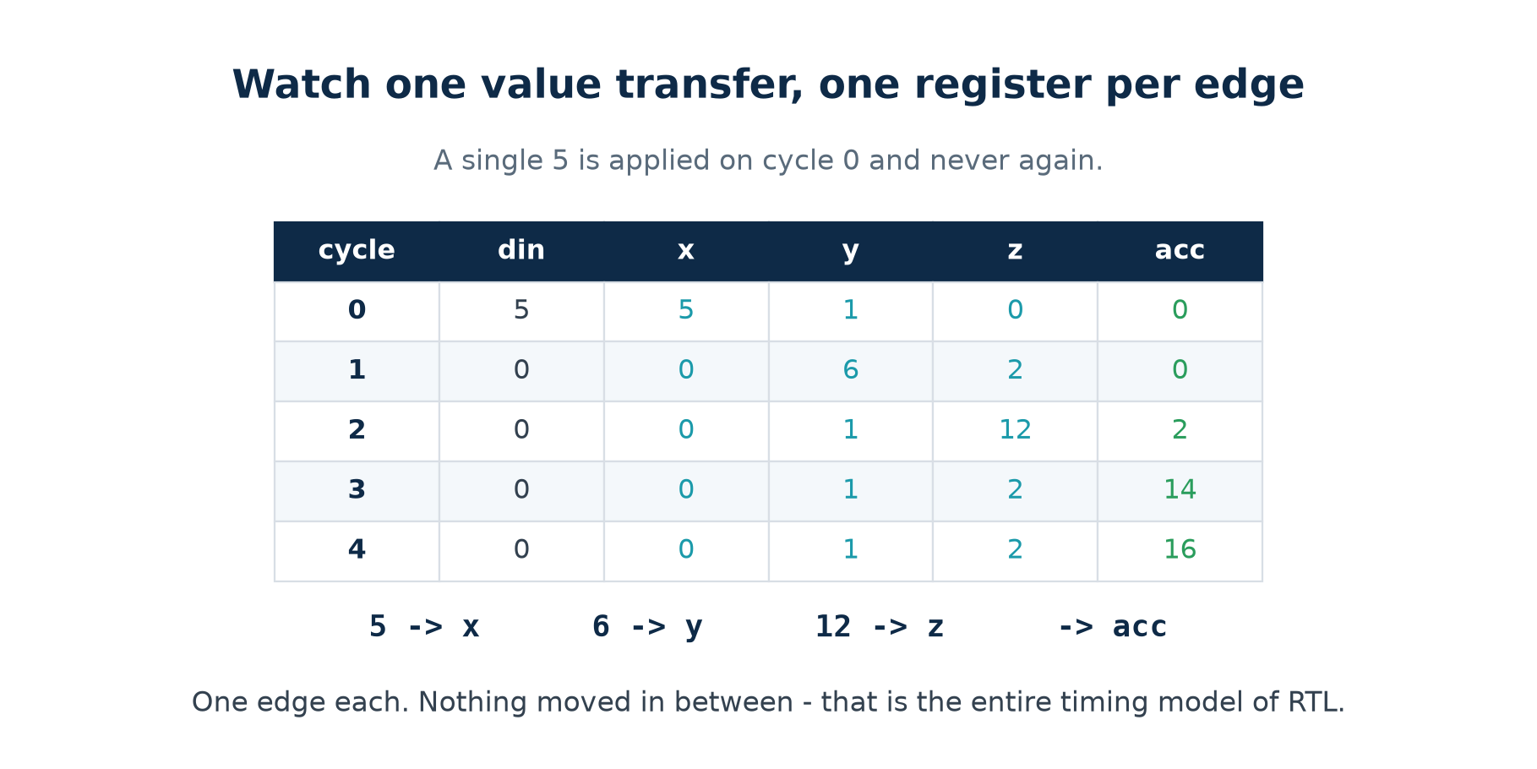
1.4 · RTL, DEFINED
Watch One Value Transfer
One register per clock edge, and nothing moving in between. That is the whole timing model.
Chip Design Associate · Module 2 · Verilog RTL Coding for Synthesis · Topic 2: RTL Design Methodology
M2-T2 · 16

Slide 17
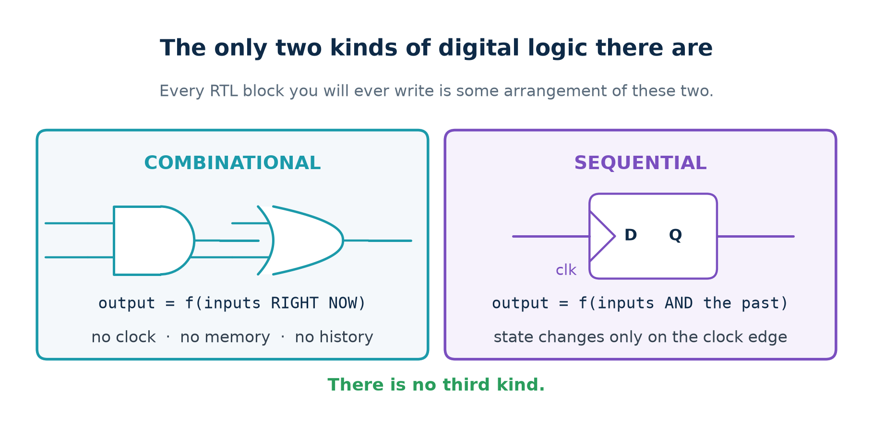
1.5 · THE TWO KINDS
Combinational and Sequential
There is no third kind. Every block in this course is an arrangement of these two.
Chip Design Associate · Module 2 · Verilog RTL Coding for Synthesis · Topic 2: RTL Design Methodology
M2-T2 · 17

Slide 18
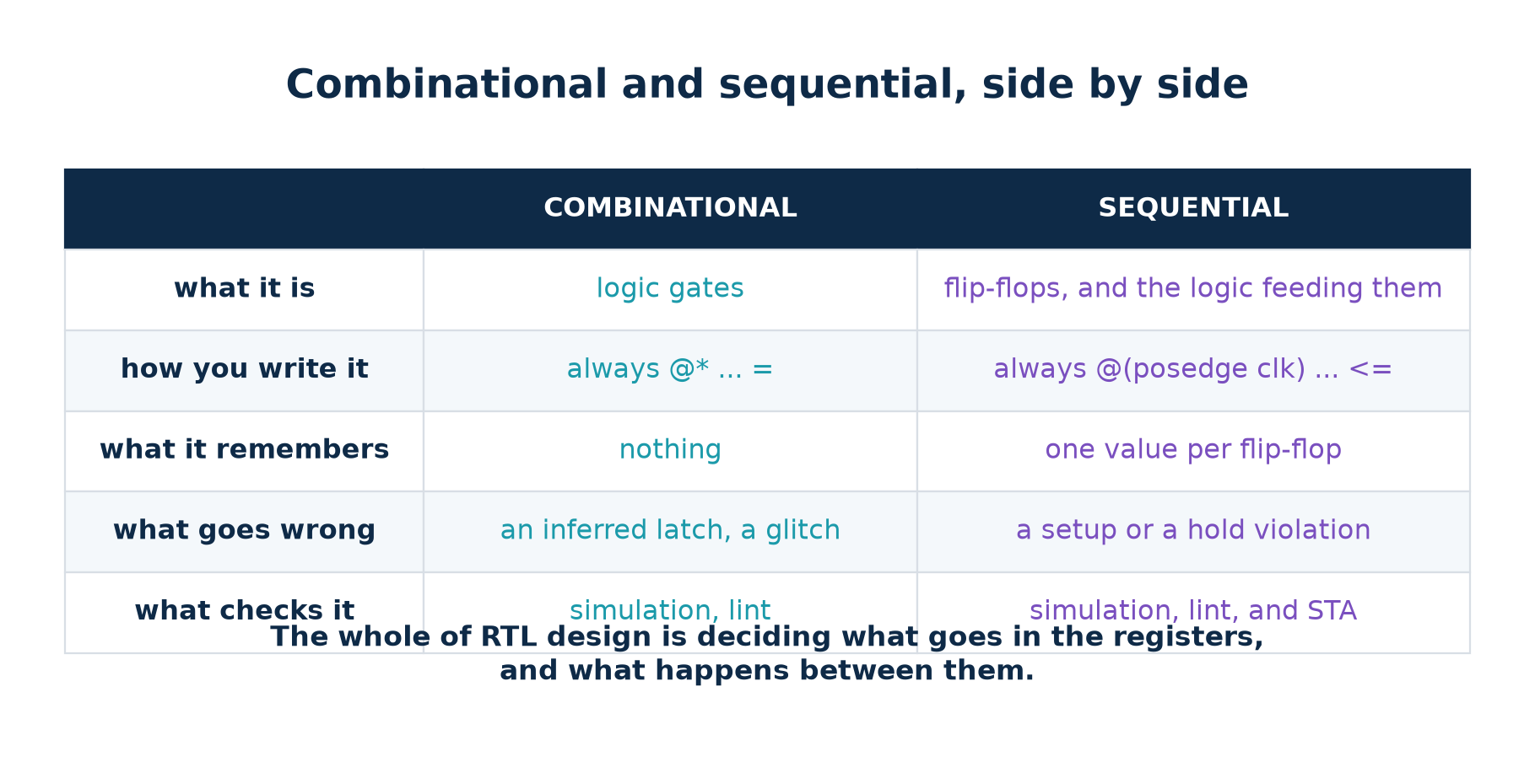
1.5 · THE TWO KINDS
Side By Side
Each row is a rule you will use every day. Learn which column you are in before you write a line.
Chip Design Associate · Module 2 · Verilog RTL Coding for Synthesis · Topic 2: RTL Design Methodology
M2-T2 · 18

Slide 19
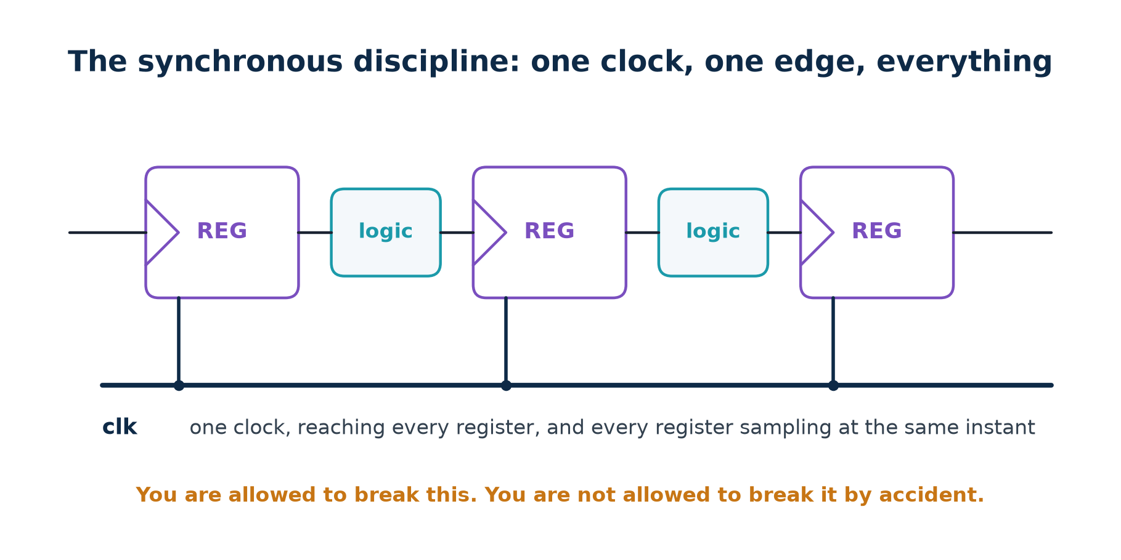
1.6 · THE DISCIPLINE
One Clock, One Edge, Everything
Almost every rule in this topic is a consequence of this one decision.
Chip Design Associate · Module 2 · Verilog RTL Coding for Synthesis · Topic 2: RTL Design Methodology
M2-T2 · 19

Slide 20
1.6 · THE DISCIPLINE
What the Discipline Buys You
ANALYSABLE
With one clock and one edge, timing analysis is a finite question: for every path from a flip-flop to a flip-flop, does the data arrive in time? Add a gated clock and the question multiplies.
COMPOSABLE
Two blocks written to the same discipline can be wired together without a conversation. Two blocks written to different disciplines need one, every time.
REVIEWABLE
A reviewer can read your block for what it computes, because the question of WHEN has already been answered the same way it always is.
TESTABLE
Scan insertion, the technique that makes a chip testable after manufacture, assumes edge-triggered flip-flops on one clock. Latches and gated clocks each need special handling.
You are allowed to break these rules. You are not allowed to break them by accident.
Chip Design Associate · Module 2 · Verilog RTL Coding for Synthesis · Topic 2: RTL Design Methodology
M2-T2 · 20

Slide 21
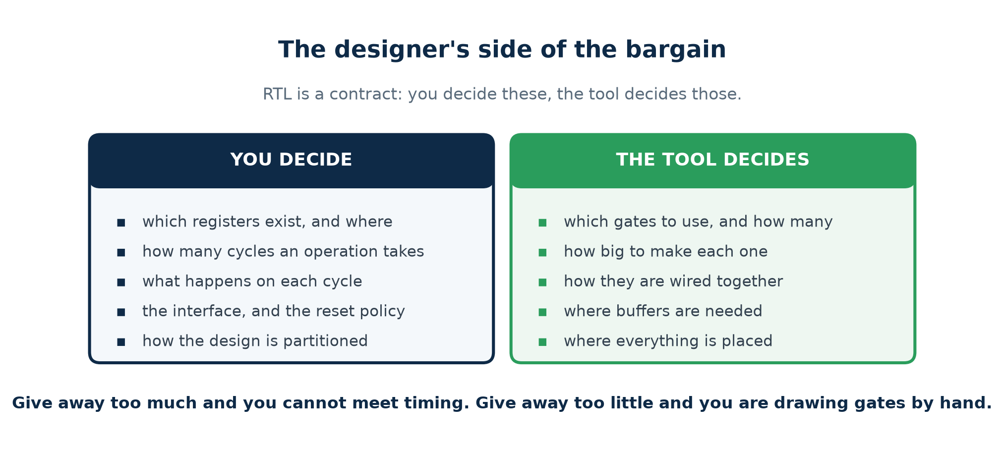
1.7 · THE DESIGNER'S VIEW
What You Decide, What the Tool Decides
This split IS the abstraction. Learning RTL is learning where the line falls.
Chip Design Associate · Module 2 · Verilog RTL Coding for Synthesis · Topic 2: RTL Design Methodology
M2-T2 · 21

Slide 22
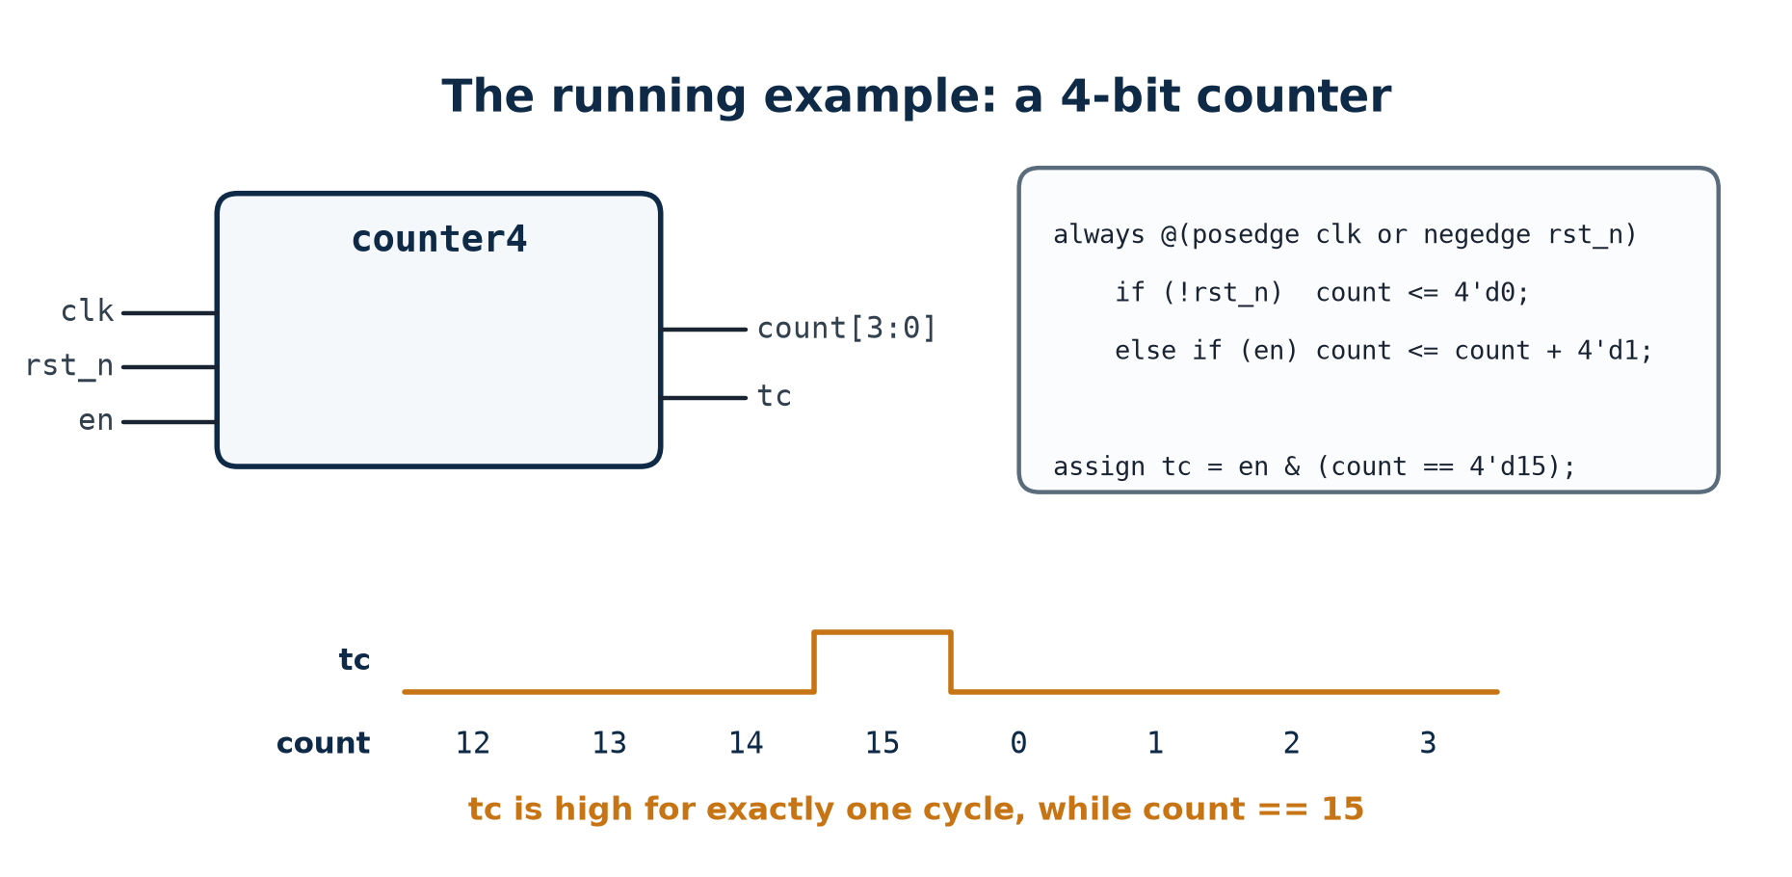
1.8 · THE RUNNING EXAMPLE
One Design, Carried All the Way Through
Four bits, an asynchronous reset, an enable and a terminal count. Small enough to read in one glance, big enough to be a real design.
Chip Design Associate · Module 2 · Verilog RTL Coding for Synthesis · Topic 2: RTL Design Methodology
M2-T2 · 22

Slide 23
1.8 · THE RUNNING EXAMPLE
Read It Line By Line
module counter4 (
input clk,
input rst_n, // asynchronous, active LOW
input en,
output reg [3:0] count,
output tc // one cycle high at 15
);
always @(posedge clk or negedge rst_n) begin
if (!rst_n) count <= 4'd0; // reset wins
else if (en) count <= count + 4'd1;
end // no else: HOLD
assign tc = en & (count == 4'd15);
endmodule
Four decisions are visible in fourteen lines
The reset is ASYNCHRONOUS, so it is in the sensitivity list; it is ACTIVE LOW, so the port is named rst_n and the test is !rst_n. Reset is tested FIRST, so it wins over the enable. And the missing else is deliberate — in a CLOCKED block, no assignment means hold, which is what a flip-flop does anyway.
Chip Design Associate · Module 2 · Verilog RTL Coding for Synthesis · Topic 2: RTL Design Methodology
M2-T2 · 23

Slide 24
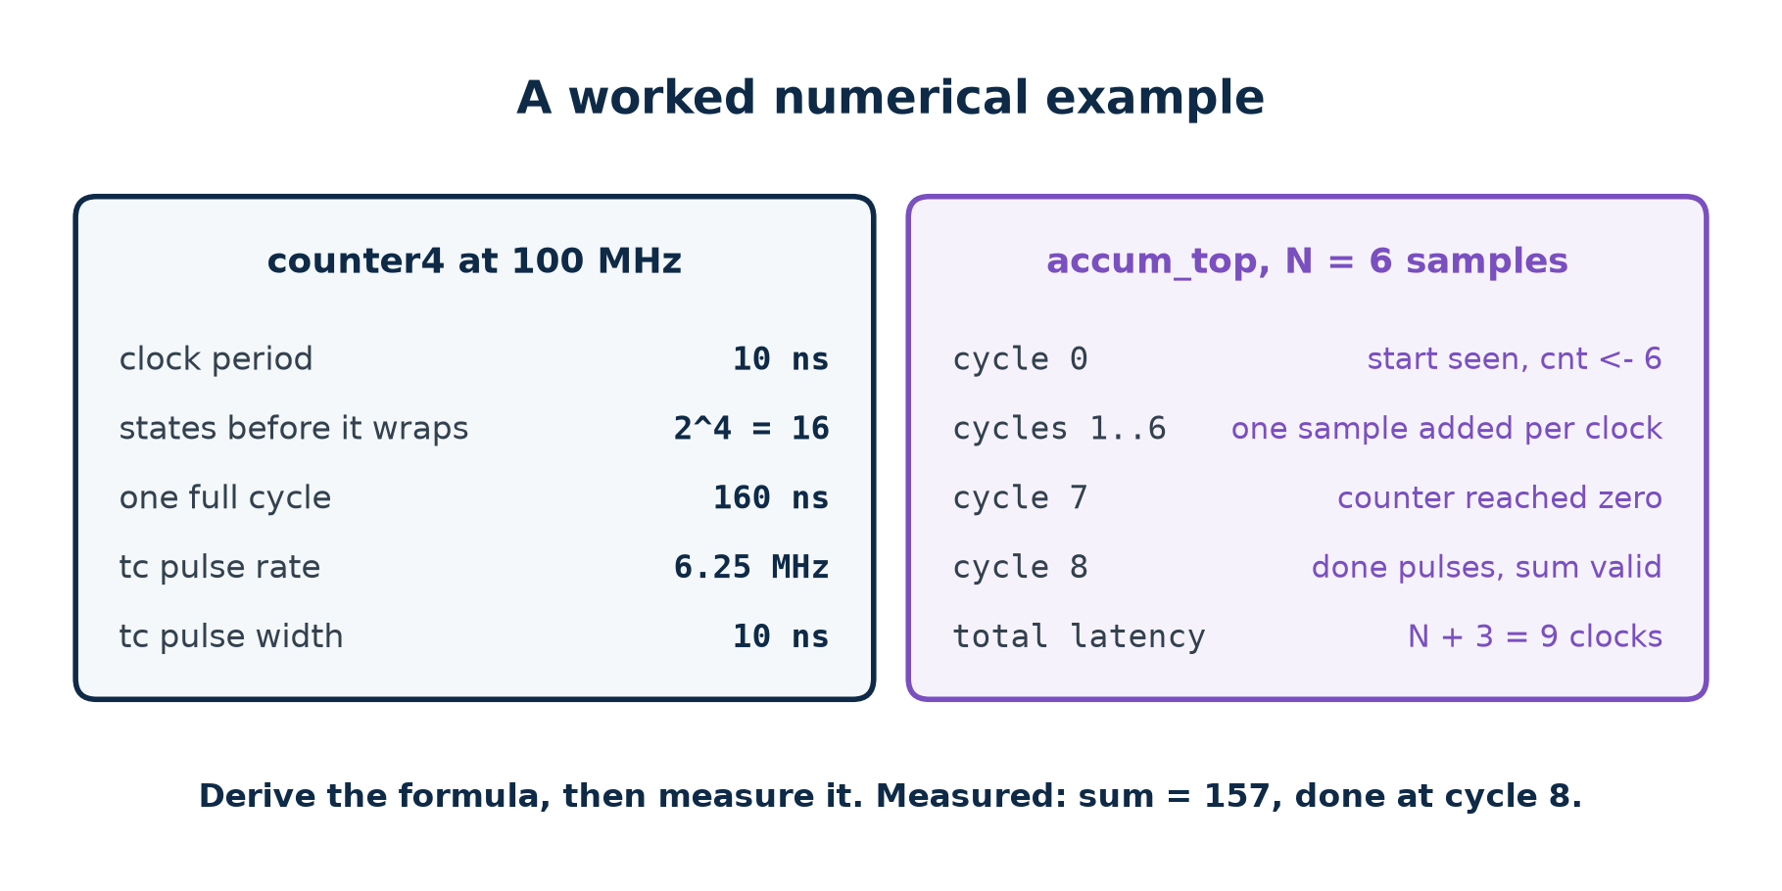
1.8 · THE RUNNING EXAMPLE
The Numbers, Worked Out
Derive the formula, then measure it. A testbench that only ever tries one value of N has told you almost nothing.
Chip Design Associate · Module 2 · Verilog RTL Coding for Synthesis · Topic 2: RTL Design Methodology
M2-T2 · 24

Slide 25
THEORY 1 · CHECKPOINT
Ten Questions
#
Question
The answer in one line
1
What is physically on the chip?
transistors, wired into gates, flip-flops and blocks
2
What does a 1 on a wire physically mean?
a voltage in the upper band, not a number
3
Why does changing a wire take time?
the wire is a capacitor and has to be charged
4
What does a flip-flop do at the clock edge?
captures D, then holds it until the next edge
5
Name the four phases of one clock period.
clk-to-Q, settling, stable, setup window
6
Why are glitches during settling harmless?
nothing samples until the next edge
7
Which rung of the abstraction ladder is RTL?
below the algorithm, above the gate netlist
8
What two things does an RTL description state?
which registers exist, and what transfers into them
9
What are the only two kinds of digital logic?
combinational and sequential — there is no third
10
Name three things you decide that the tool does not.
the registers, the cycle count, the interface
Theory 2 is the notation you write all of that down in.
Chip Design Associate · Module 2 · Verilog RTL Coding for Synthesis · Topic 2: RTL Design Methodology
M2-T2 · 25

Slide 26
THEORY 2
The Language You Say It In
Theory 1 was about the hardware. This section is about how you write it down - and the first thing to unlearn is that this is programming.
Why an HDL is not a programming language
Everything happens at once
The parts of a module, and the word reg that confuses everyone
<= and =, and why the clock edge forces the difference
How a simulator runs an HDL
Verilog and VHDL as reference cards, and both actually run
Chip Design Associate · Module 2 · Verilog RTL Coding for Synthesis · Topic 2: RTL Design Methodology
M2-T2 · 26

Slide 27
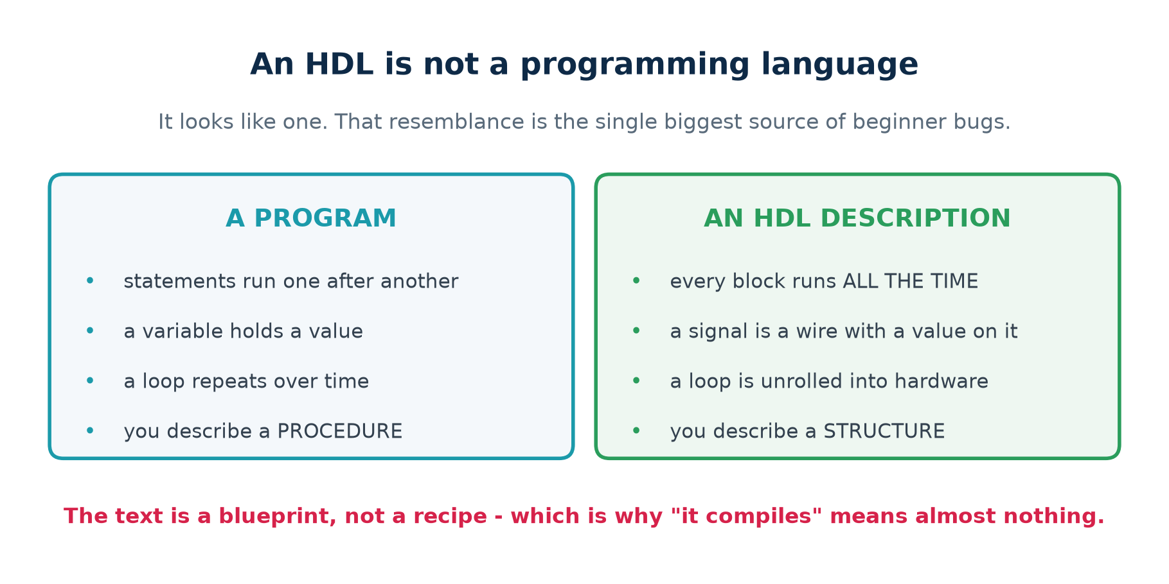
2.1 · NOT A PROGRAM
An HDL Is Not a Programming Language
You are not writing instructions for a machine to follow. You are writing a description of a machine.
Chip Design Associate · Module 2 · Verilog RTL Coding for Synthesis · Topic 2: RTL Design Methodology
M2-T2 · 27

Slide 28
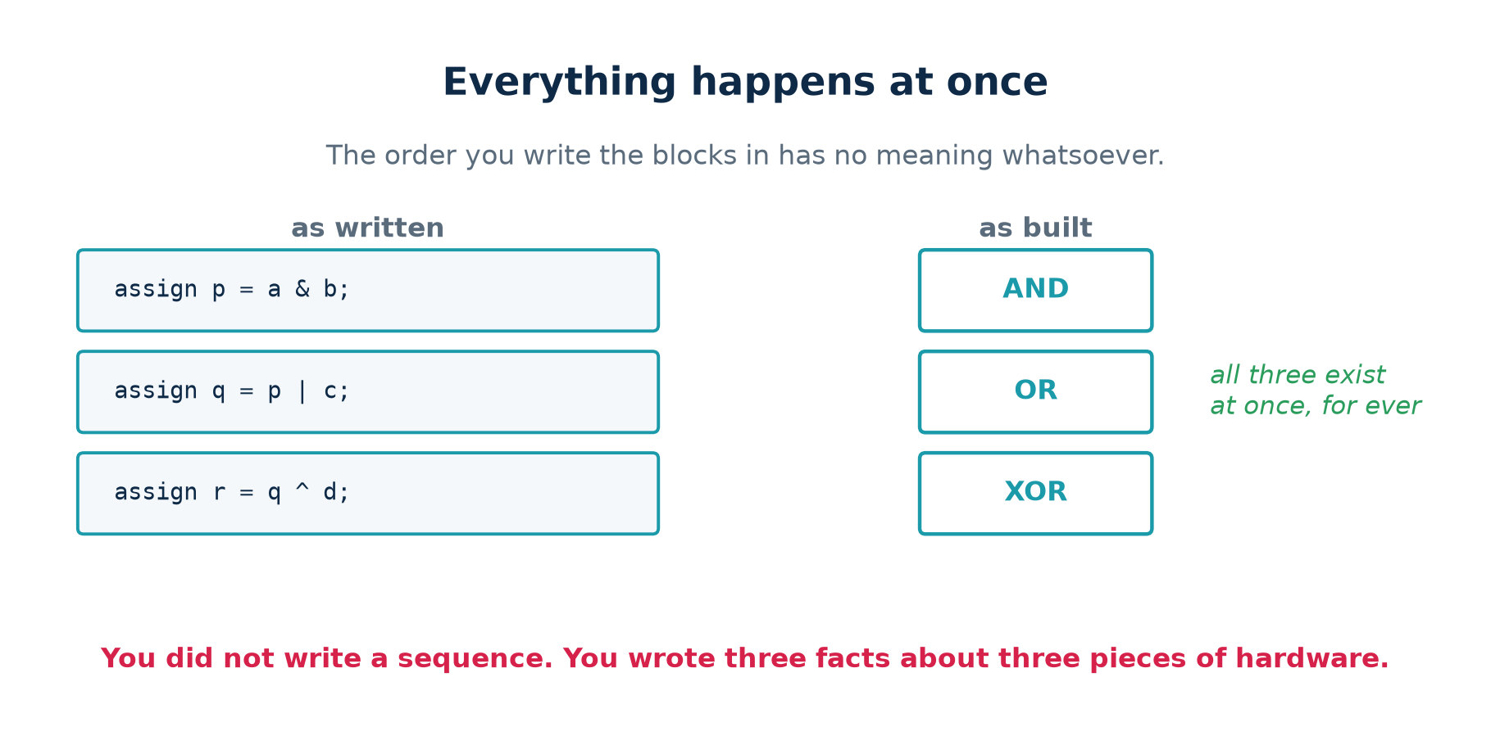
2.2 · CONCURRENCY
Everything Happens At Once
Write those three assign lines in any order you like — the circuit is identical.
Chip Design Associate · Module 2 · Verilog RTL Coding for Synthesis · Topic 2: RTL Design Methodology
M2-T2 · 28

Slide 29
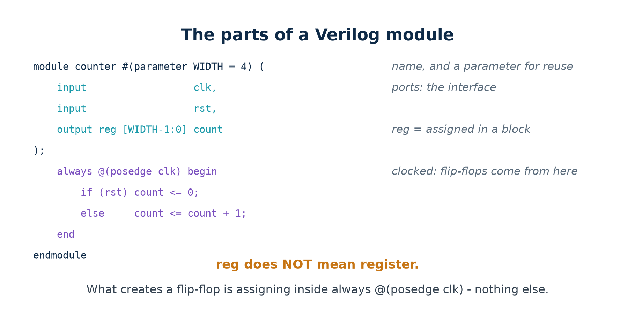
2.3 · ANATOMY
The Parts of a Verilog Module
reg does not mean register. What creates a flip-flop is assigning inside always @(posedge clk) — nothing else.
Chip Design Associate · Module 2 · Verilog RTL Coding for Synthesis · Topic 2: RTL Design Methodology
M2-T2 · 29

Slide 30
2.4 · <= AND =
Where This Rule Comes From
Go back to the clock edge in Theory 1
Every flip-flop in the design captures at the SAME instant. None of them can see what any other one is about to become — they all see the values that were on the wires just before the edge.
Non-blocking assignment is how you write that down. It is not a style convention; it is the notation for physical simultaneity.
THE HARDWARE
THE NOTATION
GET IT WRONG
All registers sample at once, from the values already settled on their inputs.
<= reads every right-hand side first, then updates every left-hand side together.
= makes each line finish before the next starts, so a later line sees a value that does not exist yet.
The operator is a consequence of the physics, not a preference.
Chip Design Associate · Module 2 · Verilog RTL Coding for Synthesis · Topic 2: RTL Design Methodology
M2-T2 · 30

Slide 31
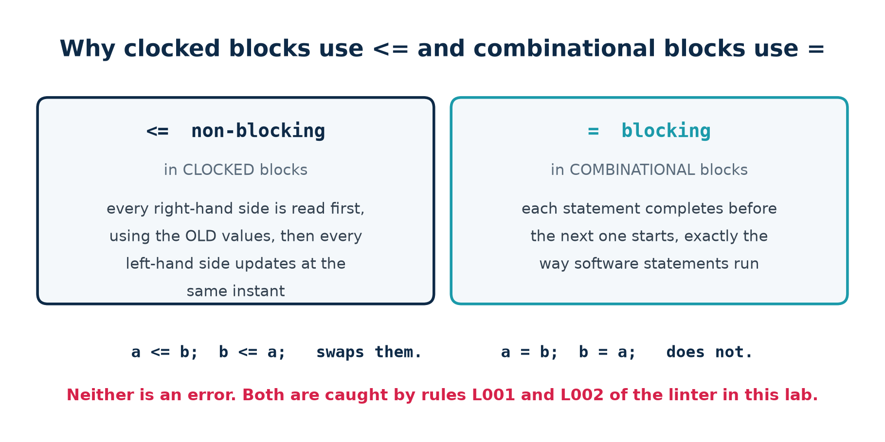
2.4 · <= AND =
The Two Assignment Operators, and Why It Matters
The mirror-image mistake matters too: <= in a combinational block simulates like a register while synthesis builds plain logic.
Chip Design Associate · Module 2 · Verilog RTL Coding for Synthesis · Topic 2: RTL Design Methodology
M2-T2 · 31

Slide 32
2.4 · <= AND =
The Swap, Worked Through
// NON-BLOCKING - inside always @(posedge clk)
// Step 1: read every right-hand side, using the OLD values.
// Step 2: update every left-hand side, all at the same instant.
a <= b; // reads old b
b <= a; // reads old a
a and b are SWAPPED. This is what a hardware register does.
// BLOCKING - inside always @*
// Each statement finishes before the next one starts.
a = b; // a is now b
b = a; // a is already b, so this does nothing
BOTH end up holding b. This is what software does.
Why the rule is absolute rather than stylistic
Two clocked blocks using blocking assignments can see each other's half-updated values, and which one wins depends on the order the simulator happens to evaluate them in — an order the language standard deliberately does not fix.
Non-blocking assignment exists precisely to make that race impossible.
Chip Design Associate · Module 2 · Verilog RTL Coding for Synthesis · Topic 2: RTL Design Methodology
M2-T2 · 32

Slide 33
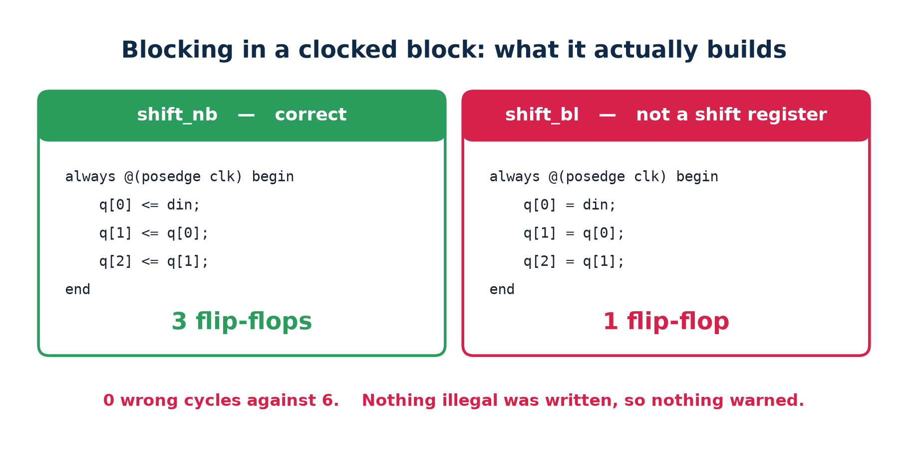
2.4 · <= AND =
And What Each One Actually Builds
Three flip-flops against one. Nothing illegal was written, so nothing warned.
Chip Design Associate · Module 2 · Verilog RTL Coding for Synthesis · Topic 2: RTL Design Methodology
M2-T2 · 33

Slide 34
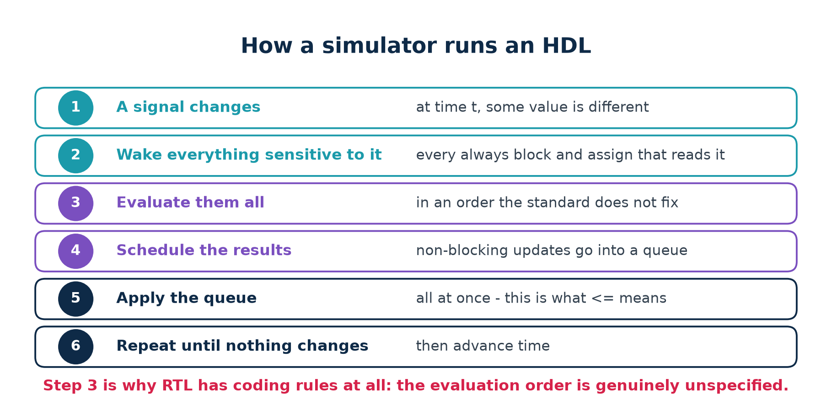
2.5 · SIMULATION
How a Simulator Runs an HDL
The order blocks are evaluated in is genuinely unspecified. That is why non-blocking assignment exists.
Chip Design Associate · Module 2 · Verilog RTL Coding for Synthesis · Topic 2: RTL Design Methodology
M2-T2 · 34

Slide 35
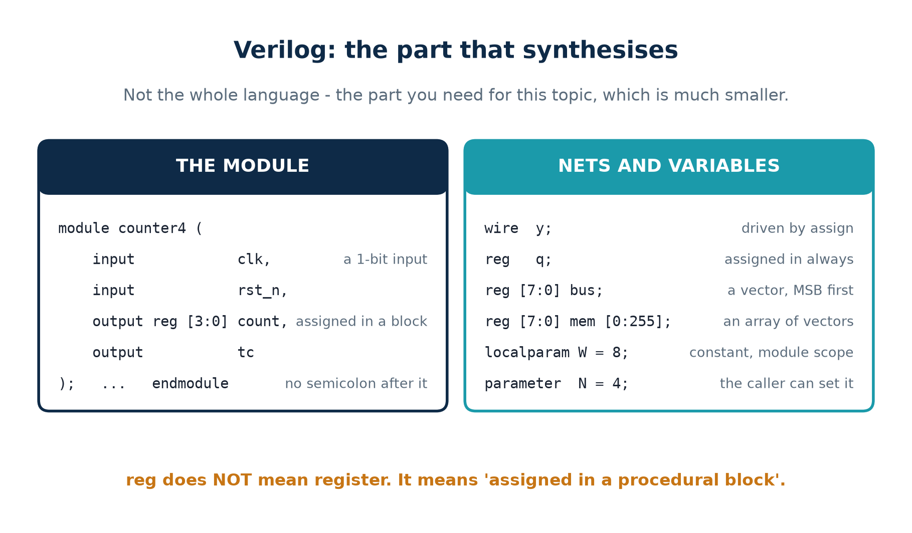
2.6 · REFERENCE
Verilog On One Page
Not the whole language — the part that synthesises, which is much smaller.
Chip Design Associate · Module 2 · Verilog RTL Coding for Synthesis · Topic 2: RTL Design Methodology
M2-T2 · 35

Slide 36
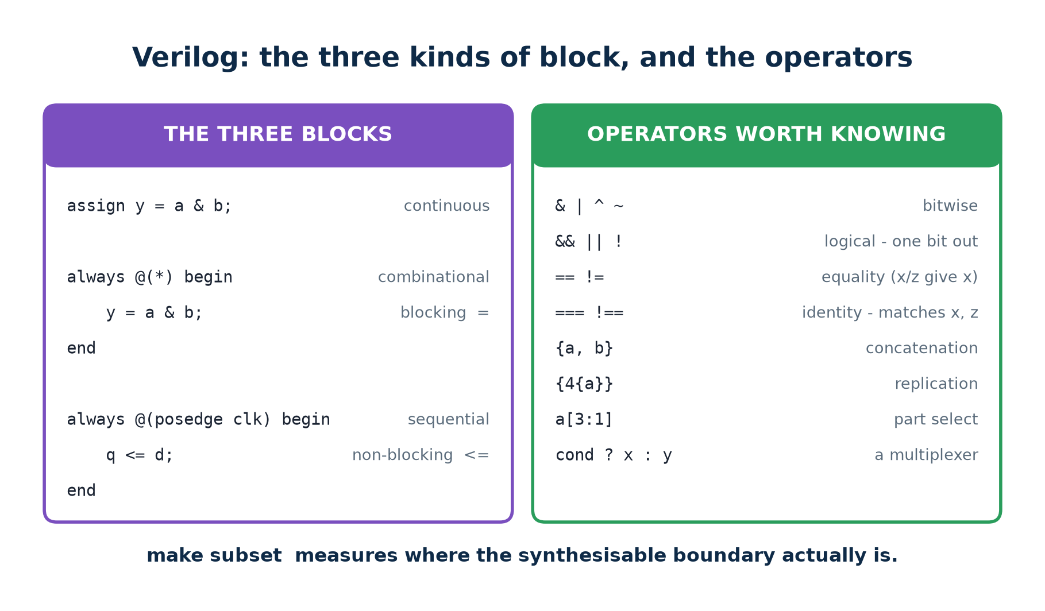
2.6 · REFERENCE
Verilog: Blocks and Operators
Three kinds of block, and the operators you will actually use.
Chip Design Associate · Module 2 · Verilog RTL Coding for Synthesis · Topic 2: RTL Design Methodology
M2-T2 · 36

Slide 37
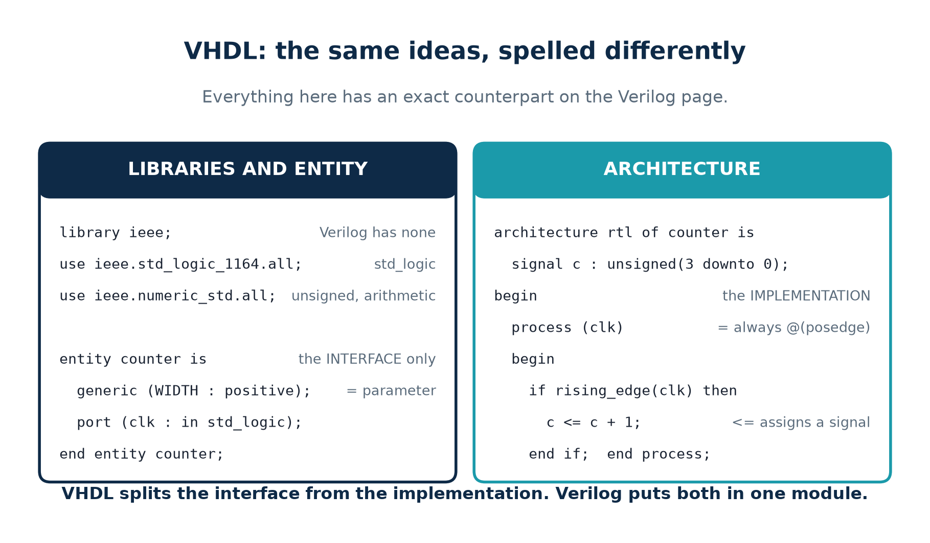
2.6 · REFERENCE
VHDL On One Page
Everything on this page has an exact counterpart on the previous one.
Chip Design Associate · Module 2 · Verilog RTL Coding for Synthesis · Topic 2: RTL Design Methodology
M2-T2 · 37

Slide 38
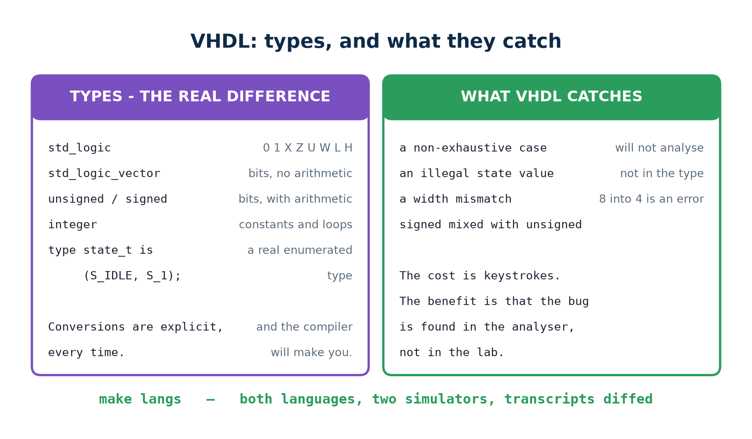
2.6 · REFERENCE
VHDL: Types, and What They Catch
The type system is the real difference between the two languages.
Chip Design Associate · Module 2 · Verilog RTL Coding for Synthesis · Topic 2: RTL Design Methodology
M2-T2 · 38

Slide 39
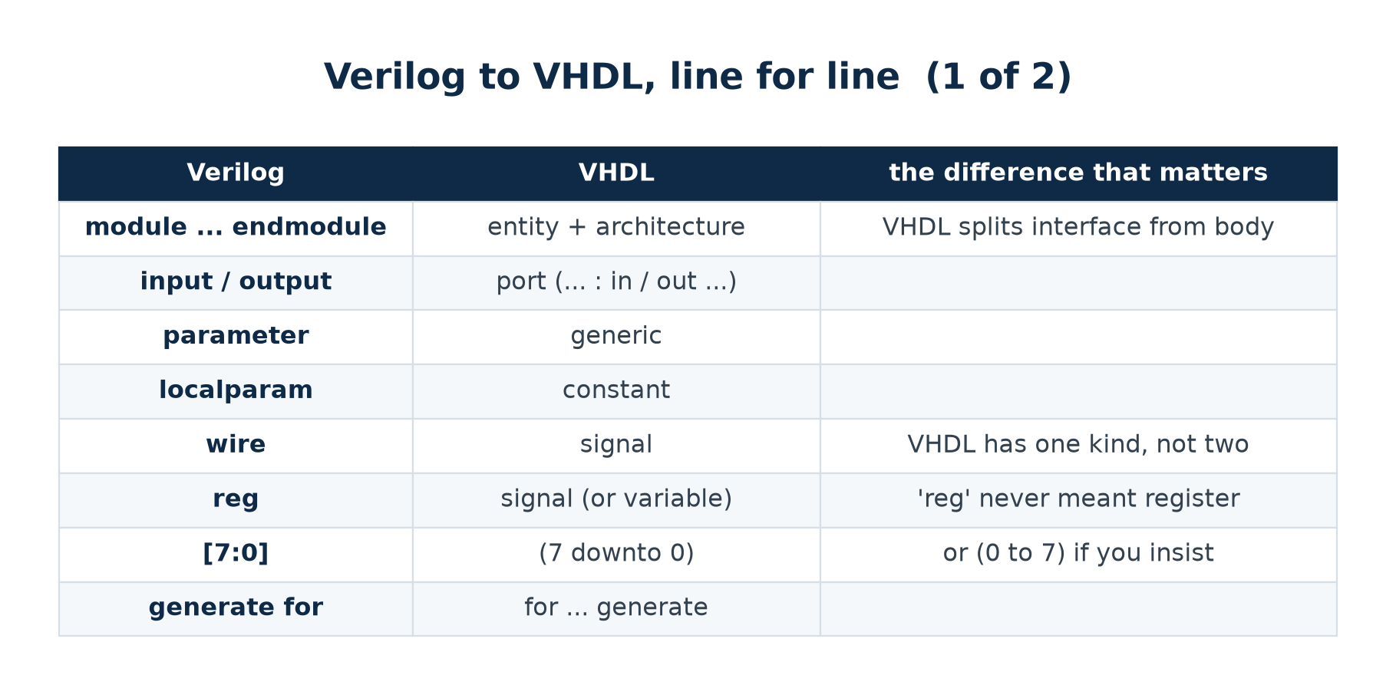
2.6 · REFERENCE
Verilog to VHDL, Line For Line (1 of 2)
Learn one and you can read the other in an afternoon. These two tables are the afternoon.
Chip Design Associate · Module 2 · Verilog RTL Coding for Synthesis · Topic 2: RTL Design Methodology
M2-T2 · 39

Slide 40
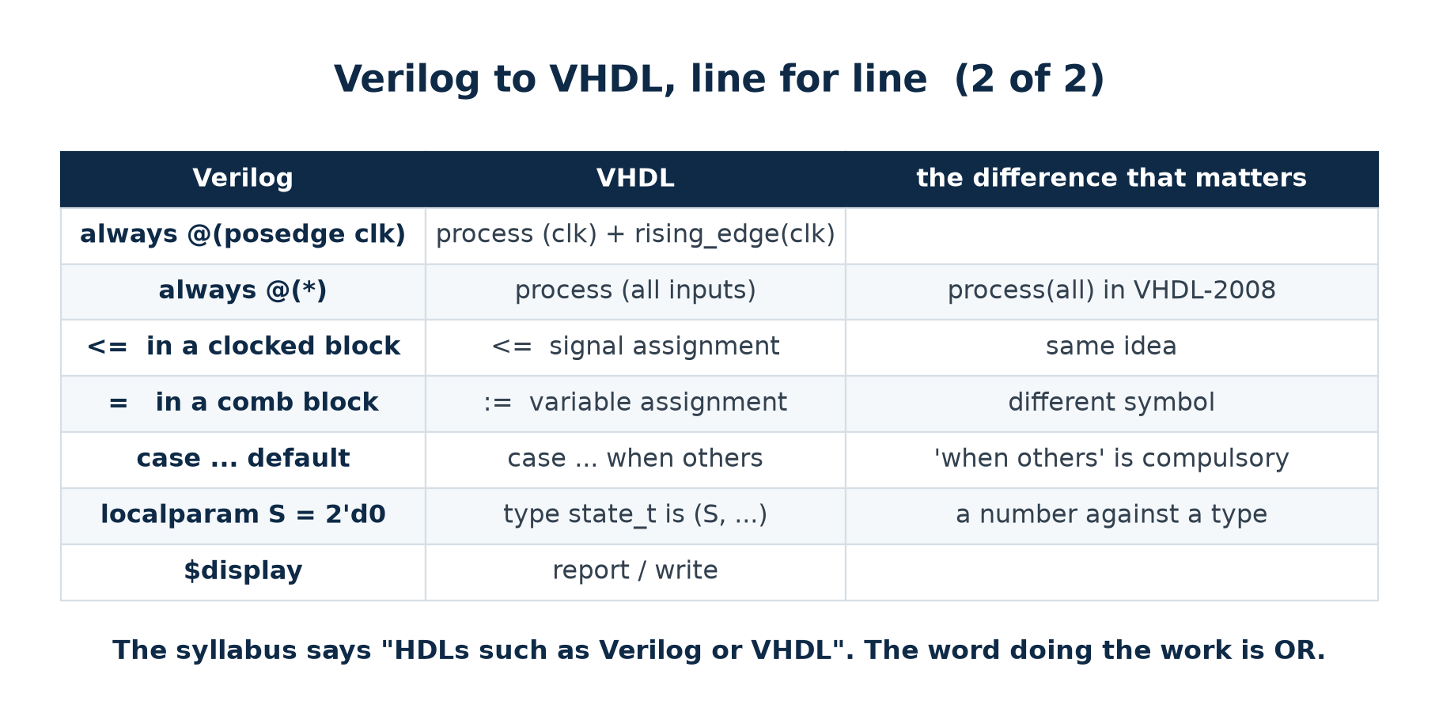
2.6 · REFERENCE
Verilog to VHDL, Line For Line (2 of 2)
Nothing in this topic depends on which one you use.
Chip Design Associate · Module 2 · Verilog RTL Coding for Synthesis · Topic 2: RTL Design Methodology
M2-T2 · 40

Slide 41
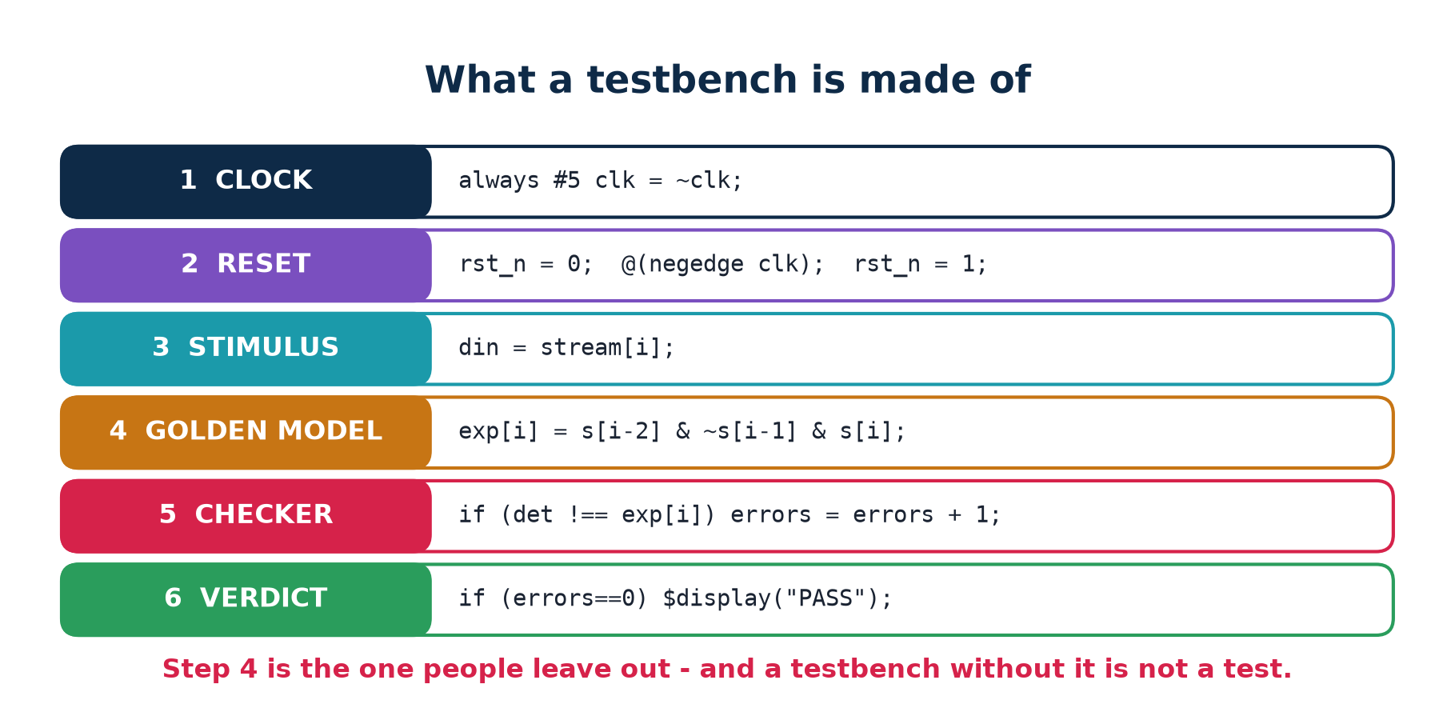
2.6 · REFERENCE
What a Testbench Is Made Of
Topic 5 covers verification properly. These six parts are the minimum you need to finish Topic 2.
Chip Design Associate · Module 2 · Verilog RTL Coding for Synthesis · Topic 2: RTL Design Methodology
M2-T2 · 41

Slide 42
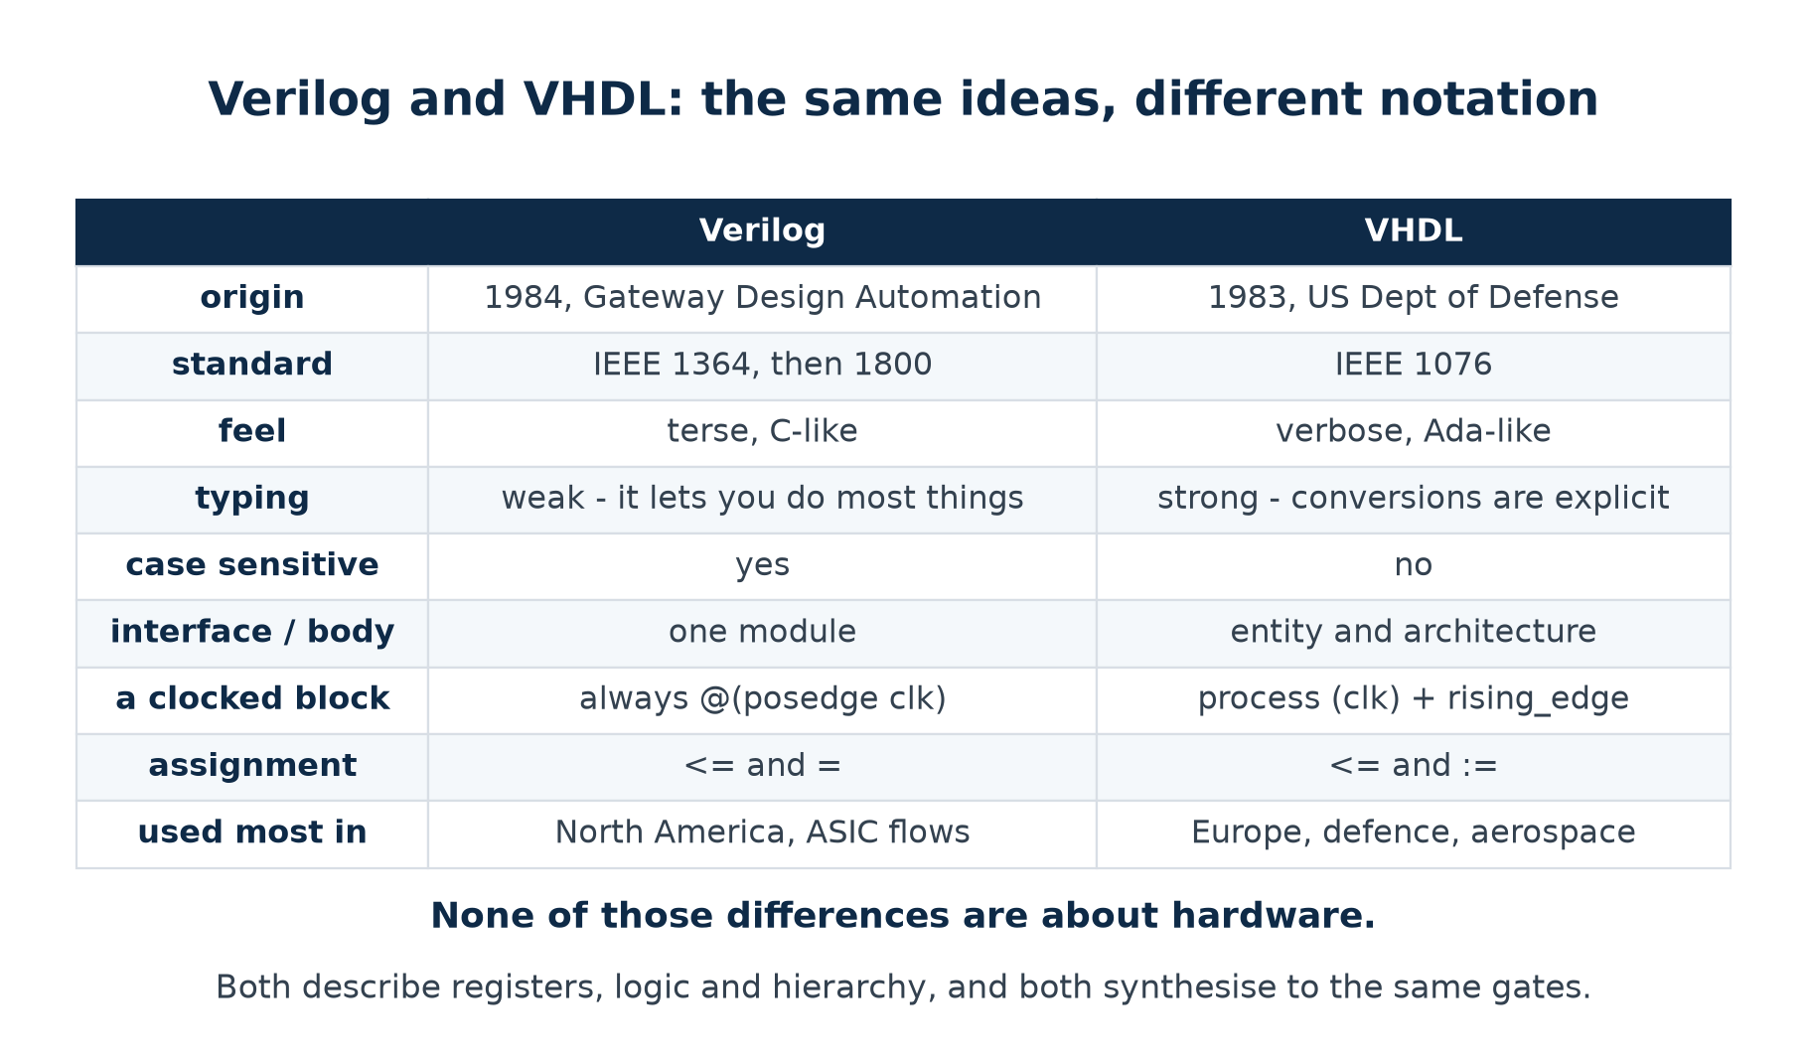
2.7 · TWO LANGUAGES
Verilog and VHDL, Side By Side
None of those differences are about hardware. Both describe registers, logic and hierarchy; both synthesise to the same gates.
Chip Design Associate · Module 2 · Verilog RTL Coding for Synthesis · Topic 2: RTL Design Methodology
M2-T2 · 42

Slide 43
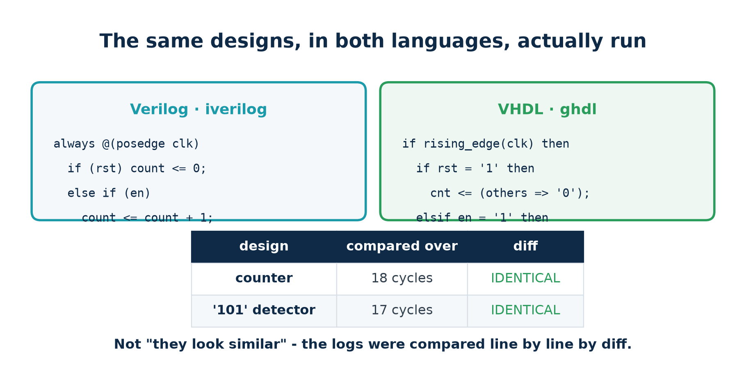
2.7 · TWO LANGUAGES
Both Designs, In Both Languages, Actually Run
Not "they look similar"
Both transcripts were compared line by line by diff, and there was nothing to report. The state machine is the interesting one: VHDL gives the states a real enumerated TYPE, so an illegal state will not compile. Verilog gives them numbers.
Chip Design Associate · Module 2 · Verilog RTL Coding for Synthesis · Topic 2: RTL Design Methodology
M2-T2 · 43

Slide 44
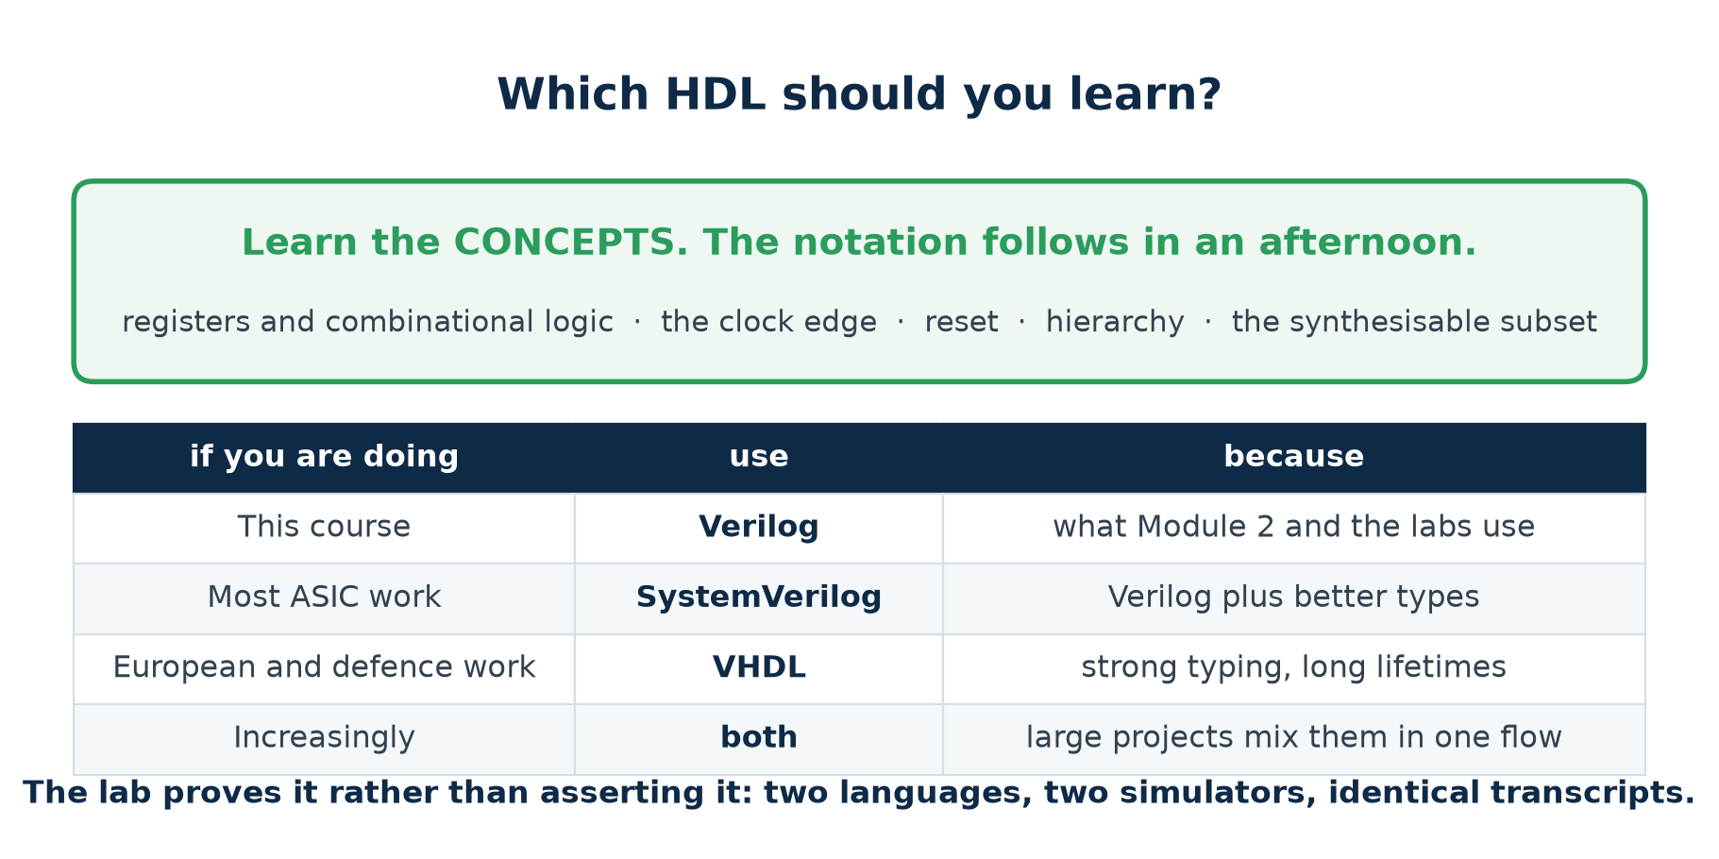
2.8 · WHICH ONE
Which HDL Should You Learn?
Learn the concepts. The notation follows in an afternoon.
Chip Design Associate · Module 2 · Verilog RTL Coding for Synthesis · Topic 2: RTL Design Methodology
M2-T2 · 44

Slide 45
THEORY 2 · CHECKPOINT
Seven Questions
#
Question
The answer in one line
1
Name the biggest difference between an HDL and a program.
everything in an HDL runs all the time, concurrently
2
Does the order of assign statements matter?
no — they describe hardware that exists together
3
What does reg actually mean?
assigned in a procedural block; NOT a flip-flop
4
Why is the evaluation order unspecified?
the standard leaves it free; <= makes it not matter
5
Verilog or VHDL?
either — the concepts are identical, and the lab proves it
6
What does VHDL catch that Verilog does not?
illegal states, non-exhaustive cases, width mismatches
7
Where must a testbench's expected answer come from?
the stimulus — never from the design under test
Chip Design Associate · Module 2 · Verilog RTL Coding for Synthesis · Topic 2: RTL Design Methodology
M2-T2 · 45

Slide 46
THEORY 3
The RTL Design Process and Methodology
You know the hardware and you know the notation. This section is about the process that turns one into the other - and every habit in it is attached to something you can run.
The design flow, and where this topic sits in it
The synthesisable subset — measured, not asserted
The bug that makes simulation and silicon disagree
Seven coding rules, and a tool that checks them
Micro-architecture: the decisions RTL cannot make for you
Chip Design Associate · Module 2 · Verilog RTL Coding for Synthesis · Topic 2: RTL Design Methodology
M2-T2 · 46

Slide 47
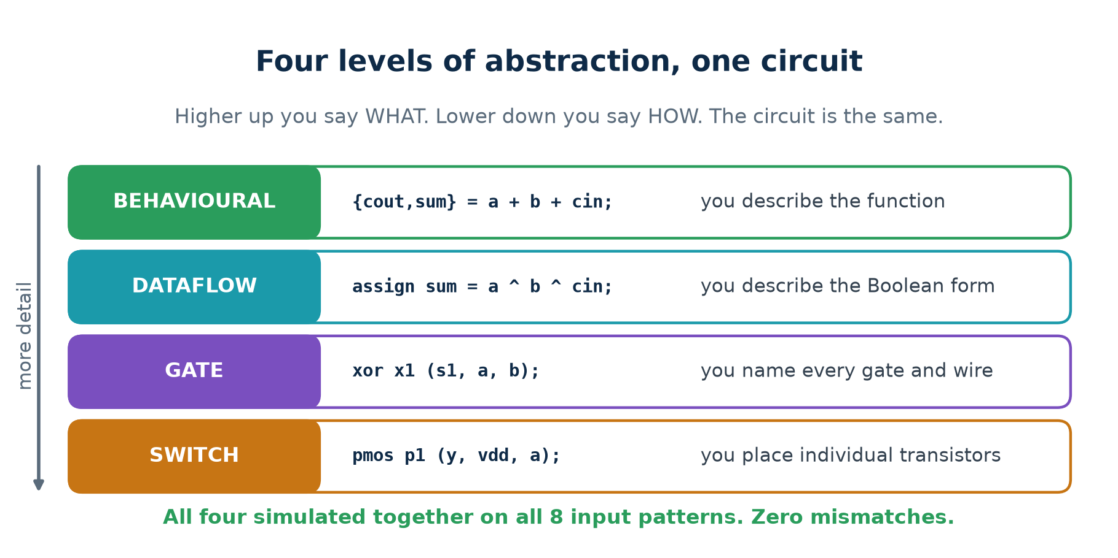
3.1 · THE LADDER, IN CODE
Four Levels, One Circuit
The level of abstraction changes WHAT WAS WRITTEN, not what it does.
Chip Design Associate · Module 2 · Verilog RTL Coding for Synthesis · Topic 2: RTL Design Methodology
M2-T2 · 47

Slide 48
3.1 · THE LADDER, IN CODE
The Same Adder, Written Four Ways
// BEHAVIOURAL - you describe the function
always @* {cout, sum} = a + b + cin;
// DATAFLOW - you describe the Boolean form
assign sum = a ^ b ^ cin;
assign cout = (a & b) | (b & cin) | (a & cin);
// GATE - you name every gate and every wire
xor x1 (s1, a, b); xor x2 (sum, s1, cin);
and a1 (ab, a, b); and a2 (bc, b, cin); and a3 (ac, a, cin);
or o1 (cout, ab, bc, ac);
// SWITCH - you place individual transistors
pmos p1 (y, vdd, a); nmos n1 (y, gnd, a); // one CMOS inverter
Chip Design Associate · Module 2 · Verilog RTL Coding for Synthesis · Topic 2: RTL Design Methodology
M2-T2 · 48

Slide 49
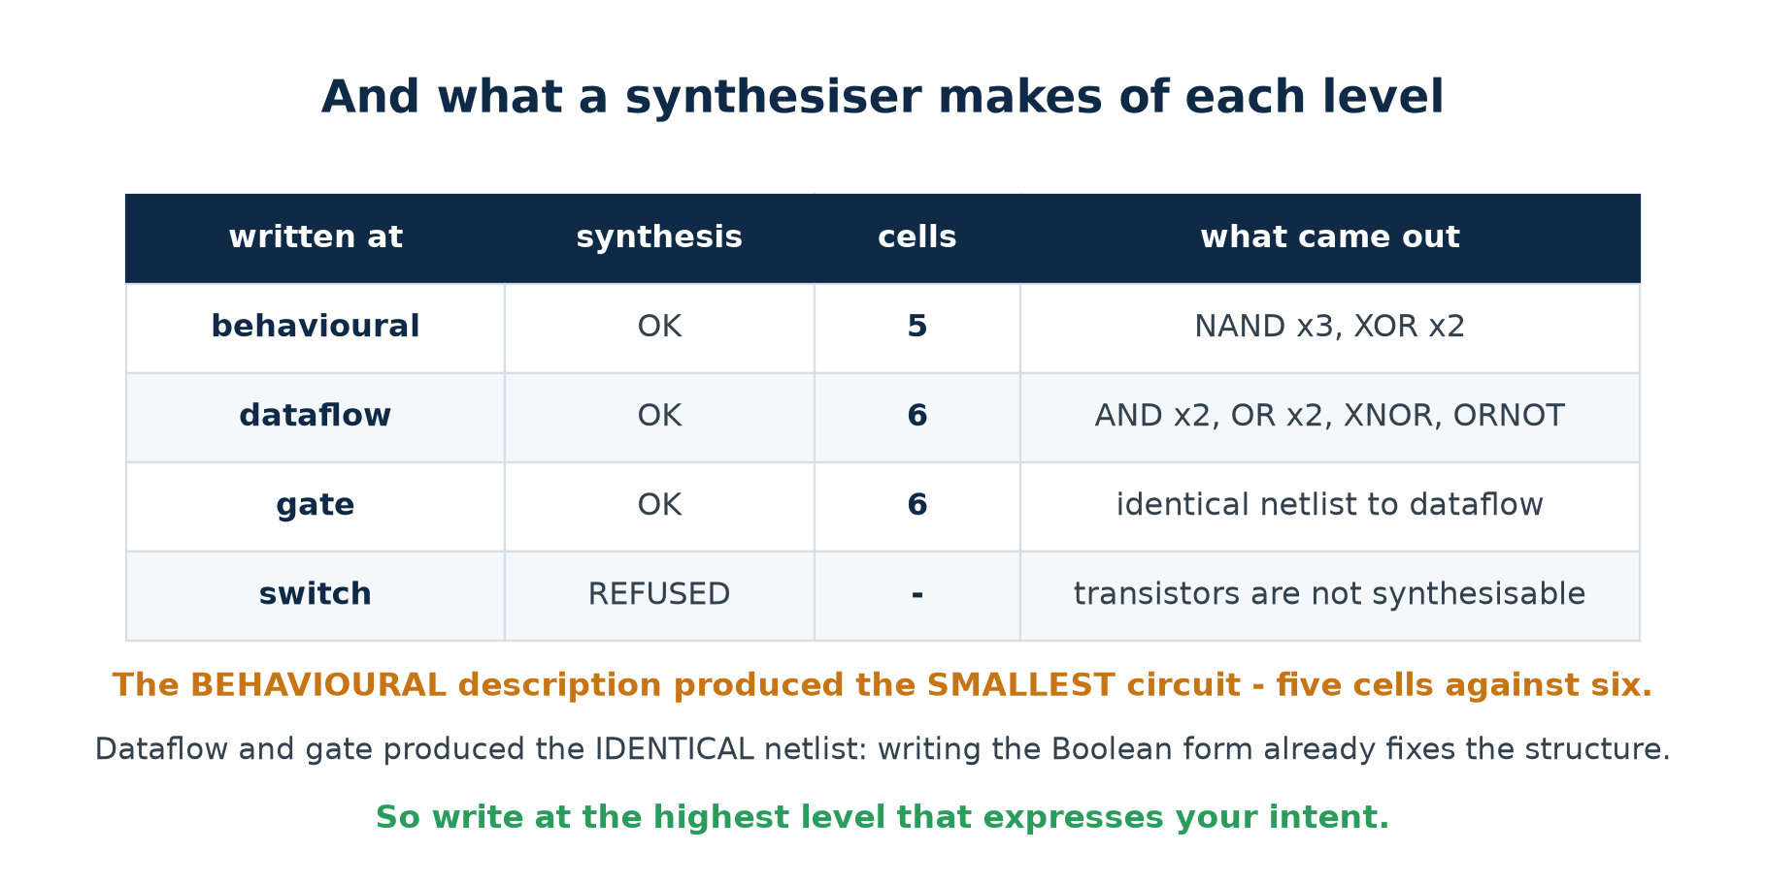
3.1 · THE LADDER, IN CODE
And What a Synthesiser Makes of Each
The behavioural description produced the SMALLEST circuit — and dataflow and gate produced the identical netlist.
Chip Design Associate · Module 2 · Verilog RTL Coding for Synthesis · Topic 2: RTL Design Methodology
M2-T2 · 49

Slide 50
3.1 · THE LADDER, IN CODE
The Rule This Gives You
Write at the highest level that expresses your intent
Every level you descend takes a decision away from the tool and gives it to you — whether or not you wanted it.
What the tool is better at than you
What you are better at than the tool
Choosing a gate mix for a Boolean function.
Balancing a logic tree.
Meeting a timing constraint by restructuring.
Doing all of that again, consistently, at 3 a.m.
How many clock cycles the job should take.
Where the registers go.
What is shared and what is duplicated.
What the interface should look like.
Give the tool the first list. Keep the second one for yourself.
Chip Design Associate · Module 2 · Verilog RTL Coding for Synthesis · Topic 2: RTL Design Methodology
M2-T2 · 50

Slide 51
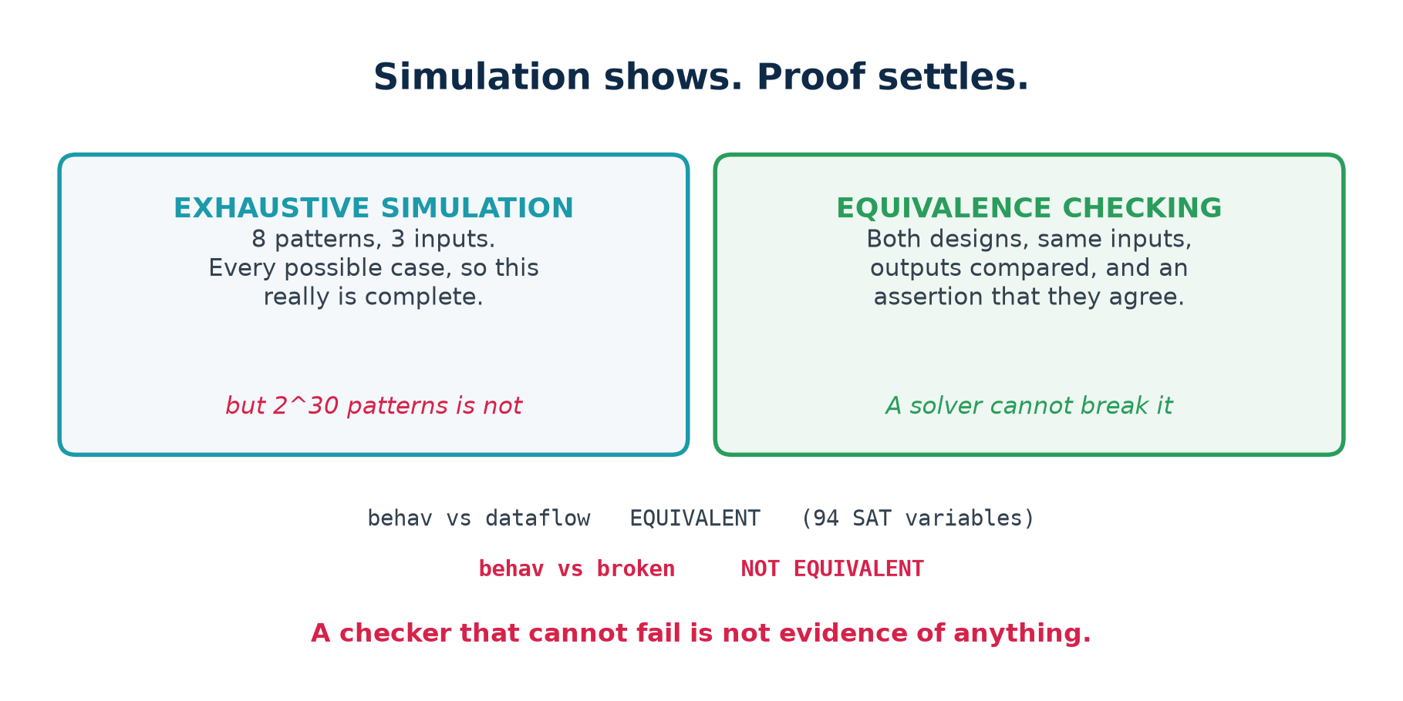
3.2 · PROOF
Simulation Shows. Proof Settles.
A checker that cannot fail is not evidence of anything — which is why the lab includes a deliberately broken adder.
Chip Design Associate · Module 2 · Verilog RTL Coding for Synthesis · Topic 2: RTL Design Methodology
M2-T2 · 51

Slide 52
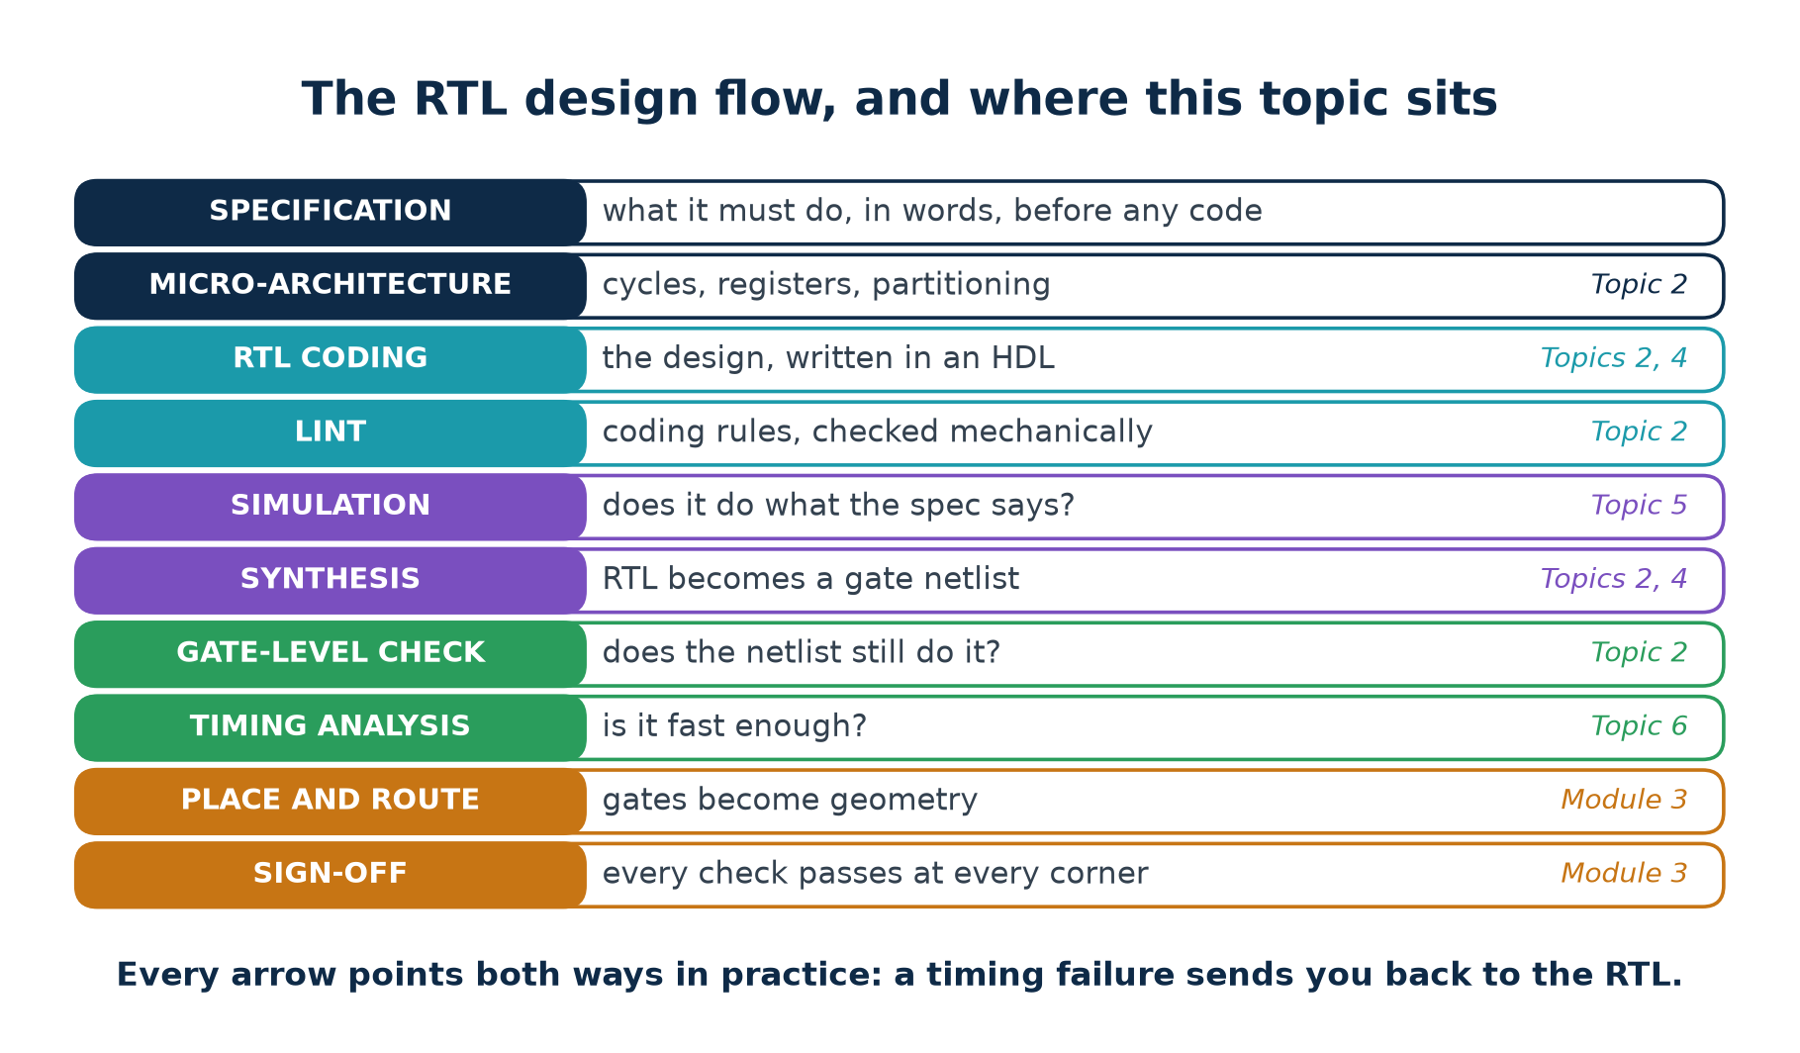
3.3 · THE FLOW
The RTL Design Flow
Every arrow points both ways in practice: a timing failure sends you back to the RTL, a synthesis surprise back to the micro-architecture.
Chip Design Associate · Module 2 · Verilog RTL Coding for Synthesis · Topic 2: RTL Design Methodology
M2-T2 · 52

Slide 53
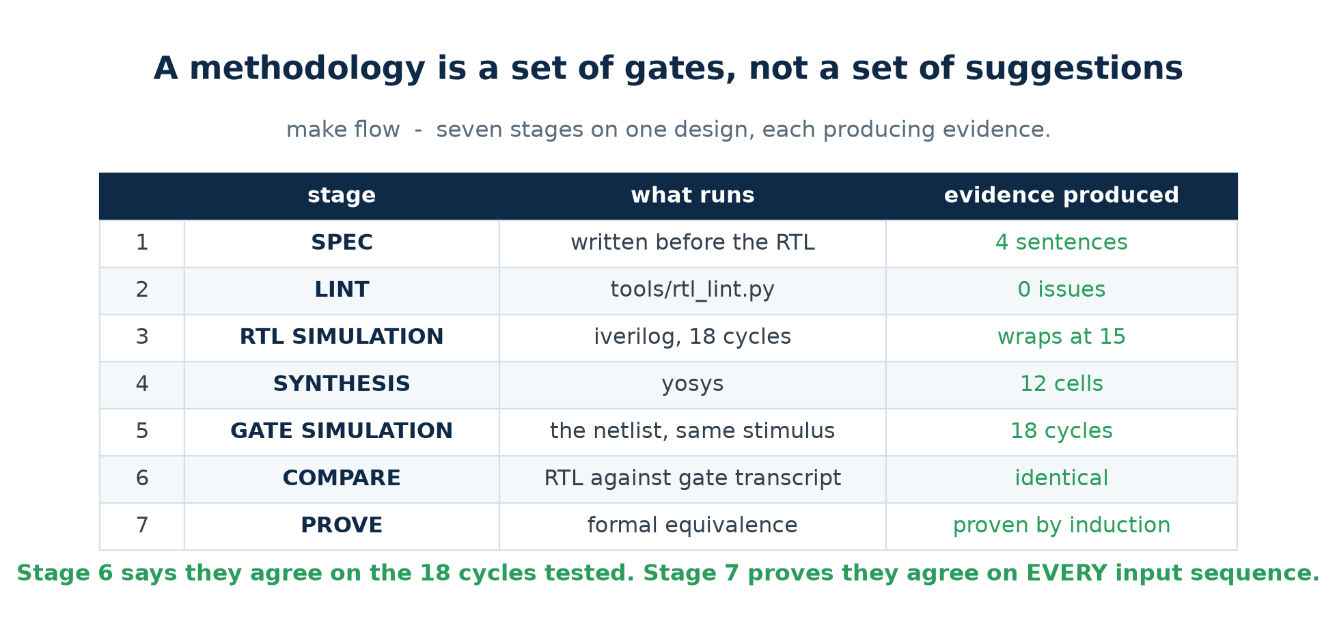
3.3 · THE FLOW
Executed, Not Described
make flow stops at the first stage that fails. That is what makes it a methodology rather than a diagram.
Chip Design Associate · Module 2 · Verilog RTL Coding for Synthesis · Topic 2: RTL Design Methodology
M2-T2 · 53

Slide 54
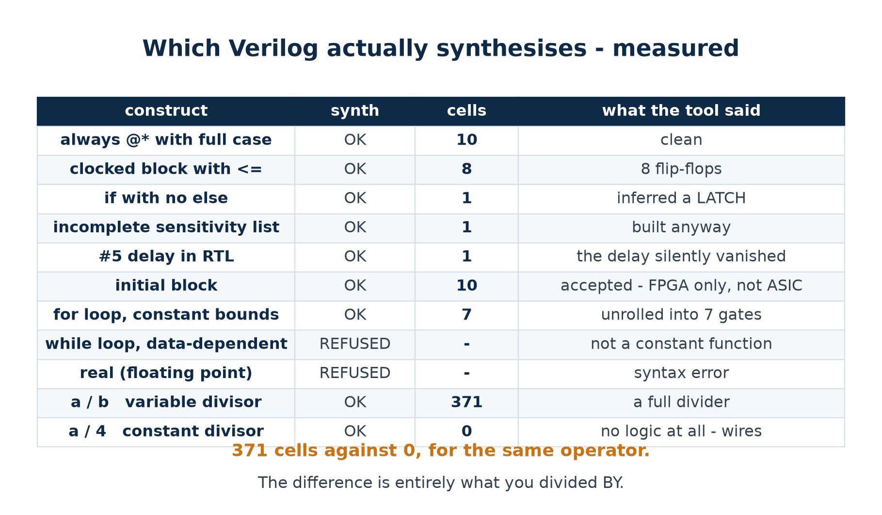
3.4 · THE SUBSET
Which Verilog Actually Synthesises
Eleven constructs, run through a real synthesiser. The table is measured, not remembered.
Chip Design Associate · Module 2 · Verilog RTL Coding for Synthesis · Topic 2: RTL Design Methodology
M2-T2 · 54

Slide 55
3.4 · THE SUBSET
Three Rows Worth Discussing
371 cells against 0
#5 vanished silently
initial was accepted
a / b where b is a signal builds a full combinational divider — 371 cells.
a / 4 builds nothing at all. It is a rename of wires.
Same operator. The difference is entirely what you divided BY.
A delay is a simulation instruction. Silicon has no way to wait five time units.
Synthesis ignored it and built the gate. Your simulation and your chip now behave differently.
Yosys targets FPGAs, where the bitstream really does initialise the flops.
An ASIC flow would not. This is how code that works on an FPGA fails on an ASIC.
The habit this table is for
Before you write a construct you are unsure about, synthesise a ten-line module containing only that construct and read what came out. It takes two minutes and it is the only way to actually know.
Chip Design Associate · Module 2 · Verilog RTL Coding for Synthesis · Topic 2: RTL Design Methodology
M2-T2 · 55

Slide 56
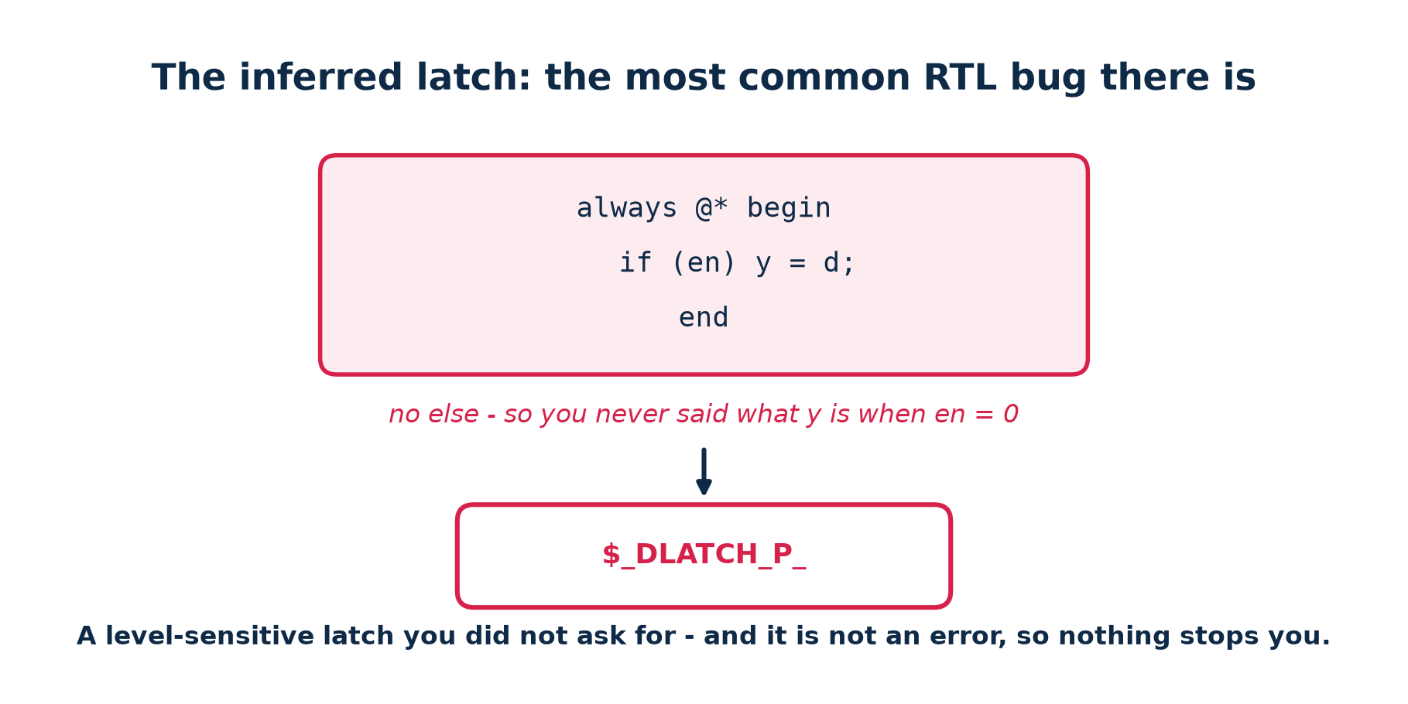
3.5 · THE LATCH
The Most Common RTL Bug There Is
It is not an error. The tool builds it, mentions it in a log nobody reads, and hands you the design.
Chip Design Associate · Module 2 · Verilog RTL Coding for Synthesis · Topic 2: RTL Design Methodology
M2-T2 · 56

Slide 57
3.5 · THE LATCH
Why a Latch In the Middle of Your Logic Hurts
A flip-flop
A latch
captures
on the clock EDGE
while the enable is HIGH
is transparent
never
for the whole enable window
timing analysis
one clean check per edge
time-borrowing; much harder to analyse
in a scan chain
standard
usually needs special handling
you asked for it
yes, by writing posedge
no — you forgot an else
So the rule is mechanical
In a combinational block, assign every output on every path. An if needs an else; a case needs a default. If you would rather not write them out, assign a default value at the top of the block and let later assignments override it.
Rules L005 and L006 of the linter catch this, and make lintcheck confirms the linter agrees with Yosys on every file.
Chip Design Associate · Module 2 · Verilog RTL Coding for Synthesis · Topic 2: RTL Design Methodology
M2-T2 · 57

Slide 58
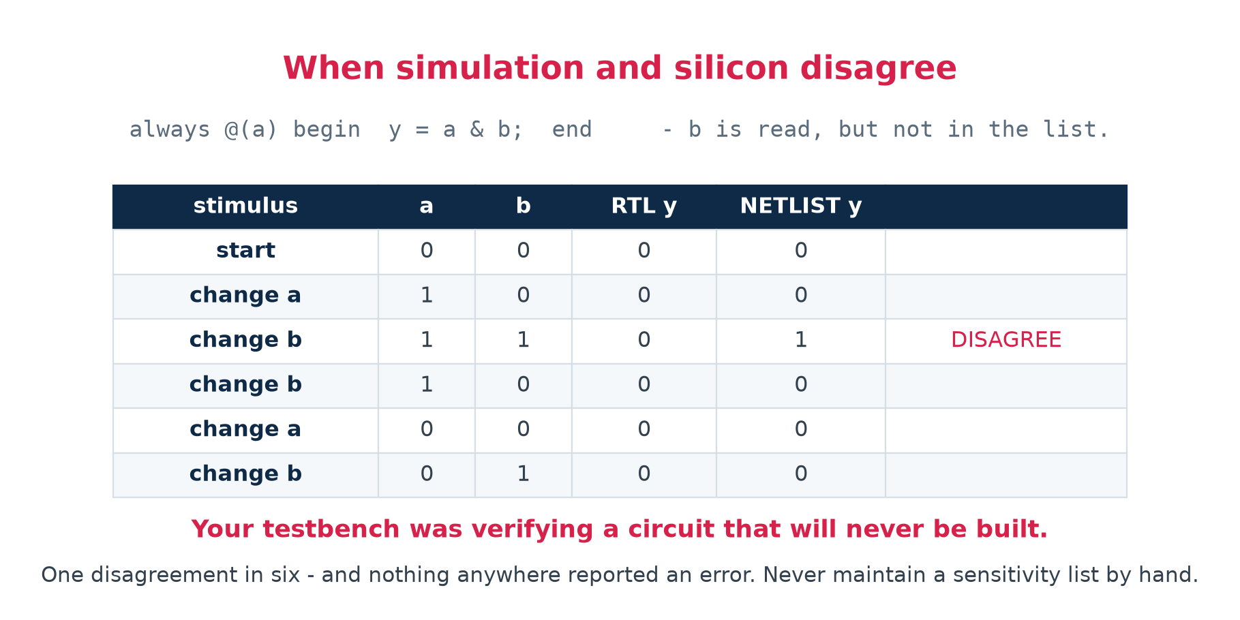
3.6 · THE WORST BUG
When Simulation and Silicon Disagree
One disagreement in six — and nothing anywhere reported an error.
Chip Design Associate · Module 2 · Verilog RTL Coding for Synthesis · Topic 2: RTL Design Methodology
M2-T2 · 58

Slide 59
3.6 · THE WORST BUG
Why This Class of Bug Is Special
Most bugs are found by testing. This one cannot be, because the thing you are testing is not the thing that will be built. Every test you write passes, and the chip still fails.
Cause
What simulation does
What synthesis does
incomplete sensitivity list
the block sleeps; the output goes stale
ignores the list; builds the logic
# delays in RTL
waits the specified time
ignores them entirely
initial block (ASIC)
sets the value at time zero
ignores it; the flop powers up unknown
blocking in a clocked block
result depends on evaluation order
builds one specific circuit
All four have the same cure
Use always @* and never a hand-written sensitivity list. No delays in RTL. A real reset instead of an initial block. Non-blocking in clocked blocks. Then lint for all four, so that nobody has to remember.
Chip Design Associate · Module 2 · Verilog RTL Coding for Synthesis · Topic 2: RTL Design Methodology
M2-T2 · 59

Slide 60
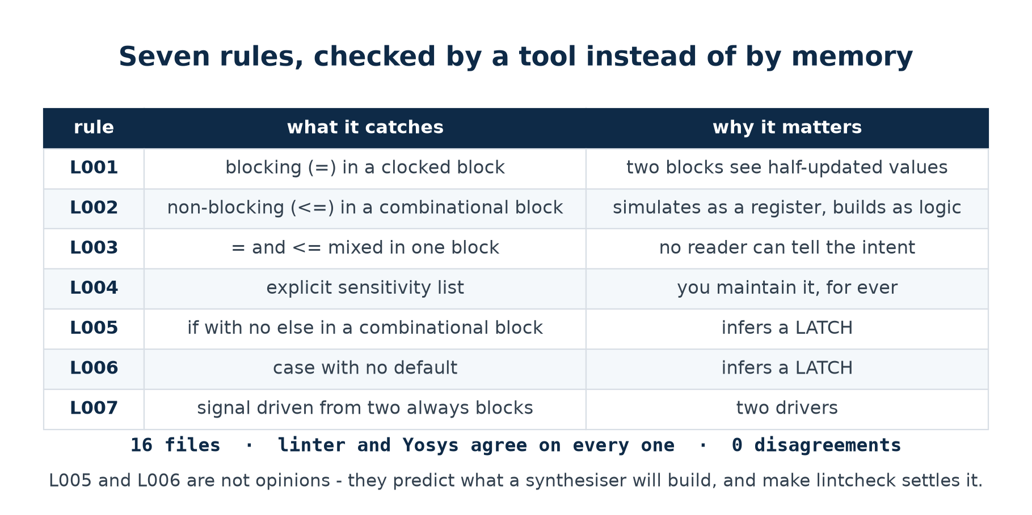
3.7 · THE RULES
Seven Rules, Checked By a Tool
A linter that cries wolf gets switched off. One that stays quiet is worse than none at all.
Chip Design Associate · Module 2 · Verilog RTL Coding for Synthesis · Topic 2: RTL Design Methodology
M2-T2 · 60

Slide 61
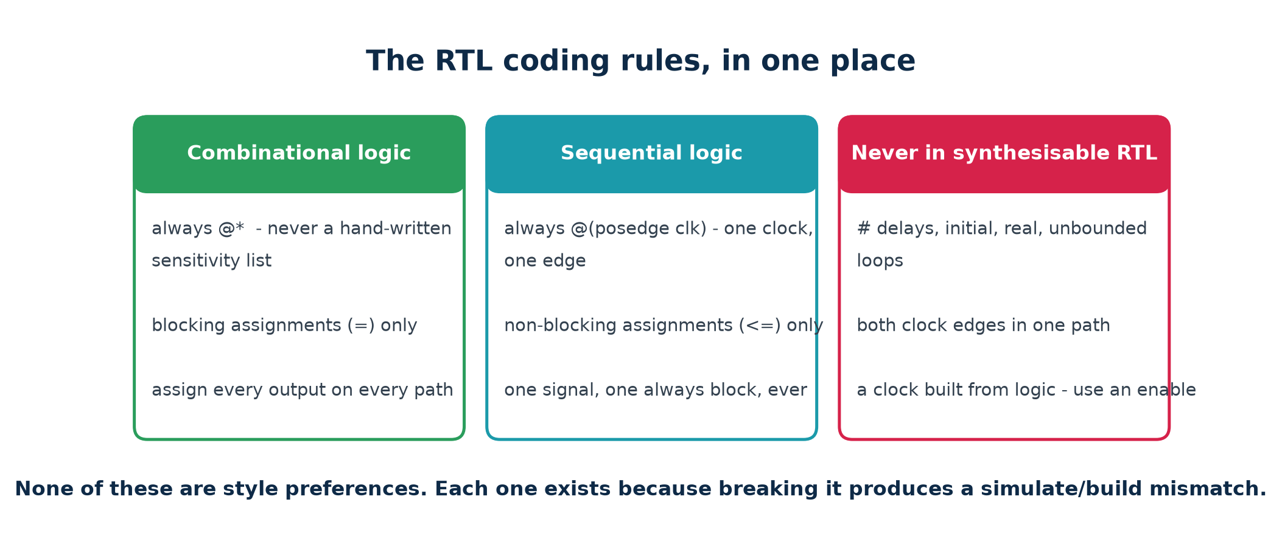
3.7 · THE RULES
The Coding Standard, In One Place
None of these are style preferences. Every one exists because breaking it produces a design that simulates differently from the way it is built.
Chip Design Associate · Module 2 · Verilog RTL Coding for Synthesis · Topic 2: RTL Design Methodology
M2-T2 · 61

Slide 62
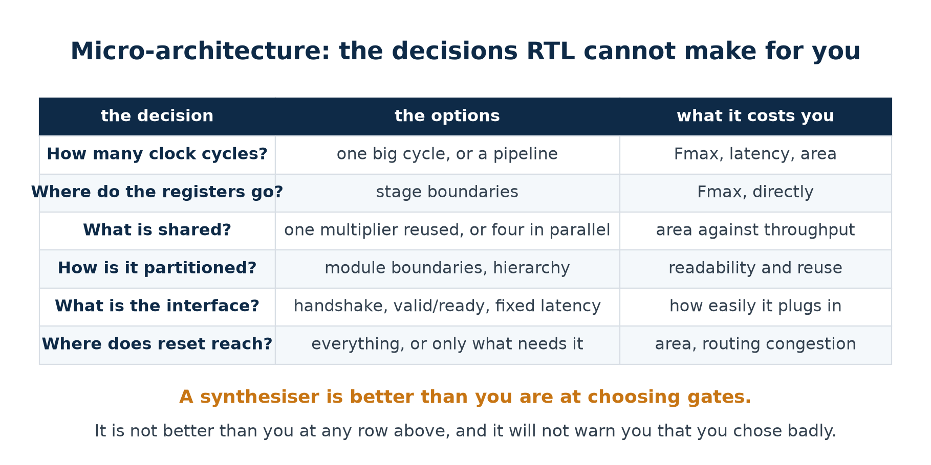
3.8 · MICRO-ARCHITECTURE
The Decisions RTL Cannot Make For You
Make these on paper, before the first line of RTL. A synthesiser will faithfully build whatever you chose.
Chip Design Associate · Module 2 · Verilog RTL Coding for Synthesis · Topic 2: RTL Design Methodology
M2-T2 · 62

Slide 63
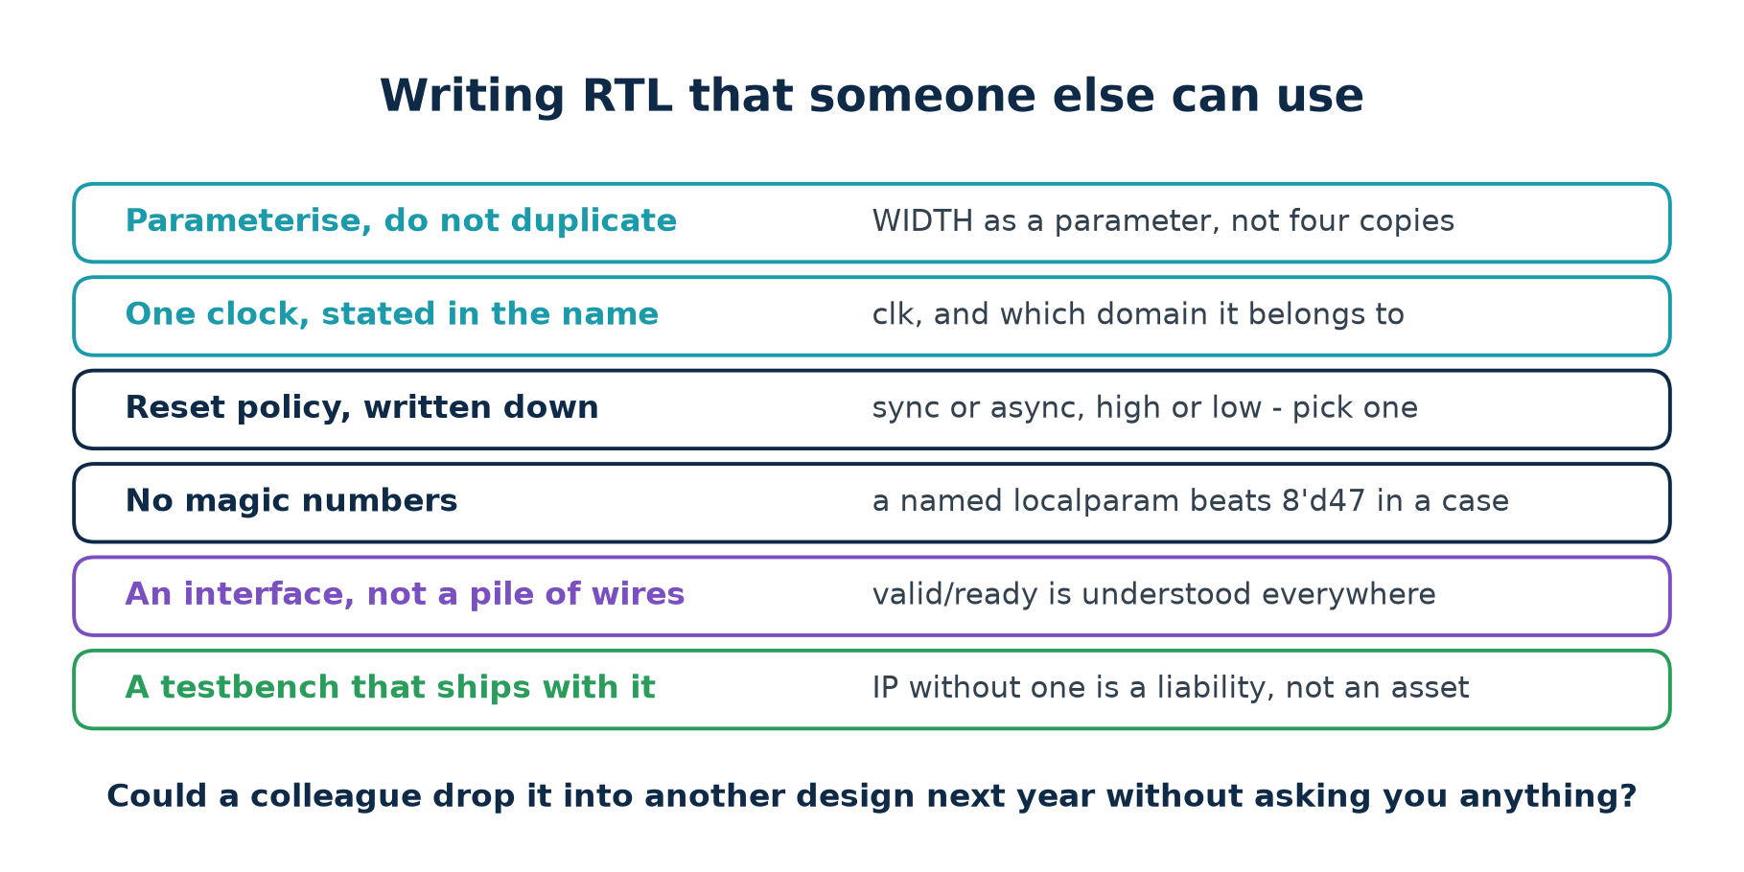
3.9 · REUSE
Writing RTL That Someone Else Can Use
Module 2's fourth terminal outcome asks for this by name
"Emulate, debug and characterise reusable IPs." Reuse is not something you add to a design afterwards — it is a set of decisions you take while writing it, and every one of them is listed above.
Chip Design Associate · Module 2 · Verilog RTL Coding for Synthesis · Topic 2: RTL Design Methodology
M2-T2 · 63

Slide 64
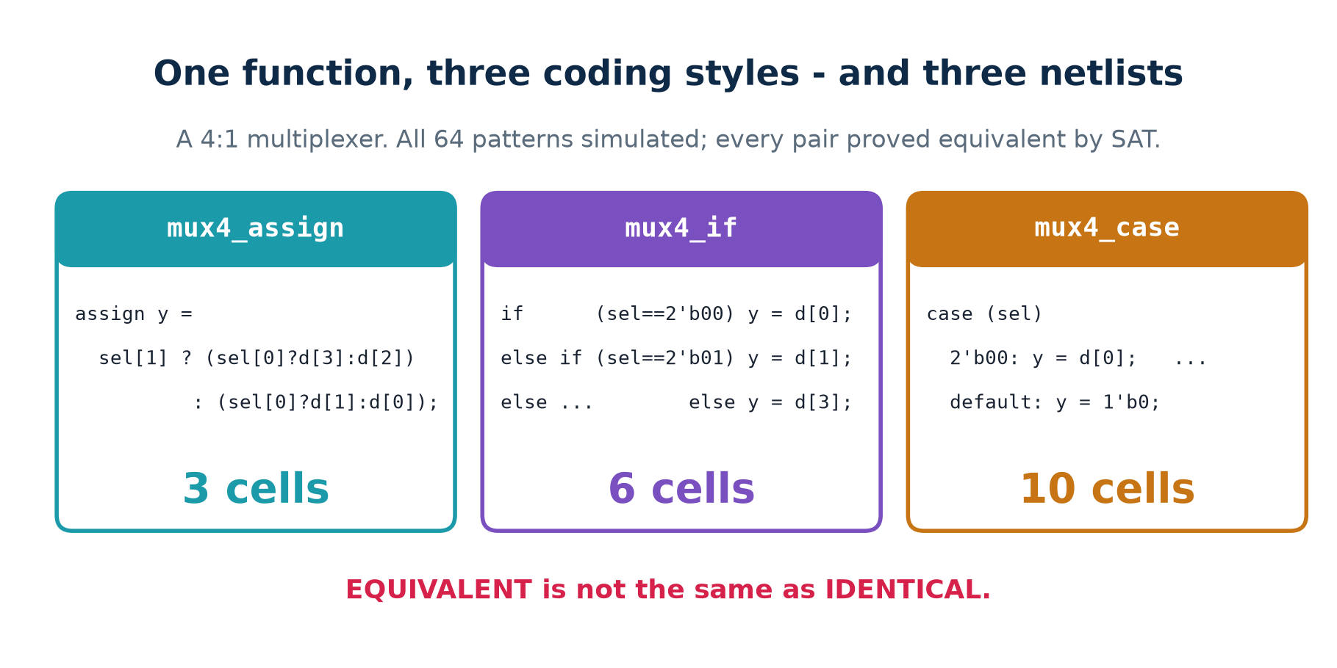
3.10 · STYLE
One Function, Three Coding Styles
Proved equivalent by SAT — and still three different netlists.
Chip Design Associate · Module 2 · Verilog RTL Coding for Synthesis · Topic 2: RTL Design Methodology
M2-T2 · 64

Slide 65
3.10 · STYLE
What To Take From That
EQUIVALENT is not IDENTICAL
MEASURE YOUR OWN TOOL
SO WHICH DO YOU WRITE?
A formal equivalence proof answers exactly one question: do these two descriptions compute the same function?
It says nothing about area, nothing about timing and nothing about power. Those are separate questions with separate tools.
The claim 'the optimiser flattens the difference' is the most repeated statement in RTL teaching, and on this toolchain it is false: 3, 6 and 10 cells.
A different synthesiser may well close the gap. Find out rather than assume.
Whichever reads best to the next person, which is usually the case statement for anything with more than three branches.
Then measure, and only reach for the terse form if the block is actually on a critical path.
Why the three differ at all
The conditional expression hands sel[1] and sel[0] straight to the multiplexer selects. The case and if/else versions ask the tool to build equality comparators against 2'b00, 2'b01 and so on, and then to work out for itself that those comparisons ARE the select bits. It gets part of the way.
Chip Design Associate · Module 2 · Verilog RTL Coding for Synthesis · Topic 2: RTL Design Methodology
M2-T2 · 65

Slide 66
THEORY 3 · CHECKPOINT
Nine Questions
#
Question
The answer in one line
1
Name the first four stages of the flow.
spec, micro-architecture, RTL coding, lint
2
Why lint before simulating?
it costs seconds and catches what tests cannot
3
What builds a latch?
a combinational block that does not assign on every path
4
a / b against a / 4 — what did they cost?
371 cells against 0
5
Why is an incomplete sensitivity list so dangerous?
simulation and synthesis then build different circuits
6
What does # do in synthesisable RTL?
nothing at all — it is silently ignored
7
Name three decisions synthesis will not make for you.
cycle count, register placement, sharing, interface
8
Does formal equivalence say anything about area?
no — equivalent is not the same as identical
9
The three mux styles: how many cells each?
3, 6 and 10 — style did reach the netlist here
Theory 4 is about the patterns every real block is built from.
Chip Design Associate · Module 2 · Verilog RTL Coding for Synthesis · Topic 2: RTL Design Methodology
M2-T2 · 66

Slide 67
THEORY 4
The Patterns Every Block Is Built From
Three structures account for almost all synthesisable RTL. Once you can recognise them, most designs stop looking unfamiliar.
Datapath and controller — the split that organises everything else
The finite state machine, and the three-block way to write one
Moore against Mealy, in structure and in measured timing
State encoding, and what it actually costs
Parameters, hierarchy and generate: from a module to an IP
Chip Design Associate · Module 2 · Verilog RTL Coding for Synthesis · Topic 2: RTL Design Methodology
M2-T2 · 67

Slide 68
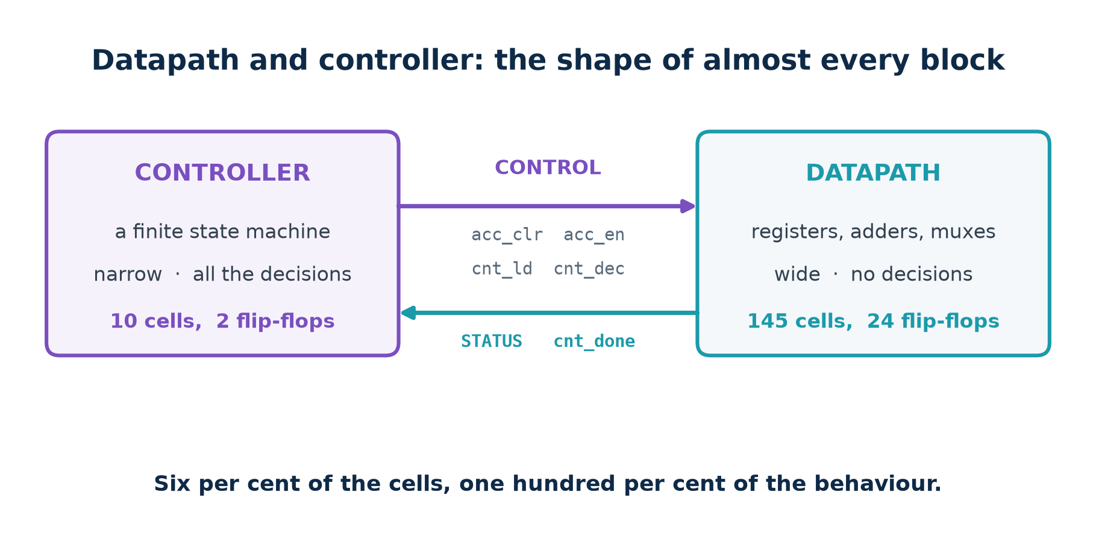
4.1 · THE SPLIT
Datapath and Controller
A UART, a cache, a GPU. Different sizes, the same two halves.
Chip Design Associate · Module 2 · Verilog RTL Coding for Synthesis · Topic 2: RTL Design Methodology
M2-T2 · 68

Slide 69
4.1 · THE SPLIT
The Worked Example: Accumulate N Samples
// the CONTROLLER decides. Narrow. No data passes through it.
always @(*) begin
acc_clr = 0; acc_en = 0; cnt_ld = 0; cnt_dec = 0; done = 0;
case (state)
S_IDLE : if (start) begin acc_clr=1; cnt_ld =1; end
S_RUN : if (!cnt_done) begin acc_en =1; cnt_dec=1; end
S_DONE : done =1;
endcase
end
// the DATAPATH holds and transforms. Wide. It decides nothing.
always @(posedge clk or negedge rst_n)
if (!rst_n) sum <= 0;
else if (acc_clr) sum <= 0;
else if (acc_en) sum <= sum + data;
Read the interface between them
Four control wires down, one status wire up. That is the entire contract. The controller never touches sum; the datapath never looks at state.
Chip Design Associate · Module 2 · Verilog RTL Coding for Synthesis · Topic 2: RTL Design Methodology
M2-T2 · 69

Slide 70
4.1 · THE SPLIT
Measured, On the Accumulator
module
cells
flip-flops
what it contains
accum_ctrl
10
2
three states, five control outputs
accum_datapath
145
24
a 16-bit accumulator, an 8-bit down-counter
accum_top
156
26
both, plus the wires between them
Six per cent of the cells, one hundred per cent of the behaviour
That ratio is the whole argument for the split. You will re-time, widen and pipeline the expensive half many times over the life of a design — and each time, the half that decides what happens stays exactly as it was.
It also means the part that is hardest to get right is the part small enough to read in one sitting.
make dpctrl prints every control signal on every cycle, next to the accumulated sum.
Chip Design Associate · Module 2 · Verilog RTL Coding for Synthesis · Topic 2: RTL Design Methodology
M2-T2 · 70

Slide 71
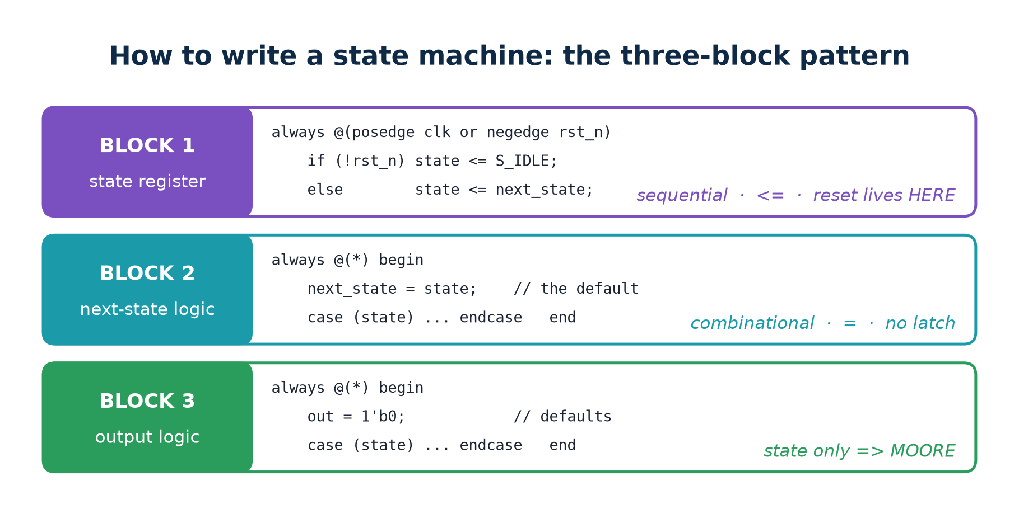
4.2 · THE FSM
The Three-Block Coding Pattern
Every state machine in this lab is written exactly like this. So is most industrial RTL.
Chip Design Associate · Module 2 · Verilog RTL Coding for Synthesis · Topic 2: RTL Design Methodology
M2-T2 · 71

Slide 72
4.2 · THE FSM
Why Not One Block?
You can write a working state machine in a single clocked block, with the case statement inside it. Nothing about it is illegal.
one block
three blocks
works?
yes
yes
where is the reset?
mixed in with the logic
block 1, and nowhere else
where is the clock?
wrapped around everything
block 1, and nowhere else
outputs are
registered, always
your choice — Moore or Mealy
reviewing a change
you re-read the timing every time
blocks 2 and 3 have no timing to re-read
adding a state
one place, easy to miss a branch
two places, both of them a case statement
One block is not wrong. Three blocks are easier to be right in, which over a project is the same thing.
Chip Design Associate · Module 2 · Verilog RTL Coding for Synthesis · Topic 2: RTL Design Methodology
M2-T2 · 72

Slide 73
4.2 · THE FSM
The Default Assignment, and Why It Matters
always @(*) begin
next_state = state; // <-- THE DEFAULT ASSIGNMENT
case (state)
S_MAIN_GREEN : if (car && timeout) next_state = S_MAIN_YELLOW;
S_MAIN_YELLOW : if (timeout) next_state = S_SIDE_GREEN;
...
endcase
end
// Not one of those if statements has an else. Not one of them needs
// one: next_state was already written, unconditionally, on line 2.
// No path through this block leaves it unassigned, so no latch.
This is the idiom the lab linter had to learn
A naive latch rule flags every one of those if statements. Yosys builds a latch in none of them. make lintcheck puts the two opinions side by side on sixteen designs — and a linter that cries wolf gets switched off, which makes it worse than no linter at all.
Chip Design Associate · Module 2 · Verilog RTL Coding for Synthesis · Topic 2: RTL Design Methodology
M2-T2 · 73

Slide 74
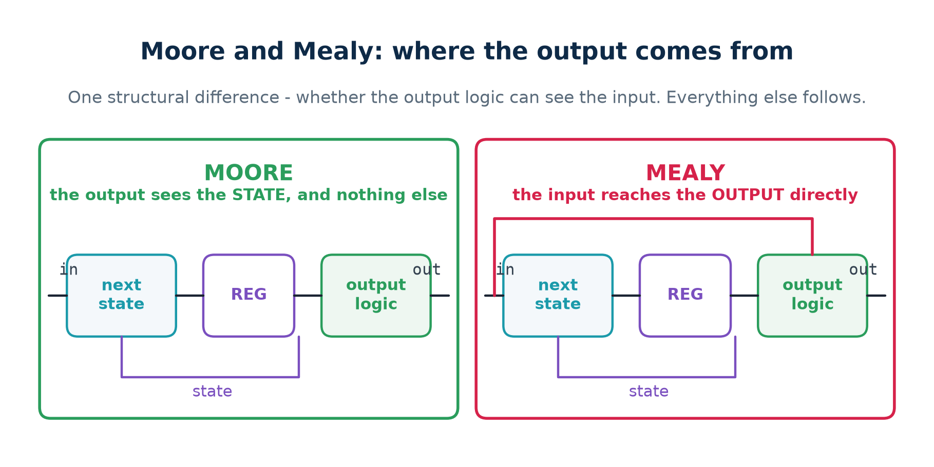
4.3 · MOORE AND MEALY
Where the Output Comes From
One structural difference — whether the output logic can see the input. Everything else follows.
Chip Design Associate · Module 2 · Verilog RTL Coding for Synthesis · Topic 2: RTL Design Methodology
M2-T2 · 74

Slide 75

4.3 · MOORE AND MEALY
The Differences, In One Table
Five rows. The last one is measured, not assumed.
Chip Design Associate · Module 2 · Verilog RTL Coding for Synthesis · Topic 2: RTL Design Methodology
M2-T2 · 75

Slide 76

4.3 · MOORE AND MEALY
The '101' Detector, Moore
Four states. The output is decoded from the state register alone.
Chip Design Associate · Module 2 · Verilog RTL Coding for Synthesis · Topic 2: RTL Design Methodology
M2-T2 · 76

Slide 77

4.3 · MOORE AND MEALY
The Same Detector, Mealy
Three states. The output is written on the arrows, as input / output.
Chip Design Associate · Module 2 · Verilog RTL Coding for Synthesis · Topic 2: RTL Design Methodology
M2-T2 · 77

Slide 78

4.3 · MOORE AND MEALY
The One-Cycle Difference, Measured
Five matches, zero mismatches against a golden model computed from the stream itself.
Chip Design Associate · Module 2 · Verilog RTL Coding for Synthesis · Topic 2: RTL Design Methodology
M2-T2 · 78

Slide 79
4.3 · MOORE AND MEALY
Choosing Between Them
CHOOSE MOORE
when the output leaves the block, drives other logic, or is timing critical. It comes out of a decode of registered bits, so it is clean, predictable and easy to constrain.
CHOOSE MEALY
when the cycle genuinely matters — a handshake that must be answered immediately, or a pipeline where one more cycle of latency costs throughput you cannot spare.
EITHER WAY, REGISTER IT AT THE BOUNDARY
A Mealy output that leaves your block hands the next designer a combinational path they did not ask for. If it crosses a module boundary, put a flip-flop on it — which turns it back into Moore.
The trap in the folklore
"Mealy needs fewer states" is true and almost never the reason to pick it. Here it saved one flip-flop's worth of nothing — both machines needed two — and cost one cell more. The real trade is the cycle against the glitch-free output, and that is a system question, not a coding one.
Chip Design Associate · Module 2 · Verilog RTL Coding for Synthesis · Topic 2: RTL Design Methodology
M2-T2 · 79

Slide 80

4.4 · ENCODING
The Choice You Make By Typing Numbers
Same behaviour, different hardware — and the direction of the difference is not the one usually quoted.
Chip Design Associate · Module 2 · Verilog RTL Coding for Synthesis · Topic 2: RTL Design Methodology
M2-T2 · 80

Slide 81

4.4 · ENCODING
Which Encoding, and When
Three encodings, three different reasons. None of them is a default.
Chip Design Associate · Module 2 · Verilog RTL Coding for Synthesis · Topic 2: RTL Design Methodology
M2-T2 · 81

Slide 82

4.5 · A CONTROLLER WITH A TIMER
The Traffic Light
Two safety properties, checked on every one of forty cycles. Zero violations.
Chip Design Associate · Module 2 · Verilog RTL Coding for Synthesis · Topic 2: RTL Design Methodology
M2-T2 · 82

Slide 83
4.5 · A CONTROLLER WITH A TIMER
Checking a Property Instead of a Waveform
// P1 : the two roads are never green at the same time
if (main_light == GREEN && side_light == GREEN) begin
$display("*** P1 VIOLATED at cycle %0d", cycles);
errors = errors + 1;
end
// P2 : a green never goes straight to red - yellow comes first
if (prev_main == GREEN && main_light == RED) begin
$display("*** P2 VIOLATED at cycle %0d", cycles);
errors = errors + 1;
end
You write the rule once; the simulator tests it every cycle of every run
This is the cheap half of formal verification, available in any simulator, in about ten lines. It scales to runs far longer than anyone would page through by hand, and it keeps working after you change the design.
The expensive half — proving the property holds for every possible input — is what make prove does with a SAT solver.
Chip Design Associate · Module 2 · Verilog RTL Coding for Synthesis · Topic 2: RTL Design Methodology
M2-T2 · 83

Slide 84

4.6 · FROM MODULE TO IP
Parameters, Hierarchy and Generate
Eight flip-flops per stage, exactly N stages, measured at four depths.
Chip Design Associate · Module 2 · Verilog RTL Coding for Synthesis · Topic 2: RTL Design Methodology
M2-T2 · 84

Slide 85
4.6 · FROM MODULE TO IP
What Elaboration Actually Does
module delayline #(parameter W = 8, parameter N = 4)
(input clk, rst, en, input [W-1:0] din,
output [W-1:0] dout);
wire [W-1:0] tap [0:N]; // one more element than stages
assign tap[0] = din;
genvar k;
generate
for (k = 0; k < N; k = k + 1) begin : stage
preg #(.W(W)) u_reg (.clk(clk), .rst(rst), .en(en),
.d(tap[k]), .q(tap[k+1]));
end
endgenerate
assign dout = tap[N];
endmodule
The for loop is an instruction to the ELABORATOR, not a loop in hardware. After elaboration there are N preg instances and no loop anywhere.
Chip Design Associate · Module 2 · Verilog RTL Coding for Synthesis · Topic 2: RTL Design Methodology
M2-T2 · 85

Slide 86
THEORY 4 · CHECKPOINT
Eight Questions
#
Question
The answer in one line
1
What are the two halves of almost every block?
a datapath that holds, a controller that decides
2
What crosses between them?
control signals down, status signals up
3
Name the three blocks of an FSM.
state register, next-state logic, output logic
4
Why does a default assignment prevent a latch?
every output is written before any branch runs
5
What does the output logic read in a Moore machine?
the state, and nothing else
6
How much later does a Moore output appear?
exactly one clock cycle, every time
7
One-hot: fewer or more flip-flops than binary?
more — one per state instead of log2(states)
8
Does a generate loop exist in the netlist?
no — it is elaborated away before synthesis
The practical section is where every number in this deck was produced.
Chip Design Associate · Module 2 · Verilog RTL Coding for Synthesis · Topic 2: RTL Design Methodology
M2-T2 · 86

Slide 87
PRACTICAL
Labs A–N
26 hours, 103 graded exercises, and not one number in this deck that you cannot reproduce yourself.
Which tool answers which question, and how to install them
Labs A–D: what RTL means, the ladder, proof, and the subset
Labs E–H: the mismatch, the coding rules, style, and the two pitfalls
Labs I–L: state machines, a controller with a timer, datapath and controller, and reuse
Labs M–N: two languages, the whole flow, and the vendor tools
Chip Design Associate · Module 2 · Verilog RTL Coding for Synthesis · Topic 2: RTL Design Methodology
M2-T2 · 87

Slide 88

PRACTICAL · TOOLS
The Tools, and What Each One Is For
Yosys is the interesting one: the only free tool here that both synthesises your RTL and PROVES the netlist matches it.
Chip Design Associate · Module 2 · Verilog RTL Coding for Synthesis · Topic 2: RTL Design Methodology
M2-T2 · 88

Slide 89

PRACTICAL · INSTALL
Two apt Lines, and the Whole Lab Runs
No licence, no account, no download manager. Two lines and the whole lab runs.
Chip Design Associate · Module 2 · Verilog RTL Coding for Synthesis · Topic 2: RTL Design Methodology
M2-T2 · 89

Slide 90

PRACTICAL · INSTALL
The Vendor Tools the Syllabus Names
They add a real device library and a flow you will meet at work. They add nothing to the concepts.
Chip Design Associate · Module 2 · Verilog RTL Coding for Synthesis · Topic 2: RTL Design Methodology
M2-T2 · 90

Slide 91

PRACTICAL · THE FLOW
Four Questions About One Piece of Code
Does it follow the rules? Does it do what the spec says? What will be built? Is that still your design?
Chip Design Associate · Module 2 · Verilog RTL Coding for Synthesis · Topic 2: RTL Design Methodology
M2-T2 · 91

Slide 92

PRACTICAL · MAP
Fourteen Parts, Twenty-Six Hours
A–D build the mental model, E–H the methodology, I–L the patterns every block is built from, M–N the connection to other languages and real tools.
Chip Design Associate · Module 2 · Verilog RTL Coding for Synthesis · Topic 2: RTL Design Methodology
M2-T2 · 92

Slide 93
LABS A–C
What RTL Means, the Ladder, and Proof
A · what RTL means (1 h)
B · the ladder (2 h)
C · proof (2 h)
Run make transfer. Follow a single 5 through four registers.
Predict the value in each register on each cycle BEFORE running it.
Deliverable: the table, and why y is 1 on cycle 0.
Write the same full adder at all four levels.
Run make ladder — all four together, exhaustively.
Then synthesise each and compare cell counts.
Deliverable: why behavioural won.
Run make prove. Three pairs proved equivalent.
Then break the adder yourself and watch the checker catch it.
Deliverable: why 8 patterns was enough here and will not be next time.
The exercise that teaches the most is C
Delete a different term from fa_broken.v and predict which input pattern the solver will find. Getting that prediction right means you understand both the circuit and the tool.
Chip Design Associate · Module 2 · Verilog RTL Coding for Synthesis · Topic 2: RTL Design Methodology
M2-T2 · 93

Slide 94
LABS D–F
The Subset, the Mismatch, and the Rules
$ make subset
s03_latch OK 1 YES inferred a LATCH: $_DLATCH_P_
s08_whileloop REFUSED - - "only allowed in constant functions"
s10_divide OK 371 no a full combinational divider
s11_shift OK 0 no no logic at all - just wires
$ make mismatch
change b (list ASLEEP) a=1 b=1 RTL y=0 NETLIST y=1 <-- THEY DISAGREE
$ make lintcheck
10 files · linter and Yosys agree on every one · 0 disagreements
Exercise
Task
D.1
Predict the cell count for each construct before running make subset
D.2
Add a twelfth construct of your own and predict the result
E.1
Explain the mismatch to someone who has not seen it, in three sentences
F.1
Add rule L008 to the linter — your choice — and justify it
F.2
Find a file the linter gets wrong, and say why regexes cannot fix it
Chip Design Associate · Module 2 · Verilog RTL Coding for Synthesis · Topic 2: RTL Design Methodology
M2-T2 · 94

Slide 95
LABS G–H
Coding Style, and the Two Pitfalls
$ make mux
mux4_assign vs mux4_case EQUIVALENT (proved, 92 SAT variables)
mux4_assign 3 cells 0 flip-flops
mux4_if 6 cells 0 flip-flops
mux4_case 10 cells 0 flip-flops
$ make pitfalls
non-blocking version : 0 wrong cycles
blocking version : 6 wrong cycles
shift_nb (non-blocking) 3 cells 3 flip-flops
shift_bl (blocking) 1 cells 1 flip-flops
s03_latch (missing else) 1 cells *** 1 LATCH INFERRED ***
Exercise
Task
G.1
Predict the three cell counts before you run make mux
G.2
Write a fourth style of your own and predict where it lands
H.1
Predict q_bl for the first six cycles, then run it
H.2
Explain in two sentences why no tool warned about shift_bl
H.3
Add an else to s03_latch and confirm the latch disappears
Chip Design Associate · Module 2 · Verilog RTL Coding for Synthesis · Topic 2: RTL Design Methodology
M2-T2 · 95

Slide 96
LABS I–K
State Machines, a Timer, and a Datapath
$ make fsm
matches in the stream : 5 mismatches vs golden : 0
PASS - same language, Moore trails Mealy by one cycle,
and the one-hot encoding is indistinguishable
seq101_moore binary 13 cells 2 flip-flops
seq101_moore one-hot 30 cells 4 flip-flops
cycles checked : 40 property violations : 0 (traffic light)
$ make dpctrl
golden total : 157 hardware sum : 157
accum_ctrl (controller) 10 cells 2 flip-flops
accum_datapath (datapath) 145 cells 24 flip-flops
Exercise
Task
I.1
Draw the state diagram for '110' before you write any code
I.2
Write it in both styles and confirm the one-cycle offset
I.3
Re-encode the Moore machine as gray and measure the cells
J.1
Add a pedestrian request input and a third property to check
K.1
Move the terminal-count test into the controller. What breaks, and why is it worse?
Chip Design Associate · Module 2 · Verilog RTL Coding for Synthesis · Topic 2: RTL Design Methodology
M2-T2 · 96

Slide 97
LAB L
From a Module to an IP
$ make reuse
delayline mismatches : 0 prescaler ratio errors : 0
delayline #(W=8, N) synthesised at four different depths:
N = 1 8 cells 8 flip-flops
N = 2 16 cells 16 flip-flops
N = 4 32 cells 32 flip-flops
N = 8 64 cells 64 flip-flops
Exercise
Task
L.1
Predict the cell count for N = 16 before running it
L.2
Add a bypass parameter that removes the registers entirely when N = 0
L.3
Instantiate counter_n three times to divide by 4096, and check the ratio
L.2 is the one worth arguing about
A generate loop with N = 0 builds nothing, so dout must come straight from din. Getting that right means understanding that the parameter is resolved before any hardware exists — which is the whole point of the lab.
Chip Design Associate · Module 2 · Verilog RTL Coding for Synthesis · Topic 2: RTL Design Methodology
M2-T2 · 97

Slide 98
LABS M–N
Two Languages, the Whole Flow, and the Vendor Tools
$ make langs
=== Verilog: iverilog === === VHDL: ghdl ===
IDENTICAL over all 18 cycles - including the wrap and the terminal count.
IDENTICAL over all 17 cycles, detections included. (the '101' detector)
$ make flow
STAGE 2 LINT 0 issues
STAGE 4 SYNTHESIS 12 cells
STAGE 6 COMPARE IDENTICAL on all 18 cycles
STAGE 7 PROVE Equivalence PROVEN by induction
All seven stages passed.
Lab N: the same design in Vivado
Read the design, synthesise for a real part, report utilisation, write the netlist for gate-level simulation. Vivado is not installed in the environment these materials were built in, so lab N is the one whose output is not reproduced here — run it and record what you get.
Chip Design Associate · Module 2 · Verilog RTL Coding for Synthesis · Topic 2: RTL Design Methodology
M2-T2 · 98

Slide 99

PRACTICAL · VENDOR
The Same Flow in Vivado and ModelSim
Stated plainly on the slide: these commands were not run here. Every number in this deck came from the free toolchain.
Chip Design Associate · Module 2 · Verilog RTL Coding for Synthesis · Topic 2: RTL Design Methodology
M2-T2 · 99

Slide 100

LABS · ASSESSMENT
How the 103 Exercises Are Weighted
Predict, then measure. Being wrong and knowing why is the whole point of a lab.
Chip Design Associate · Module 2 · Verilog RTL Coding for Synthesis · Topic 2: RTL Design Methodology
M2-T2 · 100

Slide 101
PRACTICAL · LIMITS
What This Lab Does Not Show You
▪
rtl_lint.py is regular expressions, not a Verilog parser. It reads code the way a careful reviewer skims it and can be fooled by unusual formatting.
▪
The cell counts come from Yosys' generic library, not a foundry library. They compare designs against each other; they are not area figures.
▪
fa_switch.v is a functional transistor model. There are no threshold voltages and no capacitances — SPICE is the tool for that.
▪
Yosys accepts initial blocks because it targets FPGAs. An ASIC flow would not, and that difference is a genuine trap.
▪
Vivado and ModelSim were not run. Every measured number here came from iverilog, ghdl and yosys, and is reproducible with make.
▪
Nothing here covers verification methodology beyond a directed testbench and a handful of assertions — that is Topic 5, a large subject on its own.
▪
The state machines here are small and single-clock. Clock-domain crossing, reset synchronisers and safe-state recovery are all real, and all later.
Chip Design Associate · Module 2 · Verilog RTL Coding for Synthesis · Topic 2: RTL Design Methodology
M2-T2 · 101

Slide 102
SUMMARY
Topic 2 In Eighteen Lines
▪
A signal is a voltage on a wire, and changing it takes real time.
▪
A register is a door the clock edge opens for an instant; between edges nothing you can see changes.
▪
One clock period = clk-to-Q, then settling, then stable, then setup.
▪
RTL is a RUNG on the abstraction ladder: below the algorithm, above the gate netlist.
▪
RTL says which registers exist and what transfers into them. Nothing else.
▪
There are two kinds of logic, combinational and sequential, and no third.
▪
<= reads every right-hand side first, then updates together. = does not — and the blocking version built 1 flip-flop where 3 were meant.
▪
Four levels of abstraction describe the same circuit — proved, not assumed.
▪
Write at the highest level that says what you mean: behavioural gave 5 cells against 6.
▪
Not all legal Verilog is synthesisable, and a / b cost 371 cells against 0.
▪
A combinational block that does not assign on every path builds a latch; a default assignment at the top of the block prevents it.
▪
An incomplete sensitivity list makes simulation and silicon disagree silently.
▪
Equivalent is not identical: three mux styles, 3, 6 and 10 cells.
▪
Almost every block is a datapath and a controller. Here: 145 cells against 10.
▪
Write state machines in three blocks — register, next state, output.
▪
Moore trails Mealy by exactly one cycle, and one-hot was BIGGER here.
▪
parameter, hierarchy and generate are elaborated away before synthesis.
▪
Verilog and VHDL produced identical transcripts, on both designs.
Chip Design Associate · Module 2 · Verilog RTL Coding for Synthesis · Topic 2: RTL Design Methodology
M2-T2 · 102

Slide 103

CLOSE
What To Do Next
Coming next in Module 2
Topic 3 covers the digital logic this all rests on. Topic 4 writes much more RTL. Topic 5 is verification — how you know it works. Topic 6 is timing — whether it is fast enough.
Chip Design Associate · Module 2 · Verilog RTL Coding for Synthesis · Topic 2: RTL Design Methodology
M2-T2 · 103

