Slide 1
MODULE 3 · TOPIC 1
Overview of VLSI STA
Introduction to timing analysis · Combinational circuit timing: races and hazards · Sequential circuit timing: setup and hold · Maximum frequency of operation · Timing constraints for synthesis
Theory 1 · What timing analysis is, and what a truth table cannot tell you
Theory 2 · Races and hazards — the new material, and most of the session
Theory 3 · Setup, hold, maximum frequency, and real violations
Theory 4 · Timing constraints for synthesis, and what synthesis does back
Practical · Labs A–G · 12 hours · 58 exercises · Vivado on Zynq-7000
Chip Design Associate · Module 3 · Static Timing Analysis of VLSI Circuits · Topic 1: Overview of VLSI STA
M3-T1 · 1

Slide 2
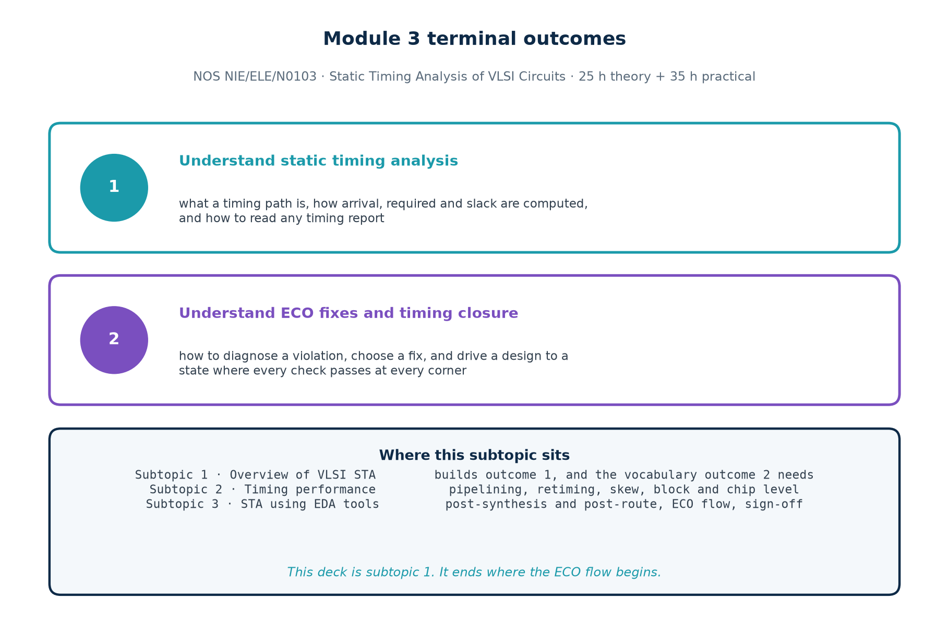
MODULE 3 · NOS NIE/ELE/N0103
Terminal Outcomes
This subtopic is the foundation for both of them
Outcome 1 is built here and completed in subtopic 3. Outcome 2 needs the vocabulary and the diagnostic habits this subtopic establishes — you cannot write an ECO for a violation you cannot classify.
Chip Design Associate · Module 3 · Static Timing Analysis of VLSI Circuits · Topic 1: Overview of VLSI STA
M3-T1 · 2

Slide 3
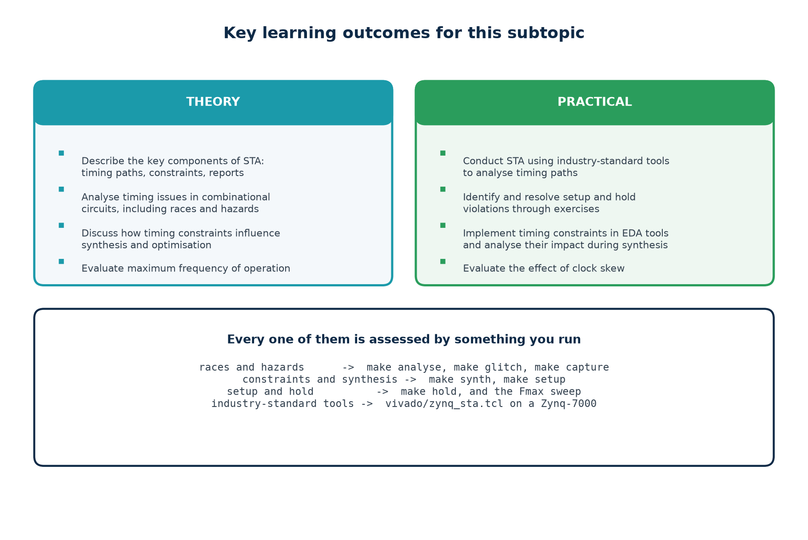
MODULE 3 · TOPIC 1
Key Learning Outcomes
Every outcome on that slide is assessed by something you run, not by something you recite.
Chip Design Associate · Module 3 · Static Timing Analysis of VLSI Circuits · Topic 1: Overview of VLSI STA
M3-T1 · 3

Slide 4
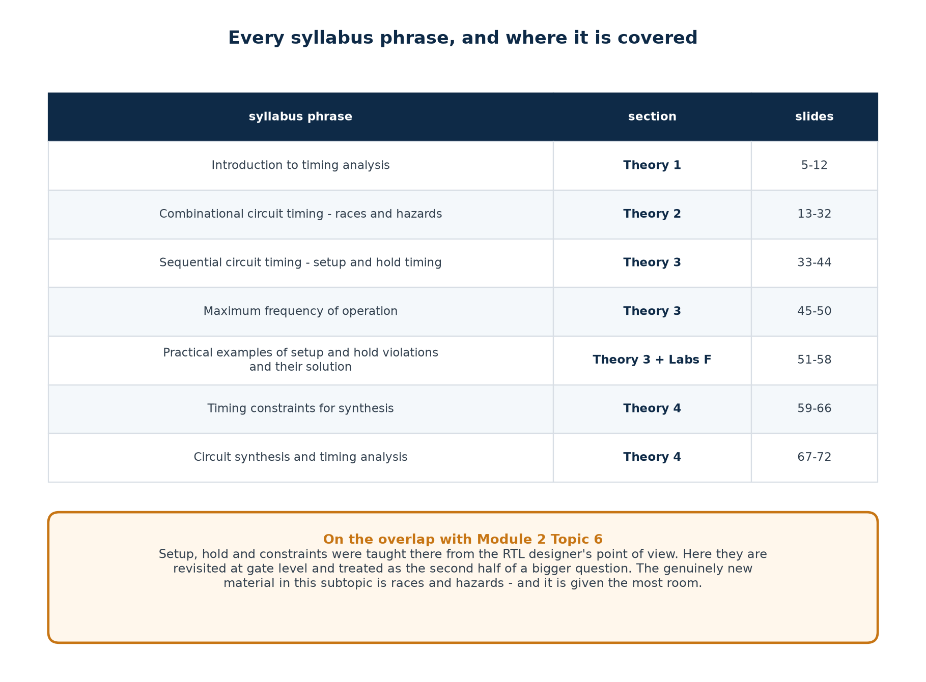
TOPIC 1 · COVERAGE
Every Syllabus Phrase, and Where It Is Covered
The genuinely new material in this subtopic is races and hazards, so it is given the most room.
Chip Design Associate · Module 3 · Static Timing Analysis of VLSI Circuits · Topic 1: Overview of VLSI STA
M3-T1 · 4

Slide 5
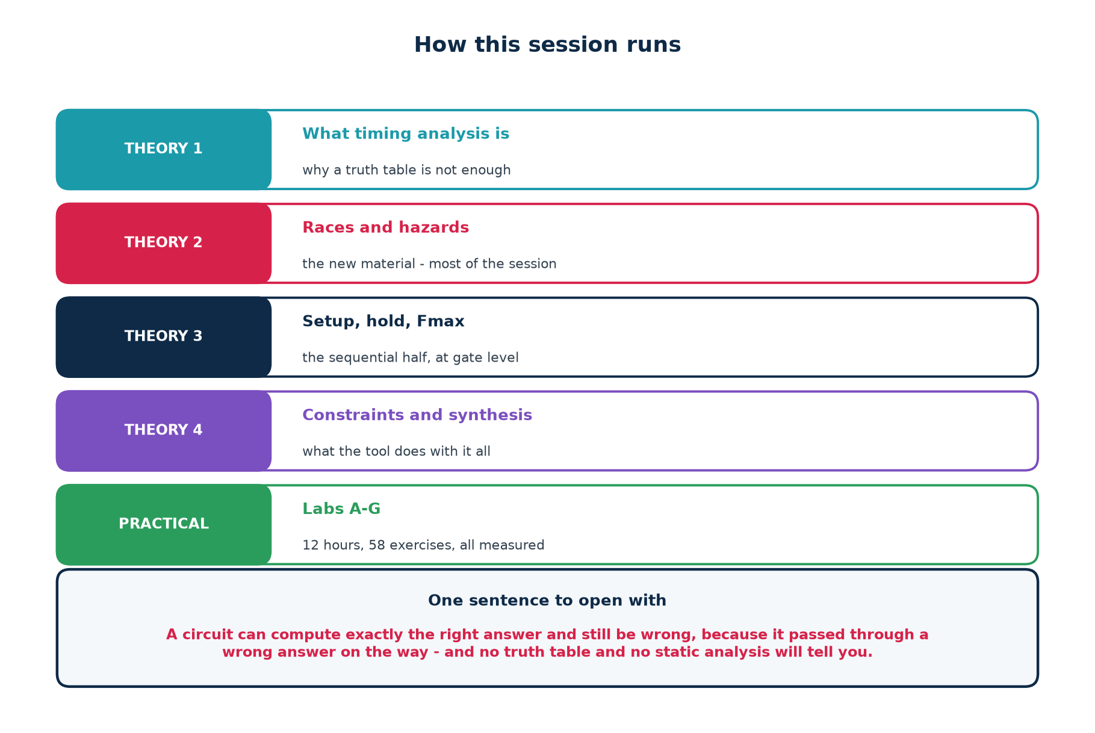
TOPIC 1 · STRUCTURE
How This Session Runs
A note on overlap with Module 2 Topic 6
Setup, hold and constraints were taught there from the RTL designer's point of view. Here they return at gate level, as one half of a larger question — because a circuit can pass every timing check and still misbehave.
Chip Design Associate · Module 3 · Static Timing Analysis of VLSI Circuits · Topic 1: Overview of VLSI STA
M3-T1 · 5

Slide 6
THEORY 1
What Timing Analysis Is
A truth table tells you what a circuit computes. It says nothing at all about when.
Why a correct circuit can still be wrong
The three questions timing asks
Static analysis and dynamic simulation — two different questions
The vocabulary the rest of the session assumes
Chip Design Associate · Module 3 · Static Timing Analysis of VLSI Circuits · Topic 1: Overview of VLSI STA
M3-T1 · 6

Slide 7
1.1 · WHY
A Circuit Can Be Correct and Still Be Wrong
A truth table is a promise about settled values. It says that once everything has stopped moving, the output will be this. It makes no promise whatsoever about the journey — and real gates take real time to make that journey.
What the truth table guarantees
What it does not guarantee
And what neither one checks
Given inputs A, B, C, the output will eventually be F.
Every row, every time.
This is what your RTL simulation checks.
That F goes there directly.
That F does not visit the wrong value first.
That F arrives before the next clock edge.
Whether the value that mattered was sampled at the right instant.
A design can be functionally perfect and electrically unusable.
Two failures that a functional simulation will never show you
1. The output passes through a wrong value on its way to the right one — a HAZARD.
2. The output arrives after the flip-flop needed it — a SETUP VIOLATION.
Both are invisible in a zero-delay simulation, because a zero-delay simulation has no delays to get wrong.
Chip Design Associate · Module 3 · Static Timing Analysis of VLSI Circuits · Topic 1: Overview of VLSI STA
M3-T1 · 7

Slide 8
1.2 · THE QUESTIONS
Timing Analysis Asks Three Things
The question
The failure if the answer is no
Answered by
Did the data arrive before the capturing edge needed it?
setup violation — the chip runs, but slower
static timing analysis
Did the data stay put long enough after that edge?
hold violation — the chip does not work at all
static timing analysis
Did the output pass through a wrong value on the way?
a hazard — a glitch, harmless or fatal depending on where it goes
simulation with delays
The first two are about ONE path. The third is about TWO.
Setup and hold ask how long a path is. A hazard asks what happens when two paths of different length reconverge — so no measurement of any single path can detect one.
That is why this topic needs two different tools on the same circuit, and why a flow with only one of them has a blind spot.
Module 2 Topic 6 answered the first two thoroughly. This topic starts with the third.
Chip Design Associate · Module 3 · Static Timing Analysis of VLSI Circuits · Topic 1: Overview of VLSI STA
M3-T1 · 8

Slide 9
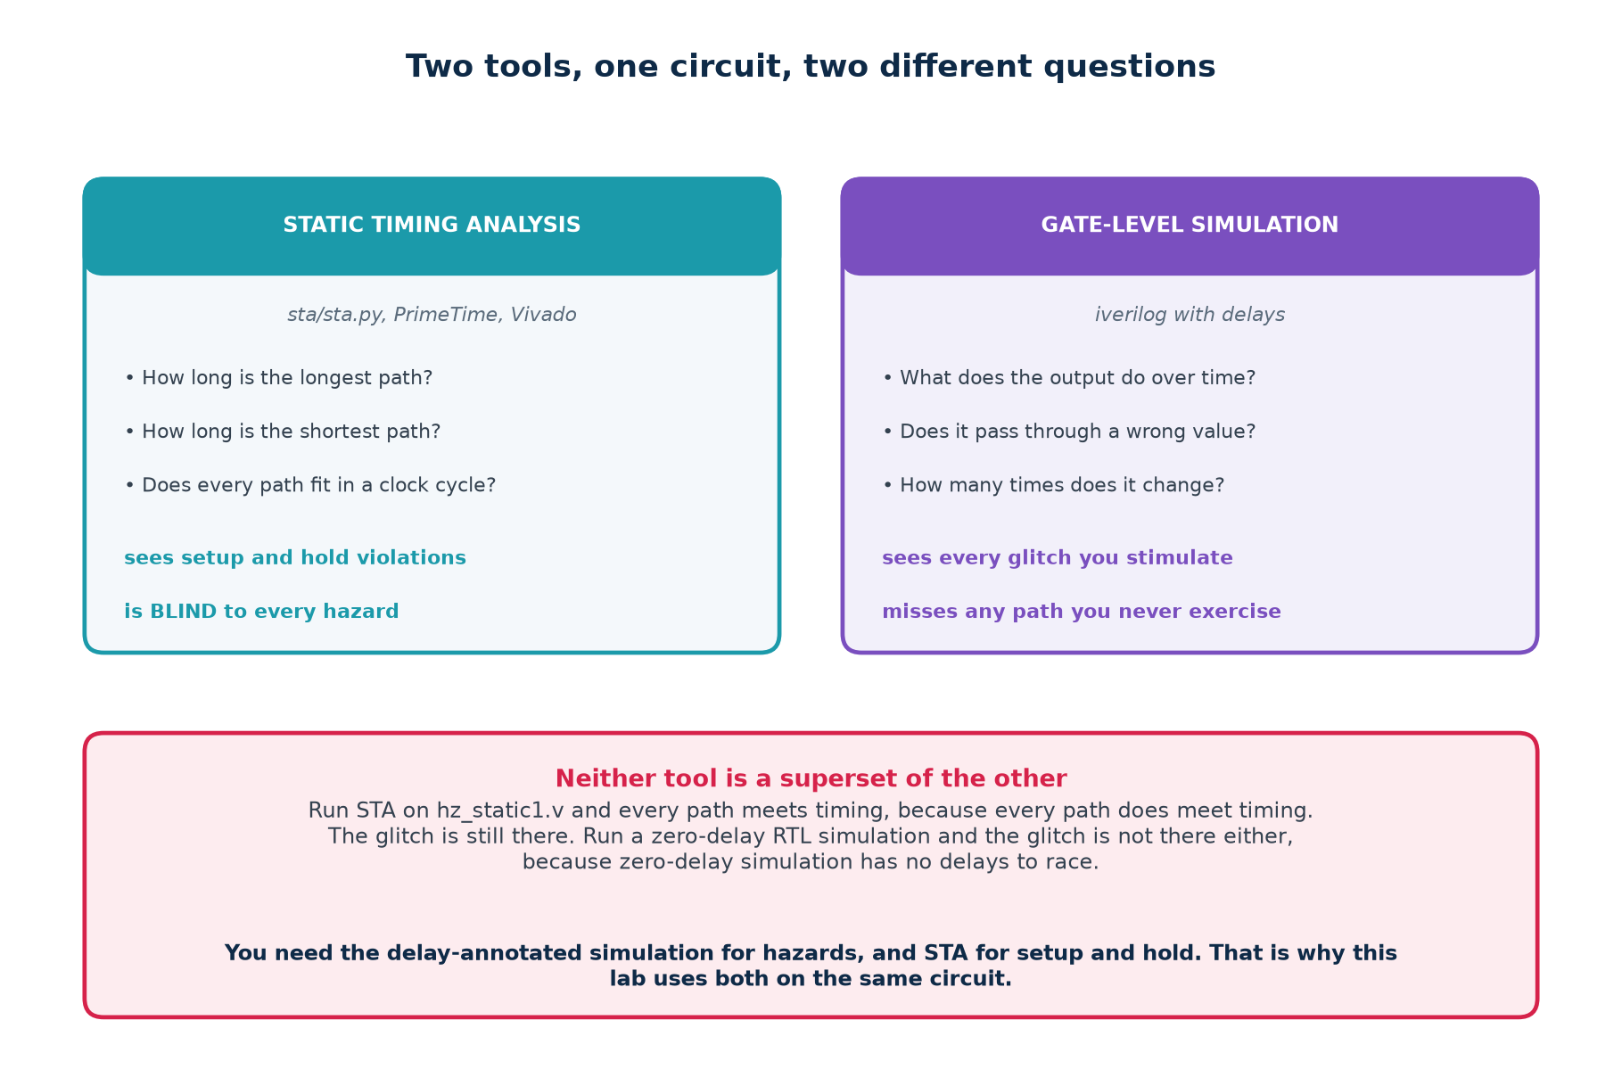
1.3 · TWO TOOLS
Two Tools, One Circuit, Two Different Questions
Run STA on the hazard circuit and every path meets timing, because every path does meet timing. The glitch is still there.
Chip Design Associate · Module 3 · Static Timing Analysis of VLSI Circuits · Topic 1: Overview of VLSI STA
M3-T1 · 9

Slide 10
1.4 · VOCABULARY
The Words the Rest of the Session Assumes
Term
Meaning
combinational logic
output depends only on the present inputs
sequential logic
output depends on the inputs and on stored state
propagation delay
how long a gate takes to react to its input
timing path
a route from a start point to an end point, with a delay
arrival time
when the data actually reaches a pin
required time
when it had to be there for the check to pass
slack
required minus arrival; negative means it does not fit
setup time
how long D must be stable BEFORE the clock edge
hold time
how long D must stay stable AFTER the clock edge
clock skew
the same edge reaching two registers at different instants
glitch
a momentary wrong value on an output
hazard
a circuit's POTENTIAL to glitch, given unlucky delays
race
two signals changing where the order decides the outcome
Chip Design Associate · Module 3 · Static Timing Analysis of VLSI Circuits · Topic 1: Overview of VLSI STA
M3-T1 · 10

Slide 11
1.5 · A DISTINCTION
Hazard and Glitch Are Not the Same Word
HAZARD
GLITCH
A property of the CIRCUIT.
It means: there exists an assignment of gate delays for which this output glitches.
You can find it by inspecting the logic, with no simulation at all — which is what tools/hazard.py does.
It is either there or it is not.
An EVENT in one simulation.
It means: on this run, with these delays, the output actually moved when it should not have.
You can only see it by simulating with delays, and only on the transitions you stimulated.
It may or may not show up.
Why the distinction earns its keep
A circuit with a hazard may run for years without glitching, because the delays happened to fall the right way — until a new process corner, a new temperature, or a re-synthesis changes them. You remove hazards, not glitches.
Chip Design Associate · Module 3 · Static Timing Analysis of VLSI Circuits · Topic 1: Overview of VLSI STA
M3-T1 · 11

Slide 12
THEORY 2
Combinational Circuit Timing: Races and Hazards
The part of this subtopic that Module 2 never covered, and the part that static timing analysis is structurally unable to see.
What a hazard is, and why it is a property of the circuit
Static-1, static-0, dynamic — and the function hazard you cannot fix
Finding them: the adjacency rule, on a K-map and in code
Removing them: the consensus term, and where it stops working
Races, and why synchronous design mostly makes them go away
Chip Design Associate · Module 3 · Static Timing Analysis of VLSI Circuits · Topic 1: Overview of VLSI STA
M3-T1 · 12

Slide 13
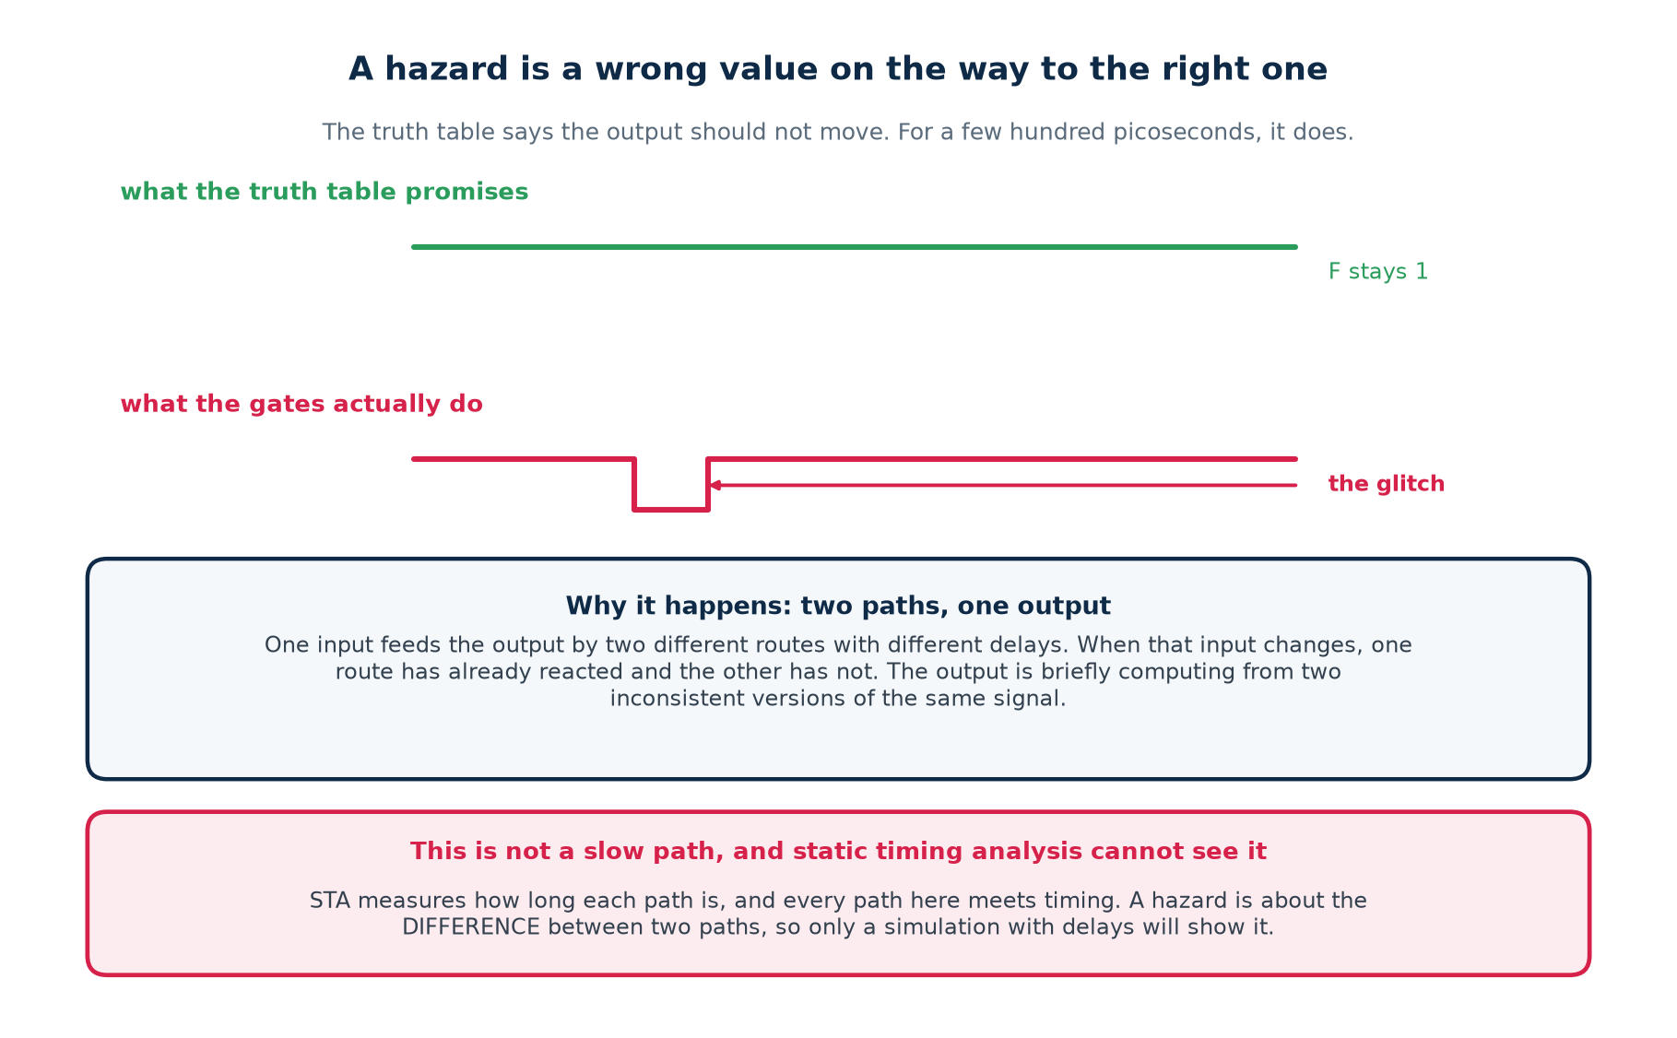
2.1 · THE IDEA
A Wrong Value On the Way To the Right One
Two paths from one input, different delays, one output. That is the entire mechanism.
Chip Design Associate · Module 3 · Static Timing Analysis of VLSI Circuits · Topic 1: Overview of VLSI STA
M3-T1 · 13

Slide 14
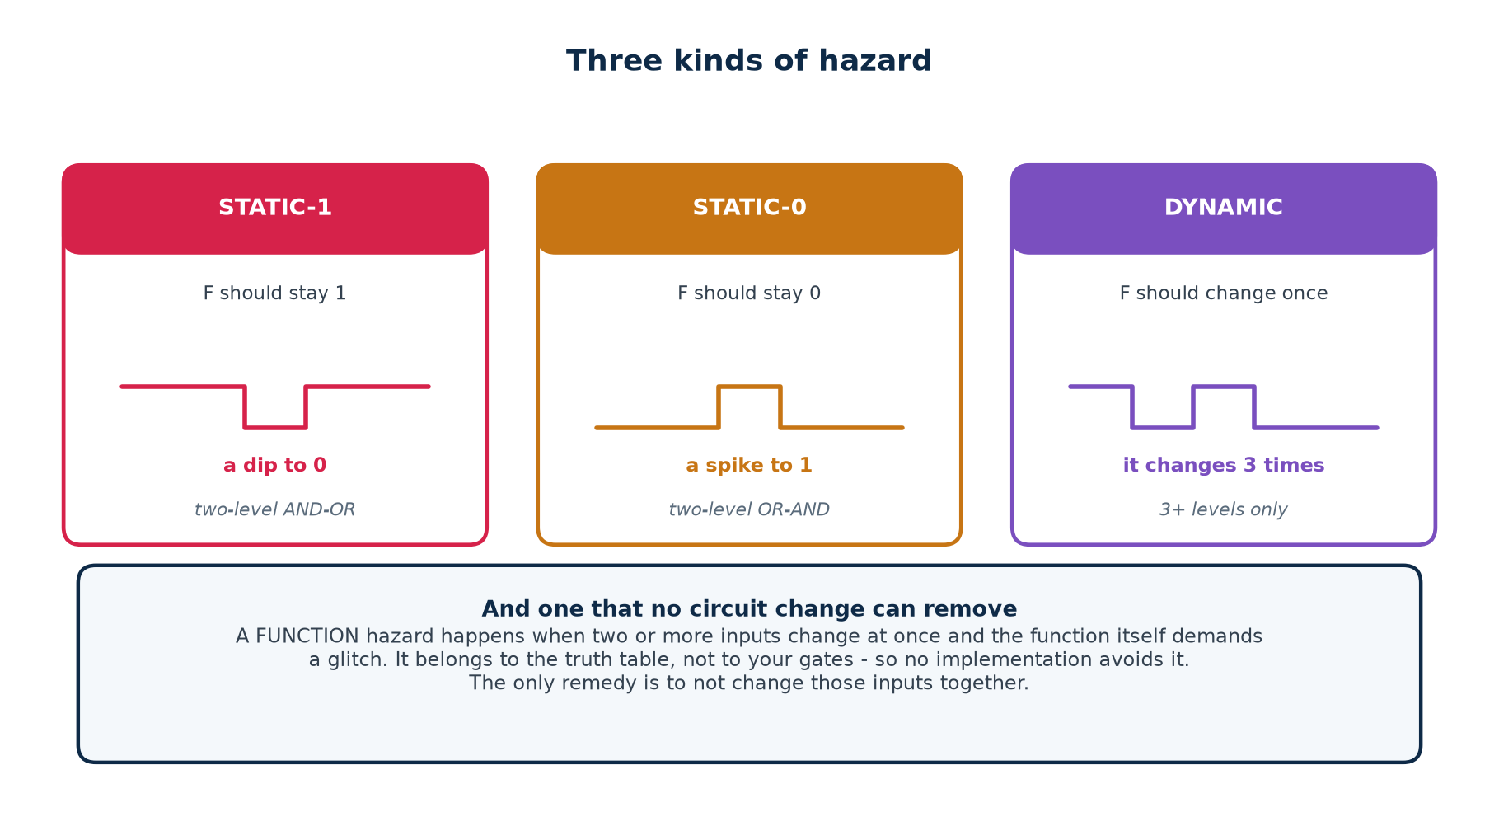
2.2 · THE KINDS
Three Kinds of Hazard, and One You Cannot Remove
Logic hazards come from your implementation and can be removed. A function hazard belongs to the truth table itself.
Chip Design Associate · Module 3 · Static Timing Analysis of VLSI Circuits · Topic 1: Overview of VLSI STA
M3-T1 · 14

Slide 15
2.3 · FUNCTION HAZARDS
The One No Implementation Can Fix
Everything else in this section assumes one input changes at a time. Let two change at once and a new problem appears that no amount of redundant logic will touch.
two inputs changing at once
F = A B' + B C with A = 1, C = 0
start A=1 B=1 C=0 -> F = 0
end A=1 B=0 C=1 -> F = 1
Two inputs changed. In between, the circuit necessarily passes through
either A=1 B=1 C=1 (F = 1) or A=1 B=0 C=0 (F = 1),
depending which input the wiring happens to deliver first.
Both intermediate states give F = 1. The output is SUPPOSED to end at 1,
so here it is harmless - but change the example and it need not be.
Why it cannot be fixed
What to do instead
The glitch is in the FUNCTION, not the gates. Every correct implementation must pass through one of those intermediate states, because the inputs really do go through them.
Do not change those inputs simultaneously — which, in a synchronous design, is exactly what a common clock guarantees.
This is one more reason the clocked discipline is worth its cost.
From here on: one input at a time, and every hazard we discuss is a LOGIC hazard.
Chip Design Associate · Module 3 · Static Timing Analysis of VLSI Circuits · Topic 1: Overview of VLSI STA
M3-T1 · 15

Slide 16
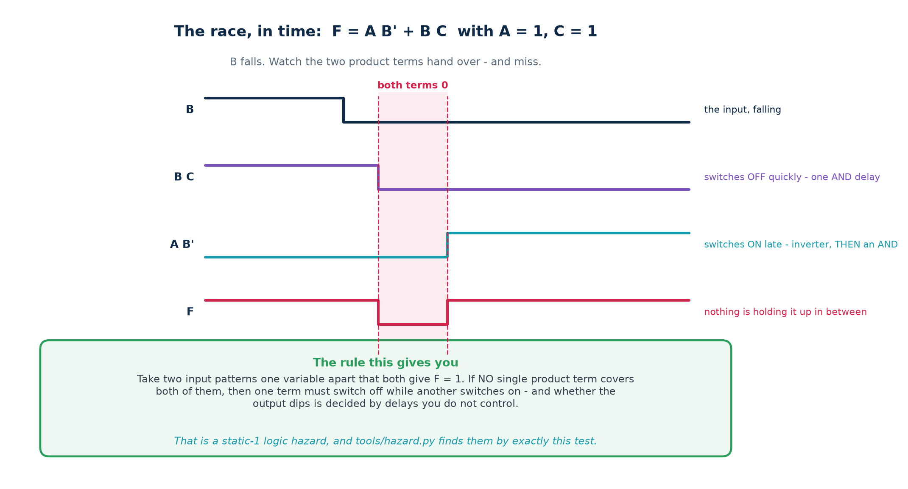
2.4 · THE MECHANISM
The Race, In Time
B C switches off as soon as B falls. A B' cannot switch on until B has been through the inverter. In between, nothing is holding F up.
Chip Design Associate · Module 3 · Static Timing Analysis of VLSI Circuits · Topic 1: Overview of VLSI STA
M3-T1 · 16

Slide 17
2.5 · THE RULE
How To Find One Without Simulating Anything
The adjacency rule, in one sentence
Take two input patterns that differ in exactly ONE variable and both give F = 1. If no single product term covers both of them, the circuit has a static-1 logic hazard on that transition.
F = A B' + B C A=1, C=1, and B changes
B=1 : F = 1, held up by B C
B=0 : F = 1, held up by A B'
Does one term cover BOTH?
A B' needs B=0 -> covers only the second
B C needs B=1 -> covers only the first
No. So the output is handed from one term to the other, and whether
it dips depends on which gate wins.
Why this is the right test
If some term is 1 for both patterns, that term does not change at all during the transition — so it holds the output up throughout and no delay assignment can produce a dip. If no term does, then one must switch off while another switches on, and the order is decided by delays you do not control.
Chip Design Associate · Module 3 · Static Timing Analysis of VLSI Circuits · Topic 1: Overview of VLSI STA
M3-T1 · 17

Slide 18
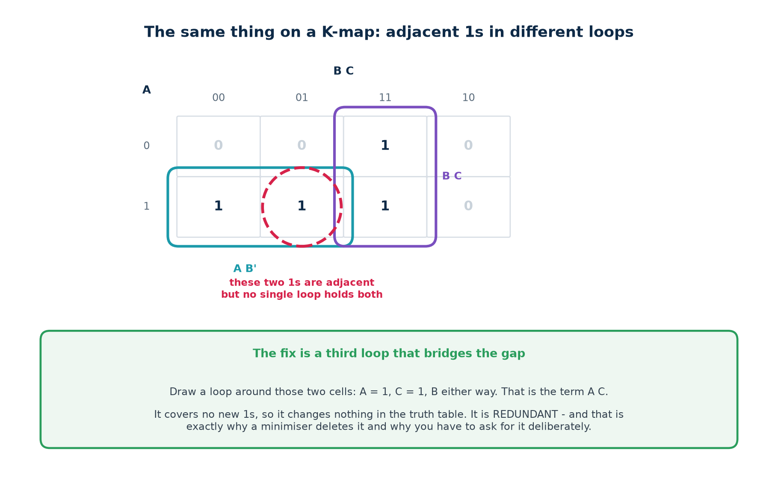
2.6 · ON A K-MAP
Adjacent 1s In Different Loops
Two 1-cells side by side with no single loop around both. That is the same test, drawn.
Chip Design Associate · Module 3 · Static Timing Analysis of VLSI Circuits · Topic 1: Overview of VLSI STA
M3-T1 · 18

Slide 19
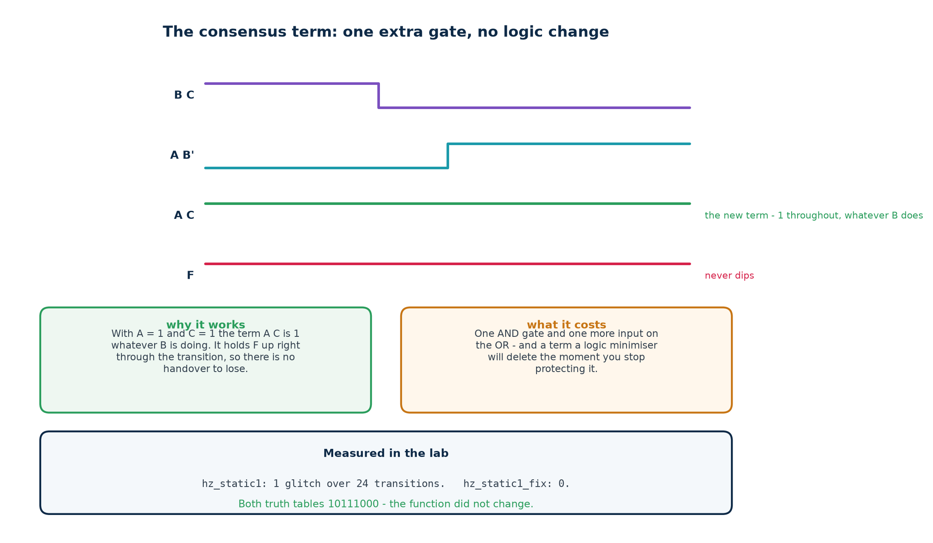
2.7 · THE FIX
The Consensus Term
A term that covers no new 1s, changes nothing in the truth table, and holds the output up through the handover.
Chip Design Associate · Module 3 · Static Timing Analysis of VLSI Circuits · Topic 1: Overview of VLSI STA
M3-T1 · 19

Slide 20
2.7 · THE FIX
Redundant Is Not a Criticism — It Is the Requirement
The consensus term is logically redundant by construction. Delete it and the truth table is identical. That is not a flaw in the fix — it is what makes the fix safe, and it is also what makes it fragile.
Why redundancy is required
Why it will not survive
A term that changed the function would not be a fix, it would be a bug.
The only way to hold the output up without altering what the circuit computes is to add cover that is already covered.
Removing redundancy is precisely what a logic optimiser exists to do.
Write the consensus term in RTL and synthesis will delete it — measured in Theory 4 of this session.
How to find the term, every time
Take the two input patterns. Write down every variable they agree on, at the value they agree on. Drop the one that changed. That product is the term to add — and tools/hazard.py prescribes it automatically.
Chip Design Associate · Module 3 · Static Timing Analysis of VLSI Circuits · Topic 1: Overview of VLSI STA
M3-T1 · 20

Slide 21
2.8 · THE ANALYSER
Doing It In Code
$ python3 tools/hazard.py "A B' + B C"
1 static-1 logic hazard(s) found:
B changes 1 -> 0 with A=1, C=1
before the change, the output is held up by : B C
after the change, the output is held up by : A B'
no single term covers both, so the handover is a race.
ADD the redundant term: A C
hazard-free cover:
F = A B' + B C + A C
checking the proposed cover:
remaining static-1 hazards : 0
truth table unchanged : yes
It checks its own answer, and that matters
A tool that proposes a fix without verifying it is a tool that will eventually propose a wrong one. This one re-runs the analysis on the patched cover and re-derives the truth table before it prints.
Chip Design Associate · Module 3 · Static Timing Analysis of VLSI Circuits · Topic 1: Overview of VLSI STA
M3-T1 · 21

Slide 22
2.8 · THE ANALYSER
How We Know the Rule Is Actually Right
The adjacency rule is a claim about logic. Whether an output glitches is a fact about time. Those are different things, so the analyser's self-test checks one against the other.
$ python3 tools/hazard.py --selftest
D. the combinatorial rule agrees with a delay simulation
(random functions; the rule and the timeline must never differ)
static-1 transitions cross-checked PASS (got True, want True)
disagreements between rule and simulation PASS (got 0, want 0)
E. the suggested fix always works, and never changes the function
fixes that left a hazard behind PASS (got 0, want 0)
fixes that altered the truth table PASS (got 0, want 0)
SELF-TEST PASSED
What that test actually does
It generates hundreds of random covers. For every single-variable transition it asks the covering rule, and separately builds a timeline with randomised per-gate delays to see whether a dip is possible. Over several thousand transitions the two answers never differed.
That is the difference between believing a textbook rule and having checked it.
Chip Design Associate · Module 3 · Static Timing Analysis of VLSI Circuits · Topic 1: Overview of VLSI STA
M3-T1 · 22

Slide 23
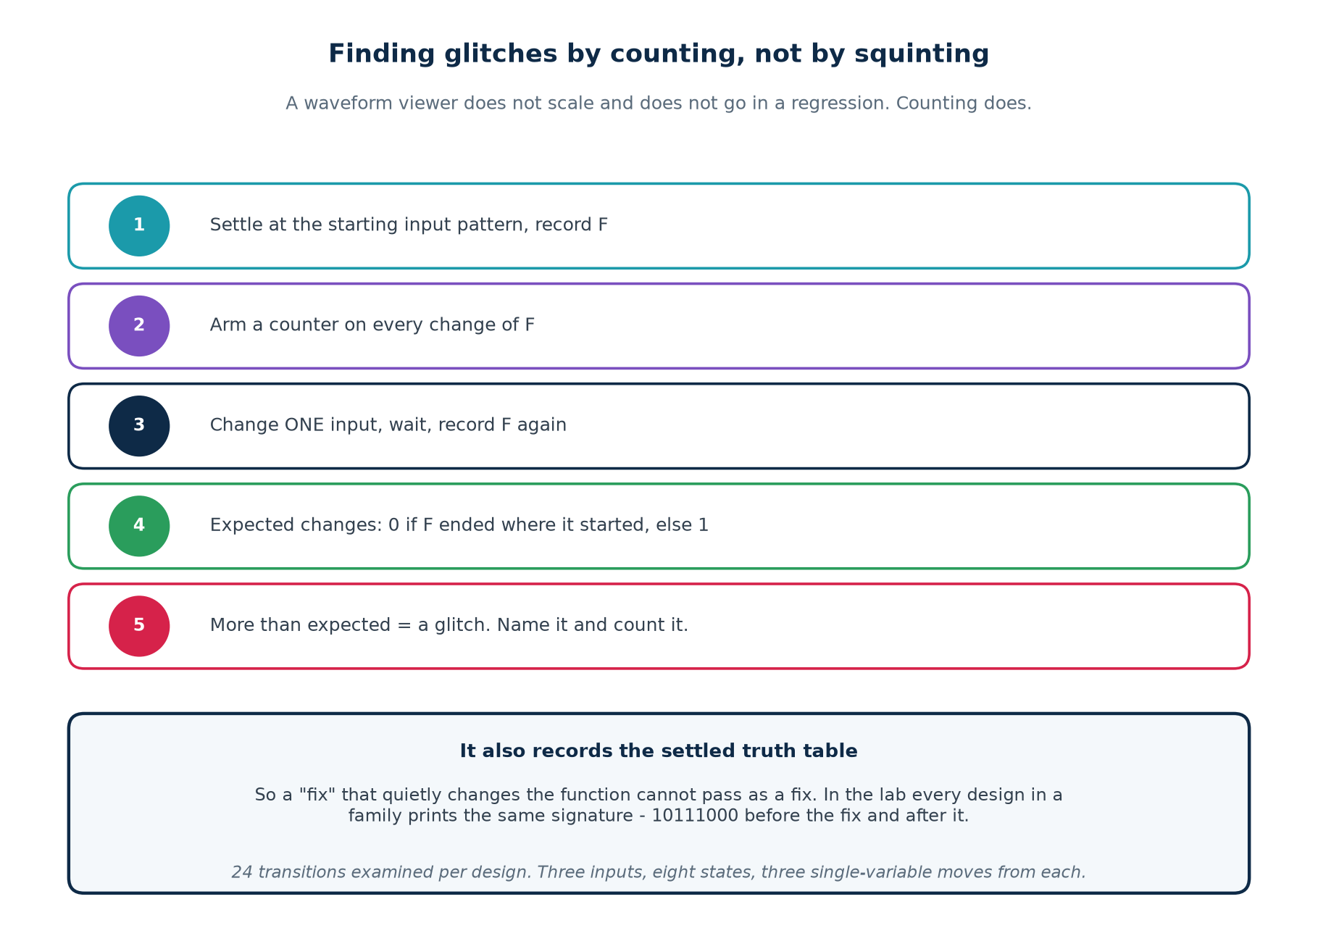
2.9 · MEASURING
Finding Glitches By Counting, Not By Squinting
A waveform viewer does not scale, does not go in a regression, and does not tell you when you have fixed something.
Chip Design Associate · Module 3 · Static Timing Analysis of VLSI Circuits · Topic 1: Overview of VLSI STA
M3-T1 · 23

Slide 24
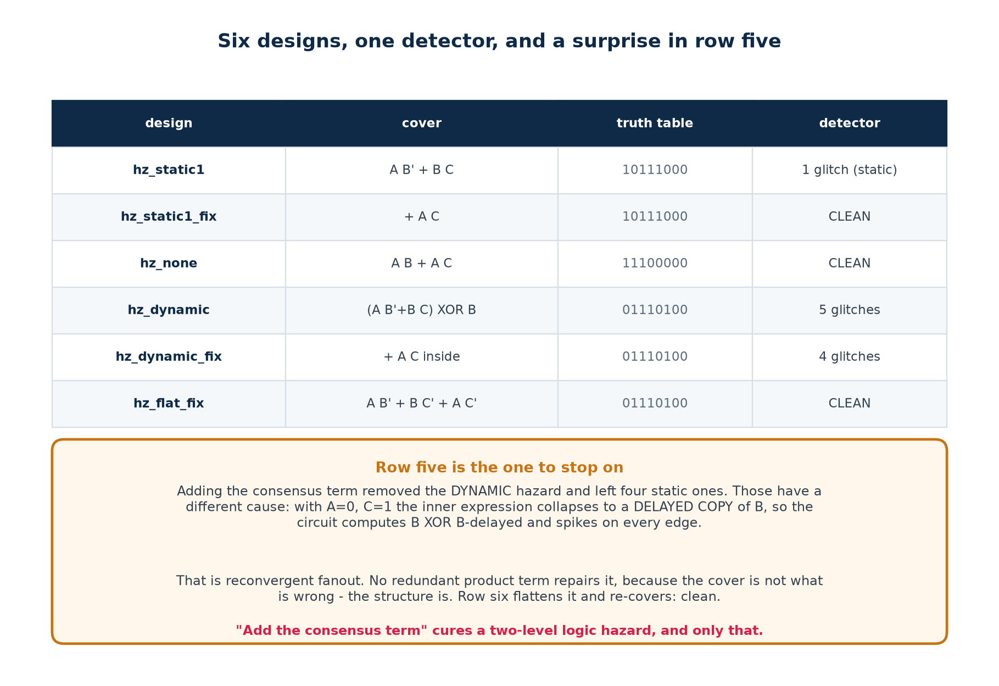
2.10 · RESULTS
Six Designs, One Detector, and a Surprise
Read row five before the next slide.
Chip Design Associate · Module 3 · Static Timing Analysis of VLSI Circuits · Topic 1: Overview of VLSI STA
M3-T1 · 24

Slide 25
2.11 · THE LIMIT
Where "Add the Consensus Term" Stops Working
hz_dynamic feeds the hazardous expression into an XOR where B reconverges. The detector reports five glitching transitions. Adding the consensus term removes one of them.
design
glitching transitions
what changed
hz_dynamic
5 (4 static, 1 dynamic)
the starting point
hz_dynamic_fix
4 (4 static)
consensus term added inside
hz_flat_fix
0
flattened to two levels, then re-covered
Why the four survivors do not respond to a redundant term
With A=0, C=1 the inner expression collapses to a delayed copy of B. The circuit is then computing B XOR B-delayed, which spikes on every edge no matter what.
That is reconvergent fanout with unequal path delays. The cover is not what is wrong — the STRUCTURE is, and only restructuring fixes it.
The consensus term cures a two-level logic hazard, and only that. Know the limit of your tool.
Chip Design Associate · Module 3 · Static Timing Analysis of VLSI Circuits · Topic 1: Overview of VLSI STA
M3-T1 · 25

Slide 26
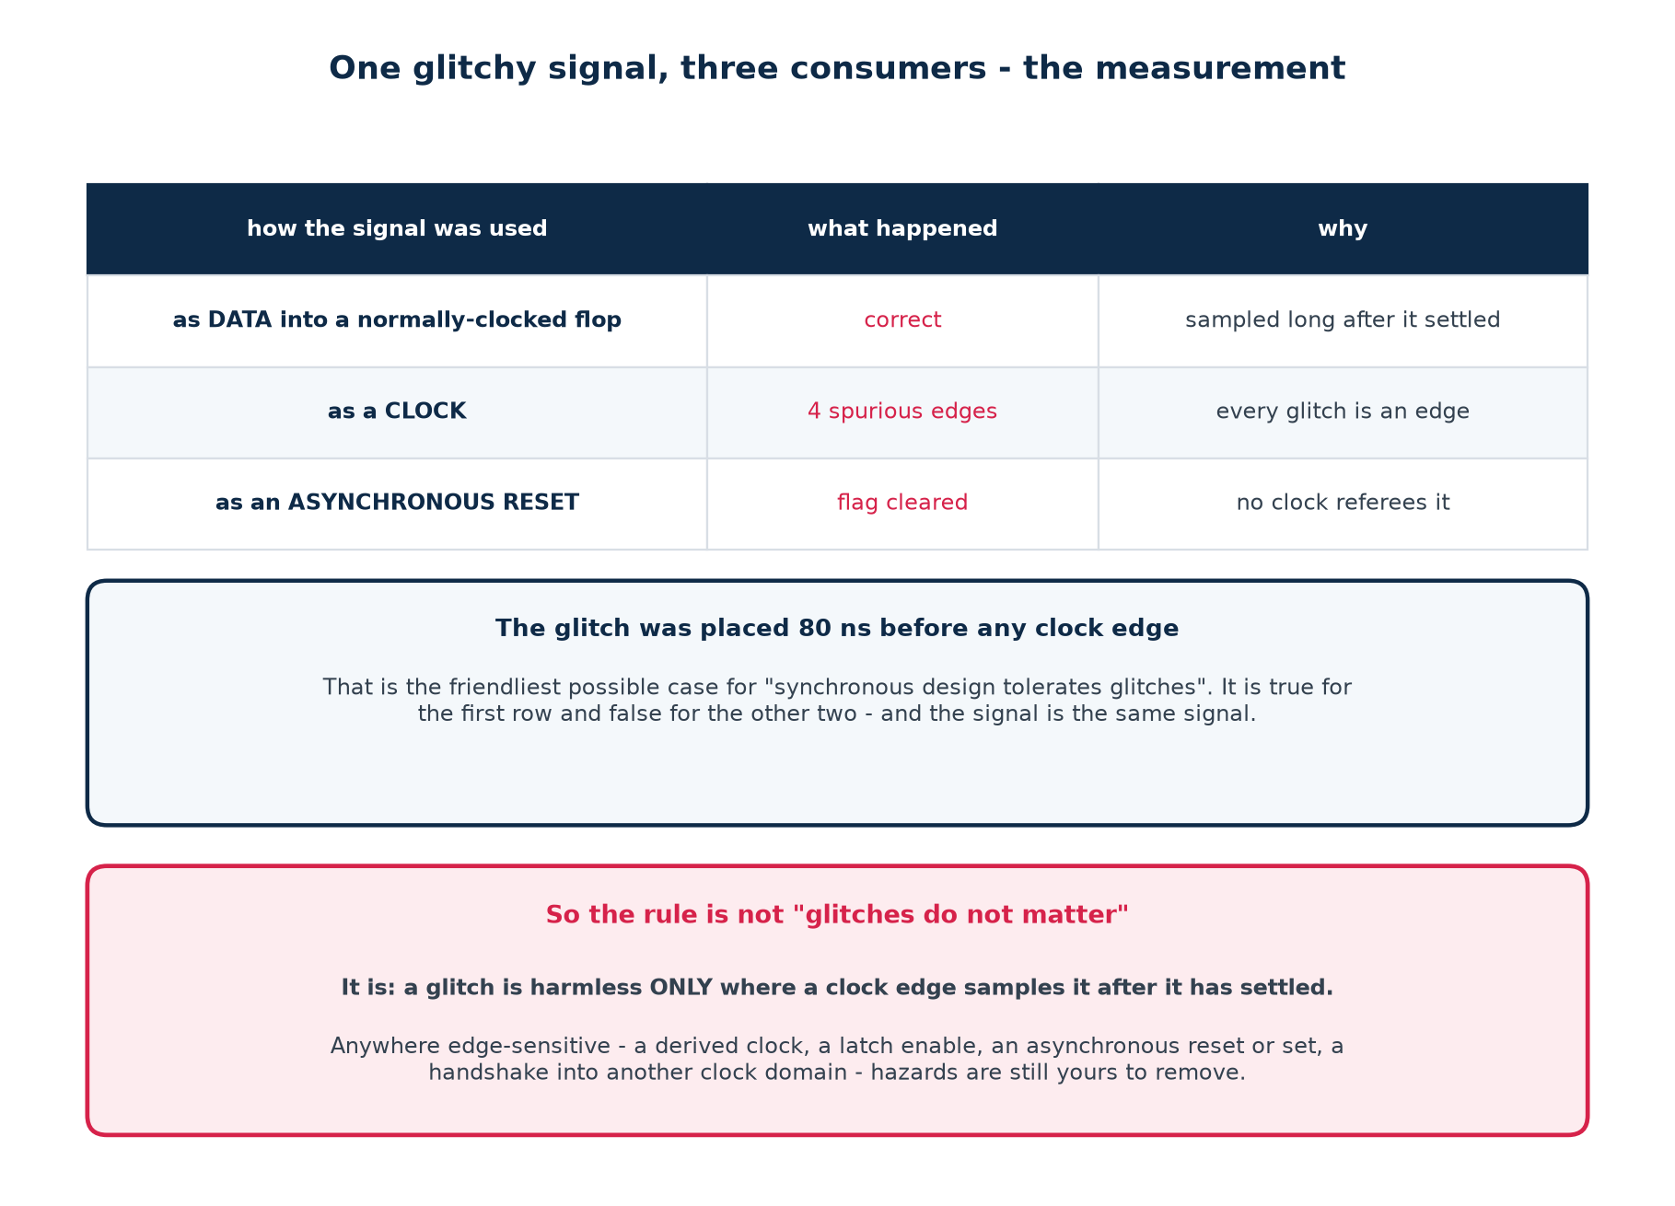
2.12 · DOES IT MATTER?
One Glitchy Signal, Three Consumers
The glitch was placed 80 ns before any clock edge — the friendliest possible case for the usual reassurance.
Chip Design Associate · Module 3 · Static Timing Analysis of VLSI Circuits · Topic 1: Overview of VLSI STA
M3-T1 · 26

Slide 27
2.12 · DOES IT MATTER?
The Rule, Stated Properly
Not "glitches do not matter in synchronous design"
A glitch is harmless ONLY where a clock edge samples the signal after it has settled.
Safe: level-sampled by a clock
Unsafe: anything edge-sensitive
Data into a normally-clocked flip-flop.
Combinational logic between two registers in the same domain.
Here the clock is the referee, and the glitch has a whole cycle to go away.
Logic driving a CLOCK — every glitch is a clock edge.
An ASYNCHRONOUS reset or set — no clock referees it.
A LATCH enable — the latch is transparent while it is high.
A handshake crossing into another clock domain.
And one cost that applies everywhere
Every glitch charges and discharges capacitance. On a wide bus that switches spuriously, glitch power is real and measurable — a reason to care about hazards even where they are functionally harmless.
Chip Design Associate · Module 3 · Static Timing Analysis of VLSI Circuits · Topic 1: Overview of VLSI STA
M3-T1 · 27

Slide 28
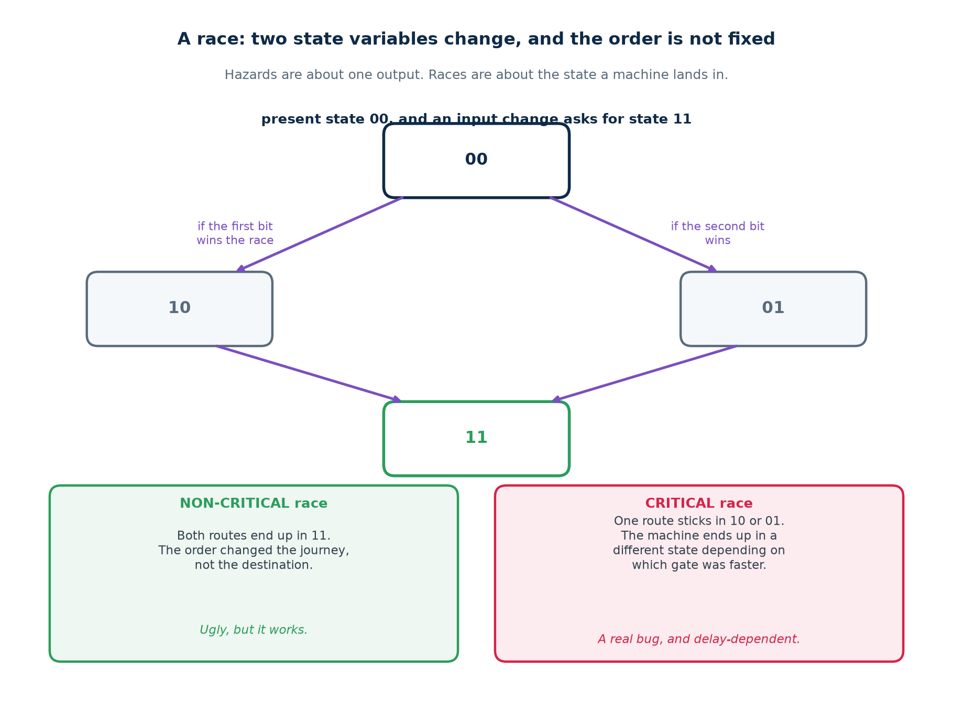
2.13 · RACES
When Two State Variables Change At Once
A hazard is about one output taking a wrong value. A race is about a machine landing in the wrong STATE.
Chip Design Associate · Module 3 · Static Timing Analysis of VLSI Circuits · Topic 1: Overview of VLSI STA
M3-T1 · 28

Slide 29
2.13 · RACES
Critical, Non-Critical, and the Essential Hazard
Name
What happens
Is it a bug?
Non-critical race
the state variables change in either order and the machine still lands in the intended state
no — untidy, but correct
Critical race
the final state depends on which variable changed first
yes — and it is delay-dependent
Essential hazard
an input change races its own inverted copy through the feedback path, and the machine sees the input twice
yes — cured by delay in the feedback, not by logic
Why these are asynchronous problems
All three need state to change in response to an INPUT change. Put a clock in charge and state changes only on an edge, by which time everything has settled — which is why an entire class of problem disappears the moment you adopt synchronous discipline.
Chip Design Associate · Module 3 · Static Timing Analysis of VLSI Circuits · Topic 1: Overview of VLSI STA
M3-T1 · 29

Slide 30
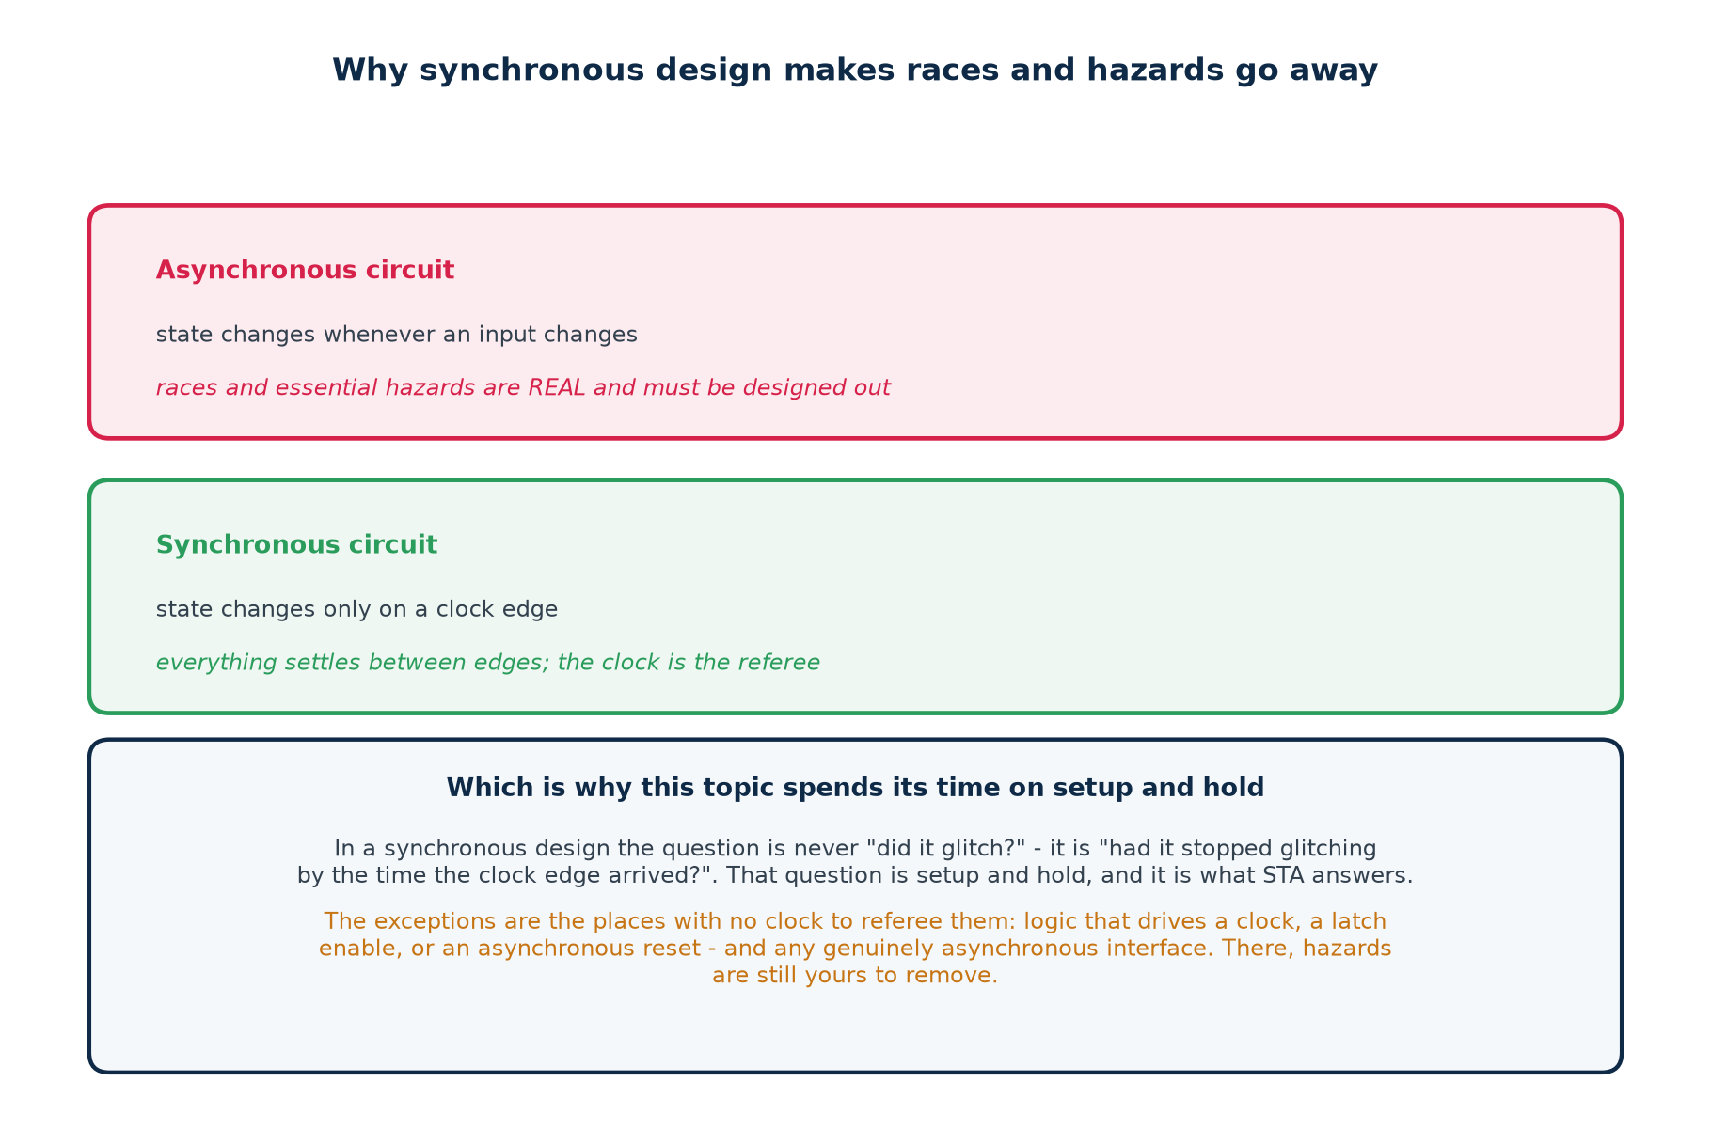
2.14 · THE CURE
What Synchronous Design Buys You, and What It Does Not
It buys you almost everything in this section — except at the boundaries, where there is no clock to referee.
Chip Design Associate · Module 3 · Static Timing Analysis of VLSI Circuits · Topic 1: Overview of VLSI STA
M3-T1 · 30

Slide 31
THEORY 2 · CHECKPOINT
Ten Questions Before We Move On
#
Question
The answer in one line
1
Hazard or glitch — which is a property of the circuit?
the hazard; the glitch is one event in one run
2
Which hazard can a two-level AND-OR circuit have?
static-1 only
3
How many levels does a dynamic hazard need?
three or more
4
What is a function hazard?
two inputs change at once and the function itself demands a glitch
5
State the adjacency rule.
two 1-cells one variable apart, covered by no single term
6
How do you build the fixing term?
the literals both patterns agree on, minus the one that changed
7
Why will synthesis delete it?
it is redundant, by design
8
When does the consensus term NOT help?
reconvergent fanout — a structural problem, not a cover one
9
Where is a glitch genuinely dangerous?
clocks, async resets, latch enables, domain crossings
10
Why can STA not find any of this?
it measures one path; a hazard needs two
If question 8 or 10 is fuzzy, say so now — Theory 3 assumes both.
Chip Design Associate · Module 3 · Static Timing Analysis of VLSI Circuits · Topic 1: Overview of VLSI STA
M3-T1 · 31

Slide 32
THEORY 3
Sequential Circuit Timing
Once a clock is in charge, the question stops being "did it glitch?" and becomes "had it finished glitching by the time the edge arrived?".
The sampling window: setup and hold
Maximum frequency of operation, derived rather than quoted
A real setup violation and the fix that clears it
A real hold violation, and why the clock frequency cannot help
Chip Design Associate · Module 3 · Static Timing Analysis of VLSI Circuits · Topic 1: Overview of VLSI STA
M3-T1 · 32

Slide 33
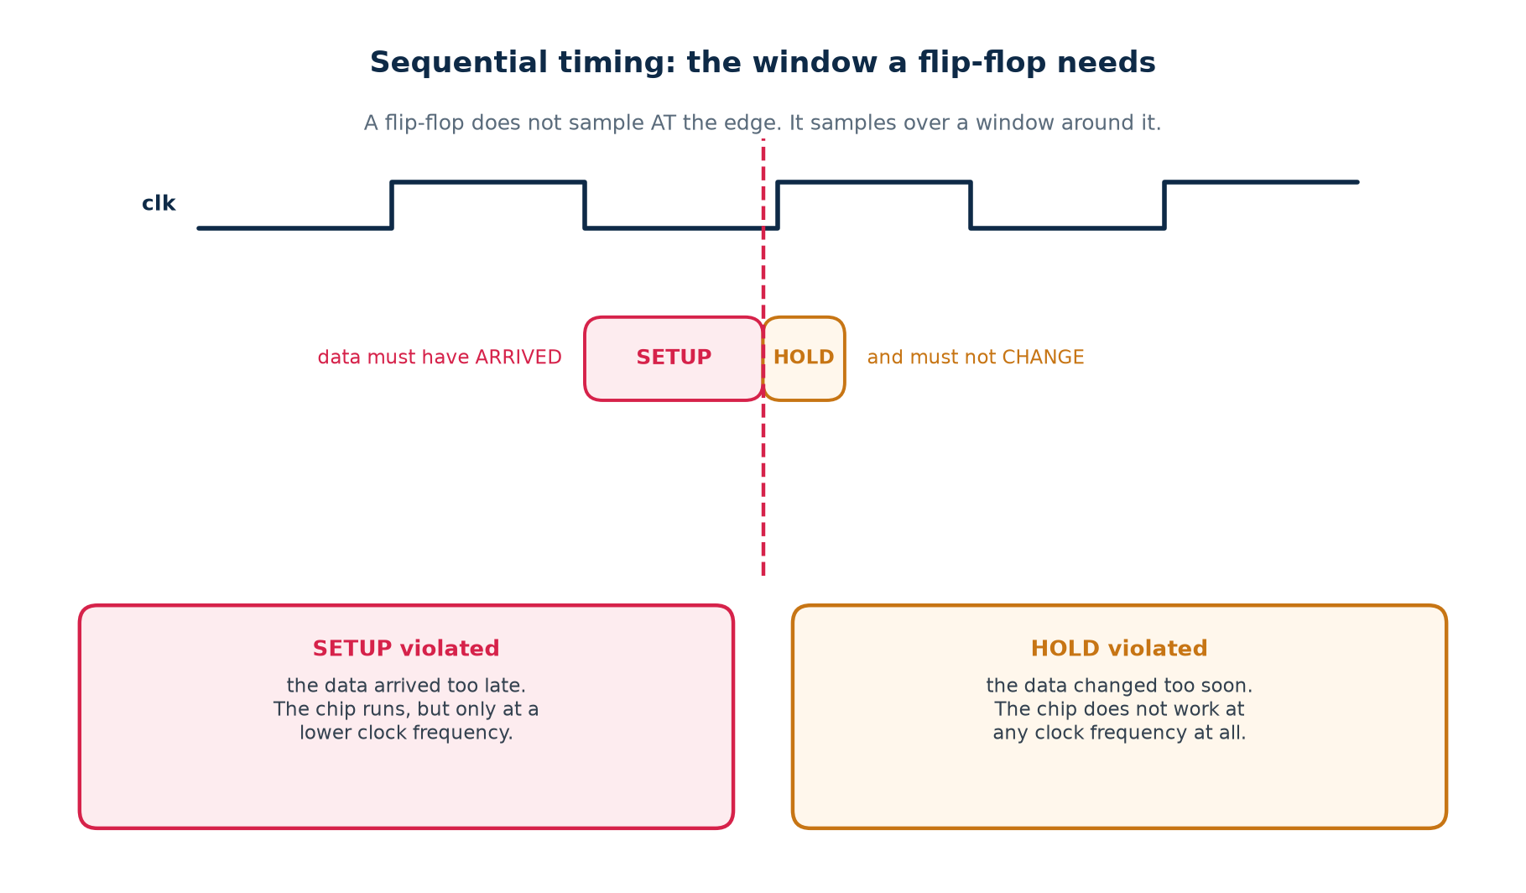
3.1 · THE WINDOW
A Flip-Flop Samples Over a Window, Not At an Instant
Everything in this section comes from that one picture
Break the first half and the flop captures the previous value — a setup violation. Break the second and it captures the NEXT value, a whole cycle early — a hold violation.
Chip Design Associate · Module 3 · Static Timing Analysis of VLSI Circuits · Topic 1: Overview of VLSI STA
M3-T1 · 33

Slide 34
3.2 · THE FOUR TERMS
What Consumes the Clock Period
Term
What it is
Who sets it
clock-to-Q
delay from the launching edge until Q is valid
the library cell
logic delay
every gate and wire between the two flops
your design, and synthesis
setup time
how early the capturing flop needs the data
the library cell
clock skew
the difference in clock arrival between the two flops
the clock tree, after layout
uncertainty
jitter, plus skew that is not modelled yet
you, in the constraint file
setup: t_cq + t_logic <= T + t_skew - t_setup - t_unc
hold: t_cq + t_logic >= t_skew + t_hold + t_unc
# the clock period T is in the first line and NOT in the second.
# everything surprising about hold follows from that one asymmetry.
Note the sign on skew
A capture clock that arrives LATE gives the data more time, so it helps setup — and it eats hold margin by exactly the same amount. Every clock-tree decision trades one against the other.
Chip Design Associate · Module 3 · Static Timing Analysis of VLSI Circuits · Topic 1: Overview of VLSI STA
M3-T1 · 34

Slide 35
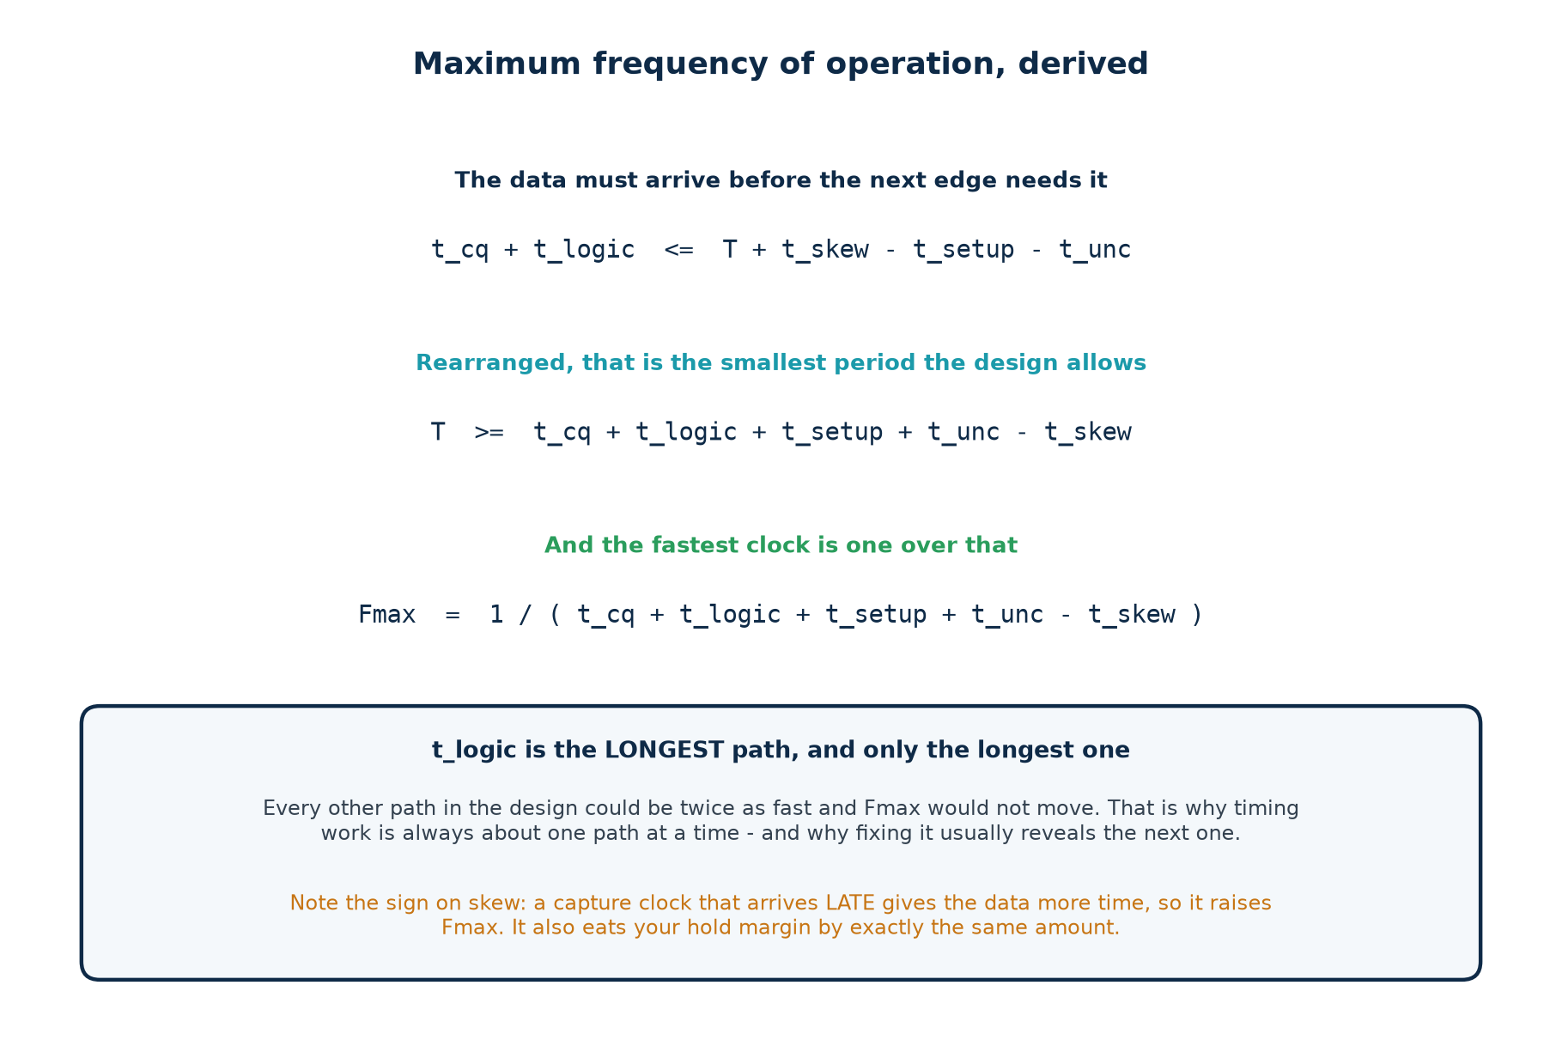
3.3 · FMAX
Maximum Frequency of Operation, Derived
Not quoted from a datasheet — rearranged from the setup inequality you just saw.
Chip Design Associate · Module 3 · Static Timing Analysis of VLSI Circuits · Topic 1: Overview of VLSI STA
M3-T1 · 35

Slide 36
3.3 · FMAX
Worked, With Real Numbers
A path in the teaching library:
clock-to-Q (DFF) 0.145 ns
logic: one XOR2 driving a flop D pin 0.117 ns
setup time (DFF) 0.090 ns
uncertainty 0.000 ns
skew 0.000 ns
-----------
minimum period 0.352 ns
Fmax = 1 / 0.352 ns = 2841 MHz
Add 0.15 ns of uncertainty and the same path gives 1992 MHz.
The circuit did not change. Your honesty about the clock did.
Which is why an Fmax figure without its assumptions is marketing
Ask what corner, what uncertainty, and whether it is post-synthesis or post-route. The same netlist will happily produce two numbers a factor of two apart under different answers to those three questions.
Chip Design Associate · Module 3 · Static Timing Analysis of VLSI Circuits · Topic 1: Overview of VLSI STA
M3-T1 · 36

Slide 37
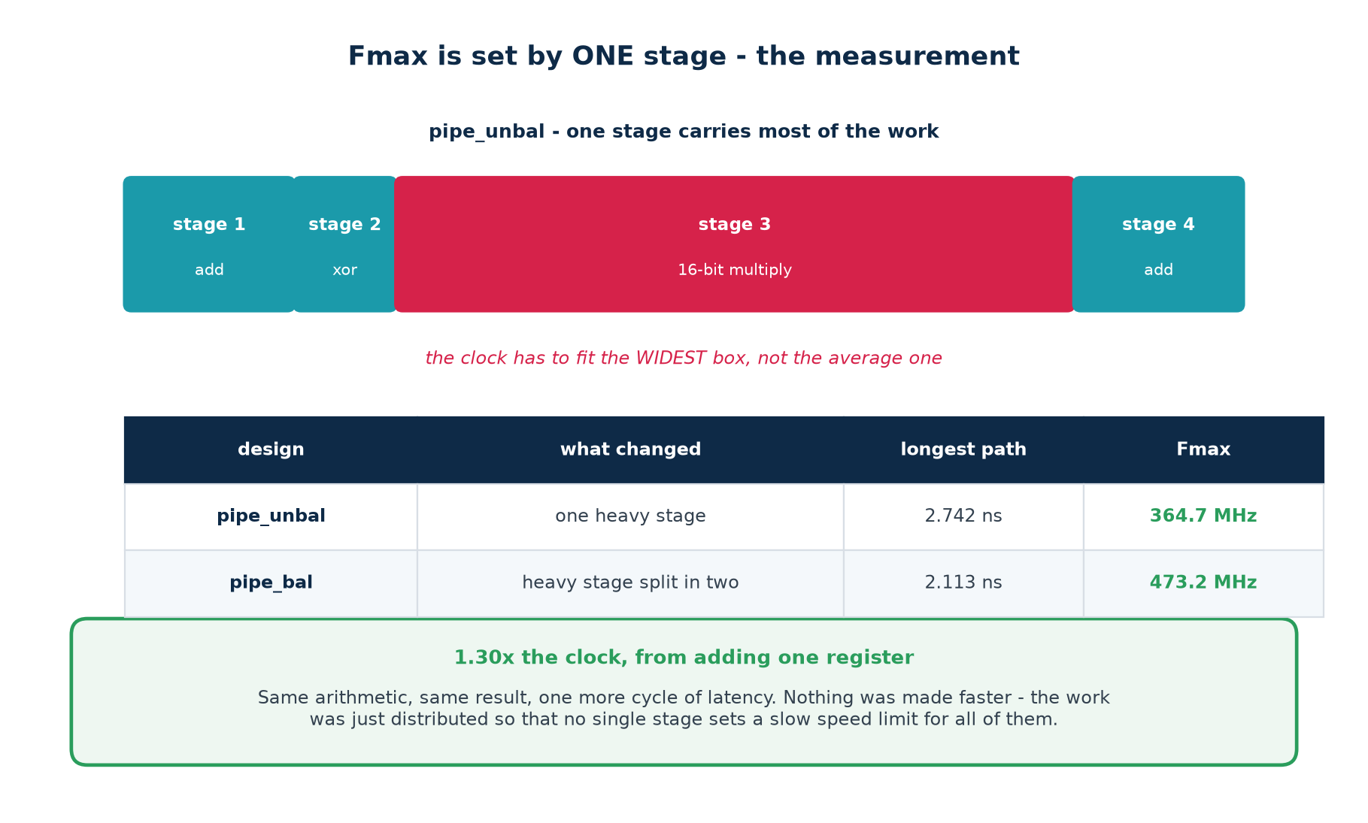
3.4 · ONE STAGE
Fmax Is Set By One Stage — The Measurement
364.7 MHz to 473.2 MHz, by moving work rather than by making anything faster.
Chip Design Associate · Module 3 · Static Timing Analysis of VLSI Circuits · Topic 1: Overview of VLSI STA
M3-T1 · 37

Slide 38
3.4 · ONE STAGE
What Pipelining Costs, and What It Does Not
What you gain
What you pay
A shorter longest path, so a faster clock.
Throughput is unchanged once the pipe is full — one result per cycle, still.
Measured here: 1.30x.
One more cycle of latency.
One more bank of registers — area and power.
And every control signal travelling beside the data must be delayed to match, or the design meets timing and computes the wrong answer.
The classic pipelining bug
You cut the datapath and forget to delay a valid flag, an operand or an address alongside it. Timing improves; correctness quietly does not. Every optimisation needs a functional re-check — which is why the Module 2 lab ends with make verify.
Chip Design Associate · Module 3 · Static Timing Analysis of VLSI Circuits · Topic 1: Overview of VLSI STA
M3-T1 · 38

Slide 39
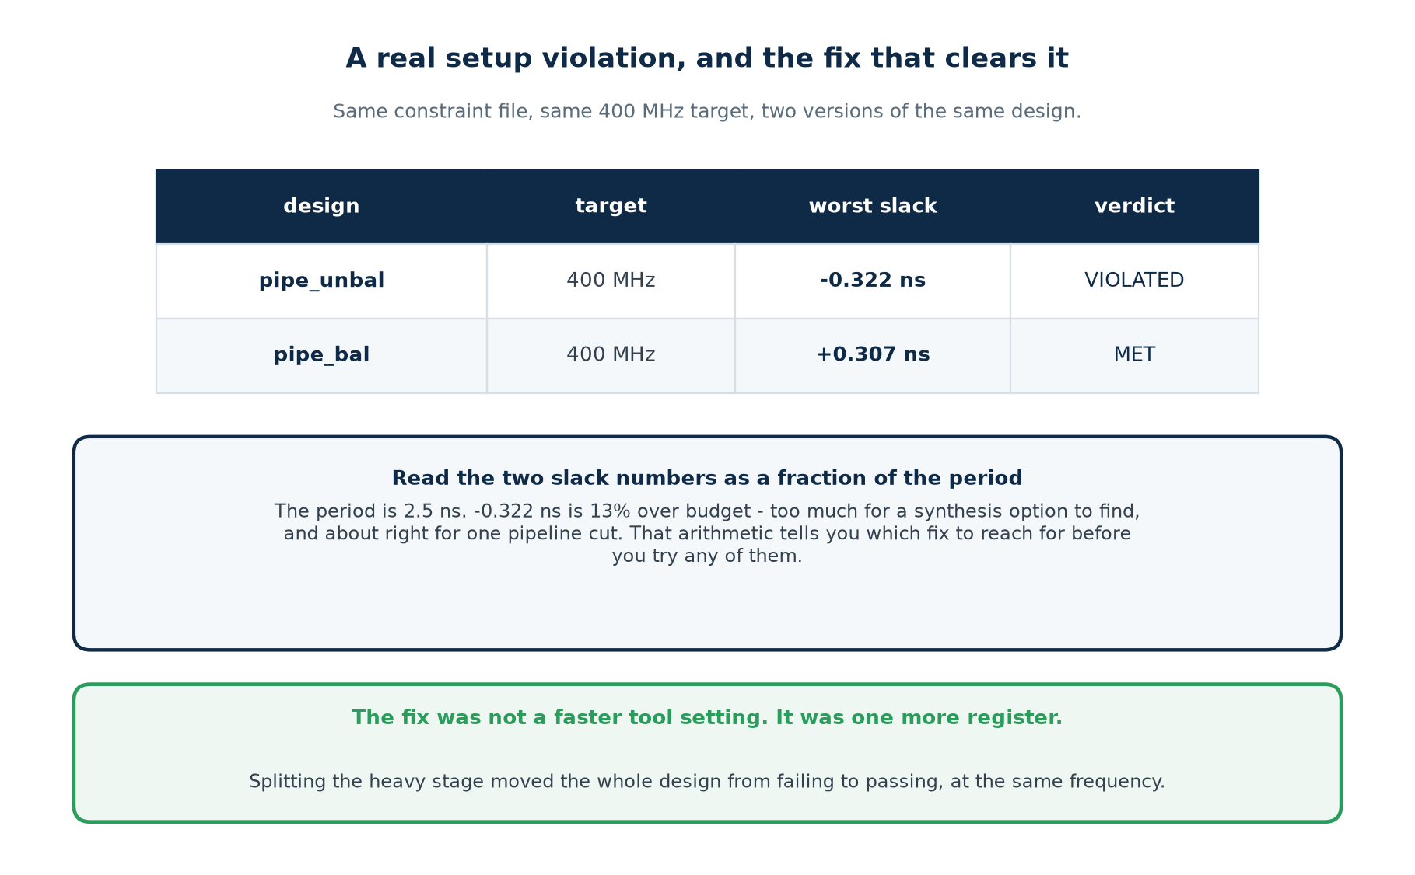
3.5 · SETUP
A Real Setup Violation, and the Fix That Clears It
Same constraint file, same target, two versions of the same arithmetic.
Chip Design Associate · Module 3 · Static Timing Analysis of VLSI Circuits · Topic 1: Overview of VLSI STA
M3-T1 · 39

Slide 40
3.5 · SETUP
Sizing the Problem Before Choosing the Fix
Slack as a fraction of the period
What that usually means
Where to start
under about 2%
the tool nearly got there
check the constraint, then raise synthesis effort
2% to 10%
a genuinely long path
restructure the logic, or retime
10% to 40%
too much work in one cycle
pipeline it
over about 40%
the target is wrong for this technology
renegotiate the frequency, or change architecture
The measured case
−0.322 ns on a 2.5 ns period is 13% over budget. That is out of reach of a synthesis option and about right for one pipeline cut — which is exactly what fixed it. Doing this arithmetic first saves you from trying the cheap fixes on a problem too big for them.
Change one thing per run, or you will not know which change helped.
Chip Design Associate · Module 3 · Static Timing Analysis of VLSI Circuits · Topic 1: Overview of VLSI STA
M3-T1 · 40

Slide 41
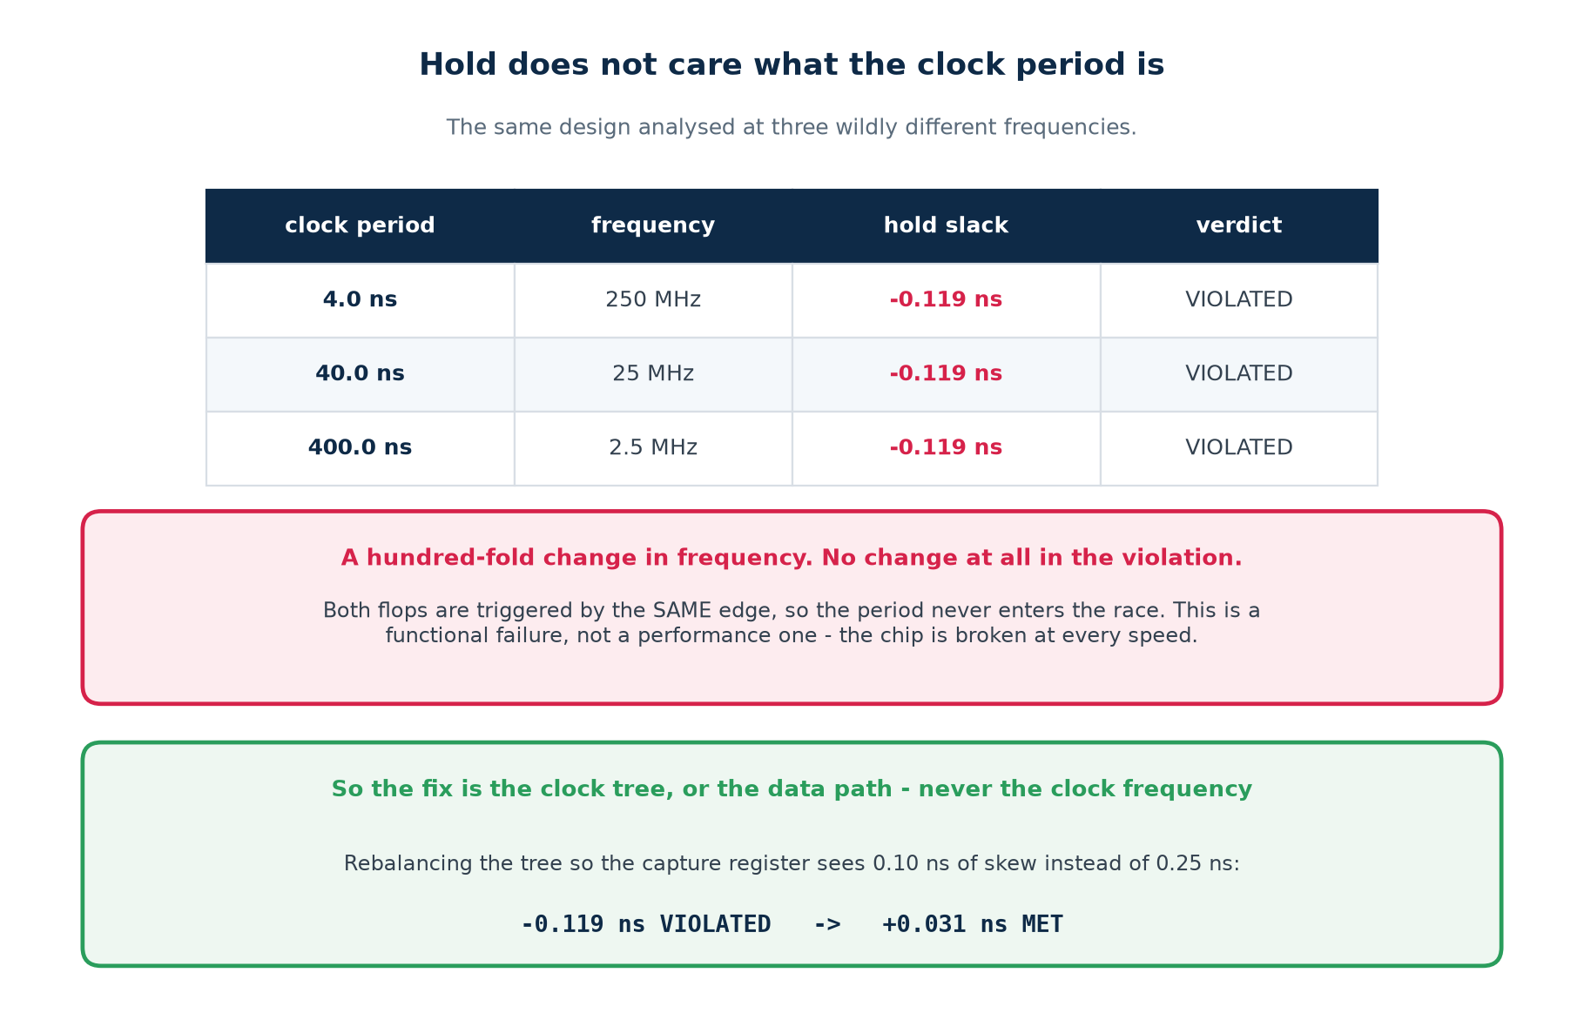
3.6 · HOLD
Hold Does Not Care What the Clock Period Is
A hundred-fold change in frequency. Not one picosecond of change in the violation.
Chip Design Associate · Module 3 · Static Timing Analysis of VLSI Circuits · Topic 1: Overview of VLSI STA
M3-T1 · 41

Slide 42
3.6 · HOLD
Why It Is a Different Kind of Failure
SETUP violation
HOLD violation
The data arrived too late for this clock.
Slow the clock down and the chip works.
You have shipped a less competitive product — but a working one.
Found at synthesis, and again after layout.
The data changed too soon after the same edge.
There is no clock frequency at which the chip works.
Reaching silicon with one means a re-spin.
Found only once a real clock tree exists.
So the fix is never the clock
It is the clock TREE — rebalance it so the capture register sees less skew — or the data path: insert delay. Measured here: dropping skew from 0.25 ns to 0.10 ns took the slack from −0.119 ns to +0.031 ns.
Chip Design Associate · Module 3 · Static Timing Analysis of VLSI Circuits · Topic 1: Overview of VLSI STA
M3-T1 · 42

Slide 43
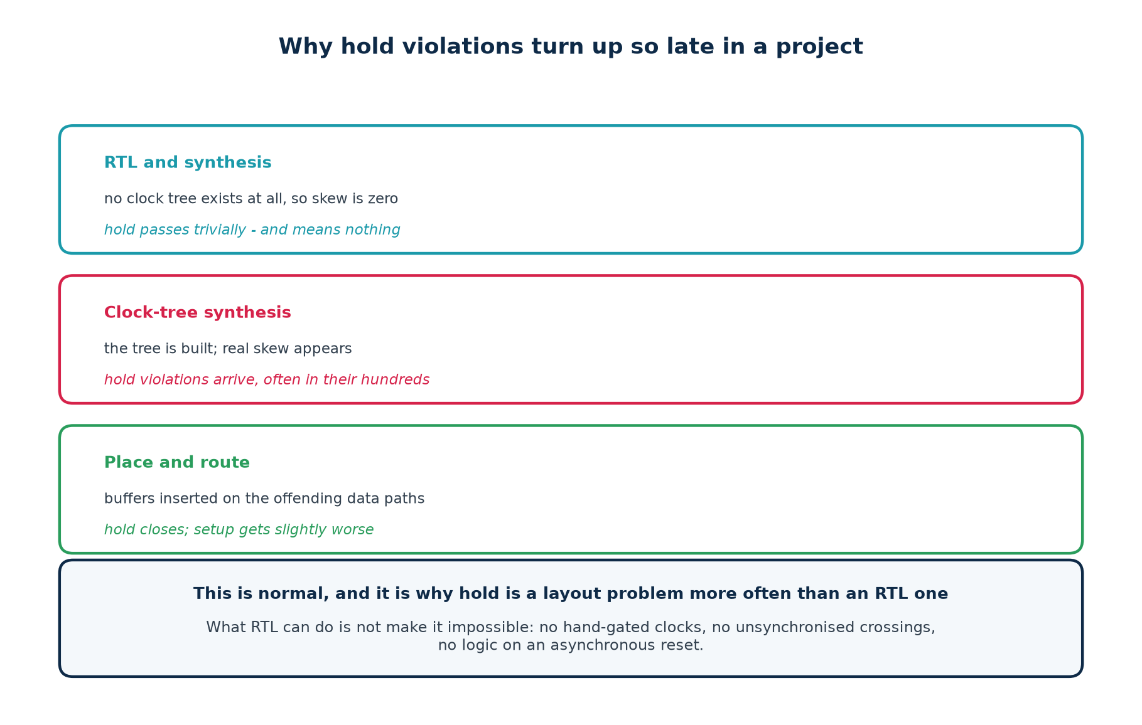
3.6 · HOLD
Why Hold Violations Turn Up So Late
What RTL can do about it: not make it impossible
No hand-gated clocks — use a clock enable. No unsynchronised domain crossings. No logic on an asynchronous reset. Beyond that, hold is place-and-route's job, and it has the one thing you do not: the real clock tree.
Chip Design Associate · Module 3 · Static Timing Analysis of VLSI Circuits · Topic 1: Overview of VLSI STA
M3-T1 · 43

Slide 44
3.7 · IN PRACTICE
Practical Examples of Violations, and Their Solutions
Symptom
Likely cause
Solution
one path fails, the rest are fine
a genuinely long path
restructure or pipeline that path
one cell has a huge incremental delay
high fanout or a weak driver
set_max_fanout; let the tool buffer it
fifty small cells in one path
the logic is too deep
balance it into a tree, then pipeline
every path fails by a similar amount
the period is too aggressive
check the target against the technology
fails only after place-and-route
routing delay, not logic
floorplan; keep the path local
fails only at the slow corner
correct behaviour
that is the corner you sign off at
hold fails on a short path after CTS
clock skew
rebalance the tree; insert hold buffers
hold fails everywhere, at every speed
a structural problem
look for gated clocks and domain crossings
a huge violation on a reset path
a missing false path
constrain it properly — this is not a design bug
Chip Design Associate · Module 3 · Static Timing Analysis of VLSI Circuits · Topic 1: Overview of VLSI STA
M3-T1 · 44

Slide 45
THEORY 3 · CHECKPOINT
Eight Questions
#
Question
The answer in one line
1
Write the setup inequality.
t_cq + t_logic <= T + skew - setup - uncertainty
2
Which term is missing from the hold inequality?
the clock period T
3
Setup violation — what does the chip do?
works, at a lower frequency
4
Hold violation — what does it do?
does not work at any frequency
5
Late capture clock helps which check?
setup; it hurts hold by the same amount
6
Which stage sets Fmax?
the slowest one, on its own
7
−0.322 ns on a 2.5 ns period — how big a problem?
13%; pipeline territory, not a tool setting
8
Why do hold problems appear after CTS?
before it there is no clock tree, so no real skew
Theory 4 asks what synthesis does with everything you have just decided.
Chip Design Associate · Module 3 · Static Timing Analysis of VLSI Circuits · Topic 1: Overview of VLSI STA
M3-T1 · 45

Slide 46
THEORY 4
Timing Constraints for Synthesis
A constraint file is not a report setting. It is the objective the optimiser is trying to meet — and it decides what circuit you get.
What constraints actually do to synthesis
The minimum honest constraint set
What synthesis does to a hazard fix (it deletes it)
Circuit synthesis and timing analysis as one loop
Chip Design Associate · Module 3 · Static Timing Analysis of VLSI Circuits · Topic 1: Overview of VLSI STA
M3-T1 · 46

Slide 47
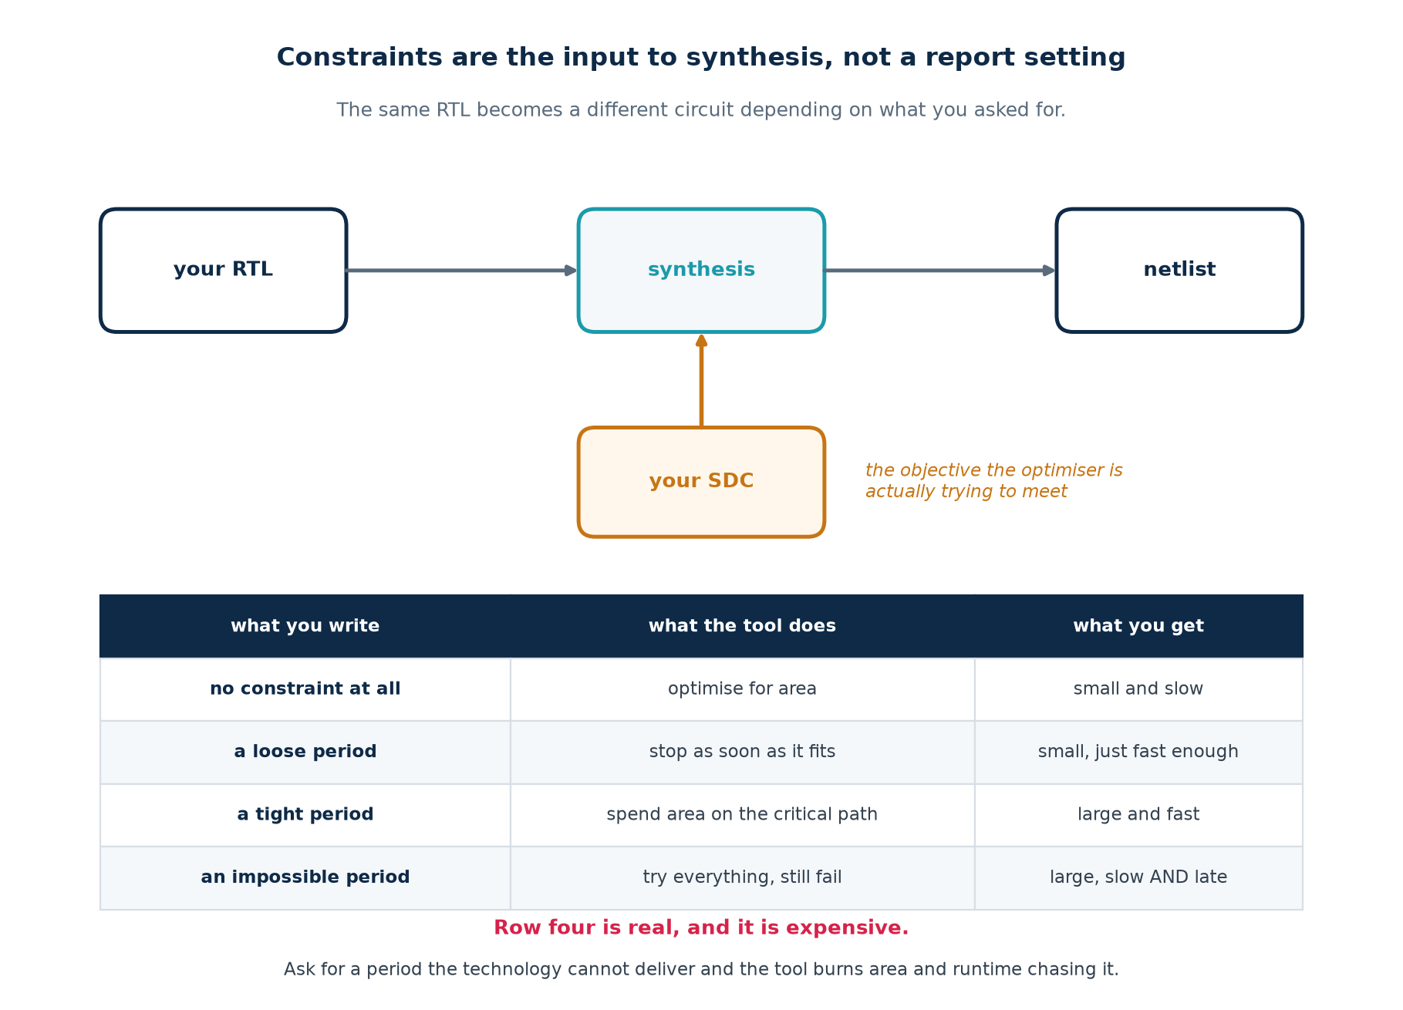
4.1 · THE INPUT
Constraints Are an Input to Synthesis
The same RTL becomes a different circuit depending on what you asked for.
Chip Design Associate · Module 3 · Static Timing Analysis of VLSI Circuits · Topic 1: Overview of VLSI STA
M3-T1 · 47

Slide 48
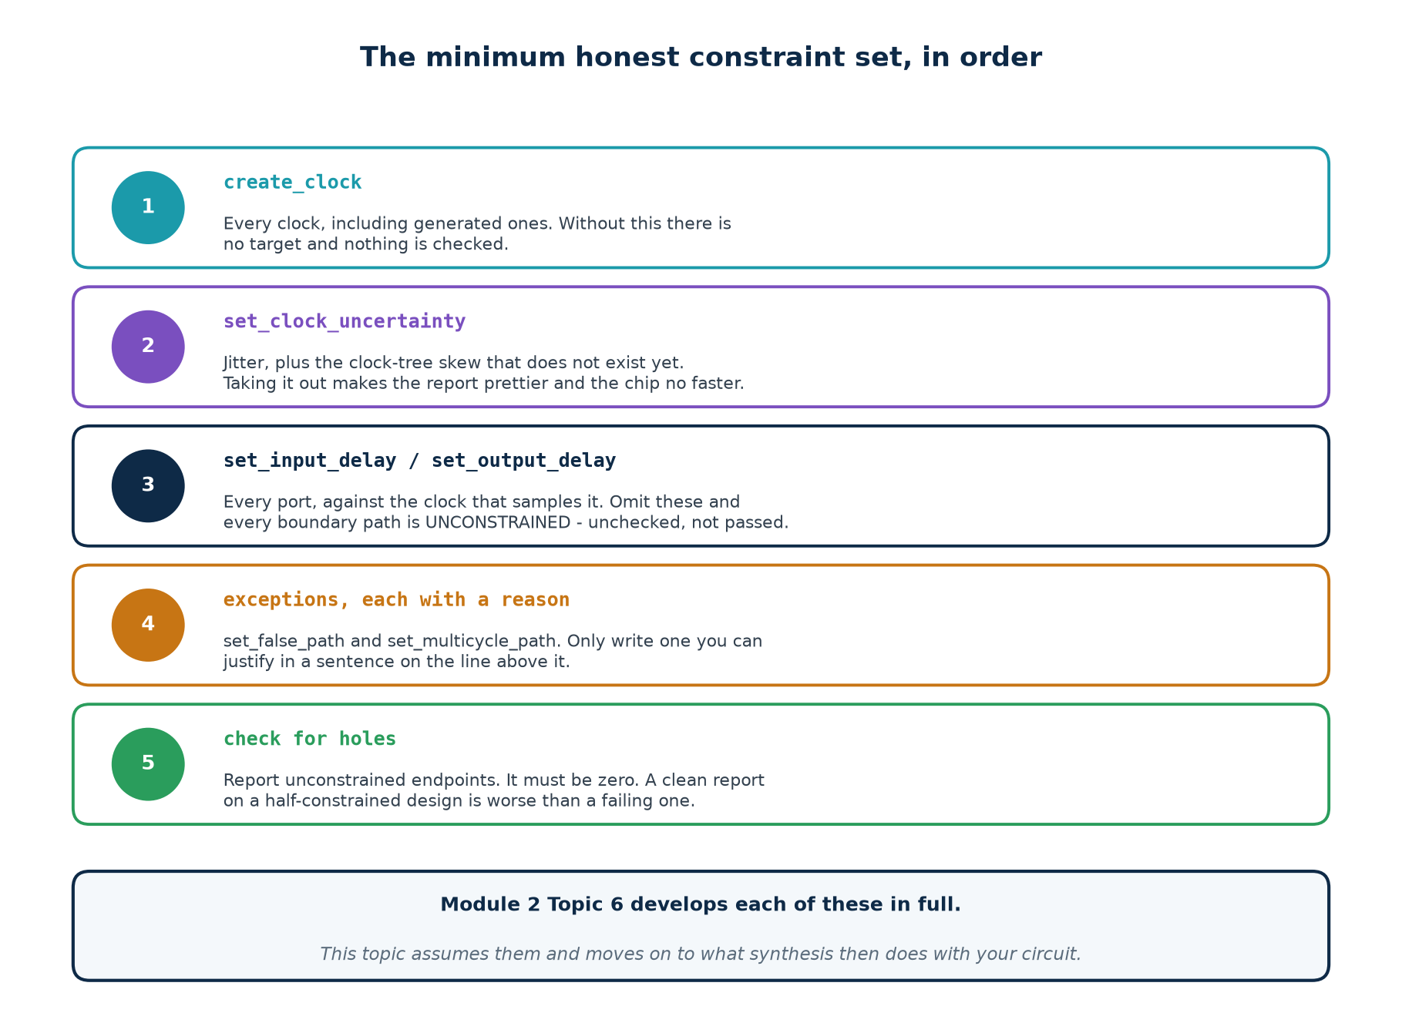
4.2 · THE MINIMUM
The Minimum Honest Constraint Set, In Order
Module 2 Topic 6 develops each of these in full. Here the point is what synthesis does once you have written them.
Chip Design Associate · Module 3 · Static Timing Analysis of VLSI Circuits · Topic 1: Overview of VLSI STA
M3-T1 · 48

Slide 49
4.2 · THE MINIMUM
A Complete File For the Lab Design
# ==================================================== constraints/pipe.sdc
# ---- clock ------------------------------------------------------------
# 400 MHz. pipe_unbal cannot make this; pipe_bal can. That is the experiment.
create_clock -period 2.500
# jitter, plus a placeholder for the clock-tree skew that does not exist yet
set_clock_uncertainty 0.080 -setup
set_clock_uncertainty 0.020 -hold
# ---- boundary ---------------------------------------------------------
# Without these two lines every path touching a port is UNCONSTRAINED,
# and the analyser says so. Run without them once and read the warning.
set_input_delay 0.40 -clock clk
set_output_delay 0.35 -clock clk
The line to check on every single run
The count of unconstrained endpoints. It must be zero. A design with WNS +2.0 ns and four hundred unconstrained endpoints is in far worse shape than one with WNS −0.1 ns and none — the first has not been analysed at all.
Chip Design Associate · Module 3 · Static Timing Analysis of VLSI Circuits · Topic 1: Overview of VLSI STA
M3-T1 · 49

Slide 50
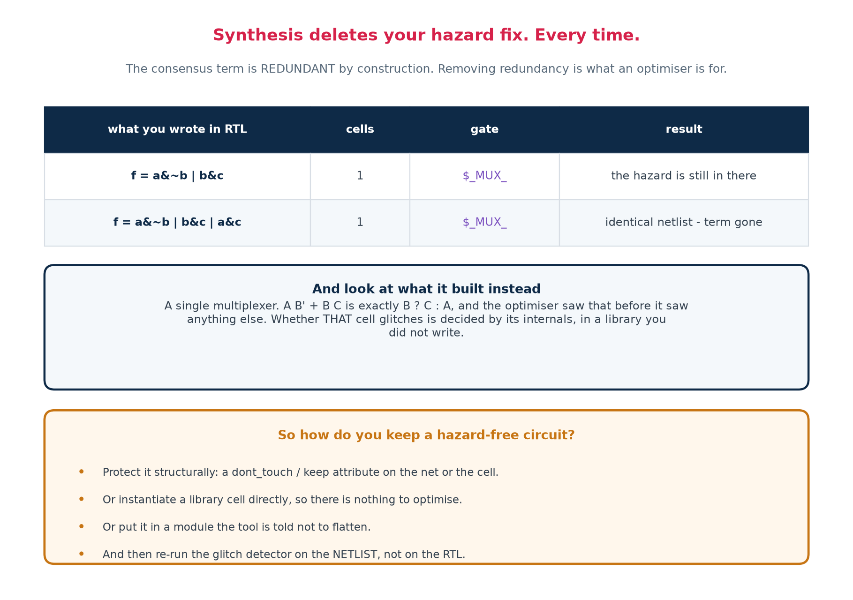
4.3 · THE COLLISION
Synthesis Deletes Your Hazard Fix. Every Time.
Both RTL versions produced the identical netlist: one multiplexer.
Chip Design Associate · Module 3 · Static Timing Analysis of VLSI Circuits · Topic 1: Overview of VLSI STA
M3-T1 · 50

Slide 51
4.3 · THE COLLISION
Why This Is the Most Important Slide In the Session
Theory 2 taught you to add a redundant term to remove a hazard. Theory 4 has just shown that a synthesiser deletes it. Those two facts have to be reconciled, and the reconciliation is the practical skill.
What NOT to conclude
What to conclude
"Hazard analysis is pointless because the tool undoes it."
"Just write the RTL and trust synthesis."
Both are wrong, and the second one ships broken asynchronous interfaces.
Hazard-freedom is a property of the NETLIST, not of your source.
So it has to be protected structurally, and then verified on the netlist.
And on the vast majority of nets — everything sampled by a clock — you do not need it at all.
How to protect it, when you genuinely need it
A dont_touch or keep attribute on the net or cell · instantiate the library cell directly · put it in a module the tool is told not to flatten · and then re-run the glitch detector on the post-synthesis netlist, not on the RTL.
Chip Design Associate · Module 3 · Static Timing Analysis of VLSI Circuits · Topic 1: Overview of VLSI STA
M3-T1 · 51

Slide 52
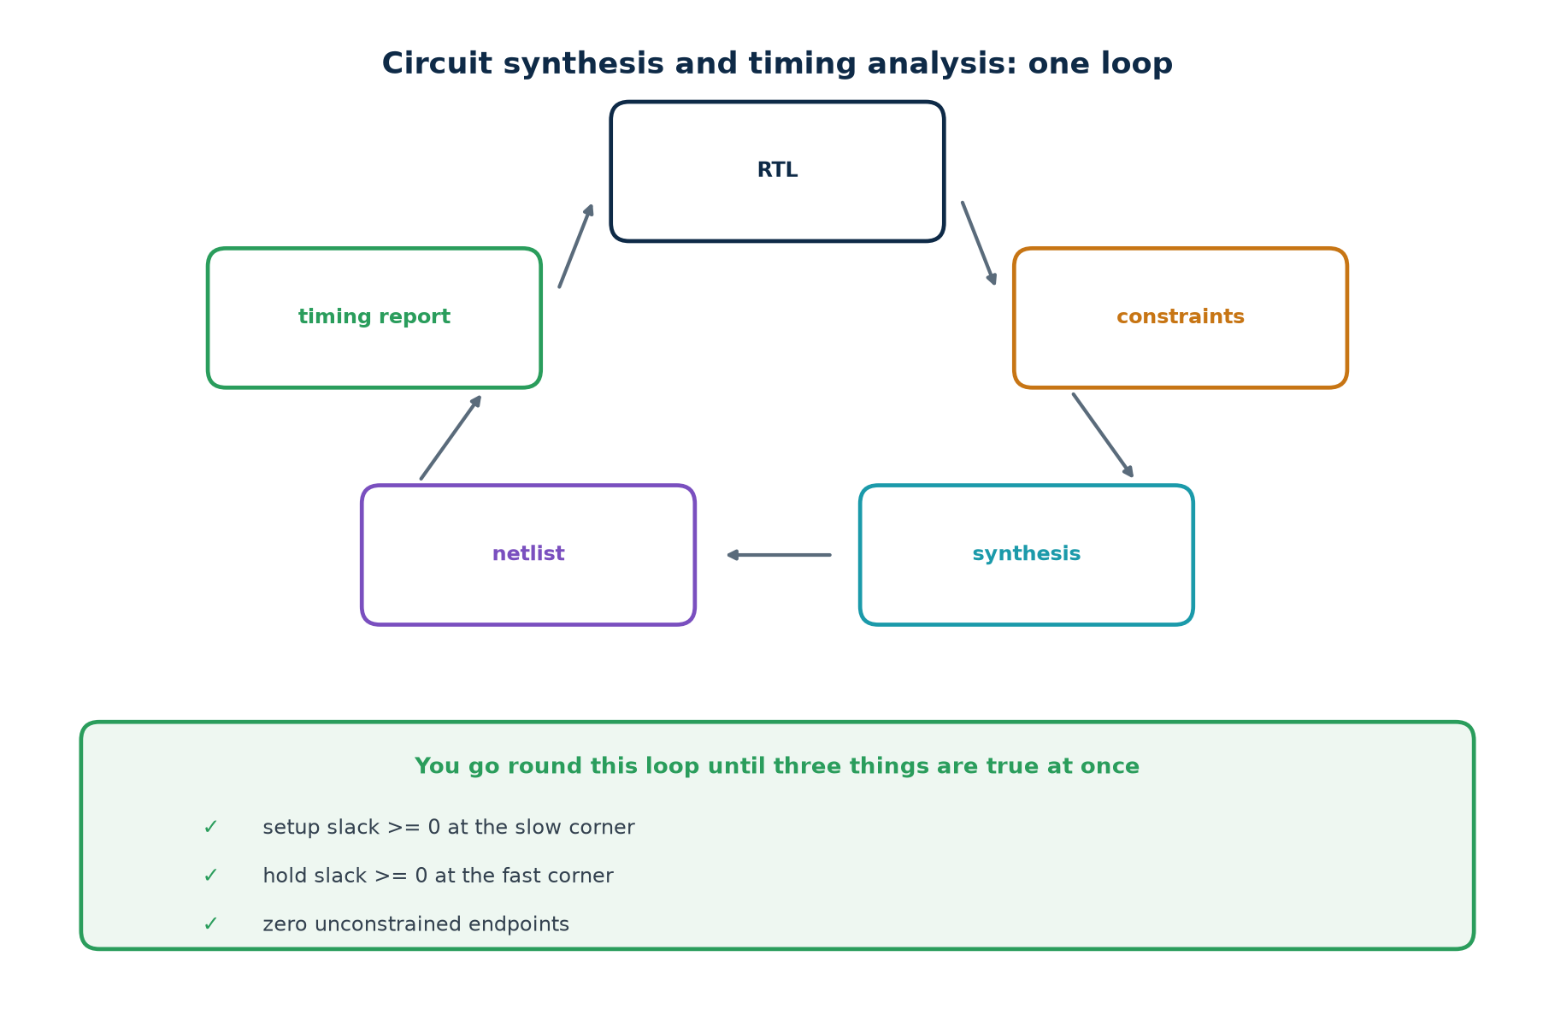
4.4 · THE LOOP
Circuit Synthesis and Timing Analysis
You leave the loop once, when all three conditions hold together. Two out of three is not closure.
Chip Design Associate · Module 3 · Static Timing Analysis of VLSI Circuits · Topic 1: Overview of VLSI STA
M3-T1 · 52

Slide 53
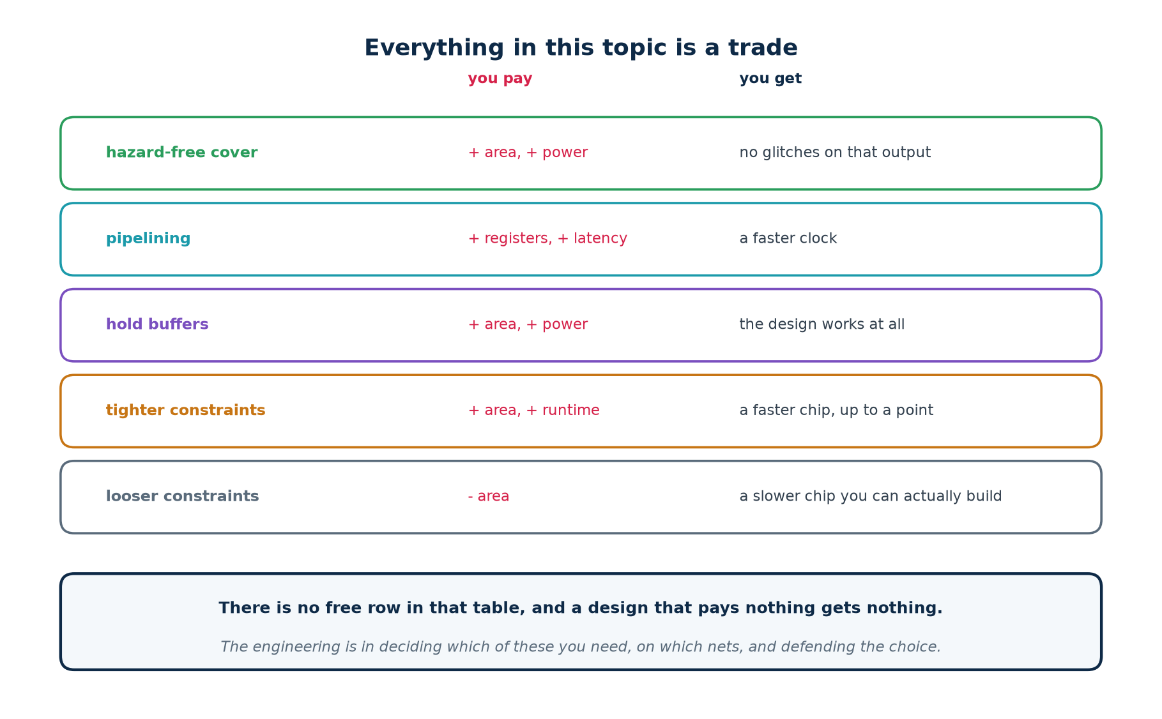
4.5 · THE TRADE
Everything In This Topic Is a Trade
There is no free row in that table, and a design that pays nothing gets nothing.
Chip Design Associate · Module 3 · Static Timing Analysis of VLSI Circuits · Topic 1: Overview of VLSI STA
M3-T1 · 53

Slide 54
THEORY 4 · CHECKPOINT
Six Questions
#
Question
The answer in one line
1
What does a constraint file do to synthesis?
it is the objective the optimiser tries to meet
2
What happens with no constraints at all?
the tool optimises for area; you get small and slow
3
What happens with an impossible period?
it burns area and runtime and still fails
4
What did synthesis do to the consensus term?
deleted it — both versions gave one identical MUX
5
So where does hazard-freedom have to be checked?
on the netlist, never on the RTL
6
When do you leave the synthesis/analysis loop?
setup met, hold met, zero unconstrained endpoints
That is the theory. The rest of the session is at the keyboard.
Chip Design Associate · Module 3 · Static Timing Analysis of VLSI Circuits · Topic 1: Overview of VLSI STA
M3-T1 · 54

Slide 55
PRACTICAL
Labs A–G
12 hours, 58 graded exercises, and not one number in this deck that you cannot reproduce yourself.
Which tool answers which question, and how to install them
Labs A–C: hazards, on paper, in code, and in simulation
Labs D–E: does it matter, and what synthesis does about it
Labs F–G: setup, hold, Fmax — then the same design on a Zynq-7000
Chip Design Associate · Module 3 · Static Timing Analysis of VLSI Circuits · Topic 1: Overview of VLSI STA
M3-T1 · 55

Slide 56
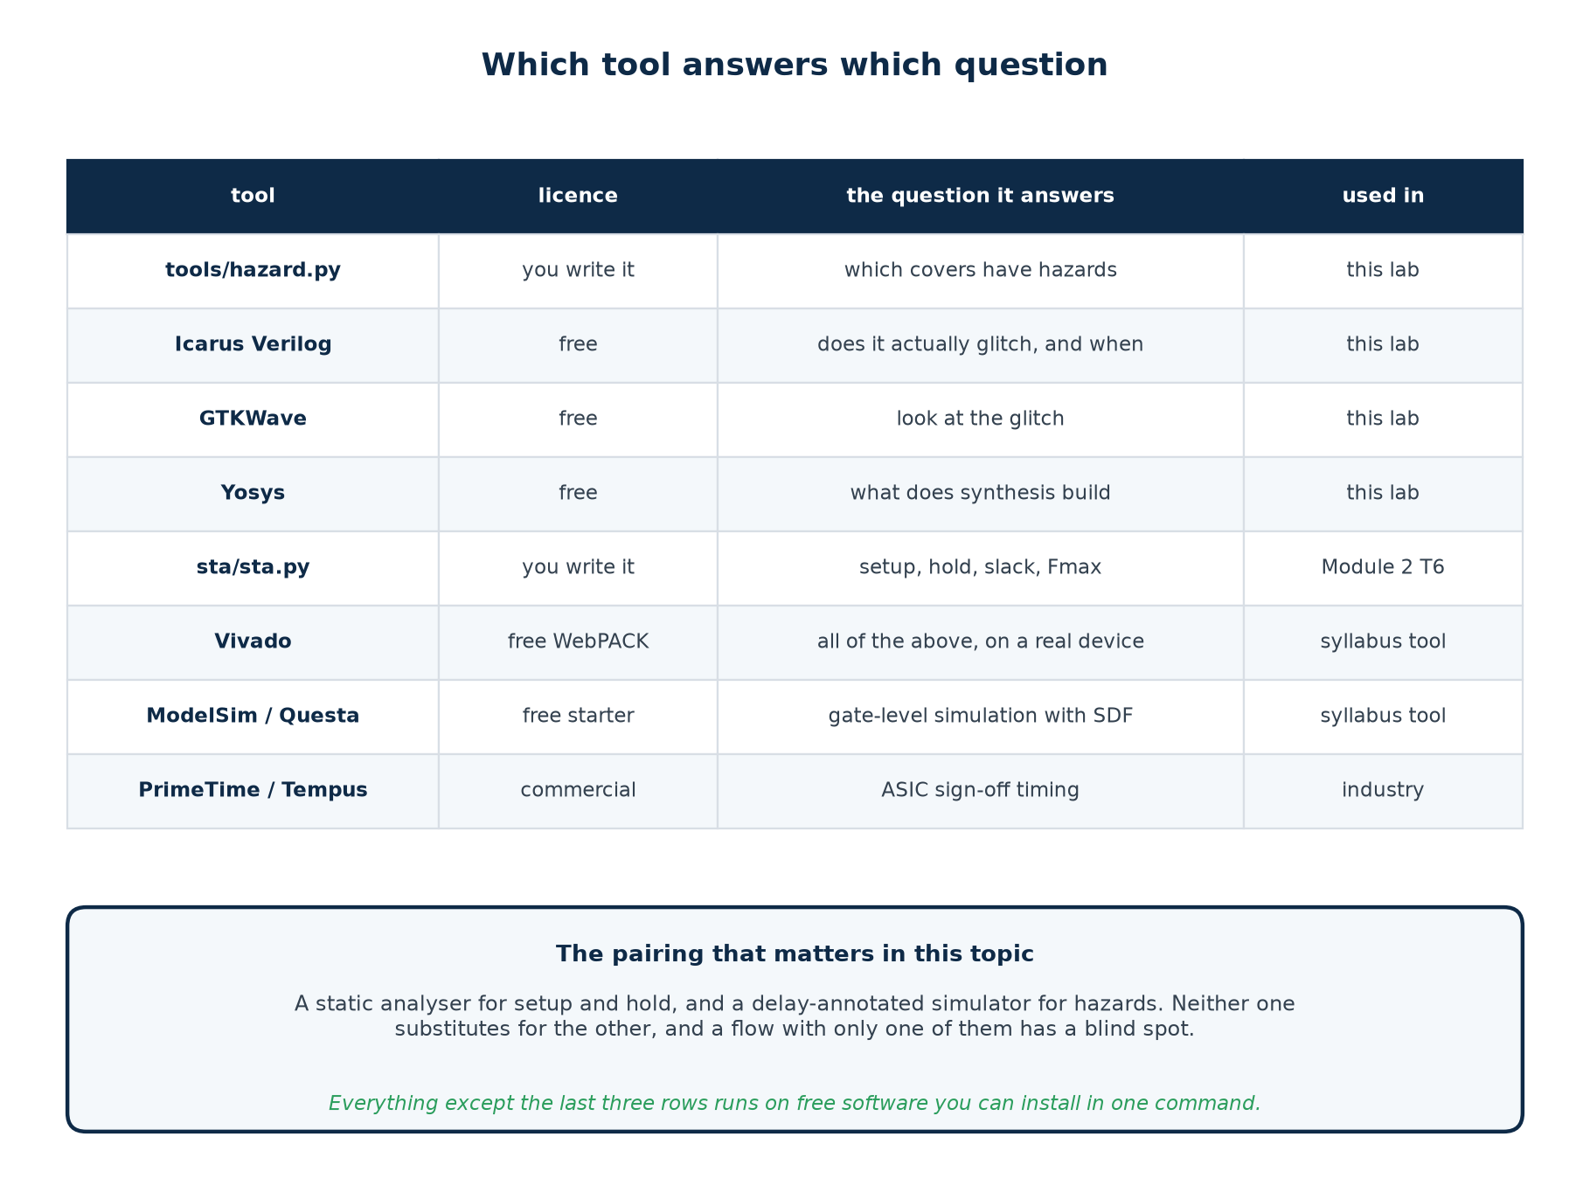
PRACTICAL · TOOLS
Which Tool Answers Which Question
A static analyser for setup and hold, a delay-annotated simulator for hazards. Neither substitutes for the other.
Chip Design Associate · Module 3 · Static Timing Analysis of VLSI Circuits · Topic 1: Overview of VLSI STA
M3-T1 · 56

Slide 57
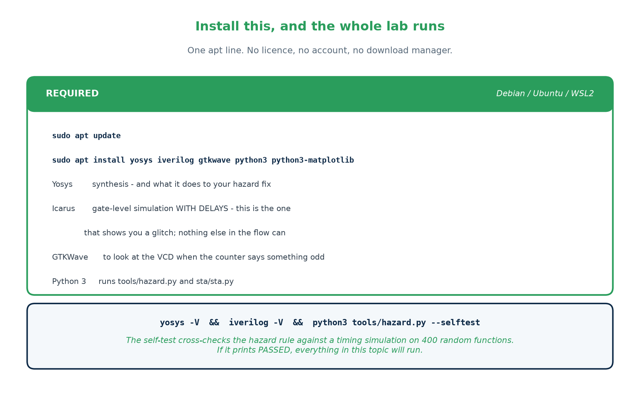
PRACTICAL · INSTALL
One apt Line, and the Whole Lab Runs
Debian / Ubuntu / WSL2 — copy this
sudo apt update
sudo apt install yosys iverilog gtkwave python3 python3-matplotlib
yosys -V && iverilog -V && python3 tools/hazard.py --selftest
On Windows: wsl --install first, then the same three lines inside it.
Chip Design Associate · Module 3 · Static Timing Analysis of VLSI Circuits · Topic 1: Overview of VLSI STA
M3-T1 · 57

Slide 58
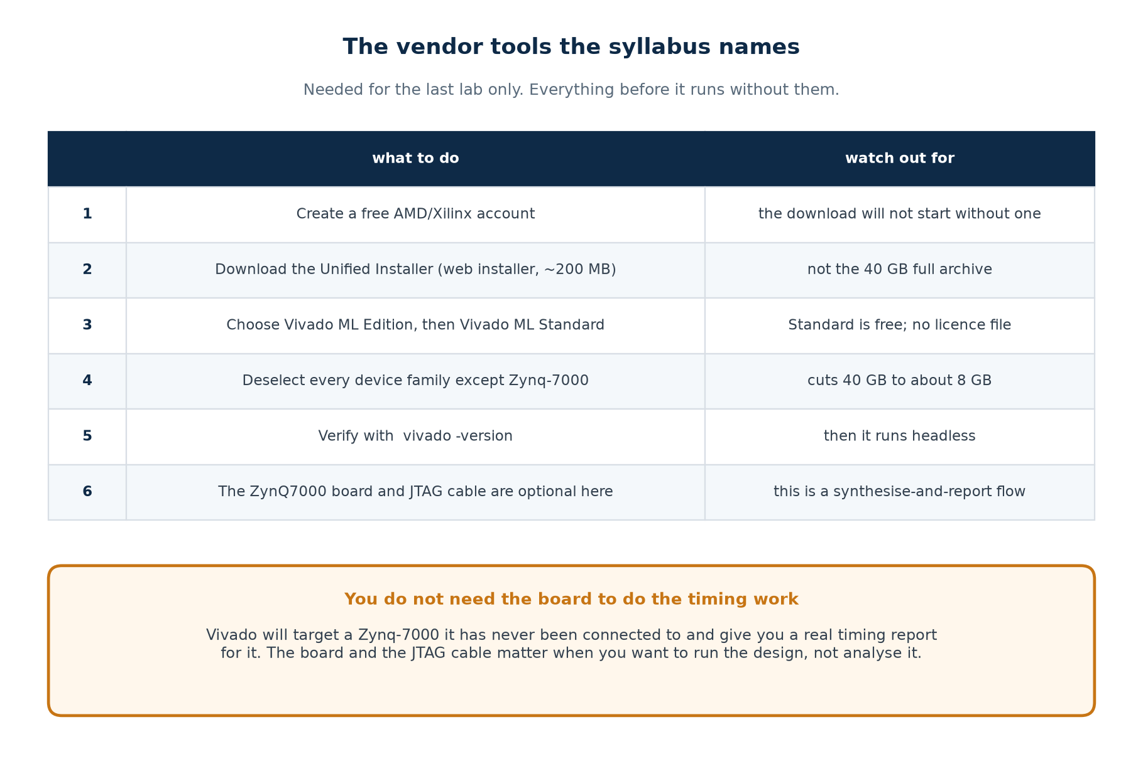
PRACTICAL · INSTALL
The Vendor Tools the Syllabus Names
Needed for lab G only. Labs A–F — 53 of the 58 exercises — run on the free toolchain alone.
Chip Design Associate · Module 3 · Static Timing Analysis of VLSI Circuits · Topic 1: Overview of VLSI STA
M3-T1 · 58

Slide 59
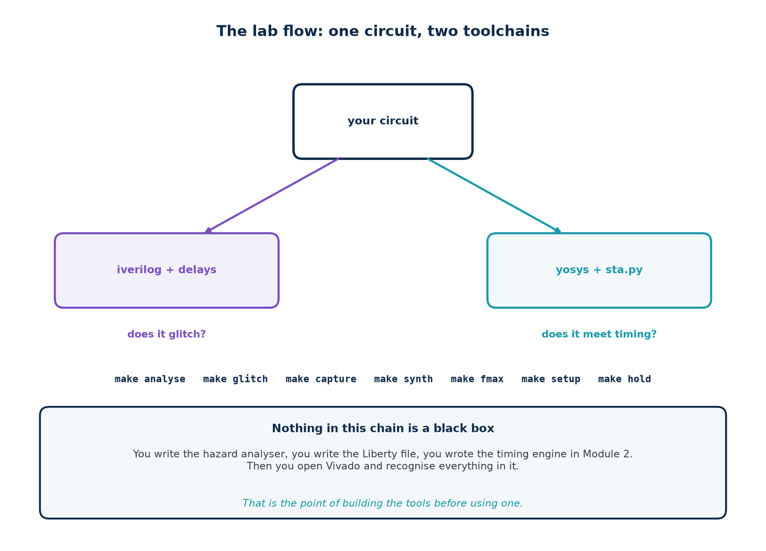
PRACTICAL · THE FLOW
One Circuit, Two Toolchains
You write the hazard analyser here; you wrote the timing engine in Module 2. Nothing in the chain is a black box.
Chip Design Associate · Module 3 · Static Timing Analysis of VLSI Circuits · Topic 1: Overview of VLSI STA
M3-T1 · 59

Slide 60
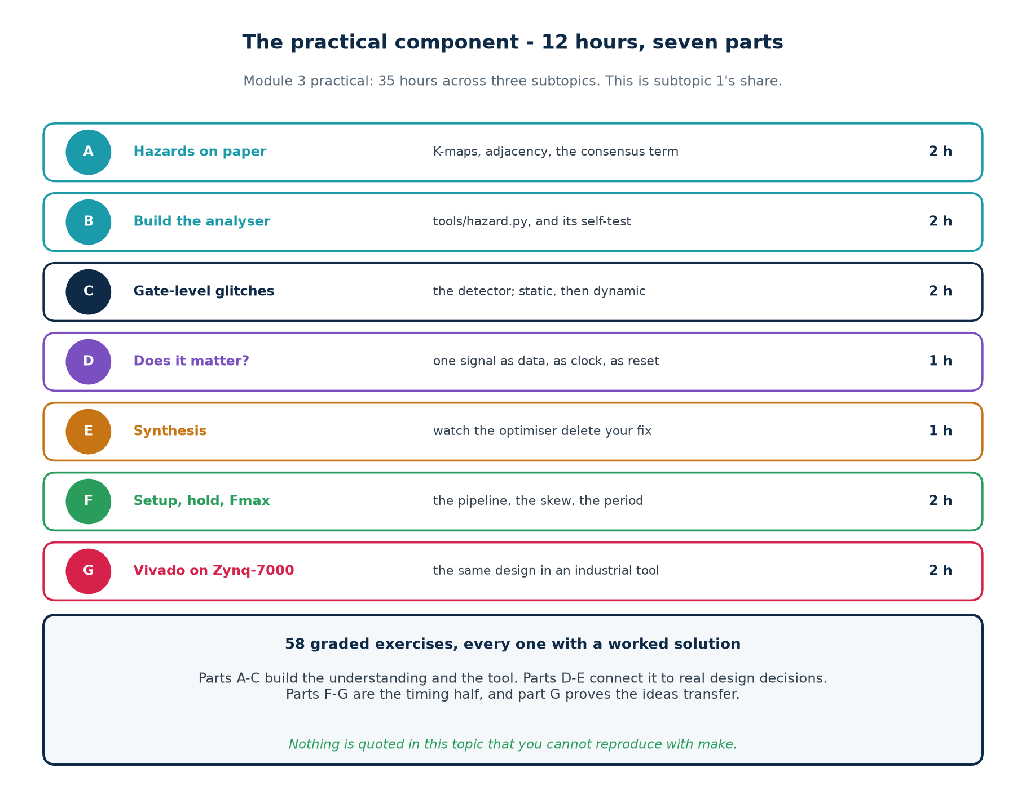
PRACTICAL · MAP
Seven Parts, Twelve Hours
Parts A–C build the understanding and the tool. D–E connect it to design decisions. F–G are the timing half.
Chip Design Associate · Module 3 · Static Timing Analysis of VLSI Circuits · Topic 1: Overview of VLSI STA
M3-T1 · 60

Slide 61
LABS A–C
Hazards: On Paper, In Code, In Simulation
A · on paper (2 h)
B · in code (2 h)
C · in simulation (2 h)
Draw the K-map for F = A B' + B C.
Find the adjacent 1s that share no loop.
Derive the consensus term by hand.
Deliverable: the term, and a sentence saying why it works.
Write the adjacency test in tools/hazard.py.
Make the self-test pass, including the cross-check against a delay timeline.
Deliverable: PASSED, and an explanation of what section D of it proves.
Build the glitch detector.
Predict the glitching transition BEFORE running it.
Then the dynamic case, and its two different fixes.
Deliverable: the six-row results table, explained.
The exercise that teaches the most is C
Predict which of the 24 transitions will glitch, from the analyser's output, before you simulate. When the prediction matches, you have connected a piece of logic reasoning to a physical measurement — which is the whole of this subtopic.
Chip Design Associate · Module 3 · Static Timing Analysis of VLSI Circuits · Topic 1: Overview of VLSI STA
M3-T1 · 61

Slide 62
LABS D–E
Does It Matter, and What Synthesis Does About It
both results, measured
$ make capture
f as DATA, sampled by the clean clock -> correct
f as a CLOCK edges after power-up = 4 <- should be 0
f as an ASYNC RESET r_flag = 0 <- should be 1
$ make synth
f = a&~b | b&c 1 cell {'$_MUX_': 1}
f = a&~b | b&c | a&c (fixed) 1 cell {'$_MUX_': 1}
The two netlists are IDENTICAL. The consensus term was deleted.
Exercise
Task
D.1
Move the glitch to 5 ns before the clock edge. Does the DATA column still hold?
D.2
Replace the async reset with a synchronous one. Re-measure.
D.3
Name three signals in a design you have written that are edge-sensitive.
E.1
Add a keep attribute to the consensus term. Does it survive?
E.2
Re-run the glitch detector on the post-synthesis netlist.
E.3
Explain in writing why the tool chose a MUX.
Chip Design Associate · Module 3 · Static Timing Analysis of VLSI Circuits · Topic 1: Overview of VLSI STA
M3-T1 · 62

Slide 63
LABS F–G
Setup, Hold, Fmax — Then an Industrial Tool
$ make fmax
pipe_unbal Fmax : 364.7 MHz
pipe_bal Fmax : 473.2 MHz
$ make setup # target 400 MHz
pipe_unbal WNS : -0.322 ns VIOLATED
pipe_bal WNS : +0.307 ns MET
$ make hold
period 4.0 ns WNS : -0.119 ns VIOLATED
period 40.0 ns WNS : -0.119 ns VIOLATED
period 400.0 ns WNS : -0.119 ns VIOLATED
skew 0.25 -> 0.10 WNS : -0.119 -> +0.031 ns MET
Lab G: the same design on a Zynq-7000
vivado -mode batch -source vivado/zynq_sta.tcl, targeting xc7z020clg400-1. The absolute numbers will differ — a Zynq LUT is not the teaching library. What must match is the shape of the report, which path is critical, and the direction of every constraint change.
Chip Design Associate · Module 3 · Static Timing Analysis of VLSI Circuits · Topic 1: Overview of VLSI STA
M3-T1 · 63

Slide 64
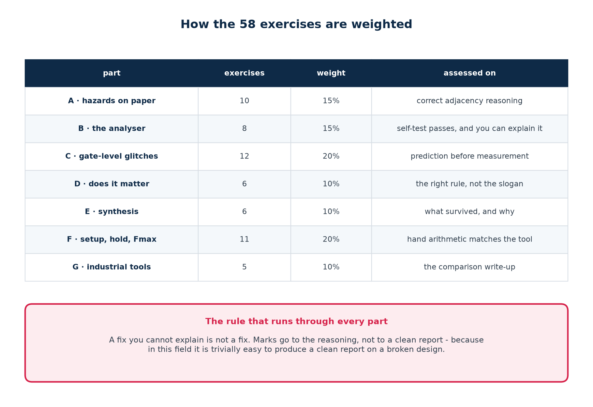
LABS · ASSESSMENT
How the 58 Exercises Are Weighted
A fix you cannot explain is not a fix.
Chip Design Associate · Module 3 · Static Timing Analysis of VLSI Circuits · Topic 1: Overview of VLSI STA
M3-T1 · 64

Slide 65
PRACTICAL · LIMITS
What This Lab Does Not Show You
▪
The gate delays are teaching-sized. A real inverter is not 4 ns; the mechanism is real, the timescale is not.
▪
The delay numbers in the Liberty file are invented, not any vendor's. They are chosen to be checkable by hand.
▪
sta/sta.py is a teaching analyser: straight-line delays, no slew propagation, no wire RC, one corner at a time.
▪
The hazard analyser handles two-level covers. Multi-level hazard analysis is a much harder problem, and hz_dynamic shows you why.
▪
vivado/zynq_sta.tcl has NOT been executed in the environment these materials were built in — Vivado is not installable there. It is the one file whose output is not reproduced in the README.
▪
Nothing here covers on-chip variation, crosstalk, or signal integrity. Those belong to sign-off, in subtopic 3.
Chip Design Associate · Module 3 · Static Timing Analysis of VLSI Circuits · Topic 1: Overview of VLSI STA
M3-T1 · 65

Slide 66
SUMMARY
Topic 1 In Ten Lines
▪
A truth table promises settled values. It says nothing about the journey.
▪
A hazard is the circuit's potential to glitch; a glitch is one event in one run.
▪
Two 1-cells one variable apart, covered by no single term, is a static-1 hazard.
▪
The fix is the term made of the literals they agree on — redundant, by design.
▪
That fix cures two-level logic hazards and nothing else. Structure needs restructuring.
▪
A glitch is harmless only where a clock edge samples it after it settles.
▪
Static timing analysis cannot see any of this: it measures one path, not two.
▪
The clock period is in the setup equation and nowhere in the hold equation.
▪
Fmax is set by one stage; moving work took 364.7 MHz to 473.2 MHz.
▪
And synthesis will delete your hazard fix, so verify on the netlist.
Chip Design Associate · Module 3 · Static Timing Analysis of VLSI Circuits · Topic 1: Overview of VLSI STA
M3-T1 · 66

Slide 67
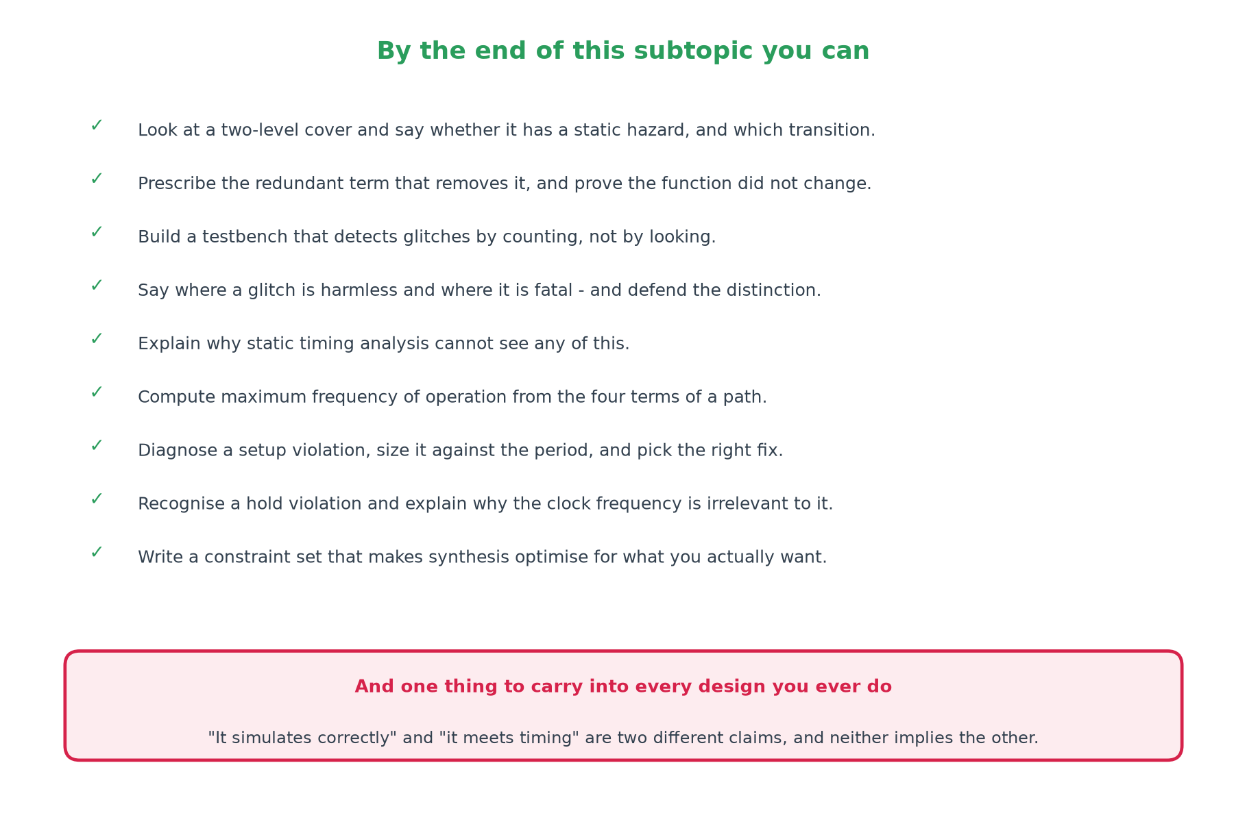
CLOSE
What To Do Next
Coming next in Module 3
Subtopic 2 takes the optimisation techniques further — pipelining, retiming, open- and closed-loop timing, block-level versus chip-level. Subtopic 3 is the EDA flow end to end: post-route analysis, ECO, and sign-off.
Chip Design Associate · Module 3 · Static Timing Analysis of VLSI Circuits · Topic 1: Overview of VLSI STA
M3-T1 · 67

