Slide 1
Pipelining

Slide 2
Pipelining
A technique used in advanced microprocessors where the microprocessor begins executing a second instruction before the first has been completed.
A Pipeline is a series of stages, where some work is done at each stage. The work is not finished until it has passed through all stages.
With pipelining, the computer architecture allows the next instructions to be fetched while the processor is performing arithmetic operations, holding them in a buffer close to the processor until each instruction operation can performed.

Slide 3
How it works
The pipeline is divided into segments and each segment can execute it operation concurrently with the other segments. Once a segment completes an operations, it passes the result to the next segment in the pipeline and fetches the next operations from the preceding segment

Slide 4
Example

Slide 5
5 Stage Pipelining

Slide 6
A pipeline diagram shows the execution of a series of instructions.
The instruction sequence is shown vertically, from top to bottom.
Clock cycles are shown horizontally, from left to right.
Each instruction is divided into its component stages. (We show five stages for every instruction, which will make the control unit easier.)
Pipeline Terminology:
Depth of the Pipeline – number of stages(5)
Filling – the first three clock cycles the pipeline is in filling, since there are unused functional units.
Full – 4th and 5th clock cycles are full.All hardware units are in use.
Emptying – 6th to 8th clock cycles are emptying.

Slide 7
Instructions Fetch
The instruction Fetch (IF) stage is responsible for obtaining the requested instruction from memory.
The instruction and the program counter (which is incremented to the next instruction) are stored in the IF/ID pipeline register as temporary storage so that may be used in the next stage at the start of the next clock cycle.

Slide 8
Instruction Decode
The Instruction Decode (ID) stage is responsible for decoding the instruction and sending out the various control lines to the other parts of the processor.
The instruction is sent to the control unit where it is decoded and the registers are fetched from the register file.

Slide 9
Execution
The Execution (EX) stage is where any calculations are performed.
The main component in this stage is the ALU.
The ALU is made up of arithmetic and logic capabilities.

Slide 10
Memory and IO
The Memory and IO (MEM) stage is responsible for storing and loading values to and from memory.
It also responsible for input or output from the processor.
If the current instruction is not of Memory or IO type than the result from the ALU is passed through to the write back stage.

Slide 11
Write Back
The Write Back (WB) stage is responsible for writing the result of a calculation, memory access or input into the register file.

Slide 12
Advantages/Disadvantages
Advantages:
More efficient use of processor
Quicker time of execution of large number of
instructions
Disadvantages:
Pipelining involves adding hardware to the chip
Inability to continuously run the pipeline
at full speed because of pipeline hazards
which disrupt the smooth execution of the
pipeline.

Slide 13
Hazards
Hazards cause the pipeline to stall because of
some conflict in the pipeline.
Prevents the next instruction to be executed.
Types:
Structural hazards- contention for same hardware resource
Data hazards- dependency between instructions
Control hazards- branch/jump instruction stall the pipeline until the target address is loaded in PC.

Slide 14
Structural Hazards
Structural Hazards
Resource conflicts in the pipeline
Examples
Single memory port shared for instruction and data access
Register file with `t a separate write port

Slide 15
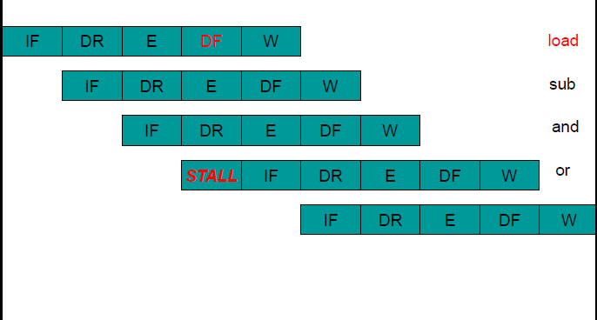
Structural Hazard

Slide 16
Structural hazard
IF and DF compete for single memory port
Ideal Machine
No stalls, 1 cycle per instruction
Assume 30% of instructions access data
With structural hazard, 1.3 cycles per instruction
Performance has gone down by 30%
Solutions:
Pipeline stall (insert bubble)
Have 2 memory ports for shared instruction-data cache-memory (expensive)
Have separate instruction cache-memory and data cache-memory

Slide 17
Data Hazards

Slide 18
Data Hazards
Three Generic Data hazards:
RAW- Read after Write.
WAR – Write after read
WAW- Write after write.

Slide 19
Data Hazards-RAW
Instr1 followed by Instr2
add r1, r3, r2
add r4, r5, r1
Instr2 tries to read operand before Instr1writes it
Can be due to true “data dependency” (data must be produced before it can be consumed)
Or can be due to pipeline staging (data already produced, but not yet written to general register file

Slide 20
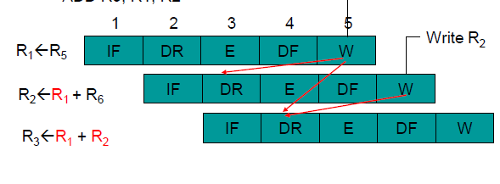
Data Hazard-RAW
Overlapping instructions cause dependencies on data (RAW)
e.g., MOVA R1, R5
ADD R2, R1, R6
ADD R3, R1, R2

Slide 21
Data Hazard-WAR
Instr1 followed by Instr2
ld r1, (r3)+
add r3, r4, r1
Instr2 tries to write operand before Instr1 reads it
Instr1 gets wrong operand
Can’t happen in the 5-stage pipeline we just covered
All instruction take 5 stages
Reads are always in stage 2
Writes are always in stage 5

Slide 22
Data hazards- WAW
Instr1 followed by Instr2
mul r1, r0, r2
add r1, r5, r6
Instr2 tries to write operand before Instr1 writes it
Leaves wrong result (Instr1, not Instr2)
Can’t happen in our 5-stage pipeline because
All instructions take 5 stages
Writes are always in stage 5

Slide 23
Data hazards Remedy
Software – Compiler
Hardware- Hardware stalls and Hardware Data Forwarding.
Software:
Software delay (compiler or machine code programming to insert NOPs)
MOVA R1, R5
NOP
NOP
ADD R2, R1, R6
NOP
NOP
ADD R3, R1, R2

Slide 24
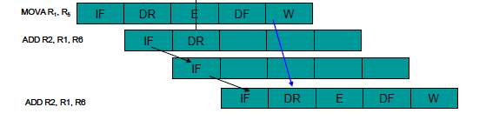
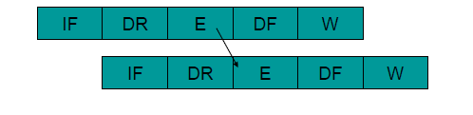
Hardware remedy for Data Hazards
Hardware stalls
Hardware Data Forwarding
Add an extra path connecting ALU outputs to ALU inputs on the next clock

Slide 25
Control hazards
For branch or jump instruction, the correct instruction to execute is not known in time (at the start of the IF stage of the instruction after the Branch)
Condition not yet determined (for conditional branch instruction)
Target instruction address not yet calculated

Slide 26
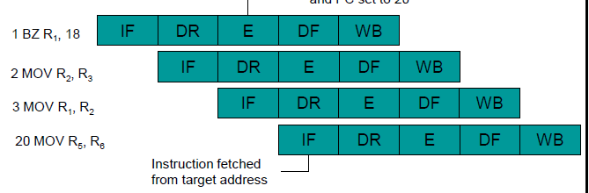
Conflicts that arise from changes in the Program Counter
Branch instructions
IF 2 instructions following branch happens before you know whether or not to branch and where to branch
ISA may allow code to run useful instructions
Can use branch prediction to improve performance

Slide 27
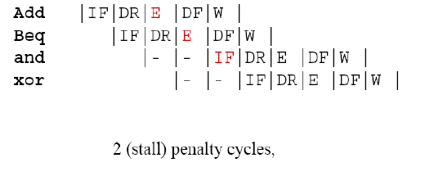
Solution 1: stall
The instructions after the branch are stalled, until the branch condition is checked and target address is generated

Slide 28
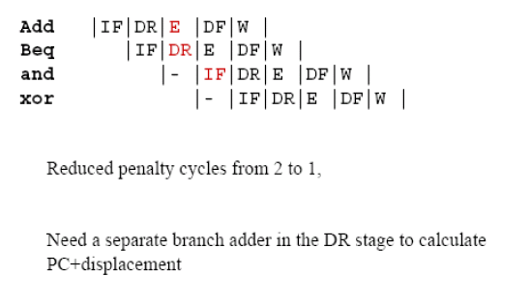
Solution 2
Perform target address calculation earlier in DR stage

Slide 29
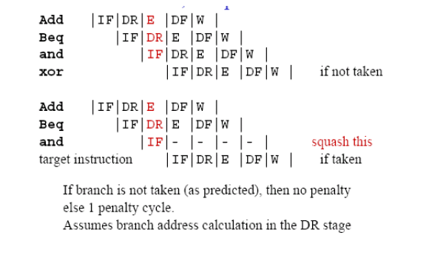
Solution 3a
Assume branch not taken, fixup if taken

Slide 30
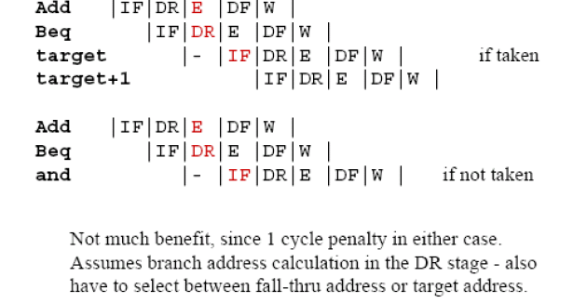
Solution 3b
Assume branch taken, fixup if not taken

Slide 31
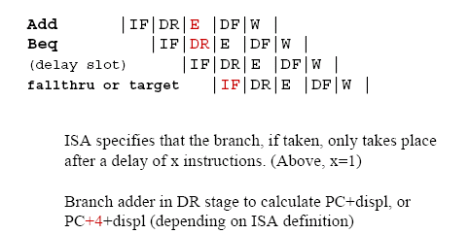
Solution 4
Delayed branch (ISA change)

Slide 32
Solutions to control Hazards-Summary
Micro-architecture solution
Stall the pipes
Calculate target address and condition earlier in pipeline (DR)
Assume branch always goes untaken (taken) and fix up pipe if it is actually taken (untaken)
ISA solution
Have delay branches
Branch target takes place after n (delay) instructions
For n penalty cycles, must have (n-1) stages between IF and the stage where target and condition are determined
Have instruction which separate target address calculation and condition generation from actual branching, so these can be executed earlier (e.g., IA-64)
Branch prediction

Slide 33
Handling hazards-Summary
Avoid some hazards “by design”
Eliminate DF-IF structural hazard by having separate I-cache and D-cache
Eliminate WAR by always fetching operands earlier in pipe (DR)
Eliminate WAW by doing all Ws in order (last stage, static) – not always the best micro-architecture decisions though!
Delayed branch in ISA to reduce control hazard penalty
Detect and resolve remaining ones
Stall or forward (if possible)

