Slide 1
Disk-based storage in computers
Memory/storage hierarchy
  Combining many technologies to balance costs/benefits
  Recall the memory hierarchy and virtual memory lectures
Notes:
*

Slide 2
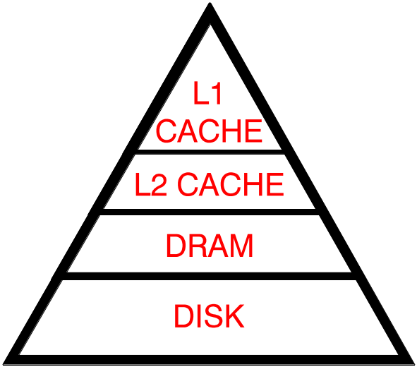
Memory/storage hierarchies
Balancing performance with cost
  Small memories are fast but expensive
  Large memories are slow but cheap
Exploit locality to get the best of both worlds
  locality = re-use/nearness of accesses
  allows most accesses to use small, fast memory
Capacity
Performance

Slide 3
An Example Memory Hierarchy
Smaller,
faster,
and
costlier
(per byte)
storage
devices
L0:
registers
CPU registers hold words retrieved from L1 cache.
L1:
on-chip L1
cache (SRAM)
L1 cache holds cache lines retrieved from the L2 cache memory.
L2:
off-chip L2
cache (SRAM)
L2 cache holds cache lines retrieved from main memory.
L3:
main memory
(DRAM)
Larger,
slower,
and
cheaper
(per byte)
storage
devices
Main memory holds disk
blocks retrieved from local
disks.
L4:
local secondary storage
(local disks)
Local disks hold files retrieved from disks on remote network servers.
L5:
remote secondary storage
(tapes, distributed file systems, Web servers)
From lecture-9.ppt

Slide 4
Page Faults
A page fault is caused by a reference to a VM word that is not in physical (main) memory
  Example: An instruction references a word contained in VP 3, a miss that triggers a page fault exception
Physical memory
(DRAM)
Virtual address
Physical page
number or
disk address
Valid
VP 1
PP 0
PTE 0
0
null
VP 2
VP 7
1
VP 4
PP 3
1
0
1
0
null
Virtual memory
(disk)
0
PTE 7
1
VP 1
Memory resident
page table
(DRAM)
VP 2
VP 3
VP 4
VP 6
From lecture-14.ppt
VP 7

Slide 5
Disk-based storage in computers
Memory/storage hierarchy
  Combining many technologies to balance costs/benefits
  Recall the memory hierarchy and virtual memory lectures
Persistence
  Storing data for lengthy periods of time
    DRAM/SRAM is “volatile”: contents lost if power lost
    Disks are “non-volatile”: contents survive power outages
  To be useful, it must also be possible to find it again later
    this brings in many interesting data organization, consistency, and management issues
      take 18-746/15-746 Storage Systems ☺
    we’ll talk a bit about file systems next
Notes:
*

Slide 6
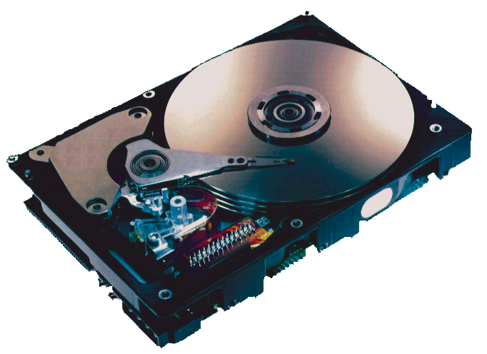
What’s Inside A Disk Drive?
Spindle
Arm
Platters
Actuator
Electronics
SCSI
connector
Image courtesy of Seagate Technology

Slide 7
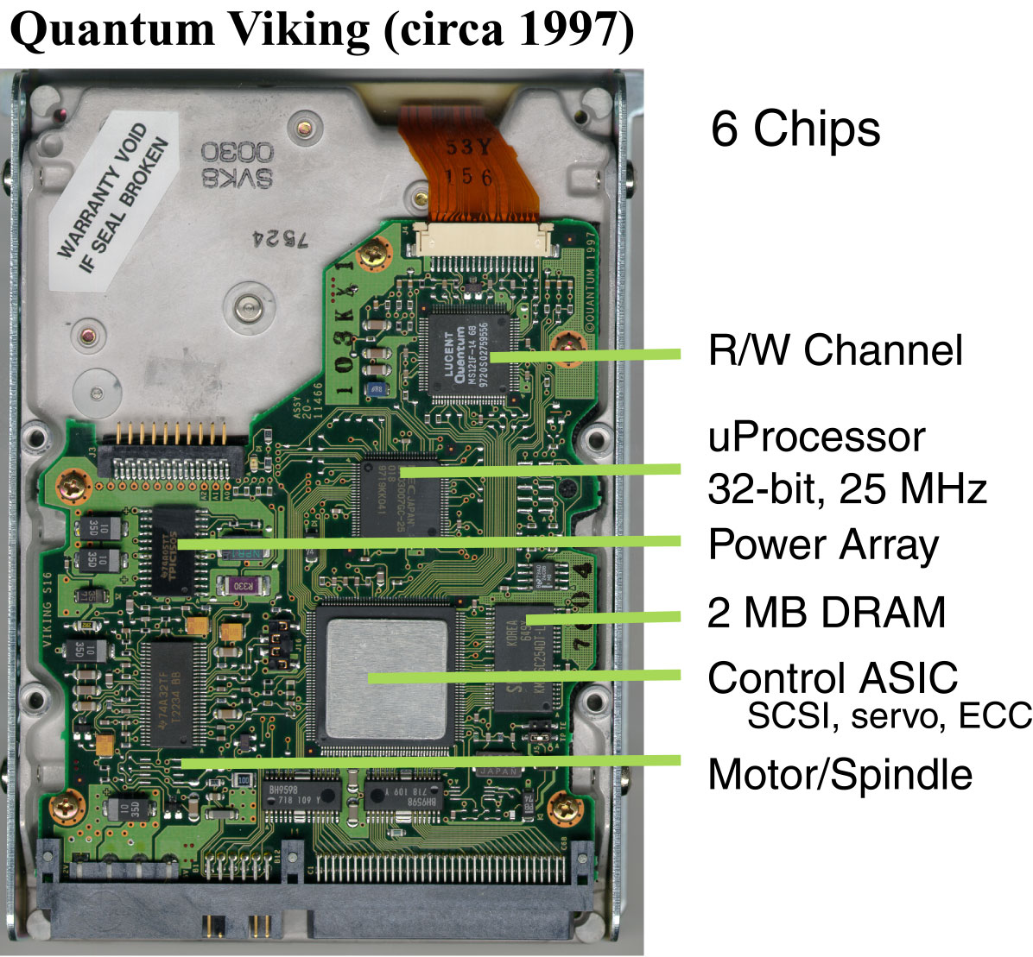
Disk Electronics
Connect to disk
Control processor
Cache memory
Control ASIC
Connect to motor
Just like a small computer – processor, memory, network iface
Notes:
No copyright needed – scanned by Erik Riedel.

Slide 8
Disk “Geometry”
Disks contain platters, each with two surfaces
Each surface organized in concentric rings called tracks
Each track consists of sectors separated by gaps
tracks
surface
track k
gaps
spindle
sectors

Slide 9
Disk Geometry (Muliple-Platter View)
Aligned tracks form a cylinder
cylinder k
surface 0
platter 0
surface 1
surface 2
platter 1
surface 3
surface 4
platter 2
surface 5
spindle

Slide 10
Disk Structure
Read/Write Head
Arm
Upper Surface
Platter
Lower Surface
Cylinder
Track
Sector
Actuator

Slide 11
Disk Operation (Single-Platter View)
The disk surface
spins at a fixed
rotational rate
The read/write head
is attached to the end
of the arm and flies over
the disk surface on
a thin cushion of air
spindle
spindle
spindle
spindle
spindle
By moving radially, the arm can position the read/write head over any track

Slide 12
Disk Operation (Multi-Platter View)
read/write heads
move in unison
from cylinder to cylinder
arm
spindle

Slide 13
Disk Structure - top view of single platter
Surface organized into tracks
Tracks divided into sectors
Notes:
Goal:
Show the inefficeincy of current disk requests.
Conveyed Ideas:
Rotational latency is wasted time that can be used to service tasks
Background Information:
None.
Slide Background:
None.
Kill text and arrows

Slide 14
Disk Access
Head in position above a track
Notes:
Goal:
Show the inefficeincy of current disk requests.
Conveyed Ideas:
Rotational latency is wasted time that can be used to service tasks
Background Information:
None.
Slide Background:
None.
Kill text and arrows

Slide 15
Disk Access
Rotation is counter-clockwise
Notes:
Goal:
Show the inefficeincy of current disk requests.
Conveyed Ideas:
Rotational latency is wasted time that can be used to service tasks
Background Information:
None.
Slide Background:
None.
Kill text and arrows

Slide 16
Disk Access – Read
About to read blue sector
Notes:
Goal:
Show the inefficeincy of current disk requests.
Conveyed Ideas:
Rotational latency is wasted time that can be used to service tasks
Background Information:
None.
Slide Background:
None.
Kill text and arrows

Slide 17
Disk Access – Read
After BLUE read
After reading blue sector
Notes:
Goal:
Show the inefficeincy of current disk requests.
Conveyed Ideas:
Rotational latency is wasted time that can be used to service tasks
Background Information:
None.
Slide Background:
None.
Kill text and arrows

Slide 18
Disk Access – Read
After BLUE read
Red request scheduled next
Notes:
Goal:
Show the inefficeincy of current disk requests.
Conveyed Ideas:
Rotational latency is wasted time that can be used to service tasks
Background Information:
None.
Slide Background:
None.
Kill text and arrows

Slide 19
Disk Access – Seek
After BLUE read
Seek for RED
Seek to red’s track
Notes:
Goal:
Show the inefficeincy of current disk requests.
Conveyed Ideas:
Rotational latency is wasted time that can be used to service tasks
Background Information:
None.
Slide Background:
None.
Kill text and arrows

Slide 20
Disk Access – Rotational Latency
After BLUE read
Seek for RED
Rotational latency
Wait for red sector to rotate around
Notes:
Goal:
Show the inefficeincy of current disk requests.
Conveyed Ideas:
Rotational latency is wasted time that can be used to service tasks
Background Information:
None.
Slide Background:
None.
Kill text and arrows

Slide 21
Disk Access – Read
After BLUE read
Seek for RED
Rotational latency
After RED read
Complete read of red
Notes:
Goal:
Show the inefficeincy of current disk requests.
Conveyed Ideas:
Rotational latency is wasted time that can be used to service tasks
Background Information:
None.
Slide Background:
None.
Kill text and arrows

Slide 22
Disk Access – Service Time Components
After BLUE read
Seek for RED
Rotational latency
After RED read
Seek
Rotational Latency
Data Transfer
Notes:
Goal:
Show the inefficeincy of current disk requests.
Conveyed Ideas:
Rotational latency is wasted time that can be used to service tasks
Background Information:
None.
Slide Background:
None.
Kill text and arrows

Slide 23
Disk Access Time
Average time to access a specific sector approximated by:
  Taccess = Tavg seek + Tavg rotation + Tavg transfer
Seek time (Tavg seek)
  Time to position heads over cylinder containing target sector
  Typical Tavg seek = 3-5 ms
Rotational latency (Tavg rotation)
  Time waiting for first bit of target sector to pass under r/w head
  Tavg rotation = 1/2 x 1/RPMs x 60 sec/1 min
    e.g., 3ms for 10,000 RPM disk
Transfer time (Tavg transfer)
  Time to read the bits in the target sector
  Tavg transfer = 1/RPM x 1/(avg # sectors/track) x 60 secs/1 min
    e.g., 0.006ms for 10,000 RPM disk with 1,000 sectors/track
    given 512-byte sectors, ~85 MB/s data transfer rate

Slide 24
Disk Access Time Example
Given:
  Rotational rate = 7,200 RPM
  Average seek time = 5 ms
  Avg # sectors/track = 1000
Derived average time to access random sector:
  Tavg rotation = 1/2 x (60 secs/7200 RPM) x 1000 ms/sec = 4 ms
  Tavg transfer = 60/7200 RPM x 1/400 secs/track x 1000 ms/sec = 0.008 ms
  Taccess = 5 ms + 4 ms + 0.008 ms = 9.008 ms
    Time to second sector: 0.008 ms
Important points:
  Access time dominated by seek time and rotational latency
  First bit in a sector is the most expensive, the rest are free
  SRAM access time is about 4 ns/doubleword, DRAM about 60 ns
    ~100,000 times longer to access a word on disk than in DRAM

Slide 25
Disk storage as array of blocks
…
…
5
6
7
12
23
OS’s view of storage device
(as exposed by SCSI or IDE/ATA protocols)
Common “logical block” size: 512 bytes
Number of blocks: device capacity / block size
Common OS-to-storage requests defined by few fields
  R/W, block #, # of blocks, memory source/dest

Slide 26
Page Faults
A page fault is caused by a reference to a VM word that is not in physical (main) memory
  Example: An instruction references a word contained in VP 3, a miss that triggers a page fault exception
“logical block” number can be remembered in page table to identify disk location for pages not resident in main memory
Physical memory
(DRAM)
Virtual address
Physical page
number or
disk address
Valid
VP 1
PP 0
PTE 0
0
null
VP 2
VP 7
1
VP 4
PP 3
1
0
1
0
null
Virtual memory
(disk)
0
PTE 7
1
VP 1
Memory resident
page table
(DRAM)
VP 2
VP 3
VP 4
VP 6
From lecture-14.ppt
VP 7

Slide 27
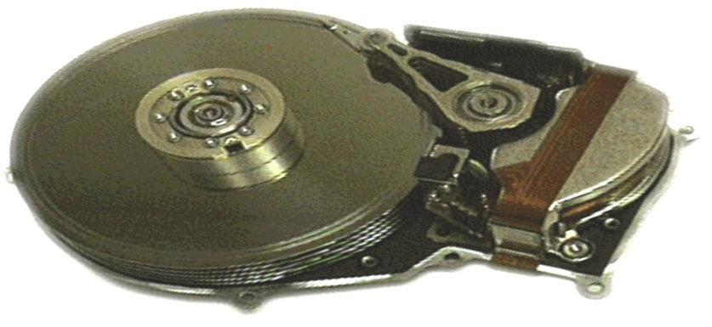
In device, “blocks” mapped to physical store
Disk Sector
(usually same size as block)

Slide 28
Physical sectors of a single-surface disk

Slide 29
LBN-to-physical for a single-surface disk
4
5
3
16
17
6
15
28
29
18
27
40
41
30
2
14
39
42
19
7
26
38
43
31
25
37
44
13
32
1
36
45
20
8
47
46
24
33
12
35
34
21
0
23
22
9
11
10

Slide 30
Disk Capacity
Capacity: maximum number of bits that can be stored
  Vendors express capacity in units of gigabytes (GB), where
  1 GB = 10⁹ Bytes (Lawsuit pending! Claims deceptive advertising)
Capacity is determined by these technology factors:
  Recording density (bits/in): number of bits that can be squeezed into a 1 inch linear segment of a track
  Track density (tracks/in): number of tracks that can be squeezed into a 1 inch radial segment
  Areal density (bits/in²): product of recording and track density

Slide 31
Computing Disk Capacity
Capacity = (# bytes/sector) x (avg. # sectors/track) x
(# tracks/surface) x (# surfaces/platter) x
(# platters/disk)
Example:
  512 bytes/sector
  1000 sectors/track (on average)
  20,000 tracks/surface
  2 surfaces/platter
  5 platters/disk
Capacity = 512 x 1000 x 80000 x 2 x 5
= 409,600,000,000
= 409.6 GB

Slide 32
Looking back at the hardware
CPU chip
register file
ALU
main
memory
bus interface

Slide 33
Connecting I/O devices: the I/O Bus
CPU chip
register file
ALU
system bus
memory bus
main
memory
bus interface
I/O
bridge
I/O bus
Expansion slots for
other devices such
as network adapters
USB
controller
graphics
adapter
disk
controller
mouse
keyboard
monitor
disk

Slide 34
Reading from disk (1)
CPU chip
CPU initiates a disk read by writing a READ command, logical block number, number of blocks, and destination memory address to a port (address) associated with disk controller
register file
ALU
main
memory
bus interface
I/O bus
USB
controller
graphics
adapter
disk
controller
mouse
keyboard
monitor
disk

Slide 35
Reading from disk (2)
CPU chip
Disk controller reads the sectors and performs a direct memory access (DMA) transfer into main memory
register file
ALU
main
memory
bus interface
I/O bus
USB
controller
graphics
adapter
disk
controller
mouse
keyboard
monitor
disk

Slide 36
Reading from disk (3)
CPU chip
When the DMA transfer completes, the disk controller notifies the CPU with an interrupt (i.e., asserts a special “interrupt” pin on the CPU)
register file
ALU
main
memory
bus interface
I/O bus
USB
controller
graphics
adapter
disk
controller
mouse
keyboard
monitor
disk

