Slide 1
Optical Storage CD-ROM
Originally for audio
650Mbytes giving over 70 minutes audio
Polycarbonate coated with highly reflective coat, usually aluminium
Data stored as pits
Read by reflecting laser
Constant packing density
Constant linear velocity

Slide 2
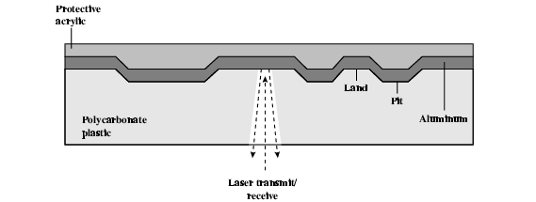
CD Operation

Slide 3
CD-ROM Drive Speeds
Audio is single speed
Constant linier velocity
1.2 ms⁻¹
Track (spiral) is 5.27km long
Gives 4391 seconds = 73.2 minutes
Other speeds are quoted as multiples
e.g. 24x
Quoted figure is maximum drive can achieve

Slide 4
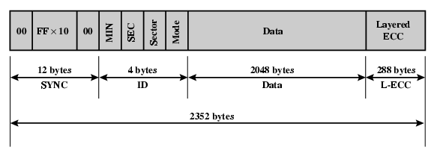
CD-ROM Format
Mode 0=blank data field
Mode 1=2048 byte data+error correction
Mode 2=2336 byte data

Slide 5
Random Access on CD-ROM
Difficult
Move head to rough position
Set correct speed
Read address
Adjust to required location
(Yawn!)

Slide 6
CD-ROM for & against
Large capacity (?)
Easy to mass produce
Removable
Robust
Expensive for small runs
Slow
Read only

Slide 7
Other Optical Storage
CD-Recordable (CD-R)
WORM
Now affordable
Compatible with CD-ROM drives
CD-RW
Erasable
Getting cheaper
Mostly CD-ROM drive compatible
Phase change
Material has two different reflectivities in different phase states

Slide 8
DVD - what’s in a name?
Digital Video Disk
Used to indicate a player for movies
Only plays video disks
Digital Versatile Disk
Used to indicate a computer drive
Will read computer disks and play video disks
Dogs Veritable Dinner
Officially - nothing!!!

Slide 9
DVD - technology
Multi-layer
Very high capacity (4.7G per layer)
Full length movie on single disk
Using MPEG compression
Finally standardized (honest!)
Movies carry regional coding
Players only play correct region films
Can be “fixed”

Slide 10
DVD – Writable
Loads of trouble with standards
First generation DVD drives may not read first generation DVD-W disks
First generation DVD drives may not read CD-RW disks
Wait for it to settle down before buying!

Slide 11
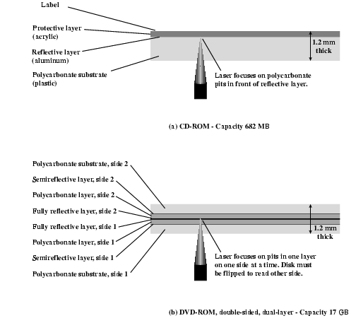
CD and DVD

Slide 12
Magnetic Tape
Serial access
Slow
Very cheap
Backup and archive

Slide 13
Digital Audio Tape (DAT)
Uses rotating head (like video)
High capacity on small tape
4Gbyte uncompressed
8Gbyte compressed
Backup of PC/network servers

