Slide 1
UNIT VI
RAID

Slide 2
RAID (redundant array of independent disks; originally redundant array of inexpensive disks) is a way of storing the same data in different places on multiple hard disks to protect data in the case of a drive failure. However, not all RAID levels provide redundancy.

Slide 3
RAID 0 (Disk striping):
RAID 0 splits data across any number of disks allowing higher data throughput. An individual file is read from multiple disks giving it access to the speed and capacity of all of them.
This RAID level is often referred to as striping and has the benefit of increased performance.
However, it does not facilitate any kind of redundancy and fault tolerance as it does not duplicate data or store any parity information (more on parity later).
Both disks appear as a single partition, so when one of them fails, it breaks the array and results in data loss.
RAID 0 is usually implemented for caching live streams and other files where speed is important and reliability/data loss is secondary.

Slide 4
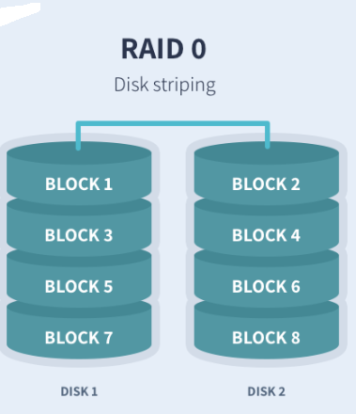

Slide 5
Minimum number of disks: 2
Pros: Increased performance (Write and read speeds). Cons: No redundancy. Business use: Live streaming, IPTV, VOD Edge Server

Slide 6
RAID 1 (Disk Mirroring):
RAID 1 writes and reads identical data to pairs of drives.
This process is often called data mirroring and it’s primary function is to provide redundancy.
If any of the disks in the array fails, the system can still access data from the remaining disk(s).
Once you replace the faulty disk with a new one, the data is copied to it from the functioning disk(s) to rebuild the array.
RAID 1 is the easiest way to create failover storage.

Slide 7
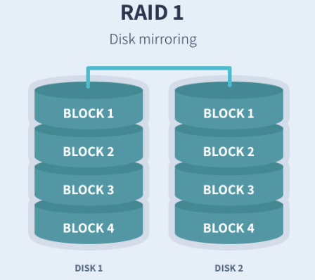

Slide 8
Minimum number of disks: 2 Pros: Fault tolerance and easy data recovery. Increased read performance.
Cons: Lower usable capacity. Higher cost per megabyte (double the amounts of drives is required to achieve desired capacity).
Business use: Standard application servers where data redundancy and availability is important.

Slide 9
RAID 5 (Striping with parity):
RAID 5 stripes data blocks across multiple disks like RAID 0, however, it also stores parity information (Small amount of data that can accurately describe larger amounts of data) which is used to recover the data in case of disk failure.
This level offers both speed (data is accessed from multiple disks) and redundancy as parity data is stored across all of the disks.
If any of the disks in the array fails, data is recreated from the remaining distributed data and parity blocks.
It uses approximately one-third of the available disk capacity for storing parity information.

Slide 10
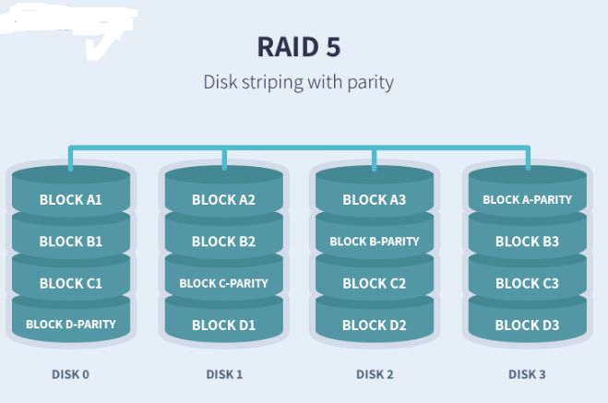

Slide 11
Minimum number of disks: 3
Pros: Fault tolerance and increased performance (lower than RAID 0) Cons: Lower performance with servers performing large amounts of write operations because of parity overhead. Ideal use: File storage servers and application servers.

Slide 12
RAID 6 (Striping with double parity):
Raid 6 is similar to RAID 5, however, it provides increased reliability as it stores an extra parity block.
That effectively means that it is possible for two drives to fail at once without breaking the array.

Slide 13
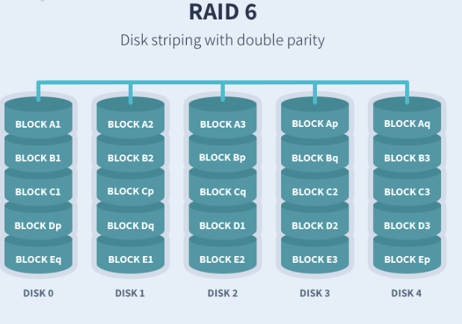

Slide 14
Minimum number of disks: 4 Pros: Even higher redundancy than RAID 5. Increased read performance.
Cons: Lower performance with servers performing large amounts of write operations because of parity overhead.
Ideal use: Large file storage servers and application servers.

Slide 15
RAID 10 (Striping + Mirroring):
RAID 10 combines the mirroring of RAID 1 with the striping of RAID 0.
Or in other words, it combines the redundancy of RAID 1 with the increased performance of RAID 0.
It is best suitable for environments where both high performance and security is required.

Slide 16
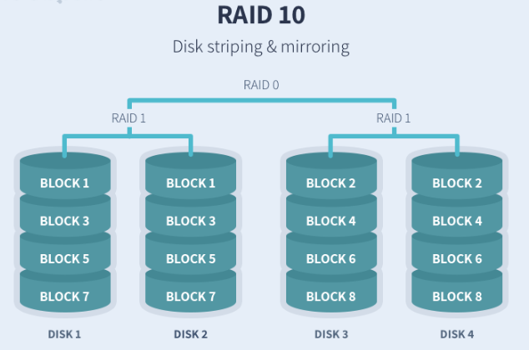

Slide 17
Minimum number of disks: 4
Pros: Very high performance. Fault tolerance. Cons: Lower usable capacity/High cost. Limited scalability Ideal use: Highly utilized database servers/ servers performing a lot of write operations.

