Slide 1
RAID
Redundant Array of Independent Disks
Redundant Array of Inexpensive Disks
6 levels in common use
Not a hierarchy—but different design architectures with 3 common characteristics:
Set of physical disks viewed as single logical drive by O/S
Data distributed across physical drives of an array
Can use redundant capacity to store parity information, which guarantees data recoverability in case of a disk failure (except RAID 0)

Slide 2
RAID 0
No redundancy
Data striped across all disks
Round Robin striping
Increase speed
Multiple data requests probably not on same disk
Disks seek in parallel
A set of data is likely to be striped across multiple disks
disk striping: The procedure of combining a set of same-size disk partitions that reside on separate disks (from 2 to 32 disks) into a single volume, forming a virtual "stripe" across the disks that the operating system recognizes as a single drive. Disk striping enables multiple I/O operations in the same volume to proceed concurrently, thus offering enhanced performance. Microsoft Press« Computer and Internet Dictionary, 4th Edition, ©2000 Microsoft Corporation. All rights reserved.

Slide 3
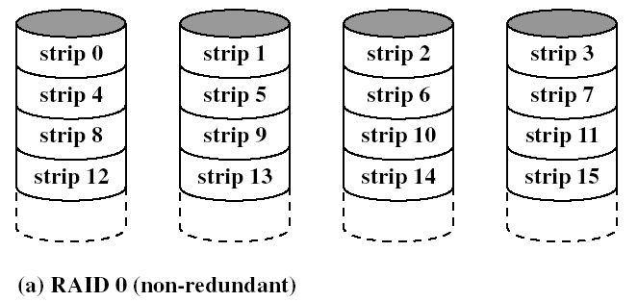
RAID 0 Striping

Slide 4
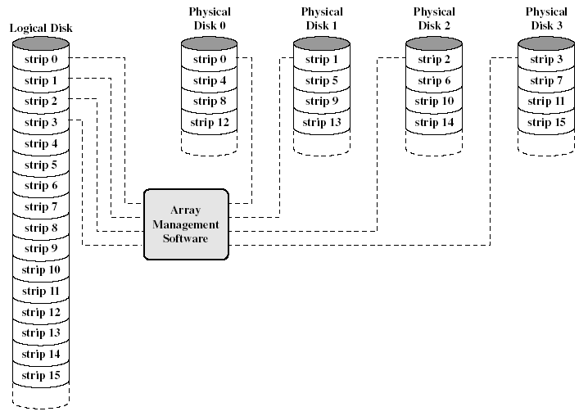
RAID 0 Logical Disk

Slide 5
RAID 1
Mirrored Disks
Data is striped across disks
2 copies of each stripe on separate disks
Read from either to speed up reads
Write to both at the same time in parallel
Recovery is simple
Swap faulty disk & re-mirror
No down time
Expensive—two complete sets of drives

Slide 6
RAID 2
Disks are synchronized
Very small stripes
Often single byte/word
Error correction calculated across corresponding bits on disks
Multiple parity disks store Hamming code error correction in corresponding positions
Lots of redundancy
Expensive
Not commercially available

Slide 7
RAID 3
Similar to RAID 2
Only one redundant parity disk, no matter how large the array
Simple parity bit for each set of corresponding bits
Data on failed drive can be reconstructed from surviving data and parity info
Very high transfer rates

Slide 8
RAID 4
Each disk operates independently
Good for high I/O request rate
Large stripes
Bit by bit parity calculated across stripes on each disk
Parity stored on parity disk
Not commercially available

Slide 9
RAID 5
Like RAID 4
Parity striped across all disks
Round robin allocation for parity stripe
Avoids RAID 4 bottleneck at parity disk
Commonly used in network servers
N.B. DOES NOT MEAN 5 DISKS!!!!!

Slide 10
RAID 6
Two parity calculations
Stored in separate blocks on different disks
User requirement of N disks needs N+2
High data availability
Three disks need to fail for data loss
Significant write penalty

Slide 11
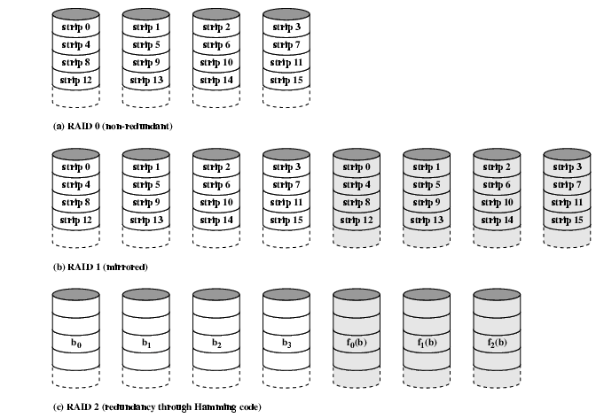
RAID 0, 1, 2

Slide 12
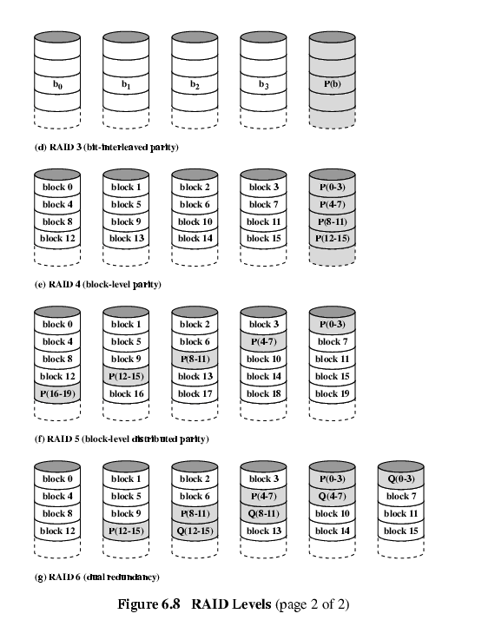
RAID 3 & 4

Slide 13
RAID 5 & 6

Slide 14
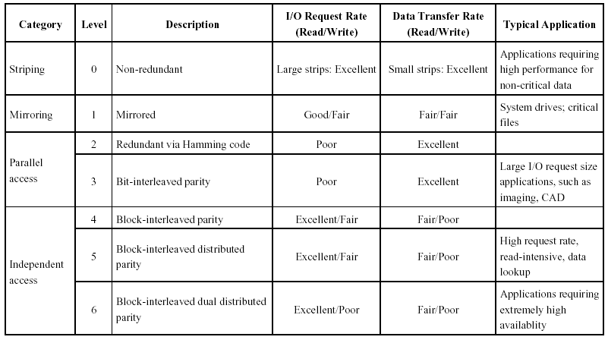
RAID Levels

