Slide 1
Multiprocessors

Slide 2
Why Choose a Multiprocessor?
A single CPU can only go so fast, use more than one CPU to improve performance
Multiple users
Multiple applications
Multi-tasking within an application
Responsiveness and/or throughput
Share hardware between CPUs

Slide 3
Multiprocessor Symmetry
In a multiprocessing system, all CPUs may be equal, or some may be reserved for special purposes.
A combination of hardware and operating-system software design considerations determine the symmetry.
Systems that treat all CPUs equally are called symmetric multiprocessing (SMP) systems.
If all CPUs are not equal, system resources may be divided in a number of ways, including asymmetric multiprocessing (ASMP), non-uniform memory access (NUMA) multiprocessing, and clustered multiprocessing.

Slide 4
Instruction and Data Streams
Multiprocessors can be used in different ways:
Uniprossesors (single-instruction, single-data or SISD)
Within a single system to execute multiple, independent sequences of instructions in multiple contexts (multiple-instruction, multiple-data or MIMD);
A single sequence of instructions in multiple contexts (single-instruction, multiple-data or SIMD, often used in vector processing);
Multiple sequences of instructions in a single context (multiple-instruction, single-data or MISD, used for redundancy in fail-safe systems and sometimes applied to describe pipelined processors or hyper threading).

Slide 5
Processor Coupling
Tightly-coupled multiprocessor systems:
Contain multiple CPUs that are connected at the bus level.
These CPUs may have access to a central shared memory (Symmetric Multiprocessing, or SMP), or may participate in a memory hierarchy with both local and shared memory (Non-Uniform Memory Access, or NUMA).
Example: IBM p690 Regatta, Chip multiprocessors, also known as multi-core computing.
Loosely-coupled multiprocessor systems:
Often referred as clusters
Based on multiple standalone single or dual processor commodity computers interconnected via a high speed communication system, such as Gigabit ethernet.
Example: Linux Beowulf cluster

Slide 6
Multiprocessor Communication Architectures
Message Passing
  Separate address space for each processor
  Processors communicate via message passing
  Processors have private memories
  Focuses attention on costly non-local operations
Shared Memory
  Processors communicate with shared address space
  Processors communicate by memory read/write
  Easy on small-scale machines
  Lower latency
  SMP or NUMA
  The kind that we will focus on today

Slide 7
Shared-Memory Processors
Single copy of the OS (although some parts might be parallel)
Relatively easy to program and port sequential code to
Difficult to scale to large numbers of processors
. . .
processor
1
processor
2
processor
N
cache
cache
cache
interconnection network
. . .
memory
1
memory
2
memory
M
UMA machine block diagram

Slide 8
Types of Shared-Memory Architectures
UMA
  Uniform Memory Access
  Access to all memory occurred at the same speed for all processors.
  We will focus on UMA today.
NUMA
  Non-Uniform Memory Access
  a.k.a. “Distributed Shared Memory”.
  Typically interconnection is grid or hypercube.
  Access to some parts of memory is faster for some processors than other parts of memory.
  Harder to program, but scales to more processors

Slide 9
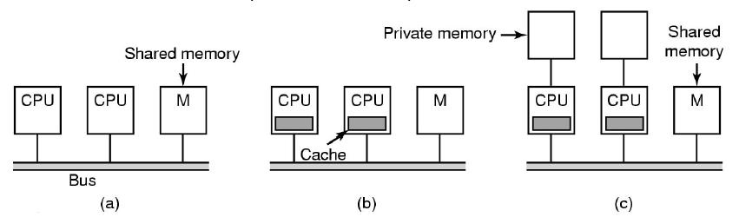
Bus Based UMA
(a) Simplest MP:
More than one processor on a single bus connect to memory, bus bandwidth becomes
a bottleneck.
(b) Each processor has a cache to reduce the need to access to memory.
(c) To further scale the number of processors, each processor is given private local memory.

Slide 10
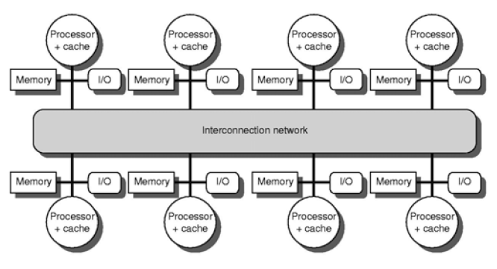
NUMA
All memories can be addressed by all processors, but access to a processor’s own local memory is faster than access to another processor’s remote memory.
Looks like a distributed machine, but the interconnection network is usually custom-designed switches and/or buses.

Slide 11
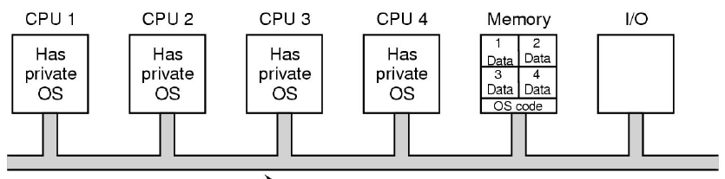
OS Option 1
Each CPU has its own OS
Statically allocate physical memory to each CPU
Each CPU runs its own independents OS
Share peripherals
Each CPU handles its processes system calls
Used in early multiprocessor systems
Simple to implement
Avoids concurrency issues by not sharing
Issues: 1. Each processor has its own scheduling queue.
2. Each processor has its own memory partition.
3. Consistency is an issue with independent disk buffer caches and
potentially shared files.

Slide 12
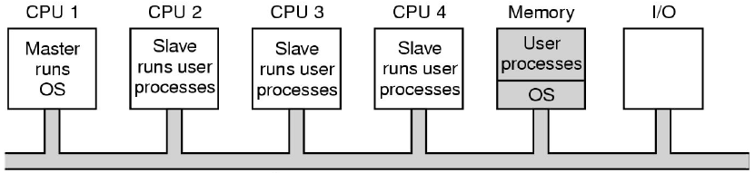
OS Option 2
Master-Slave Multiprocessors
OS mostly runs on a single fixed CPU.
User-level applications run on the other CPUs.
All system calls are passed to the Master CPU for processing
Very little synchronisation required
Single to implement
Single centralised scheduler to keep all processors busy
Memory can be allocated as needed to all CPUs.
Issues: Master CPU becomes the bottleneck.

Slide 13
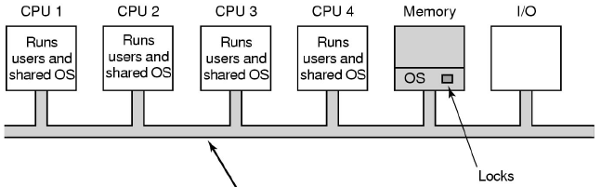
OS Option 3
Symmetric Multiprocessors (SMP)
OS kernel runs on all processors, while load and resources are balanced between all processors.
One alternative: A single mutex (mutual exclusion object) that make the entire kernel a large critical section; Only one CPU can be in the kernel at a time; Only slight better than master-slave
Better alternative: Identify independent parts of the kernel and make each of them their own critical section, which allows parallelism in the kernel
Issues: A difficult task; Code is mostly similar to uniprocessor code; hard part is identifying independent parts that don’t interfere with each other

Slide 14
Earlier Example
Quad-Processor Pentium Pro
SMP, bus interconnection.
4 x 200 MHz Intel Pentium Pro processors.
8 + 8 Kb L1 cache per processor.
512 Kb L2 cache per processor.
Snoopy cache coherence.
Employed in Compaq, HP, IBM, NetPower.
OS: Windows NT, Solaris, Linux, etc.

Slide 15
Example
HP Integrity Superdome
The HP Integrity Superdome is HP's high-end addition to the family of industry-standard Itanium®-based solutions. The Superdome offers several configurations from 2-way multiprocessing all the way to 128 CPUs supporting multiple operating systems such as HP-UX 11iV2, Microsoft Windows Server 2003 Datacentre Edition, Linux and OpenVMS.
Processor: 2 to 64 Intel Itanium 2 processors (1.6 GHz with 9 MB cache)
Memory: Up to 1TB DDR memory
1-16 cell boards (each cell: 2 or 4 processors and 2 to 32 GB memory)
48 - 96 PCI-X internal hot-plug I/O card slots (Optional Server Expansion Unit)
4 -16 hardware partitions (nPars) using Server Expansion Unit

Slide 16
Conclusion
Parallel processing is a future technique for higher performance and effectiveness for multiprogrammed workloads.
MPs combine the difficulties of building complex hardware systems and complex software systems.
Communication, memory, affinity and throughputs presents an important influence on the systems costs and performances
On-chip MPs (MPSoC) technology appears to be growing

Slide 17
References
www.intel.com
www.webopedia.com
www.wikipedia.org
www.IBM.com
www.hp.com
www.cis.upenn.edu/~milom/cis700-Spring04/
www.tkt.cs.tut.fi/kurssit/3200/S06/Luennot/Lec_notes06/
www.cs.berkeley.edu/~pattrsn
www.cs.caltech.edu/~cs284
cgi.cse.unsw.edu.au/~cs3231/06s1/lectures

