Slide 1
Module 7
Introduction to Pipelining
Performance Enhancements
Classification of models - Flynn’s taxonomy of parallel machine models ( SISD, SIMD, MISD, MIMD)- Introduction to Pipelining- Pipelined data path-Introduction to hazards.
Prepared By: I. Mala Serene, AP(SG), SCOPE,VIT

Slide 2
Parallel Processing
Definition:
is used to provide the simultaneous data-processing tasks to increase the computational speed of a computer system.
To perform concurrent data processing to achieve faster execution time.
For Example:
When an instruction is being executed in the ALU, the next instruction can be read from memory
System may have two or more ALU’s and able to execute two or more instructions at the same time.
System may have two or more processor operating concurrently
Prepared By: I. Mala Serene, AP(SG), SCOPE,VIT

Slide 3
Purpose of parallel Processing
To speed up the computer processing capability
Increase its throughput → amount of processing that can be accomplished during a given interval of time.
Drawback:
amount of hardware increases with parallel processing, so the cost of the system increases
But the technology develop have reduced the cost of hardware. So parallel processing becomes economically feasible.
Prepared By: I. Mala Serene, AP(SG), SCOPE,VIT

Slide 4
Pipelining
What is Pipelining?
A technique used in advanced microprocessors where the microprocessor begins executing a second instruction before the first has been completed.
A Pipeline is a series of stages, where some work is done at each stage. The work is not finished until it has passed through all stages.
Prepared By: I. Mala Serene, AP(SG), SCOPE,VIT

Slide 5
How Pipelines Works
The pipeline is divided into segments and each segment can execute it operation concurrently with the other segments.
Once a segment completes an operations, it passes the result to the next segment in the pipeline and fetches the next operations from the preceding segment.
Prepared By: I. Mala Serene, AP(SG), SCOPE,VIT

Slide 6
What Is Pipelining
Laundry Example
Ann, Brian, Cathy, Dave each have one load of clothes to wash, dry, and fold
Washer takes 30 minutes
Dryer takes 40 minutes
“Folder” takes 20 minutes
A
B
C
D
Appendix A - Pipelining
Prepared By: I. Mala Serene, AP(SG), SCOPE,VIT

Slide 7

What Is Pipelining
6 PM
7
8
9
10
11
Midnight
Time
30
40
20
30
40
20
30
40
20
30
40
20
T
a
s
k
O
r
d
e
r
A
Sequential laundry takes 6 hours for 4 loads
If they learned pipelining, how long would laundry take?
B
C
D
Prepared By: I. Mala Serene, AP(SG), SCOPE,VIT

Slide 8
What Is Pipelining Start work ASAP
6 PM
7
8
9
10
11
Midnight
Time
30
40
40
40
40
20
T
a
s
k
O
r
d
e
r
A
Pipelined laundry takes 3.5 hours for 4 loads
B
C
D
Appendix A - Pipelining
8
Prepared By: I. Mala Serene, AP(SG), SCOPE,VIT

Slide 9
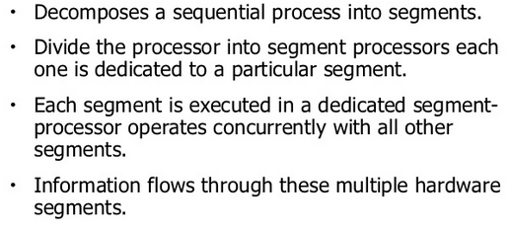
Pipelining
Prepared By: I. Mala Serene, AP(SG), SCOPE,VIT

Slide 10
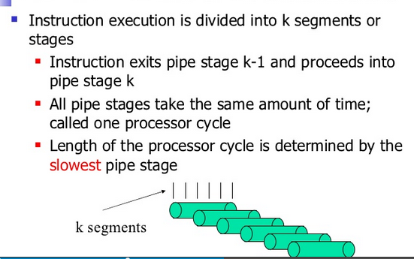
Pipelining
Prepared By: I. Mala Serene, AP(SG), SCOPE,VIT

Slide 11
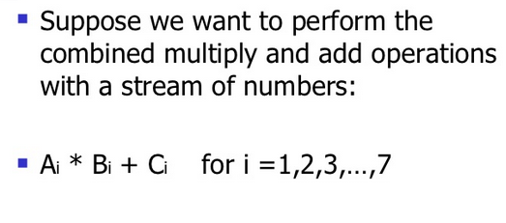
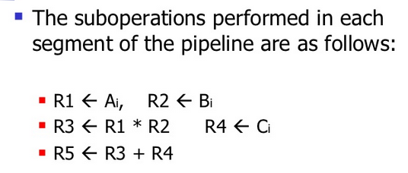
Example
Prepared By: I. Mala Serene, AP(SG), SCOPE,VIT

Slide 12
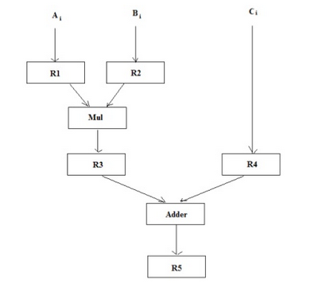
Example of pipelining processing
R1 to R5 are registers
MUL and ADD are combinational circuits registers
Prepared By: I. Mala Serene, AP(SG), SCOPE,VIT

Slide 13
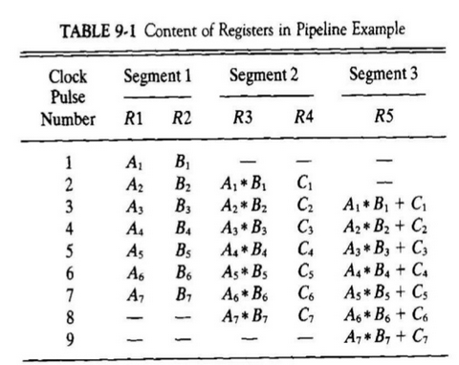
Content of registers in Pipeline example
First clock Pulse:
Transfers the A₁ and B₁ to R₁ and R₂
Second Clock Pulse:
Transfers the product of R₁ and R₂ into R₃ and C into R₄
Same clock pulse transfers A₂ and B₂ into R₁ and R₂
Third Clock Pulse:
Operates on all segments simultaneously
Places A₃ and B₃ into R₁ and R₂
Transfers the product of R₁ and R₂ into R₃ and C into R₄
Places the sum of R₃ and R₄ into R₅
From there on each clock produces a new output and moves the data one step down the pipeline.
This happens as long as new input data flow into the system
When input data not available, the clock must continue until the last output emerges out of the pipeline
Prepared By: I. Mala Serene, AP(SG), SCOPE,VIT

Slide 14
Clock
S1
R1
S2
R2
S3
R3
S4
R4
Input
Four-segment pipeline
The operands pass through all four segments in a fixed sequence.
S_{i} → combinational circuit, performs a sub operation over a data stream flowing through the pipe.
R_{i} → registers, holds the intermediate results between the stages.
Information flows between adjacent stages under the control of common clock applied to the registers simultaneously.
Task→ total operation performed going through all the segments in the pipeline.

Slide 15
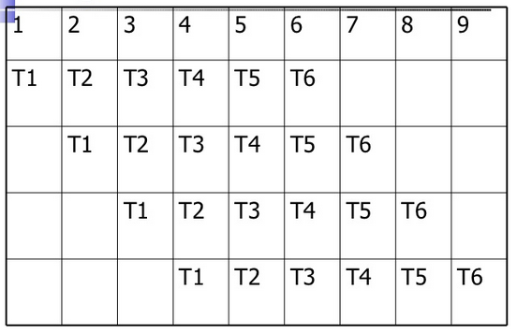
Space time diagram for 4-segment pipeline
Fig shows the segment utilization as a function of time.
X axis→ time in clock cycles
Y axis → segment number
Six tasks executed in 4 segments
Initially task1 is handled by segment 1
After the first clock , seg.2 is busy with T₁ , while seg1 is busy with T2.
First task is completed after 4th cycles.
No matter how many segments there are in the system, once the pipeline is full, it takes only one clock period to obtain the output.
Clock cycles
Seg1
Seg 2
Seg3
Seg4
Prepared By: I. Mala Serene, AP(SG), SCOPE,VIT

Slide 16
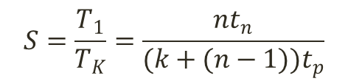
Speedup and Efficiency
For a pipeline processor:
k-stage pipeline processes with a clock cycle time t_{p} is used to execute n tasks.
The time required for the first task T₁ to complete the operation = k*t_{p} (if k segments in the pipe)
The time required to complete (n-1) tasks = (n-1) *t_{p}
Therefore to complete n tasks using a k-segment pipeline requires =k + (n-1) clock cycles.
For the non-pipelined processor :
Time to complete each task = t_{n}
Total time required to complete n tasks=n*t_{n}
Speed up = non pipelining processing/pipelining processing
$$S=\frac{T_{1}}{T_{K}}=\frac{nt_{n}}{(k+(n−1))t_{p}}$$
Prepared By: I. Mala Serene, AP(SG), SCOPE,VIT

Slide 17
Speed up cont.,
As the number of tasks increases, n becomes much larger than k-1, and approaches the value of n.
Under this condition, speed up becomes
S= t_{n} / t_{p}
Assume the time taken for pipeline and non pipeline circuits are same then t_{n} =k*t_{p}
Speed up reduces to= S= (k*t_{p})/t_{p}= k
This shows that the theoretical maximum speedup that a pipeline can provide is k, where k is the number of segments in the pipeline.
Prepared By: I. Mala Serene, AP(SG), SCOPE,VIT

Slide 18
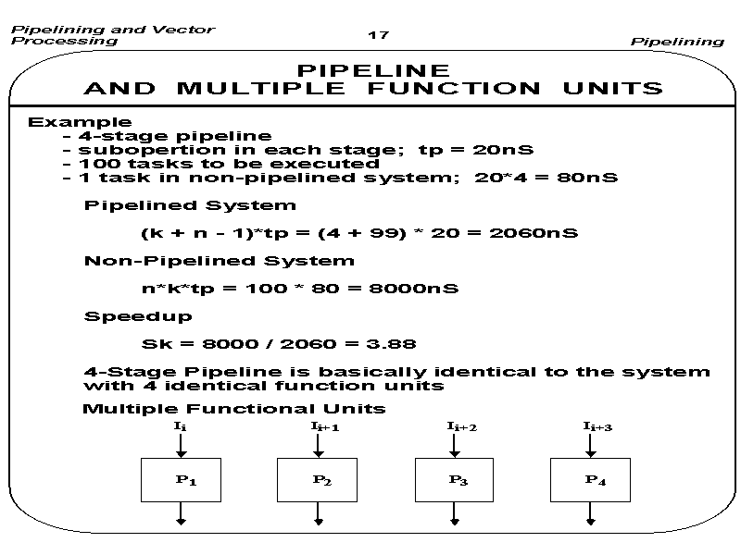

Slide 19
Advantages/Disadvantages
Advantages:
More efficient use of processor
Quicker time of execution of large number of
instructions
Disadvantages:
Pipelining involves adding hardware to the chip
Inability to continuously run the pipeline
at full speed because of pipeline hazards
which disrupt the smooth execution of the
pipeline.
Prepared By: I. Mala Serene, AP(SG), SCOPE,VIT

Slide 20
MAJOR HAZARDS IN PIPELINED EXECUTION
Structural hazards(Resource Conflicts)
caused by access to memory by two segments at the same time.
Most of these conflicts can be resolved by using separate instruction
and data memories.
Data hazards (Data Dependency Conflicts)
An instruction scheduled to be executed in the pipeline requires the
result of a previous instruction, which is not yet available
R1 <- B + C
R1 <- R1 + 1
ADD
DA
B,C
+
Data dependency
INC
DA
bubble
R1
+1
Control hazards
Branches and other instructions that change the PC
make the fetch of the next instruction to be delayed
JMP
ID
PC
+
PC
Branch address dependency
bubble
IF
ID
OF
OE
OS
Hazards in pipelines may make it
necessary to stall the pipeline
Pipeline Interlock:
Detect Hazards Stall until it is cleared

Slide 21
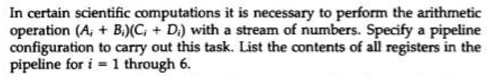
Problem 1:

Slide 22
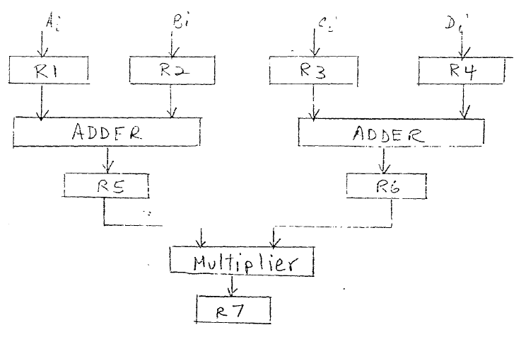
Problem 1 Solution

Slide 23
Problem2:

Slide 24
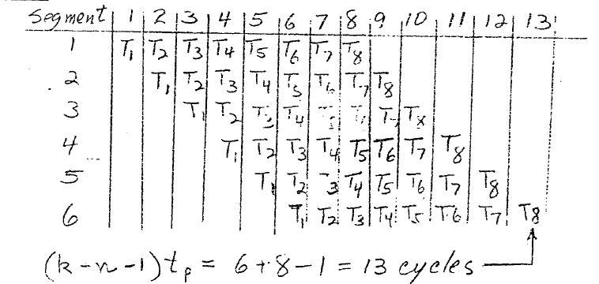
Problem 2 Solution

Slide 25
Problem 3:

Slide 26
Problem 3 Solution

Slide 27
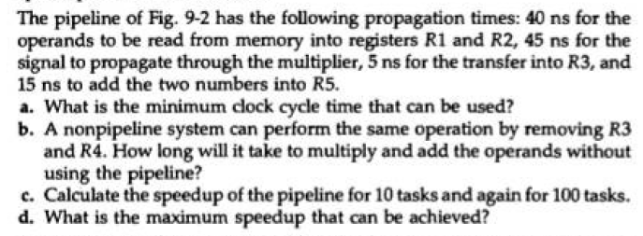
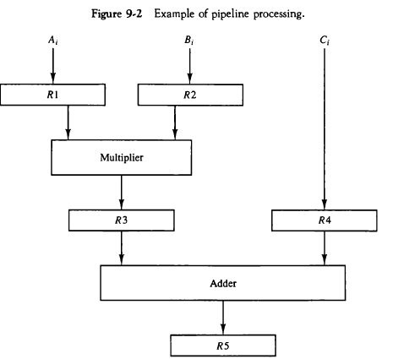
Problem 4

Slide 28
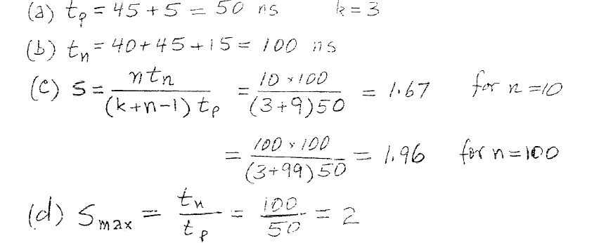
Problem 5 Solution

Slide 29
References
Computer System Architecture by Morris mano
Prepared By: I. Mala Serene, AP(SG), SCOPE,VIT

