Slide 1
PARALLEL PROCESSING

Slide 2
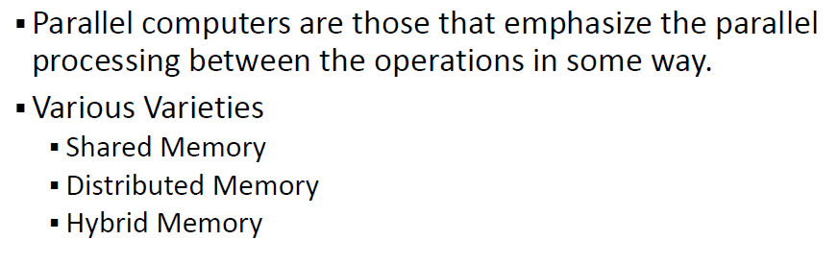

Slide 3
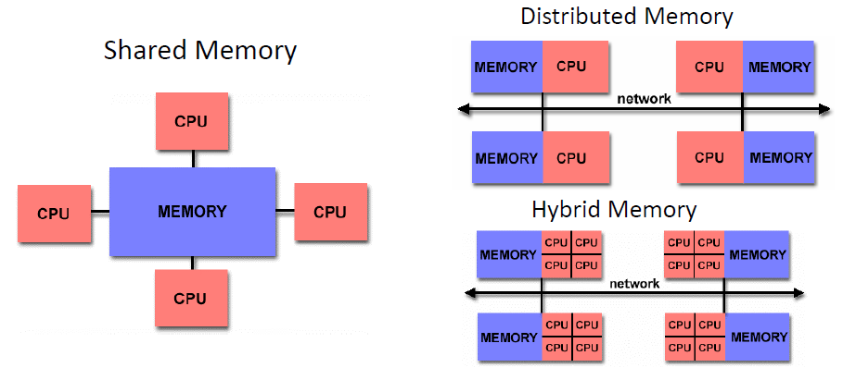

Slide 4
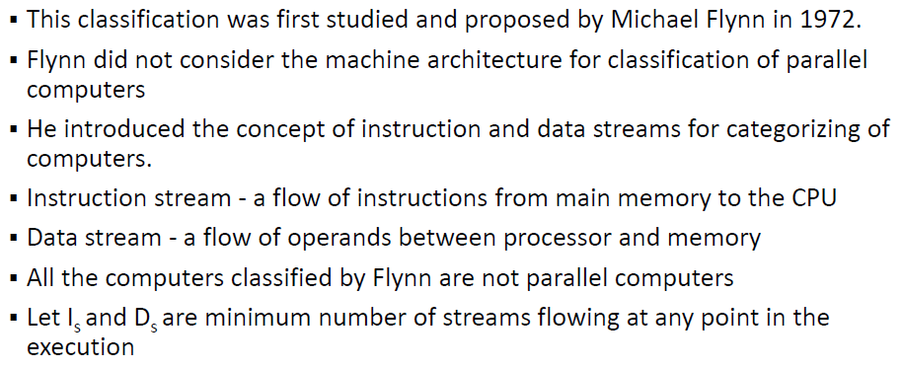
Flynn’s Taxonomy

Slide 5
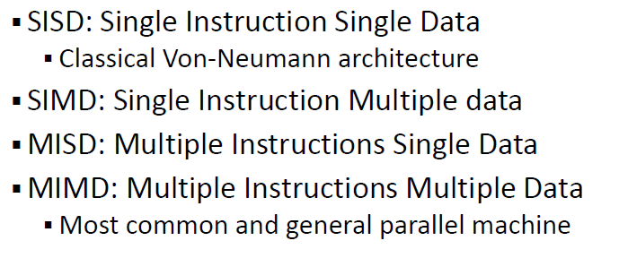
Flynn’s Classification

Slide 6
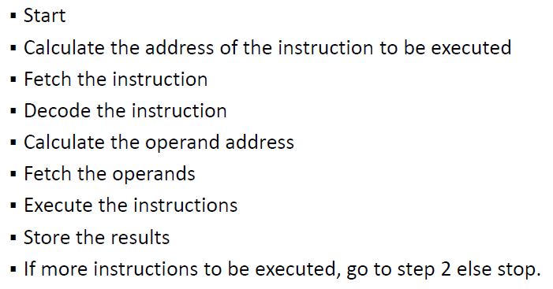
Instruction Cycle

Slide 7
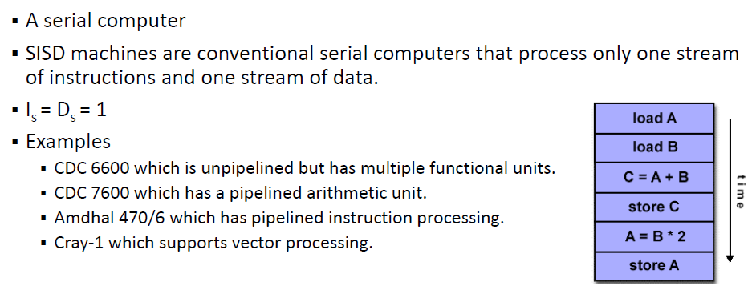
Single Instruction Single Data stream

Slide 8
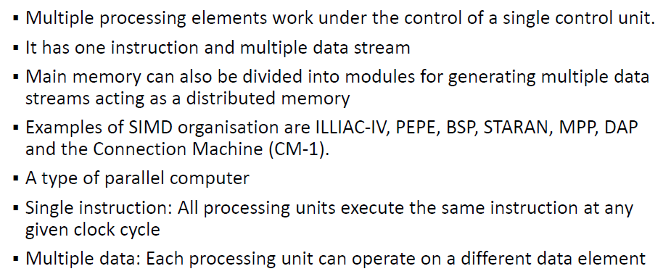
Single Instruction Multiple Data stream

Slide 9
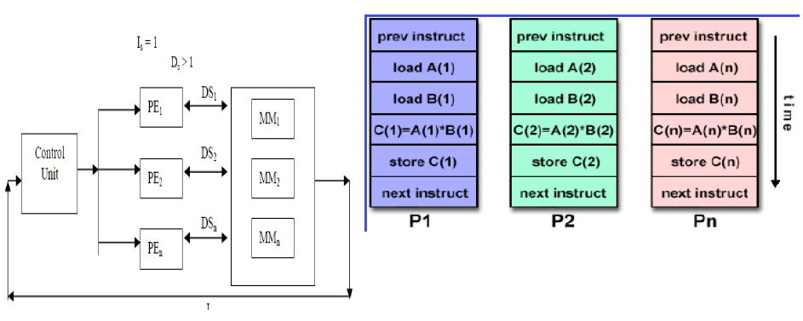
SIMD

Slide 10
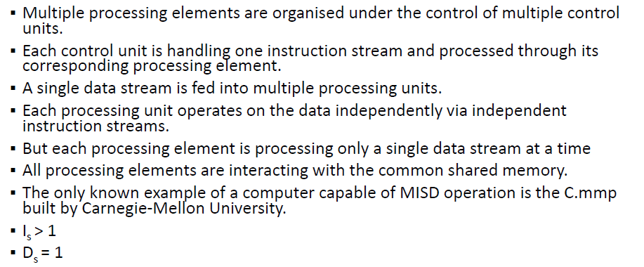
Multiple Instruction Single Data stream

Slide 11
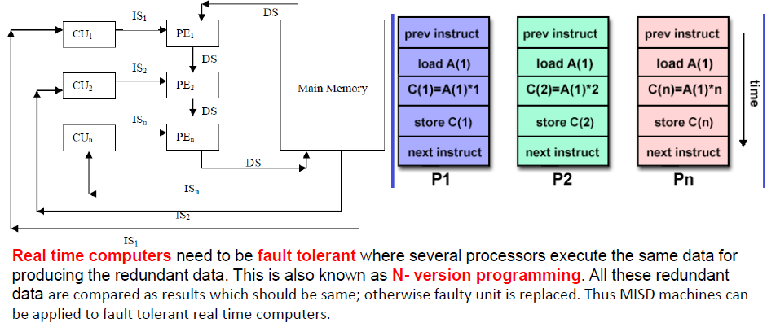
MISD

Slide 12
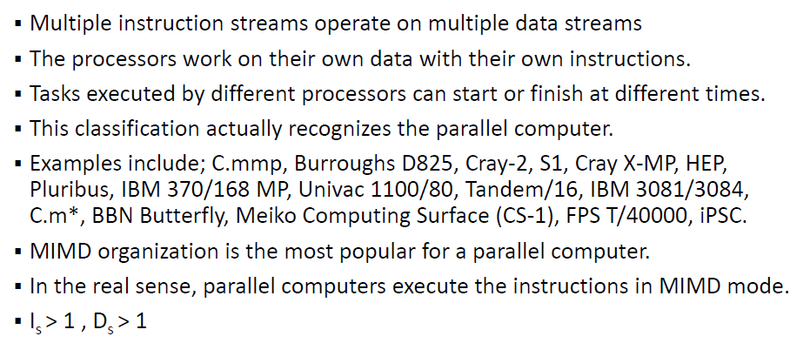
Multiple Instruction Multiple Data stream

Slide 13
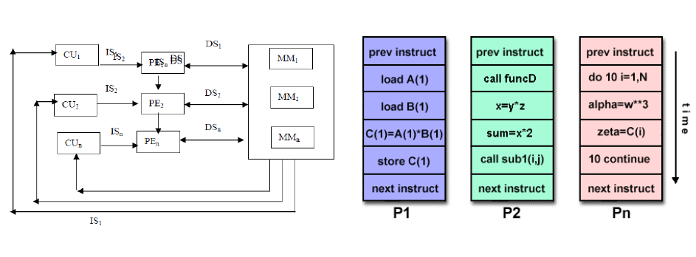
MIMD

